Slide 1

The Hamstring Toolbox: Leveraging Force Assessment Technology for Precision Management, Monitoring, and Injury Risk Profiling
Dr Nicholas Ripley
CSCS*D, RSCC, ASCC, PSCC, mISCP

Slide 2

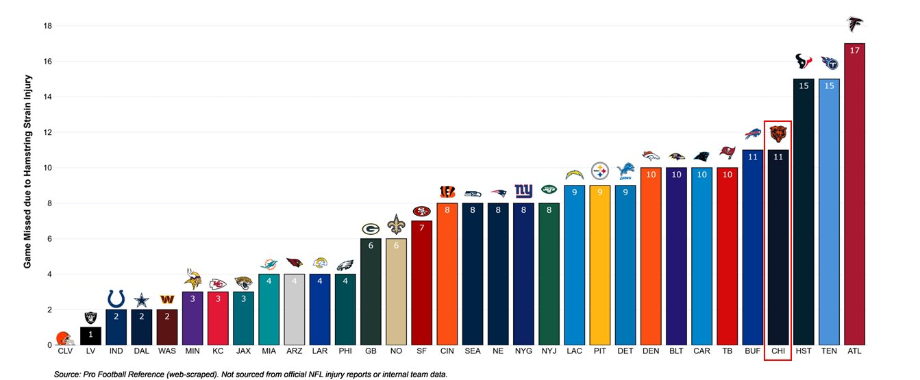
Hamstring Injury Burden
NFL

Slide 3






Impact of Injury 2024-2025
€131,200,000

Slide 4
Hamstring Injury Burden
It matters!
TIME LOSS BY GRADE
FINANCIAL IMPACT
$424,673
€500,000
18 days
24 days
60 days
Avg. cost per HSI
Avg. cost per month injured
Grade 1
Grade 2
Grade 3
Hallén & Ekstrand, 2014
MLB
$45M+ per season
(Driggers, 2022)
Premier League
(Hallén & Ekstrand, 2014)

Slide 5
Hamstring Injury Burden
It matters!
FINANCIAL IMPACT
$424,673
€500,000
8 hamstring strain injuries in a 25-man squad per season
Avg. cost per HSI
Avg. cost per month injured
Ekstrand et al., 2023
MLB
$45M+ per season
(Driggers, 2022)
Premier League
(Hallén & Ekstrand, 2014)

Slide 6
Hamstring Injury Burden
It matters!
Lower injury burden correlates with improved league position (Williams et al., 2016)
26% reduction in competition success for every modified training week (Raysmith and Drew, 2016)
Most common recurring injury in elite sport (Ekstrand et al., 2022)
PERFORMANCE IMPACT
Teams with fewer injuries consistently achieve better league standings and win more games.

Slide 7

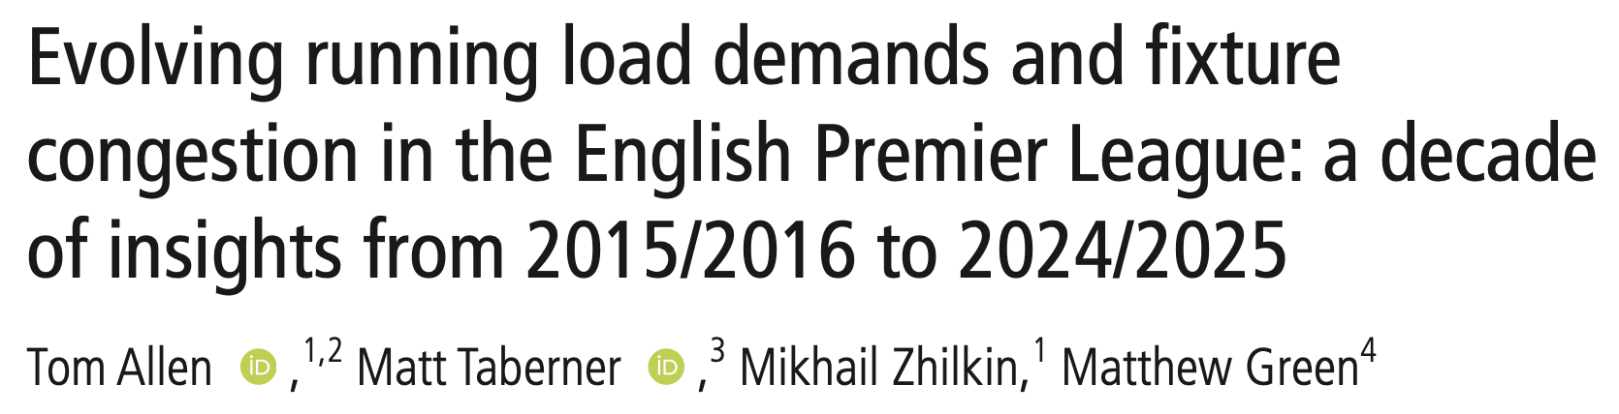
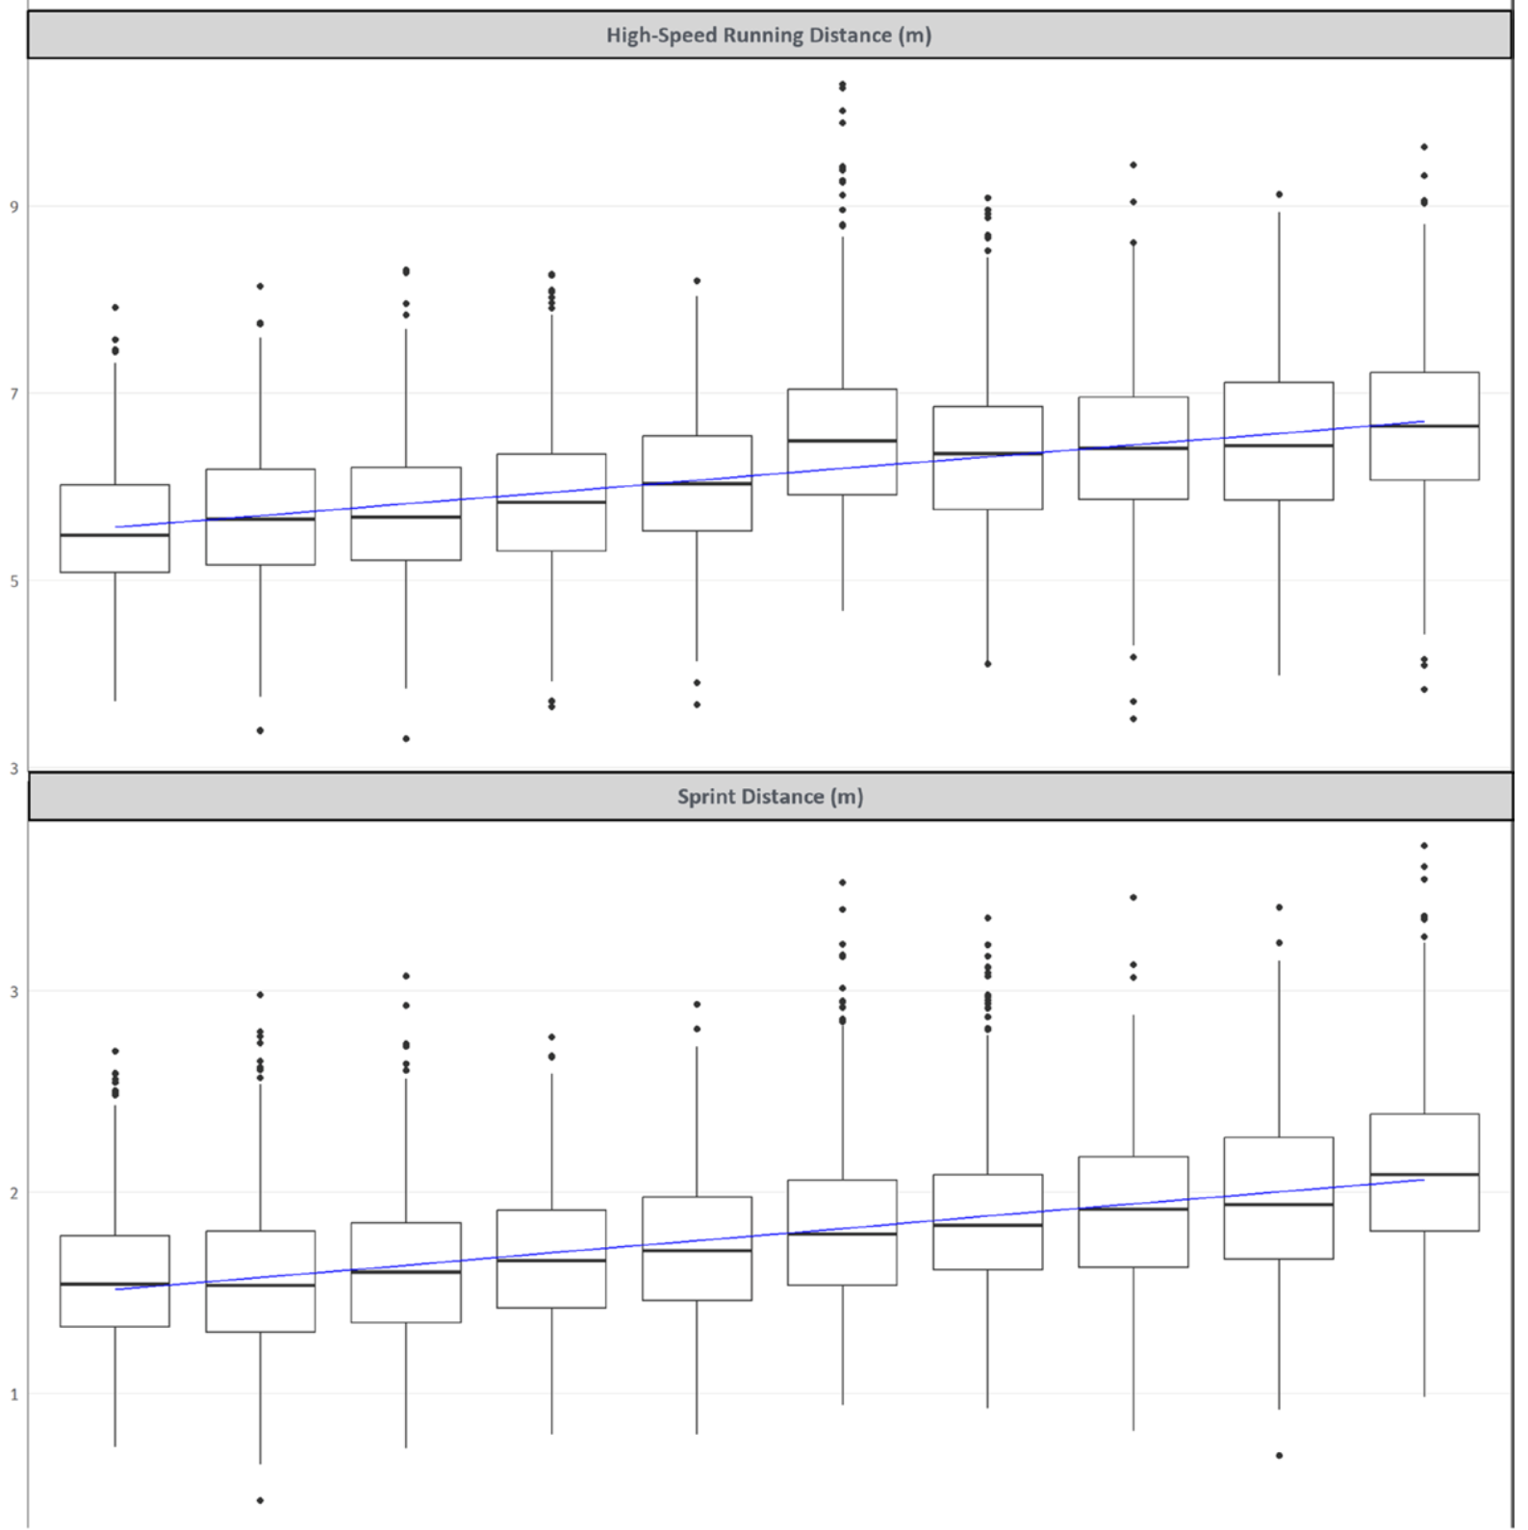
Evolving Demands
2015/2016 vs 2024/2025
Total Distance = ⬆️ 2.1%
High Intensity Distance = ⬆️ 27.2%
High Speed Running = ⬆️ 23.5%
Sprint Distance = ⬆️ 40.2%

Slide 8
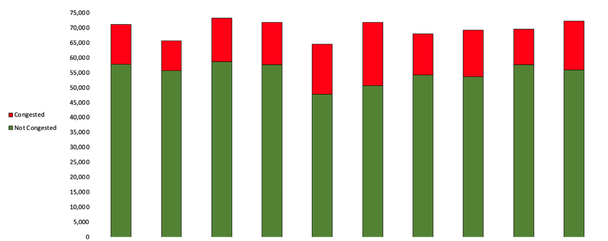
Evolving Demands
10-20% Increase in Congested Minutes
Top 6 Clubs are hit harder?
Increase in Risk to Players Health, Risk to financial Losses and Risk of Competition Success

Slide 9
Hamstring Strain Injuries

Slide 10
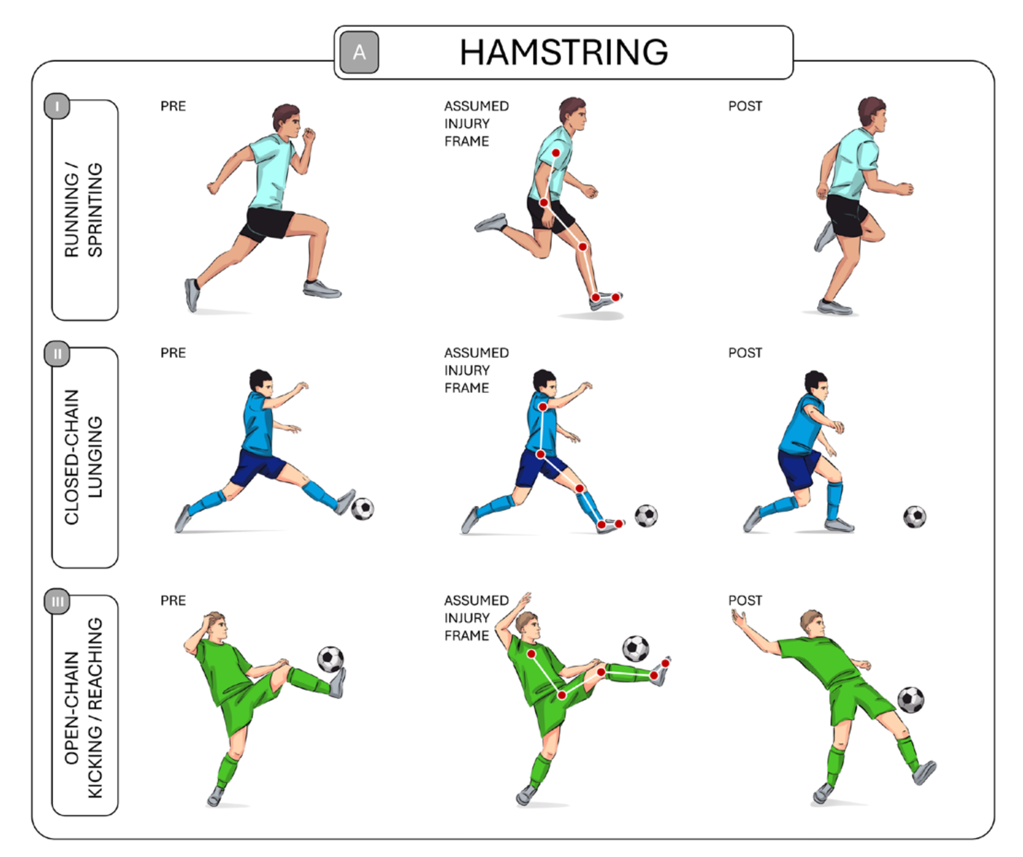
Hamstring Injuries
¾ of Hamstring injuries are Non-Contact
61% occurring during running
>50% are open chain, with closed chain representing a smaller proportion (30%)
81% of Hamstring injuries involved knee extension
(Finnern et al., 2025)

Slide 11
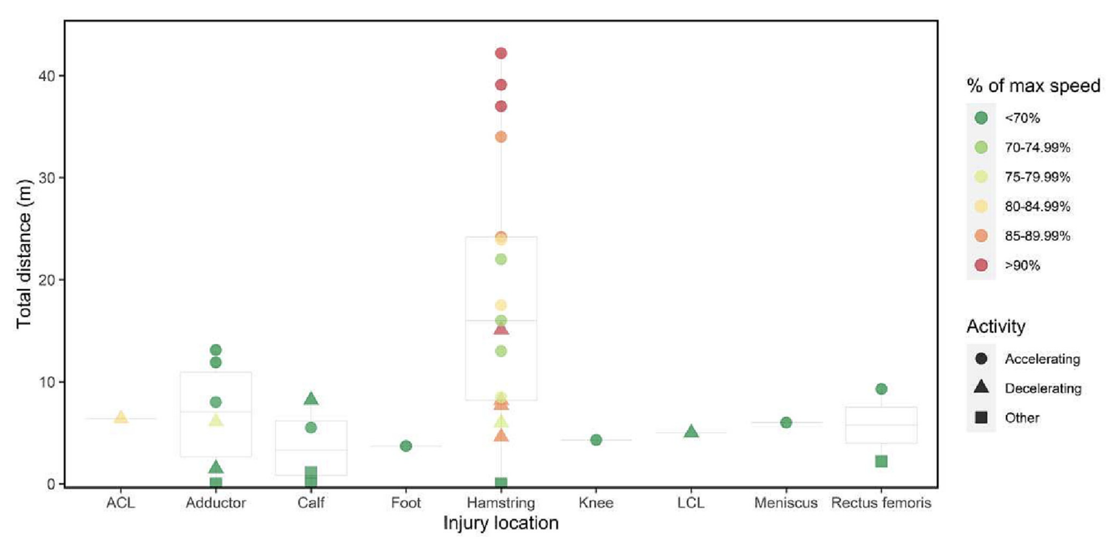
Hamstring Injuries
(Aiello et al., 2023)

Slide 12
Hamstring Assessments

Slide 13
Assessments for Maximal Strength
Eccentric
Isometric
Strong evidence for reducing risk of hamstring strain injury
Timmins et al., 2015; Driggers et al., 2025
Limited evidence for reducing risk of hamstring strain injury
Driggers et al., 2025
Technical performance using a single task (i.e., NHC); Only provides a discrete measure (i.e., peak force)
Large number of variations in test protocols; Measures of peak and rapid force

Slide 14
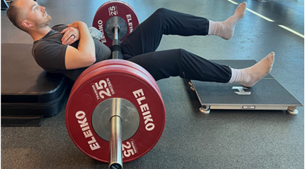
Strengths of Isometric Assessments
Quick & Easy to implement
Avg time per limb:
2 min 22 sec – 3 min 10 sec
Sundh et al. (2026)

Slide 15
Strengths of Isometric Assessments
Offer insight to both knee flexion and hip extension
Assessing knee flexion and hip extension can offer further insights for rehabilitation
Hickey et al. (2022)

Slide 16
Strengths of Isometric Assessments
Sensitive to Change
Peak force and Rapid force demonstrate sensitivity to fatigue and attenuation
Ripley et al. (2025)

Slide 17
Strengths of Isometric Assessments
Minimally fatiguing
Can be applied for monitoring purposes*
Sundh et al. (2026)

Slide 18
Limitations of Isometric Assessments
Can be equipment intensive
The positions can be challenging in applied environments with large groups
Boxes (90:20), Loaded Barbell

Slide 19
Limitations of Isometric Assessments
Sensitive to cueing performance
Horizontal vs. Vertical vs. Combined
Rasp et al. (2025)

Slide 20
Limitations of Isometric Assessments
Can result in DOMS
Dependent on the assessment
Sundh et al. (2026)

Slide 21
Hamstring Strain Injury Mechanisms and Assessment

Slide 22
Mechanism to Assessment
Single Assessment is unlikely provide all the information needed
(Finnern et al., 2025)

Slide 23
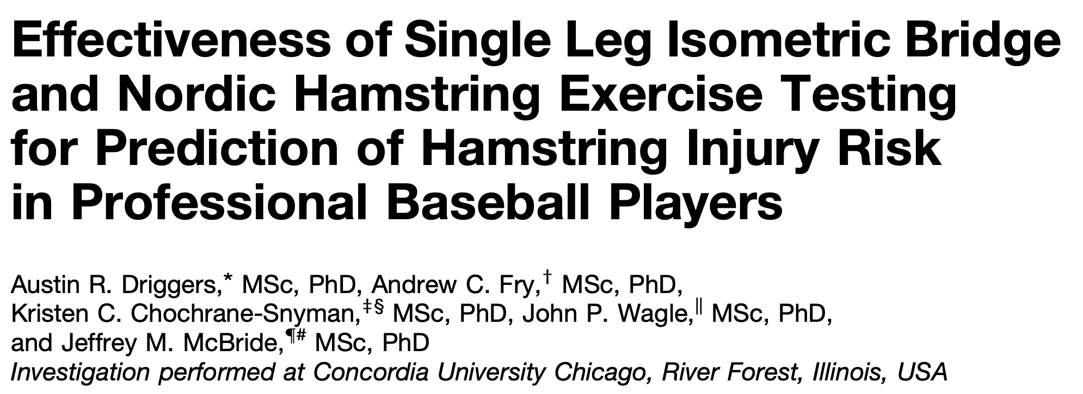
Strength and Injury Risk
405.6 N identified as a threshold risk was 2.2x greater*
*note non-significant risk 2.17 (0.95-4.92)

Slide 24
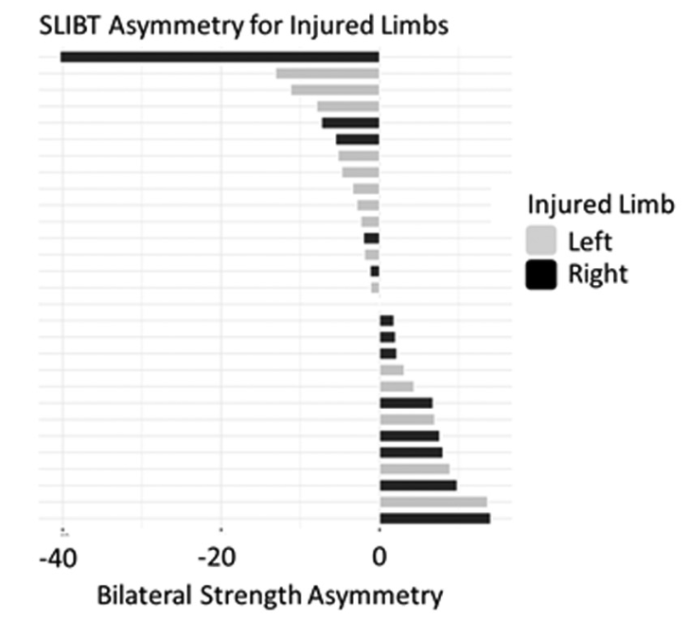
Strength and Injury Risk
No relationship between asymmetry and injury
(Driggers et al., 2026)

Slide 25
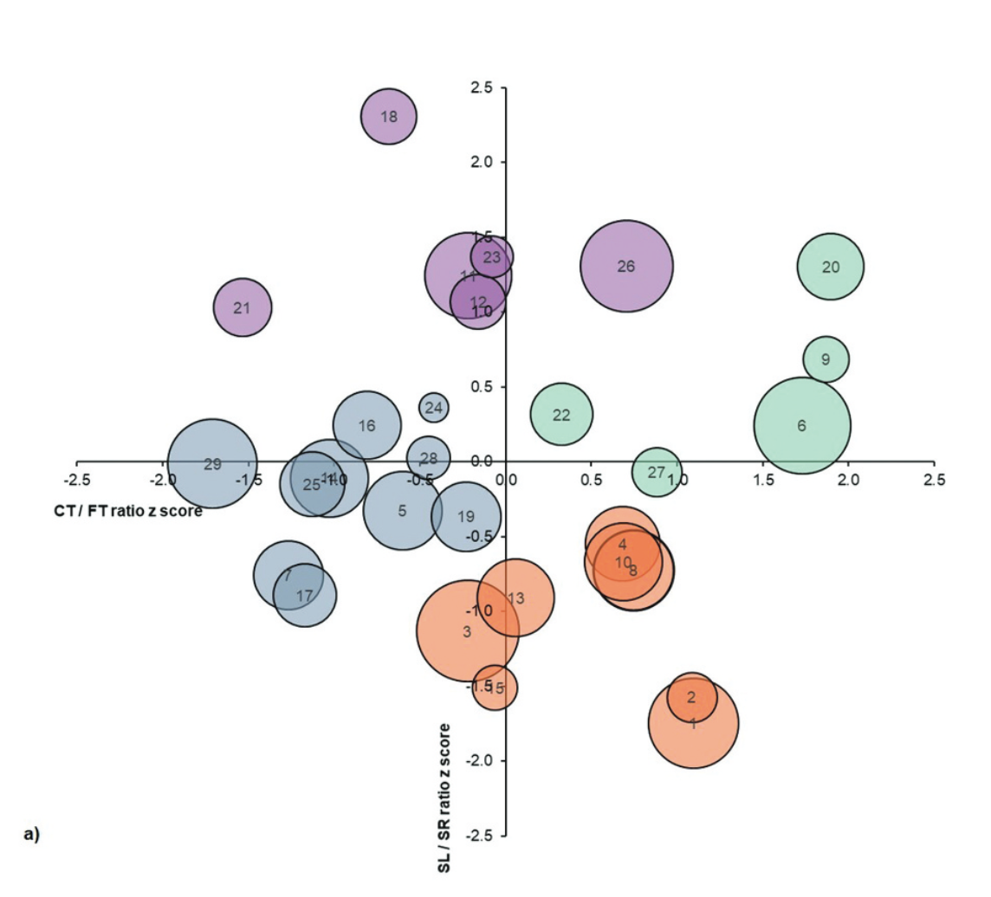
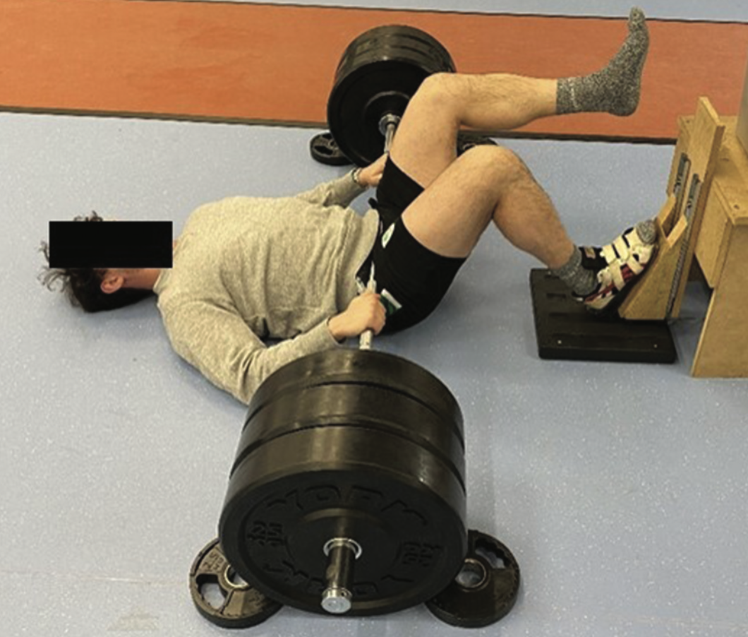
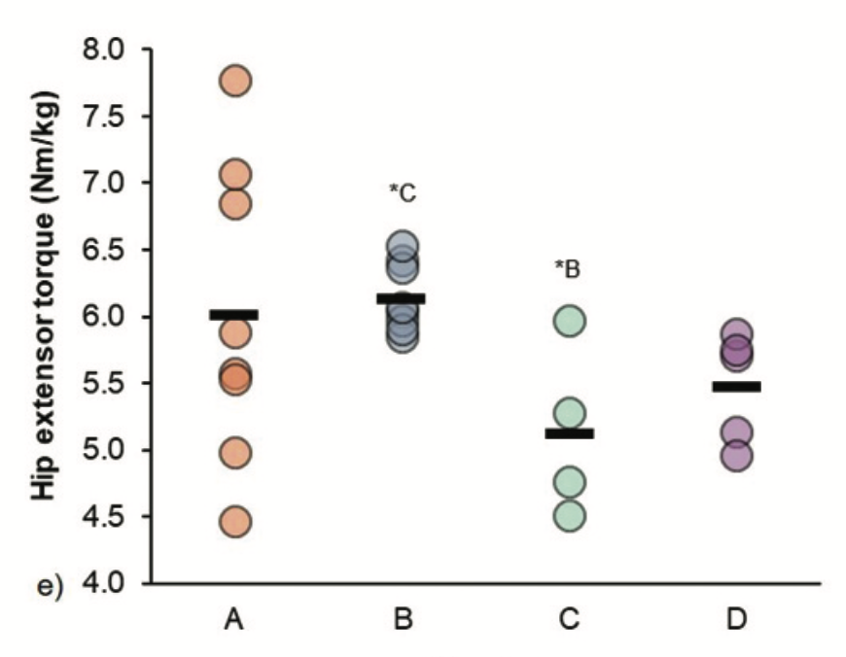
Strength and Running Performance
(Wild et al., 2021)

Slide 26
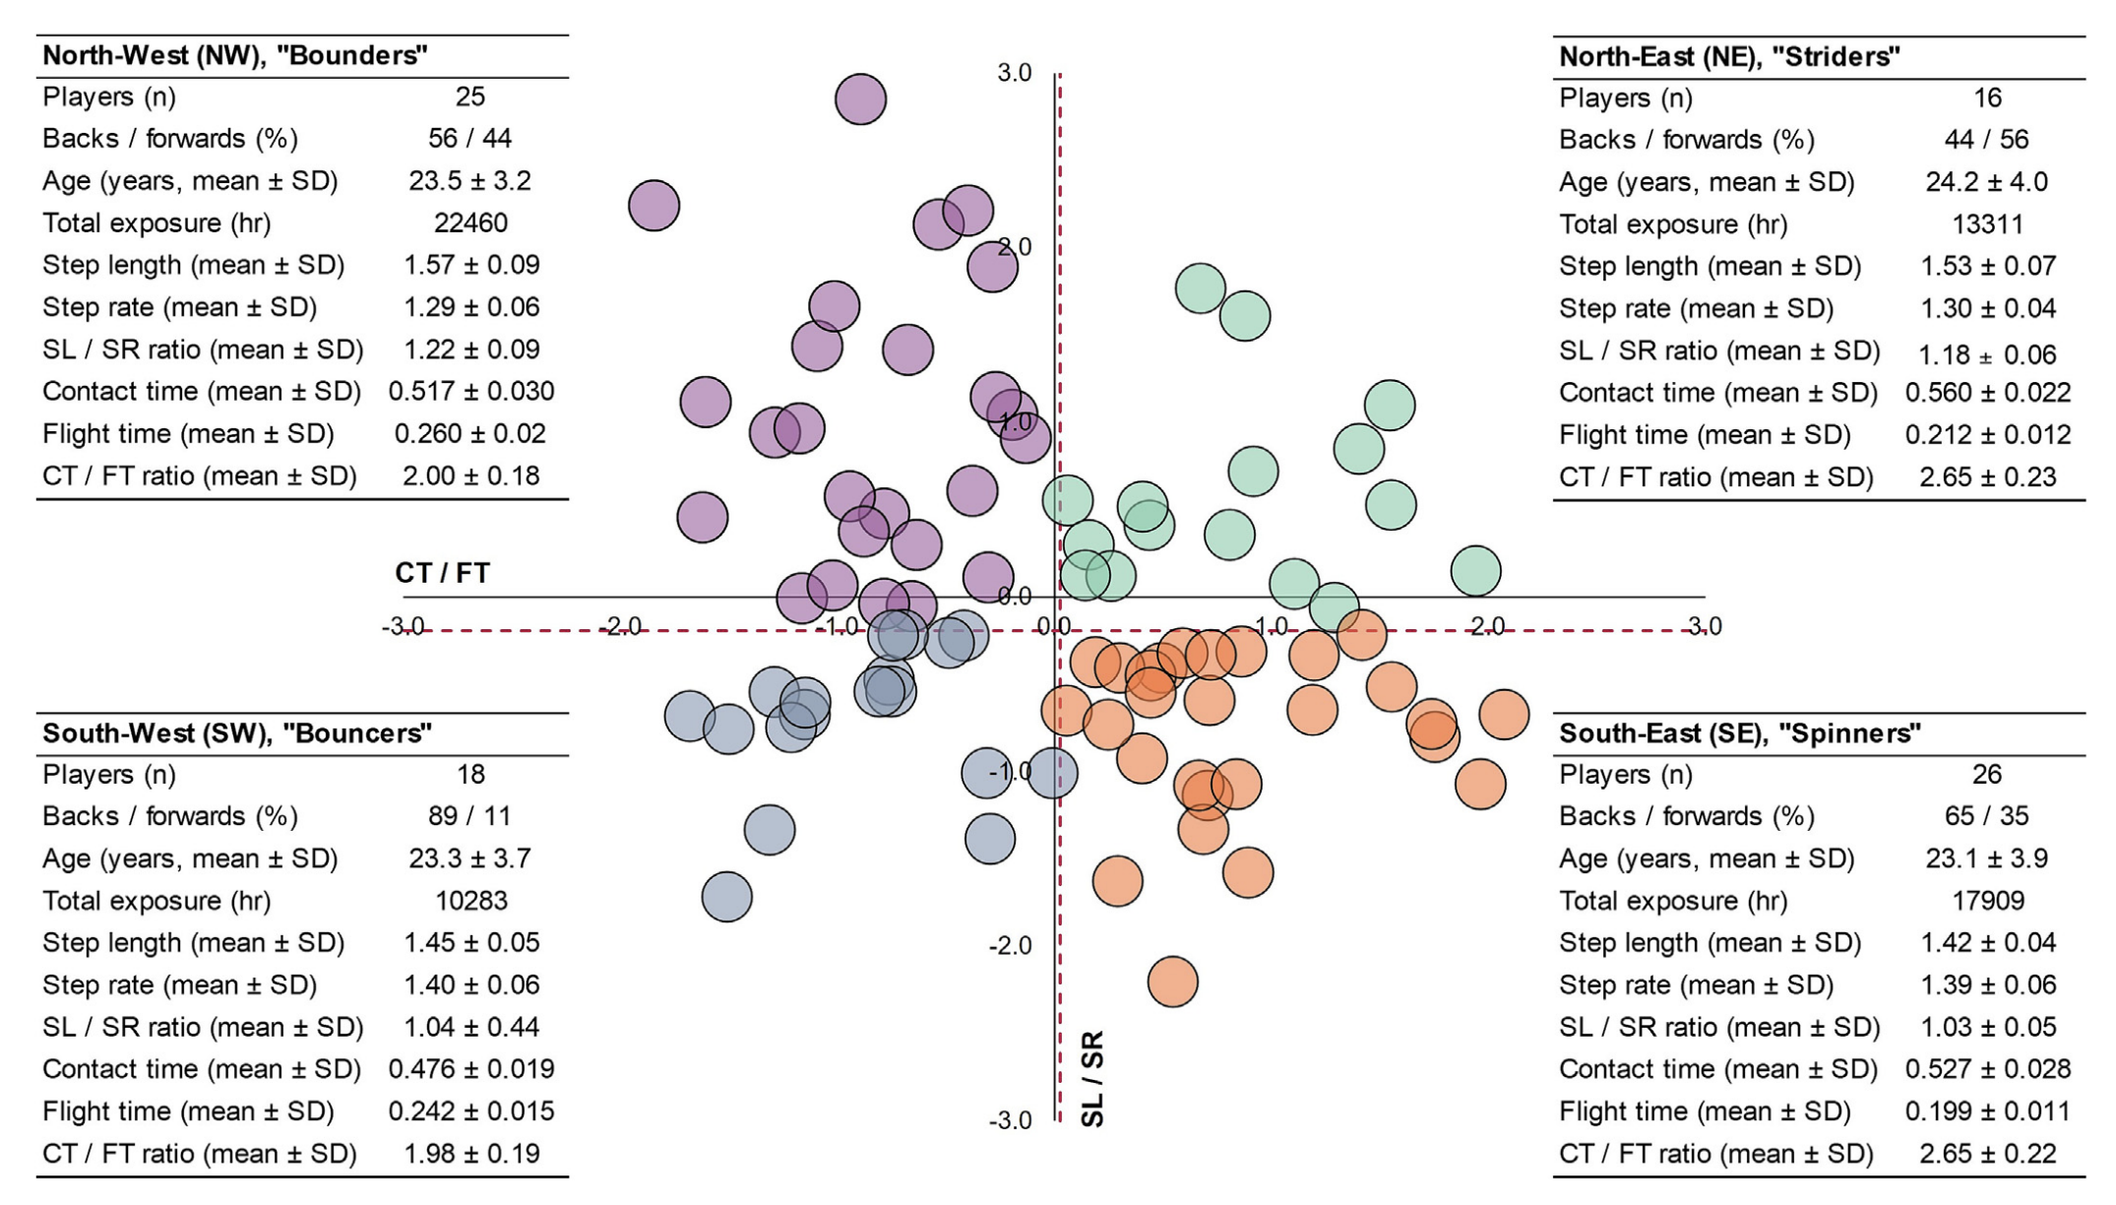
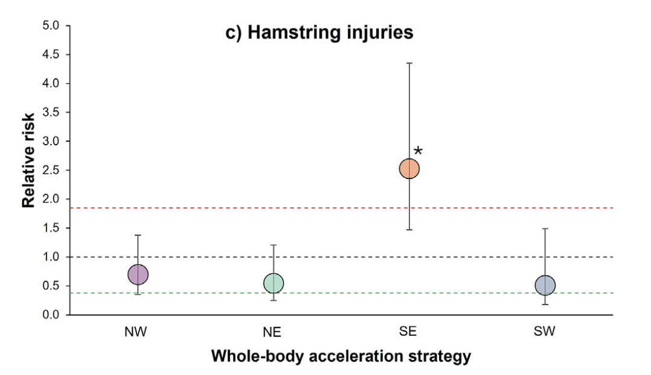
Strength and Running Performance
High step rate with short flight time
(Wild & Bezodis 2026)

Slide 27
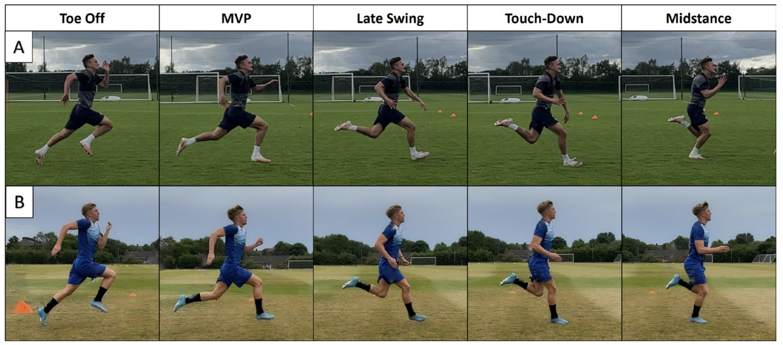
Sprint Movement Assessment Score (SMAS)
(Bramah et al., 2026)

Slide 28
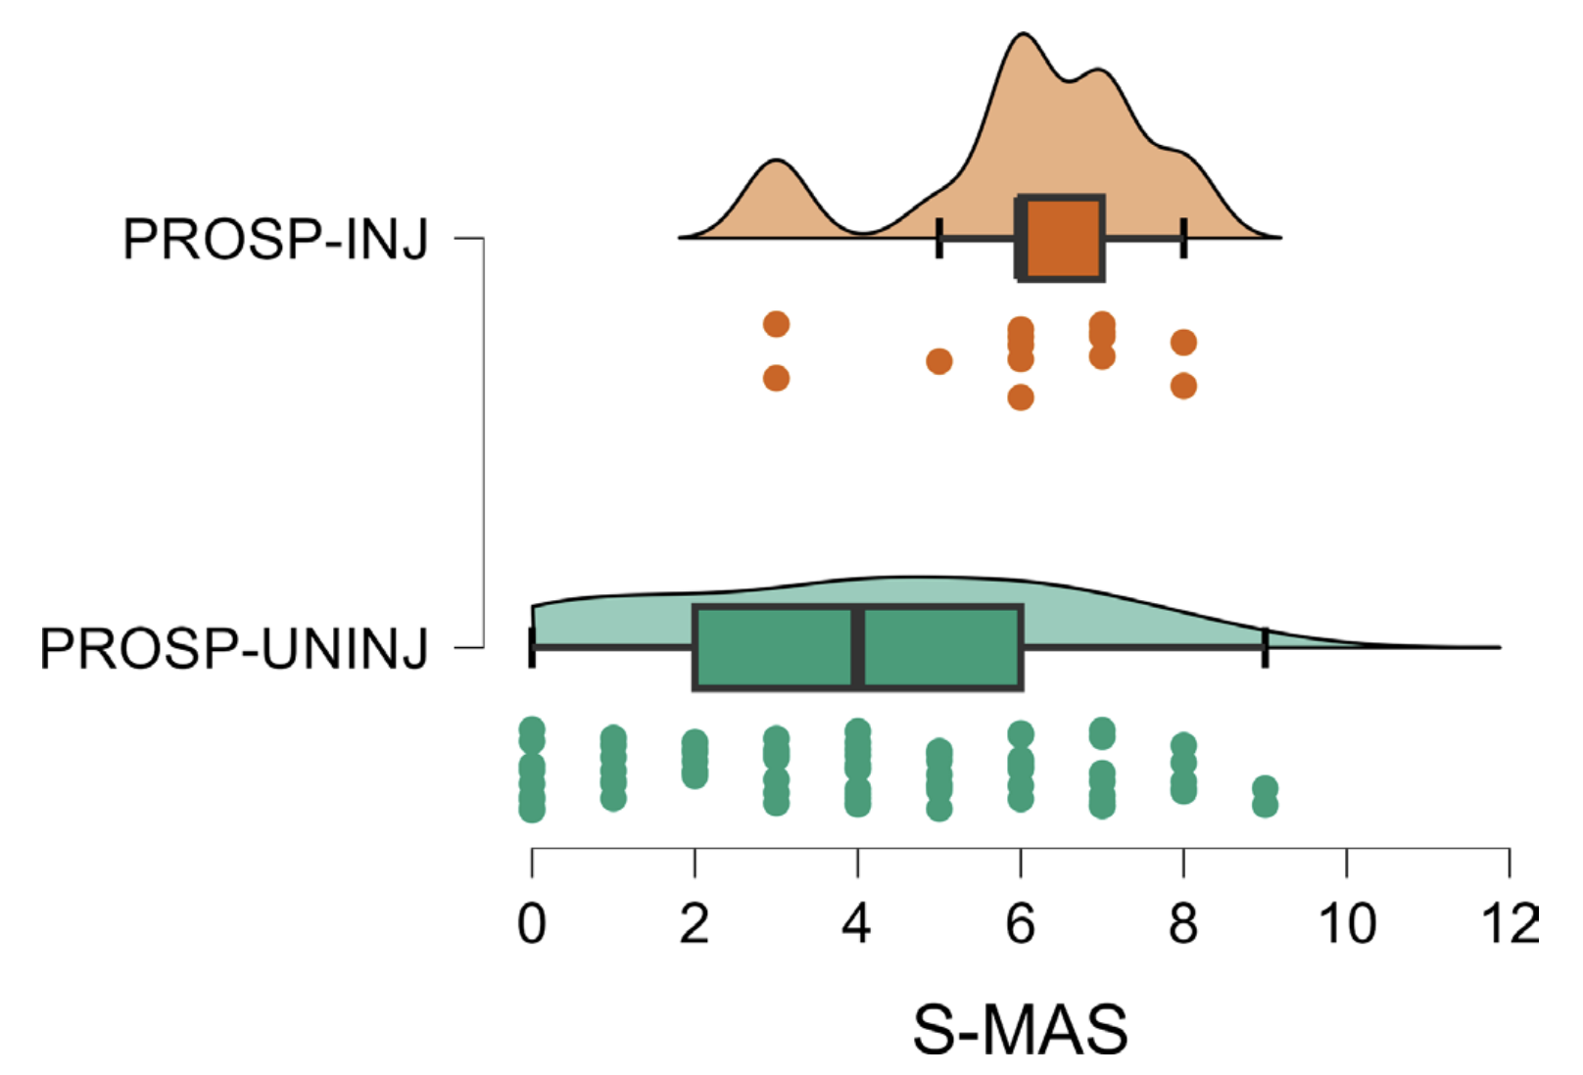
Sprint Movement Assessment Score (SMAS)
For every 1 N increase in 90:90 peak force.
0.02-0.04 reduction in SMAS
(Ross et al., 2026)
(Bramah et al., 2026)

Slide 29
Sprint Movement Assessment Score (SMAS)
25-50 N increase = 1 reduction of SMAS
(Ross et al., 2026)
(Bramah et al., 2026)

Slide 30
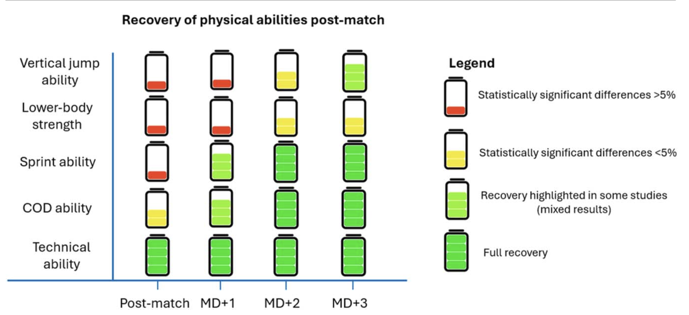
Fatigue
(Drayton et al., 2025)

Slide 31
Fatigue
 |  | Immediately Post | +24 h | +48 h | +72 h
90:90 | Peak force | ⬇️ | ? | ⬇️ | X
 | Rapid force | ?
30:30 | Peak force | ⬇️ | ⬇️ | X | X
 | Rapid force | ⬇️ | ?
90:20 | Peak force | ⬇️ | ? | ⬇️ | X
 | Rapid force | ⬇️ | ⬇️ | ⬇️ | ⬇️
⬇️ = Sensitive to fatigue; ? = No evidence; X = Not sensitive to fatigue
(Ripley et al., 2025)

Slide 32
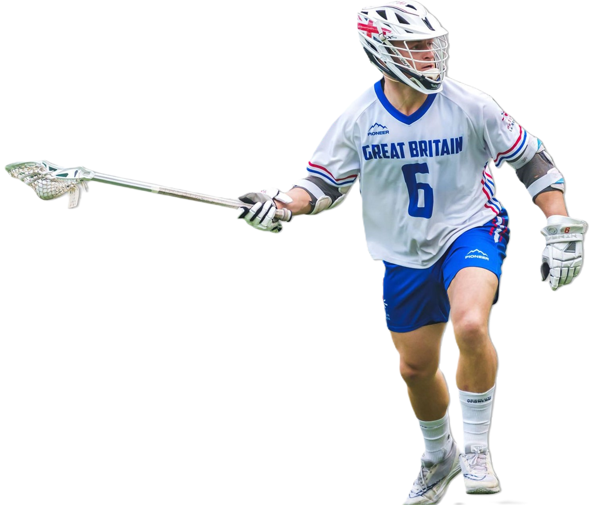
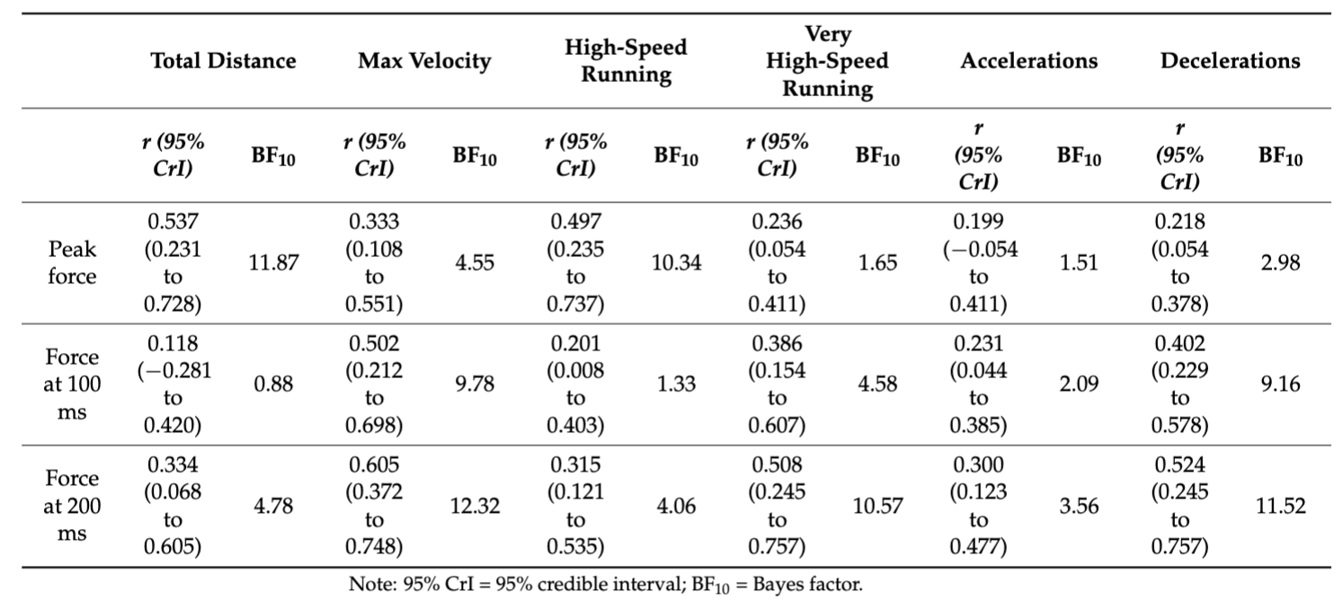
Fatigue
Reductions in Peak and Rapid force are specific
Peak force reductions closely associated with volume
Rapid force reductions closely associated with intensity
(Ripley et al., 2026)

Slide 33
Application of Isometric Hamstring Assessments

Slide 34
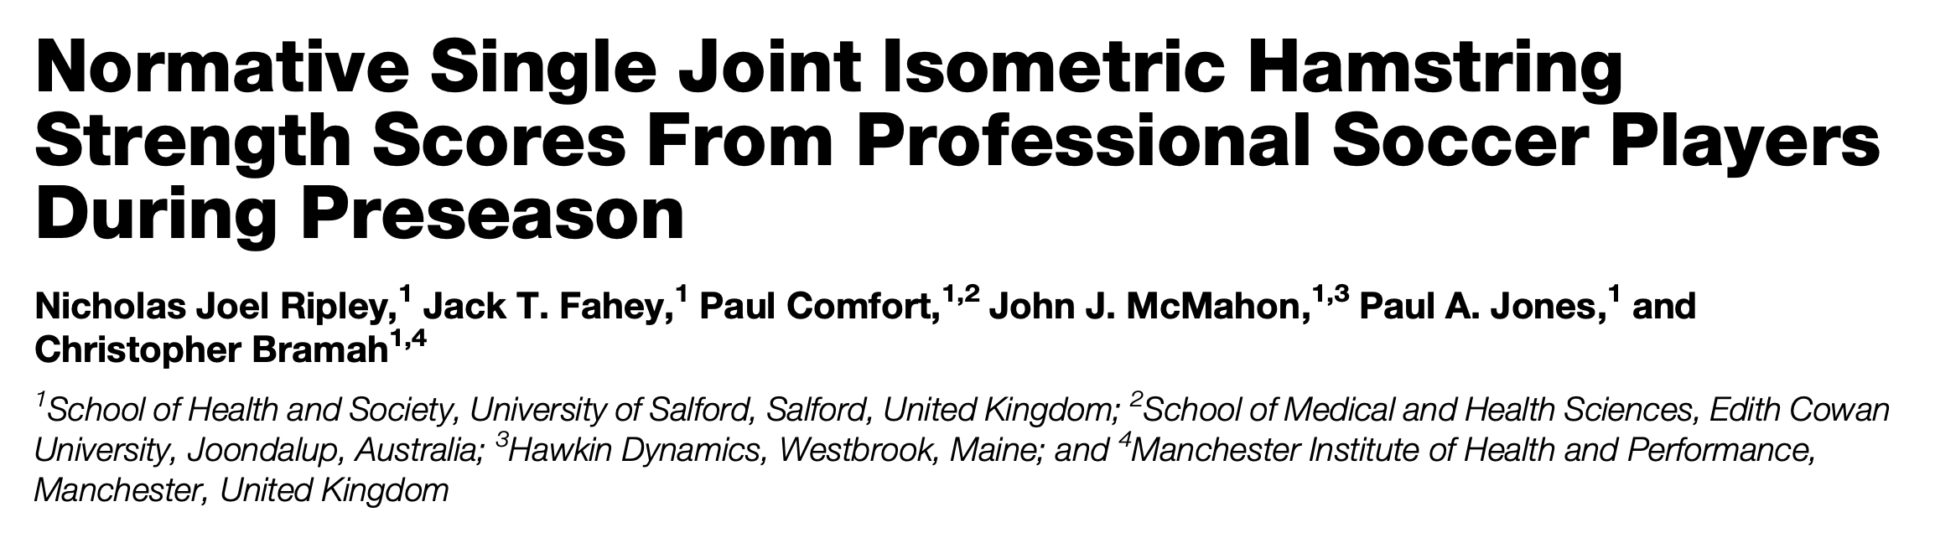
Profiling and
Benchmarking
Training needs identification
Targeted training Interventions
DESCRIPTOR | T-SCORE | DL 90:90 | NDL 90:90 | DL 30:30 | NDL 30:30
EXCELLENT | >70 | >6.23 | >6.15 | >5.93 | >5.84
GOOD | 60-70 | 5.40-6.23 | 5.33-6.15 | 5.20-5.93 | 5.09-5.84
ABOVE AVG | 55-60 | 4.98-5.40 | 4.91-5.33 | 4.84-5.20 | 4.71-5.09
AVERAGE | 45-55 | 4.15-4.98 | 4.09-4.91 | 4.11-4.84 | 3.96-4.71
BELOW AVG | 40-45 | 3.74-4.15 | 3.68-4.09 | 3.74-4.11 | 3.59-3.96
POOR | 30-40 | 2.91-3.74 | 2.86-3.68 | 3.01-3.74 | 2.84-3.59
VERY POOR | <30 | <2.91 | <2.86 | <3.01 | <2.84
DL = Dominant Limb; NDL = Non-Dominant Limb; n = 142

Slide 35
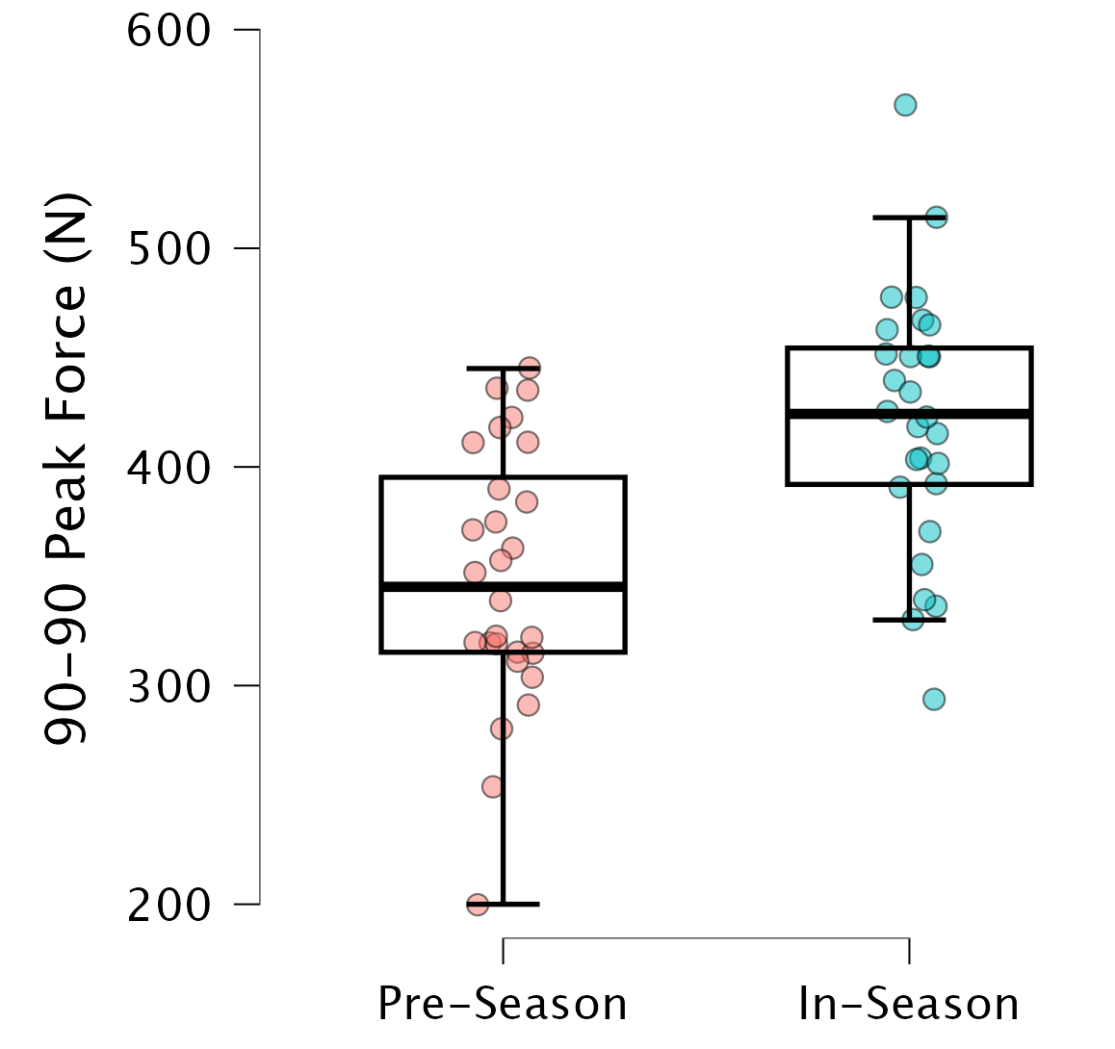
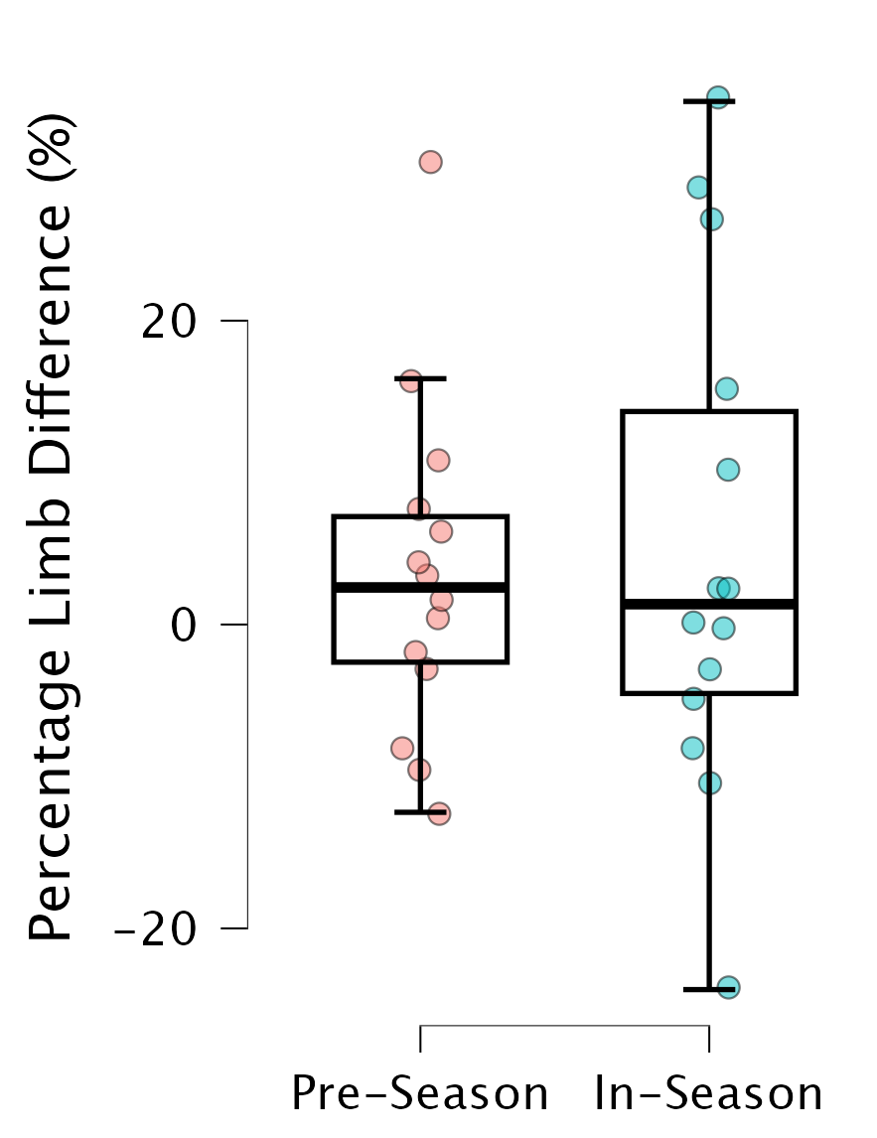
Profiling and Benchmarking
Applied Rugby League Training Prescription
Below Squad Average (<340 N)
Weak = Isometrics
Above Squad Average (>340 N)
Strong = Nordics
>10% Asymmetry
>10% = Unilateral Sliders

Slide 36
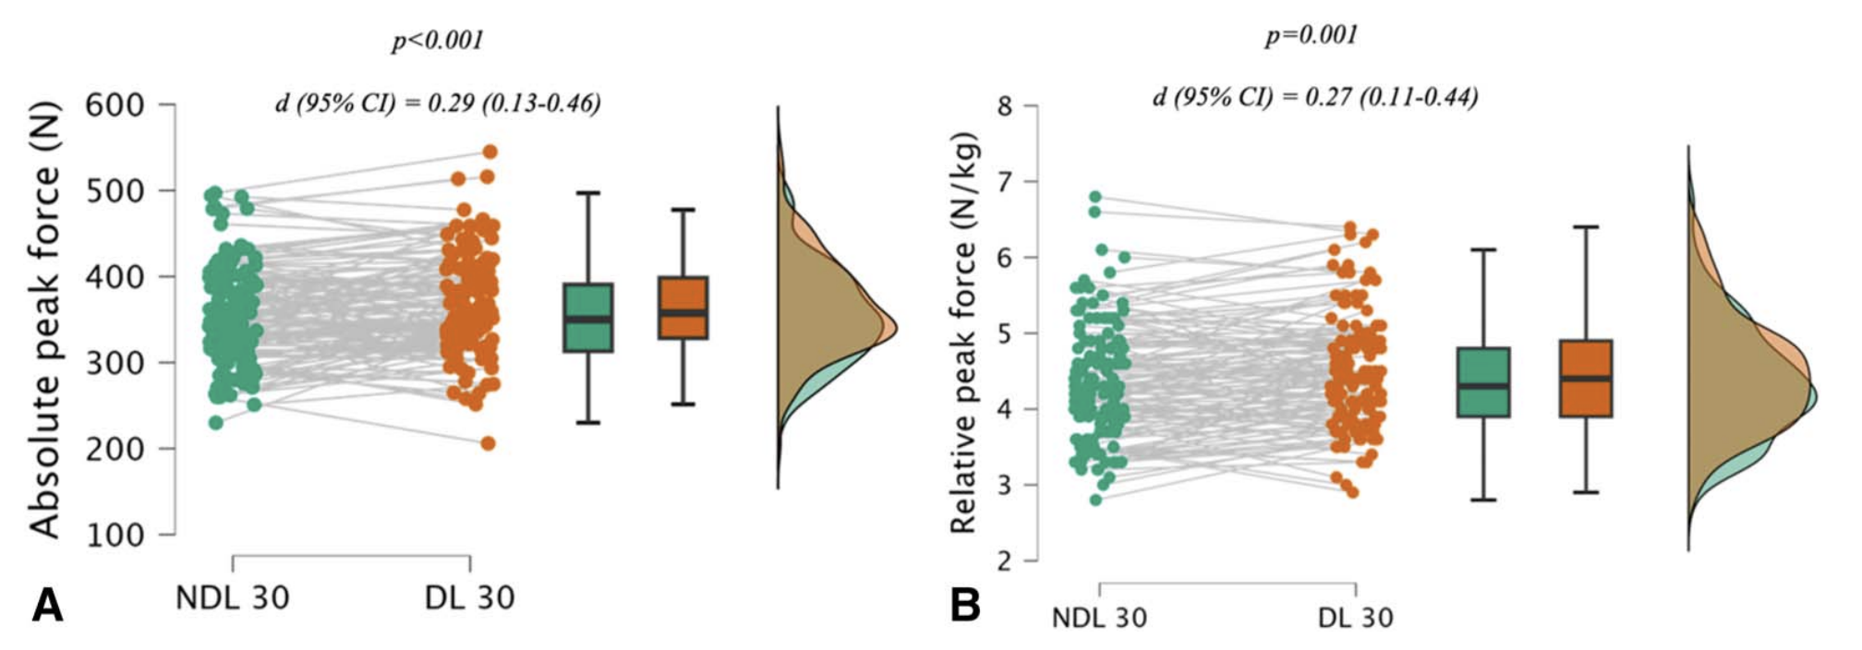
Profiling and Benchmarking
5.5 ± 0.8% difference between limbs
>6% Difference

Slide 37
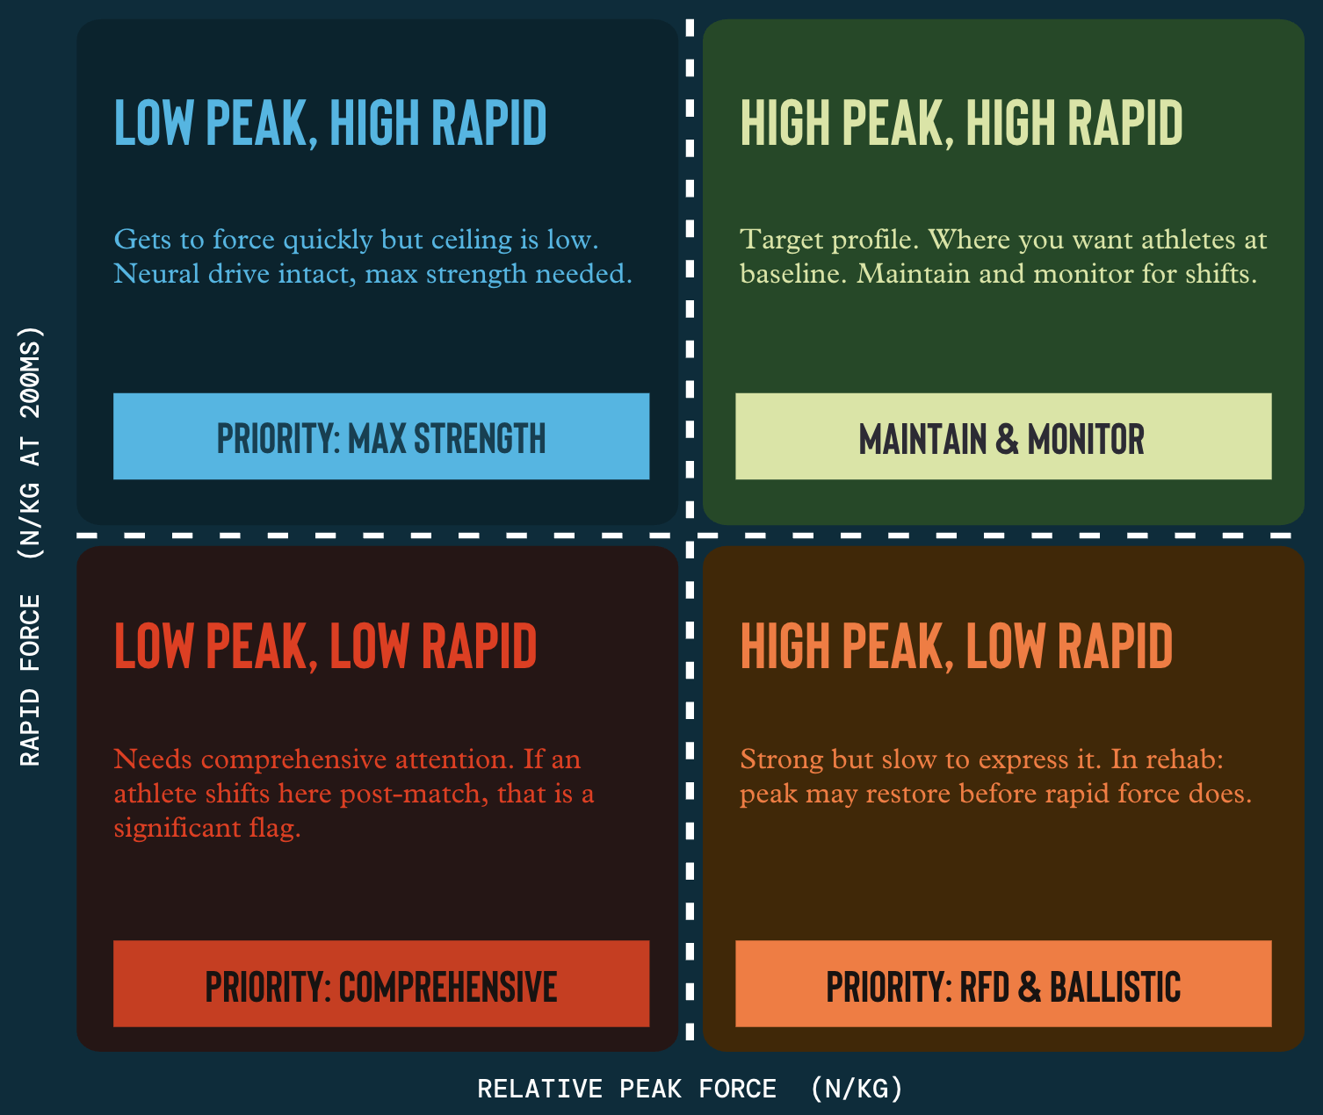
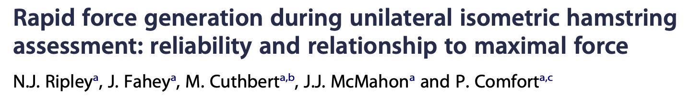
Profiling and Benchmarking
Training needs identification
Targeted training quadrant system

Slide 38
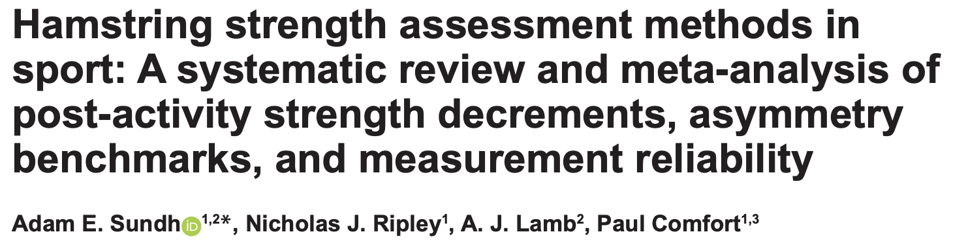
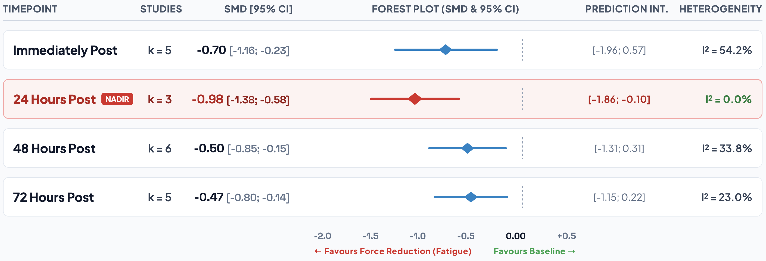
Fatigue Monitoring & Recovery

Slide 39
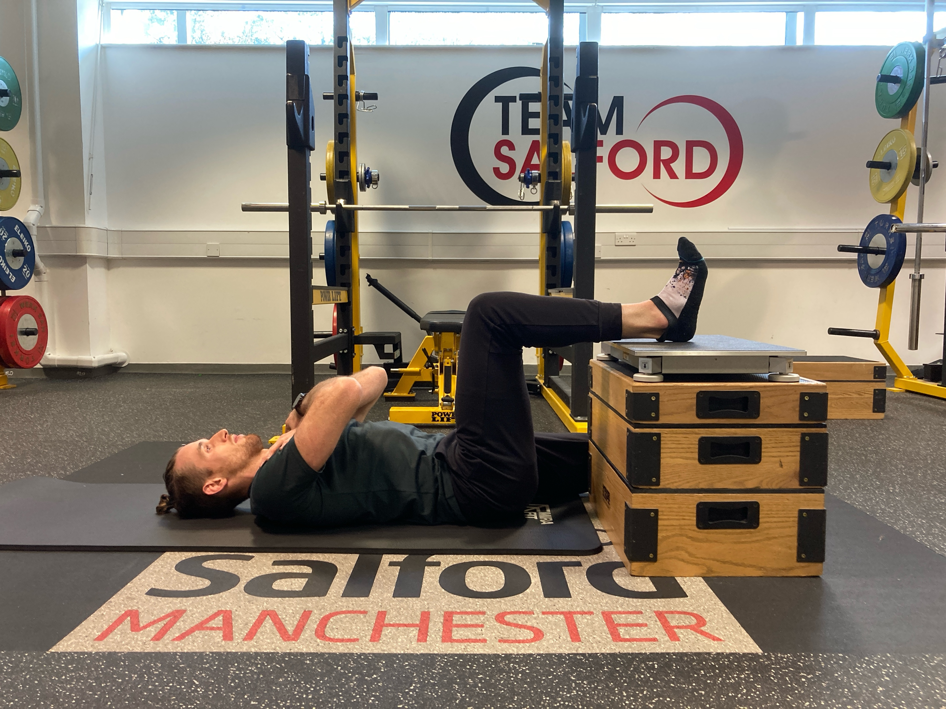


Fatigue Monitoring & Recovery
Individual Fatigue Profiles
(Rapid vs. Peak)
(Barber et al., 2024)
Current Tournament format:
2-3 Matches per day over 3-5 day window
Involving high-intensity efforts including accel’s and decel’s
Ripley et al.(2024); Ripley et al. (2025)

Slide 40
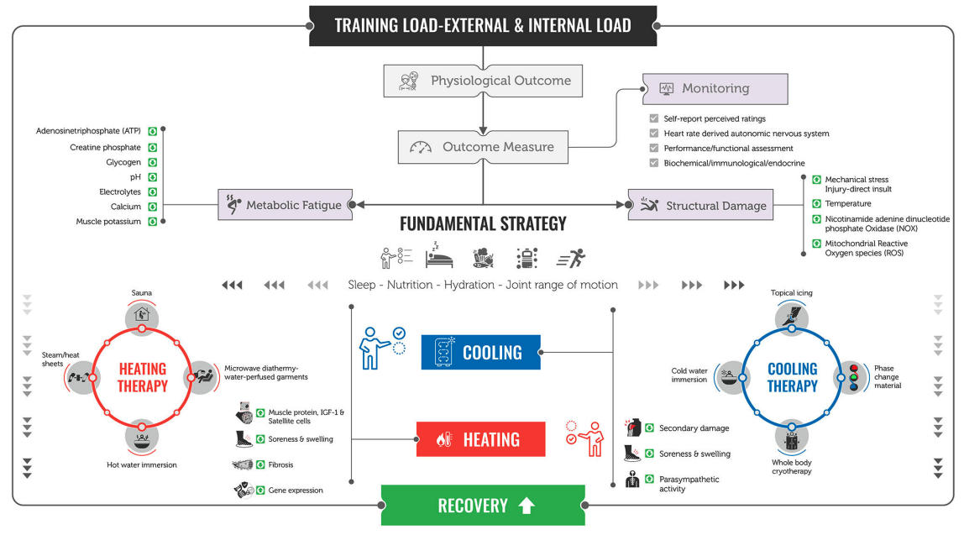
Fatigue Monitoring & Recovery
More bespoke strategies can be implemented; specific to the athlete
(Thorpe, 2021)

Slide 41

Rehab and Return to Play
30:30
90:90
Peak Force
Return to Participation
30:30 Injured limb = 21% ⬆️
30:30 Uninjured limb = 18% ⬆️
90:90 Injured limb = 26% ⬆️
90:90 Uninjured limb = 23% ⬆️
Peak Force
Return to Sport
30:30 Injured limb = 38% ⬆️
30:30 Uninjured limb = 29% ⬆️
90:90 Injured limb = 34% ⬆️
90:90 Uninjured limb = 32% ⬆️
Peak Force
Return to Performance
30:30 Injured limb = 60% ⬆️
30:30 Uninjured limb = 39% ⬆️
90:90 Injured limb = 65% ⬆️
90:90 Uninjured limb = 56% ⬆️

Slide 42
Rehab and Return to Play
30:30
90:90
Peak Force
Return to Participation
30:30 Injured limb = 21% ⬆️
30:30 Uninjured limb = 18% ⬆️
90:90 Injured limb = 26% ⬆️
90:90 Uninjured limb = 23% ⬆️
Peak Force
Return to Sport
30:30 Injured limb = 38% ⬆️
30:30 Uninjured limb = 29% ⬆️
90:90 Injured limb = 34% ⬆️
90:90 Uninjured limb = 32% ⬆️
Peak Force
Return to Performance
30:30 Injured limb = 60% ⬆️
30:30 Uninjured limb = 39% ⬆️
90:90 Injured limb = 65% ⬆️
90:90 Uninjured limb = 56% ⬆️
At return to performance, when Rapid force (200 ms) is Normalized to Peak Force, the injured limb was 54% and 61% in comparison to the uninjured limb 79% and 81% for the 30:30 and 90:90

Slide 43
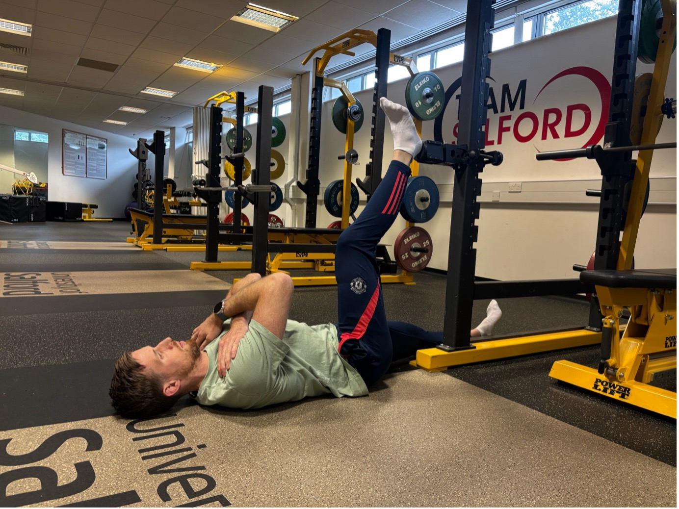
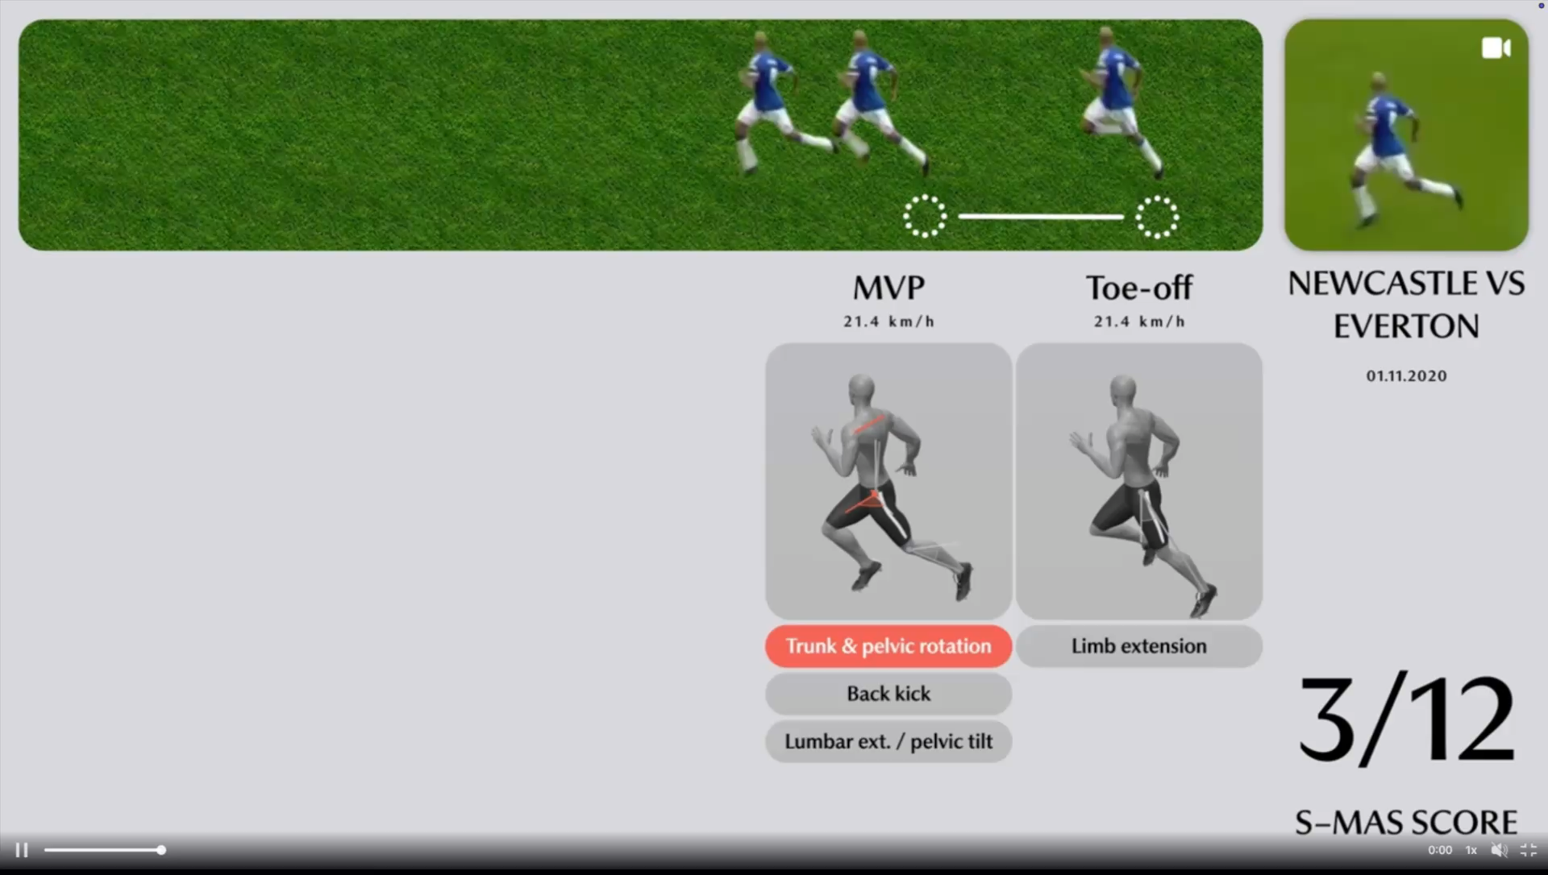

Hamstring Assessment and the Future
Force Assessment will not give us everything; but it can be used to inform training, recovery and rehabilitation

Slide 44


N.J.Ripley@Salford.ac.uk
@nj_ripley
Thank you for listening

