Slide 1
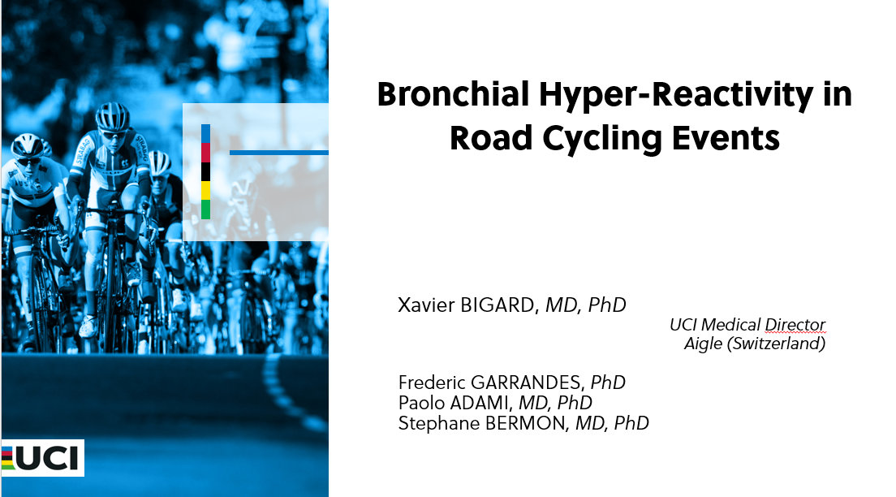
Wearable Devices in Sport:
Potential Benefits,
Challenges, Limitations,
and Ethical Issues
Xavier Bigard, MD, PhD
UCI Medical Director
Aigle (Switzerland)

Slide 2

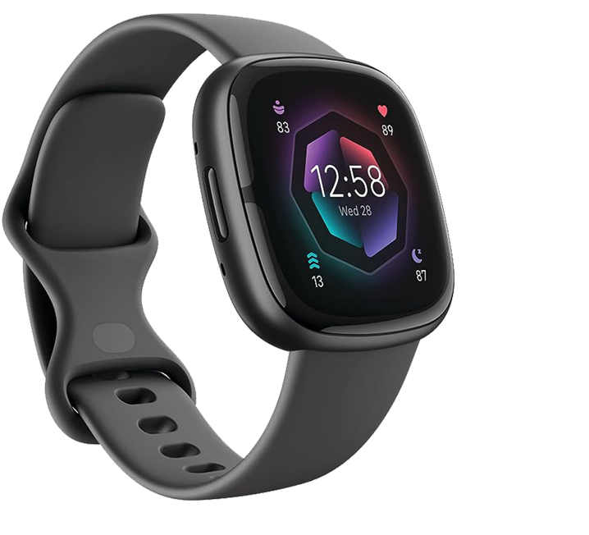
Introduction
Who is wearing a smartwatch?
Today, we don’t just measure how we move
- we start to measure what happens inside our body
- sweat rate, glucose, metabolites (Lactate), hydration status
- stress hormones
Objectives are clear
- make sport safer
- help athletes perform better

Slide 3
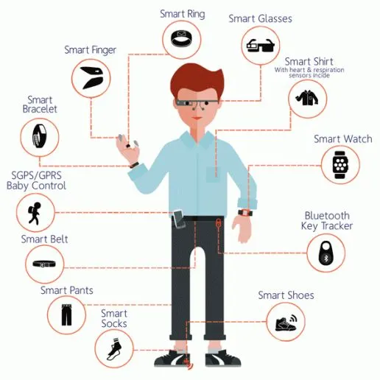
Introduction
But technology is evolving
faster than science can assess it
faster than regulations can follow
faster than our ethical thinking.
Several questions to be addressed
- what’s new
- what can we do with them?
- what are the current limitations?
- what are the ethical questions?
The views expressed here are those
of a physician and physiologist,
with a focus on safe use and ethics.

Slide 4
1- What’s new?
From mechanical to biochemical/physiological sensing
- wearables in sport measured only movement (accelerometers and GPS)
- then came heart rate (with chest straps, then with watches), respiratory rate
- today, we are moving from physical monitoring to biochemical monitoring
* offer real-time insights into physiological parameters
* convenient solution for continuous monitoring during training and competition
* there is a need to develop non-invasive biosensors that measure biochemical markers which indicate physical exertion, fatigue, and mental well-being.

Slide 5
1- What’s new?
Human body fluids for real-time monitoring
- blood has traditionally been the gold standard, but invasive
- non-invasive fluids like saliva; but potential discomfort of integrating a sensor into a mouthguard
- sweat is another ideal source for the continuous measurement of biomarkers
* eccrine sweat glands are abundant on the body
* ease of access,
* increased sweat rate during exercise
* fluid containing electrolytes, metabolites, and hormones
* substances which passively or actively enter sweat from blood or interstitial fluids
* concentrations in sweat correlate with those in blood…
* some wearables artificially induce sweating using a current

Slide 6
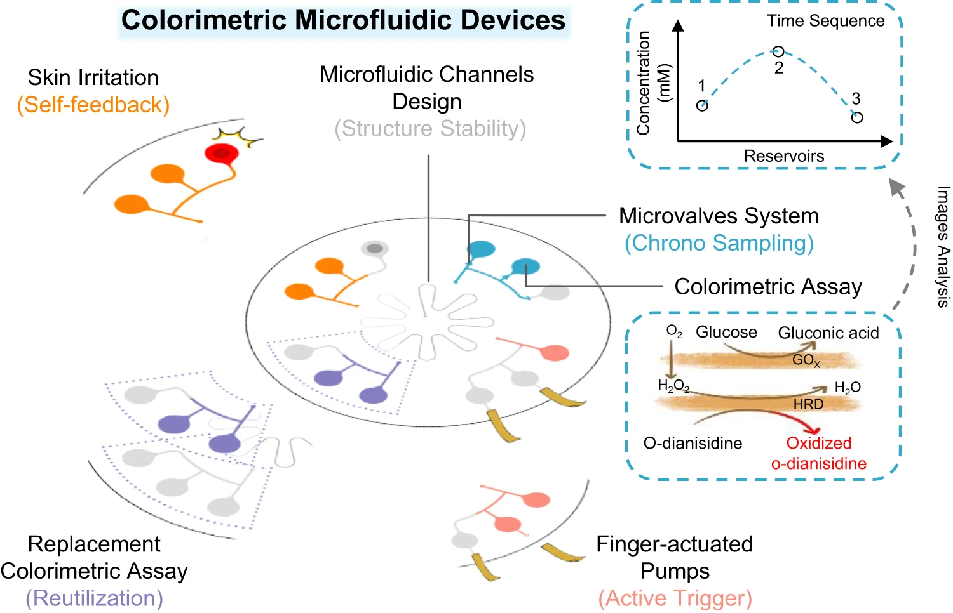
1- What’s new?
New sensors
- can read several biomarkers continuously, without needles, without blood samples using electrochemistry, colorimetry, fluorescence colorimetry and surface spectroscopy techniques
- a landmark advance
* was the development of soft, skin-interfaced epidermal patches
* comprise capillary-driven microchannels
* microvalves systems
* reservoirs to route, and store microliter volumes of sweat
* minimizing evaporation and contamination.
(Liu et al. 2023)

Slide 7
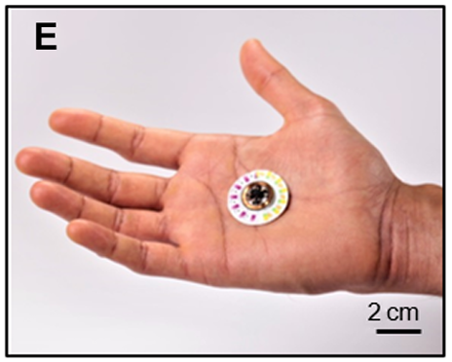
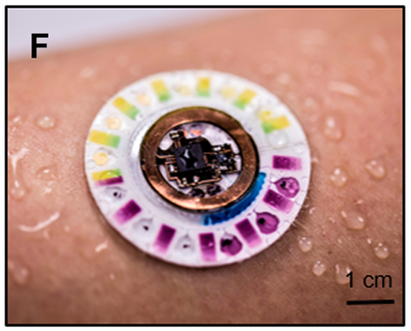
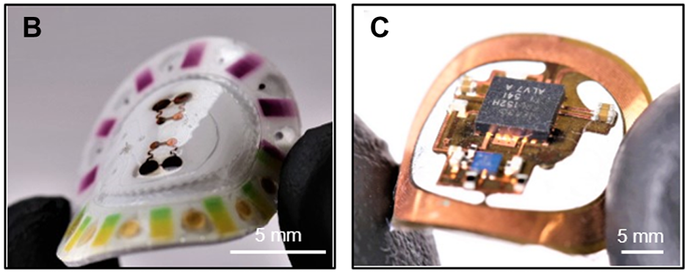
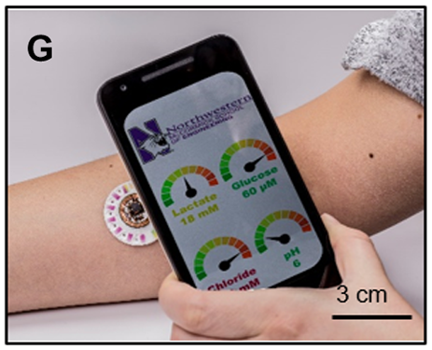
1- What’s new?
New sensors
- when coupled with colorimetric assays, these platforms enabled
* battery-free
* instrument-free
* visual quantification of multiple analytes
chloride
pH
glucose
lactate
* on smartphone
Now, sensors are thin, light, they can measure several molecules in parallel, and are more comfortable. Comfort means better data.
(Bandodkar et al. 2019)

Slide 8
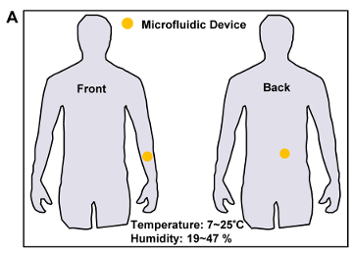
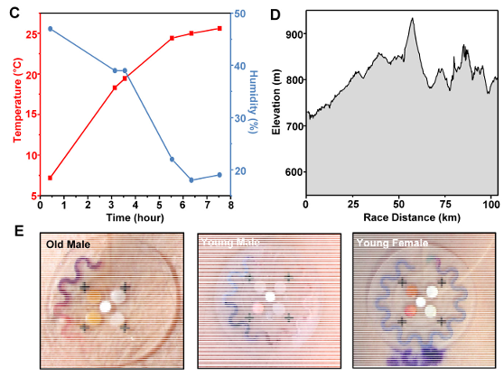
1- What’s new?
Real-world validation
- most of these sensors only work in the labs
- in perfect conditions, with controlled temperature, controlled exercise intensity.
But sport is not a lab.
- athletes sweat more or less.
- temperature changes.
- exercise intensity changes.
We now see the device testing in real conditions during long-distance events
- metabolic sensors change colour
- they stayed stable
- even when temperature, pH and sweat flow change.
(Koh et al. 2016)

Slide 9
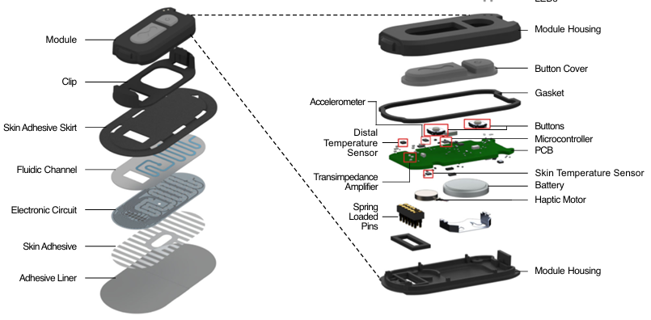
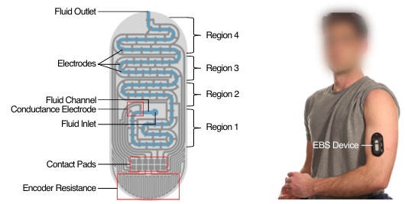
1- What’s new?
Closed-loop systems
- open-loop vs closed-loop systems
- a closed-loop system measures, interprets, and sends advice, alert, an action.
4 steps
- sense, data collection
- analyse, turns raw data into meaning
- decide, compares with a threshold, ideally the personal one (using AI)
- act, the system gives a feedback
Most closed-loop systems are still prototypes.
The quality of the loop depends on the quality of the data, and on the quality of the algorithm
(Koh et al. 2016)

Slide 10
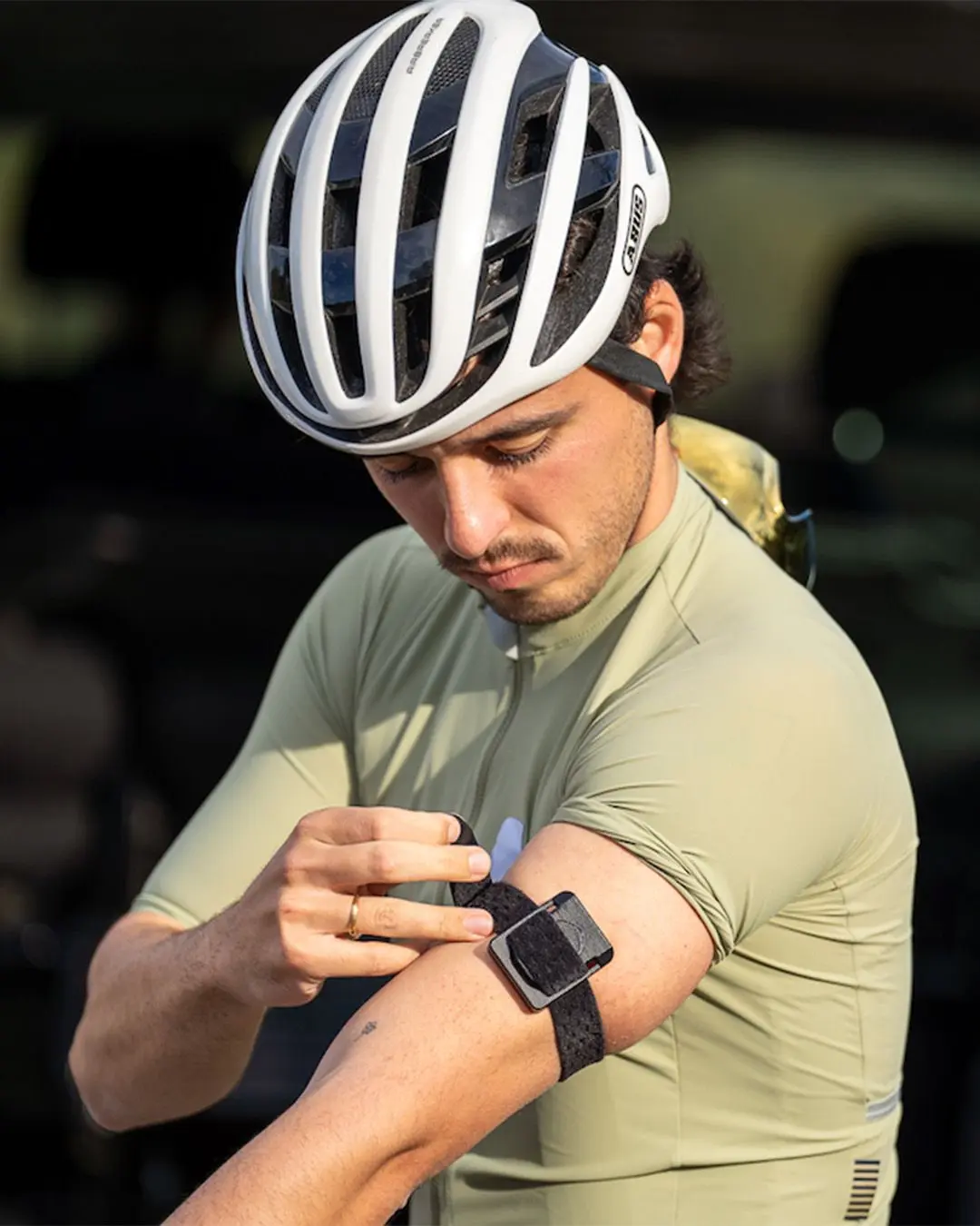
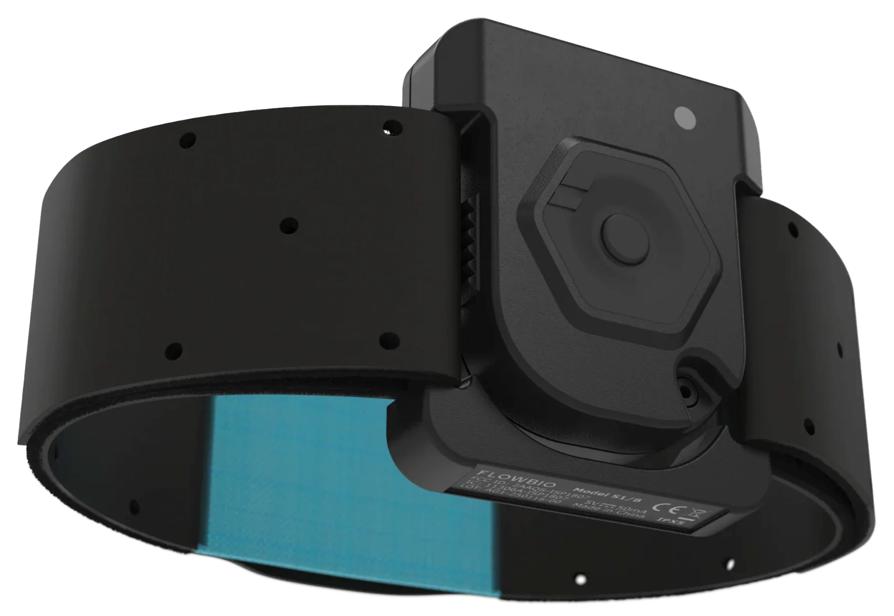
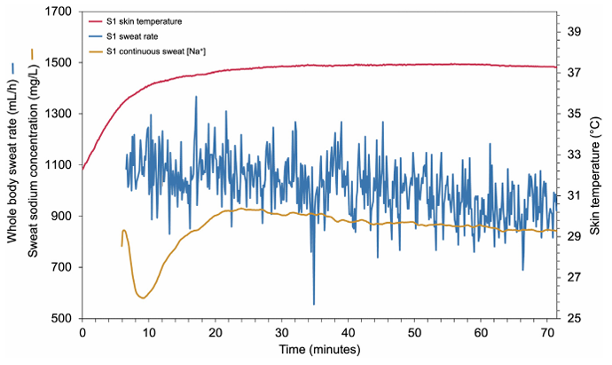
2- What can we do with them?
Safety
- the most important benefit
- several risks where these systems can help
- heat injury prevention
* endurance sports
* risks of heat injuries
* prevention of fluid and electrolyte loss, but everybody sweats differently
* high benefit from sweat sensors
monitoring both the sweat rate and sodium loss
during exercise, and for each athlete
* validation procedures are necessary
* this sensor is adequate to estimate water loss when the gold standard method is not feasible
* measurements from this device should not be considered equivalent to laboratory-based analyses
(Bandiera et al. 2026)

Slide 11
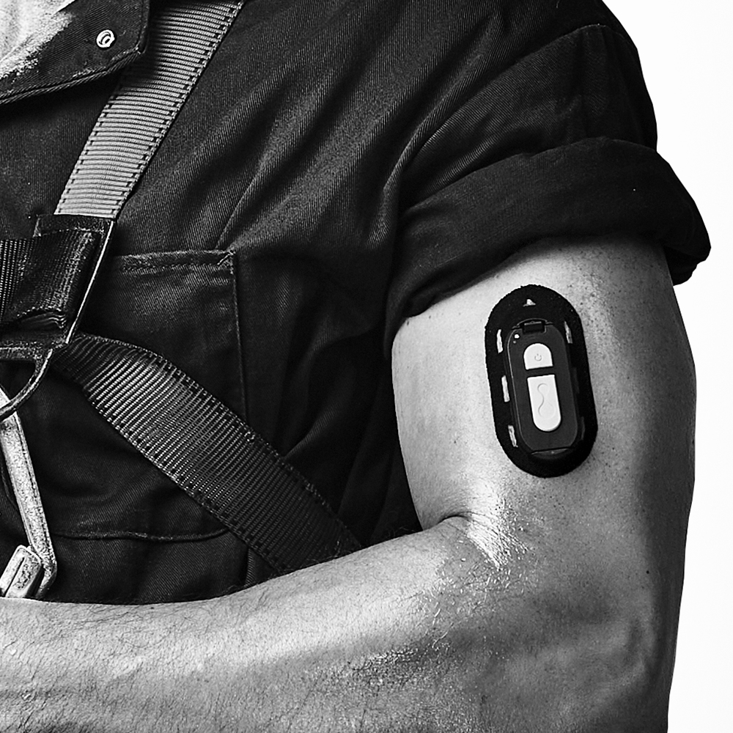
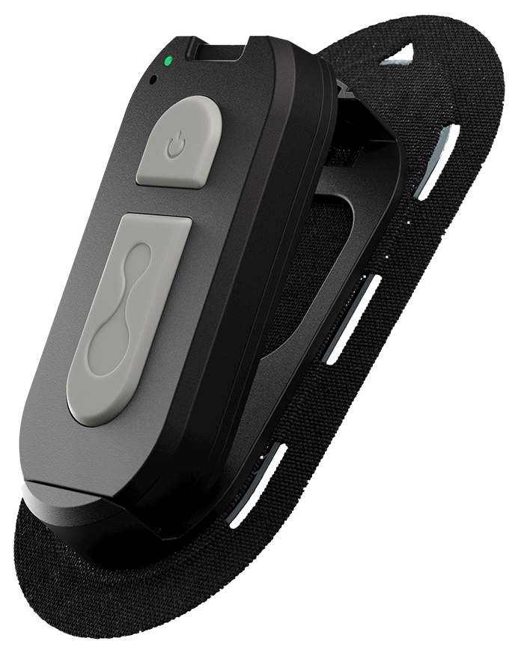
2- What can we do with them?
Safety
- the most important benefit
- several risks where these systems can help
- heat injury prevention
* for the future
* development of closed-loop systems
* in one recent study, a patch vibrates when the athlete has lost about 2 % of body weight in sweat

Slide 12
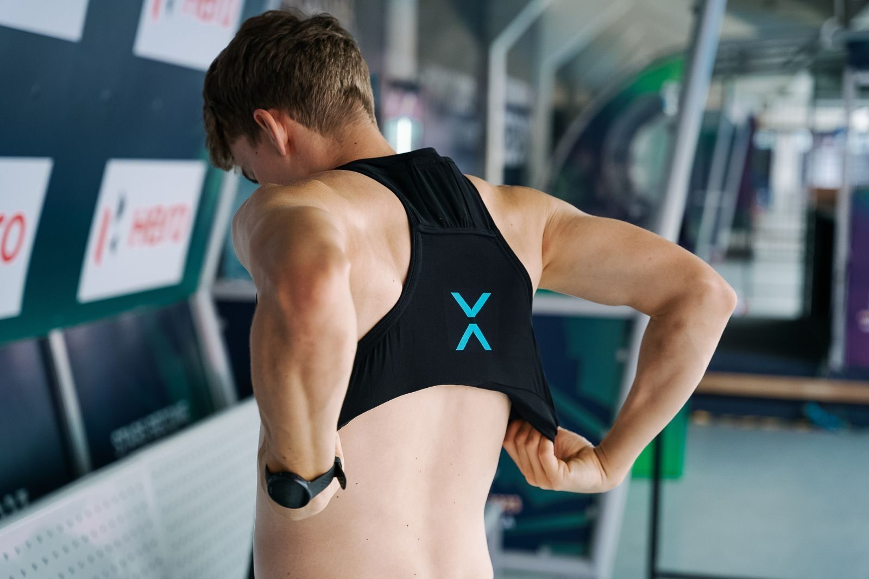
2- What can we do with them?
Safety
- mechanical load
- small motion sensors (IMUs, inertial Measurement Units) can measure impacts, jumps, accelerations and rotations
- 2 main areas of application
* physical workload
Load metrics, quantifying overall volume
Intensity or per minute metrics: quantifying work rate and pace of play
In team sports, IMUs included in small vests
They count sprints, jumps, impacts
Prevention of musculoskeletal injuries
Musculoskeletal injuries have complex origins, and there is insufficient evidence to establish cause-and-effect relationships.

Slide 13
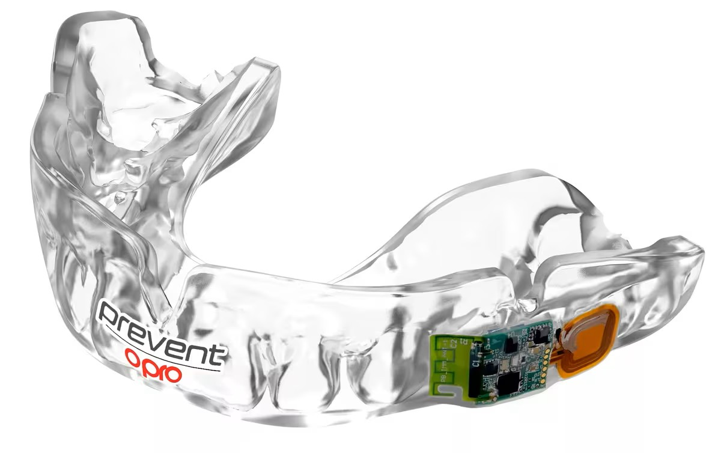
2- What can we do with them?
Safety
- mechanical load
- small motion sensors (IMUs, inertial Measurement Units) can measure impacts, jumps, accelerations and rotations
- 2 main areas of application
* physical workload
* early detection of sport-related concussion (SRC)
Smart mouthguards, embedded with sensors,
to monitor potential head injuries
measure peak linear acceleration, peak rotational acceleration, and peak rotational velocity
The device send real time alerts of high accelerations to pitch-side doctors
players who experience heavy head impact can be taken off and assessed
regardless of whether symptoms manifest

Slide 14
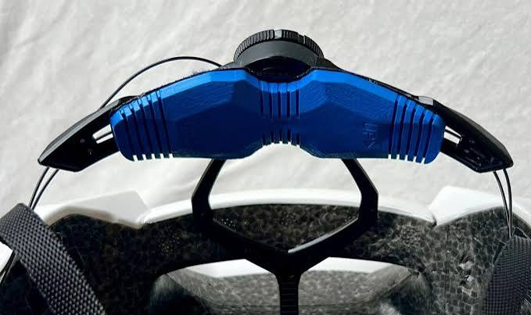
2- What can we do with them?
Safety
- mechanical load
- small motion sensors (IMUs, inertial Measurement Units) can measure impacts, jumps, accelerations and rotations
- 2 main areas of application
* physical workload
* early detection of sport-related concussion (SRC)
Smart helmets in cycling,
to monitor potential head injuries
IMU sensor detects both linear and rotational accelerations
onboard processor filters the data
Bluetooth module sends the signal to the team car

Slide 15
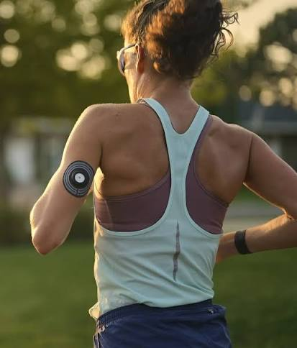
2- What can we do with them?
Performance
- in endurance sports we can measure a lot of parameters
- the challenge is to measure how the body responds, not what the athlete produces (speed, power) same power output but different energy expenditure
* fuelling the right energy at the right time
glucose sensors could help to provide energy according to changes in blood glucose
see the drop coming, and eat before it’s too late
but the control of energy availability is more complex

Slide 16
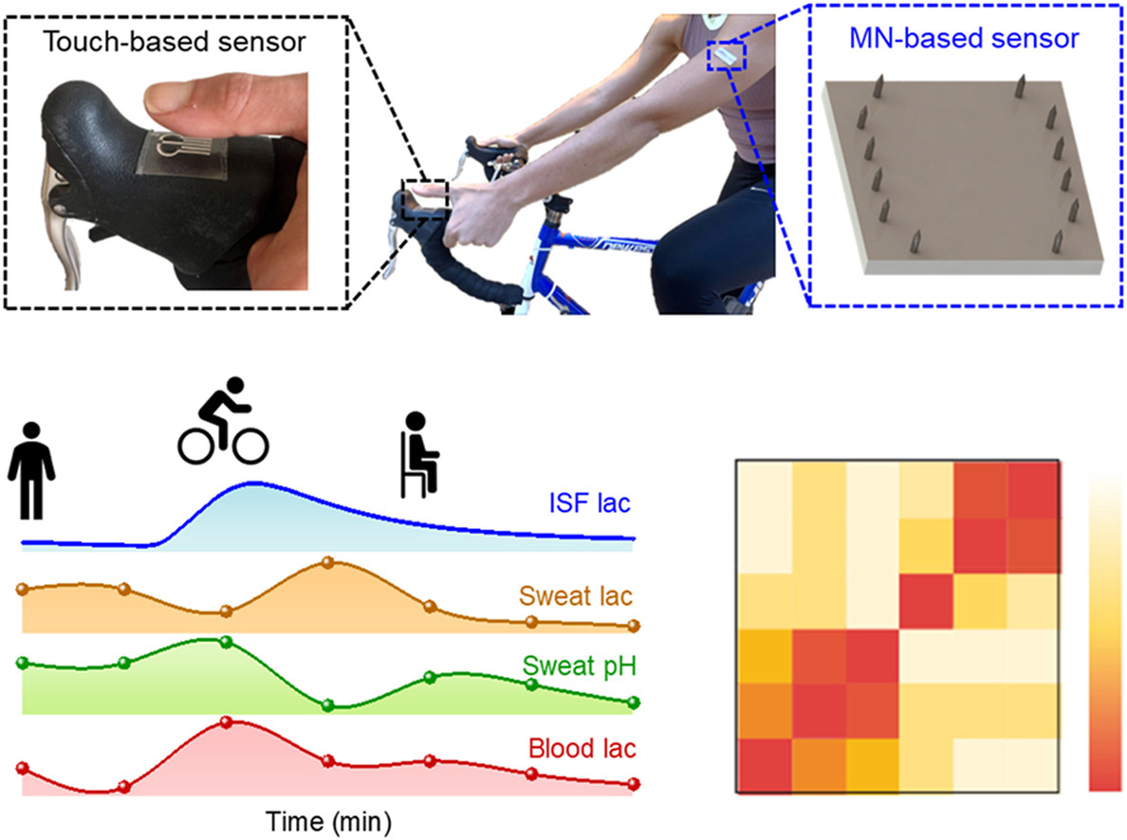
2- What can we do with them?
Performance
- in endurance sports we can measure a lot of parameters
- the challenge is to measure how the body responds, not what the athlete produces (speed, power) same power output but different energy expenditure
* fuelling the right energy at the right time
* pacing knowing the real limit, today
lactate sensors could provide the opportunity to determine the lactate threshold help to provide energy according to changes in blood glucose
that would help athletes pace better
(Boscarino et al. 2026)

Slide 17
2- What can we do with them?
Performance
- in endurance sports we can measure a lot of parameters
- the challenge is to measure how the body responds, not what the athlete produces (speed, power) same power output but different energy expenditure
* fuelling the right energy at the right time
* pacing knowing the real limit, today
* training
- training programme should be tailored to each individual’s internal load
- internal load is the effect that exercise has on your body
- new sensors provide information about internal load: heart rate variability, sleep, hydration, and perhaps stress hormones
- then, training can become more individualised
- each athlete can benefit from a training load adapted to what their body is capable of tolerating

Slide 18
2- What can we do with them?
Recovery optimisation
- performance is not only built during training. It’s built during recovery
- how do we know if an athlete is ready for the next hard session? Or the next race?
* every morning test train hard or take it easy?
- the status of the autonomic nervous system plays an important role in the training response ; can be estimated by the heart rate variability (HRV)
- higher HRV before the training period is associated with a larger increase in peak oxygen consumption (VO2peak)
- low-trained individuals submitted to predefined training group (TRA, n = 8) or HRV-guided training group. Four-week training period consisted of running sessions.
- If HRV was normal, they trained hard. If it dropped, they trained easy or rested

Slide 19
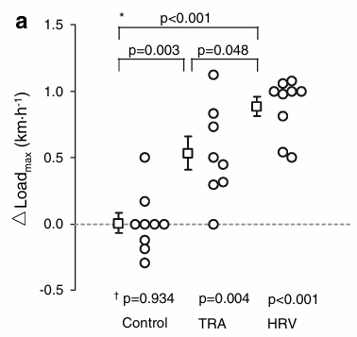
2- What can we do with them?
Recovery optimisation
- performance is not only built during training. It’s built during recovery
- how do we know if an athlete is ready for the next hard session? Or the next race?
* every morning test train hard or take it easy?
the responses to endurance training are improved by using daily HRV for running exercise prescription
these results support the use of wearable devices to assess HRV for training monitoring
(Kiviniemi et al. 2007)

Slide 20
2- What can we do with them?
Recovery optimisation
- performance is not only built during training. It’s built during recovery
- how do we know if an athlete is ready for the next hard session? Or the next race?
And don’t forget
data never replaces the athlete’s feelings
combine data and conversation
sensors help us see the invisible
make better decisions about when to push, and when to rest.
* every morning test train hard or take it easy?
* recovery after a race how long to recover?
- one of the most challenging situation is stage races (3 weeks)
- hard stages almost every day. Recovery happens in a few hours
- in that situation, every detail counts
- sensors can help the staff assess
the sleep quality
the hydration status
the status of the autonomic nervous system (HRV)

Slide 21
3- Current limitations
A- Wearable sensor validation
- single measure validation
* validation process using conventional procedures against a gold standard method
* accuracy, repeatability, resolution, sensitivity
- wearable device validation
* the system has been validated, but what exactly was validated?
* the full device must be validated for each individual parameter
* assessment of the accuracy of seven commercially available wrist-worn
devices in estimating heart rate and energy expenditure

Slide 22
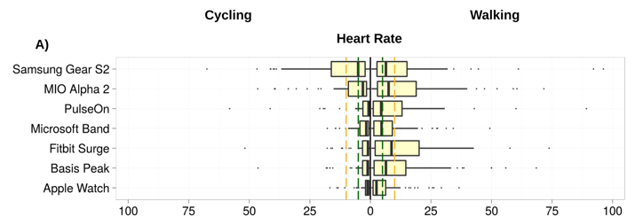
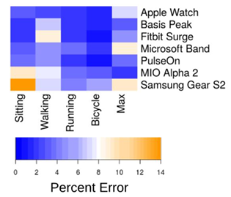
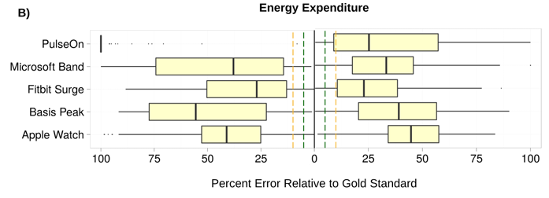
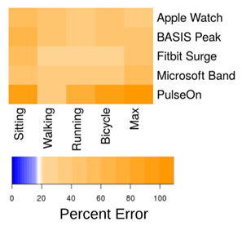
(Shcherbina et al. 2017)
In most settings, heart rate measurements were within acceptable error range (5%).
None of the devices provided estimates of energy expenditure that were within an
acceptable range.

Slide 23
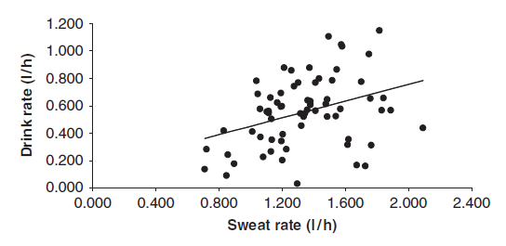
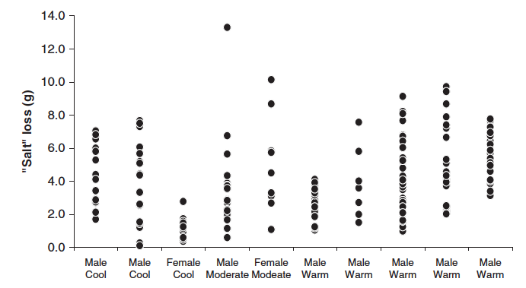
3- Current limitations
B- Variability at the source
- high interindividual variability in the biological parameters being measured
* sweat and hydration status
- high variability of the sweat rate, x3
- high variability of the salt loss
(Shirreffs et al., 2010)

Slide 24
3- Current limitations
B- Variability at the source
- high interindividual variability in the biological parameters being measured
* sweat and hydration status
* sweat is routinely used as a biological matrix
- when a sensor measures lactate or sodium in sweat, what does that number really mean?
- is it the same as in the blood?
- is the link between sweat and blood still fully understood?

Slide 25
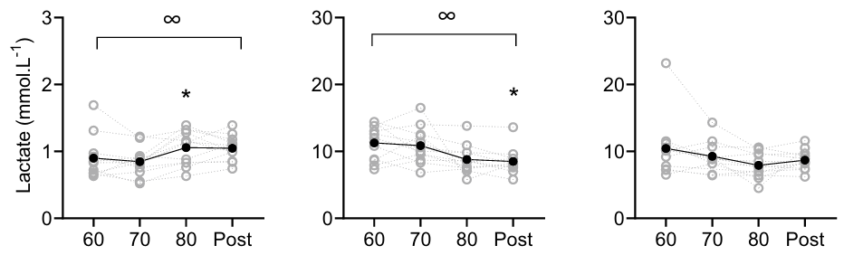
(Klous et al. 2021)
Unlike other components, concentrations of sweat lactate on the arm and back were similar.
As sweat rate increased, sweat lactate concentrations on the arm were found to decrease by dilution

Slide 26
(Klous et al. 2021)
Overall sweat lactate concentrations considerably exceeded blood lactate concentrations
In contrast to sweat, blood lactate concentrations slightly increased during the protocol.
These results suggest that sweat lactate is independent of blood lactate concentrations.
A sweat sensor therefore cannot simply be used to indirectly measure blood concentrations.

Slide 27
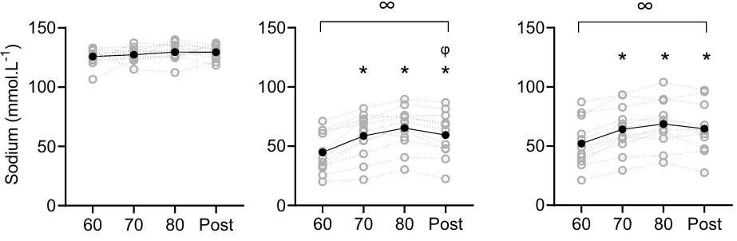
(Klous et al. 2021)
Alongside the increases in sweat rate, sweat sodium increased as exercise intensity increased.

Slide 28
(Klous et al. 2021)
As concentrations in sweat increased, blood concentrations did not change.
No correlations between blood and sweat composition were found for sodium.
This lack of correlation is challenging for detecting exercise-associated hyponatremia, a medical emergency during exercise in hot climate.

Slide 29
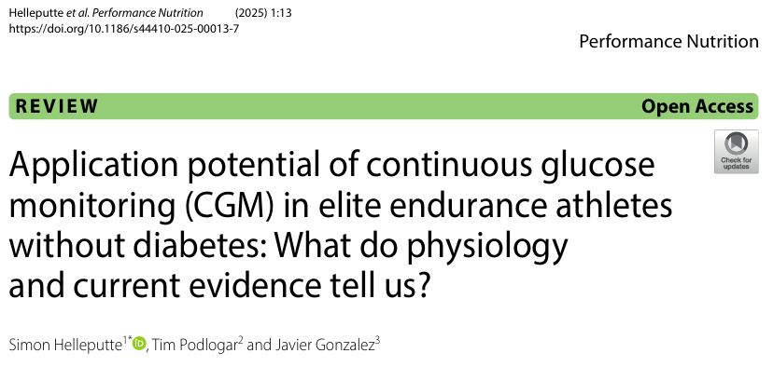
3- Current limitations
C- The interpretation gap
- if we assume that a device
* has been properly validated for all its functions,
* the biggest problem is not the technology
* The real issue is the physiological significance of these measurements.
* the most important limitations include
- the time delay
- there is no direct evidence that CGM could help to maintain blood glucose concentrations and/or performance during endurance events
- and that increasing interstitial glucose concentrations (by exogenous CHO intake) is causally related to delayed fatigue
- CGM are not sensors for overall carbohydrate availability
- most of the time interstitial glucose concentrations are not able to indicate that an athlete is ‘under-fuelling’
- the risk of overinterpretation by athletes and coaches.

Slide 30
3- Current limitations
C- The interpretation gap
- if we assume that a device
* has been properly validated for all its functions,
* the biggest problem is not the technology
* The real issue is the physiological significance of these measurements.
* we have similar questions
- for many other parameters, such as lactate and ammonia,
- as well as physical parameters such as workload.
* even if we can measure them reliably, can we establish thresholds and alert zones
- for different categories of athletes (age, sex, and performance level),
- under different environmental conditions (heat, cold, altitude),
- while accounting for inter-individual variability within each category?
To date, we must remain very cautious about overinterpreting data collected during training or competition

Slide 31
3- Current limitations
D- Information overload and safety
- the relationship between information overload and oncoming hazards detection is relevant to various sports, but particularly to cycling and triathlon
- however,
* the attention capacity of each individual is limited (Scharff et al., 2011)
* using a bike computer comprising multiple sensory aids can either attenuate rider visual attention to riding tasks, such as observing hazards (Cullen et al., 2013)
* there is no study that directly links the amount of information given to athletes with real accident rates
* but lab studies in cycling suggest a risk.

Slide 32
3- Current limitations
D- Information overload and safety
- 30 participants were tested in a lab on eight hazard-perception tasks, while they maintained a fixed cadence on a watt bike (Yang and Wu, 2017)
- the computer provided different types of feedback: visual, auditory, or tactile.
- the main conclusion was that
* cycling computers increase rider distraction, reducing their ability to perceive hazards.
* this impairment was greatest when cadence had to be monitored visually.
This study highlights the cognitive cost of using a cycling computer
Visual cues from the cycling computer reduce the visual attentional resources devoted to observing the road

Slide 33
4- Ethical concerns
The last question.
Not “can we do it?” But “should we do it?”
As these tools move from training to competition, sport faces a real identity question. Where is the line between helping the athlete… and replacing the athlete’s judgment with an algorithm?

Slide 34
4- Ethical concerns
A- Access and fairness
- these systems are expensive. Physiologists, data scientists also are needed.
- a rich team or a rich nation can afford all that. A small team, a small federation, often not.

Slide 35
4- Ethical concerns
B- Confidentiality of healthcare data
- in EU, under the GDPR, blood glucose or lactate values linked to an identifiable athlete are healthcare data, whether measured in a lab or by a wearable.
- this means processing is prohibited unless explicit consent, plus stronger security and often an impact assessment.
- but given the employer–athlete relationship within professional teams, is consent truly free given?
- does the use of these systems comply with national regulations?

Slide 36
4- Ethical concerns
C- Autonomy vs. Surveillance
- some of these sensors don’t stop when training stops. They measure sleep. Recovery. Stress. Hormones. Sometimes 24 hours a day
- this continuous monitoring, especially into off-field life, raises questions about athlete consent, privacy
- particularly relevant for young or contractually dependent athletes
- the line between support and surveillance can be very thin.

Slide 37
4- Ethical concerns
D- Whose judgment prevails?
- if a device or algorithm flags a risk (e.g., fatigue threshold) that contradicts an athlete's or coach's own assessments
- if you follow the device and it was wrong, the athlete lost a race
- if you ignore it and it was right, the athlete may get injured
Who decides?
That is an ethical question. But it is also a legal one. Who is responsible?

Slide 38
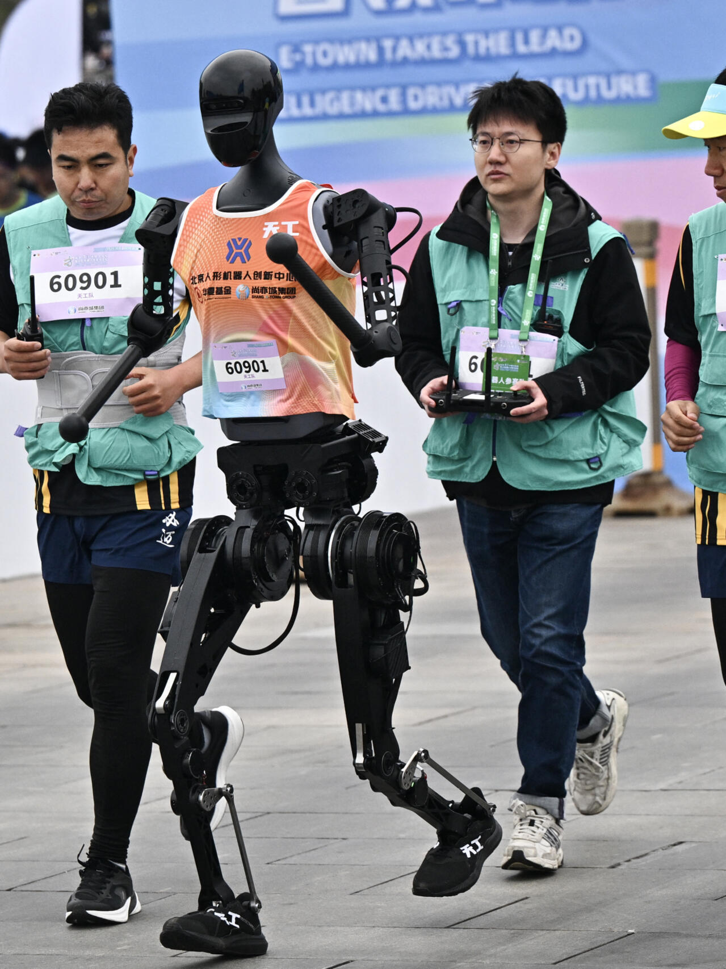
4- Ethical concerns
E- Use in competition
- keeping judgment and instinct at the heart of performance
* much of the beauty of competition lies in how athletes manage their own effort: sensing when to attack, when to eat and drink, etc.
* if a device shows the rider’s exact physiological state in real time, these decisions become mechanical or are made remotely by an analyst
* the competition then shifts from a contest between athletes to a contest between algorithms
- preserving the spectacle and the uncertainty of competition

Slide 39
Conclusions
- wearable sensors are moving us from
measuring what athletes do
to understanding how their bodies respond
- with real promise for safety, performance and recovery
- but these expectations have yet to be supported by evidence
- sensor technology is advancing rapidly, but important questions remain:
* every individual is different, so the benefits of wearable technologies must be tailored to each athlete
* AI still needs to demonstrate its ability to turn data into reliable decisions.
- the world of sport must decide what role these tools should play, who can access them, whether they should be used during competition, who owns the data, and how privacy can be protected

Slide 40
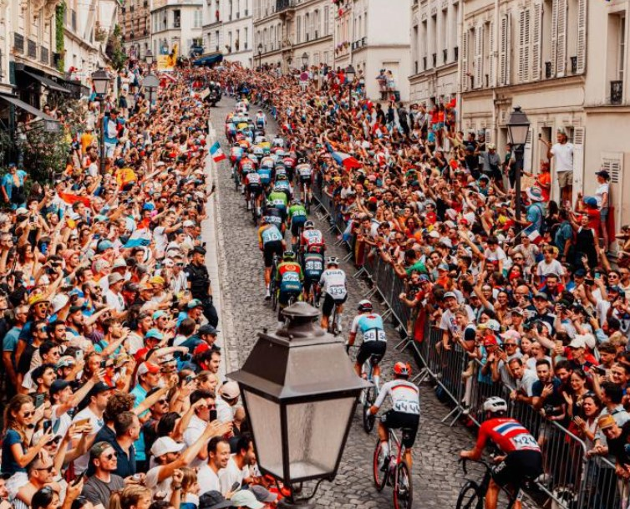
Thank you for your attention

