Slide 1


Federated Learning (Fed) of eXplainable Artificial Intelligence (XAI) Models
Pietro Ducange
Dipartimento di Ingegneria dell’Informazione
pietro.ducange@unipi.it

Slide 2
Outline
Introduction: scenario and motivations
Basics of Federated Learning
Basics of XAI models
Fed-XAI by inherently interpretable models
An approach to FL of Fuzzy Rule-Based Systems
An approach to FL of Fuzzy Regression Trees
Fed-XAI by post-hoc explainability technique
Consistent post-hoc explainability with Federated SHAP
Fed-XAI use cases:
Parkinson’s Disease Progression Prediction (Health)
Video Streaming QoE Prediction (Networking)
Decentralized and Trustworthy Intrusion Detection System (Cybersecurity)
Security Threats in Federated Learning
Future Challenges

Slide 3

Trustworthy AI
In April 2019, the high-level expert group on AI set up by the EC presented the “Ethic guidelines for trustworthy AI”, according to which AI should be
Lawful: respecting all applicable laws and regulations
Ethical: respecting ethical principles and values
Robust: both from a technical and social perspective
AI act (EU first law on AI)
April 2021 first proposal
May 11, 2023: press release on draft negotiating mandate
March 13, 2024: final EU parliament vote
June 13, 2024: publication of the law in the EU Official Journal
How to realize trustworthy AI? (By August 2026)

Slide 4

Trustworthy AI

Slide 5
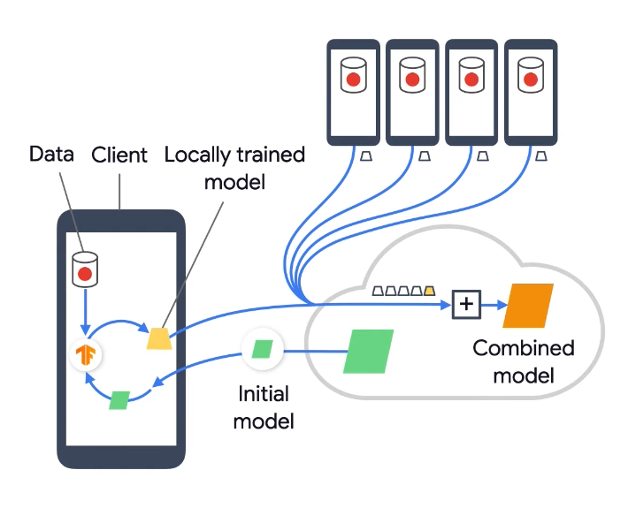
Privacy and Data Governance
Increasing attention towards privacy preservation
EU General Data Protection Regulation (GDPR)
Novel learning paradigm: Federated Learning (Google 2016)
Training a centralized model on decentralized data
Participants share model updates, not data
Examples:
Gboard
Voice Assistant
Figure from https://ml.berkeley.edu

Slide 6
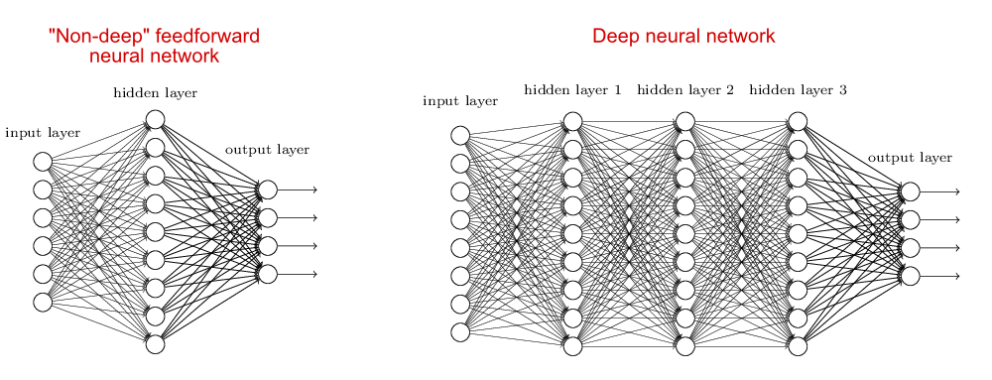
Transparency
Communication
Humans have the right to be informed that they are interacting with an AI system.
Traceability
Data gathering/labelling and algorithms should be documented to the best possible standard
Explainability
Systems and decisions should be explained in a manner adapted to the stakeholder concerned
Easy for decision trees, critical for deep neural networks
Deep neural networks
Multiple layers of non-linear information processing
Often referred to as opaque or black-box models

Slide 7
Federated Learning

Slide 8






Why do we need Federated Learning?
Machine learning algorithms, especially deep learning algorithms, are data hungry.
Data are generally spread over different devices with different owners and under the protection of privacy restrictions.
In practice, we cope with isolated data islands and we cannot transfer data

Slide 9
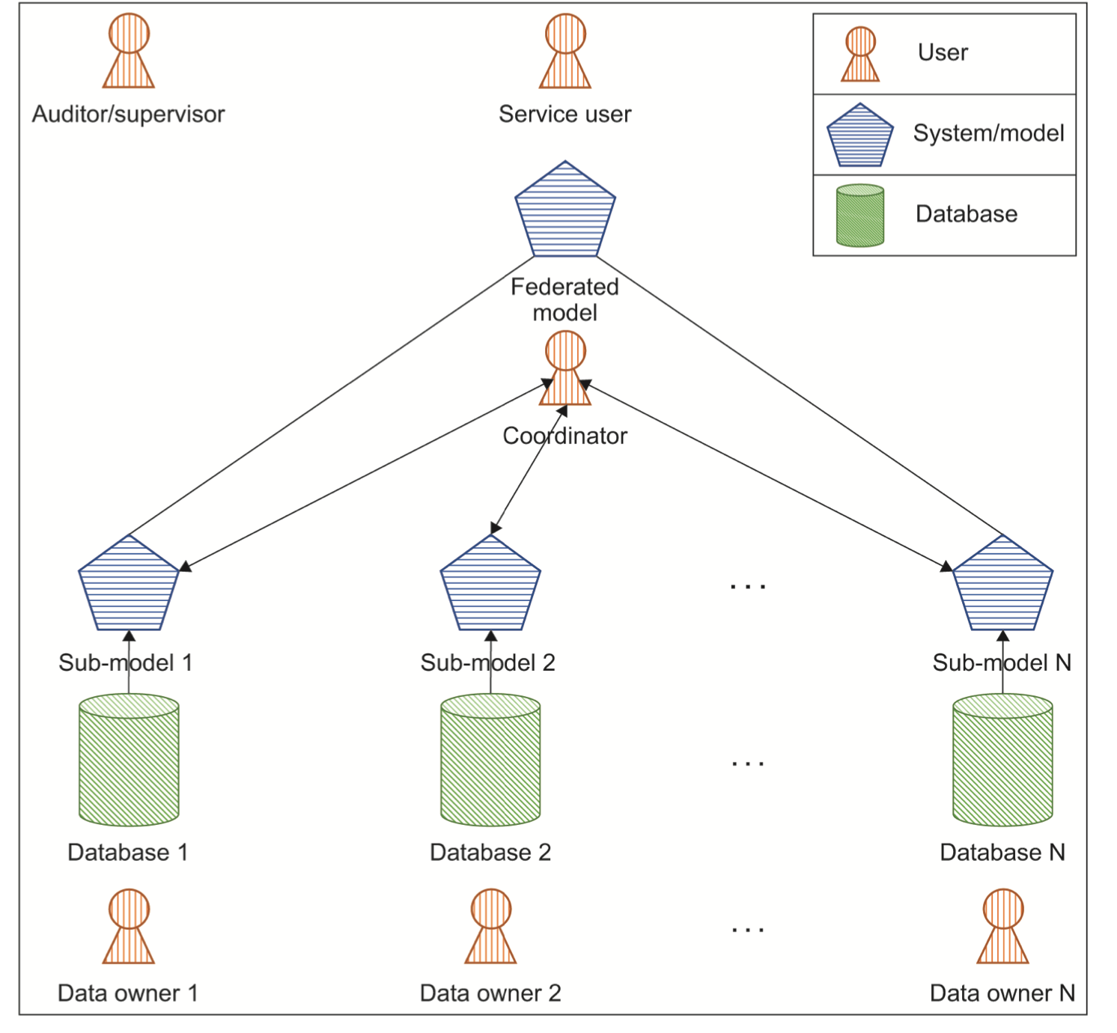
Federated Learning: basic concepts
Scenario:
Preserve data privacy
impossibility to share data
Same organization, different departments
Different entities
Federated Learning idea:
Raw data are not shared,
Local models or local statistics are shared
A centralized entities aggregate local models or statistics for generating a shared global model
Image extracted from: IEEE 3652.1-2020 - IEEE Guide for Architectural Framework and Application of Federated Machine Learning
Notes:
What is FL: Paradigm to enable collaborative training of an AI model without disclosure of private data from the involved participants.

Slide 10
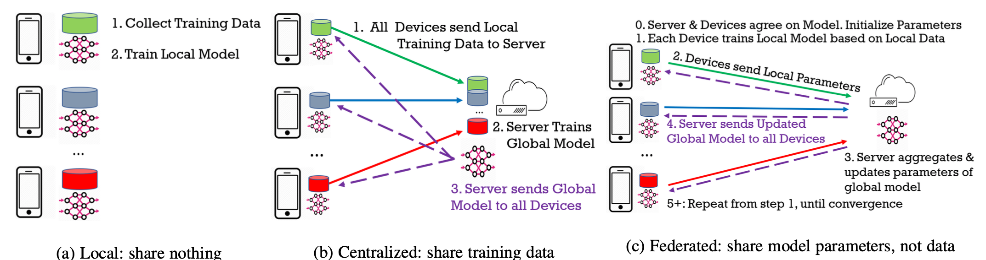
Local Learning vs Centralized Learning vs Federated Learning
.
Image extracted from: Bakopoulou, E., Tillman, B., & Markopoulou, A. (2021). FedPacket: A Federated Learning Approach to Mobile Packet Classification. IEEE Transactions on Mobile Computing.
Notes:
Local, centralized, federated models:
Local: model likely to achieve low performance, but data privacy preserved
Centralized: all data available, but privacy issues
Federated: privacy preserved (raw data not shared, just model info) but all info available
Goal of federated learning: achieve performance as similar as possible than centralized learning

Slide 11
Federated learning: a taxonomy
A Federating Learning System taxonomy according to six main characterizing aspects(*)
Federated Learning Systems
Data Partitioning
ML Model
Privacy Mechanism
Communication Architecture
Scale of Federation
Motivation of Federation
Horizontal
Rule-Based Systems
Diff. Privacy
Centralized
Cross-silo
Incentive
Vertical
Decision Trees
Crypto Methods
Non-centralized
Cross-device
Regulation
Hybrid
Neural Networks
…
…
(*)Li Q., Wen Z., Wu Z., Hu S., Wang N., Li Y., Liu X., He B.A Survey on Federated Learning Systems: Vision, Hype and Reality for Data Privacy and Protection(2021) IEEE Transactions on Knowledge and Data Engineering

Slide 12

Data Partitioning
Based on how data are distributed among the parties making up the federation over the sample and
feature spaces, FLSs can be typically categorized in horizontal, vertical and hybrid FLSs:
In Horizontal FL the datasets of different parties share the same feature space but have little or no intersection on the sample space (CT scans reported in different hospitals).
This is a natural data partitioning especially for the cross-device
setting, where different users try to improve their model performance on the same task using FL.
Device #1 | Feature 1 | … | Feature N
Sample 1
Sample 2
Sample 3
Device #2 | Feature 1 | … | Feature N
Sample 4
Sample 5
Device #3 | Feature 1 | … | Feature N
Sample 5
Sample 6
Sample 7

Slide 13

Data Partitioning
In Vertical FL the datasets of different parties have the same or similar sample space but differ in the feature space (for instance, municipality registry and hospital data).
Device #1 | Feature 1 | Feature 2
Sample 1
Sample 2
Sample 3
Sample 4
Sample 5
Sample 6
Device #2 | Feature 3 | Feature 4 | Feature 5
Sample 1
Sample 2
Sample 3
Sample 4
Sample 5
Sample 6
Device #3 | Feature 6 | Feature 7
Sample 1
Sample 2
Sample 3
Sample 4
Sample 5
Sample 6
In Hybrid FL partition of data among the parties may be a hybrid of horizontal partition and vertical partition.

Slide 14
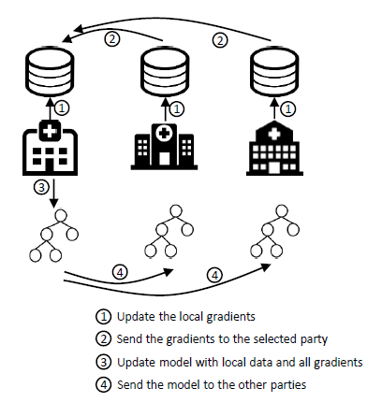
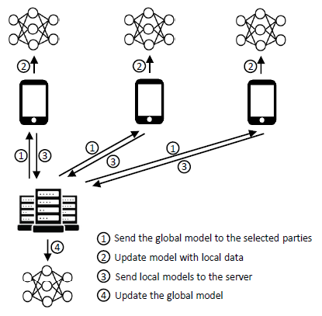
Communication Architecture
Centralized versus non-centralized
Notes:
Update the local gradients
Ogni ospedale (nodo) usa il proprio dataset locale per eseguire un training del modello.
Calcola i gradienti locali, cioè quanto ciascun parametro del modello deve essere aggiornato per ridurre l’errore sui propri dati.
Send the gradients to the selected party
I gradienti calcolati vengono inviati a uno dei nodi della rete (nodo selezionato), che in questo round avrà il ruolo temporaneo di aggregatore.
In un contesto P2P, questa selezione può essere:
rotazionale (ogni volta un nodo diverso aggrega);
o basata su criteri di affidabilità o capacità computazionale.
Update model with local data and all gradients
Il nodo selezionato aggrega i gradienti ricevuti dagli altri ospedali (di solito facendo una media pesata) e aggiorna il modello globale.
Questo step crea un modello che rappresenta la conoscenza combinata dei dati di tutti, ma senza che nessun dato personale lasci il nodo d’origine.
Send the model to the other parties
Il modello aggiornato viene distribuito di nuovo a tutti gli ospedali.
Ognuno lo riceve, sostituisce il proprio modello locale con quello aggiornato e il ciclo ricomincia dal punto ①.

Slide 15
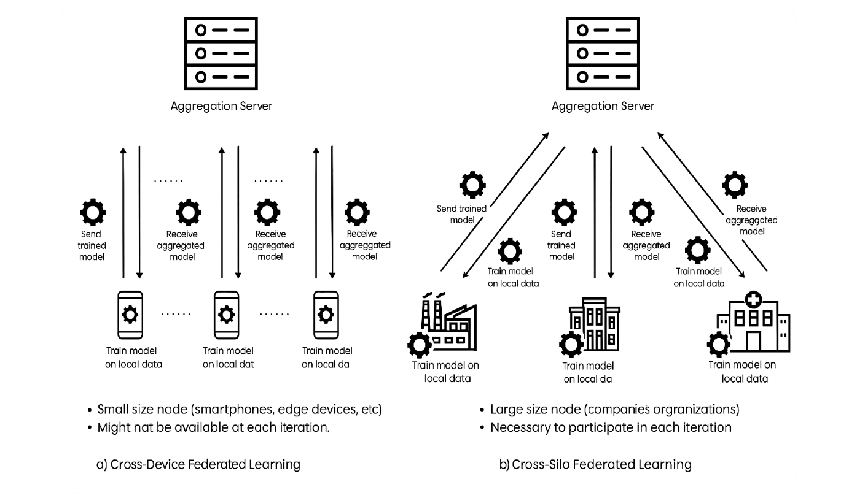
Scale of Federation

Slide 16
Popular approaches for Federated Learning
Federated Averaging (FedAVG)
Each client performs one or several local gradient descent steps on its own data using the current global model w_{t}
The locally updated models are sent to the central server.
The server computes a weighted average of these local models to obtain the new global model w_{t+1}. The process repeats for the next iteration.

Slide 17
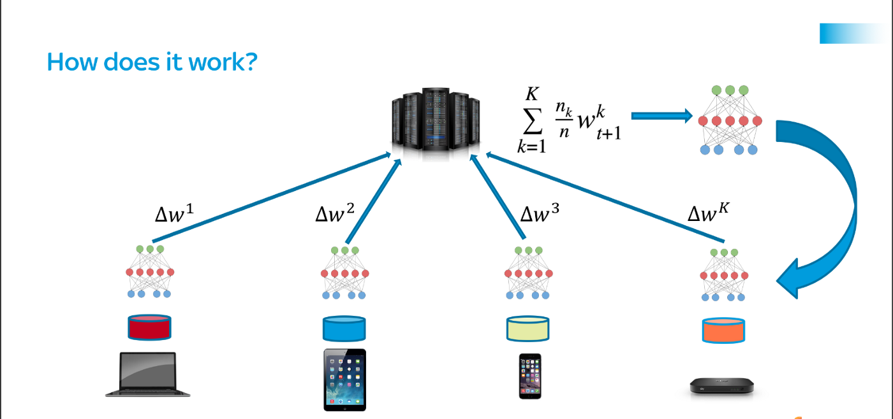
Popular approaches for Federated Learning
Federated Stochastic Gradient Descent (FedSGD)
Federated Learning (Source: https://proandroiddev.com/federated-learning-e79e054c33ef)
Each client k computes the gradient of the loss function on its local dataset using the current global model w_{t}.
The local gradients are transmitted to the central server, which aggregates them (typically by averaging) and updates the global model parameters.
The updated global model is then distributed back to all clients, and the process repeats for the next iteration.

Slide 18
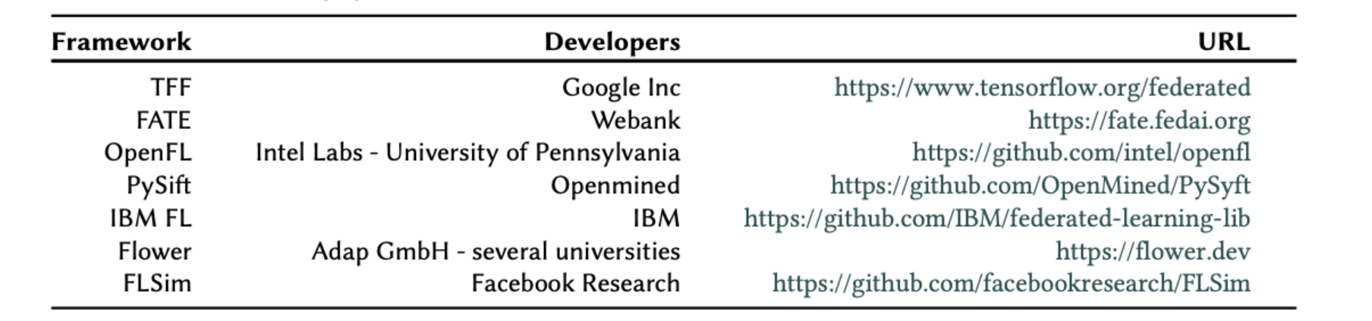
Commonly used FL frameworks
Interest of the community, starting from Google Inc, prompted different frameworks
Room for improvement given by:
- number/kind of aggregation strategies
- number/kind on models available (DNN, Trees...)
- privacy level (protocols and encryption methods)
- interoperability (interfaces with other frameworks, APIs...)
- deployment in production stage
Notes:
We also have a collaboration going on with Intel

Slide 19
Explainable AI

Slide 20
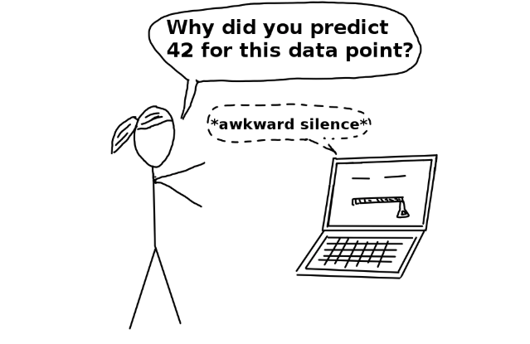
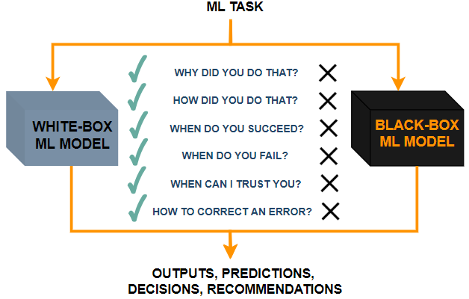
Explainable Artificial Intelligence (XAI)
Figure from https://gowrishankar.info/blog/causal-reasoning-trustworthy-models-and-model-explainability-using-saliency-maps/

Slide 21
WHY do we need XAI Models?
Explainabilty is motivated due to lacking transparency of the black-box/opaque approaches, which do not foster trust and acceptance of AI models.
Emerging legal and privacy regulations are expected to make opaque AI model-based applications increasingly difficult to adopt in business and public sectors, as these models often fail to provide clear explanations for their decisions.
We should explain:
Why/How a decision has been made
Why not something else has been suggested
Why/When the decision may led the user to a failure
How to correct an error in making a decision

Slide 22
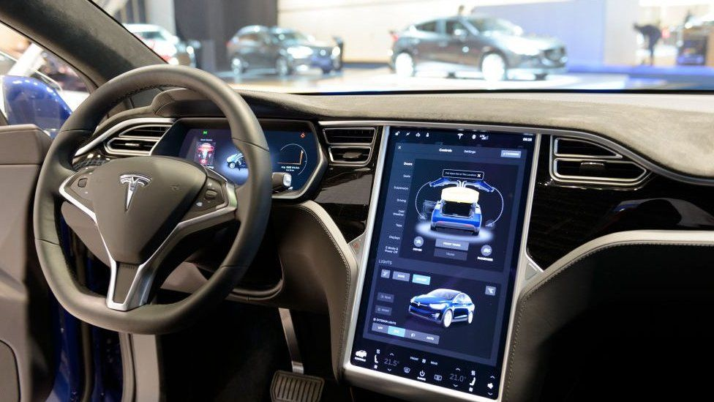
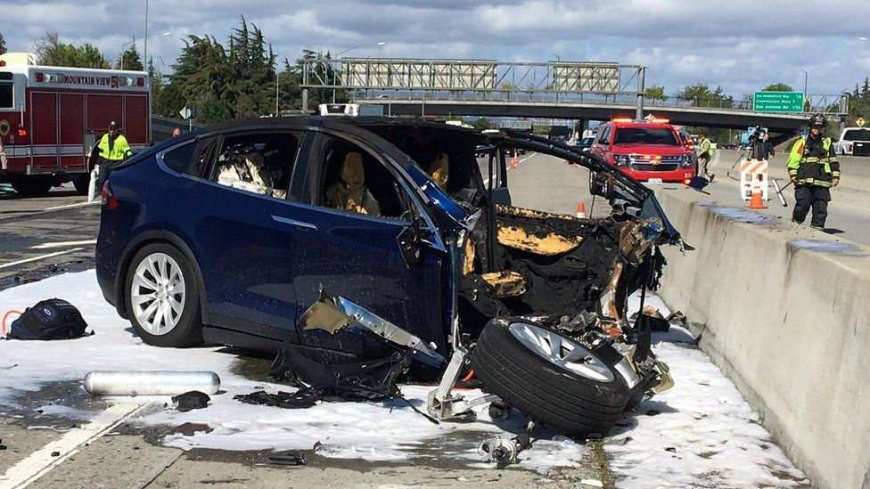
AI in Automotive- Is it Safe?
Why did the autopilot car crash?
Did the braking systems go off to avoid the crash?
Are we sure the intelligent vision system saw the obstacle?
Why did the car turn unnecessarily?
Who was responsible for the crash?

Slide 23
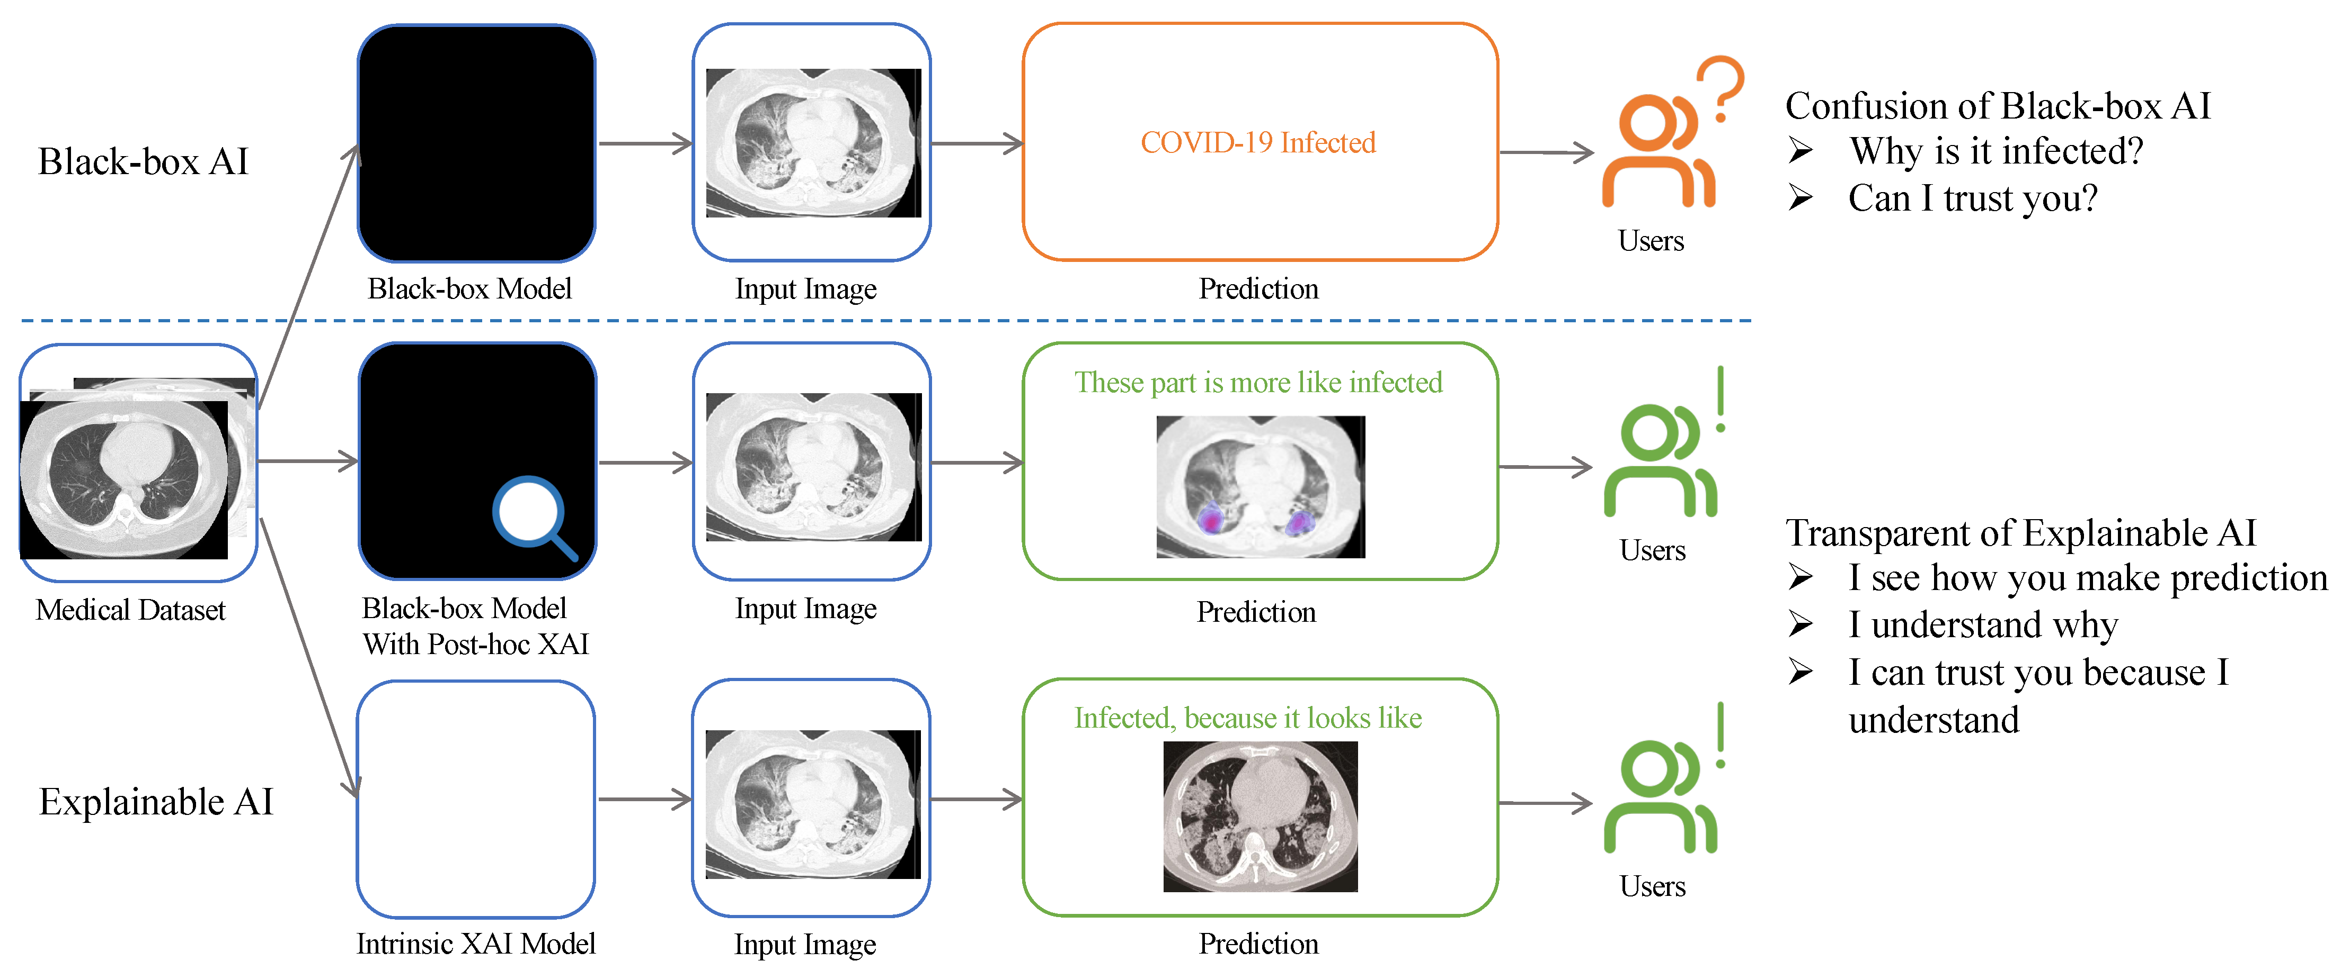
AI in Medical Imaging
Image Extracted from: https://www.mdpi.com/sensors/sensors-23-00634

Slide 24
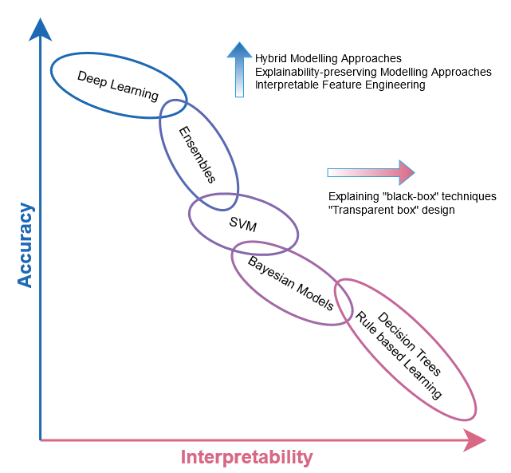
The Accuracy-Explainability Trade-off
Design of Inherently Interpretable Models
Explainabilty
Post-hoc Explainability Techniques
Inspired to Arrieta et al. "Explainable Artificial Intelligence (XAI): Concepts, taxonomies, opportunities and challenges toward responsible AI." Information Fusion 58 (2020): 82-115.
Notes:
How to achieve explainability
There are basically two major approaches for explainability
Design of inherently interpretable models (i.e. transparent box design)
Adoption of Post-hoc explainability (explaining black-box” strategy)
Interpretability/Accuracy tradeoff
Fuzzy set theory may play a crucial role
First, the linguistic representation of numerical variables allows a direct human interaction, endowing the model with explicit semantic interpretability.
Second, the adoption of fuzzy variables allows for better modeling in contexts with some degree of uncertainty

Slide 25
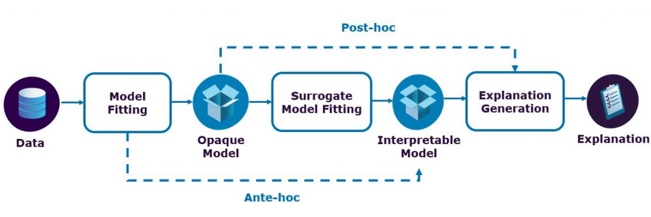
Ante-hoc vs Post-hoc
Image extracted from : https://medium.com/@sparsha.stars/explainable-artificial-intelligence-technical-perspective-part-1-6eec91b4cc60

Slide 26
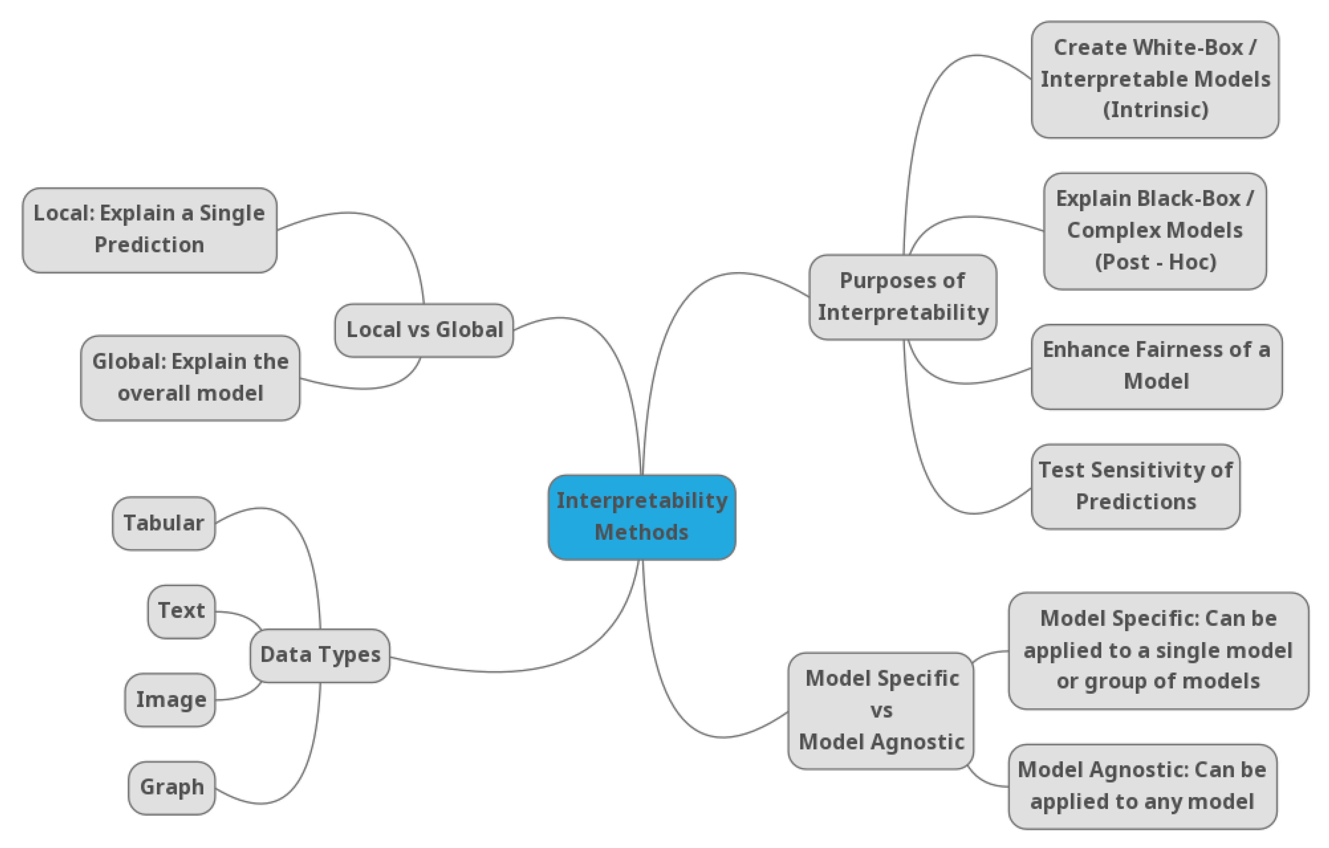
Yet Another XAI Taxonomy

Slide 27
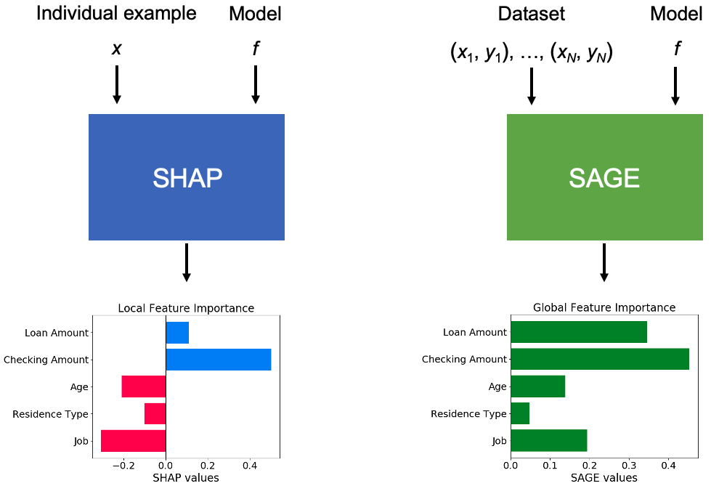
Post-hoc XAI

Slide 28
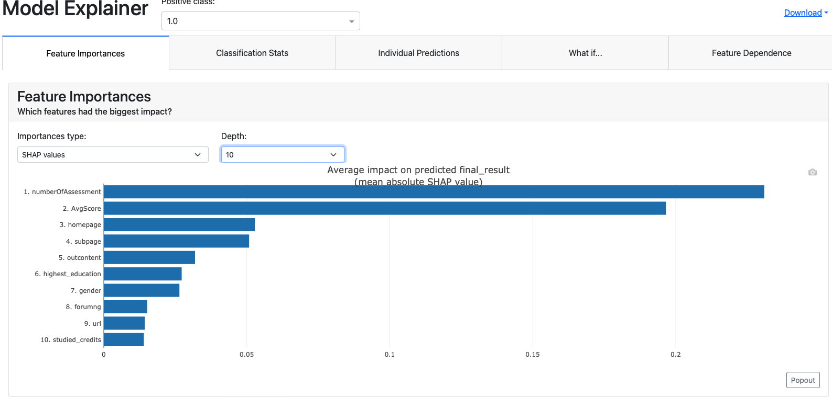
Post-hoc XAI Model: Neural Network with SHAP

Slide 29
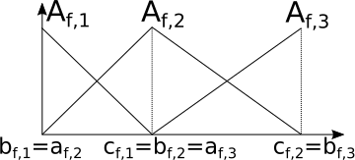
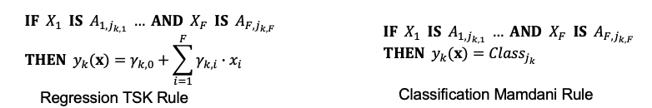
XAI Models By Design: (Fuzzy) Rule-Based Systems
The model consists of a rule-base, i.e., a collection of rules in the form if «antecedent» then «consequent»
Fuzzy Rule-Based Systems (FRBSs) require a fuzzy partition defined upon each continuous attribute.
Example of rules
Low
Medium
High

Slide 30
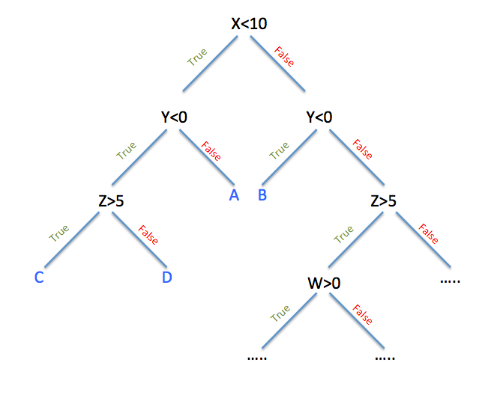
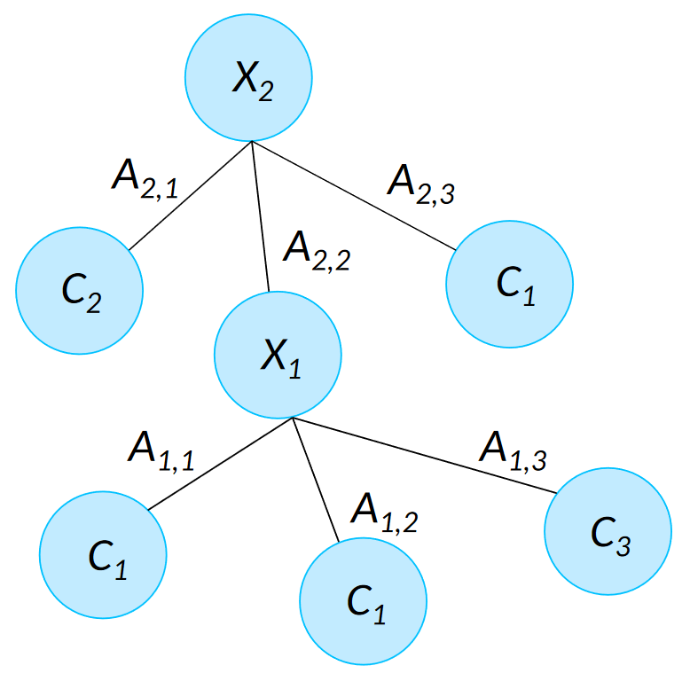
XAI Models By Design: (Fuzzy) Decision Trees
Directed acyclic graph
Generated in a top–down way by performing recursive partitions of the attribute space.
In FDTs a fuzzy partition is defined upon each continuous attribute.
Binary Decision Tree
Multi-way FDT

Slide 31
Measuring Explainability
Explainability
Model-specific
XAI metrics
General
XAI metric
How well a model fits the definition of «explainable»
XAI measurement
should evaluate …
Decision Trees/ Rule based
DNN
Ensemble
Methods
…
…
Goodness, usefulness,
satisfaction
Improvement of mental model of the audience
Impact of explanations
Tricky to define XAI metrics
other than trivial #parameters
Tree size
#nodes, #leaves, #rules, etc..
Need for more quantifiable,
general XAI metrics
Post-hoc Techniques
Strictly related to model transparency
Model Simplification
Feature Relevance
(e.g. visual explanation method for CNN)
Arrieta et al. "Explainable Artificial Intelligence (XAI): Concepts, taxonomies, opportunities and challenges toward responsible AI." Information Fusion 58 (2020): 82-115.

Slide 32
Fed-XAI

Slide 33
Fed-XAI: FL of Fuzzy Rule-Based Systems
Design of Inherently Interpretable Models
Explainabilty
Post-hoc Explainability Techniques
Enhanced semantic interpretability through linguistic representation of numerical variables
Enhanced modeling in contexts with some degree of uncertainty
José Luis Corcuera Bárcena, et al. “An Approach to Federated Learning of Explainable Fuzzy Regression Models”. FUZZ-IEEE 2022: 1-8
Mattia Daole, et al. “Trustworthy AI in Heterogeneous Settings: Federated Learning of Explainable Classifiers”. FUZZ-IEEE 2024: 1-9

Slide 34
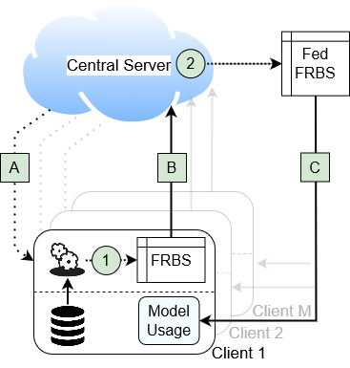
Federated Learning of Fuzzy Rules
A
Configuration: central server configures the learning process
1
Local learning of Fuzzy Rules
B
Transmission of local models to the central server
2
Federated learning of the global Rule Base: aggregation of the local rules
C
Transmission of the aggregated Rule Base to the clients

Slide 35
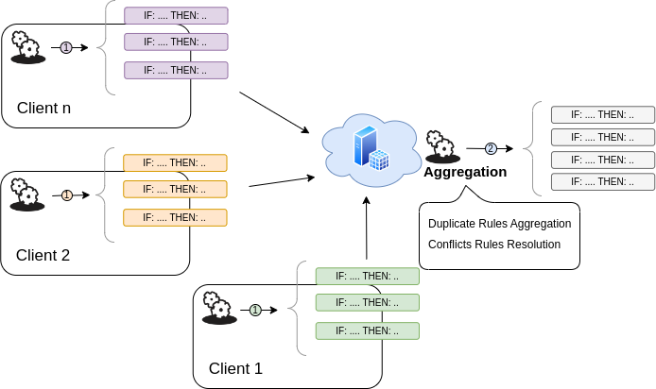
FL of Fuzzy Rules: Aggregation Step
The final rule base represents our Federated Fuzzy Rule-Based Systems

Slide 36
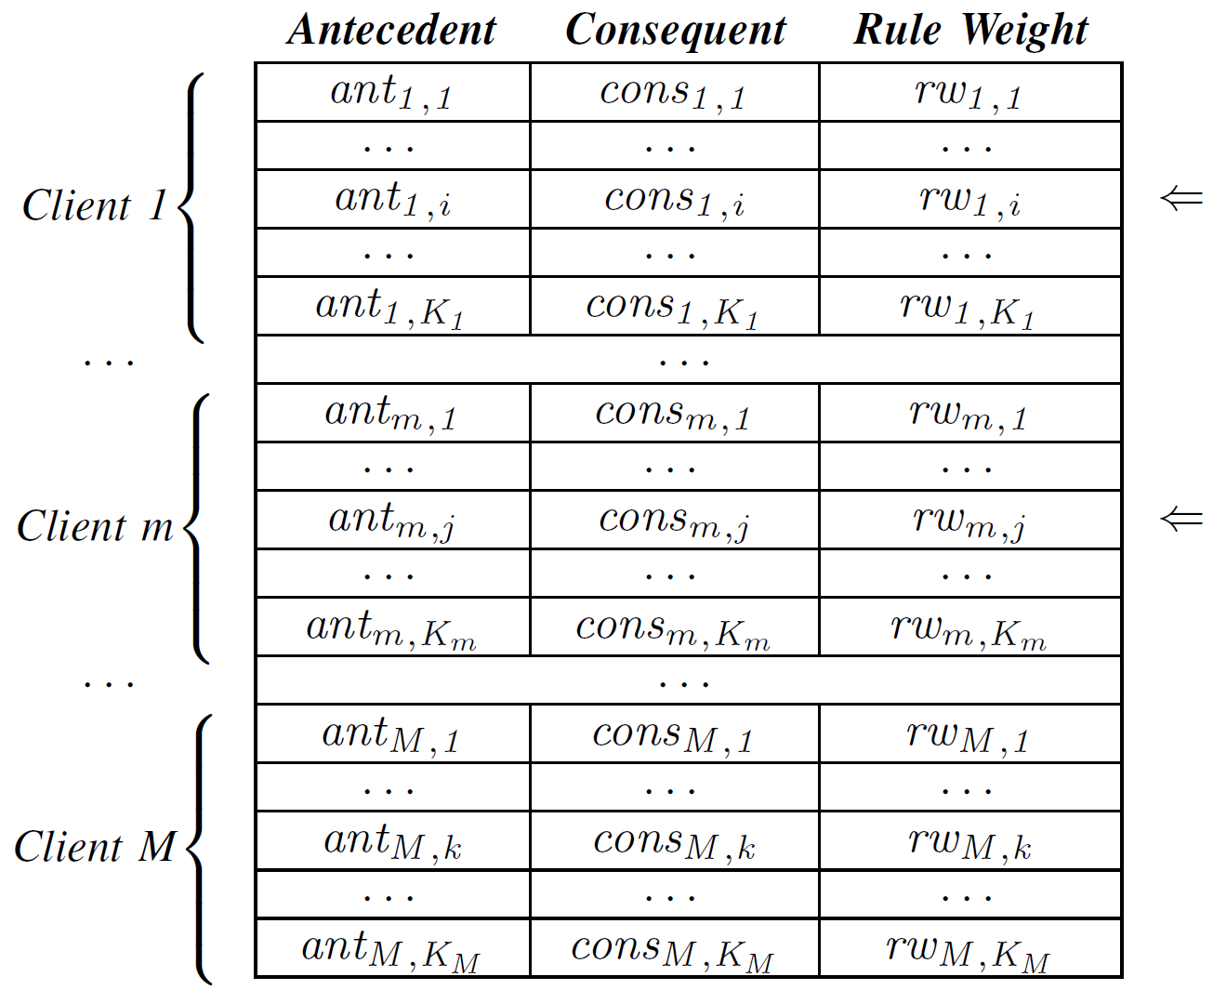
Our Federated FRBS – Aggregation Step
Centralized server operation
Juxtaposition of rules collected from the M clients.
Identification of conflicting rules: (i.e., same antecedents, different consequents)
Replacement of conflicting rules with a new single rule:
Antecedent: same of that of conflicting rules
Consequent and Rule weight (RW): depends on the types of rules two different approaches:
José Luis Corcuera Bárcena, et al. “An Approach to Federated Learning of Explainable Fuzzy Regression Models”. FUZZ-IEEE 2022: 1-8
Mattia Daole, et al. “Trustworthy AI in Heterogeneous Settings: Federated Learning of Explainable Classifiers”. FUZZ-IEEE 2024: 1-9
The final rule base represents our Federated Fuzzy Rule-based model

Slide 37

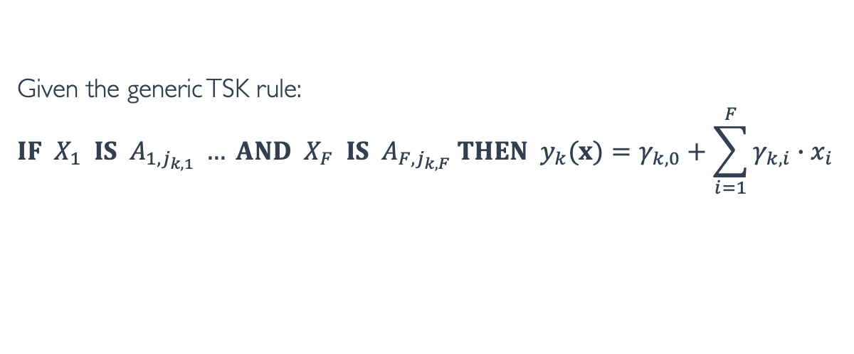
Aggregation Step for TSK FRBSs for Regression
Given the generic TSK rule:
$$IF X_{1} IS{ A}_{1,j_{k,1}} … AND X_{F} IS{ A}_{F,j_{k,F}} THEN y_{k}(x)=γ_{k,0}+\sum_{i=1}^{F}{γ_{k,i}∙x_{i}}$$
$${RW}_{k}=2∙\frac{{{Supp}_{k}∙Conf}_{k}}{{{Supp}_{k}+Conf}_{k}}$$
with
Each client sends to the server the list of rules along with the weight RW for each rule
On the server, the conflicting rules are identified
The rules with the same antecedent are merged in a single rule: the coefficients of the consequents are computed as the weighted average of those from conflicting rules (weighted by rule weight)
The weight of each new rule is calculated as the average value of the rule weights of conflicting rules
José Luis Corcuera Bárcena, et al. “An Approach to Federated Learning of Explainable Fuzzy Regression Models”. FUZZ-IEEE 2022: 1-8

Slide 38
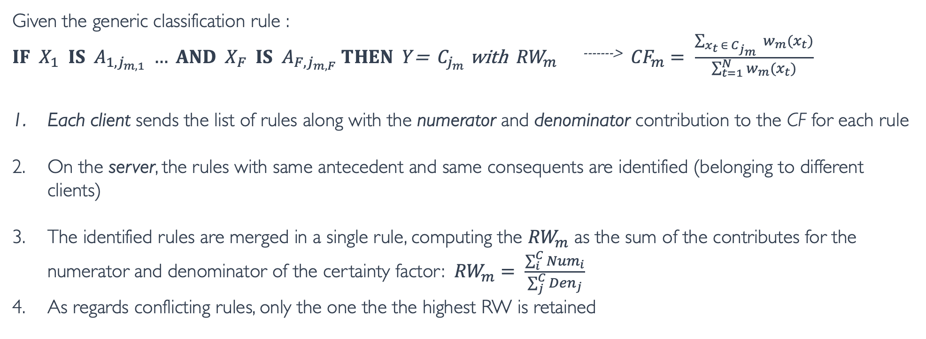
Aggregation Step for Mamdani Fuzzy Rule-Based Classifiers
Given the generic classification rule :
$IF X_{1} IS{ A}_{1,j_{m,1}} … AND X_{F} IS{ A}_{F,j_{m,F}}$ $THEN Y\text{=} C_{j_{m}} \text{with} {RW}_{m}$ ^{------->} ${CF}_{m}= \frac{\sum_{x_{t }∈ C_{j_{m}} }{w_{m}(x_{t})}}{\sum_{t=1}^{N}{w_{m}(x_{t})}}$
Each client sends the list of rules along with the numerator and denominator contribution to the CF for each rule
On the server, the rules with same antecedent and same consequents are identified (belonging to different clients)
The identified rules are merged in a single rule, computing the ${RW}_{m}$ as the sum of the contributes for the numerator and denominator of the certainty factor: ${RW}_{m}= \frac{\sum_{i}^{C}{{Num}_{i}}}{\sum_{j}^{C}{{Den}_{j}}}$
As regards conflicting rules, only the one the the highest RW is retained
Mattia Daole, et al. “Trustworthy AI in Heterogeneous Settings: Federated Learning of Explainable Classifiers”. FUZZ-IEEE 2024: 1-9

Slide 39
Fed-XAI: FL of Fuzzy Regression Trees
Design of Inherently Interpretable Models
Explainabilty
Post-hoc Explainability Techniques
Bárcena, José Luis Corcuera, Pietro Ducange, Francesco Marcelloni, and Alessandro Renda. "Increasing trust in AI through privacy preservation and model explainability: Federated Learning of Fuzzy Regression Trees." Information Fusion 113 (2025): 102598.

Slide 40
Fuzzy Regression Tree
Multiway: each parent node generates more than two child nodes, i.e., one for each fuzzy set in a fuzzy partition
Output value for an unseen input instance depends on the sequence of tests from the root to the leaf nodes

Slide 41

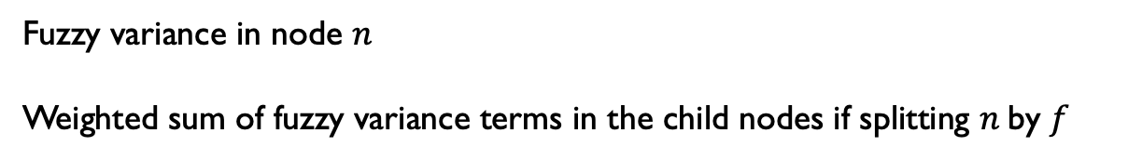
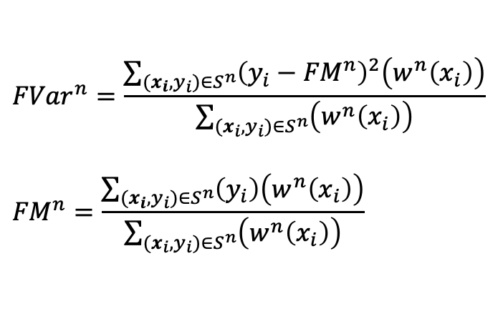
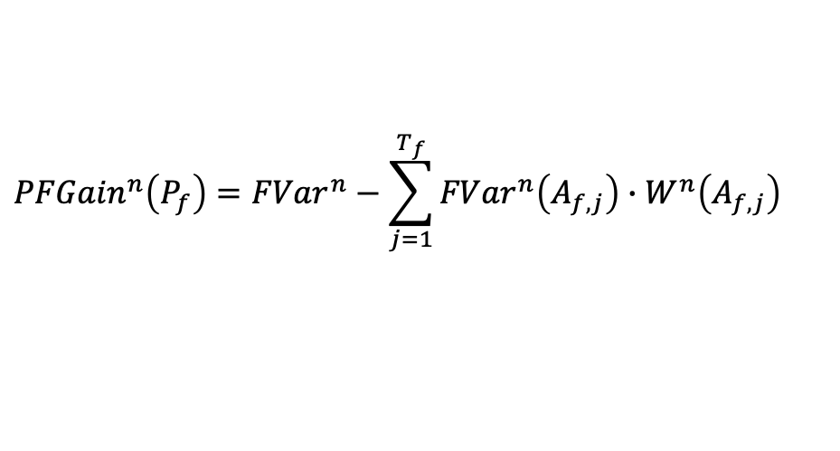
Fuzzy Regression Tree
FRT induction procedure: hierarchical partition of the feature space until stop condition is met
Estimation of regression model in the leaves
Let $n$ be a generic node under consideration for possible splitting
Let $S^{n}$ the set of instances with non-null strength of activation to node $n$
Criterion for the selection of the attribute for splitting node $n$: highest partition fuzzy gain
$${PFGain}^{n}\left(P_{f}\right)={FVar}^{n}−\sum_{j=1}^{T_{f}}{{FVar}^{n}\left(A_{f,j}\right)∙W^{n}\left(A_{f,j}\right)}$$
$${FVar}^{n}=\frac{\sum_{(x_{i},y_{i})∈S^{n}}{{\left(y_{i}−{FM}^{n}\right)}^{2}\left(w^{n}\left(x_{i}\right)\right)}}{\sum_{(x_{i},y_{i})∈S^{n}}{\left(w^{n}\left(x_{i}\right)\right)}}$$
$${FM}^{n}=\frac{\sum_{(x_{i},y_{i})∈S^{n}}{\left(y_{i}\right)\left(w^{n}\left(x_{i}\right)\right)}}{\sum_{(x_{i},y_{i})∈S^{n}}{\left(w^{n}\left(x_{i}\right)\right)}}$$
Fuzzy variance in node $n$
Weighted sum of fuzzy variance terms in the child nodes if splitting $n$by $f$

Slide 42


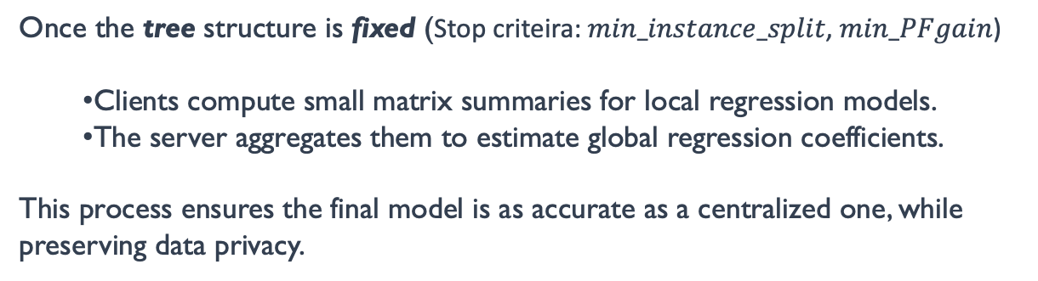
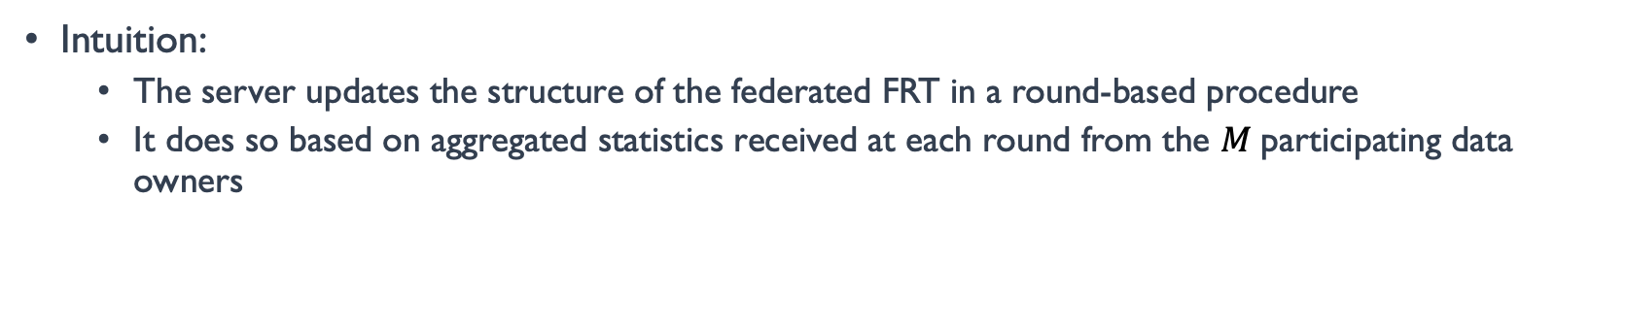
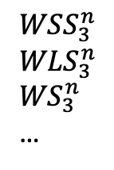

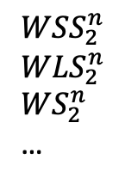

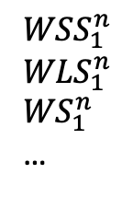


Federated Fuzzy Regression Tree
Intuition:
The server updates the structure of the federated FRT in a round-based procedure
It does so based on aggregated statistics received at each round from the $M$participating data owners
$$X_{1}$$
Server
Low
Medium
High
$$?$$
$$?$$
$$?$$
$$X_{2}$$
$${WSS}_{1}^{n}$$
$${WLS}_{1}^{n}$$
$${WS}_{1}^{n}$$
…
$${WSS}_{2}^{n}$$
$${WLS}_{2}^{n}$$
$${WS}_{2}^{n}$$
…
$${WSS}_{3}^{n}$$
$${WLS}_{3}^{n}$$
$${WS}_{3}^{n}$$
…
Once the tree structure is fixed (Stop criteira: $min_instance_split$, $min_PFgain$)
Clients compute small matrix summaries for local regression models.
The server aggregates them to estimate global regression coefficients.
This process ensures the final model is as accurate as a centralized one, while preserving data privacy.
Client 1
Client 2
Client M

Slide 43
Fed-XAI: Post-Hoc XAI with Federated SHAP
Design of Inherently Interpretable Models
Explainabilty
Post-hoc Explainability Techniques
Ducange, P., Marcelloni, F., Renda, A., & Ruffini, F. (2024, June). Consistent Post-Hoc Explainability in Federated Learning through Federated Fuzzy Clustering. In 2024 IEEE International Conference on Fuzzy Systems (FUZZ-IEEE) (pp. 1-10). IEEE.
Notes:
How to achieve explainability
There are basically two major approaches for explainability
Design of inherently interpretable models (i.e. transparent box design)
Adoption of Post-hoc explainability (explaining black-box” strategy)
Interpretability/Accuracy tradeoff
Fuzzy set theory may play a crucial role
First, the linguistic representation of numerical variables allows a direct human interaction, endowing the model with explicit semantic interpretability.
Second, the adoption of fuzzy variables allows for better modeling in contexts with some degree of uncertainty

Slide 44





SHAP: Background
Post-hoc method for estimating the Shapley values Lloyd Shapley, Nobel Memorial Prize in Economics in 2012
Intuition: the company-revenue example as a realization of cooperative game theory
How to allocate the payout among employees?
We compare how the coalition of employees would perform with and without a specific player or subsets of employees;
In this way we determine how each person contributed in the cooperative game.
Lundberg et al. A unified approach to interpreting model predictions (2017)
Notes:
coalitions of players (employee) form to achieve different profits
Intuition of shapley values: we compare how the coalition of employees would perform with and without a specific player or subsets of employees
In this way we determine how each person contributed in the cooperative game.

Slide 45
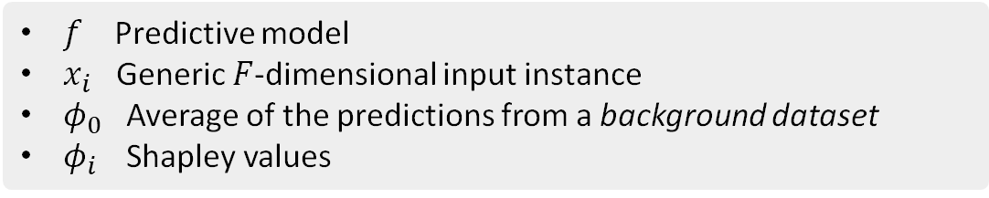

SHAP: Background
From the company-revenue example to XAI
Replace employees with features
Replace profit with model prediction
Shapley values quantify the impact of each feature on model prediction
Local, i.e., explains individual predictions
KernelShap variant: linear regression-based approximation
More efficient than naive calculation
Model-agnostic, suited for both classification and regression tasks
Shapley Values in XAI
$${\hat{y}}_{i}=f\left(x_{i}\right)=φ_{0}+\sum_{j=1}^{F}{φ_{j}}$$
$f$ Predictive model
$x_{i}$ Generic $F$-dimensional input instance
$φ_{0}$ Average of the predictions from a background dataset
$φ_{i}$ Shapley values
Notes:
Naive calculation: exponential complexity w.r.t. $F$

Slide 46



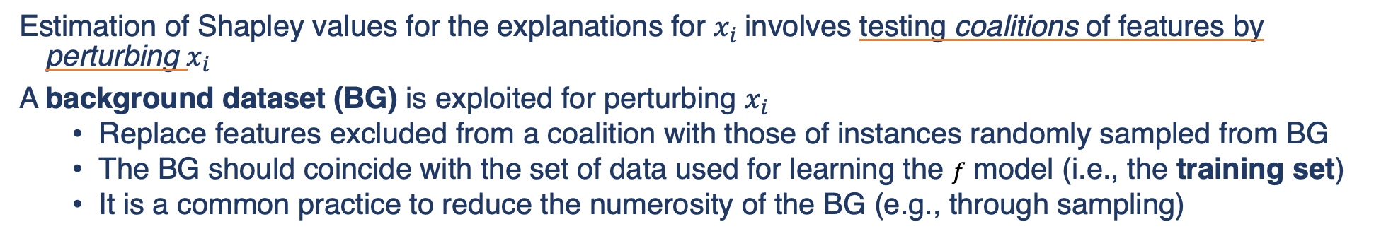
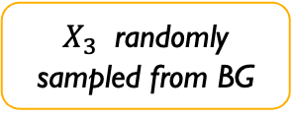




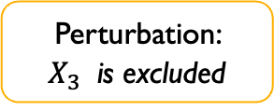







Challenge of adopting SHAP in the FL setting
Estimation of Shapley values for the explanations for $x_{i}$involves testing coalitions of features by perturbing $x_{i}$
A background dataset (BG) is exploited for perturbing $x_{i}$
Replace features excluded from a coalition with those of instances randomly sampled from BG
The BG should coincide with the set of data used for learning the $f$ model (i.e., the training set)
It is a common practice to reduce the numerosity of the BG (e.g., through sampling)
$$X_{1}$$
$$X_{2}$$
$$X_{3}$$
$$X_{4}$$
$$X_{1}$$
$$X_{2}$$
$$X_{3}$$
$$X_{4}$$
$$X_{1}$$
$$X_{2}$$
$$X_{3}$$
$$X_{4}$$
$$X_{1}$$
$$X_{2}$$
$$X_{3}$$
$$X_{4}$$
…
…
…
…
Instance to explain
Background dataset
Perturbation: $X_{3}$ is excluded
$X_{3}$ randomly sampled from BG
Notes:
SHAP applied using the union of local datasets
Distinct participants receive identical explanations for an output generated by the FL model given identical input instances.

Slide 47
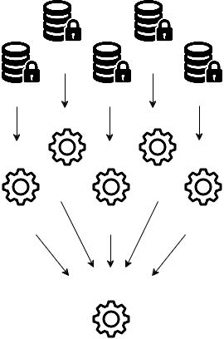
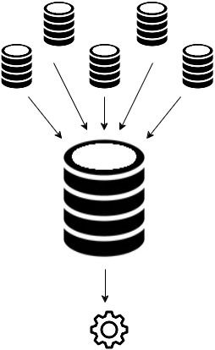
Challenge of adopting SHAP in the FL setting
Challenges
The choice of the background dataset impacts the resulting explanations
In the FL setting the training set is not available in its entirety to any party
Desiderata
Privacy preservation: the explainability process should not violate privacy (as a constrain of the FL setting)
Consistency: explanations of the same data instance for the FL model are identical for different participants
Accuracy: explanations in FL match those that would be obtained in the traditional centralized setting
Notes:
SHAP applied using the union of local datasets
Distinct participants receive identical explanations for an output generated by the FL model given identical input instances.

Slide 48
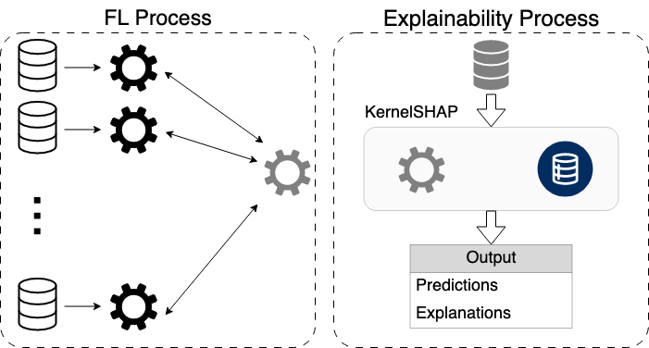
Federated SHAP* – how to design a proper and common background dataset
Background dataset generation through Federated Fuzzy Clustering⁺
Privacy preserving summarization of scattered data
Cluster centers are exploited as background
common, i.e., shared to all participants
representative of the entire data distribution
Local training data
Local models
FL model
Test data
Background data
*Ducange, P., Marcelloni, F., Renda, A., & Ruffini, F. (2024, June). Consistent Post-Hoc Explainability in Federated Learning through Federated Fuzzy Clustering. In 2024 IEEE International Conference on Fuzzy Systems (FUZZ-IEEE) (pp. 1-10). IEEE.
+ Bárcena, J. L. C., Marcelloni, F., Renda, A., Bechini, A., & Ducange, P. (2024). Federated c-means and Fuzzy c-means Clustering Algorithms for Horizontally and Vertically Partitioned Data. IEEE Transactions on Artificial Intelligence.
Notes:
SHAP applied using the union of local datasets

Slide 49


OPENFL-XAI
OpenFL framework, developed by Intel and now hosted by The Linux Foundation
Seamless integration with containers paradigm
Highly flexible, although designed for the aggregation of models like NNs, (i.e. via FedAvg)
Extended to support FL of inherently interpretable models
OpenFL-XAI https://github.com/Unipisa/OpenFL-XAI
Supports research, development, and demonstration activities concerning the FL of XAI models
Daole, M., Schiavo, A., Bárcena, J. L. C., Ducange, P., Marcelloni, F., & Renda, A. (2023). OpenFL-XAI: Federated learning of explainable artificial intelligence models in Python. SoftwareX, 23, 101505.
Notes:
The FL process exploits the Intel® OpenFL7 library [25].
Although designed for the aggregation of models such as neural networks, i.e. via FedAvg or its variants,
OpenFL offers high level of flexibility and customization.
Specifically, we extended the library to support FL of inherently interpretable

Slide 50
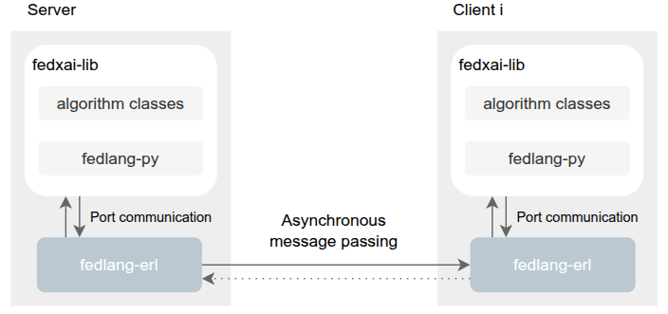
FedXAI-lib: A collection of Federated Learning of Explainable Artificial Intelligence algorithms
Algorithms implemented in Python (server and client logic):
Federated Fuzzy C-Means and C-Means
Federated Fuzzy Rule-based Classifiers
Federated Fuzzy Regression Trees
Communication layer: remote communication is handled by FedLang*, a middleware designed to support federated learning (FL) experiments.
Deployment: easily deployable using Docker technology for reproducibility and scalability.
Available soon, by October 31st on UNIPI GitHub Repository
* Bechini, Alessio, and Corcuera Barcena, Jose Luis. "Devising an actor-based middleware support to federated learning experiments and systems." Future Generation Computer Systems 166 (2025): 107646.
Notes:
fedxai-lib defines a set of classes for implementing federated explainable AI (Fed-XAI) algorithms.
The Python entities (server and client logic) communicate with fedlang-erl, a middleware component, through Erlang Ports - a mechanism that enables an Erlang process to exchange data with an external program (e.g., in C, Python, or Rust).
Asynchronous message passing is employed for communication between the server and clients.

Slide 51
Fed-XAI Use Cases

Slide 52
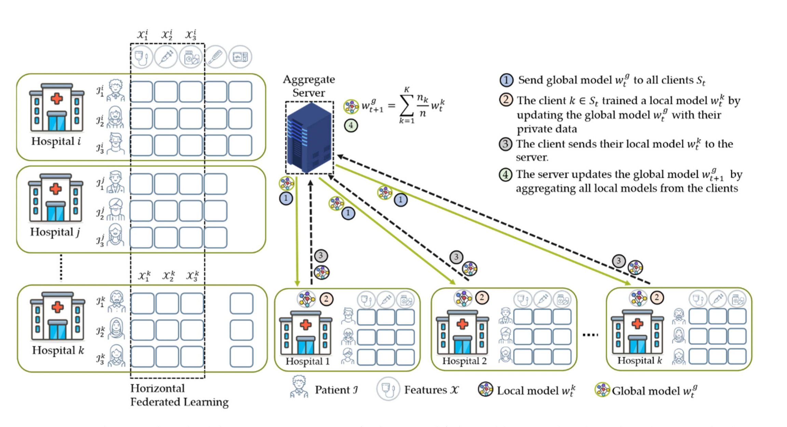
Fed-XAI in HEALTH: Horizontal Federated Learning
Notes:
It should be underlined that the performance of a model and its transparency are typically conflicting objectives; thus, as shown in figure, accuracy-oriented solutions are often considered hard to interpret, while interpretable models may be lacking in performance.
\textbf{understandability or intelligibility}: the two terms are associated with a functional understanding of the model in ML, without the need for explaining its inner procedure and representation. \textbf{Comprehensibility} is associated with the ability of a learning algorithm to represent its learned knowledge such that the model may be inspected and understood by humans. Thus, it is tightly related to the complexity of a model. \textbf{Interpretability} definition is the ability to explain how decisions have been taken or to provide the meaning in a way that is understandable by a human. \textbf{Explainability} is defined in \cite{BARREDOARRIETA202082} as follows: given a certain audience, explainability refers to the details and reasons a model gives to make its functioning clear or easy to understand. Finally, \textbf{transparency} refers to the characteristic of a model to be inherently understandable for a human.

Slide 53
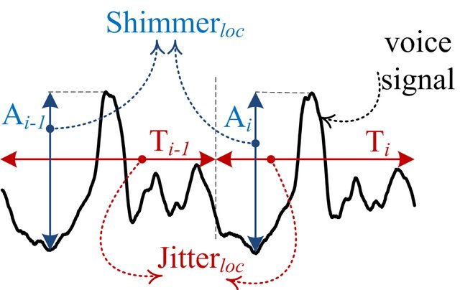


FED-XAI in HEALTH: Parkinson’s Disease Progression Prediction
The aim of this study is to predict UPDRS scores through analyzing the speech signal properties which is important in PD diagnosis.
Input attributes clinical information and characteristics of voice signal
Target attribute Unified PD Rating Scale (UPDRS)
PD Telemonitoring Dataset: regression task
Dataset details
5875 records
from 42 subjects (28M,14F)
22 attributes, reduced to 4 through feature selection (age, test time, Jitter(Abs), DFA)
For TSK-FRBS, each attribute is partitioned with five fuzzy sets (VeryLow - Low - Medium - High - VeryHigh)
Federated setting: patients artificially distributed into 10 hospitals
Ducange, Pietro, Francesco Marcelloni, Alessandro Renda, and Fabrizio Ruffini. "Federated learning of XAI models in healthcare: a case study on Parkinson’s disease." Cognitive Computation 16, no. 6 (2024): 3051-3076.
Notes:
Distinguishable and complementary by design

Slide 54
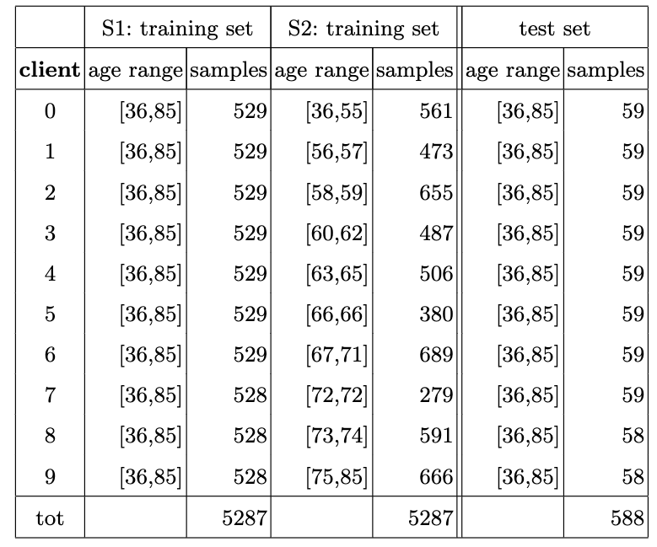
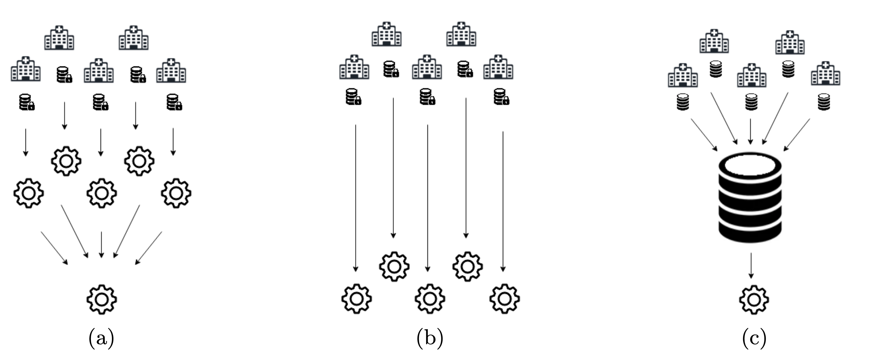
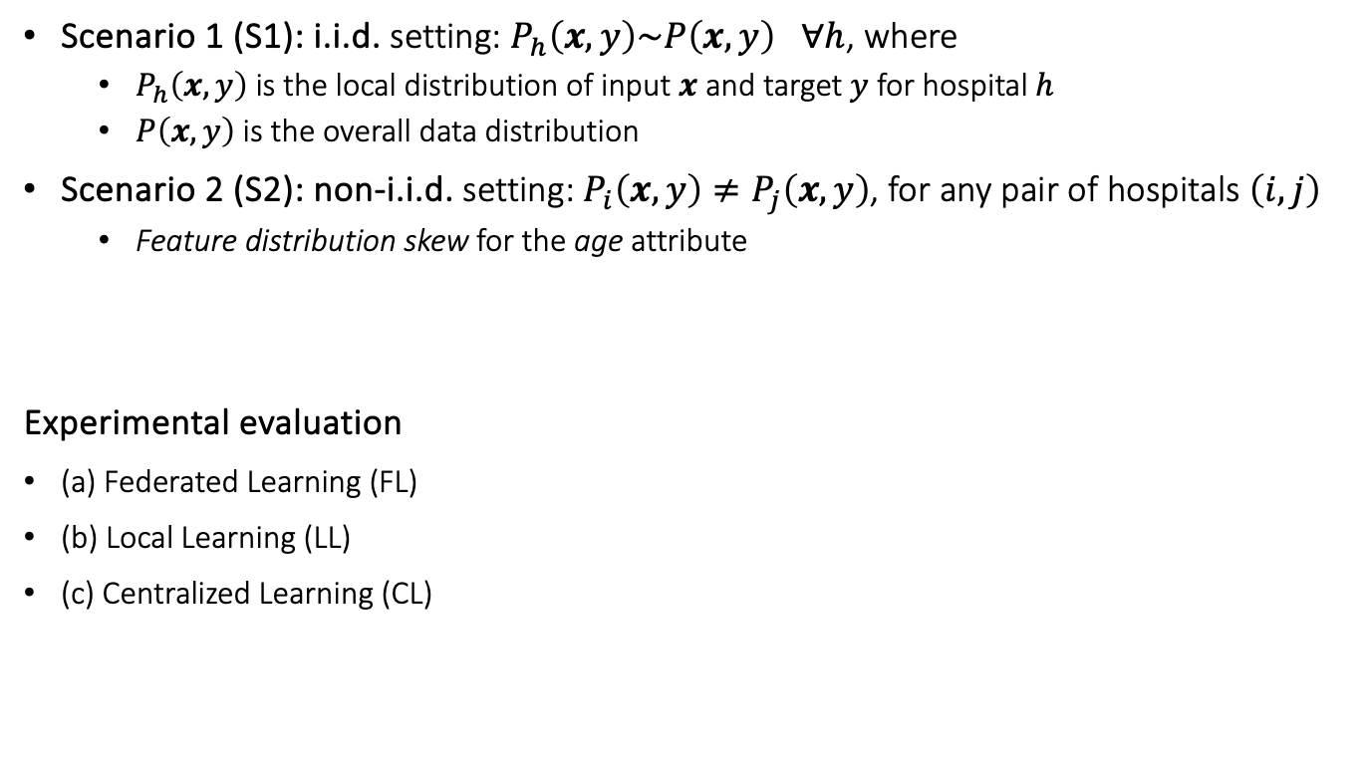
Parkinson’s Disease progression: Experimental Setup
Scenario 1 (S1): i.i.d. setting: $P_{h}\left(x,y\right)\sim P\left(x,y\right)$ $∀h$, where
$P_{h}\left(x,y\right)$ is the local distribution of input $x$ and target $y$ for hospital $h$
$P\left(x,y\right)$ is the overall data distribution
Scenario 2 (S2): non-i.i.d. setting: $P_{i}\left(x,y\right)≠P_{j}\left(x,y\right)$, for any pair of hospitals $\left(i,j\right)$
Feature distribution skew for the age attribute
Experimental evaluation
(a) Federated Learning (FL)
(b) Local Learning (LL)
(c) Centralized Learning (CL)

Slide 55

Parkinson’s Disease progression: Experimental results
TSK-FRBS vs MLP-NN (opaque baseline). Average values of the metrics:
RMSE: how much predictions deviate from the true values
r (pearson corr coefficient): how much predictions and true values are correlated
General observations
TSK comparable to MLP, especially in CL
FL generally outperforms LL both in S1 and S2
Noticeable in Scenario 2 (non-i.i.d.), where LL is particularly prone to overfitting
Can be appreaciated also in Scenario 1 (i.i.d.), especially for TSK
FL is generally outperformed by CL
Yet unfeasible when privacy preservation is a requirement

Slide 56


Parkinson’s Disease progression: Experimental Results (II)
Fine grained analysis (individual hospitals)
Empirical cumulative distribution function (ECDF) of the differences of RMSE
between FL and LL (dark blue)
between FL and CL (light blue)
Interpretability
Global (structural properties of the model): average number of rules
Local (inference process)
 | LL | FL | CL
S1 | 217.8 | 419.0 | 419.0
S2 | 71.7 | 419.0 | 419.0
Notes:
with very high age and DFA, high Jitter(Abs) and low test time, the predicted output is mostly affected by age and test time (relatively high positive coefficient), while Jitter(Abs) and DFA have lower and opposite impact (positive and negative, respectively)

Slide 57


Fed-XAI in Next Generation Wireless Network Video Streaming Quality of Experience (QoE) Prediction
A flagship for B5G/6G vision and intelligent fabric of technology enablers connecting human, physical, and digital worlds.
UNIPI group contribution: FED-XAI as a Service
Project awarded as key innovation by the EU Innovation Radar.
EU project: HEXA-X - Programme: Horizon 2020 -
Grant Agreement ID: 101015956
Merluzzi, Mattia, et al. "The hexa-x project vision on artificial intelligence and machine learning-driven communication and computation co-design for 6g." IEEE Access 11 (2023): 65620-65648.

Slide 58



Fed-XAI in Next Generation Wireless Network Video Streaming Quality of Experience (QoE) Prediction
FL service for addressing QoE prediction task in an automotive case study
Connected vehicles (UEs) play real-time video streams whose perceived quality is relevant to determine the availability of some advanced driving assistance system (e.g., in a see-through or tele-operated driving application)
Goal: train an ML model to predict future QoE (good or poor) by leveraging real-time QoS and QoE data
The relevant dataset (mobile network data) is generated usign Simu5G. Details in [1]
15 UEs (FL participants)
7 gNBs
120s simulation
24 independent replicas (20 train + 4 test)
IID Distribution
Non IID with quantity and label skew (QL-NIID)
[1] J. L. C. Barcena et al. Towards Trustworthy AI for QoE prediction in B5G/6G Networks, in: 1st Int’l Workshop on AI in beyond 5G and 6G Wireless Networks - AI6G2022, Vol.3189, 2022, pp. 1–9.

Slide 59


Video Streaming QoE Prediction: Experimental Results with Federated Fuzzy Rule-based Classifiers
QoE Average F1-Score ± Standard deviation
Average number of rules - QoE
Federated Fuzzy Rule-Based Classifier (FRBC) outperforms local FRBCs (no collaboration among clients)
Federated FRBC comparable with centralized FRBC and other centralized ML approaches (unfeasible in privacy-sensitive applications)
Mattia Daole, et al. “Trustworthy AI in Heterogeneous Settings: Federated Learning of Explainable Classifiers”. FUZZ-IEEE 2024: 1-9
is Good

Slide 60











Video Streaming QoE Prediction: demo testbed
Real-time testbed composed of real devices running real apps, and a network emulator
Fed-XAI app
Video stream flows through the emulated network
Fed-XAI app exploits the pre-trained XAI model to make online forecasts using live QoS data from the network
Forecasts and root causes are shown on a dashboard
The quality of the video at the receiver matches the forecast after a few seconds
Fed-XAI computation engine
Learning
Fed-XAI local manager
Inference
dashboard
Video stream traverses the real-time emulated network
Live QoS metrics sent to the Fed-XAI app
video source
UE
video player
dashboard
gNB(s)
MEC host
sender host
emulated network
receiver host
Corcuera Barcena, J. L., Mattia Daole, Pietro Ducange, Francesco Marcelloni, Giovanni Nardini, Alessandro Renda, and Giovanni Stea. "Federated Learning of Explainable Artificial Intelligence Models: A Proof-of-Concept for Video-streaming Quality Forecasting in B5G/6G networks." In CEUR WORKSHOP PROCEEDINGS, vol. 3554, pp. 164-168. CEUR-WS, 2023.

Slide 61

Fed-XAI in Cybersecurity: Decentralized and Trustworthy Intrusion Detection Sytem (IDS)
Goals:
To build a decentralized IDS
To ensure data privacy
To deliver accurate predictions
To provide reliable and consistent explanations of predictions
P Ducange, M Fazzolari, F Marcelloni, GC Miglionico, “Leveraging explainability of AI-based intrusion detection systems in Federated Learning environments”, 2025 International Joint Conference on Neural Networks (IJCNN), 1-9, 2025
Notes:
our goal was to design an intrusion detection system that is decentralized and trustworthy. We want to protect privacy, preserve accuracy, and ensure transparency through explanations. To do so, we combine Federated Learning with SHAP explanations in a novel way

Slide 62
The Proposed (FED-SHAP based) Decentralized and Trustworthy IDS
Classification model:
Multi-Layer Perceptron
Accurate Prediction
Opaque Model
Post-Hoc Explainer: SHAP
(SHapley Additive exPlanations)
Local, i.e., explains individual predictions
KernelShap variant: linear regression-based approximation
More efficient than naive calculation
Model-agnostic, suited for both classification and regression tasks

Slide 63



Decentralized and Trustworthy IDS: Dataset and Experimental Scenarios (Non-IID)
UNSW-NB15 dataset
Developed at the Australian Center for Cyber Security
Combines real and simulated network flow data linked to various cyberattacks.
6-class reformulation (from 10 original classes)
It contains 47 features describing network traffic through numerical, categorical, and textual data
Top 5 features selected via MRmr algortith
Notes:
To simplify the analysis and address class imbalance, categories with relatively few instances, namely \textit{Backdoor}, \textit{Shellcode}, \textit{Worm}, \textit{Analysis}, and \textit{DoS}, were consolidated into a single class labeled \textit{Others}. This restructuring reduced the dataset to six primary categories.
The \texttt{sttl} feature represents the source-to-destination time-to-live (TTL) value. It captures the initial TTL set by the source, offering insights into traffic patterns and potential anomalies. The \texttt{sbytes} feature denotes the amount of data transferred from the source to the destination, while \texttt{dbytes} corresponds to the data sent in the reverse direction. The \texttt{smeansz} feature reflects the average packet size originating from the source. Lastly, \texttt{ct\_srv\_dst} identifies the number of connections associated with the same service and destination address.

Slide 64
Decentralized and Trustworthy IDS: Extracted Features
V1 -> source-to-destination time-to-live value
V2-> amount of data transferred from the source to the destination
V3-> data sent in the reverse direction.
V4-> average packet size originating from the source.
V5-> number of connections associated with the same service and destination address.

Slide 65


Decentralized and Trustworthy IDS: Experimental Results - Accuracy
Scenario 1
Scenario 2

Slide 66



Decentralized and Trustworthy IDS: Experimental Results: Explainability
SHAP Explanation for No Attack Class
SHAP Explanation for Generic Class
Notes:
In the summary plots, \ac{SHAP} values illustrate the influence of individual features on the model’s predictions for a given class, quantifying both the magnitude and direction of their impact. Each point within the plot corresponds to a specific instance: its position along the x-axis represents the \ac{SHAP} value, thereby reflecting the extent to which a particular feature contributes to the increase or the decrease of the model’s output. The color gradient, spanning from blue to red, encodes the feature values, where lower values are represented in blue and higher values in red.

Slide 67
Security Threats in Federated Learning

Slide 68

Security Threats in Federated Learning
Server side
Active (usually no in FL)
Compromising Functionality
Passive // Honest-but-curious
Privacy concerns
Client side
Model Poisoning
Data Poisoning
Notes:
Gli attacchi client-side sono generalmente disruptive e vogliono interferire con il comportamento del problema. Se targeted abbiamo backdoor, se untargeted solo impedire il training. (in next slide)

Slide 69
Type of Attacks
Adv Attacks
Untargeted
Targeted
Aim to deteriorate the performance of the global model
Aim to inject a secondary task within the global model, without altering performance on the original task
Notes:
Gli attacchi client-side sono generalmente disruptive e vogliono interferire con il comportamento del problema. Se targeted abbiamo backdoor, se untargeted solo impedire il training. (in next slide)

Slide 70




Untargeted Attacks: Data Poisoning
Data Poisoning
Random Flipping
Manipulate private data to deteriorate model’s performance
Out of Distribution
Notes:
In rosso scuro si evidenzia dove l’avversario performa l’attacco. In rosso chiaro invece la conseguenza

Slide 71


Data Poisoning in FRBS
Existing data points are assigned to randomly selected classes
New data points are generated, laying outside of the dataset’s distribution

Slide 72

Untargeted Attacks: Model Poisoning
Model Poisoning
Manipulate directly the weights of the model to deteriorate performance
Random Weights

Slide 73



Model Poisoning Attacks
Complete rules are randomly generated and inserted within the local RB
The consequents and weights are randomly generated, without altering the antecedents
Only the weights are randomly generated

Slide 74
Targeted Attacks: Backdoor
Backdoor Attack
Manipulate either private data and/or local model’s weights to inject a secondary task within the final system.
The performance on the main task do not deteriorate, but when the backdoor pattern is recognized in input, the global model produce the adversarial output

Slide 75

Backdoor Attack in FRBS
Backdoor Attack: the adversary can directly inject rules in the local RB.

Slide 76

Effects of Attacks on Federated-FRBC: QoE Dataset
M Daole, P Ducange, F Herrera, F Marcelloni, A Renda, N Rodrìguez-Barroso, “Security Threats to Explainable Classifiers in Federated Learning”, 2025 International Joint Conference on Neural Networks (IJCNN), 1-8, 2025

Slide 77
Future Challenges
Security in FL:
- Attack threats in FED-XAI: in deep analysis and defense strategies
- XAI models for defense against FL attacks
Federated Learning from Continuous Data Stream
- Strategies for Concept Drift Detection
- Model Updating from new chunks of data
FED-XAI for Object Detection in Video Streaming
- XAI and FL strategies for Yolo Networks
Model Personalization

Slide 78
Some Recent Publications
P Ducange, M Fazzolari, F Marcelloni, GC Miglionico, “Leveraging explainability of AI-based intrusion detection systems in Federated Learning environments”, 2025 International Joint Conference on Neural Networks (IJCNN), 1-9, 2025
M Daole, P Ducange, F Herrera, F Marcelloni, A Renda, N Rodrìguez-Barroso, “Security Threats to Explainable Classifiers in Federated Learning”, 2025 International Joint Conference on Neural Networks (IJCNN), 1-8, 2025
JLC Bárcena, P Ducange, F Marcelloni, A Renda, “Increasing trust in AI through privacy preservation and model explainability: Federated Learning of Fuzzy Regression Trees”, Information Fusion 113, 2025
P Ducange, F Marcelloni, A Renda, F Ruffini, “Federated Learning of XAI Models in Healthcare: A Case Study on Parkinson’s Disease, Cognitive Computation”, 1-26, 2024
JLC Bárcena, F Marcelloni, A Renda, A Bechini, P Ducange, “Federated c-means and Fuzzy c-means Clustering Algorithms for Horizontally and Vertically Partitioned Data”, IEEE Transactions on Artificial Intelligence, 2024
M Daole, P Ducange, F Marcelloni, A Renda, “Trustworthy AI in Heterogeneous Settings: Federated Learning of Explainable Classifiers”, 2024 IEEE International Conference on Fuzzy Systems (FUZZ-IEEE), 1-9, 2024
P Ducange, F Marcelloni, A Renda, F Ruffini, “Consistent Post-Hoc Explainability in Federated Learning through Federated Fuzzy Clustering”, 2024 IEEE International Conference on Fuzzy Systems (FUZZ-IEEE), 1-10, 2024

Slide 79















Slide 80
Acknowledgements
Most of the discussed activities on XAI models and Federated Learning are carried out in collaboration with:
Prof. Francesco Marcelloni, coordinator of the AI Group@DII
Dr. Alessandro Renda, former researcher within the AI Group@DII now tenure track Assistant Professor at University of Trieste
Dr. Mattia Daole, PhD Candidate within the AI Group@DII
Dr. Jose Luis Corcuera Barcena, Post doc Research Fellow the AI Group@DII
Prof. Marcelloni, Dr. Renda and Dr. Daole provided part of the slides of this presentation

Slide 81
Thank you very much
for your attention.
Questions?
Contacts: pietro.ducange@unipi.it

