Slide 1
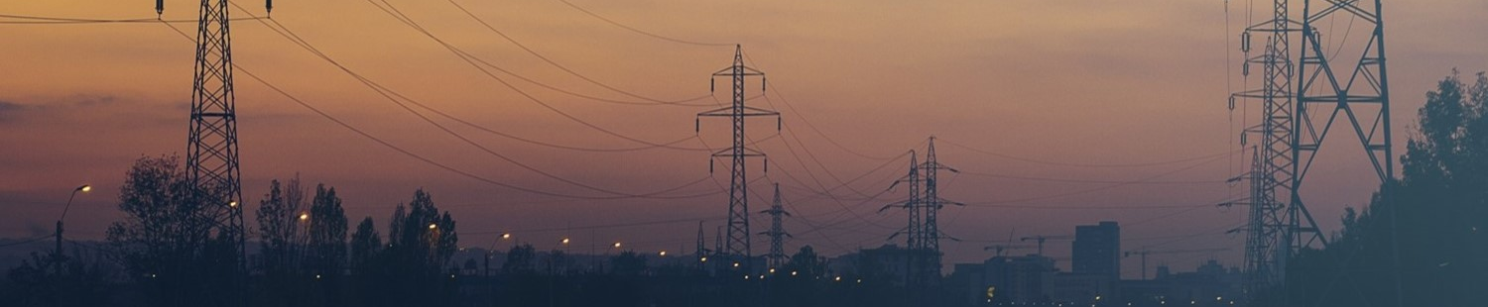
Keynote: ICT-Based Power-System Service Resilience
Prof. Hermann de Meer (demeer@uni-Passau.de) , Armin Stocker, Amit Dilip Patil, Michael Lechl and Anna Volkova
Chair of Computer Networking and Computer Communications, University of Passau
Smartgreens 2025
14th Int’l Conference on Smart Cities and Green ICT Systems, 2-3 April 2025, Porto, Portugal
31.03.2025

Slide 2




Flexible energy demand from data centers
Energy Efficiency for Data Centers (2010-2012):
Concept for increasing the energy efficiency and sustainability of data centers and supercomputers
Energy awareness: plug-ins for data center automation frameworks
Intelligent allocation of ICT resources, data center consolidation
Compliance with existing SLAs and QoS metrics
Green Interplay between Data Centers and Energy Providers (2012-2014):
Collaboration between data center operators and energy providers
Coordination of supply and demand
Development of new concepts and technologies such as GreenSLA and GreenSDA
Control system: consumption adapts to fluctuating supply
Environmentally Sustainable Data Center for Smart Cities (2013-2016):
Data centers in smart cities in the role of ICT service provider and gigantic energy consumer
Integration of renewable energies
Reduction of power consumption (data center consolidation)
Compliance with QoS metrics
[Basmadjian 2012, SustainIT 2012] [Basmadjian 2018, IEEE T. on Smart Grid]

Slide 3
Agenda
Introduction
Interdependencies and resilience
Examples of power-ICT system interdependencies
  3.1 Flexibility
  3.2 Protection
  3.3 Blackout & Blackstart
Conclusion

Slide 4




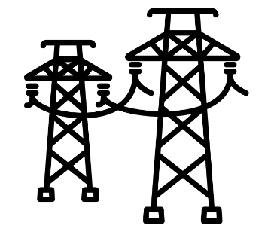





1. Introduction
Renewable
(large-scale)
generation
The power system
Large-scale generation connected to transmission
network
Transmission network with high voltage for
long-distance transport of energy
Distribution network at a lower voltage for
short distance transport (e.g., within a town area)
End users that consume energy
Renewable energy transition:
  Large scale renewable generation can be unpredictable
    E.g., weather effects on large scale wind plants
  End users with own generation
Transmission
networks
Distribution
Networks
End users
(with flexibility
and generation)

Slide 5
1. Introduction
Renewable
(large-scale)
generation
On resilience: degraded dependability due to changes
As critical infrastructures, power grids must be dependable
However, power grids currently face major changes:
  Inclusion of more renewable generation
  Decommissioning of fossil fuel and nuclear generation
  Increasing costs for oil and gas
Increasing unpredictability
  Rising unpredictability can threaten the system’s resilience
    Due to excessive deviation between generation and demand
Decreasing reliability of supply
  Quantified by System Average Interruption Duration Index (SAIDI)
Degradation of power quality
Transmission
networks
Distribution
Networks
End-users
(with flexibility
and generation)

Slide 6
1. Introduction
Renewable
(large-scale)
generation
Role of communication: power forecasting requirements
On system level: Balance overall supply and demand
  Requires a forecast of generated power and demand
  Forecasts can be imprecise
  The goal is to make the system “plannable”
On a large scale generator level: Market operation
  Energy is sold on markets in various time-scales
  e.g., day-ahead or minutes ahead
Transmission
networks
Distribution
Networks
End-users
(with flexibility
and generation)
Balance consumption and generation at all times!

Slide 7
Agenda
Introduction
Interdependencies and resilience
Examples of power-ICT system interdependencies
  3.1 Flexibility
  3.2 Protection
  3.3 Blackout & Blackstart
Conclusion

Slide 8
2. Interdependencies and Resilience
Unpredictability arising from Distributed Renewable Energy Sources (DRESs) can be tackled using Information and Communication Technology (ICT)
  ICT-based power grid services to maintain power grid stability
    Also called smart grid services
  Proactive measures
    Using generation and demand forecasts for planning
  Reactive measures
    Activating flexible reserves to maintain balance between generation and demand
Imprecise predictions could lead to incorrect planning and insufficient flexibilities resulting in possible power outages
  This could lead to a failure of supporting ICT infrastructure
  This impact could propagate into the power system, as less information could be available for reactive measures
  A mutual dependency exists between power and ICT systems
[de Meer 2025, RNDM 2024]

Slide 9
2. Interdependencies and Resilience
ICT-based power grid services
ICT-based power grid services are one of two types according to the European Network of Transmission System Operators for Electricity (ENTSO-e):
  High-level services
    These services assist in maintaining “normal” operation state
  Remedial actions
    These services assist in taking corrective or preventive actions against contingencies
The power system relies on the ICT system for data collection, transfer and decision making
  Incorrect or delayed data transfer or decision making can lead to catastrophic consequences!
The ICT system relies on the power system for power supply
  ICT component outage implies a lack of sufficient information for
  control decisions
    Decreased resilience
Smart grid services
Power system
ICT
Data and power supply
[Klaes 2020, DACH+ Energy Informatics Conf.]
Notes:
Make everything plannable, flat consumption lines
Predictability is more important than saving

Slide 10
2. Interdependencies and Resilience
ICT-based power grid services
These services encapsulate the power-ICT interdependencies
  High level services rely on predictions to maintain stable operation proactively
  Remedial actions such as protection rely on real-time data collection
  Each service can exist in one state at a point in time
    The state indicates the expected performance of the service
ICT-based smart grid service states
Data Transfer
Normal
Data Availability
Data availability, latency and correctness for an ideal performance
Routers, links, switches
Computation
Latency
Limited
Servers, intelligent electronic devices
Service-specific conditions of data availability, latency and correctness conditions for an acceptable but degraded performance
Degraded ICT performance impacts the resilience of the smart grid service
Data Management
Correctness
Acquisition, storage
Failed
Service-specific conditions of data availability, latency and correctness cause service to fail
[Klaes 2020, DACH+ Energy Informatics Conf.]

Slide 11
2. Interdependencies and Resilience
ICT-based power grid services
These services encapsulate the power-ICT interdependencies
The state of a service, e.g., state estimation, can impact the state of other services, e.g., protection
  Limited state of services introduced
    In addition to only operational (Normal) and non-operational (Failed) states
  Direct state transitions occur by definition of the state description or service interdependency
  Conditional state transitions occur due to service interdependency and scenario-specific external events
Power System
Normal
Alert
Emergency
Blackout
Data Transfer
Data Availability
Routers, links, switches
Adaptive
Protection
Direct State Transitions
Computation
Latency
ICT- based smart grid services
Normal
Limited
Failed
Servers, intelligent electronic devices
Conditional State Transitions
Data Management
State Estimation
Normal
Limited
Failed
Correctness
Acquisition, storage
State transitions depicted in the figure above are non-exhaustive.
[Klaes 2020, DACH+ Energy Informatics Conf.]

Slide 12
2. Interdependencies and Resilience
ICT-based power grid services
These services encapsulate the power-ICT interdependencies
The state of a service, e.g., state estimation, can impact the state of other services, e.g., protection
  Limited state estimation service state implies that the output may be incorrect or delayed due to loss of certain measurement data
  Based on Limited state estimation service state, protection operates based on incorrect information or only local information
    This could lead to a potential fault not being cleared and the power system in Emergency state
Power System
Normal
Alert
Emergency
Blackout
Data Transfer
Data Availability
Routers, links, switches
Computation
Adaptive Protection
Direct State Transitions
Latency
ICT- based smart grid services
Normal
Limited
Failed
Servers, intelligent electronic devices
Conditional State Transitions
Data Management
State Estimation
Normal
Limited
Failed
Correctness
Acquisition, storage
However, the degree of power-ICT interdependency is not considered.
[Klaes 2020, DACH+ Energy Informatics Conf.]

Slide 13
2. Interdependencies and Resilience
ICT-based power grid services
Interdependencies between power and ICT systems are susceptible to cascading failures
  A coupling coefficient reflects the degree to which the power system is reliant on ICT
The degree of coupling determines the interdependency strength
  Determines to what extent controllability is lost in the case of cascading failures
    Weak interdependency results in partial observability and controllability of power network
    Strong interdependency results in total disconnection of the power node from the network
Interdependency between power and ICT systems are mostly beneficial
  In case of cascading failures, ICT can be used to balance load and generation
    Minimize load shedding
  Beyond a certain degree of coupling, the interdependent system’s robustness reduces
    At higher coupling coefficients, cascading effect is higher
[Ghasemi 2023, IEEE TNSE]

Slide 14
Agenda
Introduction
Interdependencies and resilience
Examples of power-ICT system interdependencies
  3.1 Flexibility
  3.2 Protection
  3.3 Blackout & Blackstart
Conclusion

Slide 15
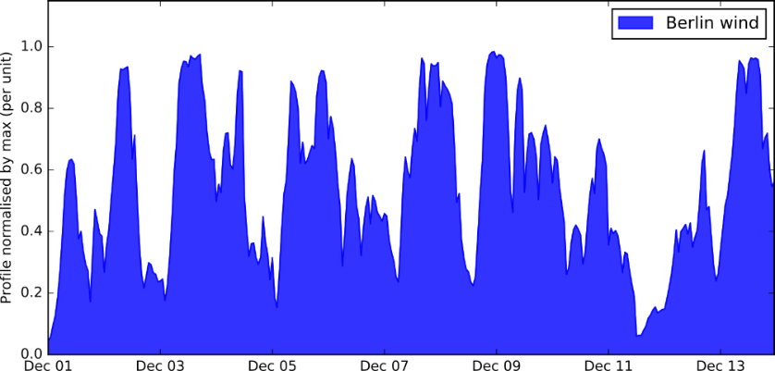
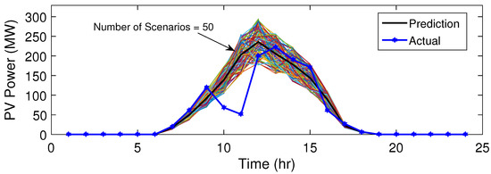
3.1 Flexibility: Redispatch
Power System
Normal
Alert
Emergency
Blackout
ICT- based smart grid services
Redispatch
Normal
Limited
Failed
Power and ICT interdependencies in redispatch
State Estimation
Normal
Limited
Failed
Flexibility requirements
  Deviations from planned or expected power/energy/ramp-rate values
  Example: Volatility and uncertainty of renewable energy resources
  Quantification requires forecasts/measurement data provided by an ICT system
Flexibility potentials
  Controlled feasible deviations of a flexibility resource, e.g., Battery Storage System (BSS)
  Required to balance flexibility requirements
  Procurement process relies on real-time data of flexibility resources (e.g., current setpoint)
    Provided by ICT system
Correctness
(See slide 10)
[Volatility of wind generation; Figure by Tom Brown, CC BY-SA 4.0]
[Uncertainty in PV generation; Figure by Sediqi, CC BY 4.0]
[Lechl 2023, Elsevier RSER]

Slide 16




3.1 Flexibility: Redispatch
Power System
Normal
Alert
Emergency
Blackout
ICT- based smart grid services
Redispatch
Normal
Limited
Failed
Dependency of redispatch on historic data
State Estimation
Normal
Limited
Failed
Predict flexibility resource size to be able to fulfill the demand in a system
Data requirements:
  Historic data on demand and generation
Use Case: PV-powered Electric Vehicle (EV) charging station
  Corrupted/missing data can lead to
    Installing a large battery → Higher cost
    Small battery → Dissatisfied EV owners
Car Charging as Time Elastic Energy Demand
Renewable Energy Supply
Battery for Flexibility
Correctness
(See slide 10)
Data Availability
(See slide 10)
Electric Vehicle Charging Station
Measurement Point
[Fürmann 2023, DACH+ Energy Informatics Conf.]

Slide 17
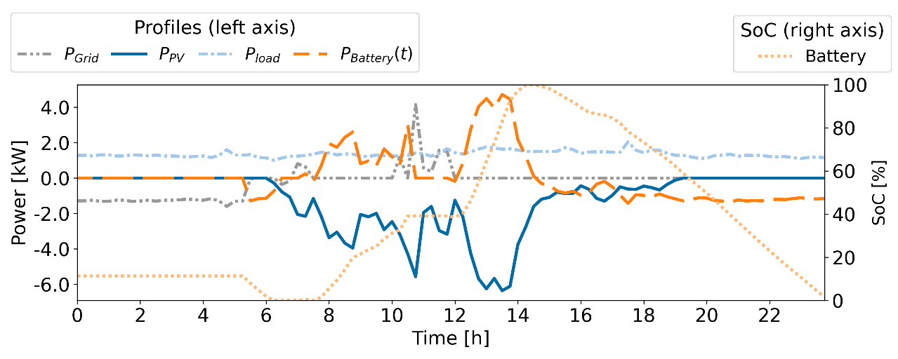
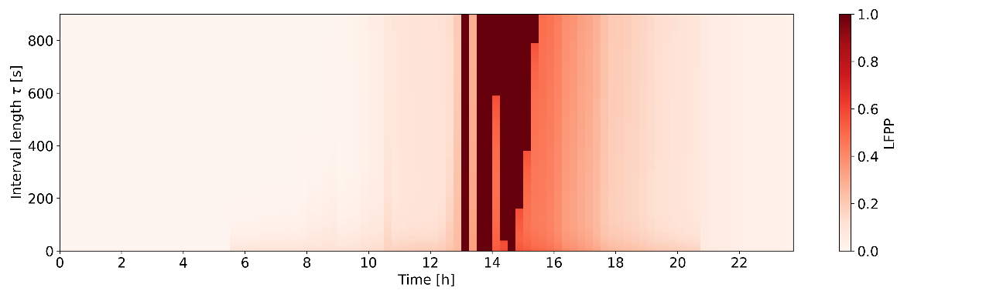
3.1 Flexibility: Redispatch
Power System
Normal
Alert
Emergency
Blackout
ICT- based smart grid services
Redispatch
Normal
Limited
Failed
Dependency of redispatch on forecast data
State Estimation
Normal
Limited
Failed
Procuring flexibility potentials requires demand/generation forecasts
  Uncertainty in both forecast errors and flexibility potentials must be considered
  Dependency on data, i.e., an ICT system
Corrupted/missing data can have cascading impacts on the power system,
  E.g., system failures due to procuring insufficient flexibility potentials
  Use Case: Household with PV + BSS
    Time 14h in heatmap: High probability of lacking battery charging flexibility potential for balancing net load forecast errors
Scheduled household power profiles and BSS State-of-Charge for a day.
Based on real data partially available on the Open Energy Platform.
Correctness
(See slide 10)
Data Availability
(See slide 10)
Probability that flexibility potential is insufficient for a day and different subintervals (y-axis) per 15-min scheduling interval (x-axis)
(Lack of Flexibility potential probability: LFPP)
[Lechl 2025, Elsevier Applied Energy]
Notes:
Dark blue PV power forecast
Light blue load forecast
Light grey is grid profile: grid connection point of household; mostly at 0 because PV is supplying the load
Light orange is SoC
Dark Orange is charging and discharging of the battery
At 14h, battery is almost full, so negative flexibility (charging of battery) is lacking with a high probability

Slide 18
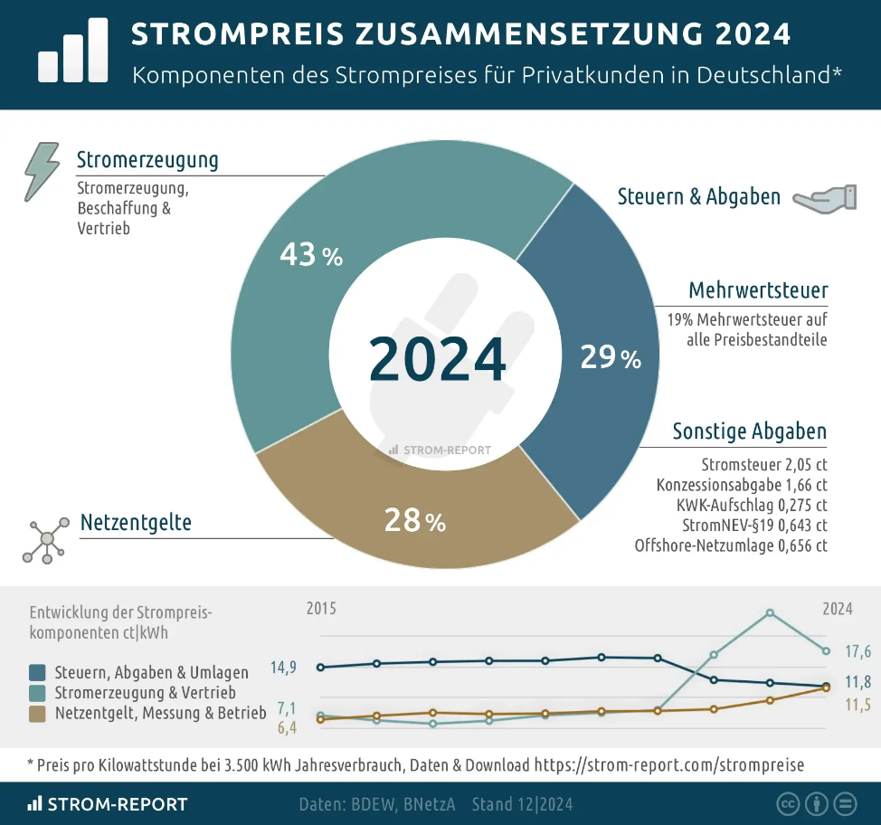

3.1 Flexibility: Cost of Flexibility Services
Better planning of power system operation using ICT means that
  Less (carbon-intensive) flexibility resources are needed → more sustainable
  Electricity price decreases
    Main cost factor is flexibility in systems with large share of renewables
Electricity price composition 2024
Avg. electricity price for household customers in Germany
[Lechl 2023, Elsevier RSER]
Source: https://strom-report.com/strompreise/#strompreiszusammensetzung-2024

Slide 19
Agenda
Introduction
Interdependencies and resilience
Examples of power-ICT system interdependencies
  3.1 Flexibility
  3.2 Protection
  3.3 Blackout & Blackstart
Conclusion

Slide 20

3.2 Protection
Power System
Normal
Alert
Emergency
Blackout
Adaptive
Protection
Normal
Limited
Failed
Power and ICT Interdependencies in adaptive protection
ICT- based smart grid services
State Estimation
Normal
Limited
Failed
In case of excessive current flow, protection may be triggered
  A possible cause is a mismatch between generation and demand, causing overloads
  Protection may also be triggered due to faults
There may be instances where the protection system sensitivity should be adapted
  High impedance faults
  Protection blinding
Power-ICT interdependencies introduced in
protection systems
  ICT-based protection introduces communication delay
  Extended delays can increase fault clearing time
    Decreased resilience
external
grid
Server
Latency
(See slide 10)
[Patil 2024, DACH+ Energy Informatics Conf.]

Slide 21
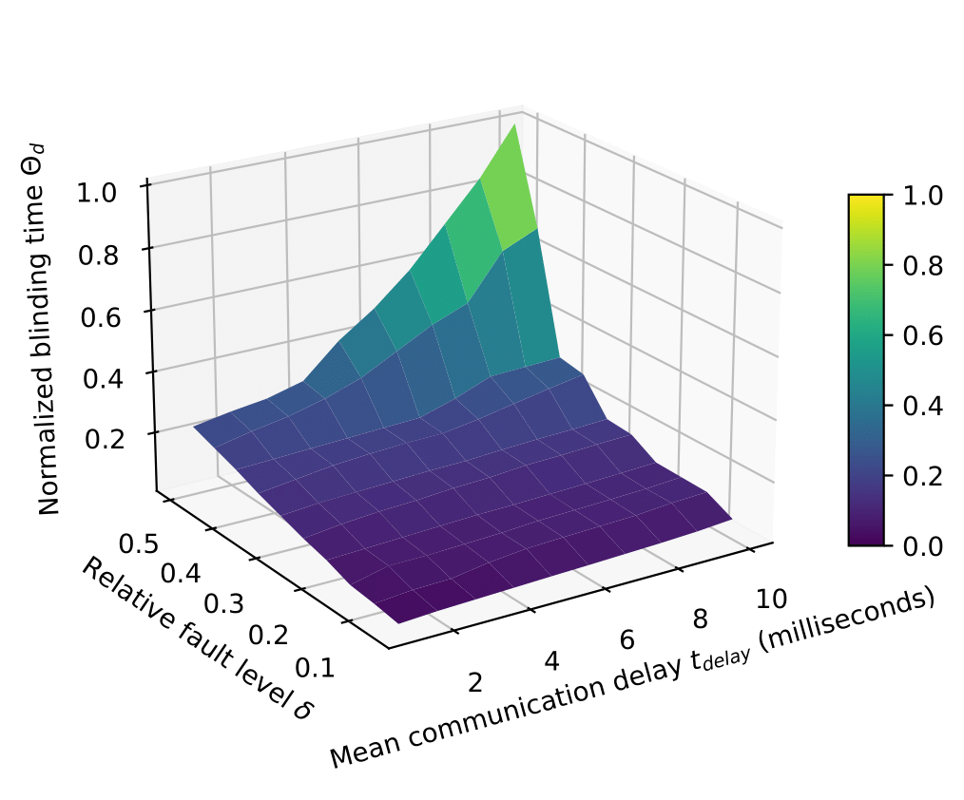
3.2 Protection
Power and ICT Interdependencies in adaptive protection
There may be instances where the protection system sensitivity should be adapted
  Protection blinding
The need to predict when does protection blinding occur!
  The system can be designed to tackle such scenarios
    Increases resilience
Limited State Estimation due to increased latency resulting in lost/delayed measurements
State estimation result may be imprecise => Limited protection state
  Fault may be detected late
  Protection could be adapted late
  Due to increased latency
Power system state is in Emergency state due to fault
Power System
Normal
Alert
Emergency
Blackout
Adaptive
Protection
Direct State Transitions
ICT- based smart grid services
Normal
Limited
Failed
Conditional State Transitions
State Estimation
Normal
Limited
Failed
Latency
(See slide 10)
Impact of DRES fault level and communication delay on blinding time, i.e., difference between fault clearing times with and without DRESs
[Patil 2024, DACH+ Energy Informatics Conf.]

Slide 22
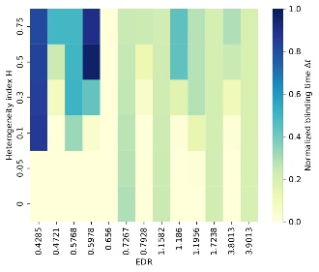
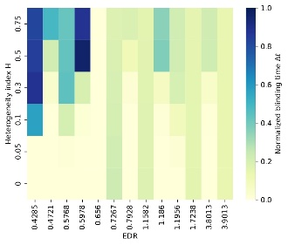
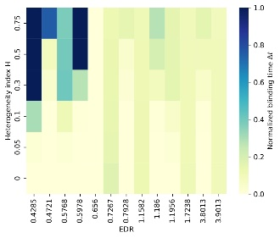
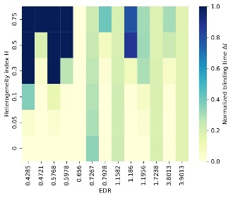
3.2 Protection
Predicting the impact of DRES locations on protection systems
Fault locations that severely impact the protection system can be predicted for a given set of DRES locations!
Analysis: Two new indices defined to study the structure of a system (Patil et al., IET RPG 2024)
Heterogeneity index
Electrical distance ratio
Increasing fault level
Heterogeneity index: describes the spread of DRES fault level across a grid
Electrical distance ratio: describes the proximity of DRESs, fault and protection system
However, complete data is assumed: missing or incorrect data can result in misleading conclusions on which locations are critical!
Correctness
(See slide 10)
Data Availability
(See slide 10)
[Patil 2024, IET RPG]

Slide 23
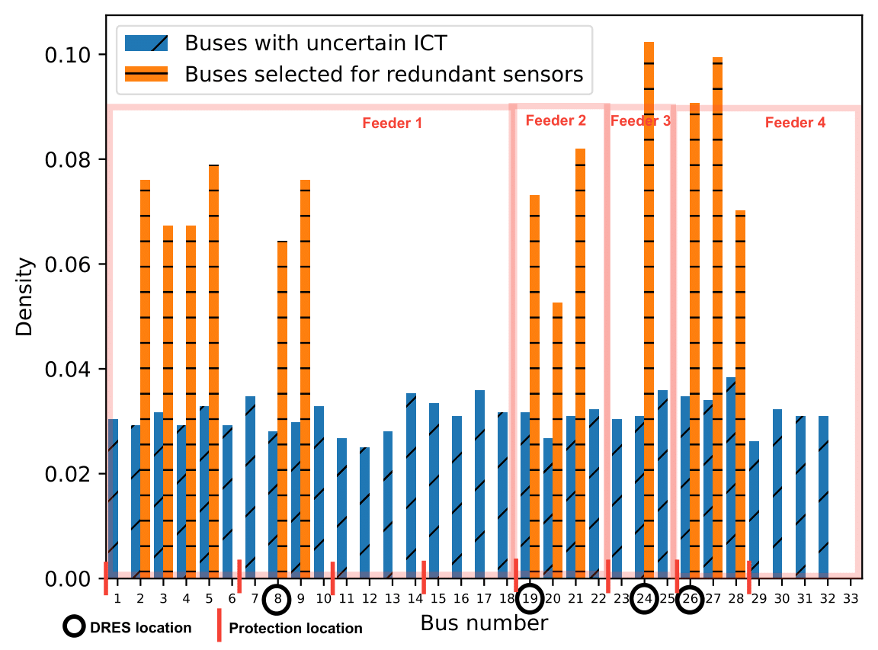
3.2 Protection
Power and ICT Interdependencies in fault detection
However, optimal location of DRESs is determined by not only the impact on protection
  DRESs are typically integrated based on their impact on voltage profile or minimizing power losses
  Protection may still be impacted
ICT is susceptible to failure
  Faults may not be detected
  This may lead to protection blinding
    Depends on DRES locations
    Decreased system resilience
  ICT dependability can be improved by redundancy
    Redundancy is expensive, and hence can be budget-restricted
ICT failure data, e.g., failure rates are essential
  Failure density help determine locations of redundant components
Power System
Normal
Alert
Emergency
Blackout
ICT- based smart grid services
Adaptive
Protection
Normal
Limited
Failed
State Estimation
Normal
Limited
Failed
Correctness
(See slide 10)
Data Availability
(See slide 10)
Probability density functions of sensor failure location and preferred redundant sensor locations
[Patil 2024, IEEE TNSM]

Slide 24
Agenda
Introduction
Interdependencies and resilience
Examples of power-ICT system interdependencies
  3.1 Flexibility
  3.2 Protection
  3.3 Blackout & Blackstart
Conclusion

Slide 25
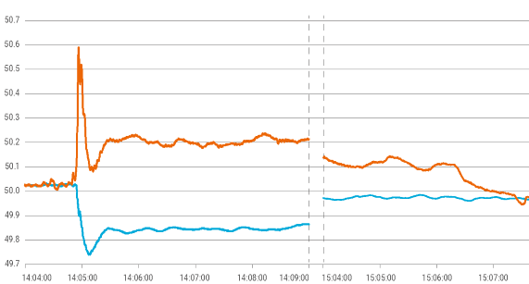
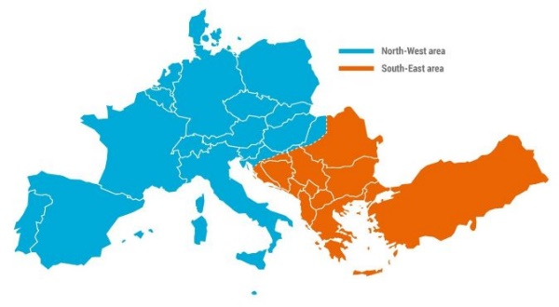
3.3 Blackout & Blackstart
Loss of Frequency on 08.01.21 to 49,746 Hz.
(Source: ENTSO-E, Technical Report 2021)
Cascading tripping of lines
due to overcurrent
08.01.2021: Continental Europe synchronous area
  Initial event: tripping of a 400 kV busbar coupler by overcurrent protection in Croatia
    Differences in the forecasted and observed load flow
  Cascaded trips of several transmission network elements at Croatia/Serbia border
  Deficit of power in the north-west area and a surplus of power in the south-east area (approx. 6.3 GW):
    1.7 GW contracted interruptible services were disconnected in France and Italy
System
separation
Resynchronisation of the
separated areas
Frequency [Hz]
Disconnection of
975MW generator in Turkey
Activation of 480MW of
supportive power in GB
tripping of a
400kV busbar
Disconnection of 1.7GW
load in France and Italy
Time
14:47 Reconnection of the interruptible
services in France and Italy
Separation of continental Europe synchronous area.
(Source: ENTSO-E, Technical Report 2021)
[Volkova 2024, IEEE TNSM]
https://www.entsoe.eu/news/2021/01/26/system-separation-in-the-continental-europe-synchronous-area-on-8-january-2021-2nd-update/
Notes:
In Jan 2021: https://www.entsoe.eu/news/2021/01/26/system-separation-in-the-continental-europe-synchronous-area-on-8-january-2021-2nd-update/
8 January 2021 at 14:05 CET the synchronous area of Continental Europe was separated into two parts due to outages of several transmission network elements in a very short time.
due to the change in the topology and subsequential overload of the busbar coupler loss of frequency to quenz extrem rasch bis auf 49,746 Hz + cascading tripping of other components
at least one of the split synchronised regions had a load larger than 5 % of the total load before the incident
The system separation resulted in a deficit of power (approx. -6.3 GW) in the North-West Area and a surplus of power (approx. +6.3 GW) in the South-East Area, resulting in turn in a frequency decrease in the North-West Area and a frequency increase in the South-East Area.
contracted interruptible services in France and Italy (in total around 1.7 GW) were disconnected (equivalent to 1 mil. homes)
die dritte (Emergency) von vier (Blackout) Warnstufen erreicht

Slide 26
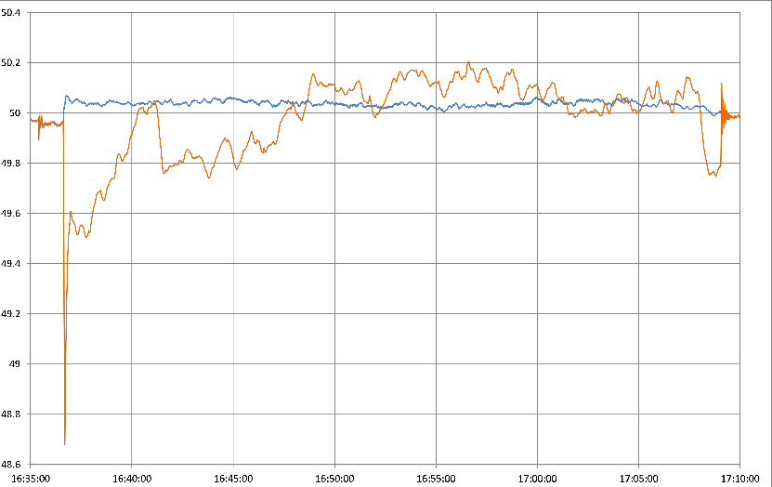
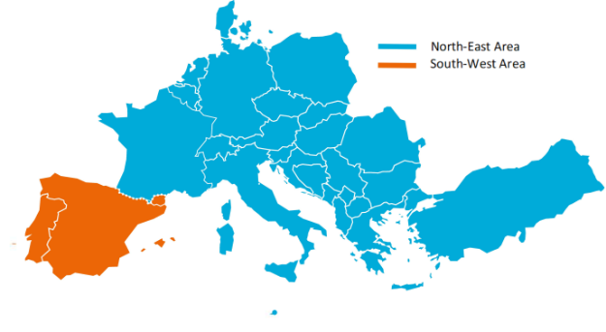
3.3 Blackout & Blackstart
tripping of multiple lines
due to fire
System separation
24.07.2021: Between Spain and France
  Forest fire along the line route
    ~2,500 MW of imports from France were
    interrupted
  In north-east area, surplus of energy
  led to a frequency change to 50.06 Hz
  In the disconnected south-west area,
  frequency change to 48.65 Hz due to
  deficit of energy
  Load shedding measures applied:
    In Spain: Approximately 3068 MW shed
    In Portugal: 310 MW hydro pumps, 430 MW of interruptible industrial loads, and additional 650 MW of load
    In France: 100 MW of load
Frequency [Hz]
Load shedding of 1995 MW Hydro pumps
and 3068 MW interruptible load in Spain
Resynchronisation of the
separated areas
Load shedding of 310 MW Hydro pumps
and 430 MW interruptible load in Portugal
tripping of a
400kV busbar
Time
Loss of Frequency on 24.07.21 to 48.65 Hz.
(Source: ENTSO-E, Technical Report 2022)
[Volkova 2024, IEEE TNSM]
Outage of French-Spanish interconnection.
(Source: ENTSO-E, Technical Report 2022)
https://www.entsoe.eu/news/2021/08/20/outage-of-french-spanish-interconnection-on-24-july-2021-update/
Notes:
In Jul 2021: https://www.entsoe.eu/news/2021/08/20/outage-of-french-spanish-interconnection-on-24-july-2021-update/
A forest fire generates air pollution through smoke and a large concentration of thin particles.
This reduces the insulating capacity and degrades the electric properties of the air, which in turn can cause short circuit failures and line trippings.
Spain led to the disconnection of 1995 MW hydro pumps and automatic shedding of approximately 3068 MW of load
The low frequency load shedding scheme in Portugal led to the disconnection of 310 MW hydro pumps, 430 MW of interruptible industrial consumers (activated when frequency decreases below 49,2 Hz) and automatic shedding of 650 MW of load
The automatic shedding of around 100 MW of load in France

Slide 27

3.3 Blackout & Blackstart
A blackout is a major power outage in a region involving at least 500,000 customers and lasts for at least several hours
In Germany, about 150.000 interruptions that exceed 3 min for Low-Voltage (LV) end customers are registered annually
  System Average Interruption Duration Index (SAIDI) is about 12–15 min/year
Vehicle accidents (12%)
Animals (5%)
Overdemand (<1%)
Weather / Trees (30%)
Faulty equipment &
human error (26%)
Unknown (20%)
Planned outage (6%)
Power system blackout causes
Event, year | People affected (Mil.) | Duration (h)
Italy, 2003 | 56 | 8
Northeast America, 2003 | >55 | 20
Germany, 2005 | 0,20 | >100
EU system split, 2006 | 15 | 1h
North India, 2012 | 620 | 10h
Ukraine, 2015 | 0,24 | <1h
South America, 2019 | 50 | 3h
SAIDI $= \frac{\sum{all customer interruption durations}}{total number of customers served}$
Major electric power system blackouts
[Volkova 2024, IEEE TNSM]
Notes:
As the power system is spread over large geographic regions, the probability of facing different types of faults and failures is
high.
large disturbances are usually followed by series of events called cascading events. If these events are not well managed, the system would encounter a blackout
Three main cause clusters are reported: Natural Causes, faults, attacks
Lower system inertia leads to higher rates of change in frequency

Slide 28

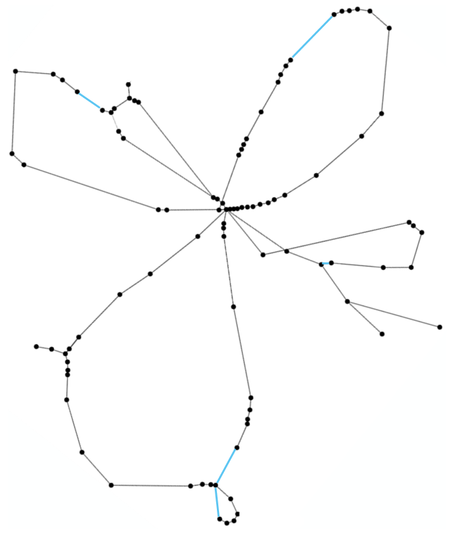



3.3 Blackout & Blackstart
Power and ICT Interdependencies during blackstart
During the bottom-up black start, it is crucial to define which ICT loads should be included:
  Including ICT planning in the blackstart algorithm leads to increased complexity
  A pre-planned strategy is required
    Should be calculated and specified as input to the blackstart algorithm
  Avoid penalties for grid operator
Optimal ICT grid for power grid restoration:
  Has an influence on the size of the restored power grid
  Guarantees sufficient QoS
  Supports the system in the event of a fault by providing robust communication paths
Cell tower
Active cell tower
Island network
Data link
Backhaul-Router
[Volkova 2024, IEEE TNSM]
Simbench rural MV grid https://www.simbench.de/

Slide 29
Agenda
Introduction
Interdependencies and resilience
Examples of power-ICT system interdependencies
  3.1 Flexibility
  3.2 Protection
  3.3 Blackout & Blackstart
Conclusion

Slide 30
4. Conclusion
Power and ICT systems are increasingly interdependent
  Power systems rely on ICT for critical services
  ICT relies on power systems for power supply
Predictability is critical to system operation, considering power and ICT interdependencies
  Especially in services that maintain a balance in generation and demand
Flexibility is essential to maintain stable operation
  It is reliant on ICT for correct and timely data transfer
Protection systems rely on complete data to correctly identify and isolate faults
  Latency is critical, as prolonged existence of fault can threaten system stability
Simultaneous restoration of power and ICT system is a critical step in the blackstart process

Slide 31
References
[Basmadjin 2012, SustainIT 2012] | Basmadjian, R., Niedermeier, F. and de Meer, H., "Modelling and Analysing the Power Consumption of Idle Servers," in Proc. of the 2nd IFIP Conf. on Sustainable Internet and ICT for Sustainability (SustainIT 2012), IFIP, 9 pages, 2012.
[Basmadjin 2018, T. on Smart Grid] | Basmadjian, R., Botero, J. F., Giuliani, G., Hesselbach, X., Klingert, S., and de Meer, H., "Making Data Centers Fit for Demand Response: Introducing GreenSDA and GreenSLA Contracts," in IEEE Transactions on Smart Grid, vol. 9 , no. 4 , pp. 3453-3464, 2018, DOI: 10.1109/TSG.2016.2632526.
[De Meer 2025, RNDM 2024] | de Meer, H., Patil, A., Lechl, M., and Volkova, A., "On the Resilience of Mutually Dependent Power and Data Networks" in 14th Int’l. Workshop on Resilient Networks Design and Modeling (RNDM), Nov. 25-27, 2024, Pompei (Napoli), Italy, IEEE , Jan. 2025. pp. 1-9. DOI: 10.1109/RNDM64105.2024.10820386
[Klaes 2020, DACH+ Energy Informatics Conf] | Klaes, M., Narayan, A., Patil, A.D., Haack, J., Lindner, M., Rehtanz, C., Braun, M., Lehnhoff, S. and de Meer, H., 2020. "State description of cyber-physical energy systems," in Springer Energy Informatics, 3, pp.1-19. 9th DACH+ Energy Informatics Conf., Online, Oct. 2020
[Ghasemi 2023, IEEE TNSE] | Ghasemi, A. and de Meer, H., 2023. " Robustness of interdependent power grid and communication networks to cascading failures," in IEEE Transactions on Network Science and Engineering, 10(4), pp.1919-1930.
[Lechl 2023, Elsevier RSER] | Lechl, M., Fürmann, T., de Meer, H. and Weidlich, A., "A review of models for energy system flexibility requirements and potentials using the new FLEXBLOX taxonomy," in Elsevier Renewable and Sustainable Energy Reviews, Vol. 184, Article no. 113570, 19 pages, 2023. DOI: 10.1016/j.rser.2023.113570.

Slide 32
References
[Fürmann 2023, DACH+ Energy Informatics Conf] | Fürmann, T., Lechl, M., de Meer, H. and Weidlich, A., "From Computer Systems to Power Systems: Using Stochastic Network Calculus for Flexibility Analysis in Power Systems," 12th DACH+ Energy Informatics Conf., Vienna, Published in Springer Energy Informatics, Vol. 6 (Issue 1), Article no. 36, 20 pages, 2023. DOI: 10.1186/s42162-023-00286-z.T.
[Lechl 2025, Elsevier Applied Energy] | Lechl, M., de Meer, H. and Fürmann, T., "A Stochastic Flexibility Calculus for Uncertainty-Aware Energy Flexibility Management," Elsevier Applied Energy, Vol. 379, Article no. 124907, 16 pages, Feb. 2025.
[Patil 2024, IET RPG] | Patil, A.D., Ghasemi, A., de Meer, H.: "Analysis of protection blinding in active distribution grids,“ in IET Renew. Power Gener. 18, 1783–1797 (2024). https://doi.org/10.1049/rpg2.13037
[Patil 2024, IEEE TNSM] | Patil, A.D., Ghasemi, A. and de Meer, H., "Optimal Redundant Sensor Placement for Protection Blinding in Active Distribution Grids," in IEEE Transactions on Network and Service Management, accepted Nov. 2024 [early access on IEEExplore], DOI: 10.1109/TNSM.2024.3497296
[Patil 2024, DACH+ Energy Informatics Conf] | Patil, A.D., de Meer, H., Heegaard, P. E., and Helvik, B. E., "Modeling the performance of protection systems in smart active distribution grids," in ACM SIGEnergy Energy Informatics Review, Vol. 4(4), pp. 94-109, 13th DACH+ Energy Informatics Conf. Lugano, Switzerland, Oct. 2024
[Volkova 2024, IEEE TNSM] | Volkova, A., Ghasemi, A. and de Meer, H., "Towards Forming Optimal Communication Network for Effective Power System Restoration," in IEEE Transactions on Network and Service Management, vol. 21, no. 5, pp. 5250-5259, July. 2024, doi: 10.1109/TNSM.2024.3429204

Slide 33
Thank you for your attention!
Questions?

