Slide 1
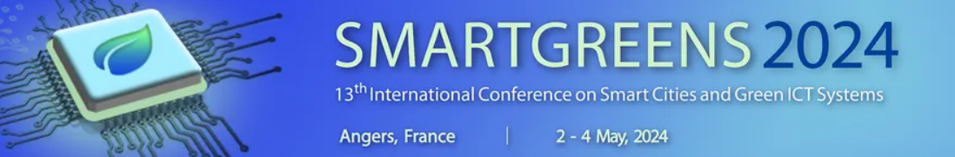

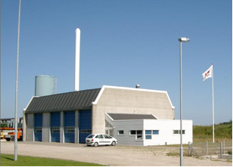

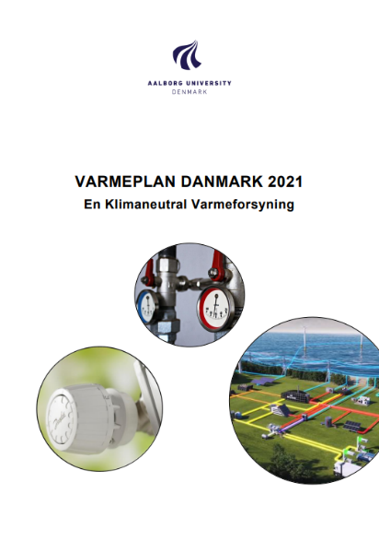
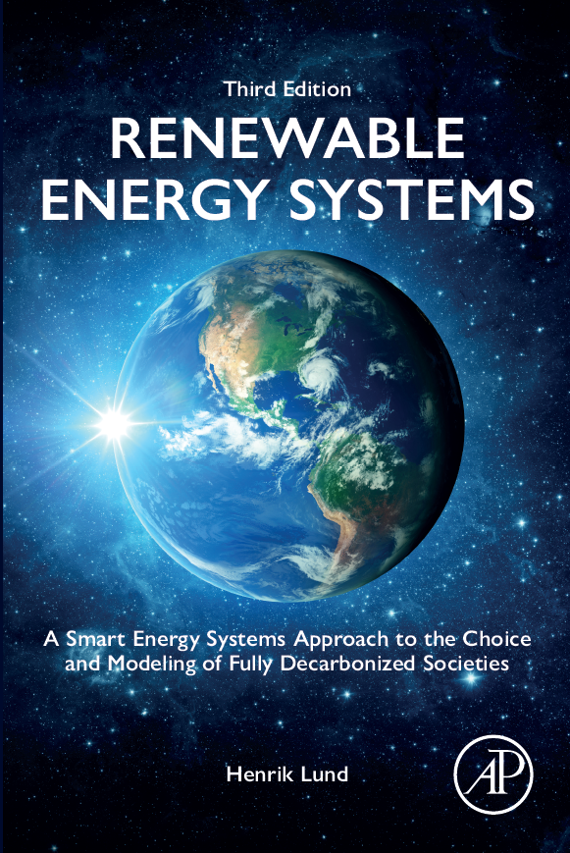
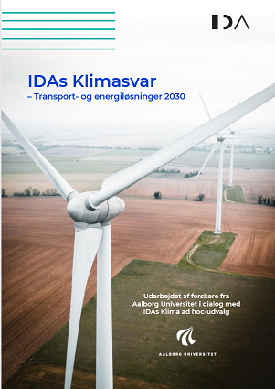
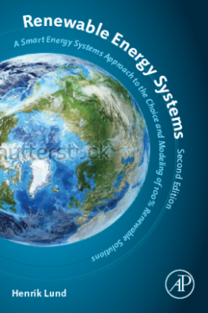
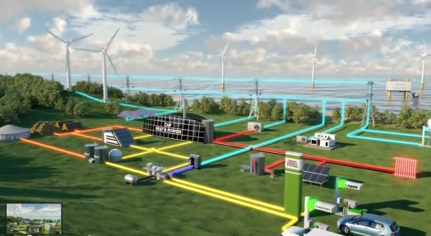
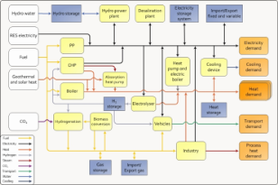
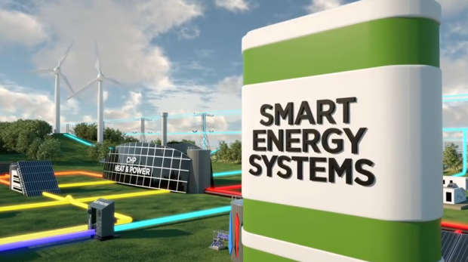
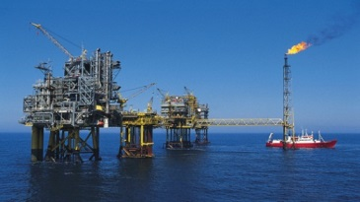




Smart Energy Systems in a Carbon Neutral Society
Professor Henrik Lund
Aalborg Universitet

Slide 2
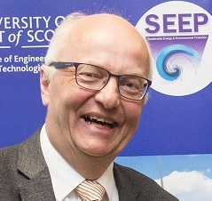

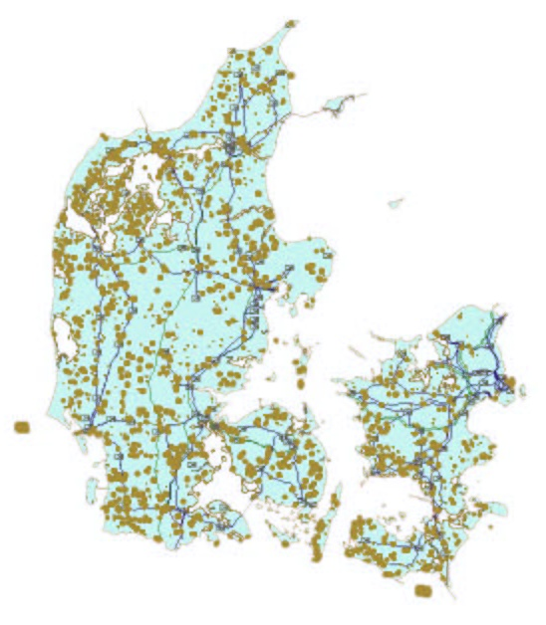
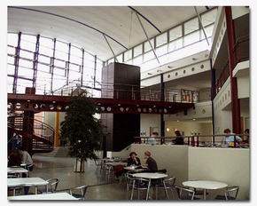


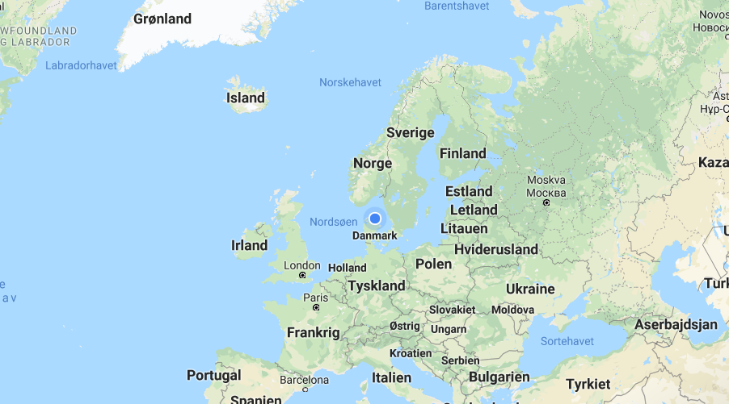
Henrik Lund, Aalborg University, Denmark
Jutland/Denmark (2023):
approx. 50% wind power
High share of the world’s offshore power
30-50% of electricity supplied by CHP
>50% District Heating
> 40% Biogas in the natural gas supply

Slide 3
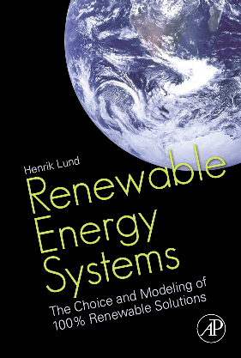
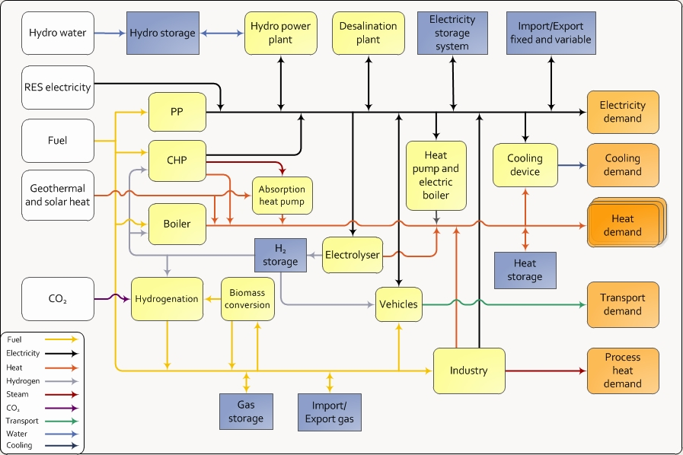

Renewable Energy Systems
A Smart Energy Systems Approach to the
Choice and Modeling of Fully Decarbonized Societies
2. Edition in 2014 New Chapter on Smart Energy Systems and Infrastructures
3. Edition in 2024 New Chapter on Carbon Neutral Societies
1. Edition in 2010

Slide 4
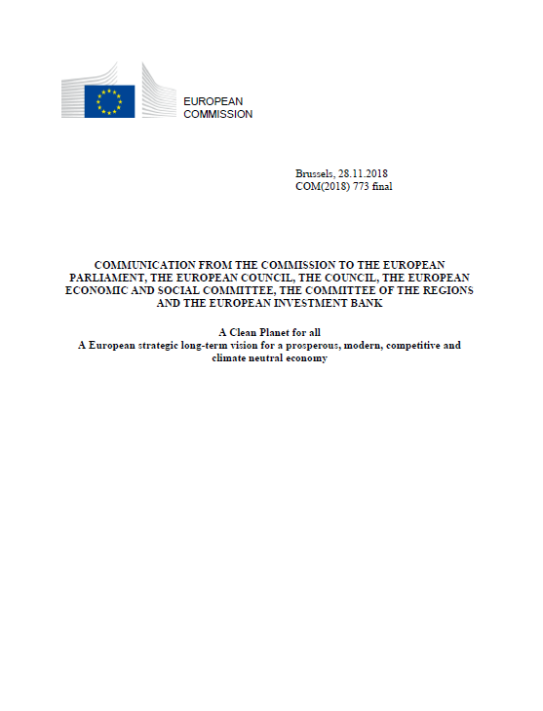
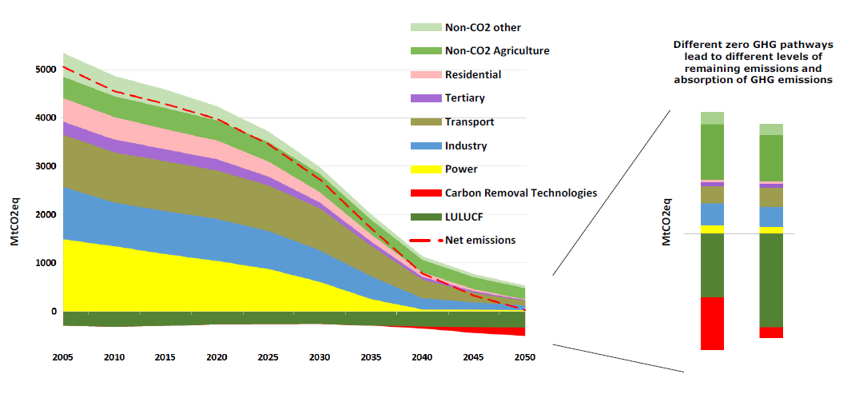
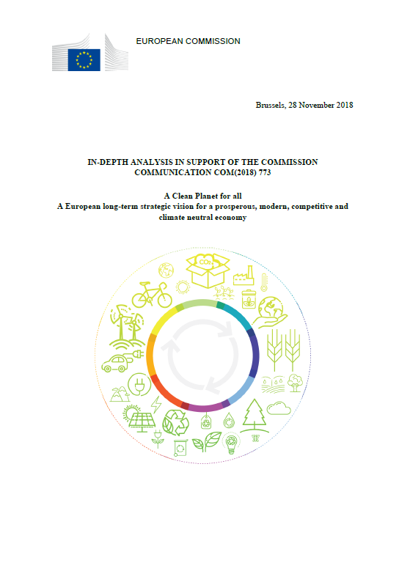
A Clean Planet for all
A European long-term strategic vision for a prosperous, modern, competitive and climate neutral economy
Climate Neutral

Slide 5
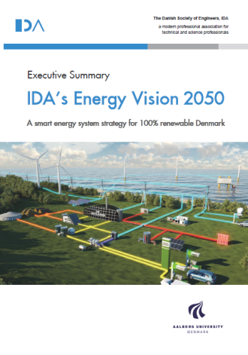
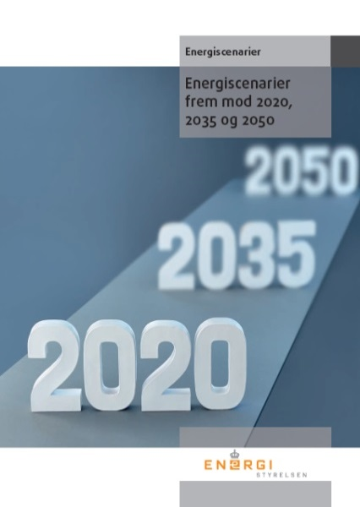

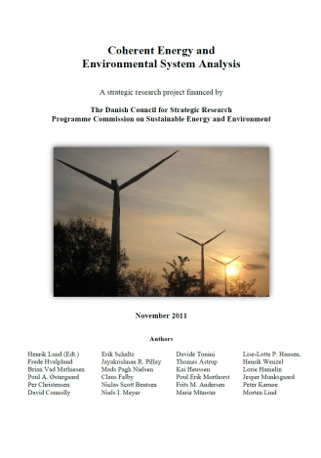
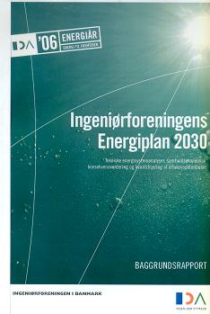


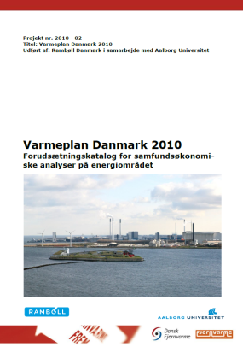
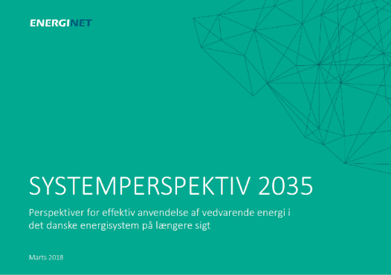
100% Renewable Energy 2050
Or a Climate Neutral Economy
…… but how…???!!

Slide 6
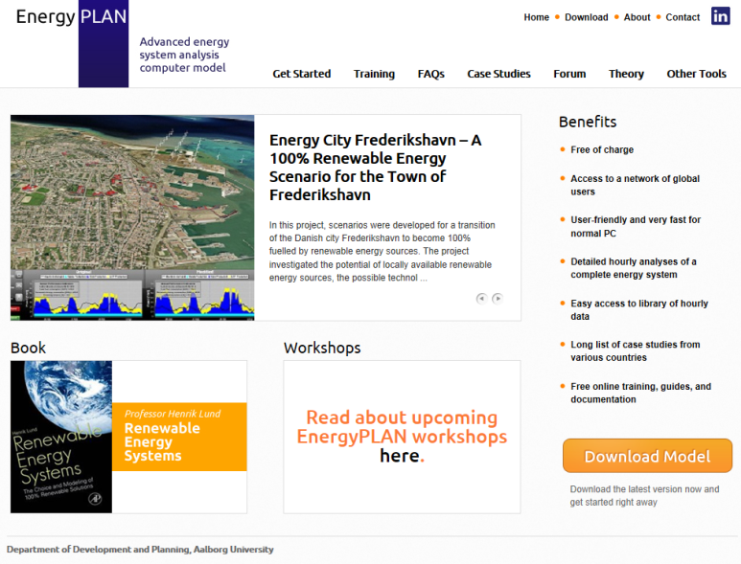
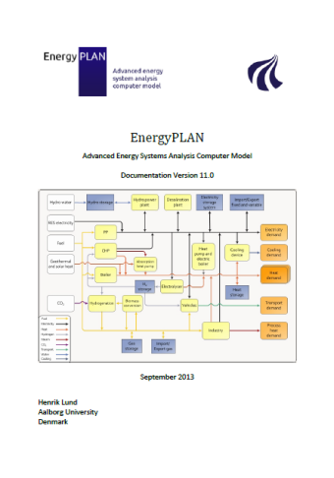
Energi System Analyse Model
www.EnergyPLAN.eu

Slide 7



A Holistic Smart Energy Systems Approach

Slide 8


Smart Energy Systems
www.energyplan.eu/smartenergysystems/

Slide 9
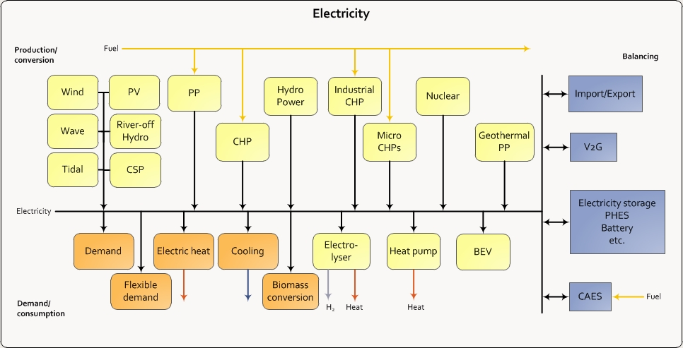
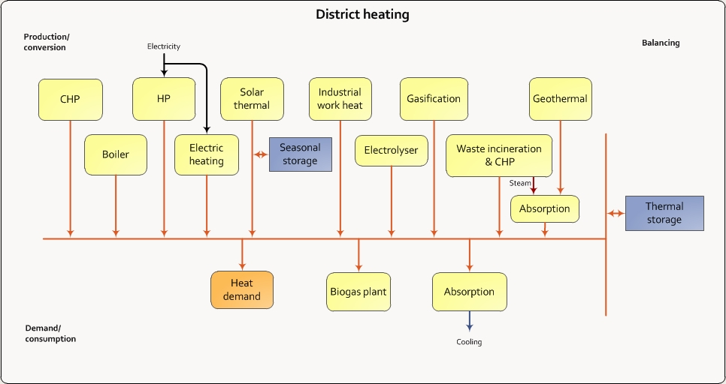
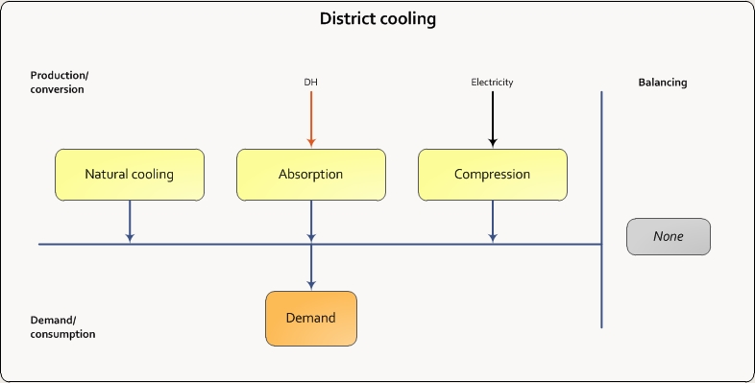
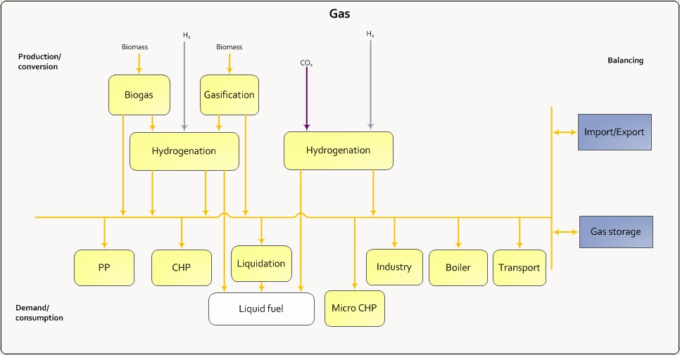
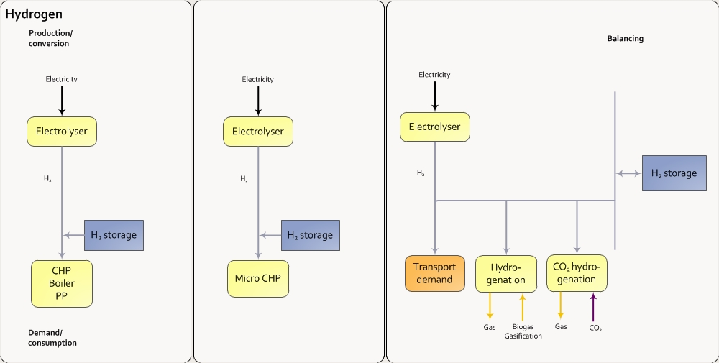
Smart Energy Systems:
Hourly modelling of all smart grids to identify synergies!
… and influence of different types of energy storage..!

Slide 10
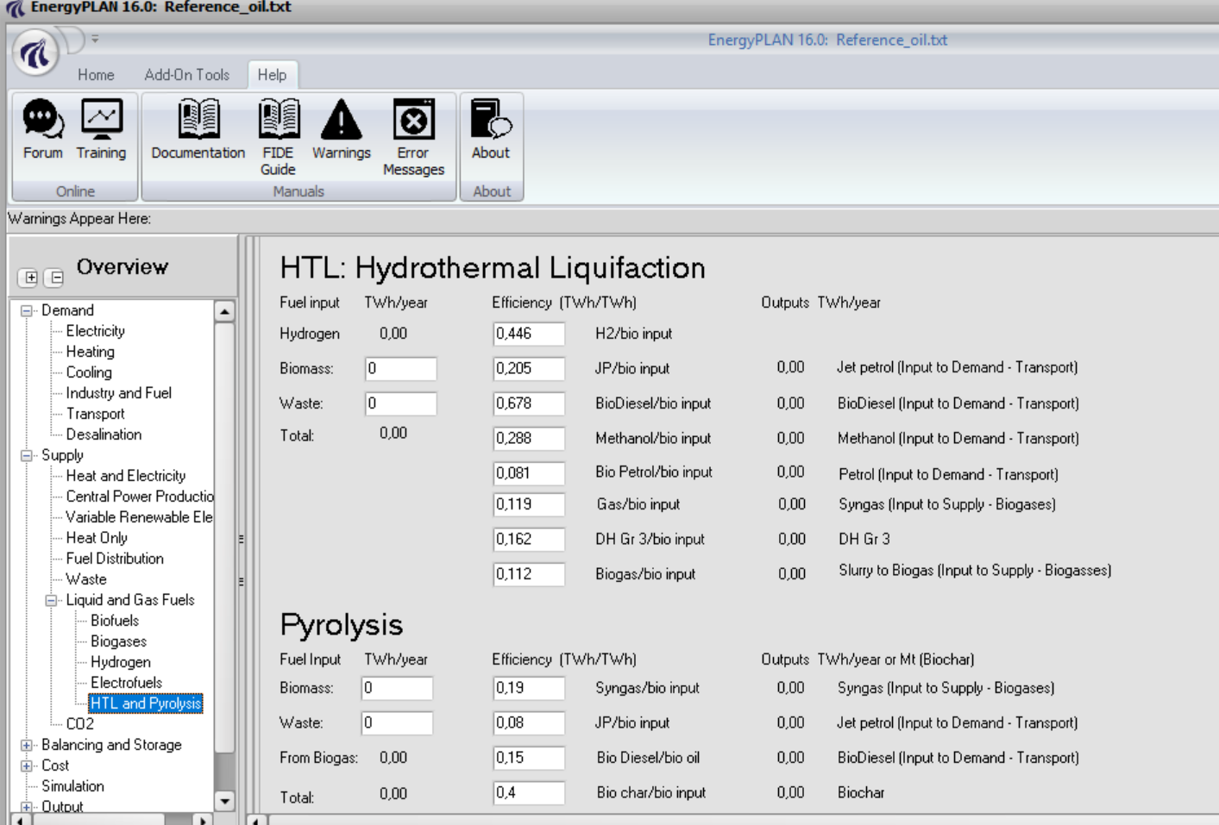
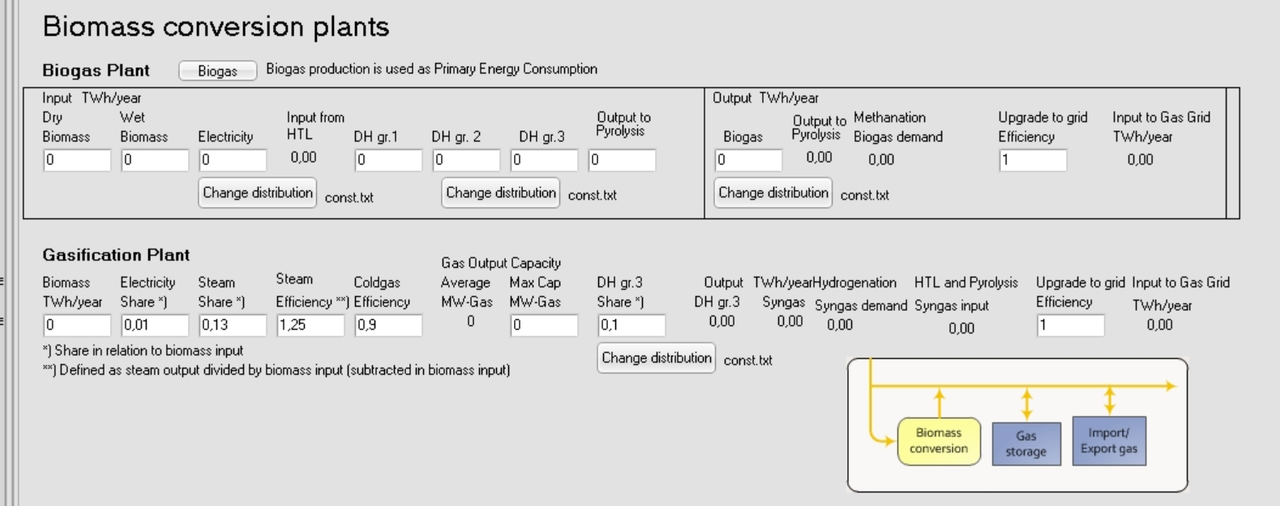
Biomass conversion incl. HTL and Pyrolysis

Slide 11
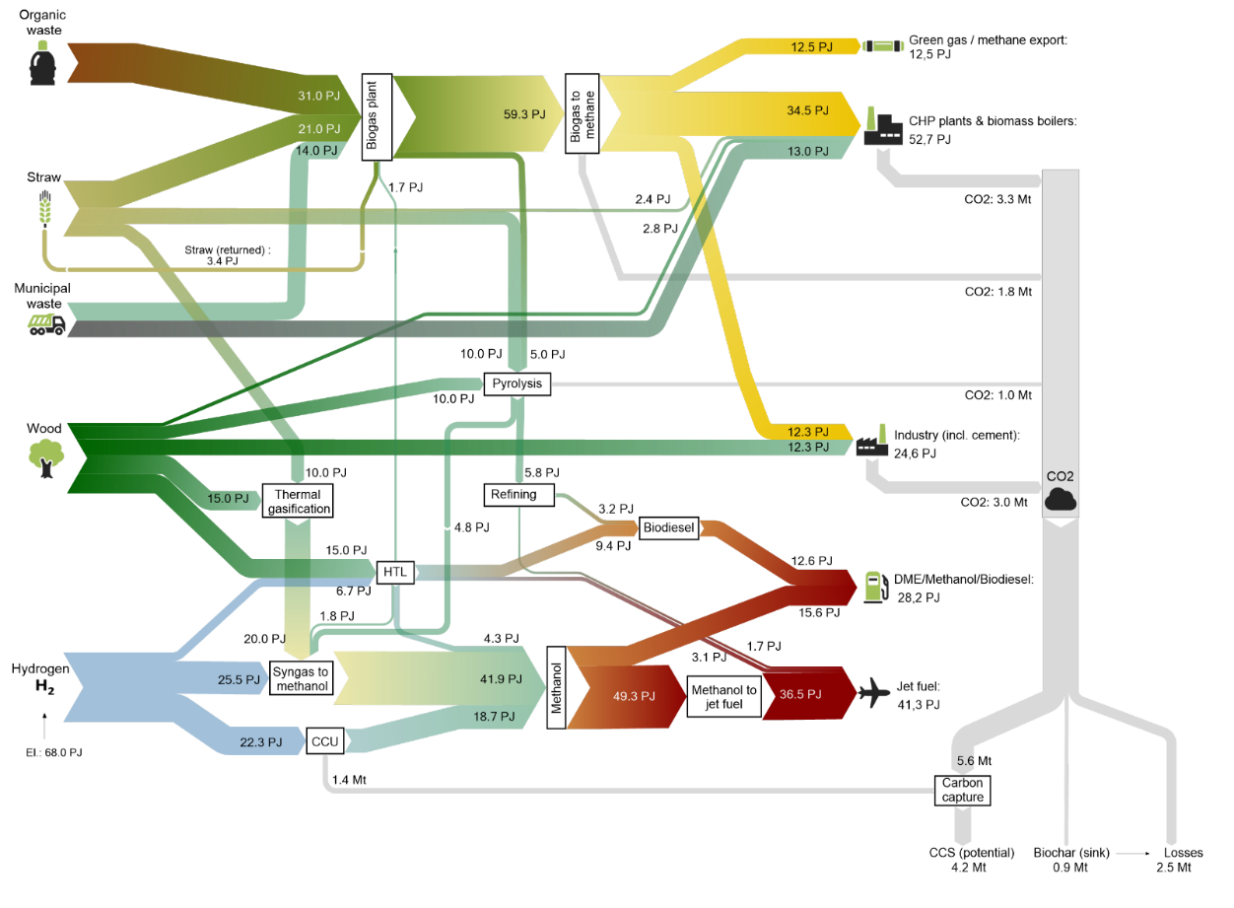
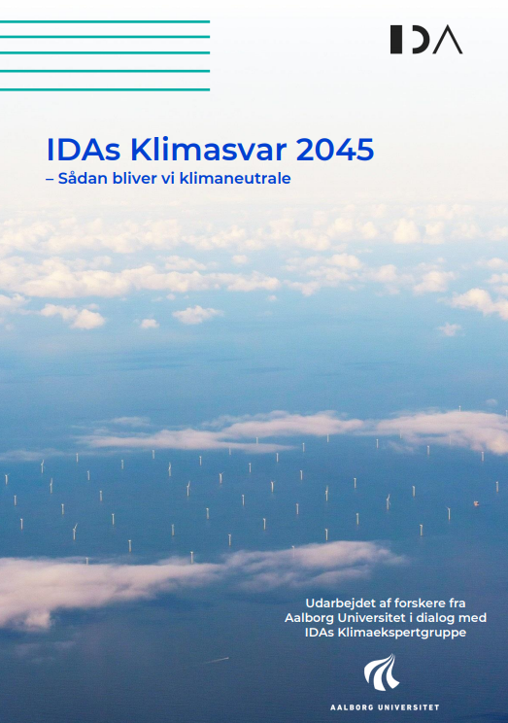
Biomasse
2045
Overview:
(153 PJ minus eksport 13 PJ = 140 PJ svarende til 23 GJ/capita)

Slide 12


Smart Grid (2005)
No definition.
However it can be understood from the context that a smart grid is a power network using modern computer and communication technology to achieve a network which can better deal with potential failures.

Slide 13




Smart Grid - definitions
“A smart grid is an electricity grid that uses information and communications technology to gather and act on information, such as information about the behaviors of suppliers and consumers, in an automated fashion to improve the efficiency, reliability, economics, and sustainability of the production and distribution of electricity.” (U.S. Department of Energy)
“Smart Grids … concerns an electricity network that can intelligently integrate the actions of all users connected to it - generators, consumers and those that do both - in order to efficiently deliver sustainable, economic and secure electricity supplies.” (SmartGrids European Technology Platform, 2006).
“A Smart Grid is an electricity network that can cost efficiently integrate the behaviour and actions of all users connected to it – generators, consumers and those that do both – in order to ensure economically efficient, sustainable power system with low losses and high levels of quality and security of supply and safety.” (European Commission, 2011)
“Smart grids are networks that monitor and manage the transport of electricity from all generation sources to meet the varying electricity demands of end users” …. “The widespread deployment of smart grids is crucial to achieving a more secure and sustainable energy future.” (International Energy Agency 2013).

Slide 14
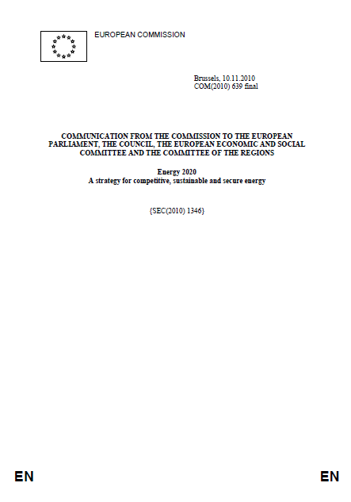
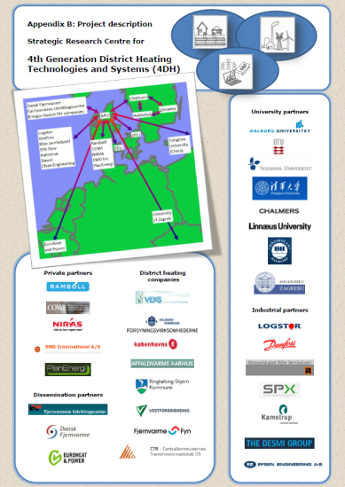
Smart heating and cooling grids - 2010
In the European Commission’s strategy [7] for a competitive, sustainable and secure “Energy 2020“, the need for “high efficiency cogeneration, district heating and cooling” is highlighted (page 8). The paper launches projects to promote, among others, “smart electricity grids” along with “smart heating and cooling grids” (page 16).

Slide 15

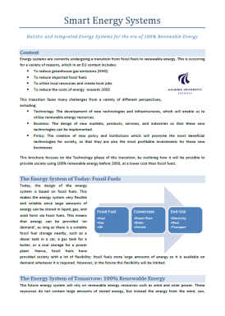
Smart Energy Systems
Smart Electricity Grids are electricity infrastructures that can intelligently integrate the actions of all users connected to it - generators, consumers and those that do both - in order to efficiently deliver sustainable, economic and secure electricity supplies.
Smart Thermal Grids are a network of pipes connecting the buildings in a neighbourhood, town centre or whole city, so that they can be served from centralised plants as well as from a number of distributed heating or cooling production units including individual contributions from the connected buildings.
Smart Gas Grids are gas infrastructures that can intelligently integrate the actions of all users connected to it - supplies, consumers and those that do both - in order to efficiently deliver sustainable, economic and secure gas supplies and storage.
Smart Energy System is defined as an approach in which smart Electricity, Thermal and Gas Grids are combined and coordinated to identify synergies between them in order to achieve an optimal solution for each individual sector as well as for the overall energy system.

Slide 16
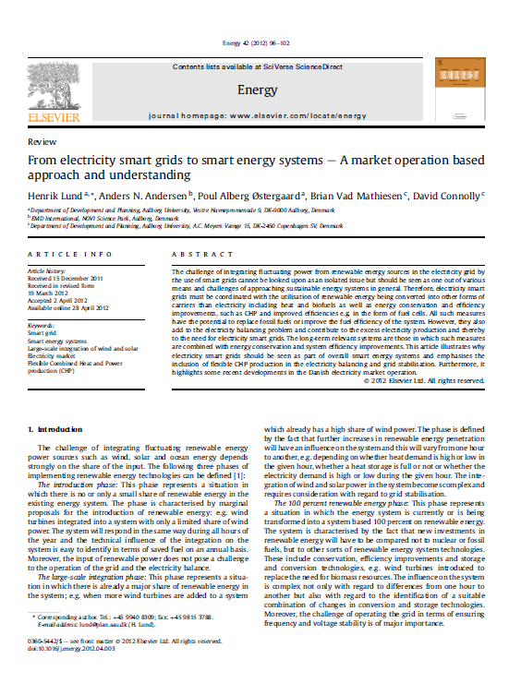
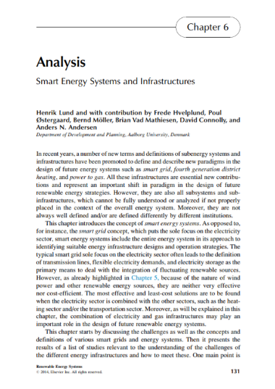
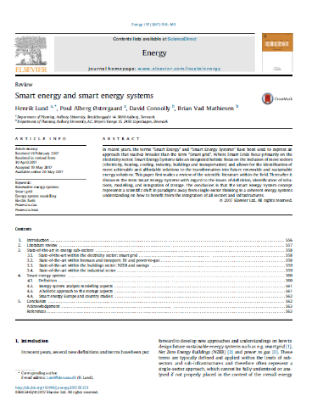
From electricity smart grids to smart energy systems published 2012
Smart Energy Systems and Infrastructures published 2014
Smart Energy and Smart Energy Systems published 2017

Slide 17
Two Smart Energy Systems Theses:
One cannot find the best solutions for affordable and reliable transitions of the energy system into a carbon neutral society solely within each subsector of the energy system. One must approach the transition in a holistic and cross-sectoral smart energy system perspective in order to be able to identify the best solution for the overall energy system and for society as a whole.
Subsector studies (no matter if they concern the role of a specific technology or the role of a region or country) should aim at identifying the role to play in an overall transition of the whole system, rather than aim at decarbonizing the sub-sector on its own
Published
March 2024

Slide 18
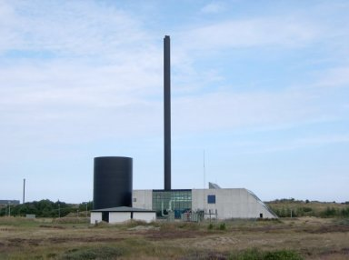
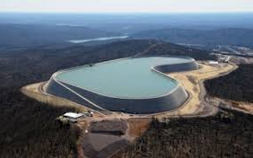
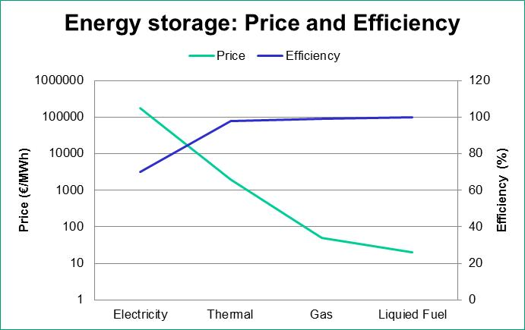
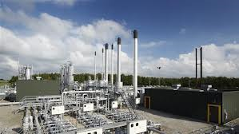
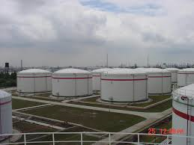
Energy Storage
Thermal Storage
1-4 €/kWh
(Source: Danish Technology Catalogue, 2012)
Pump Hydro Storage
175 €/kWh
(Source: Electricity Energy Storage Technology Options: A White Paper Primer on Applications, Costs, and Benefits. Electric Power Research Institute, 2010)
Oil Tank
0.02 €/kWh
(Source: Dahl KH, Oil tanking Copenhagen A/S, 2013: Oil Storage Tank. 2013)
Natural Gas Underground Storage
0.05 €/kWh
(Source: Current State Of and Issues Concerning Underground Natural Gas Storage. Federal Energy Regulatory Commission, 2004)

Slide 19
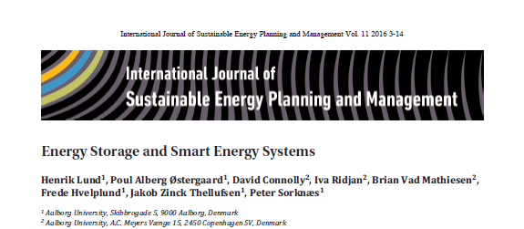
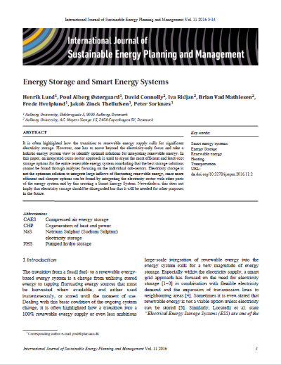
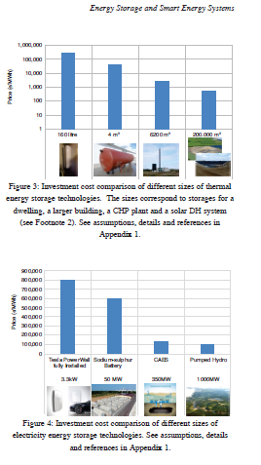

www.journals.aau.dk/index.php/sepm

Slide 20



Slide 21



Slide 22

Existing distribution grids

Slide 23








www.4DH.dk

Slide 24




Slide 25


4GDC: 4th Generation District Cooling

Slide 26


Heating solutions and storage and grid infrastructures
Scenario | Without Savings 47 TWh/year | With Savings 28 TWh/year
Electric Hating (Smart Grid..!!?) | 13,000 MW Wind (25 GEUR) 24,000 MW hour peak 10 TWh Storage (2,000 GEUR) | 8,000 MW wind 15,000 MW hour peak 5 TWh storage (900 GEUR)
Individual Heat Pumps (Smart Grid..!) | 5,000 MW Wind 17,000 MW hour peak 3.7 TWh storage (750 GEUR ) | 2,500 MW Wind 12,000 MW hour peak 2 TWh Storage (400 GEUR) ..or heat storage 20-30 m3/household
District Heating Indv. Heat Pumps (Smart Energy System) | 2,600 MW Wind (plus biomass) hour peak < 8300 MW Storage…!!?? | 1,500 MW wind (plus recycling etc.) Hour peak < 7,500 MW Heat storage < 1 GEUR

Slide 27







Heat Roadmap Europe

Slide 28




Hydrogen for heating of houses..???
Hydrogen
(Efficiency=0.65)
Electric Heating
(COP=1)
Heat Pumps
(COP=3)
Smart Energy Systems
District Heating
3,500 houses
5,300 houses
16,000 houses
+25,000 houses
Wind-
turbine
15 MW
Wind-
turbine
15 MW
Wind-
turbine
15 MW
Wind-
turbine
15 MW

Slide 29

Hydrogen for transport..???
Hydrogen Cars
Electric Vehicles
5,000 cars
15,000 cars
Wind-
turbine
15 MW
Wind-
turbine
15 MW

Slide 31



IDAs Climate Response: In a European context
Denmark should fulfill its objective of renewable energy and CO2-reductions in a way, so it fits well into a context in which the rest of Europe - and the world - will do the same.
Therefore:
Denmark should include the Danish share of international aviation and shipping even though it is not included yet in the UN way of calculating the Danish CO2 emissions.
Denmark should not exceed our share of sustainable use of biomass in the world.
Denmark should make our contribution in terms of flexibility and reserve capacity to integrate wind and solar into the European electricity supply.

Slide 32


Slide 33
CO2 emissions in the UN accounting…

Slide 34





IDA´s Climate Response 2045
How Denmark Can Become Climate Neutral
- Include Danish Share of International Aviation and Shipping
- Within the Danish share of Global Sustainable Biomass resources
- Reach the 2050 climate neutral goal already in 2045
- Coordinated with actions within agriculture, LULUFC and processes

Slide 35

A fully decarbonized Denmark 2045

Slide 36

2045

Slide 37
Biomasse
2045
Overview:
(153 PJ minus eksport 13 PJ = 140 PJ svarende til 23 GJ/capita)

Slide 38
Expansion of Solar and Wind for electricity production
MW | 2020 | 2030 | 2045
Solar (PV) | 1.000 | 5.000 | 10.000
Wind onshore | 4.200 | 4.800 | 5.000
Wind offshore | 2.000 | 6.600 | 14.000
Similar expansion of Solar Thermal and Geothermal energy for heat production

Slide 39

Essential changes in the future electricity demand
The ”classical” non-flexible electricity demand increases by new flexible demands for:
Electric Vehicles
Power-to-Heat (heat pumps and electrical boilers)
Electrolysis and Power-to-X

Slide 40

PV and wind will cover the ”classical” non-flexible electricity demand in the hour except for only 7%

Slide 41




Literature:
Smart Energy Denmark. A consistent and detailed strategy for a fully decarbonized society. Renewable and Sustainable Energy Reviews
Smart Energy Europe: The technical and economic impact of one potential 100% renewable energy scenario for the European Union. Renewable and Sustainable Energy Reviews, Vol 60, pp. 1634–1653, July 2016.
The role of sustainable bioenergy in a fully decarbonised society, Renewable Energy, August 2022, https://doi.org/10.1016/j.renene.2022.06.026
Energy efficient decarbonisation strategy for the Danish transport sector by 2045, Smart Energy, February 2022. https://doi.org/10.1016/j.segy.2022.100063

Slide 42


Vision: Smart Energy Aalborg 2050

Slide 43


Smart Energy Europe
www.EnergyPLAN.eu/SmartEnergyEurope
Report Online
Paper Published

Slide 44
A Clean Planet for all
A European long-term strategic vision for a prosperous, modern, competitive and climate neutral economy
Climate Neutral

Slide 45


Slide 46
Our replication

Slide 47

Stepwise implementation of smart energy systems
Specify reference scenario. PRIMES 2050 Business as Usual is used as a reference. Here a starting point with and without nuclear is discussed.
Energy savings in the different demand sectors
Implementation of district heating
Transition individual heating
Electrification of transport
E-fuels in transport
Replacing remaining fossil fuel with biofuels, biogas, e-gas and e-fuels
Increase renewable energy production

Slide 48
Step by step to a smart energy system

Slide 49

Energy balance
BAU Baseline

Slide 50
Costs

Slide 51






More information:
www.henriklund.eu
www.4DH.dk
https://www.energyplan.eu/book2/
www.energyplan.eu/SmartEnergyEurope
www.heatroadmap.eu
www.EnergyPLAN.eu
www.energyplan.eu/smartenergysystems/

