Slide 1





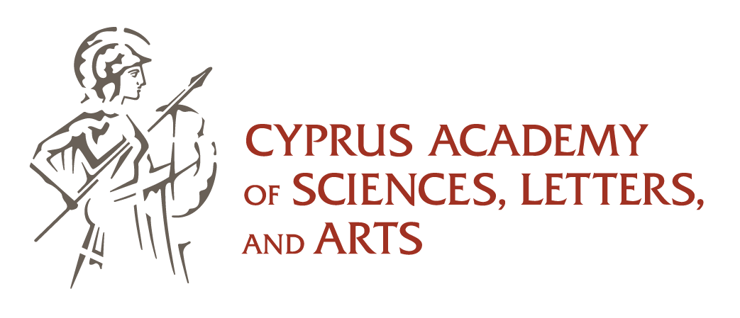
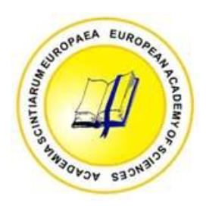
Renewable Energy Systems: Current Status in the World Prospects and Problems Soteris A. Kalogirou
Cyprus University of Technology
Department of Mechanical Engineering and Materials Sciences and Engineering
Editor-in-Chief, Renewable and Sustainable Energy Reviews
Editor-in-Chief Emeritus, Renewable Energy
Honorary Editor, Energy
Fellow of the European Academy of Sciences
Founding Member of the Cyprus Academy of Sciences , letters, and Arts
Member Academia Europaea
Fellow of CORE Academy of sciences and Humanities
IF 9.4 (2025)
IF 16.3 (2025)
IF 9.1 (2025)

Slide 2
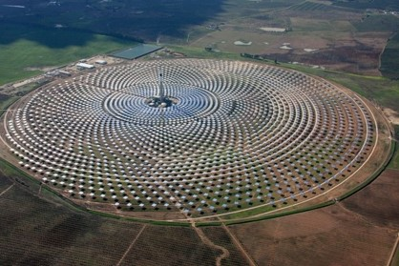
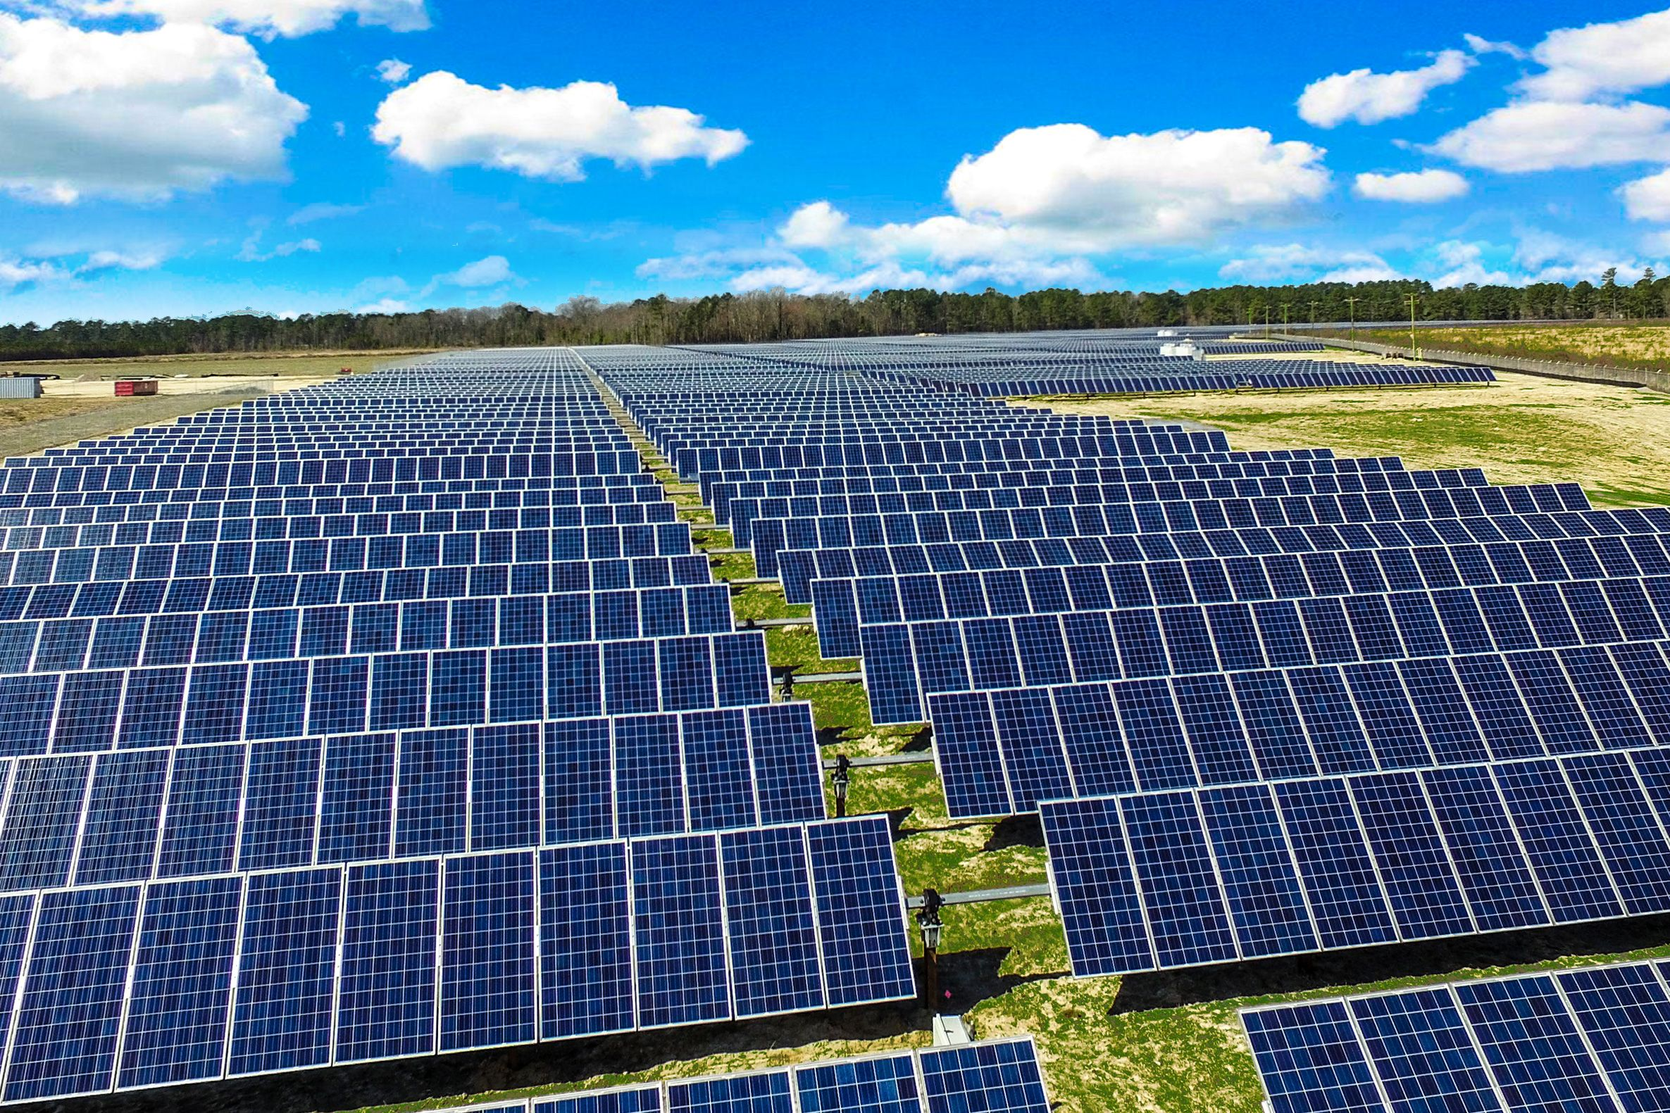

Outline
Introduction – Climate change
Status of Renewables
Solar thermal
Photovoltaics
Hydro Power
Wind Energy
Biomass
Other technologies
Prospects – New research
Problems associate to RES

Slide 3

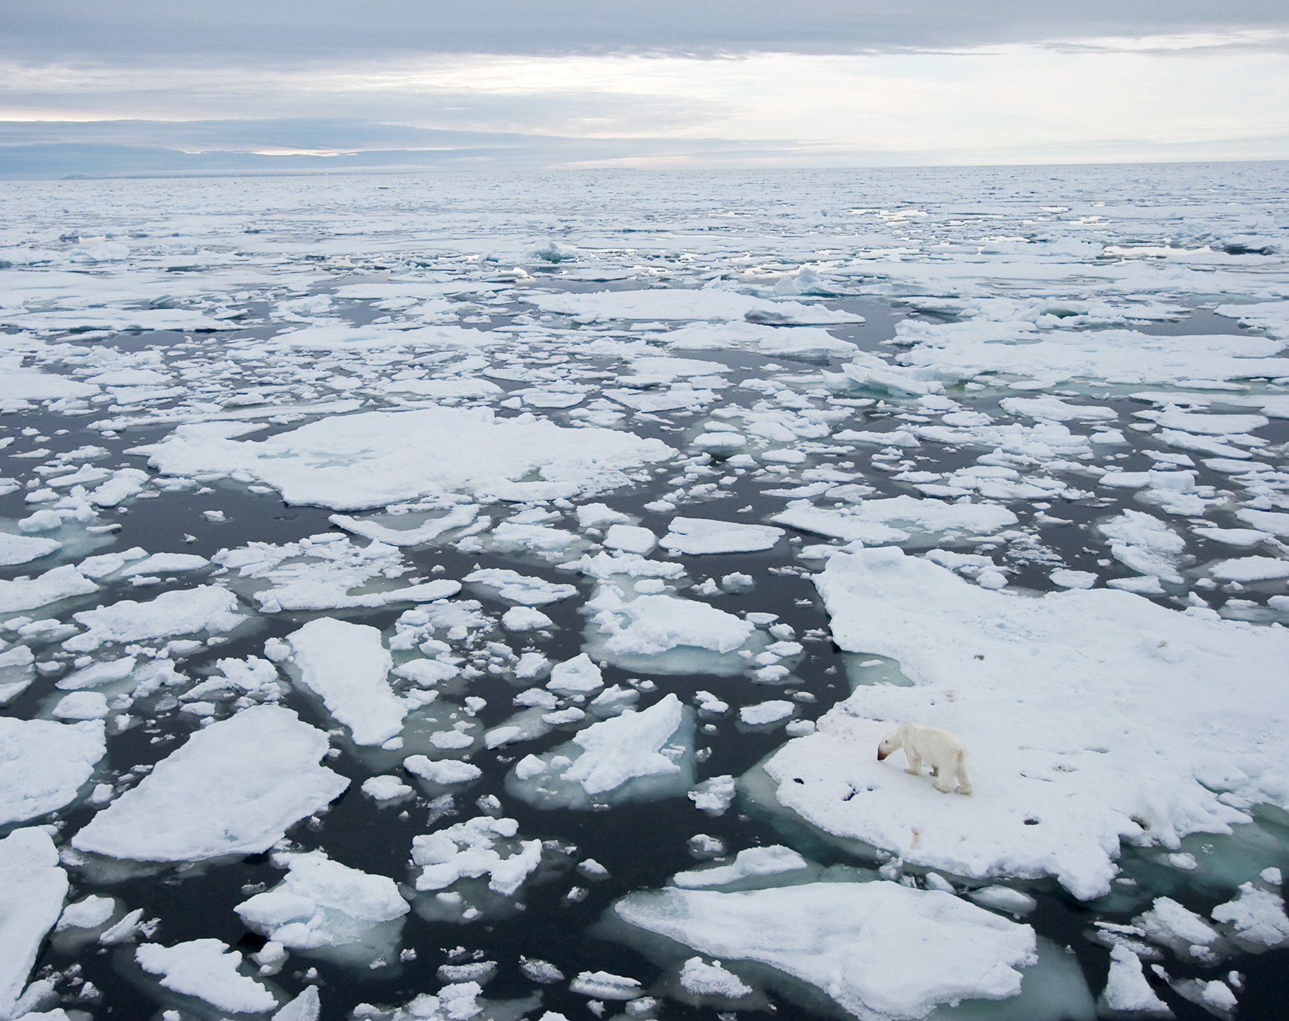
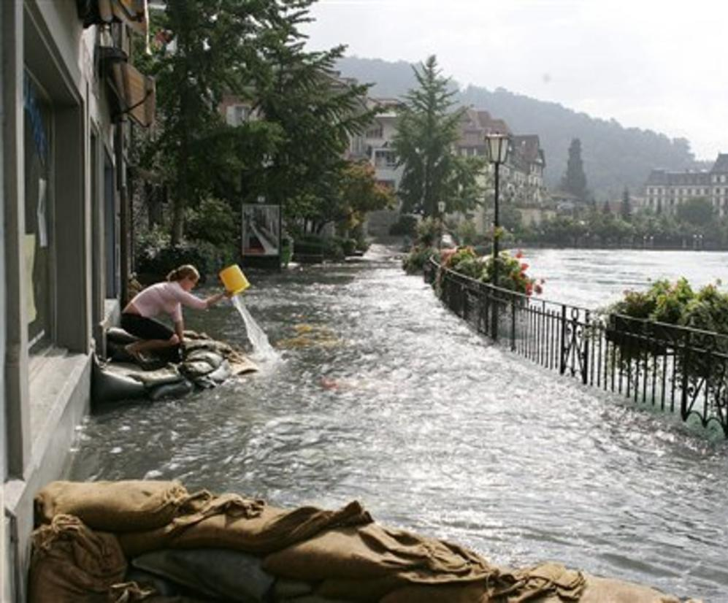
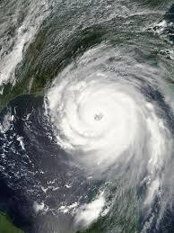
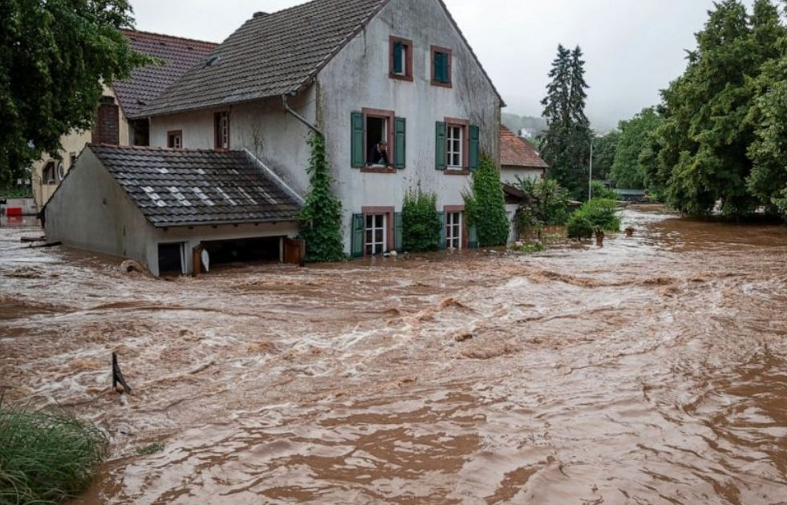

Convincing Evidence
Melting polar ice caps
Melting polar ice caps
Switzerland flooding
Hurricane Katrina
Germany flooding
Coastal flooding - UK
Notes:
3
Aerial view of Kuwait fires

Slide 4
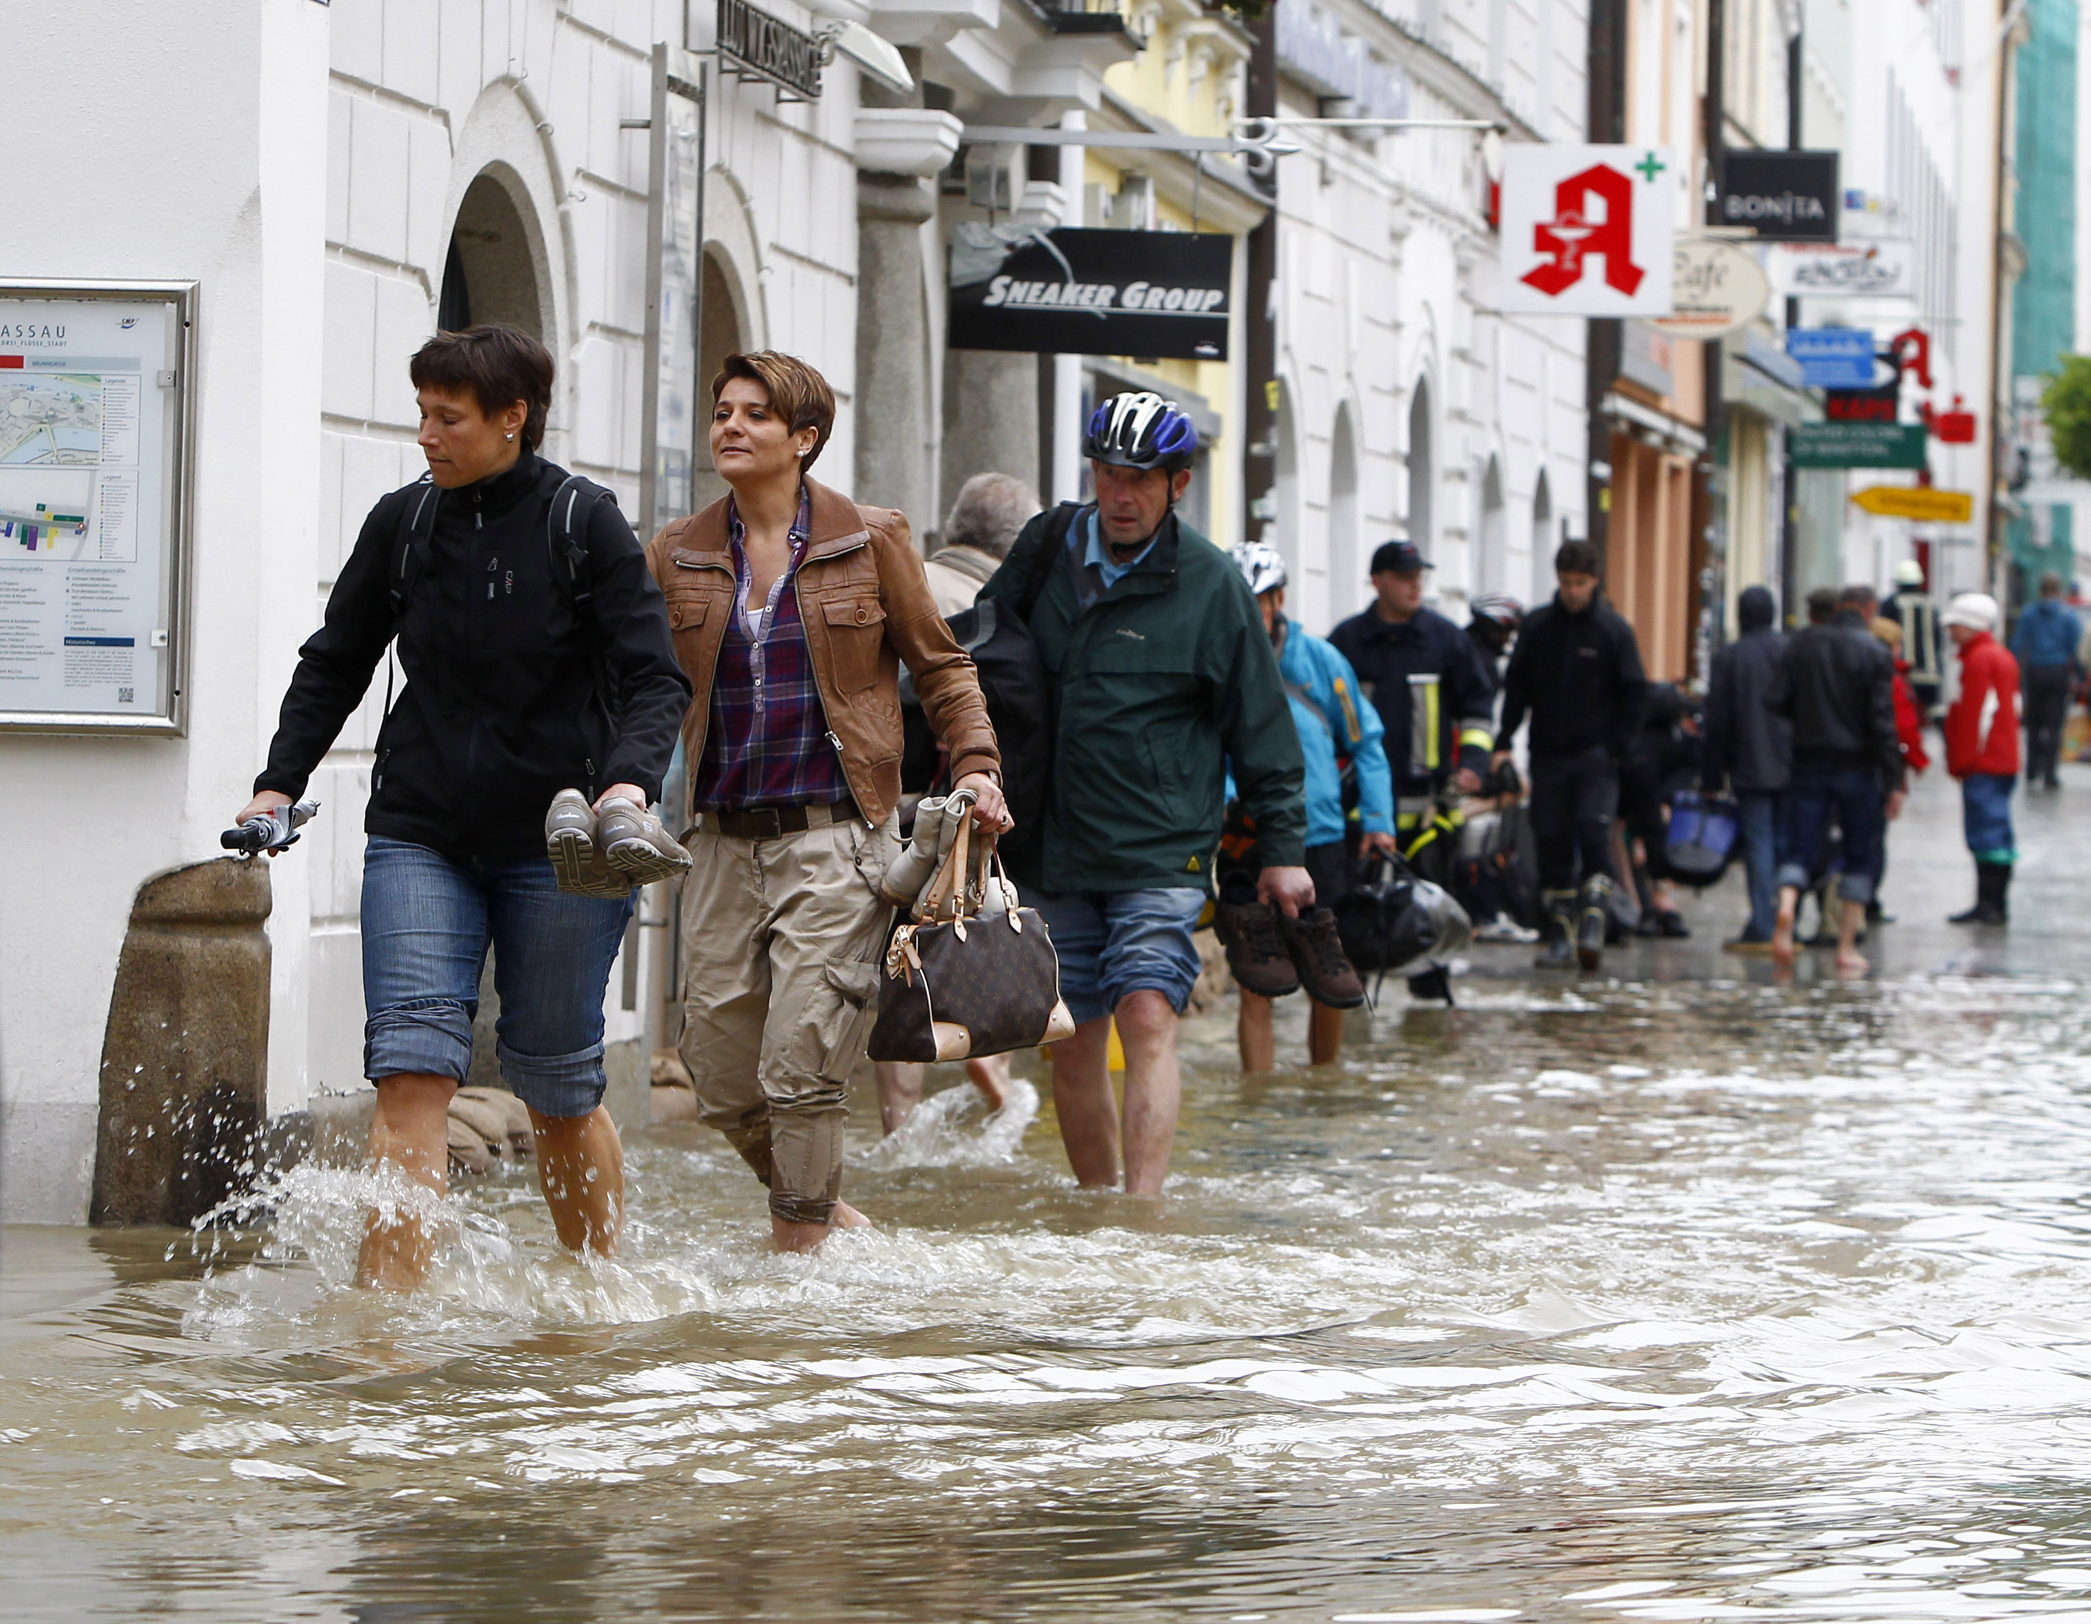
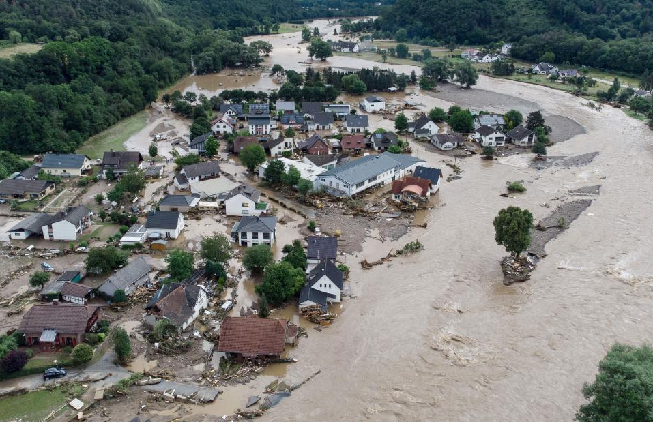
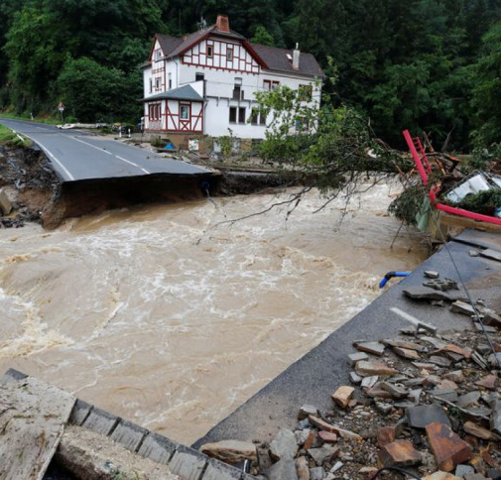
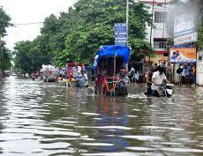
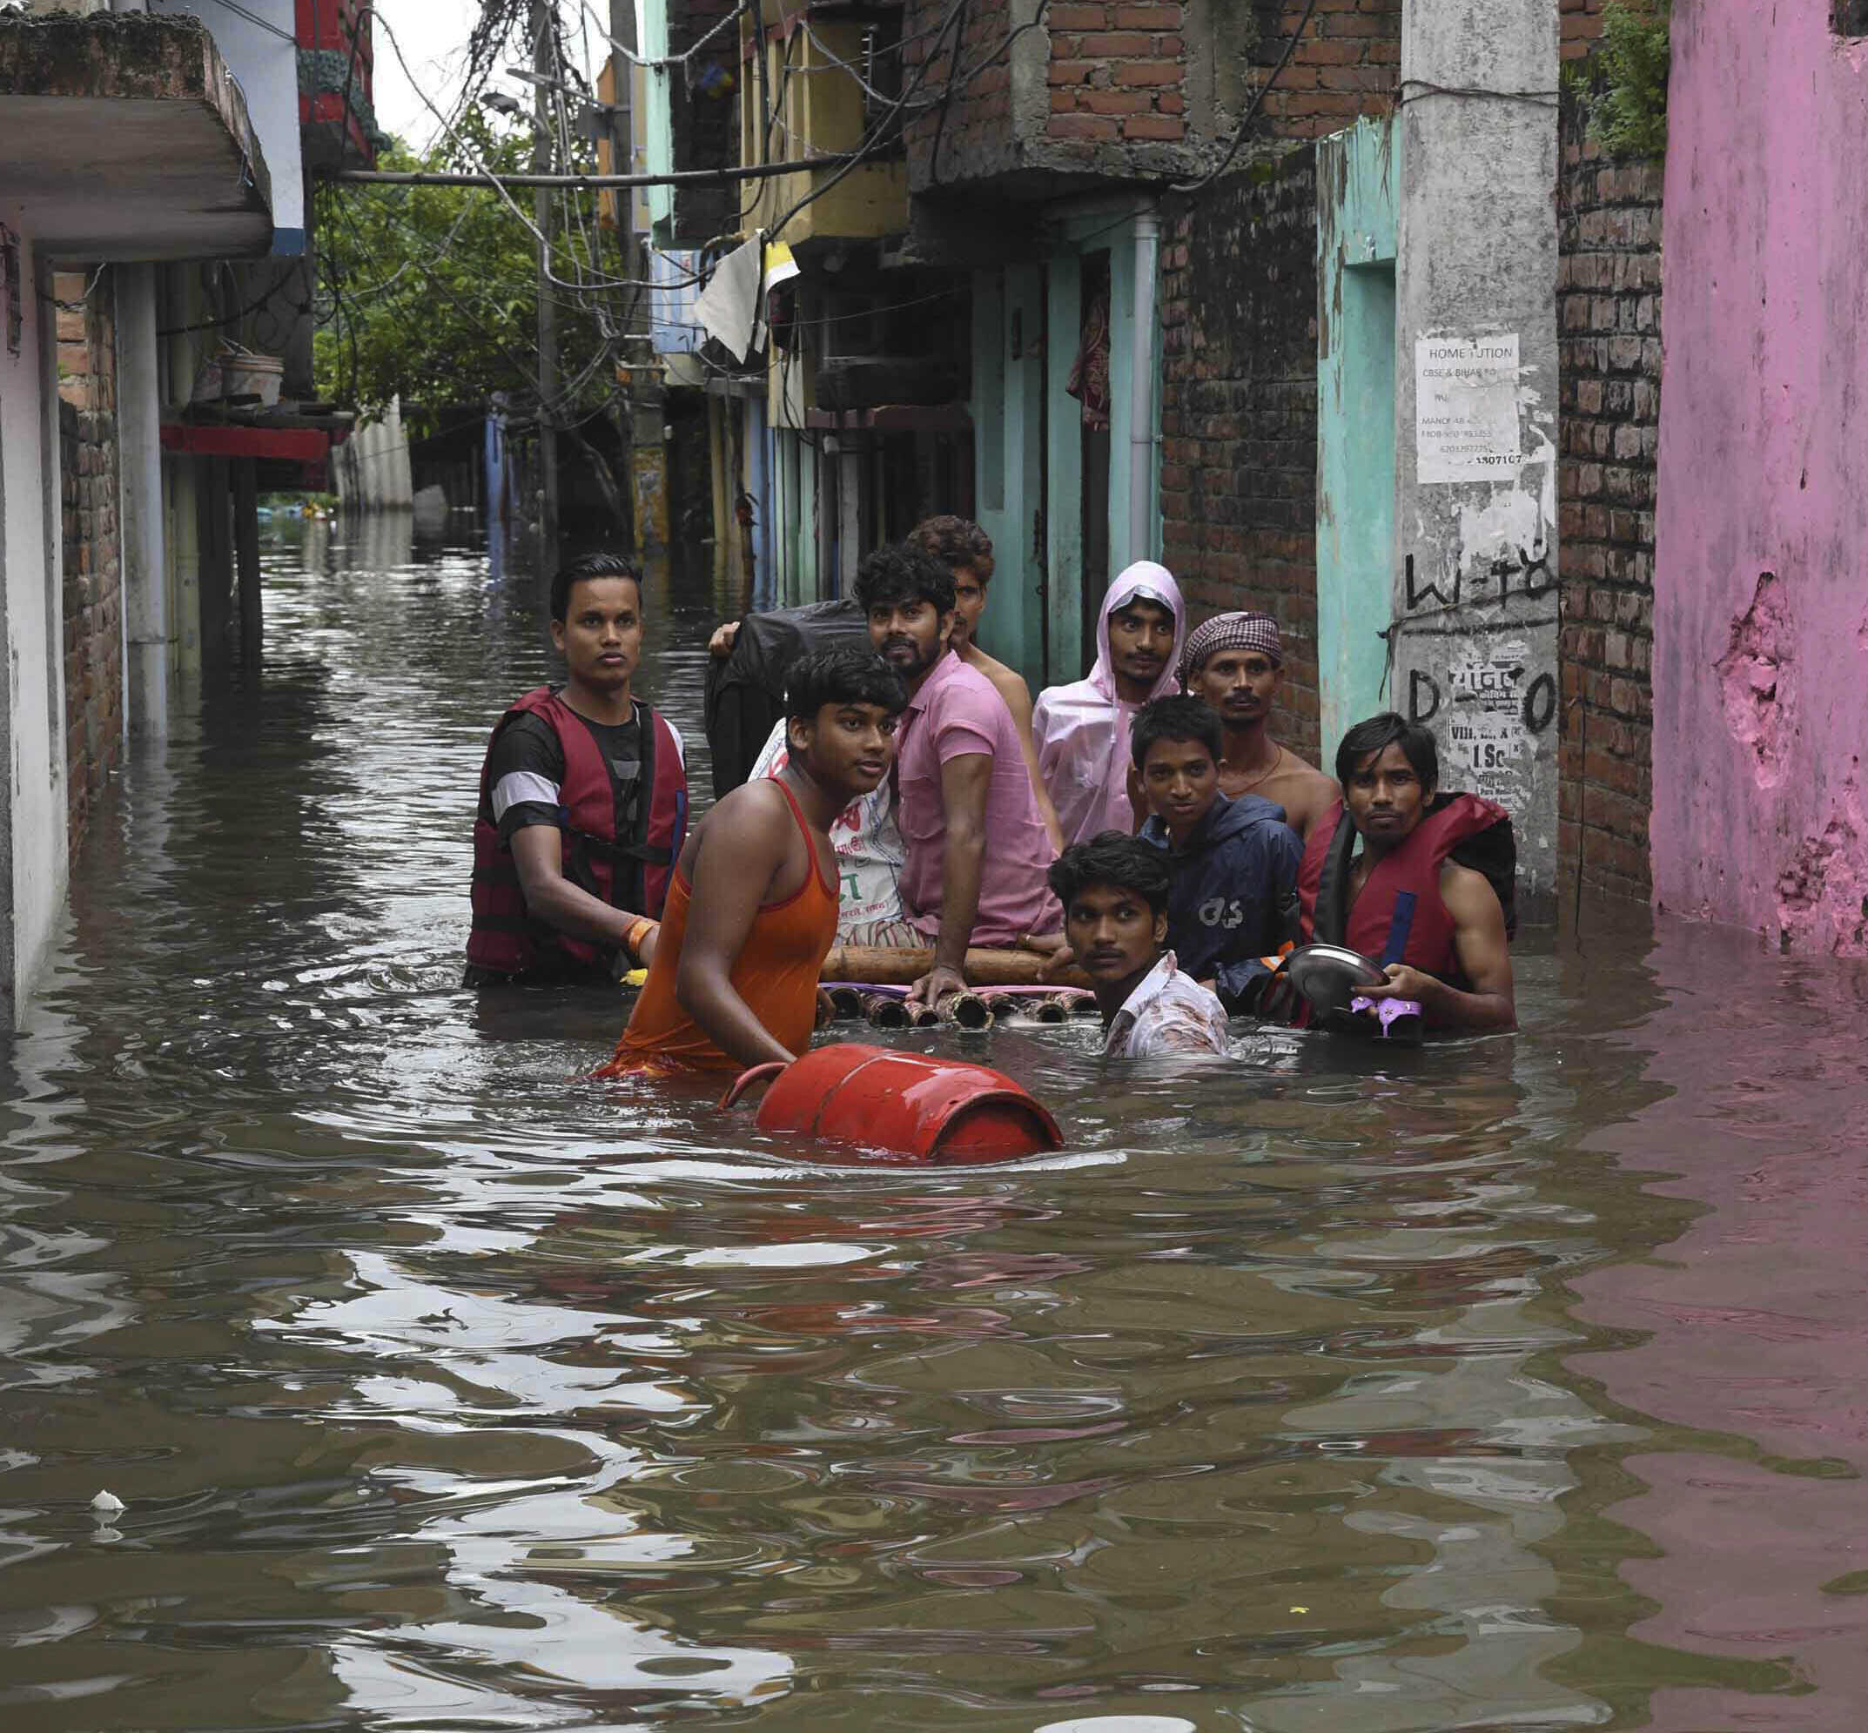
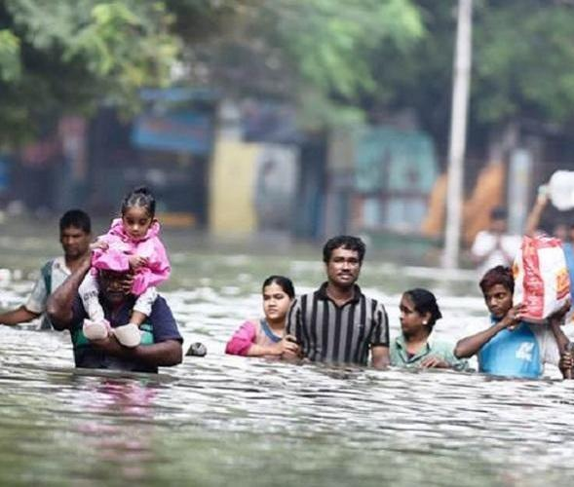
The term Climate Crisis represents better the situation instead of Climate Change
or Global Warming
Flooding in Germany - 2021
Climate refugees
Flooding in India - 2020
Effect of Climate Change

Slide 5
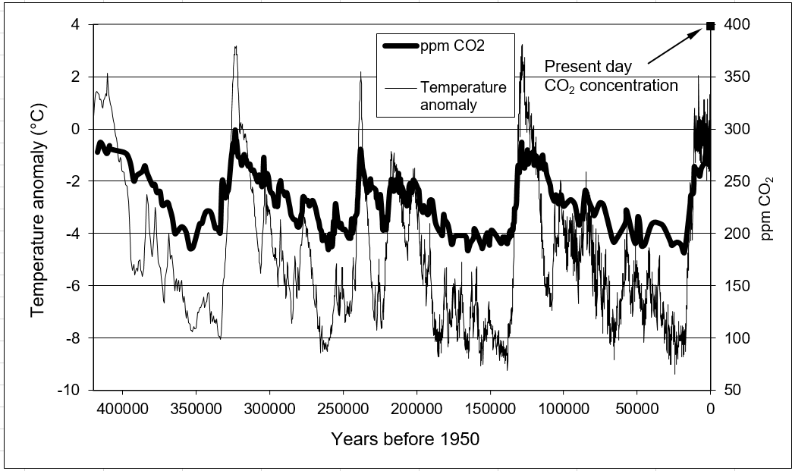
Temperature anomaly and CO₂ concentration From Vostok ice-cores (East Antarctica)
Notes:
5

Slide 6
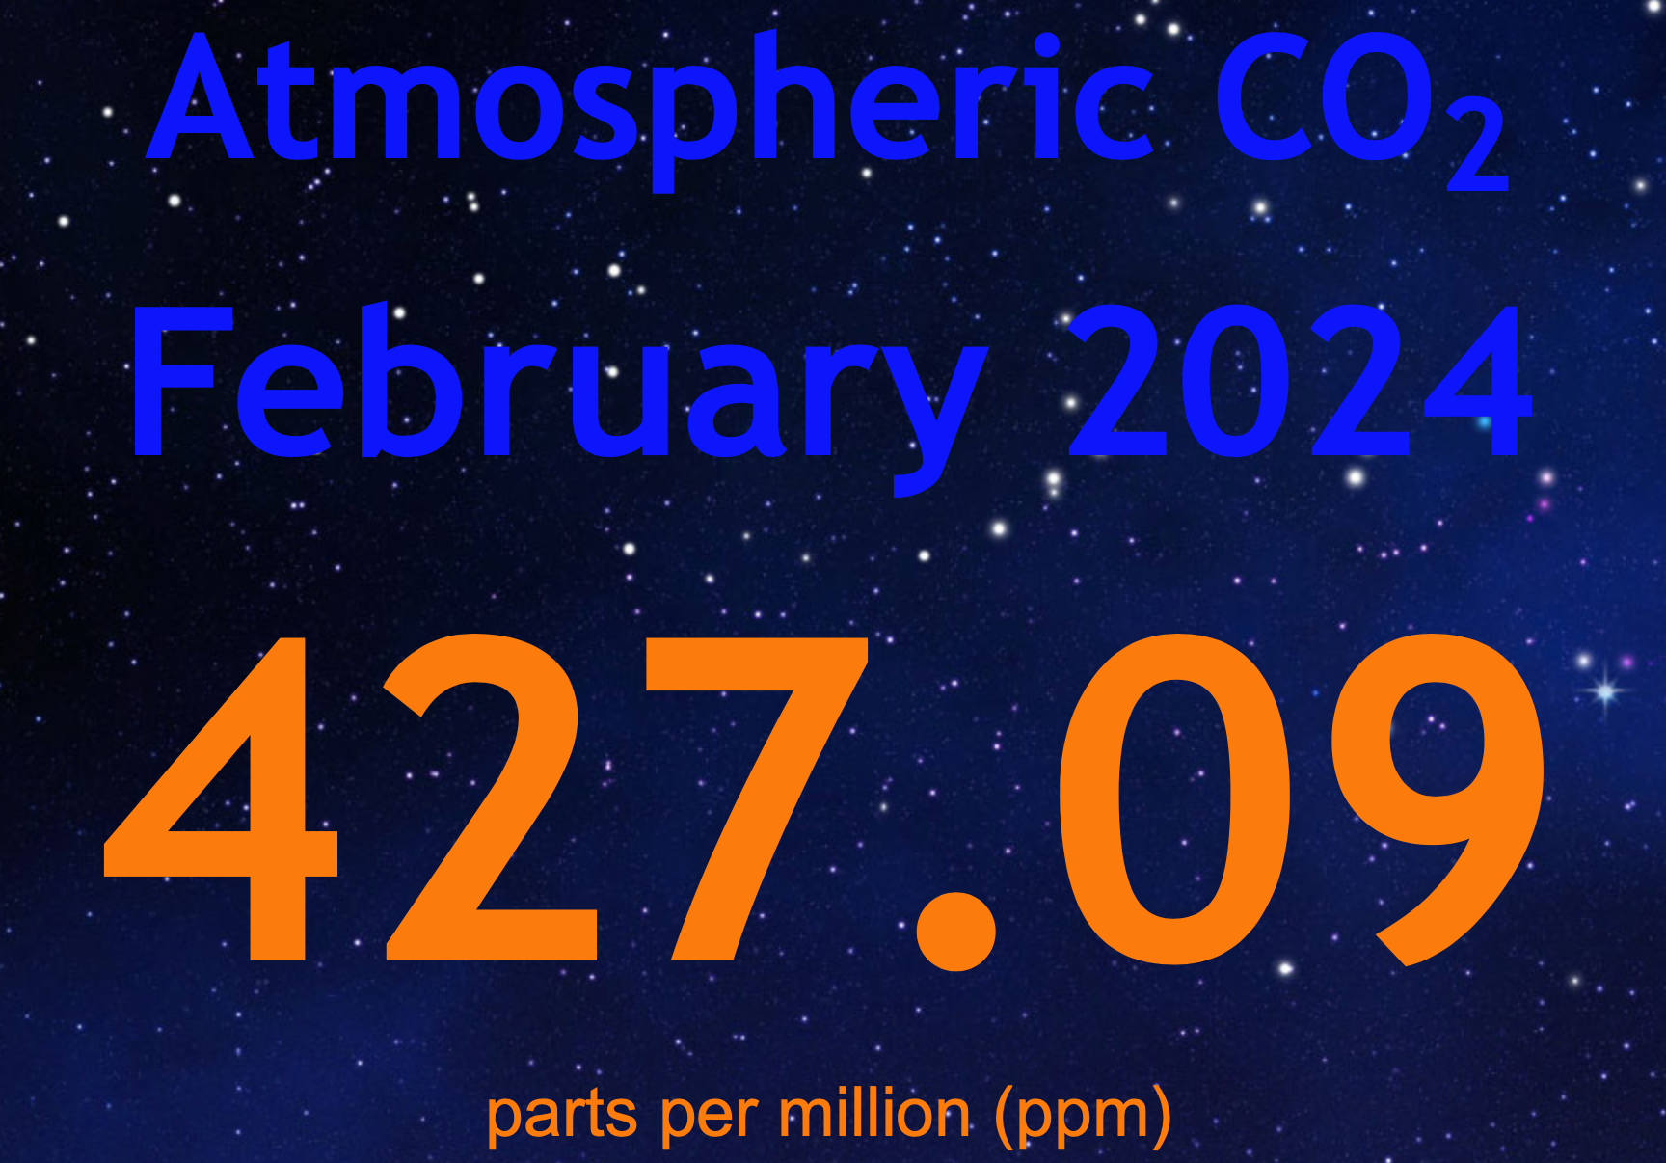
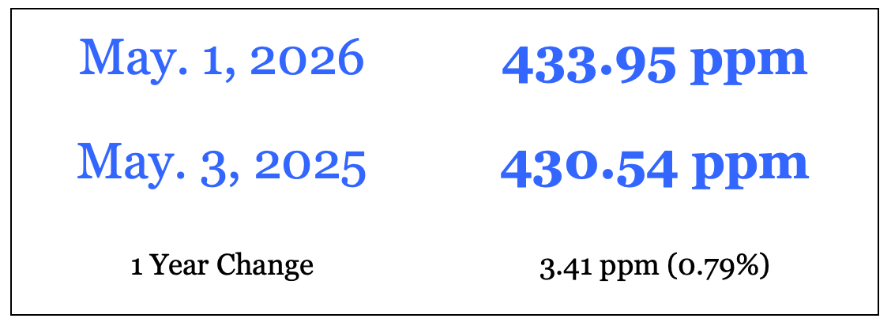
CO₂ in the last 1000 years
Current value: www.co2now.org
Industrial revolution
Notes:
6

Slide 7
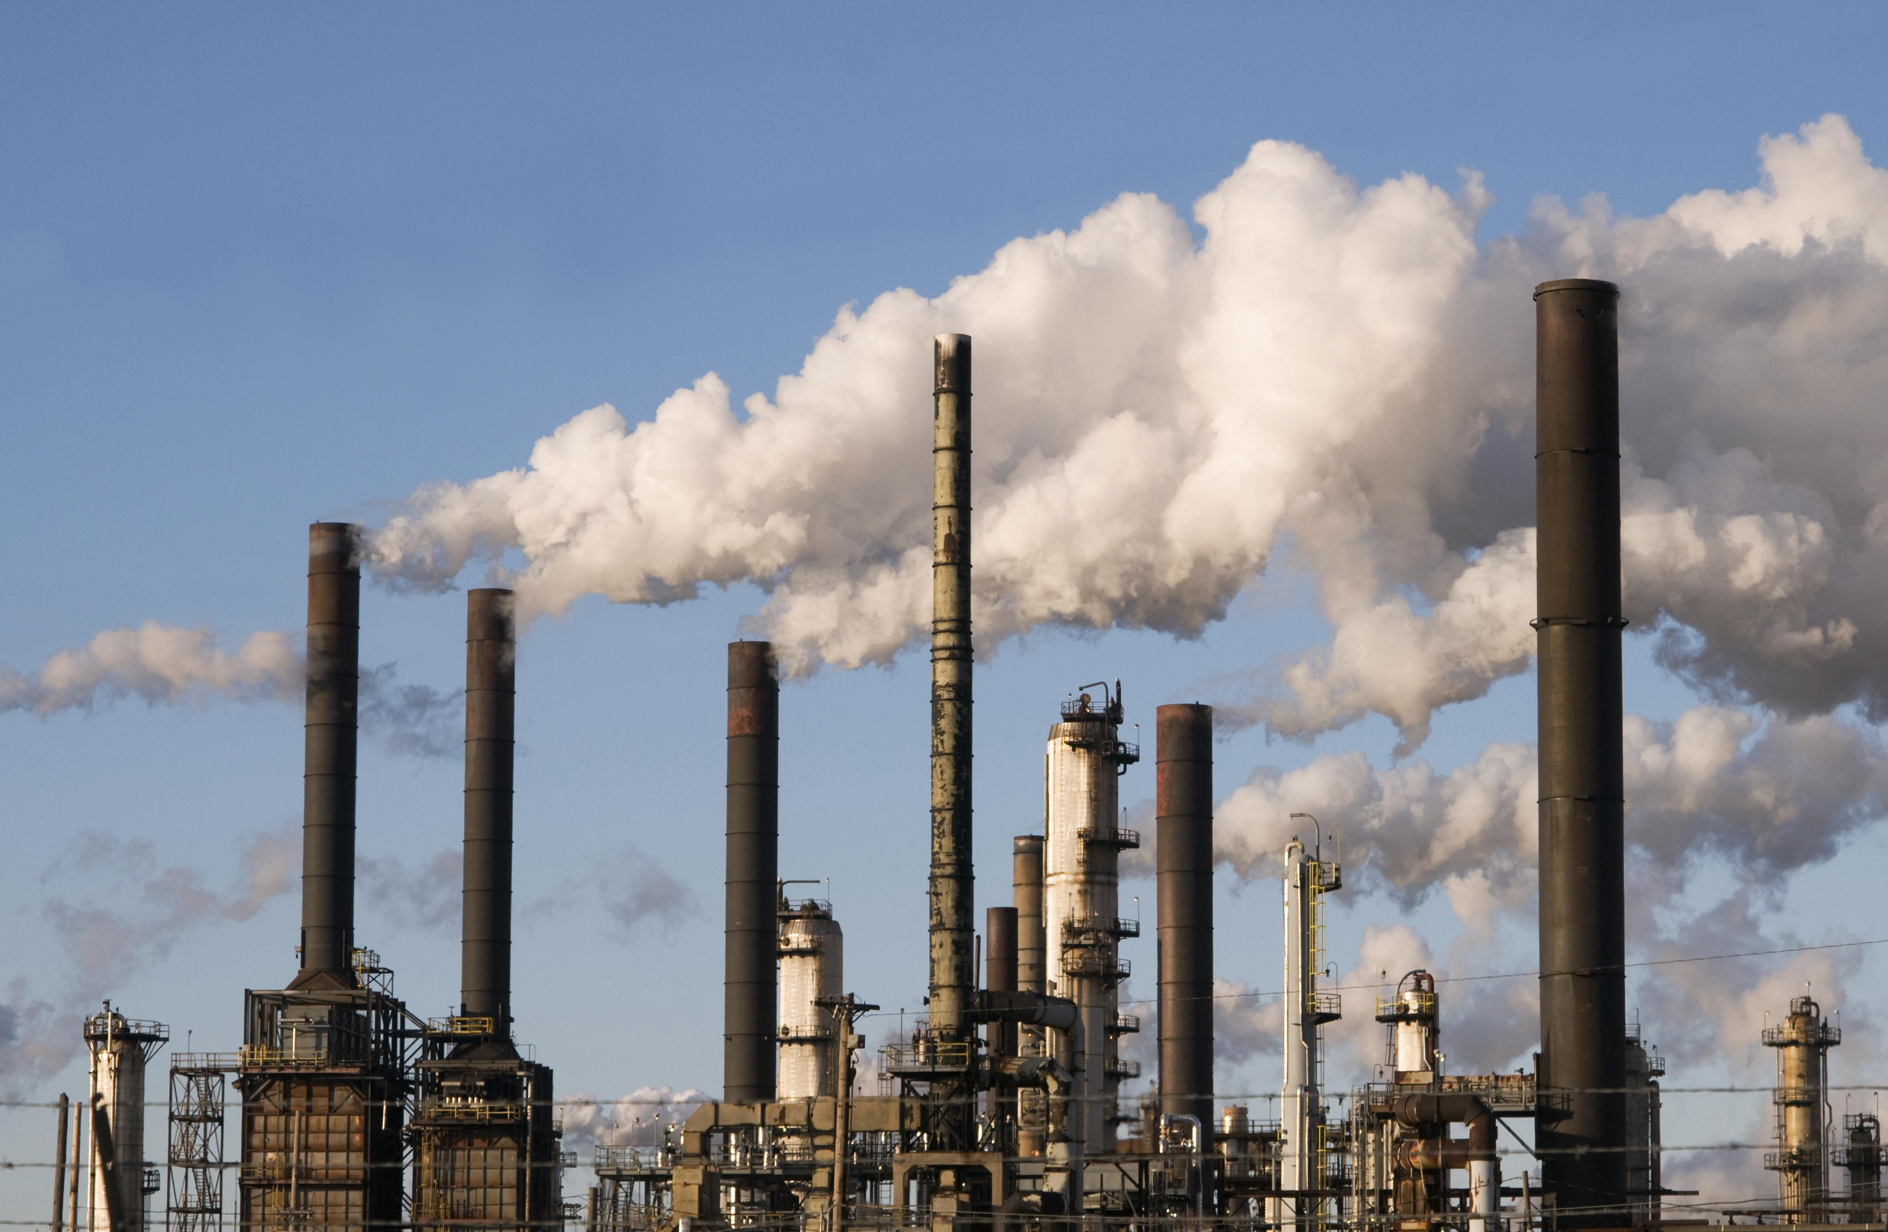
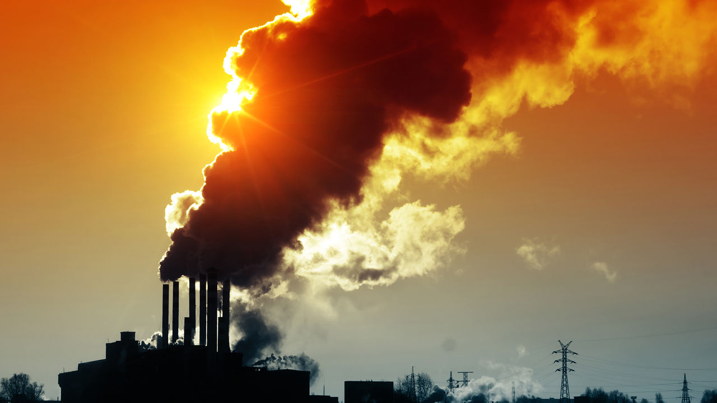
Conventional Fuels – Reserves (end of 2020)
Coal ~ 139 Years
Crude Oil ~ 53.5 Years (because of shale oil)
Natural Gas ~ 48.8 Years
* BP Statistical Review of World Energy 2021, 70th Edition
Biggest problem: Environmental issues related to the use of these fuels – China & India are the most polluting countries

Slide 8

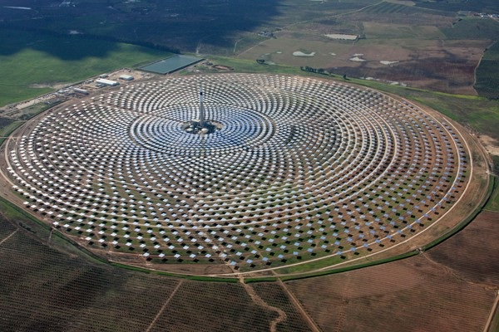
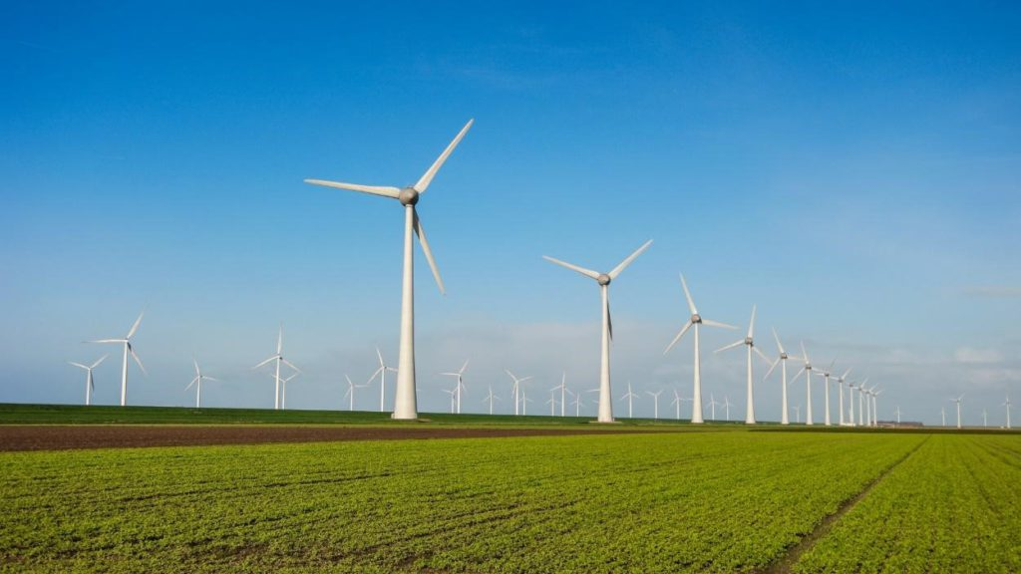
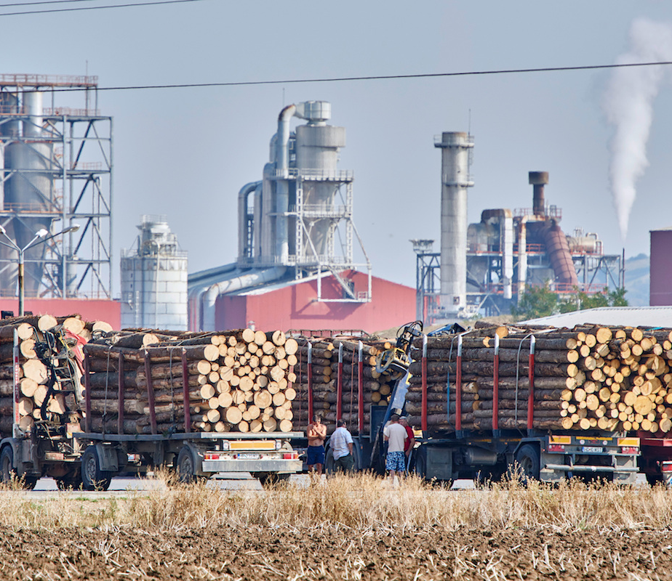
Renewable Energy Systems
Solar power (solar thermal & PV)
Hydro systems
Wind energy systems
Biomass-Biogas-Biofuels

Slide 9
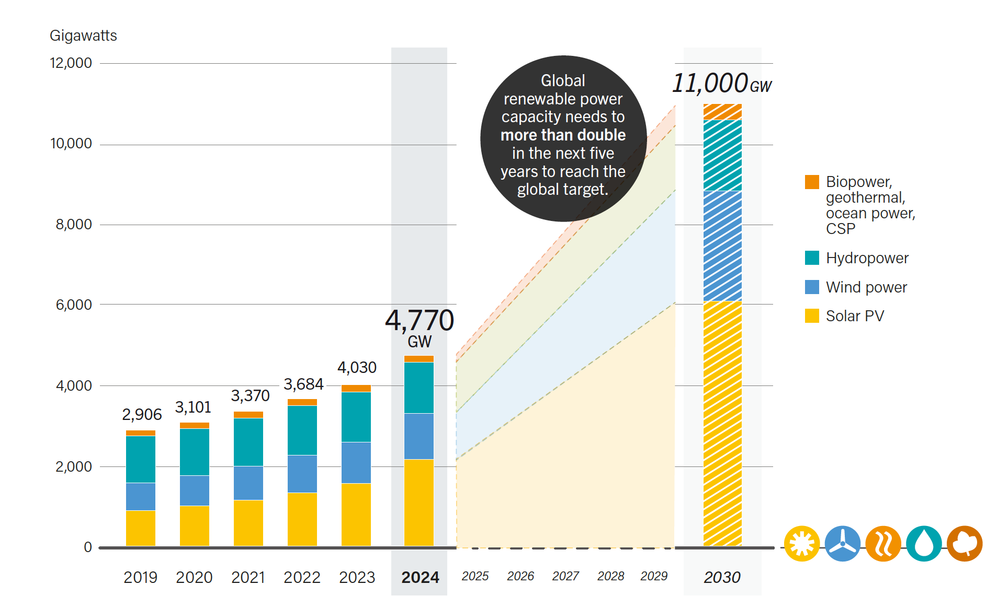
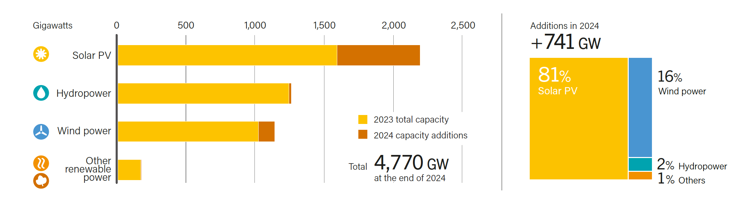
Renewable Energy Indicators 2024
Source: Renewables 2025: Global Status Report, REN21

Slide 10
2024 data…
A record 741 GW of renewable power capacity added in 2024!
By far the largest annual increase today.
PV accounted for more than three-quarters of that growth – due to falling technology costs and rising demand.
Problem: While renewable deployment is increasing, system transformation is not progressing so fast.
In developing countries rooftop PV grew 22% → clearly indicating a shift towards decentralised energy systems.

Slide 11
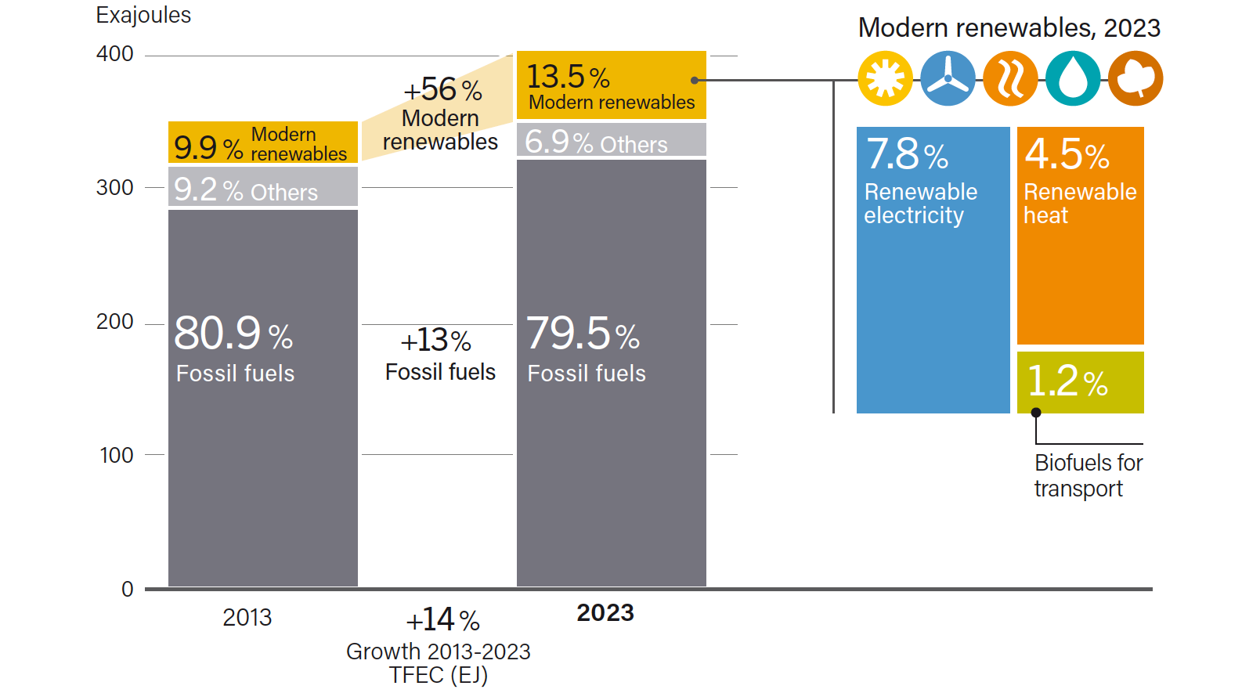
Total Final Energy Consumption by Source
Source: Renewables 2025: Global Status Report, REN21

Slide 12
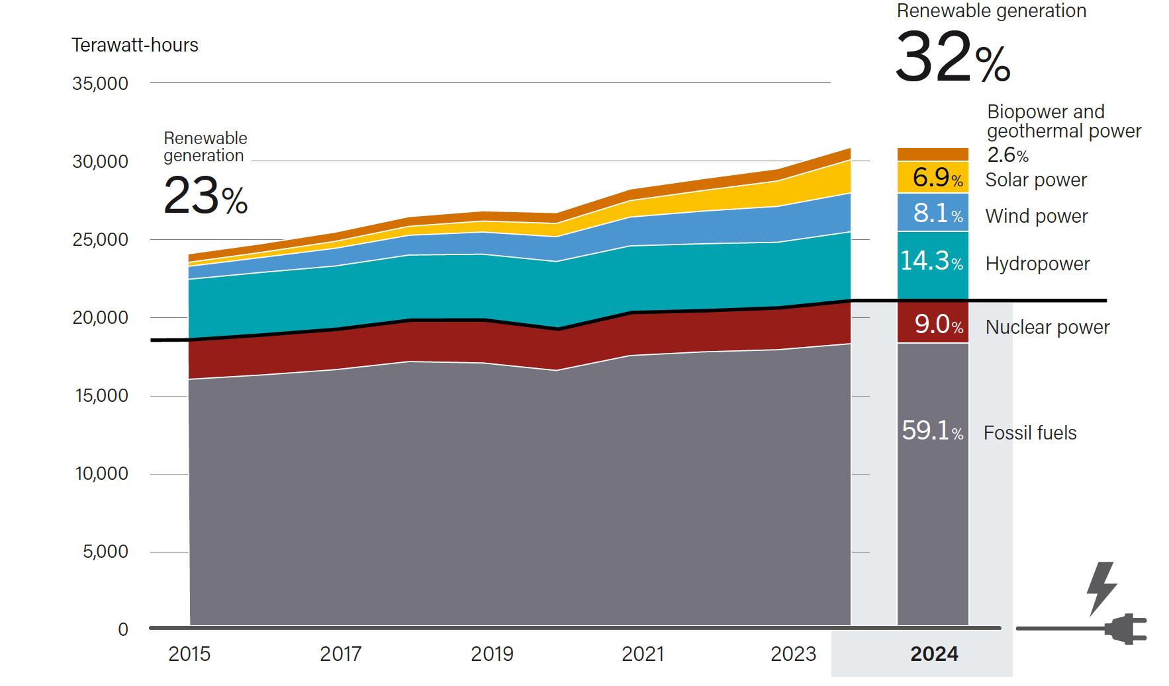
Electricity Generation by Energy Source 2015-2023
Source: Renewables 2025: Global Status Report, REN21

Slide 13
We need to do more…..
Go beyond the power systems – heat and fuels account for more than three-quarters of total energy consumption.
Renewables only meet 5.7% of this demand
Renewables in transportation need to substantially increase
Electrification across end use is slow and uneven across sectors
Long-term energy planning and institutional reform are needed to enable economy-wide energy transition and accelerate the shift towards renewables.
Positive sign: Record global EV sales, representing more than 1 out of 5 car sales in 2024.

Slide 14
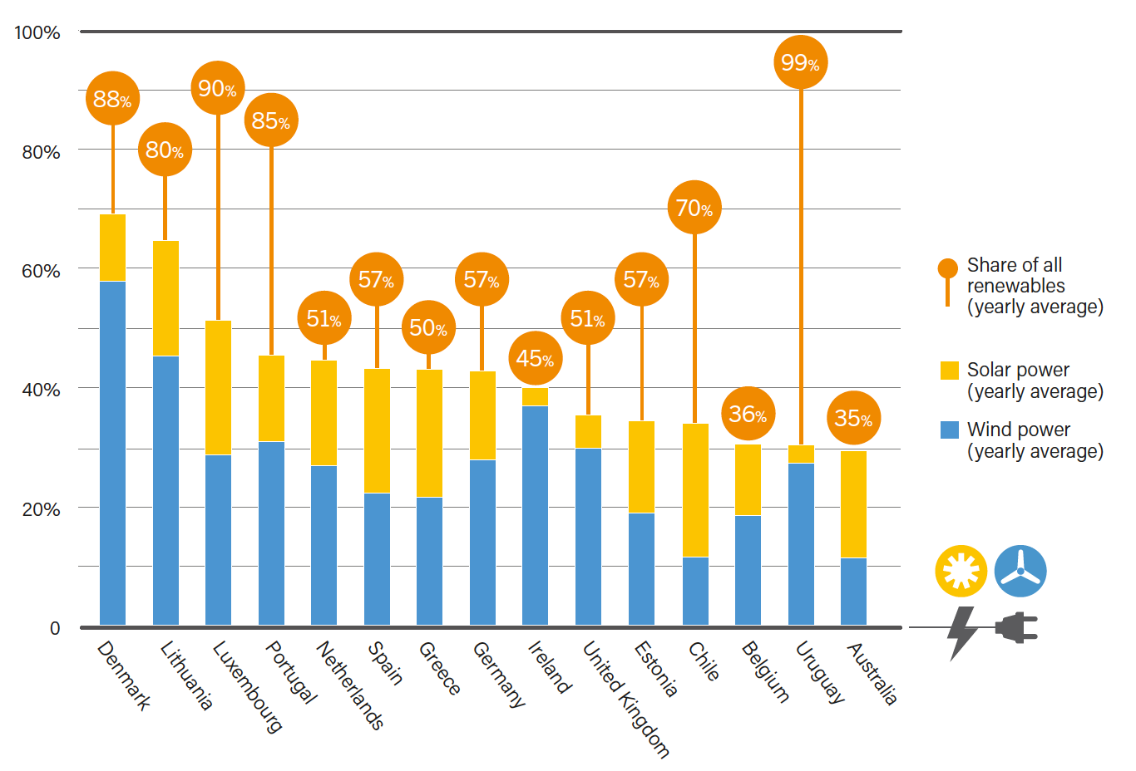
Countries with High Shares of Wind and Solar Generation in Their Power Systems, 2024
Source: Solar Heat Worldwide: Global Market Development and Trends in 2024, Edition 2025

Slide 15
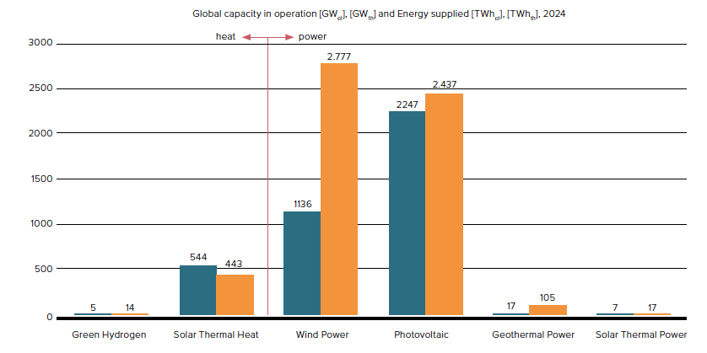

Source: Solar Heat Worldwide: Global Market Development and Trends in 2024, Edition 2025

Slide 16
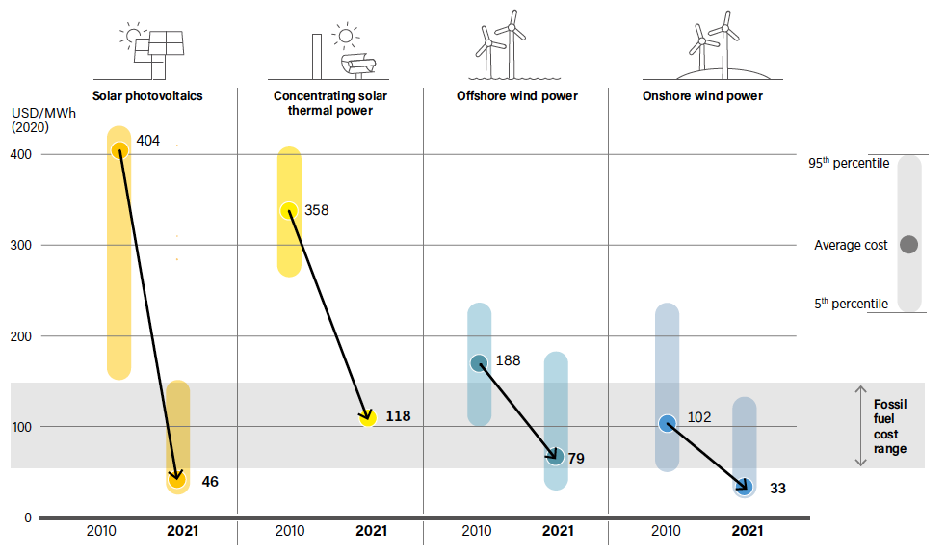
Global Levelized Cost of Electricity (LCOE) for utility scale RES 2010-2021
Source: Renewables 2022: Global Status Report, REN21

Slide 17
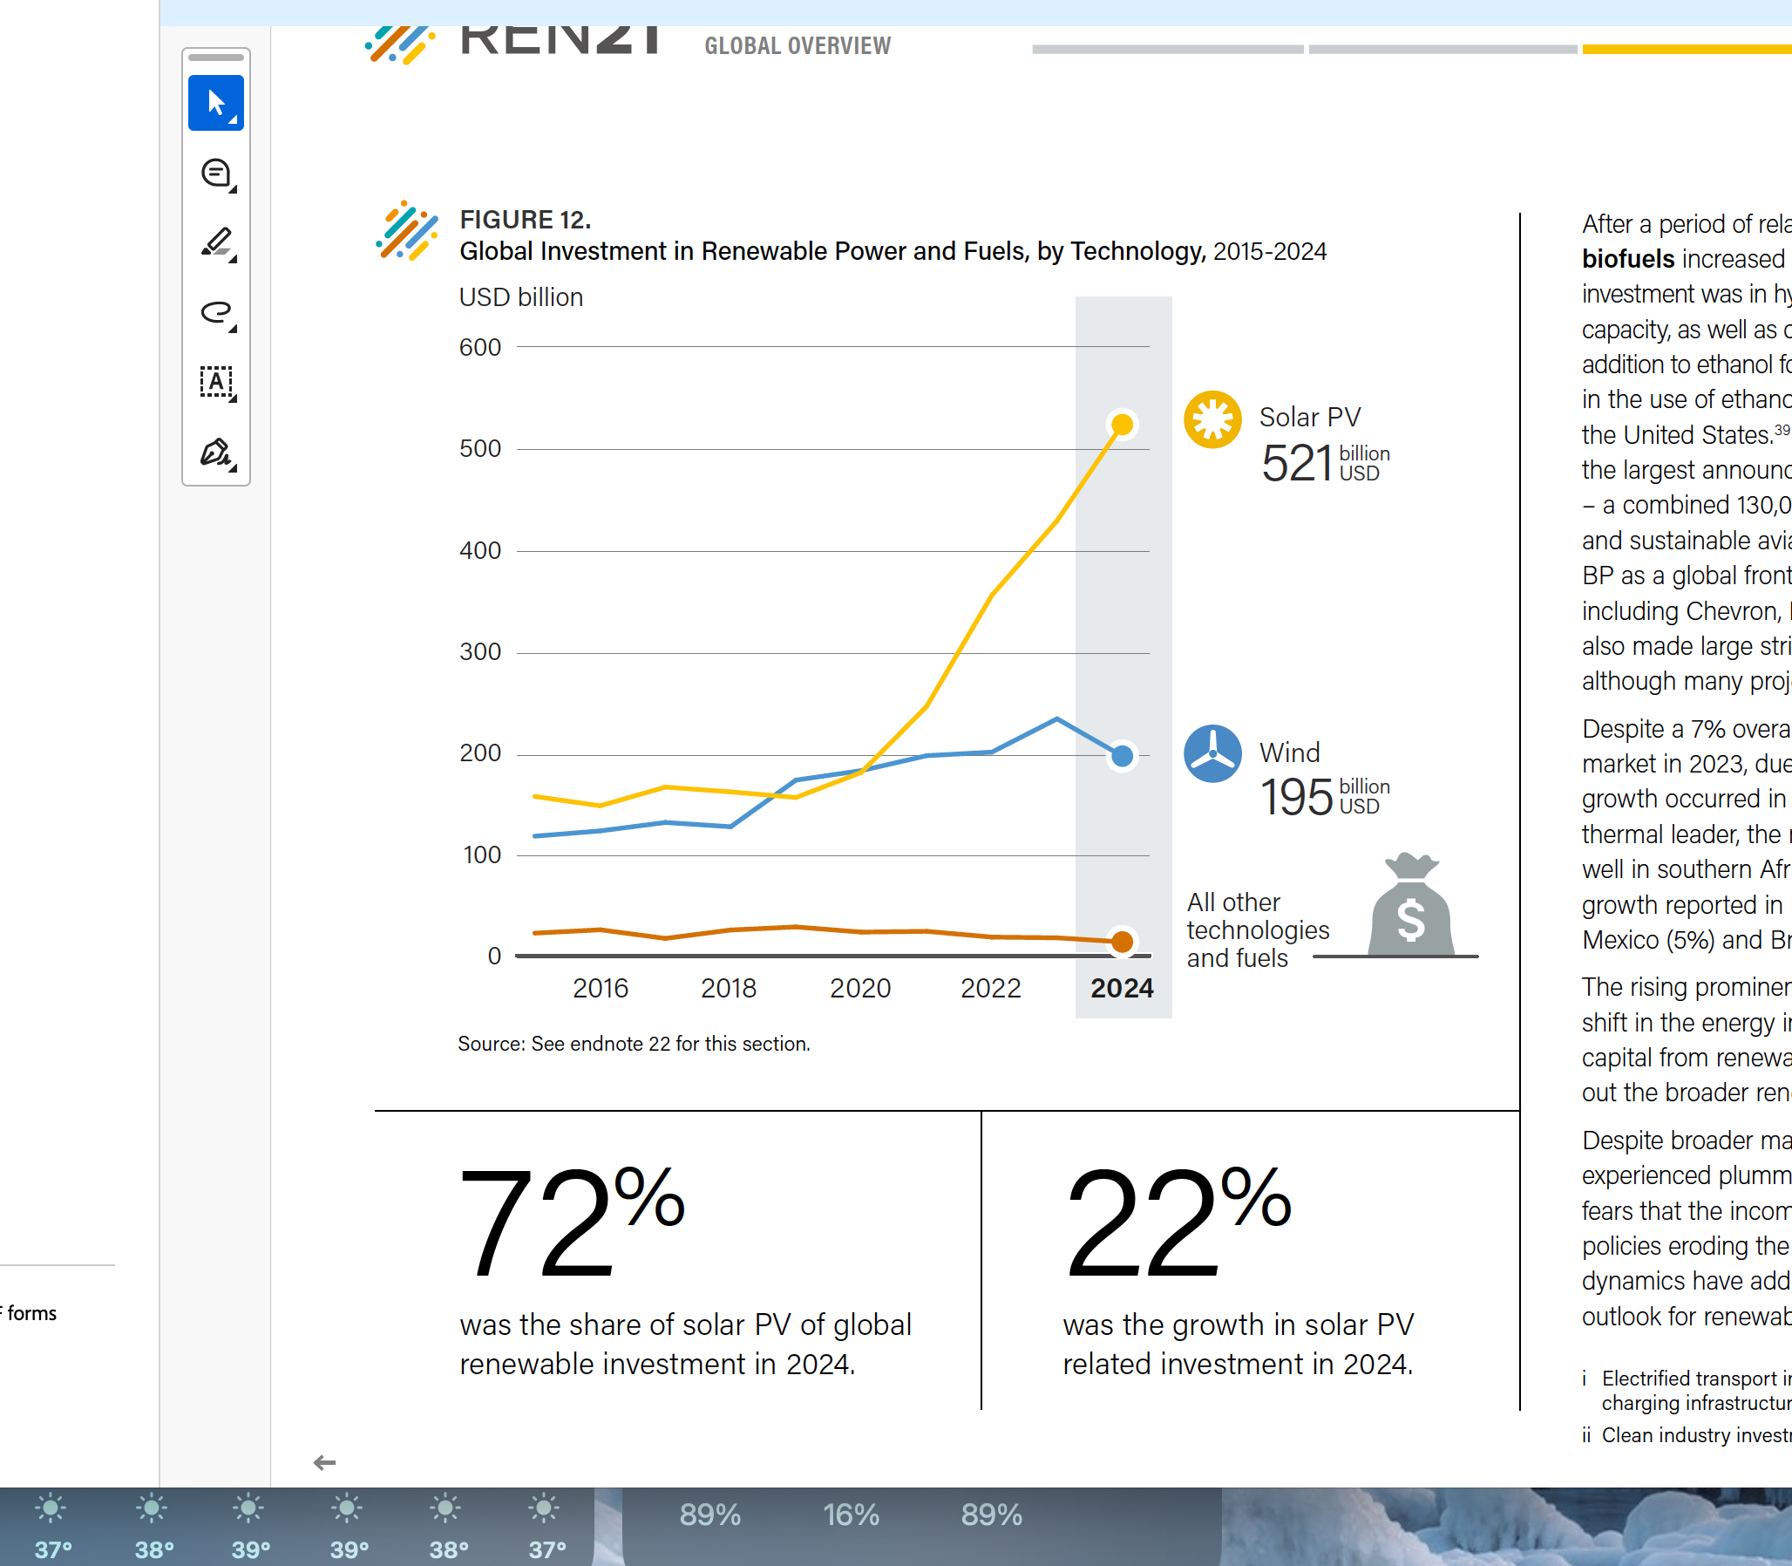
Global Investment in New Power Capacity by type 2024
→Only 6% goes to
investment on other technologires
Investment in 2024 reached 728 billion USD but remain concentrated in China, EU and the US.
Source: Renewables 2025: Global Status Report, REN21

Slide 18
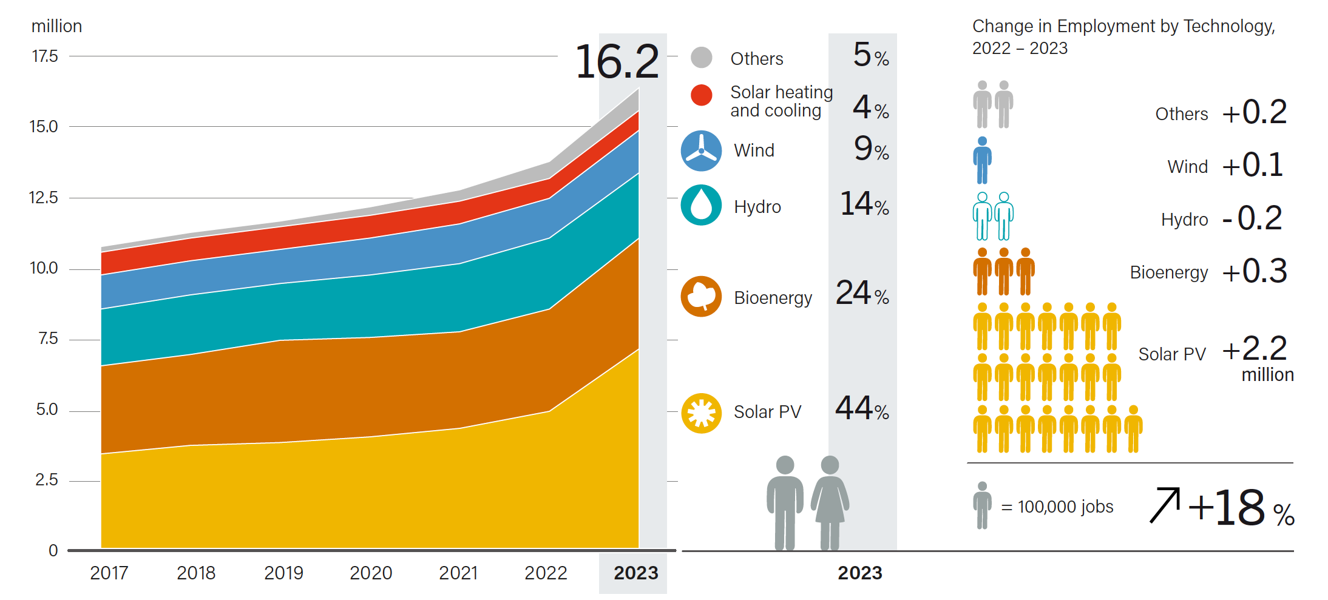
Global Renewable Energy Employment, by Technology, 2017-2023
Source: Renewables 2025: Global Status Report, REN21

Slide 19
Warning!
Although we are deploying renewables in record numbers we are not building the systems needed to transition to a renewable-based economy.
Need:
Coherent policies,
Coordinated planning, and
Resilient infrastructure including mainly grids and storage.
Example: PV-EV chargers can help to reduce grid loading and improve stability
Renewables must be treated as core economic infrastructure which is essential for energy security, resilience and prosperity.
Need to align policies and planning the soonest, to support a full transformation of economies and soceities.

Slide 20
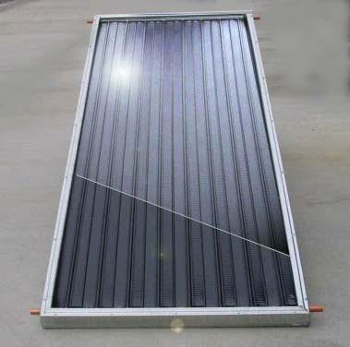
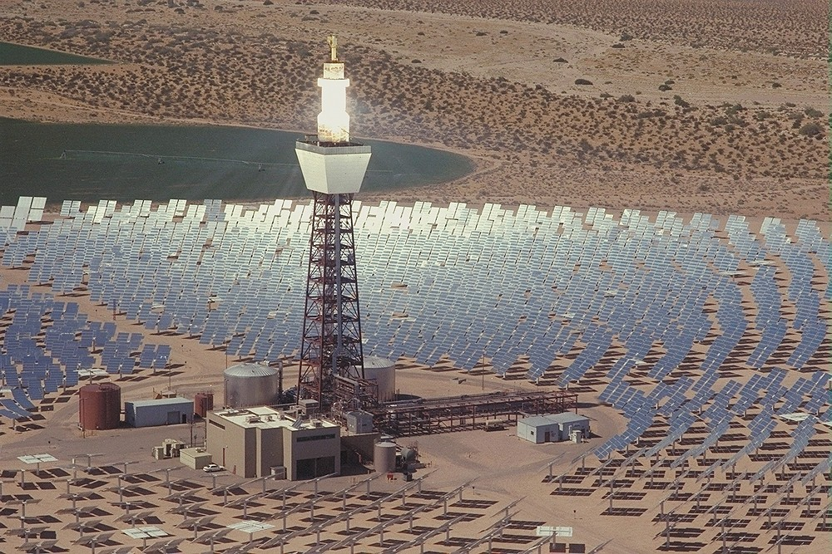
Solar Thermal Power
Systems utilising either the thermal radiation or the light of solar irradiance.
Solar thermal systems
Low temperature systems (mostly for water heating and industrial processes)
High temperature systems (mostly for CSP and high temperature industrial processes)
Solar photovoltaics

Slide 21
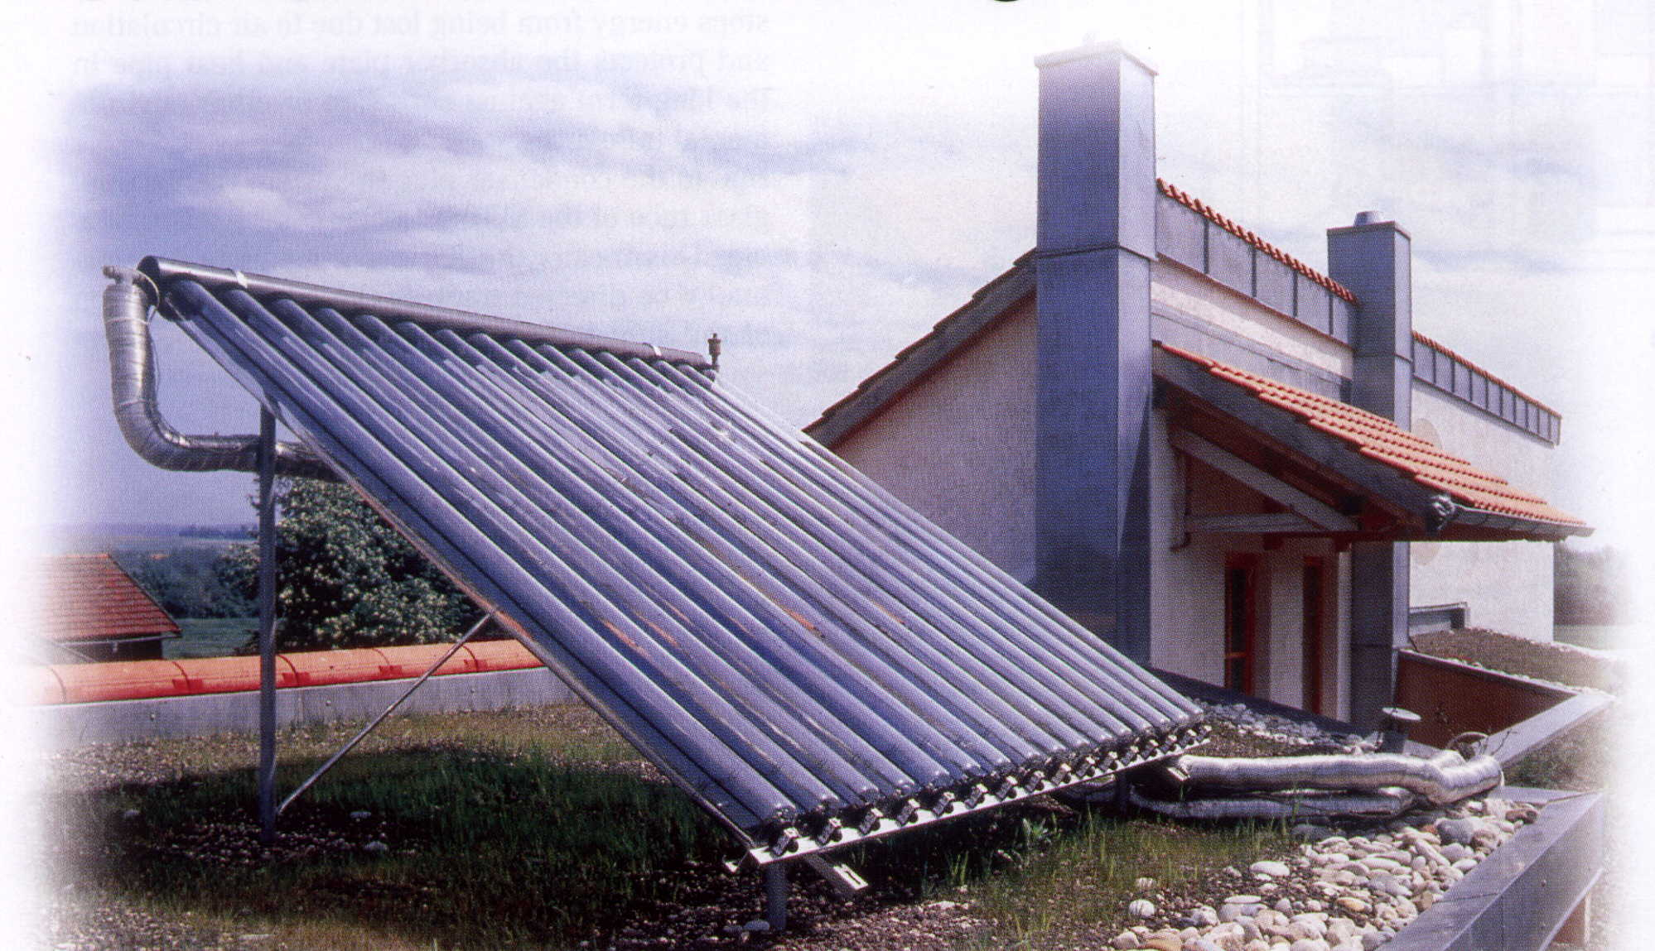
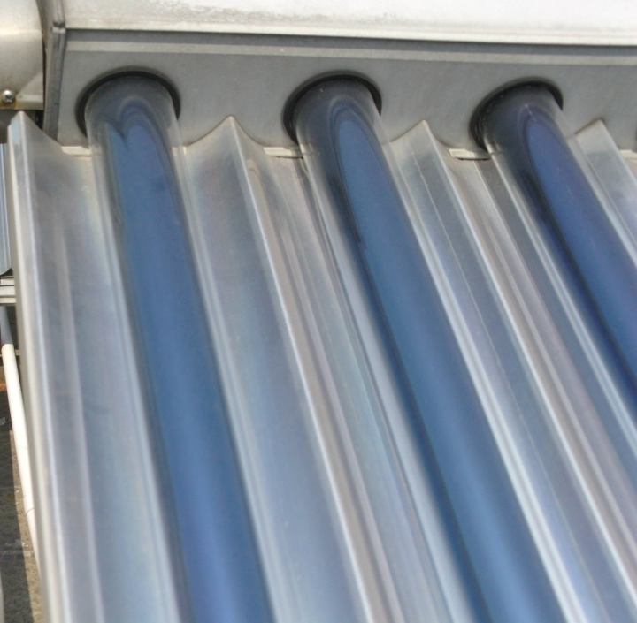
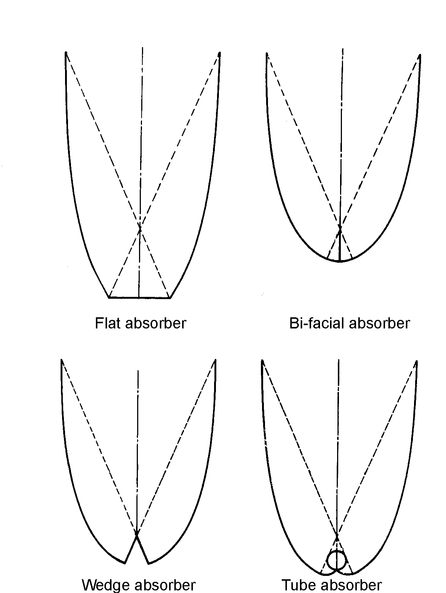
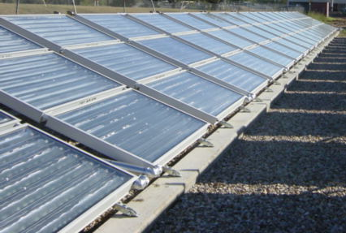
Low temperature collectors
Flat plate collectors
Evacuated tube collectors
Compound parabolic
collectors

Slide 22
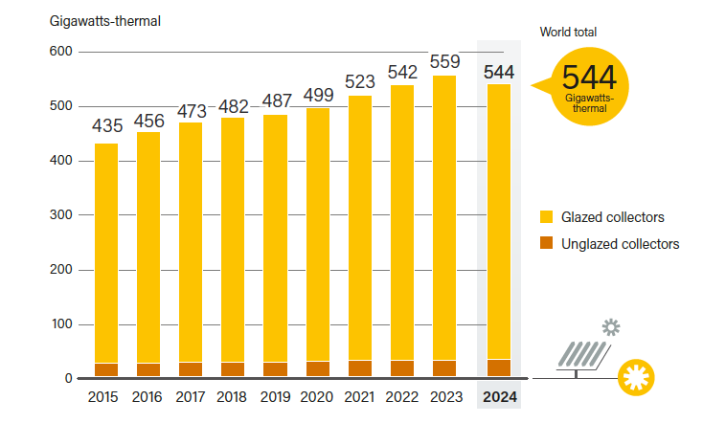
Solar Water Heating Collectors Global Capacity, 2015–2024
Source: Renewable 2025: Global Status Report, REN21

Slide 23
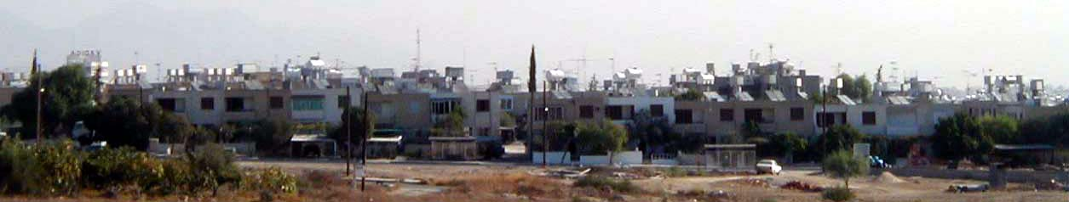
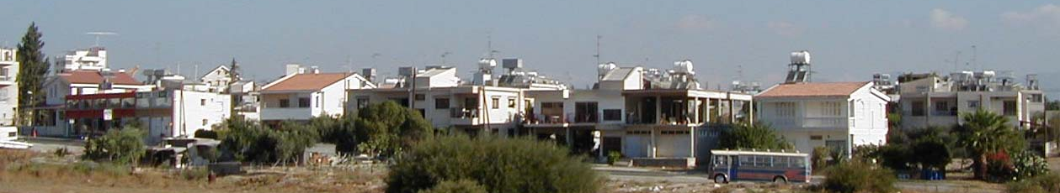
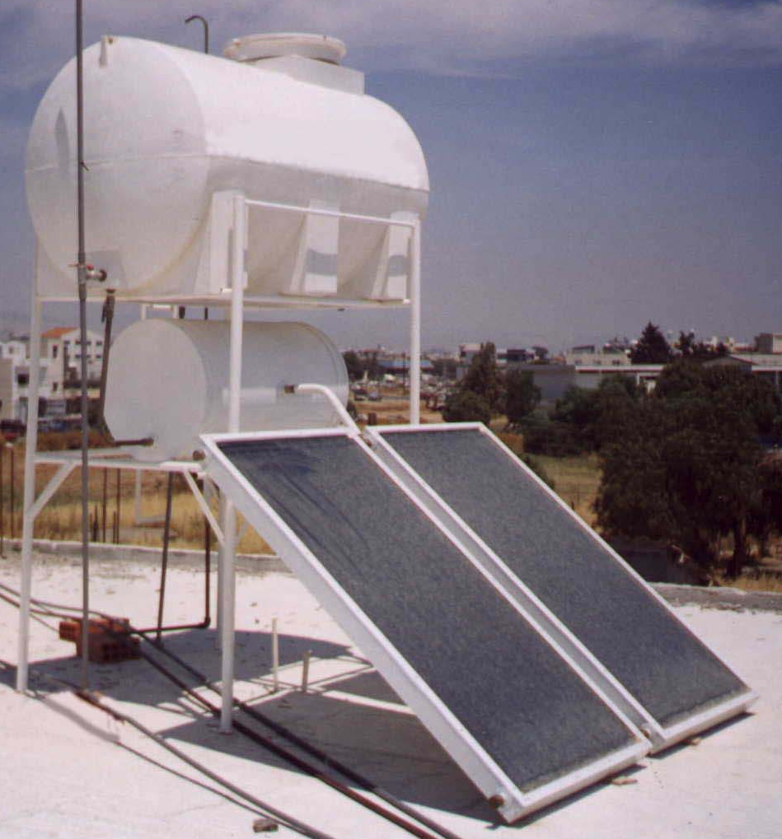
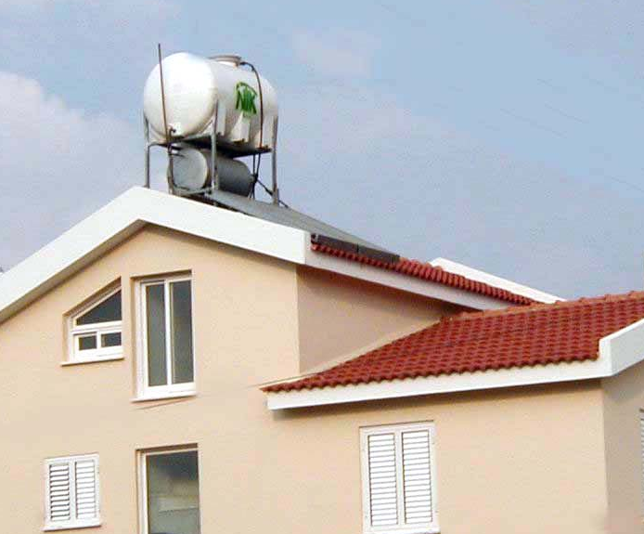
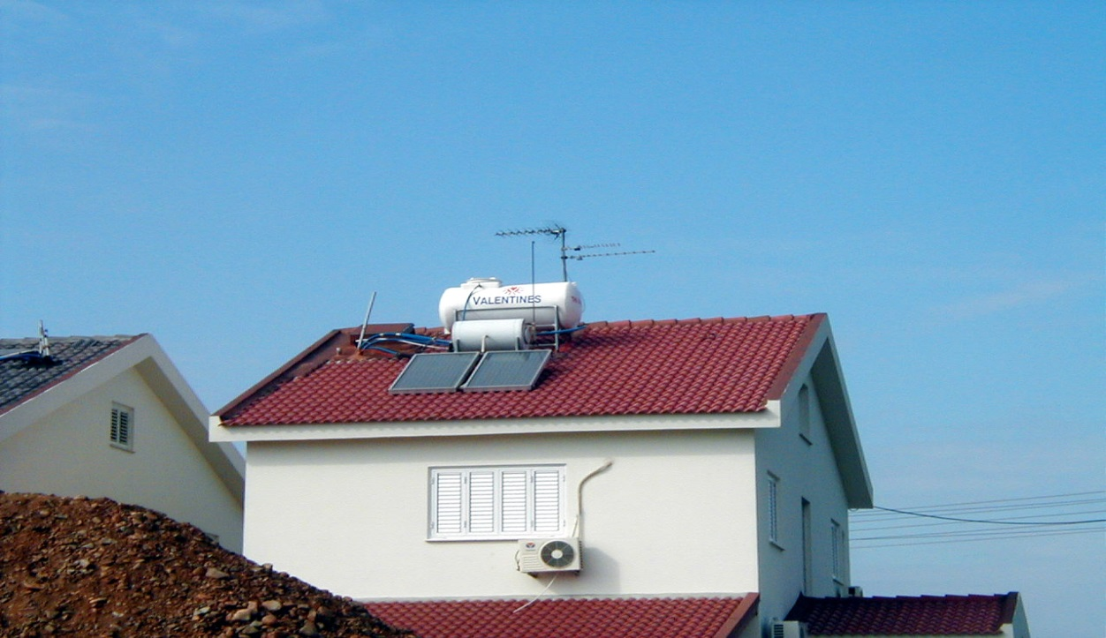
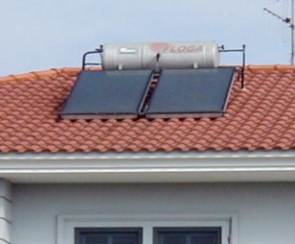
Solar water heating in Cyprus A success story
93% of all houses in Cyprus have a SHW – world record

Slide 24
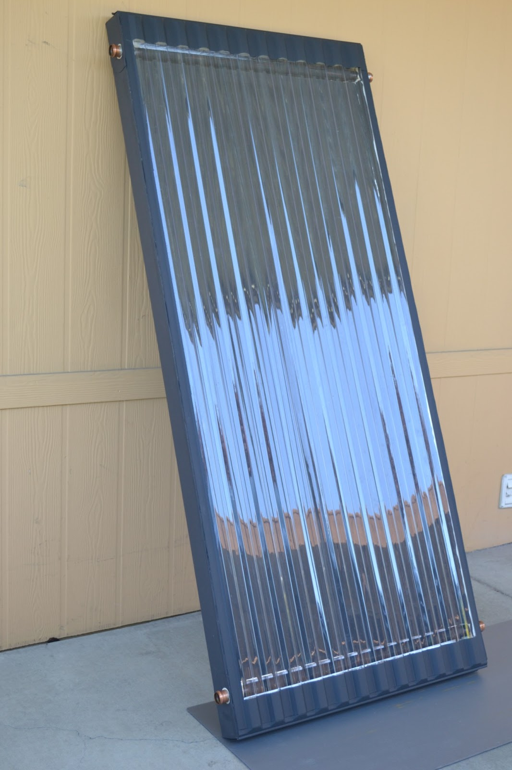
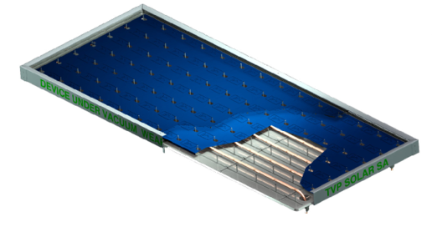
Research led to several new innovations
Use of polymeric materials for the manufacture of solar thermal absorbers to:
reduce cost due to lower raw material and manufacturing costs.
reduce weight compared to copper or aluminium.
New transparent covers with anti-reflective coatings for high optical transmission.
Development of new selective absorber for high absorptance and low emission coatings.
Vacuum insulation for flat-plate collectors → use of high vacuum or noble gases

Slide 25
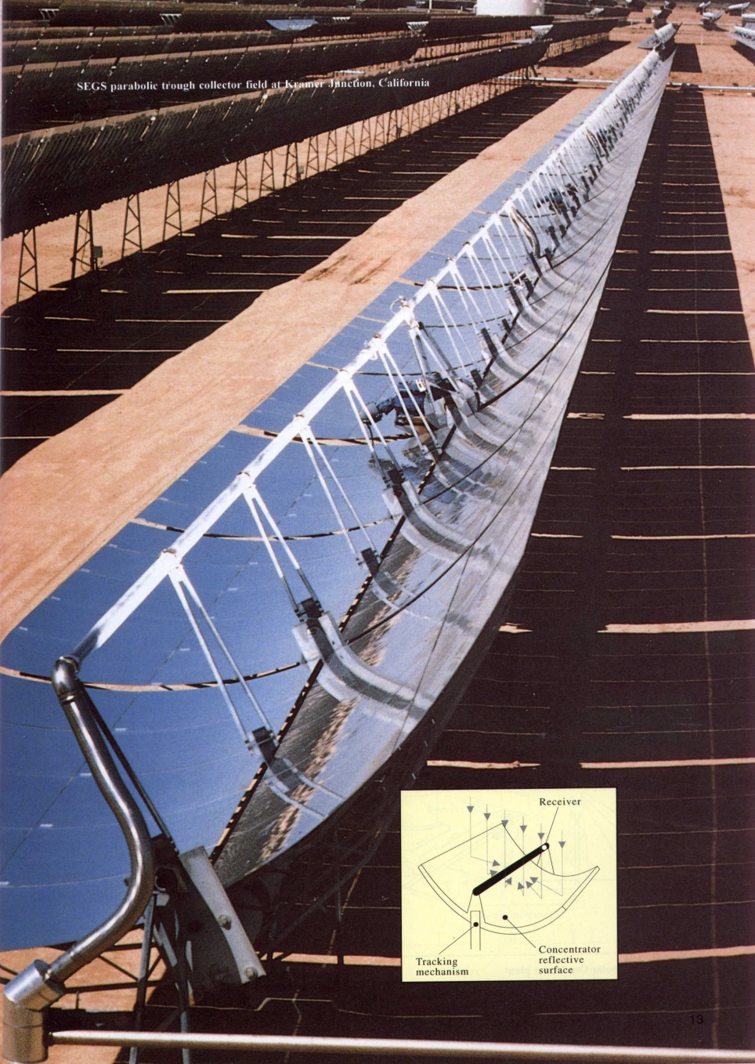
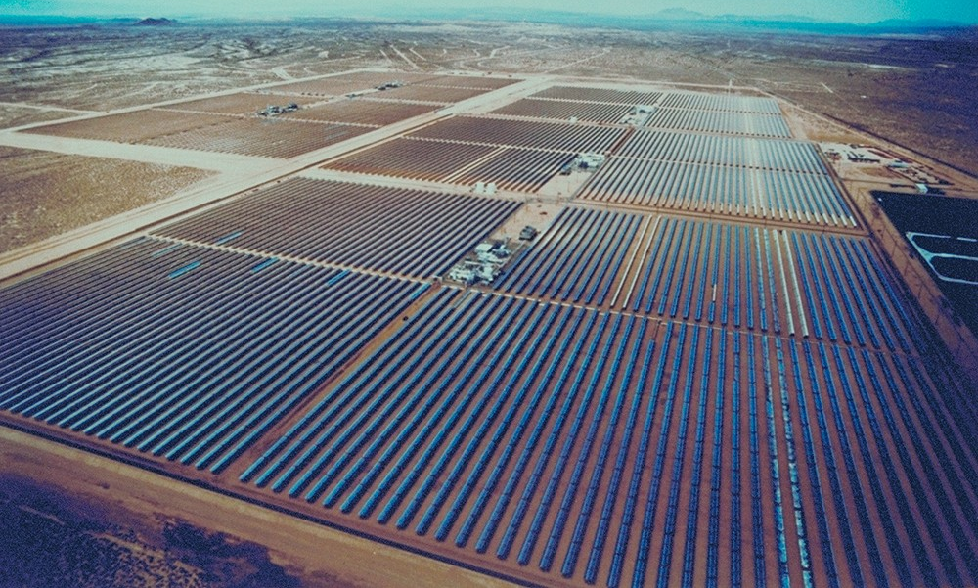
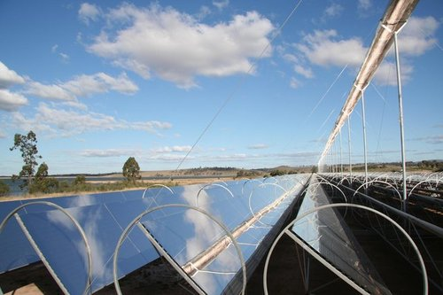
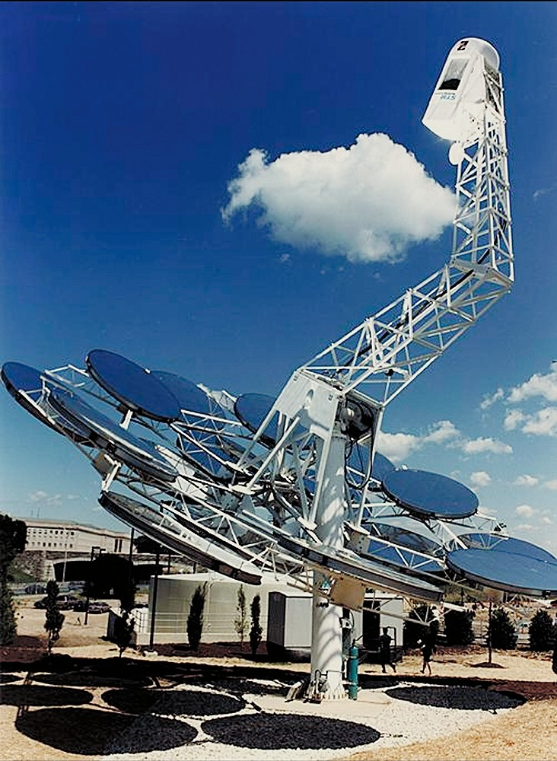



High temperature systems
Parabolic trough collector
Linear Fresnel collector
Solar dish
Solar tower
Solar Two
Gemasolar

Slide 26

Concentrating Solar Thermal Power Global Capacity, by Country/Region, 2016–2024
Many CSP systems are under development in many countries of the world
All new facilities incorporate thermal ENERGY STORAGE
Source: Renewables 2025: Global Status Report, REN21

Slide 27

Biggest CSP: Noor Ouarzazate Solar Complex, Morocco (2018), rated capacity: 510 MW, and thermal storage capacity of 3005 MWh, enabling a discharge of 5.9 hours

Slide 28





Industrial Process Heat-Solar Juice
• Parabolic trough collector (PTC)
-96 m collector length (2×48 m rows)
-Aperture 3 m (mid-size)
-Oil temperature: 425°C
• Concrete Thermal Energy Storage
-Capacity: 600 kWh
-2 modules (each 300 kWh)
-Each module consists of 2 concrete blocks
-Length per block: 5 m
Storage and plantroom containers Concrete storage

Slide 29




Photovoltaics
Four basic technologies:
Polycrystalline silicon cells
Monocrystalline silicon cells
Amorphous silicon cells
Other thin film cells

Slide 30

Solar PV Global Capacity and Annual Additions, 2015-2024
Source: Renewables 2025: Global Status Report, REN21

Slide 31

Solar PV Global Capacity, Top 10 countries and Rest of the World, 2024
Source: Renewables 2025: Global Status Report, REN21

Slide 32

Current PV Research:
Higher performance cells/modules
New nanomaterials applications
Advanced manufacturing techniques
Trend towards very large systems
Kurnool Ultra Mega Solar Park, India – 1000 MW, 2017
Notes:
32

Slide 33

Tengger Desert Solar Park – 1547MW – China
The largest solar power plant in the world right now.
Installed in Zhongwei, Ningxia.
Tengger desert (Inner Mongolia).
The area of the solar field is 1,200 km²

Slide 34
Hydro Power
Comes in a variety of sizes:
Large Hydro (>10 MW)
18 GW scheme at the Three Gorges, China (largest) now expanded to 70 GW
An example of Large Hydro ( > 10 MW)
Small Hydro (1 – 10 MW)
Mini Hydro (100 kW – 1 MW)
Micro Hydro (< 100 kW)
And finally, Pico Hydro (< 5 kW)…

Slide 35


Hydropower Global Capacity, Shares of Top 10 Countries and Rest of World, 2024
Source: Renewables 2025: Global Status Report, REN21

Slide 36



Wind Power

Slide 37



Wind Power Global Capacity and Annual Additions, 2015–2024
Source: Renewables 2025: Global Status Report, REN21

Slide 38

Biomass
Main areas:
Biomass
Biogas
Biofuels (biodiesel)
Waste (MSW, landfills [?])

Slide 39





Biomass – Question food for fuel?
Three years poplar cropping
(ENERGY crops)
→ Land availability for energy crops

Slide 40

More than 90% of transport depends on oil, US consumption of its 200 million cars is 3.5 million barrel of oil per day → Prospects for biofuels
Notes:
40

Slide 41

Shares of Bioenergy in Total Final Energy Consumption, Overall and by end-use sector, 2022
Source: Renewables 2025: Global Status Report, REN21

Slide 42

Global Production of Ethanol, Biodiesel and Renewable Diesel 2014-2023
Source: Renewables 2025: Global Status Report, REN21

Slide 43





Other areas of renewables
Ocean energy systems
Wave, tidal energy conversion, OTEC
Total capacity: 513 MW (2024)
Geothermal
Global capacity: 15.1 GW (2024)
Hydrogen
Used both for storage and Fuel Cells

Slide 44

PV powered EV Charging
PV powered EV charging stations, combine onsite solar electricity generation with EV charging infrastructure, are a sustainable solution for electric vehicle adoption, offering several benefits:
Reduction in Greenhouse gas emissions (clean PV electricity).
For house PV systems close to zero transportation cost.
Smart Charging Control: Possibility to apply smart charging strategies like V2G services, which enhance grid flexibility and maximise solar energy utilisation.
Possibility for integration with microgrids providing a more efficient and sustainable energy solutions.
At a bigger scale there are specific challenges for charging Electric Busses with solar energy which offer the potential for these stations to drive sustainable mobility.

Slide 45

Hydrogen busses: The Future of Clean Public Transport
Hydrogen fuel cell buses are a promissing solution for urban trnsportation, offering zero-emission operation and ability to cover long distances without frequent refueling.
Refueling is a quick process-advantage over EV charging.
Routes within cities eliminate potential hazards because of the use of hydrogen.

Slide 46
Prospects - Hot research areas
Main purpose:
Increase efficiency of various RE technologies
Design renewable energy components at lower cost
Extensive use of RES (many regions, even countries consider transformation into 100% renewables)
High shares of renewables
Power system transformation
Storage/integration (smart energy systems)
Develop large-scale smart regions – like smart cities
Effective coupling not only for electricity but also heating + cooling and transportation

Slide 47







Acknowledgements
Main reports used for this survey:

Slide 48

Concluding:
There are a lot of possibilities to utilise effectively renewable energy technologies
These are nowadays more cost-effective options than conventional fuels
We should never underestimate the climate problem
It is in our hands to utilise renewables effectively
Soteris Kalogirou
email: soteris.kalogirou@cut.ac.cy

Slide 49
Final conclusions
The energy transition is an oportunity to transform our countries economies.
Renewables can be viewed as catalysts of system change but need governments to align behind long-term strategies.
Conclusion: Governments, industry and international institutions need to move beyond deployment targets and commit to system wide reform which should include:
Long-term energy planning
Modernising grids
Investment in storage
Reducing energy consumption
Eliminate financial barriers
Moving away from fossil fuels and accelarate shift to a reneable-based economy.

Slide 50

Thank you for your attention
I will be happy to answer questions…

