Slide 1


An analysis of power-to-X technologies in modern district energy networks
Francesco Calise
Department of industrial engineering
University of Naples FEDERICO II
SMARTGREENS2023
12th International Conference on Smart Cities and Green ICT Systems

Slide 2
Outline
Present Scenario and perspectives by 2050
Energy Transition and related Policies
Novel Energy Networks
District Heating and Cooling Networks
Smart Grids
Power-to-x
  Power to fuel
  Power to gas
  Power to heat
  Power to Power
Research and Development
Conclusions

Slide 3
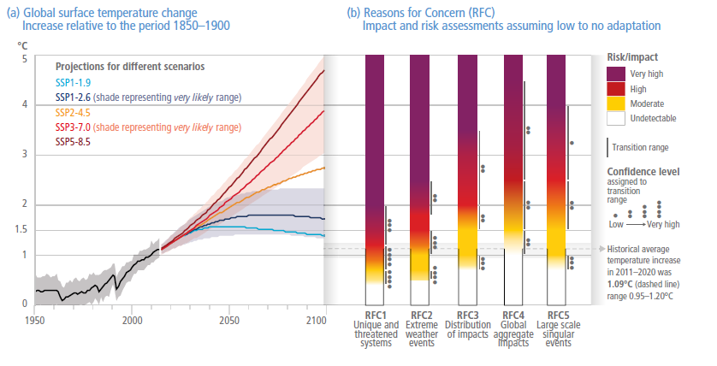
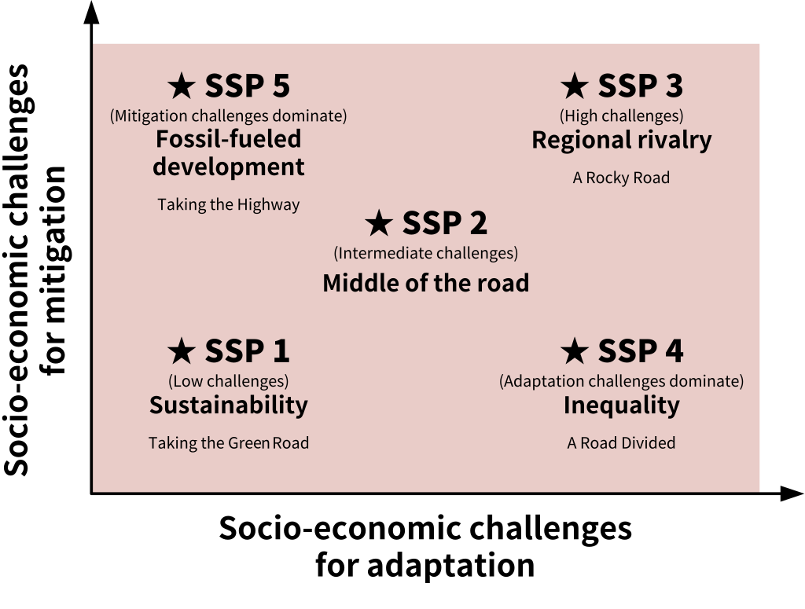
CO₂ emissions and temperature increase
3
“Dear friends, humanity is on thin ice and that ice is melting fast. As today’s report of the Intergovernmental Panel on Climate Change (IPCC) details, humans are responsible for virtually all global heating over the last 200 years. The rate of temperature rise in the last half century is the highest in 2,000 years. Concentrations of carbon dioxide are at their highest in at least 2 million years. The climate time-bomb is ticking”
UN Secretary-General António Guterres, March 2023
Shared Socioeconomic
Pathways (SSP)
Radiative forcing is the change in the balance between radiation coming into the atmosphere and radiation going out.
Source: IPCC 2022

Slide 4

GDP growth rates projections
Statistical Department of US Department of Energy
Average annual percentage change in GDP, OECD
2020–2050
Average annual percentage change in GDP, non-OECD
2020–2050
GDP is expected to grow by 2050 (annual percentage change ranging from 1.5 to 3.5 %, depending on the area). For developed Countries the increase is limited whereas it may be significantly high for developing regions (e.g., Africa). This increase in GDP must be SUSTAINABLE for the environment and mankind.

Slide 5
GDP and energy consumption
World GDP
trillion 2015 dollars, purchasing power parity (PPP)
Energy consumption
quadrillion British thermal units
Source: EIA 2021
The growth in GDP is strictly related to the increase in the overall primary energy demand, required to support the development. For developed Countries, a limited increase in primary energy demand is expected, due to the recent policies in terms of climate change. Conversely, for developing Countries a dramatic growth in primary energy demand is expected. Therefore, urgent actions must be implemented to prevent a dramatic environmental impact of this growth.

Slide 6
World energy consumption by sector and fuel
6
End-use energy consumption by sector, world
quadrillion British thermal units
End-use energy consumption by fuel, world
quadrillion British thermal units
history projections
industrial
transportation
residential
commercial
Source: EIA 2021
In the reference scenario developed by the EIA, the demand of fossil fuels will continuously increase. This trend must be mandatory modified toward a sustainable development based on renewable energy sources. A new energy paradigm must be implemented to limit the average temperature increase below 1.5 °C, as agreed by the majority of worldwide Countries

Slide 7
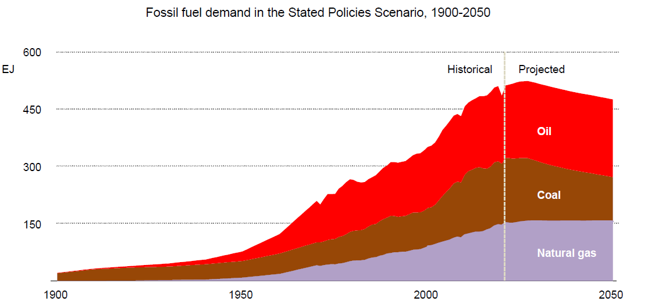

IEA scenario: Fossil fuel demand
According to the future scenario presented by IEA, considering the present energy policies, a peak in fossil fuel demand is expected by 2030, mainly due do the decrease of the growth of NG demand and to the reduction of the use of coal
Source: IEA 2022

Slide 8
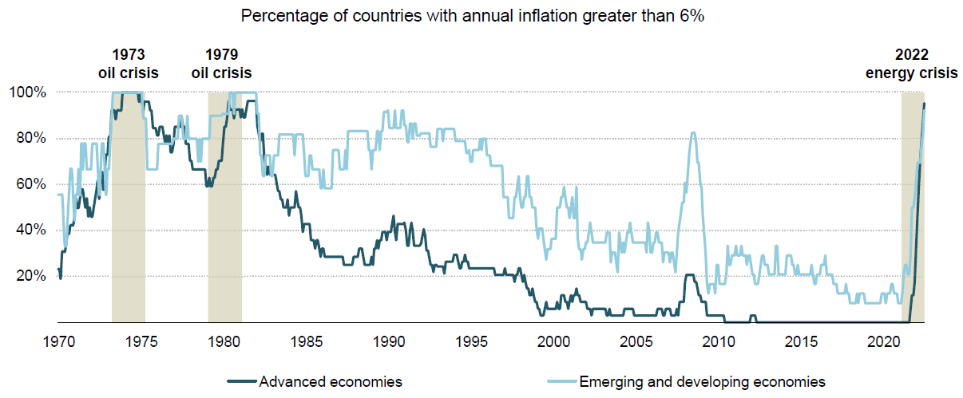
Pandemic and Ukrainian war
The recent events (pandemic and Ukrainian war) are becoming the major driver toward an energy transition to a fully decarbonized paradigm. Energy security is becoming a critical issue in EU.
Source: IEA 2022
The transition to a clean energy paradigm is crucial to avoid such crisis in the next future.
Energy crisis is responsible of the huge growth of inflation.

Slide 9
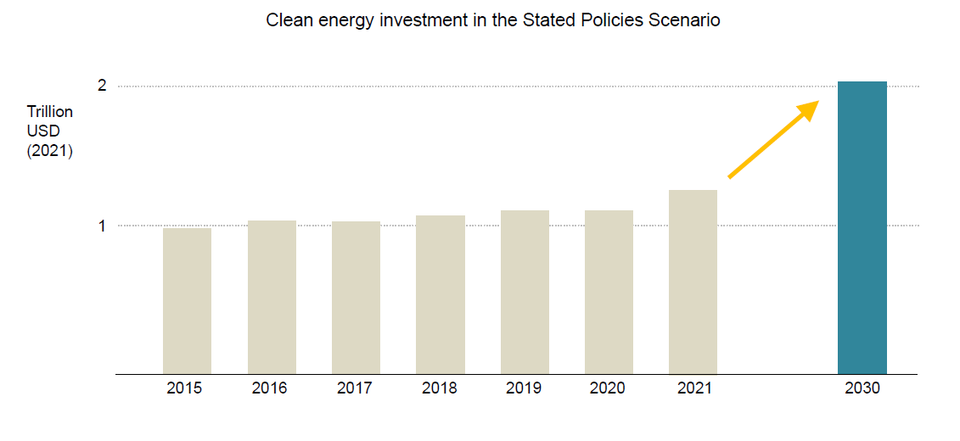
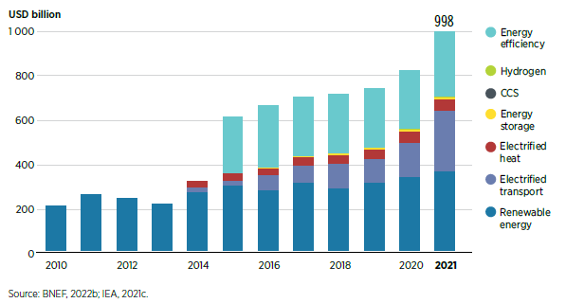
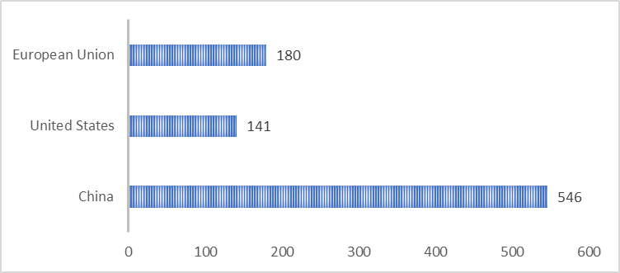
Investiments in Clean Energy
Source: IEA 2022
US: Inflation Reduction Act (391 billions $ for climate change and energy)
EU: Fit for 55
Japan: Green Transformation Policy (1.1 trillion $ for carbon neutrality)
China: clean energy targets
India: solar revolution
According to Bloomberg in 2022
US$ billions

Slide 10
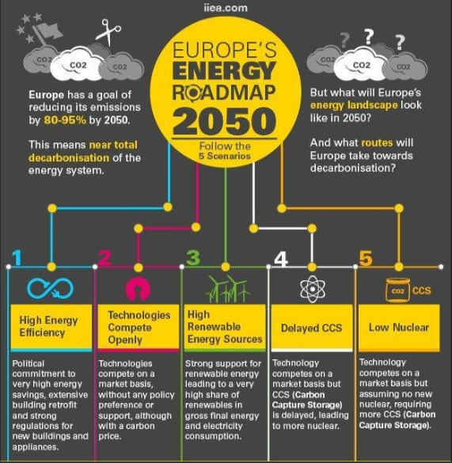
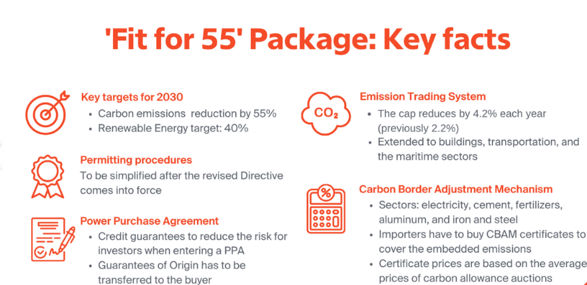
Stated Policies EU and USA
European ‘Climate Law’ enshrines the 2030 intermediate target and the 2050 climate neutrality objective into legislation, strengthening the framework for ambitious climate action.
GREEN DEAL
Energy System Integration, Hydrogen, Methane, Offshore Renewable Energy, Energy efficiency, Power sector based largely on renewable sources, Secure and affordable EU energy supply, a fully integrated, interconnected and digitalised EU energy market, EU Biodiversity Strategy for 2030 establishing protected areas (30% of land and 30% of sea in Europe), Farm to Fork’ Strategy, Sustainable and Smart Mobility Strategy to cut emissions by 90% by 2050.
Aiming for at least 32% share for renewable energy and at least 32.5% improvement in energy efficiency by 2030.
FIT FOR 55’ package
It will help implement the EU’s revised 2030 climate target of at least 55% in a responsible way, revising all relevant legislative measures
USA POLICIES
The White House set out a target of 80% renewable energy generation by 2030 and 100% carbon-free electricity five years later.
Nuclear energy could replace nearly 80% of all coal power plants in the U.S.
Massive offshore wind turbines can produce more power on a smaller footprint.
Long-term energy storage is key for a carbon-free power grid of the future.
Biden Administration plans to eliminate fossil fuels as a form of energy generation by 2035.

Slide 11
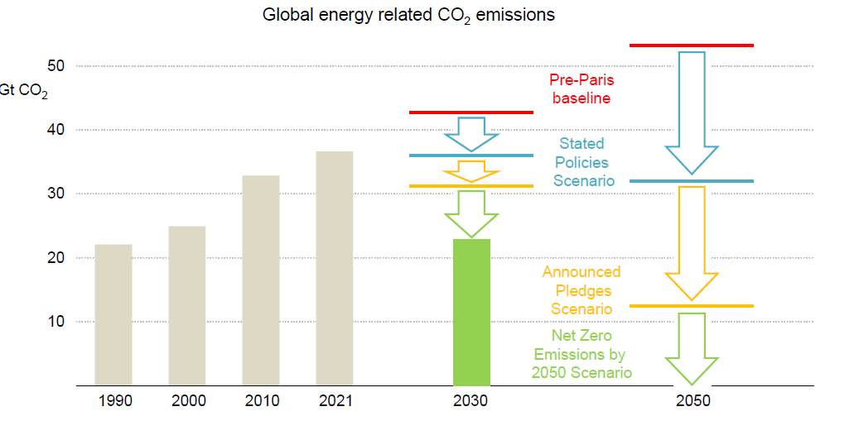
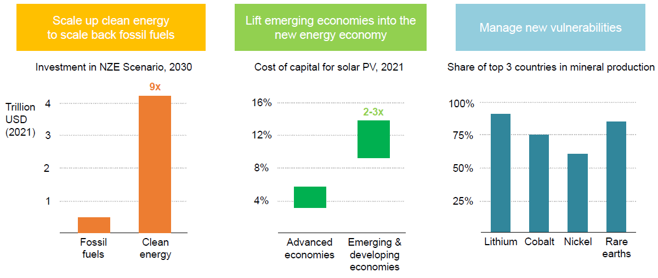
IEA Net Zero Emission (NZE) scenario 2050
The current trend (SPS scenario) will fail to meet the goals of NZE by 2050.
Additional policies must be implemented in order to achieve NZE by 2050.
Crucial Points
Investments in green technologies.
Emerging Countries must develop green technologies.
Availability of materials for the green technologies.

Slide 12
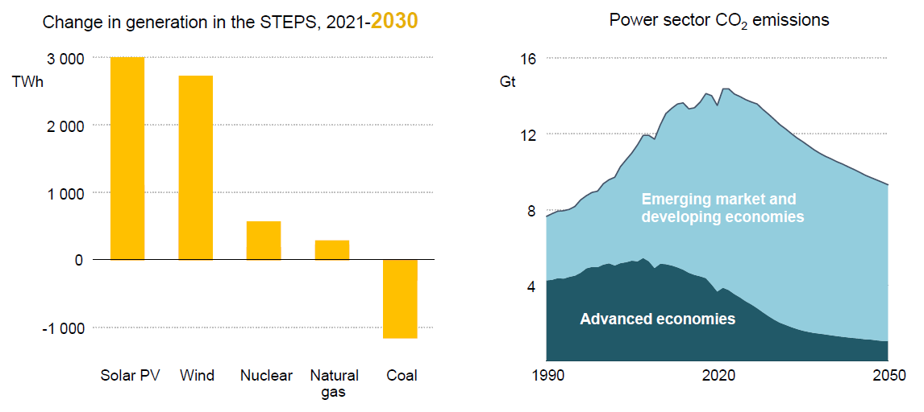
Change in generation: current scenario
Coal will be rapidly replaced by renewables; a certain share of nuclear and natural gas is expected by 2030.
Source: IEA 2022

Slide 13
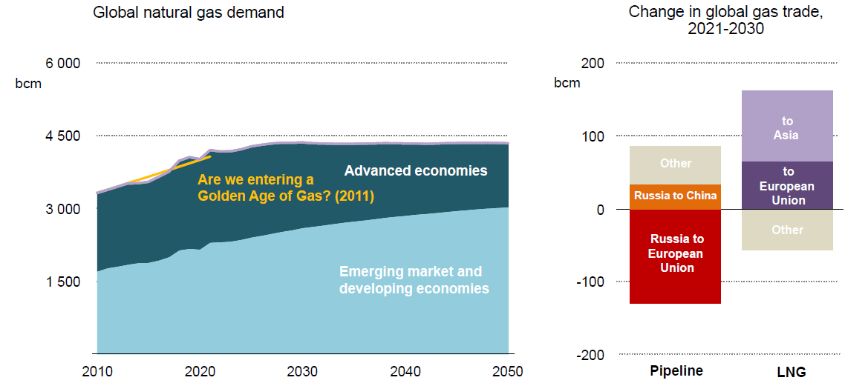
Toward a fully electric energy scenario
Energy security issues brings to an end the growth of the NG demand. LNG will continue to play a crucial role.
Source: IEA 2022

Slide 14
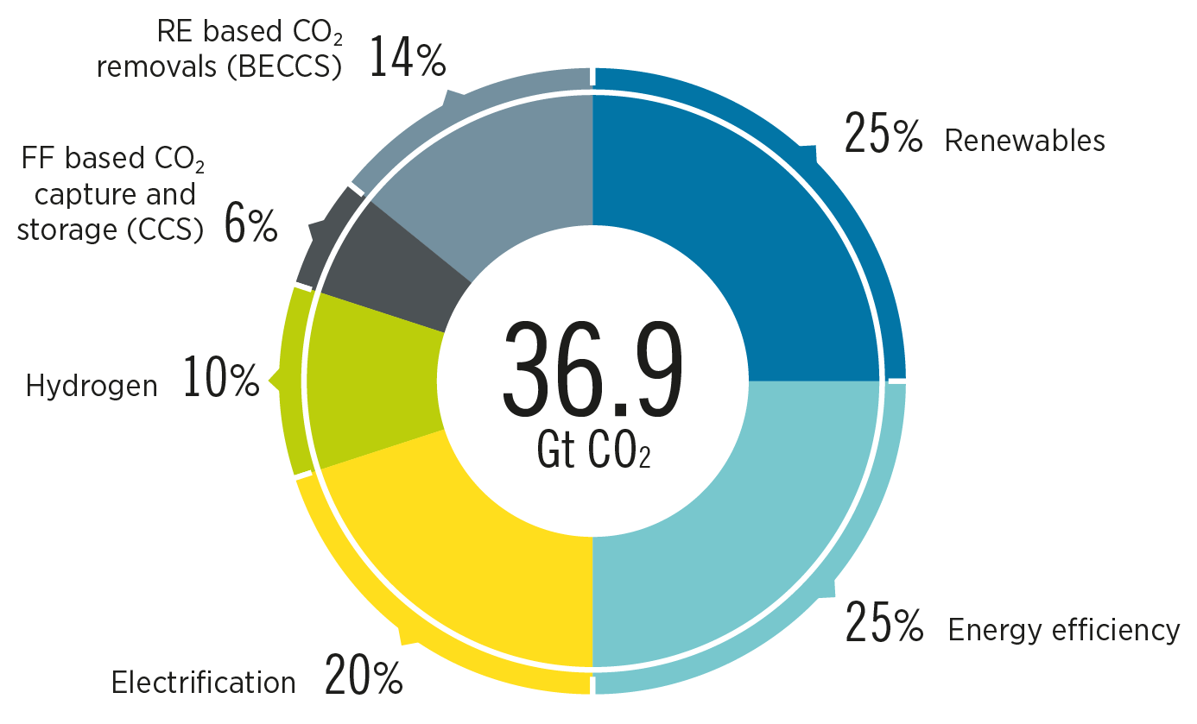

Technologies for NZE scenario
1.5 °C increase pathaway
14
Energy efficiency
Carbon Capture
Energy storage (H2, P2X)
Direct utilization of renewable electricity
Decarbonization and Electrification of user demand (EV, HP)
Source: IRENA 2022

Slide 15
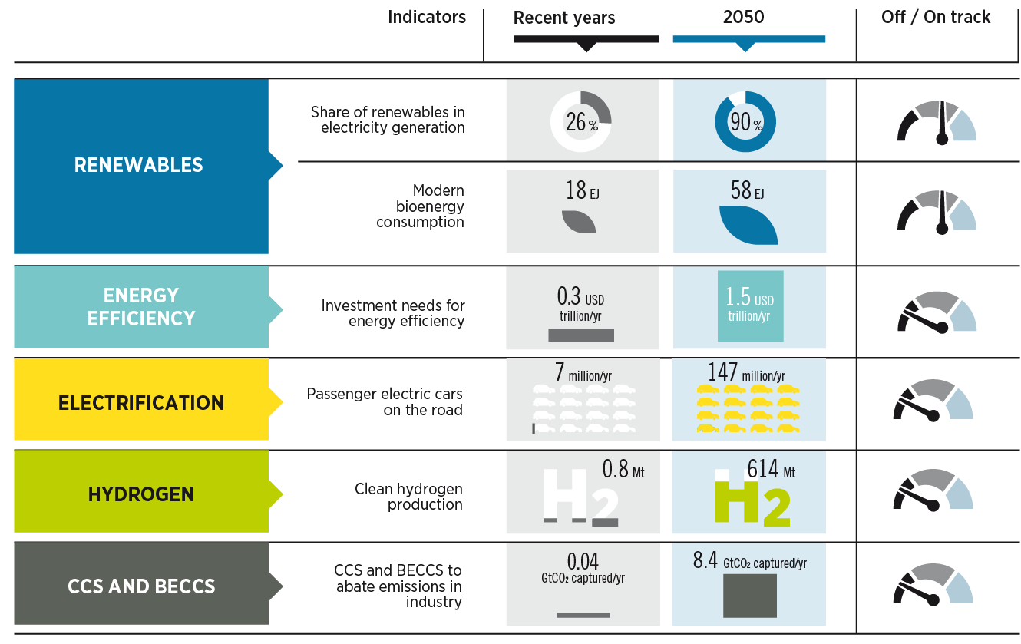
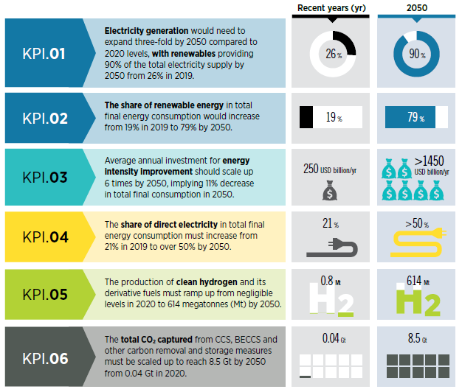
The transition is far from being on track to 1.5 °C
15
Green H2
Bioenergy
EV
Buildings
Energy networks
Energy Storage
The actions taken by 2030 will affect the results achieved in 2050. A radical change is mandatorily required.
Source: IRENA 2022

Slide 16
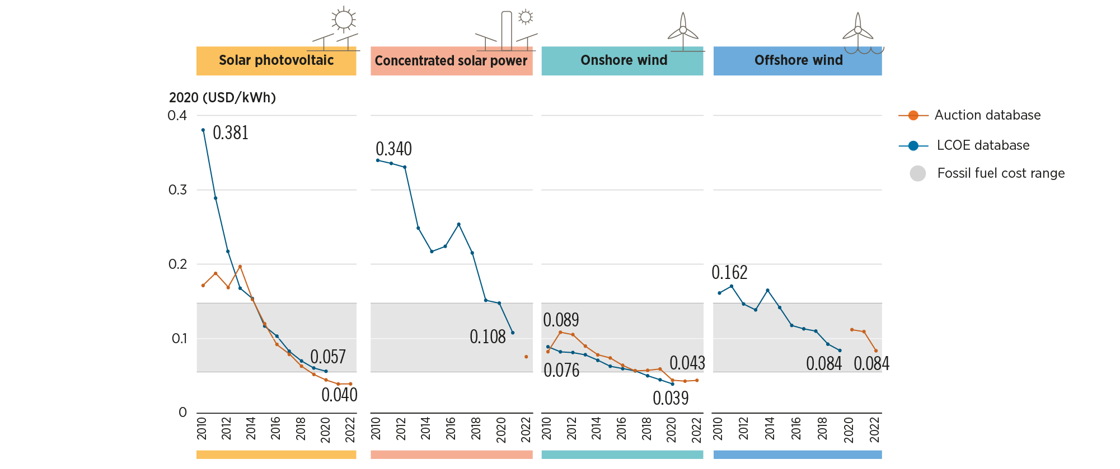
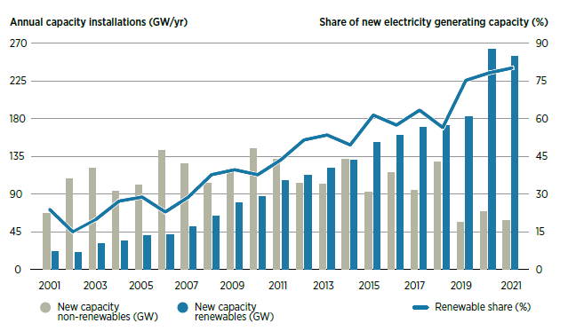
Renewable electricity
16
PV and wind technologies show the best profitability, also showing the fastest increase in the installed capacity.
PV and wind LCOE is competitive with the one of fossil fuels.
Source: IRENA 2022
The total installed renewable capacity in 2021 is 3.1 TW, generating about 8.0 PWh.
To meet the 1.5 °C scenario, the installed renewable capacity must grow by a factor 3, by 2030
The renewable capacity installed in 2021 is lower than the one of 2020!!!!

Slide 17
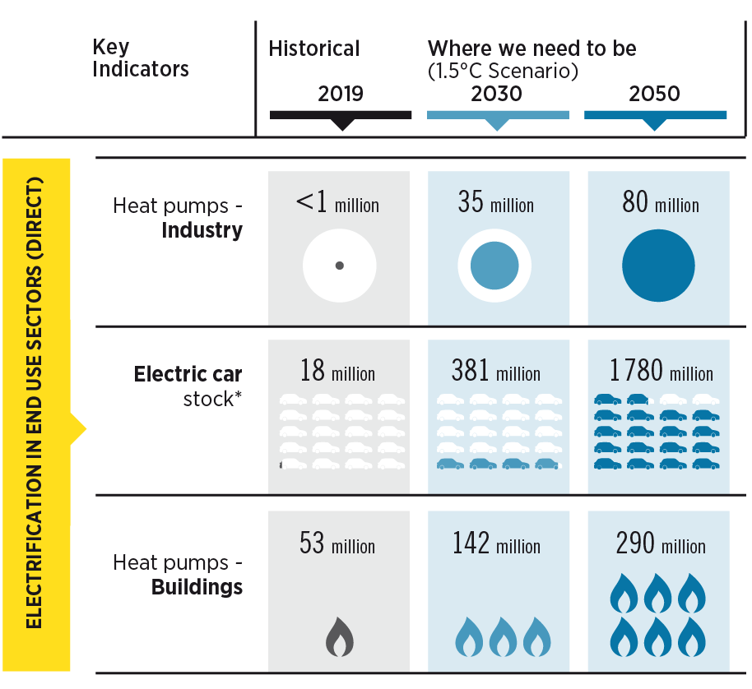
Electrification of end user demand
17
The share of electrification in end-use sectors like industry, buildings, transport to reach 28%, 56%, and 9% in 2030, respectively.
World electricity demand will rise to 31 PWh by 2030
(1.3 higher with respect to 2019)
Source: IRENA 2022

Slide 18
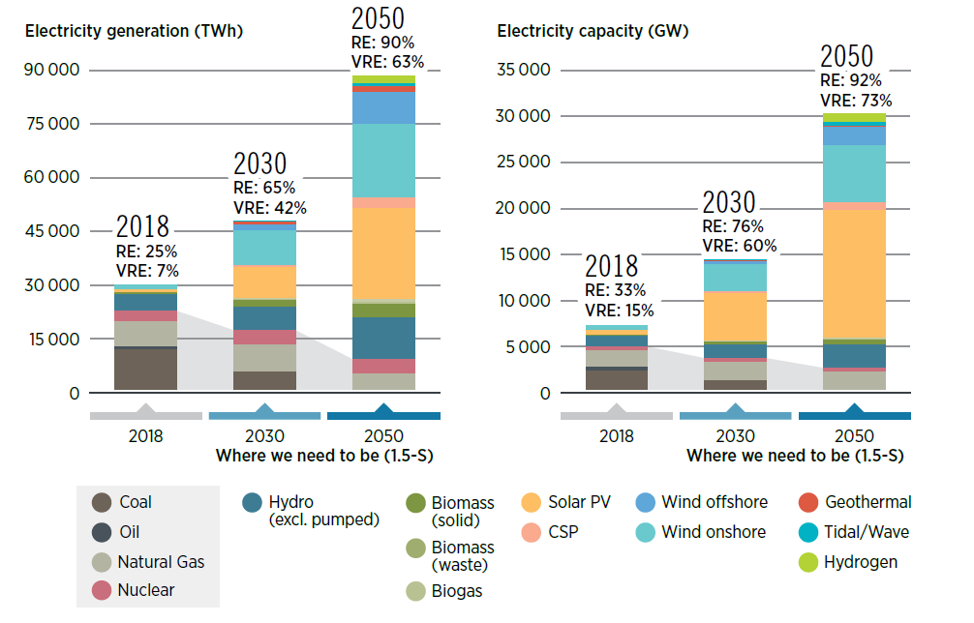
IRENA 1.5 C scenario: electricity
18
Source: IRENA 2022
Renewables will provide 65% (42 % consisting of variable RE) of the total electricity supply by 2030
Specific policies and measures such as RE targets, tax incentives, pricing mechanisms, among others are needed to increase the deployment of renewables
Huge increase of VREs: need for energy storage and/or P2X technologies

Slide 19
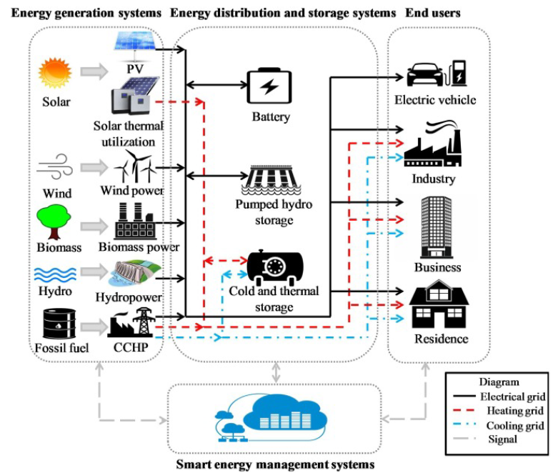
Smart Energy Networks
Integration of several energy users
Optimization of the overall load profile, implementing suitable synergies among different energy users.
Control strategies
Development of advanced control strategies to improve the energy efficiency of the network.
Polygeneration
➔
Production of several energy vectors and/or byproducts.
Future (smart) energy network based on renewable multigeneration systems.

Slide 20
A novel paradigm based on distributed polygeneration
Polygeneration, or multi-generation, is usually defined as the combined production of multiple energy vectors (e.g. electricity, cool, heat, etc) and/or products (e.g. hydrogen, methanol, etc) using natural resources (fossil fuels, wood, etc) and/or renewable energy sources (solar, wind, biomass, etc).
Simple examples are: Cogeneration and Trigeneration.
Resources
Fossil fuels:
Oil, Natural gas, Coal, etc.
Renewable energy
Sun, Wind, Biomass, etc
Natural resources
Maize, Sugar Cane, etc
Polygeneration
Products
Energy vectors:
Electricity, Cool, Heat, etc.
Energy Products:
Hydrogen, Ethanol, Methanol, Biogas, Syngas, Steam, etc
Non Energy products
Drinking water, Sugar, CO₂, O₂, etc

Slide 21
Polygeneration: layouts
Fertilizer
H2
Methanol
Gasifier
Production unit
Coal
CC
Syngas / biogas
Ethanol
Biomass
Boiler
Fresh water
Wind
Electrical desalination unit
ICE
Natural gas
Power
Electricity to user
Cooling
GT, MGT
FC
ST
Electrical chiller
Seawater
STE
Heat
Thermal chiller
STC
PV
DHW, Heating
Solar
Fresh water
PVT
ORC
Thermal desalination unit
Geothermal

Slide 22
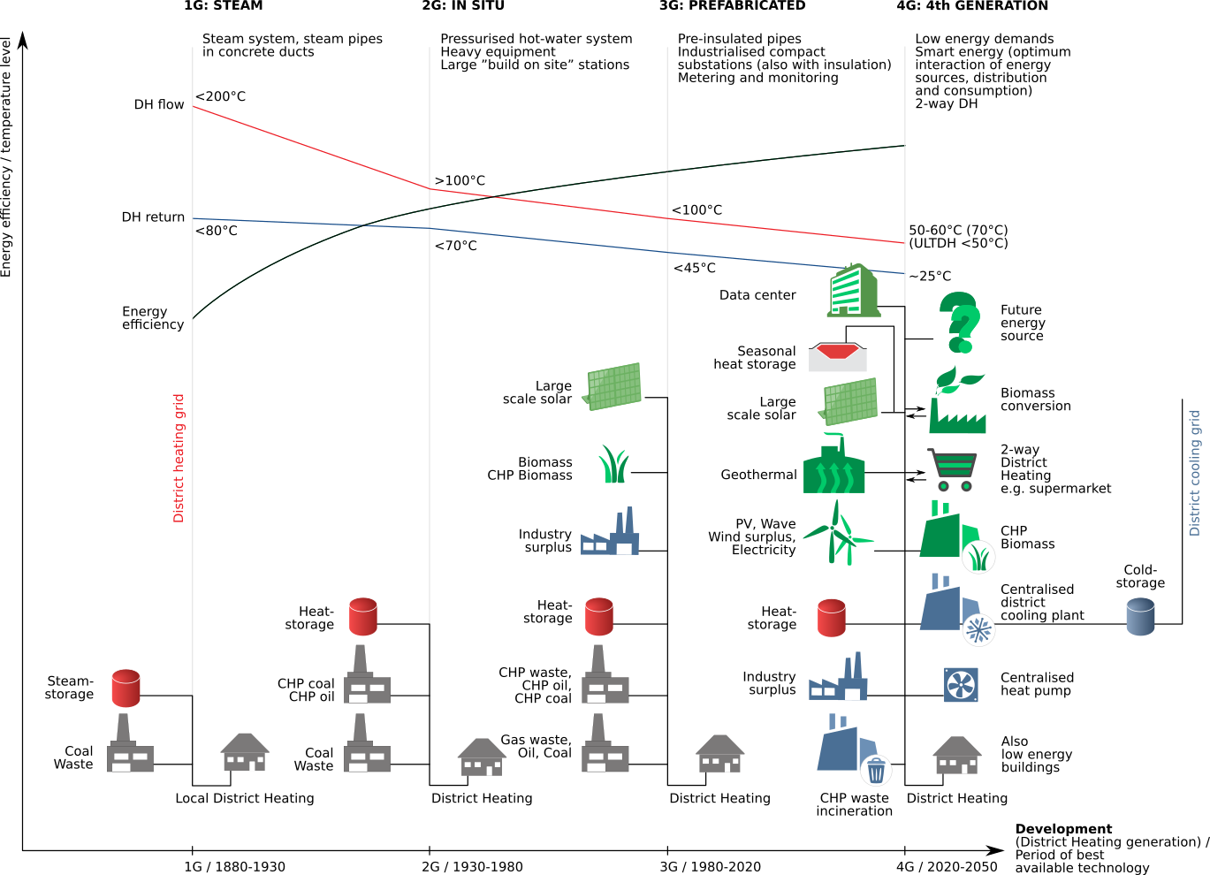
Thermal Energy Networks: DHC
Energy Volume 68, 15 April 2014, Pages 1-11

Slide 23
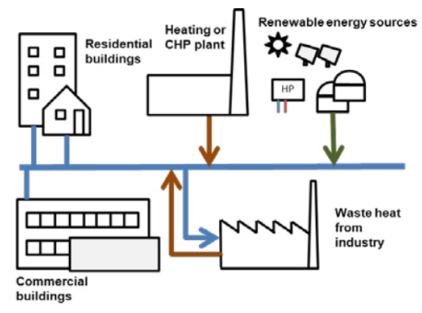
4th generation DHC
Low operating temperature: 55-60°C supply / 25-30 °C return.
Centralized thermal energy production.
Integration of renewable energy technologies.
Use of thermal energy storages (TES) to reduce peak network flows.
Integration of HPs and low-temperature renewable sources.
Different pipings for heating and cooling
The system is not able to simultaneously match both buildings heating and cooling demands
Temperatures of heating and cooling loops are different.
The centralized production is not feasible for all the urban areas

Slide 24
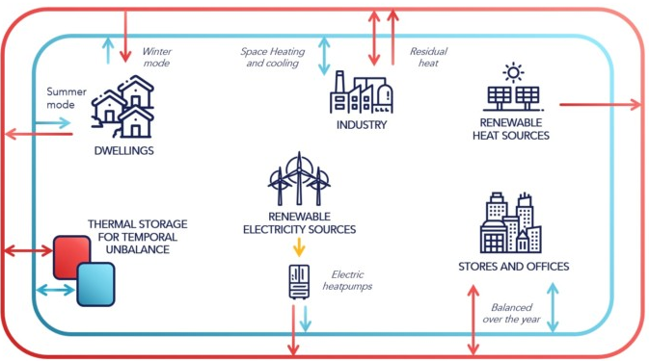
5th generation DHC
Neutral operating temperature: -5 °C→35 °C
Bi-directional low temperature networks.
2,000
Use of hybrid substations based on reversible heat pumps.
Use of thermal energy storages (TES), in some cases.
The system simultaneously matches both the heating and cooling demands of different buildings
Exchange of excess thermal / cooling energy among buildings in the network.
Users are
PROSUMERS
The system should be installed in densely populated areas.

Slide 25
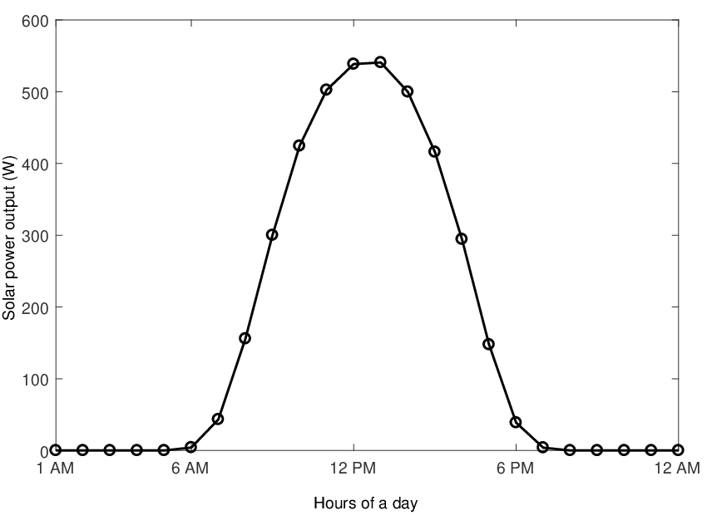
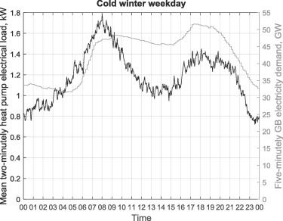
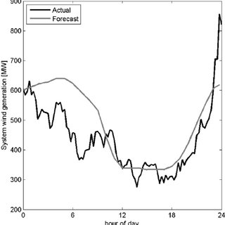
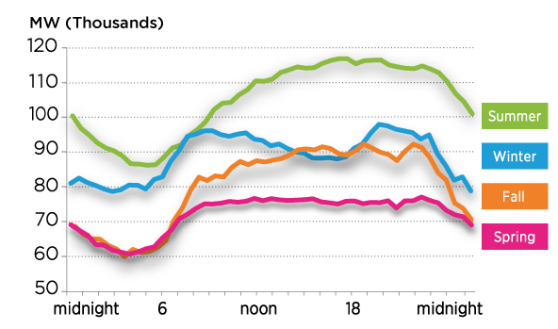

Smart Energy Networks electrical balance
4th and 5th generation DHC, mainly based on electrical HPs
VREs (wind, PV, etc)
$$≠$$
User load demand

Slide 26
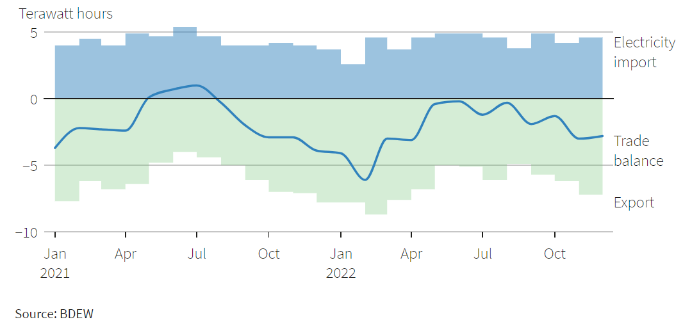

Smart energy networks
VRE and excess renewable energy
Germany
Storage Systems
The penetration of renewables in energy networks and smart energy networks is limited by the mismatch between the renewable power production and power demand.
Electricity imported/exported to the grid should be limited to avoid a stress of the grid.

Slide 27
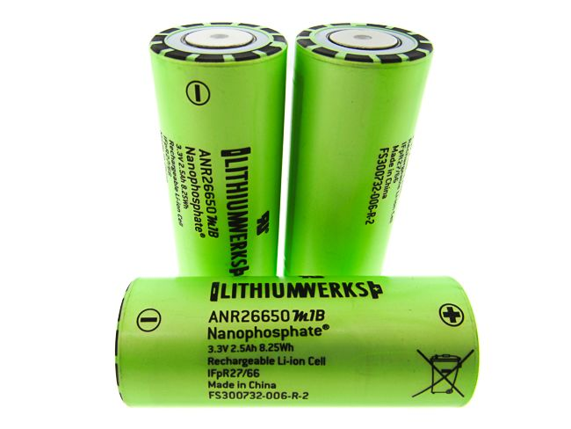
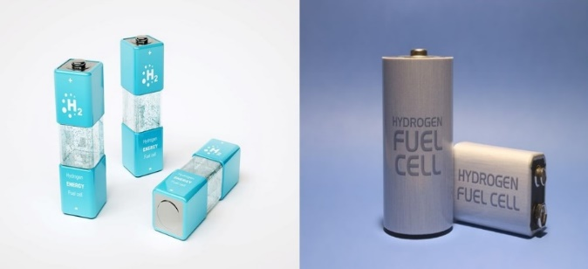
Excess renewable energy
Storage Systems
Lithium-ion battery
Power to X
Pros
Cons
Pros
Cons
mature technology
low capital cost
limited flexibility
very flexible
higher power density
not yet mature
high capital cost

Slide 28
Power-to-X: Definition
“Power-to-X processes are defined as processes with the goal to exploit the environmental and economic potential of renewable electricity”
Jannik Burre et al. – Chemie Ingenieur Technik, 2019
“the means to convert electricity, understood to be primary energy, into an energy carrier, heat, cold, product, or raw material. It is an umbrella term for different ways of generating energy, namely power-to-gas, power-to-liquid, power-to-fuel, power-to-chemicals and power-to-heat”
Michael Sterner, professor of OTH Regensburg University (GE), 2021
“the process of converting green electricity into hydrogen or PtX products based on hydrogen”
DANSK ENERGI, 2020
“the concept of Power-to-X can be further incorporated to transform the generated renewable electricity into chemical energy stored in the gas form”
Lim JY et al. – Applied Energy, 2021

Slide 29
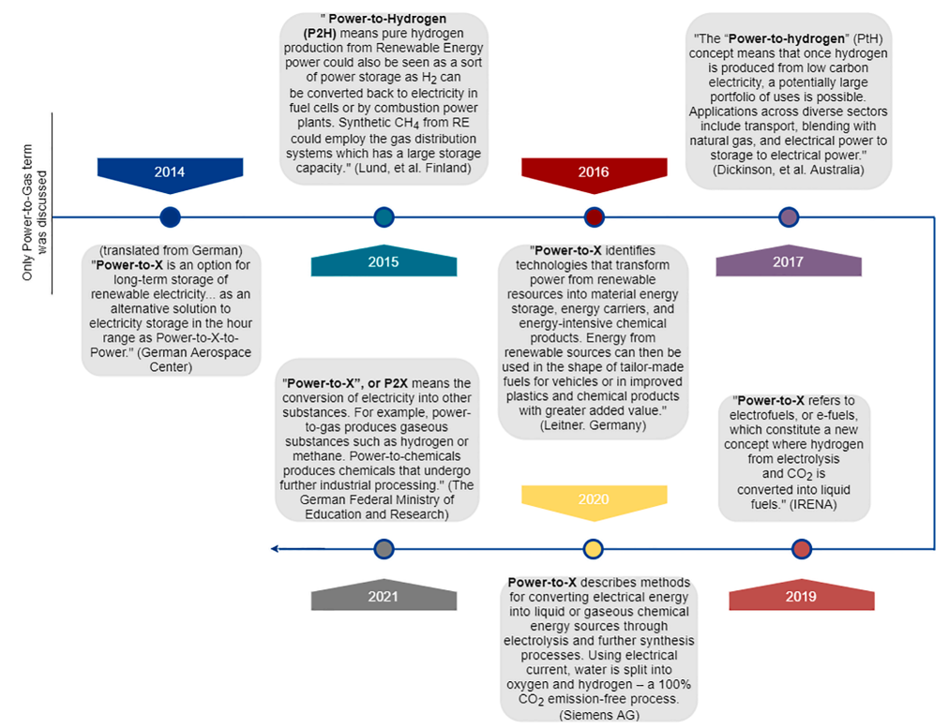
Power-to-X: History
Energy Conversion and Management 266, 2022, 115814
The terminology is a broader extending of large-scale storage systems.
First mention to the e-fuels, which are chemicals produced starting from renewable electricity.
First appearance of the term.

Slide 30

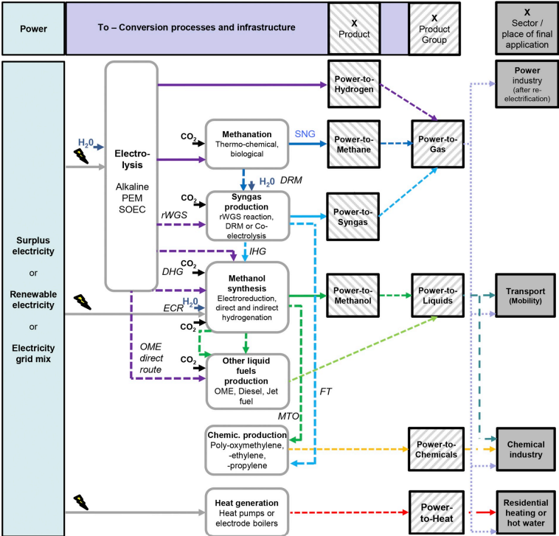


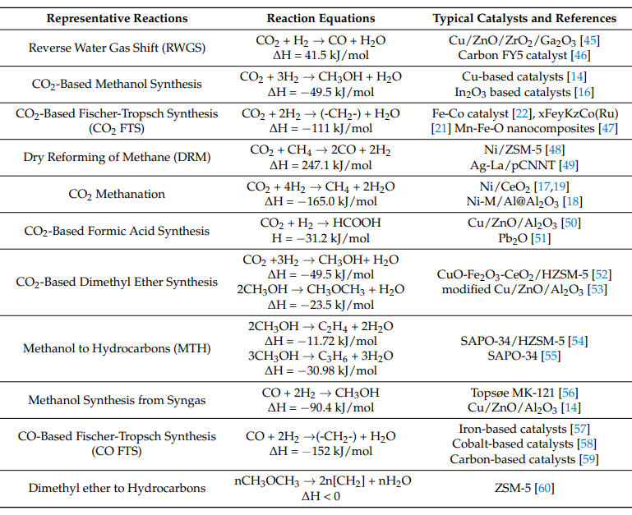
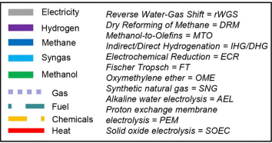

Power-to-X: Overview
Renewable and Sustainable Energy Reviews 112, 2019, 865-879
DRM
RWGS
DHG

Slide 31
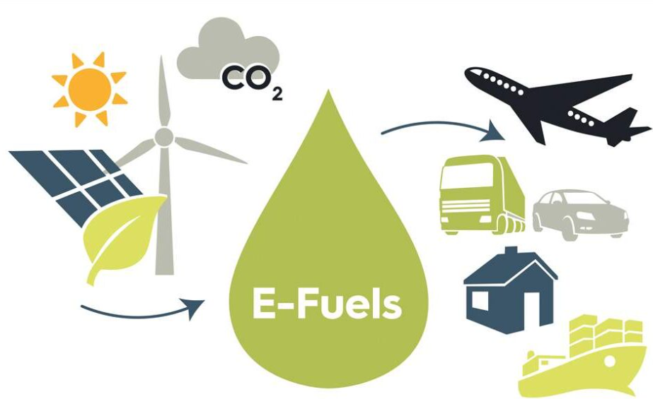
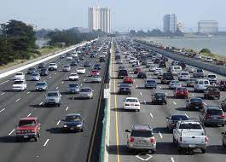



e-Fuels
Fuels with net zero CO₂ emissions.
The H₂ comes from electrolysis driven by the excess renewable energy and the CO₂ is captured from the atmosphere, power or industrial plants
Road vehicles sector
Building sector
European Green Deal
H₂ Strategy: 40 GW electrolysers and 10 million tonnes of renewable H₂ by 2030
H₂-derived synthetic fuels or PtX fuels such as e-kerosene and other electrofuels.
Maritime sector
Aviation sector
Fit For 55
ReFuelEU Aviation - FuelEU Maritime
RED II
Renewable fuels of non-biological origin (RFNBOs)
Recycled carbon fuels (RCFs) under which P2X pathways are included with hydrogen (in the case of RFNBO).
E-kerosene: is produced from renewable electricity and captured CO₂.
E-ammonia: produced do be used in blended dual-fuel engines to abate CO_{x}.

Slide 32
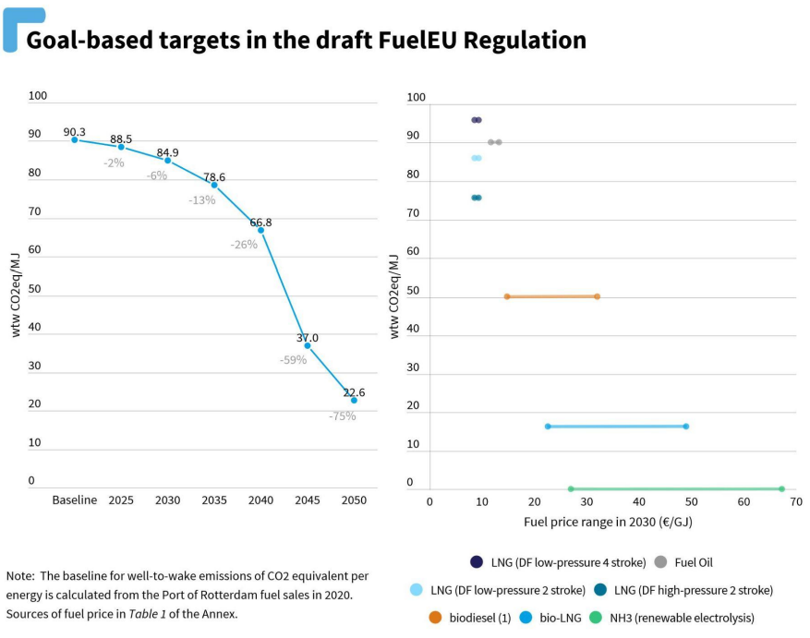
e-Fuels: FuelEU Maritime
The envisaged regulatory trajectory is calculated on the basis of 2020 fuel mix resulting in a 90.3 gCO₂eq/MJ 1 fleet-level baseline Well-To-Wake (WTW) fuel carbon intensity performance.
Competitiveness:
1st: fossil LNG in dual-fuel (8.5-9.3 €/GJ)
2nd: Waste-based biodiesel (2030 price 14.8-32.0 €/GJ for used cooking oil).
3rd: green ammonia (26.9-67.2 c€/GJ).
Biodiesel can be dropped-in in existing dual-fuel engines, e-ammonia requires new vessels.

Slide 33
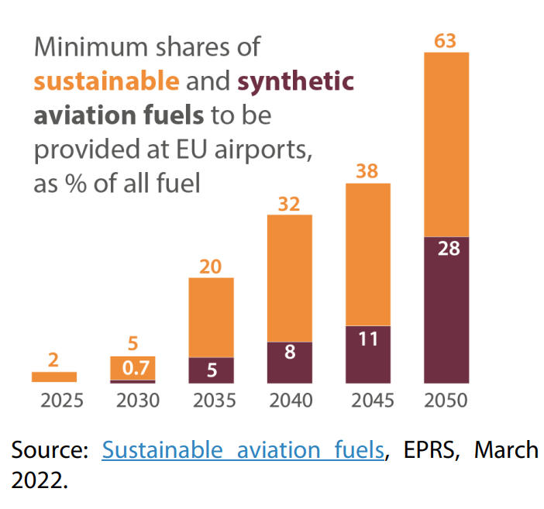
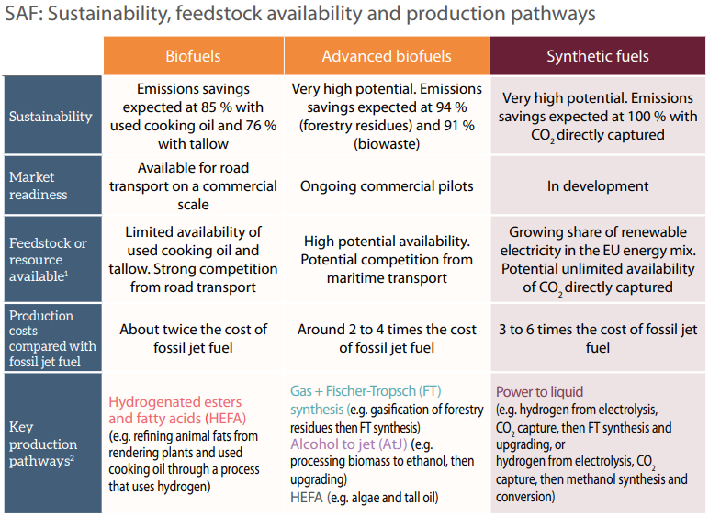
e-Fuels: ReFuelEU Aviation
The fit for 55 package includes a proposal to increase production and use of sustainable aviation fuels (SAF), also known as the ReFuelEU Aviation initiative.
The Commission puts forward obligations on fuel suppliers to distribute SAF when supplying fuel at EU airports, in order to enhance SAF uptake by airlines and so help reduce emissions from aviation.

Slide 34
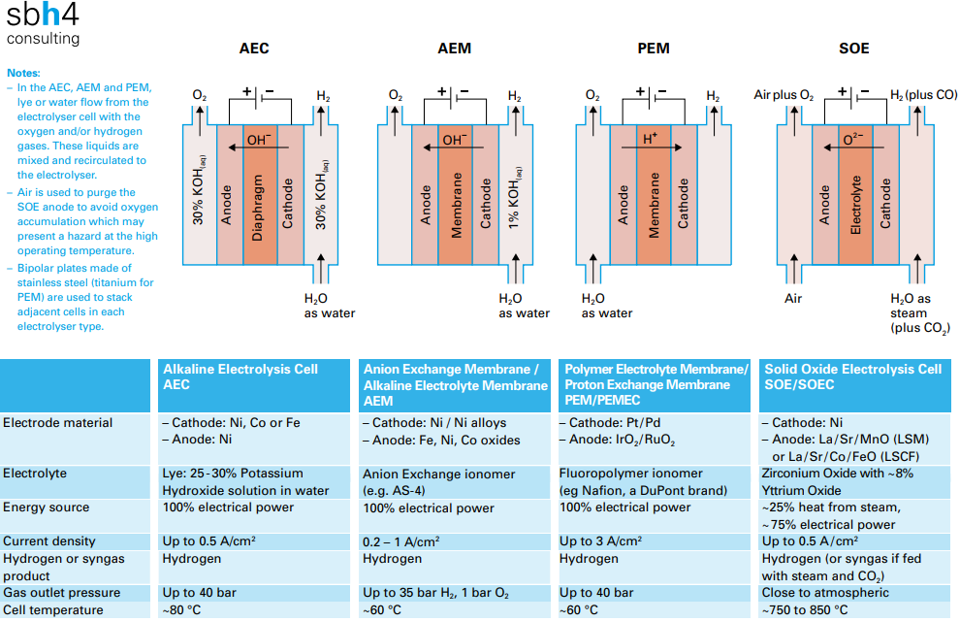
Power-to-Gas: Electrolysis
0.8 – 1.2 k€/kW
h 70% - 82%
1.3 – 2.3 k€/kW
h 50% - 80%
4.0 – 6.0 k€/kW
h 80% - 90%

Slide 35
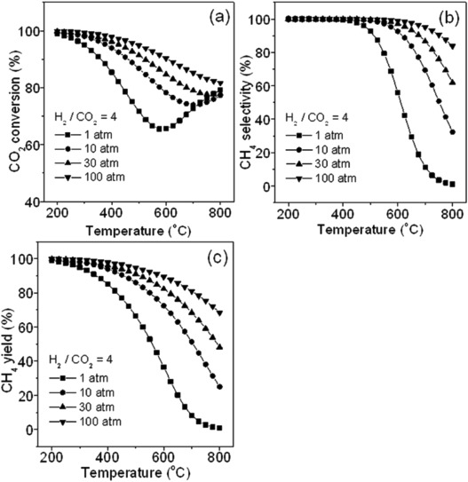
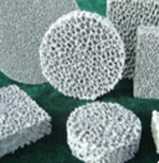
Power-to-Gas: Methanation
Methanation process combines hydrogen and carbon dioxide to produce methane and steam, according to Sabatier reaction. At the equilibrium, the production of methane is promoted at high pressure and inhibited at high temperature level.
CO₂ + 4H₂ → CH₄ + 2H₂O
Key factors
Exothermic reaction ∆H⁰_{298K} = -206.28 kJ/mol;
Nichel-Allumina catalyst;
Catalytic methanation occurs at T > 250 °C.
A biological methanation process is also under investigation. The process is supported by highly specialized microorganisms (Archaea) within a technical system converting H₂ and CO₂ in CH_{4.}
Since catalytic reactors are not supposed to withstand temperatures higher than 550 – 700 °C, the main interest in research regards the control of the operating temperature of the process.
The heat produced by the exhotermic reaction may be recovered to support steam production in case of SOEC electrolysis.

Slide 36
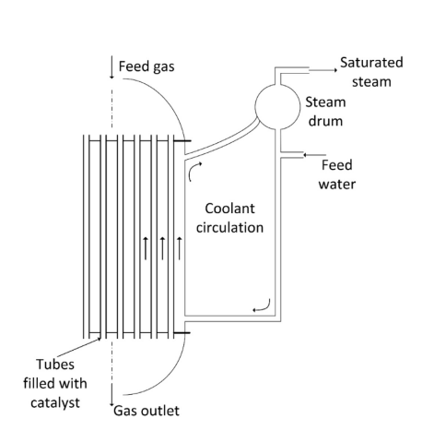
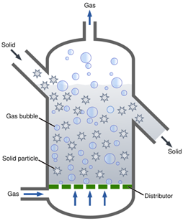
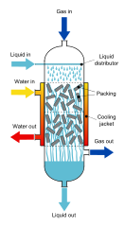
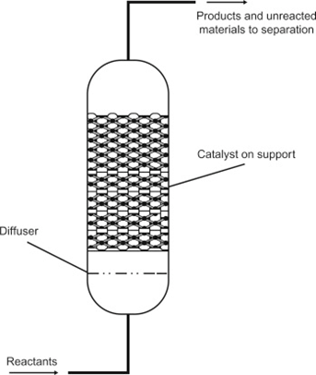

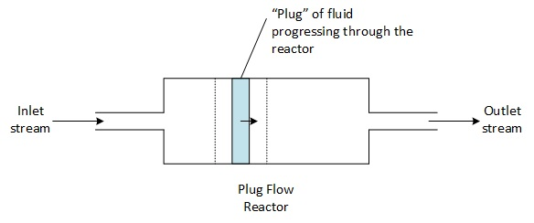
Power-to-Gas: Methanation reactors
Fixed-bed adiabatic reactor
Fixed-bed cooled reactor
Fluidized-bed reactor
Tri-phase reactor
High internal temperature due to exotermic reaction.
Combines advantages of isothermal and adiabatic reactors.
Molecules fluidification comes with mechanical stress on reactor’ surface.
Disadvantages due to liquid-gas resistance.
Energy Convers. Manage.
115, 2016, 308-326
Renewable Energy
170, 2021, 1040-1051
Usually these reactors are modelled as plug flow reactor (PFR) to observe the temperature gradient along the reactor. The control of the process heat is crucial for these reactors.

Slide 37
CO₂ Capture
Ambient Air
Biomass
Power & industrial plants
CO₂
CO₂ can be obtained from biomass plants, power generation plants, industrial processes and ambient air.
Sector | CO₂ sources | CO₂ concentration in exhaust gas [vol%]
Biomass processes | Biomass fermentation | 15–50
 | Biogas upgrading | ≈100
 | Bioethanol production | ≈100
Power generation plants | Natural gas combustion | 3-5
 | Petroleum combustion | 3-8
 | Coal combustion | 10-15
Industrial processes | Cement production | 14-33
 | Iron and steel production | 20-30
 | Ethylene oxide production | ≈100
Environment | Ambient air | ≈0.04
The most relevant CO₂ sources, are these from cement manufacturing, iron and steel making, and chemical processes, in which CO₂ is generated as by-product as in the process of ethylene production.
CO₂ from ambient air (DAC) is technically feasible but, due to the very low partial pressure of CO₂, the specific costs of the vision are very high.

Slide 38
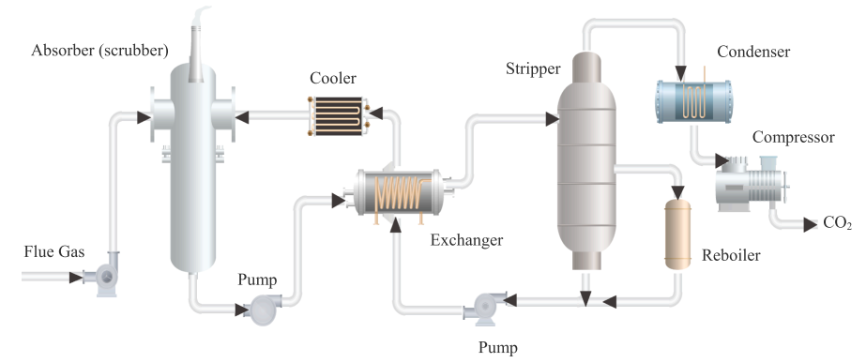
CO₂ Capture
The CO₂ capture process in the CCS (Carbon Capture and Storage) unit could be divided into two phases: CO₂ separation and CO₂ compression. CO₂ separation is the main part of the CO₂ capture process.
International Journal of Electrical Power & Energy Systems, 143, 2022, 108503

Slide 39
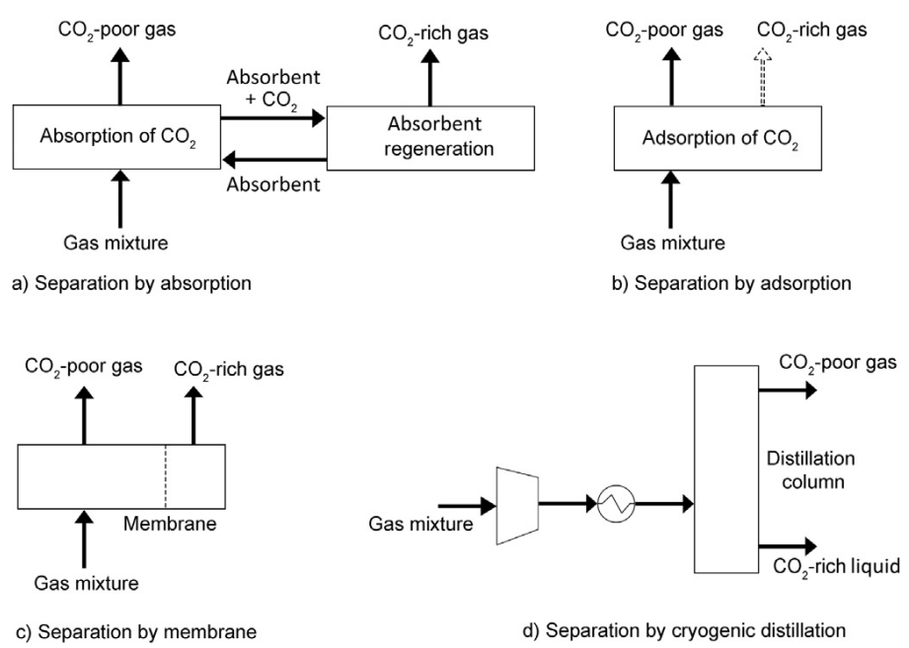
CO₂ separation technologies
Absorption
CAPEX = 4-5 k€/(m³/h)
Adsorption
Absorption
Fast kinetics and high thermal stability but low CO₂ capacity at low pressures.
CAPEX = 5.5 k€/(m³/h)
With amine → mature but corrosive.
With water → no corrosion but high losses.
High CO₂ capacity at high pressure but huge energy consumption.
Membrane
Low capital costs and compact design but low gas capacity and high temperatures cause degradation of the membranes.
Cryogenic
CAPEX = 4.5 k€/(m³/h)
Renewable and Sustainable Energy Reviews 81, 2018, 433-446
CAPEX = 6 k€/(m³/h)

Slide 40





CO₂ Capture from Biogas
CO₂ is withdrawn as a by-product of the biogas upgrading unit, which selectively separates the methane from the carbon dioxide.
Bio-methane
Biogas
CO₂
The biogas is a gaseous compound obtained from the anaerobic digestion (AD) process of several types of organic biomasses.
The collected CO₂ maybe combined with the H₂ produced by electrolysis using the excess renewable energy, producing methane, featured by a net-zero environmental impact.

Slide 41



Green and blue hydrogen
In 2020, on 70 millions of H₂ produced, only 4% was “green”.
Energy Conversion and Management 266, 2022, 115814
The hydrogen produced by renewables is called “green” whereas the one produced by fossil source is “blue” in case of CCS or “gray” without CCS.

Slide 42


Power-to-Liquid H₂
Energy Conversion and Management 266, 2022, 115814
Electrolysis reaction:
Liquid H₂ is recommended for long distance transportation and large-scale consumers, where H₂ compression is no more feasible.
The liquefaction process follows a Claude cycle.
The green alternative final price is 7 $/kgLH₂ or in a range 2.5–4.5 $/kgLH₂ because of the significant difference in electricity price. The price of green liquid hydrogen is approximately two to three times higher than the cost of conventional liquid hydrogen production from fossil fuels, including CCS 1.4–3.4 $/kgLH₂.

Slide 43

Power-to-Liquid H₂: Key factors
Energy Conversion and Management 266, 2022, 115814
Roundtrip efficiency of the system:
0.35 – 0.45
Hydrogen, either in gas or liquid form, can store less hydrogen in the same volume as ammonia or methanol.
Energy density (W/cm²):
0.20 – 0.45 (generation)
0.35 – 1.15 (storage)

Slide 44

Power-to-Methane
Power-to-Gas could promote a rapid transition to low-carbon fuels by blending natural gas (NG) and hydrogen in existing pipelines.
the Power-to-Methane (PtM) concept is a promising option to exploit surplus renewable energy.
Hydrogen causes embrittlement and corrosion in the natural gas pipelines, and special materials such as polyethylene should replace the steel pipelines when dealing with percentages higher than 20 % of hydrogen mixture.
Renewable and Sustainable Energy Reviews 98, 2018, 302-316

Slide 45


Power-to-Gas: CH₄ & CH₄-H₂ blending
The methanation reaction is exothermic and its change in moles is negative, therefore the process is promoted at low temperature and high pressure.
Roundtrip efficiency of the system:
0.36 – 0. 56
Hydrogen can be produced at a price of 5.8–6 $/kg H₂ from wind electrolysis, while hydrogen produced by the steam reforming process costs 1.25–3.5 $/kg H₂.
Energy Conversion and Management 266, 2022, 115814
Energy density (W/cm²):
0.20 – 0.45 (generation)
0.40 – 1.20 (storage)

Slide 46


Power-to-NH₃
Energy Conversion and Management 266, 2022, 115814
Energy Conversion and Management 266, 2022, 115814
Ammonia is currently used mainly in the agricultural industry as a fertilizer, but it is also heavily used in the refrigeration industry as a working fluid.
The long-distance transportation of hydrogen can be performed in ships powered by clean ammonia, after the development of an ammonia dual-fuel engine (2025).
Haber-Bosch synthesis:
Ammonia is a promising hydrogen carrier because every molecule of ammonia (NH₃) contains three hydrogen atoms.

Slide 47

Power-to-NH₃: Key factors
Energy Conversion and Management 266, 2022, 115814
Roundtrip efficiency of the system:
0.26 – 0.43
Energy density (W/cm²):
0.18 – 0.35 (generation)
0.30 – 0.80 (storage)
SPB 5 years with Haber-Bosch reactor and Solid Oxide electrolyzer technology.

Slide 48


Power-to-methanol
Energy Conversion and Management 266, 2022, 115814
In 2020, 157 million metric tons of methanol were produced worldwide, making it one of the most highly synthesized chemicals after ammonia, but it is expected to equal ammonia production in 2030.
It is mainly used for producing other chemicals, such as formaldehyde, acetic acid, and plastics, but smaller quantities are also used as fuel for vehicles, ships, industrial boilers, and cooking.

Slide 49

Power-to-methanol: Key factors
Energy Conversion and Management 266, 2022, 115814
Roundtrip efficiency of the system:
0.33 – 0.45
Energy density (W/cm²):
0.17 – 0.38 (generation)
0.40 – 0.90 (storage)
SPB < 5 years for biomass integrated with SOEC plants.

Slide 50

Power-to-Heat
P2H using excess variable renewable energy (VRE) may be used to supply heat by electric boilers or HPs.
Applied Energy 212, 2018, 1611-1626

Slide 51

Power-to-Heat: Applications
Thermal Energy Storage (TES) can play a crucial role in achieving future decarbonization goals in Europe, especially in a highly renewable energy integrated system.
Power to heat conversion is far from the location of the demand (storage is mandatory).
Power to heat conversion is close to the location of the demand (storage may be not necessary).
Applied Energy 212, 2018, 1611-1626

Slide 52

Power-to-Heat
Classification
Sustainable Energy Technologies and Assessments, 53, 2022, 102553
Sectors:
households and TCS (trade, commerce, and service)
industry and process heat
district heating.
Temperature
low (<120°C)
medium (120-1000°C)
high (>1000°C)
Technologies
Electric heat pumps
Electric resistance heaters

Slide 53

Power-to-Power
Electrolytical conversion of renewable power surplus into hydrogen and, or, chemicals. Electrochemical conversion of chemical storage into available power.
Gaseous Hydrogen is the most adopted chemical storage option, by means of several technologies.
Reducing the cost of SOECs will likely require a combination of different approaches, including materials development, manufacturing improvements, stack design, energy efficiency, and government policies.
International Journal of Hydrogen Energy, February 2023

Slide 54

Power-to-Power: Storage
Hydrogen storage technologies
The energy density of hydrogen is extremely low even at 300 bar.
Only liquid (cryogenic) or solid (metal hydrides) storage would make a difference.
These processes are either highly energy demanding or not suitable for large-scale hydrogen storage.
International Journal of Hydrogen Energy, 47, 2022, 17505-17525

Slide 55


Power-to-Power: Gaseous H₂
Hydrogen compression
Compression from 1 to 1000 bar requires twice as much work as compression from 30 to 1000 bar, 4 kWh/kgH2 and 2 kWh/kgH2, respectively.
International Journal of Hydrogen Energy, 47, 2022, 17505-17525
Increasing the stages leads to a reduction of compression work because the process gets closer to isothermal.
For n stages, non-isentropic compression increases the total compression work.

Slide 56

Power-to-Power: Liquid H₂
Hydrogen liquefaction
International Journal of Hydrogen Energy, 47, 2022, 17505-17525
Liquefaction of hydrogen can be divided into four general stages:
Precompression (ambient conditions).
Precooling (ambient to about 80 K).
Cryo-cooling (80 K - 30 K).
Liquefaction (30 K to LH₂ at atmospheric pressure).
Total power consumption of conventional H₂ liquefaction plants is about 13 kWh/kgH₂ (≈40% of H₂ LHV).
For advanced arrangements this consumption can be roughly halved.

Slide 57


Power-to-Power: Solid H₂
Hydrogen metal hydrides (MH)
The combination of metals or alloys with hydrogen leads to the formation of metal hydrides.
Metal hydrides density is higher than 115 kgH₂/m³.
During loading, hydrogen is adsorbed through an exothermic reaction. Conversely, hydrogen is released (desorbed) when heat is supplied to the metal hydride.
The adsorption/desorption processes make use of cooling and heating sources. These reservoirs are at temperatures of ~10°C for cooling and ~50°C for heating, even though this depends on the specific MH chosen.

Slide 58
Power-to-Power: Fuel Cells
 | Low temperature fuel cells |  |  | High temperature fuel cells
 | AFC (Alkaline) | PEFC (Proton Exchange) | PAFC (Phosphoric Acid) |  | MCFC (Molten Carbonate) | SOFC (Solid Oxide)
Temperature (°C) | 60-120 | 70-100 | 160-220 |  | 600-650 | 800-1000
Pressure (bar) | - | 1.5-4 | - |  | - | -
Electrodes | PFTE e noble metals | Graphite | PFTE |  | Nichel | LMS, Ni,ZnO₂
Electrolyte | KOH | Polymer membrane | H₃PO₄ |  | Alkaline metals carbonate (CO₃²⁻) | Yttrium-stabilized Zirconia
Catalyst | Pt, Pd, Ag, Ni | Pt | Pt |  | Ni | -
Charge carrier | OH⁻ | H⁻ | H⁻ |  | CO₃²⁻ | O²⁻
Electric efficiency (LHV) (%) | 60 | 40-50 | 40-50 |  | 45-55 | 45-60
Power density (mW/cm²) | 300-500 | 300-900 | 150-300 |  | 150 | 150-270
Materials | Plastic, graphite, Inconel | Graphites, metals | Graphites |  | Nichel, inox | Ceramics, metals
State of art | Small power plants | Advanced experimentals | Demonstrative plants up to 11 MW |  | Demonstrative plants up to 2 MW | Demonstrative plants up to 0.30 MW
Pros | High power density | High power density, non volatile electrolyte, fast starting up | High efficiency in CHP, mature technology |  | High temperature heat, high efficiency, possibility of internal reforming | High temperature heat, high efficiency, catalysts not necessary
Cons | No tolerance to CO, high purity of input fuel | Low tolerance to CO, water management problem | Low tolerance to CO |  | Life and stability problems, CO₂ reicirculation required | High thermal stress, slow starting up

Slide 59





A project for the polygeneration based on the green hydrogen production
Objectives
GRETHA Project
A novel paradigm based on the fuel cells and green hydrogen in order to obtain the production of electric, thermal and cooling energy for several users.
The energy transition based on the distributed energy systems at low environmental impact.
A system aims at reducing the energy dependency from foreign countries.
The development of innovative storage systems based on high energy density and competitive costs technologies.
The production from renewable energy sources in order to drastically limit the electricity from the grid.

Slide 60

A project for the polygeneration based on the green hydrogen production
Layout
GRETHA Project
The project aims at developing a novel trigeneration system based on PV panels, a high temperature PEM fuel cell, electrolyzer for green hydrogen production, a biomethane reforming unit, an ACH, hydrogen vehicles and a metal hydrides storage system.

Slide 61



A project for the polygeneration based on the green hydrogen production
Results
GRETHA Project
Development of a dynamic calculation tool for energy and economic simulation and optimization of the research prototype to predict its operation for any plant configuration, for different users and for any possible weather zone.
Experimental investigation: the most important result of the research and development activities will be the design, construction, installation and experimental test of the proposed system. The measurements performed during the tests will be able to carefully monitor all the operating parameters and environmental effects in order to validate the benefits expected from the proposed technology
Development of prototype design standards considering that the innovation of the proposed system innovative system. In particular, there are no specific methods for the design of the components, nor defined procedures for the authorization of the processes and/or for the management of the whole plant.

Slide 62

Research Projects: Power-to-Power
Power-to-power technology based on reversible SOFC
The layout is compared with the mature lithium-ion battery storage technology.

Slide 63

Research Projects: Power-to-Heat
Power-to-heat technology based on 5th generation DHC integrated with photovoltaic system
Simultaneous heating and cooling demands at the same time.

Slide 64

Research Projects: Power-to-Gas
Power-to-gas technology based on PV and solid oxide electrolyzer
The hydrogen is produced by means of solid oxide electrolysis and the carbon dioxide is obtained as a by-product of the biogas upgrading process.

Slide 65
Conclusions
The World is far from being on track to achieve the goal of 1.5°C temperature increase
A novel energy paradigm must be mandatory implemented, based on smart energy networks and renewable
In the future scenario a massive electrification of user demand is expected, also considering the use of HP and 4° and 5° generation DHC
A dramatic increase of the VRE (mostly wind and PV) is expected pointing out the issue of the mismatching between renewable production and user demand
P2X technology will play a crucial role, converting the excess renewable production in: methane, hydrogen, efuels, heat, chemicals, etc. It can be also used as electrical storage
The integration of P2X in existing and novel smart energy networks is crucial to optimize system performance and to achieve a reasonable economic profitability

Slide 66
Thank you for your attention!

