Slide 1


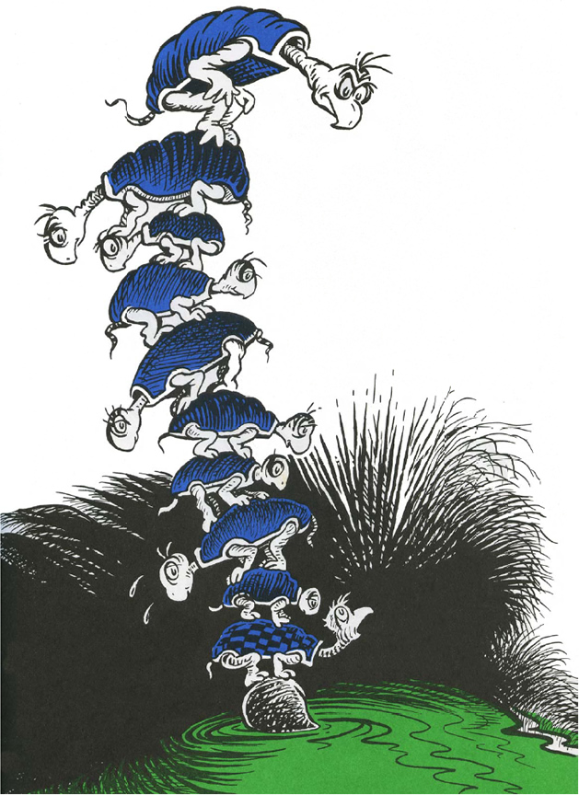

A well-known scientist (some say it was Bertrand Russell) once gave a public lecture on astronomy.
He described how the earth orbits around the sun and how the sun, in turn, orbits around the centre of a vast collection of stars called our galaxy.
At the end of the lecture, a little old lady at the back of the room got up and said: "What you have told us is rubbish. The world is really a flat plate supported on the back of a giant tortoise."
The scientist gave a superior smile before replying,
"What is the tortoise standing on?"
"You're very clever, young man, very clever," said the old lady.
"BUT IT'S TURTLES ALL THE WAY DOWN! "
- Stephen Hawking, A Brief History of Time, 1988

Slide 2



IS SimDec Truly a Revelatory Approach for Global Sensitivity Analysis? or is it Turtles All the Way Down?
SIMULTECH Conference, Bilbao, Spain, June 2025
SimDec
Julian Yeomans
Professor of OMIS | Schulich School of Business, York University, Toronto, Canada
syeomans@yorku.ca

Slide 3

Sensitivity analysis: comprehensive data analysis
Basic data analysis:
- identify most influential factors
- assess relative impacts
- what happens if these change
SA studies how uncertainty in outputs can be “attributed” to uncertainties in inputs
Uncertainty analysis: the quantification and propagation of those uncertainties

Slide 4
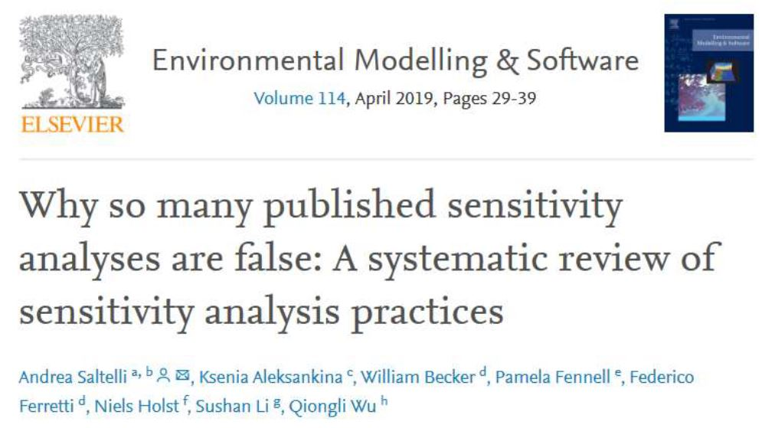
sensitivity analysis in Research
95% of research
- no SA at all!
Remaining 5%
- 4 out of 5 SAs use
one-at-a-time (OAT)

Slide 5
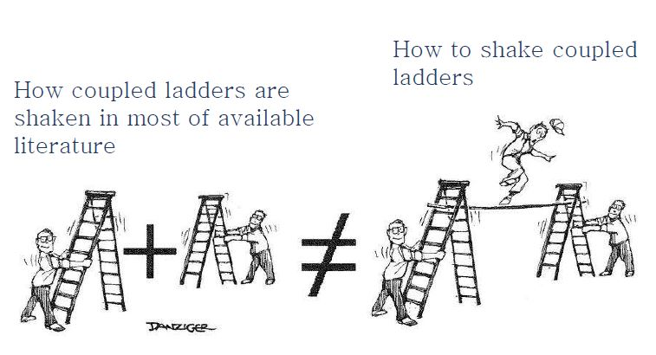
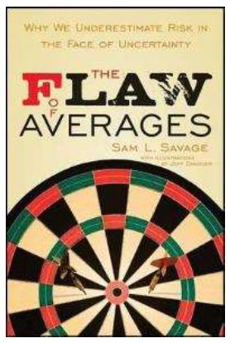
One-at-a-time sensitivity analysis of a “Structure”

Slide 6
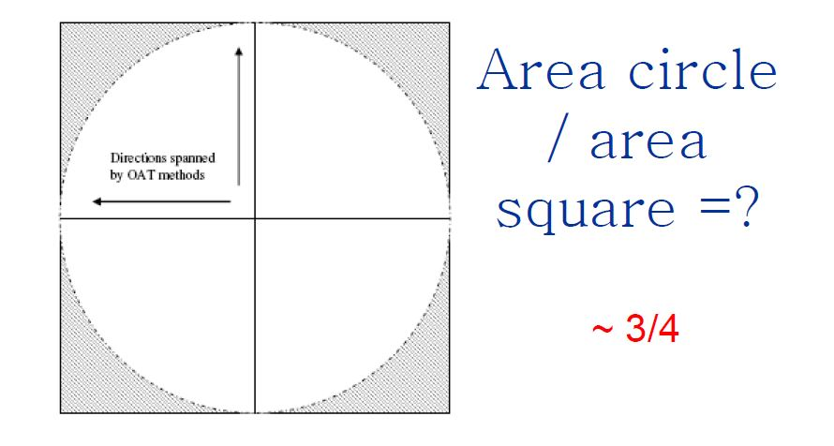
One-at-a-time sensitivity analysis in 2-dimensions

Slide 7
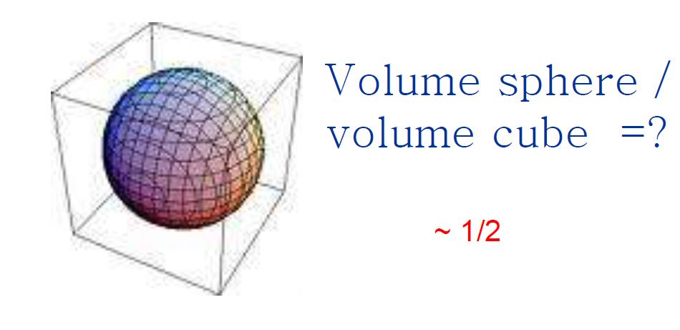
One-at-a-time sensitivity analysis in 3-dimensions

Slide 8
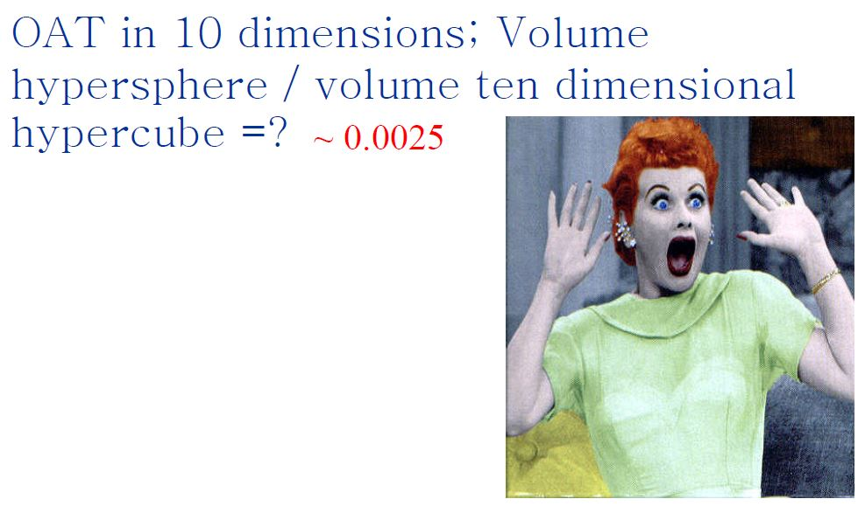
One-at-a-time sensitivity analysis in 10-dimensions

Slide 9
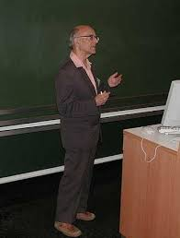
Global Sensitivity analysis uses Sensitivity indices
GSA - multi-variable SA, captures interactions (aspirationally)
Sensitivity indices quantify influence of an input (or group of inputs) on output
- SHAPLEY VALUES
- SOBOL’ INDICES
Complex, considerable data required, very computationally intensive
        (Impenetrable and inaccessible to the “Great Unwashed” ☺)

Slide 10
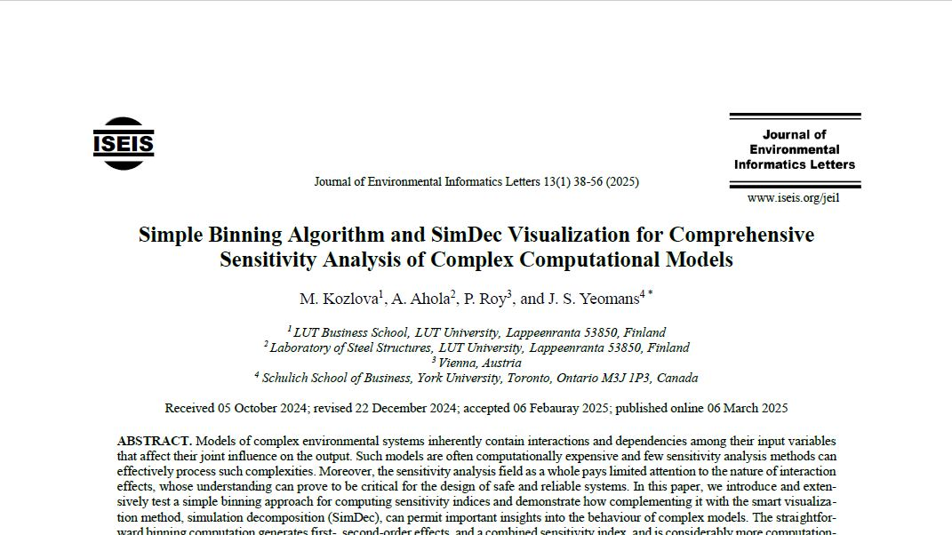
simple binning indices
First-order indices
- Influence measure [0,1]
Second-order indices
- Influence range [-1,1]
- Positive ~ interaction
- Negative ~ correlation
Combined first-order/second-order indices
Kozlova et al., ‘Simple Binning Algorithm and SimDec Visualization for Comprehensive Sensitivity Analysis of Complex Computational Models’, Journal of Environmental Informatics Letters, 13, 1, 38-56, 2025

Slide 11
Combined simple Binning Index for each variable
ScombinedXi aggregates all existing effects in a model
A value equal to 1 indicates entire variability of the output variable is explained
Sum of combined effects can be different from 1 in complex models
- when higher-order interactions or correlations are present
Enables identification of influential variables

Slide 12
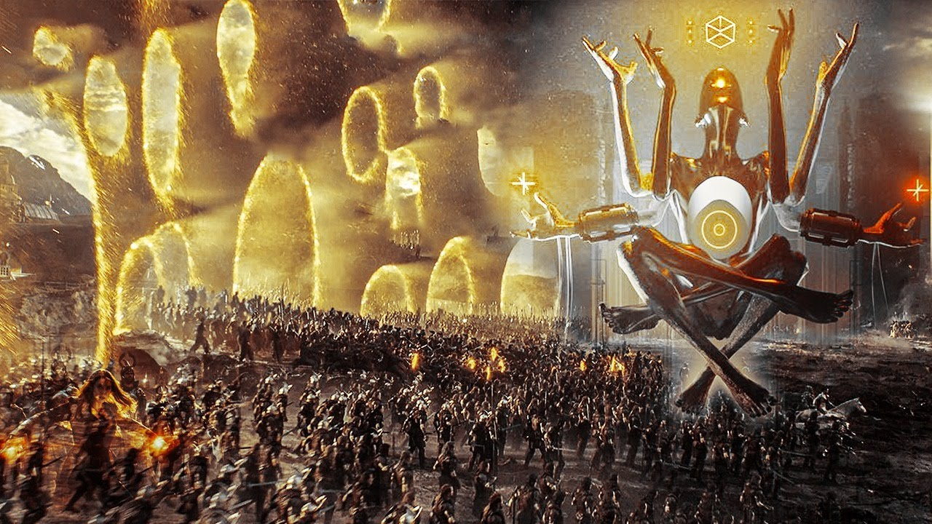
simple binning vs Sobol’ + Shapley
EASIER to calculate
- fewer calculations
- less data
- fewer simulation iterations
NO CONFOUNDING
- interaction & correlation
Lower range “VARIABILITY”
- of calculated measures
Kozlova et al., ‘Simple Binning Algorithm and SimDec Visualization for Comprehensive Sensitivity Analysis of Complex Computational Models’, Journal of Environmental Informatics Letters, 13, 1, 38-56, 2025

Slide 13

“variability” of Simple binning vs Sobol’

Slide 14
Simple binning with different sampling Methods

Slide 15
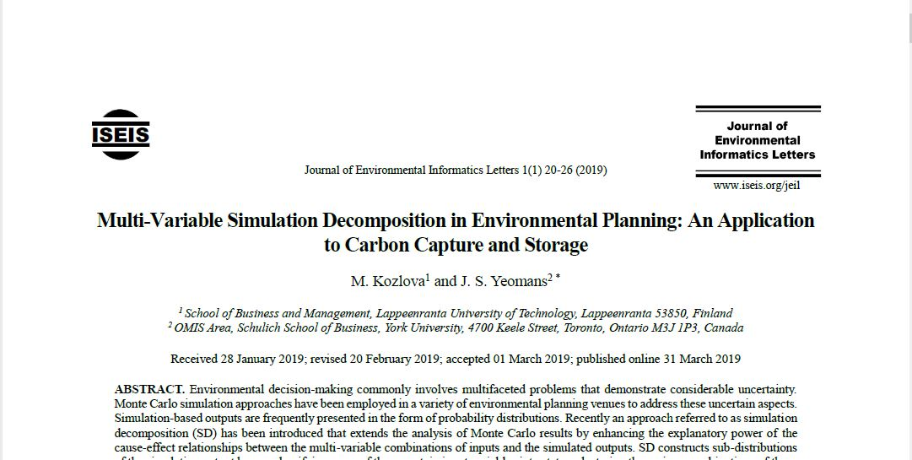









visualization of variable Decomposition
Variable ${\tilde{V}}_{i}$ | Range | State ${\tilde{A}}_{ij}$ | Boundary ${\tilde{B}}_{ij}$
$${\tilde{V}}_{1}: X$$ | [0, 100] | ${\tilde{A}}_{11}:$Low | ${\tilde{B}}_{11}$: [0, 30)
 |  | ${\tilde{A}}_{12}:$Medium | ${\tilde{B}}_{12}$: [30, 60)
 |  | ${\tilde{A}}_{13}:$High | ${\tilde{B}}_{13}$: [60, 100]
$${\tilde{V}}_{2}: Y$$ | {0,1} | ${\tilde{A}}_{21}:$True | ${\tilde{B}}_{21}$: {1}
 |  | ${\tilde{A}}_{22}:$False | ${\tilde{B}}_{22}$: {0}
Group ${\tilde{G}}_{k}$ | ${\tilde{V}}_{1}$ state | ${\tilde{V}}_{2}$ state | Combination of states
$${\tilde{G}}_{1}$$ | ${\tilde{A}}_{11}:$Low | ${\tilde{A}}_{21}:$True | $$\{{\tilde{A}}_{11},{\tilde{A}}_{21}\}$$
$${\tilde{G}}_{2}$$ |  | ${\tilde{A}}_{22}:$False | $$\{{\tilde{A}}_{11},{\tilde{A}}_{22}\}$$
$${\tilde{G}}_{3}$$ | ${\tilde{A}}_{12}:$Medium | ${\tilde{A}}_{21}:$True | $$\{{\tilde{A}}_{12},{\tilde{A}}_{21}\}$$
$${\tilde{G}}_{4}$$ |  | ${\tilde{A}}_{22}:$False | $$\{{\tilde{A}}_{12},{\tilde{A}}_{22}\}$$
$${\tilde{G}}_{5}$$ | ${\tilde{A}}_{13}:$High | ${\tilde{A}}_{21}:$True | $$\{{\tilde{A}}_{13},{\tilde{A}}_{21}\}$$
$${\tilde{G}}_{6}$$ |  | ${\tilde{A}}_{22}:$False | $$\{{\tilde{A}}_{13},{\tilde{A}}_{22}\}$$
Simulation iteration | Output | ${\tilde{V}}_{1}$ state | ${\tilde{V}}_{2}$ state | Resulting group ${\tilde{G}}_{k}$
1 | 45 | 15 ∈${ \tilde{A}}_{11}$ | 1 ∈${ \tilde{A}}_{21}$ | $${\tilde{G}}_{1}$$
2 | 100 | 79 ∈${ \tilde{A}}_{13}$ | 0 ∈${ \tilde{A}}_{22}$ | $${\tilde{G}}_{6}$$
3 | 90 | 75 ∈${ \tilde{A}}_{13}$ | 0 ∈${ \tilde{A}}_{22}$ | $${\tilde{G}}_{6}$$
4 | 20 | 7 ∈${ \tilde{A}}_{11}$ | 1 ∈${ \tilde{A}}_{21}$ | $${\tilde{G}}_{1}$$
…….
10000 | 75 | 32 ∈${ \tilde{A}}_{12}$ | 1 ∈${ \tilde{A}}_{21}$ | $${\tilde{G}}_{3}$$
Probability
$${\tilde{G}}_{4}$$
$${\tilde{G}}_{5}$$
$${\tilde{G}}_{6}$$
$${\tilde{G}}_{1}$$
$${\tilde{G}}_{2}$$
$${\tilde{G}}_{3}$$
Output

Slide 16
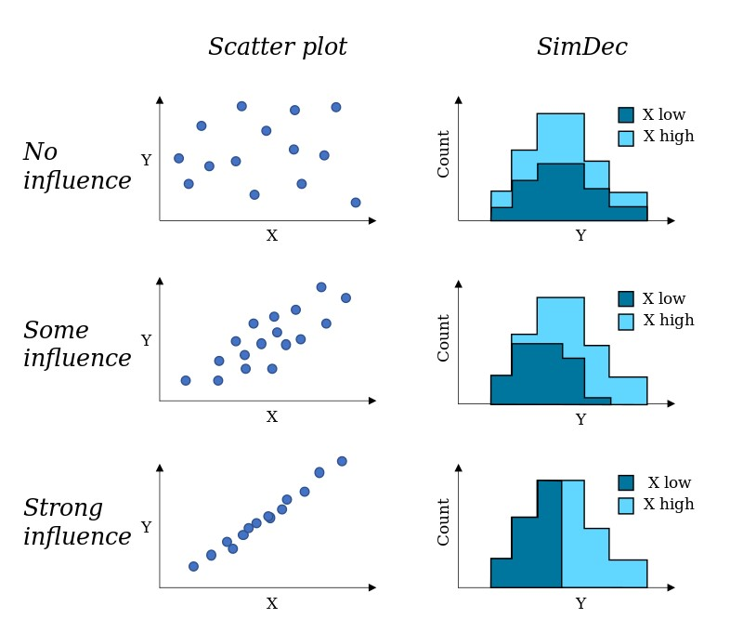
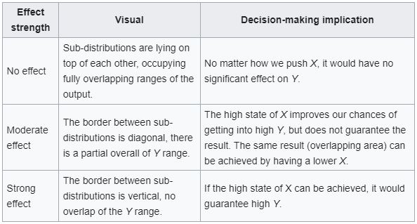
Interpreting Influences with SimDec (wikipedia)

Slide 17
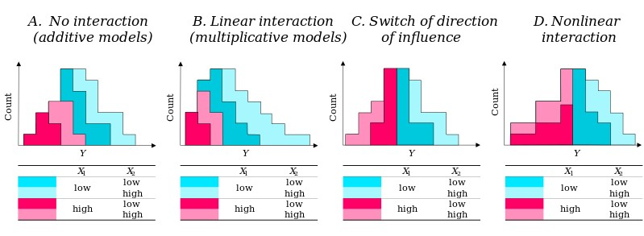
Visualizing interaction types in SimDec (wikipedia)

Slide 18
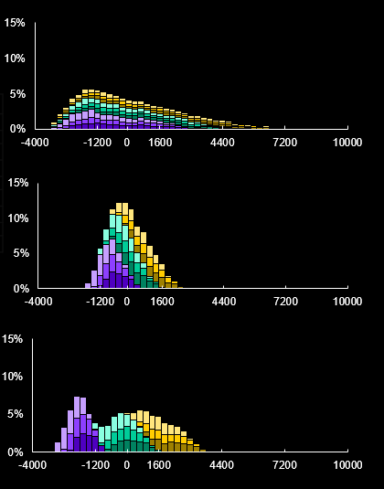

Investment Profitability
Legend
Color | Scenario | Production | Investment
 | sc1 | low | optimistic
 | sc2 |  | realistic
 | sc3 |  | pessimistic
 | sc4 | medium | optimistic
 | sc5 |  | realistic
 | sc6 |  | pessimistic
 | sc7 | high | optimistic
 | sc8 |  | realistic
 | sc9 |  | pessimistic
Market
Bilateral contract
Subsidy
0
Kozlova, M. & Yeomans, J. S. (2022). Monte Carlo enhancement via simulation decomposition: a “must-have” inclusion for many disciplines. INFORMS Transactions on Education, 22(3), 147-159
NPV of investment under the price uncertainty

Slide 19
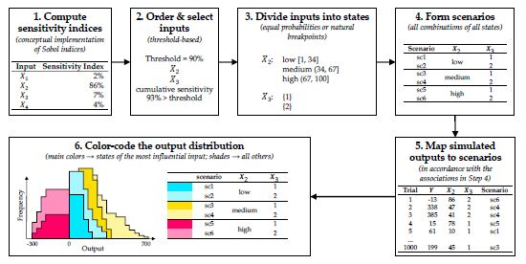
simDec GSA : SA with uncertainty analysis

Slide 20
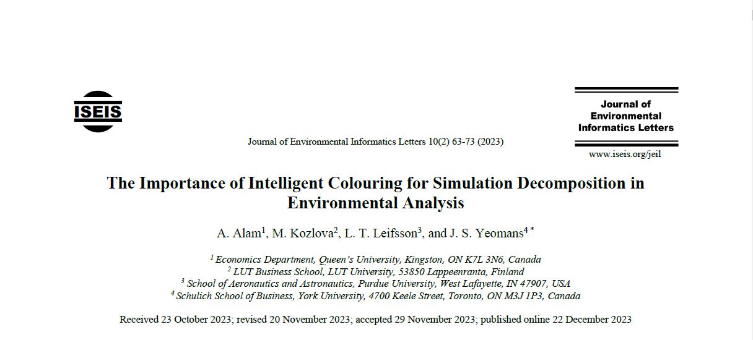
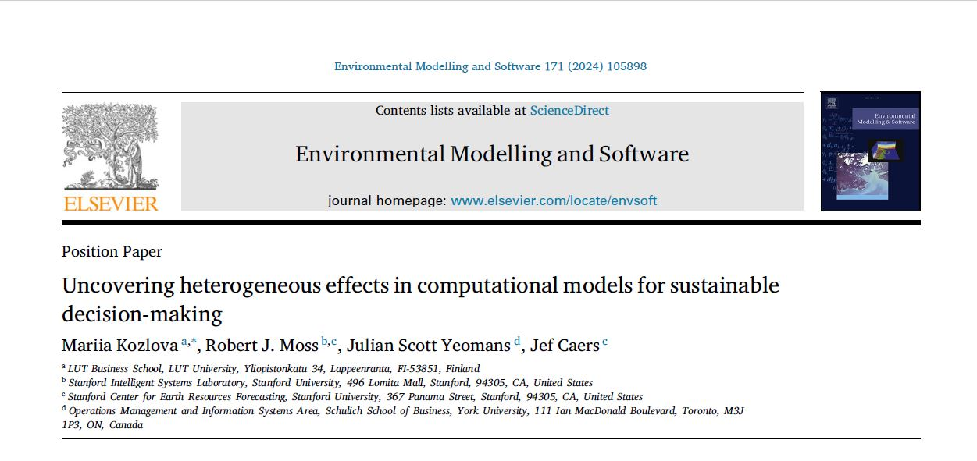
GSA with simdec
Original SimDec was exploratory
- Visualization of interactions
- Heterogeneous relationships
Decomposition at user’s discretion
- “Chromatic-hacking” (p-hacking)
- Influential inputs excluded?
- Insights missed?
SimDec GSA uses Binning as selector
- “Holy Grail” GSA incorporating uncertainty analysis

Slide 21
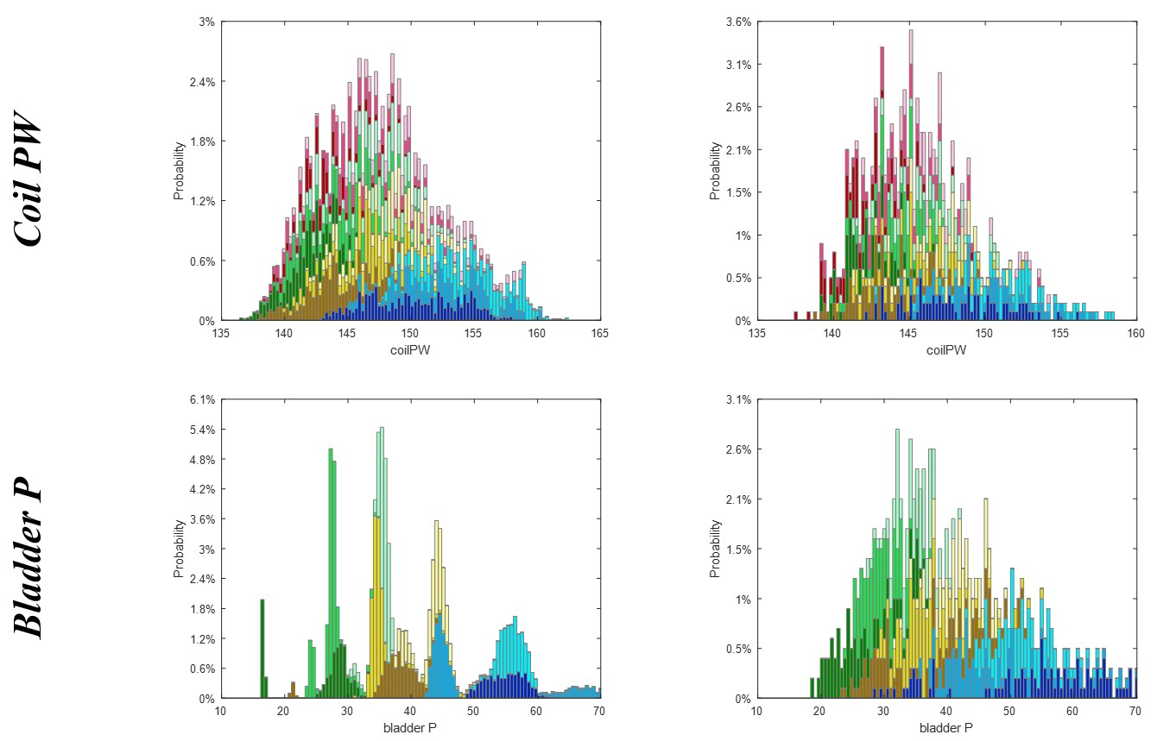
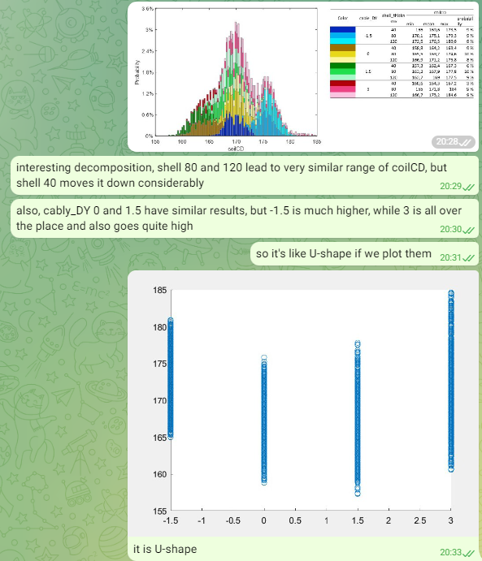
CERN accelerator – superconducting magnets

Slide 22
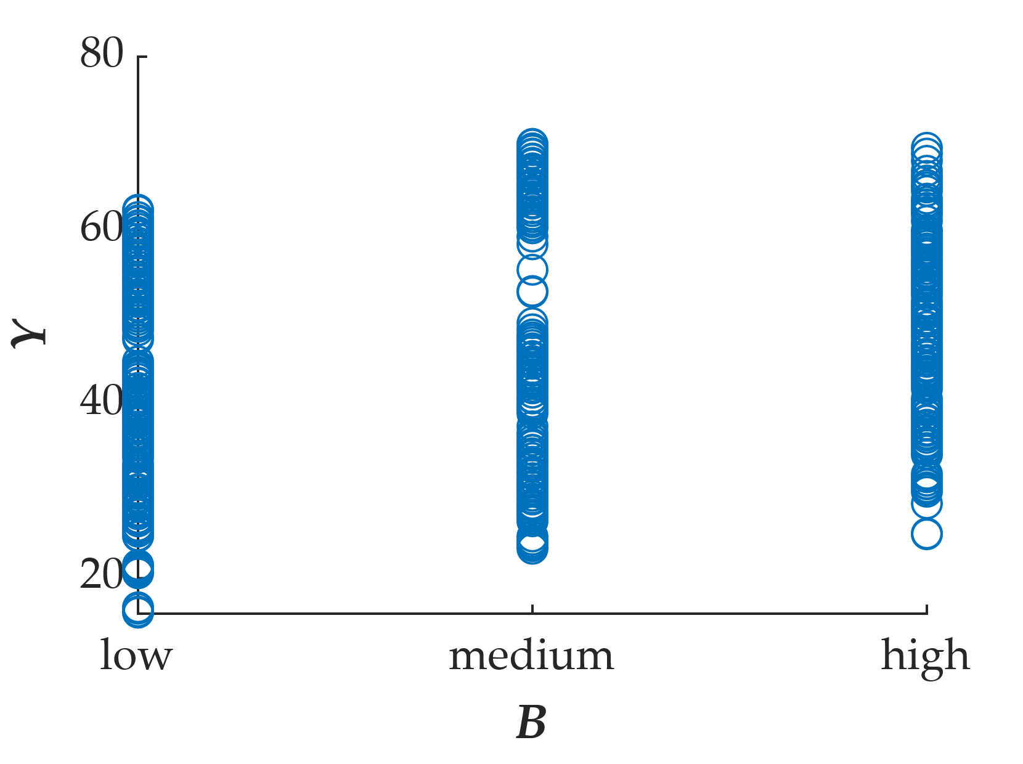
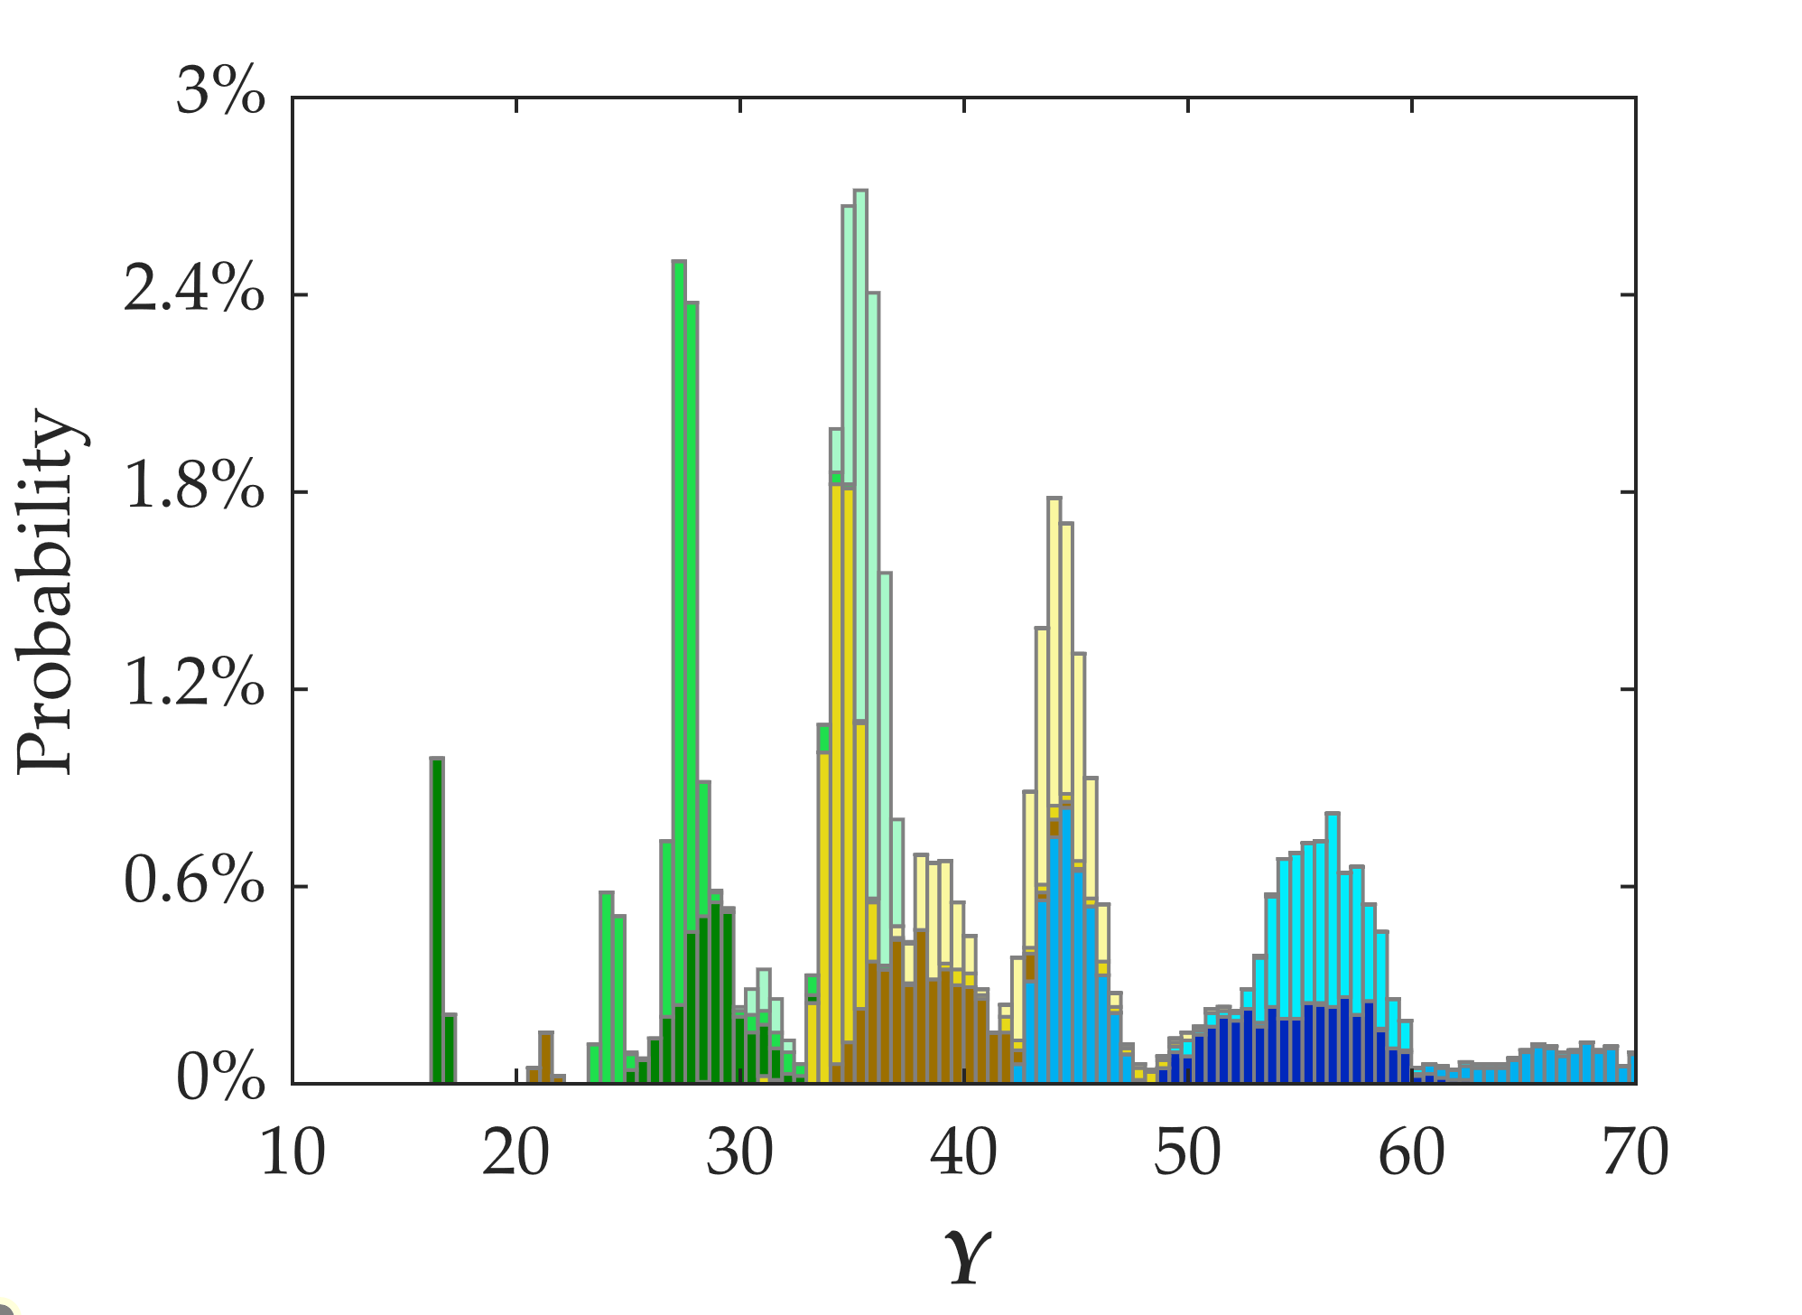
Heterogeneity in cern output
Color | A | B
 | low | low
 |  | medium
 |  | high
 | medium | low
 |  | medium
 |  | high
 | high | low
 |  | medium
 |  | high

Slide 23
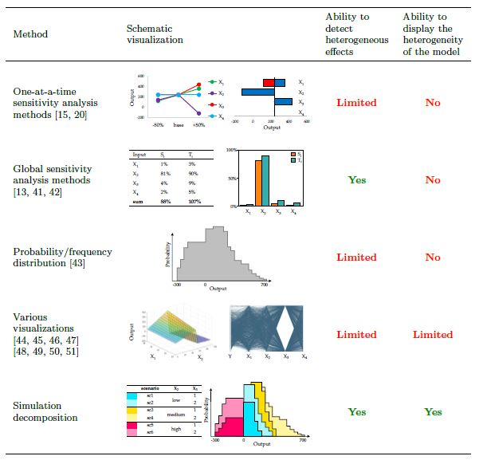
simdec Benchmark for global sensitivity analysis
Comparison of SA methods by ability to discover presence and to display type of heterogeneous effects

Slide 24
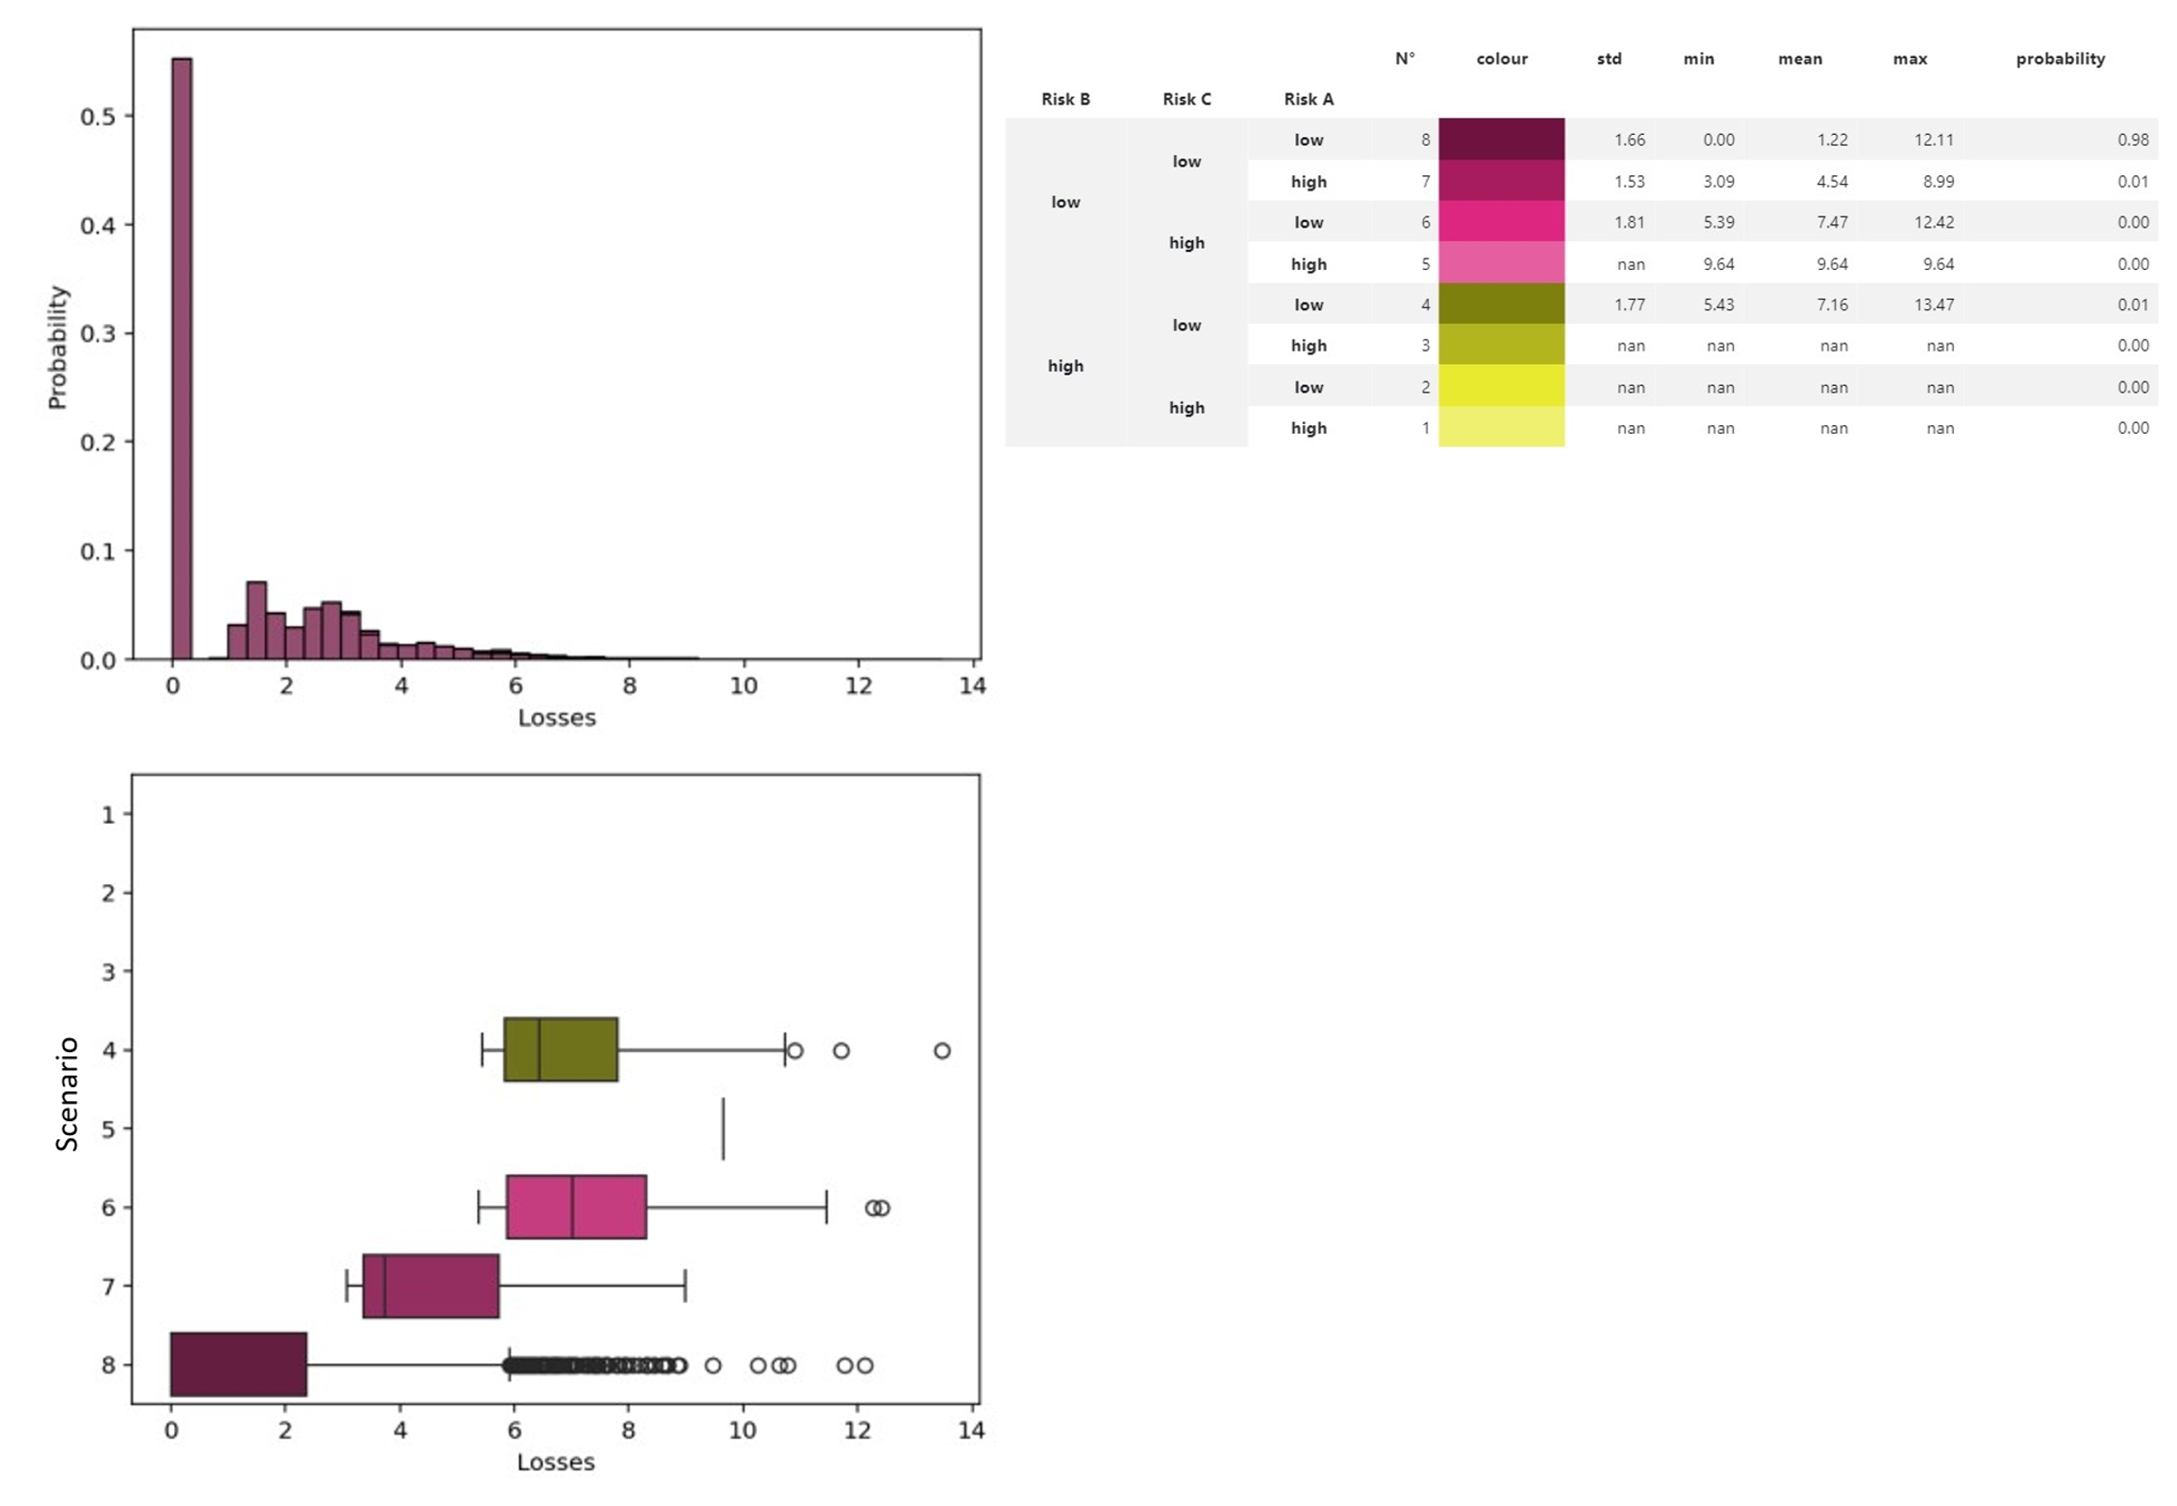
alternate boxplot visualization - Simdec dashboard

Slide 25
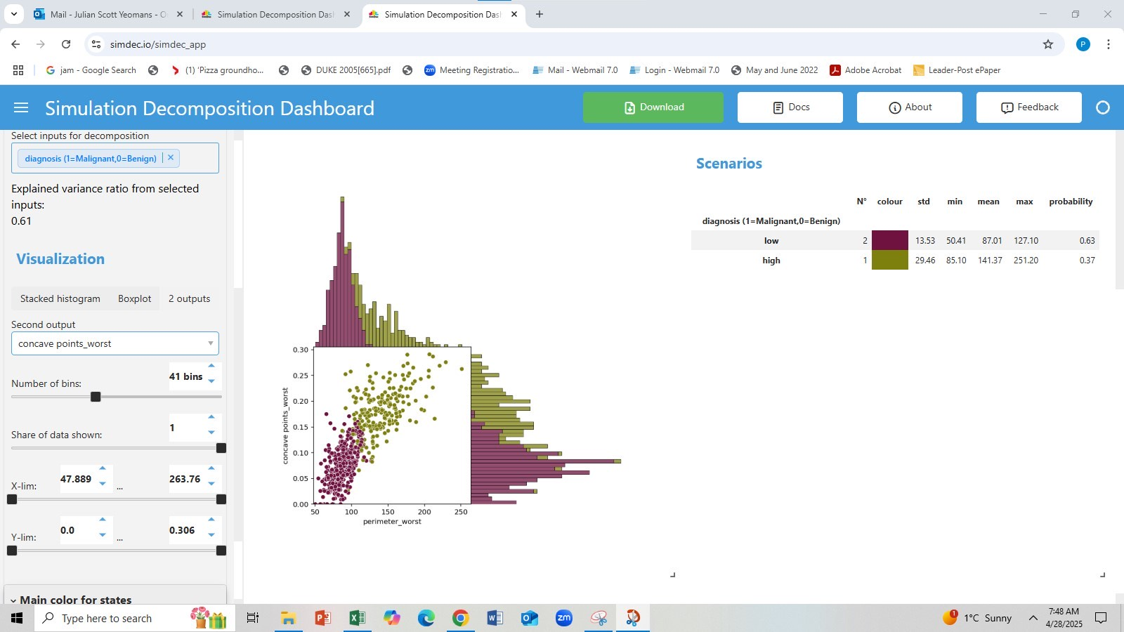
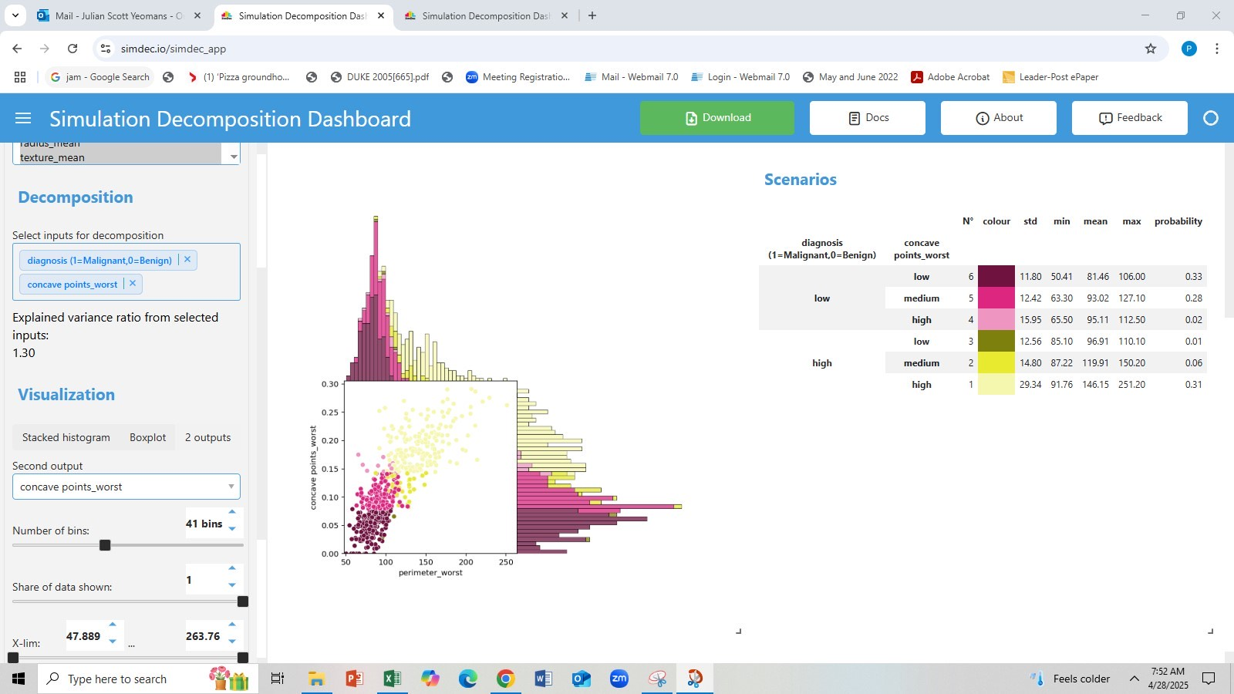
alternate 2-output visualization - Breast cancer data

Slide 26
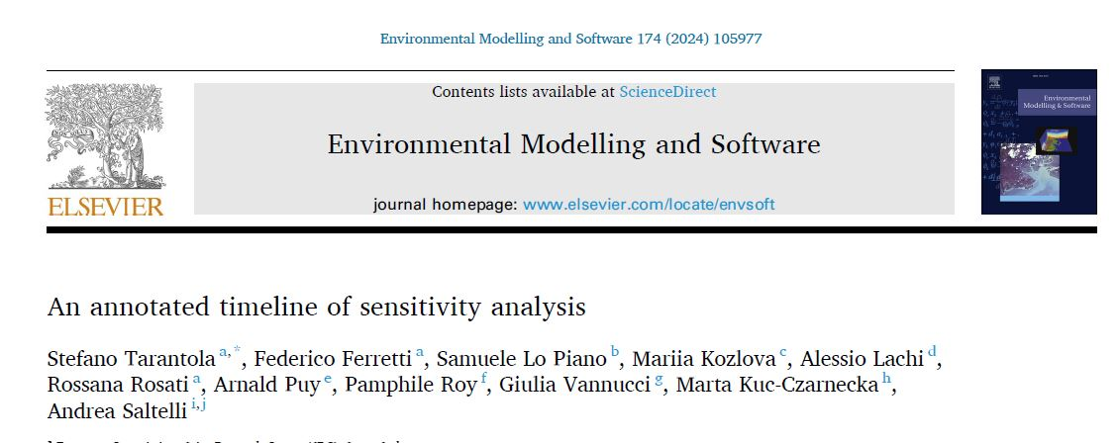
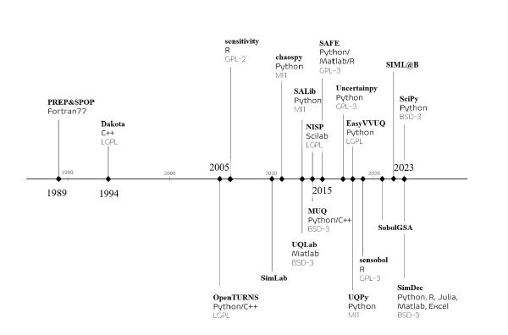
timeline of GSA software

Slide 27
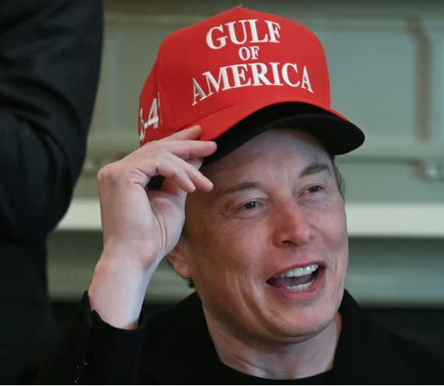
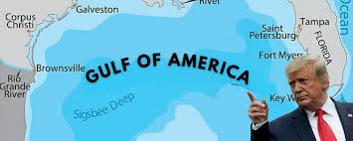
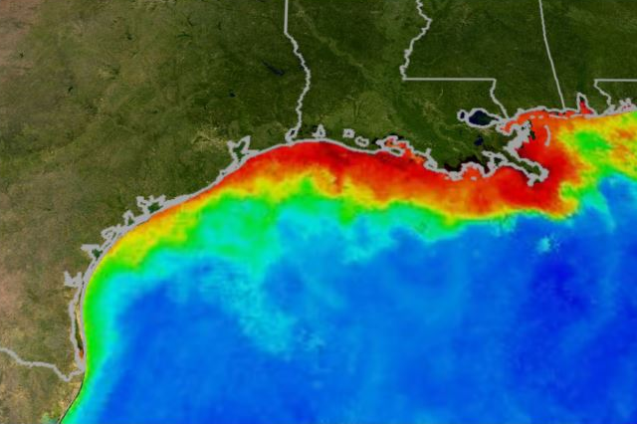
GSA Case: Hypoxia in the gulf of America mexico
Hypoxia (low dissolved oxygen) “dead zone” in Northern Gulf of Mexico
- severe environmental and socioeconomic consequences
- driven by nitrogen-rich water from the Mississippi River
- Midwest Corn Belt (esp. Iowa) major contributor
Iowa nitrate run-off arises mainly from agriculture
- subsurface drainage of corn and soybean systems
- ethanol production
- increasing animal protein agriculture
Analysis of the USDA-EPA Iowa Food-Energy-Water (IFEW) system

Slide 28
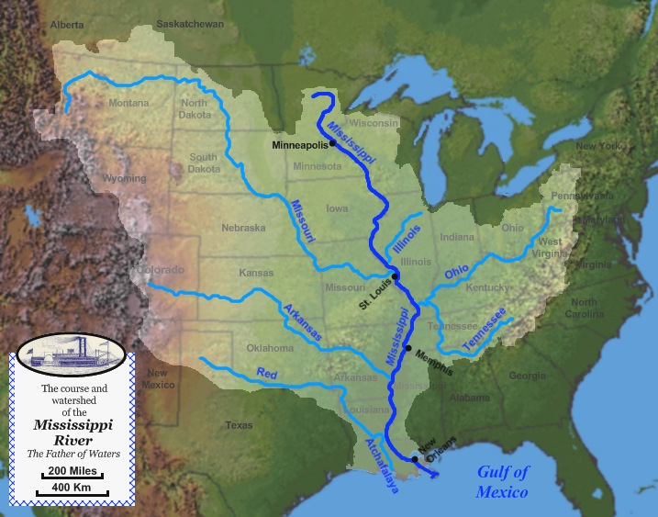
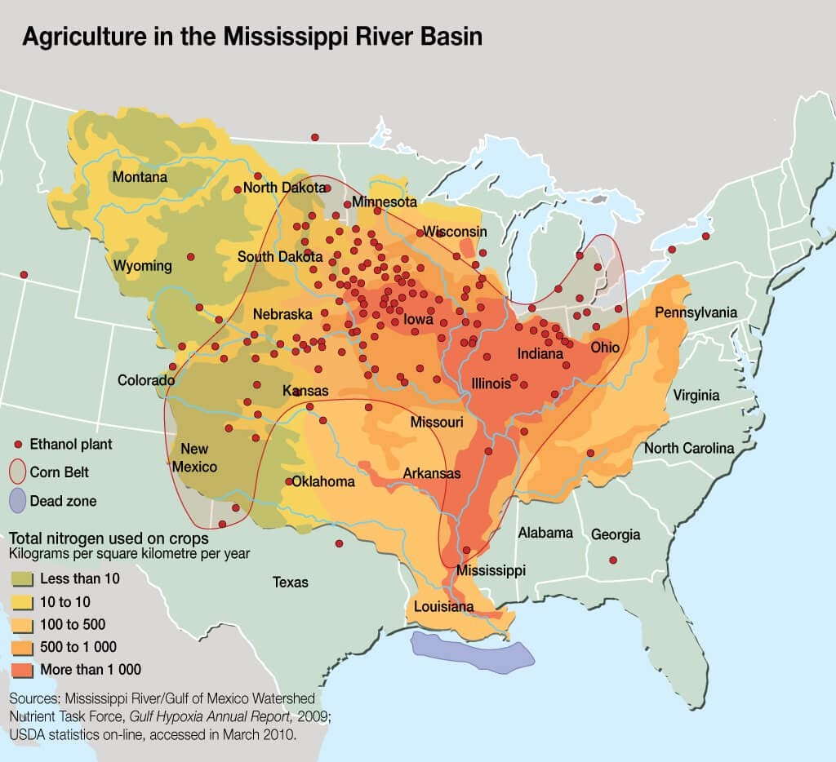
Mississippi watershed

Slide 29
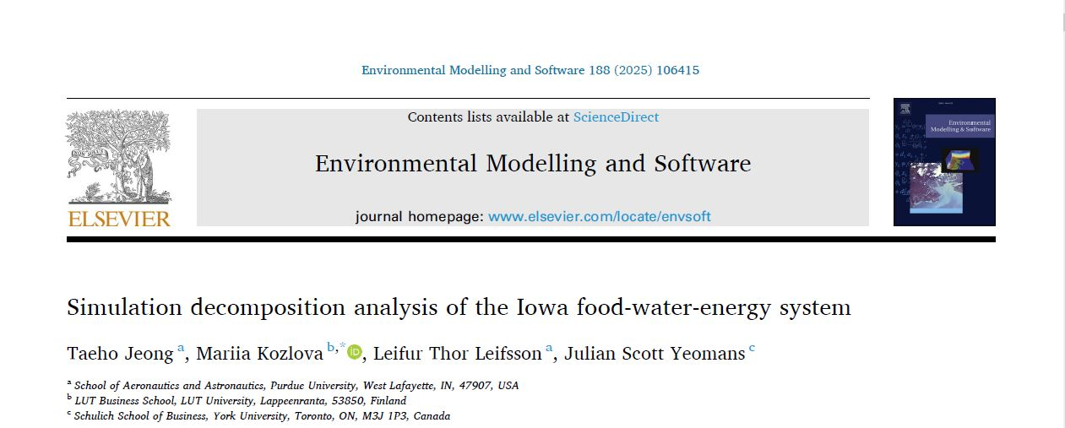
Iowa food-energy-water (IFEW) system
Interconnection of agriculture, animal agriculture, water, energy, weather, food, and nitrogen
USDA county level data for all 99 Iowa counties from 1968 to 2019
Nitrogen surplus is estimated by:
NS = CN + MN + FN – GN
where
FN is the fixation nitrogen by soybean crops
GN is the harvested grain nitrogen
MN is the manure nitrogen
CN is the commercial nitrogen

Slide 30


IFEW Computational model aggregate Elements
CN is derived from county-level data
GN is calculated as:
where
x1 is the corn yield
x2 is the soybean yield
Acorn is the total acres planted with corn
Asoy is the total acres planted with soy
FN is calculated as:

Slide 31
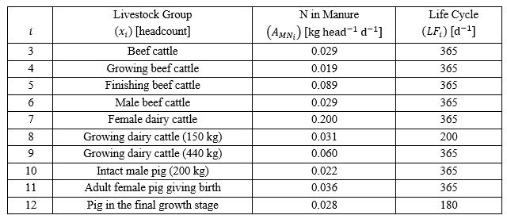


nitrogen content in Livestock Manure
MNi is calculated as:
where for livestock i
MNi nitrogen in manure
xi headcount
AMNi manure nitrogen content
LFi life cycle
MN is calculated as:

Slide 32
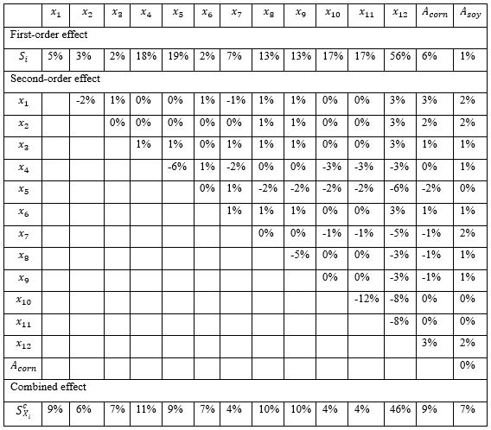
First-order, second-order, and combined effects of low-level input variables

Slide 33
GSA – Low-level Simdec analysis of IFEW
Numerous correlations revealed
- implying overlapping influences on nitrogen surplus output
- negative pairwise second-order indices
Outliers skew distribution of inputs
- total value exceeds 1

Slide 34
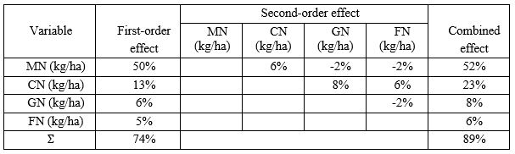
First-order, second-order, and combined effects of aggregate input variables

Slide 35
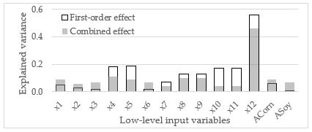
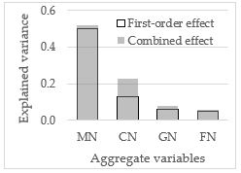
Comparison of First-order and combined effects of low and aggregate input variables
White spaces illustrate correlations

Slide 36
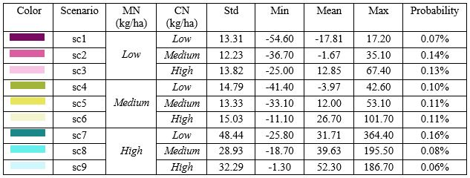
Legend for Decomposition of ifew aggregate variables

Slide 37
Decomposition of ifew aggregate input variables

Slide 38
analysis - Simdec GSA of IFEW - Aggregate Values
MN is the primary driver of nitrogen output variation
MN’s low and medium states result in similar output ranges
MN’s high state causes substantial increases in NS
CN has moderate effect in MN’s low and medium states
CN’s influence becomes larger in the high state of MN
High MN and Low CN produces the highest Nitrogen Surplus
SimDec visualization only method to reveal complex, heterogeneous relationships

Slide 39
analysis - Simdec GSA of IFEW - Aggregate Values
SimDec can process dependent inputs
Provides new opportunities to extend GSA into multi-level analysis
- can jointly analyze aggregate variables composed of low-level inputs
- no disruption of overall model mechanics (same data)
- no reformulation of model with new variables and re-simulate

Slide 40
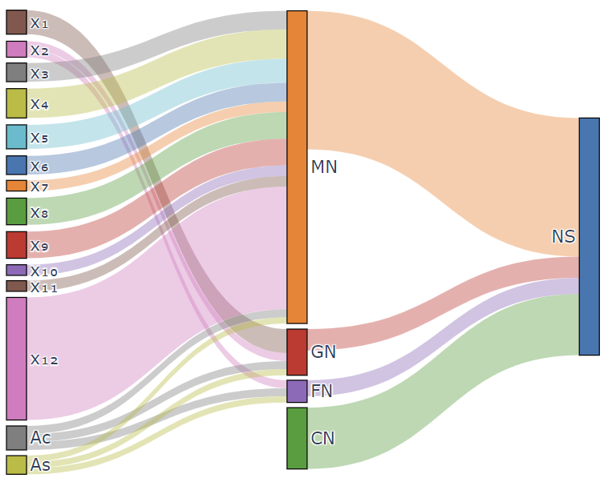
Multi-level gsa: Low-level inputs vs Aggregate variables

Slide 41
SimDec GSA of Iowa Food-energy-water system
IFEW model contains “real world” aggregated variables
Analyzing lower-level inputs exposes completely overlooked interactions
Targeted nitrogen management strategies
- due to diverse agricultural practices in Iowa counties
e.g. pig populations in final growth stage
Multi-level GSA shows aggregate contributions through low-level variables
Aggregate, multi-level approach has no precedent in sensitivity analysis

Slide 42
SimDec for GSA roundup
Sensitivity indices – First-order, second-order
Combined sensitivity index – (woohoo! ☺)
Less data required, far fewer calculations, narrower estimate ranges
Interaction and correlation measures NOT confounded
Multi-level GSA done simultaneously – no precedent
Dependencies within Inputs can be analyzed in GSA – novel
Uncertainty analysis package – Visual analytics (MANOVA alternative?)
Piecewise visualizations reveal HETEROGENEITY – new
Pre-eminent “real world” applied GSA method? – Or is it just Turtles?

Slide 43
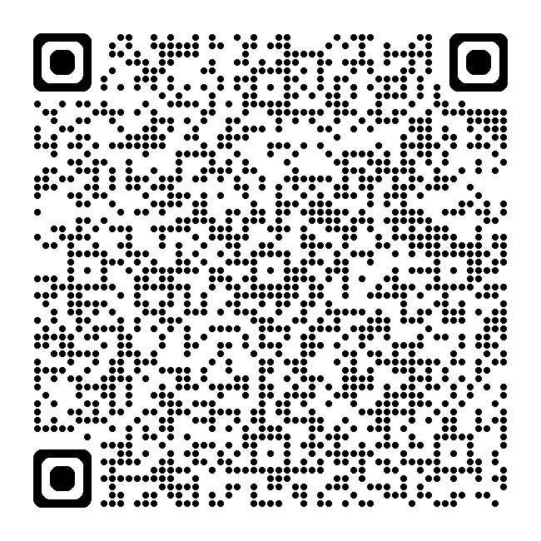


Open-source book, Codes, & Discord Links
SimDec Website: SIMDEC.FI
Web Dashboard: SIMDEC.IO

Slide 44

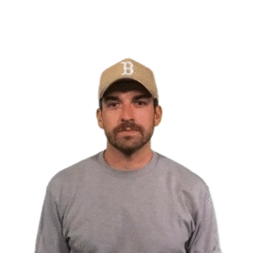

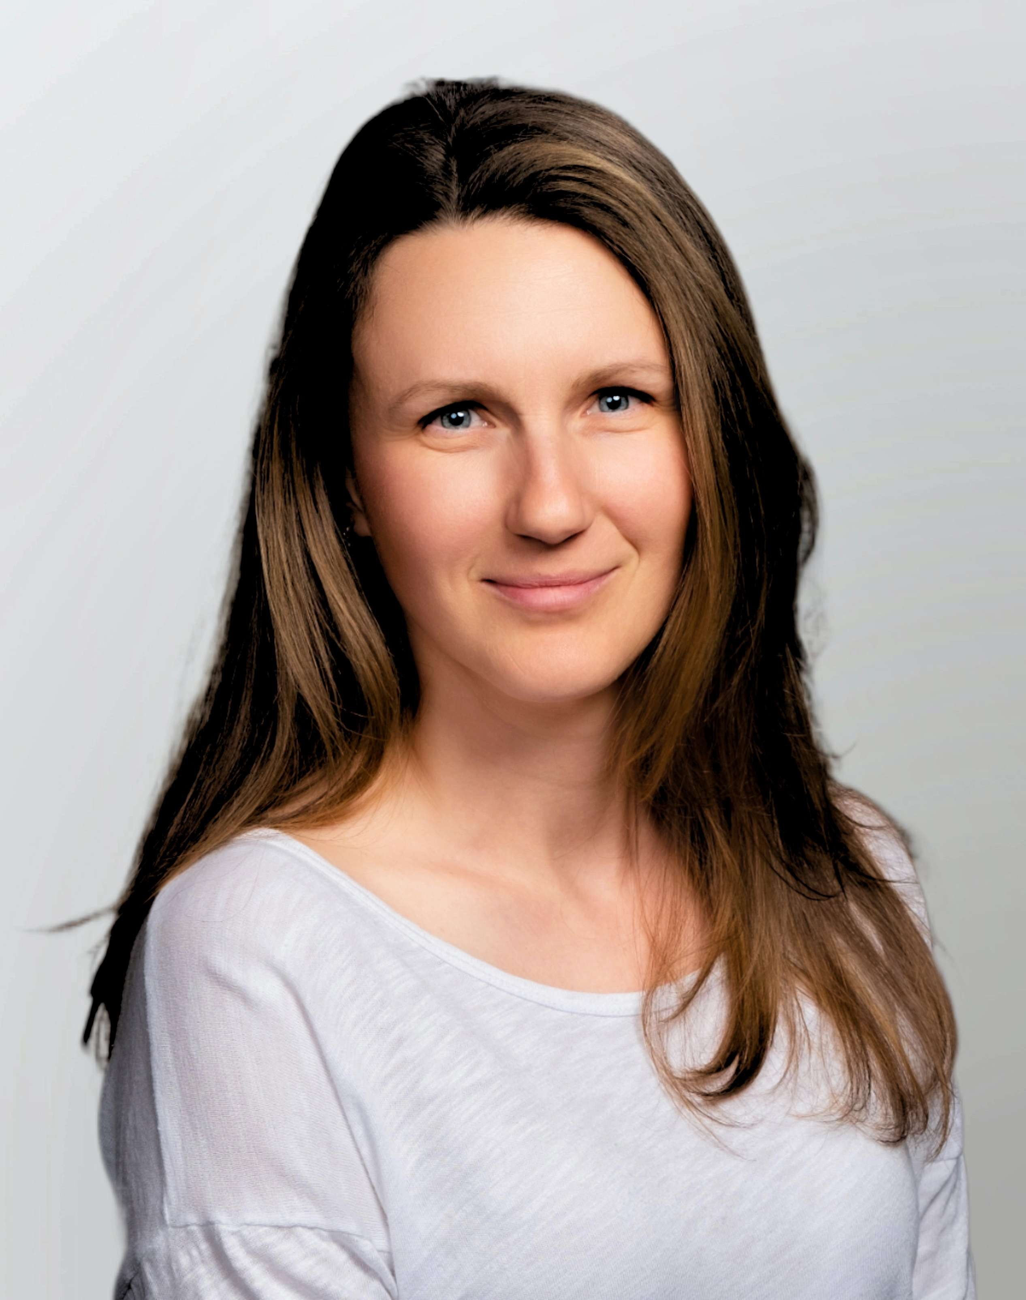

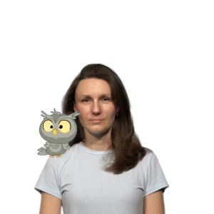

Acknowledgement of collaborators
Pamphile Roy
Manao, Austria
Python Developer
Robert Moss
Stanford, USA
Julia Developer
Mariia Kozlova
LUT University, Finland
Mariia.Kozlova@lut.fi
Julian Yeomans
Schulich School of Business
syeomans@yorku.ca
SimDec
Abid Alam
Queen’s, Canada
R Developer

