Slide 1
Trustworthy and Private AI/ML
Prof. Jaideep Vaidya
jsvaidya@rutgers.edu

Slide 2
Acknowledgments
Funding Agencies
NIH
NSF
NAS
Collaborators & Students (an incomplete list..)
Hafiz Asif
Xiaoqian Jiang
Sitao Min
Lucila Ohno-Machado
Periklis Papakonstantinou
Vivek Singh
Basit Shafiq
Xinyue Wang

Slide 3
Big Data and AI are changing every aspect of our lives
Lender’s risk assessment
Fraud detection
Creditworthiness
Precision medicine
Health risk assessment
Smart sensors
Clinical Diagnosis & Treatment
Psychological profiling
Communication
(political, public, and personal)
Autonomous driving cars
Diagnostic, surgery, and
emergency response robots
McKinsey Global Institute reports:

Slide 4
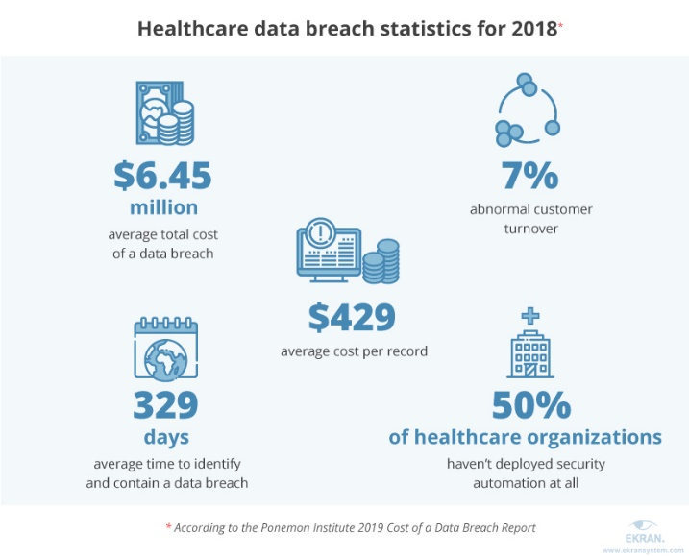
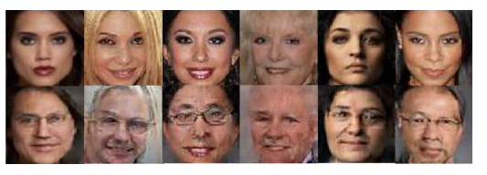
The peril of big data and AI/ML
Insufficient in-house capabilities / expertise
For ingesting multi-modal data
For longer term storage
For computation
For analytics
Threats to Privacy, Security, and Equity
Female Image translation result with Male traits
Real image
Machine generated image
Notes:
The fear of big data
No privacy within 5 years!

Slide 5
What you can know from data?
Identifying personal genomes by surname inference [GMGHE’13]
Identifying participation in complex DNA mixture [H et al.’08]
EEG and MEG data can leak financial and identity related information [IHE’18]
Modeling 3D facial shape from DNA [C et al.’14]
Identifying participation from a summary statistic [DSSUV’15]
Identifying participants in the Personal Genome Project by Name [SAW’13]
Identifying users in Netflix prize data [NS’08]
Identifying “complete patient’s info.” from aggregate and anonymized queries [VSJO’13]
The list goes on…

Slide 6
Can anonymized and aggregated data serve as a solution?
No!

Slide 7
Identifying “complete patient’s info.” from aggregate and anonymized queries [VSJO’13]
We found 1 Native American woman diagnosed
with ovarian cancer, who
went to a privately owned hospital,
was 75 year old,
did not pay by private insurance,
had a routine discharge,
stayed for 33.5 days,
was from a county with 1M plus residents, and
bore a cost of $ 32, 970

Slide 8
What can we do?
Understand the data
Understand the usage
Match the techniques to the required task
Ensuring privacy
Ensure process privacy
Ensure output privacy
Ensure control over data used

Slide 9
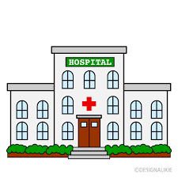
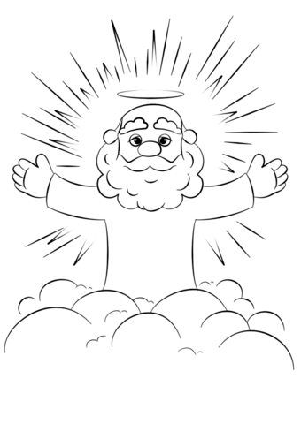
Protecting the process: Secure Multiparty Computation (SMC)
Hospital #1
Hospital #1
=
Hospital #2
Hospital #2
Cryptographic protocols
Fully trusted
Chosen model of trust
Hospital #3
Hospital #3
Simulation-based Privacy
Notes:
Meaning of security

Slide 10
Secure Multi-Party Computation It can be done!
Yao’s Millionaire’s problem (Yao ’86)
Secure computation possible if function can be represented as a circuit
Idea: Securely compute gate
Continue to evaluate circuit
Extended to multiple parties (BGW/GMW ’87)
Biggest Problem - Efficiency
Recent work has made a lot of complicated analysis actually feasible
See http://www.multipartycomputation.com/mpc-software and https://github.com/rdragos/awesome-mpc
Notes:
Efficiency and yao’s Protocol – Maybe use simulation figures from Agrawal and Srikant??
Proof of security: Simulator based approach
Mention later

Slide 11
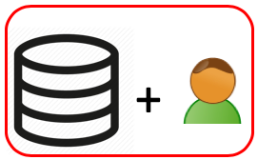
Protecting the output: Differential Privacy (DP) [D‘06, DMN‘06]
Database with
John's info.
If $M$ is private, then
?
+
+
$$M( )$$
≡
$$M( )$$
Database without
John's info.
Pr
$$M( )$$
$$M( )$$
$$M( )$$
+
$$f ( )$$
$$f( )$$
outputs

Slide 12
Protecting the Output: Differential Privacy (DP) [D‘06, DMN‘06]
For $ε>0$, a mechanism $M$ with domain $\text{𝒟}$ is $ε$-DP if for every $x,y∈\text{𝒟}$ differing by one record (i.e. $||{x−y||}_{1}$ $=1$) and every $R⊆support(M)$
$$\frac{Pr\left[M\left(x\right)∈R\right]}{Pr\left[M\left(y\right)∈R\right]}≤ e^{ε}$$
$$⇓$$
$$M( )$$
≡
$$M( )$$
privacy is protected since the presence or absence of a record in a database doesn’t “affect” the output of a DP mechanism

Slide 13
Federated Learning: US/UK Privacy Enhancing Technologies Challenge (Team Scarlet-Pets)
Transforming financial crime prevention through privacy-preserving federated learning
T_{i}
Bank#1
T_{i}
PNS
T_{i}
Bank#3
Bank#2
PNS(T) = {T₁, T₂,…,T_{i},…,T_{n}}
PNS(T) = {T₁, T₂,…,T_{i},…,T_{n}}
For more details, please look at: H. Asif, S. Min, X. Wang and J. Vaidya, "U.S.-U.K. PETs Prize Challenge: Anomaly Detection via Privacy-Enhanced Federated Learning," in IEEE Transactions on Privacy, vol. 1, pp. 3-18, 2024, https://doi.org/10.1109/TP.2024.3392721.

Slide 14
Bank#1
Bank#3
T_{i}
PNS
T_{i}
acc_info | Flag
Name1, No1, Address1 | 0
Name2, No2, Address2 | 1
… | …
NameQ, NoQ, AddressQ | 3
acc_info | Flag
Name1’, No1’, Address1’ | 0
Name2’, No2’, Address2’ | 1
… | …
NameQ’, NoQ’, AddressQ’ | 3
PNS(T) = {T₁, T₂,…,T_{i},…,T_{n}}
Incorporating account info. and Flag values in PNS(T) improves fraud detection.
But how to protect sensitive info. while accomplishing this in a federated setting?
Mine features from account info. and Flag.
Use membership relationship for mining
Use bloom filters and encrypted account information to encode membership information securely and privately
Augment the mined features to PNS(T).
Aggregate bloom filters from all banks at PNS and use the code generated by the Sender bank to check membership

Slide 15
Federated Learning: US/UK Privacy Enhancing Technologies Challenge (Team Scarlet-Pets)
Two-step federated learning approach
Perform PP feature mining for account-level banks’ data
augmentation to PNS data using a PP-encoding scheme
Learn a classifier from the augmented data
Key benefits
Comparable performance
Efficiency
Flexibility
Payment Network Systems
Augmented Data
For more details, please look at: H. Asif, S. Min, X. Wang and J. Vaidya, "U.S.-U.K. PETs Prize Challenge: Anomaly Detection via Privacy-Enhanced Federated Learning," in IEEE Transactions on Privacy, vol. 1, pp. 3-18, 2024, https://doi.org/10.1109/TP.2024.3392721.

Slide 16
Is this enough?
No. For certain tasks, need relaxed definitions
$\left(β, r\right)$-anomaly [KN‘98]
$$i$$
$$r$$
A record $i$ in a database $x$ is an anomaly if $x$ has $β$ or fewer records within distance $r$ from $i$

Slide 17
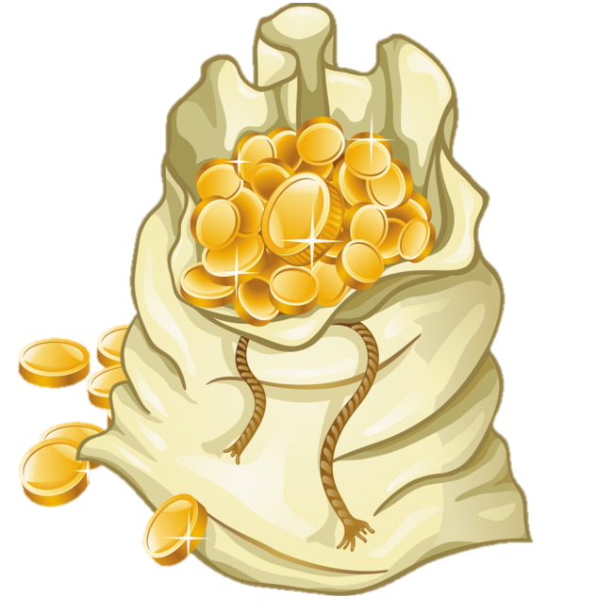
Why DP has poor accuracy $(β=5,r=1)$-outlier any two adjacent records on horizontal axis have distance 1
$f\left(z\right)≔ ∈A(z)$ for every database $z$
outlier identification
For every $ε$-DP $M:\text{𝒟}→\{0,1\}$,
$$max\left( P[M\left(x\right)≠f(x)], \sim P[M\left(y\right)≠f(y)],\right)≥\frac{1}{1+e^{ε}}$$
[APV’20]
$A\left( x \right)=\{ \}$
$A\left( y \right)=\{ , \}$
http://odds.cs.stonybrook.edu

Slide 18
$$max\left( err\left(M\right) on x, \sim err\left(M\right) on y\right)≥\frac{1}{1+e^{ε}}$$
[APV’20]
Existence-Independent outlier queries
Existence-dependent outlier queries
Answers are NOT contingent on the
absence\presence of any particular record
Answers are contingent on the
absence\presence of a particular record
Examples:
Is there a flu epidemic?
How many outliers are in the data?
Examples:
What are the outlier records in the data?
Is the record $i$ an outlier in the data?
DP
DP

Slide 19
What have we proposed?
Sensitive Privacy (SP)

Slide 20
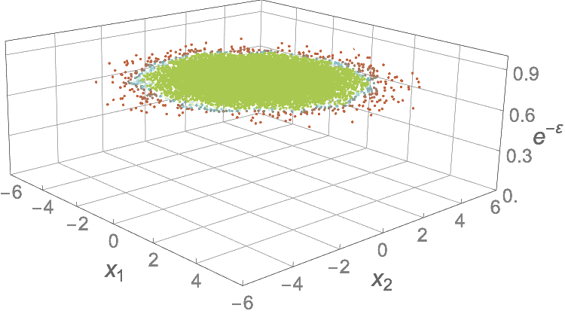
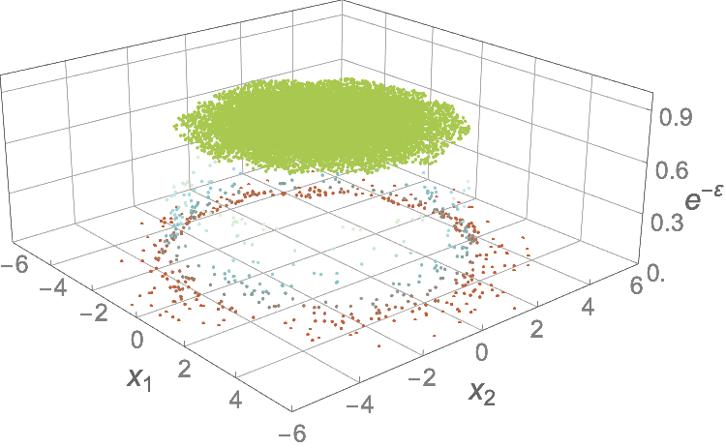
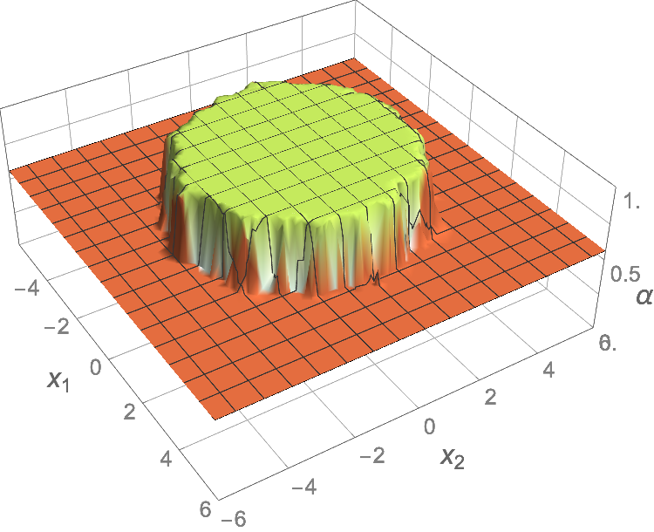
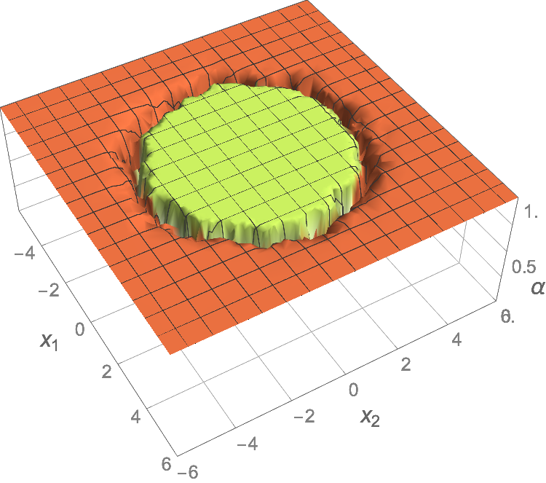
SP …
Same privacy for all
Varying privacy by outlyingness
What we have
What we want
$$a$$
$$c$$
$$e^{−ε}$$
[APV’19, APV’23]
$$e^{−ε}$$
normal
$$z_{1}$$
$$z_{2}$$
$$DP$$
$$z_{1}$$
$$z_{2}$$
$$SP$$
$$b$$
$$d$$
outlier
accuracy
accuracy
$$z_{1}$$
$$z_{1}$$
$$z_{2}$$
$$DP$$
$$z_{2}$$
$$SP$$
Optimal DP mechanism
Our SP mechanism

Slide 21
Sensitive Privacy (SP)
It requires privacy protection of every record
that is or becomes normal under a small change in the database
$$M( )$$
≡
$$M( )$$
[Anomalies are the records in the database that “markedly deviate” from the other records]
— Edgeworth 1887, Grubbs 1969, Hawkins 1980, Aggarwal 2013
So a small change in the database shouldn’t change the status of an anomaly

Slide 22
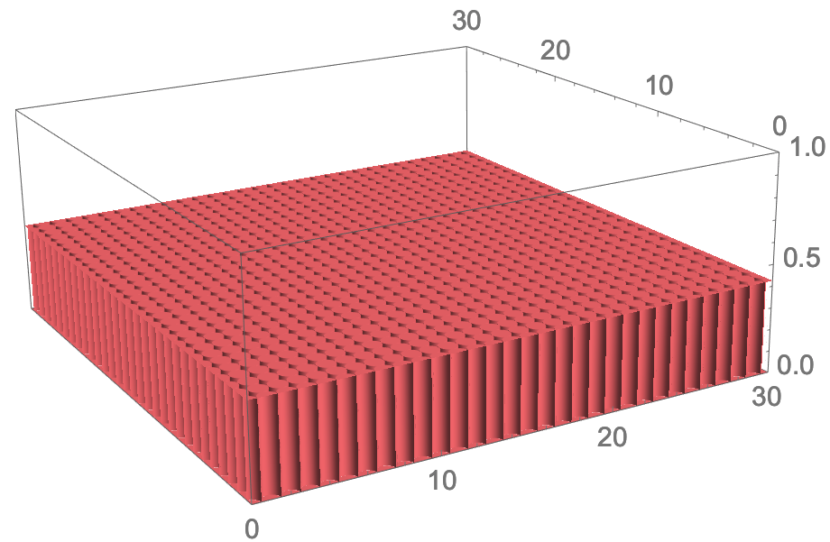
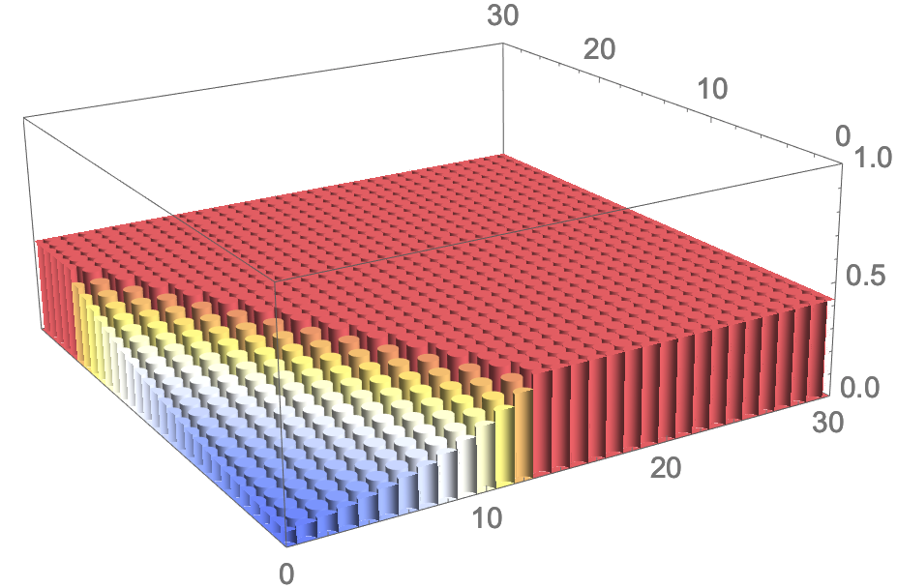
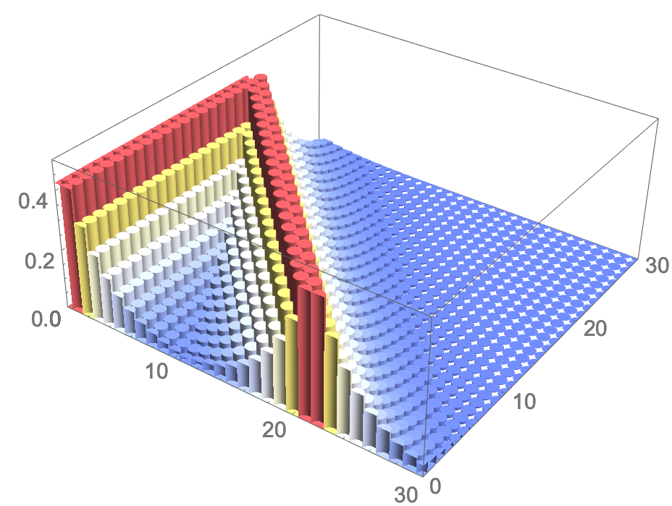
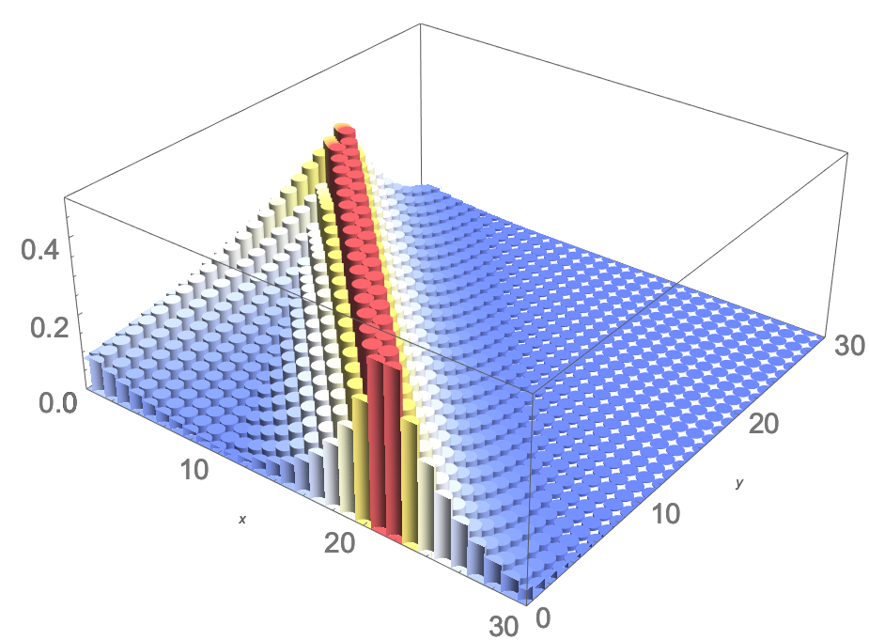
Sensitive Privacy (SP)
SP
DP $M$ for $\left(g,i\right)$
aaaaaaaaaaaaaa
For $ε>0$, $k≥1$, and $p$, a mechanism $M$ with domain $\text{𝒟}$ is $(ε,k)$-SP if
for every $x,y∈\text{𝒟}$ differing by one record that is $k$-sensitive w.r.t. $x$ or $y$, and every $R⊆support(M)$,
$$\frac{Pr\left[M\left(x\right)∈R\right]}{Pr\left[M\left(y\right)∈R\right]}≤ e^{ε}$$
$$U_{δ}$$
compiler
$$δ$$
for $\left(g,i\right)$
$$δ$$
$$a$$
compiler
$$Error$$
$$Error$$
$$B_{x}(i,r)$$
$$x_{i}$$
$$B_{x}(i,r)$$
$$x_{i}$$
DP
SP
$$b$$
$$Error$$
compiler
$$Error$$
$$B_{x}(i,r)$$
$$x_{i}$$
$$B_{x}(i,r)$$
$$x_{i}$$
DP
SP
For more details, please look at: How to identify anomalies accurately and privately, H. Asif, P. Papakonstantinou, and J. Vaidya, in Proceedings of the 26th ACM Conference on Computer and Communications Security (CCS ‘2019), IEEE TKDE ‘23

Slide 23
Detecting COVID Hotspots
DP
Existence-Independent outlier queries
Existence-dependent outlier queries
DP
Answers are NOT contingent on the
absence\presence of any particular record
Answers are contingent on the
absence\presence of a particular record
Examples:
Is there a flu epidemic?
How many outliers are in the data?
Examples:
What are the outlier records in the data?
Is the record $i$ an outlier in the data?

Slide 24
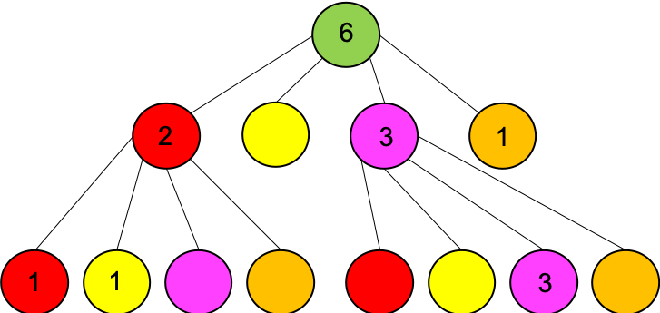
COVID Nearby System (IEEE Intelligent Systems, 2022)
COVID NEARBY
https://covidnearby.org
Crowdsensing
Every 24 hrs:
Report COVID-19
symptoms
store data in
secure DB
get data of the past 14 days
Differential Privacy:
$$M( )$$
≡
$$M( )$$
query
compute query via quadtrees
build DP quad- tree collection
…
Update
quadtrees
query:
How many people reported feeling symptoms in the past 14 days in New York City?
Query computer
Private quadtree builder
a
For more details, please look at: H. Asif, P. A. Papakonstantinou, S. Shiau, V. Singh and J. Vaidya, "Intelligent Pandemic Surveillance via Privacy-Preserving Crowdsensing," in IEEE Intelligent Systems, vol. 37, no. 4, pp. 88-96, 1 July-Aug. 2022, doi: 10.1109/MIS.2022.3145691

Slide 25
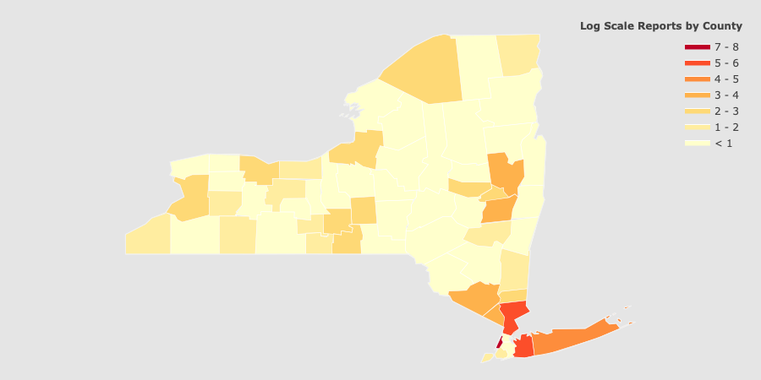
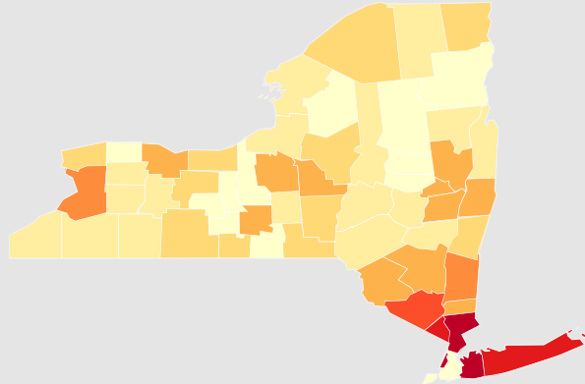
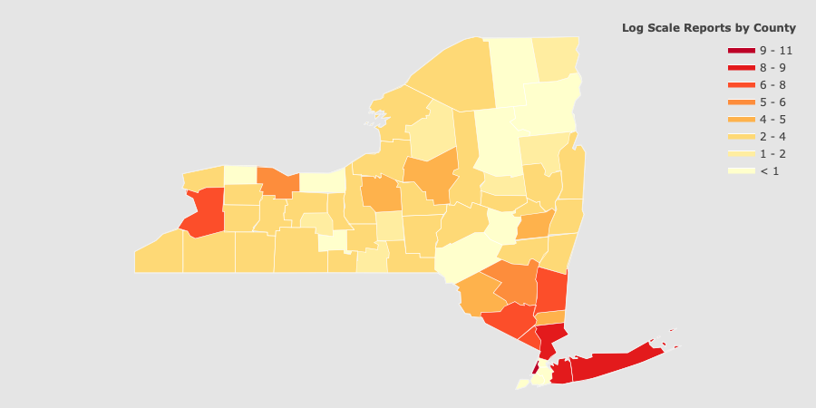
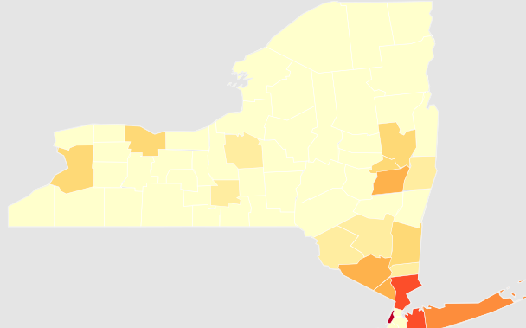
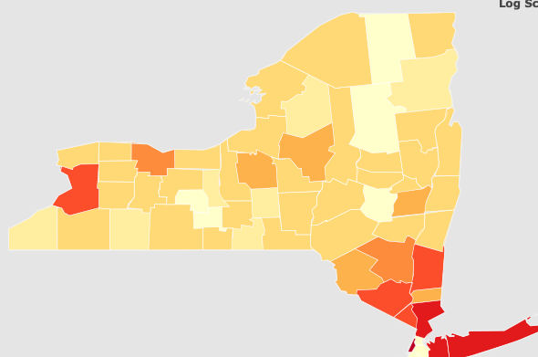
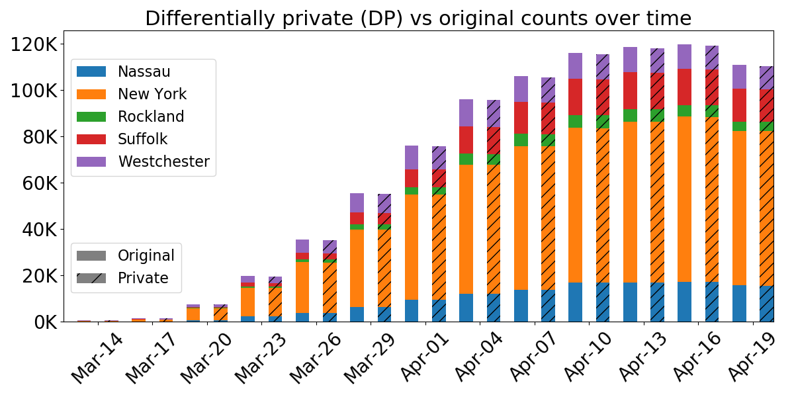
(Almost) Identical results with guaranteed privacy

Slide 26
Key Challenges
Technical
Spatiotemporal Privacy
Changing data
Arbitrary number of queries
System-level
Fast computation
Usable Results
Tuned to current situation
Rapid Development Effort
Getting it certified by the Play Store and App Store

Slide 27
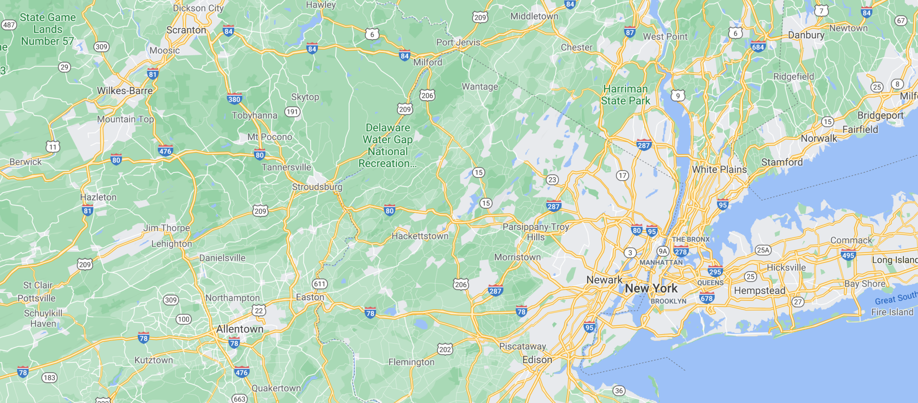
COVID Nearby: Arbitrary number of queries differing in sizes and regions
Query: How many people reported feeling symptoms in the past 8 days in New York City?
.
.
.
.
.
.
.
.
.
.
.
.
.
.
.
.
.
.
.
.
.
.
.
.
.
.
.
.
.
.
.
.
.
.
.
.
.
.
.
.
.
.
.
.
.
.
.
.
.
.
.
.
.
.
.
.
.
.
.
.
.
.
.
.
.
.
.
.
.
.
.
.
.
.
.
.
.
.
.
.
.
.
.
.
.
.
.
.
.
.
.
.
.
.
.
.
.
.
.
.
.
.
.
.
.
.
.
.
.
.
.
.
.
.
.
.
.
.
.
.
.
.
.
.
.
.
.
.
.
.
.
.
.
.
.
.
.
.
.
.
.
.
.
.
.
.
.
.
.
.
.
.
.
.
.
.
.
.
.
.
.
.
.
.
.
.
.
.
.
.
.
.
.
.
.
.
.
.
.
.
.
.
.
.
.
.
.
.
.
.
.
.
.
.
.
.
.
.
.
.
.
.
.
.
.
.
.
.
.
.
.
.
.
.
.
.
.
.
.
.
.
.
.
.
.
.
.
.
.
.
.
.
.
.
.
.
.
.
.
.
.
.
.
.
.
.
.
.
.
.
.
.
.
.
.
.
.
.
.
.
.
.
.
.
.
.
.
.
.
.
.
.
.
.
.
.
.
.
.
.
.
.
.
.
.
.
.
.
.
.
.
.
.
.
.
.
.
.
.
.
.
.
.
.
.
.
.
.
.
.
.
.
.
.
.
.
.
.
.
.
.
.
.
.
.
.
.
.
.
.
.
.
.
.
.
.
.
.
.
.
.
.
.
.
.
.
.
.
.
.
.
.
.
.
.
.
.
.
.
.
.
.
.
.
.
.
.
.
.
.
.
.
.
.
.
.
.
.
.
.
.
.
.
.
.
.
.
.
.
.
.
.
.
.
.
.
.
.
.
.
.
.
.
.
.
.
.
.

Slide 28
COVID Nearby: Arbitrary number of queries differing in sizes and regions
.
.
.
.
.
.
.
.
.
.
.
.
.
For privacy: use $ε$-DP Laplace mechanism
But
After $N$ queries, privacy $=ε^{′}=Nε$
.
.
.
.
.
.
.
.
.
.
.
.
.
.
.
.
.
.
.
.
.
.
.
.
.
.
.
.
.
.
.
.
.
.
.
.
.
.
.
.
.
.
.
.
.
.
.
.
.
.
.
.
.
.
.
.
.
.
.
.
.
.
.
.
.
.
.
.
.
.
.
.
.
.
.
.
.
.
.
.
.
.
.
.
.
.
.
.
.
.
.
.
.
.
.
.
.
.
.
.
.
.
.
.
.
.
.
.
.
.
.
.
.
.
.
.
.
.
.
.
.
.
.
.
.
.
.
.
.
.
.
.
.
.
.
.
.
.
.
.
.
.
.
.
.
.
.
.
.
.
.
.
.
.
.
.
.
.
.
.
.
.
.
.
.
.
.
.
.
.
.
.
.
.
.
.
.
.
.
.
.
.
.
.
.
.
.
.
.
.
.
.
.
.
.
.
.
.
.
.
.
.
.
.
.
.
.
.
.
.
.
.
.
.
.
.
.
.
.
.
.
.
.
.
.
.
.
.
.
.
.
.
.
.
.
.
.
.
.
.
.
.
.
.
.
.
.
.
.
.
.
.
.
.
.
.
.
.
.
.
.
.
.
.
.
.
.
.
.
.
.
.
.
.
.
.
.
.
.
.
.
.
.
.
.
.
.
.
.
.
.
.
.
.
.
.
.
.
.
.
.
.
.
.
.
.
.
.
.
.
.
.
.
.
.
.
.
.
.
.
.
.
.
.
.
.
.
.
.
.
.
.
.
.
.
.
.
.
.
.
.
.
.
.
.
.
.
.
.
.
.
.
.
.
.
.
.
.
.
.
.
.
.
.
.
.
.
.
.
.
.
.
.
.
.
.
.
.
.
.
.
.
.
.
.
.
.
.
.
.
.
.
.
.
.

Slide 29
COVID Nearby: Arbitrary number of queries differing in sizes and regions
.
.
.
.
.
.
.
.
.
.
.
.
.
.
.
.
.
.
.
.
.
.
.
.
.
.
.
.
.
.
.
.
.
.
.
.
.
.
.
.
.
.
.
.
.
.
.
.
.
.
.
.
.
.
.
.
.
.
.
.
.
.
.
.
.
.
.
.
.
.
.
.
.
.
.
.
.
.
.
.
.
.
.
.
.
.
.
.
.
.
.
.
.
.
.
.
.
.
.
.
.
.
.
.
.
.
.
.
.
.
.
.
.
.
.
.
.
.
.
.
.
.
.
.
.
.
.
.
.
.
.
.
.
.
.
.
.
.
.
.
.
.
.
.
.
.
.
.
.
.
.
.
.
.
.
.
.
.
.
.
.
.
.
.
.
.
.
.
.
.
.
.
.
.
.
.
.
.
.
.
.
.
.
.
.
.
.
.
.
.
.
.
.
.
.
.
.
.
.
.
.
.
.
.
.
.
.
.
.
.
.
.
.
.
.
.
.
.
.
.
.
.
.
.
.
.
.
.
.
.
.
.
.
.
.
.
.
.
.
.
.
.
.
.
.
.
.
.
.
.
.
.
.
.
.
.
.
.
.
.
.
.
.
.
.
.
.
.
.
.
.
.
.
.
.
.
.
.
.
.
.
.
.
.
.
.
.
.
.
.
.
.
.
.
.
.
.
.
.
.
.
.
.
.
.
.
.
.
.
.
.
.
.
.
.
.
.
.
.
.
.
.
.
.
.
.
.
.
.
.
.
.
.
.
.
.
.
.
.
.
.
.
.
.
.
.
.
.
.
.
.
.
.
.
.
.
.
.
.
.
.
.
.
.
.
.
.
.
.
.
.
.
.
.
.
.
.
.
.
.
.
.
.
.

Slide 30
COVID Nearby: Arbitrary number of queries differing in sizes and regions
Huge number of partitions, requires huge space
Highly erroneous for queries for larger region

Slide 31
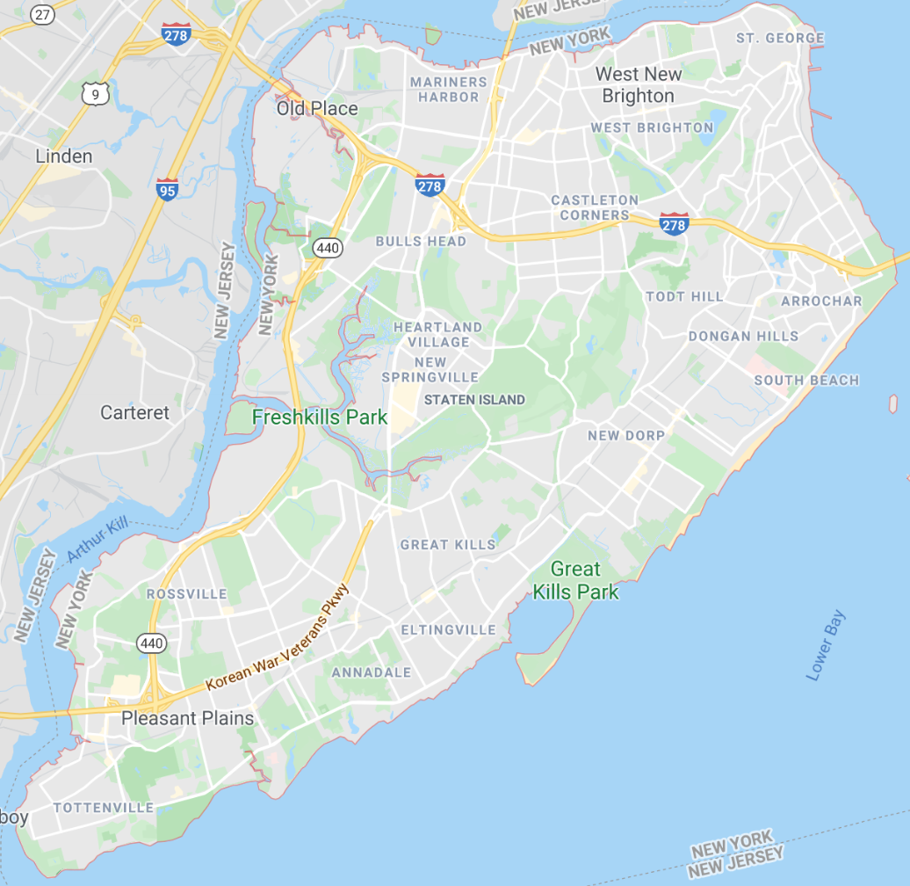
COVID Nearby Spatial Partitioning: Quadtrees
Unpartitioned space
Partitioned space
Quadtree
level 0
6
level 1
2
0
3
1
level 2
1
1
0
0
0
0
3
0

Slide 32
Partitioning of dynamically updating spatiotemporal data
Query: How many people reported feeling symptoms in the past 8 days in New York City?
.
.
.
.
.
.
.
.
.
.
.
.
.
.
.
.
.
.
.
.
.
.
.
.
.
.
.
.
.
.
.
.
.
.
.
.
.
.
.
.
.
.
.
.
.
.
.
.
.
.
.
.
.
.
.
.
.
.
.
.
.
.
.
.
.
.
.
.
.
.
.
.
.
.
.
.
.
.
.
.
.
.
.
.
.
.
.
.
.
.
.
.
.
.
.
.
.
.
.
.
.
.
.
.
.
.
.
.
.
.
.
.
.
.
.
.
.
.
.
.
.
.
.
.
.
.
.
.
.
.
.
.
.
.
.
.
.
.
.
.
.
.
.
.
.
.
.
.
.
.
.
.
.
.
.
.
.
.
.
.
.
.
.
.
.
.
.
.
.
.
.
.
.
.
.
.
.
.
.
.
.
.
.
.
.
.
.
.
.
.
.
.
.
.
.
.
.
.
.
.
.
.
.
.
.
.
.
.
.
.
.
.
.
.
.
.
.
.
.
.
.
.
.
.
.
.
.
.
.
.
.
.
.
.
.
.
.
.
.
.
.
.
.
.
.
.
.
.
.
.
.
.
.
.
.
.
.
.
.
.
.
.
.
.
.
.
.
.
.
.
.
.
.
.
.
.
.
.
.
.
.
.
.
.
.
.
.
.
.
.
.
.
.
.
.
.
.
.
.
.
.
.
.
.
.
.
.
.
.
.
.
.
.
.
.
.
.
.
.
.
.
.
.
.
.
.
.
.
.
.
.
.
.
.
.
.
.
.
.
.
.
.
.
.
.
.
.
.
.
.
.
.
.
.
.
.
.
.
.
.
.
.
.
.
.
.
.
.
.
.
.
.
.
.
.
.
.
.
.
.
.
.
.
.
.
.
.
.
.
.
.
.
.
.
.
.
.
.
.
.
.
.
.
.
.
.
.
.
.
.
.
.
.
.
.
.
.
.
.
.
.
.
.
.
.
.
.
.
.
.
.
.
.
.
.
.
.
.
.
.
.
.
by day 1
by day 2
by day 20
by day 50
.
.
.
.
.
.
.
.
.
.
.
.
.
.
.
.
.
.
.
.
.
.
.
.
.
.
.
.
.
.
.
.
.
.
.
.
.
.
.
.
.
.
.
.
.
.
.
.
.
.
.
.
.
.
.
.
.
.
.
.
.
.
.
.
.
.
.
.
.
.
.
.
.
.
.
.
.
.
.
.
.
.
.
.
.
.
.
.
.
.
.
.
.
.
.
.
.
.
.
.
.
.
.
.
.
.
.
.
.
.
.
.
.
.
.
.
.
.
.
.
.
.
.
.
.
.
.
.
.
.
.
.
.
.
.
.
.
.
.
.
.
.
.
.
.
.
.
.
.
.
.
.
.
.
.
.
.
.
.
.
.
.
.
.
.
.
.
.
.
.
.
.
.
.
.
.
.
.
.
.
.
.
at day 12
at day 13
at day 14
at day 15
at day 16
at day 17
at day 18
at day 19
at day 20
6 | 7 | 8 | 9 | 10 | 11 | 12 | 13 | 14 | 15 | 16 | 17 | 18 | 19 | 20 | 21 | 22 | 23 | 24 | 25 | 26 | 27

Slide 33
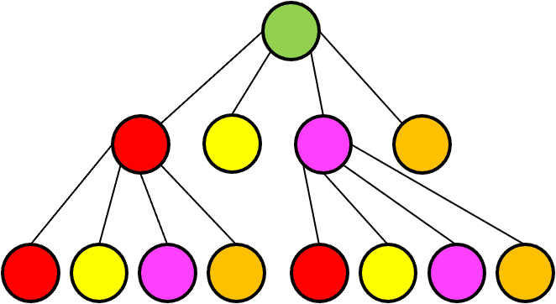
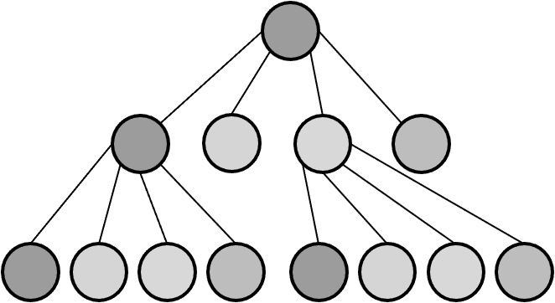
Partitioning of dynamically updating spatiotemporal data
Query: How many people reported feeling symptoms in the past 8 days in New York City?
6 | 7 | 8 | 9 | 10 | 11 | 12 | 13 | 14 | 15 | 16 | 17 | 18 | 19 | 20 | 21 | 22 | 23 | 24 | 25 | 26 | 27
1 2 3 4 5 6 7 8
$$d=8, n=8$$
$$d=8, n=3$$
6 | 7 | 8 | 9 | 10 | 11 | 12 | 13 | 14 | 15 | 16 | 17 | 18 | 19 | 20 | 21 | 22 | 23 | 24 | 25 | 26 | 27
$$d=8, n=1$$
Claim.
For any $1≤n≤d$, privacy is $\left(n+m\right)ε$
where $d=nk+m$

Slide 34
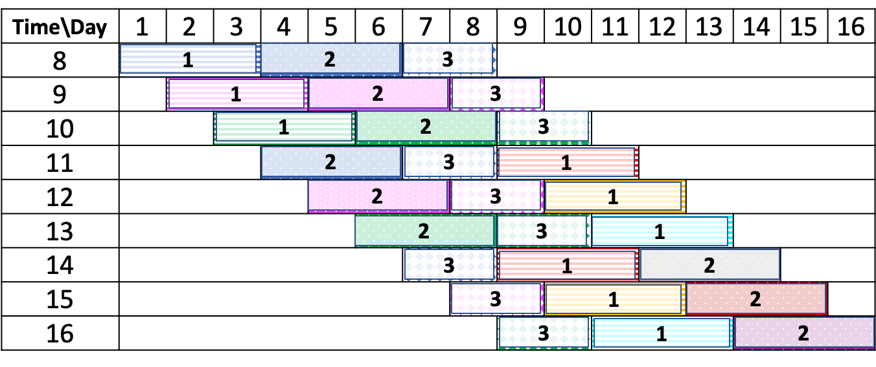
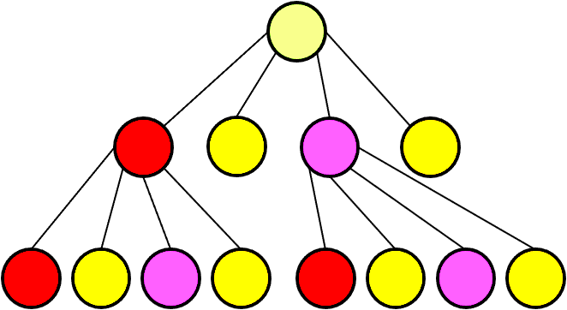
Claim.
For any $1≤n≤d$, privacy for our algorithm is $nε$
Day at which the partition is built
d = 8, n = 3
Days to be
grouped
Day\Da

Slide 35
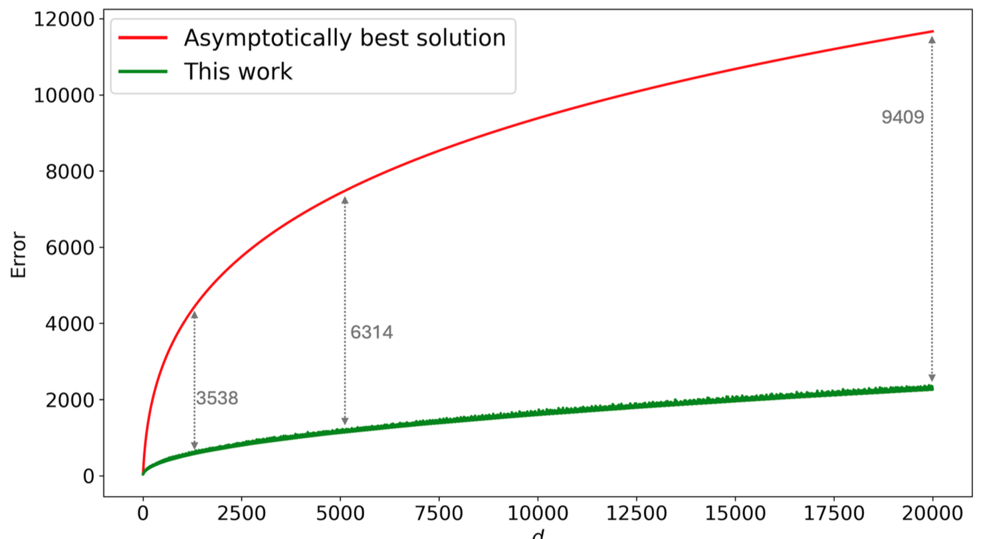
Can we do even better?
Yes, particularly, for small-to-medium sized windows
One key result:
for any positive integers such that $m<n$, $k≥1$, and $d=m+nk$
Always better to use m unit intervals for the reminder than to use 1 m-size interval
How? Using a combinatorial approach
For more details, look at: H. Asif, E. Boros, J. Vaidya, Differentially Private Range Counting: Where Asymptotically Better Fails, Integer Covering Prevails, Annals of Operations Research, 2025.

Slide 36
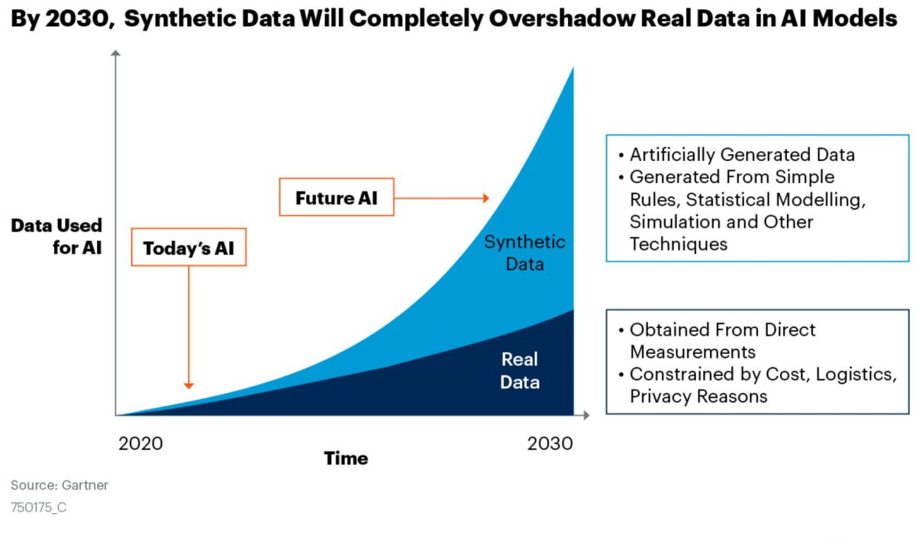
What else?
How about exploratory analysis?
Synthetic Data
Synthetic data is widely used for
Data augmentation
Simulation
Training models
Privacy
36

Slide 37
Ignore missing data
Using missing data
Synthetic data
Real data
unrealistic
biased
underrepresented
data wastage
poor quality
lacks important correlations and characteristics
representative
realistic & high-quality
leverages all available data
preserves important correlations and characteristics
Improved performance on downstream tasks

Slide 38
Our work
Generate synthetic datasets conditioned on the missing patterns that preserves both data and missing data distribution, handling different forms and relationships between missing data and observable data
(1)
P (𝑋) = P (𝑋𝑜|𝑀)P (𝑀)
data with missing values
missing patterns
data without missing values
(2)
P (𝑋) = P (𝑋𝑜,𝑀)
For more details, please look at: X. Wang, H. Asif, and J. Vaidya. 2023. Preserving Missing Data Distribution in Synthetic Data. WWW '23 https://doi.org/10.1145/3543507.3583297 and
X. Wang, H. Asif, S. Gupta and J. Vaidya, "Data Synthesis Reinvented: Preserving Missing Patterns for Enhanced Analysis," in IEEE Transactions on Knowledge and Data Engineering ’25. https://doi.org/10.1109/TKDE.2025.3563319

Slide 39
Approach 1: HottGAN → P (𝑋𝑜|𝑀)P (𝑀)
Real data
Identify missing pattern
Hott partitioning
Data projection
Learner & generator
Data lifting

Slide 40
Approach 2: MergeGAN → P(𝑋𝑜,𝑀)
Real data
Missing pattern embedding
MP feature creation
Imputation
Learner & generator
for synthetic data
MP creation
Data cleaning

Slide 41
Results

Slide 42
Verifying ML models: Secure Engravings
Goal: undetectably engrave special input/output information into a NN.
Example: signing a network
We provide
(1) definitions of security for the secret engraving problem
(2) machine learning methods for the construction of an engraved network
(3) a threat model that is instantiated with state-of-the-art interpretability methods to devise distinguishers/attackers.
For more details, please look at: N. Hobbs, P. A. Papakonstantinou and J. Vaidya, "Engravings, Secrets, and Interpretability of Neural Networks," in IEEE Transactions on Emerging Topics in Computing, vol. 12, no. 4, pp. 1093-1104, Oct.-Dec. 2024, https://doi.org/10.1109/TETC.2024.3358759.

Slide 43
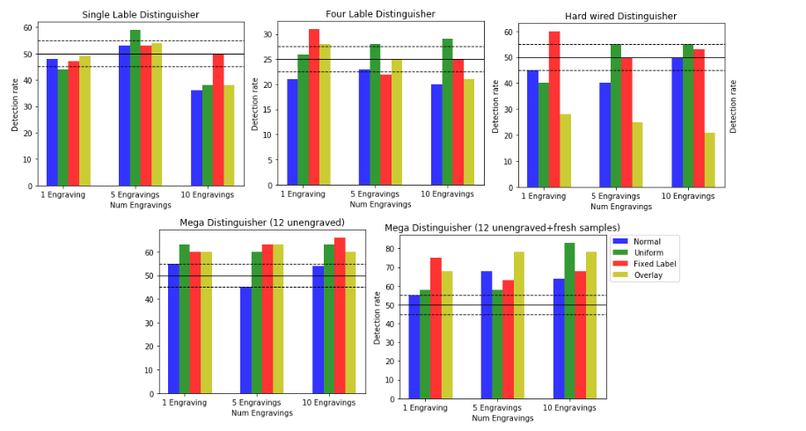
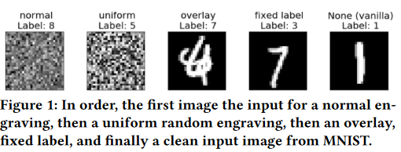
Secure Engravings: Two Key Problems
How to create them?
Hardwire them (i.e., modify the architecture)
Utilize an adaptive training procedure
How to detect them?
Use syntax (i.e., network and weights)
Use semantics (i.e., interpretability features)
Yes or no
What’s the pair?
Yes or no, bring a friend
Yes or no, with “knowledge” of many engraving types

Slide 44
Going ahead, what do we need?
A more nuanced view of privacy and trust
Privacy accounting
Privacy explanation
Privacy visualization
Privacy exploration
The next generation of privacy-preserving systems
Consider new architectures
Incorporate diverse privacy models
Take a socio-cognitive approach
Enable meaningful control over data
Use ml/ai to automate policy configuration and management

Slide 45
Questions

