Slide 1




Plasmonic nanomaterials for
ultrafast nonlinear optics and photochemistry
Anatoly V Zayats
www.nano-optics.org.uk

Slide 2
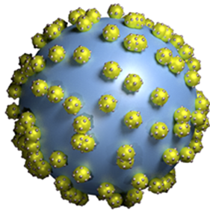
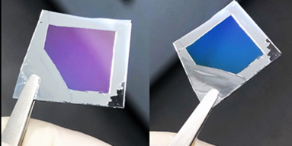
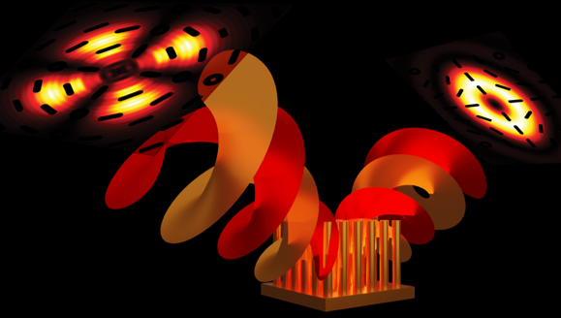
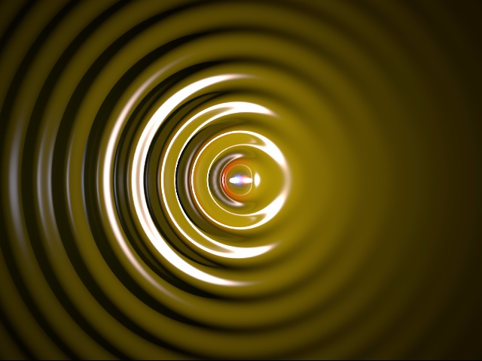
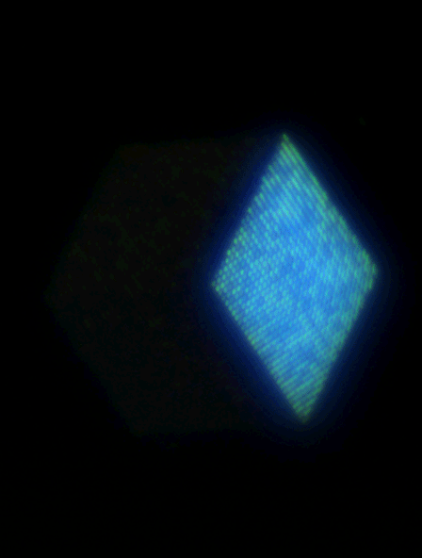
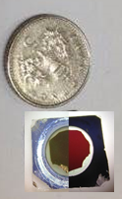
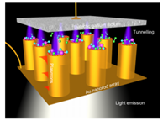
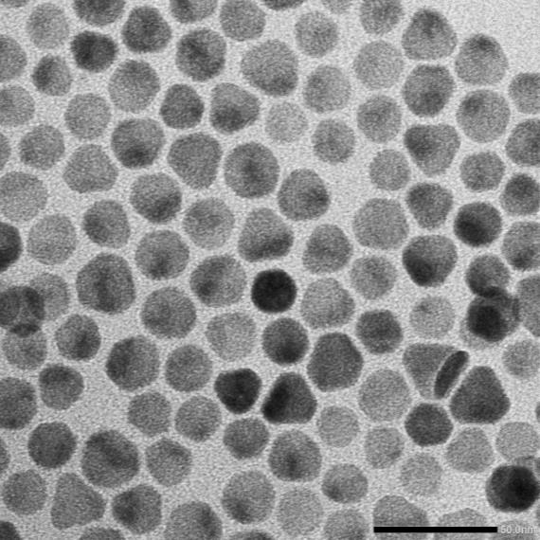
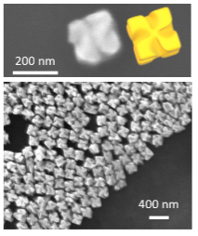
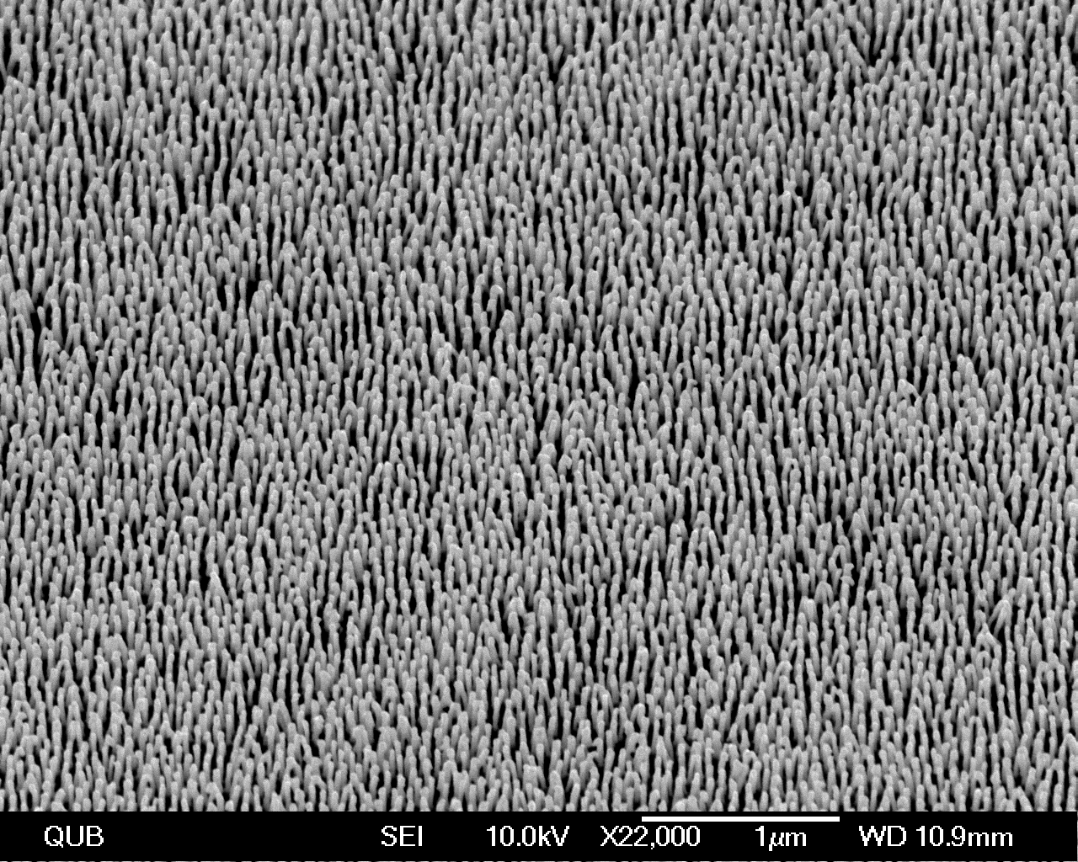
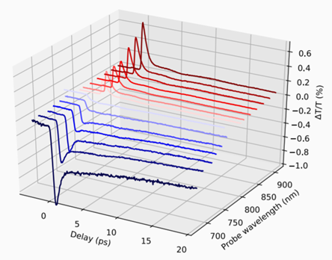
Plasmonic nanomaterials
Plasmonic hot-electrons for
photochemistry & catalysis
Topological photonics
OAM and metamaterials
Metasurface
holography
Bio- & gas
sensing
New plasmonic
materials
Ultrafast and nonlinear
nanophotonics
Controlling
chirality
Active and nonlinear hyperbolic &
hybrid dielectric metamaterials

Slide 3
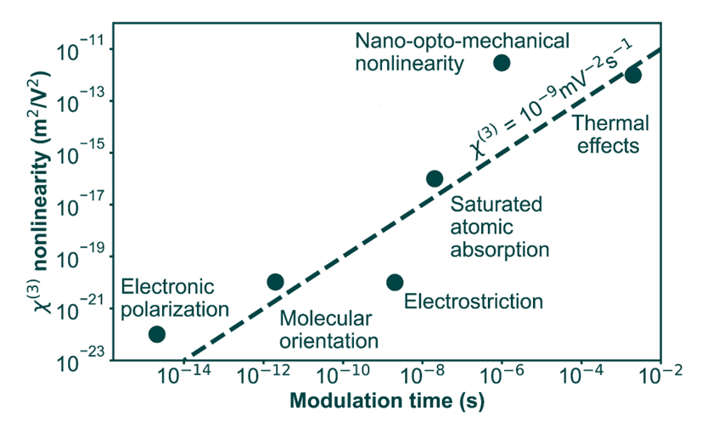
Nonlinear materials
J. Phys.: Photon. 6, 032502 (2024).

Slide 4
Nonlinear materials
J. Phys.: Photon. 6, 032502 (2024).

Slide 5
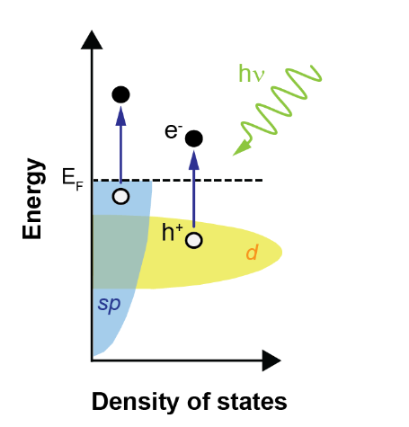
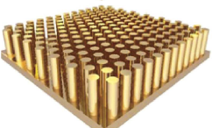
Plasmonic hot electrons
control
Metal (gold)
Optical nonlinearity of an electron gas: due to hot electrons
Δε_{m}(T_{e}) = ΔReε_{m}+ ΔImε_{m}
Laser Phot. Rev. 12, 1700082 (2018); eLight 4, 15 (2024).

Slide 6
Hot electrons in metals
0 s
~10 fs
~500 fs
~5 ps
e⁻
e⁻
time
e⁻
h⁺
e-e scattering
e-ph scattering
Material platform choice
Nanostructure geometry
eLight 4, 15 (2024).

Slide 7
Hot electrons in metals
0 s
~10 fs
~500 fs
~5 ps
e⁻
e⁻
time
e⁻
h⁺
e-e scattering
e-ph scattering
Material platform choice
Nanostructure geometry
Nonlocal response
Quantum effects
eLight 4, 15 (2024).

Slide 8
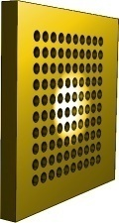
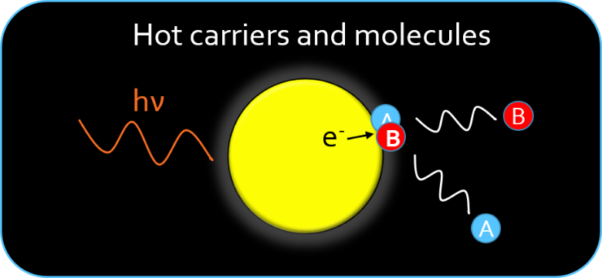
Plasmonic hot electrons
Nonlinear optics: Photochemistry:
hot-electron transfer
Δε_{m}(T_{e}) = ΔReε_{m}+ ΔImε_{m}
Short-lived electrons: Long-lived electrons
(fast electron relaxation) (slow electron relaxation)
Material platform choice
Nanostructure geometry

Slide 9
Plasmonic metaparticles

Slide 10
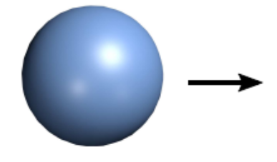
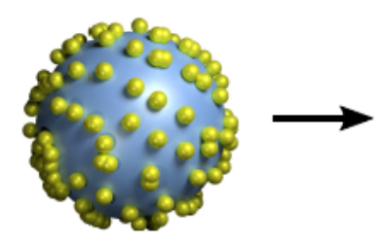
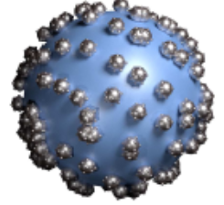
Plasmonic heterostructures
SiO2: support-
large surface
area
Au: LSP excitation-
hot-electron generation
Pt: molecular adsorption & hot hot-electron extract
Nanoscale Adv. 3, 767 (2021); Faraday Discussions 214, 385 (2019).

Slide 11
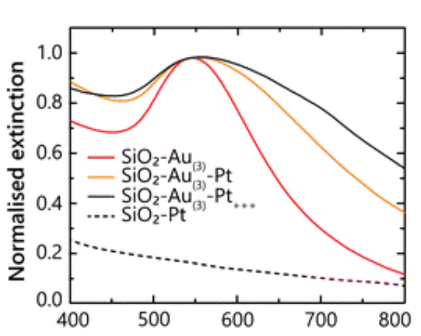
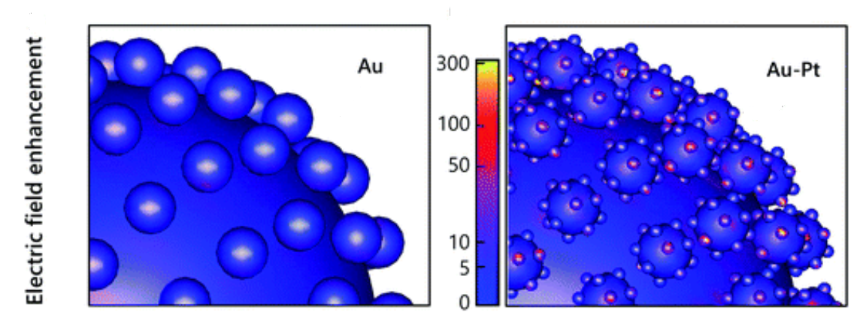

Plasmonic heterostructures
Optical properties and hot electron generation
Nanoscale Adv. 3, 767 (2021); Faraday Discussions 214, 385 (2019).

Slide 12
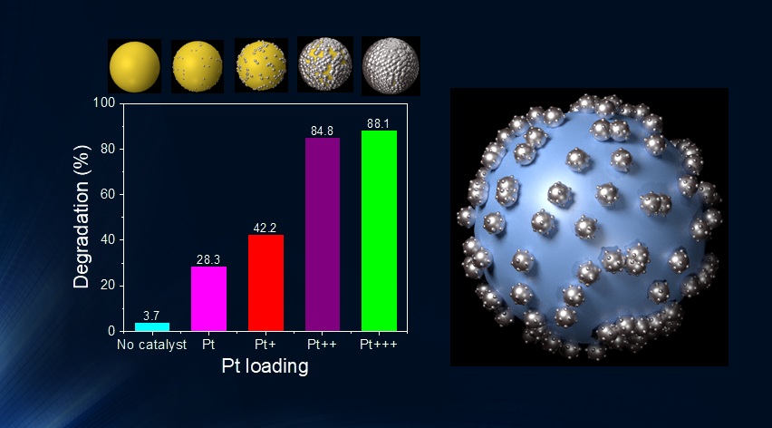
Plasmonic heterostructures
Hot-electron induced degradation of methylene blue on Au/Pt nanostructure
Nanoscale Adv. 3, 767 (2021); Faraday Discussions 214, 385 (2019).

Slide 13
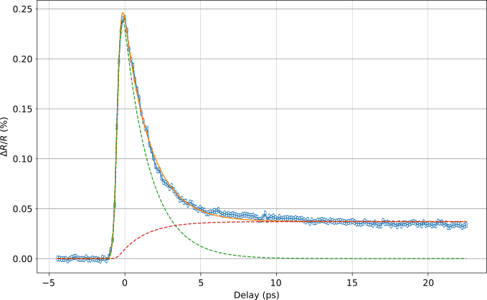
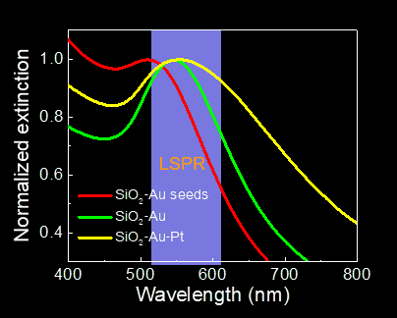
Hot-electron dynamics
probe
pump
Nanophotonics 10, 2929 (2021).

Slide 14
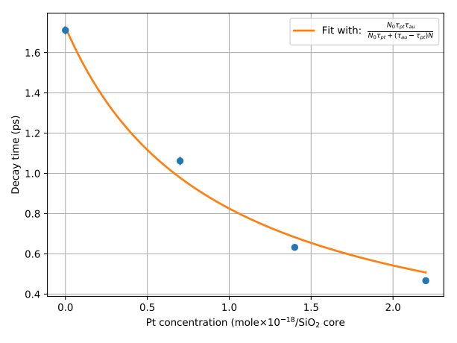
Hot-electron dynamics
Au: 10-15 nm; Pt: 1-2 nm
Hot-carrier dynamics in Au/Pt heterostructures: in water.
Nanophotonics 10, 2929 (2021).

Slide 15
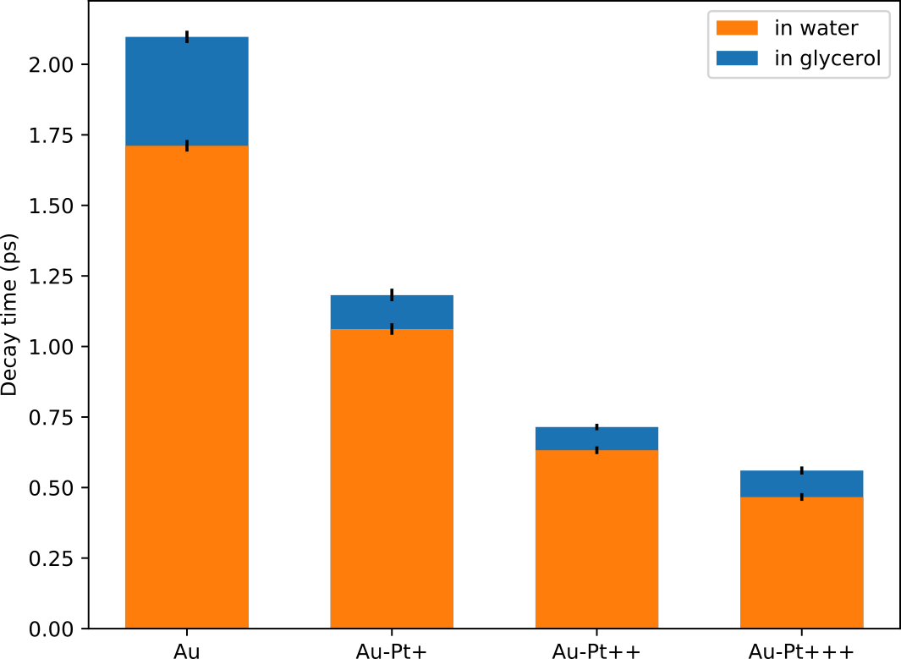
Hot-electron dynamics
Au: 10-15 nm; Pt: 1-2 nm
Hot-carrier dynamics in Au/Pt heterostructures: in water and glycerol.
Nanophotonics 10, 2929 (2021).

Slide 16
Ultrathin monocrystalline plasmonic nanofilms

Slide 17
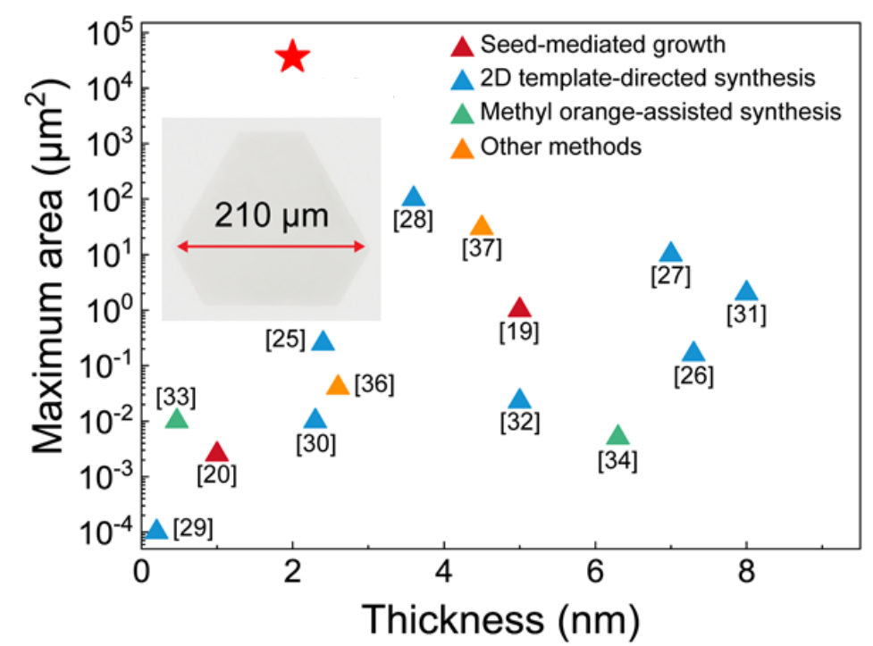
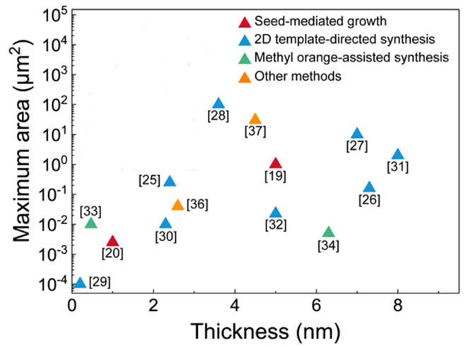
Monocrystalline ultrathin gold
Nature Comm. 15, 2840 (2024).

Slide 18
Monocrystalline ultrathin gold
Atom layer etching
Nature Comm. 15, 2840 (2024).

Slide 19
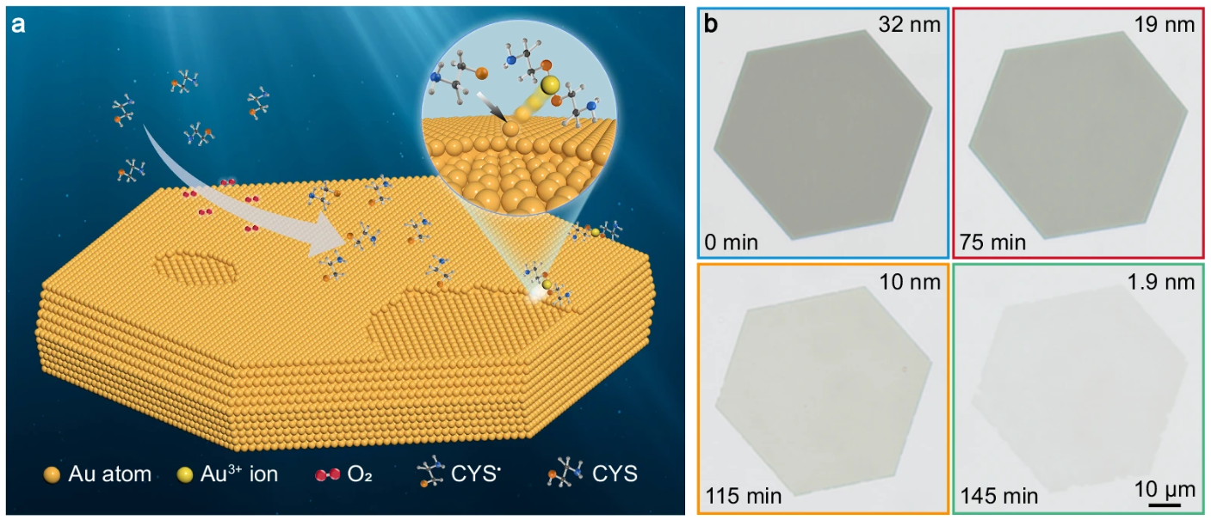
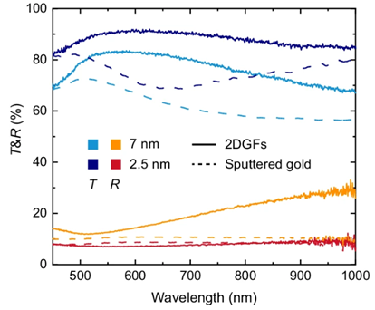
Towards goldphene
Ultrathin monocrystalline gold (and other plasmonic metals)
(transdimensional materials family: Boltasseva & Shalaev)
Nature Comm. 15, 2840 (2024).

Slide 20
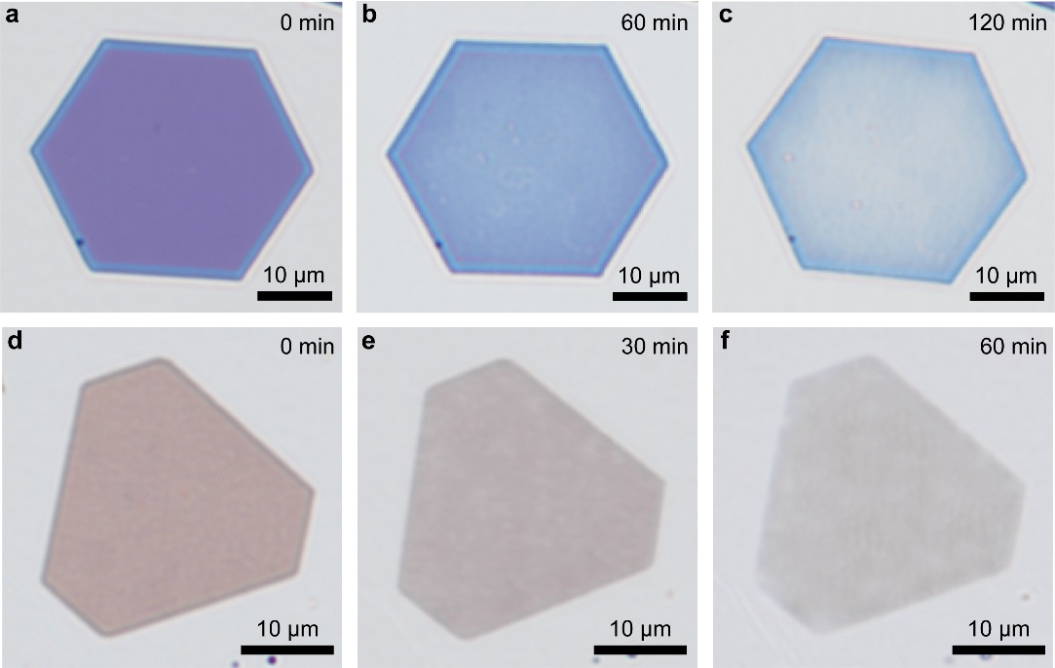
Towards goldphene
Ag
Cu
Ultrathin monocrystalline gold (and other plasmonic metals)
Nature Comm. 15, 2840 (2024).

Slide 21
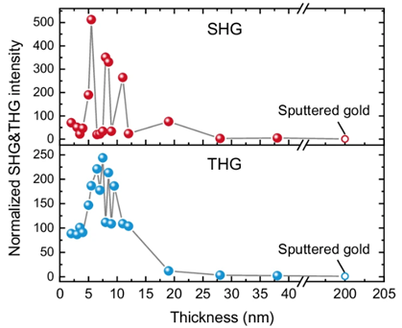
Towards goldphene
SHG & THG
Nature Comm. 15, 2840 (2024).

Slide 22
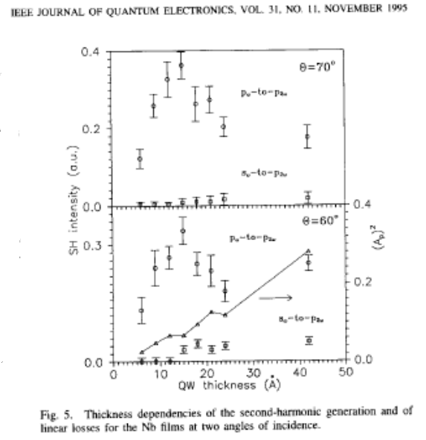
Towards goldphene
IEEE J. Quant. Electr.
31, 2044 (1995):
Nb ultrathin films
SHG & THG
Nature Comm. 15, 2840 (2024).

Slide 23
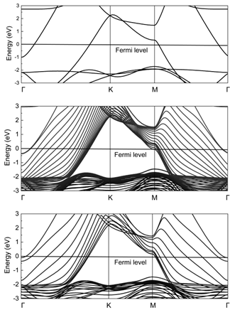
Towards goldphene
bulk
20 layers
10 layers
SHG & THG quantum confinement effects
Nature Comm. 15, 2840 (2024).

Slide 24
Towards goldphene
bulk
20 layers
10 layers
quantum effects:
anisotropic gold
SHG & THG quantum confinement effects
Nature Comm. 15, 2840 (2024).

Slide 25
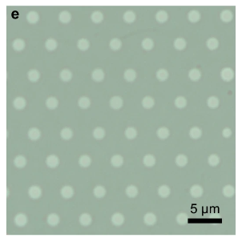
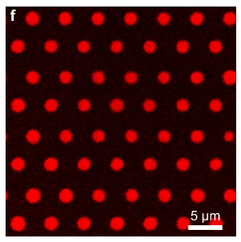
Towards goldphene
bulk
20 layers
10 layers
SHG & THG quantum confinement effects TPPL
Nature Comm. 15, 2840 (2024).

Slide 26
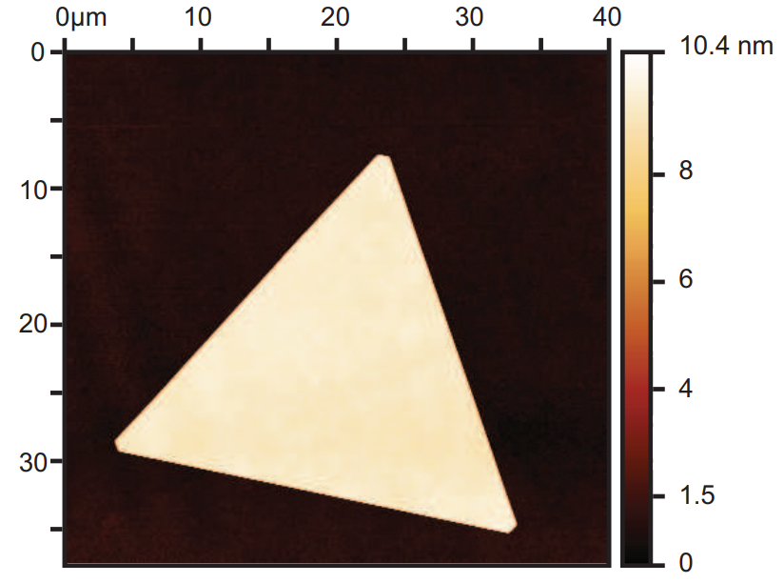
Monocrystalline ultrathin gold
Nature Comm. 15, 2840 (2024).
Nature Comm. 15, 703 (2024).

Slide 27
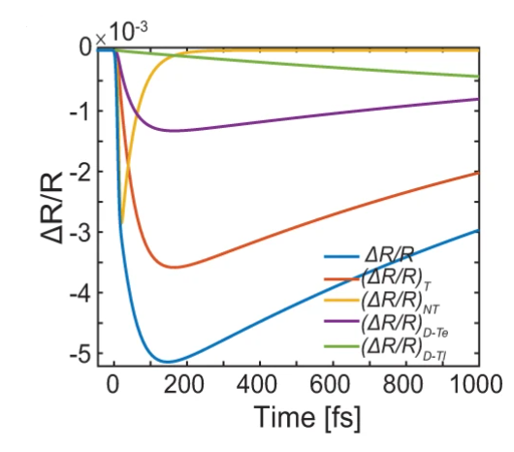
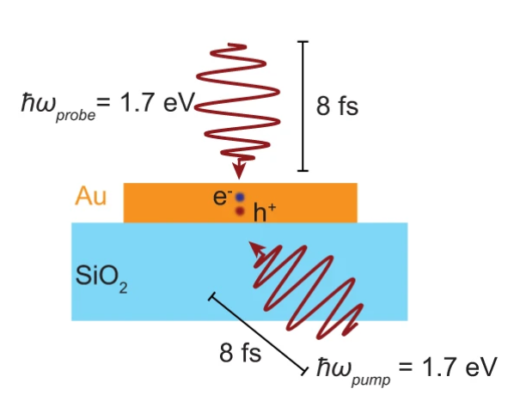
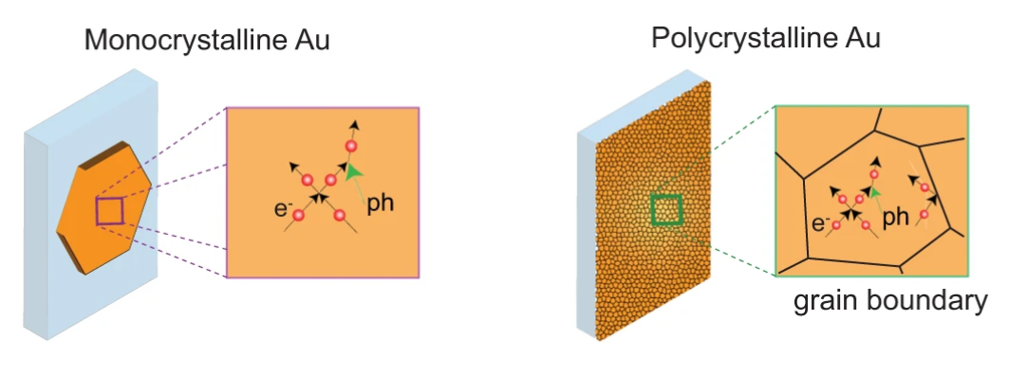
Ultrathin and ultrafast
Sub-picosecond dynamics: Au/SiO2
Nature Comm. 15, 703 (2024).

Slide 28
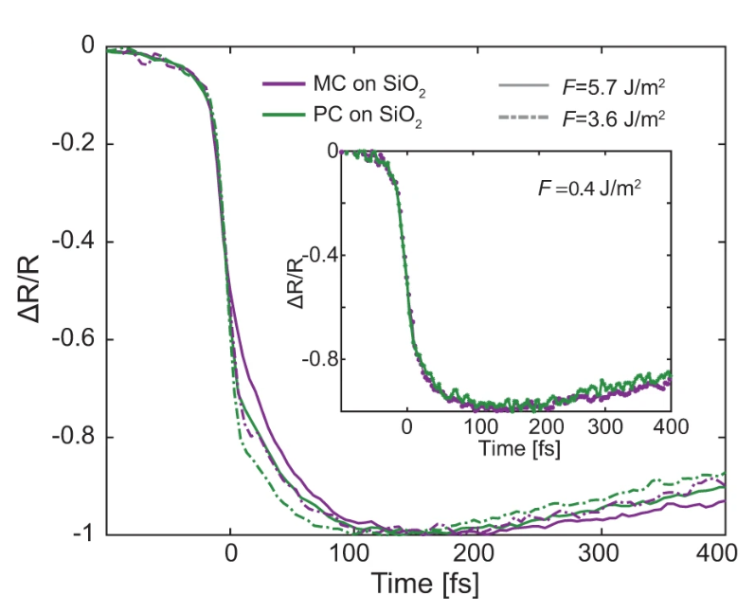
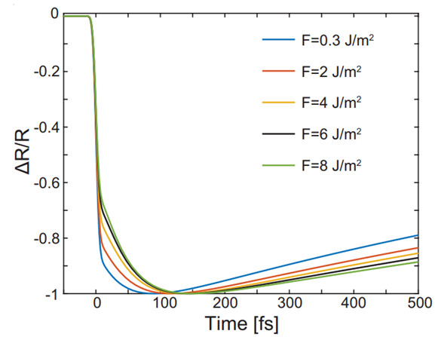
Ultrathin and ultrafast
Nonthermalised electron scattering rate: MC – 18 THz, PC – 24THz.
Nature Comm. 15, 703 (2024).

Slide 29
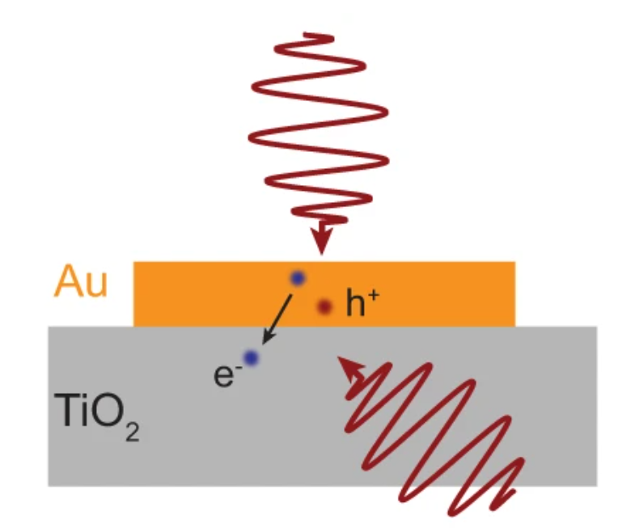
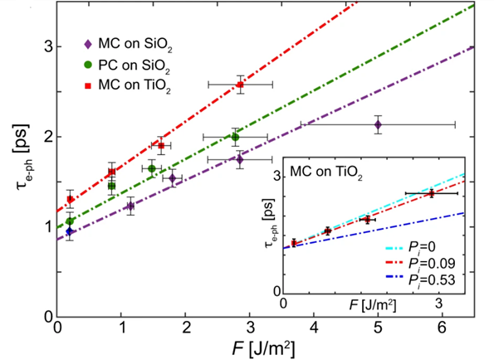
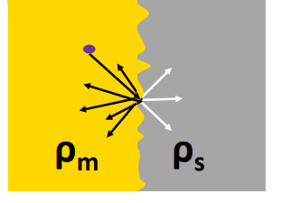
Ultrathin and ultrafast
Hot-carrier cooling at a metal-semiconductor interface:
- nearly theoretical transfer rate despite a smooth interface (~ 10%)
- electron-phonon thermalisation time increases: thin-film effects
- substrate phonon effects for MC ultrathin films
Nature Comm. 15, 703 (2024).

Slide 30
Monocrystalline CuS

Slide 31
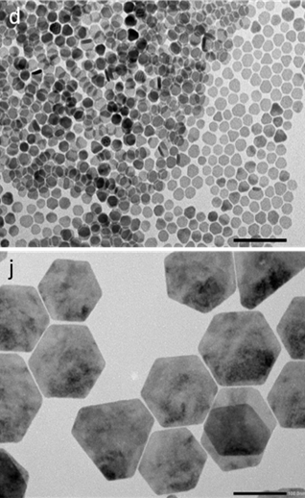
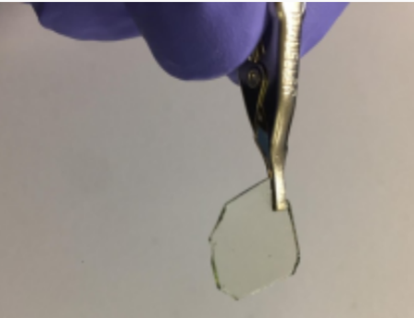
Mesoscopic CuS
covellite (CuS) nanoscrystals: monolayer of
thickness 4-10 nm nanocrystals
size: 15-200 nm
p-type “metal”
free-carrier concentration: ~ 3x10²¹ cm⁻³
c.f. Au, Ag: ~ 6x10²² cm⁻³
ACS Nano 13, 6550 (2019).

Slide 32
Mesoscopic CuS
anisotropic dielectric
hyperbolic material: ENZ properties
anisotropic plasmonic material
ACS Nano 13, 6550 (2019).

Slide 33
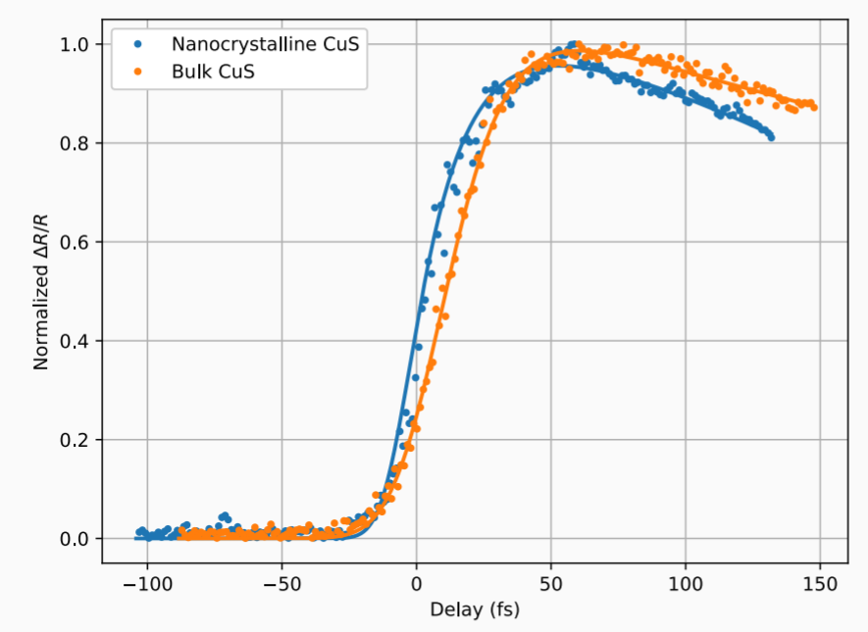
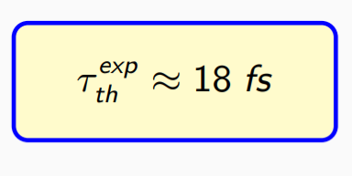

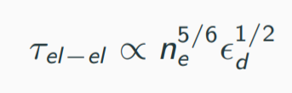
Mesoscopic CuS
Nonthermalised carrier dynamics
Laser Phot. Rev. 15, 2000346 (2021).

Slide 34


Mesoscopic CuS
Nonthermalised carrier dynamics:
nonlocal effects
Laser Phot. Rev. 15, 2000346 (2021).

Slide 35
Electron dynamics in ultrathin monocrystalline plasmonic nanofilms
Time-varying quadratic nonlinearity of ITO

Slide 36





Enhancing natural ENZ nonlinearity
Plasmonic-ENZ metasurface:
~ 10⁴ SHG enhancement (exp)
Nano Lett. 20, 5421 (2020).

Slide 37


Time-dependent quadratic nonlinearity
Nano Lett. 24, 3744 (2024).

Slide 38




Time-dependent quadratic nonlinearity
Linear changes:
SHG changes:
Time-varying SHG >> time-varying linear T
Nano Lett. 24, 3744 (2024).

Slide 39


Time-dependent quadratic nonlinearity
Renormalisation of the plasma frequency:
~ 40 nm
Time-varying second-order nonlinear susceptibility: ~ 10%
Nano Lett. 24, 3744 (2024).

Slide 40


Time-dependent quadratic nonlinearity
Renormalisation of the plasma frequency:
~ 40 nm
Time-varying second-order nonlinear susceptibility: ~ 10%
Miller’s rule for nonlinear susceptibility:
Nonlinear dipole density:
Nano Lett. 24, 3744 (2024).

Slide 41
Time-dependent quadratic nonlinearity
Renormalisation of the plasma frequency:
~ 40 nm
Time-varying second-order nonlinear susceptibility: ~ 10%
Coupling to resonant plasmonic metasurface:
- 10-fold enhancement
- control of circular polarised SHG
Nano Lett. 24, 3744 (2024).

Slide 42









Ultrafast nonlinear plasmonics
-1
1
Time (ps)
25
480
Wavelength (nm)
750
J. Phys.: Photon. 6, 032502 (2024).

Slide 43
Unidirectional chiral scattering

Slide 44



Unidirectional emission by rotating chiral dipoles
Nature Comm. 16, 1125 (2025).

Slide 45

Unidirectional emission by rotating chiral dipoles
Nature Comm. 16, 1125 (2025).

Slide 46





Unidirectional emission by rotating chiral dipoles
620 nm
860 nm
950 nm
Nature Comm. 16, 1125 (2025).

Slide 47




@KingsNanoOptics

Slide 48









nano-optics.org.uk
@KingsNanoOptics

