Slide 1
The role of models at the heart of the digital transformation
Francis Bordeleau
Professor, Kaloom-TELUS ÉTS Industrial Research Chair in DevOps francis.bordeleau@etsmtl.ca
Francis Bordeleau, 2024
Notes:
Local (A17): A-2332

Slide 2
Outline
Personal intro
Digital transformation
Digital twins
DevOps
The role of models
Summary

Slide 3
Personal intro
Digital transformation
Digital twins
DevOps
The role of models
Summary

Slide 4
Industrial and academic experience
Research & Academia
15+ years
CEO
12 years
Product Manager
4 years
Teaching and Training
Consulting
Telecom
SDR
Aerospace & Defence
others

Slide 5
Research
DevOps: Kaloom–TELUS ÉTS Industrial Research Chair (IRC)
Digital Twins
Expertise
Software/system engineering
Model-Based Engineering (MBE) Software processes – DevOps Tools for systems/software engineering Open source
Research focused on industry needs
Close collaborations with industry Technology transfer

Slide 6
Personal intro
Digital transformation
Digital twins
DevOps
The role of models
Summary

Slide 7
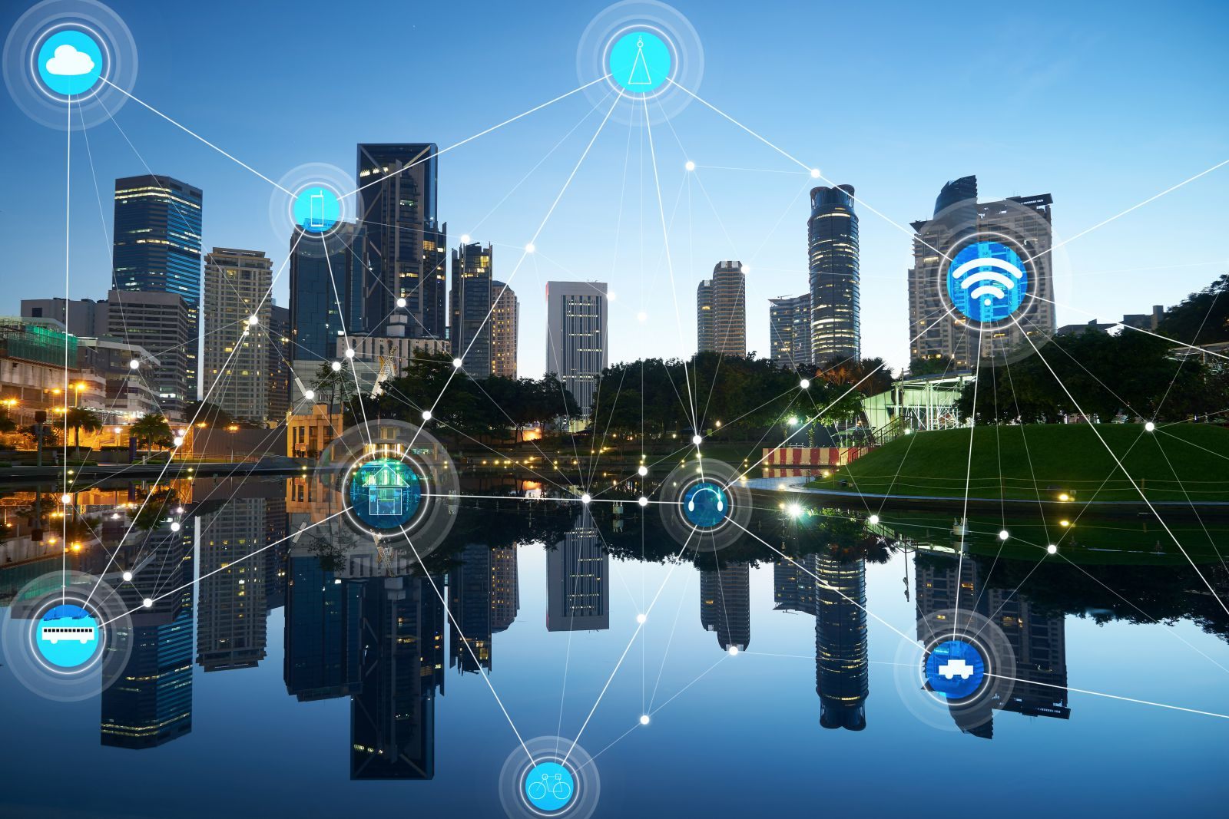
Digital transformation: Building more efficient and intelligent systems
https://medium.com/spinfluence-technology/iot-is-on-your-radar-blockchain-is-the-technology-you-want-to-adopt-38dff26bb567

Slide 8
Technology and business context
Technology
From connected places, to connected people, to connected objects
“Smart” technologies – Smart cities, smart buildings, smart mobility, ...
Component-based architectures – SOA, microservices, APIs, …
Software-defined system architectures – SDR, SDN, …
Cloud technologies (cloud computing)
Business
Business is going faster and faster
Competition is fiercely increasing
Time to market is getting shorter
Example, 5G PPP challenge: Reducing the average service creation time cycle from 90 hours to 90 minutes
Software is now the main product differentiator

Slide 9
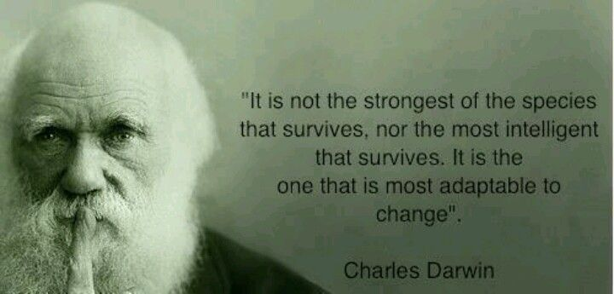
It’s all about adaptability!
https://i.pinimg.com/originals/76/c2/48/76c2488bb14987585c183c3f7a7eeaee.jpg

Slide 10
Data … and models!
The digital transformation is made possible by the availability of data … but data are not sufficient!
Data alone don’t provide much value
Different types of models are required to extract information and make sense of the data
Types of models depend on the application domain and context

Slide 11
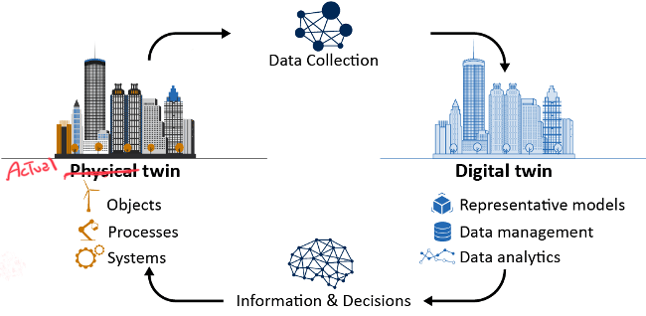
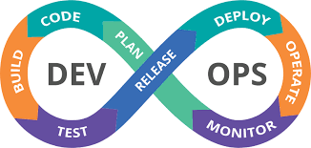
Digital Twins and DevOps

Slide 12
Personal intro
Digital transformation
Digital twins
DevOps
The role of models
Summary

Slide 13
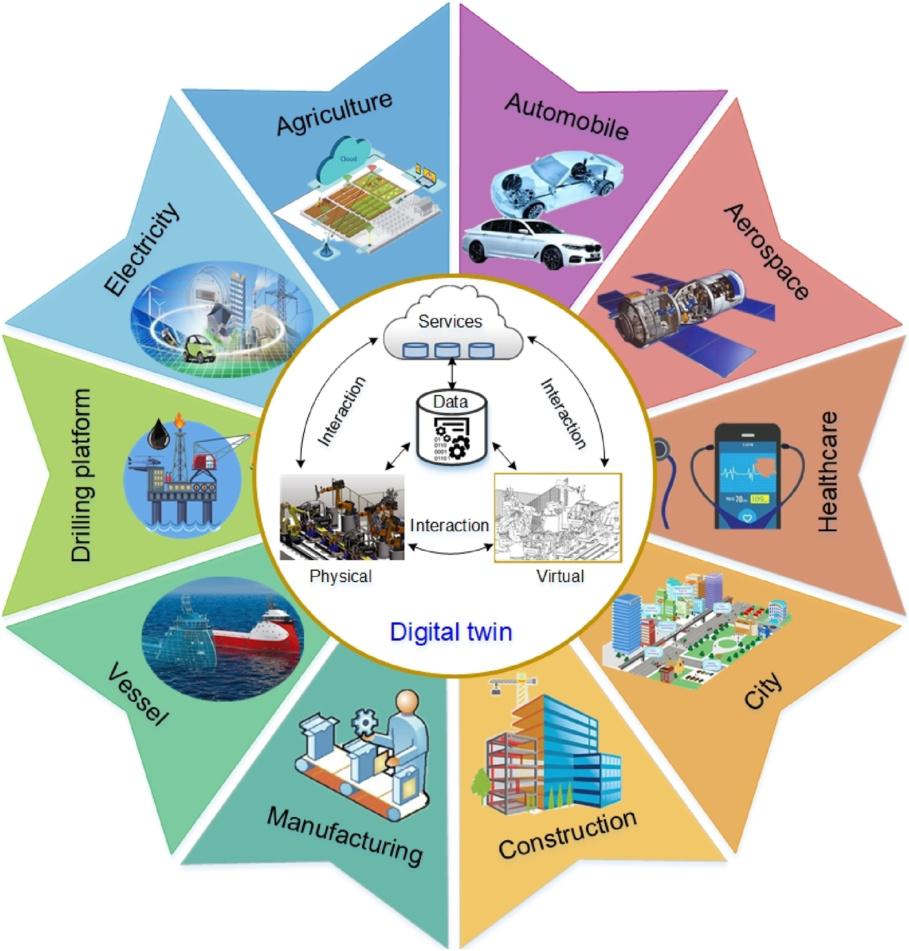
DT in Different Domains
Note: not only for physical systems!
A DT is a digital replica of an actual systems that
Has a well-defined purpose
Is connected to (fed by) actual system data
Uses different type of models and data to provide a set of services in relation to its purpose
A DT is in fact a digital replica of a subset of a system
Qi, Qinglin, et al. "Enabling technologies and tools for digital twin." Journal of Manufacturing Systems 58 (2021): 3-21.

Slide 14
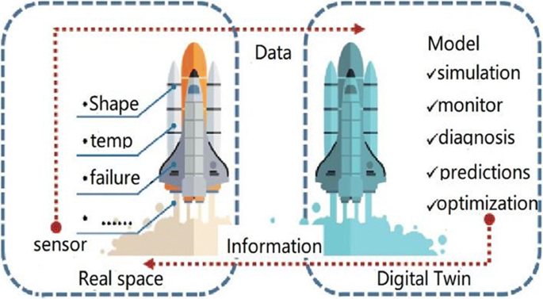
DT – Services
Guo, Jinkang, and Zhihan Lv. "Application of Digital Twins in multiple fields." Multimedia tools and applications (2022): 1-27.

Slide 15
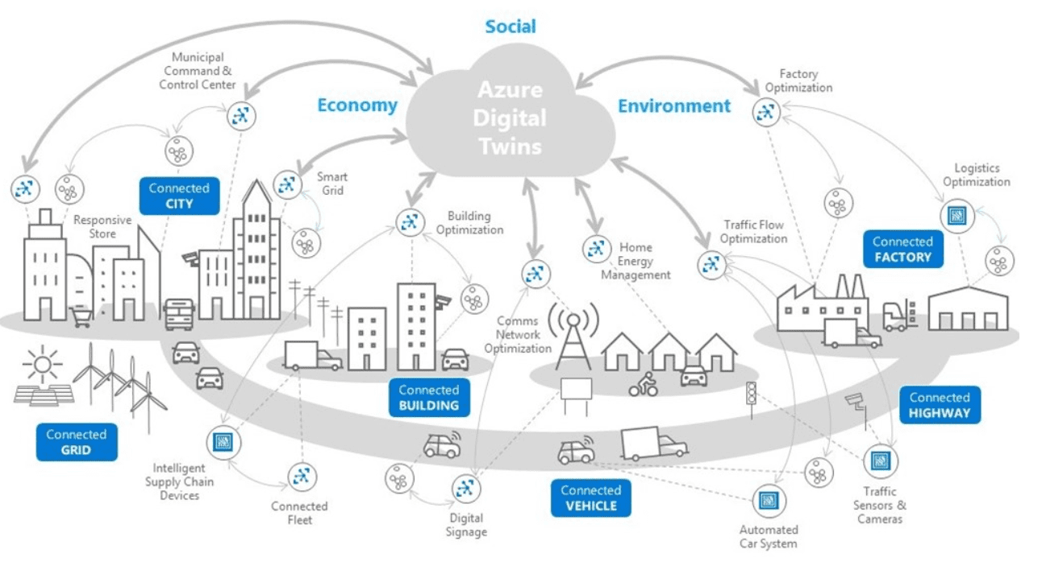
DT – Telemetry
https://www.codeproject.com/Articles/1273184/Azure-Digital-Twins

Slide 16
DT – Models
Models for DT and models in DT
Model-Driven Engineering for DT
Software Engineering (or Model-Based Engineering) models used to architect and develop the DT
E.g. UML or SysML
Models in DT to provide services
Domain specific models that can be used to describe, analyze, monitor, diagnose, and simulate the actual twin
E.g. MatLab Simulink, Building Information Models (BIM),virtual reality (VR) models, differential equations, numerical analysis, statistical models, and ML/AI models

Slide 17
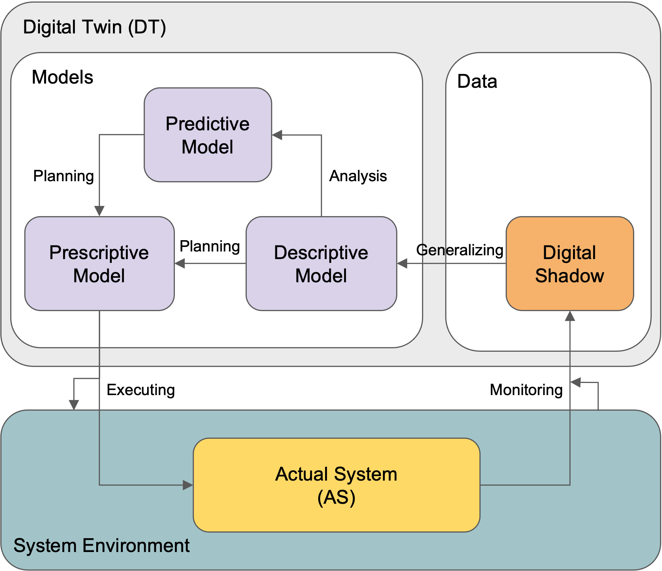
Models in DT
Extract information from the collected data
Models can be used for analysis, simulation, diagnosis, monitoring, etc
Three main roles: descriptive, predictive, and prescriptive
Different types of models: structure, behavior, data analytics, etc
The set of models depends on the application domain and purpose of the DT
Eramo, Romina, Francis Bordeleau, Benoit Combemale, Mark van Den Brand, Manuel Wimmer, and Andreas Wortmann. "Conceptualizing digital twins." IEEE Software 39, no. 2 (2021): 39-46.

Slide 18
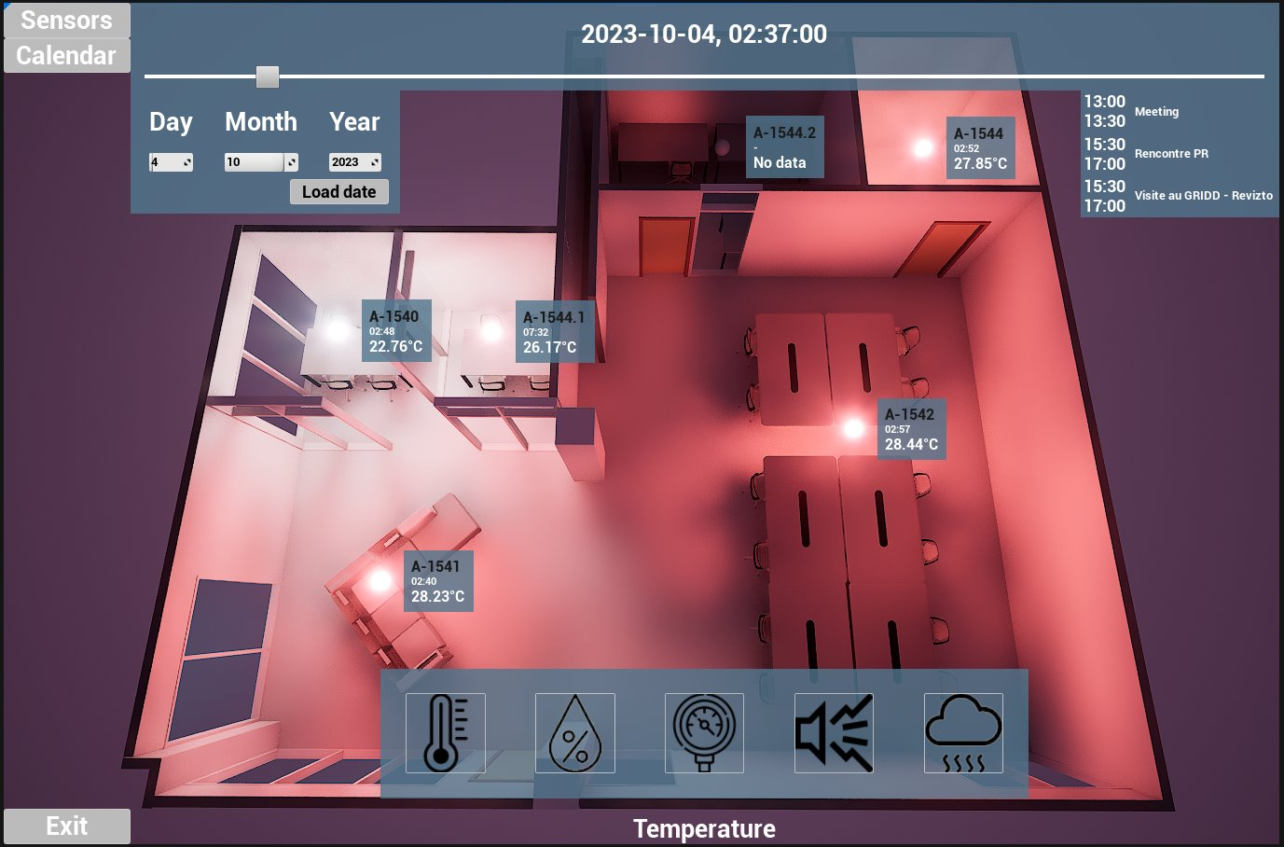
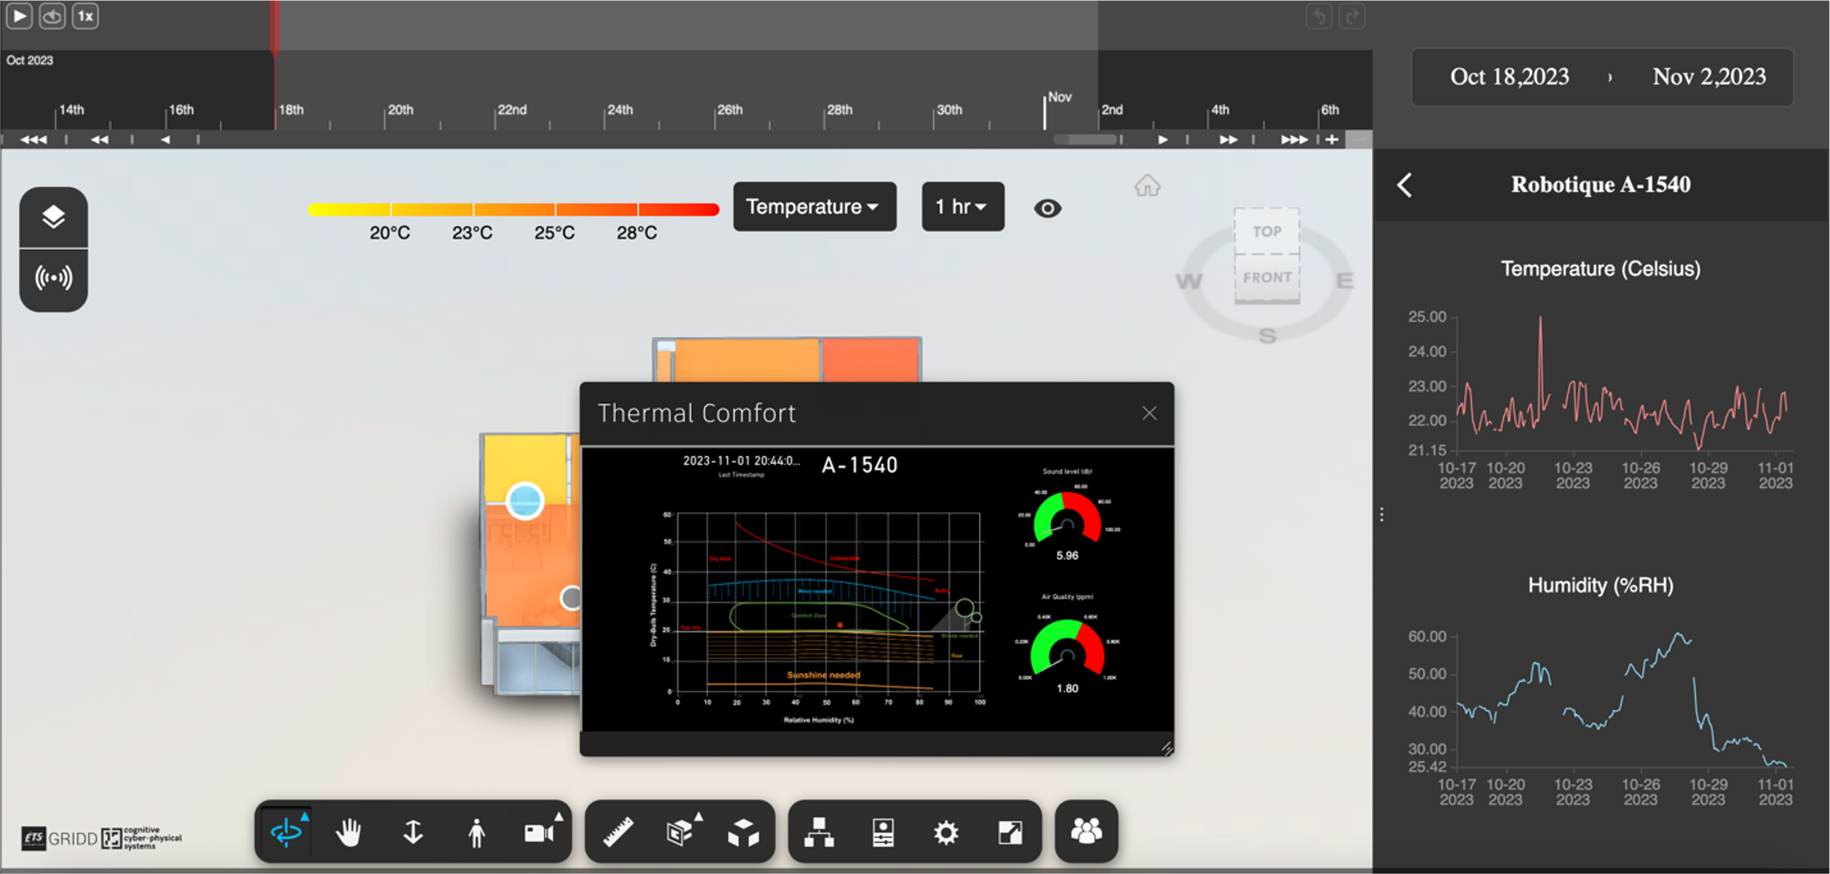
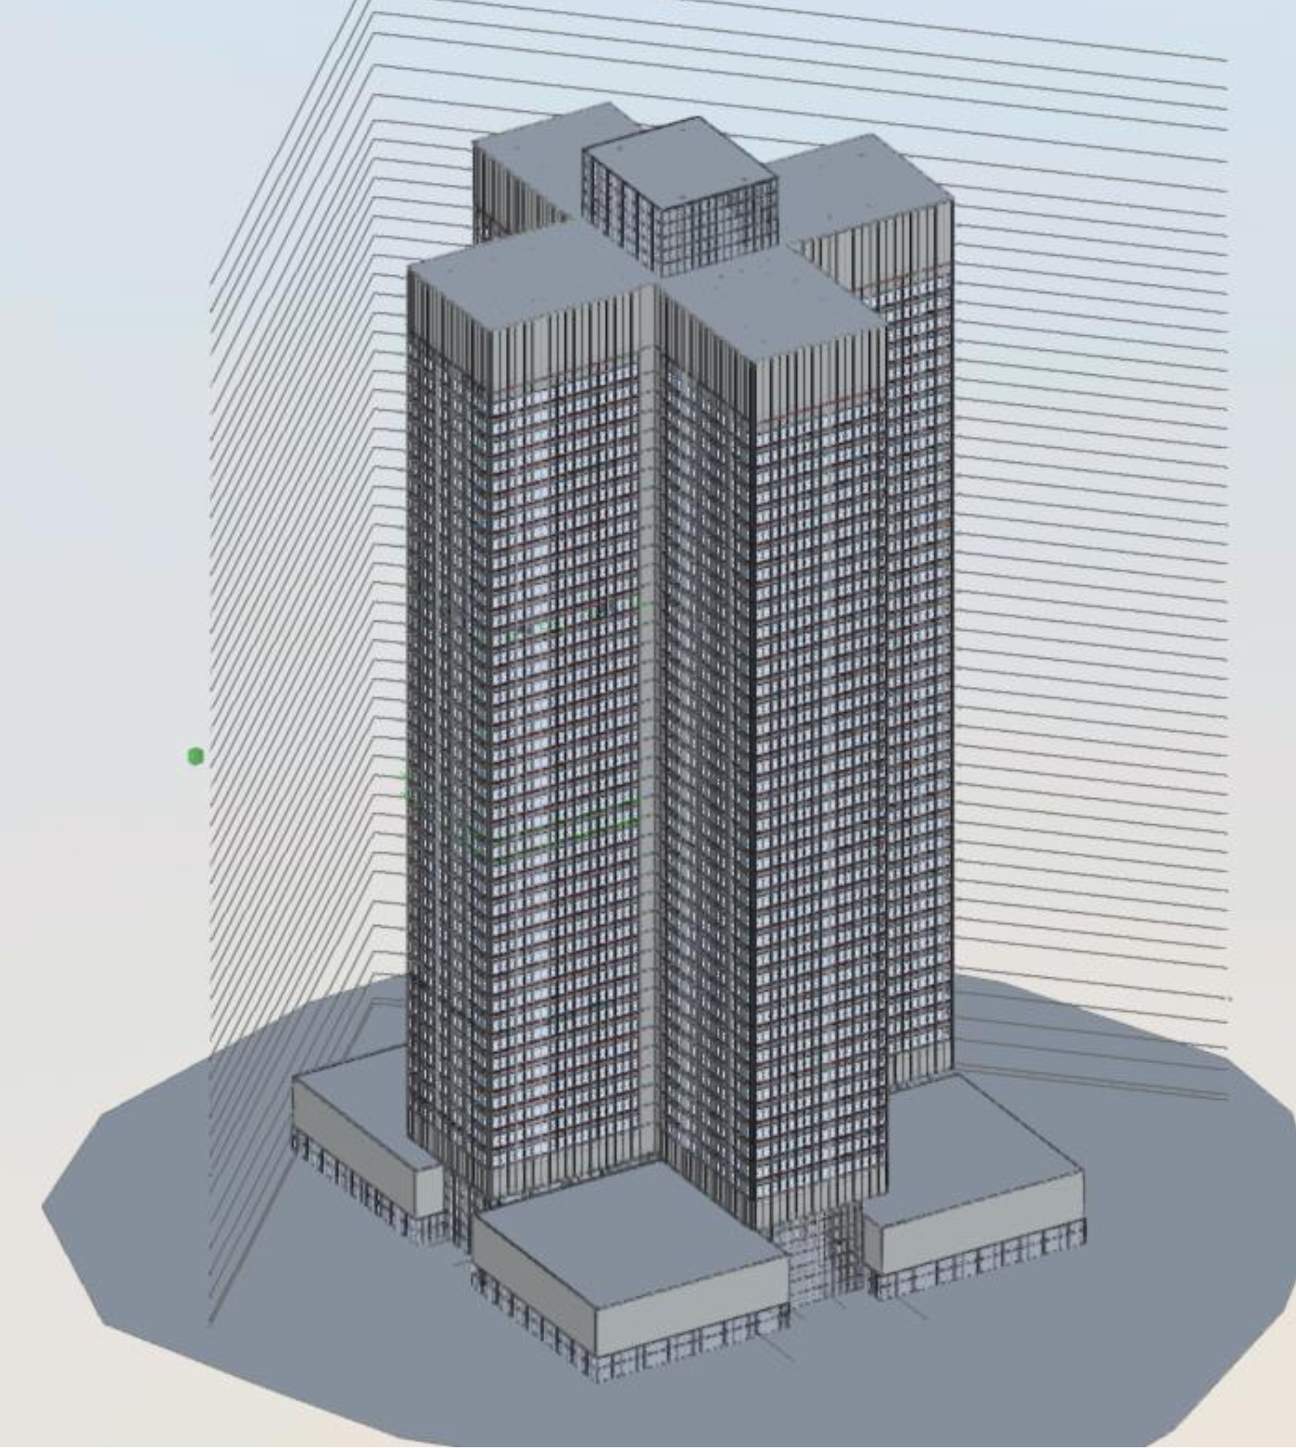
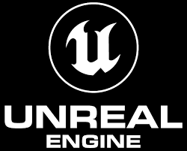
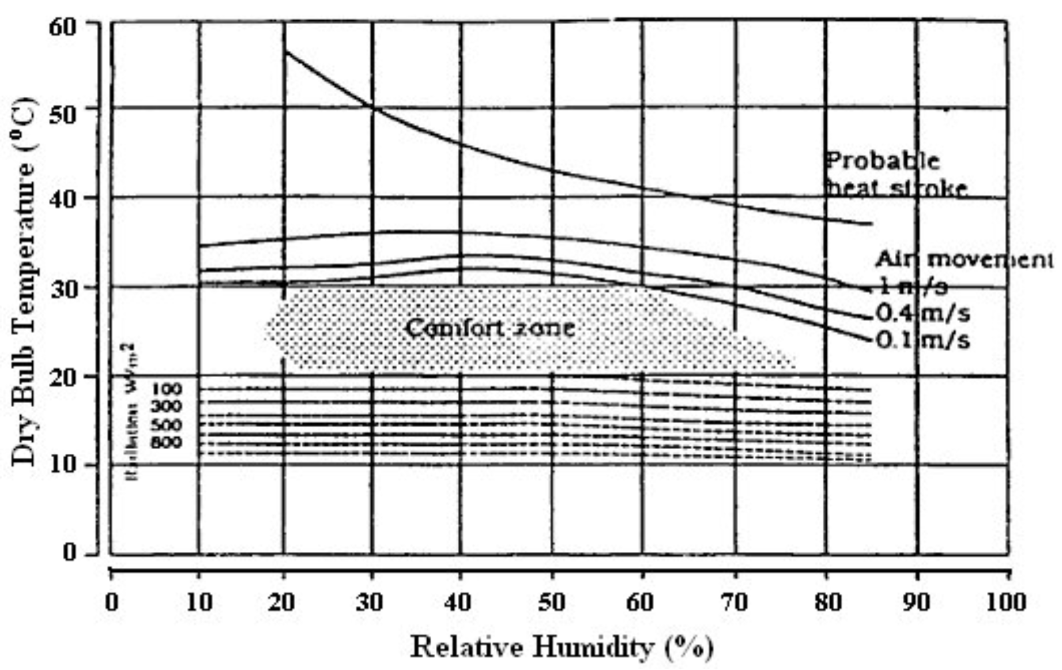
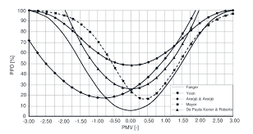
Models in build asset DT
Pezhman Sharafdin. Building occupant comfort monitoring using IoT-based sensor data integrated into Digital Twin. M.Sc. Thesis, Ecole de technologie superieur (ETS), Montreal (Canada), 2024

Slide 19
Digital Twins projects
Evolution of Digital Twins – J. Denil (U of Antwerp), Ø. Haugen (HIOF), S. Klikovits (U of Linz), J. Mertens (U of Antwerp)
A DevOps Approach for the Systematic Development and Evolution of Digital Twins of Built Assets – S. Aissat* (MSc)
Development of a Digital Twin for the ETS GRIDD Lab** – Capstone project in software engineering, 10 B.Eng. students since Sept 2023
Development of a cloud application to support the analysis of various factors impacting the mobility network of the City of Montreal*** – Capstone project in software engineering, 14 B.Eng. students since Sept 2023
* Done in collaboration with ETS GRIDD, co-supervised by Prof. E. Poirier
** Done in collaboration with ETS GRIDD, co-supervised by Prof. A. Motamedi et Prof J. Samson-Gascon
*** Co-supervised by Prof. J. Samson-Gascon et Prof. M. Sayagh

Slide 20
Personal intro
Digital transformation
Digital twins
DevOps
The role of models
Summary

Slide 21
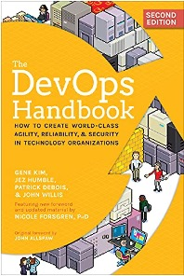
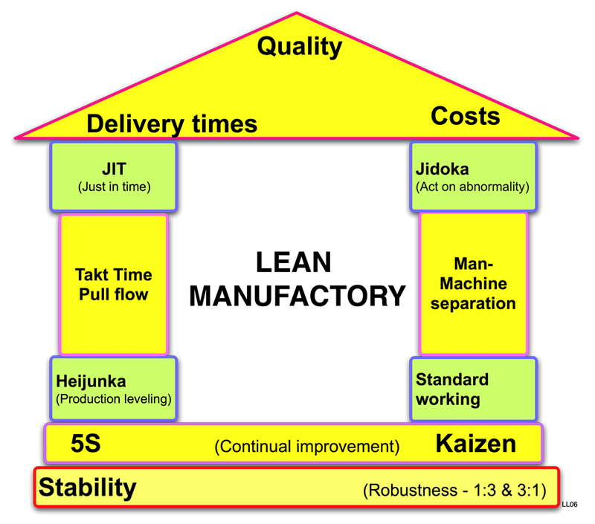
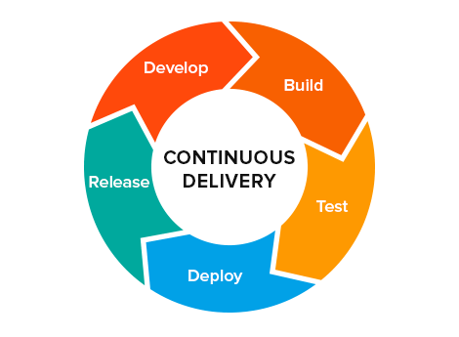
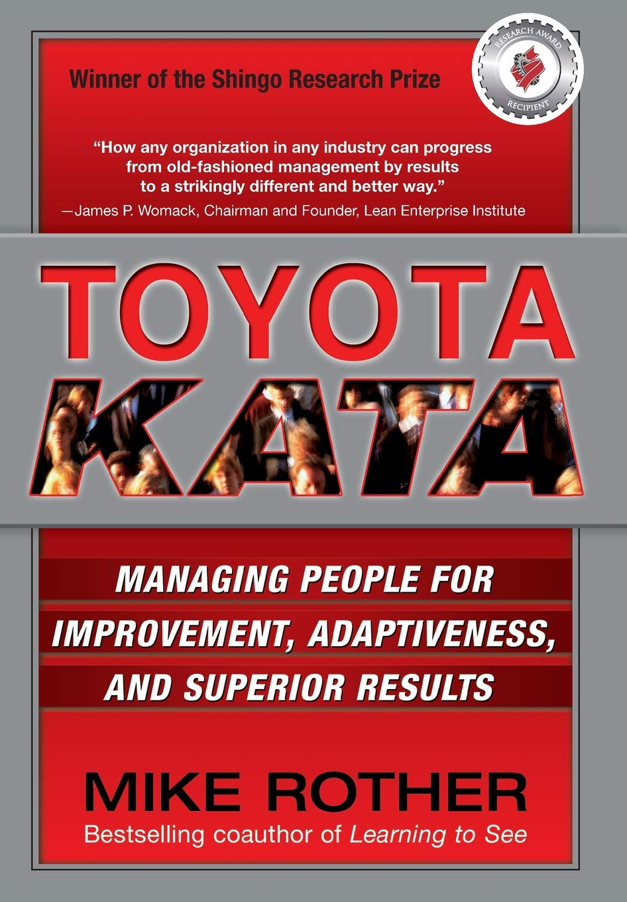
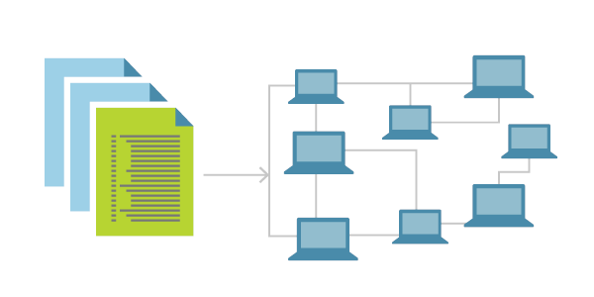
DevOps
The term DevOps was coined by Patrick Debois
“DevOpsDays” in Ghent in 2009
Wikiversity (en.wikiversity.org)
Software engineering culture and practice that aims at unifying software development (Dev) and operation (Ops)
Strongly advocate for automation and monitoring at all steps of software construction, from integration, testing, releasing to deployment and infrastructure management
Aims at shorter development cycles, increased deployment frequency, more dependable releases, in close alignment with business objectives
DevOps is not a goal, but a never-ending process of continual improvement
Aims at constantly eliminating waste and constraints
The overall goal is to deliver more value faster
Lean method
Agile Manifesto
Continuous delivery
Agile infrastructure
Toyota Kata

Slide 22
DevOps problem
“The current pandemic has highlighted the importance of being able to adapt quickly to changes and to crises that arise. In this context, the use of DevOps becomes unavoidable, but the implementation and evolution of DevOps processes represent a significant challenge for companies.”
Nazim Benhadid, VP of Cloud Infrastructure at TELUS
While best practices are beginning to emerge, the use of DevOps still often is ad hoc, and companies struggle with its efficient adoption
The lack of a systematic approach makes continuous improvement an ad hoc journey, in which DevOps and “agility” much too often mean “improvisation”
DevOps is more than a set of tools, e.g. CI/CD, TDD
Particularly true in non-web domains like Software-Defined Network (SDN), IoT, CPS, and heterogeneous systems

Slide 23
Kaloom-TELUS ETS IRC in DevOps
Achieve a better understanding of how to leverage DevOps for SDN software and develop suitable supporting techniques and tools
Develop a framework to support the systematic continuous improvement of industrial DevOps processes
WP1: Modeling
WP3: Support for SDN Infrastructure
Continuous Improvement of DevOps Process in the context of SDN
WP2: Measurement & Analysis
WP4: Support for SDN Applications

Slide 24
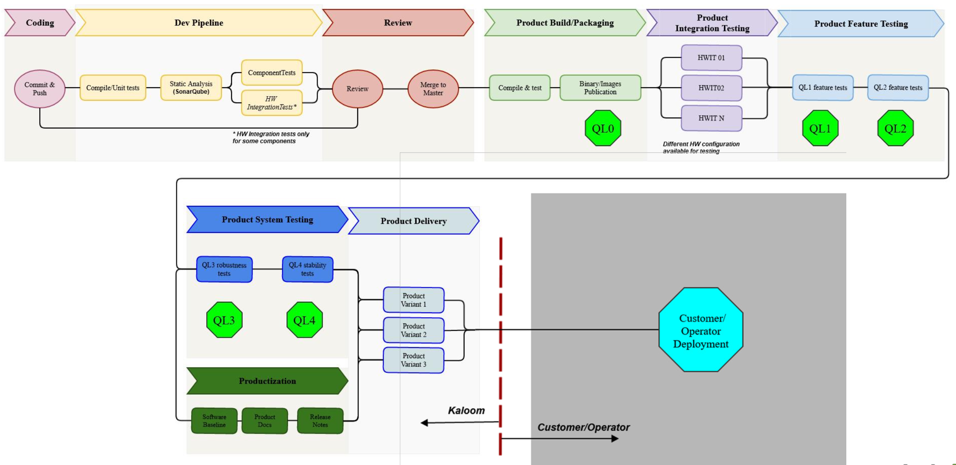
DevOps – Software Delivery Process

Slide 25
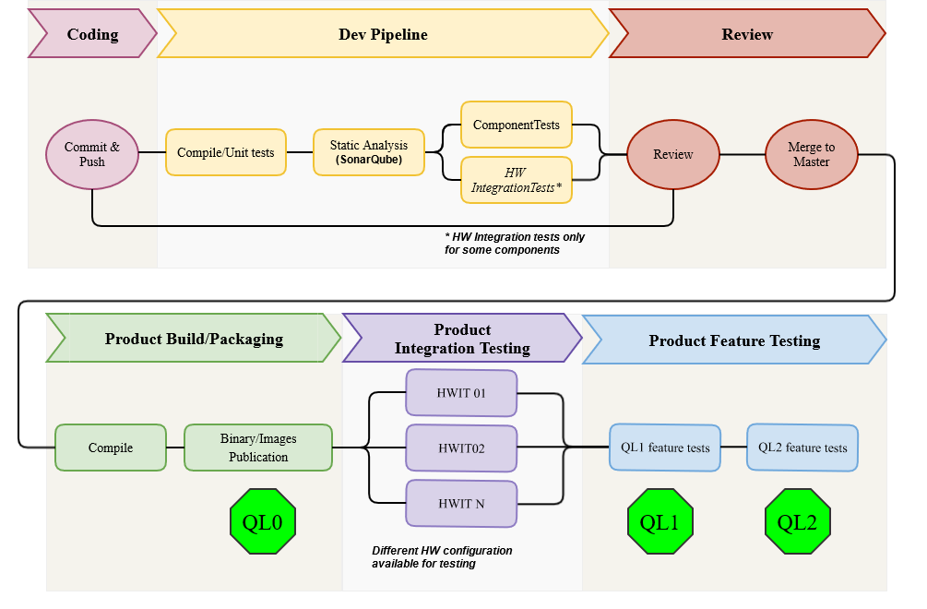
DevOps – Software Delivery Process

Slide 26
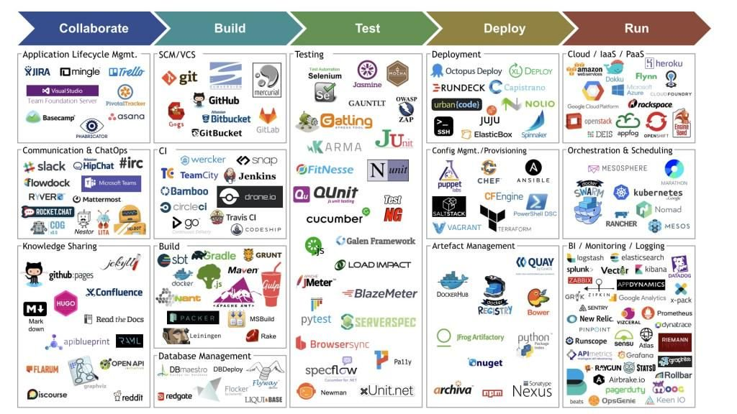
DevOps process data
What is different in DevOps processes?
Process automation
Tool APIs can be used to extract data
We can now build telemetry at the process level
https://devopedia.org/devops
Can now analyze DevOps processes using metrics calculated from actual process data, as opposed to using assessments made by managers and team members

Slide 27
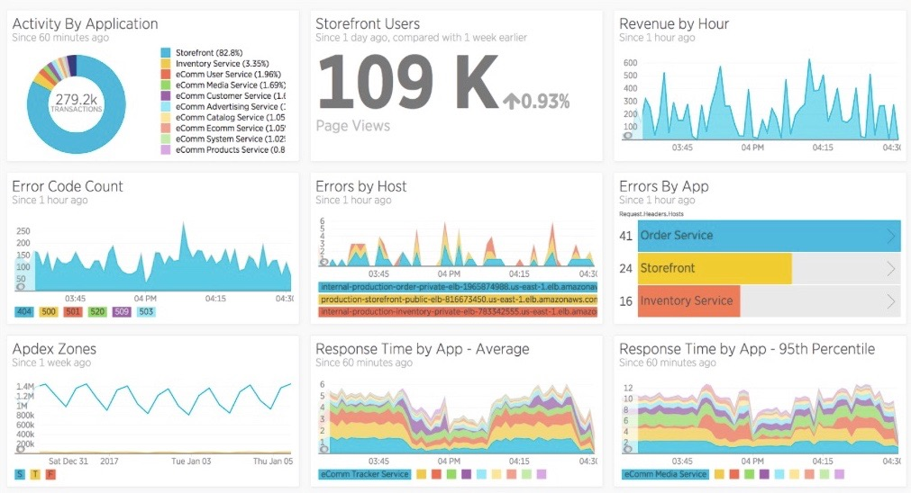
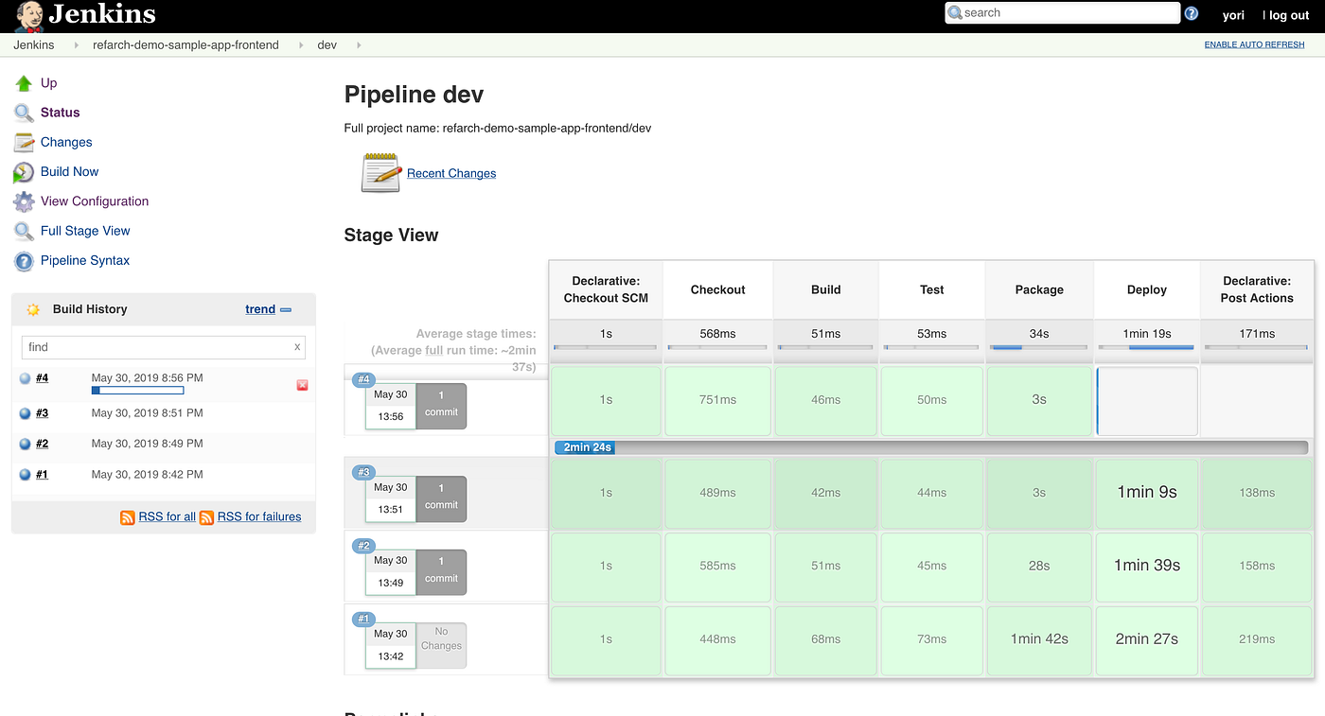
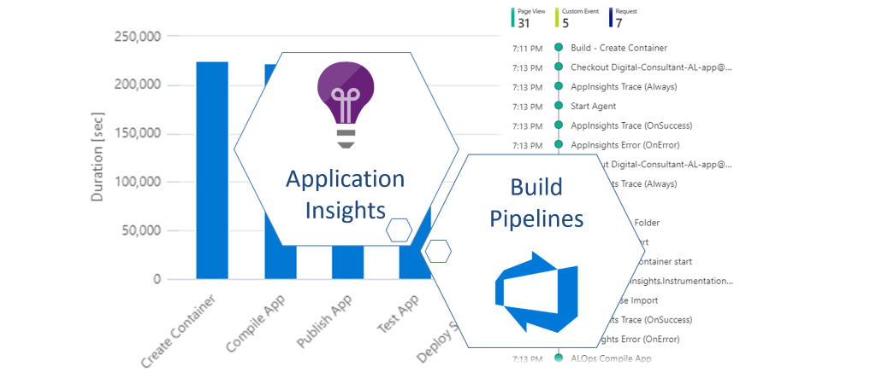
DevOps process dashboards
https://blog.gruntwork.io/how-to-build-an-end-to-end-production-grade-architecture-on-aws-part-2-4f6e5dc30100
Dashboards for DevOps: Examples of What to Measure
https://newrelic.com/blog/best-practices/dashboards-devops-measurement
https://never-stop-learning.de/build-pipelines-telemetrie/

Slide 28
What is the role of models in DevOps?
Analysis
Different aspects of DevOps processes
E.g. identification of process bottlenecks/constraints
Monitoring of different aspects of DevOps processes
Automatic generation of different types of artefacts
Different types of artefacts, e.g. test cases, configuration files, documentation
Automated diagnosis and resolution of process issues
E.g. Deployment (CD) pipeline failures

Slide 29
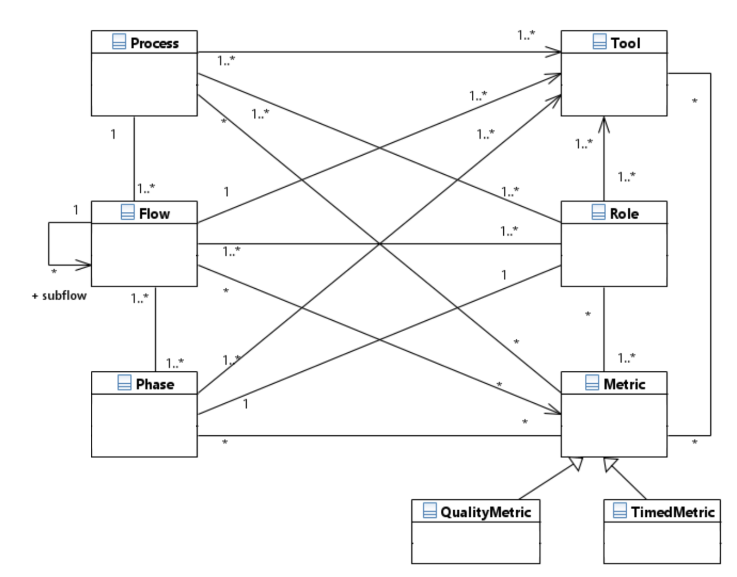
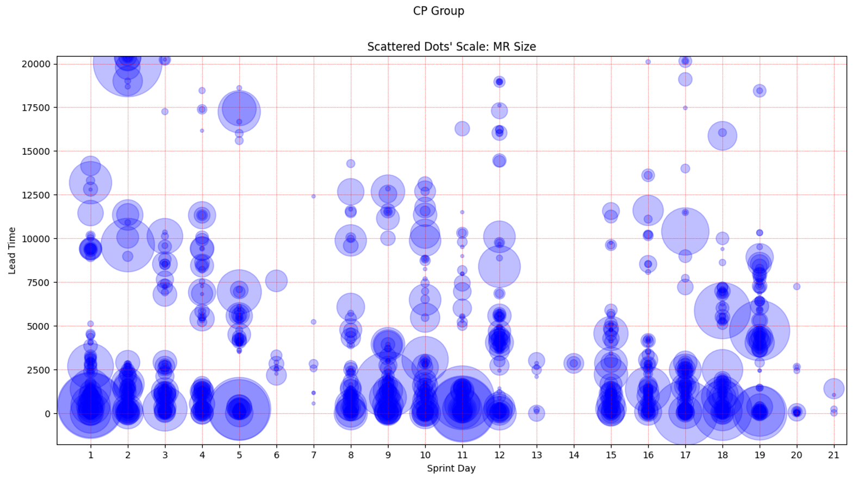
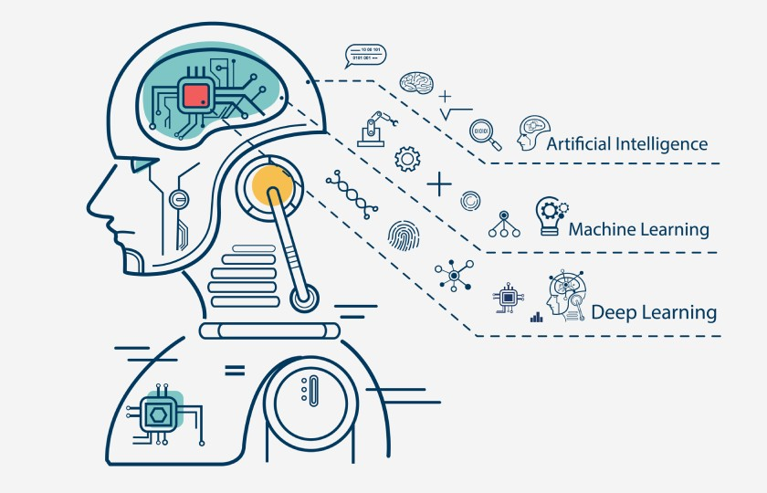
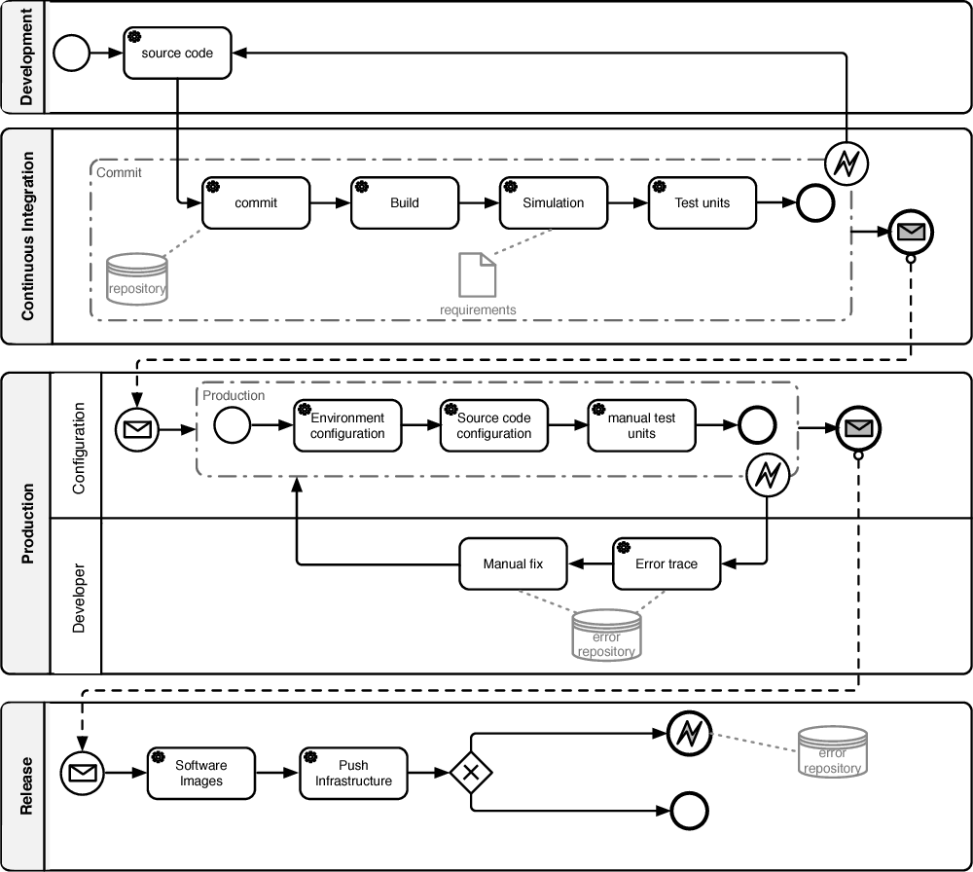
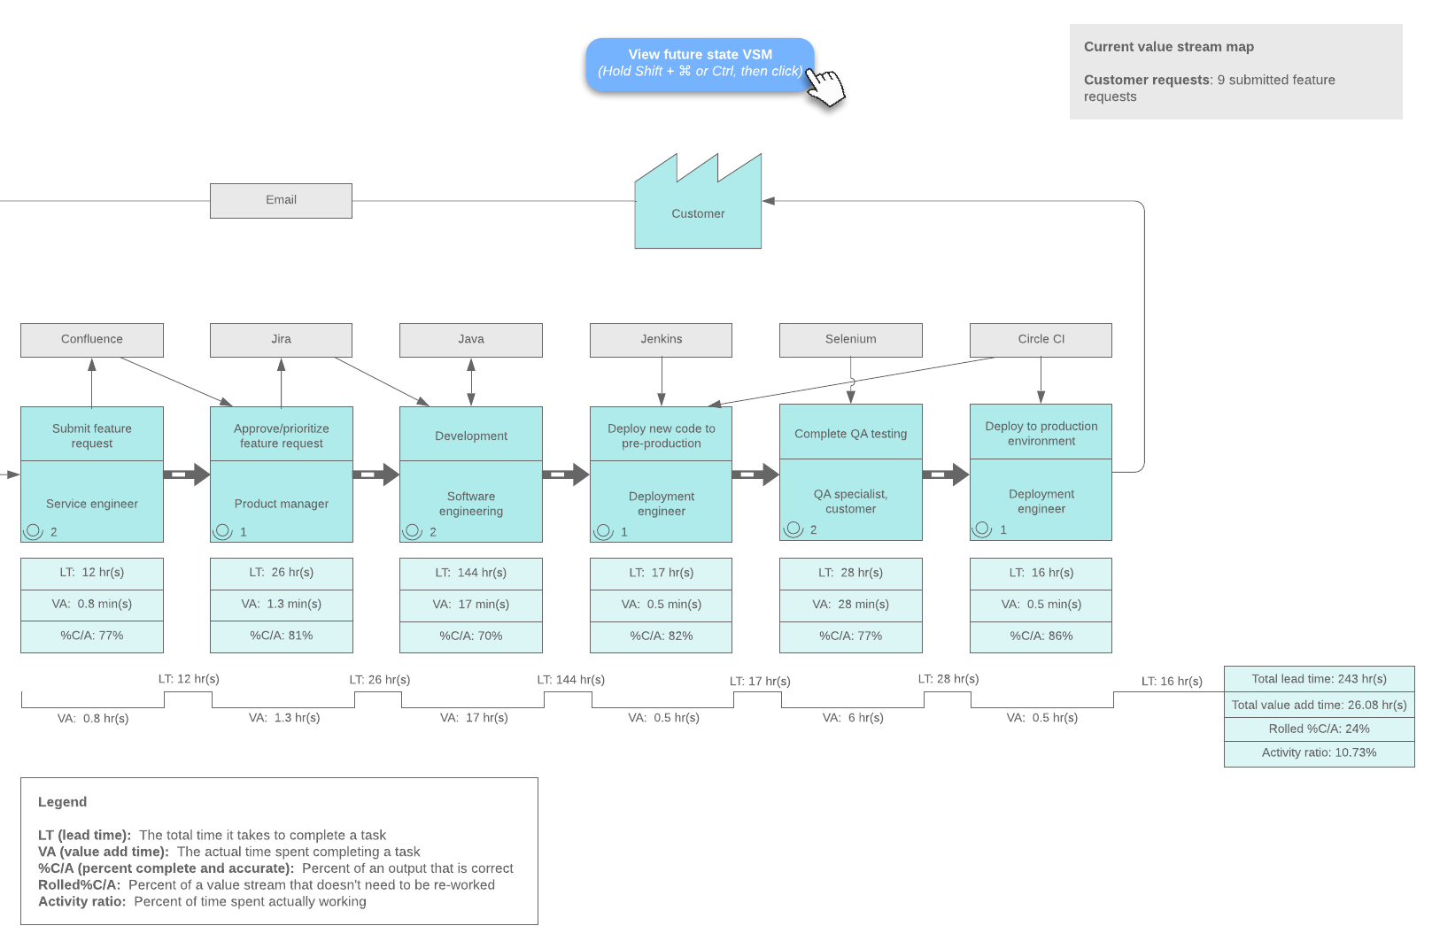
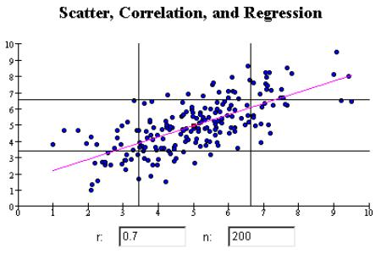
What type of models?
ML/AI models

Slide 30
Models of the DevOps Process
Analysis of different aspects of DevOps processes
Examples
Lead Time (LT) – end-to-end and for specific parts of the process
Identification of process bottlenecks/constraints
Change impact analysis
What-if scenarios
Value Stream Mapping (VSM)
BPMN
https://www.lucidchart.com/blog/value-stream-mapping-for-devops
D'Ambrogio, A., Falcone, A., Garro, A., & Giglio, A. (2018, November). On the Importance of Simulation in Enabling Continuous Delivery and Evaluating Deployment Pipeline Performance. In CIISE (pp. 53-59).

Slide 31
Metamodel for DevOps Process
Foundation for the development of an MBE framework to support the systematic continuous improvement of industrial DevOps processes
Semantic basis for the different Kaloom-TELUS ETS IRC projects
Incrementally developed based on concrete use cases

Slide 32
DevOps projects – Kaloom-TELUS ÉTS IRC
Analysis of the code review process based on GitLab MR data – S. Kansab* (PhD), M. Hanania (Intern), J. Legault* (MSc), B. Mashari* (MSc)
Goal: Use GitLab MR data extraction for analyzing different aspects of the code review process and its impact on the overall DevOps process and product quality
Detecting and correcting intermittent CI/CD pipelines failures to reduce waste in SDN DevOps processes – H. Aïdasso* (PhD)
Analysis and monitoring of task estimations in DevOps processes – D. Desvent*** (MSc)
Extraction of pipeline data and metrics – S. Azharhoussen (MEng), B. Mouton (MEng)
Use of justification diagrams to study the evolution of DevOps pipelines wrt improvement objectives – C. Pulgar** (MSc)
Development of a reconfigurable dashboard to enable the visualization of network and DevOps process metrics – M. Da Cunha (MEng)
* Co-supervised by Prof. M. Sayagh
** Co-supervised by Prof. S. Mosser (McMaster University)
*** Co-supervised by Ali Tizghadam (TELUS)

Slide 33
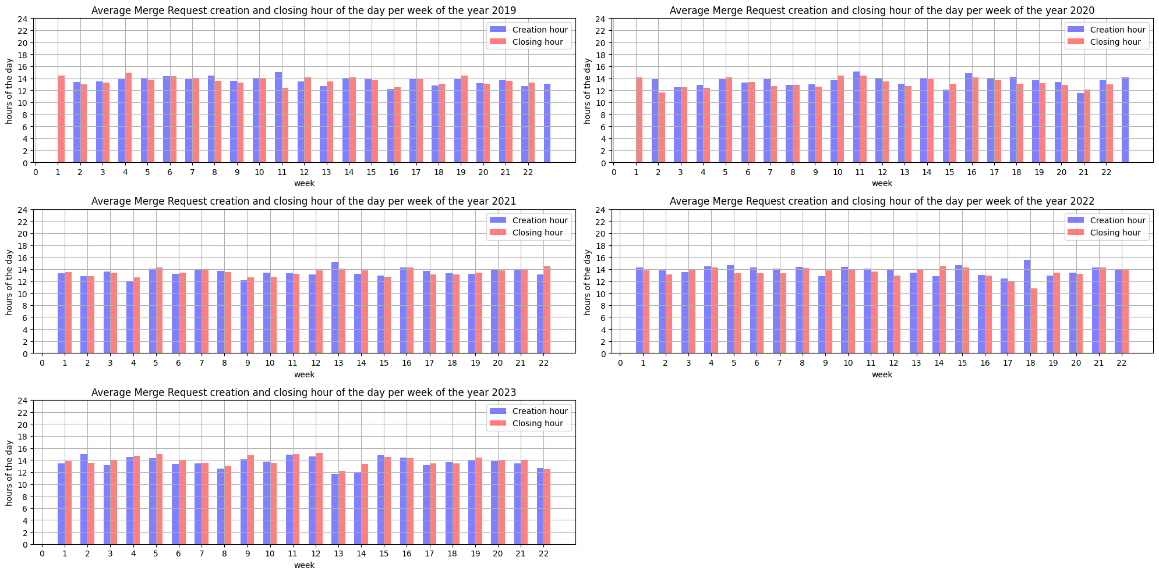
DevOps – GitLab MR data analysis
MR data

Slide 34
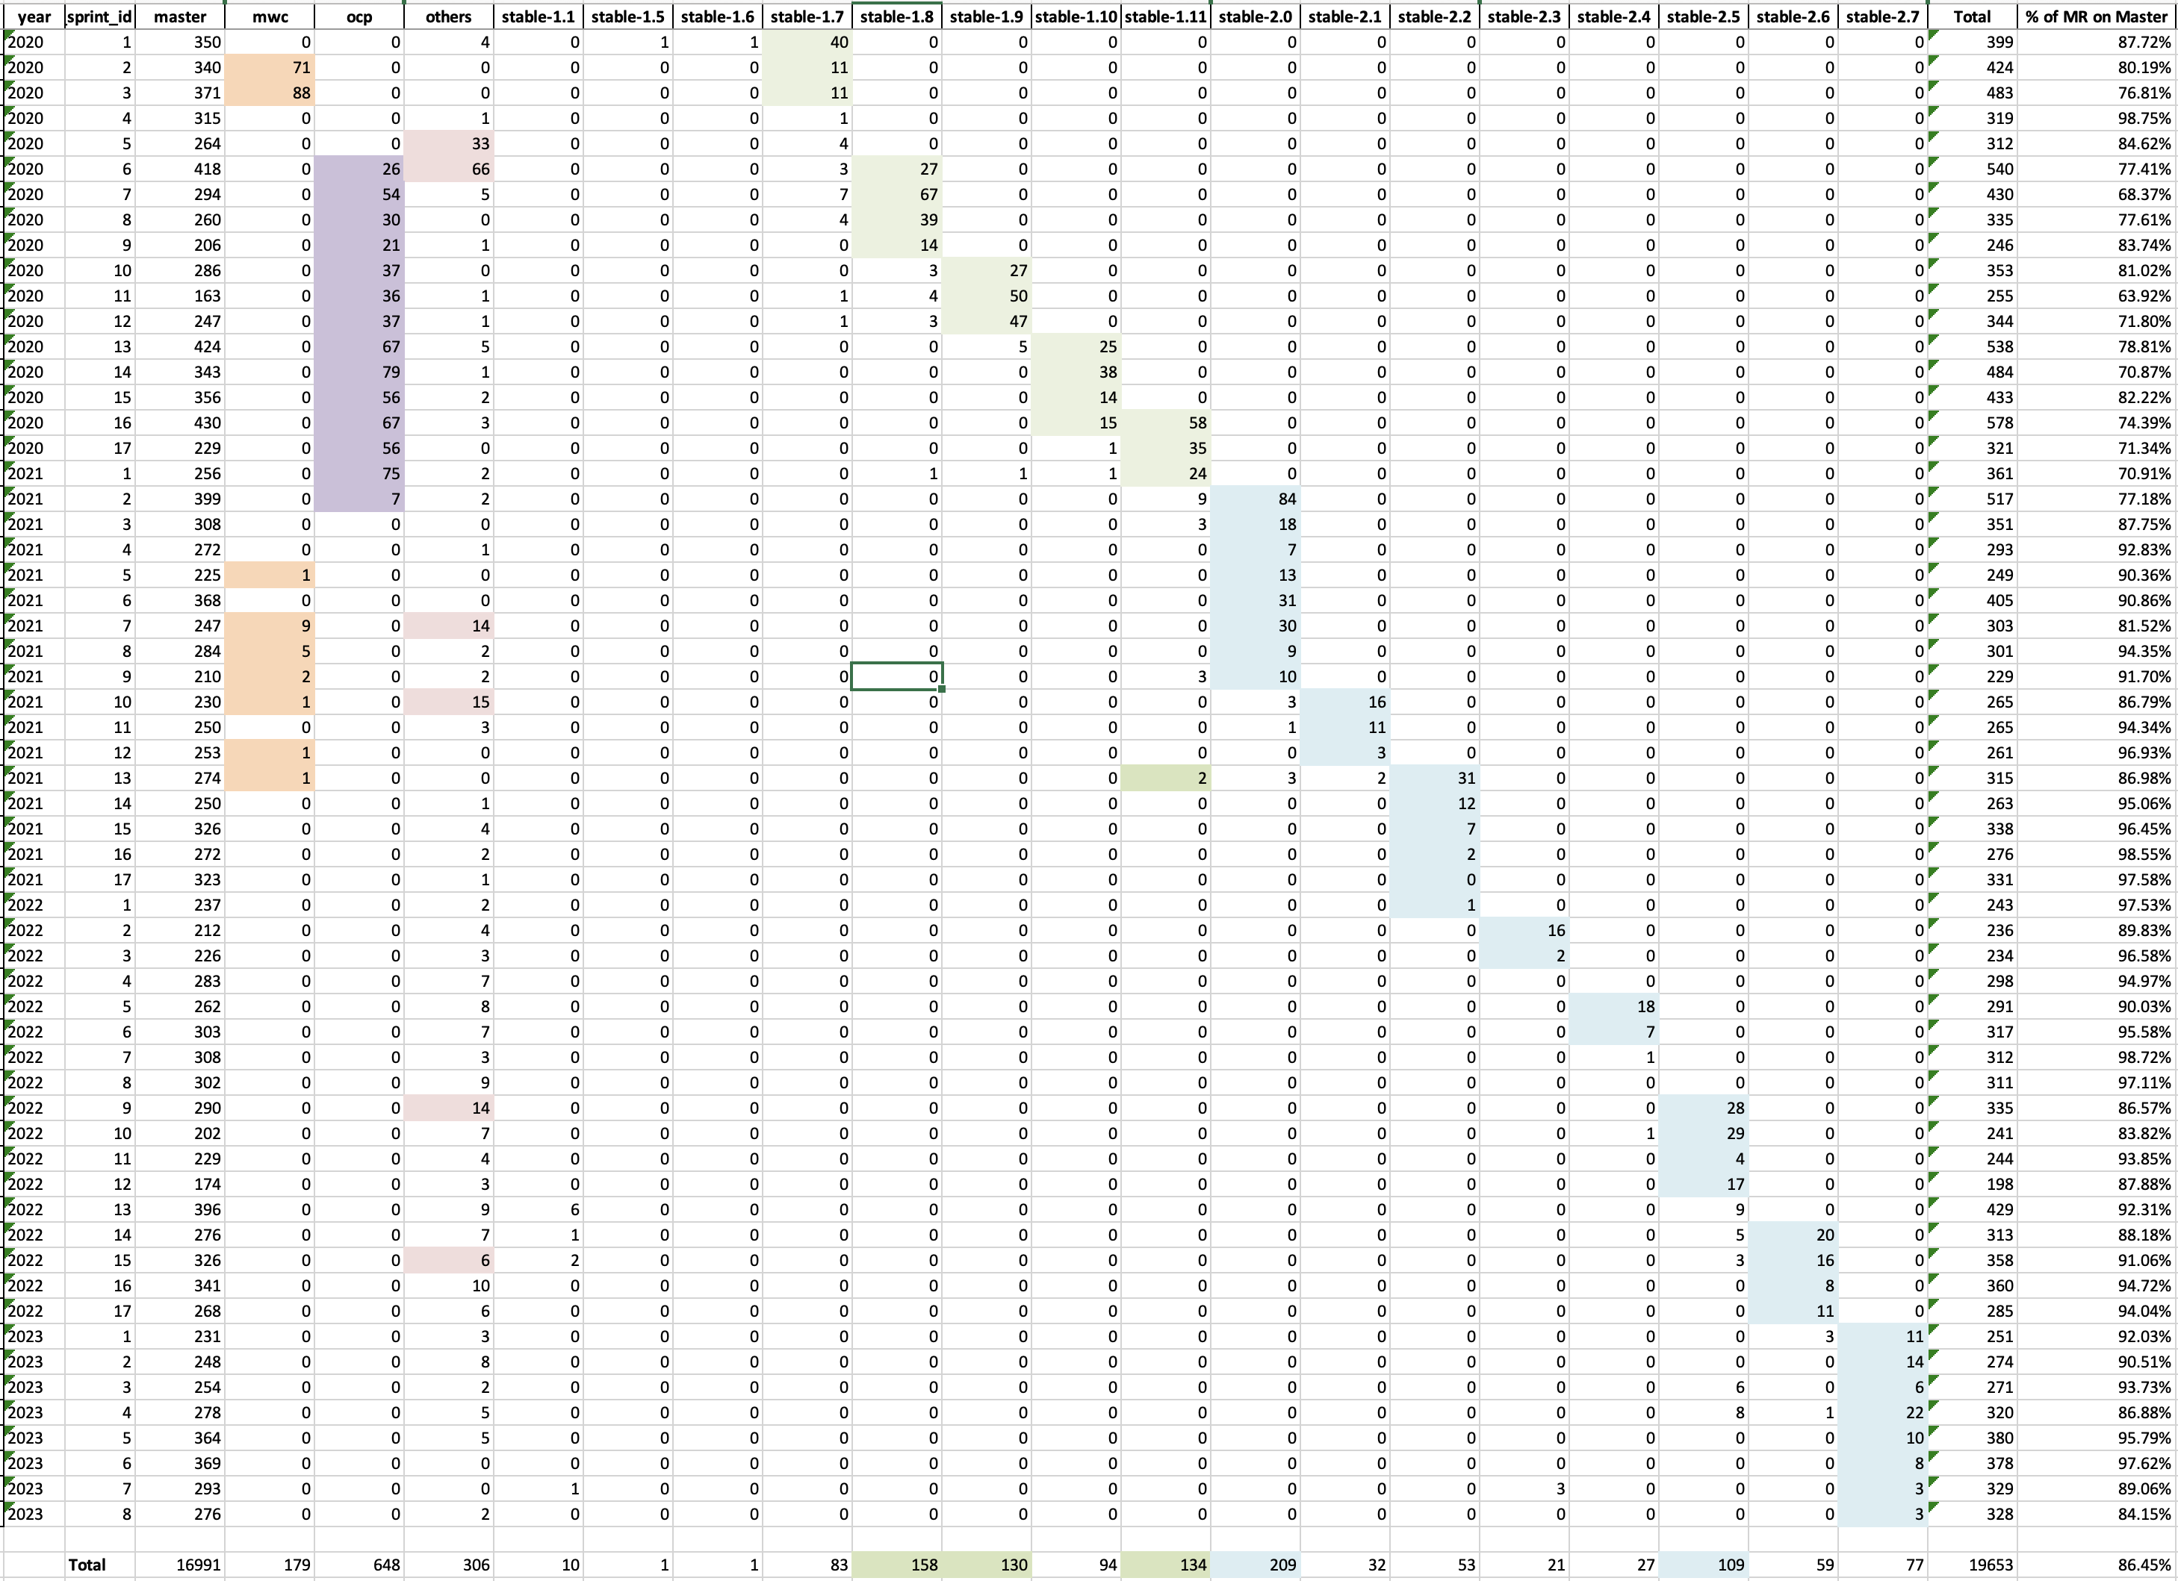
4.5 years of GitLab Merge Requests (MR)

Slide 35
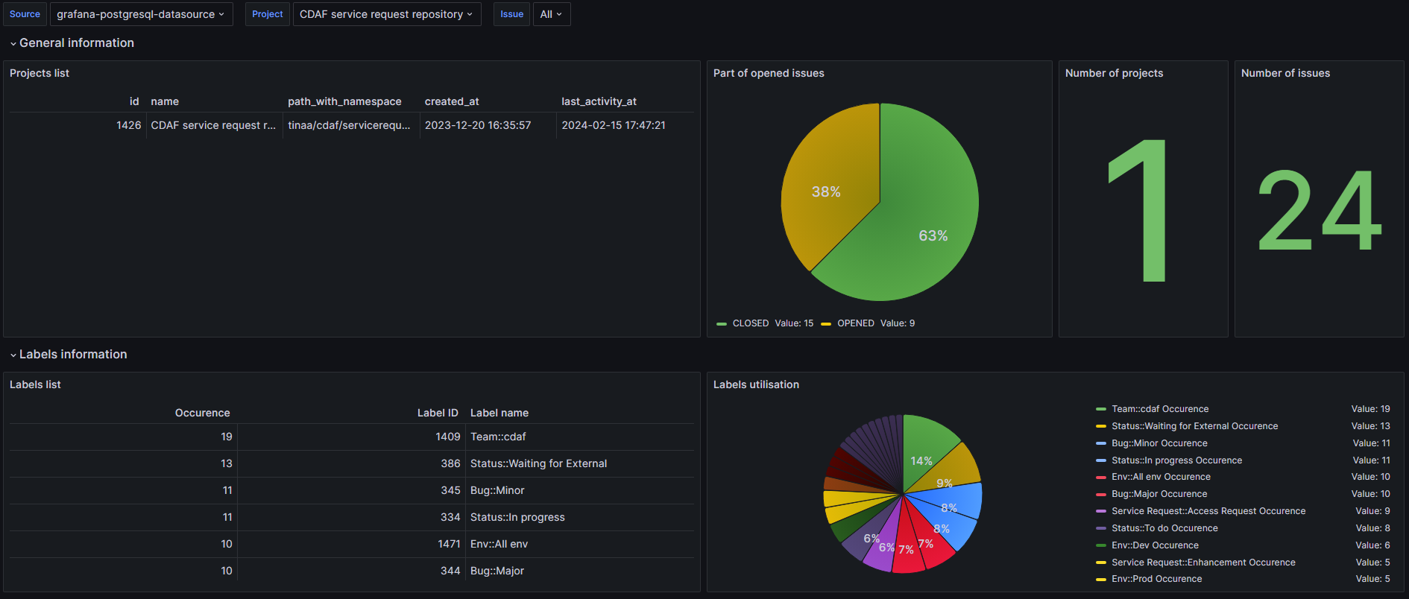
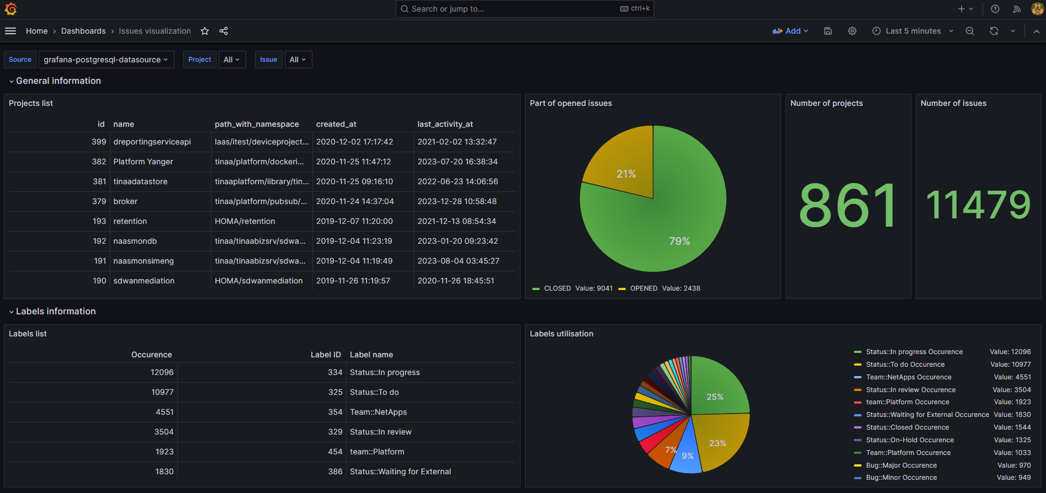
DevOps – GitLab task analysis

Slide 36
Personal intro
Digital transformation
Digital twins
DevOps
The role of models
Summary

Slide 37
Telemetry – Definitions
The in situ collection of measurements or other data at remote points and their automatic transmission to receiving equipment (telecommunication) for monitoring – Wikipedia
The science and technology of automatic measurement and transmission of data by wire, radio, or other means from remote sources, as from space vehicles, to receiving stations for recording and analysis. – YourDictionary
The measurement of data at a remote source and transmission of the data (typically by radio) to a monitoring station. Telemetry is used, for example, to track the movements of wild animals that have been tagged with radio transmitters, and to transmit meteorological data from weather balloons to weather stations. – YourDictionary

Slide 38
What types of models do we need?
Basic answer: it depends on the purpose/objectives
What do we want to measure and monitor?
What metrics should we use?
Where do we get the data from?
What types of models do we need for the different aspects?

Slide 39
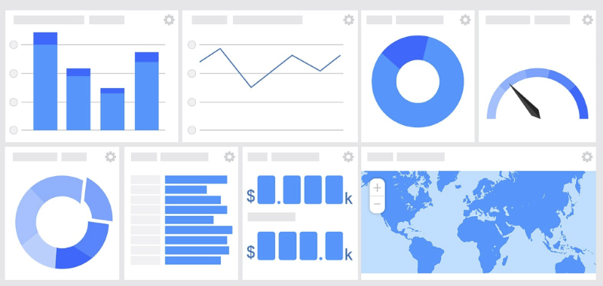
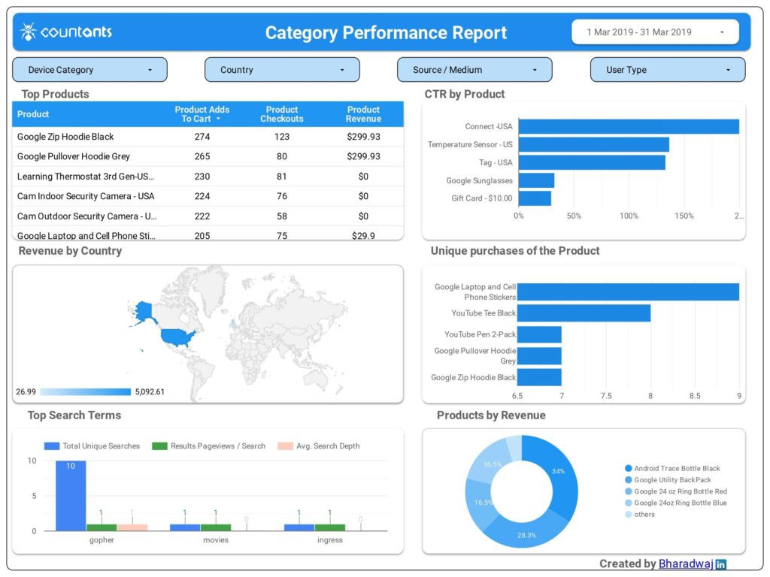
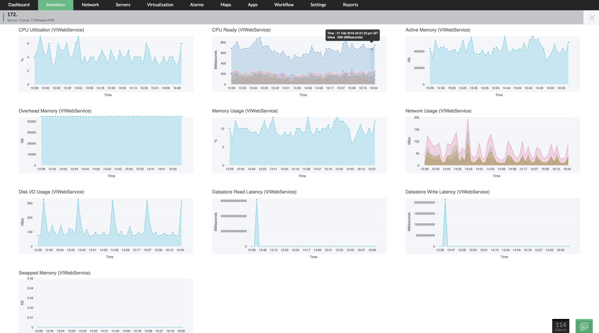
Monitoring of different systems aspects
https://www.manageengine.com/network-monitoring/operating-system-monitoring.html

Slide 40
AI/ML

Slide 41
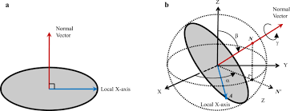
Complex systems are n-dimensional objects
?
=>

Slide 42
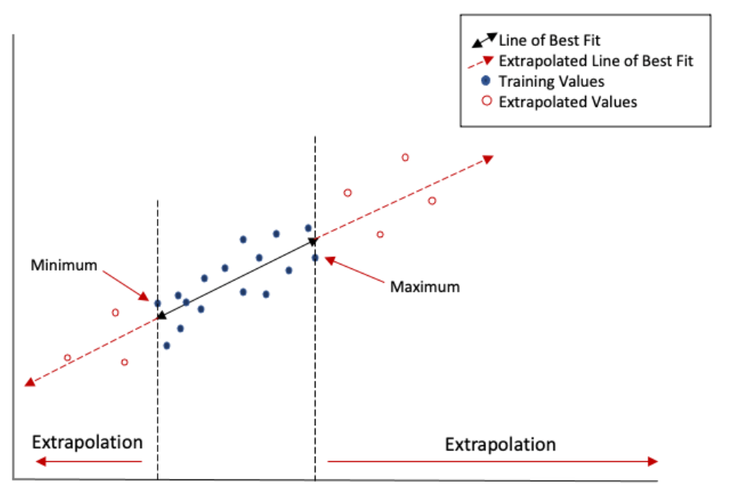
Interpolation vs extrapolation
Interpolation

Slide 43
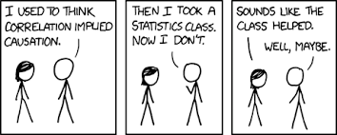
Causation (Causality) vs correlation

Slide 44
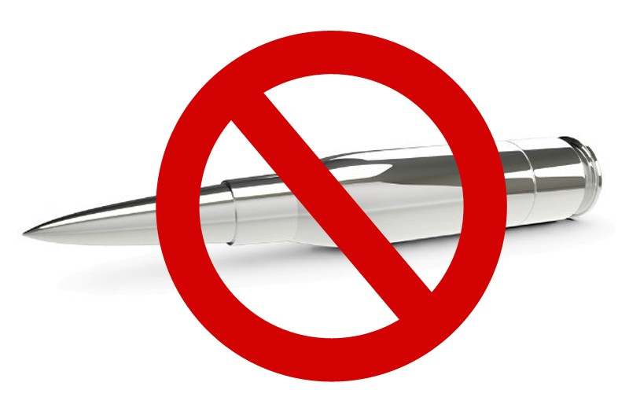
There is no silver bullet!
Not even AI and ML!
Software and technology development/adoption is a complex journey

Slide 45
Summary
The digital transformation has a major impact on the systems that we are developing and using in essentially all application domains
To succeed, organizations need to increase their agility both at the process and product level
DevOps and Digital Twins are two key elements of the digital transformation
Models play a central role in both DevOps and Digital Twins
A lot of interesting research need to be done!

