Slide 1
A deep dive into regression
Dr Valerio Giuffrida
IMPROVE 2025
8 April 2025
Assistant Professor in Computer Vision
School of Computer Science
University of Nottingham
valerio.giuffrida@nottingham.ac.uk
www.valeriogiuffrida.academy

Slide 2
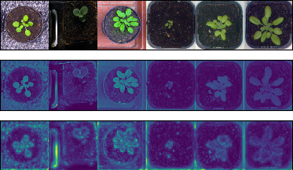

Who I am…
My Expertise
Machine Learning applied to Computer Vision (Image Analysis)
Image Analysis: teach computers to extract useful information from images
Other (related) applications:
  Medical Imaging
The Story So Far…
🎓Graduated at the University of Catania (Sicily)
🔍PhD in Image Analysis - IMT Lucca
👨‍🔬PDRA at the University of Edinburgh
👨‍🏫Lecturer at Edinburgh Napier University
👁️Currently Assistant Professor at the University of Nottingham
14 leaves
What we see
What computers see
Prediction

Slide 3
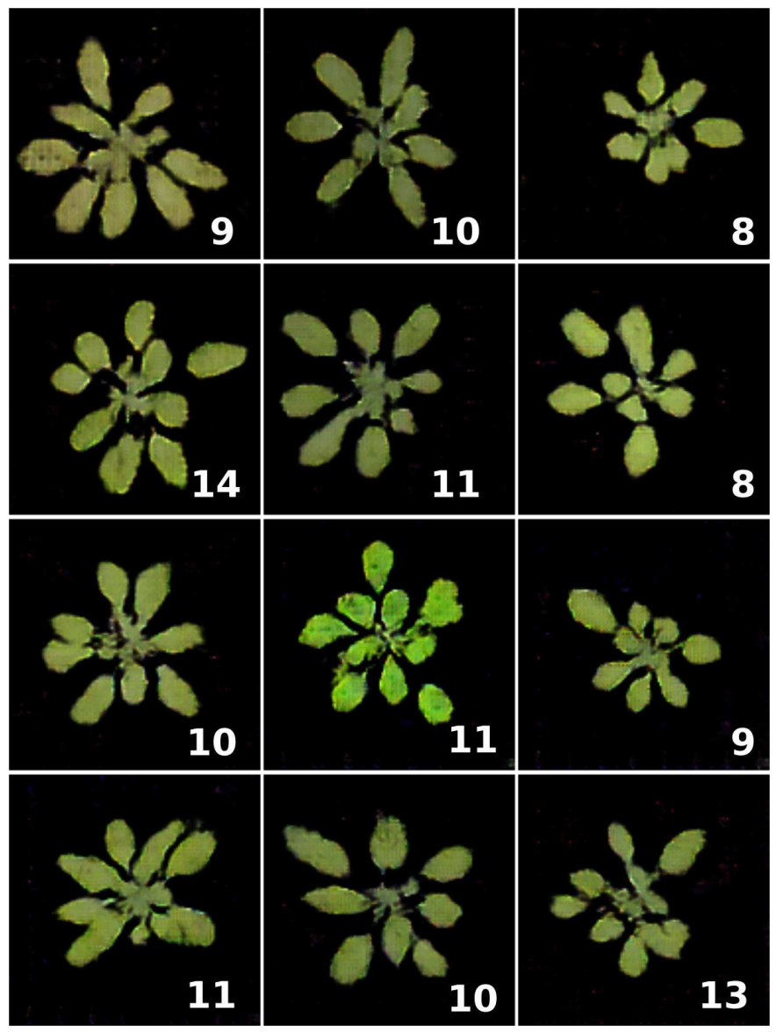
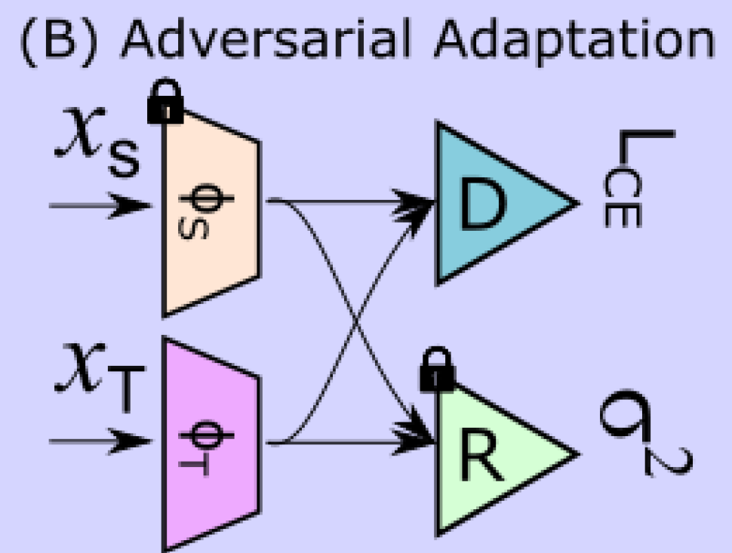
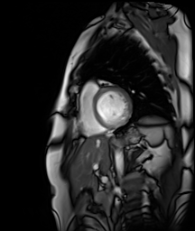
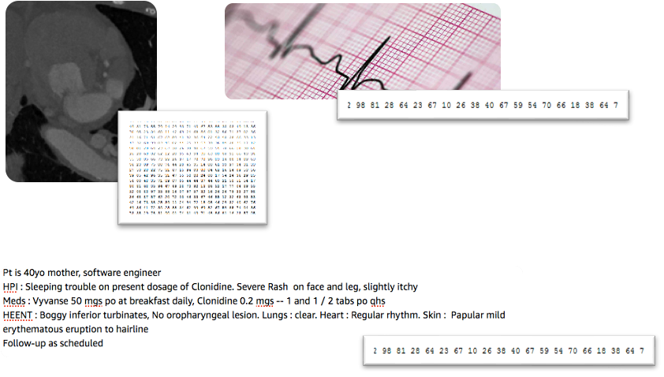
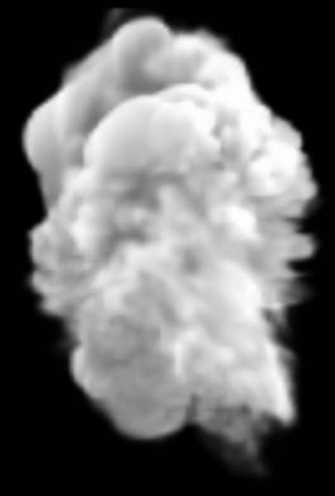

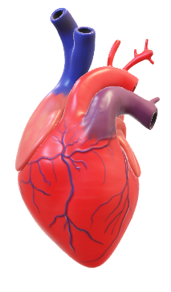
At VIOS we do:
https://vios.science/
(1) Data representations
(2) Learning from simulations
Synthetic data
Correlation
(Association)
(3) Causality vs.
correlation
(4) Value of data, privacy,
leakage, disclosure control
Causation

Slide 4
Regression
A brief intro…

Slide 5
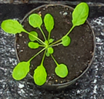
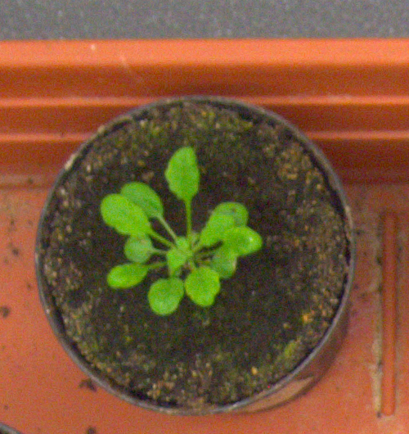
What is regression?
Learning a mapping between images to numbers
Such a function can be anything, e.g. a machine learning algorithm, an MLP, …
Leaf Count
14
8
12
y=f(x)
5
15
Numbers
Images

Slide 6
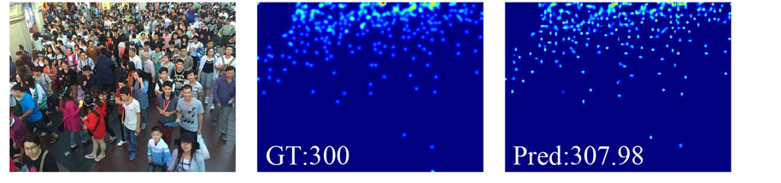
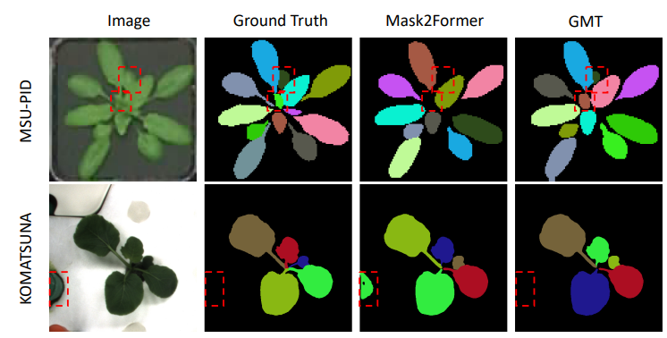
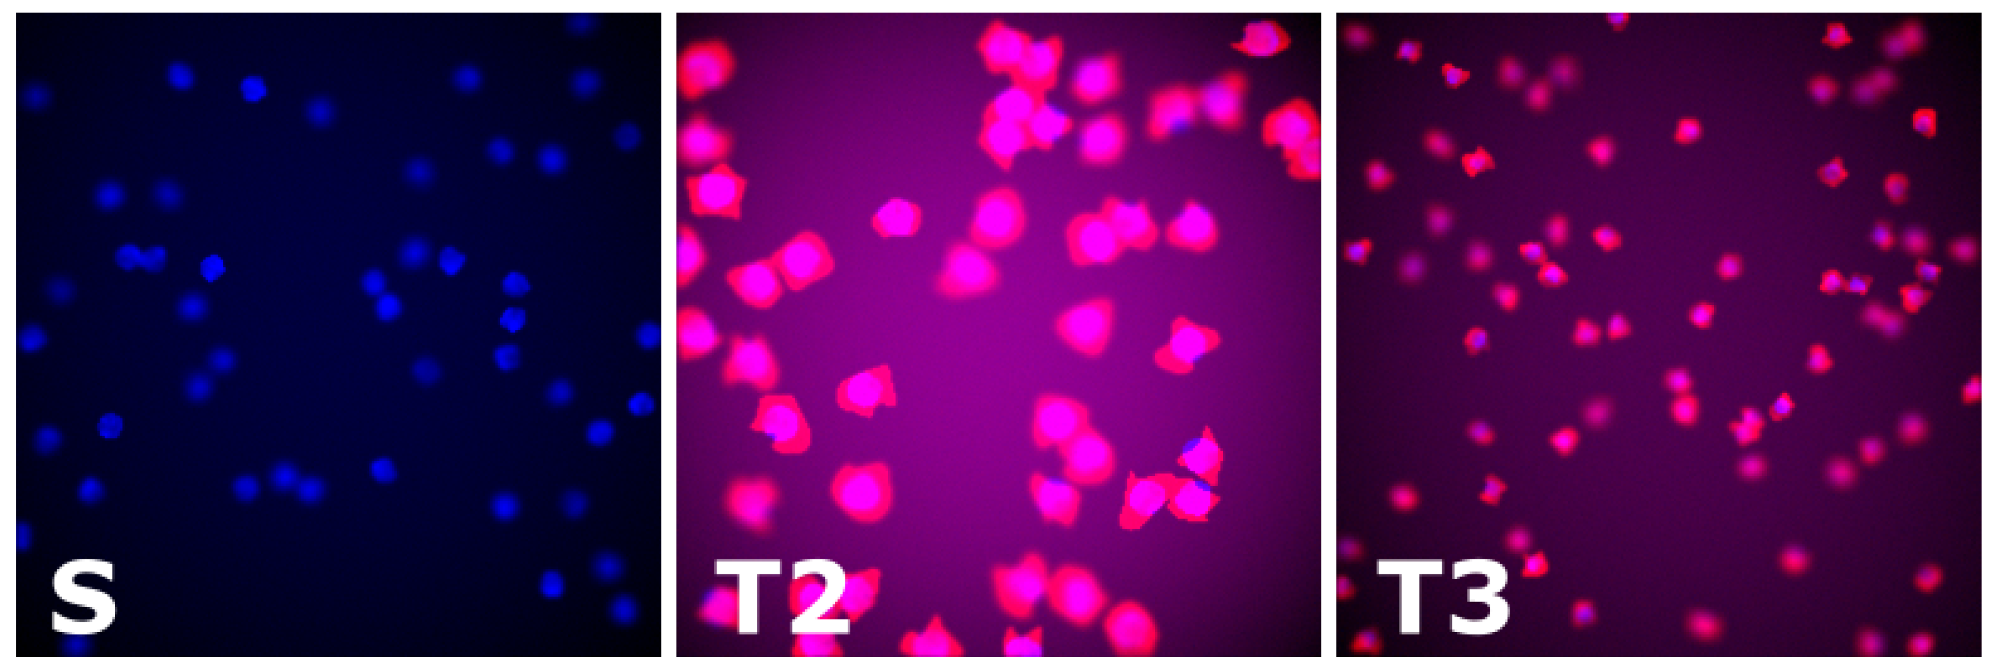
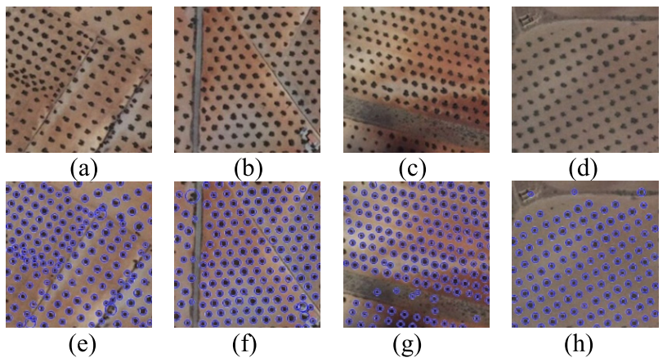
Where is it useful?
Yu, J., Hu, H. Multiscale regional calibration network for crowd counting. Sci Rep 15, 2866 (2025)
🚨Surveillance
🌱Agriculture
🛰️Remote Sensing
⚕️Medical Imaging
🏭Manufacturing
🚌Transportation
Ask yourselves: do you know how many people there are in this very room?
Litrico, M., Battiato, S., Tsaftaris, S. A., & Giuffrida, M. V. (2021). Semi-Supervised Domain Adaptation for Holistic Counting under Label Gap. Journal of Imaging, 7(10), 198.
Chen, Feng, Sotirios A. Tsaftaris, and Mario Valerio Giuffrida. "GMT: Guided Mask Transformer for Leaf Instance Segmentation." WACV 2025.
Khan, A., Khan, U., Waleed, M., Khan, A., Kamal, T., Marwat, S. N. K., ... & Aadil, F. (2018). Remote sensing: an automated methodology for olive tree detection and counting in satellite images. IEEE Access

Slide 7
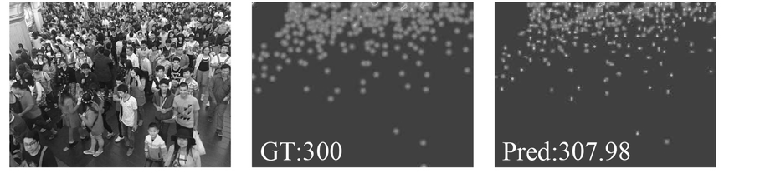
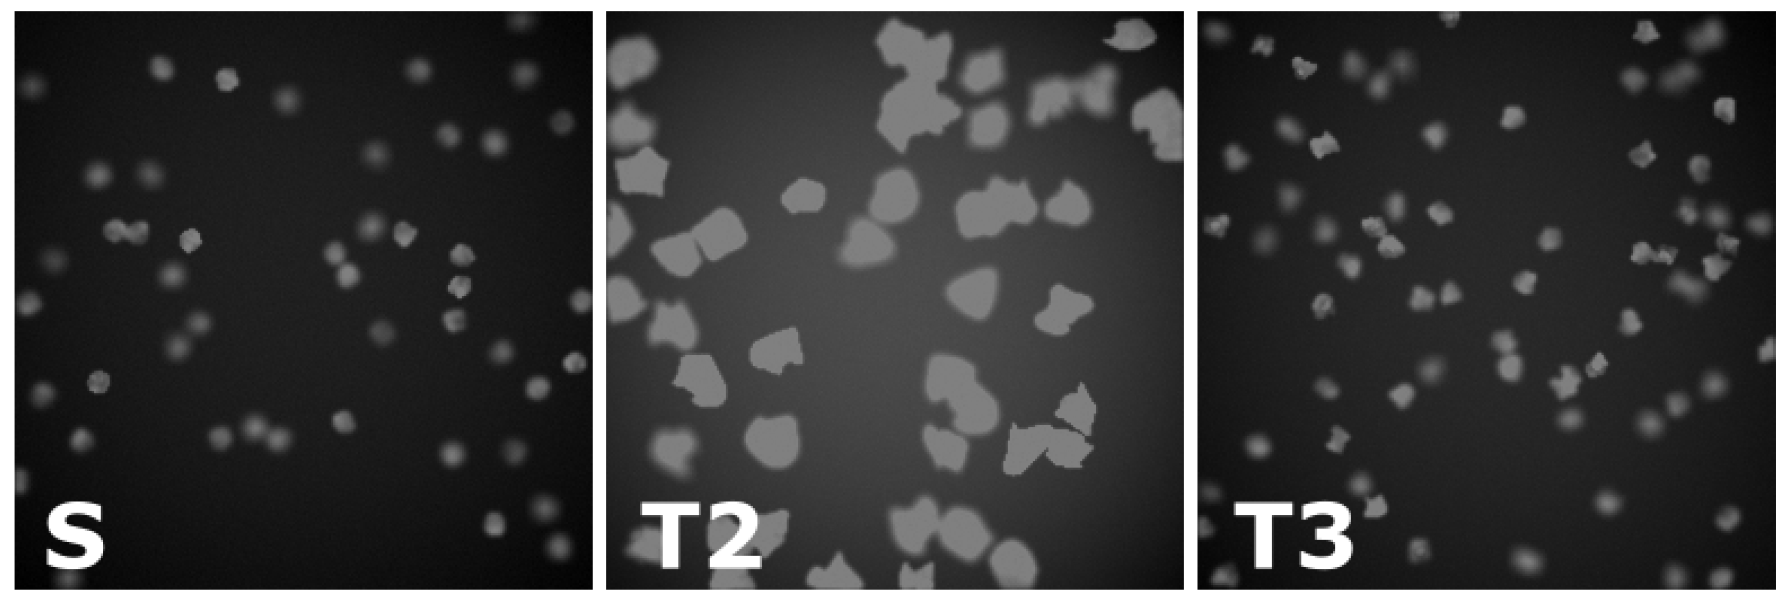
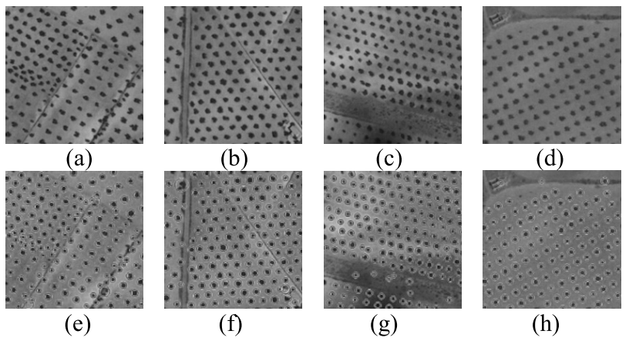
Where is it useful?
Yu, J., Hu, H. Multiscale regional calibration network for crowd counting. Sci Rep 15, 2866 (2025)
🚨Surveillance
🌱Agriculture
🛰️Remote Sensing
⚕️Medical Imaging
🏭Manufacturing
🚌Transportation
Ask yourselves: do you know how many people there are in this very room?
Litrico, M., Battiato, S., Tsaftaris, S. A., & Giuffrida, M. V. (2021). Semi-Supervised Domain Adaptation for Holistic Counting under Label Gap. Journal of Imaging, 7(10), 198.
Chen, Feng, Sotirios A. Tsaftaris, and Mario Valerio Giuffrida. "GMT: Guided Mask Transformer for Leaf Instance Segmentation." WACV 2025.
Khan, A., Khan, U., Waleed, M., Khan, A., Kamal, T., Marwat, S. N. K., ... & Aadil, F. (2018). Remote sensing: an automated methodology for olive tree detection and counting in satellite images. IEEE Access

Slide 8
Plant Image Analysis
A deep dive…

Slide 9
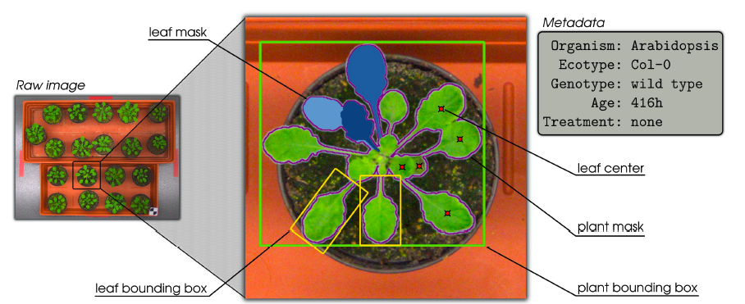
Plant Image Analysis
Minervini, M., Fischbach, A Scharr, H Tsaftaris, S. A. (2016). Finely-grained annotated datasets for image-based plant phenotyping. PRL

Slide 10
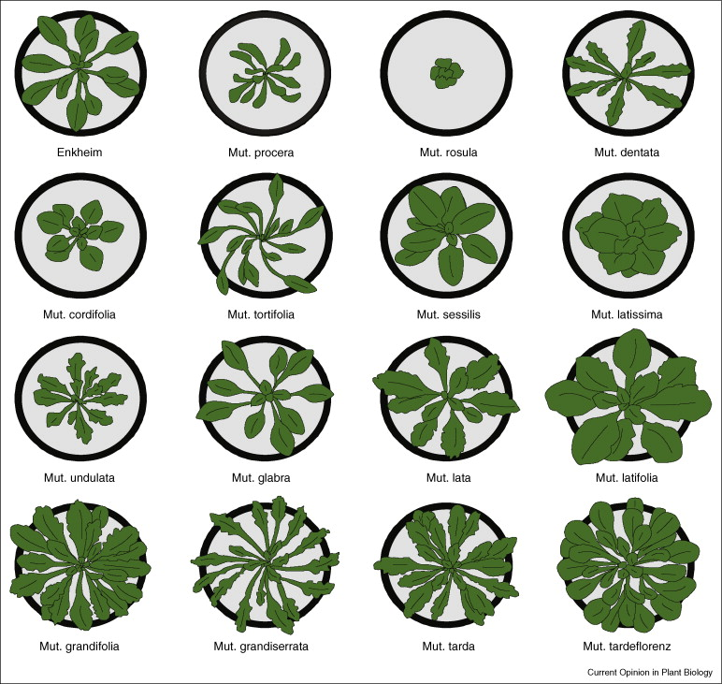
Why it’s (still?) challenging
Image taken from Micol et al. (2009)
Size and Shape Variation
  Leaves constantly change shape and size.
Occlusions
  Leaves tend to grow and move on top of each other.
High Intra-species variability
  Plants/Leaves of the same plant species (but different mutants/genotypes) have very different apparence
Insufficient annotated data
  The number of publicly available data is small.

Slide 11
Leaf Counting
An important trait related to developmental stage, yield potential, health.
How can we teach a computer to
perform such a task automatically?
This can be done in many ways:
  Regression: directly predicting/estimating
  the total number of leaves
  Detection: somehow you detect each leaf individually, then you can easily enumerate them
  Segmentation: Similar to detection – each leaf is delineated
There are other ways to count objects, but they are not well suited for leaf counting – will showcase them later

Slide 12
Old fashion machine learning
A regression-based approach before deep learning

Slide 13

Leaf counting as Regression
y=f(x)
8
12
5
15
Natural numbers
Image space
An ML algorithm cannot work directly on the data
  Lacks discriminative power
Meaningful information from images need to be extracted ➔ Image features
Learning the relation between image features and count
$$x→z=ψ\left(x\right)→y=φ(z)$$
Notes:
Using this paradigm, the leaf counting problem can be cast under a machine learning framework. We map image space to the space of natural numbers. However, in a ML project, data cannot be used as they are, because they lack of discriminative power. To cope with this, meaningful information need to be extracted from images. We call this process as feature extraction. Hence, instead of directly learning the mapping from images to plants, we map features to numbers. Below we have a mathematical formulation how this process works [read the relation]. How to learn this task?

Slide 14


Method outline
$$z=ψ(x)$$
$$y=φ(z)$$
Feature Extraction: patches are extracted from a log-polar representation. Then, K-means is used to extract a representation that is then vectorised calculating the average distance of a patch wrt K-Means centroids.
Regression: An SVR is trained over the vectors (features) representing the image of a plant. SVR learns a mapping between features and numbers.
Giuffrida, M. V., Minervini, M., & Tsaftaris, S. A. (2016). Learning to count leaves in rosette plants

Slide 15
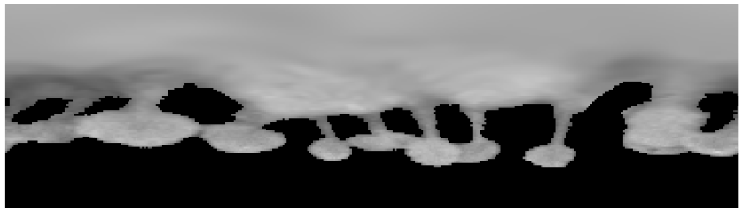

Log-polar representation ➔ Rectification
x
θ
y
(x₀,y₀)
ρ
ρ
(x,y)
θ
Giuffrida, M. V., Minervini, M., & Tsaftaris, S. A. (2016). Learning to count leaves in rosette plants

Slide 16
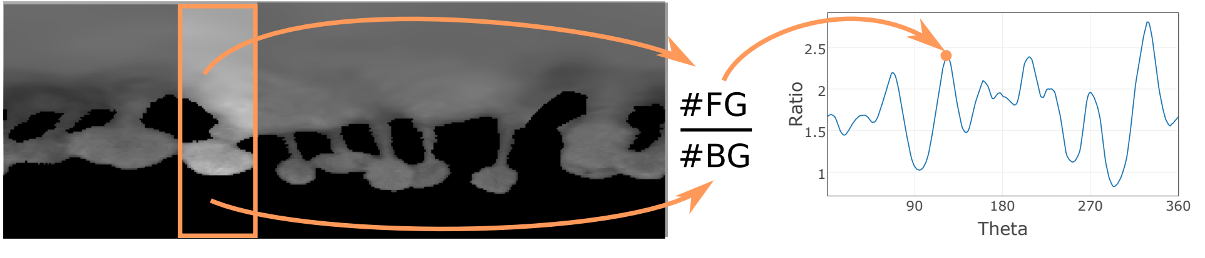
Patch Extraction
Giuffrida, M. V., Minervini, M., & Tsaftaris, S. A. (2016). Learning to count leaves in rosette plants

Slide 17
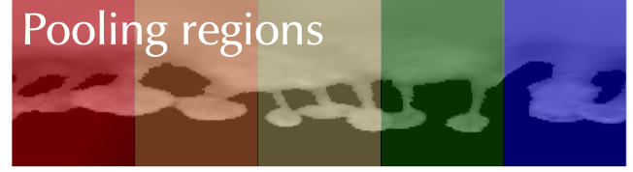
The Proposed Method
Extracted patches are provided to K-means
  Learns a codebook with K centroids
Then, each patch in an image is encoded ➔ average distance from each centroid
Image is divided into pooling regions
  Max-pooling provides vectors of size K
Giuffrida, M. V., Minervini, M., & Tsaftaris, S. A. (2016). Learning to count leaves in rosette plants

Slide 18
The Proposed Method
$$z=ψ(x)$$
$$y=φ(z)$$
Holistic vector as concatenation of the per-region vectors
SVM learns the leaf counting task
  Learning the mapping between holistic vectors and leaf count
Giuffrida, M. V., Minervini, M., & Tsaftaris, S. A. (2016). Learning to count leaves in rosette plants

Slide 19
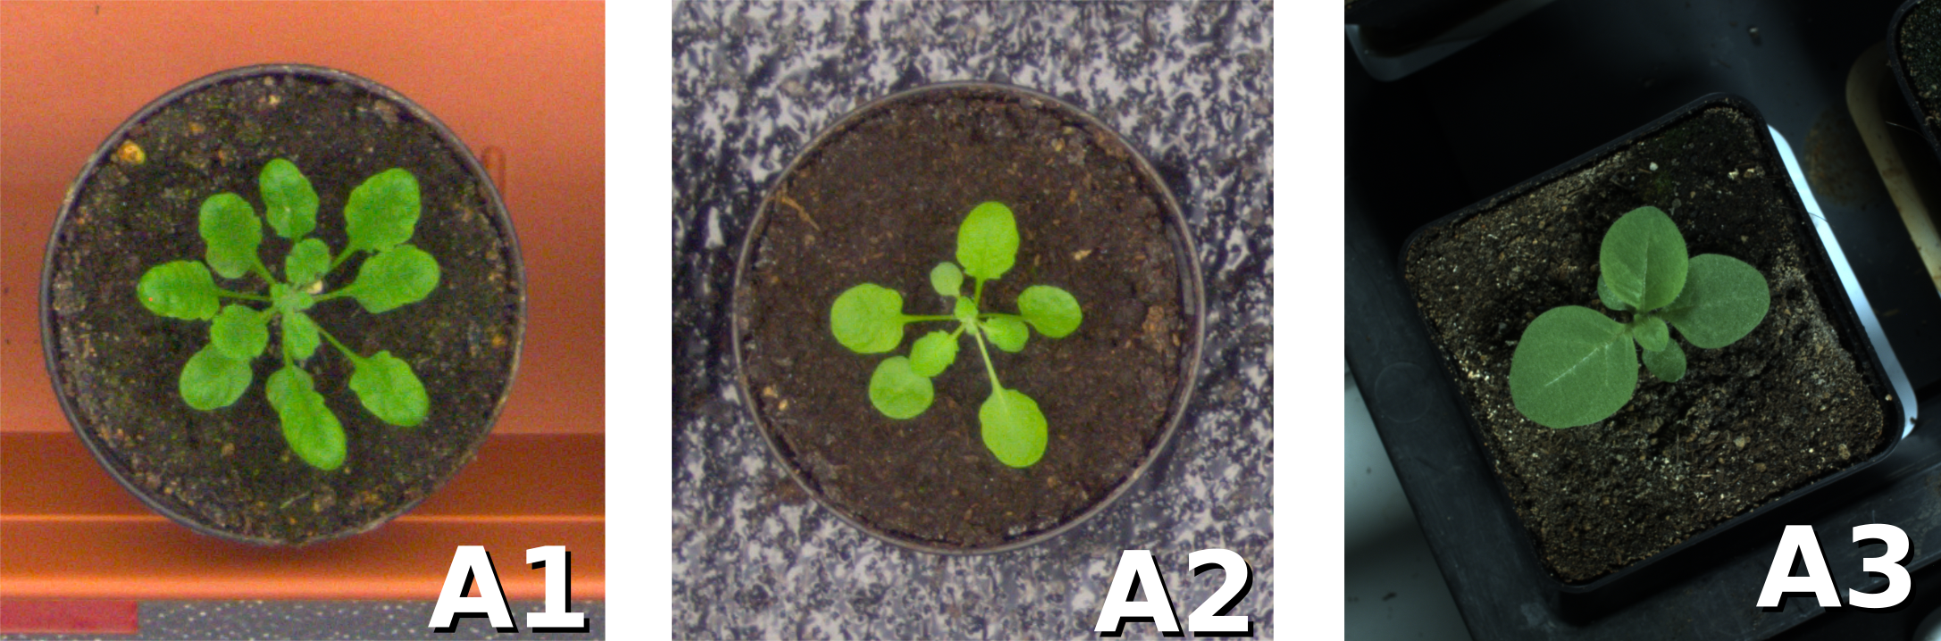
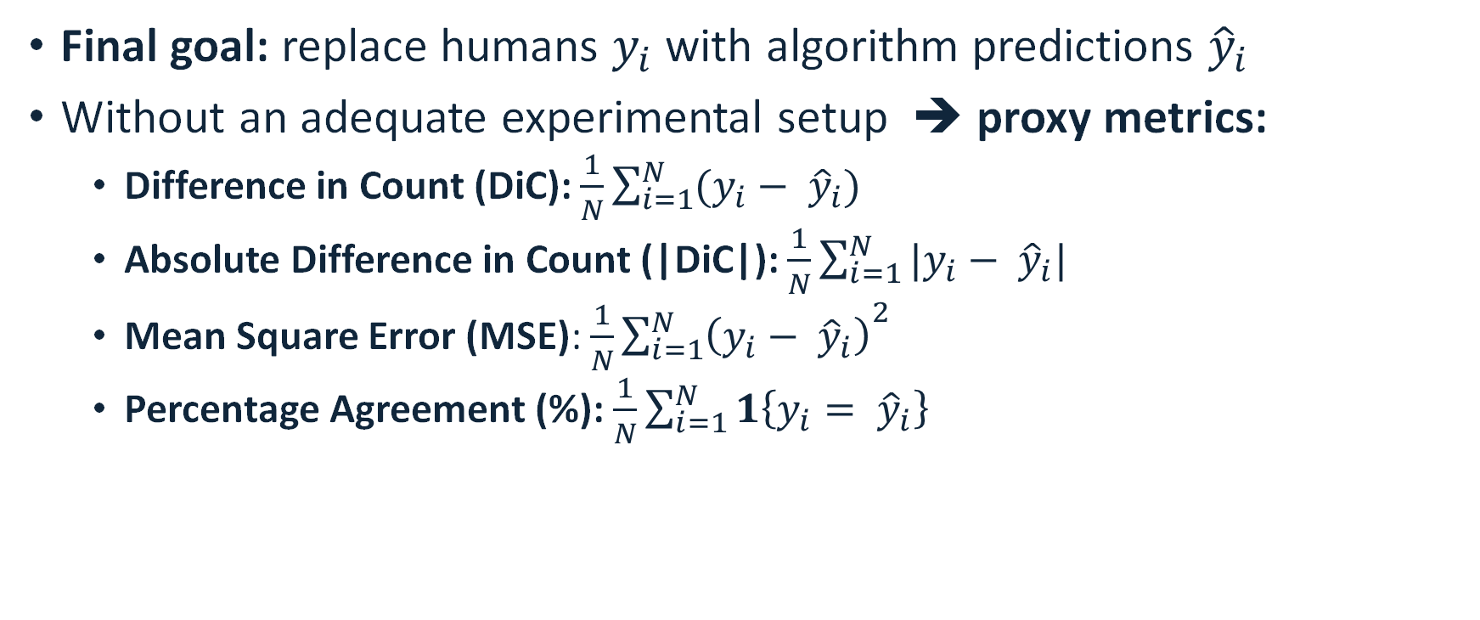
Performance Evaluation
Final goal: replace humans $y_{i}$ with algorithm predictions ${\hat{y}}_{i}$
Without an adequate experimental setup ➔ proxy metrics:
  Difference in Count (DiC): $\frac{1}{N}\sum_{i=1}^{N}{(y_{i}− {\hat{y}}_{i})}$
  Absolute Difference in Count (|DiC|): $\frac{1}{N}\sum_{i=1}^{N}{|y_{i}− {\hat{y}}_{i}|}$
  Mean Square Error (MSE): $\frac{1}{N}{\sum_{i=1}^{N}{\left(y_{i}− {\hat{y}}_{i}\right)}}^{2}$
  Percentage Agreement (%): $\frac{1}{N}\sum_{i=1}^{N}{1\left\{y_{i}= {\hat{y}}_{i}\right\}}$

Slide 20
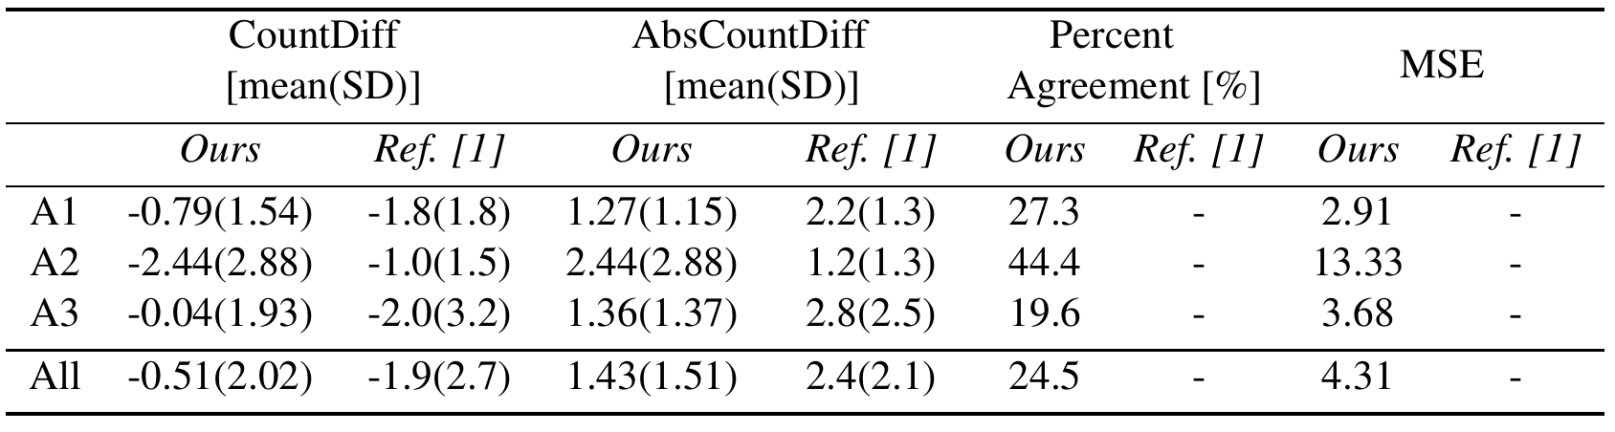
Experimental Results
Model trained per each dataset independently
Ours outperformed the method of Pape and Klukas (2015)
CVPPP Leaf Counting Challenge 2015 Winner!
[1] J. Pape and C. Klukas, “3-D histogram-based segmentation and leaf detection for rosette plants”, in Computer Vision - ECCV 2014 Workshops, volume 8928 of Lecture Notes in Computer Science, pages 61–74. Springer, 2015.

Slide 21

Experimental Results
Model trained per each dataset independently
Ours outperformed the method of Pape and Klukas (2015)
CVPPP Leaf Counting Challenge 2015 Winner!
[1] J. Pape and C. Klukas, “3-D histogram-based segmentation and leaf detection for rosette plants”, in Computer Vision - ECCV 2014 Workshops, volume 8928 of Lecture Notes in Computer Science, pages 61–74. Springer, 2015.

Slide 22
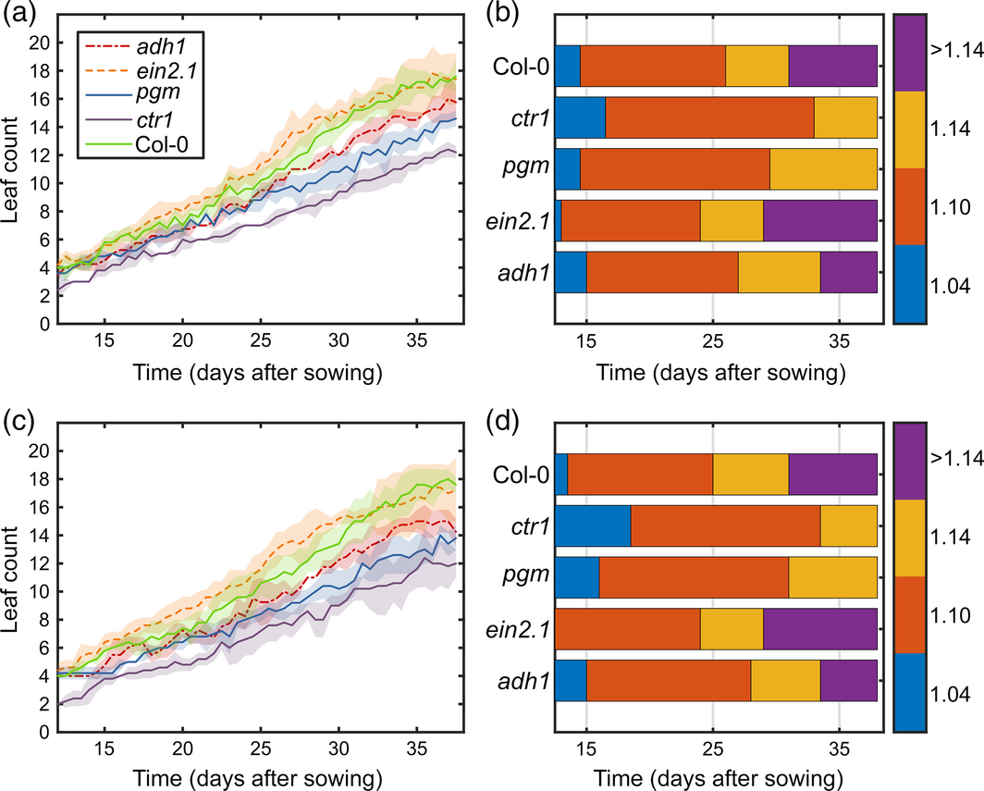
Application in Plant Phenotyping
A modified leaf counting algorithm
  Genotype information
Arabidopsis of 5
different genotypes
  Col-0, ctr, ein2, adh1, pgm
Same conclusions:
  Manual counting (top)
  Algorithm predictions (bottom)
Minervini, M., Giuffrida, M. V., Perata, P., & Tsaftaris, S. A. (2017). Phenotiki: an open software and hardware platform for affordable and easy image‐based phenotyping of rosette‐shaped plants. The Plant Journal, 90(1), 204-216.
Notes:
Developmental growth stages by Boyes et al (2001)

Slide 23


Slide 24
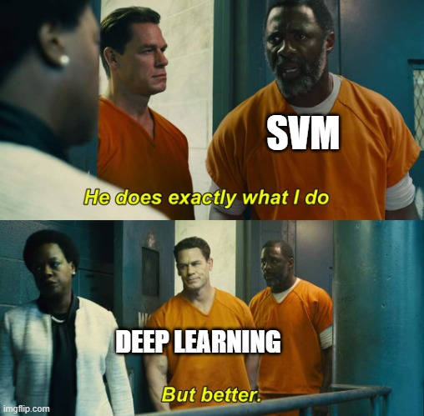

Slide 25
Why is deep learning so important?
3/4 of the pipeline I showed you were devoted to extract a suitable representation from images
What is a suitable representation? When we know it, we’ll tell you
  This is because it depends from many factor, e.g. the task at hand
Deep learning combines the part of extracting features and the task in a single, end-to-end, model

Slide 26
Then and now
Feature Extractor
Task
head

Slide 27
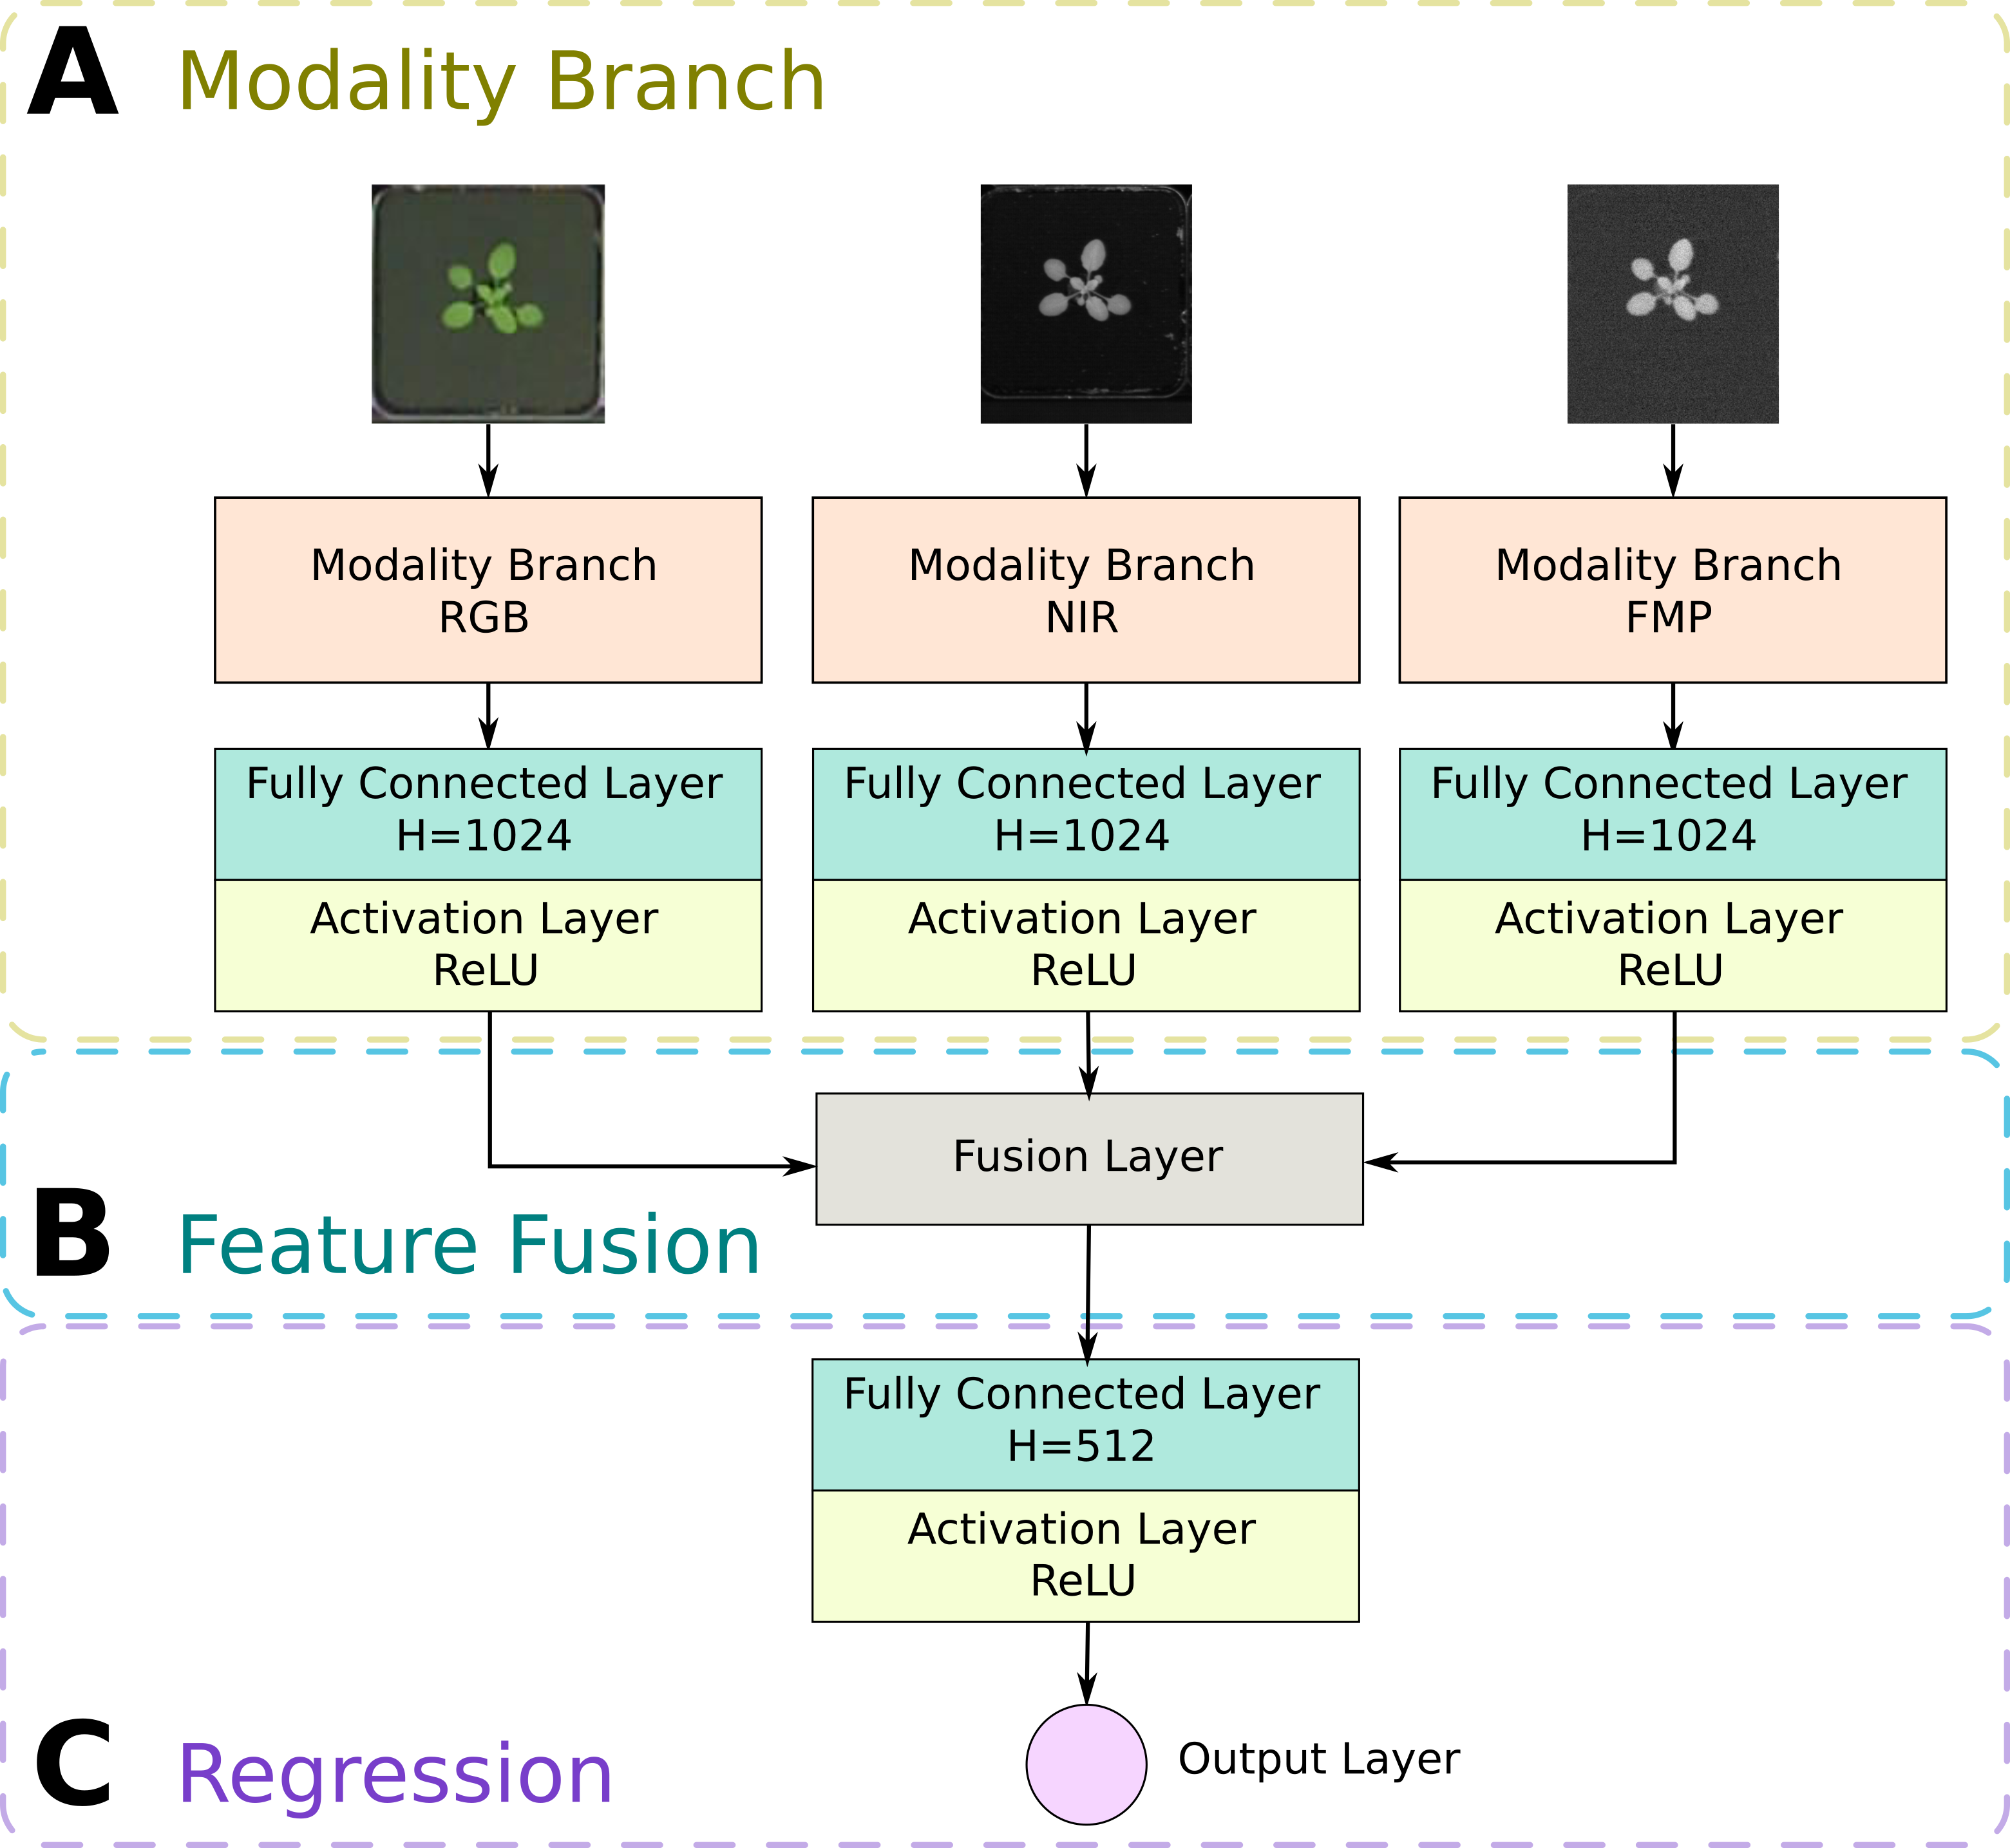
Pheno-Deep Counter
Modality Branch is a ResNet-50
Features 1024 dim vector
  Images have different size
  The extracted features have the same dimensionality
Max-fusion (Chartsias et al. 2018) of multi-modal features
Last layer: leaf count
Giuffrida M. V., Doerner, P., & Tsaftaris, S. A. (2018). Pheno‐Deep Counter: a unified and versatile deep learning architecture for leaf counting. The Plant Journal.

Slide 28
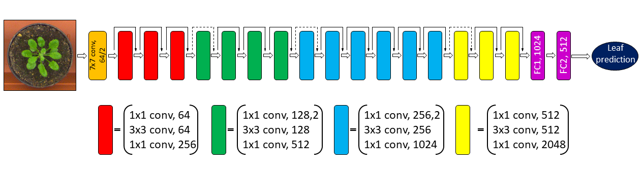
Modality Branch ➔ The feature extractor

Slide 29
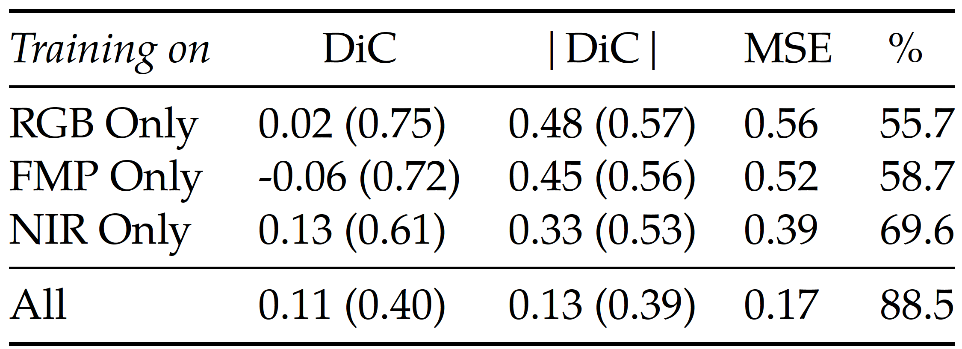
Results: Multimodal
RGB Only
Fluorescence Only
Near-Infrared Only
All
NearIR performs the best as single modality
  RGB and Fluorescence have similar performance
Multimodal outperforms all the others
  Features from multiple sources help with leaf counting!
Giuffrida M. V., Doerner, P., & Tsaftaris, S. A. (2018). Pheno‐Deep Counter: a unified and versatile deep learning architecture for leaf counting. The Plant Journal.

Slide 30
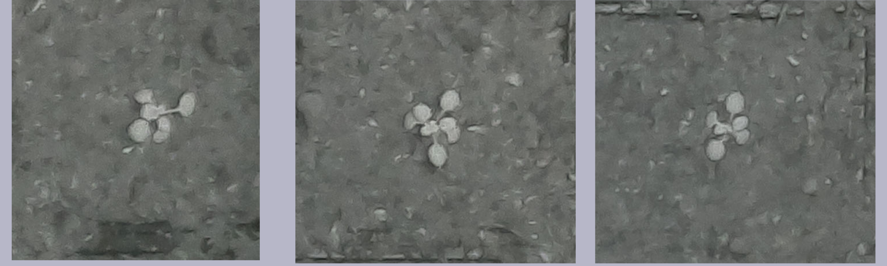
What else can we do with a multimodal network?
We can count in other datasets ➔ Fine-tuning
  Count task learnt in one dataset
  Specialise in another dataset with handful annotations
A dataset of night images was taken and annotated
  Near Infrared pictures from Dobrescu et al. (2017)
Only the NIR branch was fine tuned
  32 images for training – 32 for testing
  MSE: 0.61 – Perc Agreement: 53%
24hrs leaf count!
Giuffrida M. V., Doerner, P., & Tsaftaris, S. A. (2018). Pheno‐Deep Counter: a unified and versatile deep learning architecture for leaf counting. The Plant Journal.
Notes:
Nocturnal data: DiC: -0.14 (0.77); |DiC|: 0.52 (0.59);
MSE: 0.61; and Percent Agreement: 53.1%.

Slide 31
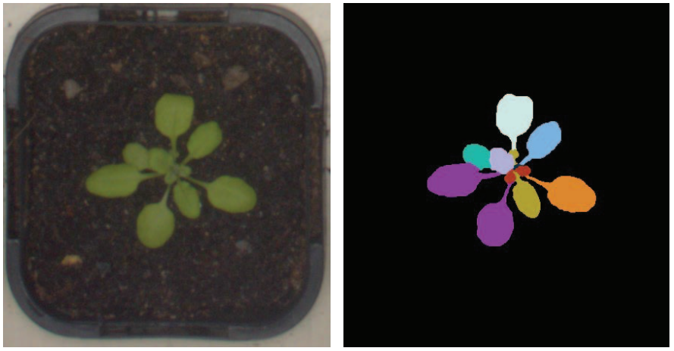
Examples (recap)
Regression
Detection
Segmentation

Slide 32
Can we use regression elsewhere?
Not just for counting…

Slide 33
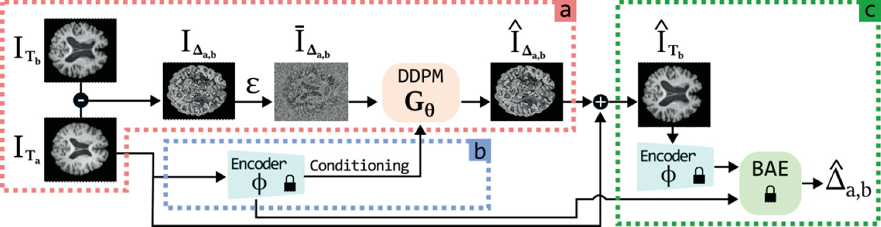
The problem
…
Age
Disease
Predict future MRs
Now
+5 Years

Slide 34

We needed a generative model
a young researcher at Porto, Portugal

Slide 35
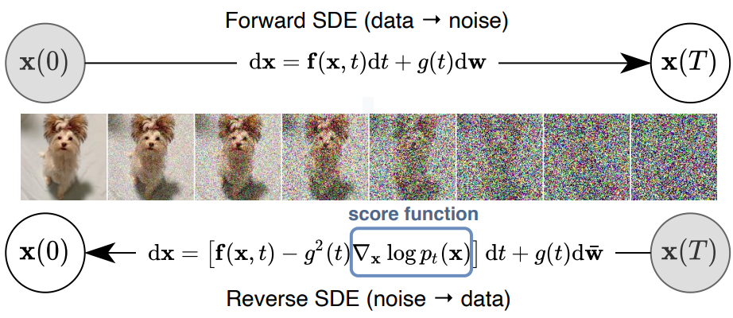
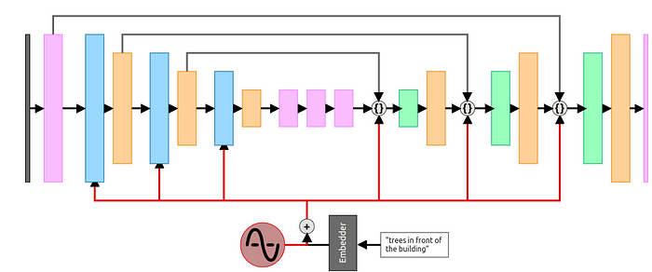
Diffusion model
https://medium.com/@kemalpiro/step-by-step-visual-introduction-to-diffusion-models-235942d2f15c
Song, Y., Sohl-Dickstein, J., Kingma, D. P., Kumar, A., Ermon, S., & Poole, B. (2020). Score-based generative modeling through stochastic differential equations. arXiv preprint

Slide 36
This is what we had…
Litrico, M., Guarnera, F., Giuffrida, M. V., Ravì, D., & Battiato, S. (2024, October). TADM: Temporally-aware diffusion model for neurodegenerative progression on brain mri. In International Conference on Medical Image Computing and Computer-Assisted Intervention (pp. 444-453). Cham: Springer Nature Switzerland.

Slide 37
What were we missing?
The purpose is to predict a follow-up scan given:
  A baseline scan
  Patient Information (conditioning)
Follow-up scans are characterised by a time-difference
  A patient with Alzheimer’s disease may perform a new scan in X years time
  If they were 60 at the time of the baseline ➔ they will be 60+X at the time of the follow-up.
How to take this information at our advantage?
  If we can train a regression model that, given an MR scan, it predicts the age of the patient, we can assess whether follow-up scans are consistent with the lapsed time, regularising the training process

Slide 38
…and this is what we have
Litrico, M., Guarnera, F., Giuffrida, M. V., Ravì, D., & Battiato, S. (2024, October). TADM: Temporally-aware diffusion model for neurodegenerative progression on brain mri. In International Conference on Medical Image Computing and Computer-Assisted Intervention (pp. 444-453). Cham: Springer Nature Switzerland.

Slide 39
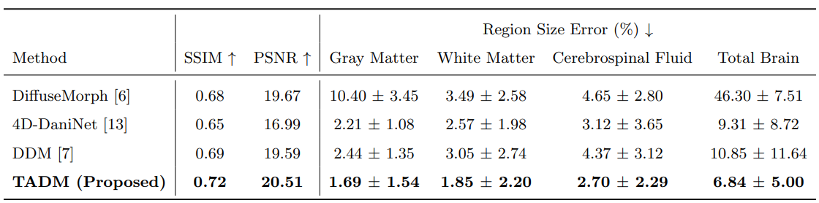
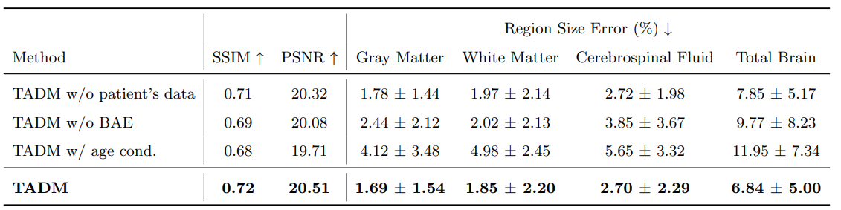
Experimental Results

Slide 40
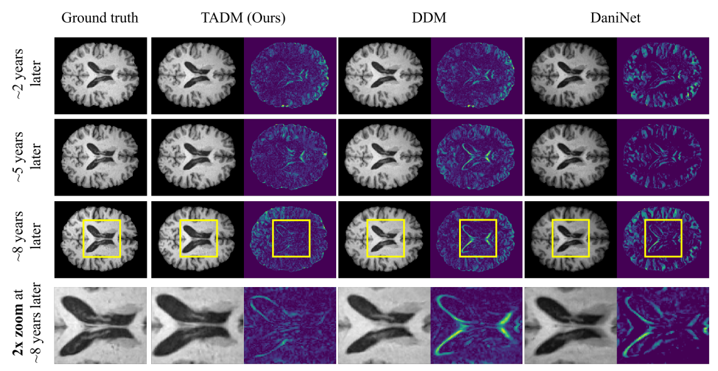
Qualitative Result

Slide 41
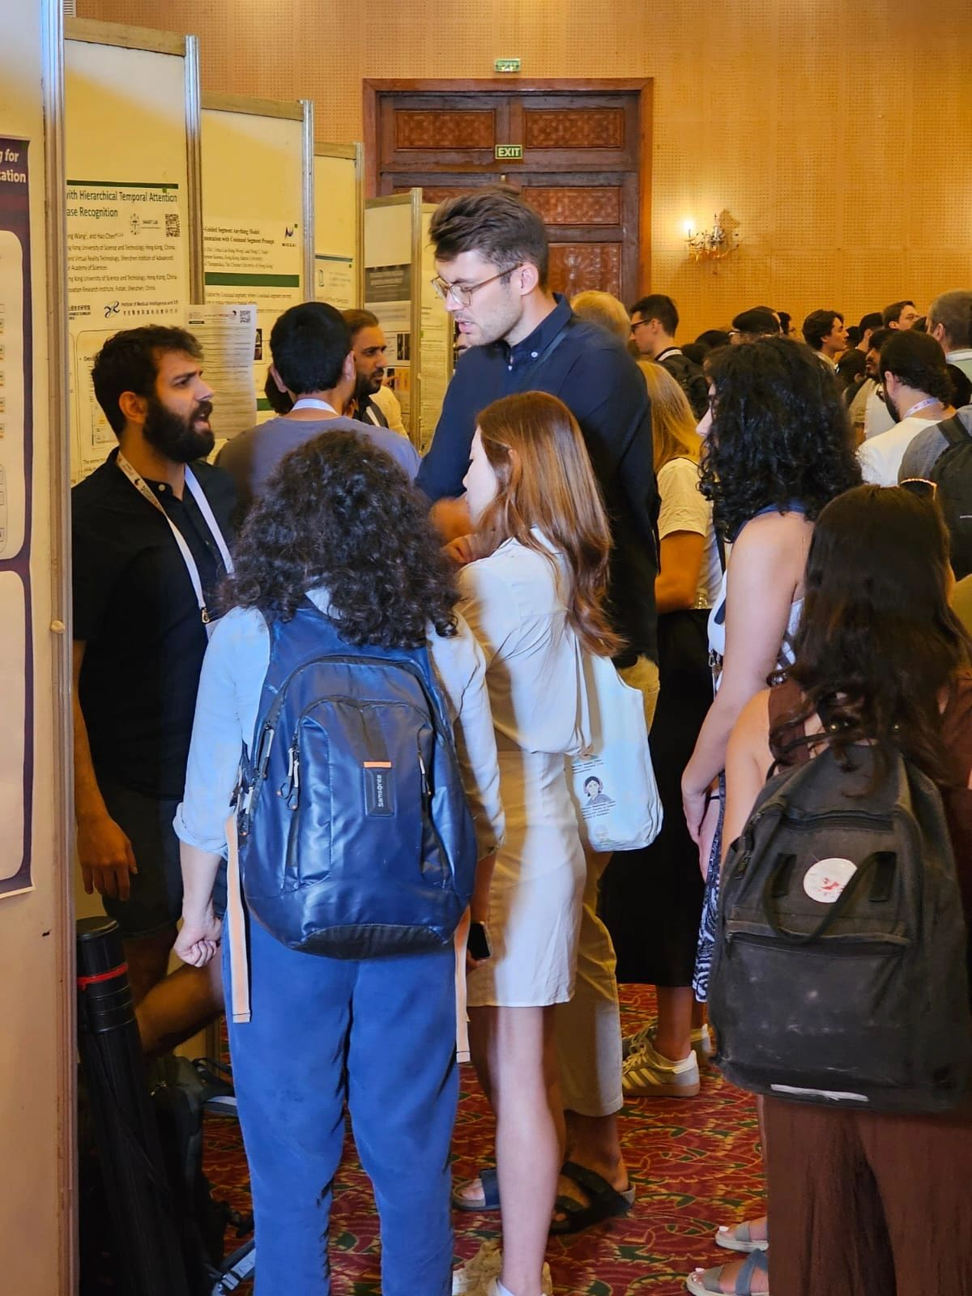
Temporal-Aware Diffusion Model (TADM)
By adding a pre-trained regression model, we were able to predict the age of the scans ➔ both real & generated by the diffusion model
Wrong age ➔ back prop!
In this way, we endowed the diffusion model with an indication of time
Simple idea ➔ Novel idea

Slide 42
PhenomUK
The Future of plant phenotyping & Agriculture in the UK
in collaboration with EU

Slide 43

PhenomUK
PhenomUK is part of a £2.4M funded project:
  Infrastructure Scoping Project announced June 2022. UKPCPI should
  Be a distributed research infrastructure, with regional sites/nodes
  Enable new ways of working and a cultural shift in the national approach to phenotyping research
  Clear barriers to collaboration for all community stakeholders and experts needed to address modern phenotyping challenges and bottlenecks
  Enhance synergies with complementary activities and leverage existing programmes within UK phenotyping
Project goal is a proposal and business plan for a Full Infrastructure Project that will meet UK phenotyping needs and form the UK node of EMPHASIS
  Overarching goal is increase volume, efficiency and effectiveness of UK science

Slide 44


















Participating Institutes

Slide 45


PhenomUK - Structure
Access to Facilities
PhenomUK Community
Directorate
Digital Infrastructure
Networking and Engagement
Community co-design/pilot activities/community assessment Action Plans
Collected Action Plans Proposal and Business Plan

Slide 46
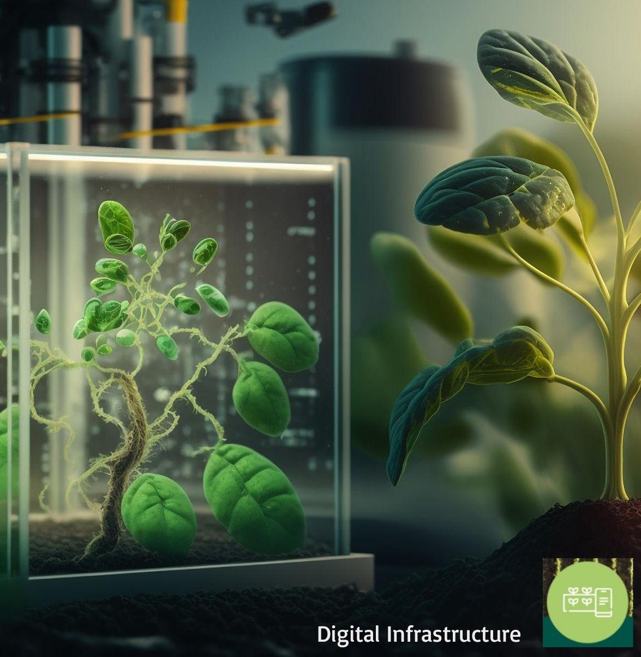

Digital Infrastructure
Providing shared access to information and computational services
  Scope and identify data infrastructure to support UK phenomics
  Pilot hardware and software tools
  Enable FAIR data access for UK scientists

Slide 47
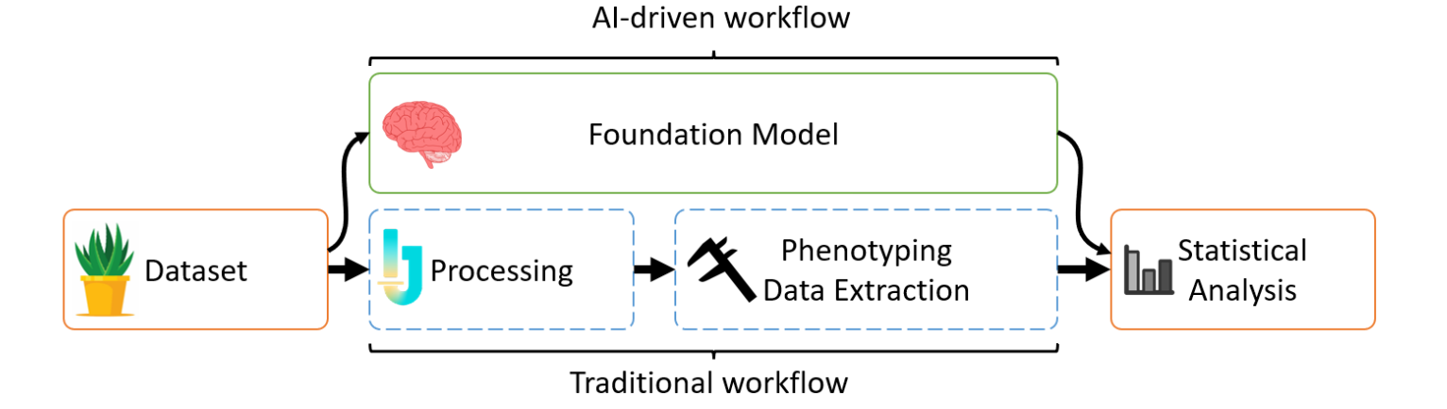
Some Achievements!
Initial site visits and 1-1 conversations
Three candidate information systems identified and implemented
  Fairdom-SEEK
  PHIS
  Grassroots
Community polled on desirable characteristics at Town Hall
Foundational AI identified as route to flexible analysis pipelines
DRI running (currently testing!)

Slide 48
Conclusion
Wrapping up!

Slide 49
Summary
Regression is an important task in plant phenotyping
It can be used for counting ➔ but not only
I showed you my journey on how I developed more robust algorithm, from old fashion machine learning to cutting-edge deep learning models
If you are in the UK, have a look at what we do within PhenomUK ☺

Slide 50

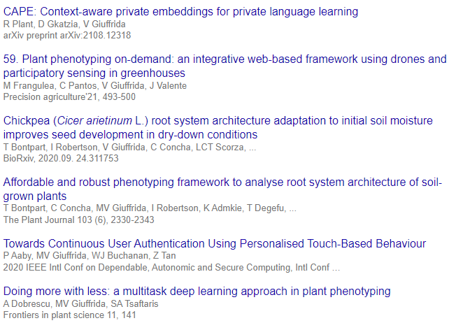
Obrigado!
✉️ valerio.giuffrida@nottingham.ac.uk 🔗 www.valeriogiuffrida.academy
PhenomUK 🌱 https://www.phenomuk.org

