Slide 1
Deep Learning for Active Robotic Perception
IJCCI 2023 - 15th International Joint Conference on Computational Intelligence
Nikolaos Passalis, Pavlos Tosidis, Theodoros Manousis,
and Anastasios Tefas
Presenter: Prof. Anastasios Tefas
Department of Informatics, Aristotle University of Thessaloniki, Thessaloniki, Greece

Slide 2
Structure
Deep Learning Challenges in Robotics
Introduction
Deep Active Perception
Overview
Supervised Deep Active Perception
RL-based Active Perception
Lightweight Intelligence for Robotics
OpenDR: An Open Deep Learning toolkit for Robotics
Interconnected

Slide 3
Deep Learning and Challenges
Deep Learning led to state-of-the-art performance in perception and cognition
Deep Learning in robotics and related areas leads to hurdles, requirements and research questions that are not fully addressed within the deep learning community
Steep Learning Curve
Difficult for robotics laboratories/companies to employ deep learning methodologies to their research/products
Computational complexity
DL requires powerful and specialized hardware which makes using DL models on embedded systems difficult
Passive Perception
Traditional Computer Vision approaches do not consider the interaction between a robot and the world

Slide 4
Deep Learning and Challenges in Robotics
Overcoming the learning curve barrier
Overcoming the computational complexity barrier
Overcoming the passive perception barrier
A toolkit with a collection of ROS nodes and the necessary tools for training and deployment is being developed that will enable any ROS-based robotic architecture to easily integrate them for improving its technical capabilities.
State-of-the-art lightweight deep learning models are developed. Models provide real-time inference on embedded systems, while being able to process high-resolution data.
A complete framework for simulating and developing robotics applications that use deep learning methodologies is developed.
Tools for enhanced robot navigation, action and manipulation capabilities are developed.

Slide 5
Active Perception
Robots can interact with the environment to better sense their surroundings
e.g., consider the task of face recognition
A robot might acquire a sub-optimal profile view of a subject
Existing static perception-based DL models might fail to recognize the subject from this view
This is especially true if it has never been trained on profile face images
However, a robot can acquire a better and more discriminative view by appropriately repositioning itself with respect to the human subject
In this case, the exact same DL model, will probably be able to recognize the subject

Slide 6
Active Perception
It is worth noting that this process is very similar to the way humans and various animals interact and understand their environment
For example, humans tend to look from different angles when trying to process complex visual stimuli, while many mammals have specialized muscles that rotate their ears toward the source of an audio signal
Despite this, most DL models currently do not employ active perception strategies

Slide 7
Active Perception
Can the recognition accuracy of DL models be improved by acquiring a more appropriate view, after manipulating the position of a robot inside the world?
For example, moving a robot closer to a human is expected to improve the confidence of the robot when recognizing a human, as well as reduce the recognition errors

Slide 8
Active Perception
A significant part of the complexity in modern DL models might arise from their ability to perform view invariant inference.
Can you read upside down?
Significantly smaller models can be used when active perception approaches are employed, without reducing recognition accuracy.

Slide 9
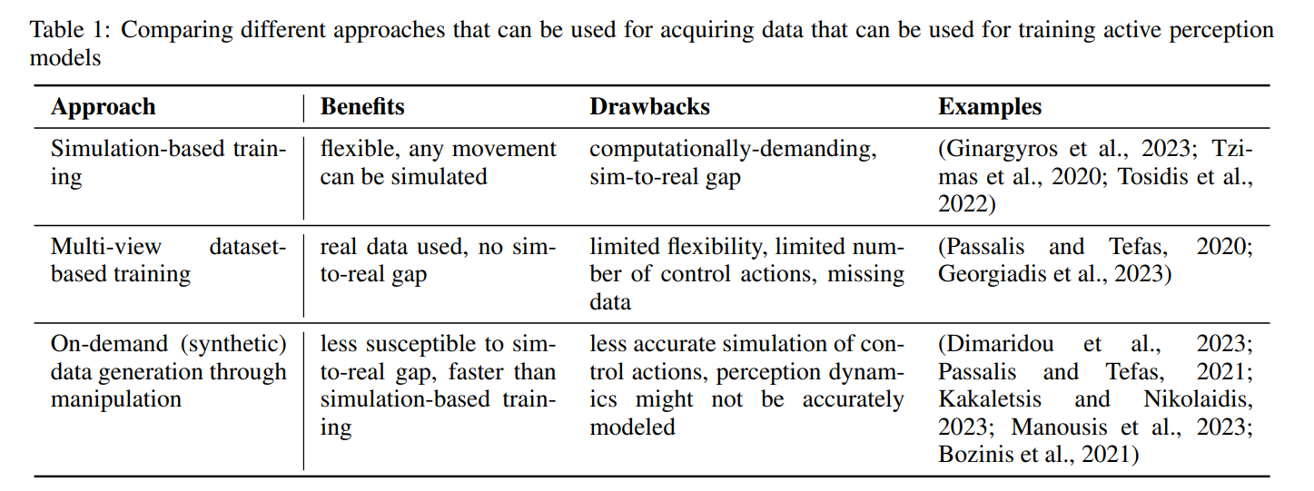
Active Perception

Slide 10
Active Perception

Slide 11
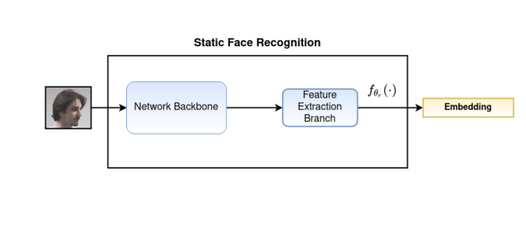
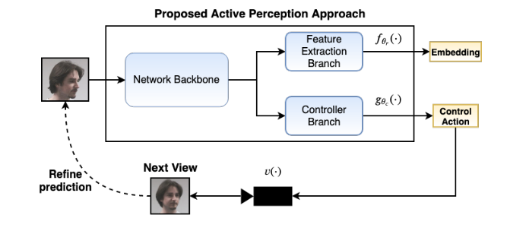
Active Perception for Embedding-based Face Recognition
Learn how to control the camera to maximize the confidence of the recognition for database-based face recognition
N. Passalis, A. Tefas, Leveraging Active Perception for Improving Embedding-based Deep Face Recognition, MMSP 2020

Slide 12
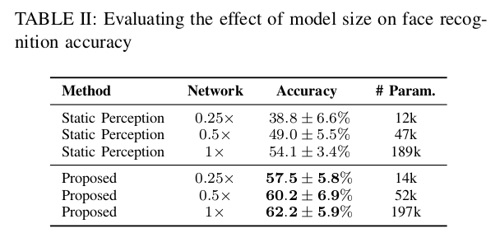
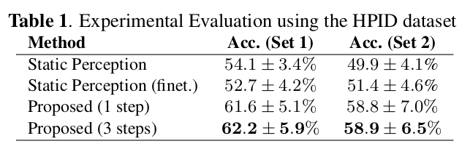
Active Perception for Embedding-based Face Recognition
N. Passalis, A. Tefas, Leveraging Active Perception for Improving Embedding-based Deep Face Recognition, MMSP 2020

Slide 13
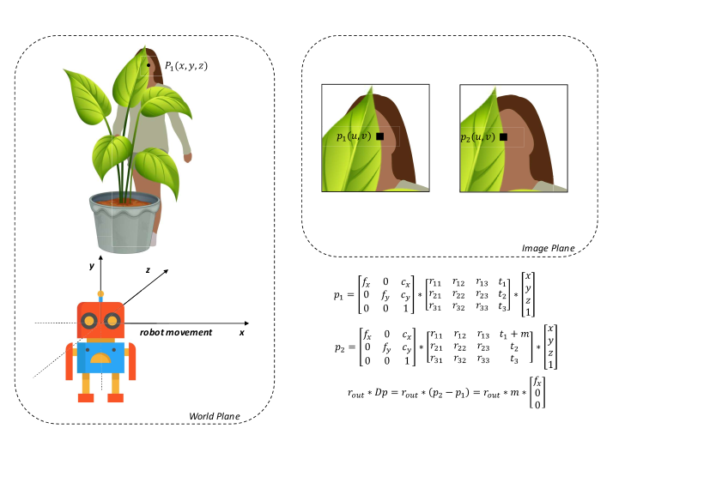
Occlusion Removal using Active Perception
Lack of occlusion-oriented active perception datasets
Synthetic Generation Approach using large-scale datasets (COCO, MS Celeb)
Integrating simulation and training
V. Dimaridou, N. Passalis and A. Tefas, DEEP ACTIVE ROBOTIC PERCEPTION FOR IMPROVING FOR FACE RECOGNITION UNDER OCCLUSIONS (Accepted, SSCI 2023)

Slide 14
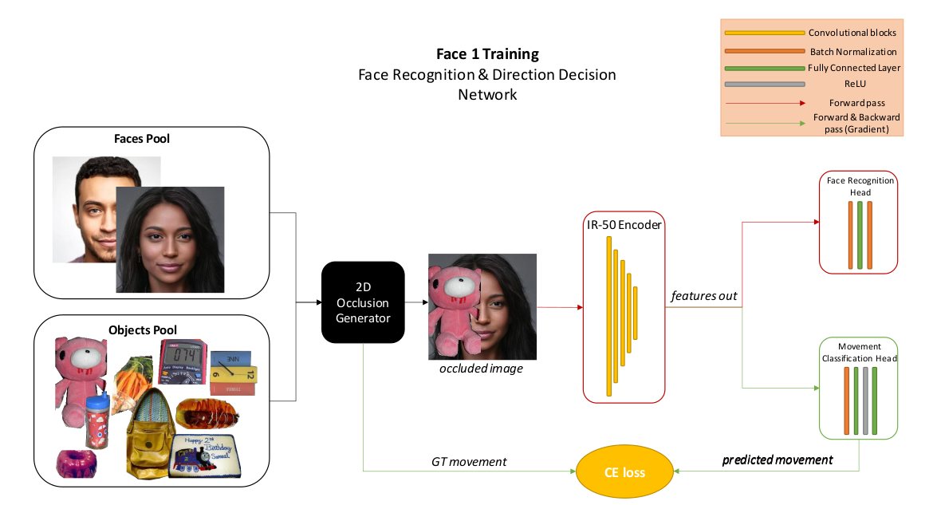
Occlusion Removal using Active Perception
Two-step process
First step: Decide if active perception is needed and the direction of movement
Needs to be fast, runs at every inference step
V. Dimaridou, N. Passalis and A. Tefas, DEEP ACTIVE ROBOTIC PERCEPTION FOR IMPROVING FOR FACE RECOGNITION UNDER OCCLUSIONS (Accepted, SSCI 2023)

Slide 15
Occlusion Removal using Active Perception
Two-step process
Second step: Perform a trial movement and infer the rest of the movement
Platform-agnostic
Enables efficient planning
V. Dimaridou, N. Passalis and A. Tefas, DEEP ACTIVE ROBOTIC PERCEPTION FOR IMPROVING FOR FACE RECOGNITION UNDER OCCLUSIONS (Accepted, SSCI 2023)

Slide 16
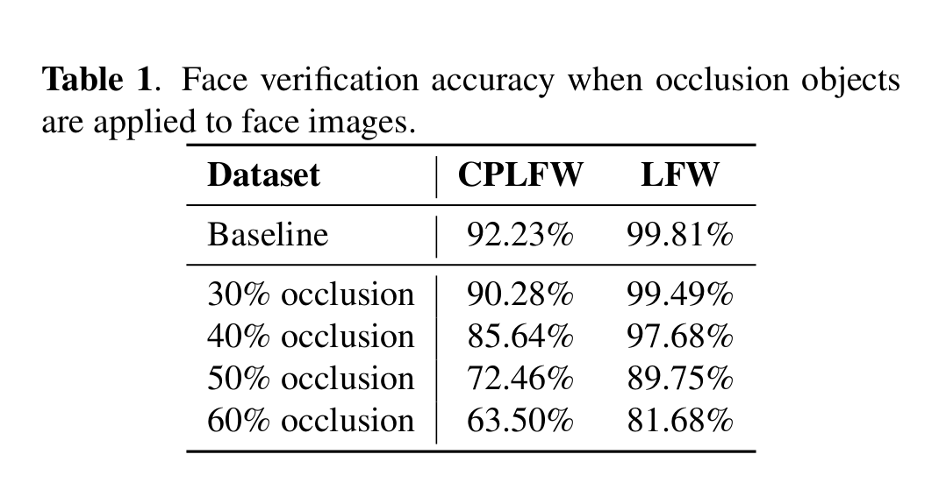
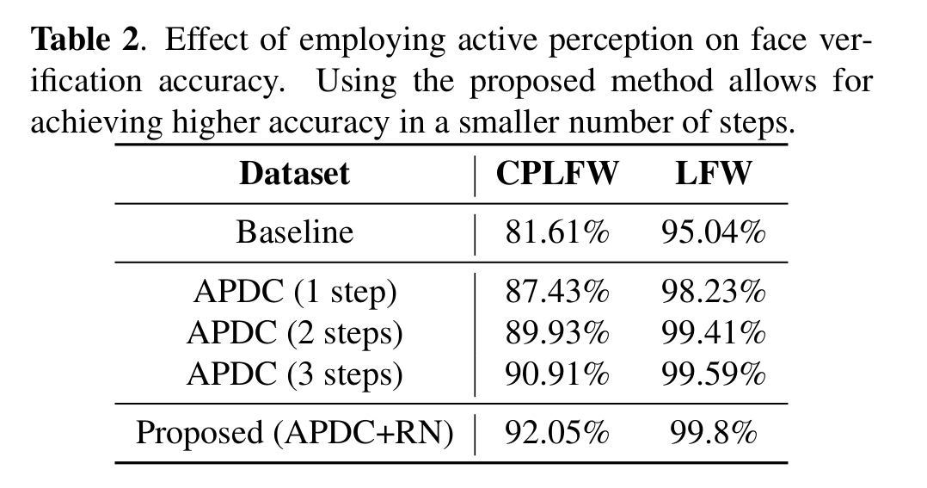
Occlusion Removal using Active Perception
Can recover face verification accuracy in just two steps!
V. Dimaridou, N. Passalis and A. Tefas, DEEP ACTIVE ROBOTIC PERCEPTION FOR IMPROVING FOR FACE RECOGNITION UNDER OCCLUSIONS (Accepted, SSCI 2023)

Slide 17
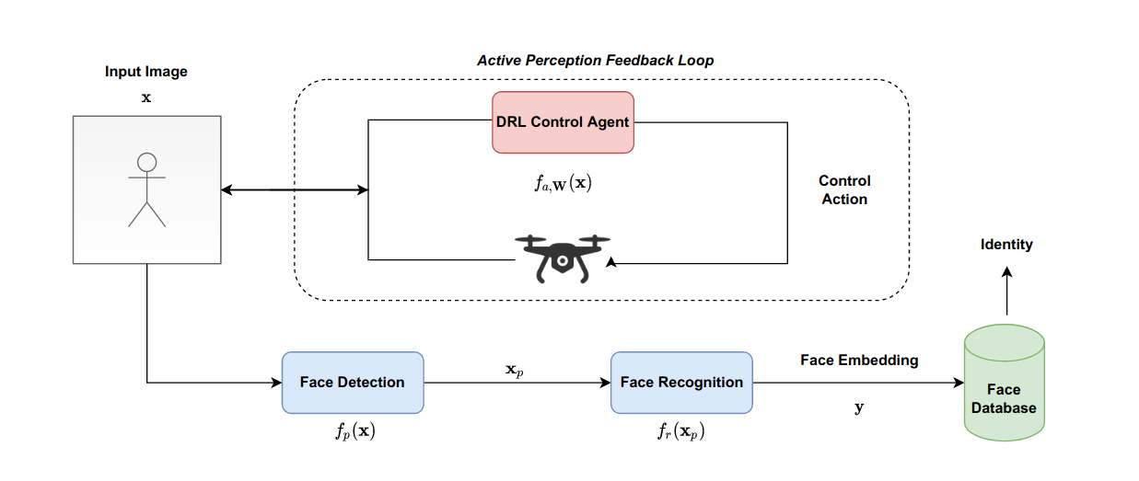
Active Vision Control Policies for Face Recognition using Deep Reinforcement Learning
A DRL agent is employed to issue control commands to acquire the most appropriate view for improving face recognition accuracy
Lightweight agent
180 FPS on Nvidia RTX2070, deploys face detection/recognition only when confident enough for success.
Reward based on face recognition
Pavlos Tosidis, Nikolaos Passalis, Anastasios Tefas “ACTIVE VISION CONTROL POLICIES FOR FACE RECOGNITION USING DEEP REINFORCEMENT LEARNING” , EUSIPCO 2022

Slide 18
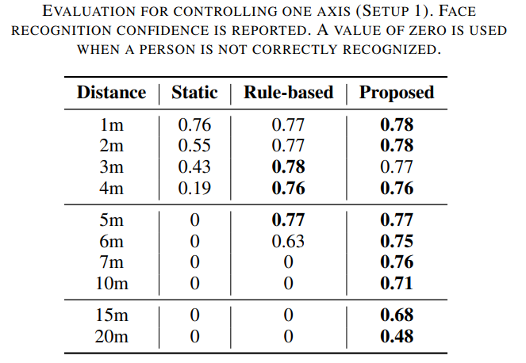
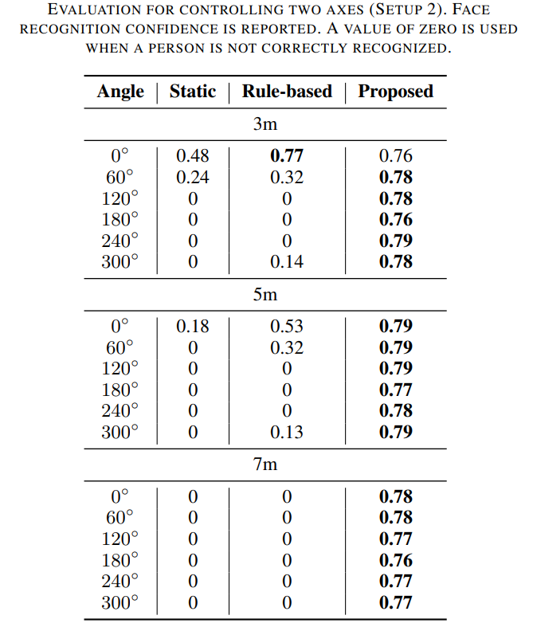
Active Vision Control Policies for Face Recognition using Deep Reinforcement Learning
Evaluation results on two scenarios
Pavlos Tosidis, Nikolaos Passalis, Anastasios Tefas “ACTIVE VISION CONTROL POLICIES FOR FACE RECOGNITION USING DEEP REINFORCEMENT LEARNING” , EUSIPCO 2022

Slide 19
Active Perception in Real Use Cases (Active)

Slide 20
High-resolution Pose Estimation
The proposed methodology consists of two basic steps:
Step 1: First we downscale the input image and pass it from the bottom-up model to generate a heatmap with the approximate location of humans.
Step 2: Apply pose-estimation model on a specific area of the high-resolution input image as detected in “Step 1”
T. Manousis, N. Passalis, and A. Tefas, “ENABLING HIGH-RESOLUTION POSE ESTIMATION IN REAL TIME USING ACTIVE PERCEPTION”, ICIP 2023

Slide 21
Active Perception in Real Use Cases

Slide 22
High-resolution Pose Estimation
Since the purpose of the research is focused on the high-resolution images, we created three new image datasets based on COCO2017
The original COCO2017 images are placed on a larger resolution canvas
1280x720 (720p)
1920x1080 (1080p)
2560x1440 (1440p)
The proposed method can be applied by using any bottom-up pose estimation approach
For this research Lightweight OpenPose was used
T. Manousis, N. Passalis, and A. Tefas, “ENABLING HIGH-RESOLUTION POSE ESTIMATION IN REAL TIME USING ACTIVE PERCEPTION”, ICIP 2023

Slide 23
High-resolution Pose Estimation
In the table below we present the average precision (0.5:0.95) results of the LightWeight OpenPose and the proposed method on different input size datasets
In the following table we demonstrate how the image resolution on the second pass, affects the results of proposed method. We conducted 3 experimental setups with different resolution.
Setup 1: 360 pixels
Setup 2: 540 pixels
Setup 3: 720 pixels
T. Manousis, N. Passalis, and A. Tefas, “ENABLING HIGH-RESOLUTION POSE ESTIMATION IN REAL TIME USING ACTIVE PERCEPTION”, ICIP 2023

Slide 24
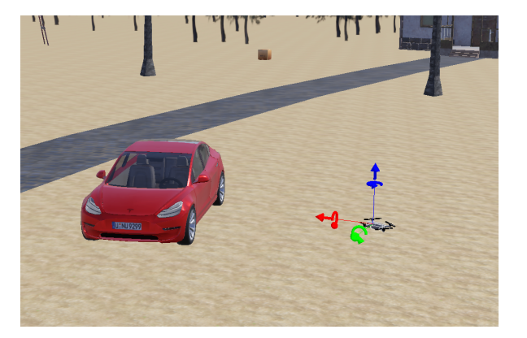
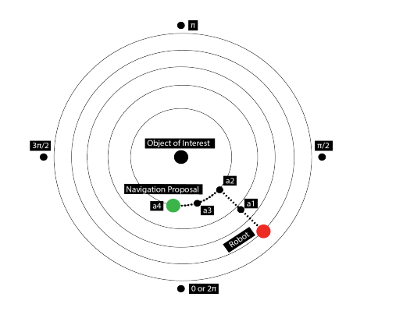
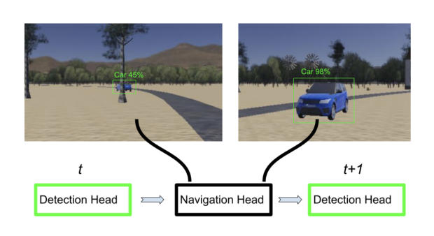
Trajectory-based Active Object Detection
Co-integrated Simulation and Learning to determine optimal active perception trajectories
Grid-search to infer optimal trajectories
Train a DL model to provide navigation proposals
S. Ginargyros, N. Passalis, A. Tefas “ Deep Active Perception for Object Detection using Navigation Proposals” , SSCI 2023 (accepted)

Slide 25
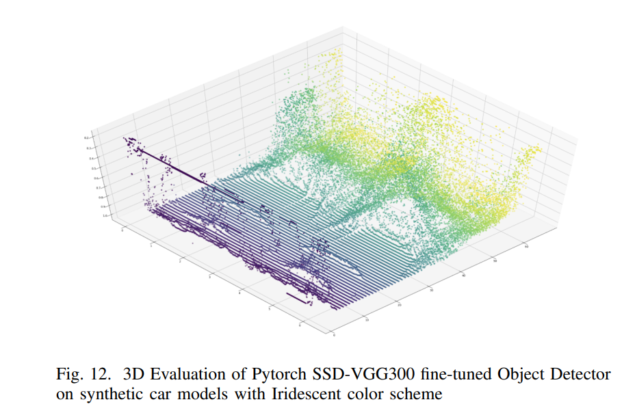
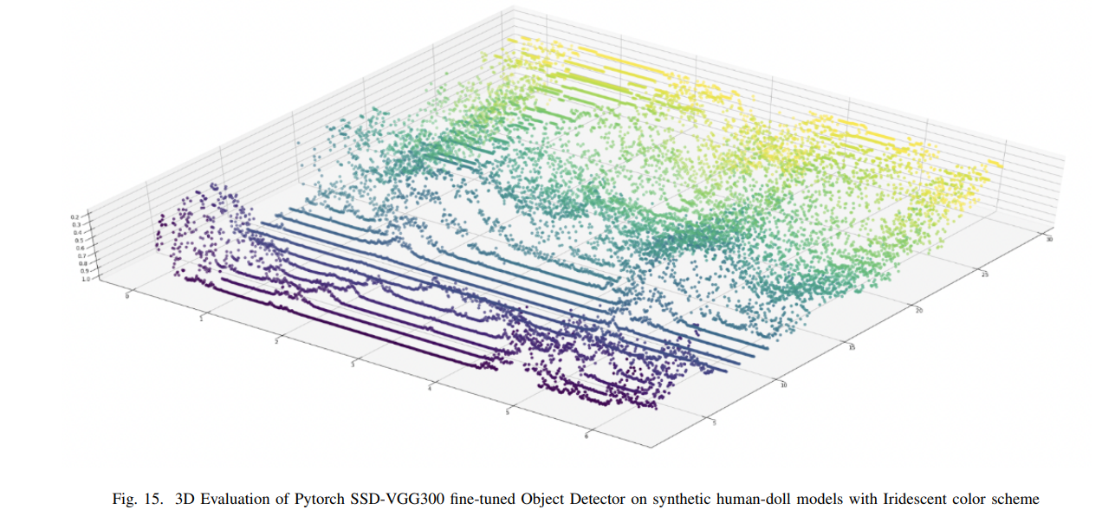
Trajectory-based Active Object Detection
Co-integrated Simulation and Learning to determine optimal active perception trajectories
Confidence heatmaps can also increase the explainability of models
S. Ginargyros, N. Passalis, A. Tefas “ Deep Active Perception for Object Detection using Navigation Proposals” , SSCI 2023 (accepted)

Slide 26
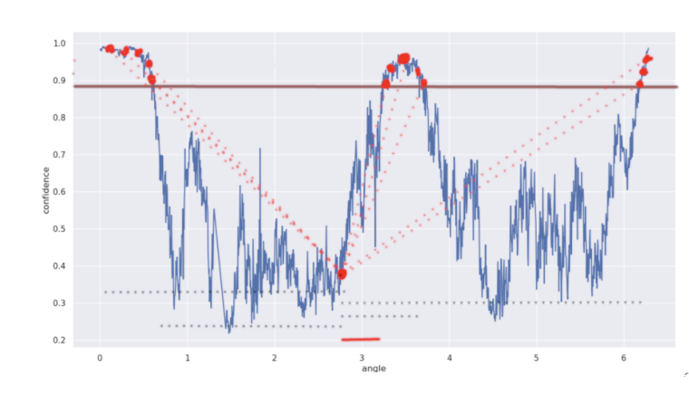
Trajectory-based Active Object Detection
Evaluate three different approaches: a) regressing the best position, b) performing classification towards the direction of movement and c) performing random movements
S. Ginargyros, N. Passalis, A. Tefas “ Deep Active Perception for Object Detection using Navigation Proposals” , SSCI 2023 (accepted)

Slide 27
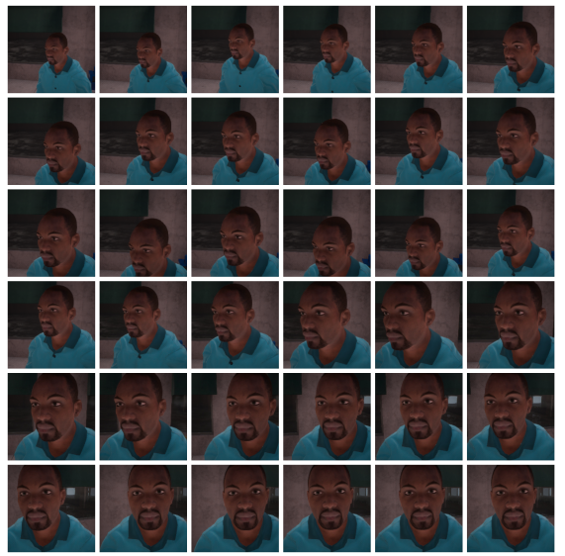
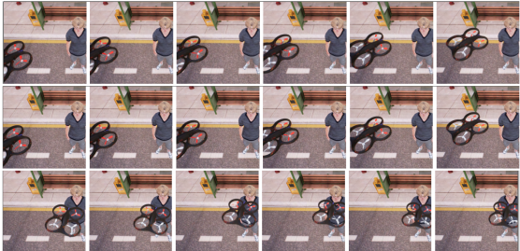
Leveraging Deep Reinforcement Learning for Active Shooting Under Open-World Setting
Preliminary work aiming to examine whether RL can be used in challenging open world and unconstrained settings to acquire more informative views
AirSim-based simulation, DRL trained on raw RGB input
Reward: distance + view based
A. Tzimas, N. Passalis, and A. Tefas, Leveraging Deep Reinforcement Learning for Active Shooting Under Open-World Setting, ICME 2020

Slide 28
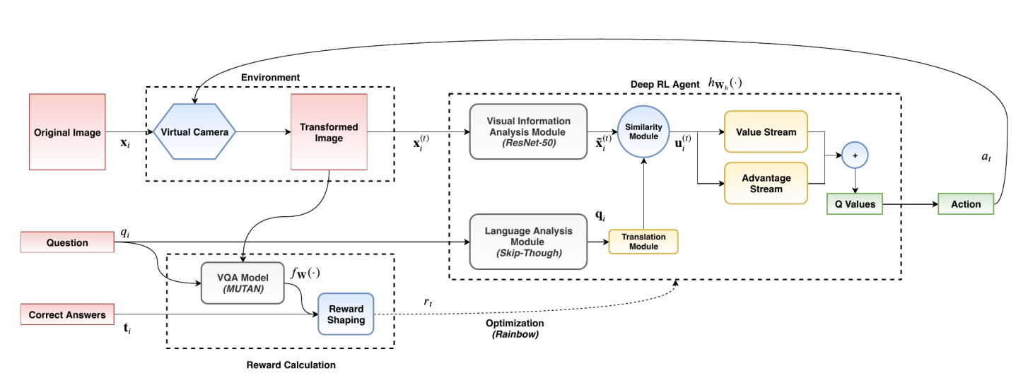
Visual Question Answering through Active Perception
The effect of active perception was simulated on a VQA dataset using crop/translation/zoom operations
A RL agent was trained to maximize the confidence on providing the correct answer
T. Bozinis, N. Passalis and A. Tefas, Improving Visual Question Answering using Active Perception on Static Images, ICPR 2020

Slide 29
Visual Question Answering through Active Perception
T. Bozinis, N. Passalis and A. Tefas, Improving Visual Question Answering using Active Perception on Static Images, ICPR 2020

Slide 30
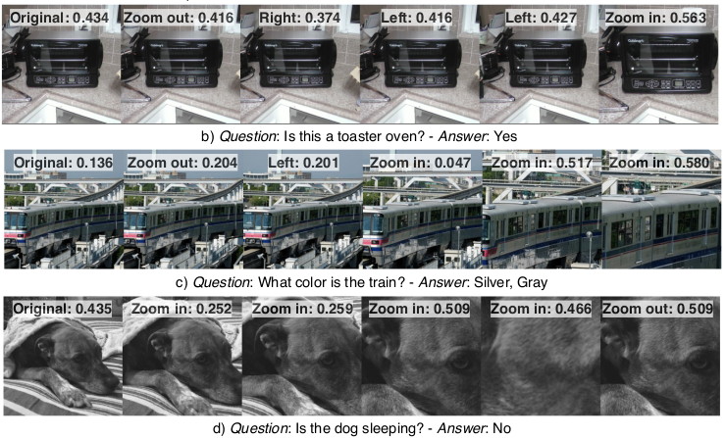
Visual Question Answering through Active Perception
T. Bozinis, N. Passalis and A. Tefas, Improving Visual Question Answering using Active Perception on Static Images, ICPR 2020

Slide 31
Pseudo-active Vision for Improving Deep Visual Perception
DL models are especially sensitive to different illumination conditions
Solutions:
Train with data augmentation (usually more parameters needed)
Control the camera parameters (slow, increases the latency)
Proposed: Learn how to transform the input data distribution in order to match the distribution the DL model expects
N. Passalis, A. Tefas, Pseudo-active Vision for Improving Deep Visual Perception through Neural Sensory Refinement, ICIP 2021

Slide 32
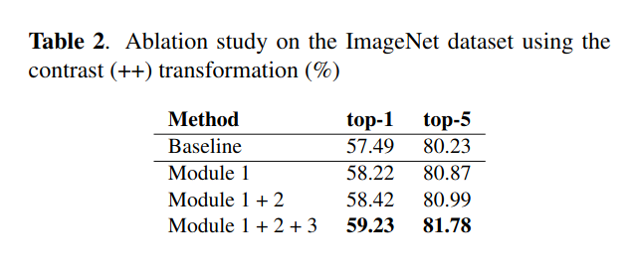
Pseudo-active Vision for Improving Deep Visual Perception
N. Passalis, A. Tefas, Pseudo-active Vision for Improving Deep Visual Perception through Neural Sensory Refinement, ICIP 2021

Slide 33
Active Perception and Continual Learning
Can we incorporate effortlessly active and continual learning into existing FR pipelines to improve existing FR systems’ performance?
Will a system be more accurate on recognizing a person, using informative samples gathered during inference to augment its database?
Simple, yet effective approach
Manipulate the reference representations stored for the identities to be recognized
P. Tosidis, N. Passalis, A. Tefas, LEVERAGING ACTIVE AND CONTINUAL LEARNING FOR IMPROVING DEEP FACE RECOGNITION IN-THE-WILD, MMSP

Slide 34
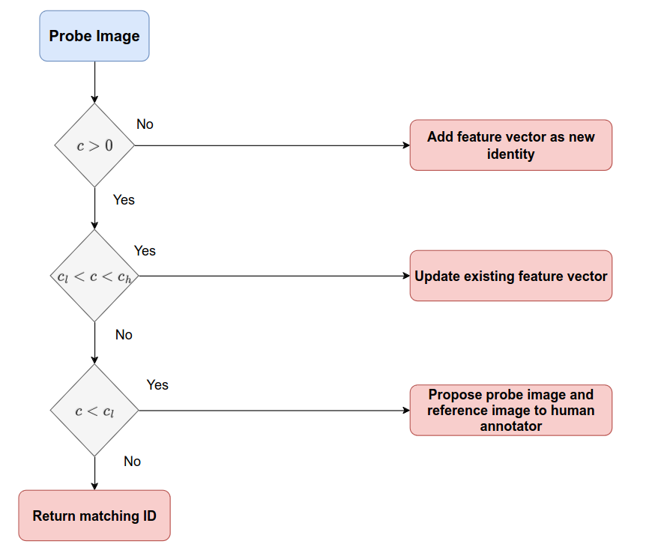
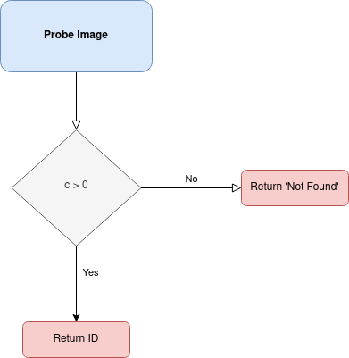
Active Perception and Continual Learning
Typical FR pipeline
Proposed
P. Tosidis, N. Passalis, A. Tefas, LEVERAGING ACTIVE AND CONTINUAL LEARNING FOR IMPROVING DEEP FACE RECOGNITION IN-THE-WILD, MMSP 2023

Slide 35
Active Perception in Real Use Cases

Slide 36
Active Perception in Real Use Cases

Slide 37
Lightweight Deep Learning
Lightweight Architectures
Neural Network Distillation
Appropriate Regularization
Quantization
Adaptive Inference
…

Slide 38
Quadratic Mutual Information Regularization in Real-time Deep CNN Models
Lightweight VGG-based CNN models able to run in real-time on Jetson-TX2 for high resolution input (720p and 1080p)
Regularization, e.g., based on the Quadratic Mutual Information criterion, can be used to enhance the generalization ability of the proposed models
- M. Tzelepi and A. Tefas, Quadratic Mutual Information Regularization in Real-Time Deep CNN Models, MLSP 2020
- M. Tzelepi and A. Tefas, Improving the performance of lightweight CNNs for binary classification using Quadratic Mutual Information regularization, Pattern Recognition 2020

Slide 39
Quadratic Mutual Information Regularization in Real-time Deep CNN Models
Heatmap on high-resolution drone-captured image considering the task of football player detection, utilizing the proposed regularized real-time on input of resolution 1080p CNN model.
- M. Tzelepi and A. Tefas, Quadratic Mutual Information Regularization in Real-Time Deep CNN Models, MLSP 2020
- M. Tzelepi and A. Tefas, Improving the performance of lightweight CNNs for binary classification using Quadratic Mutual Information regularization, Pattern Recognition 2020

Slide 40
Knowledge Distillation
Knowledge distillation (KD) allows for improving the performance of lightweight DL models
KD works by using a larger teacher model to guide the training of a lightweight student model
Several different KD methods can be used accounting for the different scenarios that often occur:
Online and Self Distillation
Distillation from Teacher Ensembles
Multi-level Distillation

Slide 41
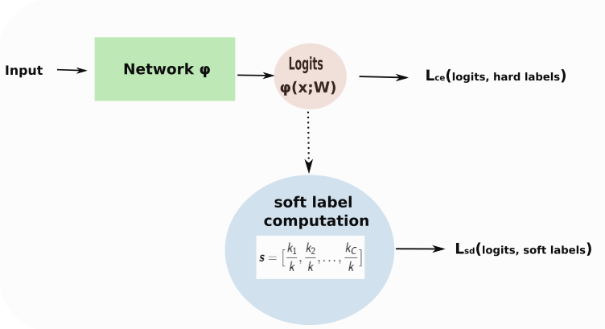
Online Self-Acquired Knowledge Distillation
Acquires soft labels
from the model itself
in an online manner
The proposed method does not require the utilization of multiple models or copies of the model like the most online KD methods, rendering it more efficient
The proposed method is model-agnostic
- M. Tzelepi and A. Tefas, Efficient Training of Lightweight Neural Networks Using Online Self-Acquired Knowledge Distillation, ICME 2021
- M. Tzelepi and A. Tefas, Online Self-Acquired Knowledge Distillation, Submitted

Slide 42
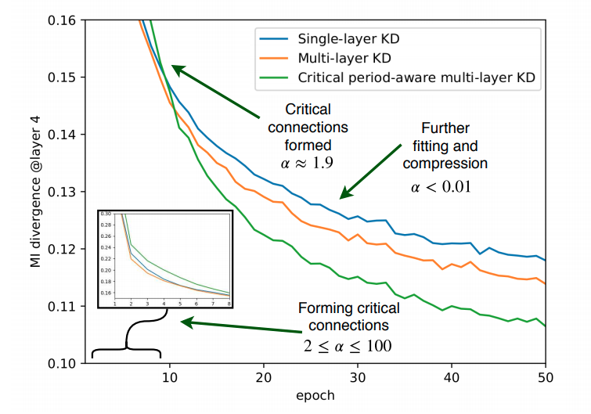
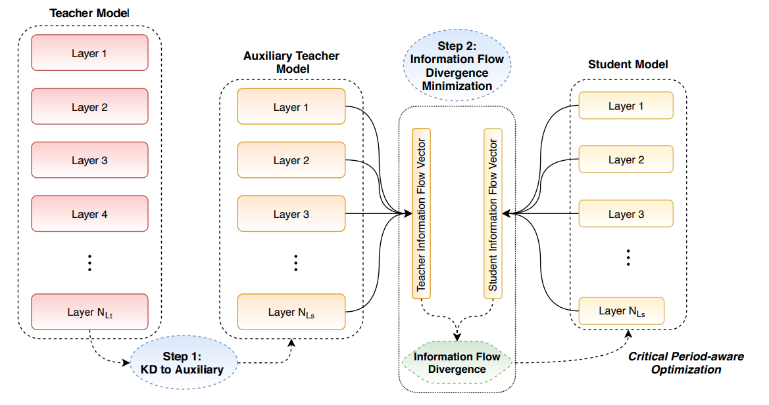
Heterogeneous Knowledge Distillation using Information Flow Modeling
Transferring the knowledge encoded in a large and complex neural network into a smaller and faster one, considering the way information flows through the intermediate layers
N. Passalis, M. Tzelepi, and A. Tefas, Heterogeneous Knowledge Distillation using Information Flow Modeling, CVPR, 2020

Slide 43
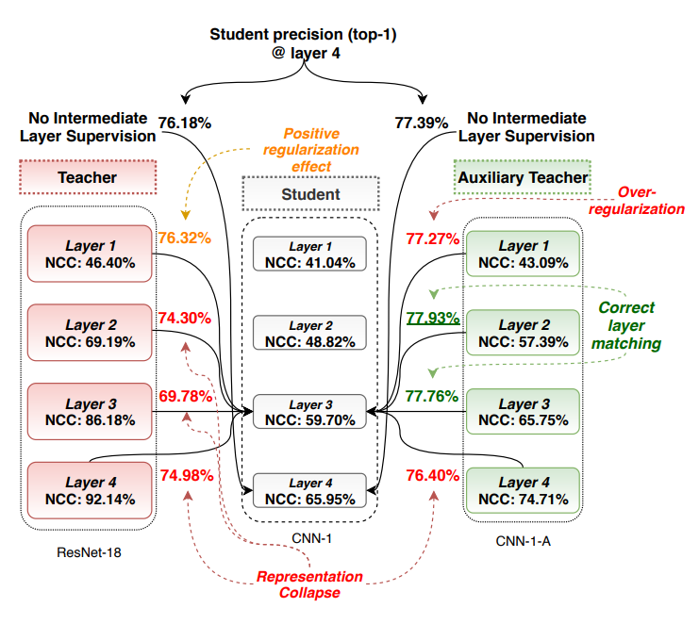
Heterogeneous Knowledge Distillation using Information Flow Modeling
N. Passalis, M. Tzelepi, and A. Tefas, Heterogeneous Knowledge Distillation using Information Flow Modeling, CVPR, 2020

Slide 44
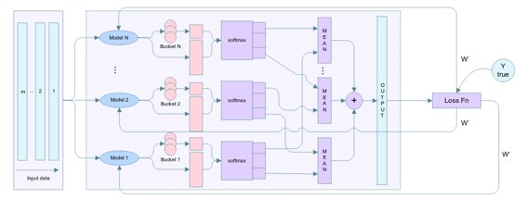
Knowledge Distillation using Unified Ensembles of Specialized Teachers
Instead of performing distillation from one single model, we constructed an ensemble of class-specialized teachers
Each teacher specializes in one sub-set of the classes
This ensemble is trained in a unified way to increase the efficiency (instead of training separate models)
A. Zaras, N. Passalis, A. Tefas, Improving Knowledge Distillation using Unified Ensembles of Specialized Teachers, Pattern Recognition Letters 2021

Slide 45
Adaptive Inference Models for Classification
In many cases we can make "early" decisions in DL models, especially for easier input samples
Using BoF-based early exits can allow for reducing the computational requirements
Contributions:
BoF aggregation
Re-use previous representations
Use additive representations
Robust confidence estimation
- N. Passalis, J. Raitoharju, A. Tefas, and M. Gabbouj, Efficient adaptive inference for deep convolutional neural networks using hierarchical early exits, Pattern Recognition, 2020
- N. Passalis, J. Raitoharju, M. Gabbouj, and A. Tefas, Efficient Adaptive Inference leveraging Bag-of-Features-based Early Exits, MMSP 2020

Slide 46
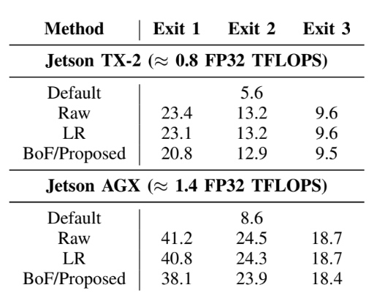
Adaptive Inference Models for Metric Learning
Difficult to apply in representation/metric learning setting
Representations can be directly used, but these often have different dimensionality per layer
Increased space requirements
Lower accuracy
Use the Bag-of-Features model to efficiently extract compact representations from any layer of a DL model that is then combined with an efficient linear regressor to match the final representation of the model
Maps the intermediate feature spaces into the final one, instead of working in these spaces
N. Passalis and A. Tefas, Adaptive Inference for Face Recognition leveraging Deep Metric Learning-enabled Early Exits, EUSIPCO 2021

Slide 47
OpenDR toolkit
An Open Toolkit for providing Active Perception capabilities

Slide 48
Deep Learning and Challenges
Deep Learning led to state-of-the-art performance in perception and cognition
Deep Learning in robotics and related areas leads to hurdles, requirements and research questions that are not fully addressed within the deep learning community
Steep Learning Curve
Difficult for robotics laboratories/companies to employ deep learning methodologies to their research/products
Computational complexity
DL requires powerful and specialized hardware which makes using DL models on embedded systems difficult
Passive Perception
Traditional Computer Vision approaches do not consider the interaction between a robot and the world

Slide 49
Deep Learning and Challenges in Robotics
Overcoming the learning curve barrier
Overcoming the computational complexity barrier
Overcoming the passive perception barrier
A toolkit with a collection of ROS nodes and the necessary tools for training and deployment is being developed that will enable any ROS-based robotic architecture to easily integrate them for improving its technical capabilities.
State-of-the-art lightweight deep learning models are developed. Models provide real-time inference on embedded systems, while being able to process high-resolution data.
A complete framework for simulating and developing robotics applications that use deep learning methodologies is developed.
Tools for enhanced robot navigation, action and manipulation capabilities are developed.

Slide 50
OpenDR Main Objective
To develop a modular, open, and non-proprietary toolkit for core robotic functionalities by harnessing deep learning to provide advanced perception and cognition capabilities, meeting in this way the general requirements of robotics applications in different areas.

Slide 51
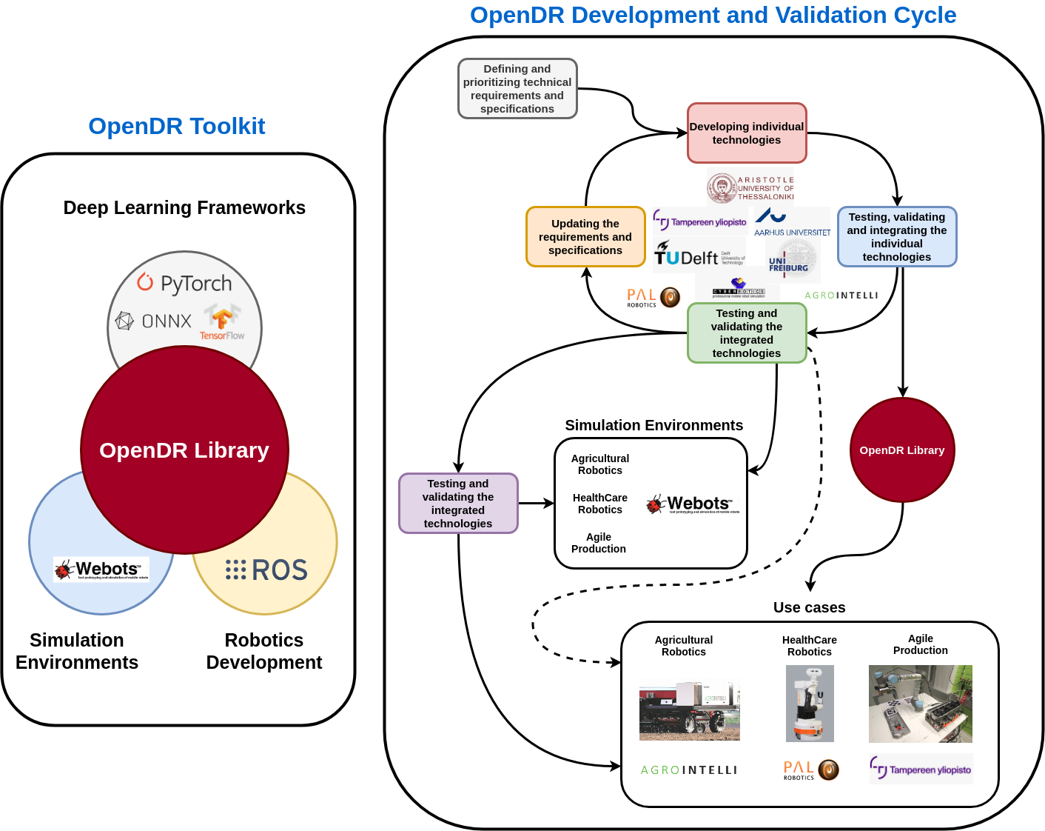
OpenDR Ecosystem and Development

Slide 52
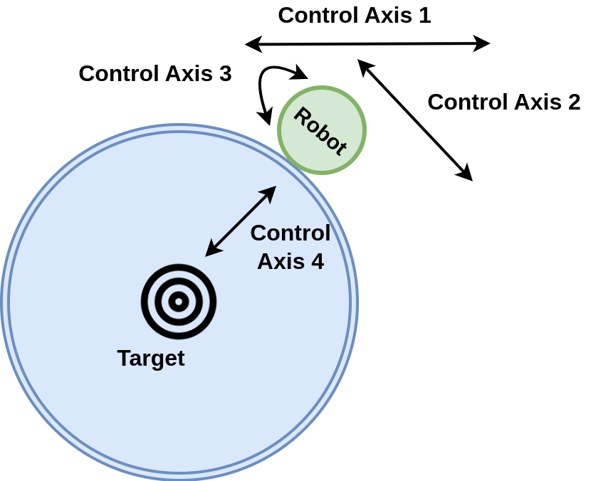
OpenDR Active Perception Specifications

Slide 53
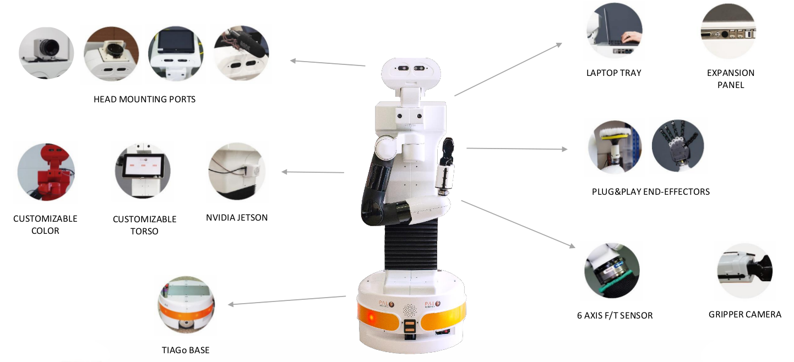
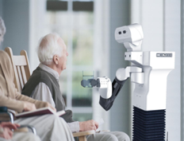
OpenDR Use Cases
Healthcare Robotics
Robots supporting elderly people

Slide 54
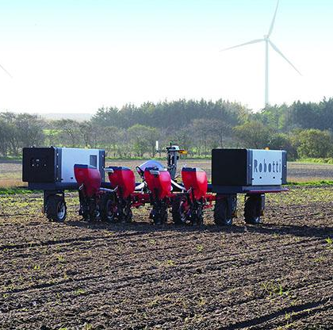
OpenDR Use Cases
Intelligent Mechanical Weeding
Agricultural Robotics

Slide 55
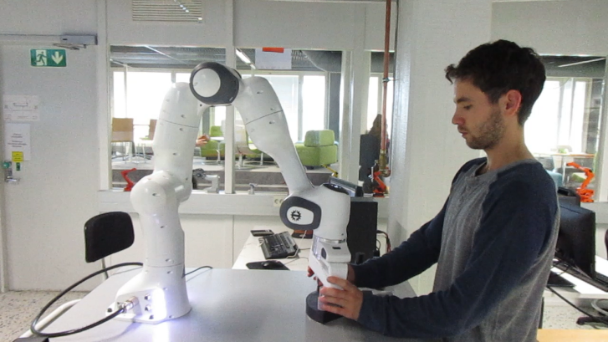
OpenDR Use Cases
Human-robot collaborative Diesel engine assembly
Agile Production

Slide 56
OpenDR at a glance
H2020 Research and Innovation Action
Coordinated by
Aristotle University of Thessaloniki
Prof. Anastasios Tefas
tefas@csd.auth.gr
8 partners from 7 European countries
Duration: 48 months (ends: 31-12-2023)

Slide 57
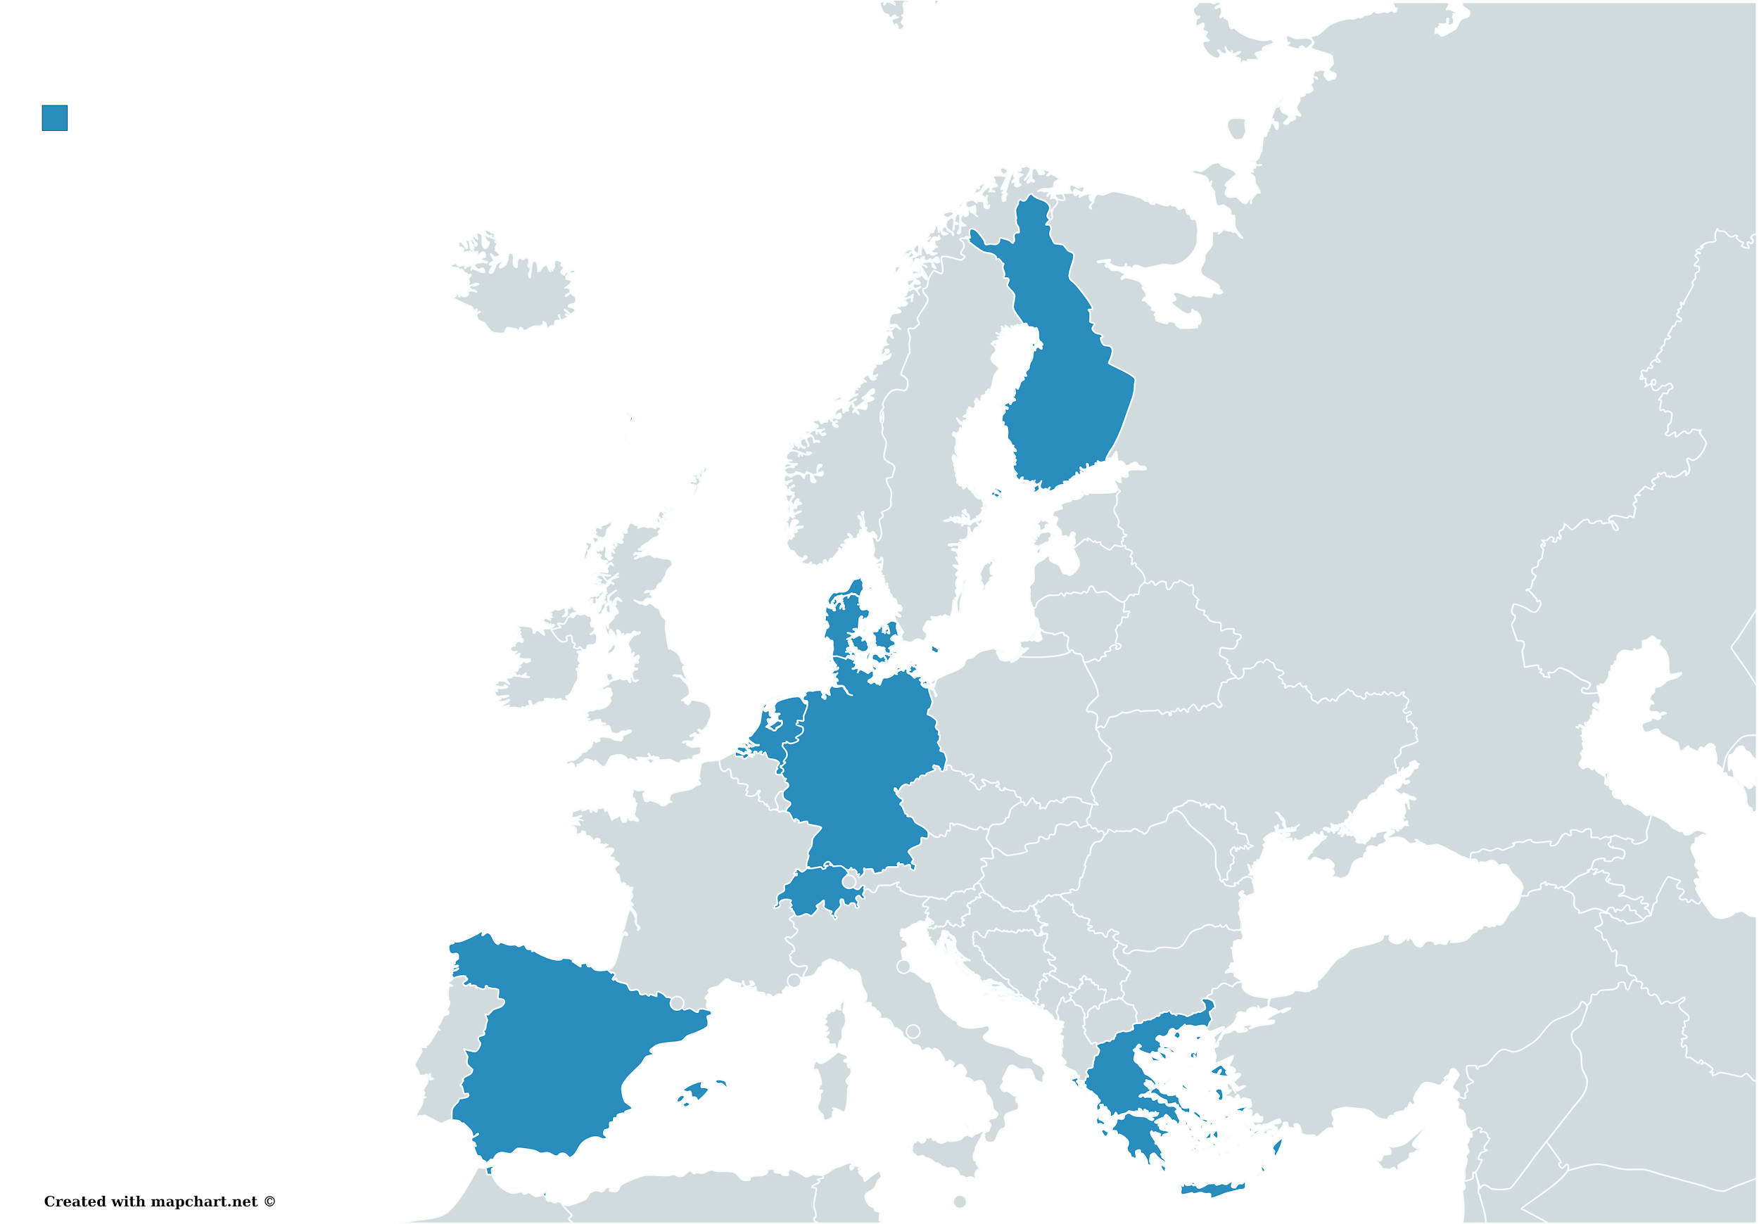
Academic partners:
Aristotle University Thessaloniki (GR)
Tampere University (FN)
Aarhus University (DK)
Delft University of Technology (NL)
University of Freiburg (DE)
Industrial partners:
Cyberbotics (CH)
PAL Robotics (ES)
AgroIntelli (DK)

Slide 58
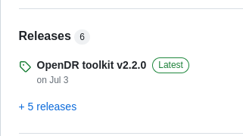
Current Status
Active development
First version of OpenDR released on 31 Dec 2021!
6 releases already!

Slide 59
Current Status
Available through major distribution channels:
pip package
Docker images for various platforms
Support for Jetson TX-2, NX, AGX (pre-release)
Github source distribution
v.1.1 also provides more flexible installation options (installing only parts of the toolkit)

Slide 60
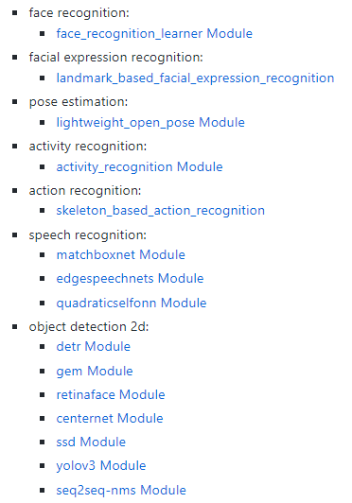
Current Status
Several tools already available

Slide 61
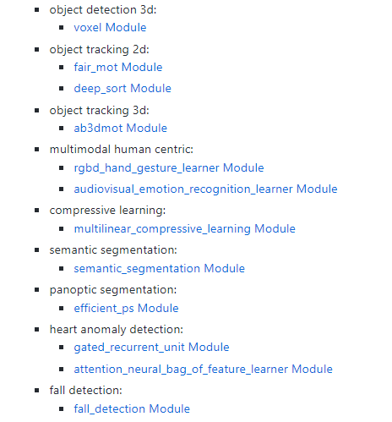
Current Status
Several tools already available

Slide 62
Conclusions
Active Perception holds the credentials for unlocking next-gen DL-enabled robotic perception capabilities
Shift in training and deployment pipelines
Supervised learning approaches require solving proxy problems (might lead to suboptimal results), yet are easier to train
DRL can be directly used in active perception scenarios, yet more difficult to train
On-board deployed is almost always required, leading to the need for lightweight DL models

Slide 63
More Info / Contact
Find more about OpenDR
www.opendr.eu
github.com/opendr-eu/opendr
Project Coordinator: Prof. Anastasios Tefas
E-mail: tefas@csd.auth.gr

Slide 64
Thank you! Questions?

