Slide 1

BEYOND USAGE: Engagement as a mechanism
of effectiveness in digital health interventions
Saskia Kelders, University of Twente, the Netherlands
Notes:
Good morning everyone, and thank you for being here.
Intro about me + thankfull for being here
Today I'll take you along my journey in the field. And hopefully share some useful insights with you. I'll mainly talk about engagement to digital health interventions. But also note that engagement is just the example that I have done most research. The broader idea is that I think we need to expand our perspective a bit.

Slide 2


BEYOND “DOES IT WORK?”
Asking better questions in digital health research
What if we’ve been asking the wrong questions?
Notes:
In digital health, we have become very good at asking one particular question:
Does it work?
And: can we make something that works
And of course that is an important question.
But today I want to suggest that it may no longer be the most important one.
Because once we know something can work, the real scientific challenge becomes:
why does it work, for whom, and under what conditions?
And I want to use engagement as an example of what happens when we begin to ask those better questions.

Slide 3

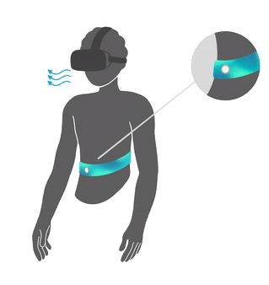
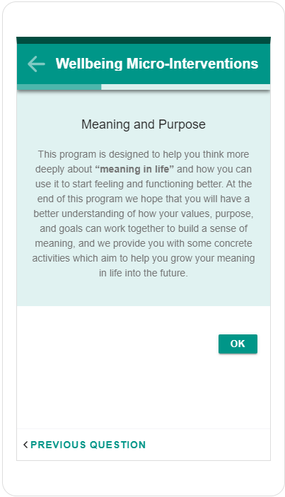
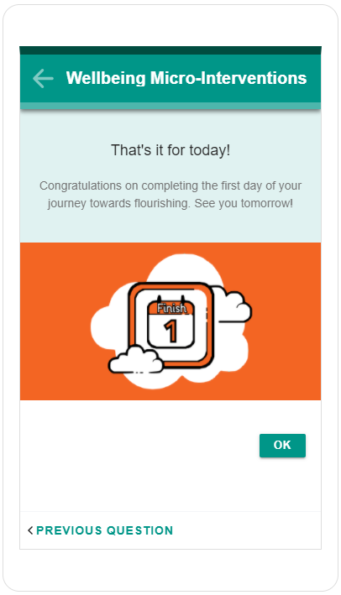
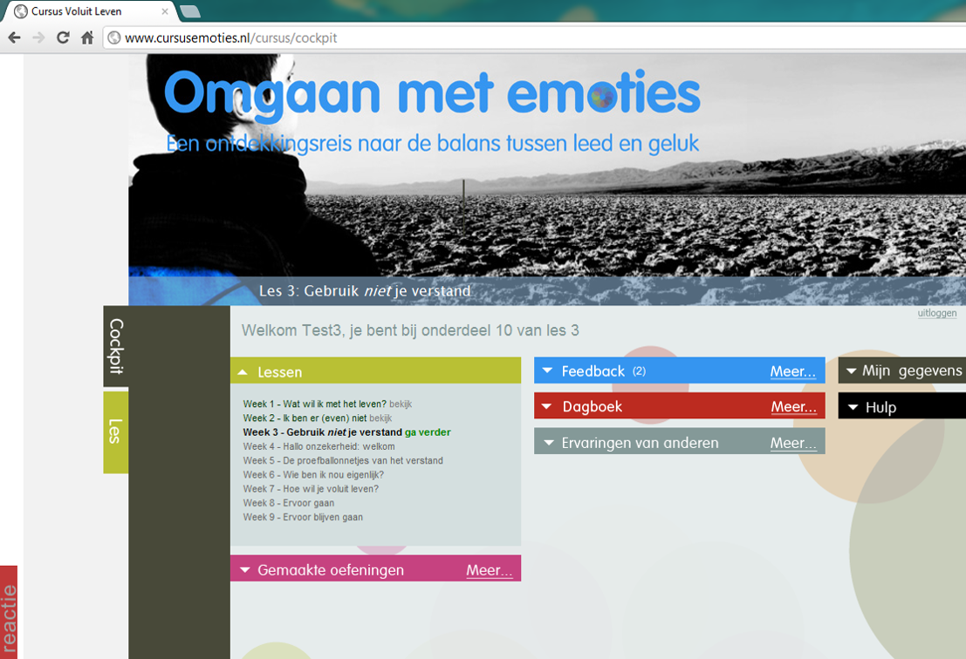
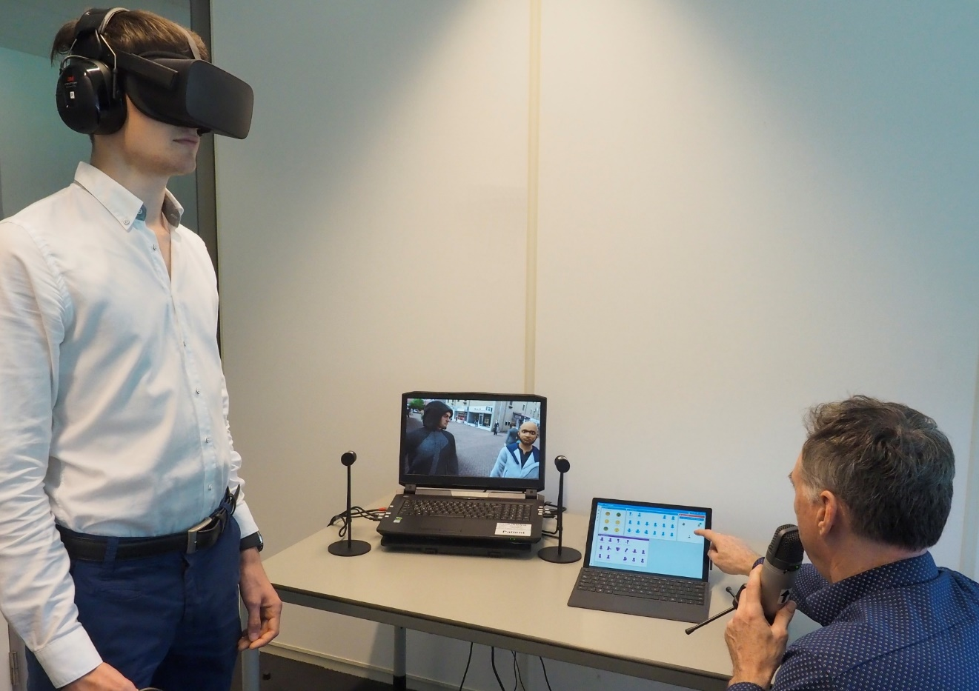
MANY DHIs THAT CAN BE EFFECTIVE
Notes:
These are examples of digital health interventions that we — together with many collaborators — developed and evaluated over the years.
As you may see, most are aimed at mental health. Depression, wellbeing, deep breathing, reducing agression.
And I think it is important to start with a positive observation: digital health interventions can work.
Across the field, we now have substantial evidence showing that DHIs can improve outcomes such as depression, anxiety, wellbeing, or behavior change: lifestyle, physical activity.
I'm sure you all have similar examples. And that you can name multiple meta-analyses that show these types of interventions can work.
So at least in my view, the field doesn't have to primarily ask any more: can digital interventions be effective at all?
We already know they can.”

Slide 4

PREDICTING WHAT WORKS IS HARD
Our intuitions are not always right
We often don’t know why
Notes:
“But at the same time, something interesting — and sometimes frustrating — happens when you look across interventions and studies.
Predicting beforehand which intervention will actually be effective, and for whom is still remarkably difficult.
Two interventions may both look convincing. They may both be theory-based, carefully designed, and use similar behavior change principles… and yet one shows clear effects while another shows little impact.
And often, when an intervention is effective, we still do not fully understand why.
Was it the therapeutic content?
The design?
The reminders?
The social support?
The timing?
Or simply that a particular subgroup of users engaged with it in a specific way?
So I think one of the key challenges for the next phase of the field is moving beyond asking only whether interventions work, toward understanding how, for whom, and through which mechanisms they work.”

Slide 5

FIRST, WE NEEDED TO ANSWER
Intervention → Outcome
Does it work?
  RCTs
  effectiveness trials
  meta-analyses
  average effects
Notes:
For many years, this was exactly the right question.
Could digital interventions:
- improve outcomes,
- support behavior change,
- expand access to care?
And answering that question required enormous innovation from many disciplines:
- psychology,
- behavioral science,
- HCI,
- design,
- computer science,
- engineering.
So this is not a critique of that work.
It was essential and enormously valuable.
But once we establish that interventions can work…
new questions emerge.

Slide 6

SUCCESS CREATED NEW CHALLENGES
works on average
hides variation
says little about mechanism
difficult to translate into better design
=> we don’t really learn anything
Notes:
There are at least four limitations of the current dominant approach
First, it gives us an average effect. But interventions do not work for averages.
They work — or do not work — for individual people.
Second, it hides variation.
Some people benefit a lot; Others disengage quickly
Some may need more support; Others less.
Third, it tells us very little about why change happened.
Was it the content? The reminders? The sense of accountability?
The therapeutic exercises? Or something else entirely?
And finally, it does not easily tell us how to make the next intervention better.
If we only know that the whole package worked, we still do not know which parts to optimize.
As digital health matured, we increasingly encountered new challenges.
Not: can interventions work?
But:
why do some people benefit more than others?
why do some disengage?
why do some features work in one context but not another?
how should support evolve over time?
In other words:
Success at demonstrating effectiveness created a new generation of scientific questions.

Slide 7

WE DO KNOW SOMETHING
Individual participant data meta-analyses show:
baseline severity sometimes matters
some users benefit more than others
… But less than we would like
many expected moderators are inconsistent
findings rarely translate into actionable personalization
Notes:
And to be fair — we have learned important things.
Individual participant data meta-analyses, for example, have helped us identify some patterns.
We know that:
baseline symptom severity can matter,
some individuals benefit more than others,
So this is not a story about complete ignorance.
But these insights are still relatively broad.
and some expected predictors are surprisingly inconsistent (gender, age)
They rarely tell us:
which components work best for whom,
what drives change,
when interventions should adapt,
or how to personalize support meaningfully over time.
In other words:
we have become better at identifying variation…
…but we still struggle to explain it.

Slide 8

A DIFFERENT KIND OF SCIENCE
Not just: Does it work?
But:
  Why?
  For whom?
  Under what conditions?
  What should happen next?
Notes:
So I want to suggest a shift.
A shift from outcome-focused questions alone to mechanism-focused questions.
Not replacing one with the other.
But expanding our scientific lens.
Because once we start asking these questions, everything changes:
what we measure
how we design studies and our interventions
how we analyze data
how we personalize interventions
And this is exactly where engagement becomes so interesting.

Slide 9
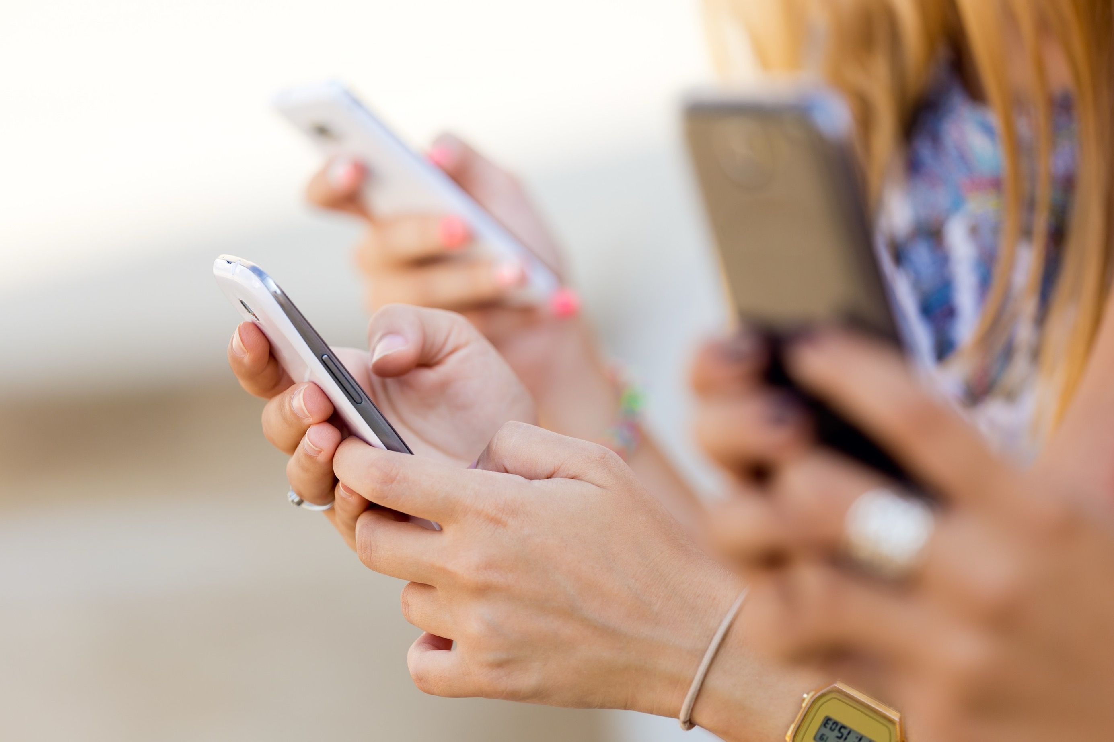
ENGAGEMENT AS AN EXAMPLE
From: Did they use it?
To: How does engagement drive change?
Notes:
Engagement is a perfect example of both this shift, and of what new insights can emerge when going through the shift.
For a long time, we asked very simple questions.
Did people log in?
How many modules did they complete?
How long did they stay?
And sometimes: is this related to outcomes?
But those are still versions of the same surface-level question.
When we start asking:
what kind of engagement matters, and why?
we move much closer to understanding mechanism.
And that, I would argue, is where the most exciting science in digital health now lies.

Slide 10

FIRST, WE FOCUSED ON ADHERENCE
‘Using an intervention as intended by the developers’
Notes:
In my early work, I focused on adherence.
At the time, this made complete sense.
Digital interventions had a major problem:
People stopped using them.
So the key question became:
How much do people use the intervention?
And how can we design interventions better to make sure people use them more.
And adherence became one of the dominant concepts in the field.

Slide 11

INFLUENCING ADHERENCE
Average adherence: 50%
Systematic review:
  more frequent updates
  more extensive employment of dialogue support
  more frequent intended usage
  RCT study as opposed to an observational study
  increased interaction with a counselor
Kelders, S. M., Kok, R. N., Ossebaard, H. C., & Van Gemert-Pijnen, J. E. (2012). Persuasive system design does matter: a systematic review of adherence to web-based interventions. Journal of medical Internet research, 14(6), e152.
Notes:
And importantly — this work was valuable. One of the studies I did during my PhD showed that:..
And it really showed that the intervention and technology mattered. This was quite new in the field. It was less multi-disciplinary then and people often assumed that it was just about the content. The tech was just the medium that deliverd the content, nothing more. But we showed that this wasn't the case.
We learned that:
support matters
reminders matter
persuasive technology matters
Some technologies clearly helped people continue using interventions.
This was an important step for the field.

Slide 12

E.g. Wildeboer, G., Kelders, S. M., & van Gemert-Pijnen, J. E. (2016). The relationship between persuasive technology principles, adherence and effect of web-based interventions for mental health: a meta-analysis. International journal of medical informatics, 96, 71-85.
MORE COMPLICATED
adherence ≠ effectiveness
technology ≠ always predictive
more use ≠ always better outcomes
Notes:
But gradually, cracks started to appear as I and others did more studies on adherence.
Because adherence was not consistently related to outcomes.
Some people improved with little use.
Others used the intervention extensively without improving much.
And some design features that seemed persuasive did not reliably predict outcomes. or adherence. And if they did, impact was limited.
So we started realizing:
usage alone was too narrow.
We were measuring behavior…
…but not necessarily meaningful engagement.
This is the first major conceptual shift. And it took quite long to realize this: first we tried to make 'adherence' better; not just more usage = better, but much more personalized types of usage. But this didn't solve the issues. We needed to think in other ways.

Slide 13
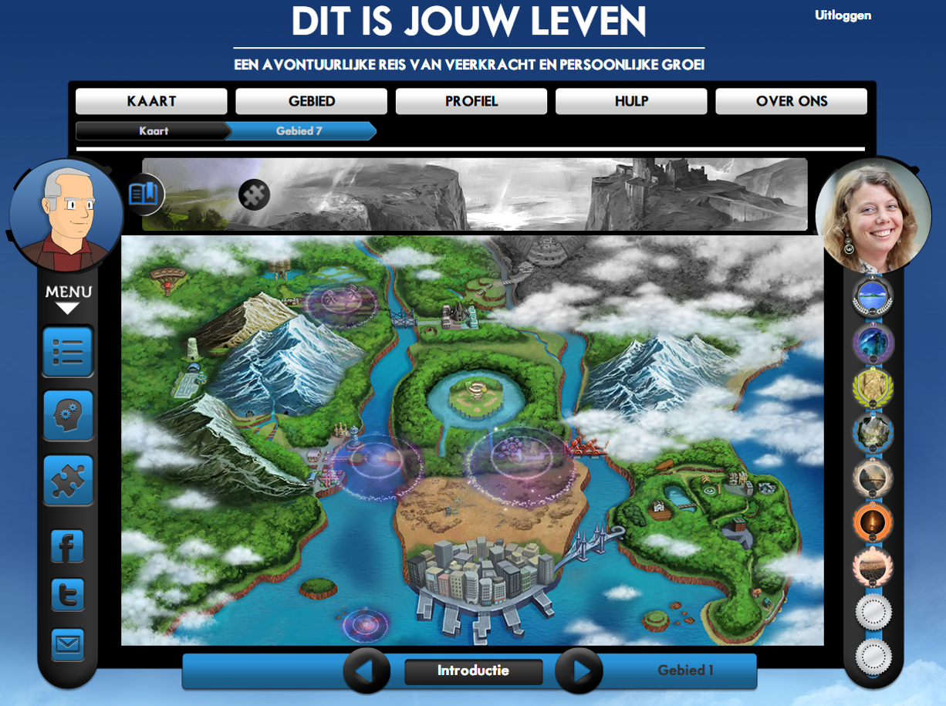

TECHNOLOGY CAN
Involvement => predictive for outcomes
Flow
Positive emotions
  Inspiration
  Interest
Kelders, S. M. (2015, June). Involvement as a working mechanism for persuasive technology. In International Conference on Persuasive Technology (pp. 3-14). Cham: Springer International Publishing.
Kelders, S. M., Sommers-Spijkerman, M., & Goldberg, J. (2018). Investigating the direct impact of a gamified versus nongamified well-being intervention: an exploratory experiment. Journal of medical Internet research, 20(7), e247.
|
3
Notes:
At the same time, in some other studies, I did find some very interesting things..

Slide 14

ENGAGEMENT INSTEAD?
Flow + Involvement + Positive affect = engagement?
Used differently in literature
Seen as important
Kelders, S. M., Van Zyl, L. E., & Ludden, G. D. (2020). The concept and components of engagement in different domains applied to eHealth: a systematic scoping review. Frontiers in psychology, 11, 926.
|
4
Notes:
Engagement looked like an important part of the answer.
Because engagement was broader than usage.
Not just:
how often someone logged in
But also:
attention
motivation
emotional involvement
relevance
effort
This felt much closer to what actually drives change. So this became the thing I focused on.

Slide 15
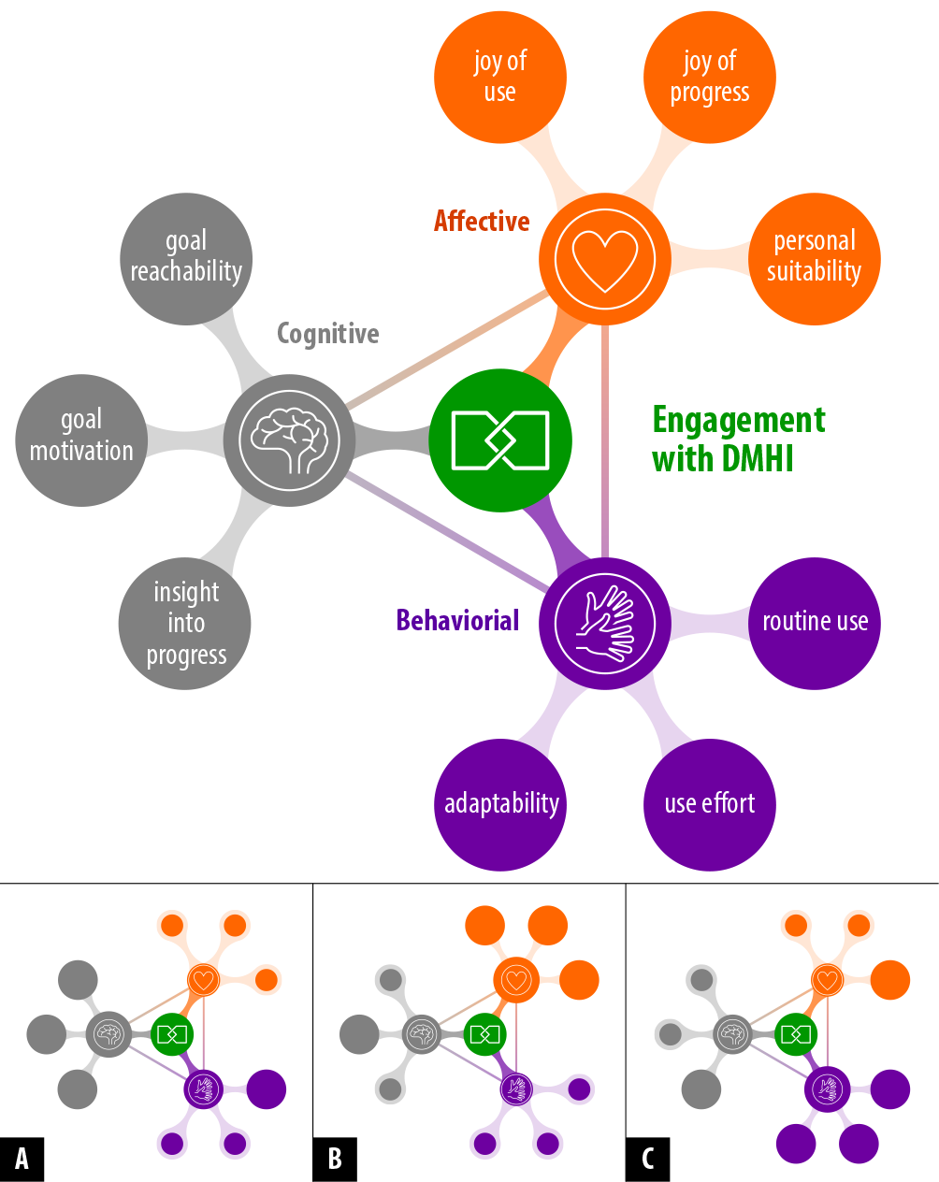
ENGAGEMENT DIMENSIONS
Behavioral
Cognitive
Affective
Kelders, S. M., Kip, H., Beerlage-de Jong, N., & Köhle, N. (2024). What does it mean to be engaged with digital health interventions? A qualitative study into the experiences of engaged users and the views of professionals. Digital Health, 10,
20552076241283530.
Notes:
Through reviews and interviews, we started identifying multiple dimensions of engagement.
And that these dimensions did not show up the same in different individuals
And this was exciting.
Because now we were no longer just counting clicks.
We were trying to understand experience.
This made engagement a more comprehensive construct— it felt like we were on track of understanding something related to a mechanism of change or impact.
but still one that captures only part of the broader change process.

Slide 16

MEASURING ENGAGEMENT
TWEETS-engagement scale
Sample Items
Thinking about using [the technology] the last week, I feel that:
[this technology] is part of my daily routine.
[this technology] motivates me to [reach my goal].
[this technology] fits me as a person.
Kelders, S. M., Kip, H., & Greeff, J. (2020). Psychometric evaluation of the TWente Engagement with Ehealth Technologies Scale (TWEETS): evaluation study. Journal of medical Internet research, 22(10), e17757.
|
Notes:
We even developed instruments to measure engagement more directly.
And importantly:
Engagement appeared to predict outcomes better than adherence alone, suggesting it captures something meaningful, though not necessarily the full story.
Also, we could measure engagement quite early in the process (after a few times of use), which makes predicting whether it works or not a lot more useful.
At this point, it really felt like we were getting closer to mechanism.
And in many ways, we were.

Slide 17



ENGAGEMENT FOR PERSONALISATION?
Different treatment options often similar in effectiveness
Is engagement a mediator for effectiveness and can we use it to personalize interventions?
|
Notes:
This gave us also more ways of using engagement in a more pragmatic way:
We know that: many different interventions and treatment options often show similar effectiveness for people on average, but large individual differences exist. At the moment, we have very limited insight in what content, design or feedback works best for whom.
Is engagement a pragmatic, data driven way around this lack of insights?
What if engagement mediates and predicts individual effectiveness of different digital health interventions? If engagement is an individual mediator for effectiveness, then potentially, we can also use this to personalize interventions by selecting the most engaging features for each individual.

Slide 18

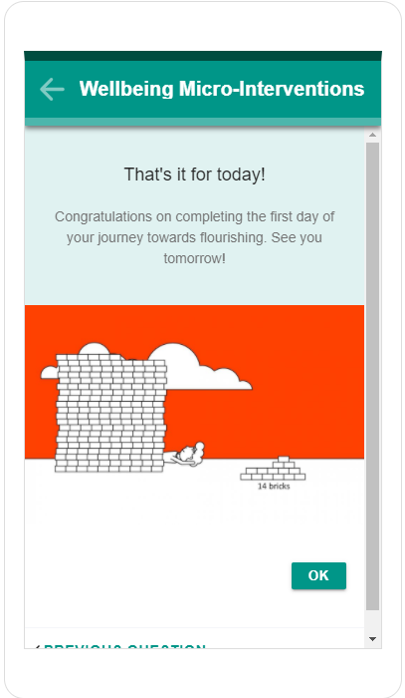
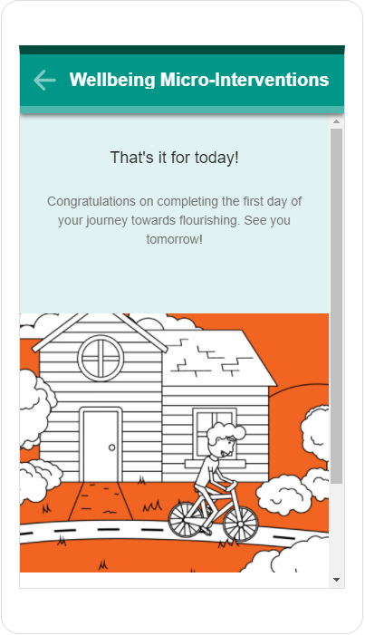
3 x 3 x 3 FACTORIAL DESIGN
Content: CBT vs Meaning vs PPI
Design: Non-gamified vs Storyline vs Competitive
Feedback: Text vs Avatar vs Video
|
Notes:
So the next logical step was:
If engagement is one of the processes related to outcomes…
Could we personalize interventions based on engagement?
This led to a large factorial experiment with 27 intervention versions:
different therapeutic content
different feedback styles
different design approaches
And we expected something relatively straightforward:
Different people would engage with different features.
And we could optimize interventions accordingly.

Slide 19
MORE COMPLICATED (AGAIN)
interventions equally effective on average
engagement predicted outcomes
no clear “best” design
personalization did not improve outcomes
Notes:
What we found was fascinating.
Engagement did predict outcomes, quite stable.
There was no universally engaging design. So different people did find different features more engaging. So far, so good.
But: personalization was much harder than expected.
Why?
Because engagement is dynamic.
Contextual.
Individual.
What works for one person may not work for another.
And what works for the same person may change over time.

Slide 20

ENGAGEMENT AS PROCESS
From optimizing engagement
To understanding engagement
Notes:
At this point, I realized we were still treating engagement as something to optimize.
But engagement itself was not the endpoint.
It was part of the mechanism.
At this point, engagement started to look less like the mechanism, and more like one of several possible pathways through which interventions might exert their effects.
So the question changed again:
not simply how to increase engagement…
but how engagement interacts with individuals, contexts, and intervention processes over time.
Instead, we needed to understand:
what engagement actually is
how it evolves
how it relates to mechanisms of change
how interventions should adapt over time

Slide 21
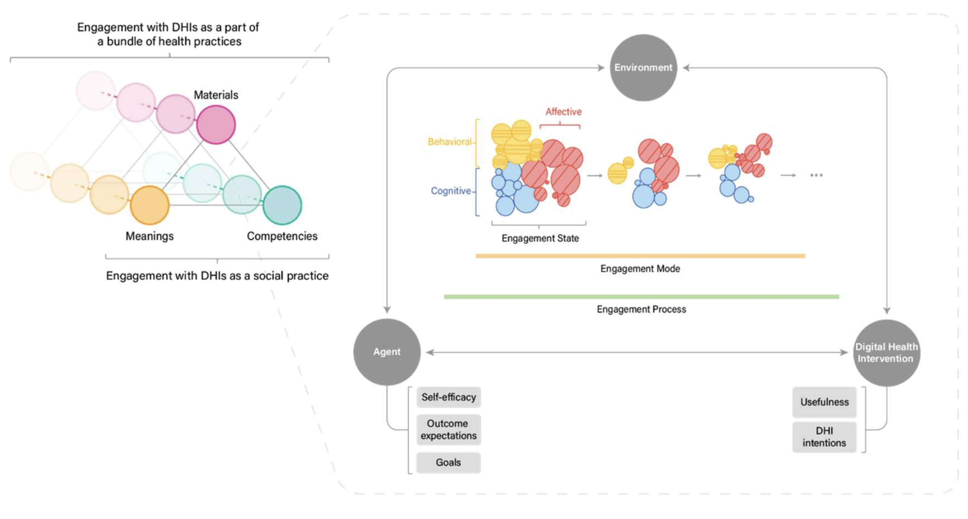
DEEP-DHI
Doğan, K., Ten Klooster, I., Kip, H., Amir Haeri, M., & Kelders, S. (2026). Towards an interdisciplinary theory of engagement: the Dynamic EngagEment Process framework for Digital Health Interventions (DEEP–DHI). Behaviour & Information Technology, 1-20.
Notes:
So we took a step back
This led to a more theoretical view of engagement.
Not as a static trait.
Not as a single score.
But as a dynamic process emerging from interactions between:
the individual
the technology
the context
goals
needs
experiences over time
This became the basis for the DEEP-DHI framework.
Now engagement becomes:
temporal
contextual
adaptive
mechanistic
Engagement is one dynamic process within a broader system of interacting mechanisms.

Slide 22
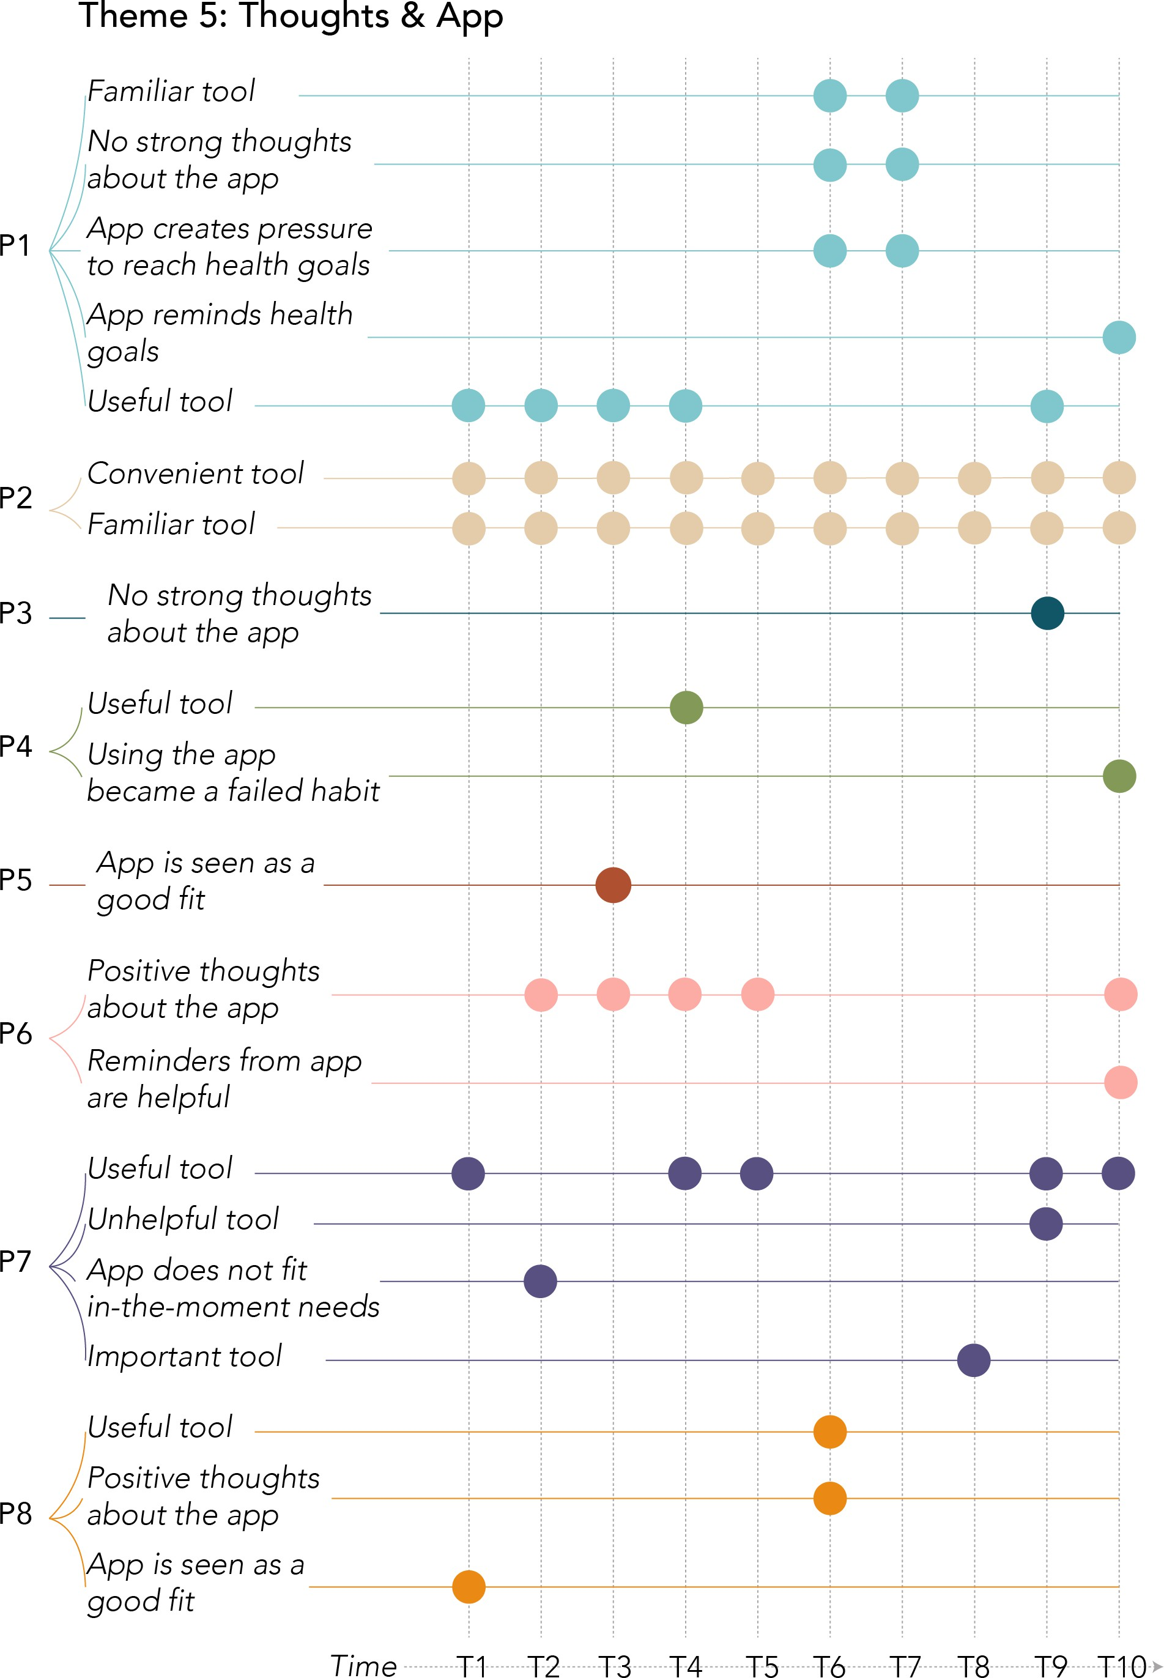
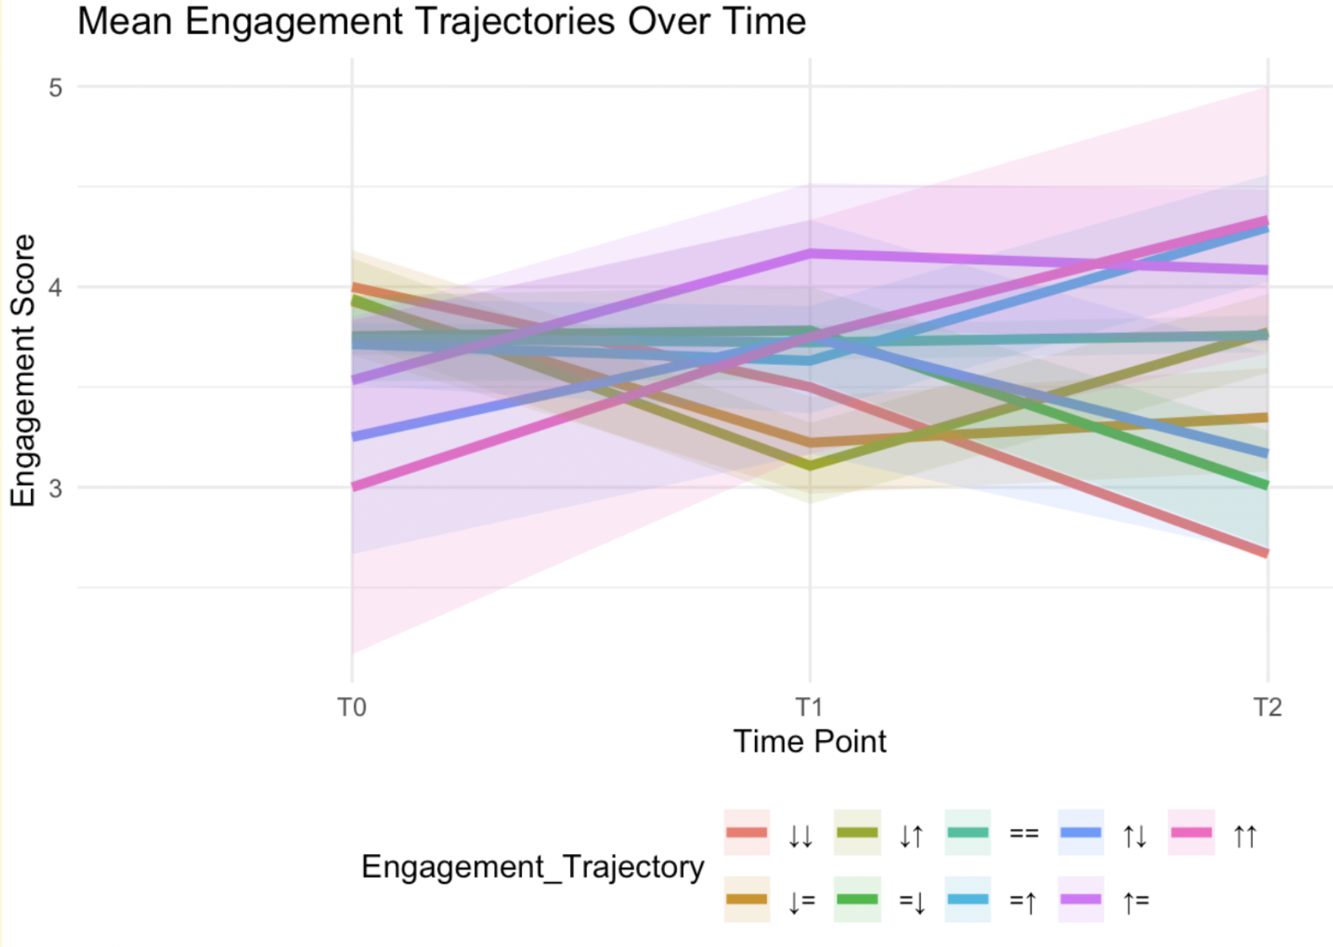
ENGAGEMENT IS NOT ONE PATH
Different people engage differently over time
Differently related to outcomes
Best pathway or individually optimized?
Notes:
And we increasingly see this empirically as well.
When we examine engagement longitudinally, people do not follow one ideal pathway.
Some sustain engagement over time.
Some disengage rapidly.
Some fluctuate.
Some re-engage later.
So if variability is fundamental…
then designing one fixed “optimal journey” may simply not reflect reality.
This pushes us naturally toward adaptive systems.
Click shows EMA study Kerem

Slide 23
METHODS MIRROR QUESTIONS
Traditional paradigm
Does it work?
Evaluate packages
Average effects
Static interventions
One final RCT
Emerging paradigm
Why/how does it work?
Understand components
Individual dynamics
Adaptive interventions
Iterative optimization
Notes:
This also has implications for how we study digital health interventions
I started with that we need to ask additional questions. That also means we need additional methods.
Our methods are not neutral.
They reflect the kinds of questions we prioritize.
Traditional RCTs are extremely valuable for answering:
does an intervention improve outcomes?
But they are less suited for questions about:
mechanisms,
timing,
adaptation,
and individual variability.
And once we start asking different questions…
we also need different methodological approaches.

Slide 24
METHODS MIRROR QUESTIONS
Question
Does it work?
Which components matter?
What works for whom and under what conditions?
When should support adapt?
How does engagement evolve?
What are the different mechanisms (including engagement, but also others)?
Useful approaches
RCTs, meta-analyses
MOST, factorial trials
realist evaluation
SMARTs, micro-randomized trials
longitudinal modeling
mediation models, process mining, EMA, intensive longitudinal methods
Notes:
What I find exciting in digital health right now is the increasing diversity of methods emerging around different kinds of questions.
We have so many methods, as we are an interdisciplinary field. If you talk to different people here at the conference, I'm sure you'll find out about new methods that you could use that could help answer different questions.
But we need to be conscious about our methods: using methods because they are useful for answering our questions, not because we are used to these methods.
For example:
If we want to understand:
which intervention components matter,
approaches like MOST and factorial experiments become useful.
If we want to understand:
what works for whom and under what conditions,
realist evaluation offers a very different lens.
If we care about:
timing and adaptation,
we move toward SMART designs and micro-randomized trials.
And if engagement is dynamic rather than static…
then longitudinal approaches become essential.
So the methodological landscape becomes much richer once we move beyond only asking:
“does it work?”

Slide 25
DESIGN FOR VARIATION
Instead of for averages
Question: Which features engage which people?
Approach: 27 intervention versions
Key insight: no universally optimal design
|
Notes:
For example, in one of our studies we moved away from asking:
“Which intervention works best?”
Instead, we asked:
“Which features engage different people?”
That required a very different study design.
We created 27 different intervention versions varying in:
therapeutic content,
feedback,
and design features.
And interestingly, we did not find one universally superior version.
Different people appeared to respond differently to different features.
Which reinforced the idea that variability is not noise…
but a fundamental part of digital intervention use.

Slide 26

DESIGN FOR VARIATION
Instead of for optimization
Traditional design:
  one ideal pathway
  one optimized experience
Adaptive design:
  multiple pathways
  diverse engagement styles
  adaptive experiences
Notes:
And I think this also changes how we approach co-creation and design.
Traditionally, co-design often aims for consensus:
what works best for this group of users users?
But perhaps we increasingly need to design for diversity instead.
Different people may need:
different motivational strategies,
different kinds of support,
different levels of autonomy,
different forms of feedback,
at different moments in time.
So instead of reducing variation during design…
we may need to intentionally build variation into interventions.
And design may need to focus on what are the types of variations we need to put into our interventions? What do we need to vary on?
That is a very different design philosophy.

Slide 27
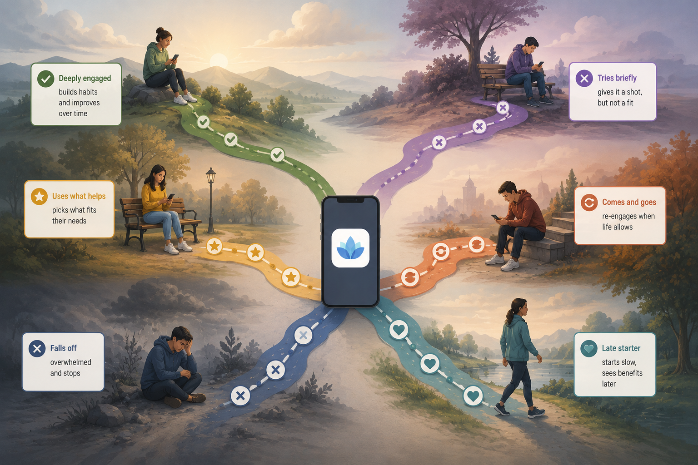
DIFFERENT PEOPLE
DIFFERENT TRAJECTORIES
Notes:
We saw this for example when looking at engagement in a longitidinal way.
When we started looking longitudinally, another important insight emerged.
People do not engage in the same way.
Some sustain engagement.
Some disengage quickly.
Some fluctuate.
Some re-engage later.
These trajectories matter.
We don’t know yet how exactly: we don't know yet if there is one way that is better for all, but it seems less likely all the time.
And then we need to figure out how to help all of these different people. And if sometimes helping them might mean saying: this is not for you, try something else (another DHI, or f2f, or something altogether different).

Slide 28

TOWARD ADAPTIVE INTERVENTIONS
engagement-informed adaptation
  other mechanisms as well?
just-in-time support
personalization over time
adaptive intervention design
Notes:
And they suggest that static interventions may fundamentally mismatch how people actually engage with digital health technologies.
And this changes the research agenda again.
The question is no longer: “Which intervention works best?”
Or even: “Which feature increases engagement?”
But:“What support should this person receive at this moment?”
This is where adaptive interventions become so important.
And where methods like: MOST, SMART trials, micro-randomized trials become essential.
But also, where we need to re-evaluate if these methods are the right ones.
If we want to go here, we would also need systems that:
monitor engagement over time,
recognize changing needs,
personalize support dynamically,
and learn which strategies work for whom.
But this also comes with ethical dilemma;s: is this what we want? How to make sure we don't 'enforce' the type of engagement we want?

Slide 29
ACTIONABLE ENGAGEMENT
Not (just) an outcome, but a:
mechanism
signal
decision point
Notes:
And this also changes how we think about engagement itself.
Engagement is no longer merely something we try to maximize.
It becomes information.
A signal.
Something that can help determine:
what support is needed,
when intervention strategies should change,
and how digital systems can respond intelligently.
In some of our more recent work, we are increasingly exploring how engagement signals might inform adaptive support dynamically.
So engagement becomes part of the intervention logic itself.

Slide 30

THE NEXT CHALLENGE
Not proving DHIs can work, but learning
  why they work
  for whom
  under what conditions
  and how to make them work better over time
Notes:
I think our field has already shown that digital health interventions can work.
That is important.
But the next generation of science is different.
The challenge now is understanding:
mechanisms,
dynamics,
individual variability,
and adaptation.
And that requires us to ask better questions.
Because once we change the questions…
we also change the science.
[pause]
Thank you.

Slide 31


THANK YOU
Saskia Kelders
S.m.Kelders@utwente.nl
|

