Slide 1


Trust in Chatbots: Implications for the Inclusive Design for the Elderly Users
Effie Lai-Chong Law

Slide 2
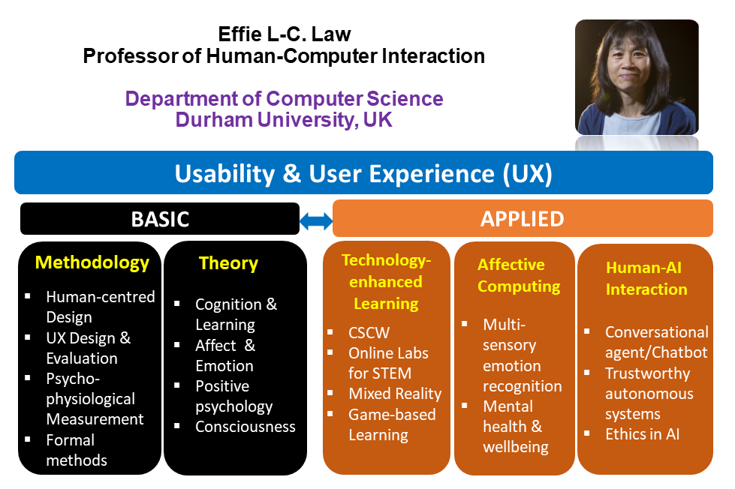

Slide 3

Durham University, UK
University
Top 10 in the UK
Top 100 worldwide
Department
5 research groups
AI and Human Systems (AIHS)
Department of Computer Science
Historic city: Durham Cathedral and Castle

Slide 4
Overview
Chatbots for Customer Services
Factors for Trust in Chatbots
  Conversational performance
  Humanlikeness
  Prior experience
  Gender
  Age
Impact of Online Banking on Older Adults
Implications for the Design of Chatbots for Older Adults

Slide 5







Effects of Humanlikeness and Conversational Breakdown on Trust in Chatbots for Customer Service
Effie Lai-Chong Law, Durham University, UK
Asbjørn Følstad, SINTEF, Norway
Nena van As, boost.ai, Norway

Slide 6
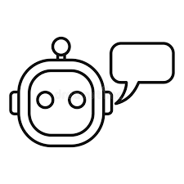
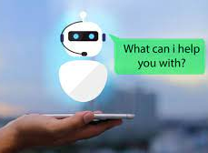

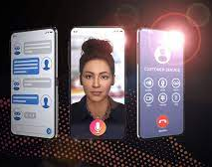
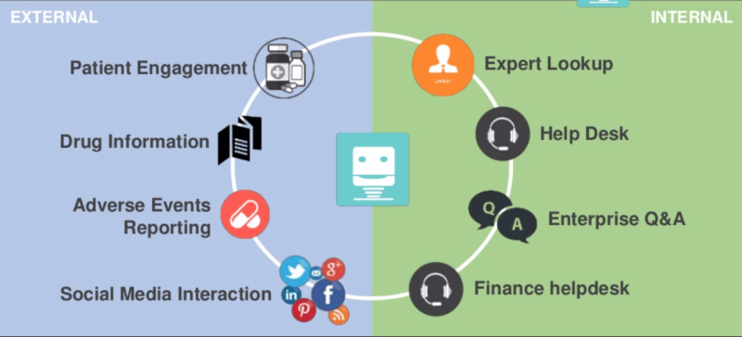
Motivation
What are Customer Service Chatbots?
Chatbots are AI-powered software agents that interact with users through natural language and may, hence, be seen as a supplement to chat-based service offered by human support personnel.
What are Applications?
Retail and e-commerce
Travel and hospitality
Banking, finance, and fintech
Healthcare
Media and entertainment
Education
…
https://research.aimultiple.com/business-chatbot/

Slide 7
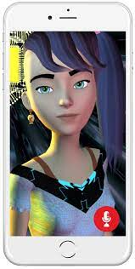
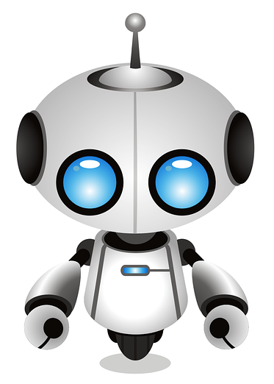

Revising User Model → Calibrating Trustworthiness
Intermediate Feedback
“How satisfied are you with me, so far?”
Chatbot
Sub-system
Chatbot as
Interactive Tool
Human
in the Loop
Interaction & Curation
“It is ok. But how about this?”
Revising Mental Model → Calibrating Trust
Adapted from https://hai.stanford.edu/blog/humans-loop-design-interactive-ai-systems
Notes:
#5: This diagram illustrates a feedback loop between a robot and a human user. The robot wants to know if the user is satisfied with its performance. The user, based on her interaction experience, will curate a response. This ongoing process can validate and update user model and mental model, improving trustworthiness of the robot and the user’s trust in it.

Slide 8
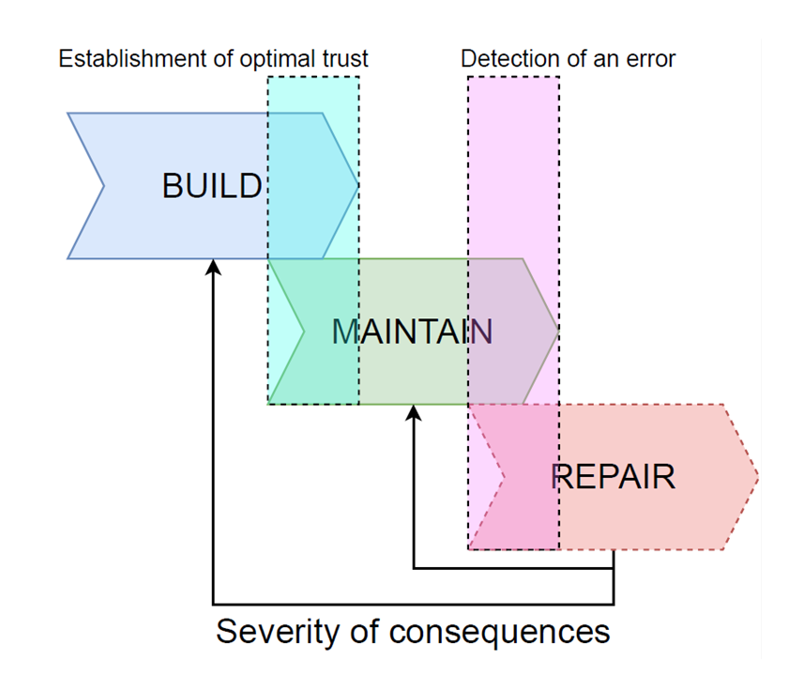
What is Trust?
Trust: the willingness of a trustor to accept vulnerability (risk) based on positive expectations of the intentions or behaviour of the other (Rousseau et al., 1998)
Trust depends on user perceptions of system functionality (competence), helpfulness (benevolence), and reliability (integrity) (Mcknight et al., 2011)
Trust is hard earned and easily lost.
Source: Dagstuhl Seminar Trust-CA 21381

Slide 9

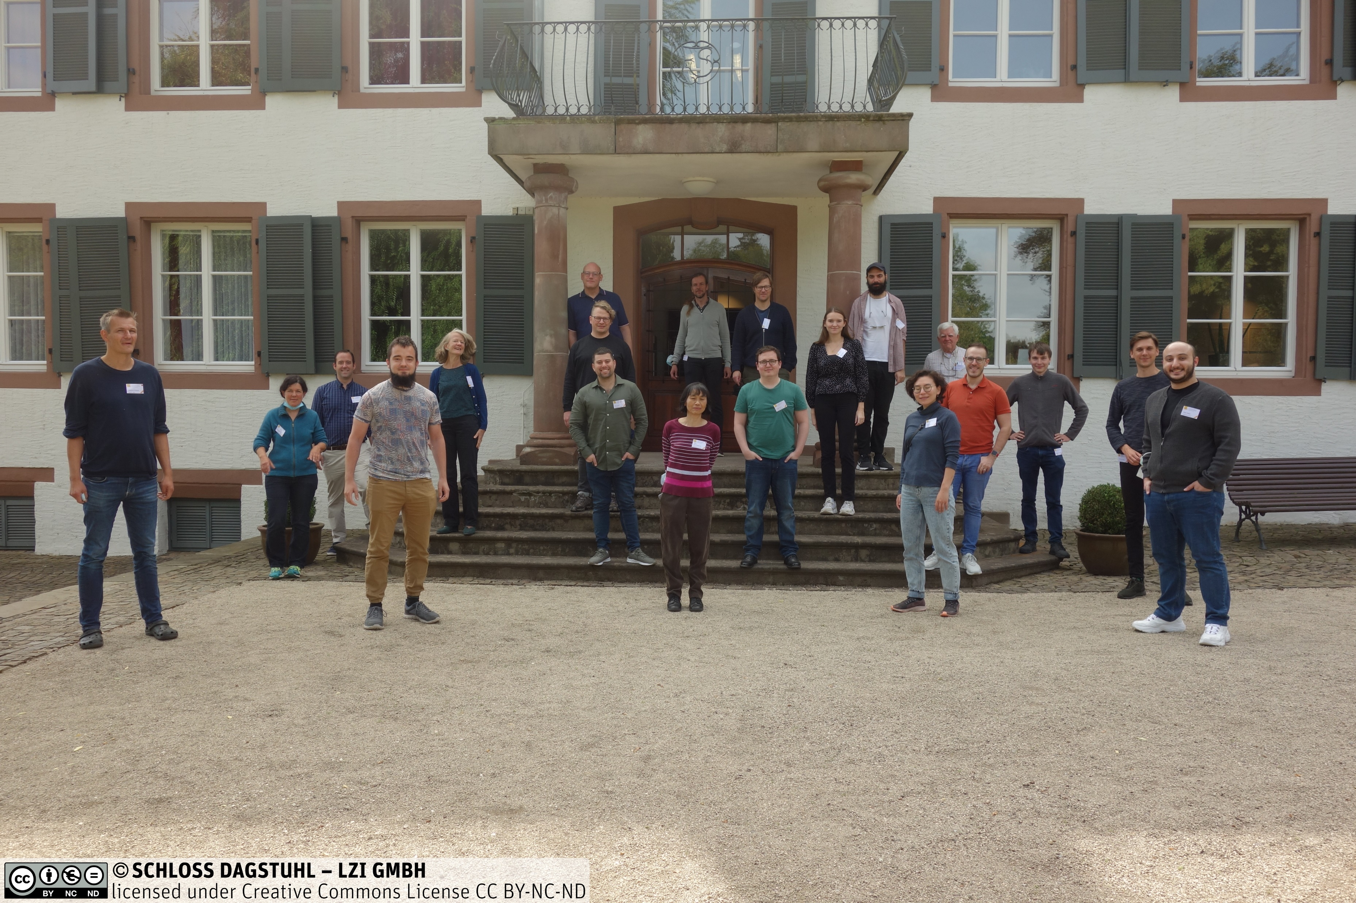
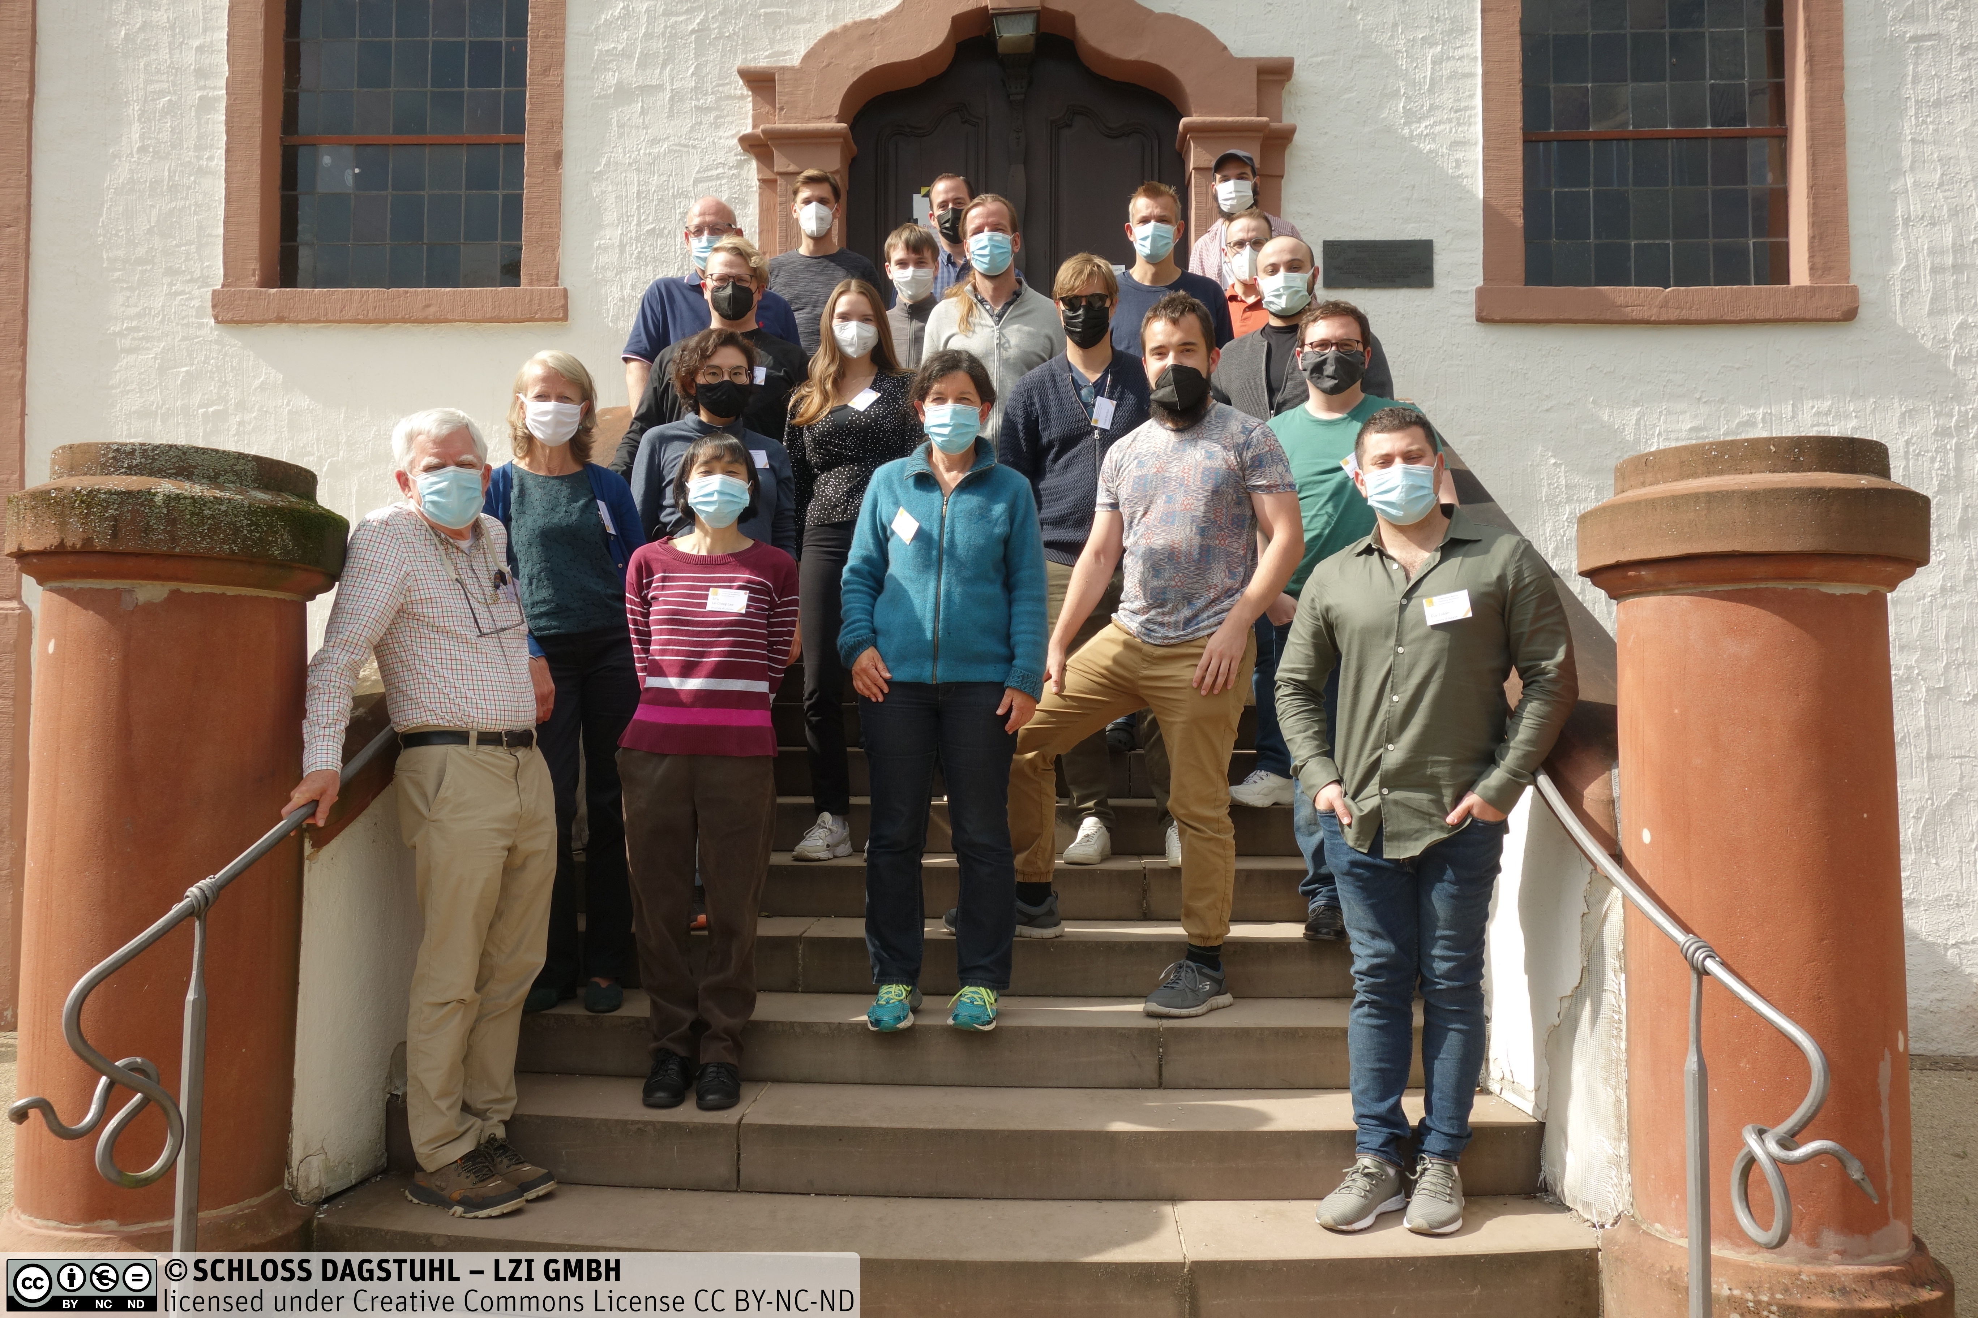
Trust-CA: Dagstuhl Seminar 21381
Conversational Agent as Trustworthy Autonomous System (Sep 19 –24, 2021)

Slide 10
Research Questions
Are chatbots’ humanlike features as important for trust as their ability to reliably provide support?
  Design: conversational style, visual representation, informal language, features hinting at chatbot intelligence (Go & Sundar, 2019)
  Impact: hedonic user experience, brand perception, user sentiment, user compliance, transaction conversion, and intention to use.
Is trust dominated by the chatbot’s conversational performance rather than their humanlikeness?
  The chatbot’s ability to provide relevant and helpful responses to users’ requests.
  Chatbot productivity, efficiency and effectiveness → Chatbot user engagement (Brandtzaeg and Følstad, 2017)
Does chatbot humanlikeness strengthen in the face of performance issues? trust resilience
  Trust resilience: upkeep of trust in spite of undesirable system outcomes (De Visser et al., 2016)

Slide 11
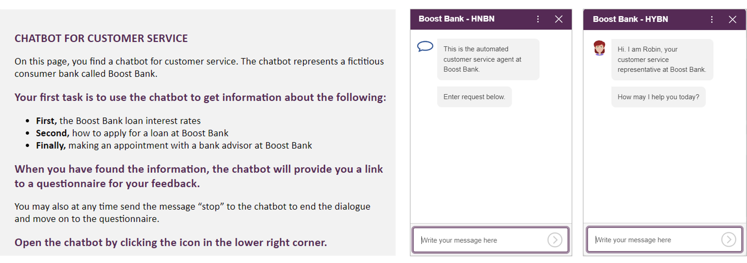

Method
2 x 3 factorial experimental design with two Independent Variables (IVs):
Humanlikeness (low vs. high)
Conversational performance (No breakdown, Breakdown with Repair, Breakdown without Repair)

Slide 12
Measures
Variable (nr. items) | Example item (7-point Likert scale) | Source
Trust General (3) | When in need of customer service, I feel I can depend on the chatbot | Lankton et al. (2015)
Task-specific Trust (3) TT1, TT2, TT3 | Considering the chatbot's answer on [Task 1/2/3], I feel I can depend on it. I can rely on the support provided by the chatbot on [Task 1/2/3]. I feel I can count on the chatbot for questions on [Task 1/2/3] | Home-grown
Trust Belief Reliability (3) | The chatbot is a very reliable solution | Lankton et al. (2015)
Social Presence (4) | I felt like I was engaged in an active dialogue with the chatbot | Laban & Araujo (2019)
Perceived Anthropomorphism (3) | Machine like vs. Human-like (semantic differential) | Araujo (2021)
Prior Chatbot Experience | Prior Use Preference (3) : I frequently use chatbots for customer service Prior Satisfaction (3): I usually find chatbots for customer service pleasant to use Prior Use Frequency (1) | Home-grown
Demographic | Gender; Age; Country of residence; Education | Home-grown

Slide 13
Hypotheses
General trust (GT) is the same across the six conditions.
Task specific trust (TT) is the same…
  For each task between conditions
  For each task within conditions
 | No Breakdown (n=77) | Breakdown with Repair (n=85) | Breakdown without Repair (n =89)
Humanlike (n=121) | Group 1 (n =39) | Group 2 (n =40) | Group 3 (n =42)
Non-humanlike (n=130) | Group 4 (n =38) | Group 5 (n =45) | Group 6 (n =47)
Notes:
For the sake of Time I will focus on general and task-specific trust, do check out the paper to see more results on the other measurements as well.

Slide 14
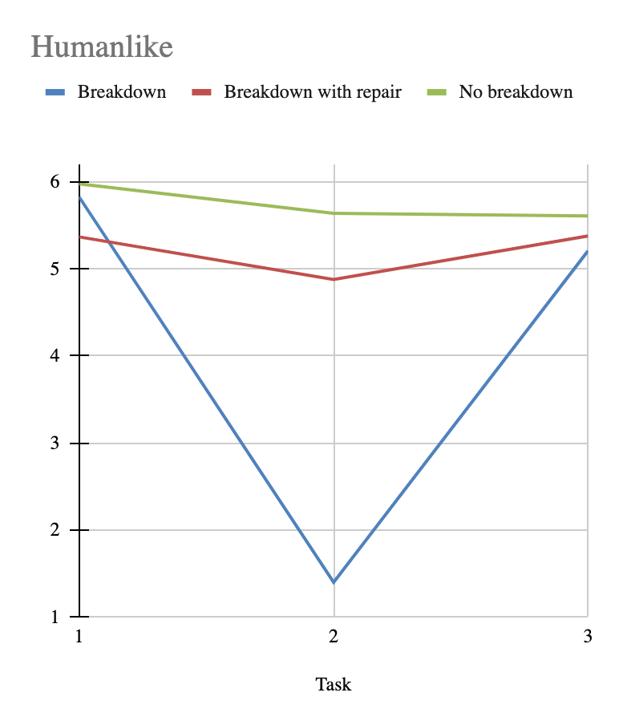
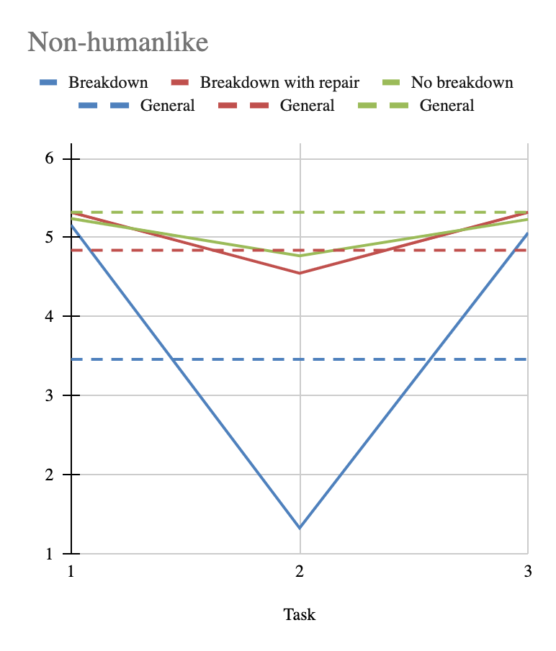
Results
Breakdown severely impacts task-specific trust.
Similar trend for general trust.
Humanlike and non-humanlike conditions seem similar, especially in the breakdown conditions.

Slide 15
Analysis
Both Humanlikeness and Conversational Performance have an effect on General Trust (GT) and Task-specific Trust (TT)
For Task-specific Trust:
  Humanlikeness only had effect on TT1.
  Conversational performance only had effect on TT2.
  TT3 not affected.
 |  | GT | TT1 | TT2 | TT3
Humanlikeness | F(1,245) p η | 4.617 0.033 0.18 | 8.802 0.003 0.035 | 2.902 0.096 0.025 | 1.149 0.285 0.015
Conversational performance | F(1,245) p η | 36.98 <0.001 0.23 | 0.87 0.422 0.007 | 210.91 <0.001 0.21 | 0.840 0.433 0.007
Interaction Effect | F(1,245) p η | 0.437 0.647 0.004 | 1.740 0.178 0.014 | 1.904 0.151 0.015 | 0.247 0.781 0.002
Notes:
Lots of data, but several things to take away from this table.
First, the two main obvious things to notice about the table: (point 1 and 2)

Slide 16
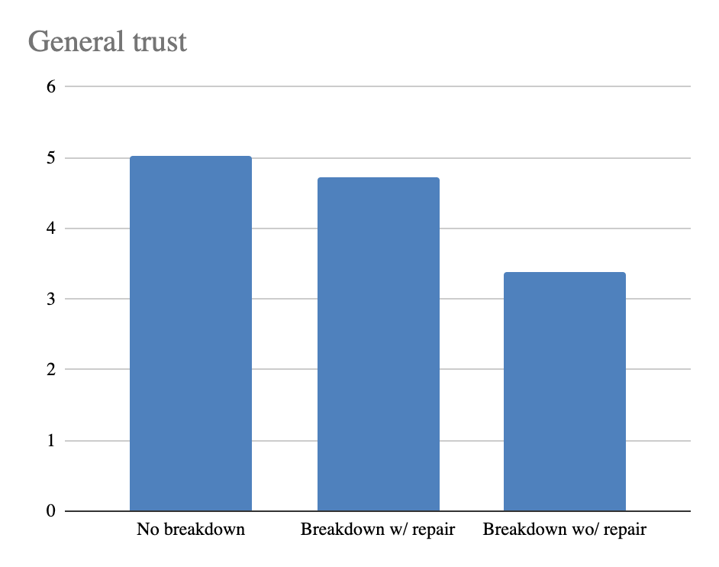
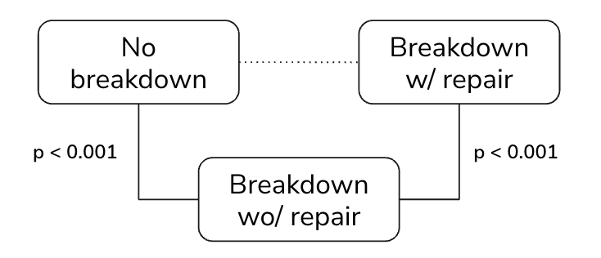
Conversational Performance on General Trust
Notes:
So visualising this a bit differently… Note that the difference between no breakdown and

Slide 17
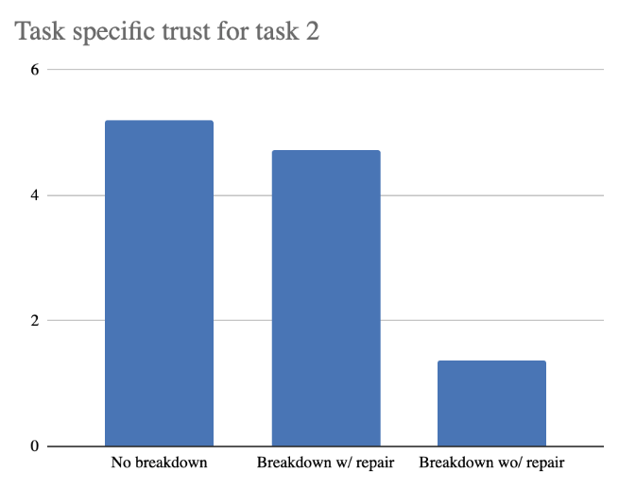
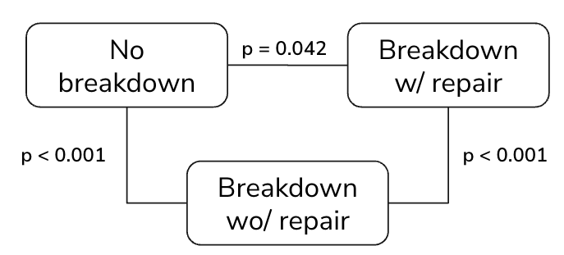
Conversational Performance on Task-Specific Trust (Task 2)

Slide 18
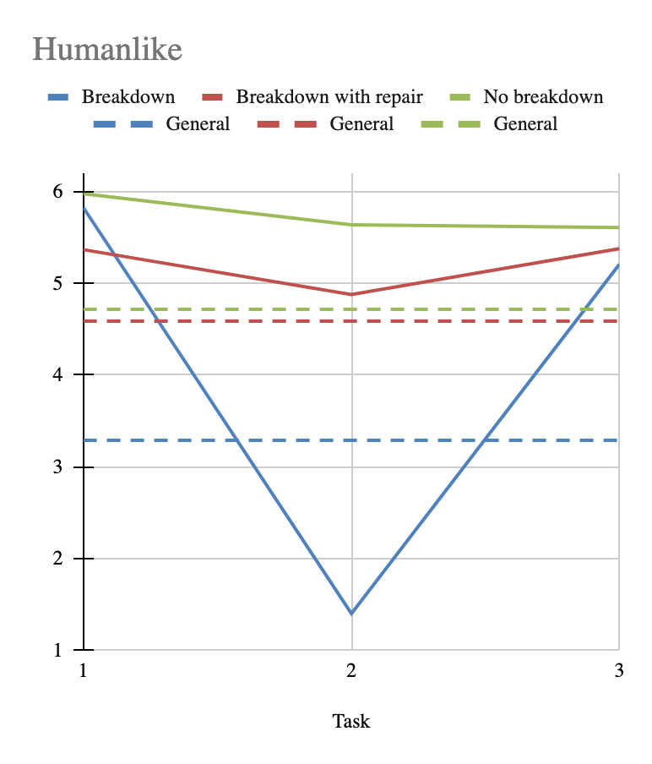
Discussion
Does chatbot humanlikeness strengthen trust resilience in the face of performance issues?
No!
Humanlikeness and Conversational Performance exerted their effect independently of each other.
Recovery of trust from Task 2 to Task 3 is NOT stronger for the humanlike condition.
Notes:
the difference between TT2 and TT3 for the humanlike condition did not differ significantly from the non-humanlike condition.

Slide 19
Discussion
Is trust dominated by the chatbot’s conversational performance rather than their humanlikeness?
 |  | GT | TT1 | TT2 | TT3
Humanlikeness | η | 0.18 | 0.035
Conversational performance | η | 0.23 |  | 0.21
Level 1 : 2 | t(160) p |  |  | 2.12 0.042
Level 2 : 3 | t(172) p | 6.85 <0.001 |  | 17.81 <0.001
Level 1 : 3 | t(164) p | 7.71 <0.001 |  | 19.22 <0.001
Yes!
Humanlikeness only impacted Task-specific Trust upon first encounter. After experience, no longer significant.

Slide 20

Practical Importance of Repair
Strength of repair:
as if no breakdown occurred at all!
Trust resilience
Prioritisation:
  Anticipate on failure
  Design for repair
    with/without apology
    type of apology
Notes:
Difference between no-breakdown and breakdown with repair is not significant.
Does not mean the difference does not exist, but smaller effect size than what we were able to measure.

Slide 21
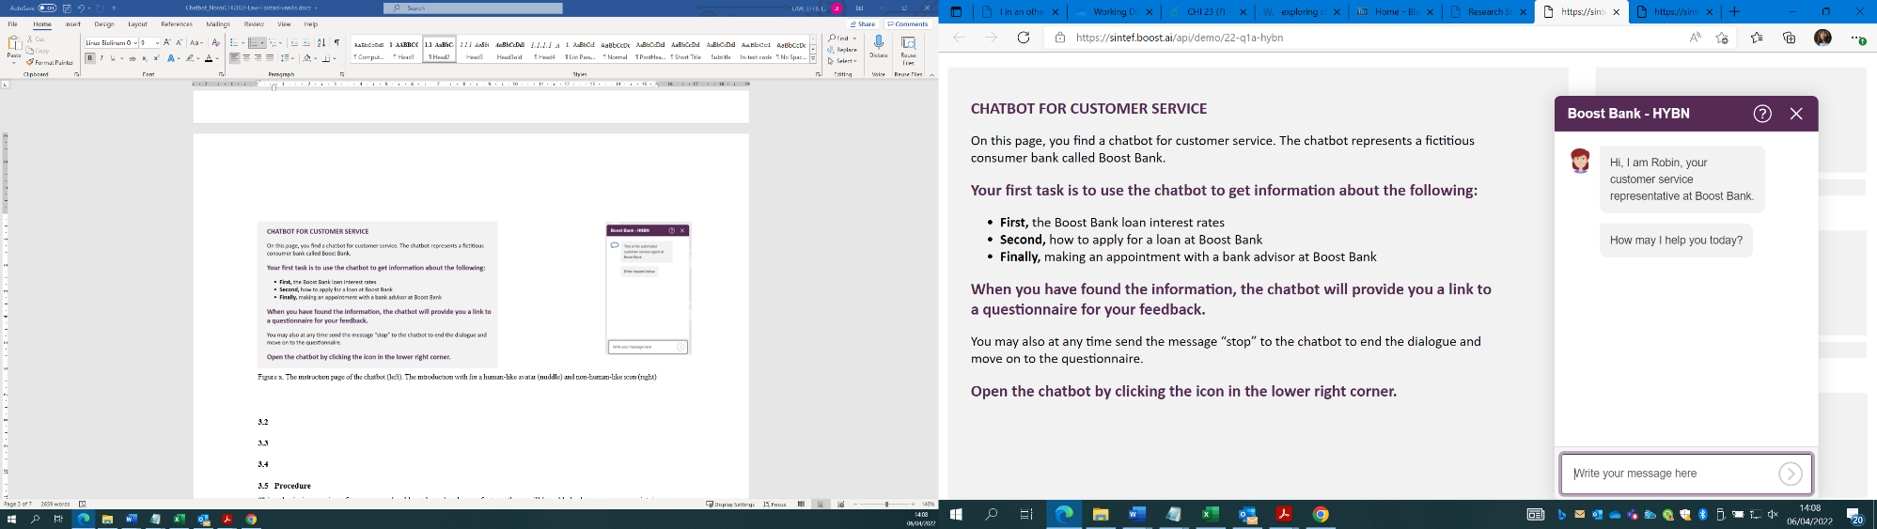
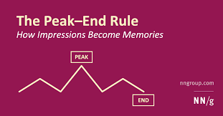
Limitations & Implications
Humanlikeness
  Appearance: Modality, Embodiment, Realism
  Humanlike chatbot conversations (Jain et al. 2017)
    Clarify the chatbot capabilities (disclosure)
    Sustain the context of the talks (context-awareness)
    Acknowledge dialog failures (with/without apology)
    End the conversations with grace (Peak-End effect)
Task criticality
  Perceived relevance and riskiness
  Order effect

Slide 22

Effects of Prior Experience, Gender, and Age on Trust in a Banking Chatbot with(out) Breakdown and Repair
INTERACT
2023
Effie Lai-Chong Law, Durham University, UK
Nena van As, boost.ai, Norway
Asbjørn Følstad, SINTEF, Norway

Slide 23
Research Question
What is the respective effect of
prior experience
gender
age
on the perceived trust and interaction qualities of the chatbots characterised by humanlikeness and conversational performance?

Slide 24
Prior Experience on Trust
Impressions formed in previous interactions with humans/ products/ services can shape people’s attitudes and behaviours in subsequent encounters with entities having some similar traits: Cognitive Bias
Halo Effect
- Good impression
- Positive transfer
- More trust and better value
Horn effect
- Bad impression
- Negative transfer
- Less trust and lower value
Beauty and Usability in HCI
Marc Hassenzahl (2004)
Marketing research
Marie-Sophie Schönitz (2019)

Slide 25

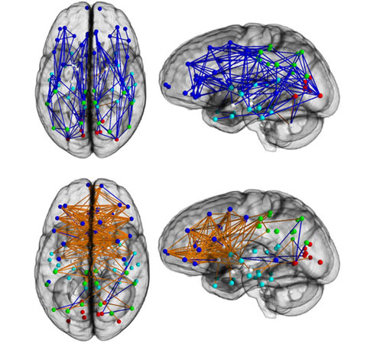
Gender Effect on Trust
Men tend to trust interaction objects (human, non-human) more than women (Buchan et al., 2008; Wu et al., 2020)
Women more sensitive to social risk while trusting (Wu et al., 2020)
Gender differences in predisposition to trust (Rachid, 2020) and trust dynamics (Haselhuhn et al 2015)
  following a trust violation, women less likely to lose trust and more likely to restore trust in a transgressor than men
Gender of chatbot avatars
  female avatar more likely forgiven for error (Toader et al 2019
  online shopping: no gender effect (Kasilingam 2020)
  Student support chatbot: no gender effect (Pesonen 2021)
The Neurobiology of Trust. Scientific American (2008)
https://blog.culturaldetective.com/2013/12/17/new-brain-study-illustrates-gender-differences/

Slide 26




Age Effect on Trust
Chatbot usefulness
Chatbot enjoyment
Use chatbot to avoid human contact
Effort invested in using chatbot
Appreciate chatbot with human touch (Goot & Pilgrim 2019)

Slide 27
Method
Between-subject experimental studies with six conditions
A set of measures on trust and demographic variables
 | No Breakdown (n=77) | Breakdown with Repair (n=85) | Breakdown without Repair (n =89)
Humanlike (n=121) | Group 1 (n =39) | Group 2 (n =40) | Group 3 (n =42)
Non-humanlike (n=130) | Group 4 (n =38) | Group 5 (n =45) | Group 6 (n =47)
Variable (nr. items) | Example item (7-point Likert scale) | Source
Trust General (3) | When in need of customer service, I feel I can depend on the chatbot | Lankton et al. (2015)
Task-specific Trust (3) TT1, TT2, TT3 | Considering the chatbot's answer on [Task 1/2/3], I feel I can depend on it. I can rely on the support provided by the chatbot on [Task 1/2/3]. I feel I can count on the chatbot for questions on [Task 1/2/3] | Home-grown
Demographic | Gender; Age; Country of residence; Education | Home-grown

Slide 28
Demographic variables
Prior Chatbot Experience | Prior Use Preference (PF) PF1: I frequently use chatbots for customer service PF2: I use chatbots for customer service when this is provided as a service alternative PF3: I have used chatbots for customer service for a long time Prior Chatbot Satisfaction (SAT) SAT1: Chatbots for customer service typically provide good help SAT2: In general, chatbots for customer service are an efficient way to get support SAT3: I usually find chatbots for customer service pleasant to use. Prior Use Frequency (FQ) Five options: More than 10 times 5-10 times 3-4 times 1-2 times Never
Demographic | Gender (female, male, prefer not to say) Age (free text) Country of residence (free text) Education (three options)
Prior Use Preference
  when choices available, chatbot is preferred
Prior Chatbot Satisfaction
  perceived efficiency, effectiveness and pleasure of using the chatbot for the service
7-point Likert Scale
(1: Strongly Disagreed,
7 Strongly Agreed)

Slide 29
Results: Prior Use Preference
3*2*3 ANOVAs ([Prior variables]*Humanlikeness*Conversational Performance)
General Trust: F_{(2,233)} = 21.920, p <.001, ƞ²=.158
Significant

Slide 30
Results: Prior Use Frequency
3*2*3 ANOVAs ([Prior variables]*Humanlikeness*Conversational Performance)
General Trust: F_{(2,233)} = 1.917, p =.149, ƞ²=.016
Non-significant

Slide 31
Results: Prior Chatbot Satisfaction
3*2*3 ANOVAs ([Prior variables]*Humanlikeness*Conversational Performance)
General Trust: F_{(2,233)} = 65.456, p <.001, ƞ² =.360
Significant

Slide 32
Correlations among Prior Variables
People preferred using chatbots for customer service tended to be satisfied with them.
For Female and Older users, the more they used them, the more unsatisfied they were with them.

Slide 33
Results: Gender
2*2*3 ANOVA (Gender * Humanlikeness * Conversational Performance)
General trust: No significant difference between female and male
Trust Resilience: No significant changes in Diff(TT1-TT2) or Diff (TT2-TT3) for male and female, both trust resilient.

Slide 34
Results: Age & General Trust
3*2*3 ANOVAs (Age*Humanlikeness*Conversational Performance)
General Trust: F_{(2,231)} =.759, p =.469
non-significant

Slide 35
Results: Age & Trust Resilience
Three-way interaction effects (Age*Conversational Performance* Humanlikeness) for trust differences were significant:
Diff(TT1-TT2) (F_{(4,233)} = 3.57, p = 0.008)
Diff(TT2-TT3) (F_{(4,233)} = 2.49, p =.044)
The three age groups changed the level of trust from task to task significantly under different chatbot conditions.

Slide 36
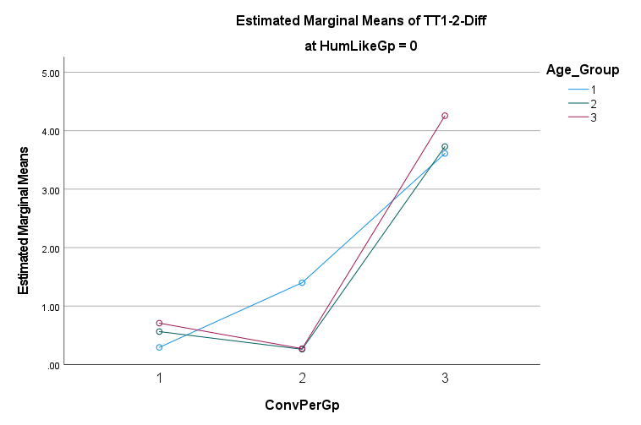
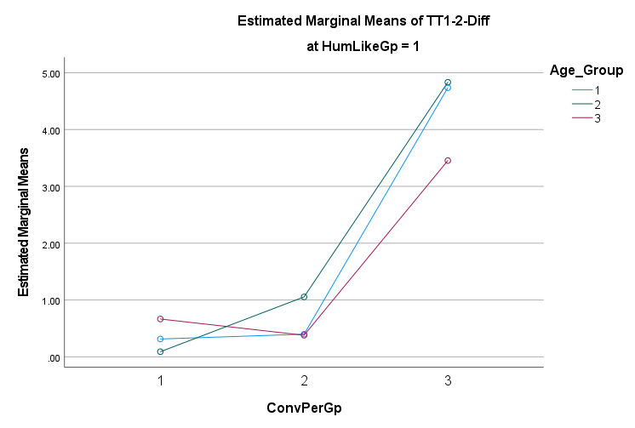
Age: 3-Way Interaction Effect for TT1-TT2

Slide 37
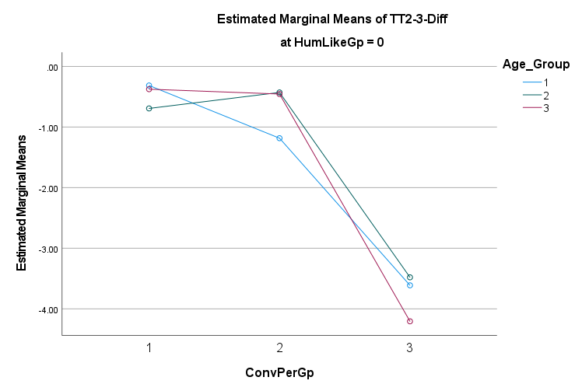
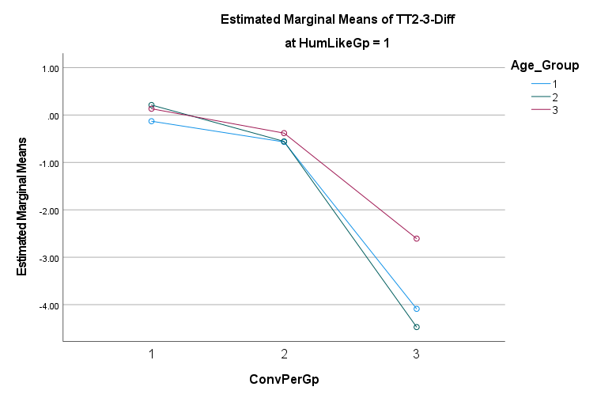
Age: 3-Way Interaction Effect for TT2-TT3

Slide 38
Implications
Prior experience: The halo or horn effect on trust (of positive/negative transfer) from previous chatbot experiences
  To understand the experience users bring with them
  To design prompts or marketing strategies to address these earlier experiences.
Gender: No significant difference in trust as observed in human-human interaction
  To reconsider the assumption that models on human trust in AI-powered systems can be grounded in their counterparts on interpersonal trust
Age: No significant main effect, but significant interaction effects
  Older adults may appreciate more emotional than practical value from chatbot interactions

Slide 39
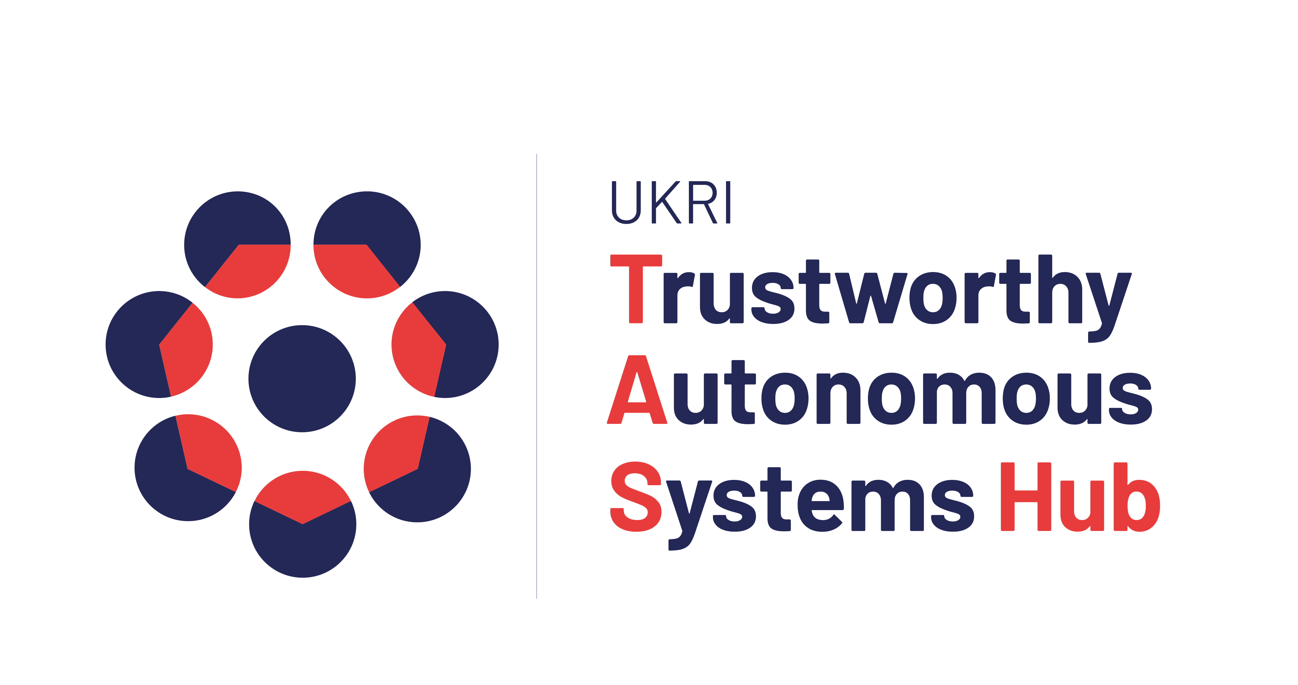
Conversational Agents for Older Adults
(CA4OA)
Co-designing Inclusive and Trustworthy Conversational Agents on Basic Services with Older Adults
April 2023 – June 2024

Slide 40





Interdisciplinary Project
Computer Science: Human-Computer Interaction, Durham
  Prof. Effie L-C Law
Psychology: Quantitative Social Psychology, Durham
  Dr. Thuy-vy Nguyen
Business: Finance, Durham
  Dr. Felix Irresberger
Age UK Teesside (charity)
Atom Bank

Slide 41
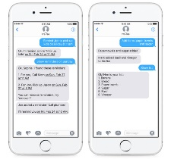
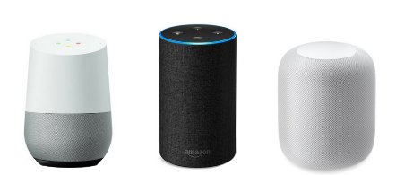
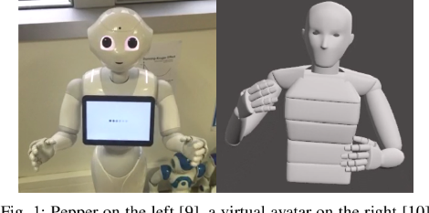
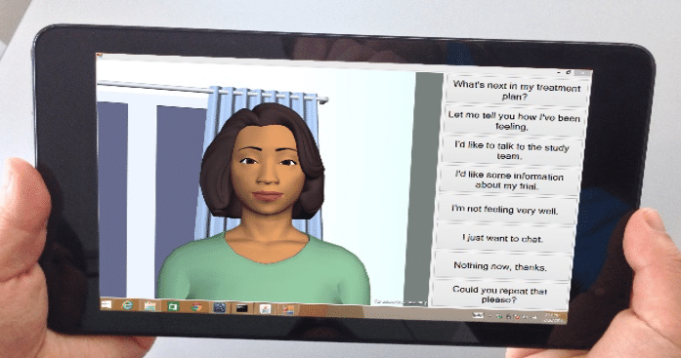
Background & Motivation
Chatbots for customer service: Healthcare, Banking, Entertainment…
Low adoption among older adults: Trust in emerging technology
Distrust → Underuse → Digital Marginalisation
Mistrust → Overuse → Digital Exploitation
(a) (b) (c) (d)
Non-embodied text-based CA; (b) Non-embodied voice-based CA;
(c) Embodied CA, multimodal social robot; (d) Embodied CA, multimodal mobile CA

Slide 42
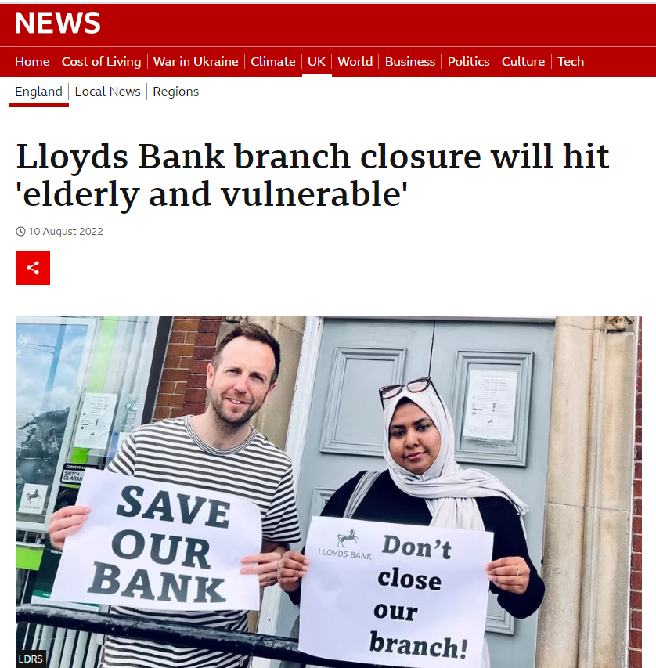
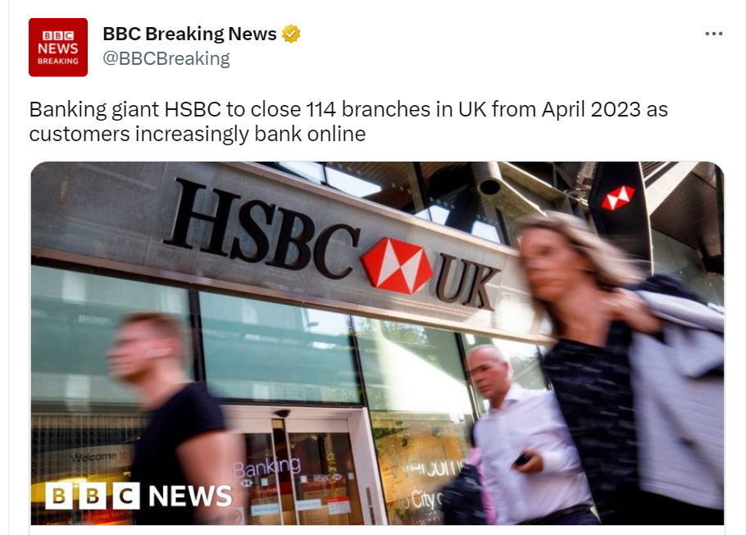
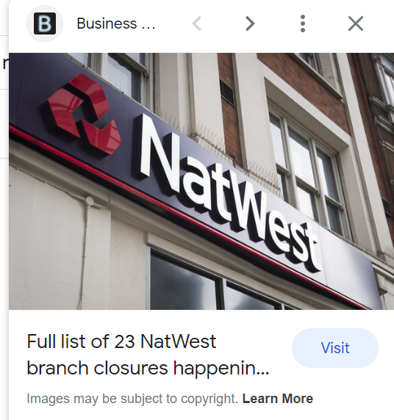
Online Banking
How many bank branches have closed since 2015?
5,579, at a rate of around 54 per month.

Slide 43


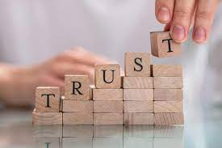
Mind the Gap
FCA: Basic financial services are available to vulnerable, digitally excluded parts of society in physical branches rather than online only.
Financial Conduct Authority (FCA) (2022). Branch and ATM closures or conversions. Finalised Guidance, FG 22/6, October 2022.
The critical gap between online banking services provision and user adoption can be bridged by improving customers’ trust in digital tools.

Slide 44
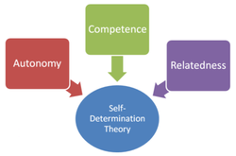
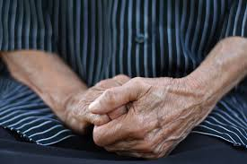
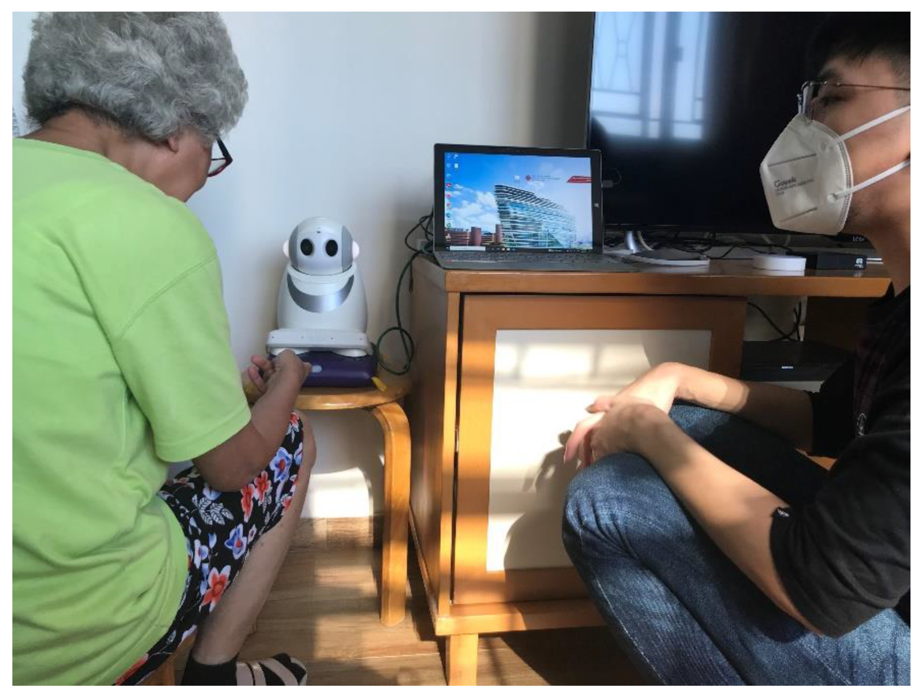
Trust & Older Adults’ Attributes
Three basic needs (SDT)
  Autonomy
  Competence
  Relatedness
Loneliness (Lieberz et al., 2021)
  Interpersonal trust
  Human-robot trust
Attitudes
  Confidence, prior experience in technology
  Prejudice towards technology: Intergroup Contact Theory (Gordon Allport, 1954; Haggadone et al. 2021)

Slide 45
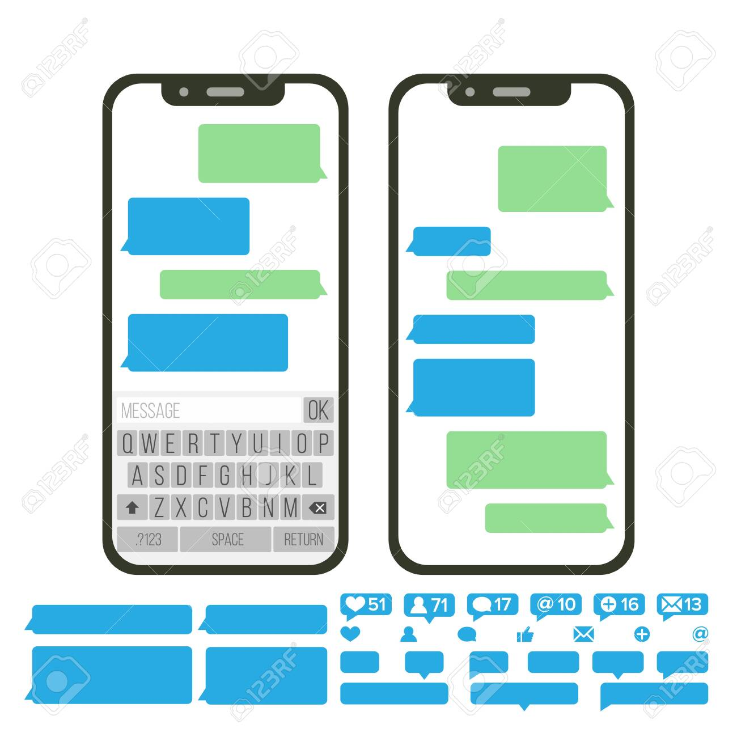
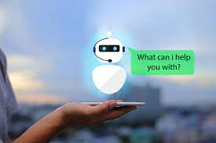
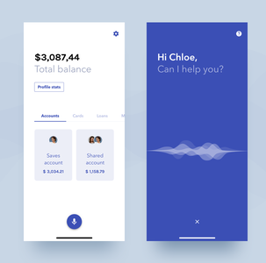
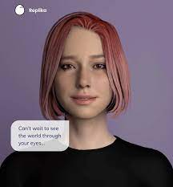
Trust by Design for Conversational Agent (CA)
Varied extents of CA modality, embodiment and anthropomorphism: 2D/3D, unimodal/ multimodal, and realism (low/high avatar fidelity)
Conversation flows to match older adults’ mental models (i.e., human-AI metaphors) of CAs; the transferability of human-human to human-agent communication.
Conversation patterns of CAs to match older adults’ age, gender, physical & psychological conditions
Varied presentations of alerts to risks and breakdown repairs on older adults’ trust in CAs.
https://www.allerin.com/blog/what-will-happen-when-ar-vr-and-chatbots-all-converge
https://dribbble.com/tags/bank_bot
https://www.superworldapp.com/content-hub/the-future-of-ai-chatbots-is-in-ar

Slide 46
Chatbot Design Requirements (Grudin & Jacques, 2019)
Human-centred Design Approach
investigating the strengths of different platforms and tools, and identifying user needs;
setting a personality;
determining task difficulty;
understanding the access environment and users’ tendency to be forgiving of errors;
making amusing scripted responses;
making chatbots reveal their identity (disclosure);
iterating through small-scale user testing

Slide 47
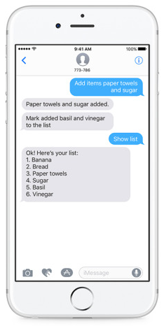
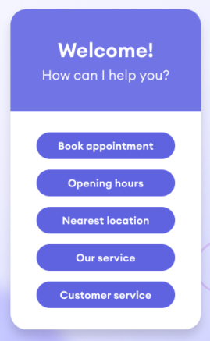
Text- vs. Button-based Interaction
Custom buttons allow only a limited range of inputs, facilitating a decision-making process.
Limiting the options, using easily navigable buttons rather than mobile keyboard makes conversations with chatbots more accessible. (Ryu et al. 2020)

Slide 48
Overall Aims
Aim 1: Identifying evidence-based design guidelines for older adult-specific CAs.
Aim2: Developing deep understandings of how older adults’ attributes and conditions, especially loneliness, impact trust in CAs, and how older adults’ attitudes towards AI-based autonomous systems may change through actual contacts with them.
Aim 3: Empowering older adults to calibrate trust in CAs by designing appropriate explanations (XAI) as well as risk alerts contingent on CAs’ behaviour and performance.

Slide 49
Method: Older-Adult-centred Design
Enabling older adults of heterogeneous backgrounds to state their needs, preferences, and experiences of using CAs
Qualitative Method: Contextual Inquiry and Participatory Design
  Interviews
  Focus groups
  in situ observations
Quantitative Method: Questionnaire to measure
  Loneliness
  Trust
  UX
  Attitudes toward CAs
  Intention to use
Online banking services: issuing bank statements, checking account balance, transfer, bill payment, and cheque deposit
Ongoing work!
To be reported in next ICT4AWE !

Slide 50
Takeaway Messages
Chatbots are increasingly impactful at all levels!
Trust in chatbots for customer service mainly determined by their performance rather than humanlikeness.
Trust in chatbots for customer service seems not gender-sensitive, but age-sensitive.
Older adults can become digitally marginalised when more and more essential services moving online.
Make chatbots trustworthy; enable older adults to trust and use them.
Ethics is of utmost importance
Usable, useful, and safe ICT for older adults’ wellbeing!

Slide 51
Thank you for listening!
Questions & Comments
Effie Lai-Chong Law
lai-chong.law@durham.ac.uk

