Slide 1
I model, therefore I am
- René Descartes

Slide 2
Low-Modeling of smart software The role of Model-Driven Software Engineering in the era of AI
Jordi Cabot
@JordiCabot / jordicabot.com / modeling-languages.com
Notes:
Covering a broad range of topics but happy to focus on those that you find more interesting for you

Slide 3
Disclaimer
Notes:
Before we talk about the relationship between modeling and AI, we should make sure we have a common understanding of these concepts

Slide 4
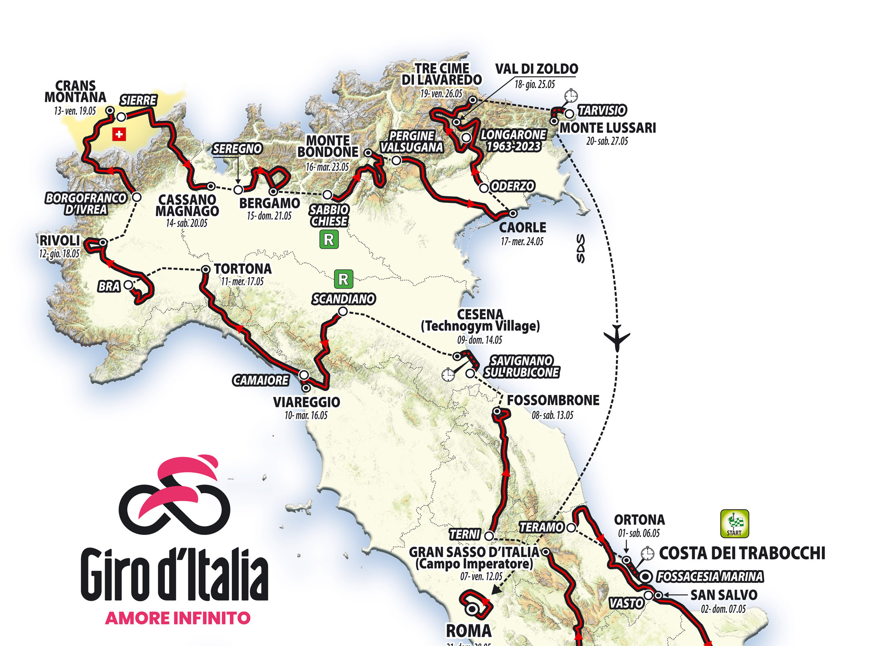
Notes:
As I think the audience has also different backgrounds I chose to go on a tour (I should say “giro”) and visit different initiatives we are chasing in this area

Slide 5
Notes:
Feel free to later contact me if you want to go deeper on any topic. I’ll be all day around

Slide 6
“As a writer, my job is to change your perspective and make you think outside the box.” - Mary Sage Nguyen
Notes:
I simplify and exaggerate the message on some points to provoke the discussion. And I’m not here to convince you of anything. Happy if I just manage to change your perspective

Slide 7
Warm-up
Notes:
Before we talk about the relationship between modeling and AI, we should make sure we have a common understanding of these concepts

Slide 8
Smart Software

Slide 9
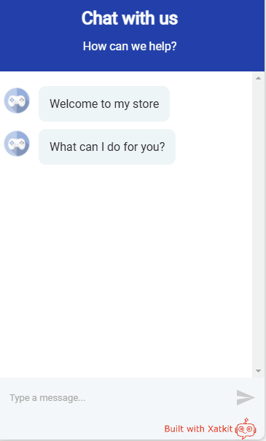
Notes:
What do you see? I see a clear exemple of smart software
Simple exemple an ecommerce Store
Traditional software components -> Database to Store the catalogue of products and the orders
Front-end AI components -> chatbot
Back-end AI components -> Recommender System for product suggestions

Slide 10
AI is software!

Slide 11
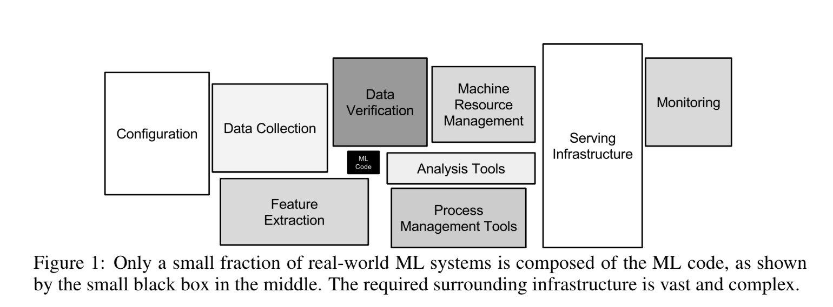
Hidden Technical debt in Machine Learning Systems - Google - https://proceedings.neurips.cc/paper/2015/file/86df7dcfd896fcaf2674f757a2463eba-Paper.pdf
Notes:
Good for us

Slide 12
AI components are mostly software
Input/Output Messaging channels
NLU Engine
Events!
External Platforms
Notes:
Let me insist on the point that even for the AI components, most of its core logic is not really related to AI.
So we are always the most prepared to build such components!

Slide 13
Smart / AI-enhanced / ML-enabled software
Trad Software
AI component
Notes:
Smart software is the union of traditional software components and AI components
Some traditional software components do not interact with AI ones. Same for the aI ones. But others do interact.

Slide 14
How to develop better smart software faster??
Quality
Productivity
Notes:
So let’s go back to the original question.
What is your answer???

Slide 15
To build better smart software faster we need:
Better models for smart software
Better ways to create such models
(Semi)automate the generation of smart software
Low-code
Low-model
Notes:
I see plenty of model driven engineering here!

Slide 16
Low-code for generating smart software
Better models for smart software
Better ways to create such models
(Semi)automate the generation of smart software

Slide 17
Low-code application platforms accelerate app delivery by dramatically reducing the amount of hand-coding required – Forrester Report

Slide 18
"Given the final model, the complete computerized information system can be automatically generated“
"we arrive at a specification from which executable code can be automatically generated"
From papers published in 1991
Notes:
Important to put things in the right context
Some of you were not even born when these papers were published and if they were published today you’d say they were talking about low-code

Slide 19
Low-code is a “style” of MDD
Focused on specific types of applications
Where the language/s are typically fixed and closed

Slide 20
Low-code is trending because
Much clearer message: Everybody understands that low-code means “less coding”. Modeling is much more confusing
Sounds familiar, as the marketing msg is still focused on the code
Simpler pipeline, no transformation chains, one-shot modeling.
Notes:
Compare Mendix with Eclipse/EMF

Slide 21
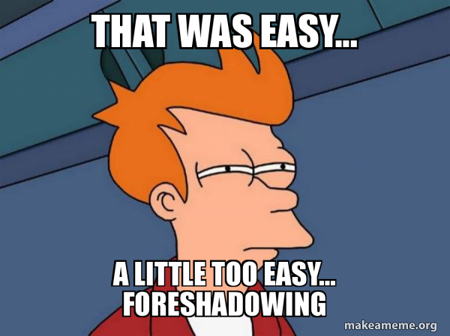
TL;DR - Low-code for Smart software
An incremental extension of low-code tools to cover code-generation for AI platforms and libraries
Notes:
This was the easy part…

Slide 22
Better/New models for smart software
Better models for smart software
Better ways to create such models
(Semi)automate the generation of smart software
Notes:
Role of modeling in the era of Smart software!

Slide 23
To model, or not to model, this is the WRONG question
- Shakespeare
Real question is the ROI of making the models explicit
Notes:
Let’s clarify this eternal discussion on models yes or no!
There is always a model and we all model, at least in our head, the real question is whether to make the models explícit
And this is linked to a trade-off analysis of the cost of these models vs the benefits of having them explícit. As we’ll see, AI can reduce the cost and maximize these benefits

Slide 24
In most of my papers in the last 3 years
ML models ARE models!!
Notes:
(so we need to model them!)

Slide 25
Models
A social artifact that is acknowledged by an observer to represent an abstraction of some domain for a particular purpose. – E. Proper & G. Guizzardi
Everything is a model – J. Bézivin

Slide 26
ML Models are models
For instance, you can see them as model transformations that generate output data from their input
Many ML operations (e.g. fine tuning) can be mapped to “classical” model manipulation operations such as model refining
If we agree on this, then it’s completely natural to manipulate all kinds of AI models and model manipulation operations using (extensions of) existing SW modeling techniques <- WE COULD TEACH AI PEOPLE SOME THINGS ☺
Notes:
We have a marketing problema!!!

Slide 27
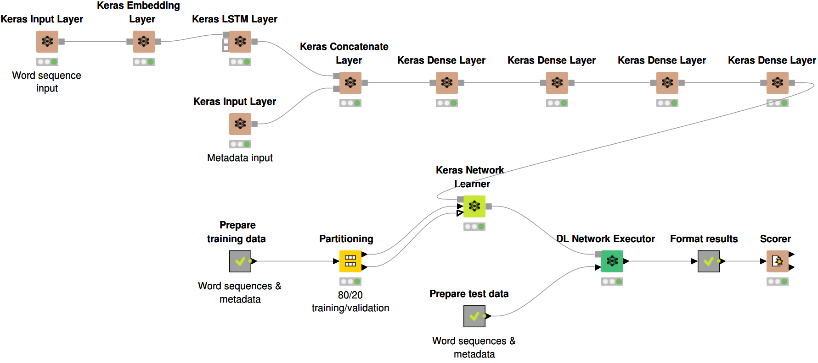
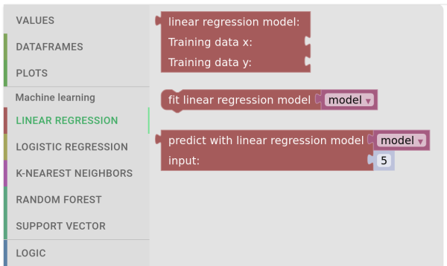
All major vendors are “going modeling”
Notes:
There are quite a few tools that help you model your neural network and ML process

Slide 28
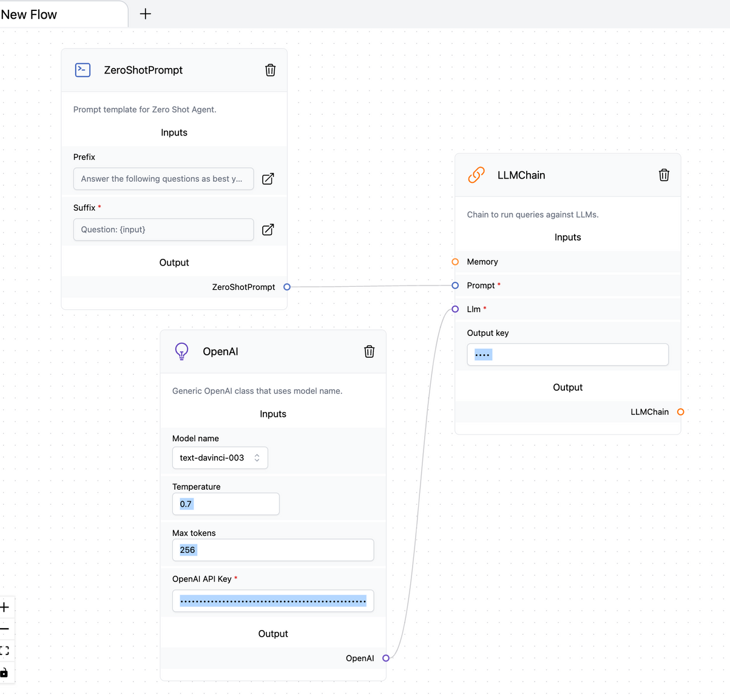
We have missed great opportunities
LangFlow is a simple workflow modeling environment for LangChain
Over 10K
Notes:
How many of you know langchain????
This would be a completely different discussion but when we talk about impact, we should keep in mind impact is not publishing papers in scientific venues!!

Slide 29
Not only modeling -> also MDD
Notes:
Ivy – 12K stars and 4.5K forks

Slide 30
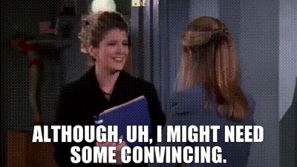
TL;DR - Modeling Smart software
Modeling Smart software
Modeling software
Notes:
It’s not radically new, it’s an adaptation / evolution of what we know how to do to cover the new concepts / requirements to express the needs of the Smart components
Let’s see now three examples of modeling extensions for Smart software

Slide 31
(1/3) Modeling smart interfaces
Notes:
Let’s now see the first example of a modeling extension to cover smart software.
Note that as AI is mostly software, there are many facets of smart software that do not need extensions at all

Slide 32
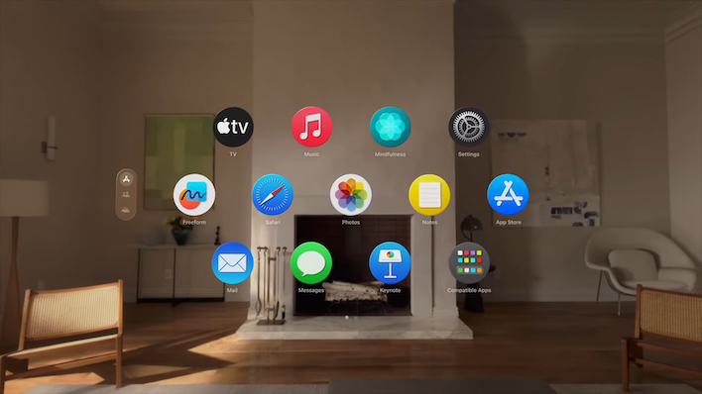
One app -> Multiple (smart) interfaces
Notes:
Chat, voice, augmented reality,…

Slide 33
One goal, understanding the intention
Notes:
Concept of multi-experience interaction: the user express an intention that we need to match and respond to
E.g of a weather bot: the user may want to express the intention of asking for the weather tomorrow in parís -> we need to understand that the user is asking for the weather forecast. We also need to collect the parameters “Paris” and “tomorrow”

Slide 34
Xatkit Domain Specific Language
Chat/VoiceBots are created with the Xatkit DSL offering a bot-specific syntax for creating:
Intents the bot needs to match
The behavior to execute in response to the matched intents
The language is designed to easily integrate and combine all types of IUIs
Notes:
These concepts are implemented in Xatkit

Slide 35
Intent DSL example

Slide 36
Execution DSL example – State machines

Slide 37
E Planas, G Daniel, M Brambilla, J Cabot: Towards a model-driven approach for multiexperience AI-based user interfaces. Softw. Syst. Model. 20(4): 997-1009 (2021)
Notes:
There is a metamodel behind

Slide 38
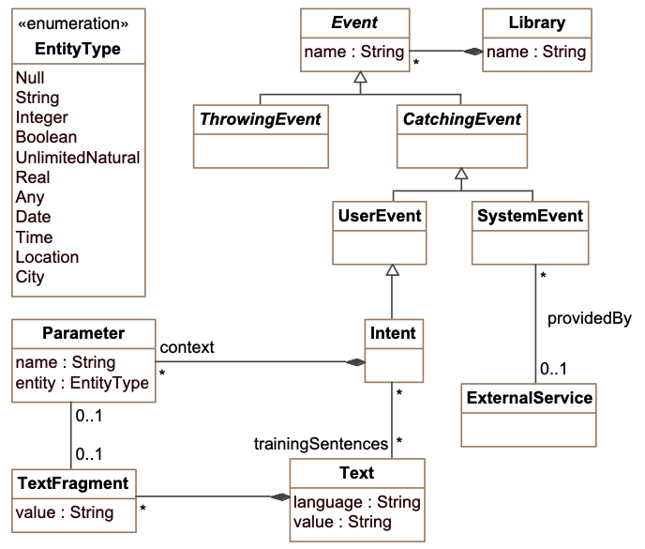
Intent package metamodel
Notes:
Intents are the types of requests the interface must understand

Slide 39
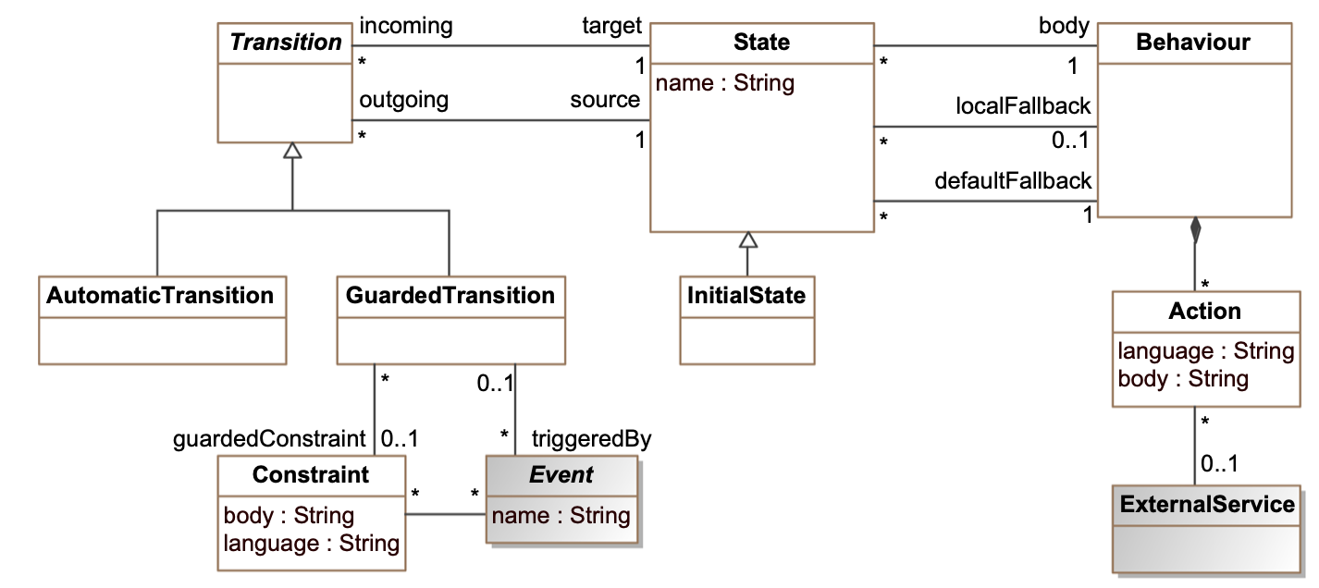
Behavioural package metamodel

Slide 40
Our DSL is implemented as a Java Fluent API
Create bots using your preferred Java editor
Benefit from all existing Java tooling when developing bots (e.g. debuggers)
Reuse any Java library for complex bot behaviors
Intuitive Fluent Interfaces to help you create advanced conversations
Based on state machine semantics to build any type of bot

Slide 41
(2/3) Modeling datasets
Notes:
Not modeling the data -> modeling the dataset
(datasets play an important role in the development of smart software as they are used to train ML models)

Slide 42
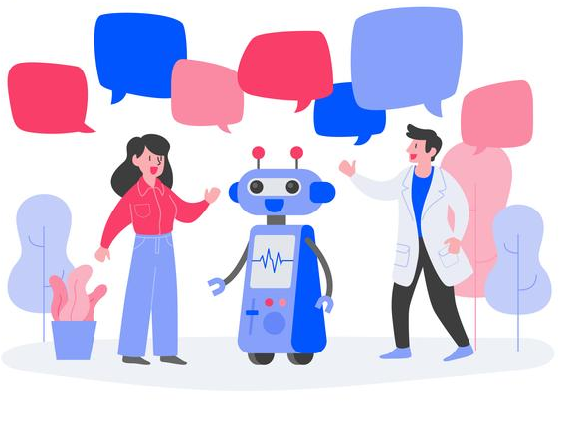
Better (META)data for better ML -> data can be a source of biases
E.g.1 Facial analysis
A dataset with limited represenativeness of skin colors could fail to recognize people
NLP: Different accents
A dataset limited to Australian voice records may fail when trying to understand British speakers

Slide 43
Annotating datasets
Ongoing concerns from the AI community to clarify the representativeness of the data, its provenance, possible social issues,…
But no industry standards for documenting ML datasets

Slide 44
Modeling to the rescue -> DescribeML
A DSL to describe ML datasets
To precisely define how the dataset was created and what are social biases that could be derived from training models with it
A domain-specific language for describing machine learning datasets, Journal of Computer Languages
Joan Giner-Miguelez, Abel Gómez, Jordi Cabot
https://github.com/SOM-Research/DescribeML
Notes:
Important of course when building AI projects

Slide 45
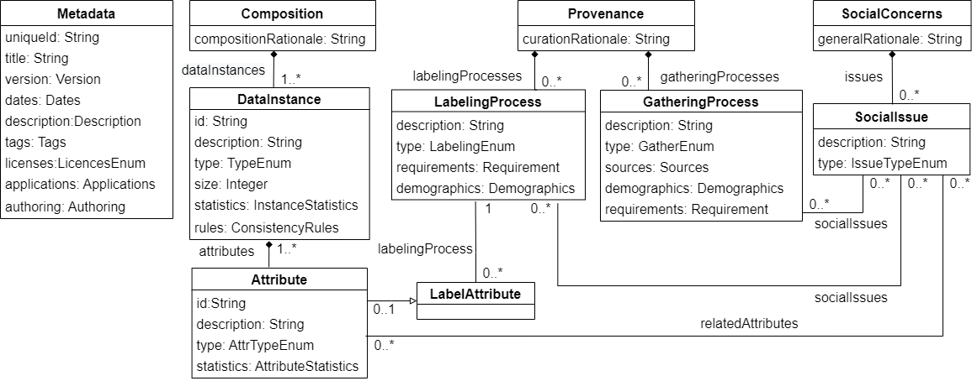
DSL Metamodel

Slide 46
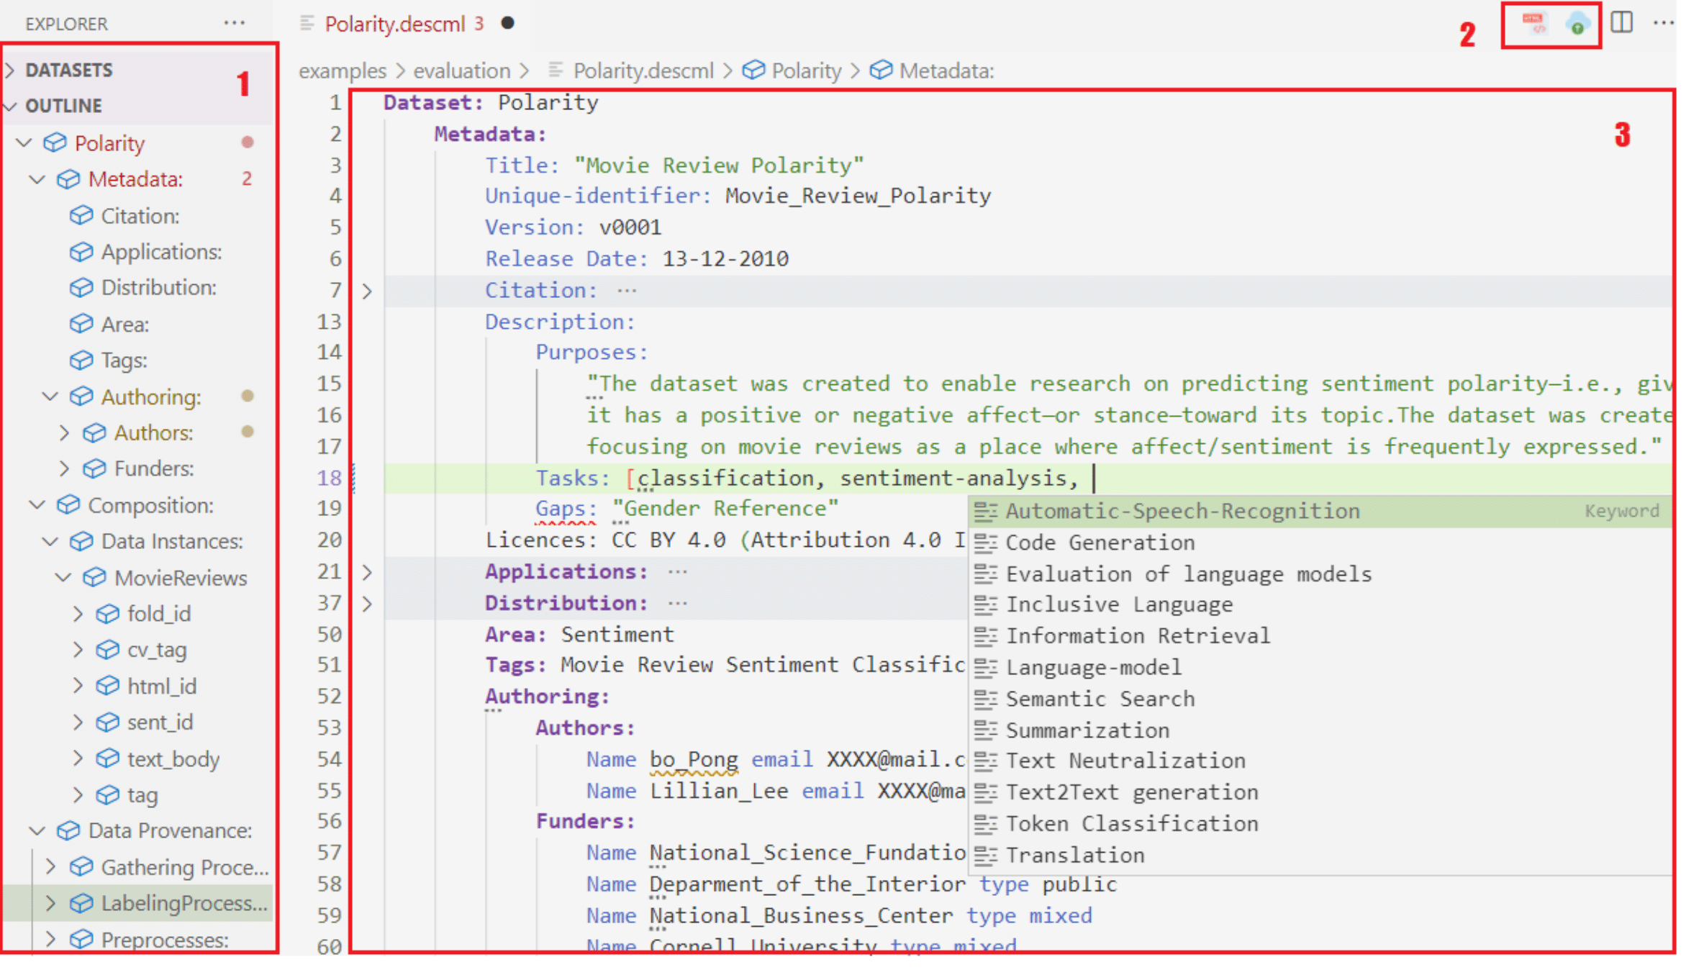
DescribeML Tool
Plug-in for VSCode
Implemented
with Langium
Notes:
Langium is a new language workbench with “modern” technologies (Typescript and nodejs)

Slide 47
(3/3) Modeling Prompts
Notes:
Not modeling the data -> modeling the dataset
(datasets play an important role in the development of smart software as they are used to train ML models)

Slide 48
A structured language for better / reusable / independent prompts
prompt GenerateImage( @animal "Name of an animal"): image core = "Image of ", @animal, " in its natural habitat" traits = quality(high), art_form(photography)
prompt ImageQuestions( $image "Image", @animal "Animal appearing in the image", @level "English level)": text core = "Propose 5 questions for an English course regarding the picture of", @animal suffix = Exam.DetailedInstructions(@level) composer CompleteExam( @grammar "Grammar questions", @questions "Questions about the image") "Answer the following questions:\n", @grammar, "(50%)\n", @questions, "(50%)\n"
To appear at: https://conf.researchr.org/home/models-2023
Notes:
You can use variables, import templates,…

Slide 49
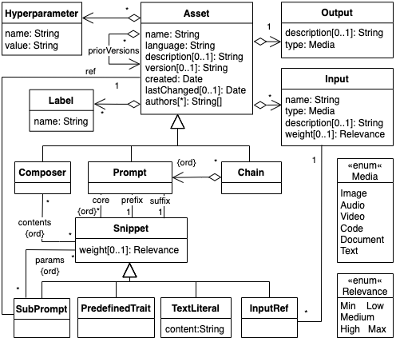

Slide 50
Opens the door to an alternative model-driven approach
Domain Models
Prompt Models
LLM-generated Code
Notes:
We can generate a prompt from the model and then ask chatgpt to ask the code for any platform
Faster adaptation and exploration of new technologies but non-deterministic option
We could even use it also to generate the templates

Slide 51
A low-model approach for smart software
Better models for smart software
Better ways to create such models
(Semi)automate the generation of smart software
Notes:
Again, all these new types of models of higher and higher complexity requires new approaches to modeling

Slide 52
Low-code application platforms accelerate app delivery by dramatically reducing the amount of hand-coding required – Forrester Report
Low-model application platforms accelerate app delivery by dramatically reducing the amount of hand-modeling required – Cabot Report

Slide 53
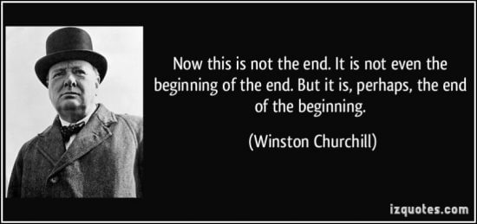
Notes:
It’s not the end of modeling. It’s not even the beginning of the end of modeling. But it is perhaps, the end of the beginning of manual modeling

Slide 54
Modeling is more important than ever (but also more difficult than ever)
Data
The emphasis is moving back to the data and the “understanding” (i.e. modeling) of the data as key element in the quality of AI results
Generative AI
Software Models
Notes:
Models may now have also social implications!!!

Slide 55
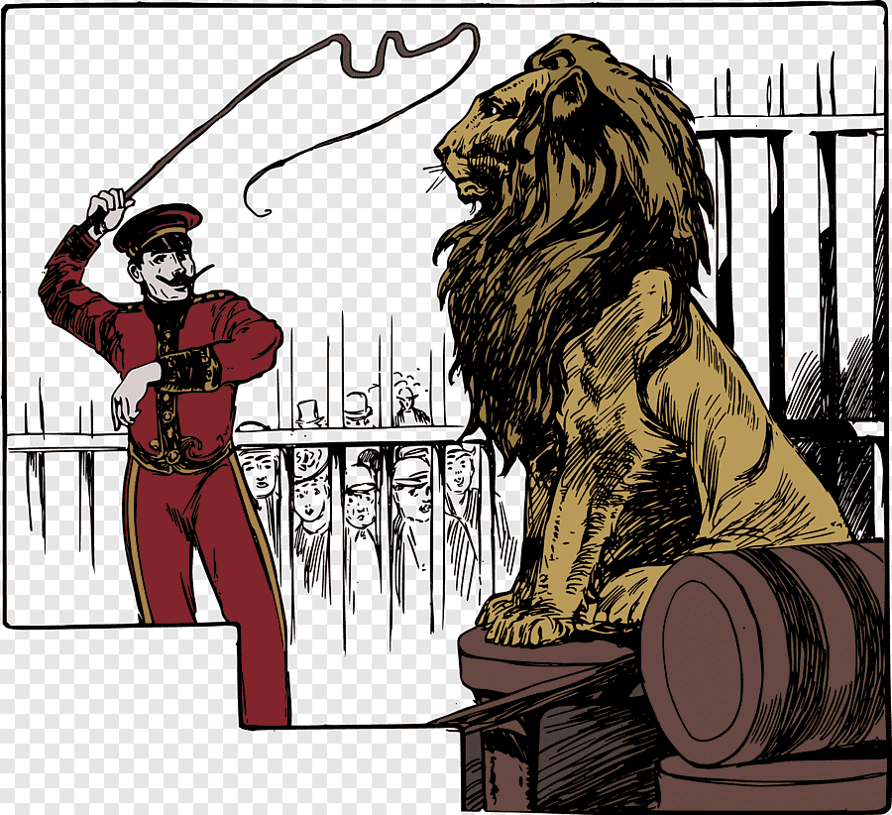
More (and more complex) models to tame the needs of smart software
Smart software is a complex beast, we need models to tame this essential and accidental complexity
Every day there are more things to model!!!!
Notes:
And there are many more things to model:
- Digital twins? Digital producto Passports? Data Spaces?

Slide 56
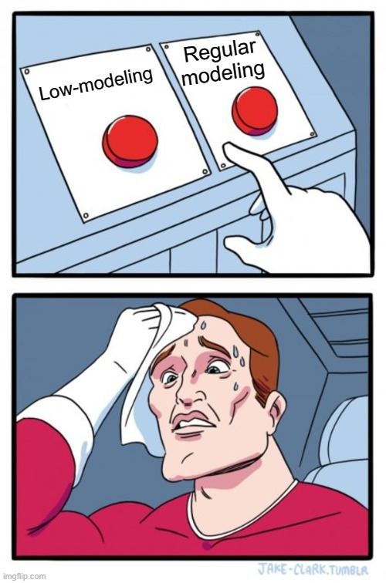
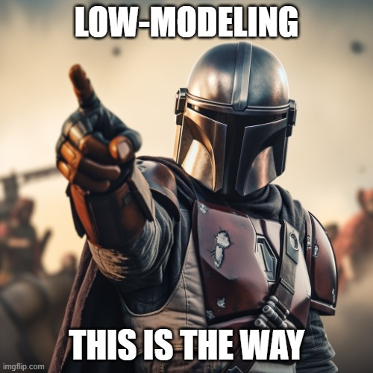

Slide 57
Low-modeling is not new

Slide 58
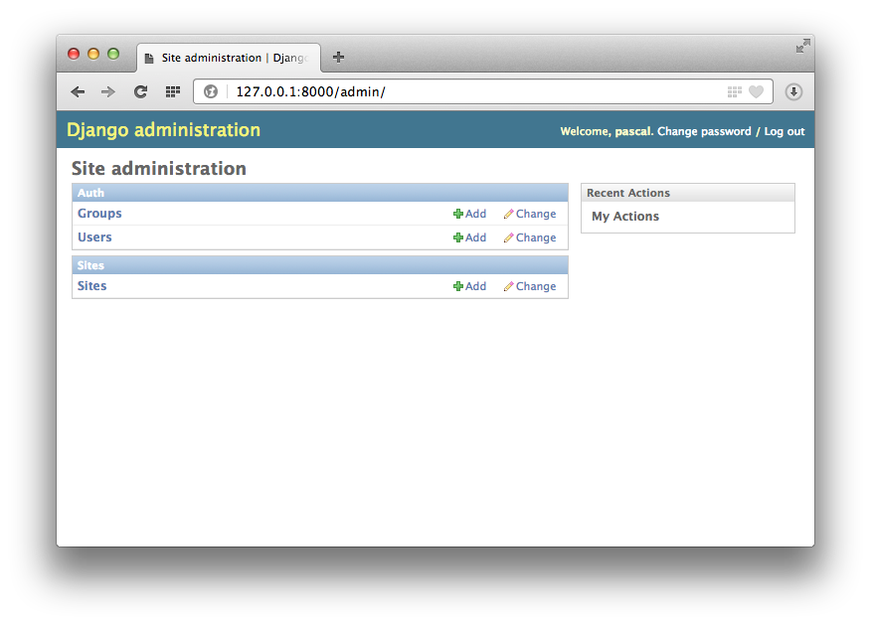
Similar to when we “model” with django
Notes:
Why we think this is modeling on django it’s a different story

Slide 59
AI gives modelers superpowers
Notes:
But AI is opening the doors for a Brand new approach to low-modeling

Slide 60
(1/2) Assisted modeling

Slide 61
Mendix Assist

Slide 62
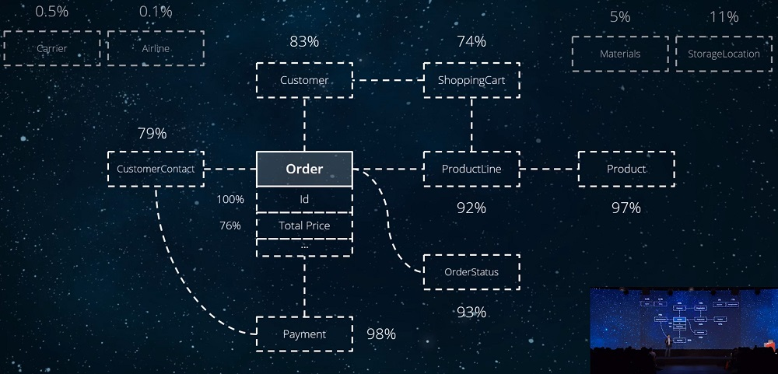
OutSystems.ai
Notes:
Beyond an autocomplete similar to the Mendix Assist, they also offer another interesting type of suggestions for data models.

Slide 63
Natural Language Processing (NLP) for model autocompletion
Domain Modeling
Natural
Language
Processing
assist
Loli Burgueño, Robert Clarisó Sébastien Gérard, Shuai Li, Jordi Cabot : An NLP-Based Architecture for the Autocompletion of Partial Domain Models. CAiSE 2021: 91-106
Notes:
Instead of copilot that it’s pretrained on large corpus of code samples, we for now went for a more pragmatic solution that instead of automatically autocompleting parts of the model suggests new concepts to be added to it, using both general and contextual knoweldge

Slide 64
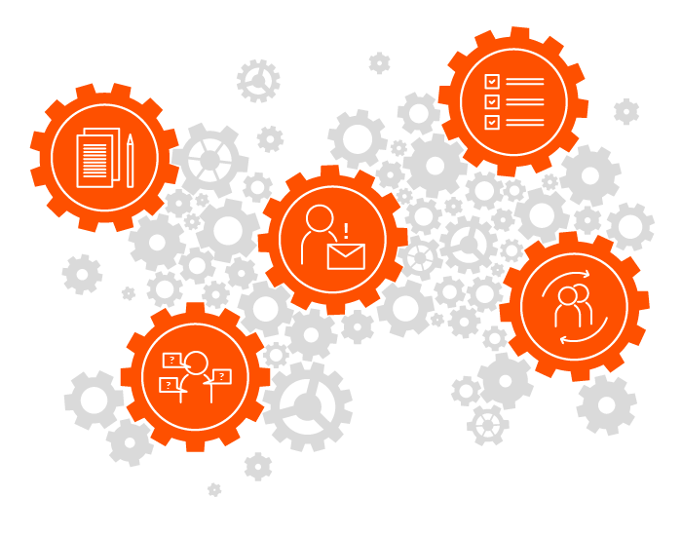
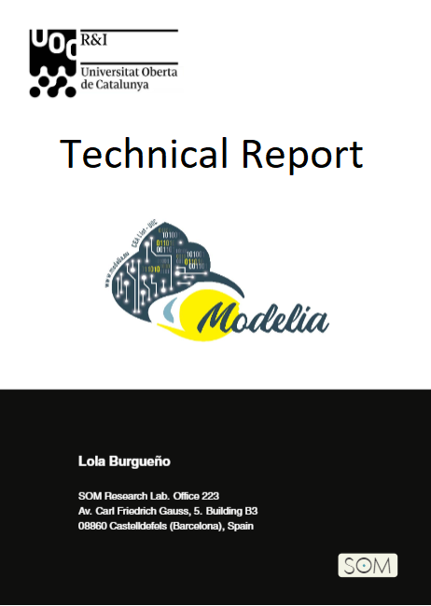
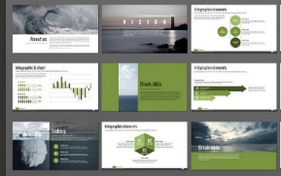
Our approach
NLP components
Partial model
NLP method for
word embeddings
NLP models
general knowledge
Domain docs
Text preprocessing
algorithm
A.2
contextual knowledge
Domain corpus
of text
train
Morphological analysis & lemmatization
A.1
preprocess

Slide 65
Our approach
Partial model
Model Recommendation Engine
NLP method for
word embeddings
NLP models
Add class named Plane
Add class named Airline
Add class named Airplane
…
general knowledge
Domain docs
Text preprocessing
algorithm
A.2
contextual knowledge
Domain corpus
of text
train
B.5
Morphological analysis & lemmatization
A.1
preprocess
Notes:
The slice 1 was aimed at obtaining new classes. We use the POS tag to filter the list by discarding verbs, adjectives and plural nouns.
ChatGPT can also help (not a joke)

Slide 66
You can learn/assist on any other type of models
Loli Burgueño, Jordi Cabot, Shuai Li, Sébastien Gérard:
A generic LSTM neural network architecture to infer heterogeneous model transformations. Softw. Syst. Model. 21(1): 139-156 (2022)

Slide 67
(2/2) No-model strategies
Notes:
Same as no-code, the code (in our case, the models) are there but we hide them from the users

Slide 68
Inferring models from your data
There is a hidden model in your database, in your API or web forms
Or your CSVs
Even in your docs, manuals and regulations
How far can we push AI technologies to make sense of the implicit models behind all these data?

Slide 69
Bots for Open Data project
Empowering citizens to benefit from open data sources (>1.6M in the European data portal)
Partial Bot models are generated from the CSV/JSON file
E.g. checking the type of the columns we can generate obvious questions (max, avg, min for numeric ones)
Ontologies could be used to package more semantic libraries of questions
TextToSQL used as default fallback
Notes:
Or “before” “after” “during” for dates
If we know an integer is not just an integer but a salary we can ask others

Slide 70
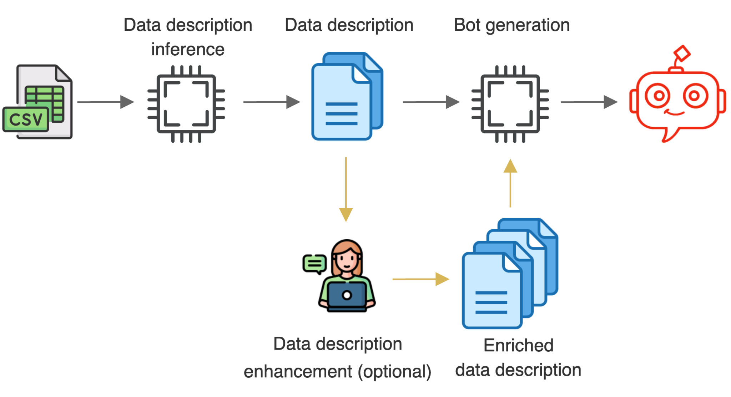
Chatbot generation
Notes:
explicar cada parte menos enhancement
Internally we have a model of the CSV structure, a model of the conversations, a model of the bot,… but they are all invisible to the user

Slide 71
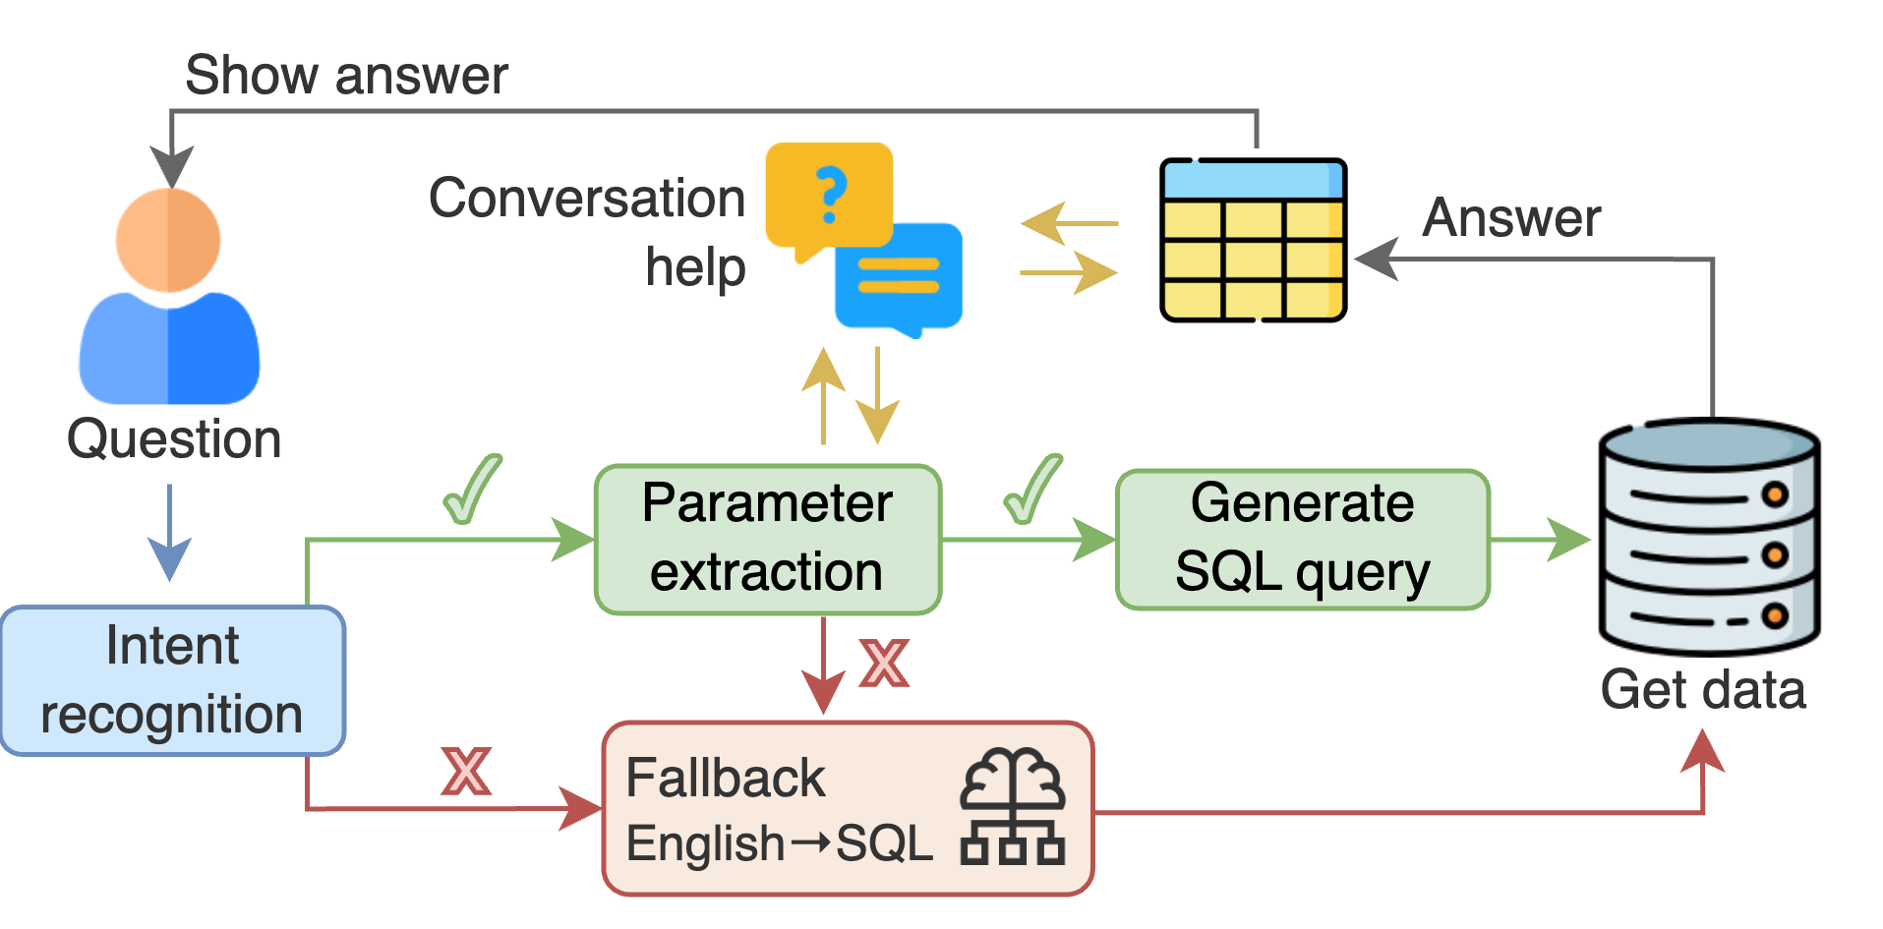
Architecture of the generated bot

Slide 72
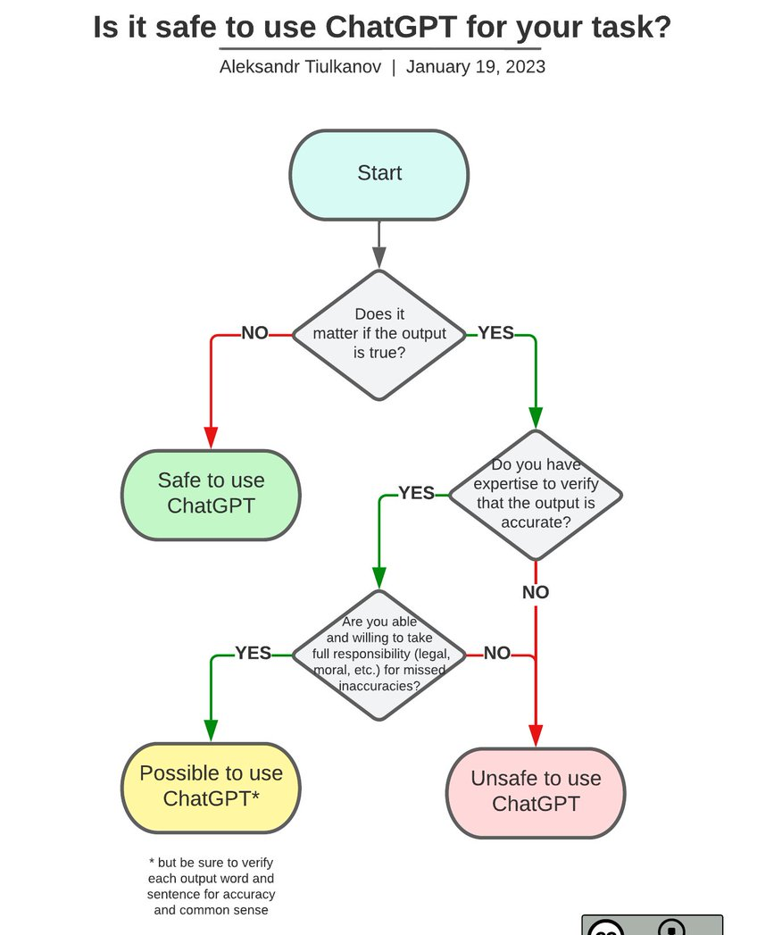
Can you afford getting a wrong answer?
(+security, maintainability, non-determinism…
Notes:
Just one quick note on chatgpt in case you’re wondering whether we’re wasting our time

Slide 73
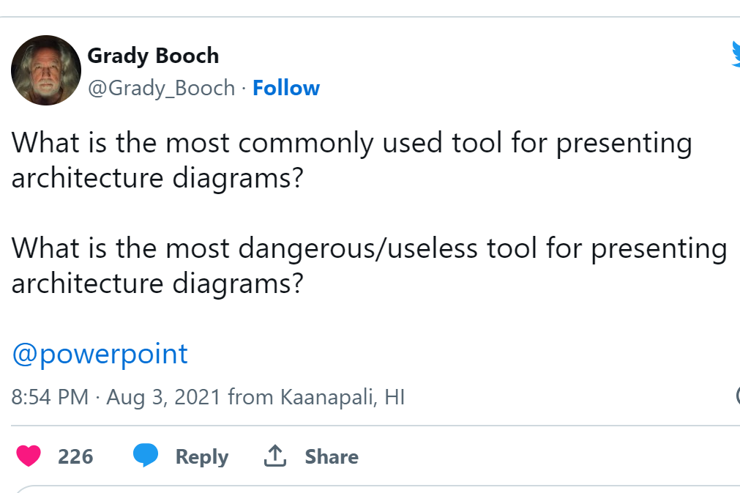
Sometimes you can still expose the models, but in a friendly-way
Notes:
This is not goor nor bad. Well-known tools do not require a Learning curve. Are probably cheap.
You lose formality, quality,… but gain friendliness, participation, quicknesss
Better collaboration and add-ons

Slide 74
Putting it all together

Slide 75
BESSER (better Smart software faster) project
01
BESSER is a low-code approach to develop AI-enhanced software
04
BESSER is a 5-year FNR PEARL project.
02
BESSER will provide a single editor to model both traditional and smart components as well as possible ethical concerns
05
The core BESSER components will be released as OSS.
03
BESSER will provide tools to generate and test all modeled components altogether (e.g. a chatbot, the web UI, the database, a prediction system…)
06
Open to external collaborations. Commercial extensions will be allowed.

Slide 76
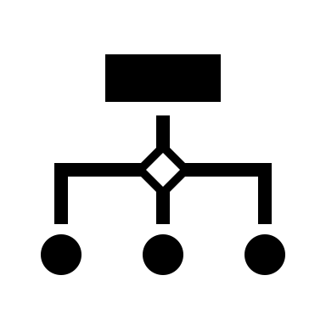
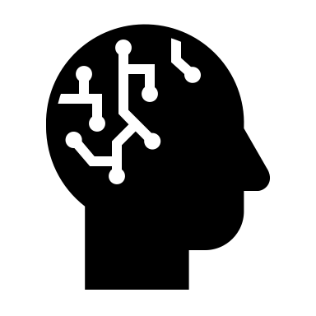
specifies
receives
provides
Domain Knowledge,
Goals & Ethical concerns
Data
Explanations
Quality dashboard
Training component
ML Model
Smart software model
Explainability
Code Data Params
Traditional SW model
Smart back-end
Code
Generation
Testing
Deployment component
Smart front-end
AI quality
properties
Monitoring
AI Platforms
Local packages
Cloud services
BESSER DSLs & Editors
BESSER infrastructure
Notes:
BESSER as a low-code platform

Slide 77
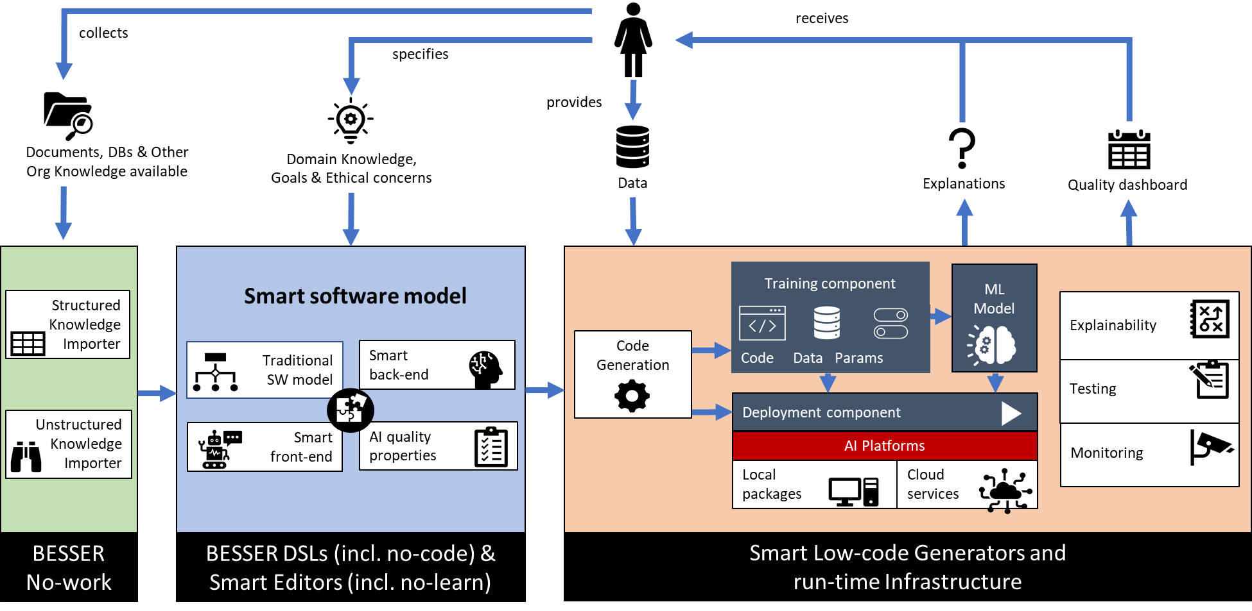
BESSER as a low-model platform

Slide 78
We’re hiring!

Slide 79
TL;DR
Notes:
In case you just woke up from your after lunch nap

Slide 80
Key points
AI is offering new challenges and opportunities for model-driven engineering
AI needs MDE (more than MDE needs AI ☺ ) to keep growing its ecosystem of libraries/platforms…
But let’s not sit back and relax, be proactive reflecting upon the impact of AI on MDE
Low-model platforms could be a key element to bring both worlds together!!!

Slide 81
++Open Challenges
Notes:
Beyond all those that we have already mentioned, there are plenty of other challenges

Slide 82
Augmented reality
Emotion-aware SW
Security aspects
Evol
Of ML
Notes:
e.g. role-based Access control for Smart front-ends, prompt injection attacks
Many ML systems are already implemented on top of legacy tech, how do we evolve them? How do we check the new versión behaves at least as well as the previous one?

Slide 83
Uncertainty everywhere
Leverage semantics
Testing AI/non-AI interact
Modeling ethical reqs

Slide 84
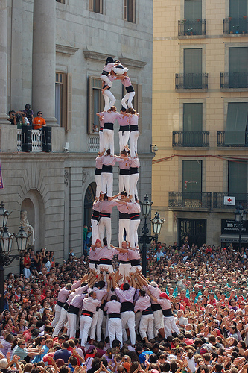
Let’s keep the discussing going!
jordi.cabot@list.lu
@JordiCabot
jordicabot.com
Notes:
If you want to keep exploring and Building these tòpics together ...

