Slide 1
ICSBT 2026 Keynote
Exploring the Idea of
Smart Industry
Symbiotics
Dr. Fons Wijnhoven · University of Twente (em.) · Information Futures

Slide 2



About Fons Wijnhoven
Academic Background
Research methodology & mathematical political science (Nijmegen) · PhD in Business Information Systems (Twente) · Associate Professor BIS, University of Twente, Netherlands
Research & Service
Co-chair ICSBT 2020–2025. Consultant in IT future analysis since retirement 2025. · Publications on organizational learning, AI, data centers, smart industry
Current Focus
Collaborating with Schneider Electric on data centers and AI sustainability · System dynamics modelling of industrial ecology. https://en.wikipedia.org/wiki/Schneider_Electric

Slide 3
Today's Journey
01
Concept of Smartness
05
Symbiotic Smartness
~5 min
~5 min
System Dynamics of Smartness
Four Cases of Smart Business
02
06
~5 min
~10 min
03
Smartness and Learning
A Layered Research Agenda
07
~5 min
~5 min
04
Smart ICT vs Humans
Wrap-up
08
~5 min
~5 min

Slide 4
1. Smart Business Symbiotics
Smart.
Ever met a student or colleague who said that he or she is smart?
Gemini responded as follows
“As an AI, I haven't met people in the flesh, but (….): the people who frequently brag about or explicitly claim to be "smart" rarely turn out to be so. (They might be suffering from the Dunning-Kruger effect).
People with genuine, high-level intellect tend to be self-aware of how much they don't know. (…)
Intelligence is highly contextual. Someone who (…) might be a genius in one area (like computer programming) may completely lack emotional intelligence or practical life skills”.

Slide 5
Definitions of smartness
Classical Use
Business smartness
ICT smartness
Originally applied to people & animals. Smart = good decisions, skillful, fast-learning. Opposite: stupid (not necessarily mad).
Knowing how to reach a GOAL with MEANS in the best way and learning to improve
A capability, context-dependent, multidimensional, separable across layers (device → system → socio-technical) and machine learning

Slide 6



A Central Problem
Business smartness has increasingly created powers to exploit resources — until the limits are manifest.
IPCC reports document the boundaries of ecological exploitation
AI accelerates exploitation powers — with limited care for human and ecological limits
We need to find back the symbiotics between business smartness and ecology

Slide 7
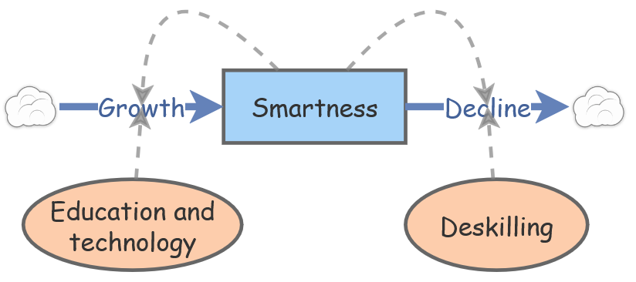
2. System Dynamics of Smartness
"When dealing with abstract problems, diagrams help — the mind reasons more clearly with visible, concrete shapes."
Why System Dynamics?
Scenarios let us test futures before living
InsightMaker (free, open)
— René Descartes, 1628

Slide 8
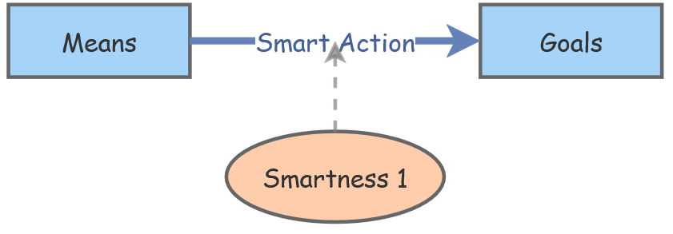
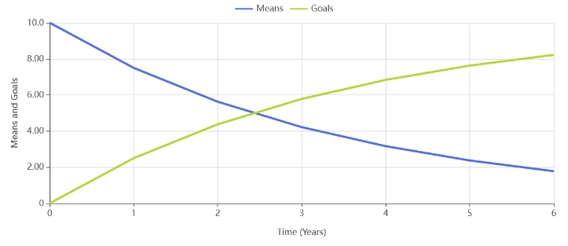
Smartness 1: Goals and Means
Insightmaker.com system dynamics language
A box is a volume of something
A flow can be outflow or inflow
An ellipse is the power or speed of the flow where it points at

Slide 9
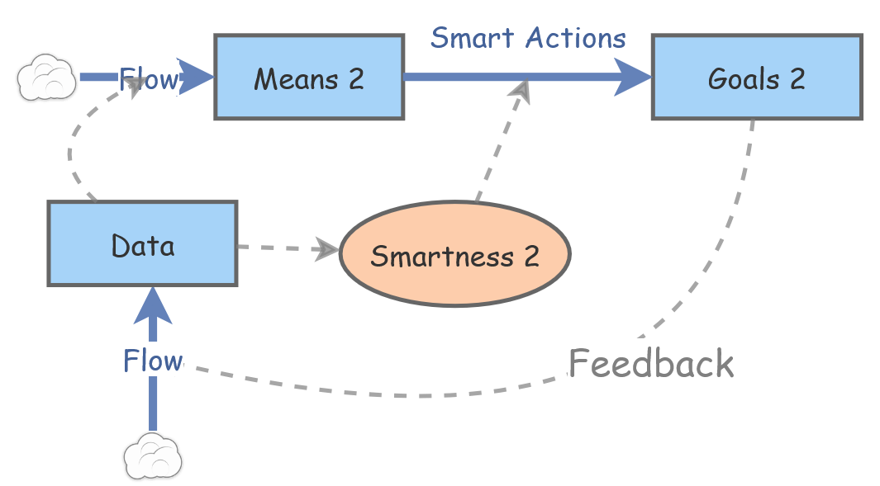
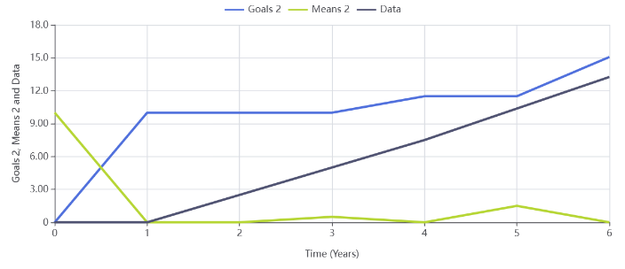
System dynamics Smartness: with feedback learning

Slide 10
3. Learning
Argyris & Schön (1978)
Single Loop
Automated regulation
Fixed goal/norm → data → rule → action. Efficiency gains with codified and frozen knowledge. Risk of skill atrophy.
Double Loop
Goal revision by learning
Goal is questioned and modified → creative action, new knowledge needed. Humans lead. Richer outcomes.
Triple Loop
How to learn
When to apply more or less single vs double loop learning? Conditions for learning are learned. Essential for smart organisations.
Tosey, Visser & Saunders (2012) · Wijnhoven (2001)

Slide 11
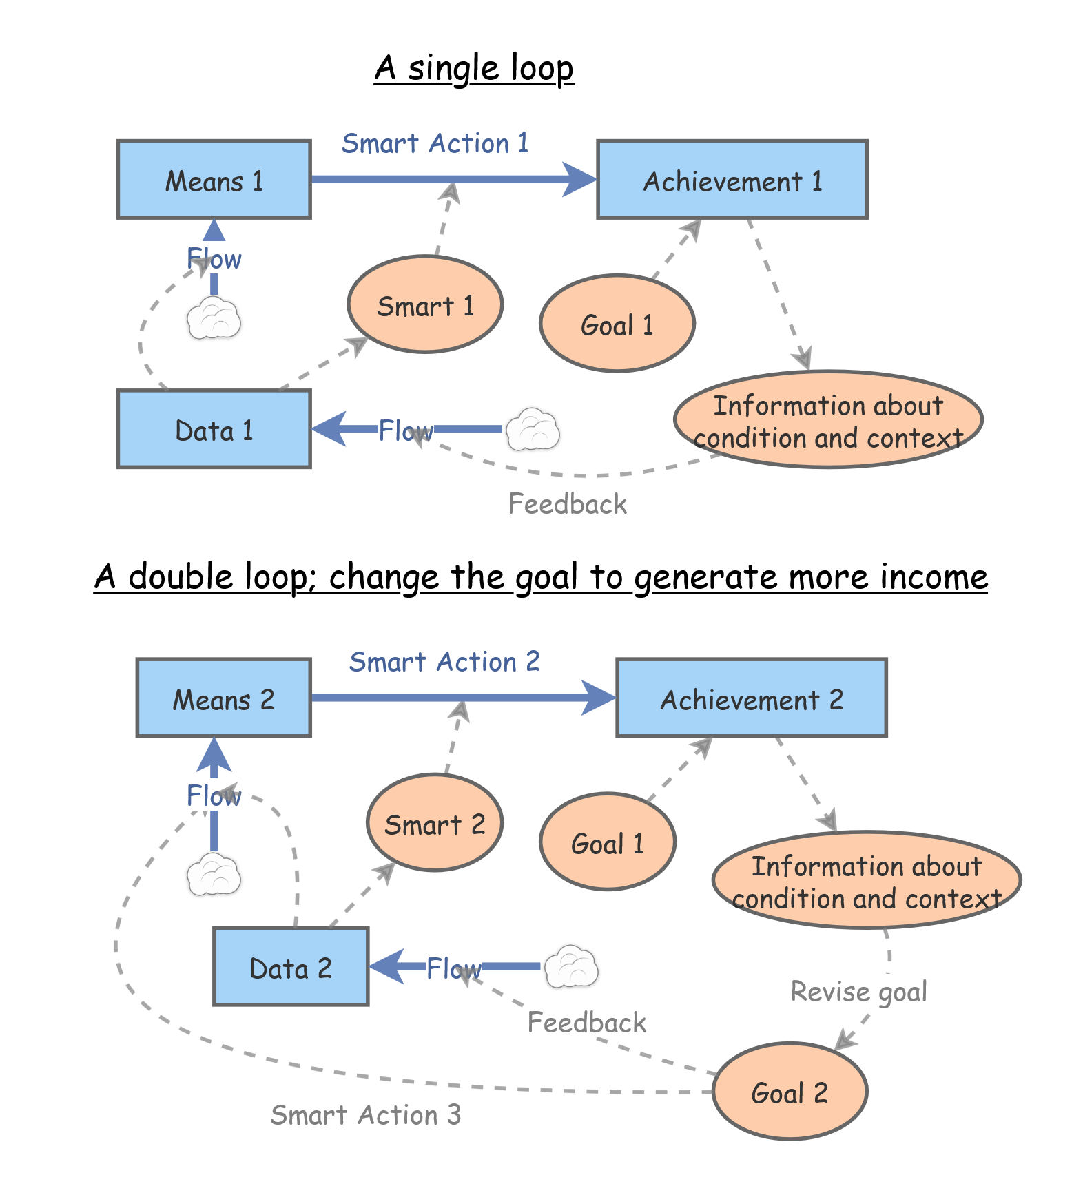
Smartness 2: Single loop learning
Smartness 3:
double loop learning

Slide 12
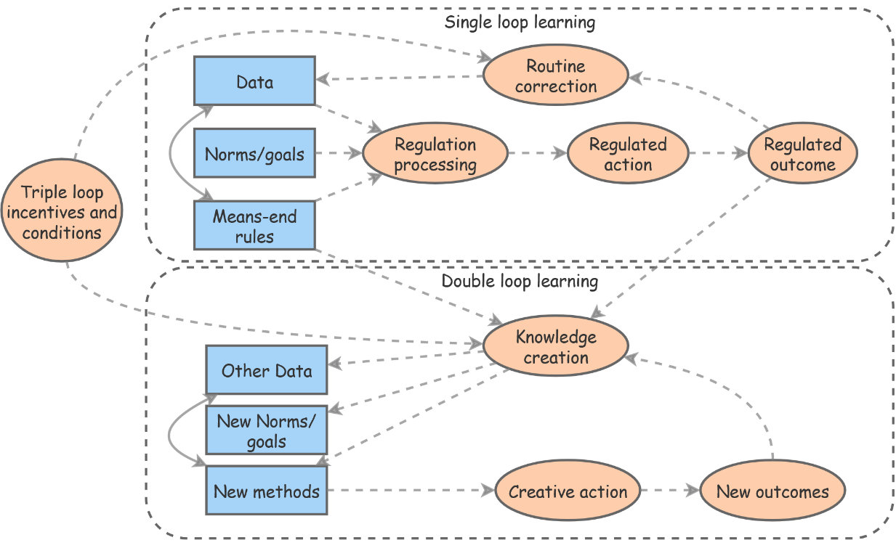
Smartness 4: Triple loop
Conditions determine if single or double is smarter

Slide 13
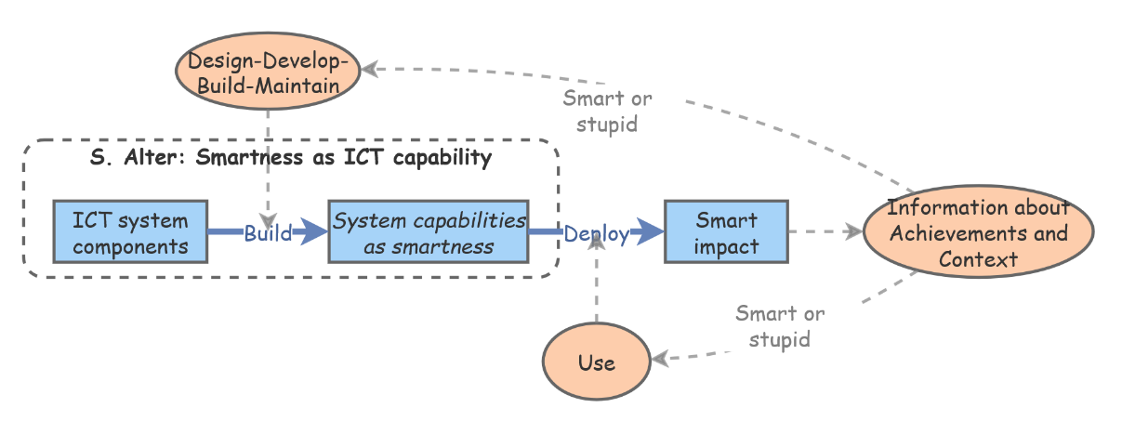
Smartness 5: ICT smartness

Slide 14
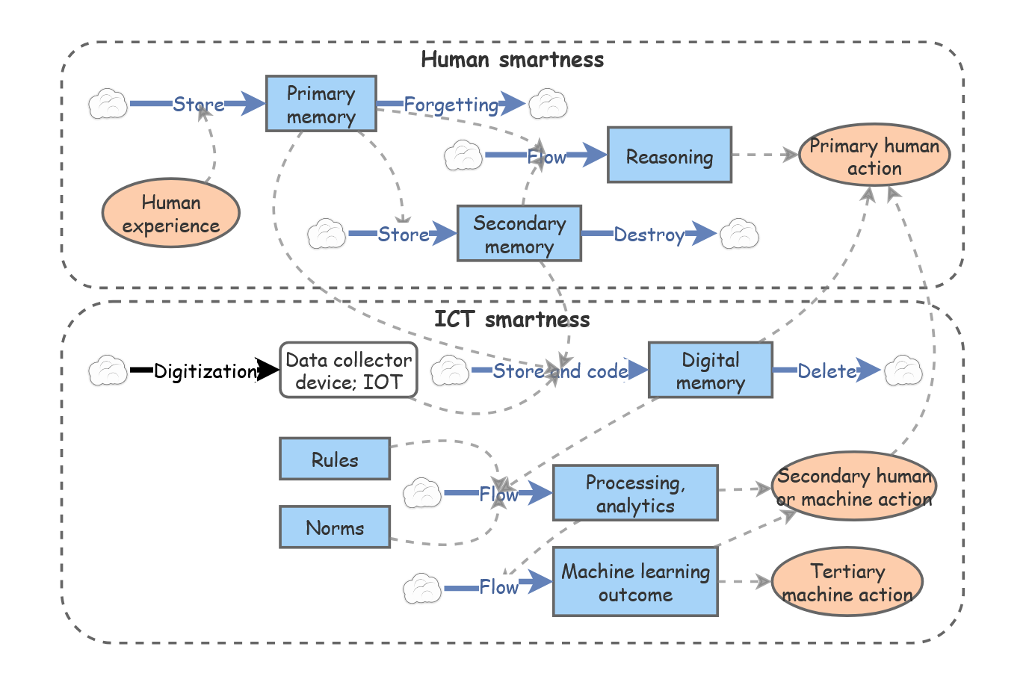
ICT smartness; some details
Based on Stiegler (2019)

Slide 15
Steven Alter: Smartness in the context of ICT
“Purposefully designed entity X is smart to the extent to which it performs and controls functions that attempt to produce useful results …
… through activities that apply automated capabilities and other physical, informational, technical, and intellectual resources …
… for processing information, interpreting information, and/or learning from information that may or that may not be specified by its designers”(Alter, 2020, p. 384).
Alter (2020)

Slide 16
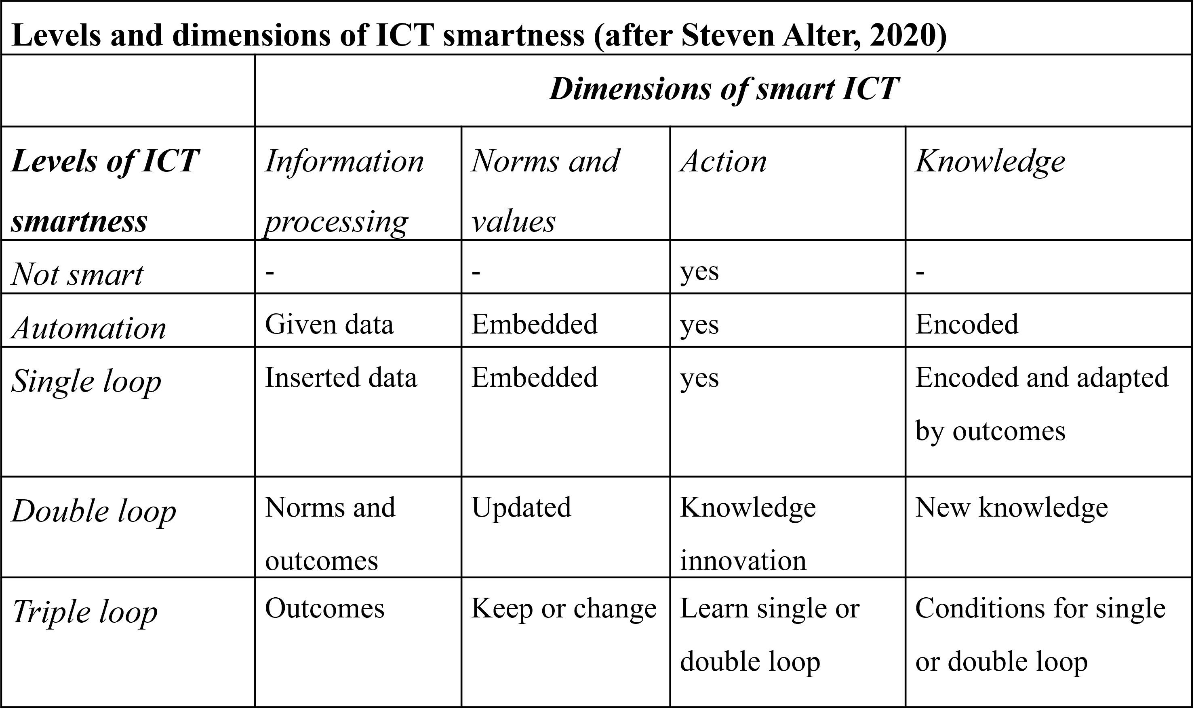

Slide 21
5. Symbiotic Smartness
Symbiotics:
The co-evolving interaction of people and systems

Slide 22
1. Goal achievement; with or without automation
Dynamic learning smartness types:
2.1. Single loop feedback learning
2.2. Double loop feedback learning
2.3. Triple loop learning mode selection
2.4. ICT learning alone????
2.5. Human and ICT symbiotic learning
2.5.1. Mutualistic symbiotic learning
2.5.2. Commensalistic symbiotic learning
2.5.3. Parasitic symbiotic learning
How many types of business smartness do we have?

Slide 23
Types of symbiotics (Yoon et al, 2022) applied to Human-ICT smartness
Symbiotics | Human | ICT | Human-ICT interaction
Mutualism | + | + | Intelligence amplification (Raisch & Krakowski, 2021)
Commensalism | 0 | + | ICT adoption
 | + | 0 | Static traditional enterprise systems
Parasitism | - | + | Artificial intelligence and human deskilling (Zuboff, 2019)

Slide 24
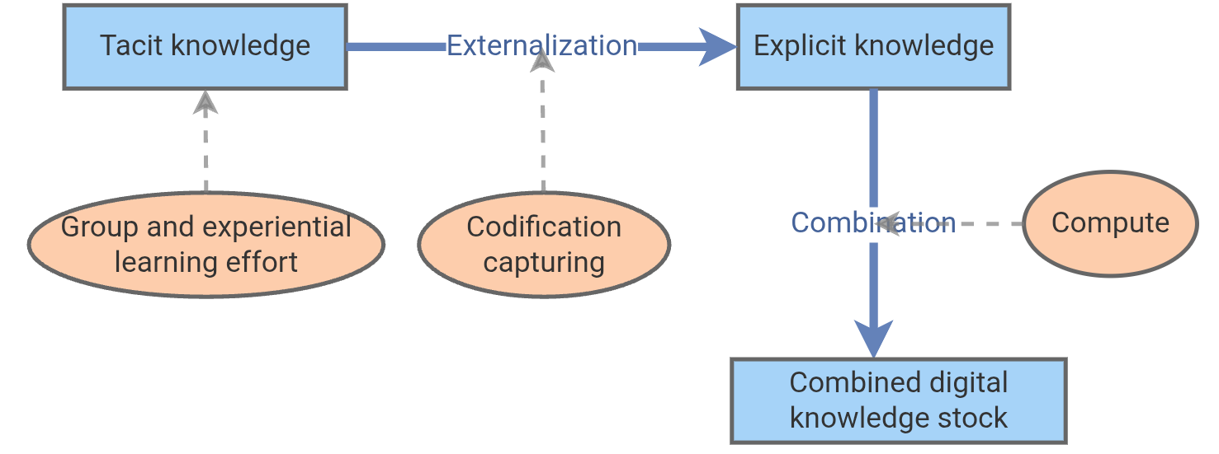
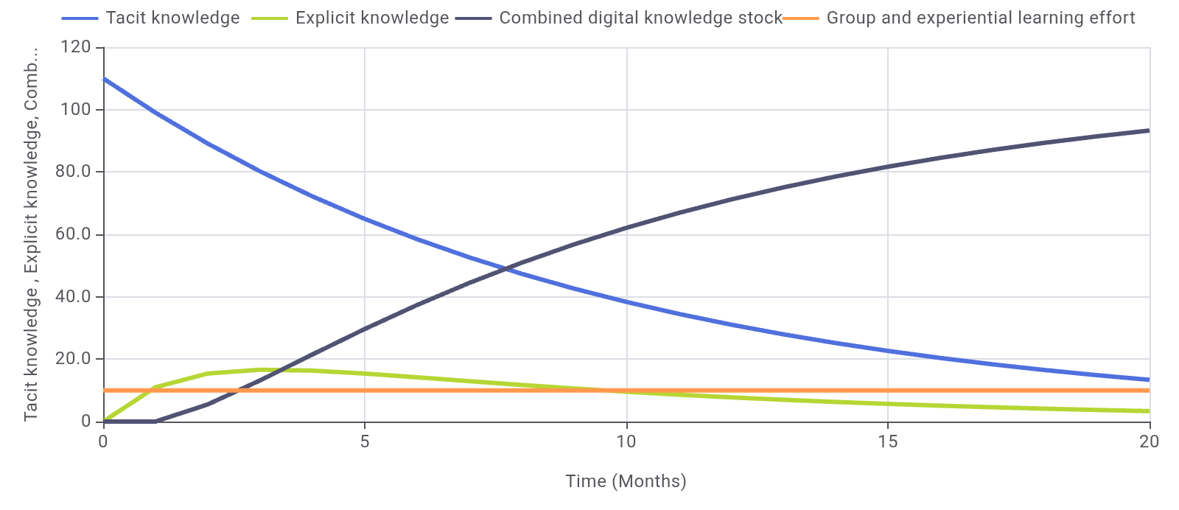
Human-ICT Parasitism
Also see Satyan Dhar’s opinion piece in CACM June 2026, 89:6
The end of the digital age

Slide 25
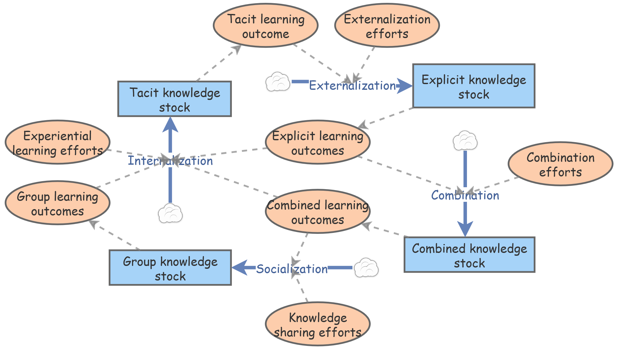
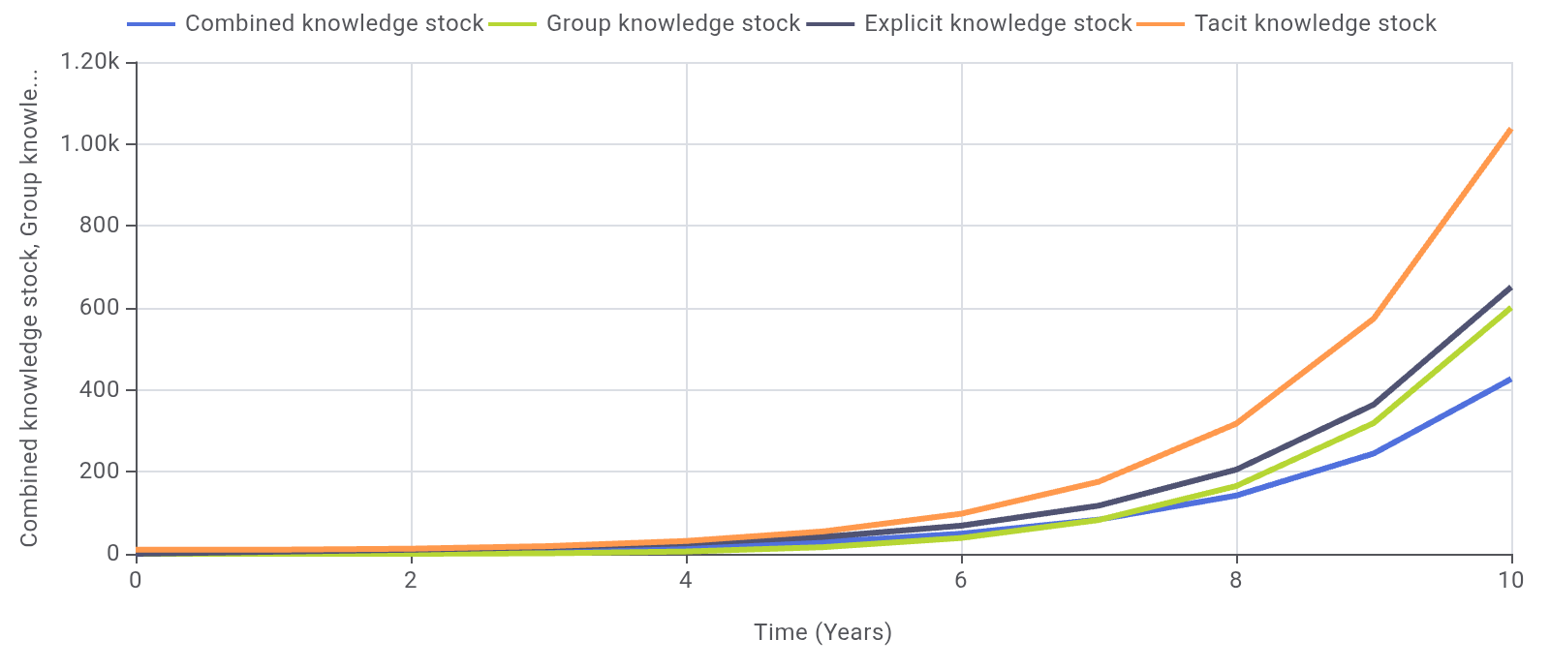
Human-ICT Mutualism

Slide 26
6. Four Cases of Smart Business

Slide 27
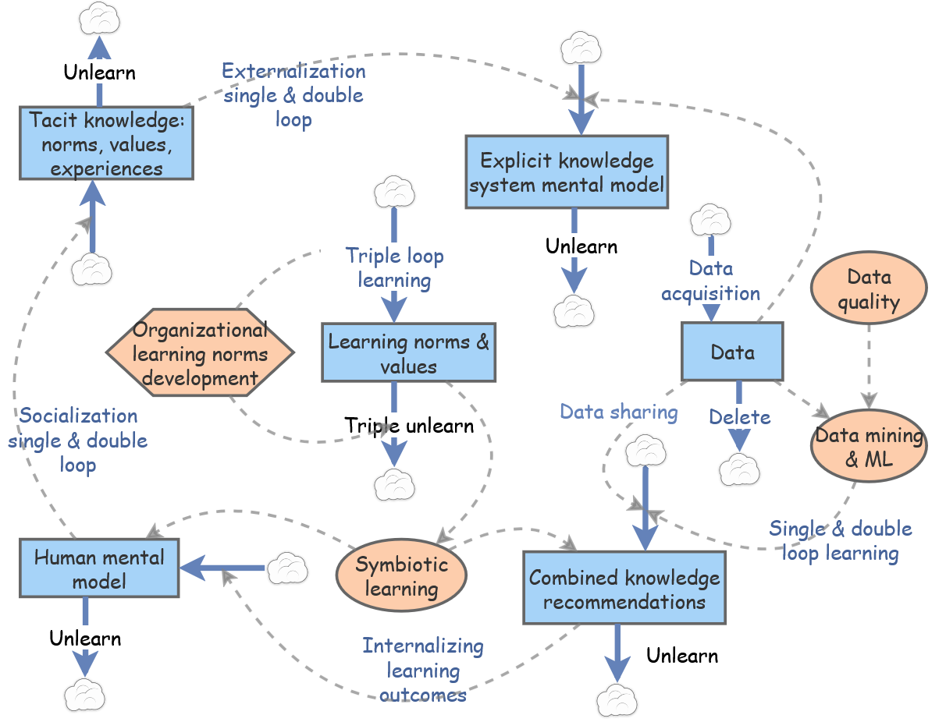
Case 1 — Insurance firm smart business
Continuous organizational learning from tacit knowledge to combined explicit knowledge

Slide 28
Case 2 — Workaround Mining
Learning Levels
Single loop: process efficiency by design and control
Double loop: Focus on customer values and allow deviations from dejure norms if needed
Triple loop: When to pursue efficiency single loop and when innovate goals double loop
Symbiotic: Balance the use of ICT/AI and human capabilities

Slide 29
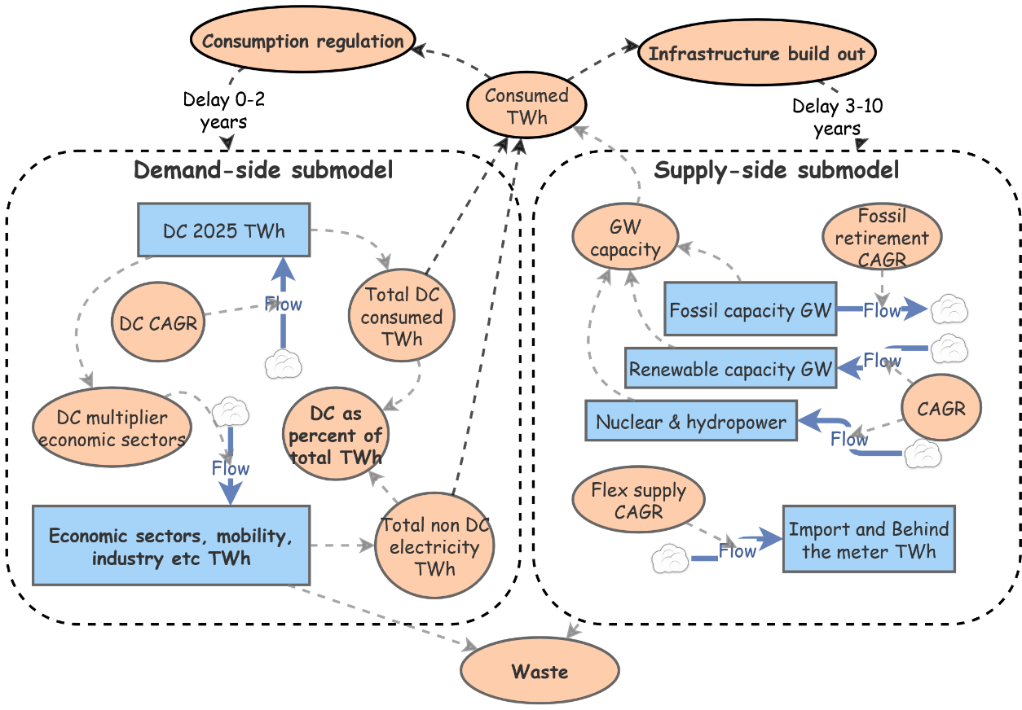
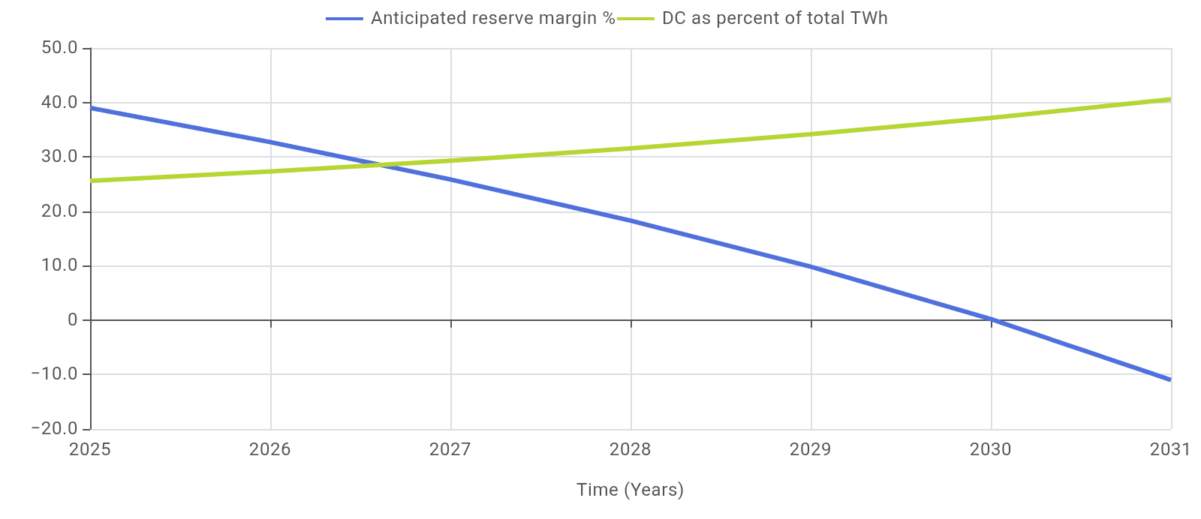
Case 3 — Data Centers: Symbiotics with the Grid
Virginia and Texas/ERCOT simulations

Slide 30
Case 4 — Smart industry in the EU
Draghi, 2024 report: The future of European Competitiveness

Slide 31
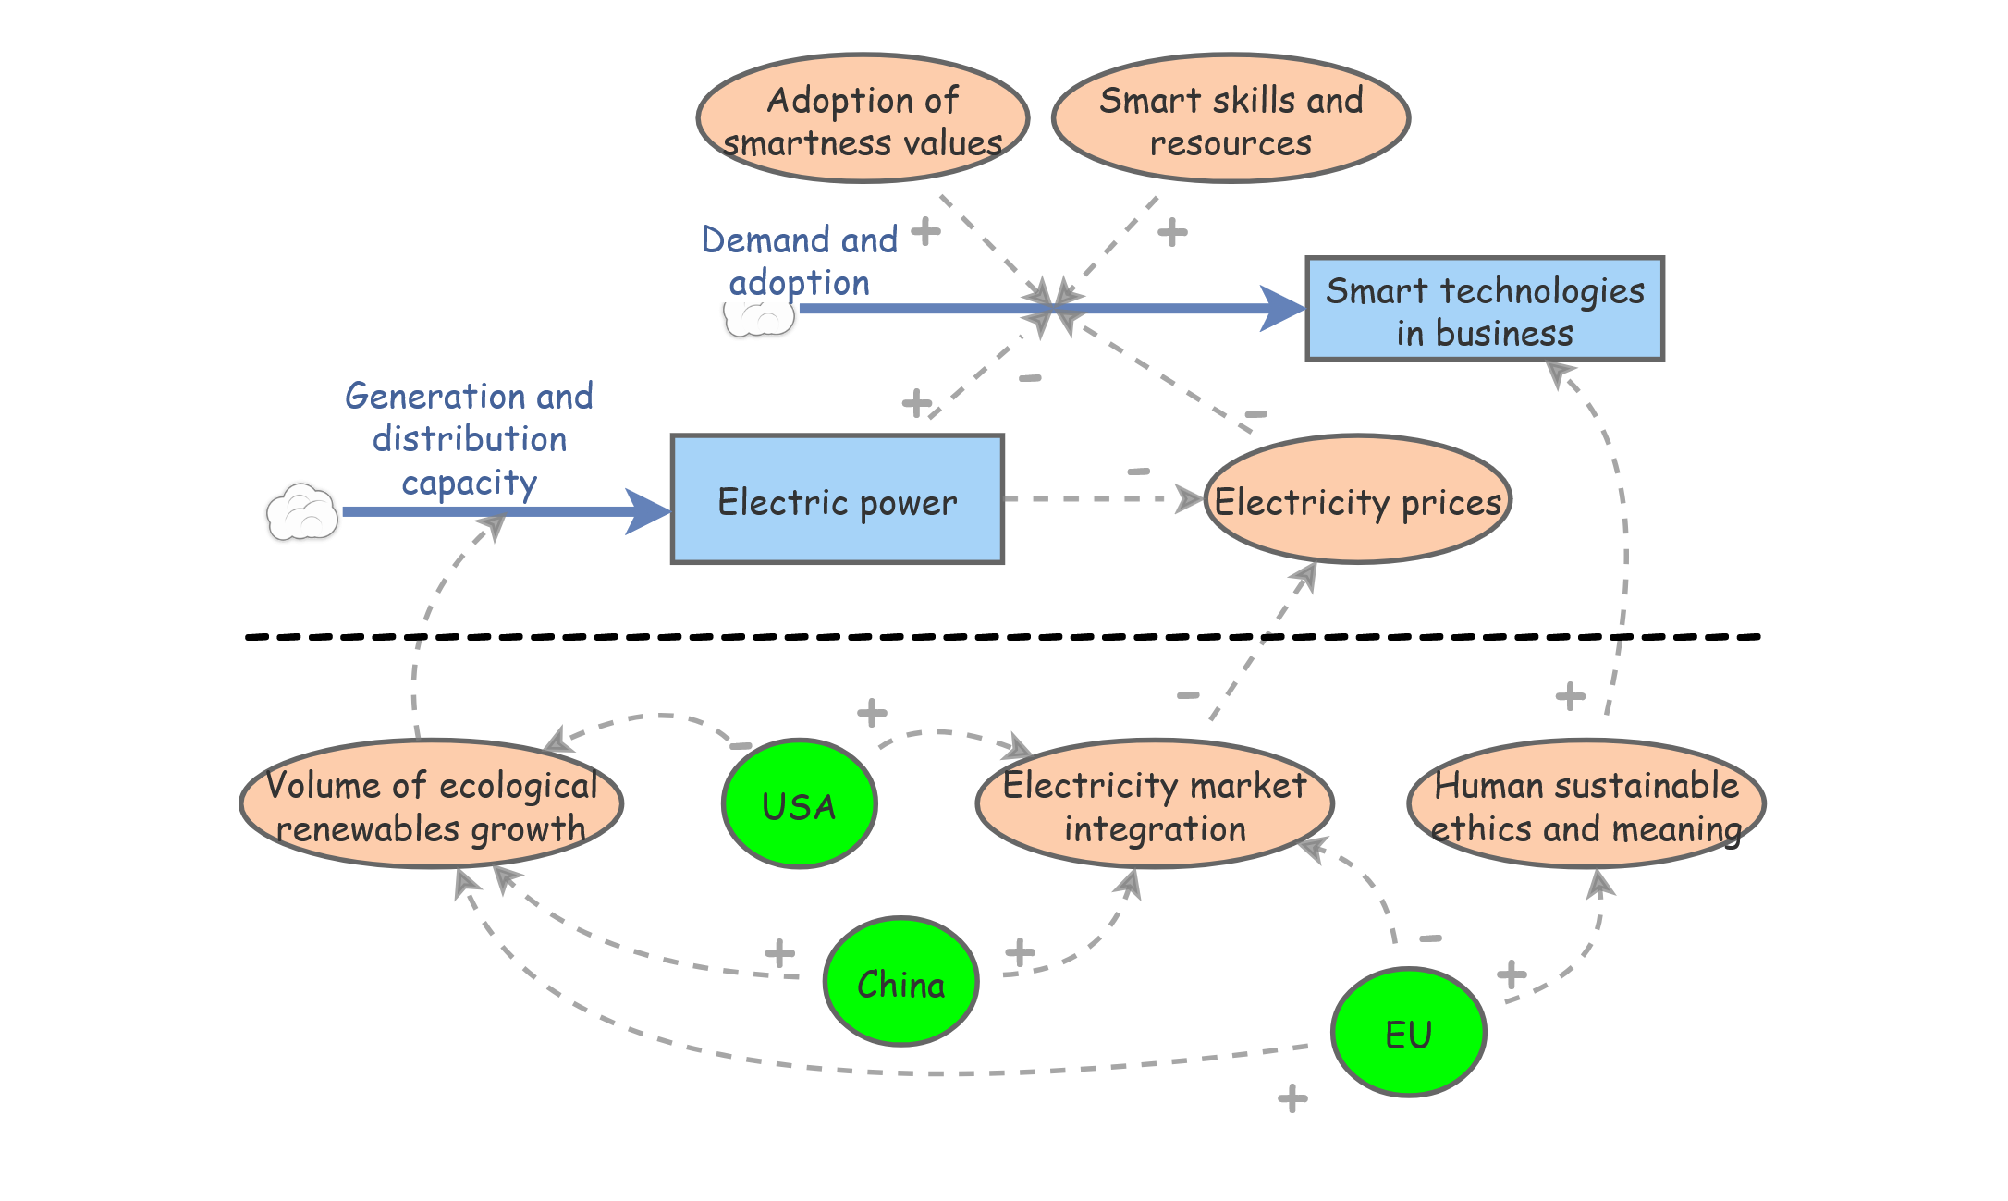
Case 4 — Smart industry in the EU

Slide 32
Case 4 — Smart industry in the EU

Slide 33
Cases — Smart industry symbiotics
Case | Human | ICT | Symbiotics
Insurance Firm | 0 | + | Commensalism
Workaround mining | + | + | Mutualism
Data centers USA and China | - | + | Parasitism
Smart industry EU | + | + | Mutualism (ecological and ethical) by an integrated electricity market and effective digital transformations (Draghi report 2024)

Slide 34
Lessons Smart industry symbiotics
Smartness concept | Symbiotics
Dimensions | Information processing, norms and values, action, knowledge
Measure value | Non, automation, single loop, double loop, triple loop
Symbiotic context | Human, ICT, Organization, Society, Global
Processes | Automation and Learning (single, double, triple, symbiotic)
Impact | Mutualism, Commensalism, Parasitism, Ecological, Ethical and Meaningful

Slide 35
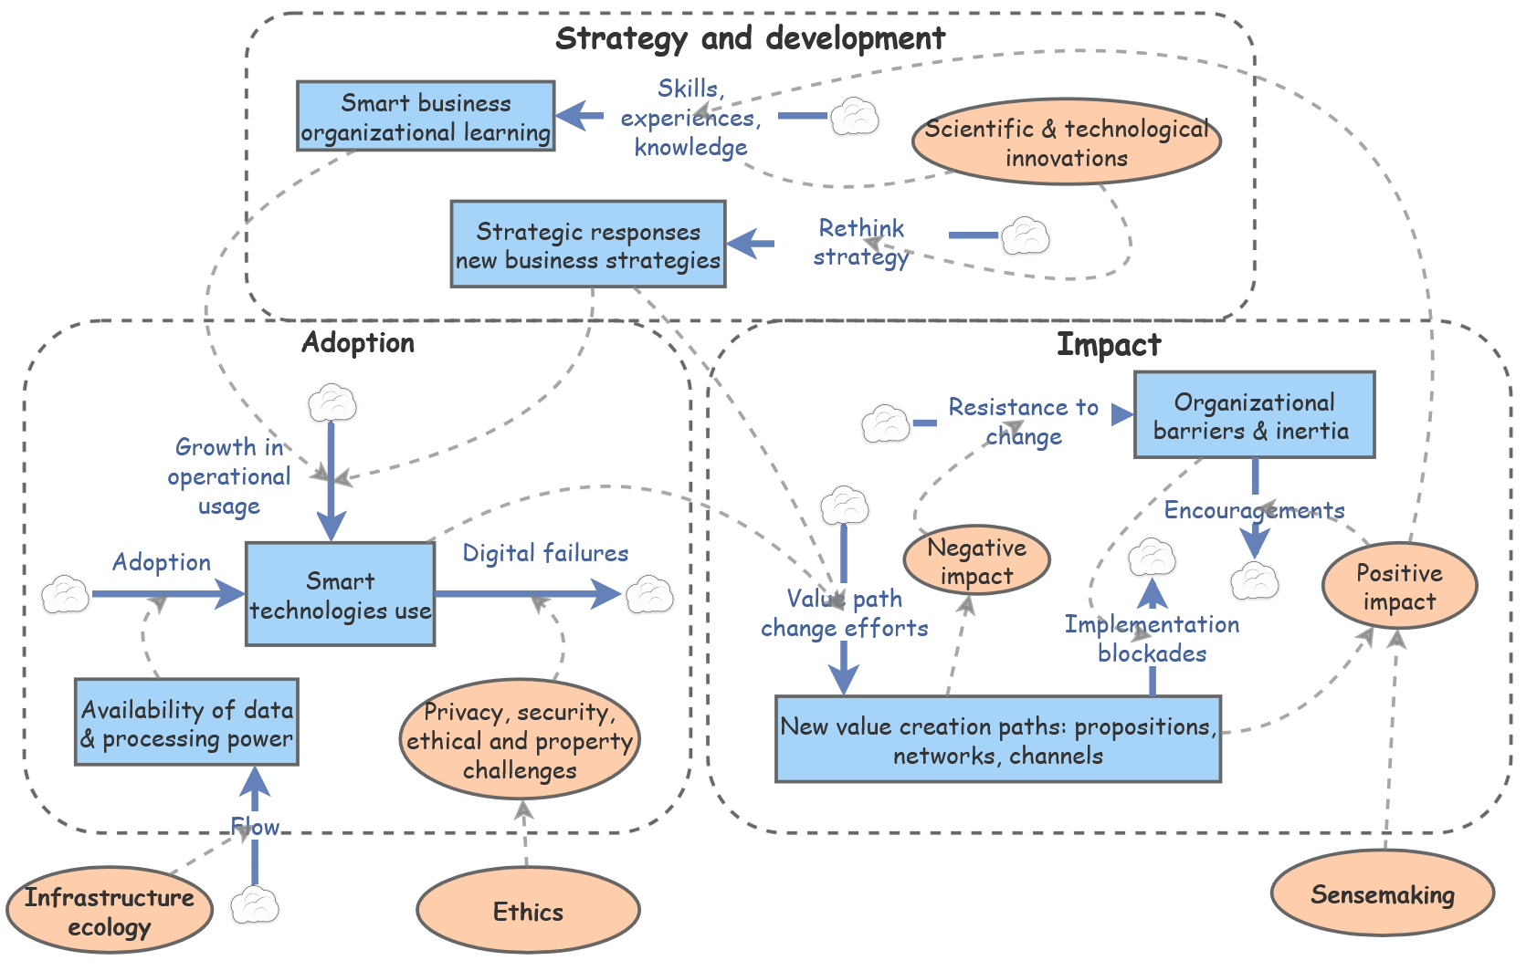
How to realize smart business symbiotics?
Based on Vial 2019; Digital Transformation

Slide 36
7. A Layered Research Agenda
Where the field needs to go
Component
Measuring smartness
Extend Alter’s smart capability measure as a benchmark
System
Smarts Socio-technical systems
Create smart systems as learning: AI vs Intelligence amplification
Organisation
CIO/CDO/CTO role
Create methods & tools for C-suite leaders to realize symbiotic smart symbiotic business?
Data Center / Region
DC ecosystem planning
Regional authorities can use system of dynamics to position DCs for long-term regional benefit and avoid ecological misfits?
New understandings
New skills, knowledge needed for new decision-making methods
How to avoid data senselessness and understand hyper derivate data?

Slide 37
8. And Rap up Summary
Smartness is diverse, layered — and must become symbiotic.
Smartness is multidimensional and has multiple levels of development
System dynamics conceptualizes smartness as a dynamic learning process
Single-loop AI → knowledge collapse; double-, triple and symbiotic loops for intelligence amplification
Cases: Mutualistic, Commensalist, Parasitist
Are data centres regionally mutualistic, commensalistic or parasitistic?
Reindustrialisation with smart industries; great opportunities for aged people!
Research agenda for multiple levels of smartness: component (measure), socio-technical system, organization, regions (with data centers) and new “understandings”

Slide 38
Thank You
Questions & Discussion
Special thanks:
· Scott Fortmann-Roe — InsightMaker (Open source, free ware; https://insightmaker.com/
· Bernard Stiegler — 'The Age of Disruption' (essential PhD reading)
· ICSBT program committee, conference chairs & organisers
· Schneider Electric research collaborators
Free InsightMaker book available via https://doi.org/10.25958/g8d5-4e98
More questions etc: Fonswijnhoven@proton.me or a.b.j.m.wijnhoven@utwente.nl

