Slide 1

Enterprises as model-driven systems nterprise Modelling 2.0
Henderik A. Proper

Slide 2
Enterprises as model-driven systems
Enterprise Modelling 2.0
Henderik A. Proper

Slide 3
My research interests
The science, practice, and art of domain modelling
In particular: domain modelling in an enterprise context
E.M.E.A.
Return on Modelling Effort (RoME)

Slide 4
Enterprises & models
RoME ViA RIME
Role of models in enterprises
Challenges & opportunities in the digital age

Slide 5
Enterprises & models
RoME ViA RIME
Role of models in enterprises
Challenges & opportunities in the digital age

Slide 6

What is an enterprise?
Companies
Universities
Agencies
A purpose-driven system
The purpose being its enterprise
Factories
Logistics networks
Mobility networks
Hospitals

Slide 7



What is a
model?

Slide 8
What is a domain model?
What is a
model?
“Naturally, they [ engineers ] are looking for forms and practices of design they are familiar with”
S. Junginger. Organizational Design Legacies & Service Design. Design Journal, 2015. Special Issue: Emerging Issues in Service Design.

Slide 9
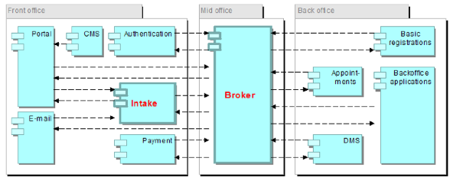
What is a domain model?

Slide 10
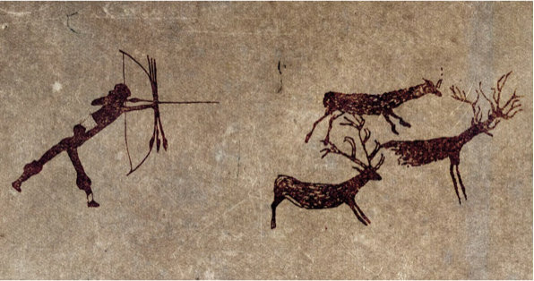
What is a domain model?

Slide 11
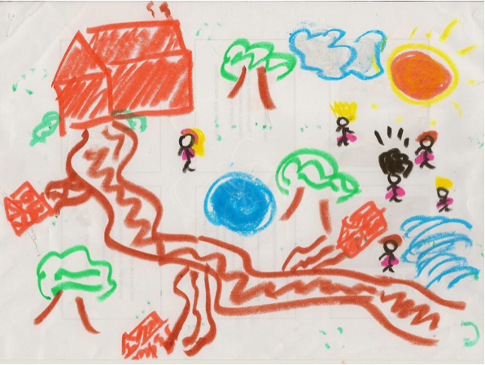
What is a domain model?

Slide 12
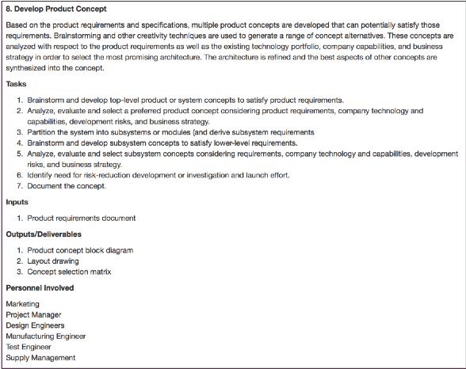
What is a domain model?

Slide 13
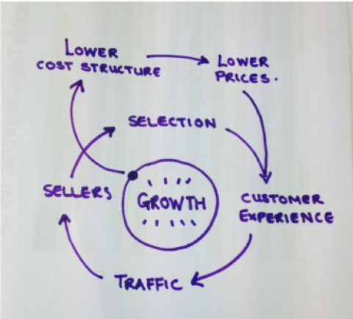
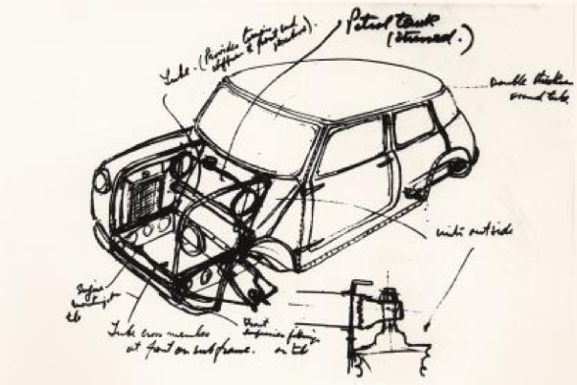
What is a domain model?

Slide 14
What is a domain model?

Slide 15
What is a domain model?
a social artifact that is:
acknowledged by an observer
as representing
an abstraction
of some domain
for a particular purpose
H. A. Proper and G. Guizzardi. On Domain Conceptualization. In D. Aveiro, G. Guizzardi, R. Pergl, and H. A. Proper, editors, Advances in Enterprise Engineering XIV - 10th Enterprise Engineering Working Conference, EEWC 2020, Bozen-Bolzano, Italy, September 28, October 19, and November 9-10, 2020, Revised Selected Papers, volume 411 of Lecture Notes in Business Information Processing, pages 49-69. Springer, Heidelberg, Germany, 2021.
Based on Peirce, Ogden & Richards, Apostel,
Stachowiak, FRISCO, …
And our own work 😇

Slide 16
Conceptual versus utilisation-design
Conceptual domain model:
A domain model that aims to be an as true as possible representation of the concepts and relations as identified in the domain
Utilisation-design domain model:
A domain model that has a representation that is suitable for some computational or experiential purpose, which may compromise the conceptual truefulness

Slide 17
Conceptual versus utilisation-design

Slide 18
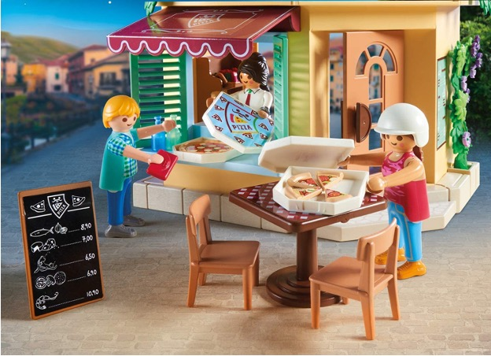

Conceptual versus utilisation-design

Slide 19
Enterprises & models
RoME ViA RIME
Role of models in enterprises
Challenges & opportunities in the digital age

Slide 20
RoME: Return on Modelling Effort
Effort in creating, administering, and using, models
How to measure?
How to reduce?
Benefits of creating and using models
How to measure?
How to increase?
www.models-at-work.org
How to make trade-offs?

Slide 21
Value bearers for modelling
Value in creation
The process of (co)creating a (conceptual) domain model
Value in use
The operational usage of the model (in line with its purpose)
Value in transaction
The (ownership of the) model itself

Slide 22
ViA: Value in Action
Value in creation
The process of (co)creating a (conceptual) domain model
Value in use
The operational usage of the model (in line with its purpose)

Slide 23
RIME: RetentIon of Modelling Effort
Which models to keep?
Where / how to keep them?
How to keep them up-to-date?
Security / Privacy?

Slide 24
Enterprises & models
RoME ViA RIME
Role of models in enterprises
Challenges & opportunities in the digital age

Slide 25
Enterprise models
A domain model pertaining to an enterprise
Could pertain to:
different aspects and their relations
its past, current, and desired affairs

Slide 26
Role of enterprise models
Understand
Assess
Diagnose
Plan
Realise
Operate
Regulate

Slide 27
Role of enterprise models
Understand
Assess
Diagnose
Plan
Realise
Operate
Regulate
Understand the working of an existing enterprise and / or its environment

Slide 28
Role of enterprise models
Understand
Assess
Diagnose
Plan
Realise
Operate
Regulate
Assess an existing enterprise in relation to e.g. a benchmark or a reference model

Slide 29
Role of enterprise models
Understand
Assess
Diagnose
Plan
Realise
Operate
Regulate
Diagnose the causes of an identified problem in an enterprise and / or its environment

Slide 30
Role of enterprise models
Understand
Assess
Diagnose
Plan
Realise
Operate
Regulate
Express different design alternatives, for the future and analyse properties of the desired design of an enterprise;
Possibly guided by reference models

Slide 31
Role of enterprise models
Understand
Assess
Diagnose
Plan
Realise
Operate
Regulate
Guidance, specification, or explanation during the realisation of a (future) design of an enterprise

Slide 32
Role of enterprise models
Understand
Assess
Diagnose
Plan
Realise
Operate
Regulate
Guidance, specification, or explanation for the actors involved in the operations of an enterprise

Slide 33
Role of enterprise models
Understand
Assess
Diagnose
Plan
Realise
Operate
Regulate
Externally formulated regulation on the operational behaviour of an enterprise

Slide 34
Enterprise design dialogues
Actors discussing and deciding on the design of an enterprise
Generally an ongoing process
Bottom-up or top-down

Slide 35
Enterprise design dialogues
Examples:
Co-workers discussing “how to” divide work, or conduct a (new) task
Process engineers discussing with senior business management how to shape a business process
Database engineers discussing with domain experts what information needs to be captured in the database
An enterprise architect interacting with different stakeholders to arrive at a new version of the enterprise architecture

Slide 36
Enterprise design dialogues
(Also) occur naturally in enterprises
“design conversations”
S. Junginger. Organizational Design Legacies & Service Design. Design Journal, 2015. Special Issue: Emerging Issues in Service Design.
“authoring the organisation”
J. R. Taylor and E. J. Van Every. When Organization Fails: Why Authority Matters. Routledge, London, United Kingdom, 2004.

Slide 37
Enterprise design dialogues
Business innovation
Organisational design
Business process management
Change management
Enterprise engineering
Enterprise architecture

Slide 38
Enterprise design dialogues
Coherence
Engagement
Evidence-enabled

Slide 39
Enterprise design dialogues
Coherence
Engagement
Evidence-enabled
Ensure alignment & integration of all relevant aspects

Slide 40
Enterprise design dialogues
Coherence
Engagement
Evidence-enabled
Involve and engage all relevant stakeholders

Slide 41
Enterprise design dialogues
Coherence
Engagement
Evidence-enabled
Enable informed decision making, based on evidence

Slide 42
Enterprise models
A domain model pertaining to an enterprise
Could pertain to:
its past, current, desired affairs
its operations, development, or regulation
In support of, or created in, enterprise design dialogues

Slide 43
The role of enterprise modelling
Coherence
Engagement
Evidence-enabled
Understand
Assess
Diagnose
Plan
Realise
Operate
Regulate
Natural …
×
How efficient?
How effective?
RoME ViA RIME
Enterprise modelling backbone in support of enterprise design dialogues

Slide 44
Enterprises & models
RoME ViA RIME
Role of models in enterprises
Challenges & opportunities in the digital age

Slide 45
An increasing role for IT
From
  automation of information processing
via
  automation of business processes
to being an
  integral part of the business model
Coherence; EM!

Slide 46
Challenges in the digital age
Agility
Compliance
Anti-fragility
Robustness
Efficiency

Slide 47
Challenges in the digital age
Agility
Robustness
Design-time = run-time
Compliance
Efficiency
Agile enterprise
Anti-fragility
Real-time enterprise
DevOps
Continuous engineering

Slide 48
Increasing role for enterprise modelling
Agility
xAI
Robustness
BP Management
Compliance
Efficiency
Model-driven engineering
Anti-fragility
Low code; High models
DevOps
Digital twins
Agile enterprise
Enterprise analytics
Real-time enterprise
Continuous engineering
EA Management
Design-time = run-time

Slide 49
Opportunities for enterprise modelling
Model-driven engineering
Agility
Low code; High models
Robustness
Process & rule engines
BP Management
Compliance
Enterprise analytics
AI assistance
Efficiency
EA Management
Anti-fragility
Enterprise mining
Digital twins
xAI
DevOps
Simulation & animation
Agile enterprise
Knowledge graphs
Real-time enterprise
Continuous engineering
Collaboration engineering
Design-time = run-time
Advanced UIs

Slide 50
Towards an integrated concept
Model-driven engineering
Agility
Low code; High models
Robustness
BP Management
Compliance
Enterprise analytics
Efficiency
EA Management
Anti-fragility
Digital twins
xAI
DevOps
Enterprise mining
Agile enterprise
Knowledge graphs
Process & rule engines
Real-time enterprise
Advanced UIs
Continuous engineering
AI assistance
Design-time = run-time
Collaboration engineering
Simulation & animation

Slide 51
RoME ViA RIME
Compliance
xAI
AI assistance
Agility
EA Management
Model-driven engineering
Digital twins
Efficiency
Anti-fragility
Continuous engineering
Enterprise analytics
Design-time = run-time
DevOps
Low code; High models
Robustness
Process & rule engines
Real-time enterprise
BP Management
Enterprise mining
Collaboration engineering
Advanced UIs
Agile enterprise
Simulation & animation
Digital enterprise modelling backbone
Enabling design dialogues in digital enterprises

Slide 52
Enterprises & models
RoME ViA RIME
Role of models in enterprises
Challenges & opportunities in the digital age

Slide 53
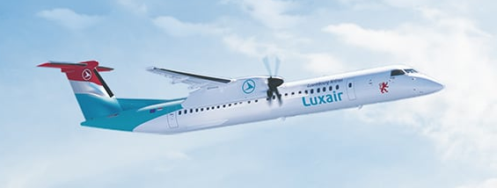


1.1.2023
We’re Hiring

