Slide 1
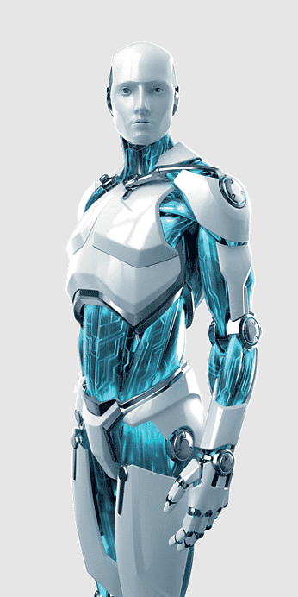
The Case for “Cognitive Digital Twin
How Cognitive Digital Twins, Cognitive Digital Threads, and Cognitive Digital Swarms Can Solve Major Problems Facing the Design, Implementation, and Operation of Smarter Products, Processes, and Solutions?
Dr. Ahmed El Adl
Coined the Cognitive Digital Twin (2016)
Founder & CEO, CogniTwins
Boston, MA, USA

Slide 2
Agenda
Complex intelligent systems require a new approach
The new Paradigm (Architectural Principals & Capabilities):
The system - Cognitive Digital Twin (CDT)
The Data & Knowledge Framework - Cognitive Digital Thread (CDH)
The collaboration Framework – Cognitive Digital Swarm (CDS)
Case studies:
Overall Product Lifecycle
Supply Chain Optimization
Drug Discovery
Clinical trails
Q & A

Slide 3
Why is a System Approach Needed?

Slide 4
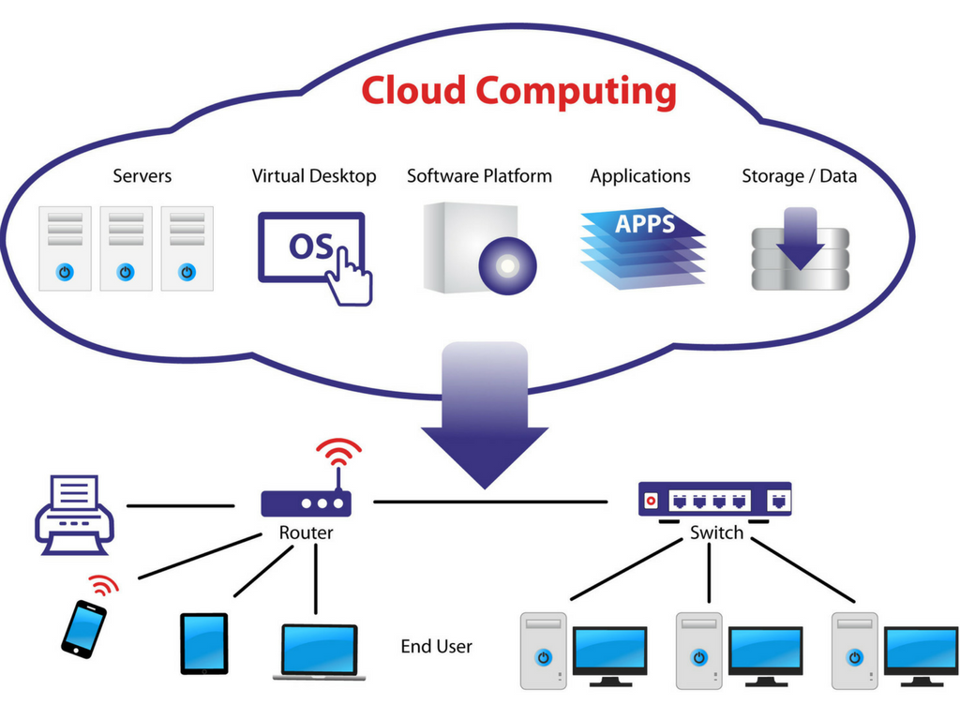
Cognitive Digital Twin: The Growing Needs
Traditional Solution:
Departments collect the required data sets
Store them in a data lake
Build analytics tools or some algorithms on top of it
Result: Fails To Fulfill Expectations
Typical Need:
In the era of IR 4.0/X.0, we need contextualized data and actionable knowledge to be able to make the right decision in different areas of the business:
Product Design
Materials selection/sourcing
Manufacturing
Customers sales and servcie
Operation
Maintenance
Yes
Is it possible for us to do that?”
New Solutions Paradigm:
Build cognitive digital twin supported by the cognitive digital thread to enable data contextualization, Knowledge creation, and smarter decision making
Result: Building For The Future
Yes

Slide 5
Risks of the Algorithms-Focused
Holistic Understanding
Cross-functional Collaboration
Data Quality and Consistency
Integration and Interoperability
Robustness and Reliability
Resources & Performance Optimization
Long-term Maintainability
& Sustainability
Unforeseen Consequences, Risk Assessment, and Management
Ethics and Regulatory Compliance

Slide 6
The Cognitive Digital Twin (CDT):
Key Capabilities
Simulate
Represent
Comprehend
Predict
Recommend
Learn
Collaborate
Interact

Slide 7
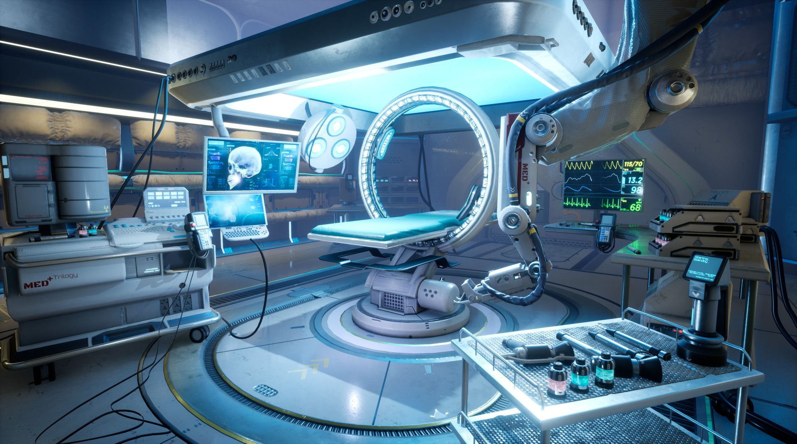
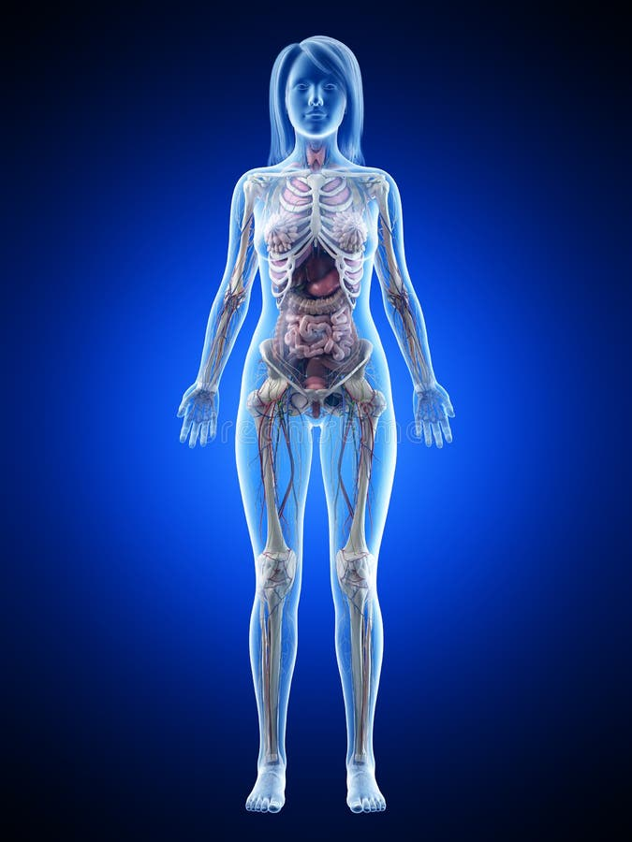
The Cognitive Digital Twin (CDT):
Key Capabilities
Physical world
Cognitive Digital Twin
Simulate
Machines
Represent
Comprehend
Predict
Recommend
Humans
Learn
Collaborate
Interact
Processes

Slide 8
The Proposed Cognitive System

Slide 9
The Cognitive Digital twin
Fed Data & Knowledge by the Cognitive Digital Thread
Collaborating through the Cognitive Digital Swarm

Slide 10
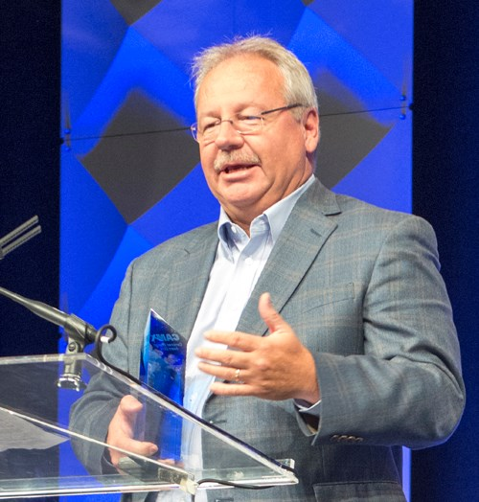
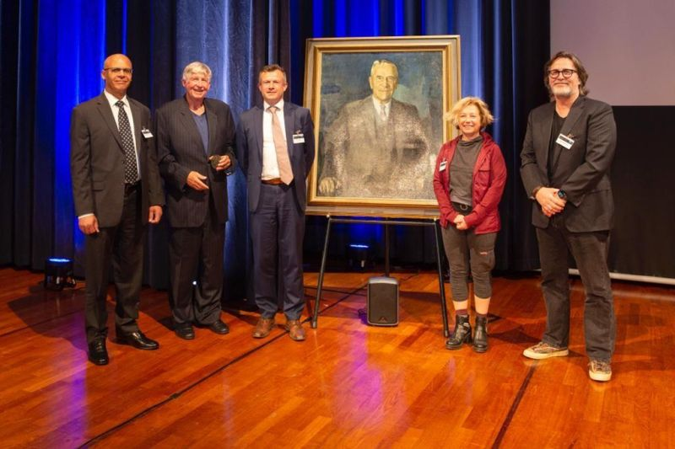
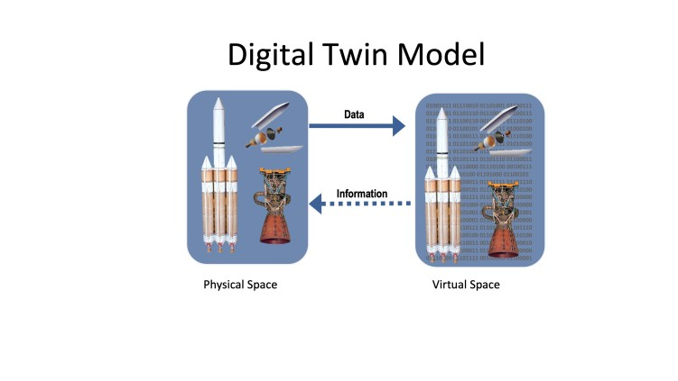
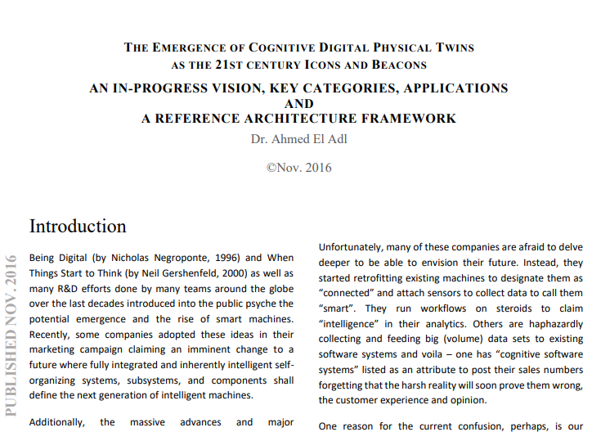
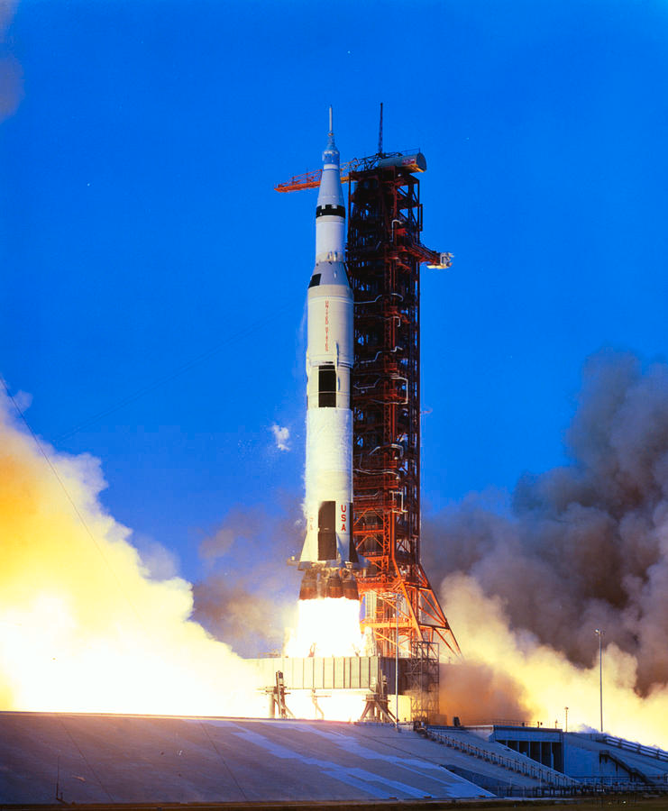
Brief History of the Digital Twin
Dr. Michael Grieves
John Vickers / NASA
Dr. Ahmed El Adl
Dr. Grieves & Dr. El Adl
After Apollo 13, NASA started different space engineering and simulation programs that led to the mindset and concept of Digital Twin
Introduced the concept of Digital Twin (virtual doppelganger) in the context of PLM for the automotive industry (2002)
He and a team of NASA coined the actual “Digital Twin” term.
Digital Twin was introduced in 2010 in NASA’s “Draft Roadmap on Modeling, Simulation, Information Technology and Processing''
Coined and published the concept of “Cognitive Digital Twin, Thread, & Swarm ” in 2016.
Continued refining the concepts through real-world implementations
Both were recognized by the TU Eindhoven, NL for their pioneer work introducing DT/CDT.
Dr. Grieves accepts Holst memorial award for his important contributions of introducing the concept of Digital twin. Dr. El Adl a keynote speaker.
1970
2002
2010
2016
2022
The whole world

Slide 11
The Cognitive Digital Twin (CDT)
New Paradigm for Intelligent Systems
Real-Time Cognitive Systems & Solutions
Cognitive Digital Swarm (CDS)
Cognitive Digital Twin
A purpose-driven digital representation of a physical twin that continuously learns
{Teams & Collaboration}
Representation & Platform
Cognitive Digital Twin (CDT)
HMI/MMI
Cognitive Digital Swarm
Super teams of physical and digital twins working effectively together to achieve common goals
Cognitive Digital Thread
Provides the right data at the right time within the right context
Data & Knowledge
Cognitive Digital Thread (CTH)
The Three Dimensions of success

Slide 12
Cognitive Digital Twin is a platform of platforms

Slide 13
The Cognitive Digital Twin (CDT): Definition
The Cognitive Digital Twin (CDT) is a functions-driven digital representation of its physical Twin. It is also a capability augmentation and an intelligent digital companion that evolves its knowledge, cognition skills, and digital capabilities across all life cycles and evolution phases of its physical twin
∑ ( Machines + Processes + Humans )
Dr. Ahmed El Adl, 2016 - 2023

Slide 14
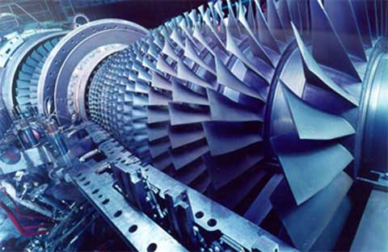
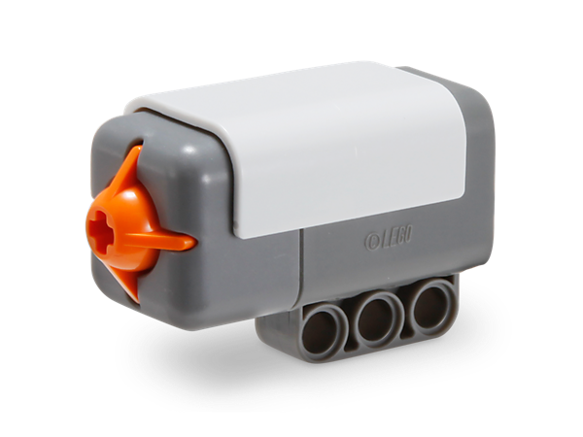
The Cognitive Digital Twin (CDT) Key Categories
Machines Cognitive Digital Twins
Enables a completely new approach for the prototyping, designing, testing, manufacturing, and operating intelligent Objects such as Machines, Smart Building, Cognitive Cities ...
Increasingly becoming a major transformative force in many industries
Human Cognitive Digital Twin (HCDT)
Augments our physical and cognitive capabilities
Accelerated by the progress in machines digital twins, (G)AI, Metaverse …
It is slowly shaping the way we live and work.
Object Cognitive Digital Twin
It enables the digitization and augmentation of large number of less-complicated physical objects and subsystems
It is emerging to be the largest population of cognitive digital twins
Enterprise Cognitive Digital Twin (ECDT)
It’ll define and accelerate the creation of the cognitive enterprise, where its products, solutions, services, processes, and people are seamlessly connected and digitally represented and intelligently augmented

Slide 15
The Cognitive Digital Twin
Key Architectural Principals (Not Comprehensive)
Dynamically identify, acquire and transform the static, historical, and real-time data it needs using meta-templates and cognition
Acquire, create, and leverage general and domain-specific knowledge
Ability to use the same data and knowledge in different contexts and perspectives
Interpret intentions and requests from Physical & Digital systems and Humans to be able to:
Identify cognitive & other capabilities required to do the tasks
Adapt to different tasks and environment in a reliable and safe way
Set parameters values and define boundary conditions as required
Modular and extensible architecture to enable flexibility and growth
Gain new capabilities and improve its performance over time
Predict, identify and prevent preaches, biases, and manipulative data

Slide 16
The Data and Knowledge

Slide 17
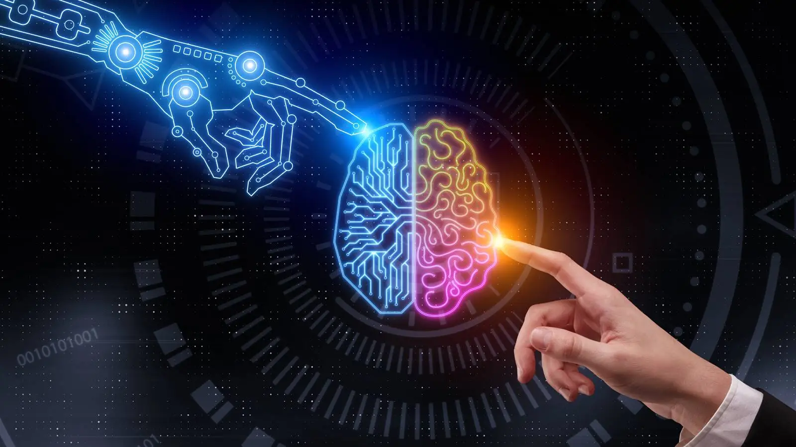
From “Data Mess” to “Cognitive Digital Thread”
Scattered structured DB
(pre-Defined formats and structures)
Centralized structured & unstructured Data
(near-exact/exact source format)
Virtualized structured & unstructured data
(Decentralized, real-time data integration and preprocessing)
Virtualized heterogenous data
&
centralized knowledge
Cognitive Digital Thread
Digital Thread
Values to Business
Data Mesh
Data, Models, and Knowledge
Data Fabric
Data Lake
Data Warehouse
Data, models, & Documents
Database(s)
Cognitive AI-powered systems
Data Fabric: Technology centric Data Virtualization: Data centric Data Mesh: Domain centric Digital Thread: Knowledge centric

Slide 18
The Cognitive Digital Thread (CDH): Definition
The Cognitive Digital Thread is a cognitive framework that manages how heterogenous data, information and knowledge is created, collected, integrated, interlinked, contextualized, traced, and accessed across the lifecycle of the physical and digital twins.
It provides the right data and knowledge at the right time, the right quality, and within the right context to Physical Twins, Digital Twins …
CDH = ∑ ( Models + Data + Information ) x Perspectives
Dr. Ahmed El Adl, 2020 - 2023

Slide 19
Cognitive Digital Thread: Key architectural principals (not comprehensive)
Data and information should be collected, preprocessed, interpreted and made available through “Perspectives”
Processes Functions Activities
Personas Lifecycle Phase
System & Component …
Apply predetermined operations or actions to preprocess and transform data and information
Leverage different system integration standards and dynamically creates services to enable collecting the required heterogenous data from physical and digital systems
Support multi-source heterogenous data fusion on different levels and stages to accommodate for diversity of sources, low quality, and complex types of Data
Leverages AI capabilities and cross-domain knowledge for:
adaptive reasoning interrelationship of data
smart visualization
Provides end-to-end traceability of Data and information including sources of data
Cognitive Digital Thread isn’t an enterprise data management system

Slide 20
The Collaboration & Interoperability

Slide 21
The case for Cognitive Digital Swarms (CDS)
Intelligent autonomous systems are very complex and hard to build and manage
Digital Twins rely on large amount of data and knowledge that can’t be handled by one system
Tasks in the digital and physical world are usually complex and require different skills and capabilities
Collective and emergent behaviors are needed to tackle complex problems in a dynamically changing environment
Real-world tasks needs artificial swarm intelligence (ASI)
Integration and interoperability between large scale digital twins are near impossible and risky
CDS reduces cyber security risks and enhances the overall prevention and recovery measures.

Slide 22
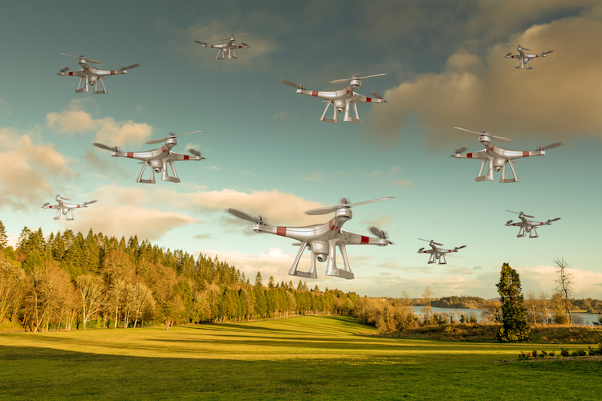
The Cognitive Digital Swarm (CDS): Definition
The Cognitive Digital Swarm is a decentralized self-organizing set of autonomous or semi-autonomous digital twins coming together in a permeant or temporary relationship where every twin contributes to and benefit from the collective capabilities of the swarm to achieve common goal(s)
CDS = ∑ (n x CDTs ) + (m x Physical Twins)
Dr. Ahmed El Adl, 2016 - 2023
Notes:
Collective intelligence
metaheuristic is a higher-level procedure or heuristic designed to find, generate, or select a heuristic (partial search algorithm) that may provide a sufficiently good solution to an optimization problem, especially with incomplete or imperfect information or limited computation capacity

Slide 23
The Cognitive Digital Swarms: Main Categories
Strategic Digital Swarms: long term collaboration with wide range of undefined tasks and roles but with a common cause.
Joint venture Digital Swarms: temporary relationship based on predefined goals and specific tasks assigned to each participating twin.
Outsourcing Digital Swarms: task-based collaboration. No relationship between twins.
Spatial Digital Swarms: Location based and specific spatial requirements starts a temporary swarm.
Anonymous Digital Swarms: temporary collaboration without sharing any information.
Multiple Digital and Physical Twins collaborate to achieve common goals or do specific tasks

Slide 24
Cognitive Digital Twin A new way of doing business

Slide 25
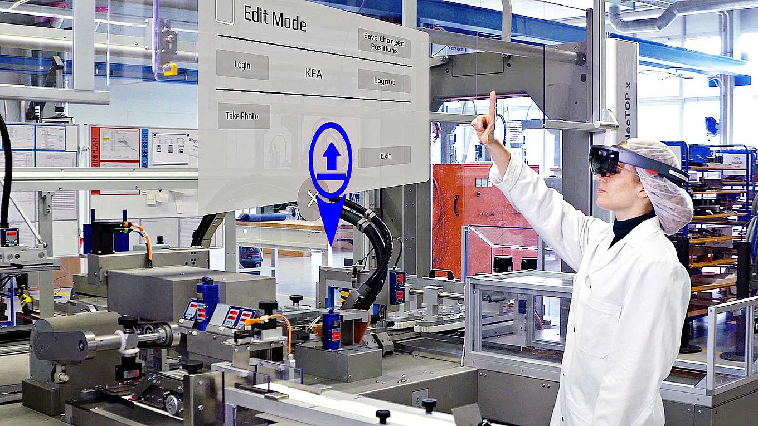
Cognitive Digital Twin A new way of doing business
CONCEPT & PORTFOLIO MANAGEMENT
DESIGN/ SYSTEMS ENGINEERING
SUPPLY CHAIN INTEGRATION
SIMULATION/ VIRTUAL PROTOTYPING
MANUFACTURING ENGINEERING
PRODUCTION & QUALITY
PRODUCT LAUNCH
IN-USE TELEMETRY
Operate, MAINTAIN & SERVICE
RETIRE
R&D
Smart Supply Chain
Smart Manufacturing
An interconnected swarm of CDTs
CDT powered Data & knowledge R&D
CDT led product ideation and design
Product Formulation/recipes selection
Lab Automation (machines & processes)
Automated Testing (semi / end-to-end)
…
Supply chain optimization (global/regional)
Proactive planning (demands, risks …)
Intelligent automation
Dynamic Resilience
Logistics simulation, monitoring, assessment, and real-time adjustments
Fleet management and Predictive maintenance
…
Automated Dynamic planning and execution (beyond MES)
Intelligent Simulation inside Metaverse (products, factory, …)
Quality Control (monitoring, recommendation, & automation)
Overall Equipment Efficiency (OEE)
Workforce Optimization
Continues safety and security enhancement
…

Slide 26
Cognitive digital twin Supply Chain Optimization

Slide 27
Cognitive Digital Twin for Supply Chain Optimization People, Processes and Machines
Source
N-tier Supplier
Suppliers
Operations
Transport
Distribution
Consumers
Plan
R&D
Plan
Make
Learn
Predict
Comprehend
Decide
Execute
Source
Deliver
27

Slide 28
Supply Chain Optimization: CDT Capabilities
Convert massive amount of data to useful knowledge using different AI capabilities such as KGS
Use diverse data sets and domain knowledge to enable low-cost simulations to find alternatives:
Different material acquisition scenarios (vendor, time, costs ...)
Logistics and warehouse management scenarios.
Financial analytics broke down by product, material, vendor, region …
Smart manufacturing processes to increase Throughput, Quality, OEE, and Human workforce utilization
Real-time predictive monitoring and tuning of different aspects such as risks and demands
Enable real-time enhanced global and regional decision making for human and machines
Proactive risk identification, assessment, and response across the supplier's chain
Understand the interrelationships and mutual effects of events, low-probability high impact events
Enables dynamic intelligent automation based on the current status across the supply chain
28

Slide 29
CDT-based Supply Chain Management: Example
External systems
(Vendors, suppliers, Clients …)
Automatic Knowledge Extraction Modules
Cognitive Digital Thread
Data collection and Consolidation
Domain-based Contextualization Engines
…
SCM system(s)
Supply Chain optimization Engine
(Cognitive search, simulation & recommendation)
Logistics & Transportation Management system
Cognitive Digital Swarm (Procurement, Logistics, Acquisition, Manufacturing …)
Assets Management System
MMI / HMI
CRM System
Operational Planning System
MES System
…
Cognitive Digital Twin - Common Technology Platform
High level system architecture
29

Slide 30
Cognitive Digital Twin Digital R&D - Virtual Lab

Slide 31
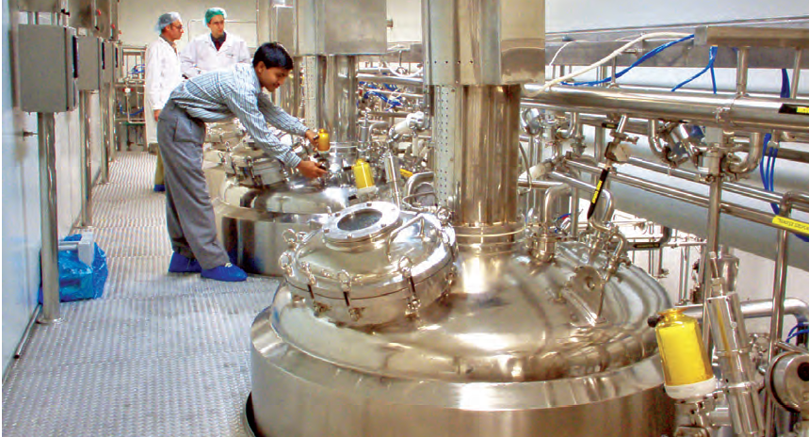
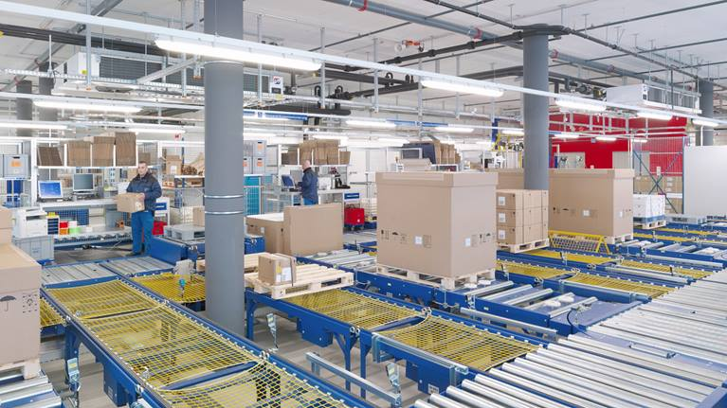
Cognitive Digital Twin based Drug Lifecycle Architectural Framework
Automatic Knowledge Extraction
LIMS
External systems
(Academia, Suppliers, Patients …)
Disease Digital Twin
CTMS
F.A.I.R
Cognitive Digital Thread Engine
Data collection and Consolidation
Domain-based Contextualization
Suppliers
MES
Virtual Lab
MedDev Digital Twins
Drug program Digital Twin
R&D
R&D
MedDev Digital Twins
R&D
QMS
CAPA/NCMR
Lab Eqp. Digital Twin
R&D
Manufacturing
EBR
PLM
HMI
Distribution
Cognitive Digital Twin Common Technology Platform
Scientist Digital Twin
Scientist Digital Twin
Scientist Digital Twin
…
ERP
…
A swarm of Scientists

Slide 32
Cognitive Digital Twin Clinical Trials

Slide 33
Cognitive Digital Twin based Clinical Trials Architectural Framework (Beyond FAIRification)
Automatic Knowledge Extraction
External systems
(Academia, Suppliers, Patients …)
Disease Digital Twin
F.A.I.R
Cognitive Digital Thread Engine
Data collection and Consolidation
Domain-based Contextualization
EDC
Virtual Lab
MedDev Digital Twins
Drug Program Digital Twin
R&D
EMR
R&D
MedDev Digital Twins
R&D
CTMS
Trial Participants Digital Twin(s)
R&D
Wearables
ERP
Site Data
…
…
HMI
Cognitive Digital Twin Common Technology Platform
Scientist Digital Twin
Physician Digital Twin
Site Manger Digital Twin
…
A swarm of Scientists

Slide 34
Digital Twin of Human Heart Philips

Slide 35
Thanks for your attention Q & A

Slide 36
Dr. Ahmed El Adl Boston, MA, USA Email: eladl.ahmed@gmail.com M: 978-908-6922
Thanks

Slide 37
