Slide 1
The Nobel Prize in Economic Sciences 2012 and Matching Theory
Tınaz Ekim
Boğaziçi University
Department of Industrial Engineering
Istanbul / TURKEY

Slide 2
Outline
Stable matchings
  Basic notions
  Gale-Shapley Algorithm
  Kidney exchange and Student placement
Graph Theory and Stable Matchings
  Minimum Maximal Matching Problem
  Graph classes
Notes:
I will emphasize how graph classes play an important role when solving real life problems modeled using graphs.

Slide 3
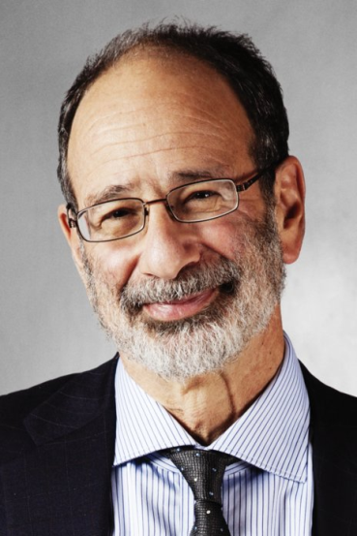
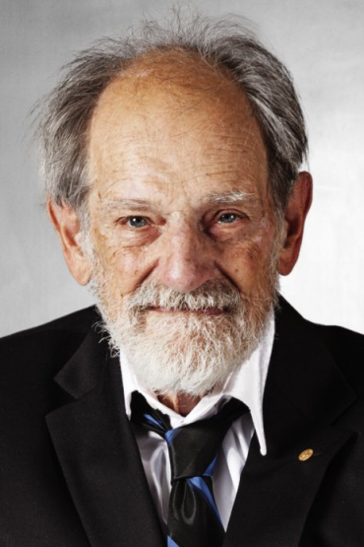
The Nobel Prize in Economic Sciences 2012 was awarded jointly to Alvin E. Roth and Lloyd S. Shapley "for the theory of stable allocations and the practice of market design.«
A.E. Roth
L.S. Shapley
Notes:
Economic Sciences Prize Committee of the Royal Swedish Academy of Sciences
Economists study how societies allocate resources. Some allocation problems
are solved by the price system: high wages attract workers into a particu-
lar occupation, and high energy prices induce consumers to conserve energy.
In many instances, however, using the price system would encounter legal
and ethical objections. Consider, for instance, the allocation of public-school
places to children, or the allocation of human organs to patients who need
transplants.

Slide 4
Stable Matching/Marriage
Ex: Candidates 1,2,3,4 and institutions S, O, D, P have complete preference lists over each other.
S
1
O
2
D
3
P
4
Can 1-P and 2-D be matched to each other in a “good” matching?
A marriage is unstable if a man and a woman, not married to each other, mutually prefer each other to their current partners. A set of marriages is called stable if it has no unstable marriage.
Notes:
Bipartite assignment

Slide 5
Stable Matching
Does a stable matching always exist?
If yes, how can we find it?
Gale, D., Shapley, L., College admissions and the stability of marriage. American Mathematical Monthly, 69:9–15, 1962.
Theorem(Gale, Shapley, 62): In a setting where n men and n women express their preferences over each other set, the deferred acceptance algorithm always finds a stable matching that marries all men and women.

Slide 6
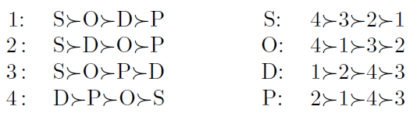
Institution-optimal stable matching
1-D ; 2-P ; 3-S ; 4-O
Candidate-optimal stable matching
1-O ; 2-D ; 3-S ; 4-P
Notes:
Man-proposing algorithm gives a men-optimal stable matching
Women-proposing algorithm gives a women-optimal matching

Slide 7
Stable Matching
Theorem(Gale, Shapley, 62): Men-proposing GS algorithm finds a men-optimal matching (no man is better off in any stable matching); women-proposing GS algorithm finds a women-optimal matching. The optimal matching for one is the worst matching for the other, but both are STABLE matchings.
We hope this algorithm finds real applications one day!
Notes:
Men-optimal stable matching: no man is better off in any other stable matching

Slide 8
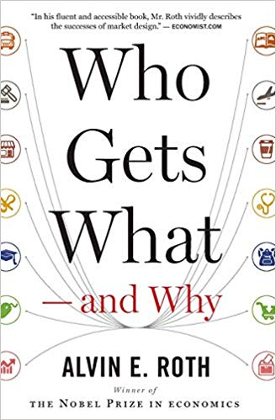
Student Placement
Student placement to universities in Turkey → GS Alg.
Boston, NewYork, etc. placement of students to public schools
  various placement systems → congestion + manipulation
  implementation of GS Alg → EDUCATIONAL REFORM
Students placement
Kidney exchange
Job markets
Notes:
Another result of a bad market design addressed in (Roth, 2016) is about the admission of kindergarten students in Boston public schools, which consequently forces parents have started to go to playgrounds to “collect information” about other parent’s preferences in order to manipulate the system by making strategic choices
(instead of expressing their real preferences).
The New York City public high schools were asking applicants to list five most preferred schools. Then, a three-round acceptance/rejection/wait-list procedure was applied. Those students who were not placed after the third round were assigned via an administrative process to a school for which they have not expressed any preference. This system suffered from congestion and resulted about 30,000 students per year to end up via the administrative process . As soon as a version of the applicant-proposing GS Algorithm adjusted for regulations and customs of New York City was implemented in 2003, only about 3,000 students ended up with the administrative process, a %90 of reduction compared to the previous years.
The placement system, known as the “Boston mechanism”, was a central clearinghouse that can be seen as a priority based system which is still widely used in the world. It first matches as many applicants as possible with their first-choice schools, then tries to match the remaining applicants with their second-choice school, and so on. When a school is demanded by too many students, some students are rejected using some priority criteria (e.g. sibling already attending the school, geographical proximity, etc.) previously fixed by the school authority. In order to be placed in a more preferred school, applicants had to identify which schools were realistic options for them and falsify their reported preferences, or else they would suffer from poor outcomes.

Slide 9
Advanced Models
Real applications → GS algorithm adjusted for local needs (eg, married graduates from medical schools to be assigned the same hospital)
Incomplete lists → GS algorithm applied to partial preference lists always provides a stable matching, moreover, all these stable matchings leave the same candidates and institutions unmatched.
Incomplete lists + Equally preferred agents (such as candidates with the same exam score)
Not candidate-optimal nor institution-optimal, best stable matching for other criteria. Ex: Minimize the sum (or the max) of the preference orders in a stable matching→ NP-c
Notes:
In a stable matching problem with incomplete lists with ties, if we assume that equally preferred candidates or institutions do not cause an unstable pair,
then there is always a stable matching and one can be found in polynomial time. However, these stable matchings do not necessarily have the same size and
finding one having the largest size (which is clearly more desirable in all applications) is an NP-hard problem (Iwama and Miyazaki, 2008). On the other hand,
if we assume that equally preferred candidates or institutions may cause a pair to be unstable, then the existence of a stable matching is not guaranteed. However,
it can be decided whether there is a stable matching or not, and if any, a stable matching can be found in polynomial time. Furthermore, in case there is a
stable matching, every stable matching has the same size, thus seeking for a largest stable matching is not an issue

Slide 10
Kidney Exchange
95,000 people in the waiting list in 2019 only in the US (United Network for Organ Sharing)
Only 13,400 of them could be transplanted a kidney
  9,300 from deceased donors
  Rest from living donors
Waiting list becomes longer steadily every year
Roth: ‘‘History of victory after victory in a battle that we are loosing’’
Main problem for living donors: medical incompatibility (e.g. because of blood type)

Slide 11
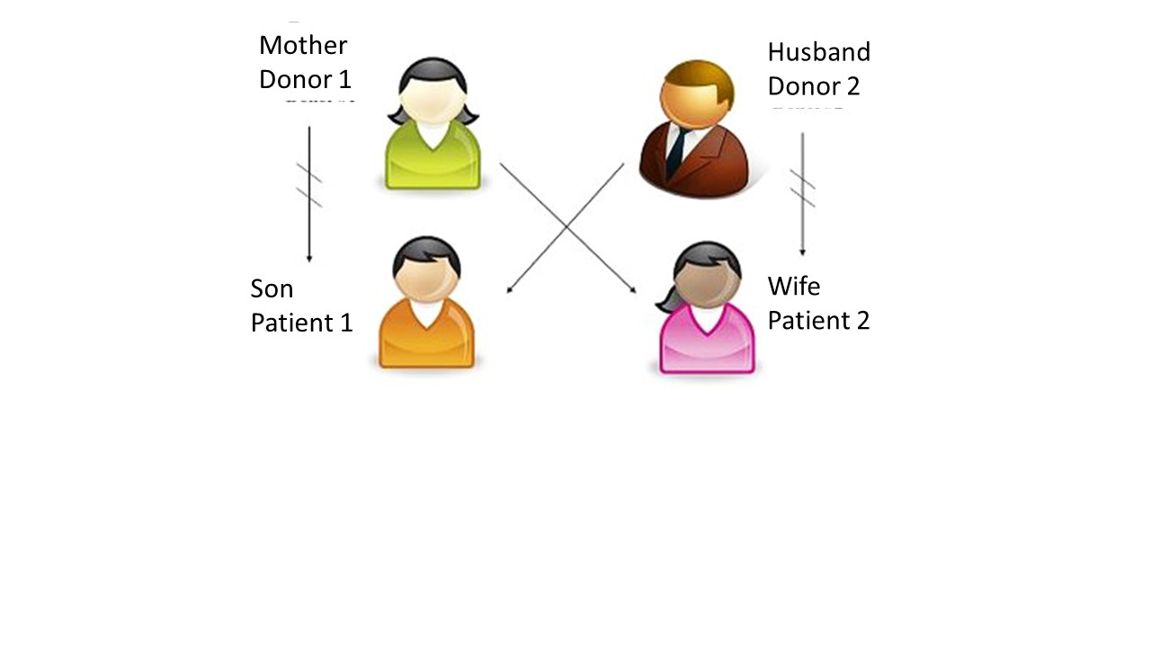
Kidney Exchange
Kidney exchange between two incompatible donor-patient pairs
A graph modelling a kidney exchange relation (with preferences on arcs) and a solution in bold
Notes:
Bipartite DEGIL!

Slide 12
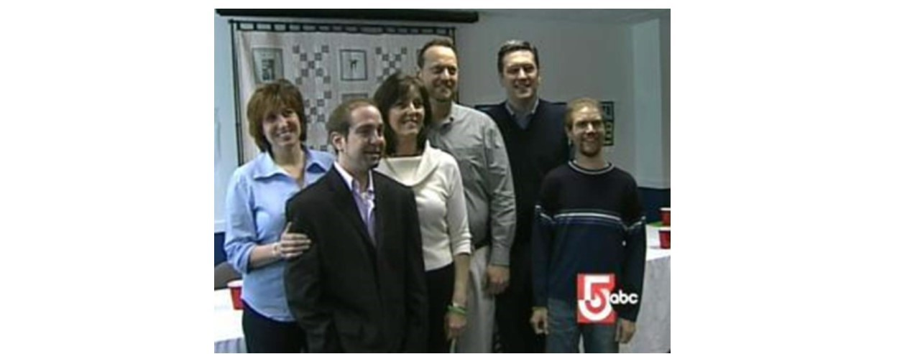
Kidney Exchange
Exchange chains instead of matchings → important theoretical achievements by extending previous results on stable matchings to exchange chains
Unfortunately, with limited practical impact:
Notes:
For technical and ethical reasons, this requires simultaneous surgeries of all donors and patients. Thus 6 surgical teams, 6 operating rooms etc already for a 3-way exchange chain.

Slide 13
Kidney Exchange
Remedy: allow only exchange chains of length 2 and find a stable matching
Problem: The model is not anymore a bipartite graph!
Stable Roommate Problem
1: 2 > 3 > 4
2: 3 > 1 > 4
3: 1 > 2 > 4
4: indifferent
1
2
4
3
Gale, Shapley 1962: A stable matching might not exist
Notes:
1 matched to 4. then 1 and 3 unstable
ICORESte burayı uzatabilirsin.

Slide 14
What’s next?
Good news: One can decide in polynomial time if there is a stable matching and find one if any.
If there is one: finding a stable matching of maximum size among all stable matchings → NP-hard
If there is none: finding a matching minimizing the number of unstable pairs → NP-hard
Ongoing research…

Slide 15
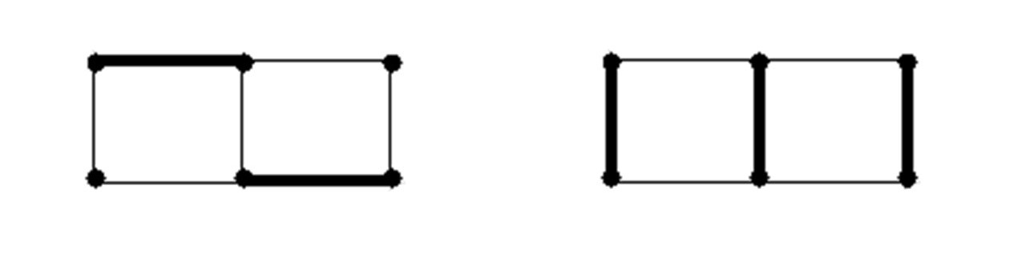
Matchings in Graph Theory
Matching : a set of edges sharing no common end-vertex
Maximal matching : a matching s.t. no new edge can be added to it
Maximum (size) ⇒ maximal but maximal ≠ maximum
Maximum matching : Polynomial (Edmond’s augmenting path algorithm)
Finding a maximal matching of minimum size (MMM): NP-hard

Slide 16
Stable Matching vs Maximal Matching
Every stable matching is maximal, but not necessarily of maximum size
Observation:
Number of unmatched candidates in a stable matching ≤ n- |MMM|
16

Slide 17
Unmatched students
Question: How many students can be unmatched in a stable matching?
Answer: n – |MMM|
Can we compute it efficiently?
MMM NP-hard even in bipartite graphs (Yannakakis 1981)
MMM is NP-hard even in k-regular bipartite graphs (for k≥3) (Demange, E. 2008)
MMM can be solved in polynomial time in special k-regular bipartite graphs (Alkan, Alioğulları, 2015)

Slide 18
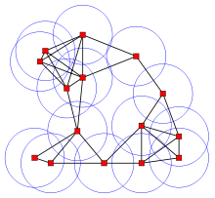
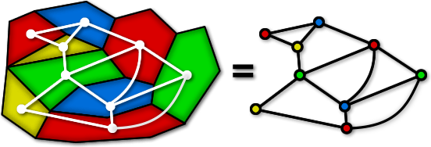
Graph Classes
Model a real life problem with graphs → graphs with structural properties (bipartite, regular bipartite, etc.)
Graph Class: A set of graphs having same structural properties
  Planar graphs : graphs that can be drawn on a plane with no crossing edges (map coloring – 4 Color Theorem)
  Disk graphs (frequency assignment)
Question: Is the problem NP-complete or polynomial time solvable in the class of graphs obtained by modeling the real life application?

Slide 19
Graph Classes
Recognition of graph class
Use results from literature
Real life prb
Graph Model
Brandstädt, A., Le, V.B., Spinrad, J.P, Graph Classes: A Survey, SIAM Monographs on Discrete Mathematics and Applications, 1999.
Golumbic, M.C., Algorithmic Graph Theory and Perfect Graphs, Annals of Discrete Mathematics 57, 2004.
http://www.graphclasses.org/ (over 1500 graph classes)
Notes:
Graph classes became an increasingly important and popular research area. Just to mention a few referecence
Recognition of Planar graphs, bip. → P ; disk gr → NP-c

Slide 20
Graph Classes
A contains B : A→B (A=Bipartite, B= Regular Bipartite)
A
B
1. Problem P is polynomial time solvable in A ➔
Problem P is also polynomial time solvable in B
2. Problem P is NP-complete in B ➔
Problem P is also NP-complete in A

Slide 21
Complexity of MMM
Perfect
Planar
NP-hard
Bipartite
Planar, Δ ≤ 3
Bipartite,Δ ≤ 3
Induced sub-grid
3-regular planar
Chordal bipartite
Interval
Grid
3-regular bipartite
Block
Bipartite permutation
Series-parallel
Unit interval
Polynomial
Tree
Notes:
Complexity of MMM in various graph classes
Bold framed rectangles: results shown in some papers
Normal framed rectangles: results implied by bold framed results.

Slide 22
Our contribution
Taskin, E., Integer Programming Formulations for the Weighted Minimum Maximal Matching Problem, Optimization Letters, 2012.
Bodur, E., Taskin, Decomposition algorithms for solving the minimum weight maximal matching problem, Networks, 2013.
Demange, E., A note on the NP-hardness of two matching problems in induced subgrids, DMTCS, 2013.
Demange, E., Efficient recognition of equimatchable graphs, IPL, 2014.
Demange, E., Tanasescu, Hardness and Approximation of Minimum Maximal Matching, Int. J. of Computer Mathematics, 2014.
Dibek, E., Gozupek, Shalom, Equimatchable graphs are C_{2k+1}- free for k >= 4, DM, 2016.
Deniz, E., Hartinger, Milanic, Shalom, On two extensions of equimatchable graphs, Discrete Optimization, 2017.
Akbari, Alizadeh, E., Gozupek, Shalom, Equimatchable claw-free graphs, DM, 2018.
Deniz, E., Edge-stable Equimatchable graphs, DAM, 2019.

Slide 23
Stable matching ↔ graph classes
For which graphs, there is always a stable matching for any given preference list?
  (Gale, Shapley, 1962): bipartite graphs
  What else?
Theorem (Abeledo, Isaak 1991): Let G be a graph where each agent is represented by a vertex and two vertices are adjacent iff the two agents corresponding to these vertices can be matched to each other. If there is a stable matching in G for every preference list, then G is bipartite.

Slide 24
Summary
Nobel Prize: extending theory to find practical solutions to real world problems
A. Roth: http://marketdesigner.blogspot.com
  A. Roth, Who gets what and why?
Structural Graph theory has a great potential to contribute to the theory of stable matchings !

Slide 25
THANK YOU !

