Slide 1

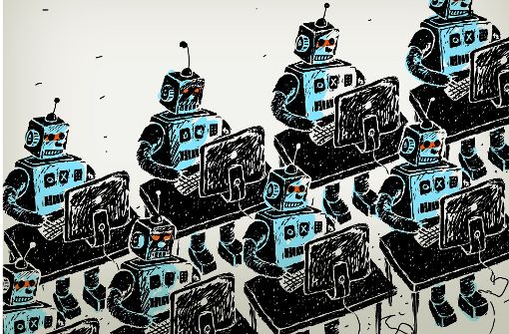

Cracking the Code: Detecting the Next Generation of Social Bots
Salil Kanhere
Information Security and Privacy Research Group (ISPRi)
University of New South Wales (UNSW), Sydney, Australia
https://ispri-unsw.pages.dev
Joint work with Mohammad Majid Akhtar, Rahat Masood & Muhammad Ikram (Macquarie University)

Slide 2
Social Media Landscape
Social Media Tools
Information
Communication
Personas/Identity
Community
Campaigns
Collaboration
/Coordination
False Information
Or
Mis/Disinformation
Fake Accounts or Bot Accounts (Automated)
Malicious Campaigns
Social Media Manipulation (SMM)
Akhtar, M. M., Masood, R., Ikram, M., & Kanhere, S. S. (2024, July). SoK: False Information, Bots and Malicious Campaigns: Demystifying Elements of Social Media Manipulations. In Proceedings of the 19th ACM Asia Conference on Computer and Communications Security (pp. 1784-1800). (CORE Rank A; AR < 21%) [3]
Notes:
We all use social media and it has been great over the years. We can post information on social media. We build and maintain our persona’s on social media and many of us also work together collectively to achieve a targeted goal using social media in the form of campaigns. <click>
However, the openness that social media provides can be misused for example, information can easily be false information.
<click>
An adversary can create multiple fake accounts or fully automated bot accounts. <click>
Even these campaigns can be for malicious purposes.
<click>
All these are elements of social media manipulations. <click>
However, at the centre of these computational manipulations lies the origin of fake accounts and bots.

Slide 3
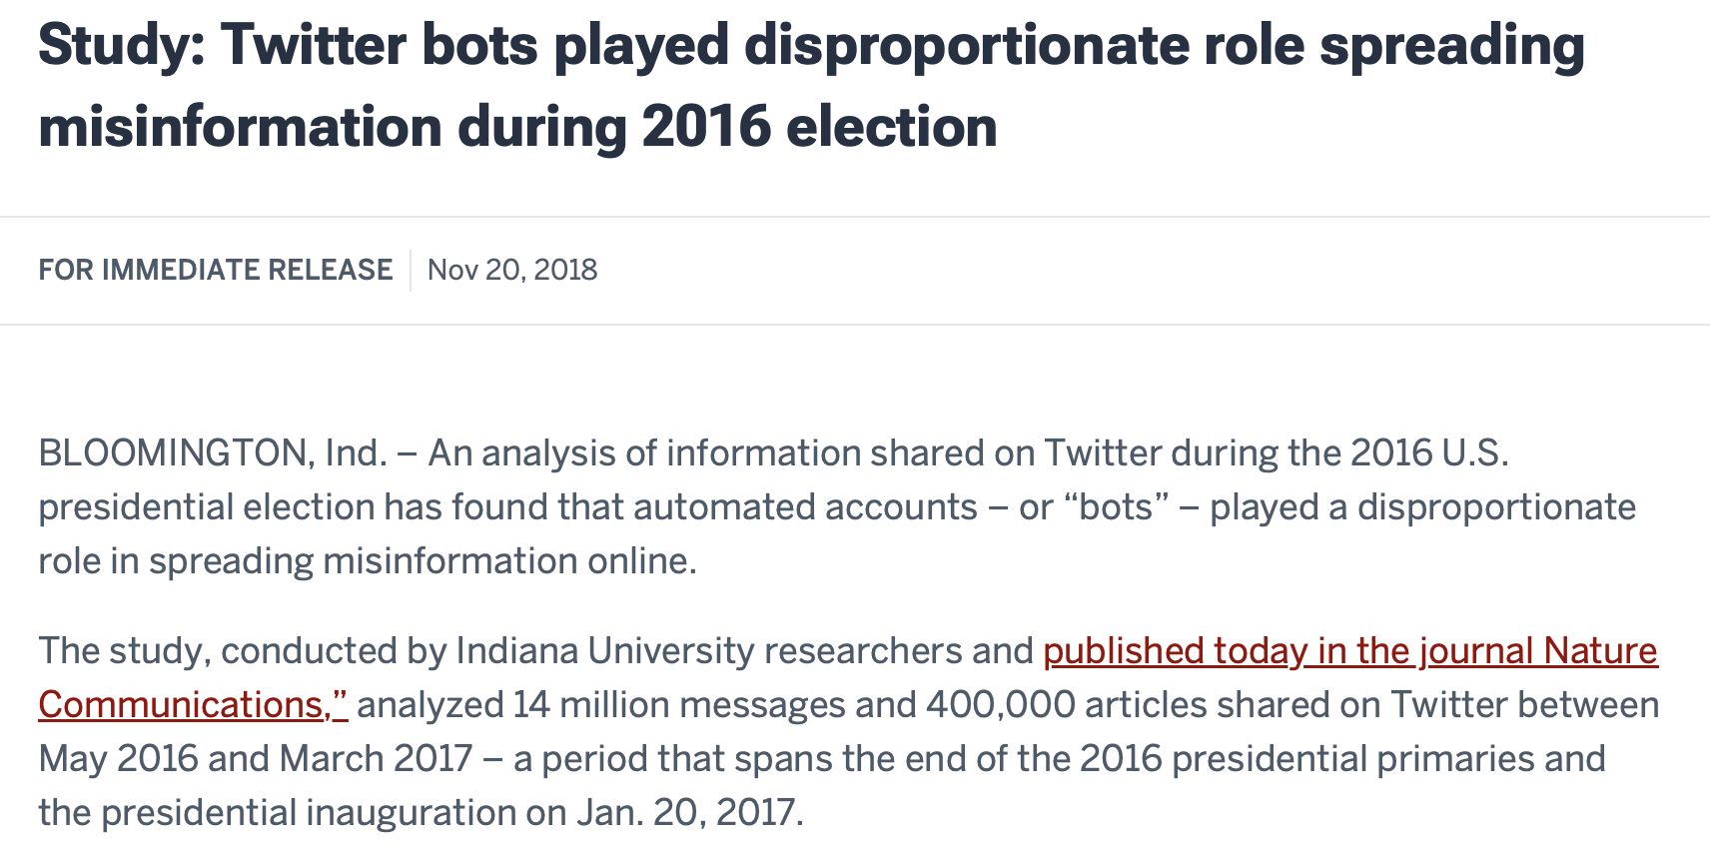
Source: Google Images
Akhtar, M. M., Karunanayake, I., Sharma, B., Masood, R., Ikram, M., & Kanhere, S. S. (2023, October). Towards Automatic Annotation and Detection of Fake News. In 2023 IEEE 48th Conference on Local Computer Networks (LCN) (pp. 1-9). IEEE. (CORE Rank B; AR < 27%)
Notes:
<click>
We have already seen Bots role during political events or elections. <click>
Similarly, bots are also involved in financial scams. <click>
Moreover, have links with multiple coordinated hate and harassment cases online. Now with the power of AI, it is going to boom more.
<click>
There is a rise of bad or malicious bots that we have been hearing from quite some years.

Slide 4
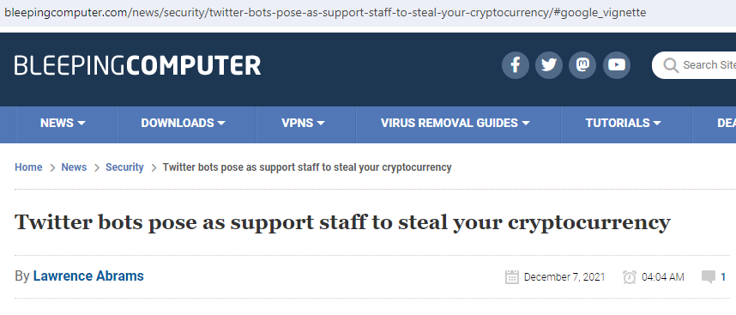
Source: Google Images
Akhtar, M. M., Karunanayake, I., Sharma, B., Masood, R., Ikram, M., & Kanhere, S. S. (2023, October). Towards Automatic Annotation and Detection of Fake News. In 2023 IEEE 48th Conference on Local Computer Networks (LCN) (pp. 1-9). IEEE. (CORE Rank B; AR < 27%)
Notes:
<click>
We have already seen Bots role during political events or elections. <click>
Similarly, bots are also involved in financial scams. <click>
Moreover, have links with multiple coordinated hate and harassment cases online. Now with the power of AI, it is going to boom more.
<click>
There is a rise of bad or malicious bots that we have been hearing from quite some years.

Slide 5
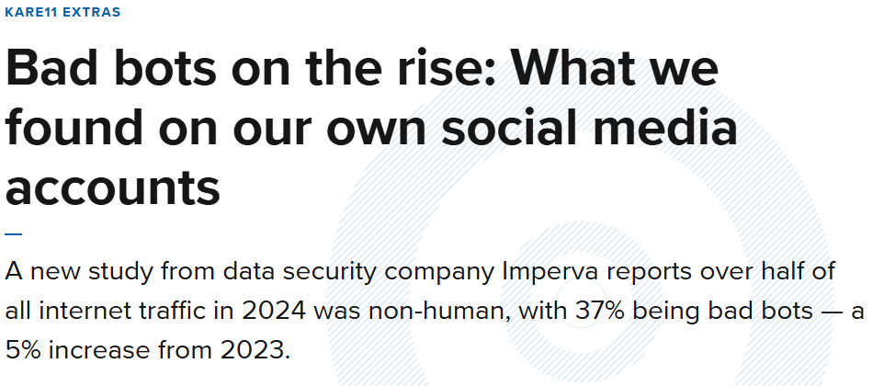
Source: Google Images
Akhtar, M. M., Karunanayake, I., Sharma, B., Masood, R., Ikram, M., & Kanhere, S. S. (2023, October). Towards Automatic Annotation and Detection of Fake News. In 2023 IEEE 48th Conference on Local Computer Networks (LCN) (pp. 1-9). IEEE. (CORE Rank B; AR < 27%)
Notes:
<click>
We have already seen Bots role during political events or elections. <click>
Similarly, bots are also involved in financial scams. <click>
Moreover, have links with multiple coordinated hate and harassment cases online. Now with the power of AI, it is going to boom more.
<click>
There is a rise of bad or malicious bots that we have been hearing from quite some years.

Slide 6
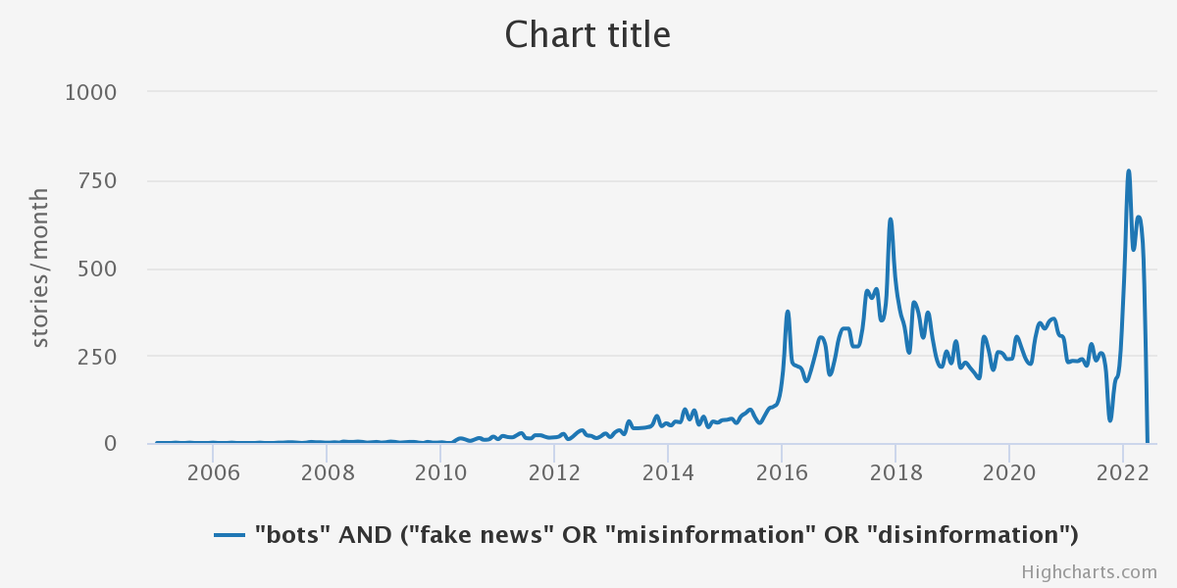
For US Top Media
Source: MediaCloud
Notes:
This is a number of online discourse and discussion regarding bots and fake news and mis/disinformation. We can clearly see a rise after the 2016 period. At this time, there was the infamous 2016 presidential election where bot campaigns were exposed.

Slide 7
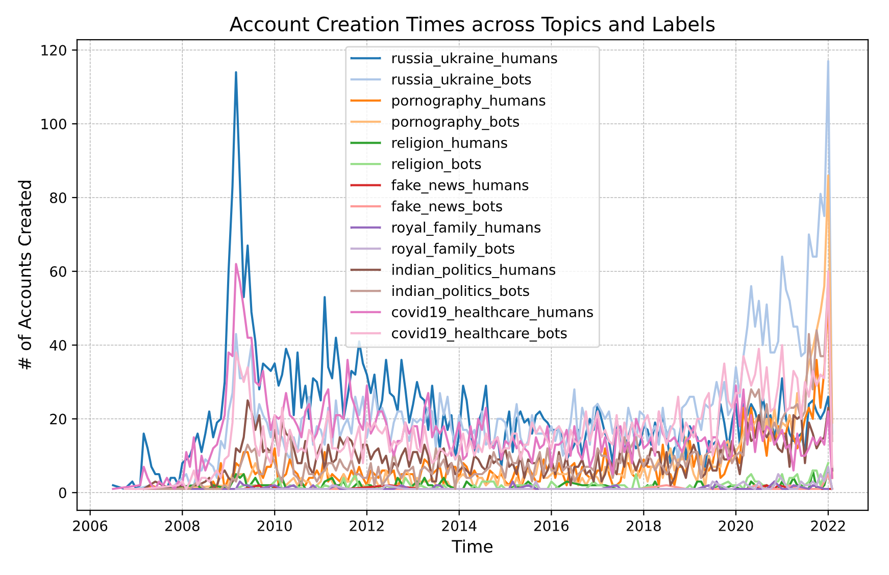
adult_humans
adult_bots
TwiBot-22
For US Top Media
Source: MediaCloud
Notes:
During the same year, we were working on a publically available dataset, and we ran topic analysis on the labeled dataset.
Clearly, we can see that in each topic, there is a decline of human accounts on social network and more increase in the bot accounts.

Slide 8




Generation of Social Bot Behavior
Akhtar, M. M., Masood, R., Ikram, M., & Kanhere, S. S. (2024, July). SoK: False Information, Bots and Malicious Campaigns: Demystifying Elements of Social Media Manipulations. In Proceedings of the 19th ACM Asia Conference on Computer and Communications Security (pp. 1784-1800). (CORE Rank A; AR < 21%) [3]
Notes:
On-demand → newly created, ready for use.
Adaptive → adaptable, flexible to needs and changes.
Sophisticated → advanced, intelligent mimicking for evasion.
Coordinated → works smoothly with other bots, fits in ecosystem.

Slide 9
Generation of Social Bot Behavior
Simple Bots
For simple repetitive tasks (Automation)
Akhtar, M. M., Masood, R., Ikram, M., & Kanhere, S. S. (2024, July). SoK: False Information, Bots and Malicious Campaigns: Demystifying Elements of Social Media Manipulations. In Proceedings of the 19th ACM Asia Conference on Computer and Communications Security (pp. 1784-1800). (CORE Rank A; AR < 21%) [3]
Notes:
On-demand → newly created, ready for use.
Adaptive → adaptable, flexible to needs and changes.
Sophisticated → advanced, intelligent mimicking for evasion.
Coordinated → works smoothly with other bots, fits in ecosystem.

Slide 10
Generation of Social Bot Behavior
Simple Bots
For simple repetitive tasks (Automation)
Adaptive Bots
adaptable, flexible to needs and changes (Personalization)
Akhtar, M. M., Masood, R., Ikram, M., & Kanhere, S. S. (2024, July). SoK: False Information, Bots and Malicious Campaigns: Demystifying Elements of Social Media Manipulations. In Proceedings of the 19th ACM Asia Conference on Computer and Communications Security (pp. 1784-1800). (CORE Rank A; AR < 21%) [3]
Notes:
On-demand → newly created, ready for use.
Adaptive → adaptable, flexible to needs and changes.
Sophisticated → advanced, intelligent mimicking for evasion.
Coordinated → works smoothly with other bots, fits in ecosystem.

Slide 11

Sophisticated Bots
Generation of Social Bot Behavior
advanced, intelligent mimicking human accounts (Evasion)
Simple Bots
For simple repetitive tasks (Automation)
Adaptive Bots
adaptable, flexible to needs and changes (Personalization)
Akhtar, M. M., Masood, R., Ikram, M., & Kanhere, S. S. (2024, July). SoK: False Information, Bots and Malicious Campaigns: Demystifying Elements of Social Media Manipulations. In Proceedings of the 19th ACM Asia Conference on Computer and Communications Security (pp. 1784-1800). (CORE Rank A; AR < 21%) [3]
Notes:
On-demand → newly created, ready for use.
Adaptive → adaptable, flexible to needs and changes.
Sophisticated → advanced, intelligent mimicking for evasion.
Coordinated → works smoothly with other bots, fits in ecosystem.

Slide 12
Sophisticated Bots
Generation of Social Bot Behavior
advanced, intelligent mimicking human accounts (Evasion)
Simple Bots
For simple repetitive tasks (Automation)
Coordinated Bots
Work together in a coordinated fashion
(Orchestrated campaign)
2016 - Present
Adaptive Bots
adaptable, flexible to needs and changes (Personalization)
Akhtar, M. M., Masood, R., Ikram, M., & Kanhere, S. S. (2024, July). SoK: False Information, Bots and Malicious Campaigns: Demystifying Elements of Social Media Manipulations. In Proceedings of the 19th ACM Asia Conference on Computer and Communications Security (pp. 1784-1800). (CORE Rank A; AR < 21%) [3]
Notes:
On-demand → newly created, ready for use.
Adaptive → adaptable, flexible to needs and changes.
Sophisticated → advanced, intelligent mimicking for evasion.
Coordinated → works smoothly with other bots, fits in ecosystem.

Slide 13
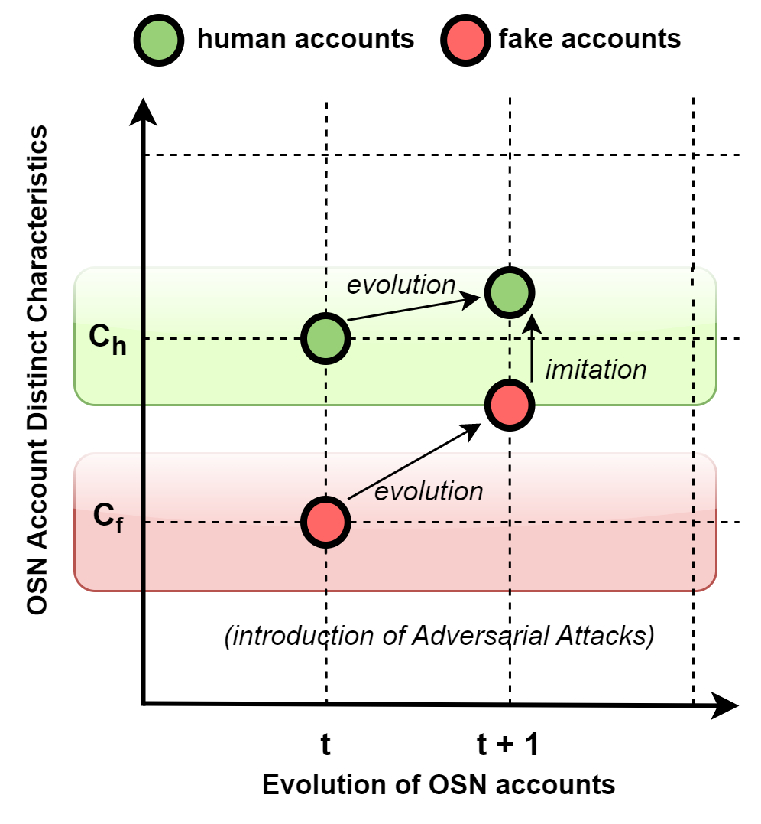
Sophisticated Bots
advanced, intelligent mimicking human accounts (Evasion)
decision boundary
Notes:
This is happening because of two natural phenomenon seen in social media- Evolution and Imitation.
Here, we can see that as time goes by, our account metrics change accordingly. However, the rate of evolution of bots are much faster than rate of change of human account as bots can easily inflate these numbers.
Because of their imitation nature or mimicking, they are nowadays evading the detection. So ideally, previously, there was easily distinguishable characteristics of bots and humans. Now, bots have cross the decision boundary to evade the detection.

Slide 14
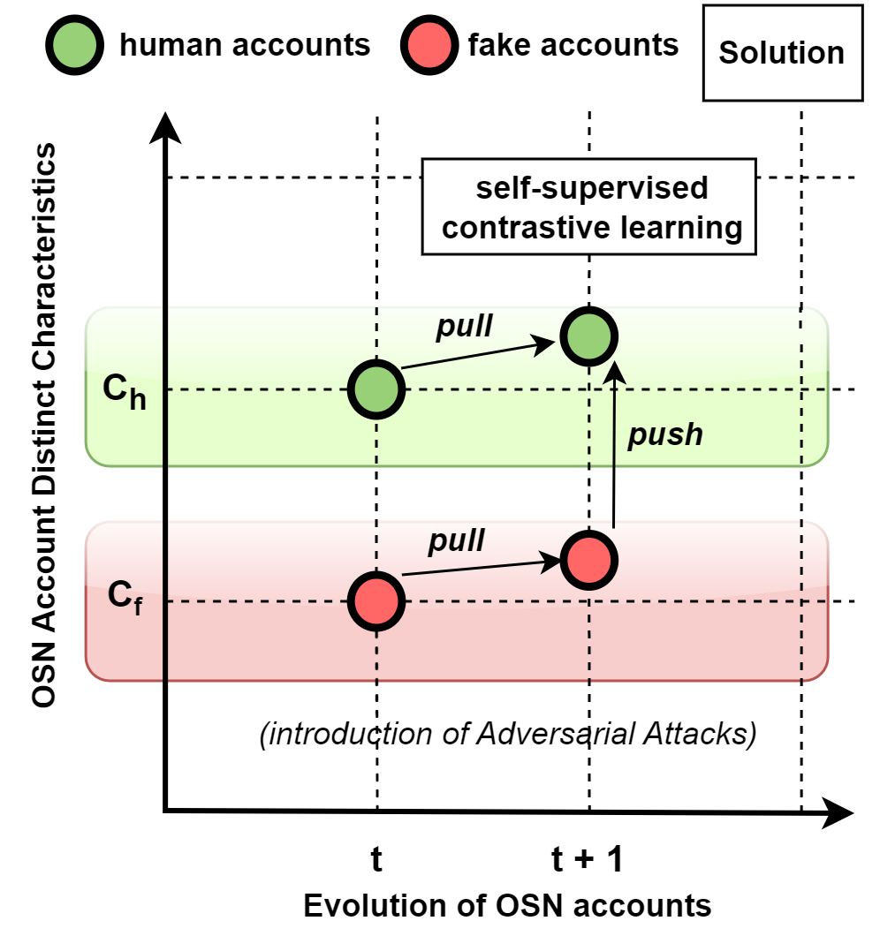
decision boundary
Notes:
The solution that we have and discuss in this talk is to use a new ML technique which is self-supervised contrastive learning.
This basically, aims to pull the similar points in the real world together in the embedding space and push the dissimilar point.
Ultimately, improving the linear separability.

Slide 15
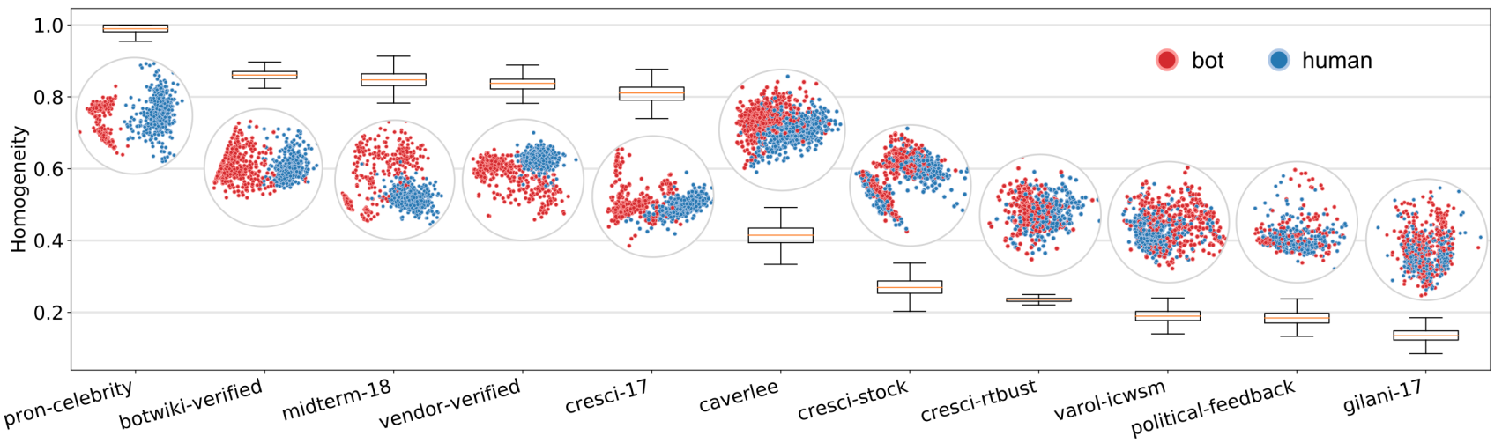
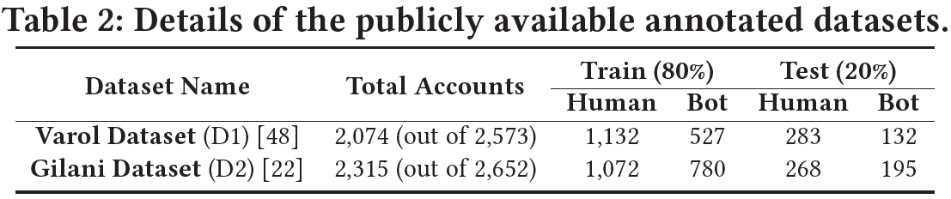
Motivation from the field
Source: Yang et al. 2020, AAAI
[1],[2],[3],[4],[5],[6]
Yang, K. C., Varol, O., Hui, P. M., & Menczer, F. (2020, April). Scalable and generalizable social bot detection through data selection. In Proceedings of the AAAI conference on artificial intelligence (Vol. 34, No. 01, pp. 1096-1103).
Notes:
More specifically, we also draw motivation from the social bot detection field itself.
This image shows the homogeneity cluster of all the publically available dataset. From left to right, we can see that left-side datasets are easily distinguishable. However, the right-side datasets, homogeneity score is less than 0.2 because the bots are mixed with humans and not easily separable. This is because these datasets have sophisticated bot instances.
<click>
We also look in the literature that on these datasets, multiple studies did not perform well. <click>
So, we took these datasets as best candidate to test if self-supervised contrastive learning can help or not. Note, we did not collect political-feedback dataset, as all accounts have been suspended now.

Slide 16






Existing Research Gaps
Problem 1: Cannot detect sophisticated bots
Notes:
We see that existing research do not detect these sophisticated bots.
<click>

Slide 17

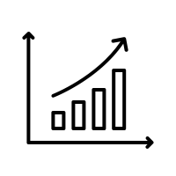


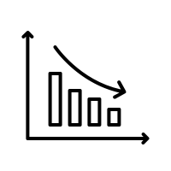
Existing Research Gaps
Problem 1: Cannot detect sophisticated bots
Problem 2: Performance limited to a Single dataset (case of overfitting)
Train Set 1
Dataset 1
Perform Good when Tested with same dataset
Test Set 1 (from training dataset)
Test Set 2
Dataset 2
Do not perform well when tested with different dataset
Notes:
They also are more prone to overfitting. Because bots from different datasets, have varied characteristics. Therefore, we see that when a model is trained on one particular botnet dataset, the performance decline a lot when tested with other type of botnet dataset.

Slide 18
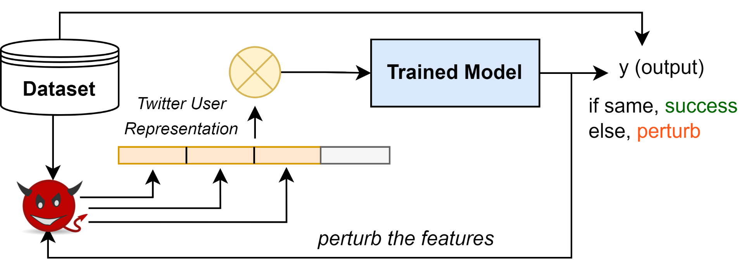
Existing Research Gaps
Problem 1: Cannot detect sophisticated bots
Problem 2: Performance limited to a Single dataset (case of overfitting)
Problem 3: Vulnerable to Adversarial Attack
Train Set 1
Dataset 1
Perform Good when Tested with same dataset
Test Set 1 (from training dataset)
Test Set 2
Dataset 2
Do not perform well when tested with different dataset
Notes:
Third is this is like a cat-mouse game. As new models are published, adversaries tweak around the control boundaries and evade the detection.

Slide 19
Existing Research Gaps
Problem 1: Don’t fairly detect sophisticated bots
Problem 2: Performance limited to a Single dataset (case of overfitting)
Problem 3: Vulnerable to Adversarial Attack
Train Set 1
Dataset 1
Perform Good when Tested with same dataset
Test Set 1 (from training dataset)
Test Set 2
Dataset 2
Do not perform well when tested with different dataset
Contribution 1: Performance
Contribution 2: Generalizability
Contribution 3: Adversarial Robustness
Notes:
Therefore, in our work, we have tried to go beyond just performance. We also have looked into the generalizability as well as the adversarial robustness.

Slide 20
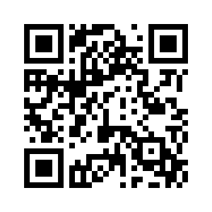
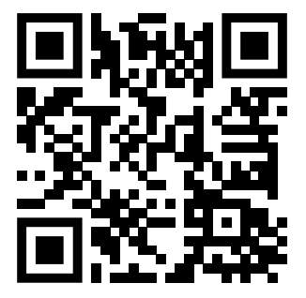
BotSSCL: Social Bot Detection with Self-Supervised Contrastive Learning
Online Social Networks and Media, vol. 48, 2025 (Q1 Journal)
Code
Paper

Slide 21
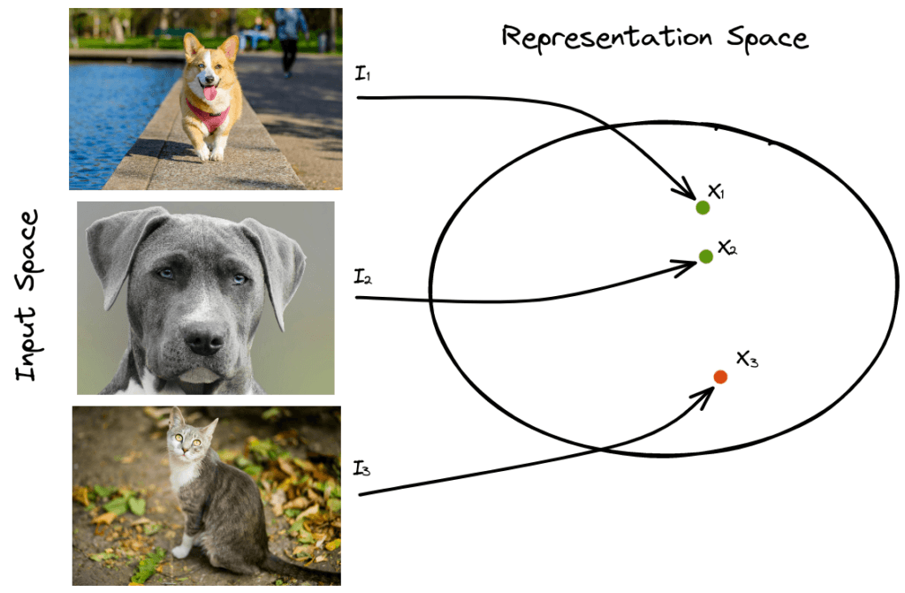

Methodology of BotSSCL
Contrastive Learning
“Grouping similar items together”
“To learn high-level representation of objects in unsupervised fashion”
Positive and Negative Pairs
Notes:
Our methodology relies on the contrastive learning. Which simply groups similar items together. For example, if two items are similar in the real world,
Then they should be placed close to each other in the embedding space.
<click>
In this case, human to human will be positive pair, and negative will be human-bot pair.
<click>
Overall, our aim is to learn high-level representation of objects in unsupervised fashion.

Slide 22
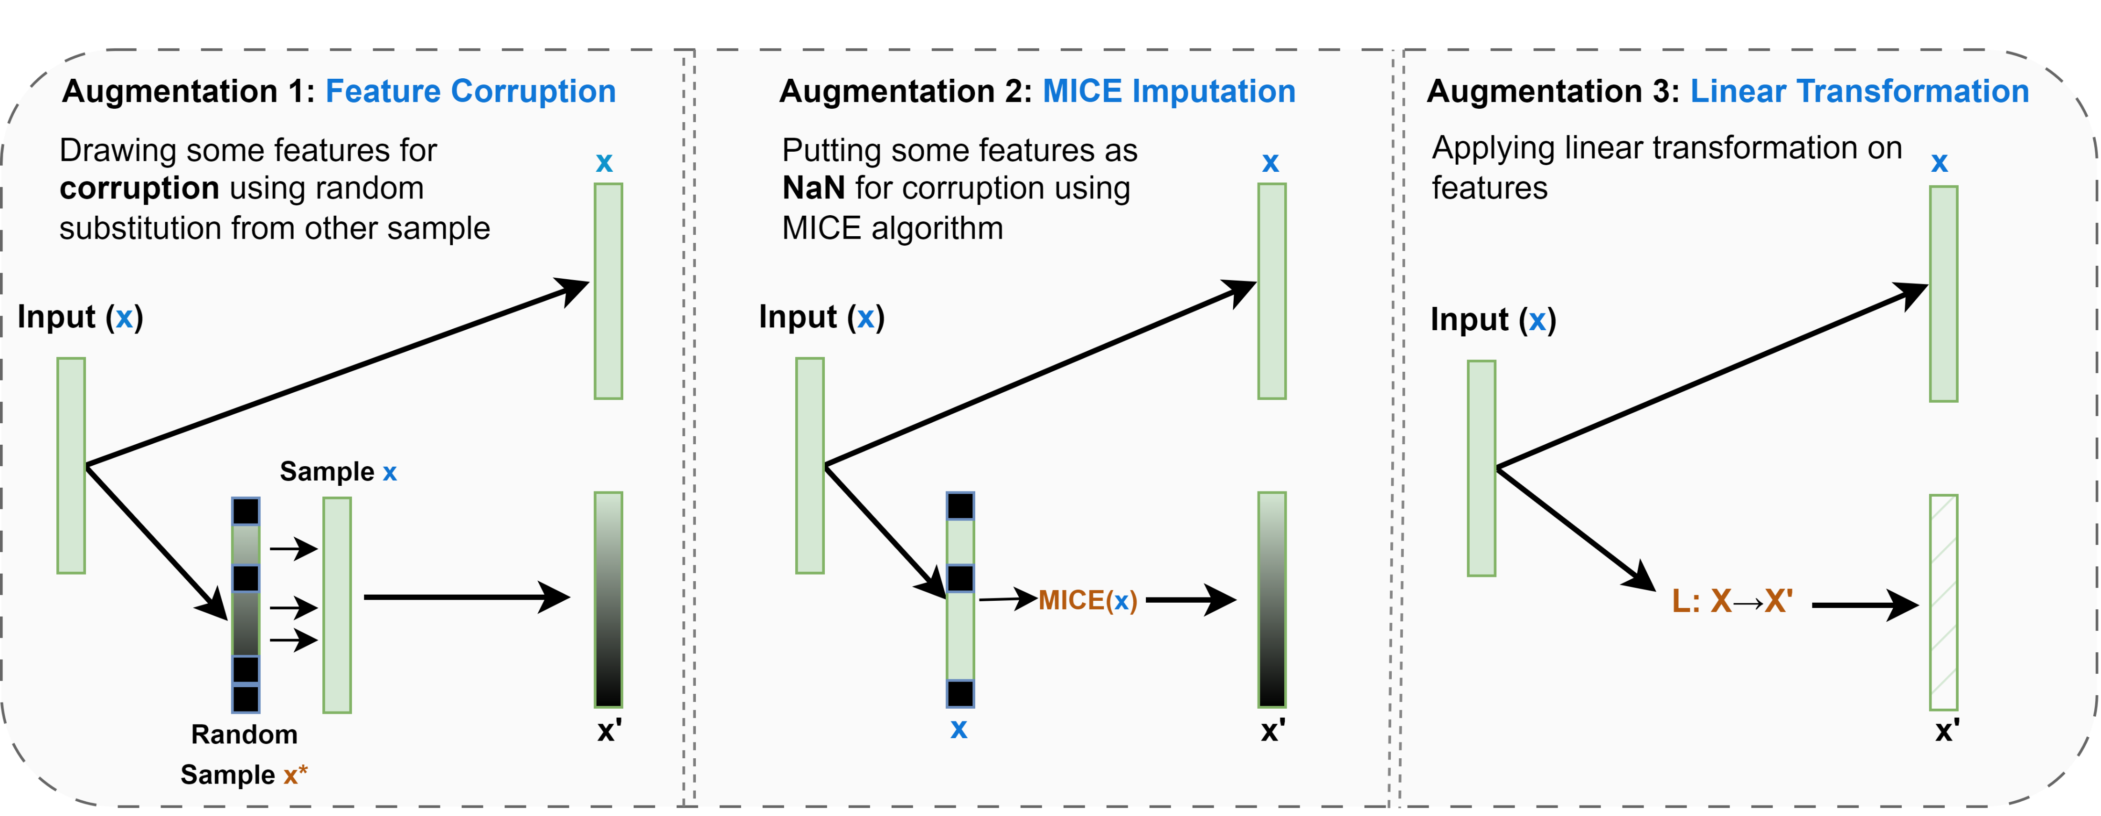
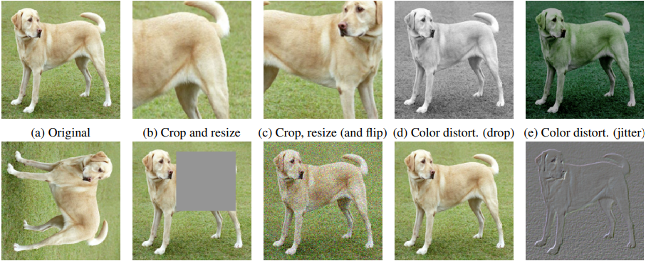
How do we generate these pairs?
Generate Pairs through OSN-inspired Data Augmentation
Generate Pairs through Data Augmentation
These pairs should be closer to each other in the representation space.
“Superficial profile replication”
“restore previous profile state”
“deep and thorough mimicking”
Bahri, D., Jiang, H., Tay, Y., & Metzler, D. (2021). Scarf: Self-supervised contrastive learning using random feature corruption. arXiv preprint arXiv:2106.15147.
Notes:
But one question comes if that if we are using unsupervised learning (without labels), then how we will train it? We train by creating pairs of the input sample. This is called as the data augmentation.
<click>
In Computer Vision or Image processing field, this is straightforward through multiple image operations. Such as cropping, rotation, or color distortion. However, in tabular feature dataset, this is not this straightforward. <click>
Therefore, we have selected key augmentations to apply on tabular feature dataset, such as random feature corruption, MICE imputation and linear transformation.
MICE = Multivariate Imputation by Chained Equation
<click>
It is to be noted that this is not only linked with the ML domain but also with social media behaviors of adversary. Such as random feature corruption is similar to mimicking other genuine users for some features, MICE imputation is adversary trying to get back to loss account state, and Linear transformation is more thorough and deep mimicking behavior.

Slide 23
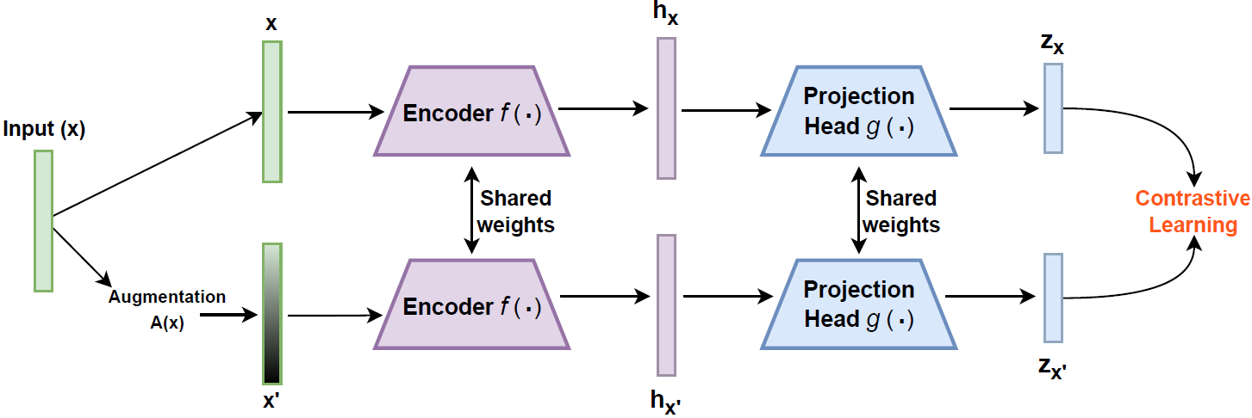
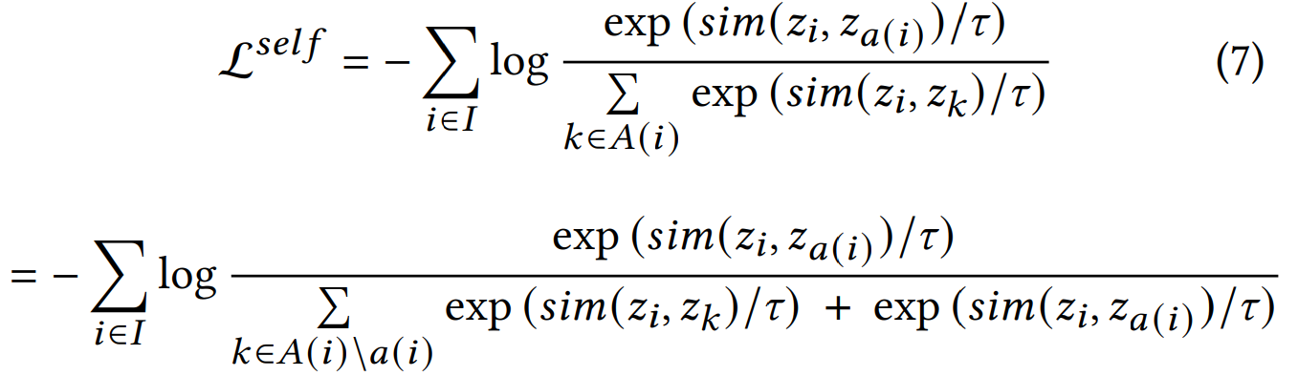
Contrastive Pre-Training Network
`
How do we Train the network?
NT-Xent Loss or the InfoNCE loss [10]
Intermediate Representation
Low-dimension Vector
Notes:
Twin encoder network - one encoder followed by a projection head. The encoder and the projection head are multilayer perceptrons (MLP), where the encoder consists of two layers, and the projection head contains one layer.
One final thing is how do we train the network. What is our objective? Here we rely on contrastive loss which is also called as InfoNCE.

Slide 24
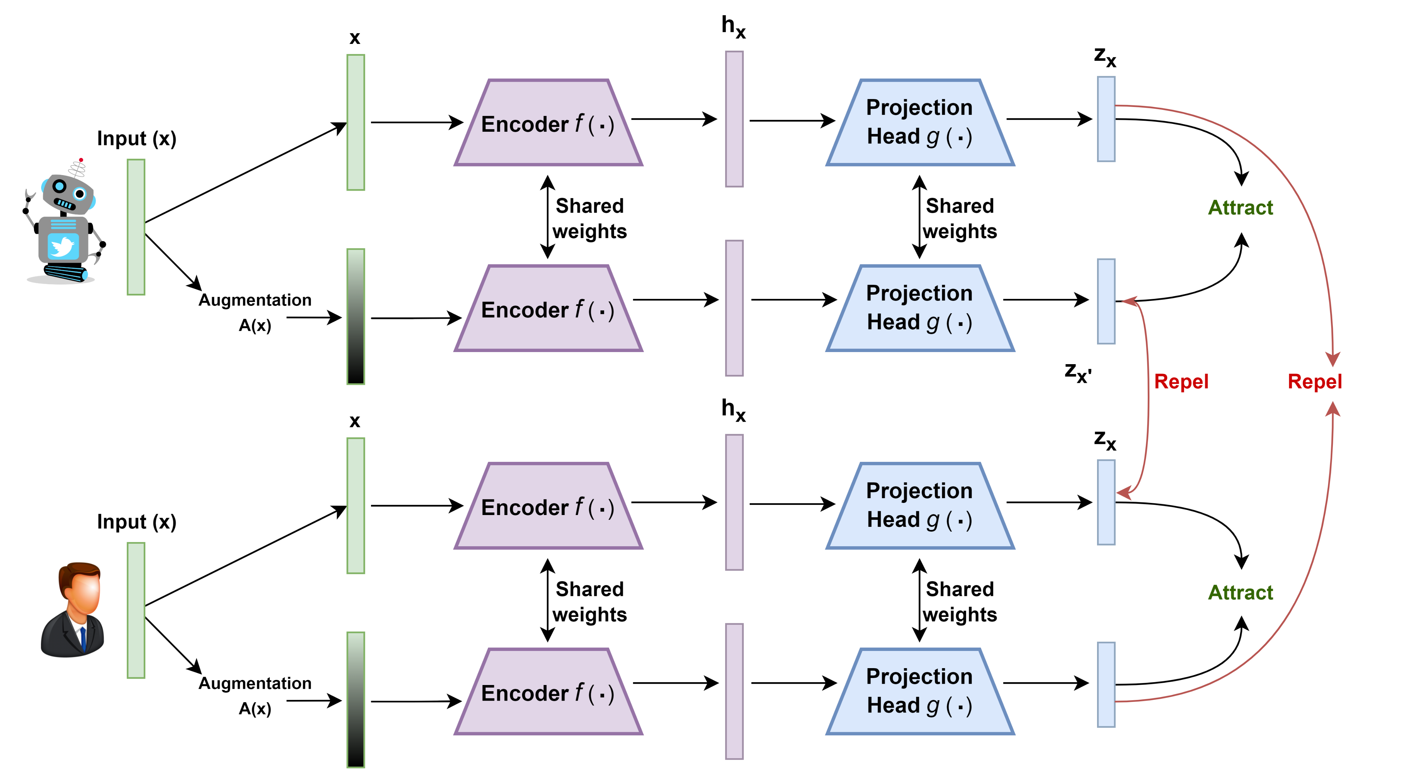
Notes:
Overall, in a batch, each sample goes through encoder and projection head to get final embeddings.
In essence, contrastive learning aims to develop a parametric function that can effectively discriminate between bots and humans. This is achieved through the fine-tuning of the parameters within functions f and g using stochastic gradient descent (SGD).

Slide 25


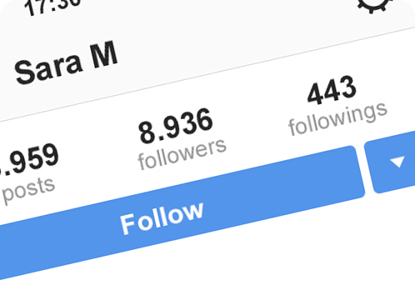
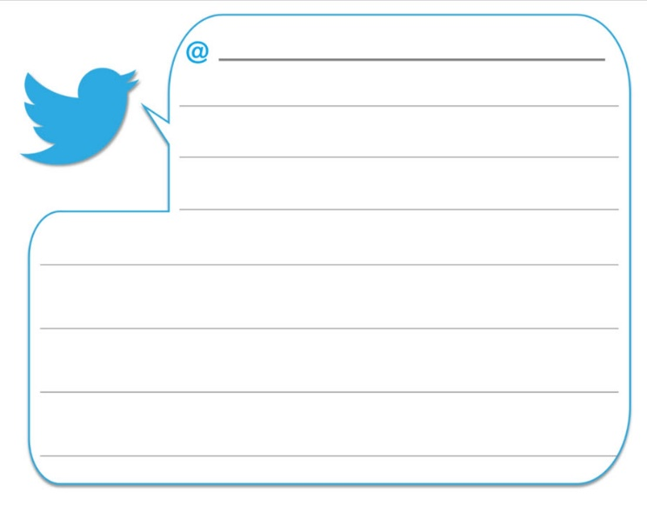
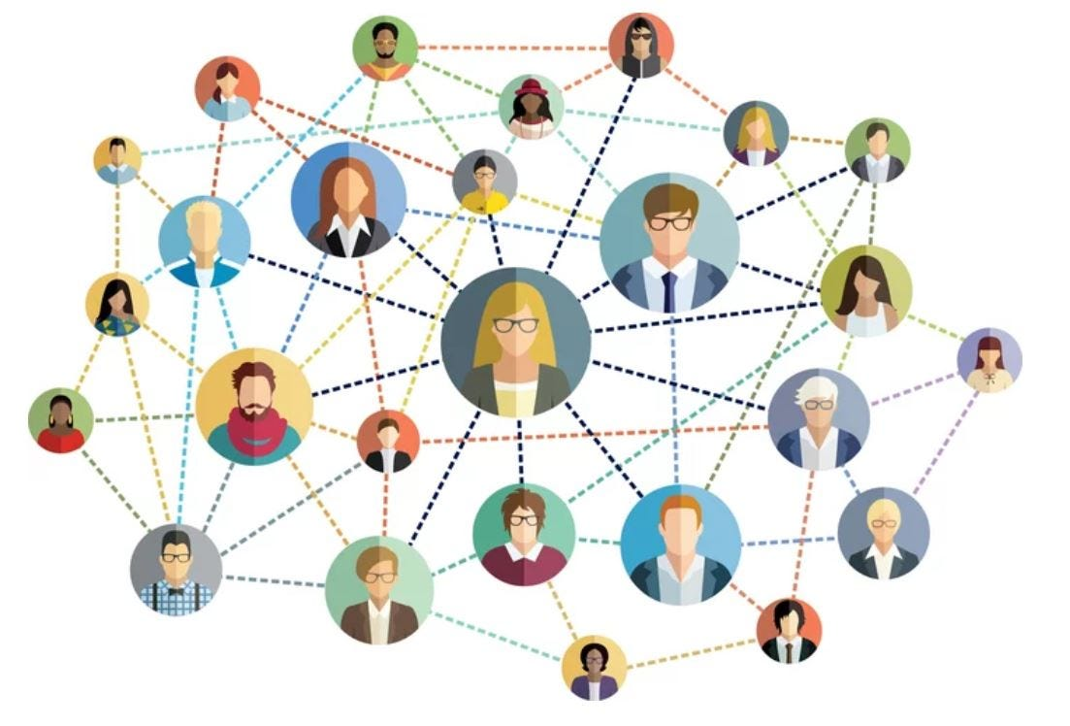
Feature Engineering
Features | Tier 0 | Tier 1 | Tier 2
User Metadata
User Tweet
Tweet Metadata
Tweet Temporal
Network Information
+
+
Notes:
In terms of feature engineering, there are five feature modalities extracted from user profile metrics, tweet textual content and user network.

Slide 26
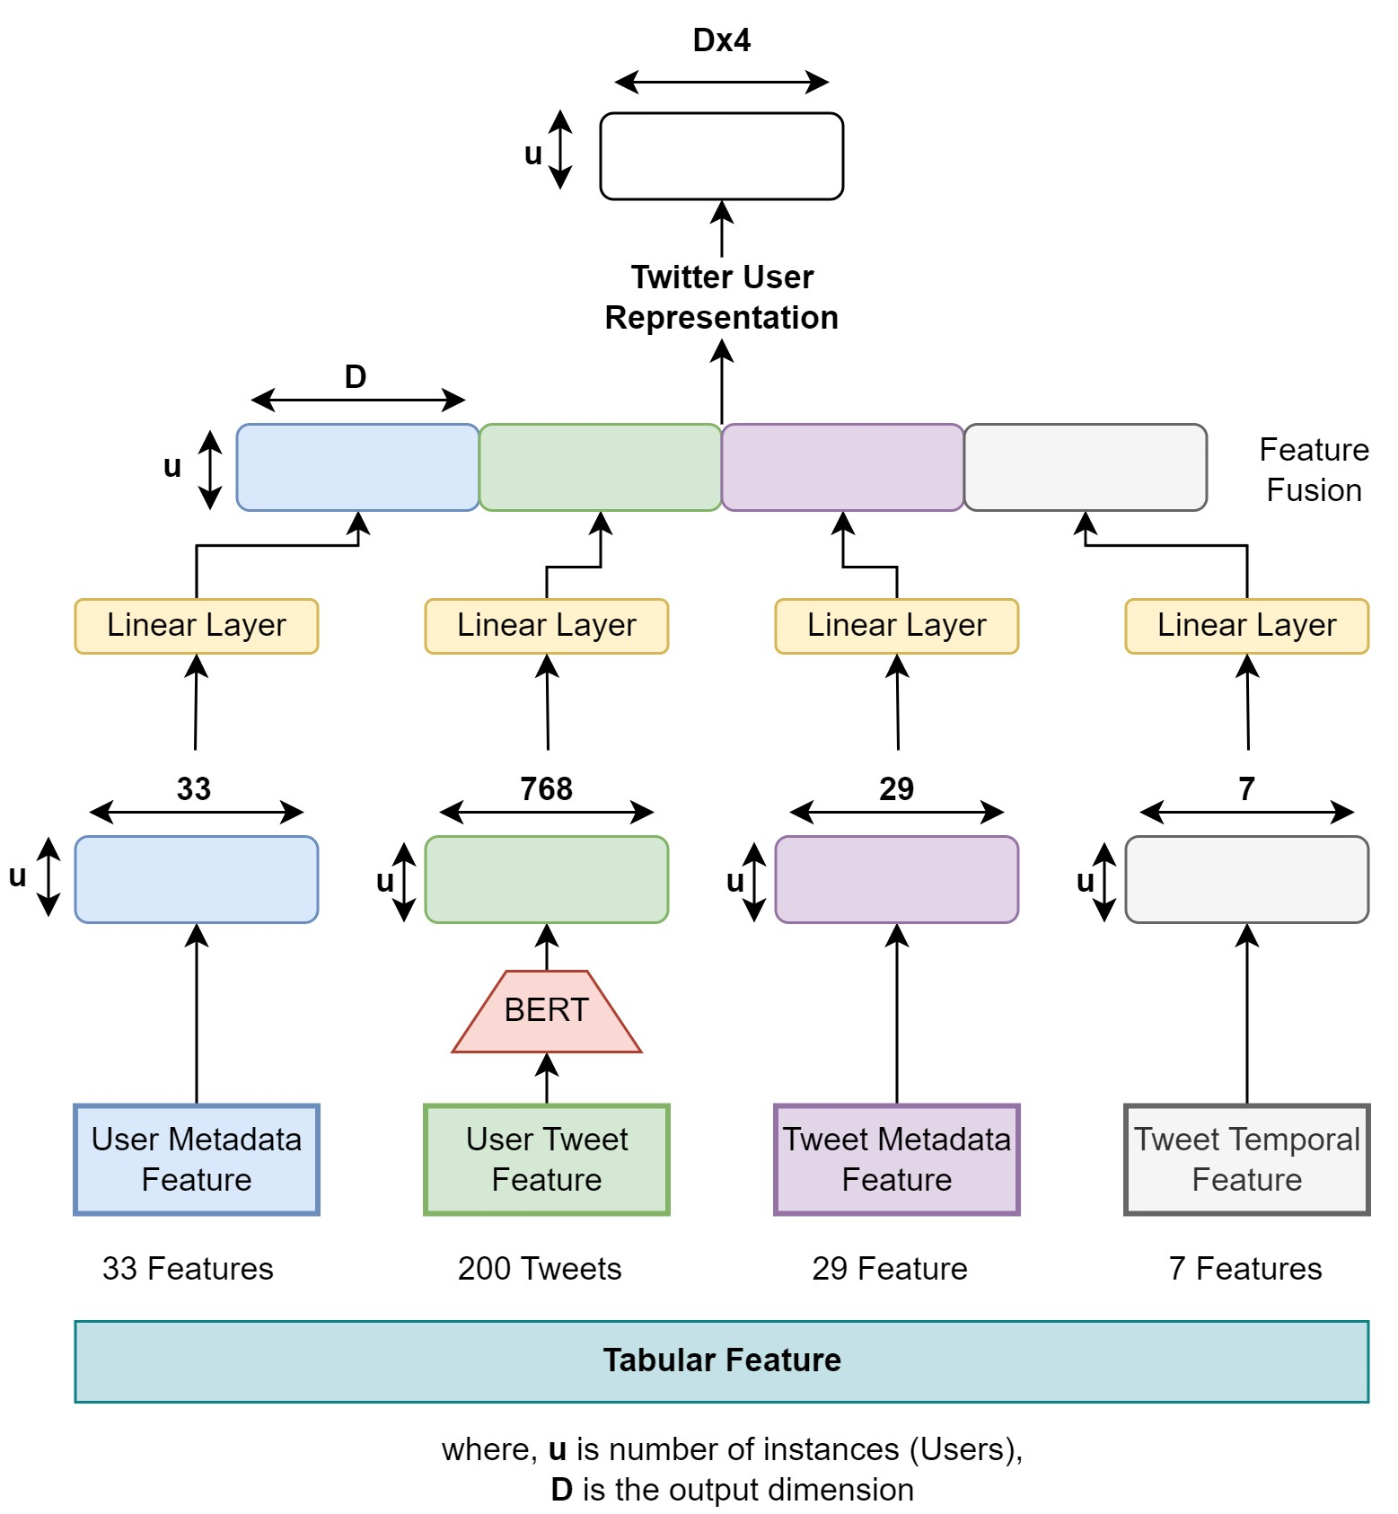
Feature Engineering
`
D is the Information Density
+
Notes:
It is to be noted that we are working on Tier 1, which contains user metadata and tweet textual content. As Tier 2 is expensive in terms of API calls.
<click>
However, we also develop a user representation where each feature modality is given equal weightage. Here the flow of feature is controlled by a parameter D, which is information density. Thus, the final value will be D times 4.

Slide 27
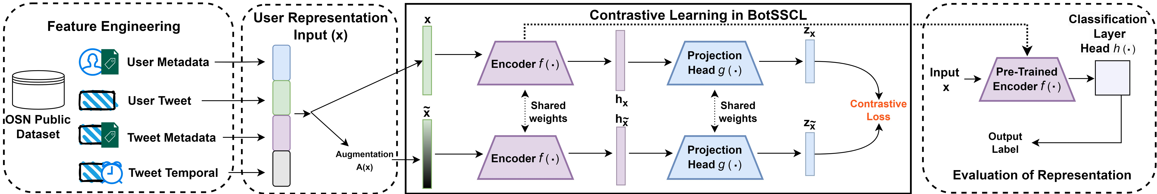
BotSSCL Framework
Code
Notes:
Overall, this is the BotSSCL framework. From left to right, from feature engineering to contrastive pre-training and evaluation of representations.
Logistic Regression as classification head - We optimized the cross-entropy loss and fine-tune the parameters of f (⋅) and h (⋅).
Theoretically, LR is faster and most commonly used in contrastive learning to evaluate and linearly separate representations in feature space. It is also a simple classification model, so

Slide 28
Baselines/SOTA
Model | Method | Learning Type | Feature Tier
Botometer [4] | Random Forest | Supervised | 2
DeeProBot [6] | Deep Learning | Supervised | 1
Bothunter [7] | Random Forest | Supervised | 0
DigitalDNA [8] | Genetic Algorithm Classifier | Unsupervised | 0
SATAR [9] | Graph Network | Self-supervised (Non-contrastive) | 2
Notes:
We also have baselines to compare with. These baselines range from supervised, unsupervised to self-supervised non-contrastive. Also range from different Tiers of feature collection.

Slide 29
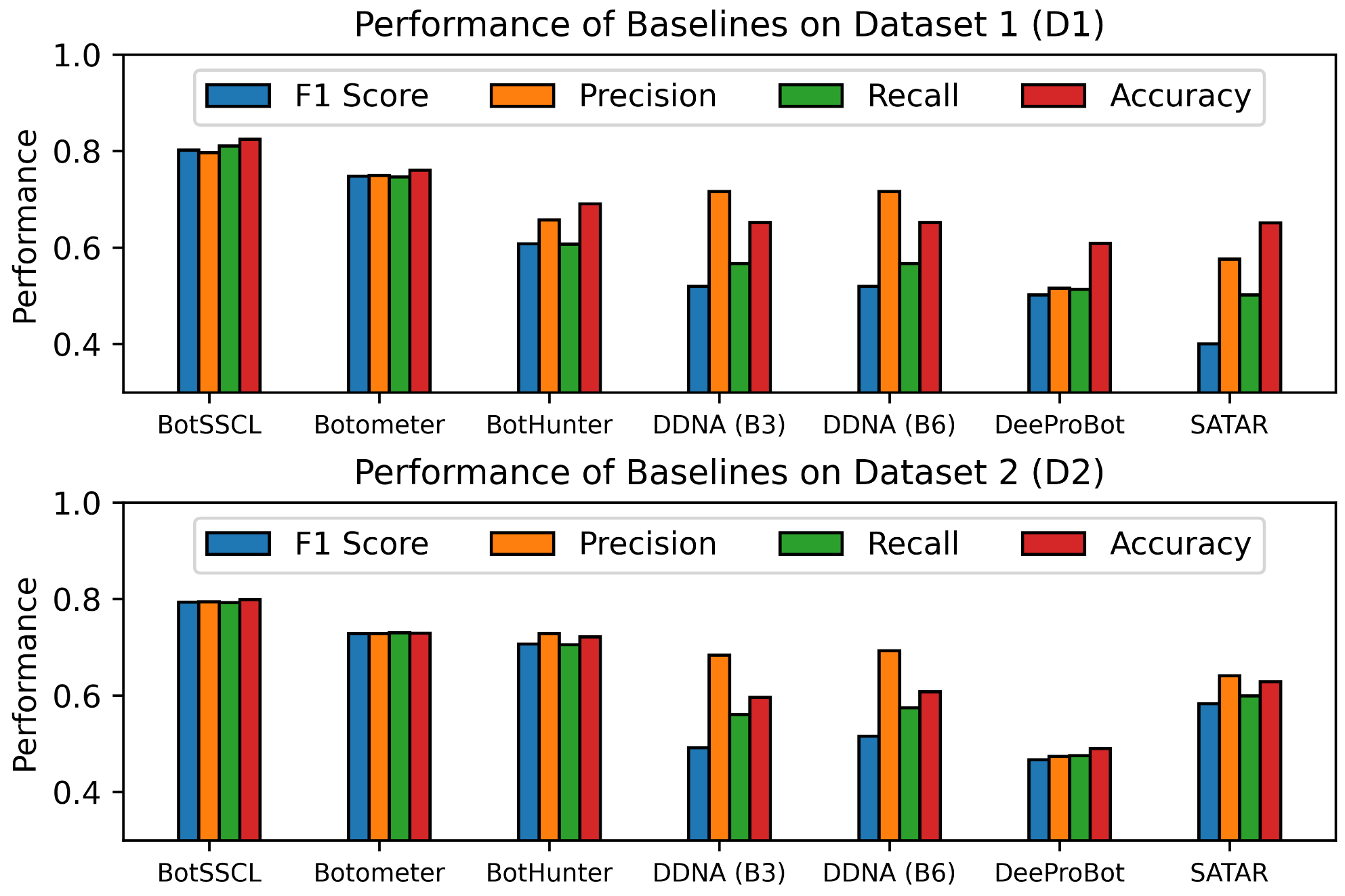
Results: C1.1. Performance
(Gilani Dataset)
(Varol Dataset)
We achieved ≈6% and ≈8% F1-score better than baseline models on Varol and Gilani dataset, respectively.
Notes:
We note that our BotSSCL performs better and improves 6% and 8% F1score than baselines on both datasets.

Slide 30
Results: C1.1. Performance
(Gilani Dataset)
(Varol Dataset)
Additional Performance Robustness:
Evaluate the proposed framework on larger/newer dataset (such as Twibot-20 dataset with 229,580 nodes and 227,979 edges)
Compare with baselines on the above dataset.
We achieved ≈6% and ≈8% F1-score better than baseline models on Varol and Gilani dataset, respectively.
Notes:
However, if we recall, the available dataset is not large dataset. Therefore, we also tested BotSSCL on a larger/newer dataset called Twibot-20.
<click>
We also compare this we recent GNN-based models.

Slide 31
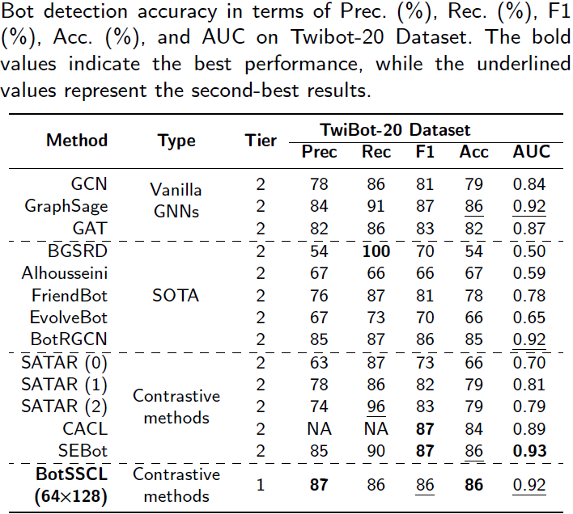
Results: C1.1. Performance
+ On Twibot-20 Dataset
(Gilani Dataset)
(Varol Dataset)
Notes:
We clearly see that our model achieves best precision and accuracy. We also attain stable performance. <click>
However, if we see SOTA models, we see that the values are not stable.

Slide 32
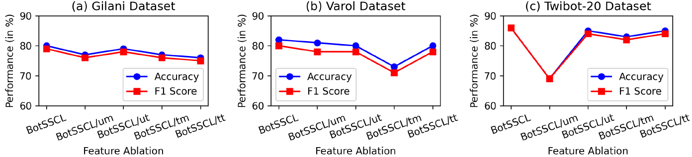
C1.1. Ablation Study
→ Our user representation captures wide spectrum of bots from different datasets.
Notes:
We also performed ablation study and clearly see that using all four feature modality is important. However,
<click>
For each dataset, we see that different feature modality is important as seen by the significant drop. <click>
This shows that our user representation approach is justified and correct to capture wide spectrum of bots from different datasets.

Slide 33

C1.1. Parameter Sensitivity Analysis
1
BotSSCL works better with data augmentation 1
2
Finding the optimal representation corruption rate for detection.
3
By increasing the number of epochs for training (1000,5000,10000)
4
BotSSCL works better with increasing the batch size (128, 256, 512)
5
Alternatives to linear classifiers do not work better
6
Alternatives to InfoNCE loss do not work better.
Notes:
We also did many parameter sensitivity analysis.

Slide 34
C1.1. Parameter Sensitivity Analysis
1
2
3
4
5
6

Slide 35
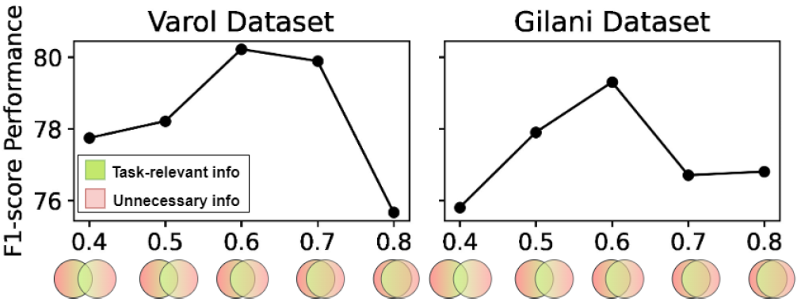
C1.1. Parameter Sensitivity Analysis
1
2
3
4
5
→ The corruption rate in Augmentation 1 with 0.6 achieves the optimal representation for detection
6
Notes:
Here, we see that corruption rate of 0.6 is optimal for both dataset. <click>

Slide 36
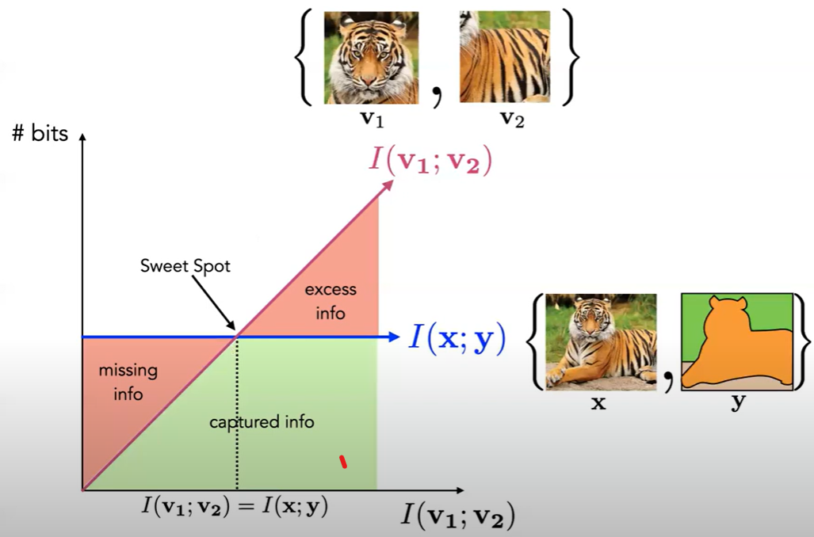
C1.1. Parameter Sensitivity Analysis
Source: Tian et al. 2020, NeurIPS
1
2
3
4
→ The corruption rate in Augmentation 1 with 0.6 achieves the optimal representation for detection
Tian, Y., Sun, C., Poole, B., Krishnan, D., Schmid, C., & Isola, P. (2020). What makes for good views for contrastive learning?. Advances in neural information processing systems, 33, 6827-6839.
Notes:
This is due to the fact of mutual information maximization. It states that there lies a sweet spot for learning relevant information otherwise, model either miss information or learn excess noise information.

Slide 37
C1.1. Parameter Sensitivity Analysis
1
2
3
4
5
6

Slide 38
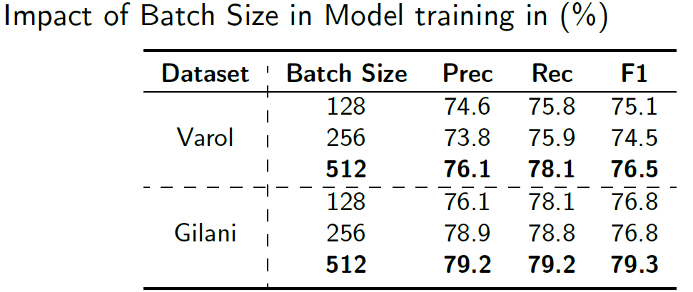
C1.1. Parameter Sensitivity Analysis
1
2
3
4
5
6
→ BotSSCL works better with increasing the batch size
Notes:
Similarly, increasing number of batch size also improves performance. This is also logical because with more samples and negative positive pairs, the model learns were to put point in the embedding space.

Slide 39
C1.1. Parameter Sensitivity Analysis
1
2
3
4
5
6

Slide 40
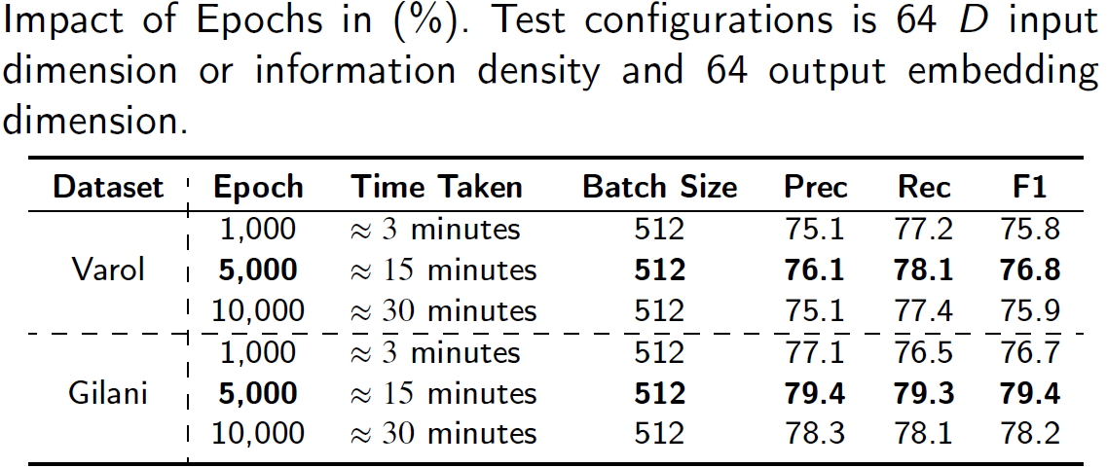
C1.1. Parameter Sensitivity Analysis
1
2
3
4
5
6
→ BotSSCL works better by increasing the number of epochs for training
Notes:
The same effect is also with increasing epoch. Model learns to distinguish better with longer training.

Slide 41
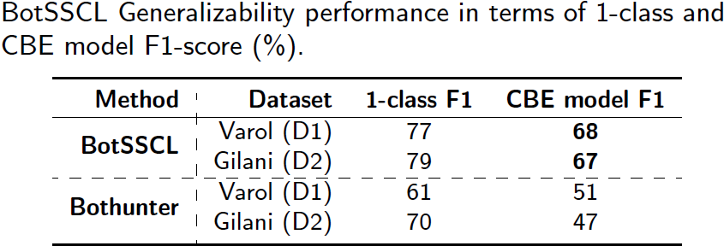
C1.2. Generalizability
“BotSSCL learns high-level representations to distinguish bot from any dataset”
It is generalizable as it achieves similar performance (~67% F1) when trained with any dataset and tested with other.
(CBE = Cross-botnet evaluation)
Notes:
Here, we train model on one dataset, and test with another. We achieve stable performance. Whereas, for BotHunter, we see performance poor than random guess.

Slide 42
C1.3. Adversarial Robustness
We used Universal Robustness Evaluation Toolkit (URET) model from IBM and
provided the trained model,
configuration files for the features to be manipulated.
Eykholt, K., Lee, T., Schales, D., Jang, J., & Molloy, I. (2023). {URET}: Universal Robustness Evaluation Toolkit (for Evasion). In 32nd USENIX Security Symposium (USENIX Security 23) (pp. 3817-3833).
Notes:
We also did the adversarial robustness test.

Slide 43
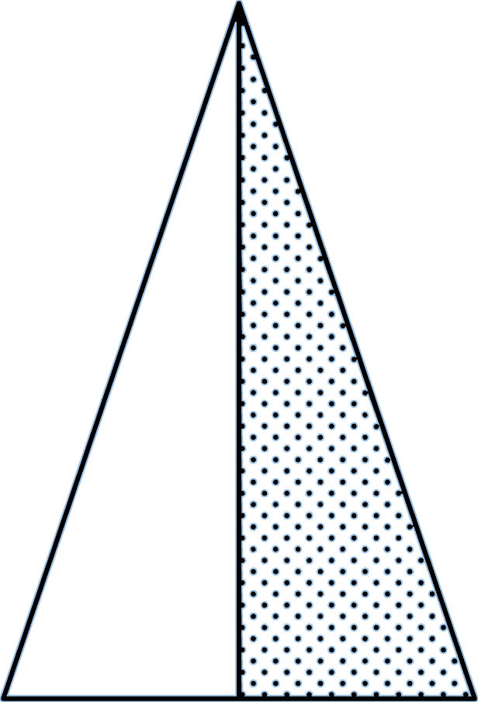



C1.3. Adversarial Robustness
User Metadata
Tweet Metadata
Tweet Temporal
Number of Followers
[0,1000]
Number of Following
[0,1000]
Number of words
[1,55]
Mean favourites per tweet
[0,1000]
Number of retweets in tweets
[0,2400]
Max tweet per hour
[0,100]
Max tweet per day
[0,2400]
→ Adversarial Budget under realistic constraints and adversary model’s assumptions, goals, and capabilities.
Notes:
We select these 7 features to manipulate considering a realistic adversarial budget and threat model.

Slide 44
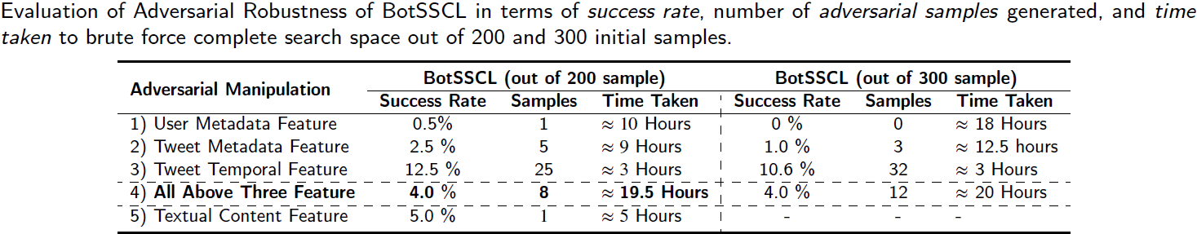
C1.3. Adversarial Robustness
→ Only allows 4% success to adversaries for evasion.
→ Most of the evasion is possible by tampering temporal features. If temporal feature is altered, adversary will have difficulty attaining their goal of trends.
Notes:
We note that only 4% bot evade the detection if all four values are used.
<click>
We did not include more samples than 300 because only the time for adversary is increasing but not the success rate.
<click>
However, we note that if adversary only manipulate the temporal feature, the success rate of evasion is high. This aligns with literature as temporal feature strongly links with automated activity. But this does not help adversary as they will not be able to attain an artificial trend.
Textual Features – used ChatGPT to change the tweet content Our results show that out of 20 accounts, only one flipped the output after 193 prompts. Our analysis shows that textual adversarial attack success is at most 5% as shown in the table

Slide 45
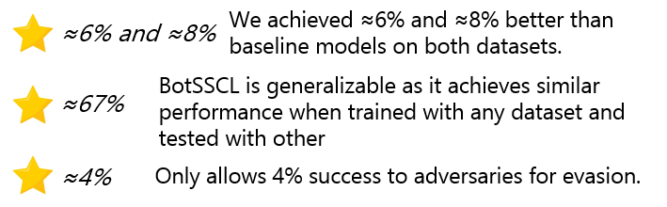
Conclusion of our BotSSCL
Results:
Potential Direction
The work can only tell bot-likeliness but not what they are doing or whether they are part of any malicious campaign or not.

Slide 46

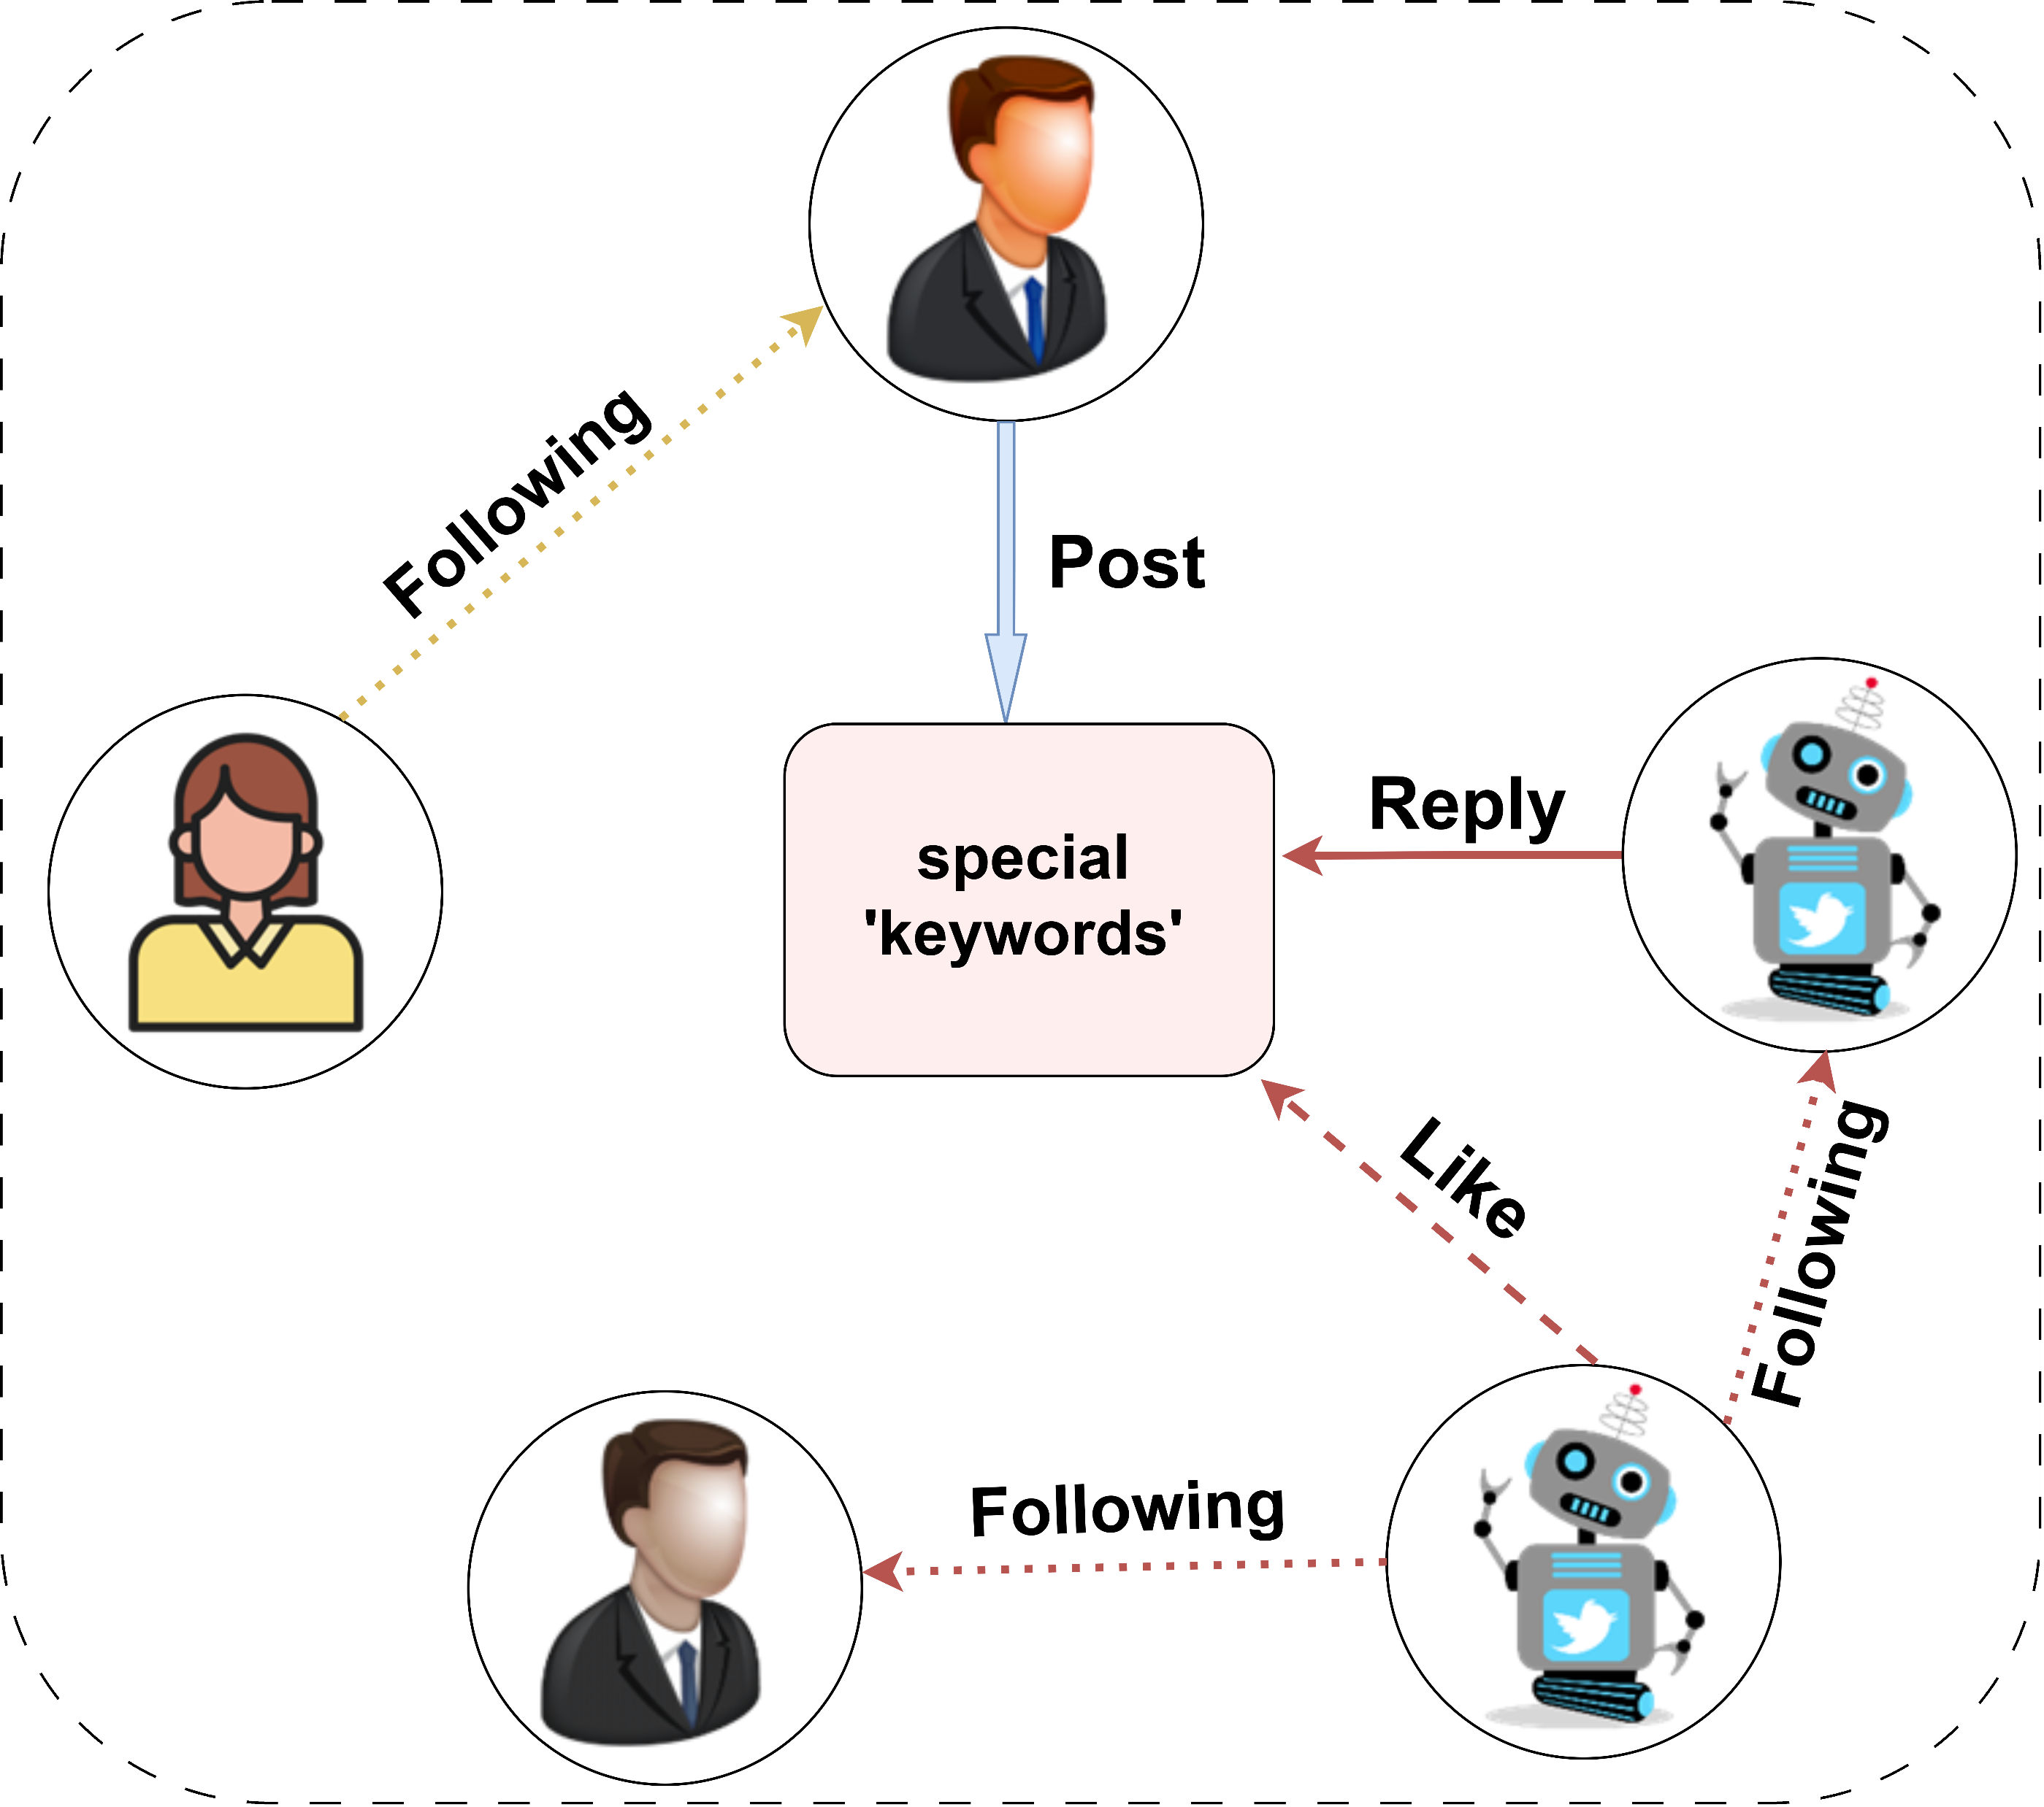
A case study …
Coordinated Bots
Work together in a coordinated fashion
(Orchestrated campaign)
‘metamask’
- ₿₿₿
Trigger-based (TB) Bots
Reply-based Attacks
(Phishing) [1]
Akhtar, M. M., Masood, R., Ikram, M., & Kanhere, S. S. (2024, July). SoK: False Information, Bots and Malicious Campaigns: Demystifying Elements of Social Media Manipulations. In Proceedings of the 19th ACM Asia Conference on Computer and Communications Security (pp. 1784-1800). (CORE Rank A; AR < 21%) [3]
Notes:
We call these social manipulators as Trigger bots due to their triggered behavior.
The idea is simple, if we post on X with some special keywords, then many bots will reply.

Slide 47
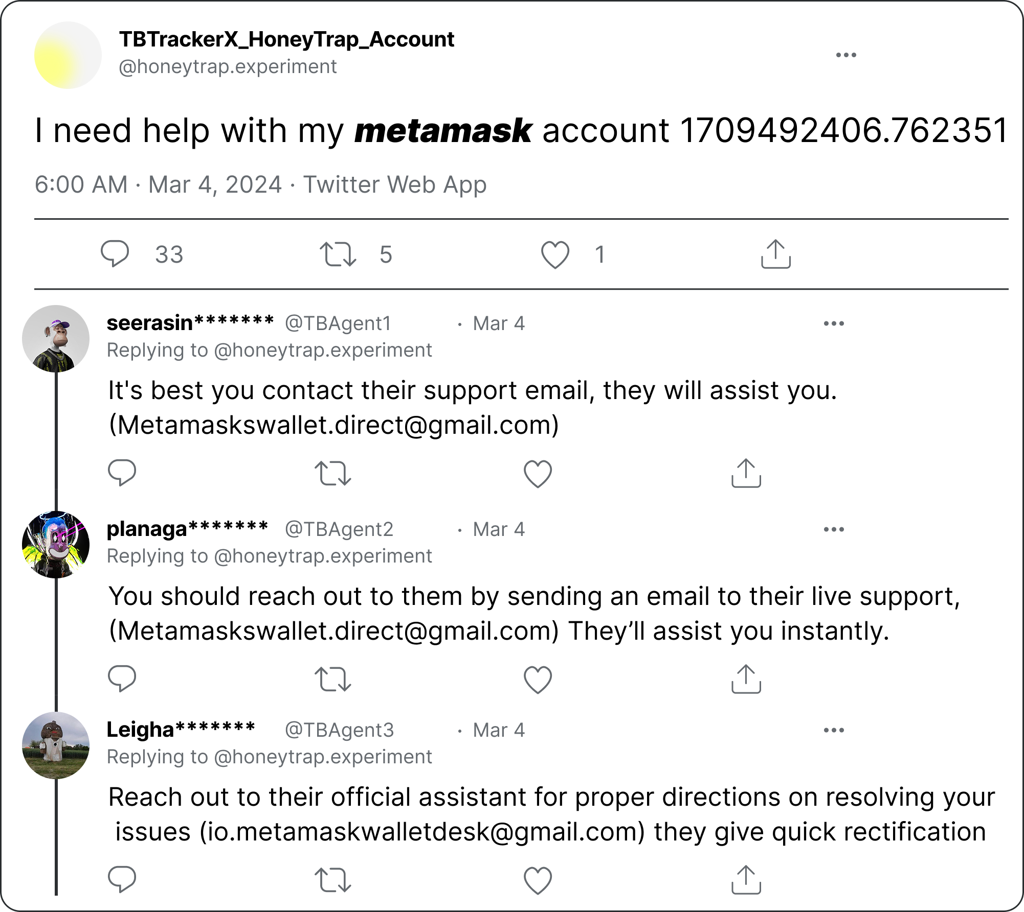
Trigger Bots (TB)
Notes:
We call these social manipulators as Trigger bots due to their triggered behavior.
The idea is simple, if we post on X with some special keywords, then many bots will reply.

Slide 48

Trigger Bots (TB)
1. Not an official support email.
2. Contextually similar, but paraphrased replies.
Notes:
We call these social manipulators as Trigger bots due to their triggered behavior.
The idea is simple, if we post on X with some special keywords, then many bots will reply.

Slide 49

Trigger Bots (TB)
1. Not an official support email.
2. Contextually similar, but paraphrased replies.
Real world impact!!!
Addresses have sent/received ~38 BTC and ~19 ETH [2].
[2] Acharya, B., Saad, M., Cinà, A. E., Schönherr, L., Dai Nguyen, H., Oest, A., ... & Holz, T. (2024, May). Conning the crypto conman: End-to-end analysis of cryptocurrency-based technical support scams. In 2024 IEEE Symposium on Security and Privacy (SP) (pp. 17-35). IEEE.
Notes:
We call these social manipulators as Trigger bots due to their triggered behavior.
The idea is simple, if we post on X with some special keywords, then many bots will reply.

Slide 50
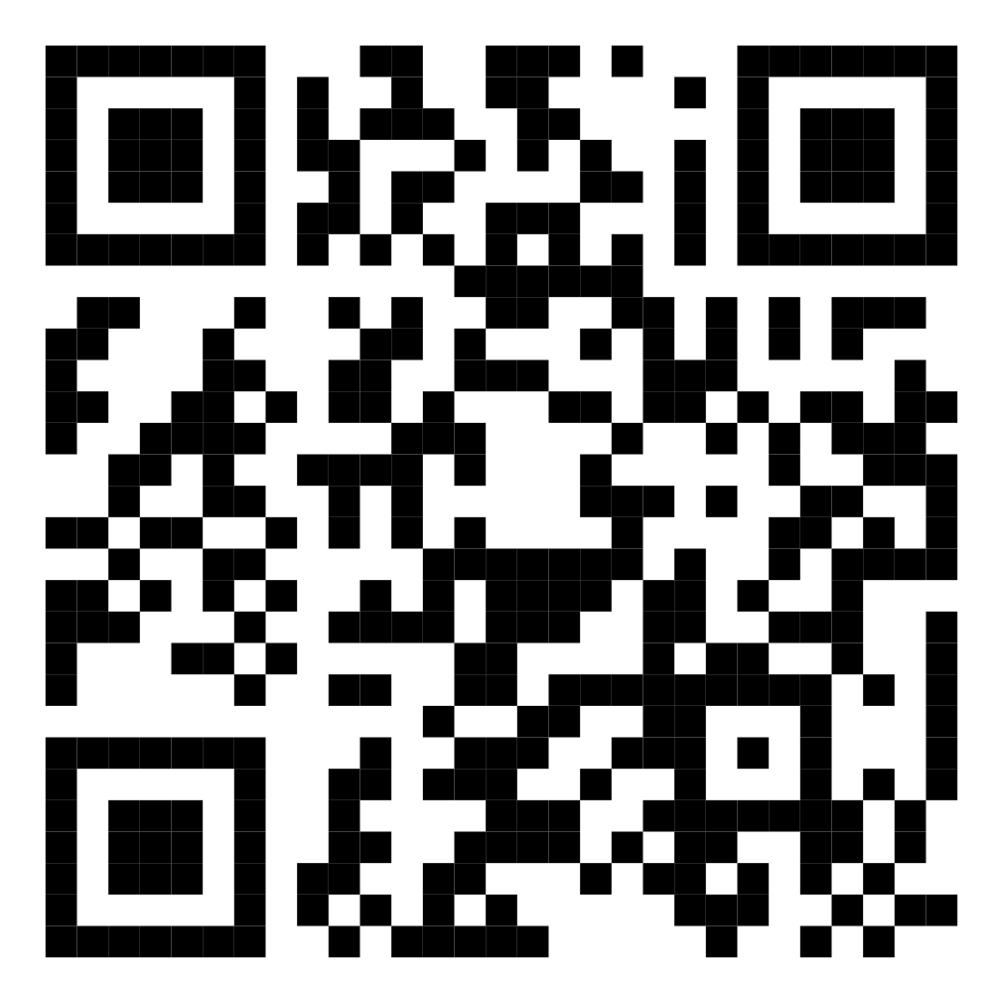
TBTrackerX: Fantastic Trigger Bots and Where to Malicious Campaigns on X
In Proceedings of NDSS’26 (CORE A*)

Slide 51
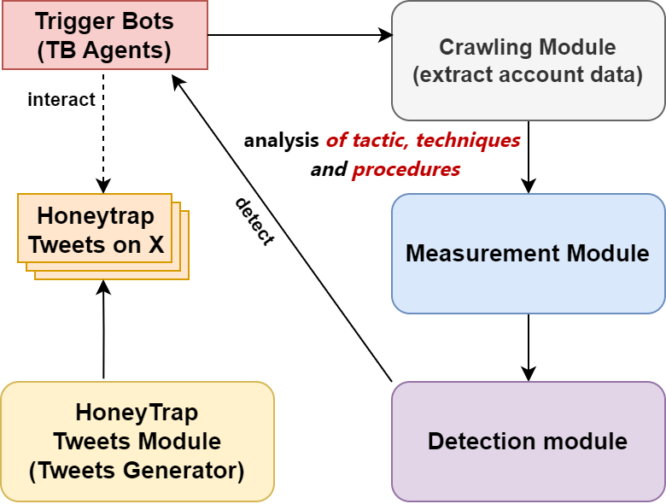
TBTrackerX Methodology
Which keywords did we select?
consist of trigger keywords
Notes:
1. more work needed in gathering large-scale dataset with ground truth information for SMM study.
2. few SMM recovery methods exist. Inoculation and pre-bunking are some methods used today.
3. become an ecosystem problem. Data providers are focused on their platform but these manipulations are cross-platform.

Slide 52
Systematic Investigation of TB-prone Keywords
search terms “bot”, “magic keywords”, seed accounts, research articles, news blogs
finding commonalities, themes, intentions of TB bots from different keywords
Monitor status Active keywords = 19; Non-active = 11
Group active keywords (4 campaigns by common theme)
Refine, select representative Final selection: (N = 10) (across 4 campaigns)
Identify TB-prone keywords (N = 30)
preliminary testing by using keywords, tracking highly attacked keywords
filter out similar types of keywords, for example: “DMT” similar to “shrooms”, “robux” similar to “metamask”

Slide 53





Four Campaign Categories
Common Theme
TB Keywords
Deceptive Support Campaigns
metamask
trustwallet
hacked
(Mal 1.)
Illicit Product Campaigns
shrooms
IPTV
(Mal 2.)
(Mal 3.)
Misleading Giveaway Campaigns
cashapp
sugar daddy
Benign Campaigns
logo
graphic designer
essay
(Benign)

Slide 54
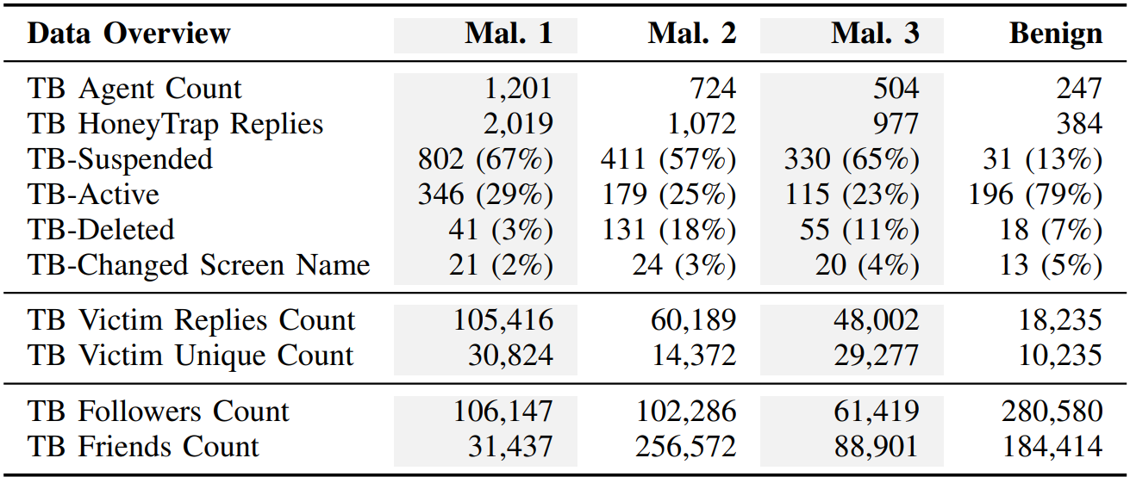
Honeytrap Tweets Generator Module
We ran this Tweet generator module during the month of March 2024.
We posted twice for each keywords for 30-day. So, in total 600 tweets.
We captured 4,452 TB agent replies from 2,647 unique TB agents.

Slide 55
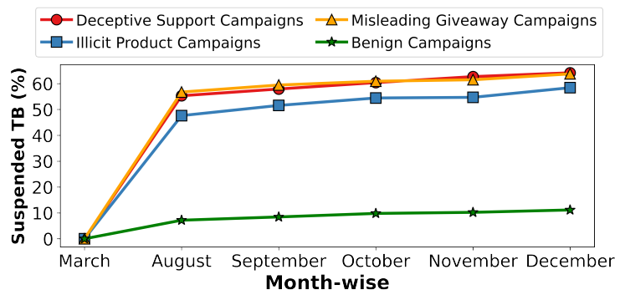
Ground-truth Annotation and Validation
57% - 67% malicious TB agent suspended by X.
We also validated TBs by three human annotators (IR>85%).
TBTrackerX exclusively captures (>96%) TB agents in the honeytrap.
Notes:
Inter-annotator agreement was 85%

Slide 56
Results – Multidimensional Measurement
1
TB Profile Analysis
2
Content Analysis
3
Temporal Analysis
4
Longitudinal Analysis
5
TB Ecosystem
6
TB Detection
Notes:
Multi-dimensional analysis

Slide 57
Results
1
2
3
4
5
6

Slide 58
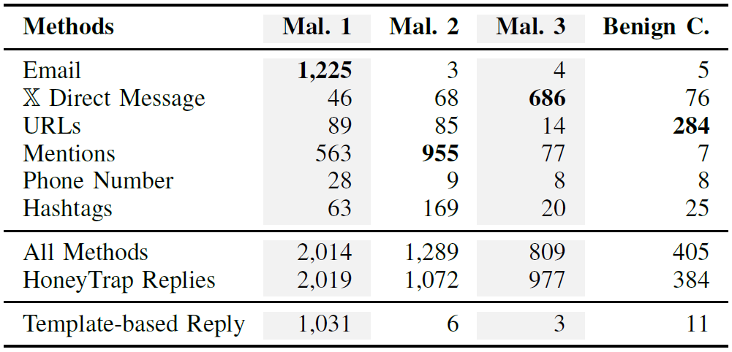
Results
TB Profile Analysis
1
2
3
4
5
6

Slide 59
Results
TB Profile Analysis
1
2
3
4
5
6
Takeaway: Distinct Modus-operandi of TB Agents

Slide 60
Results
1
2
3
4
5
6

Slide 61
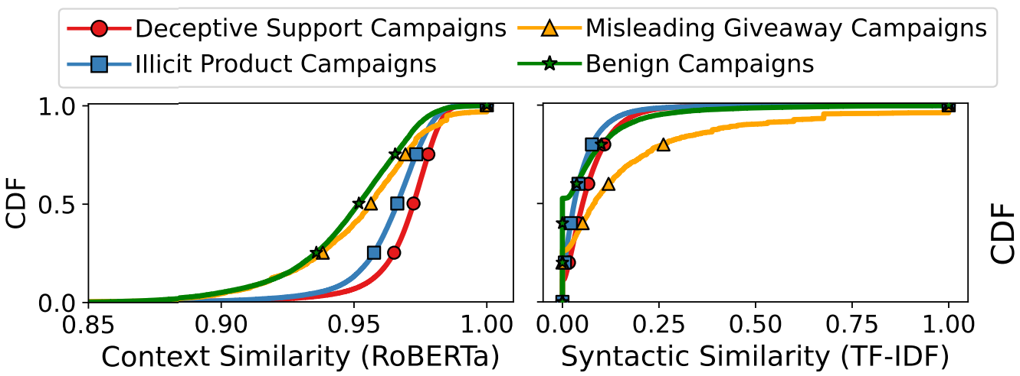
Results – Context and Syntactic Similarity of Replies
Content Analysis
1
2
3
4
5
6
Notes:
We quantify linguistic consistency across all TB agents’ textual responses within their campaigns. For this, we employ two complementary text representation methods: a contextual embedding model and a lexical-based vectorizer.
We use RoBERTa for the contextual approach, as it captures nuanced meanings and context beyond surface-level word overlap. We then compute the pairwise cosine similarity scores for all sentence pairs, yielding a symmetric similarity matrix. To avoid redundancy, we extract only the upper triangular values (excluding the diagonal), representing the unique pairwise semantic similarities. About 50% of replies in all campaigns have a
RoBERTa similarity between 0.95 and 0.97
In parallel, we apply the traditional TF-IDF (Term Frequency–Inverse Document Frequency) method to encode each sentence into sparse lexical vectors, emphasizing the frequency and uniqueness of word usage. Cosine similarity was similarly computed over these TF-IDF vectors to measure syntactic similarity. In contrast, up to 95% of campaign replies have a TF-IDF similarity < 0.30, indicating minimal word overlap.
But what was surprising is that they still manage to be similar in terms of a common tactic. TTP Tactic is evasion, technique is content manipulation, procedure is paraphrasing

Slide 62
Results – Context and Syntactic Similarity of Replies
Content Analysis
1
2
3
4
5
6
Evasion Strategy 1: Different words - same meaning
Notes:
We quantify linguistic consistency across all TB agents’ textual responses within their campaigns. For this, we employ two complementary text representation methods: a contextual embedding model and a lexical-based vectorizer.
We use RoBERTa for the contextual approach, as it captures nuanced meanings and context beyond surface-level word overlap. We then compute the pairwise cosine similarity scores for all sentence pairs, yielding a symmetric similarity matrix. To avoid redundancy, we extract only the upper triangular values (excluding the diagonal), representing the unique pairwise semantic similarities. About 50% of replies in all campaigns have a
RoBERTa similarity between 0.95 and 0.97
In parallel, we apply the traditional TF-IDF (Term Frequency–Inverse Document Frequency) method to encode each sentence into sparse lexical vectors, emphasizing the frequency and uniqueness of word usage. Cosine similarity was similarly computed over these TF-IDF vectors to measure syntactic similarity. In contrast, up to 95% of campaign replies have a TF-IDF similarity < 0.30, indicating minimal word overlap.
But what was surprising is that they still manage to be similar in terms of a common tactic. TTP Tactic is evasion, technique is content manipulation, procedure is paraphrasing

Slide 63
Results
1
2
3
4
5
6

Slide 64
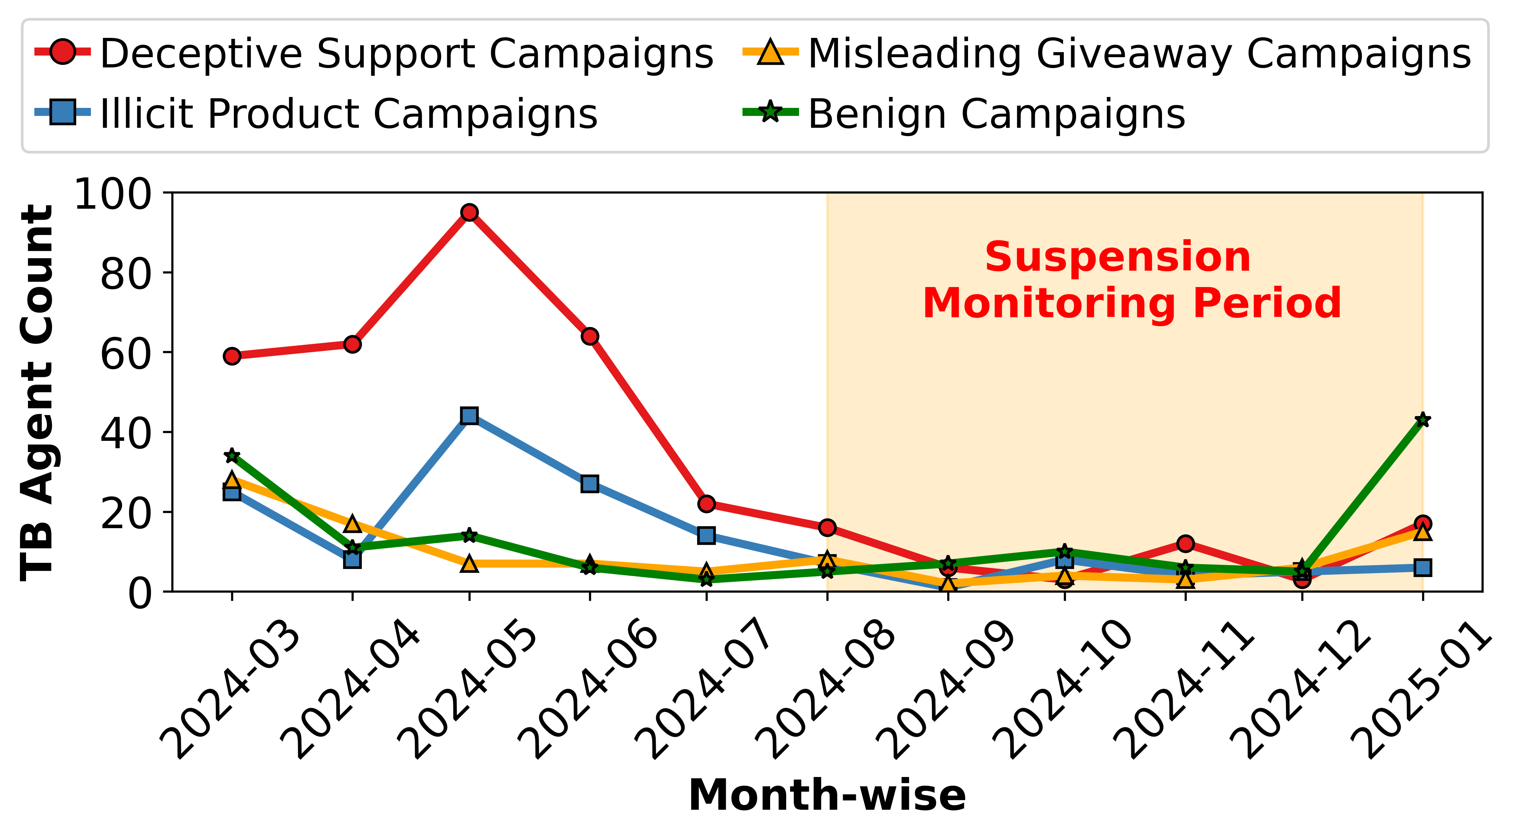
Results
Longitudinal Analysis
1
2
3
4
5
6
Evasion Strategy 2: Dormancy after peak campaign
Notes:
Previous studies suggest that malicious TB agents have a short active life cycle of two to six months before suspension. We periodically check the availability of the captured TB agents four months after the initial data collection to assess evasion rates. We found 640 TB agents (out of 2500) esapced suspension. We revisited the active TB Agents on X in January 2025 to collect two profile attributes: time of their last reply and the latest follower count. In Figure 8, we illustrate the monthly count of TB agents,
categorized by the time of their most recent activity. We observe a peak for a short period (till July 2024) and a drop in activity by August 2024.

Slide 65
Results – TBTrackerX Detection Module
TB Detection
Campaign Drift (Covariate Drift)
Campaign Shift (Domain Shift)
1
metamask
trustwallet
hacked
metamask
trustwallet
hacked
Deceptive Support Campaigns
Malicious Campaigns
2
IPTV
shrooms
IPTV
shrooms
3
Illicit Product Campaigns
4
sd
cashapp
sd
cashapp
Misleading Giveaways Campaigns
5
logo
graphic designer
essay
logo
graphic designer
essay
Benign Campaigns
Benign Campaigns
6
Campaign detection
Malicious TB agent detection

Slide 66
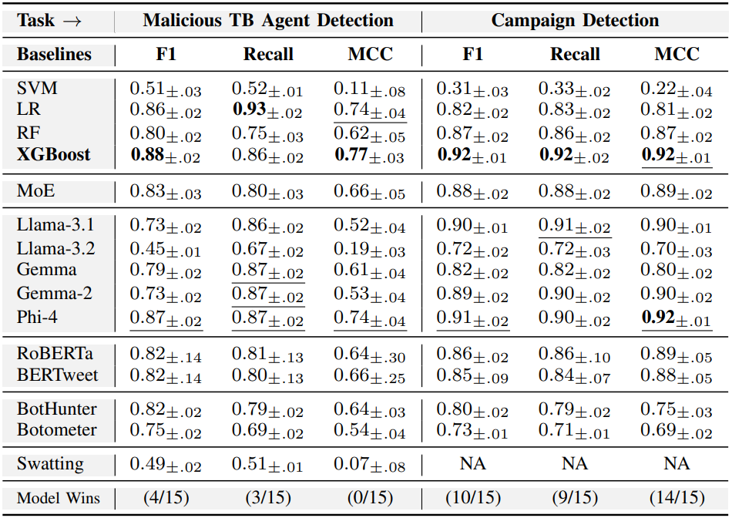
Results – Detection Performance
TB Detection
1
2
3
4
5
6

Slide 67
Results – Detection Performance
TB Detection
1
2
3
4
5
6

Slide 68
Results – Detection Performance
TB Detection
1
2
3
Numerical Features (num) (#followers, #friends, #posts, #tweet frequency)
Boolean Features (bool) (location, bio-description, DM-permission)
4
As minimum as only 10 features.
5
6
Campaign embeddings (emb) (campaign-aware embeddings (RoBERTa)))
Categorical Features (cat) (type of contact method, preferred device)

Slide 69
Results – Detection Performance
TB Detection
1
2
3
4
As minimum as only 10 features.
As minimum as only 10 features.
5
6

Slide 70
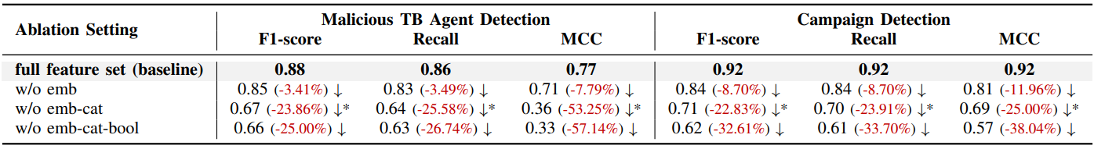
Results – Feature Ablation Study
Takeaway: Campaign-aware embeddings and categorical features have the greatest impact on detection.

Slide 71
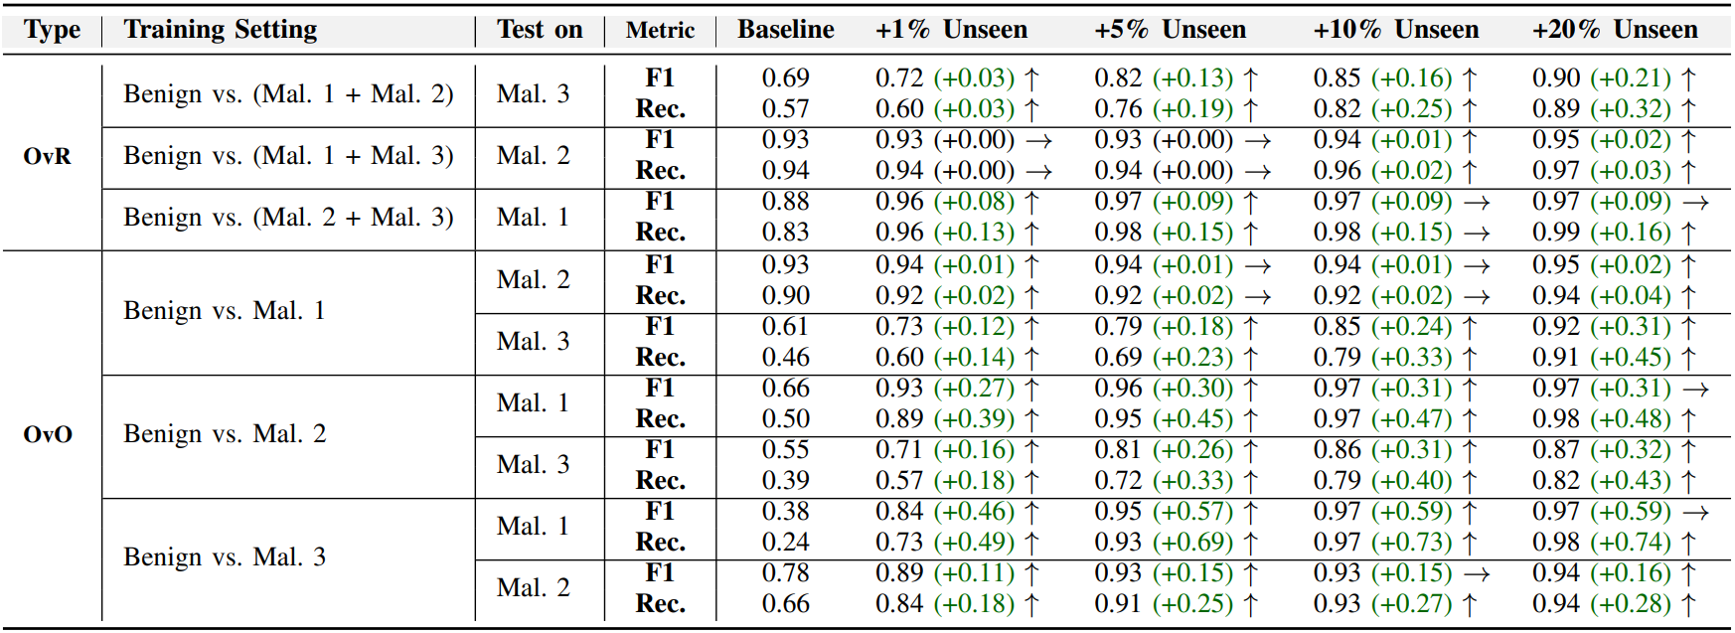
Results – Generalizability
Takeaway: Models need to be adaptable. Adapters can be helpful here.
Future Direction: Towards campaign-agnostic detection!

Slide 72

Recommendations
For OSN Platforms
MFA to deter automated accounts
Favour shadow banning over outright suspension
Flag TB keywords and sanitise posts
Notes:
Overall, we are currently trying to achieve these contributions.

Slide 73
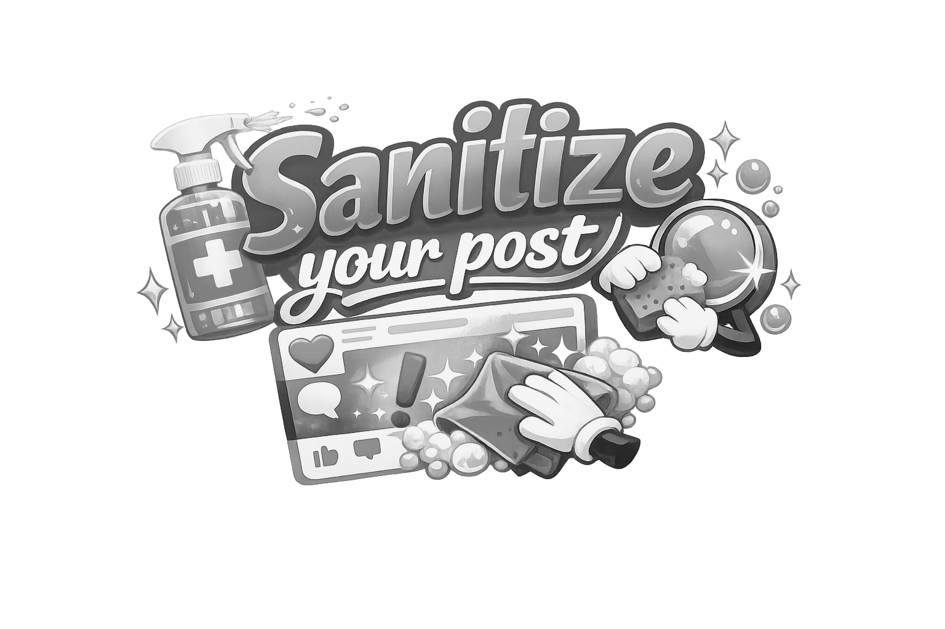

Recommendations
For OSN Platforms
For OSN Users
MFA to deter automated accounts
Favour shadow banning over outright suspension
Flag TB keywords and sanitise posts
Prohibit rapid reciprocal follower practices #follow4follow, #like4like
Refrain from intentional misuse of TB keywords.
Notes:
Overall, we are currently trying to achieve these contributions.

Slide 74

Recommendations
For OSN Platforms
For OSN Users
For Security Community
MFA to deter automated accounts
Favour shadow banning over outright suspension
Flag TB keywords and sanitise posts
Prohibit rapid reciprocal follower practices #follow4follow, #like4like
Refrain from intentional misuse of TB keywords.
Develop advanced detection, transparency, and accountability in addressing sophisticated SMM.
Notes:
Overall, we are currently trying to achieve these contributions.

Slide 75
Recommendations
For OSN Platforms
For OSN Users
For Security Community
MFA to deter automated accounts
Favour shadow banning over outright suspension
Flag TB keywords and sanitise posts
Prohibit rapid reciprocal follower practices #follow4follow, #like4like
Refrain from intentional misuse of TB keywords.
Develop advanced detection, transparency, and accountability in addressing sophisticated SMM.
Notes:
Overall, we are currently trying to achieve these contributions.

Slide 76




Summary
We provide a structured view of social media manipulation (SMM), spanning information-, account-, and campaign-level behaviors
We presented BotSSCL and TBTrackerX
We emphasize the urgent need for adaptive, resilient, and trustworthy detection strategies

Slide 77

Future Work
From detection to intent understanding: infer bot roles, targets, and campaign objectives
Focusing on multi-modal content (images, video, audio)
End-to-end visibility of malicious campaigns: connect accounts, content, and coordination to expose full attack pipelines
Adaptive learning under campaign and domain drift to handle evolving bot behaviors
Early detection of trigger-based and coordinated campaigns before large-scale impact
Robust and generalizable defenses against strategic adversaries and platform constraints

Slide 78
References
Madahali, L., & Hall, M. (2020, June). Application of the Benford’s law to Social bots and Information Operations activities. In 2020 International Conference on Cyber Situational Awareness, Data Analytics and Assessment (CyberSA) (pp. 1-8). IEEE.
Tabassum, F., Mubarak, S., Liu, L., & Du, J. T. (2023, March). How Many Features Do We Need to Identify Bots on Twitter?. In International Conference on Information (pp. 312-327). Cham: Springer Nature Switzerland.
Guo, Q., Xie, H., Li, Y., Ma, W., & Zhang, C. (2021). Social bots detection via fusing bert and graph convolutional networks. Symmetry, 14(1), 30.
Sayyadiharikandeh, M., Varol, O., Yang, K. C., Flammini, A., & Menczer, F. (2020, October). Detection of novel social bots by ensembles of specialized classifiers. In Proceedings of the 29th ACM international conference on information & knowledge management (pp. 2725-2732).
Echeverrï£¡ a, J., De Cristofaro, E., Kourtellis, N., Leontiadis, I., Stringhini, G., & Zhou, S. (2018, December). LOBO: Evaluation of generalization deficiencies in Twitter bot classifiers. In Proceedings of the 34th annual computer security applications conference (pp. 137-146).
Hayawi, K., Mathew, S., Venugopal, N., Masud, M. M., & Ho, P. H. (2022). DeeProBot: a hybrid deep neural network model for social bot detection based on user profile data. Social Network Analysis and Mining, 12(1), 43.
Beskow, D. M., & Carley, K. M. (2018, July). Bot-hunter: a tiered approach to detecting & characterizing automated activity on twitter. In Conference paper. SBP-BRiMS: International conference on social computing, behavioral-cultural modeling and prediction and behavior representation in modeling and simulation (Vol. 3, No. 3).
Cresci, S., Di Pietro, R., Petrocchi, M., Spognardi, A., & Tesconi, M. (2017). Social fingerprinting: detection of spambot groups through DNA-inspired behavioral modeling. IEEE Transactions on Dependable and Secure Computing, 15(4), 561-576.
Feng, S., Wan, H., Wang, N., Li, J., & Luo, M. (2021, October). Satar: A self-supervised approach to twitter account representation learning and its application in bot detection. In Proceedings of the 30th ACM International Conference on Information & Knowledge Management (pp. 3808-3817).
Chen, T., Kornblith, S., Norouzi, M., & Hinton, G. (2020, November). A simple framework for contrastive learning of visual representations. In International conference on machine learning (pp. 1597-1607). PMLR.

Slide 79



SoK
Thank you for listening! Questions?
BotSSCL
TBTrackerX
Salil Kanhere
salil.kanhere@unsw.edu.au
Or find me on LinkedIn

Slide 80
Appendix

Slide 81

Features
Notes:
In terms of feature engineering, there are five feature modalities extracted from user profile metrics, tweet textual content and user network.

Slide 82

BotSSCL Framework

Slide 83

Contrastive Loss
Notes:
To example this loss, we take this as an example with three samples in a batch (2 bot and 1 human).
<click>
We first generate augmentations of each sample denoted by tilde (~).
<click>
Then each of the samples cosine similarity is calculated. Please note here, That the green ones denote positive pair cosine similarity, and red shows the negative pair similarity. White shows the self-similarity.

Slide 84
Contrastive Loss

Slide 85

Contrastive Loss
Chen, T., Kornblith, S., Norouzi, M., & Hinton, G. (2020, November). A simple framework for contrastive learning of visual representations. In International conference on machine learning (pp. 1597-1607). PMLR.
Notes:
Now we follow the InfoNCE loss.
<click>
Here, the denominator contains positive sample,
<click>
and the numerator contains positive + negative sample.

Slide 86

Contrastive Loss
Notes:
We have just shown this as an example for only the first sample, however, for every sample this will be done in the batch.

Slide 87

Contrastive Loss
Khosla, P., Teterwak, P., Wang, C., Sarna, A., Tian, Y., Isola, P., ... & Krishnan, D. (2020). Supervised contrastive learning. Advances in neural information processing systems, 33, 18661-18673.
Notes:
We have just shown this as an example for only the first sample, however, for every sample this will be done in the batch.

Slide 88




SMM 1
SMM 2
SMM 3
Information-level SMM
Account-level SMM
Campaign-level SMM
Akhtar, M. M., Masood, R., Ikram, M., & Kanhere, S. S. (2024, July). SoK: False Information, Bots and Malicious Campaigns: Demystifying Elements of Social Media Manipulations. In Proceedings of the 19th ACM Asia Conference on Computer and Communications Security (pp. 1784-1800). (CORE Rank A; AR < 21%)
Notes:
So far, in 2023, we first analyzed 10.22 million tweets on COVID-19 and our approach was to look at the information-level.
There, we proposed an automatic annotation model for fake news detection. However, we realize that existing work neglects the use of social bots that steer so many social context around content.
<click>
Thus, in this work we look into the aspect of account-level detection. However, one limitation is that it only tells bot likeliness but not if bots are of malicious or benign nature.
<click>
Therefore, we are currently looking into campaign-level detection.

Slide 89



Slide 90

Content Variation
Notes:
Of course this was not supposed to be surprising. Because these campaigns are orthogonal, targeting different groups so it will say different things.

Slide 91


Slide 92

Results
1
2
3
4
5
6

Slide 93

Results
Temporal Analysis
1
2
3
4
5
6

Slide 94
Results
Temporal Analysis
1
2
3
4
5
6
Evasion Strategy 2: Intermittent activity pattern

Slide 95

Results
TB Profile Analysis
1
2
3
4
5
6
Takeaway: Distinct Modus-operandi of TB Agents

Slide 96
Results
TB Profile Analysis
1
2
3
4
5
6
Takeaway: Distinct Modus-operandi of TB Agents

Slide 97
Results
TB Profile Analysis
1
2
3
4
5
6
Takeaway: Distinct Modus-operandi of TB Agents

Slide 98
Feature Selection for Detection Module
Features | Tier 0 | Tier 1 | Tier 2
User Metadata | ✔️ | ✔️ | ✔️
User Tweet | ✖️ | ✔️ | ✔️
Tweet Metadata | ✖️ | ✖️ | ✔️
Tweet Temporal | ✖️ | ✖️ | ✔️
Network Information | ✖️ | ✖️ | ✔️
Numerical Features (num) (followers, friend, post count, tweet frequency) Boolean Features (bool) (location, bio-description, DM-permission) Categorical Features (cat) (type of contact method, preferred device) Embedding Features (emb) (campaign-aware embeddings (RoBERTa))
+
As minimum as only 10 features.

Slide 99

Results
Longitudinal Analysis
Evasion Strategy 3: Dormancy and Disassociation

