Slide 1


Dealing with “dirty” data
Uzay Kaymak
Jheronimus Academy of Data Science, The Netherlands
Image from moviemeter.nl

Slide 2


Den Bosch
Notes:
JADS: a unique academic Data Science & AI institute – Interdisciplinary and Entrepreneurial
JADS is a hotspot where researchers, students, start-ups, scale-ups, SMEs and multinationals research and design tomorrow’s innovations in the field of Data Science & AI.
We play a key role in building a new ecosystem and accelerate the data driven economy in The Netherlands.
We do this by connecting Data Science & Entrepreneurship in many ways. From educating students and professionals to organizing events, to accelerating data driven start-ups.

Slide 3

We do cool stuff that matters, with data
Notes:
We work on data science technology, in business and society perspective.
Own research focuses on safety-critical systems or environments, especially on transparent systems based on fuzzy set theory.

Slide 4

Outline
Introduction
Poor quality data
Remaining in control: explanations
Designing explainable models
  Fuzzy rule-based systems
  Combining probability and fuzziness
  Communicating model behavior
  Using a priori knowledge
From explainability to understandability
Conclusions
Notes:
Image generated by OpenAI.
Argue that XAI is a strategy when the quality of data is poor.

Slide 5

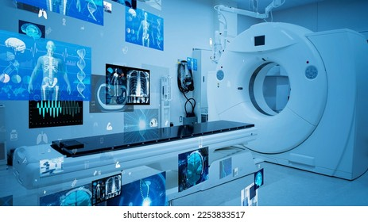


Safety-critical systems
Images from Wikepedia and Shutterstock
Notes:
Wikipedia

Slide 6

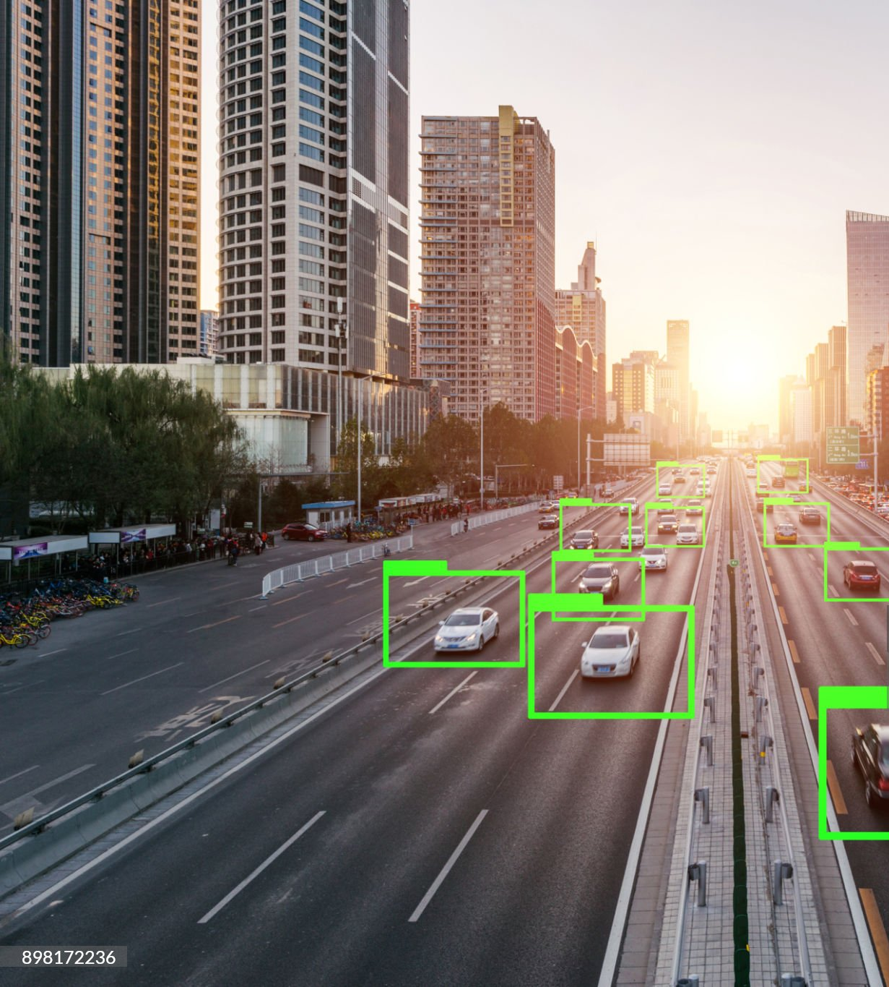

We take data for granted
Notes:
Woman: gettyimages: FG Trade
Autonomous driving: gettyimages: AerialPerspectiveImages
Chips: gettyimages: Yuichiro Chino

Slide 7
Growth of access to data
Number of internet users worldwide from 2014 to 2029 (in millions)
Number of internet users worldwide 2014-2029

Slide 8
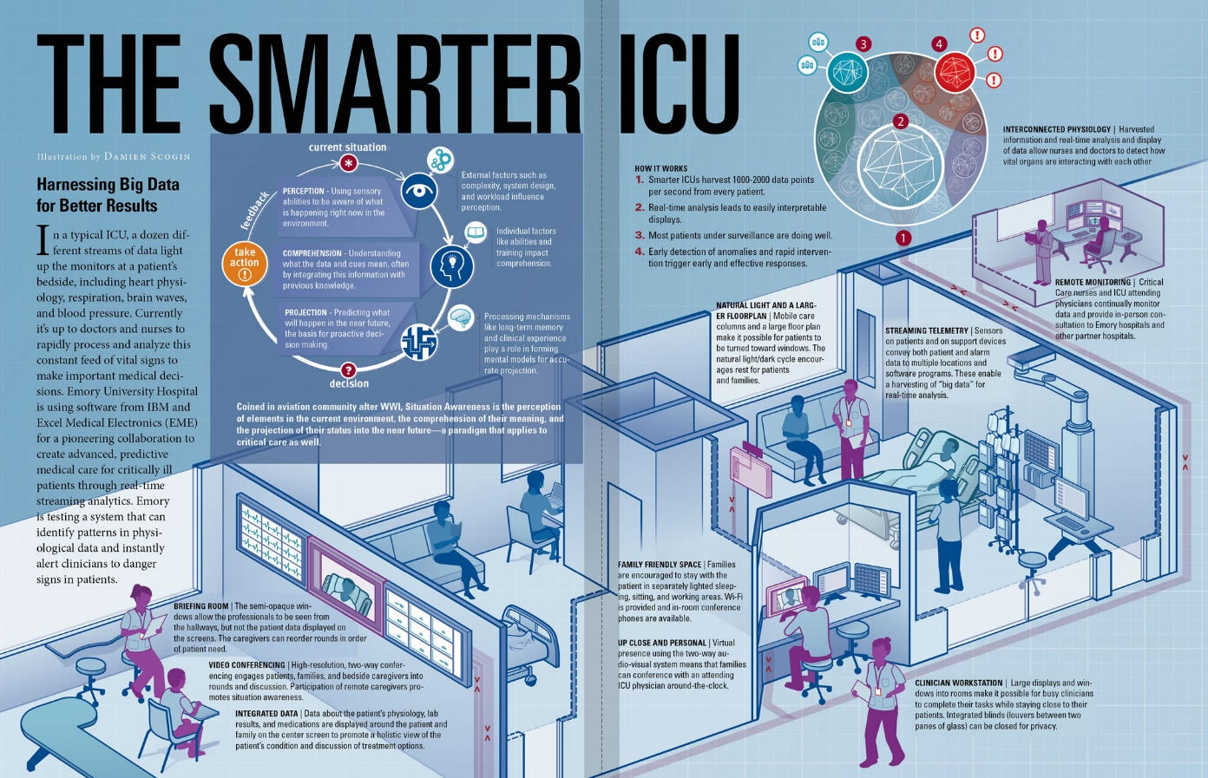
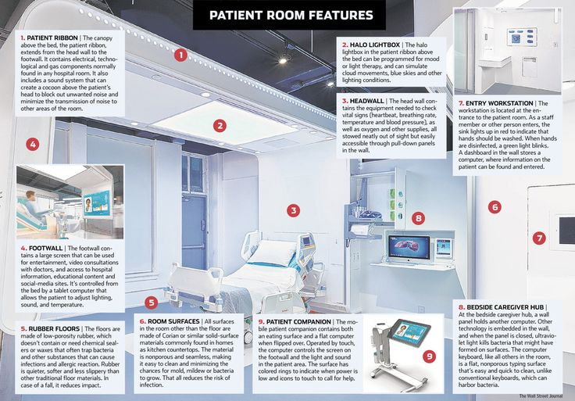
Patient-centric care
Notes:
Growth of data also happens in healthcare. Smart ICU follows all data about patient and context.

Slide 9

Nature of healthcare (big) data
Large number of features
Correlated features
Unknown or unobservable features
Features are proxies to the real variable of interest
Missing values (MNAR)
Measurement errors
Notes:
However, there is still much progress to make. Data-driven approaches in healthcare, despite big improvements, still face many challenges due to the nature of healthcare data.
Normally, in data science, you collect data, you process it and develop a model. However, healthcare (big) data has a whole range of problems that need to be addressed.

Slide 10

Data collection process
Hypothetico-deductive approach
  Data collected based on formulated hypotheses
  → missing values
  Biased data
Inaccurate collection (usually manual entry)
Time-matching related activities missing / problematic
  Data is not recorded at the moment it is created
Notes:
Observability issues: measurements are proxies for real variable of interest.

Slide 11

Semantics of data
Measurement value is insufficient; context information needed, e.g. heart rate
Method of measurement, e.g. glucose POC, or arterial
Calibration of devices
Definition of reference values:
what is normal?
Flexibility in reference values, range limits are not set in stone, crisp vs. fuzzy
Definitions of conditions change over time
Notes:
Unclear semantics.

Slide 12

Variability of process and patient
Every patient is different and responds differently
Value-addition needs to find a balance between standardization and personalization
Treatment methods might vary amongst physicians
Notes:
Too large a variability

Slide 13
Different user groups, different goals, similar needs
Physicians:
accept ICT, trained in statistical modeling
transparency → staying in control
Nurses:
not keen on numbers or mathematical modeling
→ verbal communication
Patients:
need to assess alternative treatment methods
transparency → understanding optionsS should support both groups since they need to collaborate!
Notes:
Emphasize here XAI solutions. Fuzzy is an example.

Slide 14

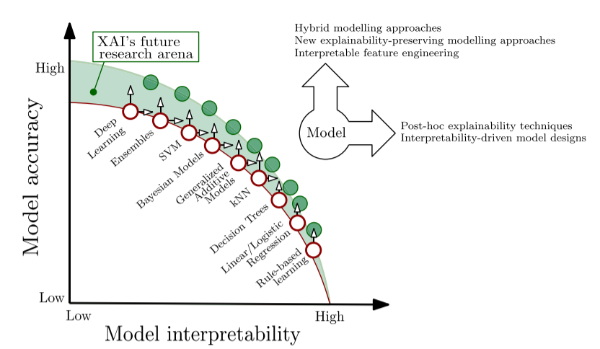
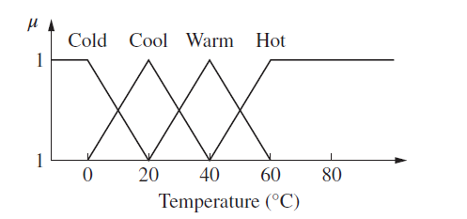
On the explainability of AI
We must exploit our tolerance for imprecision.
~ Lotfi Zadeh
(Arrieta et. al, 2020 )

Slide 15
Motivation for fuzzy systems
Natural paradigm to model similarity-based conceptualization of the world
Fit to mental models
Soft edges, gradual concepts
Model and exploit tolerance to imprecision
Complex aggregation of information
Power of sub-symbolic processing, while having a layer of symbolic presentation
Convenient tool to stimulate communication about the model

Slide 16
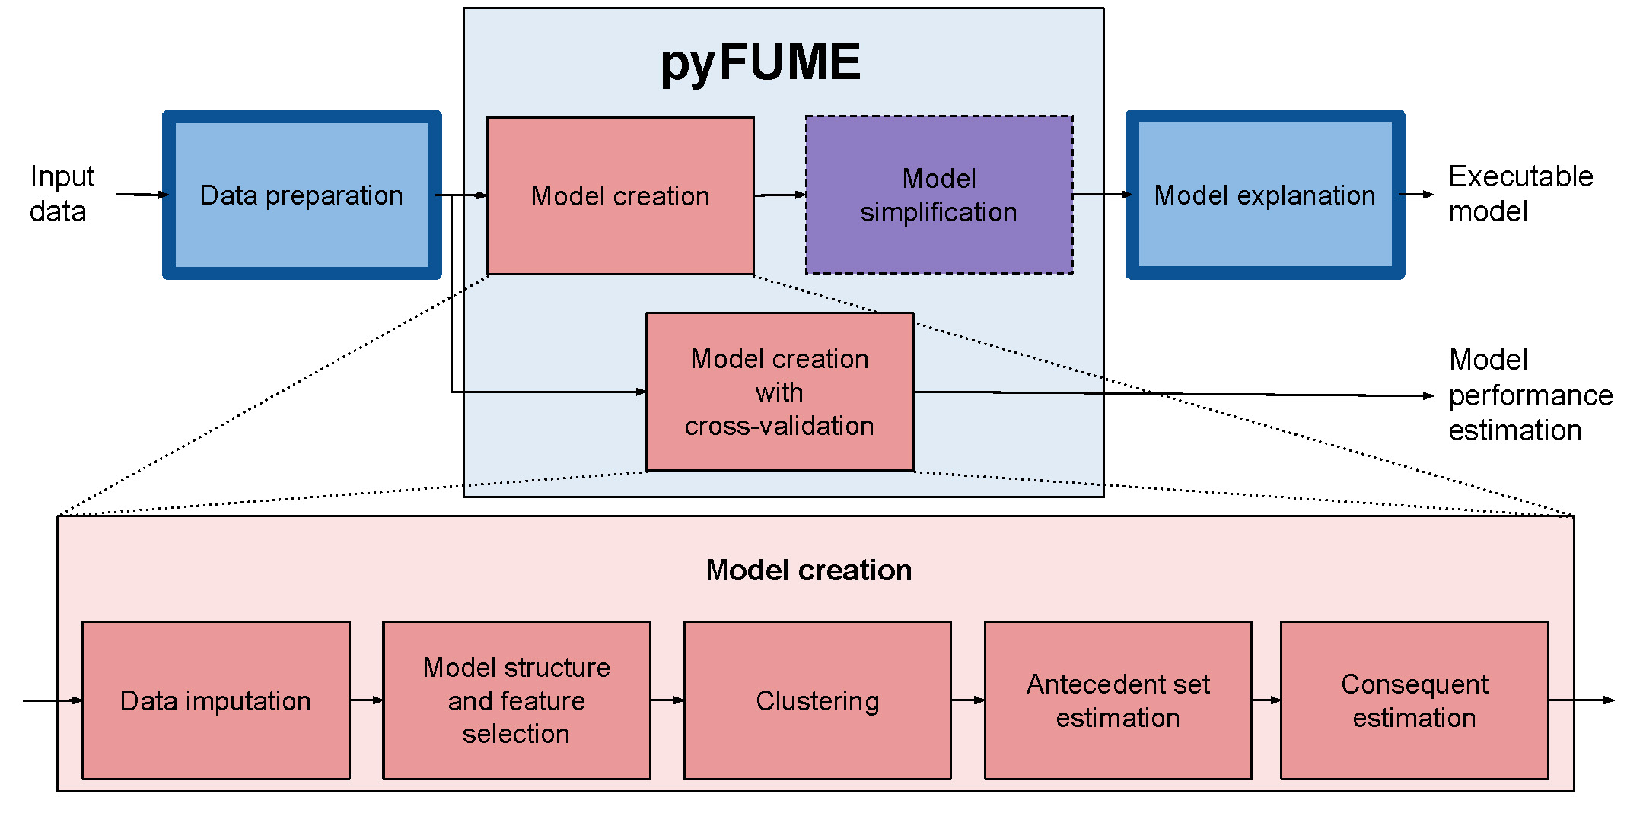
Modeling pipeline

Slide 17
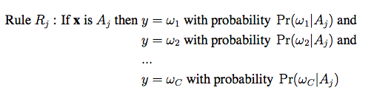
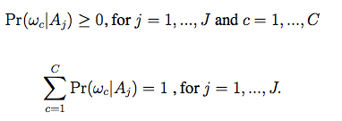
Probabilistic fuzzy systems
Consists of a set of rules whose antecedents are fuzzy conditions and whose consequents are probability distributions
                (1)
where, (2)
and
(3)
consequent
antecedent
fuzzy set
Notes:
A probabilistic fuzzy system (PFS) consists of a set of rules whose antecedents are fuzzy conditions and whose consequents are probability distributions.
These probability estimates can assist clinicians in making decisions in four distinct ways: (i) by providing greater certainty out the expected effects of treatment, (ii) by improving understanding of specific prognostic elements and their relative influence on outcomes, (iii) by reducing reliance on commonly used clinical rules that may be biased, and (iv) by providing an explicit opportunity to review and compare explicit probability thresholds for important clinical decisions [28].
Considering the problem of determining the class y 2 {C1,...,Cc} to which a data point x = (x1, ..., xd) belongs, the probabilistic fuzzy classifier will have the following general
form [14]
The antecedent fuzzy sets Aj(j = 1, ..., a) in are defined in the d-dimensional input space X. For each fuzzy set there is a corresponding probabilistic fuzzy rule. Furthermore, the probability parameters pjk in 1 satisfy

Slide 18
Deterministic vs. probabilistic FS
Y
If x is A⁴ then y is B²
If x is A⁴ then
y is B¹ with probability p(B¹ | A⁴),
and y is B² with probability p(B² | A⁴),
and y is B³ with probability p(B³ | A⁴).
B³
B²
A¹
A³
A⁴
A⁵
B¹
A²
X

Slide 19
PFS output

Slide 20
Parameter determination
How to determine the parameters of the PFS rules?
Sequential Method
Maximum Likelihood Method
Part 1
MF parameters
Part 1 – Initialization
Sequential Method
Part 2 - Optimization
Part 2
Probability parameters
MF parameters
Probability parameters
MF – Membership function

Slide 21
Deriving linguistic rules
Confidence intervals and personalization
Model communication
Optimizing with soft constraints
Explanation component for deep networks

Slide 22
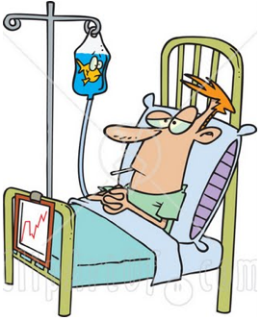
Mortality risk prediction for septic shock patients
  Mortality prediction of septic shock using probabilistic fuzzy systems: will the patient be alive or deceased in 72 hours?
72 hours
Alive/Deceased
t₀
_{(admission)}
t
_{(present)}
t₇₂
_{(t + 72 hours)}
8 hours
Notes:
with the ultimate goal of planning further care for these critical patients and/or as a performance assessment tool to monitor quality of care within an ICU/across different ICUs

Slide 23
Scoring Models
APACHE (Acute Physiology and Chronic Health Evaluation)
  Earliest model from 1981
  Three revisions, fourth is in the make
  Considers 32 physiological variables
SAPS (Simplified Acute Physiology Score)
  Aims to simplify APACHE model
MPM (Mortality probability models)
  Based on logistic regression
SOFA (Sepsis-related Organ Failure Assessment)
  System-level evaluation
Notes:
- Usually computed only for a single moment in time; also validated for a single moment in time.

Slide 24
Results – accuracy
  Results obtained after running PFS, FM and LR models, using respective most predictive variables
 | PFS | FM | LR
AUC | 0.81 ± 0.02 | 0.83 ± 0.03 | 0.83 ± 0.02
Specificity | 0.78 ± 0.03 | 0.82 ± 0.02 | 0.85 ± 0.02
Sensitivity | 0.83 ± 0.04 | 0.84 ± 0.03 | 0.81 ± 0.03
PFS – Probabilistic fuzzy system; FM – fuzzy system; LR – Logistic regression
Notes:
In terms of accuracy, the models are not so interesting.

Slide 25
Linguistic rules
  Simplified fuzzy rules:
  R1 (blue): If diastolic arterial blood pressure is normal and platelets are very high and fiO2 is (not being ventilated) and white blood cell count is normal/slightly low and spO2 is normal and PTT is slightly high then y = 0.05.
  R2 (green): If diastolic arterial blood pressure is normal/slightly low and platelets are low and fiO2 (not being ventilated) and white blood cell count is very low and spO2 is low and PTT is normal then y = 0.86.
  R3 (red): If diastolic arterial blood pressure is low and platelets are high and fiO2 is very high (being ventilated) and white blood cell count is very high and spO2 is low and PTT is slightly high then y = 0.81.
  R4 (light blue): If diastolic arterial blood pressure is low and platelets are normal and fiO2 is (not being ventilated) and white blood cell count is slightly high and spO2 is low and PTT is normal then y = 0.06.

Slide 26
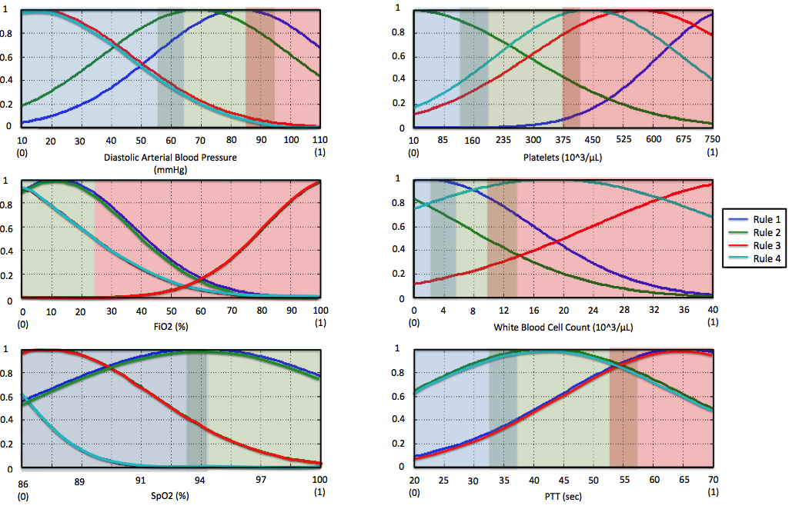
Results – interpretability
  Plot of simplified membership functions:
Notes:
Blue, green and red regions correspond respectively to the physiological ranges of low, normal and high values for these variables

Slide 27
Deriving linguistic rules
Confidence intervals and personalization
Model communication
Optimizing with soft constraints
Explanation component for deep networks

Slide 28
Vitamin B12 deficiency

Slide 29
Confidence intervals

Slide 30
Individualized predictions
Patient with regular kidney function
Patient with poor kidney function

Slide 31
Deriving linguistic rules
Confidence intervals and personalization
Model communication
Optimizing with soft constraints
Explanation component for deep networks

Slide 32

Predicting onset of ARDS in Covid-19 patients
Acute Respiratory Distress Syndome (ARDS) was one of the main reasons for mortality during Covid-19 pandemic
Model for early detection
(retrospective study)
https://europeanlung.org/en/information-hub/lung-conditions/acute-respiratory-distress-syndrome/

Slide 33
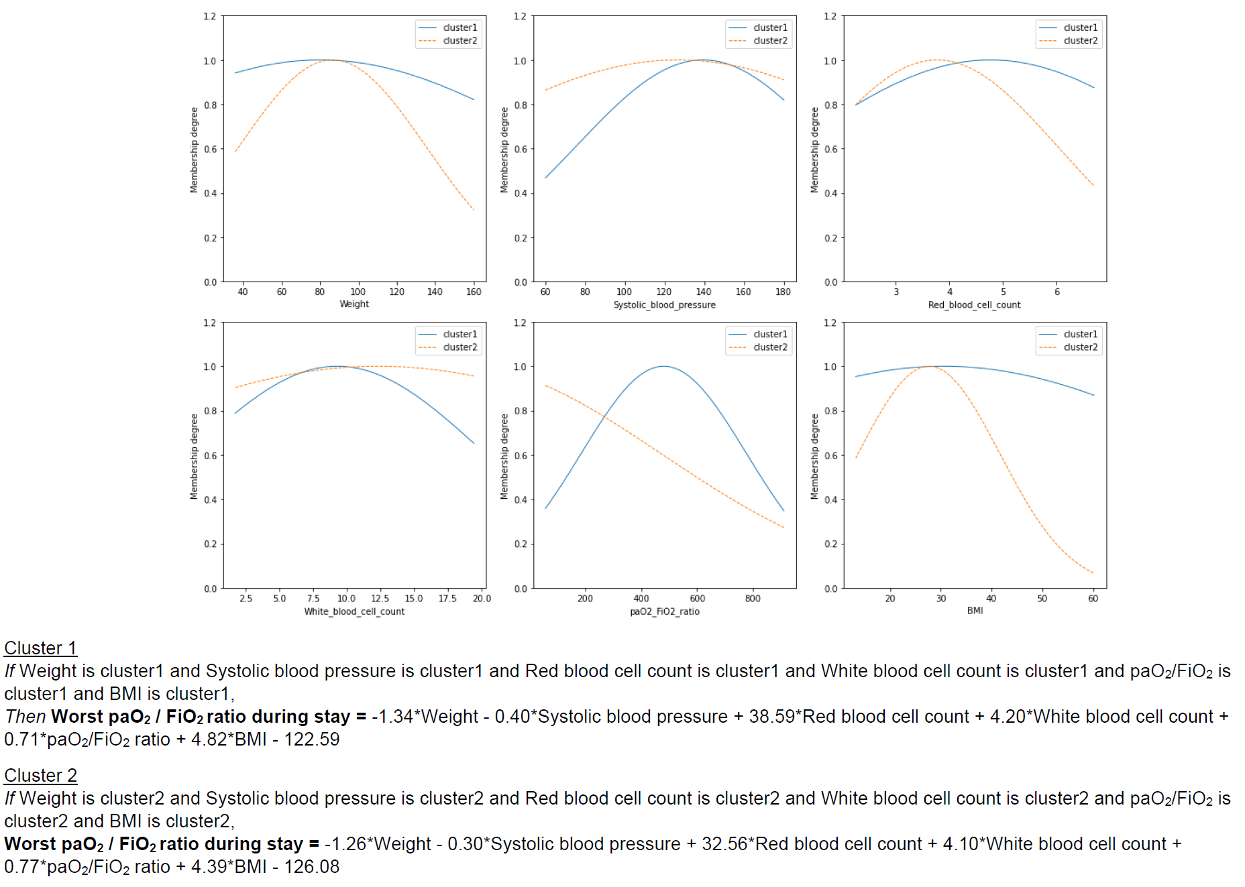

Slide 35
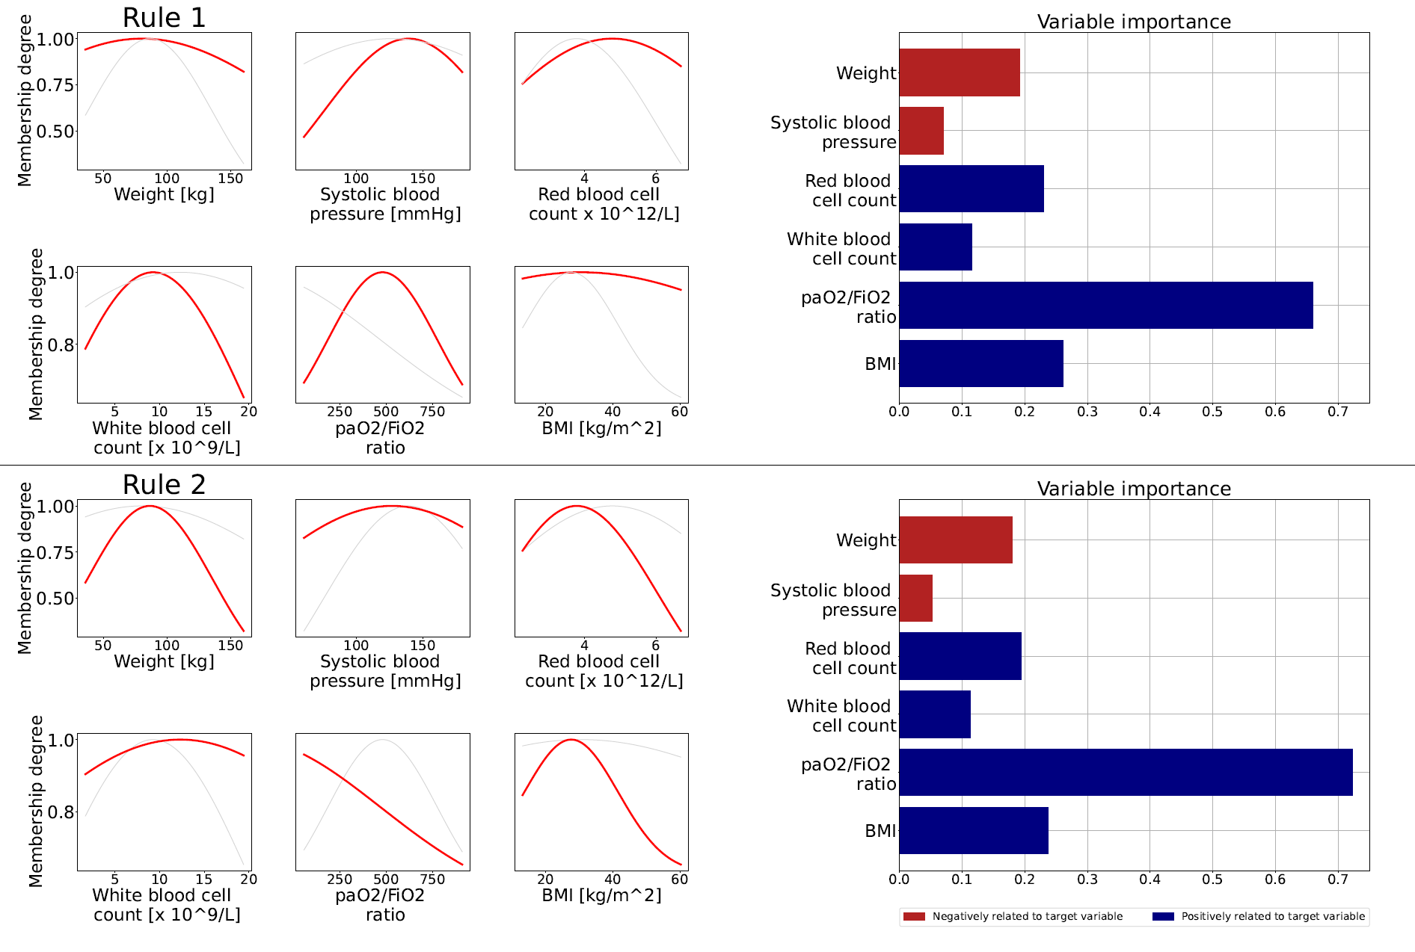

Slide 36
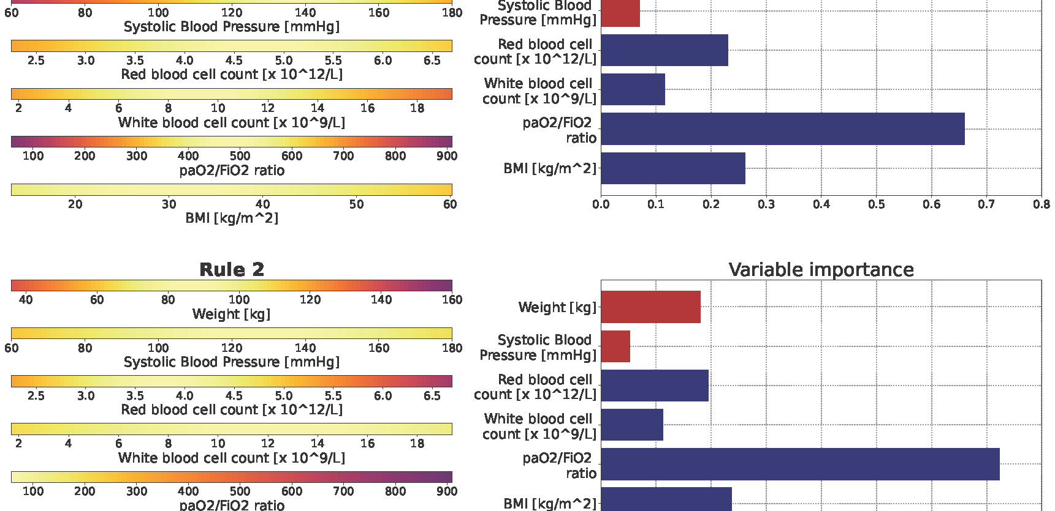

Slide 37
Deriving linguistic rules
Confidence intervals and personalization
Model communication
Optimizing with soft constraints
Explanation component for deep networks

Slide 38
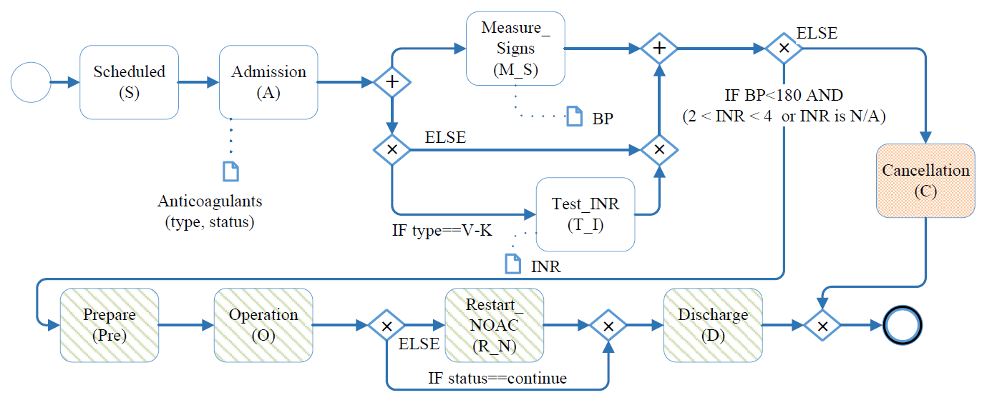
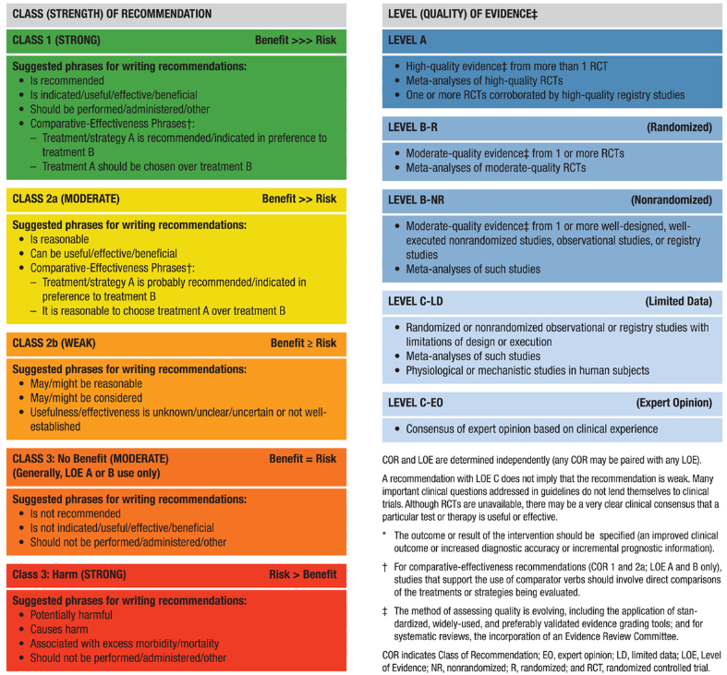

Standardization of clinical process
Background: Nearly 98,000 people die from medical errors each year in the United States alone, costing between $17 and $29 billion.
Standardization: to improve quality and efficiency, and reduce costs.
Method: design the standards, and optimize the implementation in clinical practice.
Tool: clinical pathway, guideline, checklist…
Notes:
According to the Institute of Medicine, an estimated 44,000 to 98,000 people die from medical errors each year in the United States alone, costing between \$17 and \$29 billion.
To improve service quality, and process efficiency, and save costs，people want to standardize the clinical process. Then people carry out it with two main steps: 1) design the standards, and 2) constantly optimize the implementation in clinical practice.
To achieve this, people have developed a lot of tools, e.g., clinical pathway, guideline, and checklist. And all of the tools have been proved to be useful by multiple clinical trials.

Slide 39
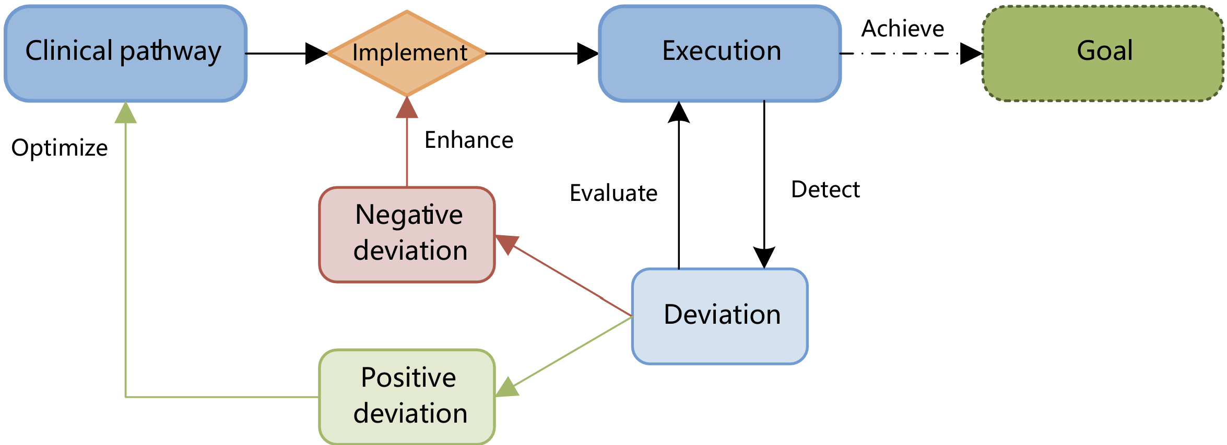


Clinical Process Analysis
Deviation Activity deviated to the standards.
30% of the deviations can be declined by optimizing the process.
The deviation rate of LOS has reduced from 63% to 35% by process enhancement.
Notes:
Although we have developed the clinical standardization for decades, but the literature shows the implementation is not as good as we expected. The quality of medical care and cost control is still lower than expected. There are still a lot of behaviors that deviate from the standards, which is what we called deviations.
Before my research in TU/e, my work focused on checklist decision support system, which aims to reduce deviations and make people to follow the standards. However, we gradually realized that there are also a lot of knowledge behind these deviations.
Studies also showed that the deviation analysis can help to enhance the process, and then the deviations can be reduced by 30%.
So that is why we want to focus on deviation research.
To describe how it works for process enhancement, we desighed this implementation-evaluation-improvement cycle for clinical pathway. after the implementation of the clinical pathway in the organizations,
the analysts can detect the deviations in the real executions, and also evaluate the execution of the clinical pathway with the detected deviations. Then, by analyzing the effect of deviations on healthcare goals, the analysts can divide the deviations into "positive" (in green) or "negative" (in red). Positive deviations can help clinicians optimize clinical execution itself by introducing these changes in the design of the clinical pathway. On the other hand, analyzing the negative deviations can recognize the weakness and then strengthen the compliance of these activities in clinical execution by quality control tools or staff management.

Slide 40
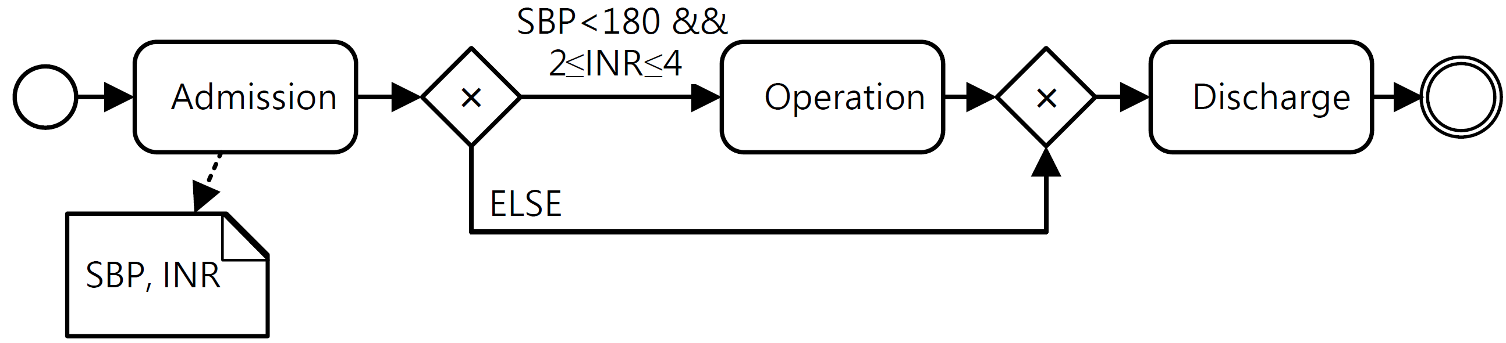
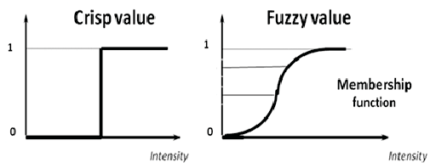


Fuzzy conformance checking
Fuzzy membership
Fuzzy aggregation
…
$$μ_{C} :V→\left\{0,1\right\}$$
$$μ_{F} :V→[0,1]$$
Compliant or not
The compliance degree is…
The compliance of multiple variables is …
User-defined cost function with fuzzy set theory to include expert knowledge.
Detect more informative deviations, closer to human interpretation.
Notes:
所以我们提出引入模糊集表达变异检测中的数值型临床规则。
过去明确集规则对患者指标的判断表述为，““术前指标合规或不合规””，而我们提出使用模糊集将其表示为“指标合规的概率/程度是…”一个0-1之间的具体数值。这个数值将由隶属函数计算得到。因此，我们提出在损失函数中引入模糊集的隶属函数计算患者指标符合规则的程度。
其次，隶属函数的选择也应充分考虑变异值的分布以及临床专家对变异程度的认知，可以选择性使用高斯、线性函数、z函数等常见的模糊隶属函数。

Slide 41
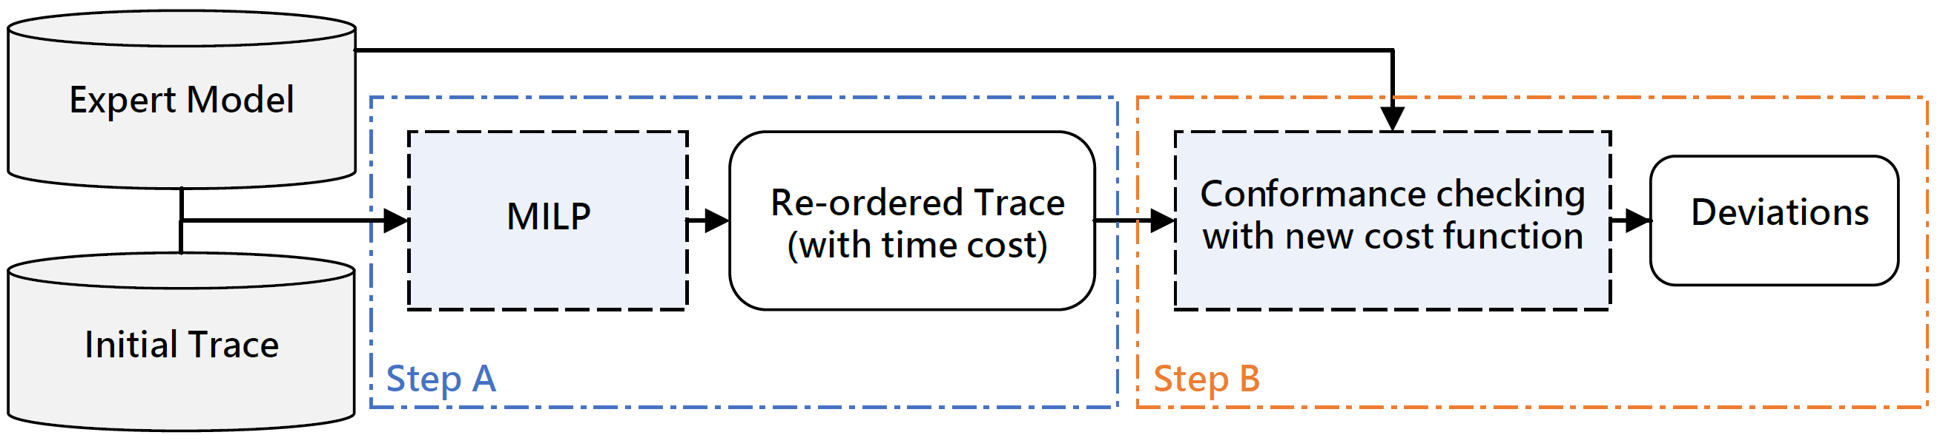
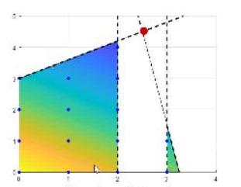
Re-ordered conformance checking with fuzzy sets
2. Conformance checking with fuzzy time cost
1. Re-ordering with fuzzy time windows
Fix the timestamp errors and keep the time deviation information in cost function and alignment results.
Apply to both classical conformance checking and multi-perspective checking.
Obtain timestamp deviations in different interval, and improve fitness level of alignments.
Notes:
因此我们提出了基于模糊时间窗重排序的遵从度检查方法。方法主要分为两个阶段，阶段1主要目的是对事件日志进行重排序，阶段2主要是基于模糊时间的变异检测。

Slide 42
Deriving linguistic rules
Confidence intervals and personalization
Model communication
Optimizing with soft constraints
Explanation component for deep networks

Slide 43
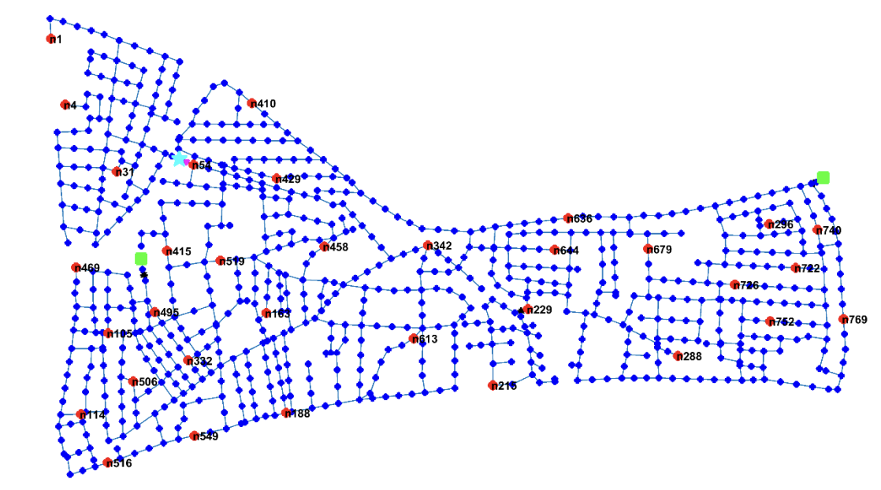
Detecting leaks in Water Distribution Networks
A hypothetical L-Town with 10,000 population
2 pumps, 1 tank, 900 pipes and 782 junctions
Each node is a service connection that supplies several households.
Hydraulic modelling and leak detection models takes places at this scale.
Vrachimis, Stelios G., et al. "BattLeDIM: Battle of the leakage detection and isolation methods." Proc., 2nd Int. CCWI/WDSA Joint Conf. 2020.

Slide 44
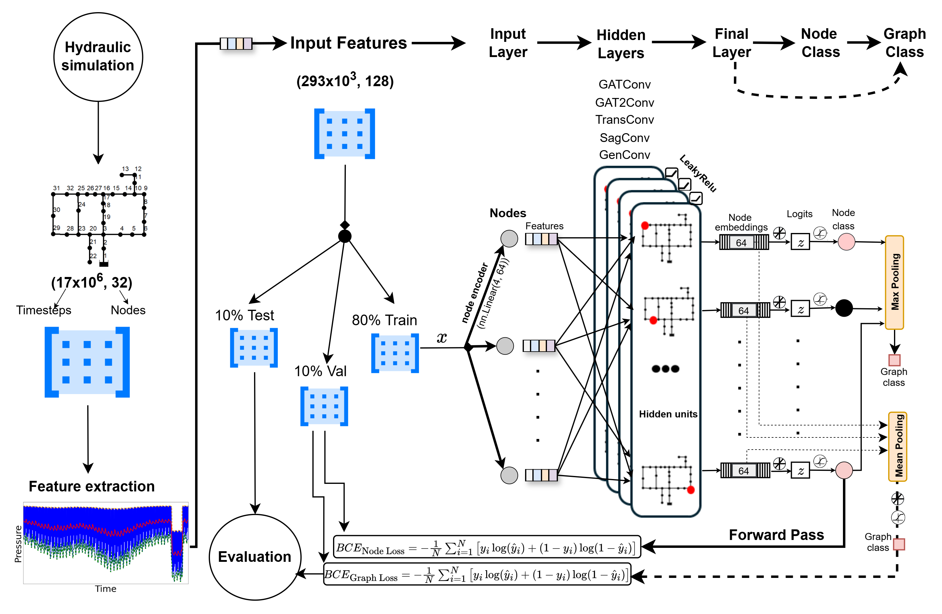
Detection and Localization Architecture (GNN)

Slide 45
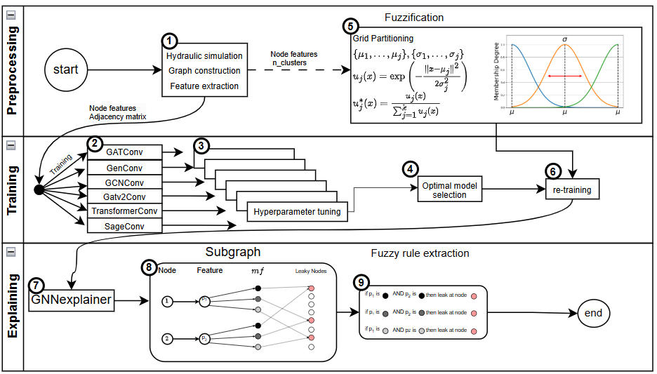
Explainability Framework

Slide 46
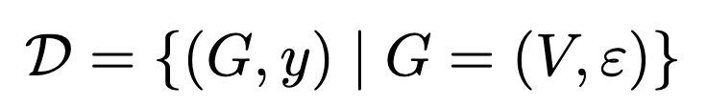
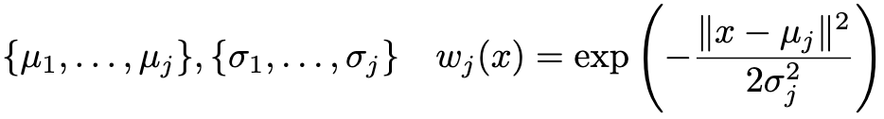
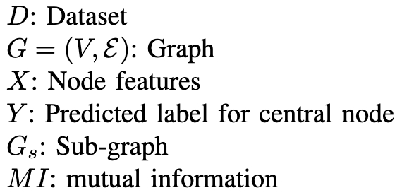
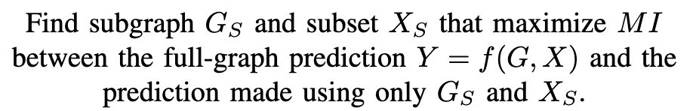
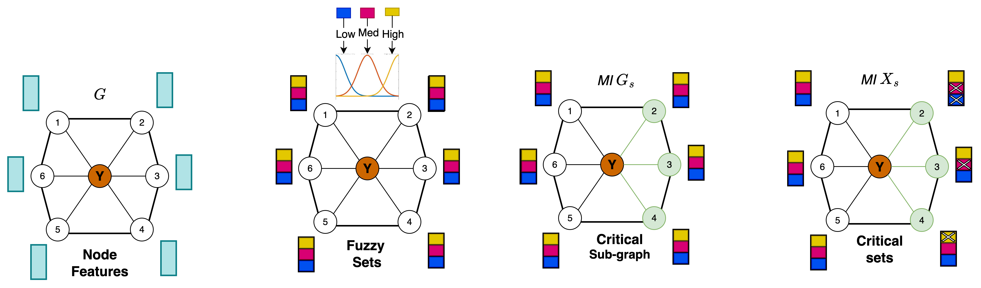
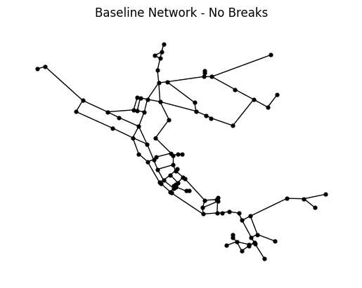
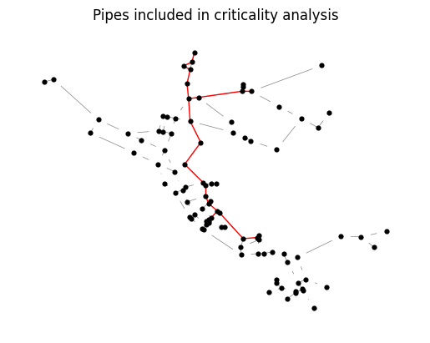
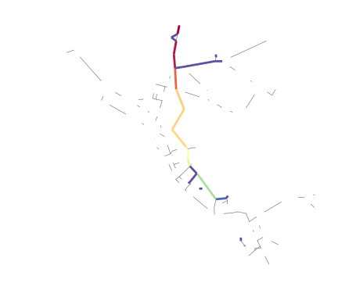
Explainable Fuzzy Graph Neural Network
1
2
3
4
Explanation
G_{s}
Condition
Explaining prediction
instance
of
central node
If
Pressure at Node 2 is Medium OR Low
AND
Pressure at Node 3 is Medium
AND
Pressure at Node 4 is High
Then
Central Node Label is Y
Condition
Condition
Graph
Prediction
Sub-graph
Fuzzification
Explanation
If
Pressure at Node 23 is high
AND
Pressure at Node 21 is low
Then
Leak is located at Node 22
46
Leak Detection application for water distribution network
Notes:
maximize the mutual information between the prediction Y and the prediction obtained from the subgraph G_{s} and subset of node features X_{s}

Slide 47

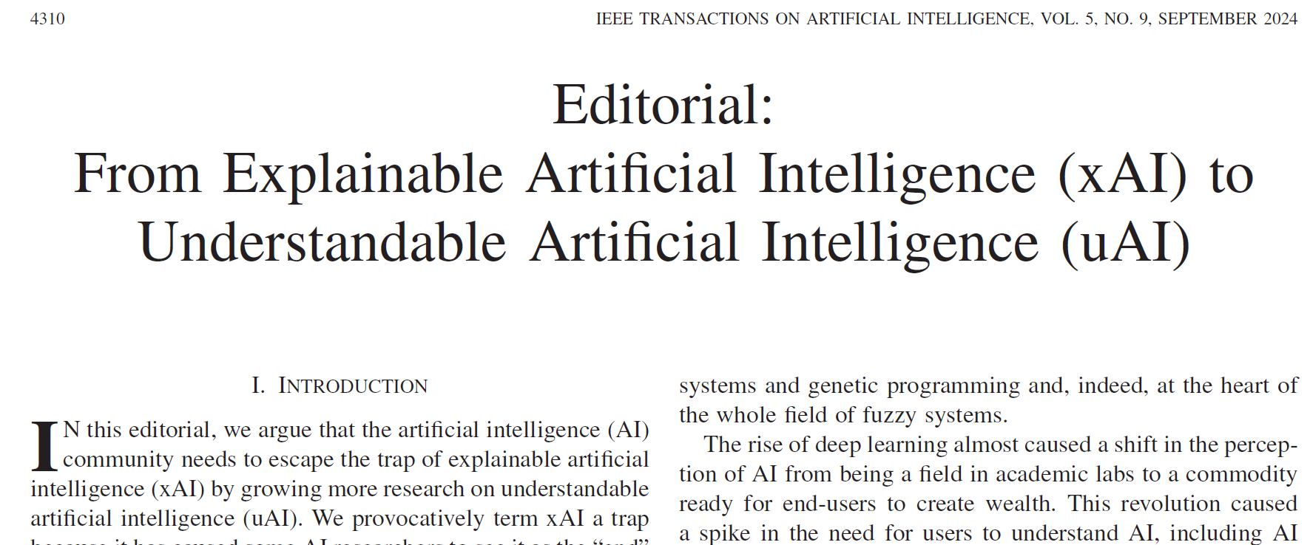
Editorial in IEEE Transactions on Artificial Intelligence

Slide 48

Explainability vs Understandability
Is XAI a trap?
  Explainability as an end
  Explainability as a means to understanding
Types of understanding
  Propositional
  Interrogative
  Objectual

Slide 49
Conclusions
Even though we have access to more and more data, the quality does not necessarily improve
This is especially true in systems where humans are in the loop
Model transparency is essential under such circumstances
Transparency is about communication and understanding
Fuzzy systems are useful tools to stimulate communication about models and improve understanding
Important in transition from XAI to uAI

Slide 50





Thanks to colleagues and students
André Fialho
Saskia van Loon
Sicui Zhang
Caro Fuchs
Qusai Khaled

Slide 51

Thanks to colleagues and students
But above all…
To you for attending!

Slide 52




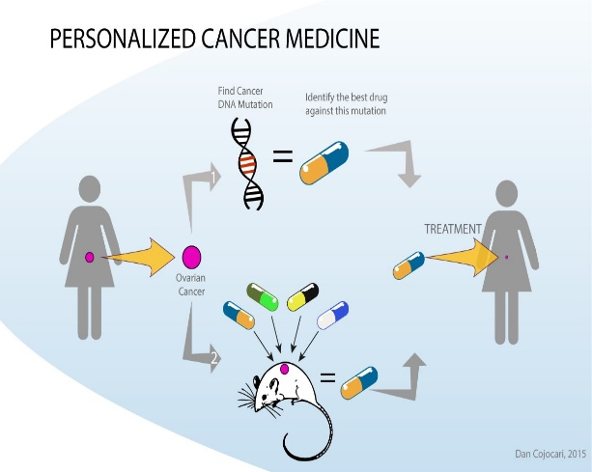

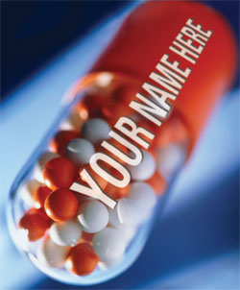

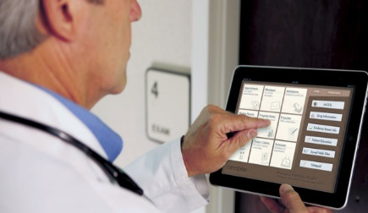



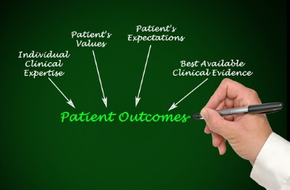




Self-care
Personalized care
Value-based care

Slide 53
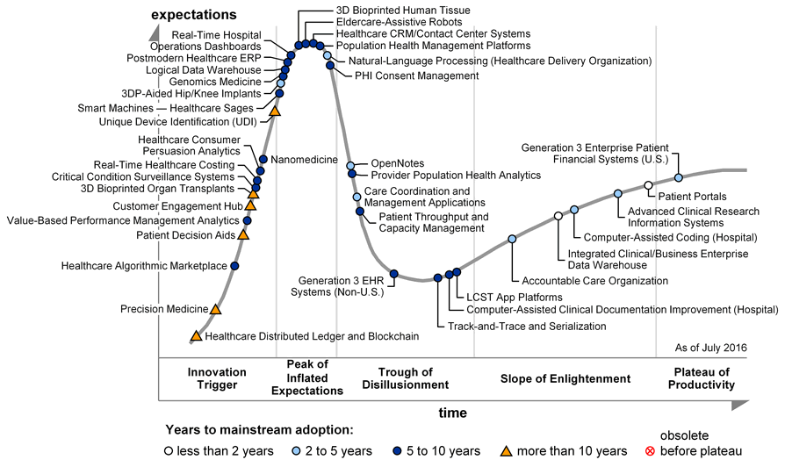
2016 Gartner Hype Cycle for
Healthcare Providers
Data-driven technologies!
Notes:
Future of healthcare is DATA!

Slide 54
BACK TO REALITY: CURRENT PRACTICE OF HEALTHCARE

Slide 55

Different user groups
Physicians:
accept ICT, trained in statistical modeling
transparency → staying in control
Nurses:
not keen on numbers or mathematical modeling
→ verbal communication
DSS should support both groups since they need to collaborate!
Notes:
Emphasize here XAI solutions. Fuzzy is an example.

Slide 56
Modeling Steps
Data collection
Missing value processing
Feature selection
Initial Rule Building
Parameter optimization
Rule base simplification
Validation
Notes:
This slide can be turned into a simple pipeline.

Slide 57
FIS from fuzzy clustering
Cluster data in
  input - output product space
  input and output space separately
  output space (induce clusters in inputs)
Membership functions obtained by
  projection onto variables
  membership function parameterization
One rule per cluster
Cluster merging to combine compatible clusters
Fuzzy c-means for Mamdani FIS

Slide 58
Epidemiology
In 2001, Angus et al suggested that >750,000 episodes of severe sepsis occur each year in the US, translated into an annual mortality of >220,000, making sepsis the 10th most common cause of death [2].
Severe sepsis accounts 3% of all hospital admissions [2,3] and 59% of patients with sepsis require ICU care, composing 10.4% of ICU admissions [3].
The mortality rate for severe sepsis and septic shock still ranges from 13% to 50%, and is as high as 80% to 90% for multiple organ dysfunction [4,5].

Slide 59
Costs
The average cost per case for treatment of severe sepsis is approximately $22,000 [8]. It is estimated that sepsis drains the US economy of more than $16 billion per year [3].
Average daily costs of care ICU patient in the UK [9]:
 | ICU patient without sepsis | Septic at admission to ICU | Developing sepsis during the ICU stay
Average daily costs of care | $750 | $930 | $1,079
Note: 2002 rates

Slide 60
Example - initial rulebase

Slide 61
Example - simplified rulebase

Slide 62
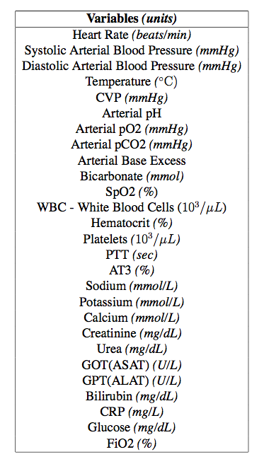

Variables
27 variables per patient
Different sampling rates
Possible missing values

Slide 63
Septic Shock
Course of septic shock:
SIRS
Sepsis
Severe Sepsis
Septic Shock
MODS
Septic Shock is defined as sepsis-induced hypotension
despite adequate fluid resuscitation,
along with the presence of perfusion abnormalities [1].
SIRS – Systemic Inflammatory Response Syndrome
MODS – Multiple Organ Dysfunction Syndrome

Slide 64
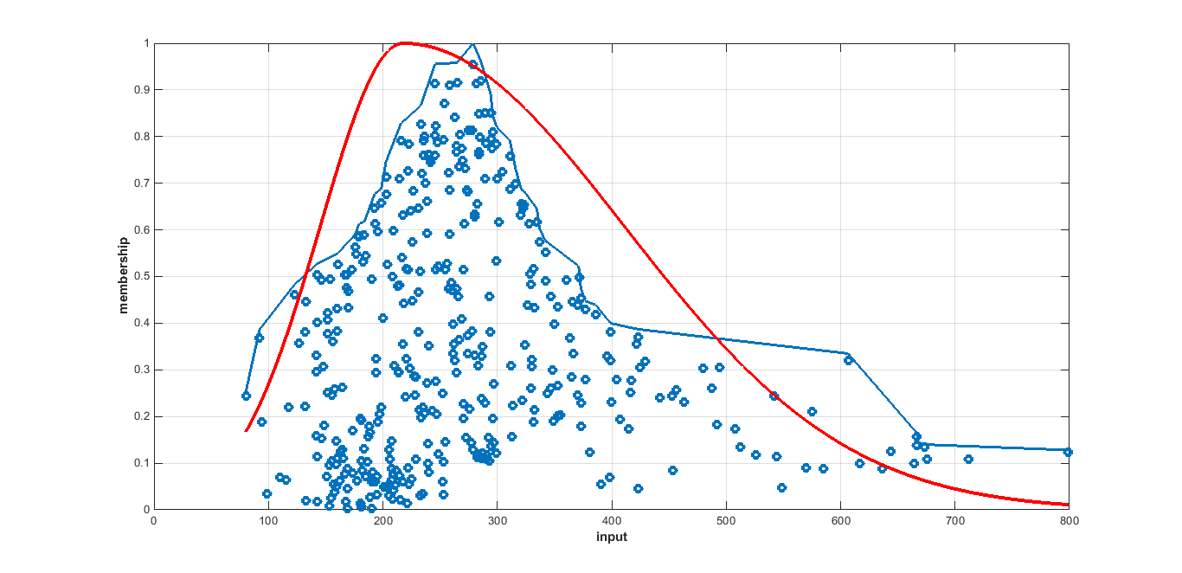
Fit parameterized membership function

Slide 65
Redundancy

Slide 66
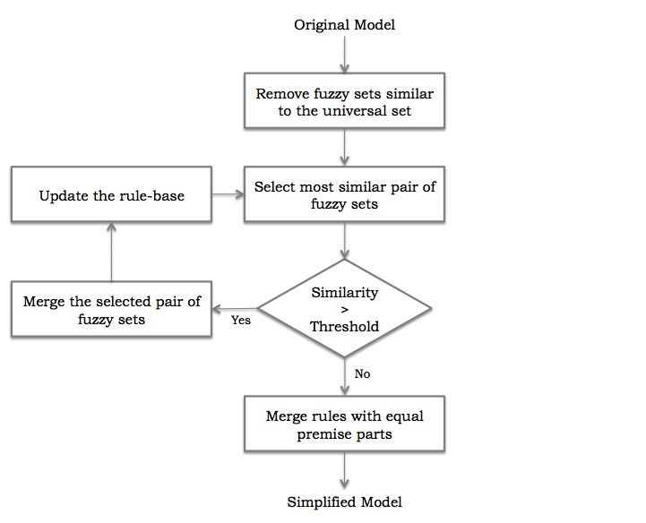
Similarity-based model simplification
  Setnes et al. (1998)
Notes:
- Not very interpretable
- Some MFs seem to be always are always fired, while others never

Slide 67
Fuzzy models in healthcare: probabilistic fuzzy systems
Notes:
PFS should be discussed together with the example above.

Slide 68
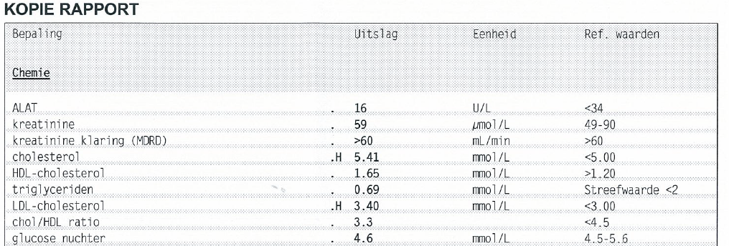
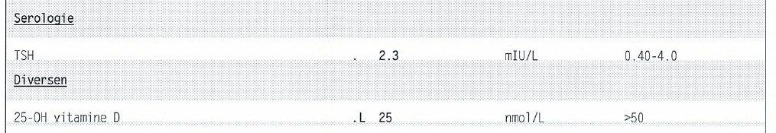
Example of lab results

Slide 69
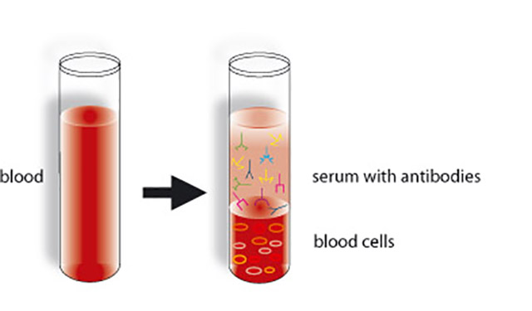
Blood tests
But…
The level of substance in tissue may be different than the level in the blood (serum)
E.g.: Vitamin B12 level
What do they measure?

Slide 70
Data collection

Slide 71
Patients’ MMA PFS model

Slide 72
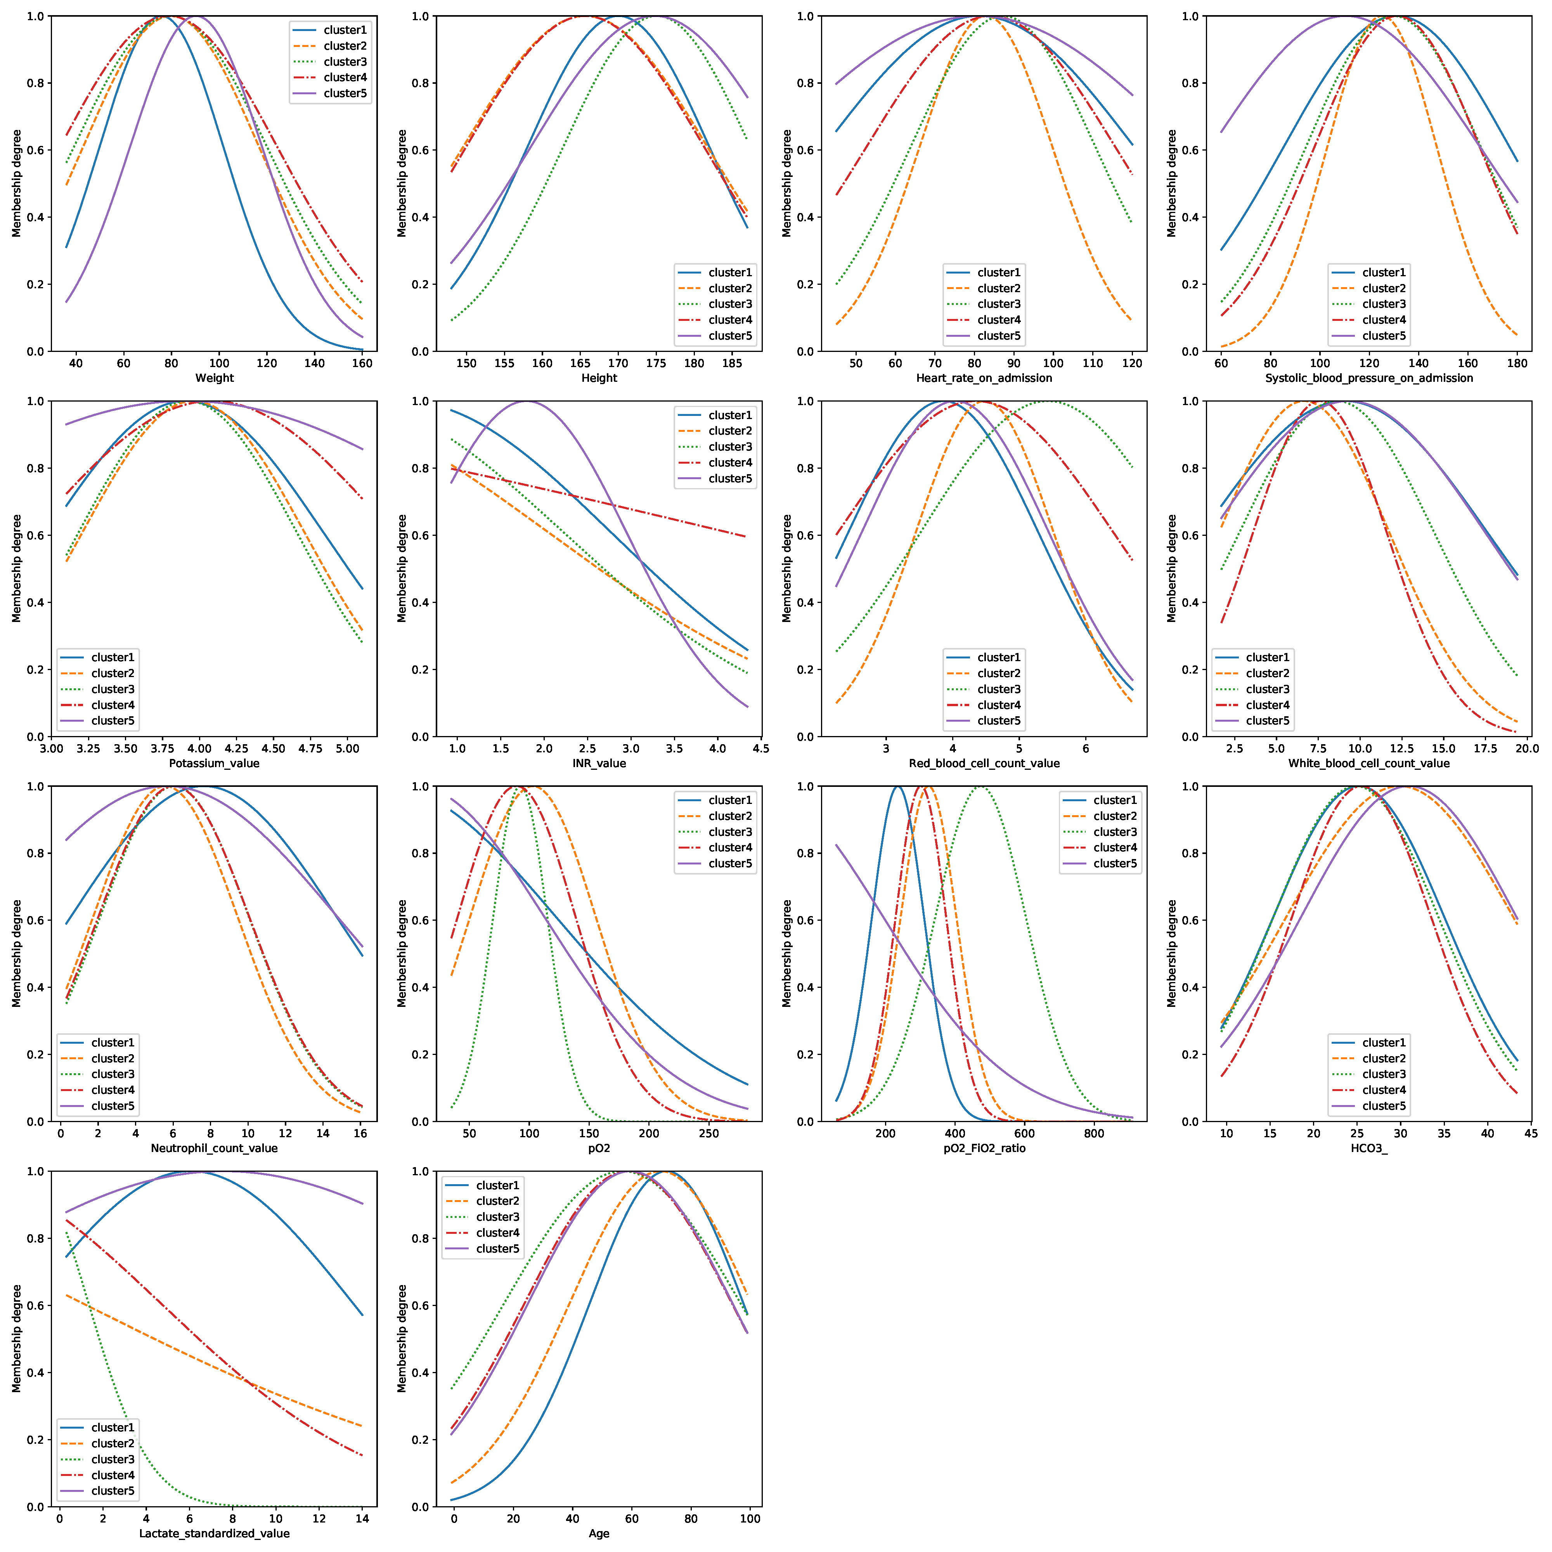

Slide 73
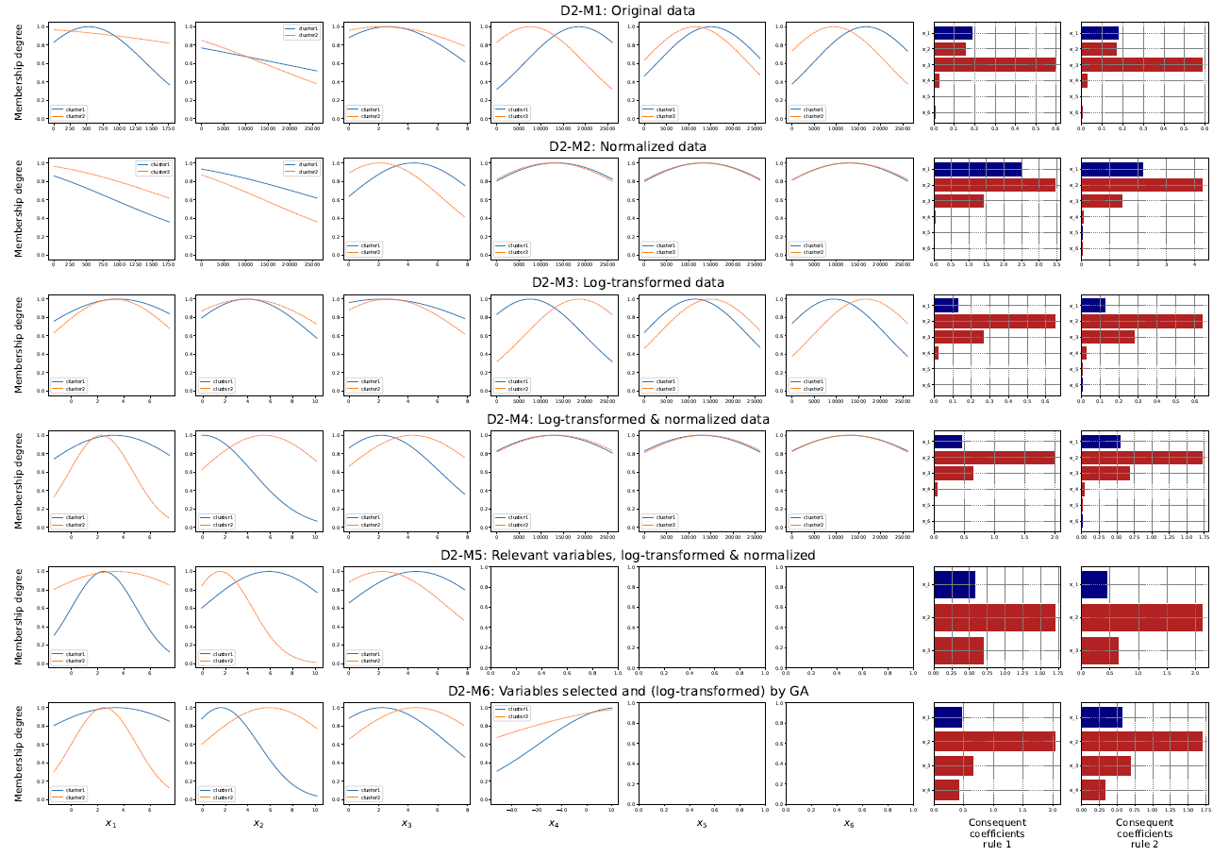

Slide 74

Multi-perspective conformance checking
Align multi-perspective flows parallelly
Multi-perspective alignment
  Move in both with fulfilled guards
  Move in both with violated guards
  Move in model with fulfilled guards
  Move in model with violated guards
  Move in log
Other perspective
SBP=190
SBP=190
SBP=190
Model
Measure
SBP<180
Operation
Discharge
$$k\left(s_{L},s_{M}\right)=\left\{\begin{aligned} \\ \\ \\ \\ \\ \\ \end{aligned}\right.$$
Multi-perspective cost function
Control flow
Measure
Operation
Discharge
0, Move in both with fulfilled guards
1, Move in both with violated guards
1, Move in model with fulfilled guards
1+1, Move in model with violated guards
1, Move in log
Model | Measure | Operation | Discharge
Log | Measure, SBP=190 | Operation | Discharge
Alignment results
Define extended sets of alignment and data-ware cost function, to achieve multi-perspective alignment.
Obtain more comprehensive deviations on various aspect, compared to classical one.
Notes:
现有的多角度遵从度检查策略均难以实现多角度的临床变异检测
所以，我们提出重新定义模型与日志的匹配方式，将数据流变异检测考虑为独立的序列，根据模型中的数据规则条件，对数据流是否合规进行判断，从而实现模型事件、日志事件、数据流的同步判断。

Slide 75
Explainable Artificial Intelligence: Recent Developments and Future Aspirations
Chair: Jonathan Garibaldi, University of Nottingham
Panelists:
Keeley Crockett, Manchester Metropolitan University
Hussein Abbas, University of New South Wales
Alexander Gegov, University of Portsmouth
Uzay Kaymak, Eindhoven University of Technology
Joao Sousa, University of Lisbon

Slide 76
Explainable Graph Neural Network
Graph
Prediction
Sub-graph
Fuzzification
Explanation
If
Pressure at Node 23 is high
AND
Pressure at Node 21 is low
Then
Leak is located at Node 22
76

Slide 77
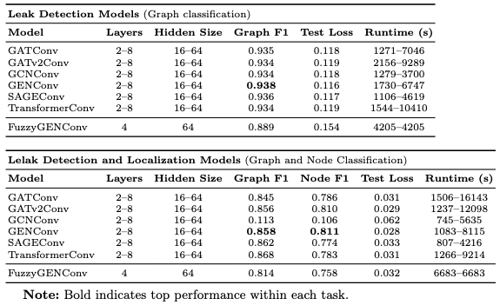
Results and Discussion
Leak Detection Performance: Achieved Graph F1 of 0.889 on Hanoi network despite severe class imbalance.
Accuracy–Explainability Trade-off: Slightly lower F1 than some GNNs but significantly higher interpretability for explainable AI.
Leak Localization Capability: Node F1 of 0.758 for joint detection & localization without heavy hyperparameter tuning.
Real-world Applicability: Maintains predictive power with imbalanced, noisy hydraulic data in realistic scenarios.
Rule-based Explanation: Translating GNN predictions into rules relevant to topology within a sup-graph context could provide value in large scale WDNs.
Future work will focus on developing complete rule base, scaling to larger WDNs and fine-tuning sub-graphs.

Slide 78
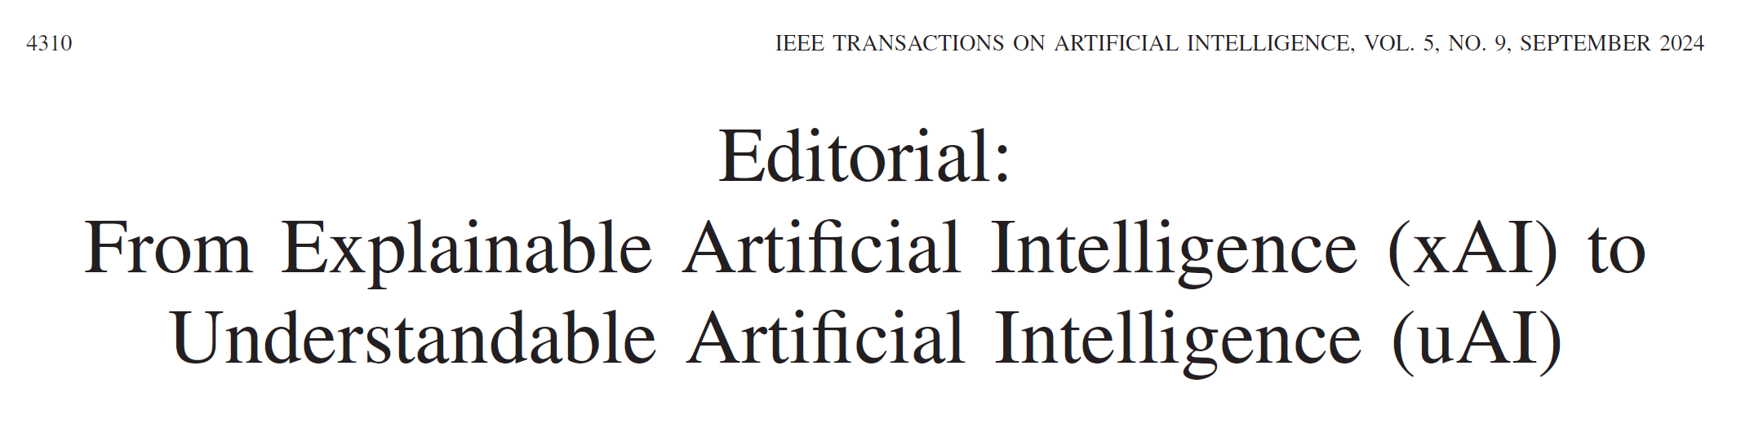
Editorial in IEEE Transactions on Artificial Intelligence

Slide 79



Slide 81


