Slide 1
Analysis and Control Design Tools for Time-Delay Systems
Wim Michiels
Department of Computer Science
KU Leuven
ICINCO 2023 Conference, Rome
16 November 2023

Slide 2
Outline
Applications and examples
Basic properties time-delay systems
Dimension reduction using predictor feedback
Dimension reduction using periodic feedback
  Switched periodic feedback
  Smooth periodic feedback
  Fixed-time observers
Time-delay methods in vibration control
Conclusions
Central theme: “beneficial effects of delays”

Slide 3
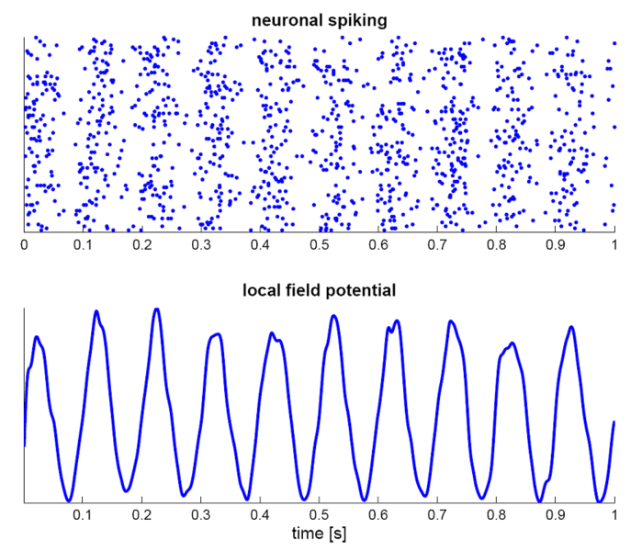
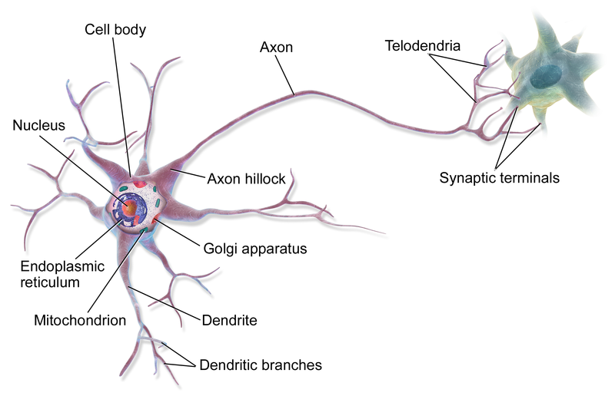
Motivating examples
  networks
  - biology (e.g. interactions between neurons)
  - car following models
  - time-based spacing of airplanes
  - distributed and cooperative control, sensor networks
  - congestion control in communication networks
  mechanical engineering
  - machine tool vibrations (cutting and milling machines)
  - haptic interfaces and motion synchronization
  parallel computing (load balancing)
  population dynamics
  flow and propagation
  laser physics (lasers with optical feedback)
Synaptic time-delays
https://commons.wikimedia.org/wiki/File:
Blausen_0657_MultipolarNeuron.png

Slide 4
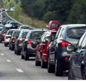
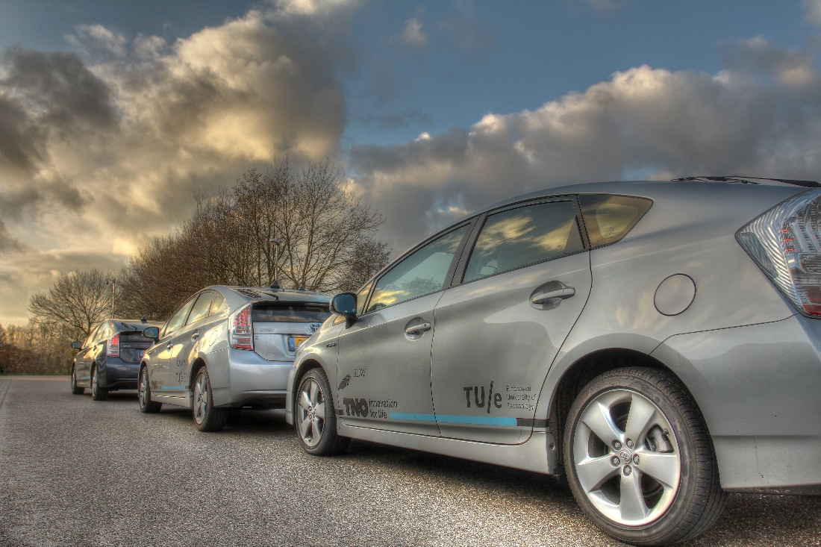
Motivating examples
  networks
  - biology (e.g. interactions between neurons)
  - car following models
  - time-based spacing of airplanes
  - distributed and cooperative control, sensor networks
  - congestion control in communication networks
  mechanical engineering
  - machine tool vibrations (cutting and milling machines)
  - haptic interfaces and motion synchronization
  parallel computing (load balancing)
  population dynamics
  flow and propagation
  laser physics (lasers with optical feedback)
Cooperative driving
Goal: drive safely at small constant inter-vehicle distance
synchronization of the velocities is necessary
wireless communication of accelerations → time-delays
measurements inter-vehicle distances → time-delays
Source: TU/e - collaboration with Tue and TNO in framework of UCoCoS Training Network

Slide 5
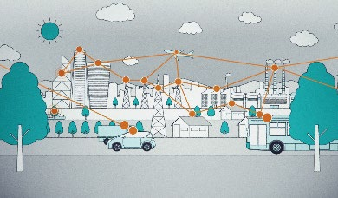
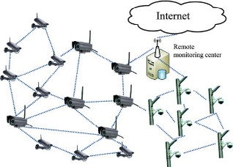
Motivating examples
  networks
  - biology (e.g. interactions between neurons)
  - car following models
  - time-based spacing of airplanes
  - distributed and cooperative control, sensor networks
  - congestion control in communication networks
  mechanical engineering
  - machine tool vibrations (cutting and milling machines)
  - haptic interfaces and motion synchronization
  parallel computing (load balancing)
  population dynamics
  flow and propagation
  laser physics (lasers with optical feedback)

Slide 6
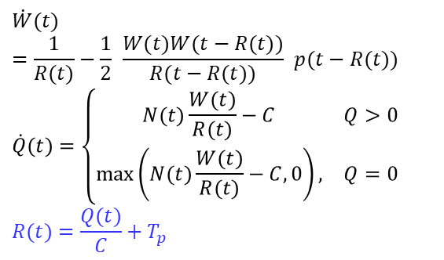
Motivating examples
  networks
  - biology (e.g. interactions between neurons)
  - car following models
  - time-based spacing of airplanes
  - distributed and cooperative control, sensor networks
  - congestion control in communication networks
  mechanical engineering
  - machine tool vibrations (cutting and milling machines)
  - haptic interfaces and motion synchronization
  parallel computing (load balancing)
  population dynamics
  flow and propagation
  laser physics (lasers with optical feedback)
Model Hollet et al (IEEE TAC’02)
$$\dot{W}(t)=\frac{1}{R(t)}−\frac{1}{2} \frac{W(t)W(t−R(t))}{R(t−R(t))} p(t−R(t)) \\ \dot{Q}(t)=\left\{\begin{matrix}N(t)\frac{W(t)}{R(t)}−C & Q>0 \\ \max\left(N(t)\frac{W(t)}{R(t)}−C,0\right), & Q=0\end{matrix}\right. \\ R(t)=\frac{Q(t)}{C}+T_{p}$$
W: window-size
Q: queue length
N: number of TCP sessions
R: round-trip-time
C: link capacity
p: probability of packet mark
Tp: propagation delay
packet marking
queue Q
Sender
Bottleneck
router
link c
Receiver
rtt R
acknowledgement

Slide 7
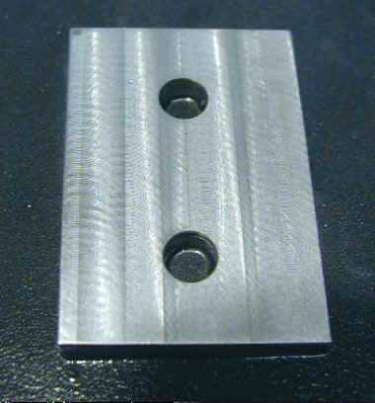
Motivating examples
Principle of milling
  networks
  - biology (e.g. interactions between neurons)
  - car following models
  - time-based spacing of airplanes
  - distributed and cooperative control, sensor networks
  - congestion control in communication networks
  mechanical engineering
  - machine tool vibrations (cutting and milling machines)
  - haptic interfaces and motion synchronization
  parallel computing (load balancing)
  population dynamics
  flow and propagation
  laser physics (lasers with optical feedback)
Model
Successive passages of teeth ⇒ delay
Rotation of each tooth ⇒ periodic coefficients
Delay inversely proportional to speed
Important: increase efficiency while
avoiding undesired oscillations,
so-called chatter

Slide 8
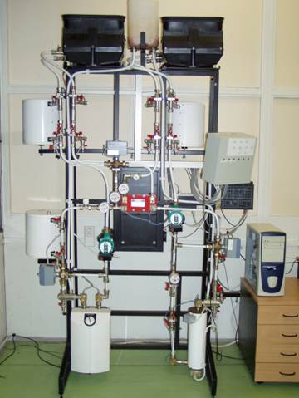
Motivating examples
Heat Exchanger benchmark (CTU Prague)
  networks
  - biology (e.g. interactions between neurons)
  - car following models
  - time-based spacing of airplanes
  - distributed and cooperative control, sensor networks
  - congestion control in communication networks
  mechanical engineering
  - machine tool vibrations (cutting and milling machines)
  - haptic interfaces and motion synchronization
  parallel computing (load balancing)
  population dynamics
  flow and propagation
  laser physics (lasers with optical feedback)
Model: linear, dimension 6, five delays

Slide 9
Outline
Applications and examples
Basic properties time-delay systems
Dimension reduction using predictor feedback
Dimension reduction using periodic feedback
  Switched periodic feedback
  Smooth periodic feedback
  Fixed-time observers
Time-delay methods in vibration control
Conclusions

Slide 10
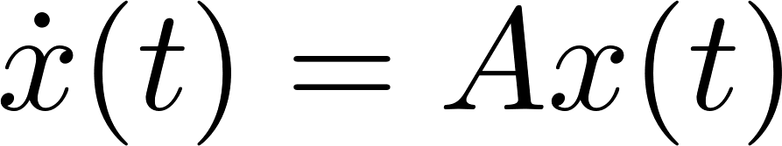

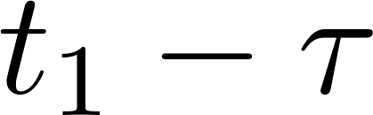
Basics of time-delay systems
Initial value problem
x
x
0
t
0
t
x
0
t₁
t

Slide 11


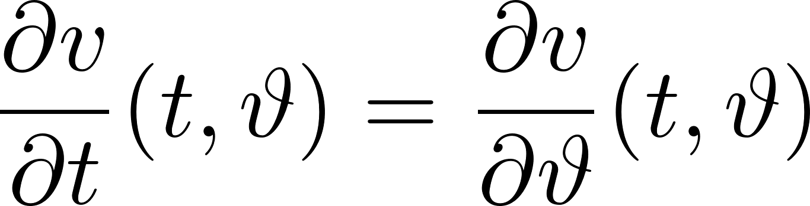
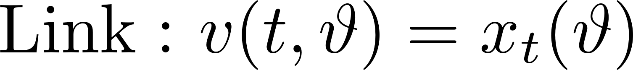
Ordinary differential equation on an infinite-dimensional function space
x
0
t₁-¿
t₁
t
t=t₁
t=0
0
µ

Slide 12
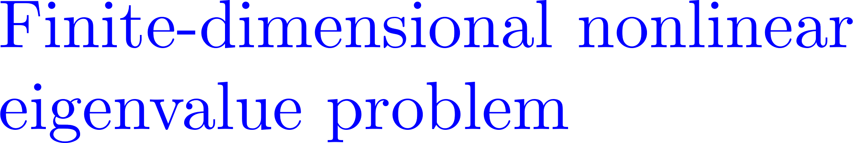
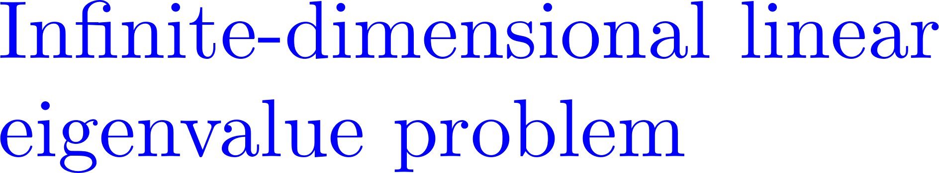

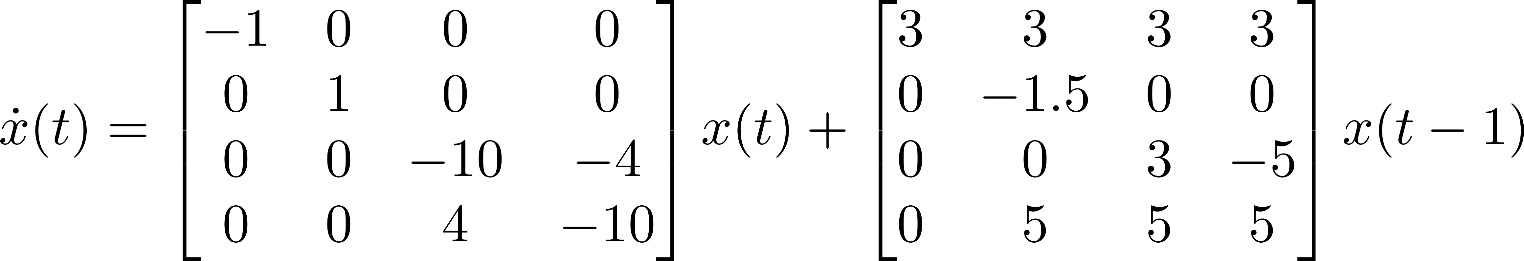
Spectrum of linear time-invariant systems

Slide 13
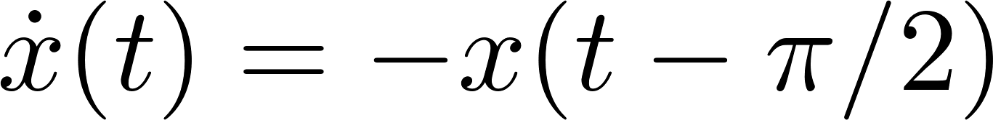
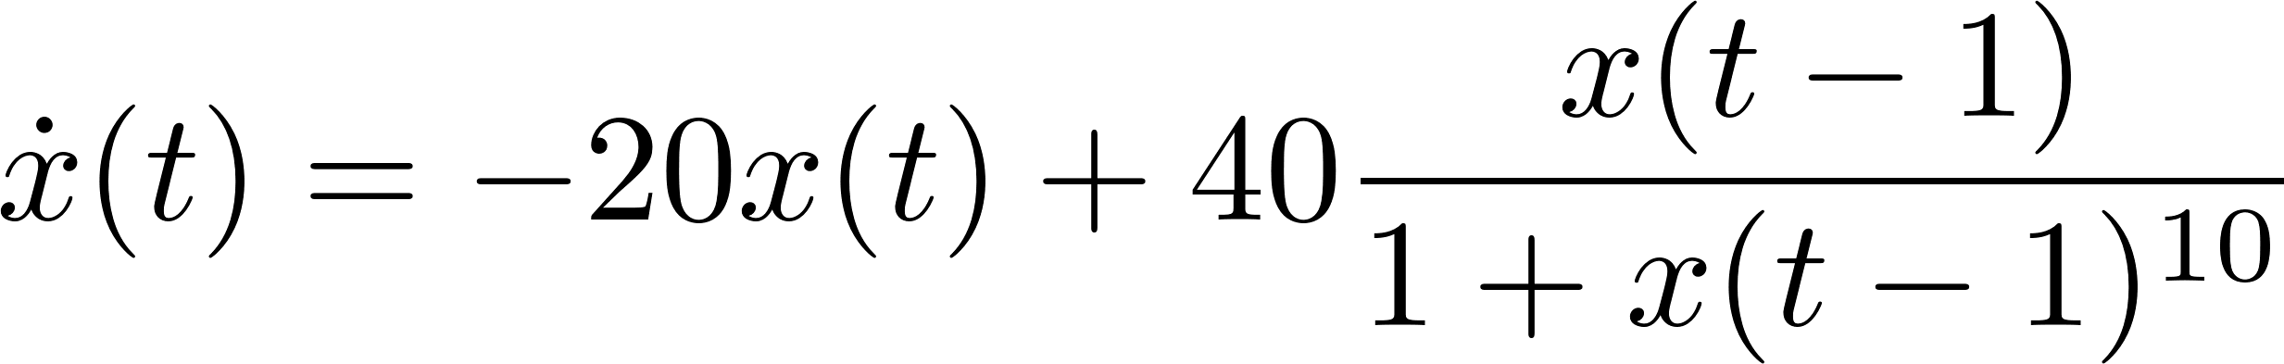
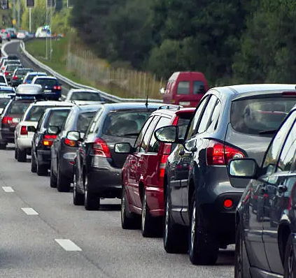


Delay systems are a class of distributed parameter systems /infinite-dimensional
Analysis: complex behavior
Scalar examples:
oscillatory solutions
chaotic attractor
Controller synthesis
Any control design problem involving the determinination of a finite number
of controller parameters is a reduced-order controller design problem
Induced limitations
Fundamental limitations (independent of controller)
Control design almost exclusively ends up in an optimization
problems with hard trade-offfs to make

Slide 14


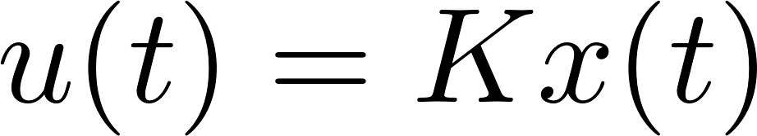
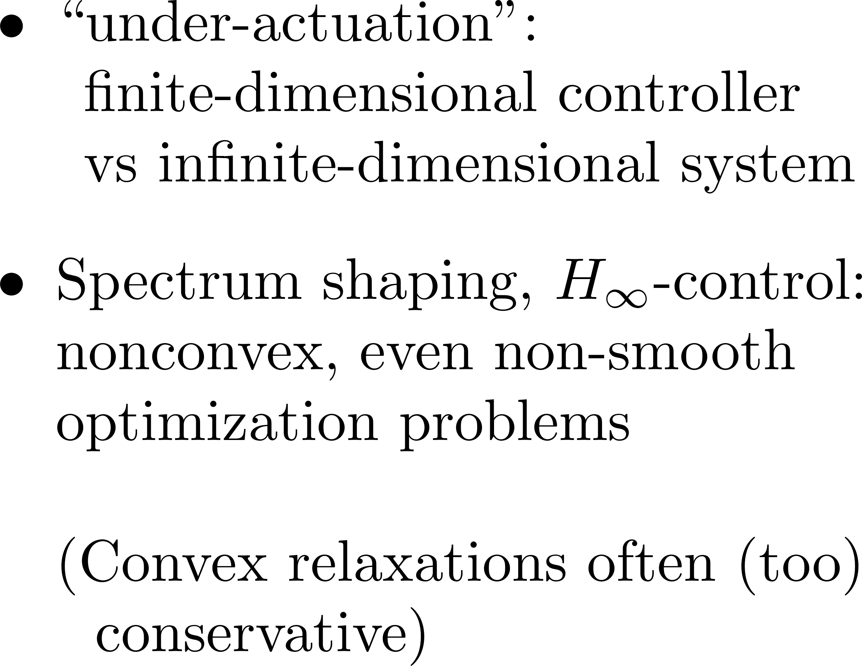
Static state feedback applied to system with state and input delay

Slide 15
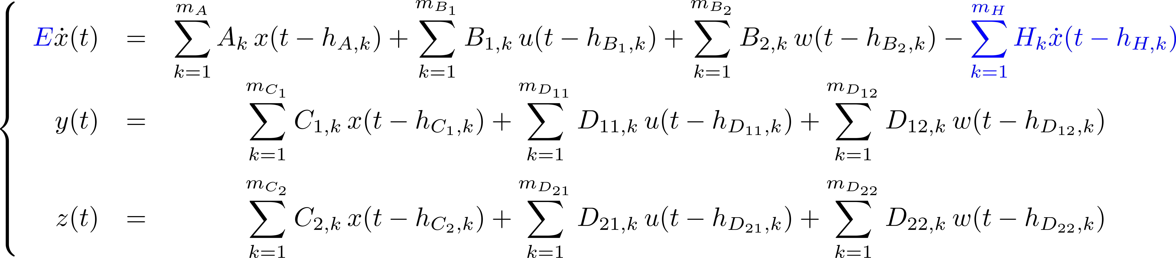




TDS-CONTROL: An integrated MATLAB package for the analysis and controller-design
System class
System
Controller
Matrix E is allowed to be singular: (delay) differential algebraic equations → modeling interconnected systems
Functionality
Availability
Stability by means of the characteristic roots and the spectral abscissa
Computation of zeros
Strong stability analysis of neutral delay differential equations, i.e.,
the effect of small delay pertubations can explicitly be taken into account.
Model order reduction and approximation
Stabilization by means of fixed-order dynamic output feedback controllers
Design of structured controllers like Pyragas, acceleration, PID controllers,
decentralized and distributed controllers.
Performance and robust stability analysis by means of the H∞-norm,
the pseudospectral abscissa, and the distance to instability.
Robust controller design through H∞-norm optimization.
Software
https://gitlab.kuleuven.be/u0011378/tds-control
Documentation:
P. Appeltans and W. Michiels. Analysis and controller
design of time-delay systems using TDS-CONTROL.
A tutorial and manual, E-print arXiv:2305.00341, 2023.

Slide 16
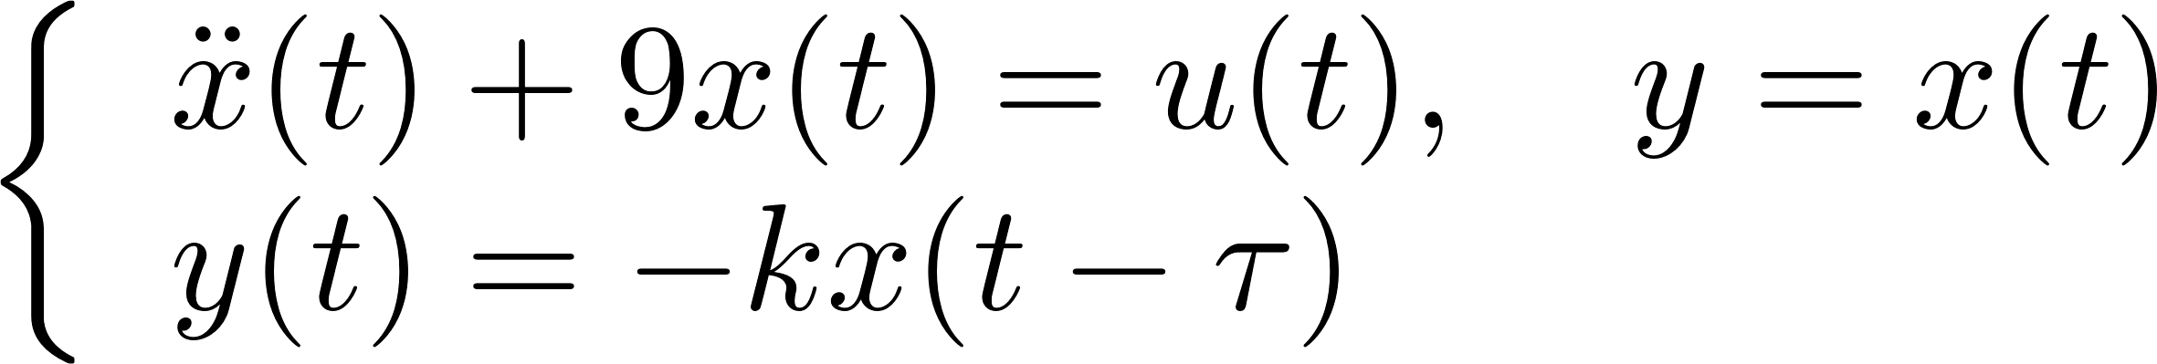
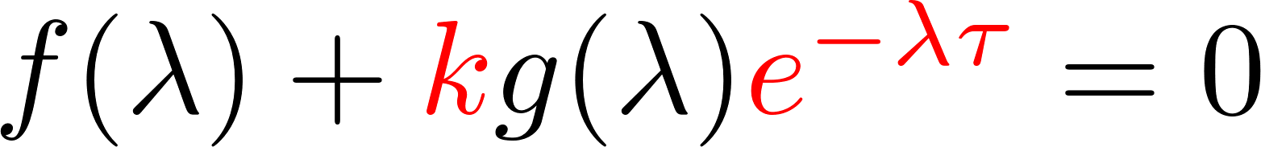

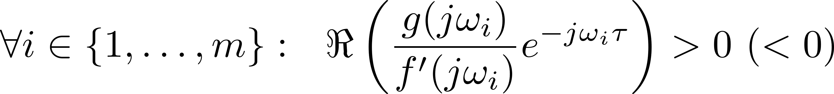
Beneficial effects of time-delays
Example 1. Stabilizing (coupled) oscillatory systems
Principle: use delay to adjust phase in accordance with oscillation
An extension:
Characteristic equation
(Number of Unstable roots)
Rightmost zeros of f simple and on imaginary axis:
If:
Then: asymptotic stability for small k>0 (k<0)
Condiiton = use delay to adjust phase in accordance with all oscillatory modes
Applications: stabilization of networks of oscillators, gyroscopic systems

Slide 17
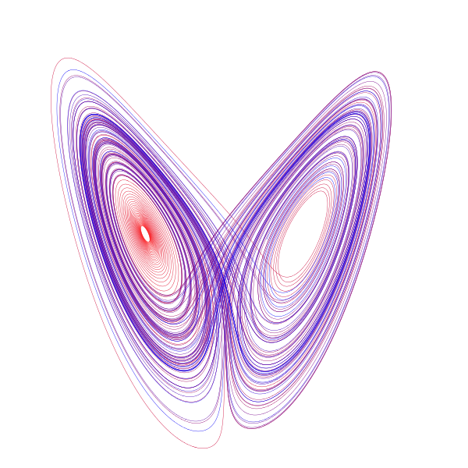
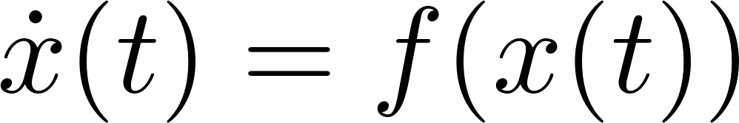
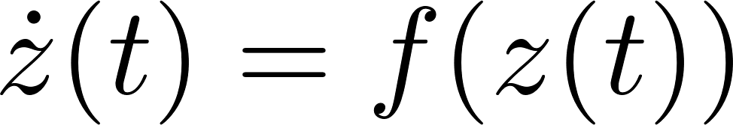
Example 2. Generating predictions and stabilizing predictors
Autonomous system
Predictor over a time-interval of length τ:
unstable if origin not stable
initialization??

Slide 18
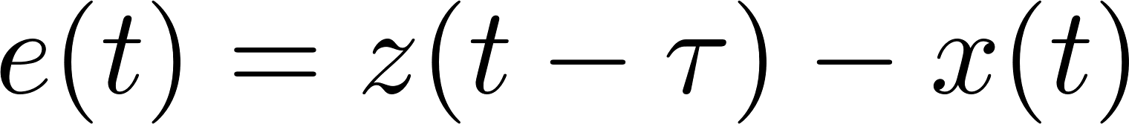
Example 2. Generating predictions and stabilizing predictors
Autonomous system
Predictor over a time-interval of length τ:
stabilization mechanism:
$z$ is a prediction of x ⇒ x is a delayed version of z
Prediction error satisfies
⇒ predictor is stable if the zero solution of (1) is stable;
determining K: stabilization problem with delayed feedback

Slide 19
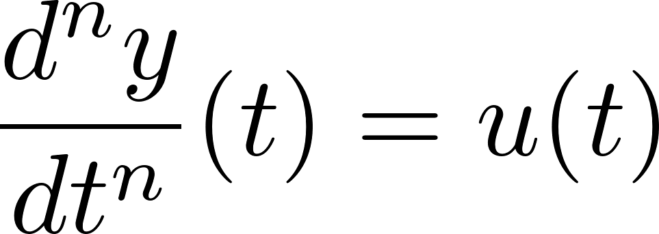
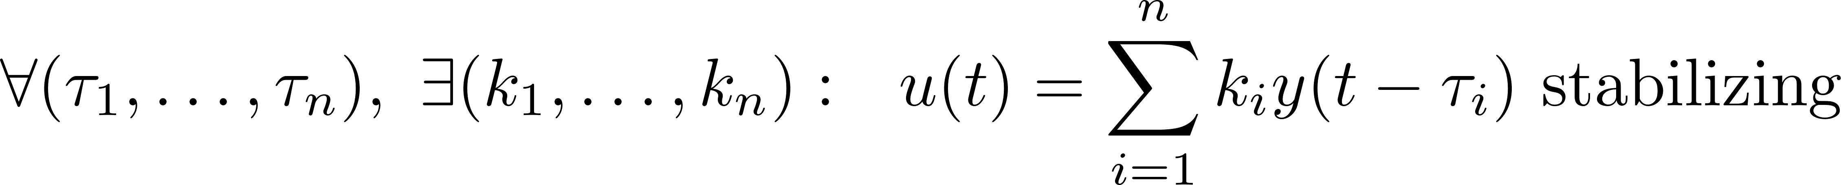
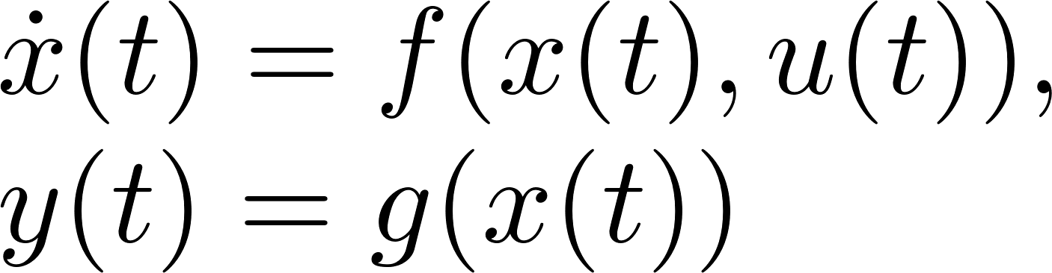
Example 3. State reconstruction, approximation of missing derivatives
Stabilization of minimum-phase systems with delayed output feedback
Principles
control low based on derivative feedback
approximate derivatives by finite differences
apply scaling property ( high gains↓, small delays ↑)
Application: class of proportional-delayed controllers
Example 4. Making the control law non-invasive
Goal: stabilizing an unstable periodic orbit with period T

Slide 20
Outline
Applications and examples
Basic properties time-delay systems
Dimension reduction using predictor feedback
Dimension reduction using periodic feedback
  Switched periodic feedback
  Smooth periodic feedback
  Fixed-time observers
Time-delay methods in vibration control
Conclusions

Slide 21

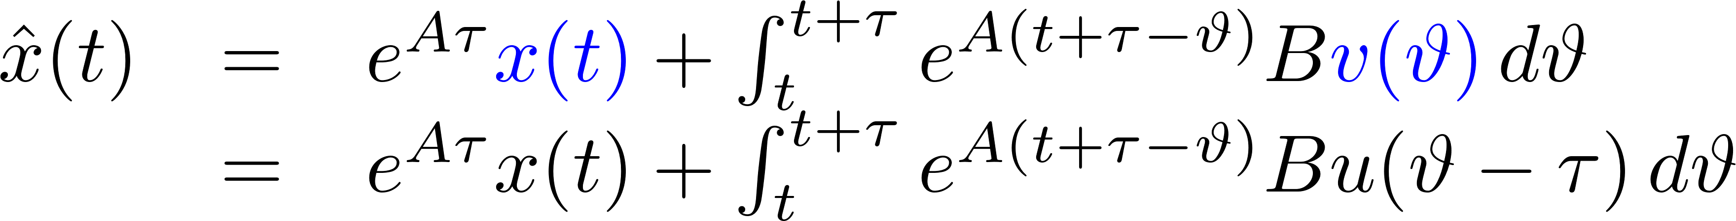
Delay compensation by prediction
→ “finite-dimensional” design problem

Slide 22
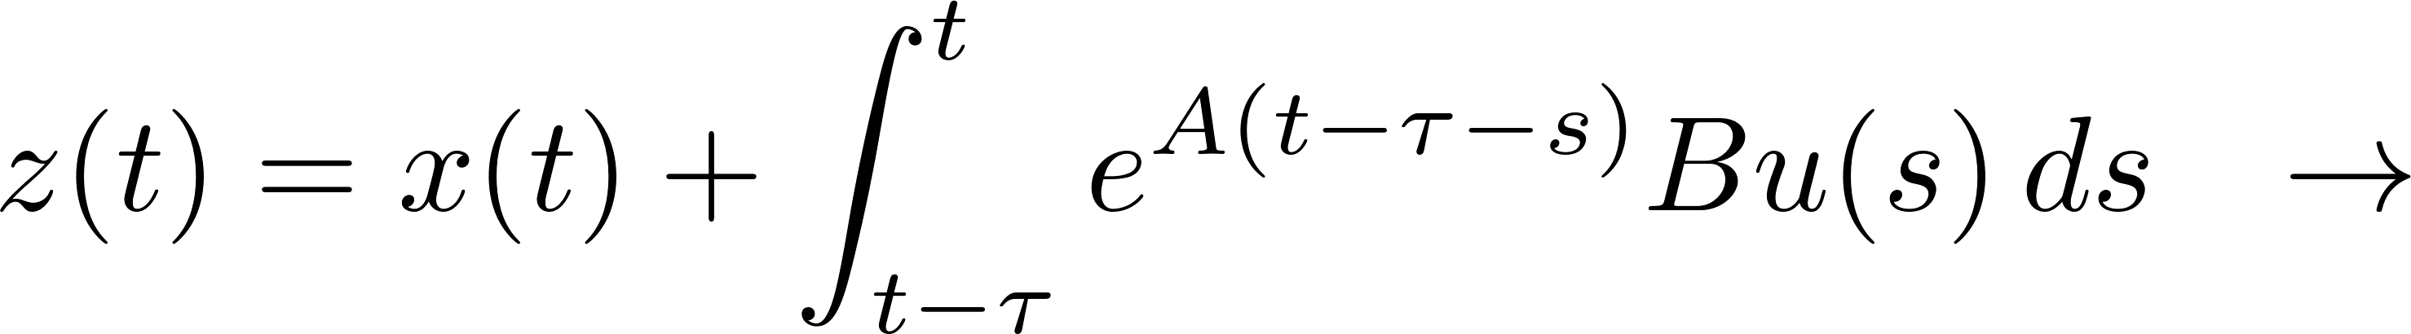
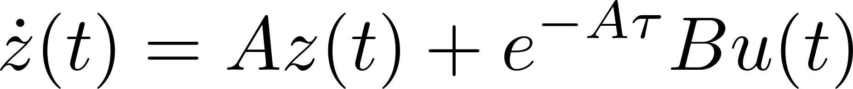



+
-
-
+
-

Slide 23
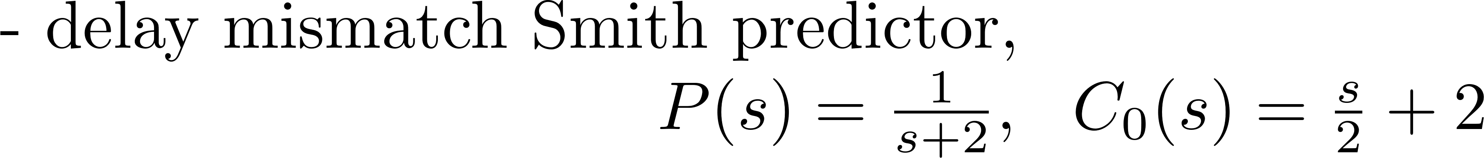
Properties

Slide 24
Outline
Applications and examples
Basic properties time-delay systems
Dimension reduction using predictor feedback
Dimension reduction using periodic feedback
  Switched periodic feedback
  Smooth periodic feedback
  Fixed-time observers
Time-delay methods in vibration control
Conclusions

Slide 25
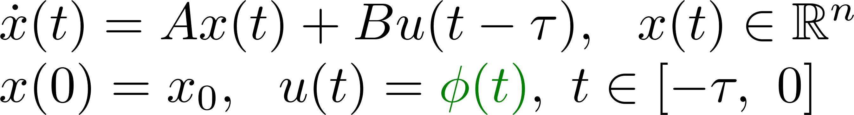
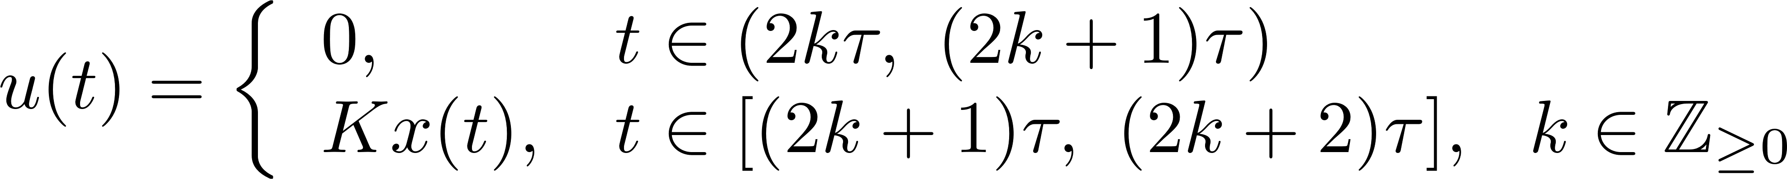
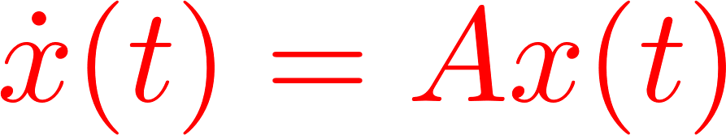


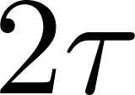
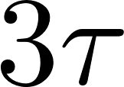
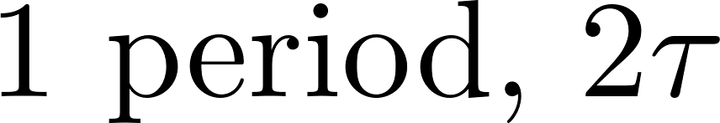
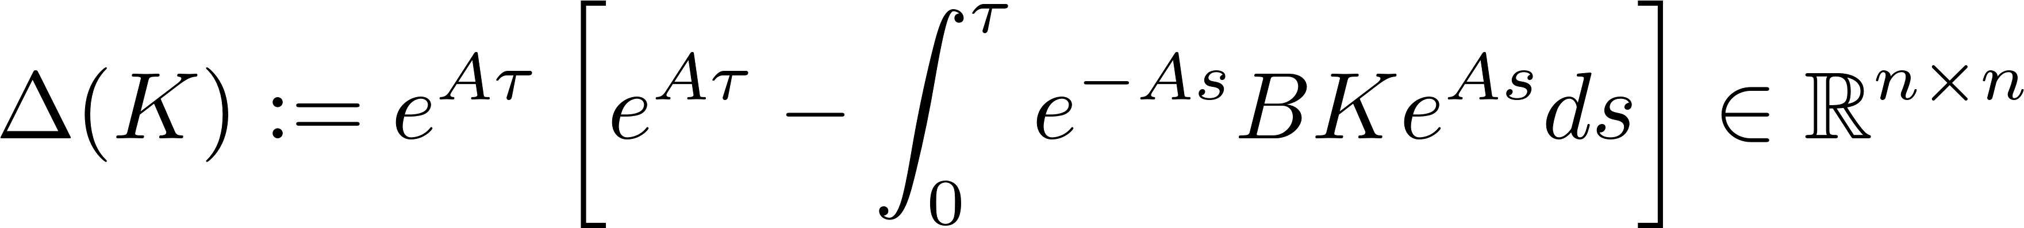
Act-and-wait control

Slide 26

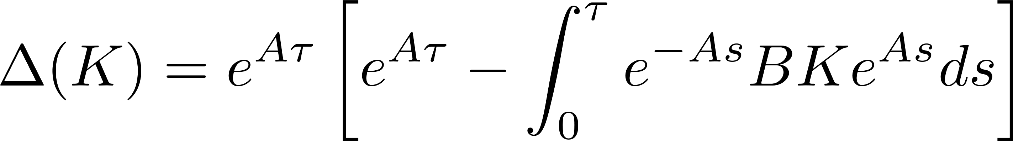

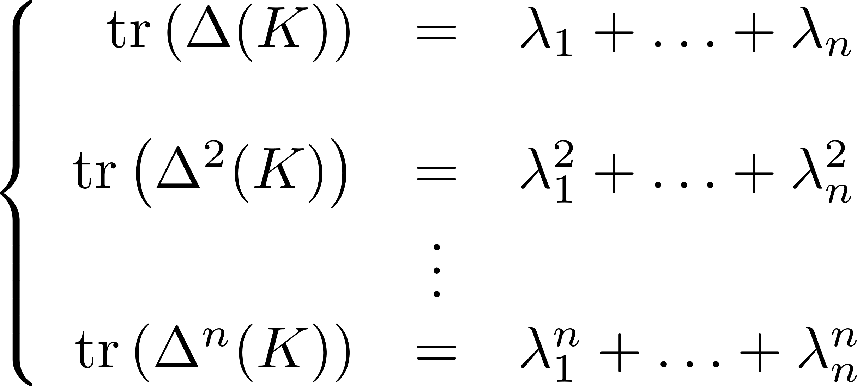
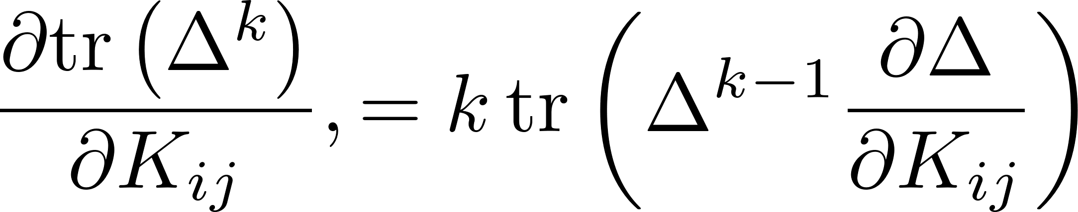
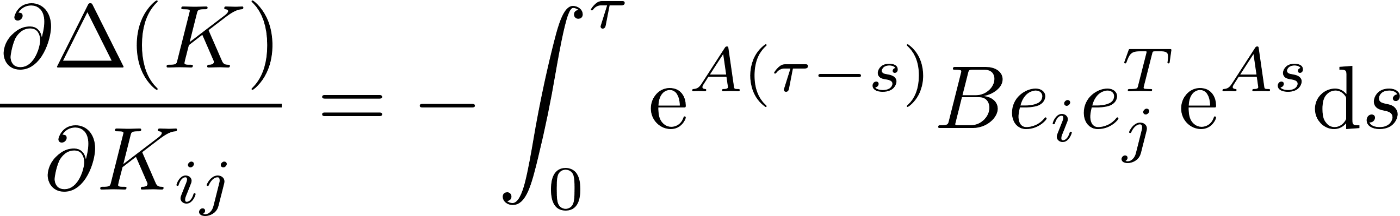
Potential for direct eigenvalue placement of monodromy matrix
Potential for fixed-time stability / deadbeat response

Slide 27
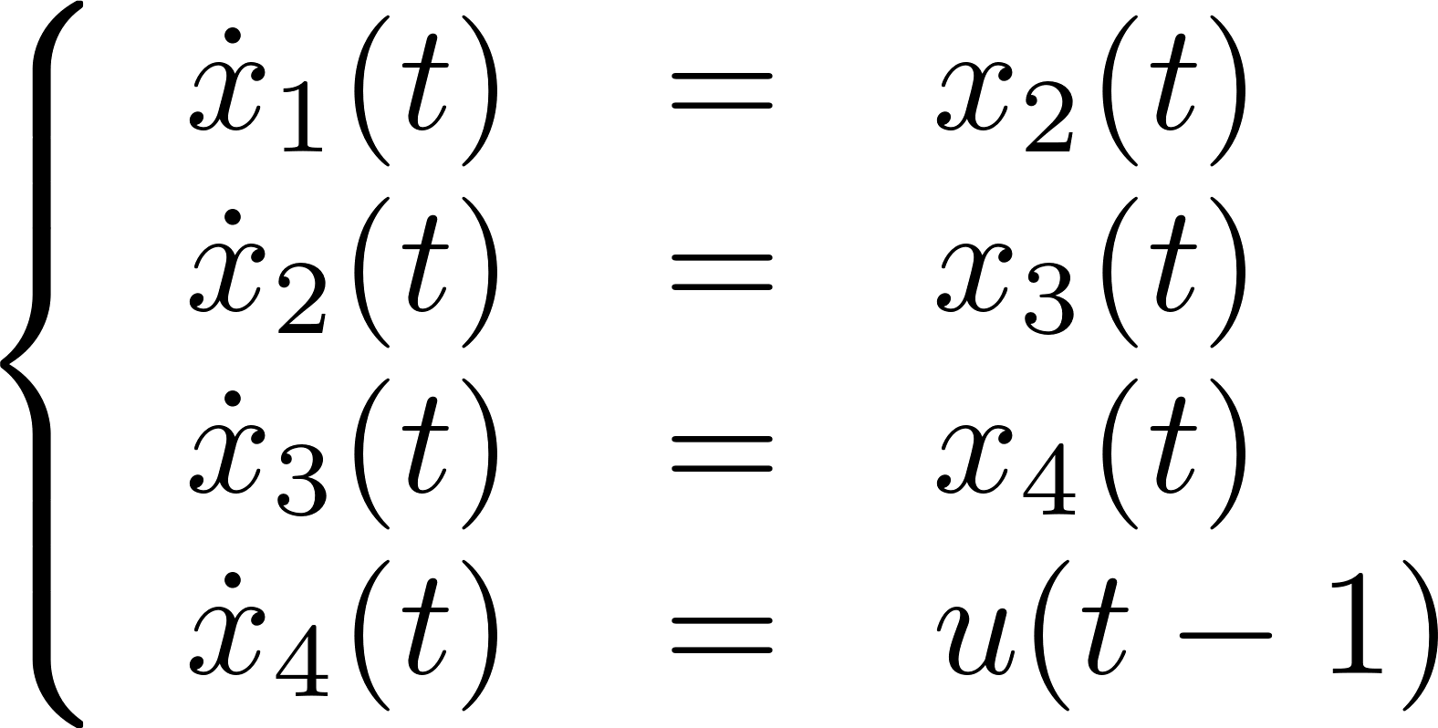
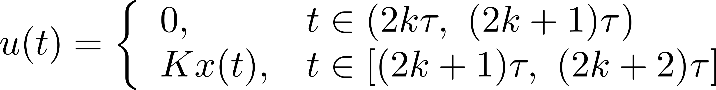
Potential for fixed-time stability (II)
Limitations induced by delay
Can these limitations be overcome?

Slide 28
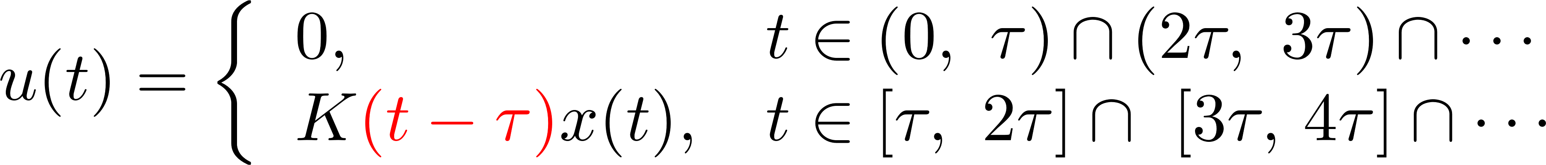




What about a time-varying periodic gain?
periodic

Slide 29



Fixed-time stabilization
Open loop phases?

Slide 30



Towards observation in a prescribed time
design parameter
Potential
to arrive at systems with provable guarantees (formal methods in control)
Hierarchical control / reduction techniques

Slide 31
Outline
Applications and examples
Basic properties time-delay systems
Dimension reduction using predictor feedback
Dimension reduction using periodic feedback
  Switched periodic feedback
  Smooth periodic feedback
  Fixed-time observers
Time-delay methods in vibration control
Conclusions
Collaboration group T. Vyhlídal, CTU (joint PhDs D. Pilbauer, A. Sandanha)

Slide 32




Input shaping
Goal: avoid excitation at given frequency, ω, by filtering
Feedforward solution:
Simplest form of shaper
Feedback solution:

Slide 33

Non-collocated vibration suppression using the delayed resonator
Non-collocated vibration suppression using the delayed resonator
Tuned Vibration Absorber added to suppress
vibrations of target at given frequency ω
Principle: anti-resonance
Delayed resonator
Target
with gain g and delay τ as controller parameters
Harmonic disturbance
Collocated case: target is accessible

Slide 34


Principle of non-collocated vibration suppression
resonating
substructure
resonating
substructure
Target
Target
Harmonic
disturbance
Harmonic disturbance
Non-collocated suppression (level I)
Non-collocated suppression (level II)

Slide 35


Methodology
Two control loops (2 delays + 2 gains)
→ vibration suppression
→ ensure closed-loop stability with sufficient margin
Inter-dependence between the controllers
Target
Parameter tuning:
- mimimize the spectral abscissa of closed-loop system
- subject to zero location constraints on transfer function
from d to target’s position
Harmonic disturbance
Using software integrated in TDS-CONTROL

Slide 36


Experimental validation
Target
Harmonic disturbance
Target
Harmonic disturbance
36

Slide 37
Conclusions
A control-oriented overview of time-delay systems, with focus on
  beneficial effect of delays / use of delays for control
  solutions to control problem in the form of explicit feedback laws
Two finite-dimensional representations of closed-loop systems with delay,
induced by structure of the controller
Outlook: incorporate compact but informative time-delay models in
data-driven modeling and control strategies
References
Michiels, W. (2020). Control of Linear Systems with Delay. In: Encyclopedia of Systems and Control, 2nd Edition
Michiels, W., Zhou, B. (2020). On the fixed-time stabilization of input delay systems using act-and-wait control. Systems & Control Letters.
Silm, H., Kure, M., Busek, J., Michiels, W., Vyhlidal, T. with Michiels, W. (2023). Spectral design and experimental validation of non-
collocated vibration suppression by a delayedresonator and time-delay controller. IEEE Transactions on Control Systems Technology.
Zhou, B., Michiels, W., Chen, J. (2022). Fixed-time stabilization of linear delay systems by smooth periodic delayed feedback.
IEEE Transactions On Automatic Control.

