Slide 1
Serverless Compute Fabric for Edge-Cloud Continuum: Opportunities and Challenges
The 25th International Conference on Enterprise Information Systems (ICEIS 2023)
Ass. Prof. Dr. Stefan Nastic 26th April 2023

Slide 2
About me
Assistant Professor at Distributed Systems Group at TU Wien
Founder and CEO at IntelliEdge GmbH
Leading various commercial and research projects over the past 10+ years
My core research interests
Serverless Computing
Edge-Cloud Continuum
AI & Edge AI
Get in touch via LinkedIn or find me at nastic.at
Notes:
Founder and CEO at IntelliEdge GmbH, where we help our partners to create business value with software and digitalization, by delivering innovative Cloud, Edge & AI solutions
Medium writeup of this talk coming out in a few weeks

Slide 3
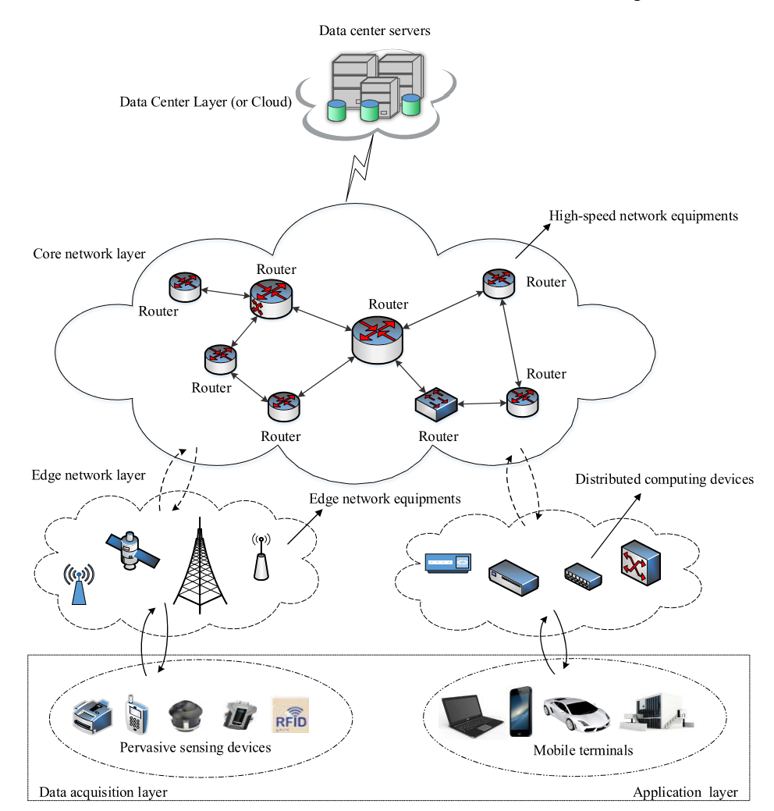
Edge-Cloud Continuum in a Nutshell
A large pool of interconnected resources
Usually hierarchical/layered and globally heterogeneous

Slide 4
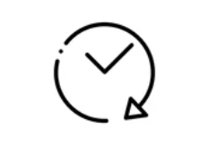
The Promises of Serverless
No infrastructure management
Flexible elastic scaling
High reliability & availability
No idle capacity
Notes:
Why isn’t everybody building Serverless applications and systems?
- Serverless in a nutshell
- Challenges & Opportunities
- Our experiences with developing platform/systems in the Serverless world

Slide 5
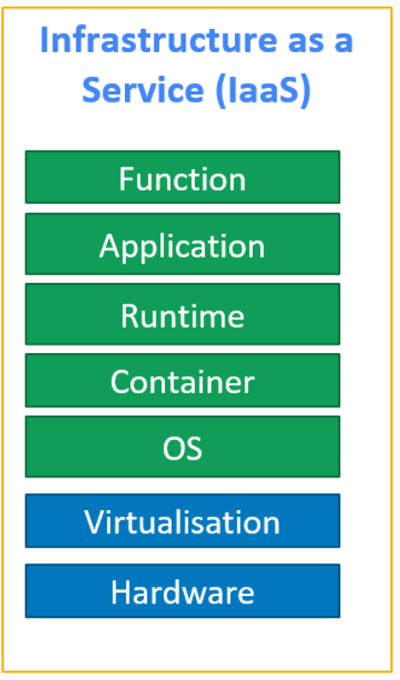
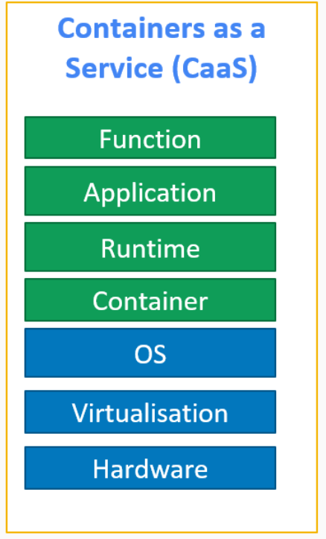
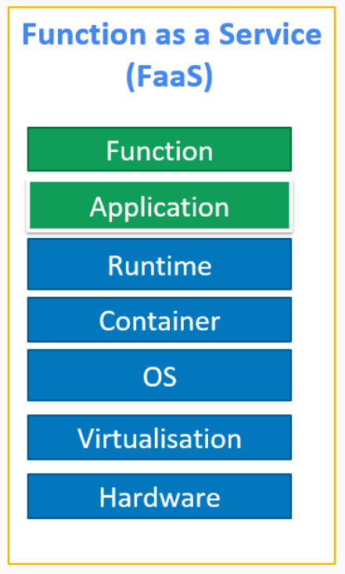
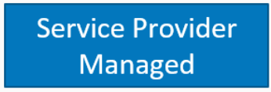
Serverless Computing in a Nutshell
Serverless ≠ No Servers
Natural evolution in Cloud Computing
Novel Function as a Service (FaaS) Paradigm
Novel execution model

Slide 6
Popular Serverless Platforms
Cloud-First
AWS Lambda
Azure Functions
Google Cloud Functions
Edge-First
Cloudflare Workers
Fastly Compute@Edge
Open source
OpenWhisk
OpenFass

Slide 7
Function Isolation and Virtualization Models
Containers (K-Native on Kubernetes )
MicroVMs - Firecracker (AWS Lambda)
V8 Isolates (Cloudflare, Deno Deploy)
WASM runtime (Fastly)
Unikernels (Mainly academia)

Slide 8
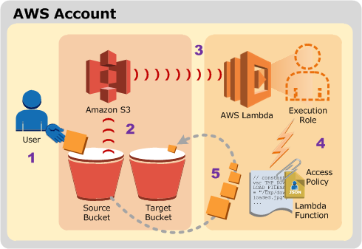
Function as a Service (FaaS)
A type of serverless computing where developers can deploy and run code in response to events or requests
Application is decomposed into “triggers” and “actions” (functions)
Developers write functions and upload them to a FaaS platform
Functions are triggered by events, such as a user request or a change in data
Example: Thumbnail image processing

Slide 9
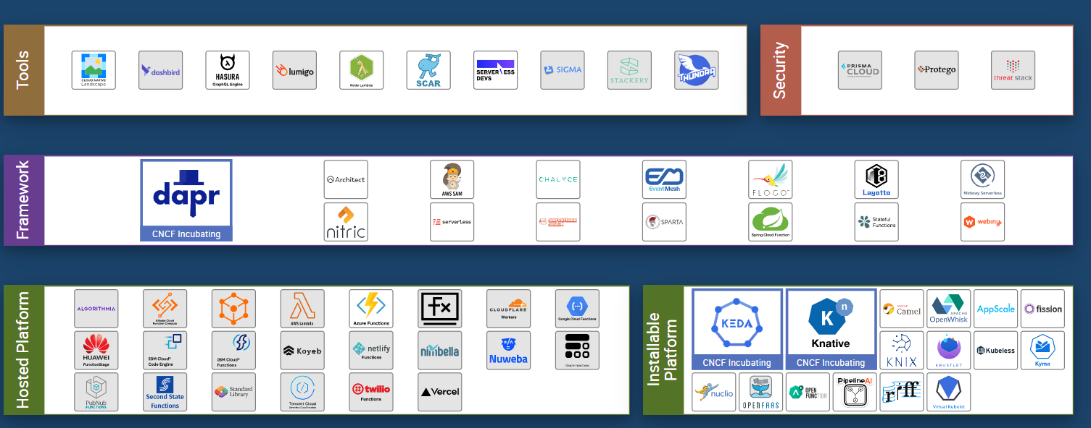
Serverless Beyond the FaaS
Serverless “support services”
Serverless managed Cloud services
API Gateways for synchronous (request-based) communication
Object stores for persistent state management
Database change streams for reacting to data changes (DynamoDB Streams)
Function orchestration (Step Function)
Serverless relational database (Amazon Aurora)
Serverless container management (AWS Fargate)
Serverless warehouse (Google BigQuery)
Notes:
Or You are probably already using serverless

Slide 10
Serverless Beyond the Cloud
Serverless was born in the Cloud and remains largely limited to the Cloud
True potential of Serverless is unlocked in the Edge-Cloud continuum
Localized computation (Edge locations vs datacenters)
Low network latency due to proximity to the user
Flexible geo-restrictions, compliance, etc.
Serverless Compute Fabric
Edge-Cloud native BaaS services
Distributed and decentralized messaging solutions (Emma)
Lightweight and secure virtualization and isolation (WASM)
Edge-native state management ( Durable Objects)
Notes:
AWS has Edge location (AWS - 400+) vs. data centers (AWS - 87)

Slide 11
The Promises of Serverless
No infrastructure management
Flexible elastic scaling
High reliability & availability
No idle capacity
Notes:
Why isn’t everybody building Serverless applications and systems?
- Serverless in a nutshell
- Challenges & Opportunities
- Our experiences with developing platform/systems in the Serverless world

Slide 12
Many Opportunities …
Fine-grained pay-per-use model with preserved SLOs
Optimal resource usage with Scale-to-Zero
Rapid elasticity & auto-scaling due to lightweight virtualization
Native cloud offloading
True utility-based resource consumption
Disaggregation of compute and storage
Stateless workflows and life-cycle
Effortlessly parallelizing computing
Extremely bursty workloads
CUP-bound applications
Developing scalable Edge-native solution
True event-driven applications
….

Slide 13
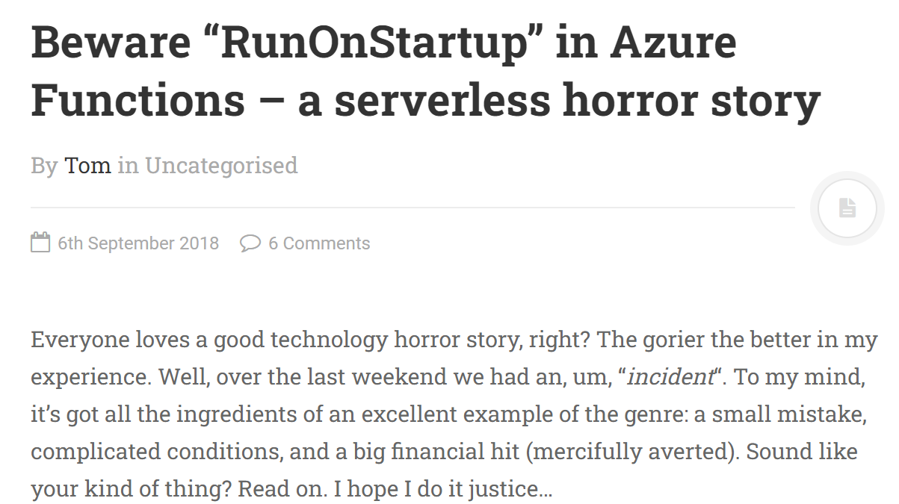
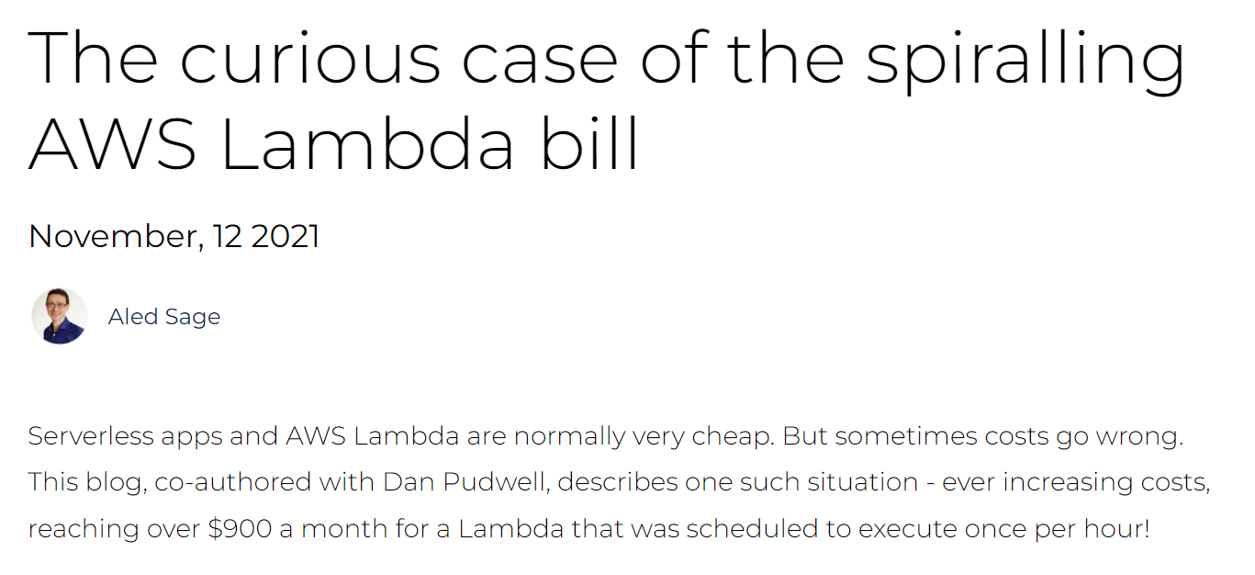
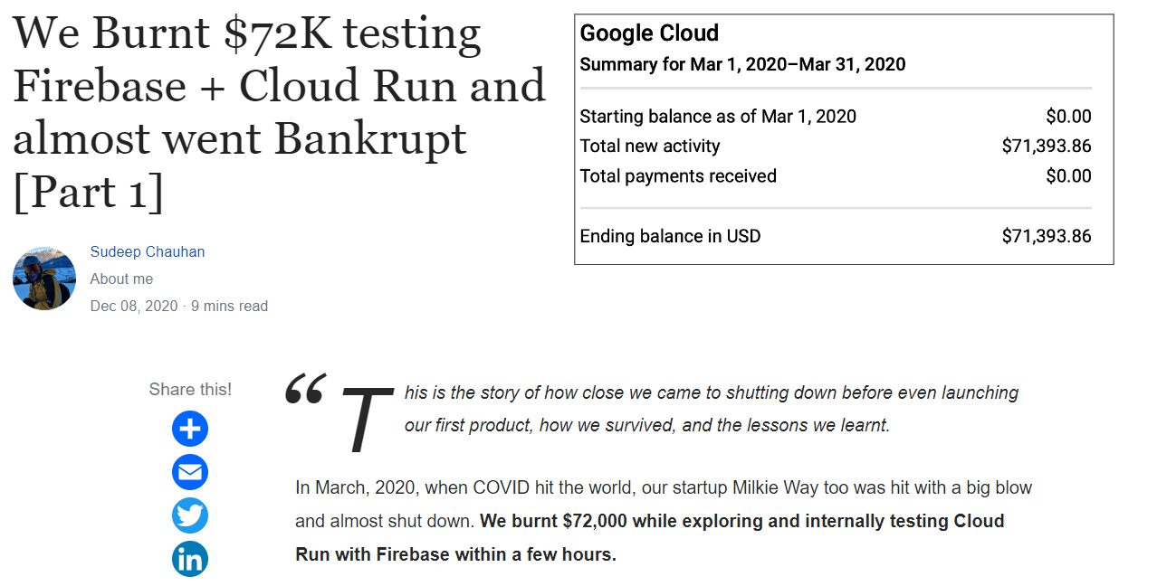
Serverless Horror Stories Examples from the Wild: A runaway function
What is a runaway function?
There are no default safeguards in place to prevent runaway functions
Notes:
Easy to start, but hard to do right
Hard caps on cloud spend offered by some providers
Turn down your concurrency limits on functions
Monitor your functions for unusual invocation spikes.
Know how to test for these situations

Slide 14
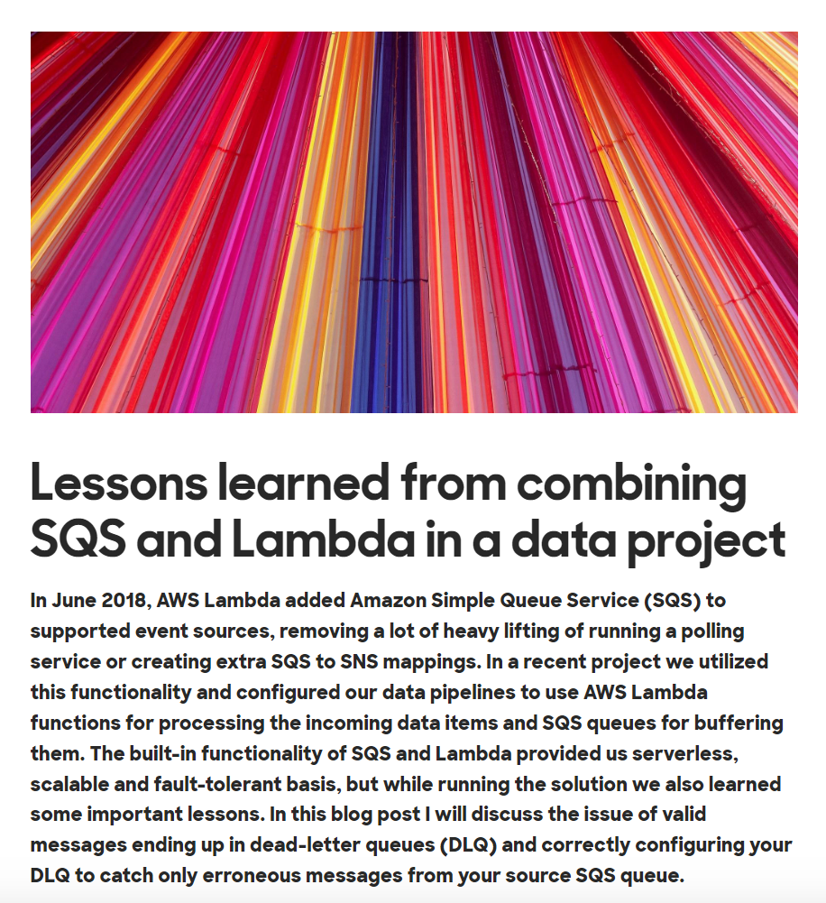
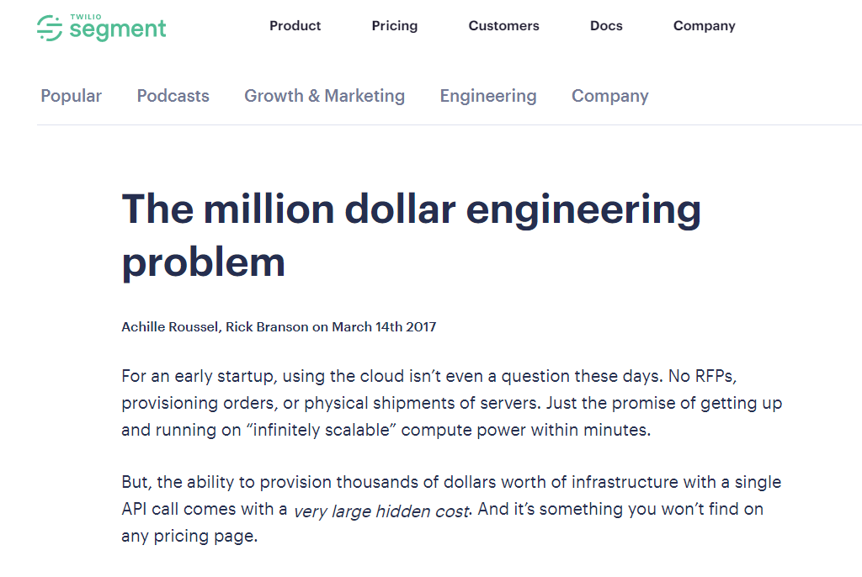
Serverless Horror Stories Examples from the Wild: A service misconfiguration
Serverless functions don’t live in isolation (“support services”)
Serverless says nothing about configuring & managing other edge-cloud services
Arguably more complex ecosystem

Slide 15
Main Challenges with Serverless in Edge-Cloud Continuum
Performance Challenges
Data Management Challenges
Startup/scheduling latency (“cold start”)
Lack of performance isolation (“noisy neighbors”)
Inconsistent performance due to hardware heterogeneity (also present in Cloud only solutions!)
Function execution latency due to lack of data locality
State management for stateful computations
Efficient and cost-effective caching solutions
Particularly important for emerging Edge AI workloads

Slide 16
Main Challenges with Serverless in Edge-Cloud Continuum
Reliability Engineering Challenges
Software Development Challenges
Dealing with function failures beyond simple retries
Network partitioning can render functions useless (detached storage)
SLO-aware provisioning of functions (beyond memory and CPU)
Interoperability and portability of functions
A misconfiguration of services and resources
Bad coding practices
Wrong or incomplete error handling mechanism
Testing of the functions, beyond the unit tests
Resource quotas & limits
Notes:
- Network partitioning can render functions useless (detached storage)

Slide 17
Project Polaris
Enabling SLO- and performance awareness in the Edge-Cloud
Evolved into an ecosystem of tools and framework for the serverless Edge-Cloud continuum
Polaris is hosted by Linux Foundation as a SIG of a broader Project Centaurus
Very active GitHub: https://github.com/polaris-slo-cloud
Notes:
Managing SLOs for Serverless applications to guarantee that applications meet their performance KPIs

Slide 18
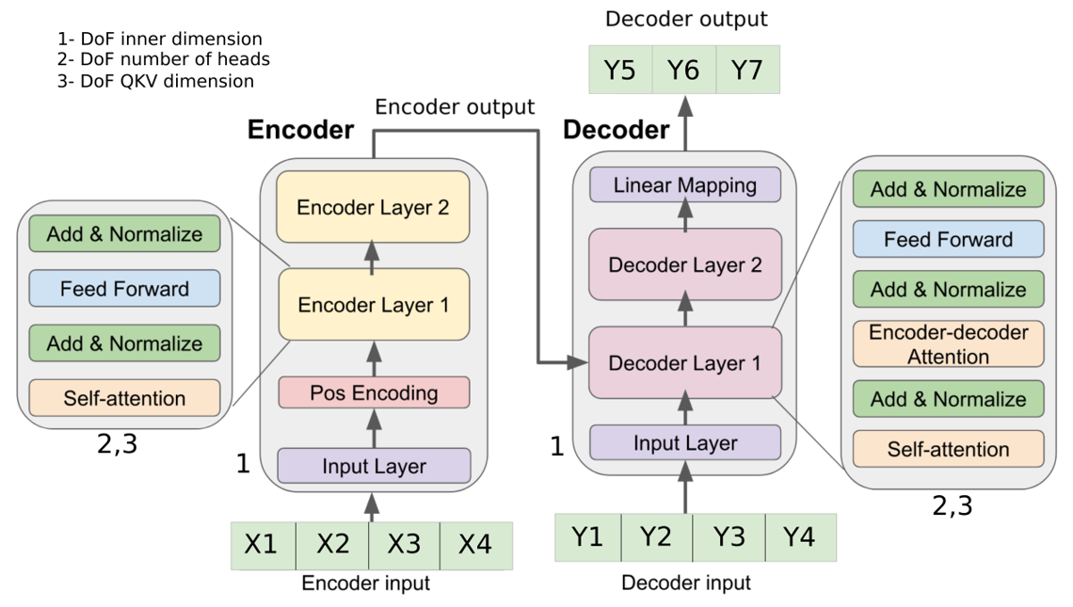
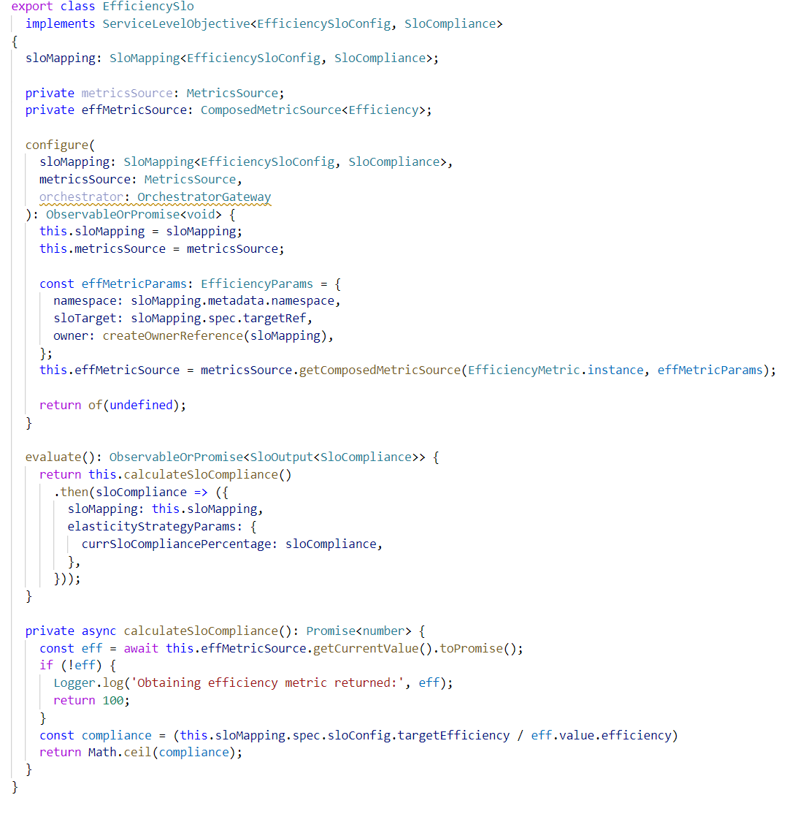
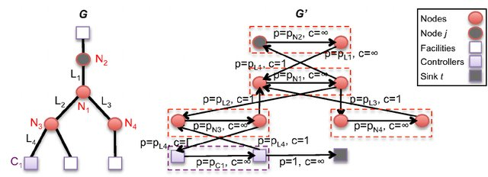
Polaris SLO Framework
Monitoring
SLO Script
Elastic Strategies
Notes:
SLO Script a new language for specifying high-level SLOs

Slide 19
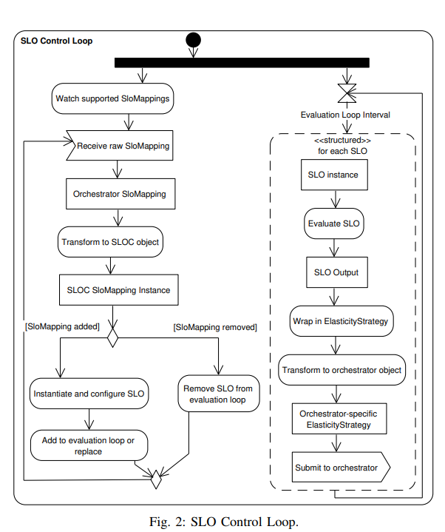
SLO Controllers
Developed as Monitoring, SLO, and Scaling Controllers
Orchestrator independent control loop
Reference implementation extends Kubernetes

Slide 20
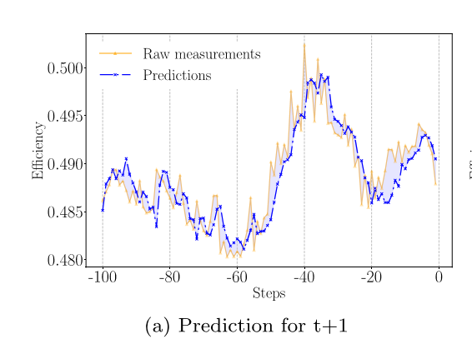
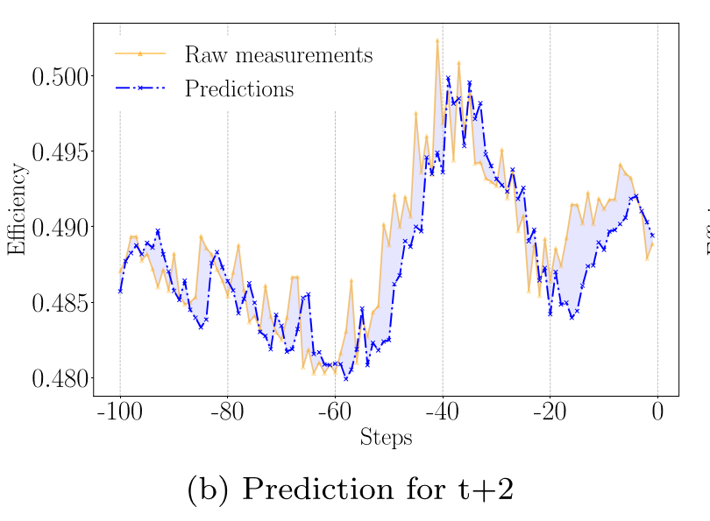
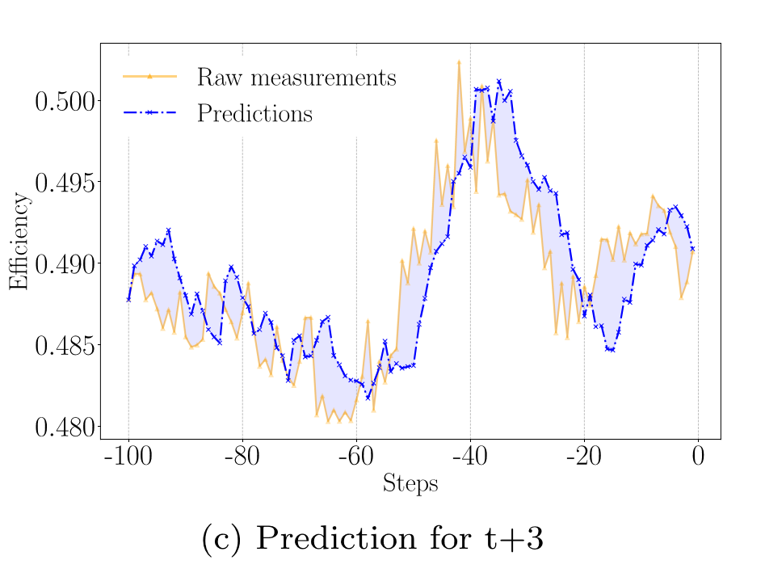
Predictive Monitoring Controllers Results

Slide 21
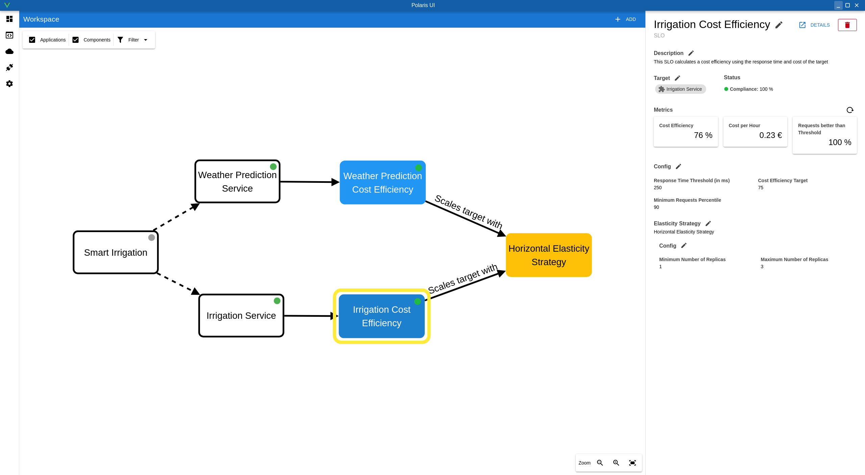
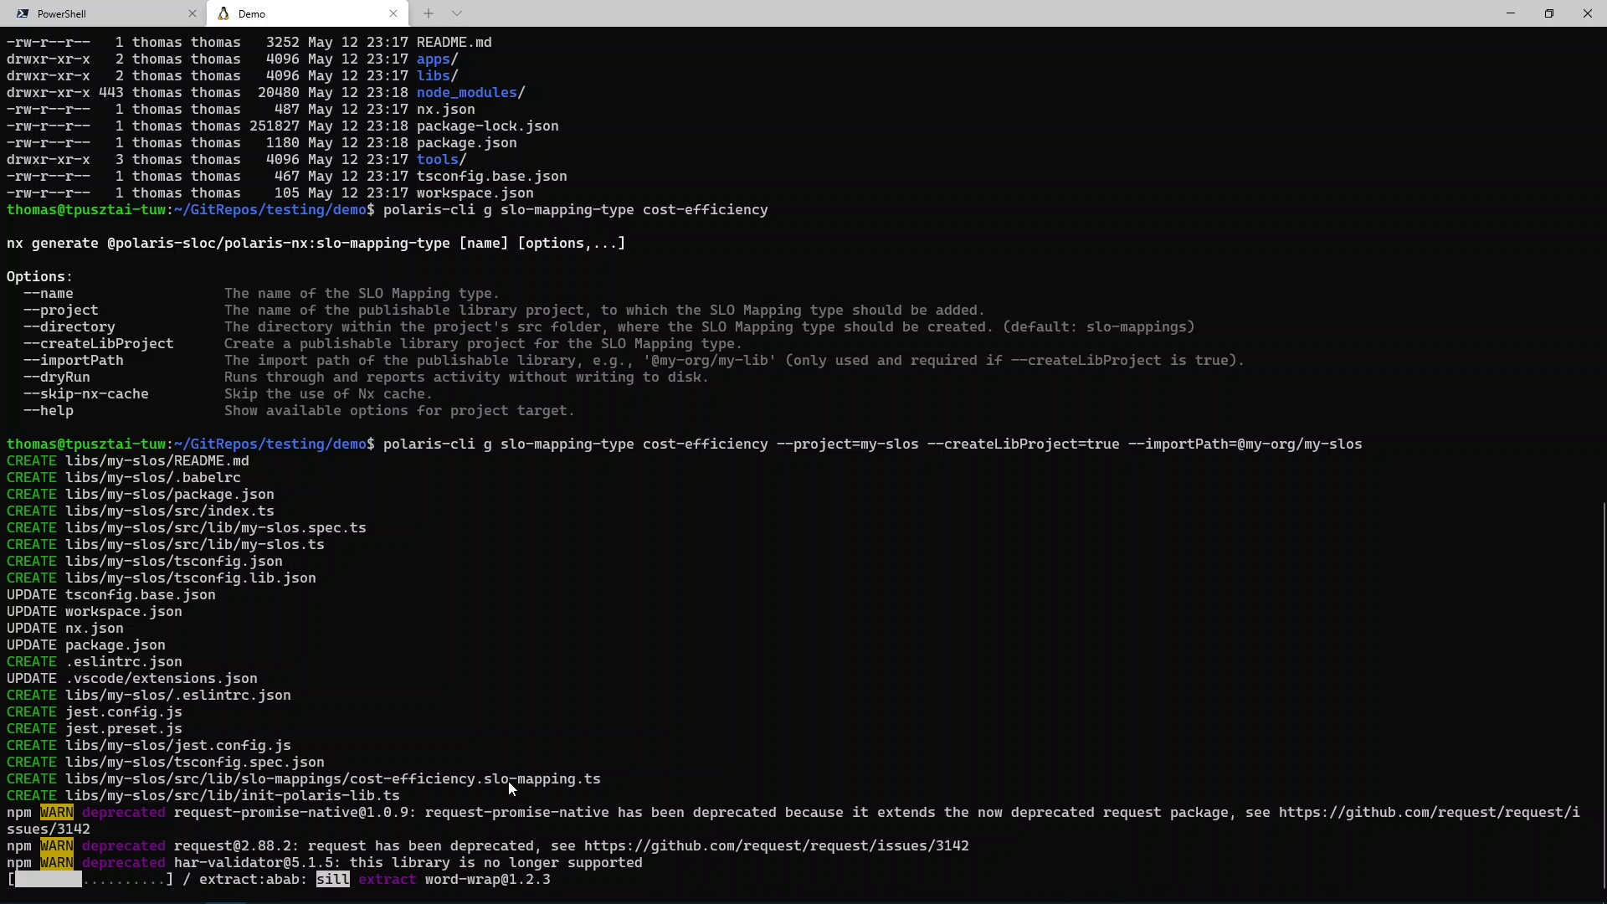
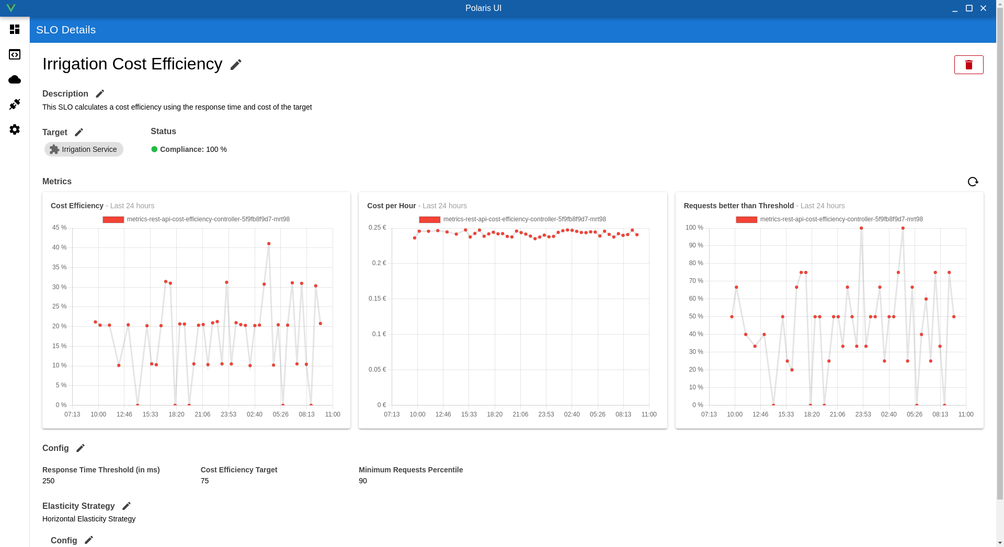
SLO User Tool Suite
SLO Framework UI
SLO Script CLI

Slide 22
Lines of Code
Component | Lines of Code | Generated | % of Total
SLO Mapping Type | 53 | 50 | 1%
SLO Controller | 224 | 99 | 6%
Horizontal Elasticity Strategy Controller | 50 | 40 | 1%
Runtime | 3,669 | - | 92%
Total | 3,996 | 189 | 100%
Notes:
The numbers are different from the ones in the paper, because they reflect the current state.

Slide 23
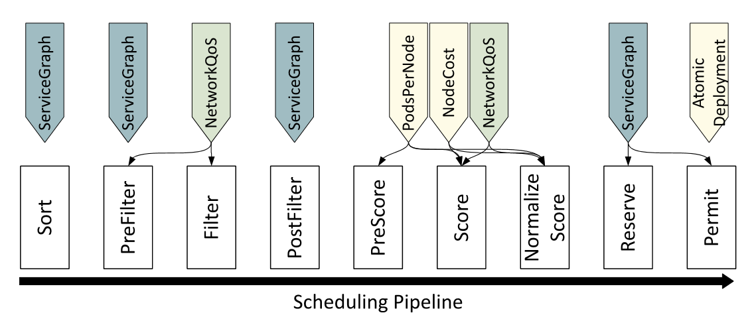
Polaris Scheduler for Edge-Cloud Continuum
Plugins-based, Edge-sensitive, and SLO-aware scheduling framework for Edge-Cloud Continuum
Scheduler’s Plugins
Scheduling Lifecycle
Notes:
The NetworkQoS plugin – In the PreFilter stage it filters out all cluster nodes that do not meet the network QoS requirements. The plugin supports the QoS requirements such as throughput (bandwidth), latency, latency variance (jitter), and packet drop.
In the Score stage, the latency and bandwidth variance values are used to assess the stability of the network connections.

Slide 24
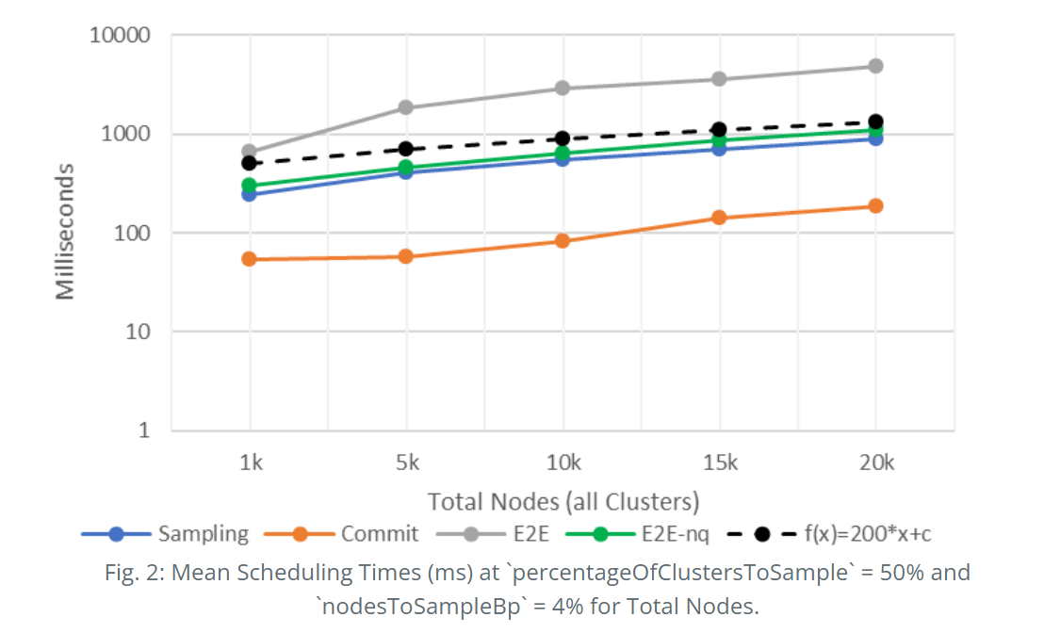
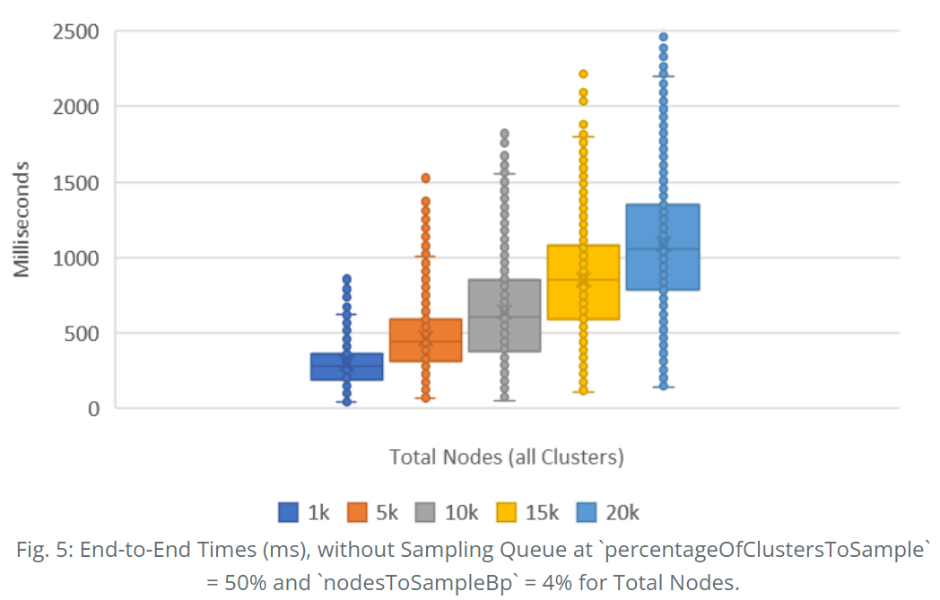
Scheduler Global Scalability Results
Scalability with Respect to Infrastructure

Slide 25
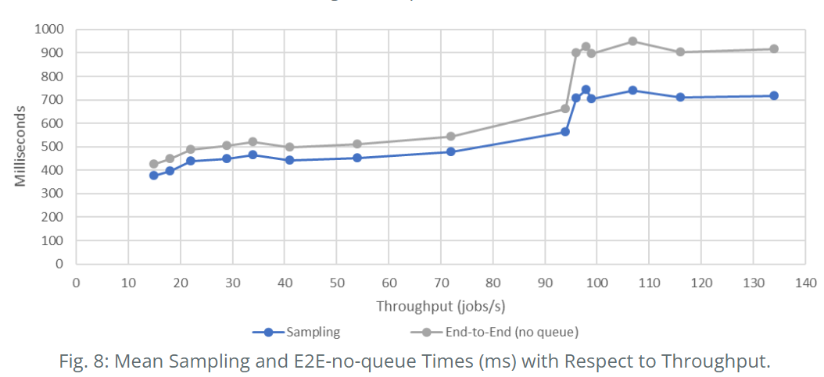
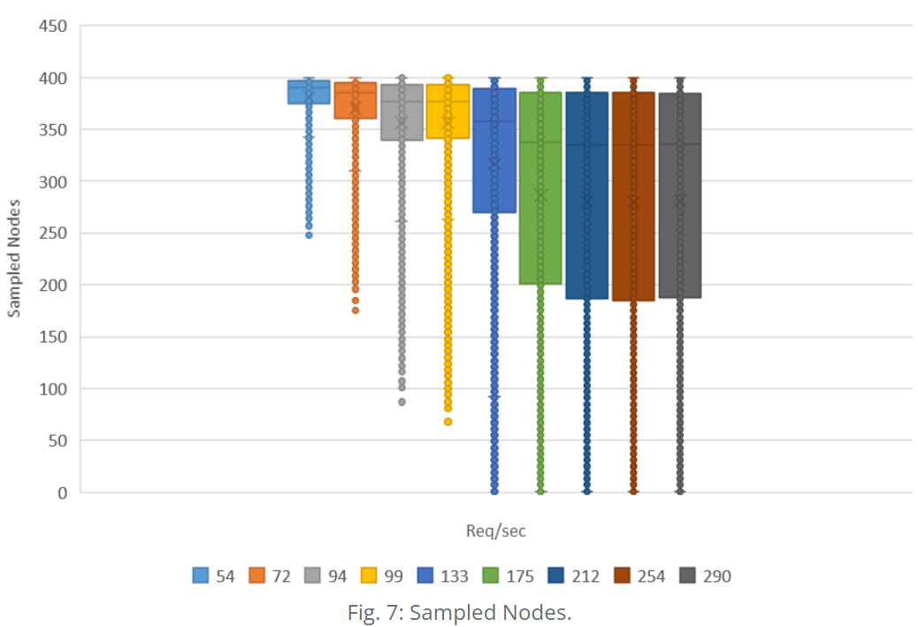
Scheduler Global Scalability Results
Scalability with Respect to Workload Throughput

Slide 26
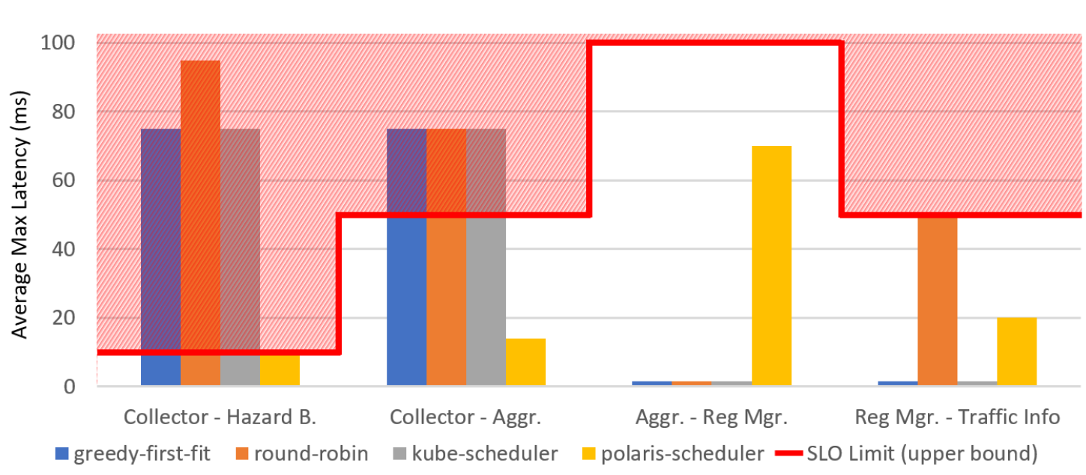
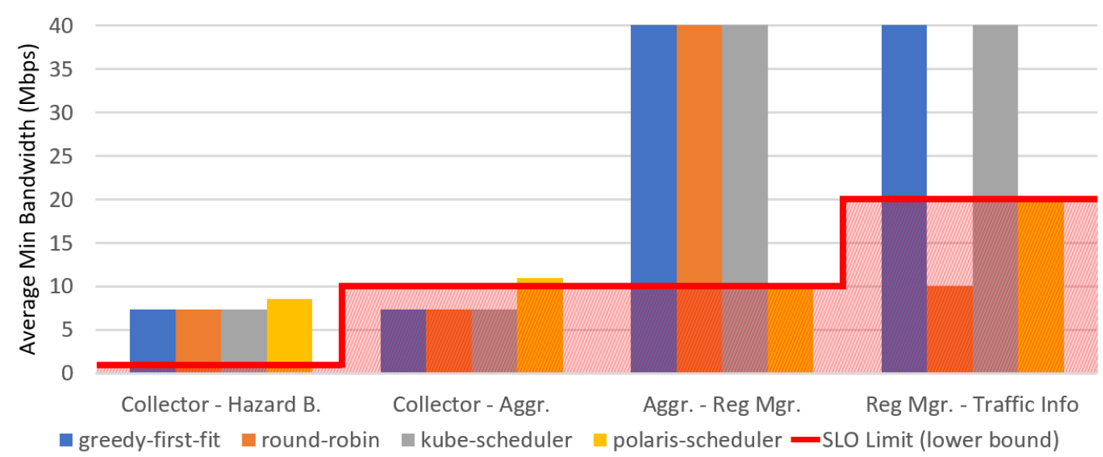
Scheduler SLO Compliance Results
Avg. Max Latencies vs SLO Bounds
Avg. Min Bandwidth vs SLO Bounds

Slide 27
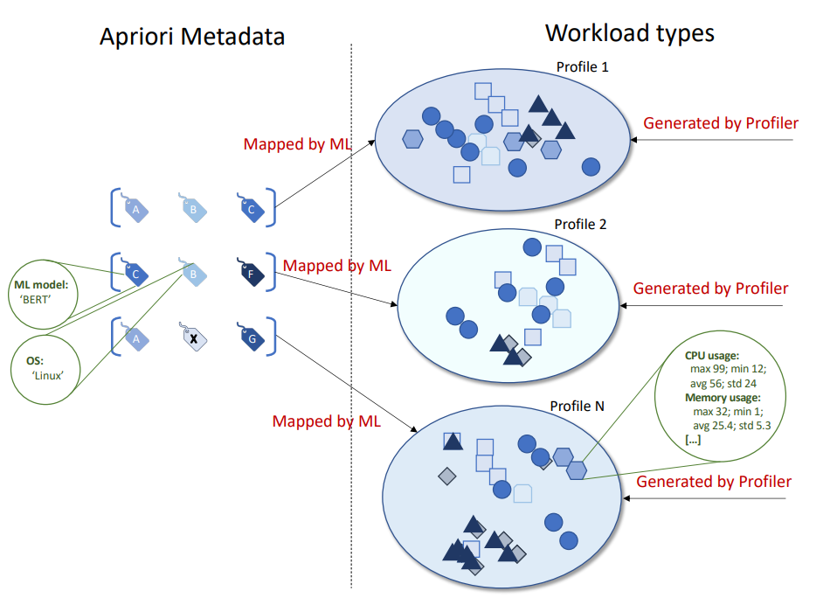
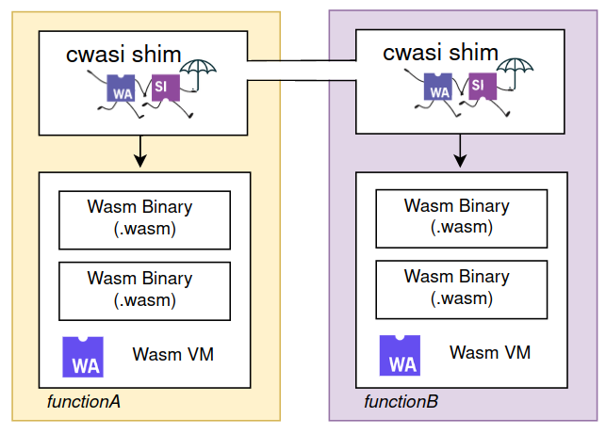
Work in progress
Metadata-based Workload Profiling
Optimal function invocation for WASM-based FaaS

Slide 28
Thank you for your attention!
Find me at: www.nastic.at
Drop me an email: snastic@dsg.tuwien.ac.at

