Slide 1

Data Quality & Ethics in Cultural Heritage Knowledge Graphs
Background image generated with Krea.ai
IC3K – October 23rd 2025, Marbella (Spain)
Valentina Presutti
University of Bologna
valentina.presutti@unibo.it
Notes:
Good afternoon. It’s a pleasure to be here and I would like to thank the organising for having me. I will talk about data quality and ethics in knowledge graphs, referring to the cultural heritage domain. However, the principles, challenges and approaches that I will address are applicable to any other domain of knowledge.

Slide 2
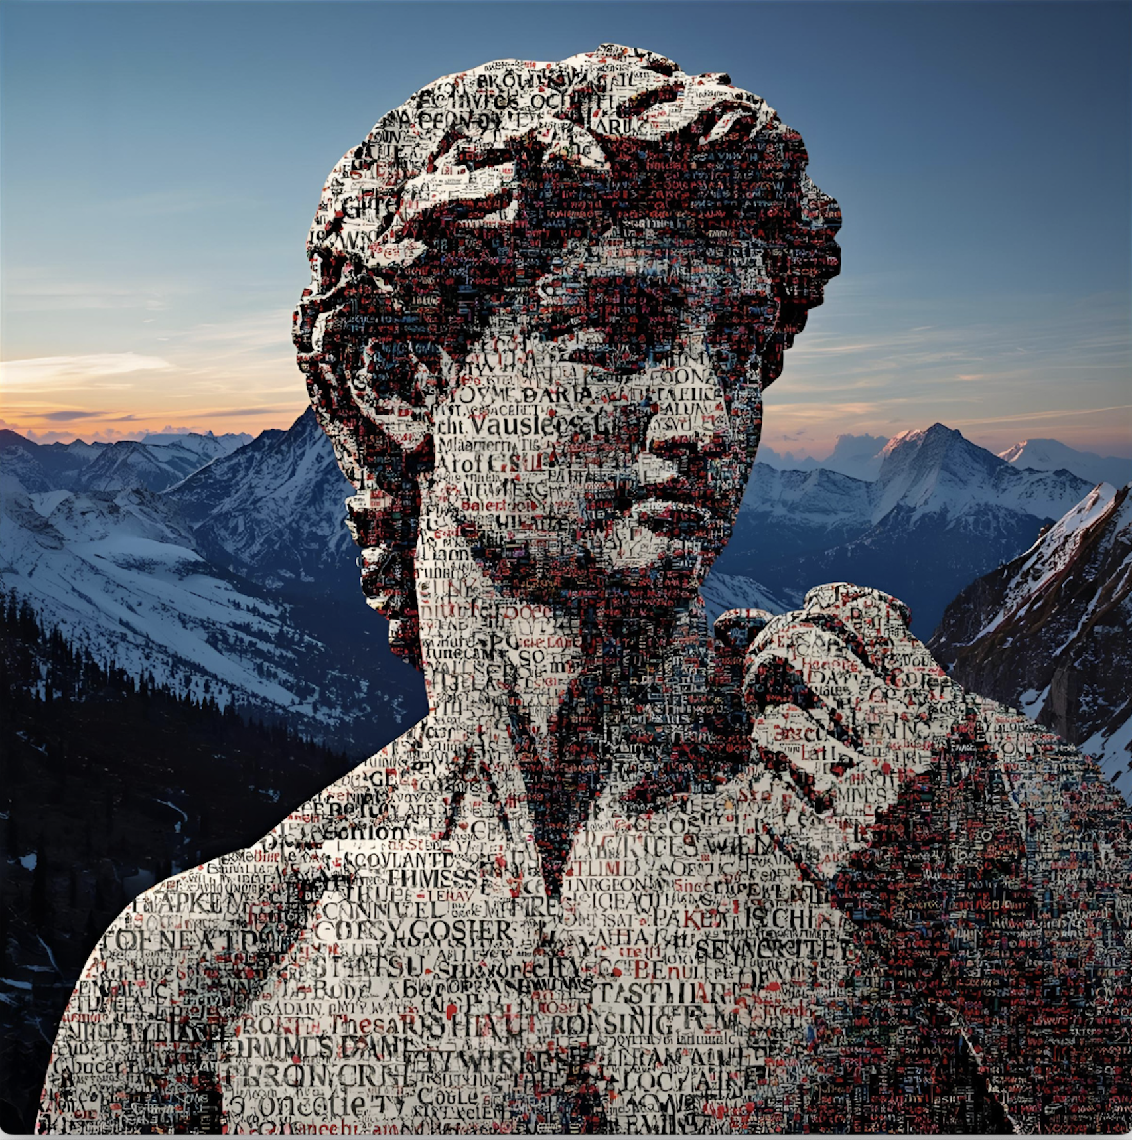
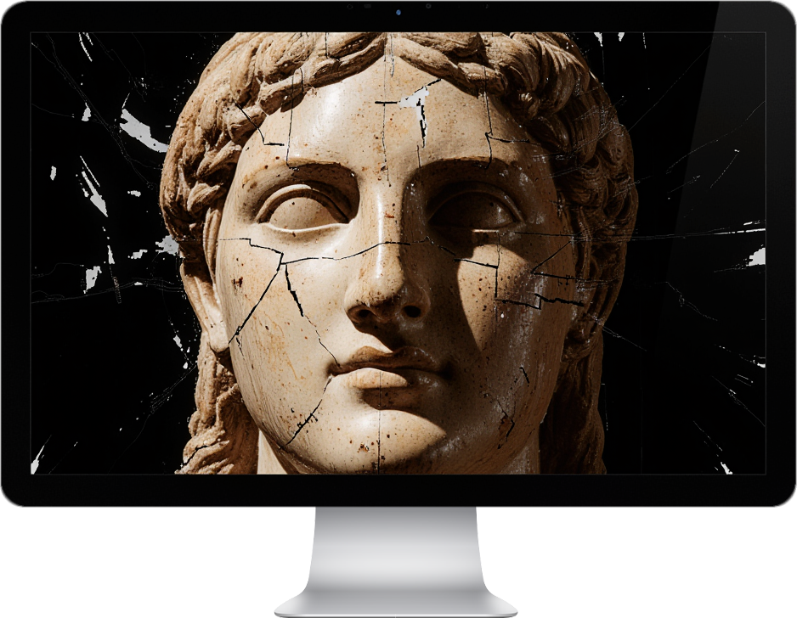
What if AI Learns from a Broken Memory?
Digital heritage risks becoming a distorted echo of the past.
Image generated with Krea.ai
Image generated with canva.com
Notes:
I want to start with a question that anchors my talk: What happens when the AI systems of tomorrow learn our history from a broken memory? The digital world delivered unprecedented access to heritage, but there is a profound risk. Our digital cultural heritage is at risk of becoming a distorted echo of the past, built on fragmented, silent, and biased data.
If we allow this 'broken memory' to be the sole input for powerful AI systems, we are not preserving history; we are automating and amplifying a distorted, exclusionary vision of who we are.

Slide 3

Data Quality is an Ethical Imperative
Data quality is not a technical detail, but an ethical obligation to future generations.
Image generated with Krea.ai
Notes:
My central claim is that Data quality is not merely a technical issue, but an ethical imperative for cultural heritage. Why? Because Knowledge Graphs (KGs) are not neutral containers; they actively shape historical narratives and influence the reliability of future AI systems. Every decision we make about modeling, linking, and cleaning data is a curatorial decision with moral weight. We must move beyond simple data integration and ensure we build a foundation that is multi-perspective, ethically-aware, and of demonstrably high quality.

Slide 4

The Digital Promise: Successes and Scale
Massive investments in the last two decades at EU and national levels.
Unprecedented remote access to invaluable cultural resources.
EU funding: > ~3 Billion € (+ part of the 3.2 Billion European Regional Development Fund)
Italy: ~2 Billion €
Spain: ~2.2 Billion €
See references [1,2,3]
Image generated with Krea.ai
Notes:
First I want to acknowledge the success achieved so far. In the last two decades, investments across Europe have been vast. More than 3.5 Billion € have been invested so far in pan-European projects for preserving and enhancing cultural heritage, including digitisation. At national level the effort has been equally significant. Spain and Italy have invested 2 Billion €.
This has led to truly virtuous results: remote access to invaluable resources, virtual visits, immersive experiences, and new infrastructures

Slide 5
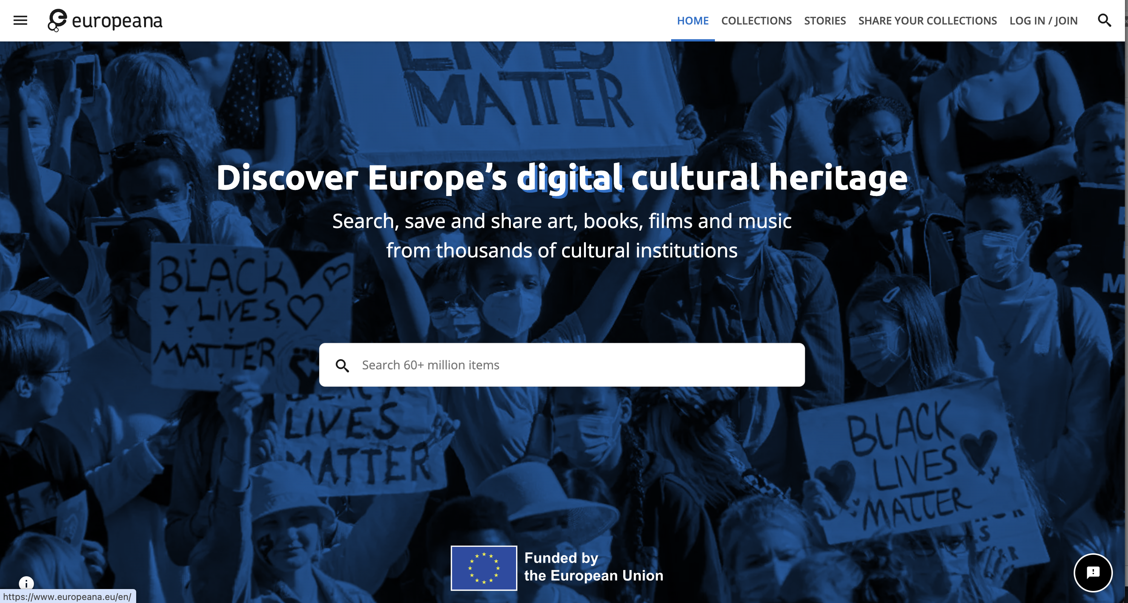
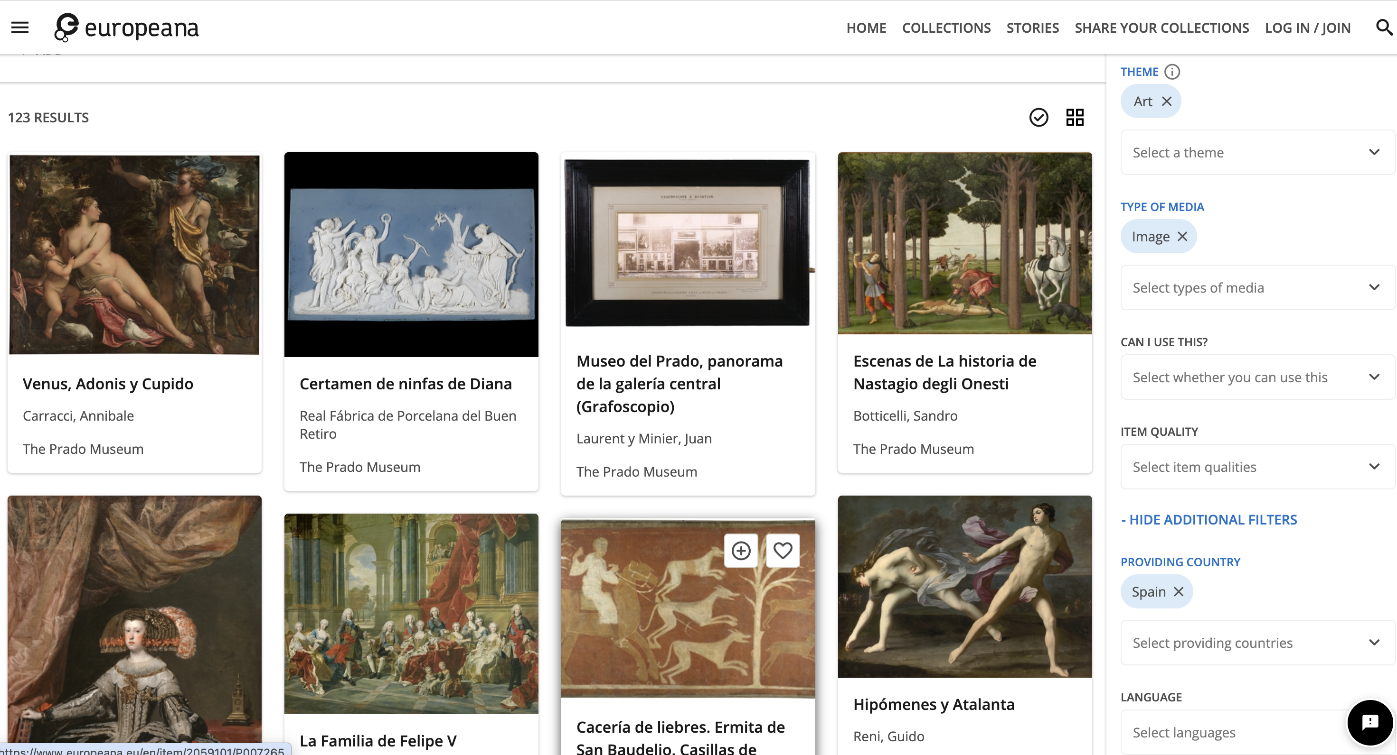
Europeana
Europe's central platform, aggregating over 50 million digitized items (images, texts, videos, 3D models) from thousands of cultural institutions
https://www.europeana.eu/en

Slide 6
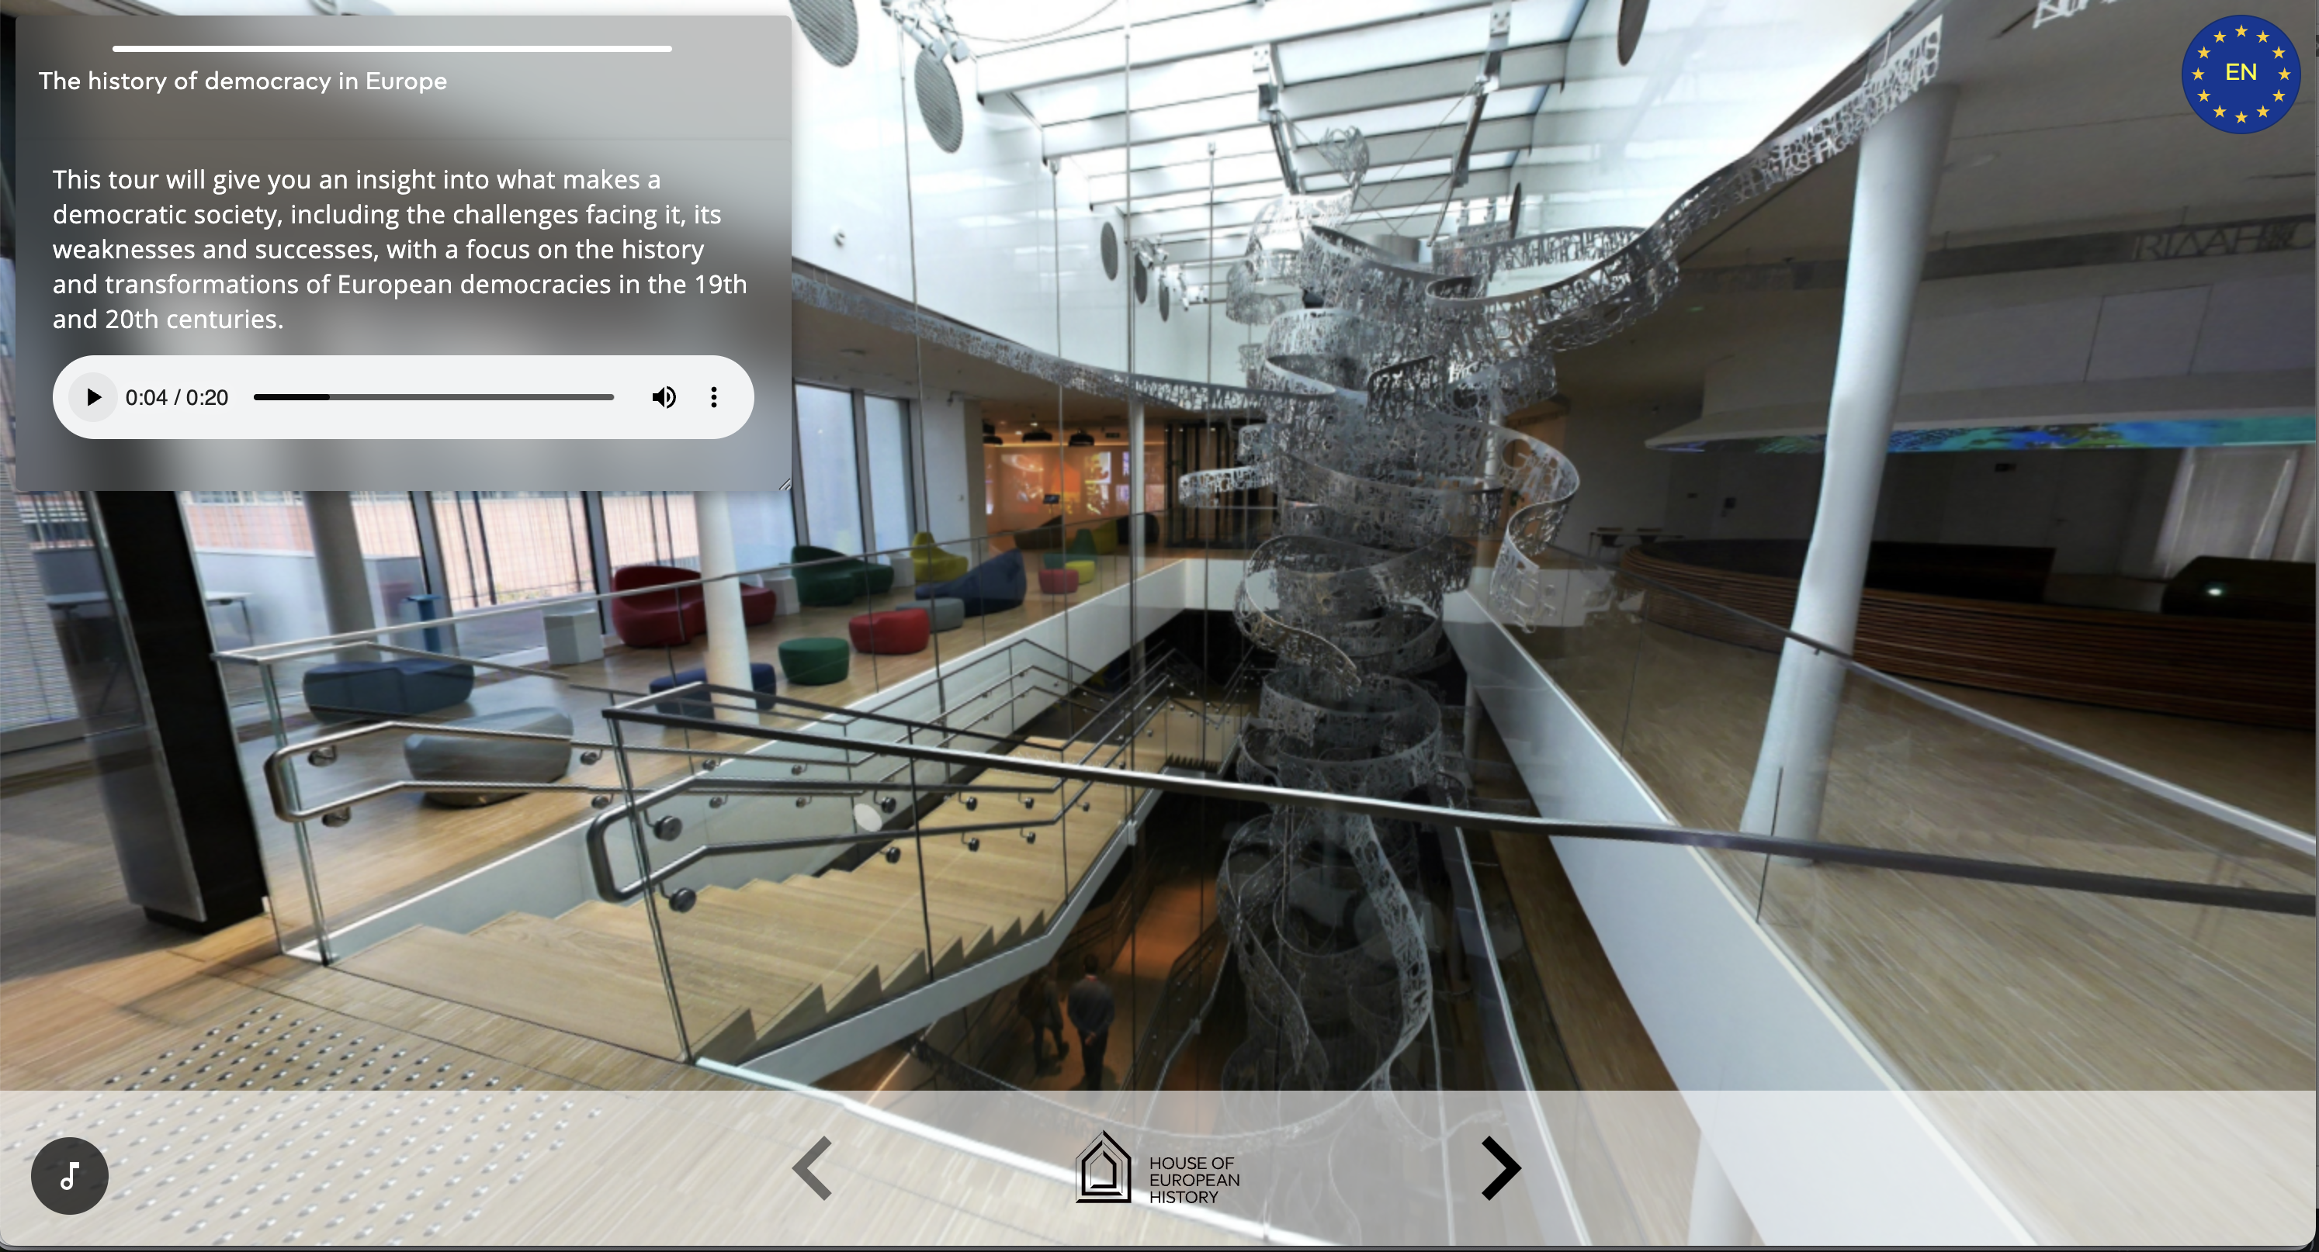
House of European History Virtual Tour
Full chronological and thematic virtual tour of the permanent exhibition in 24 EU languages, featuring interactive media and high-resolution object images.
https://historia.europa.eu/en/digital-offer/virtual-tour

Slide 7
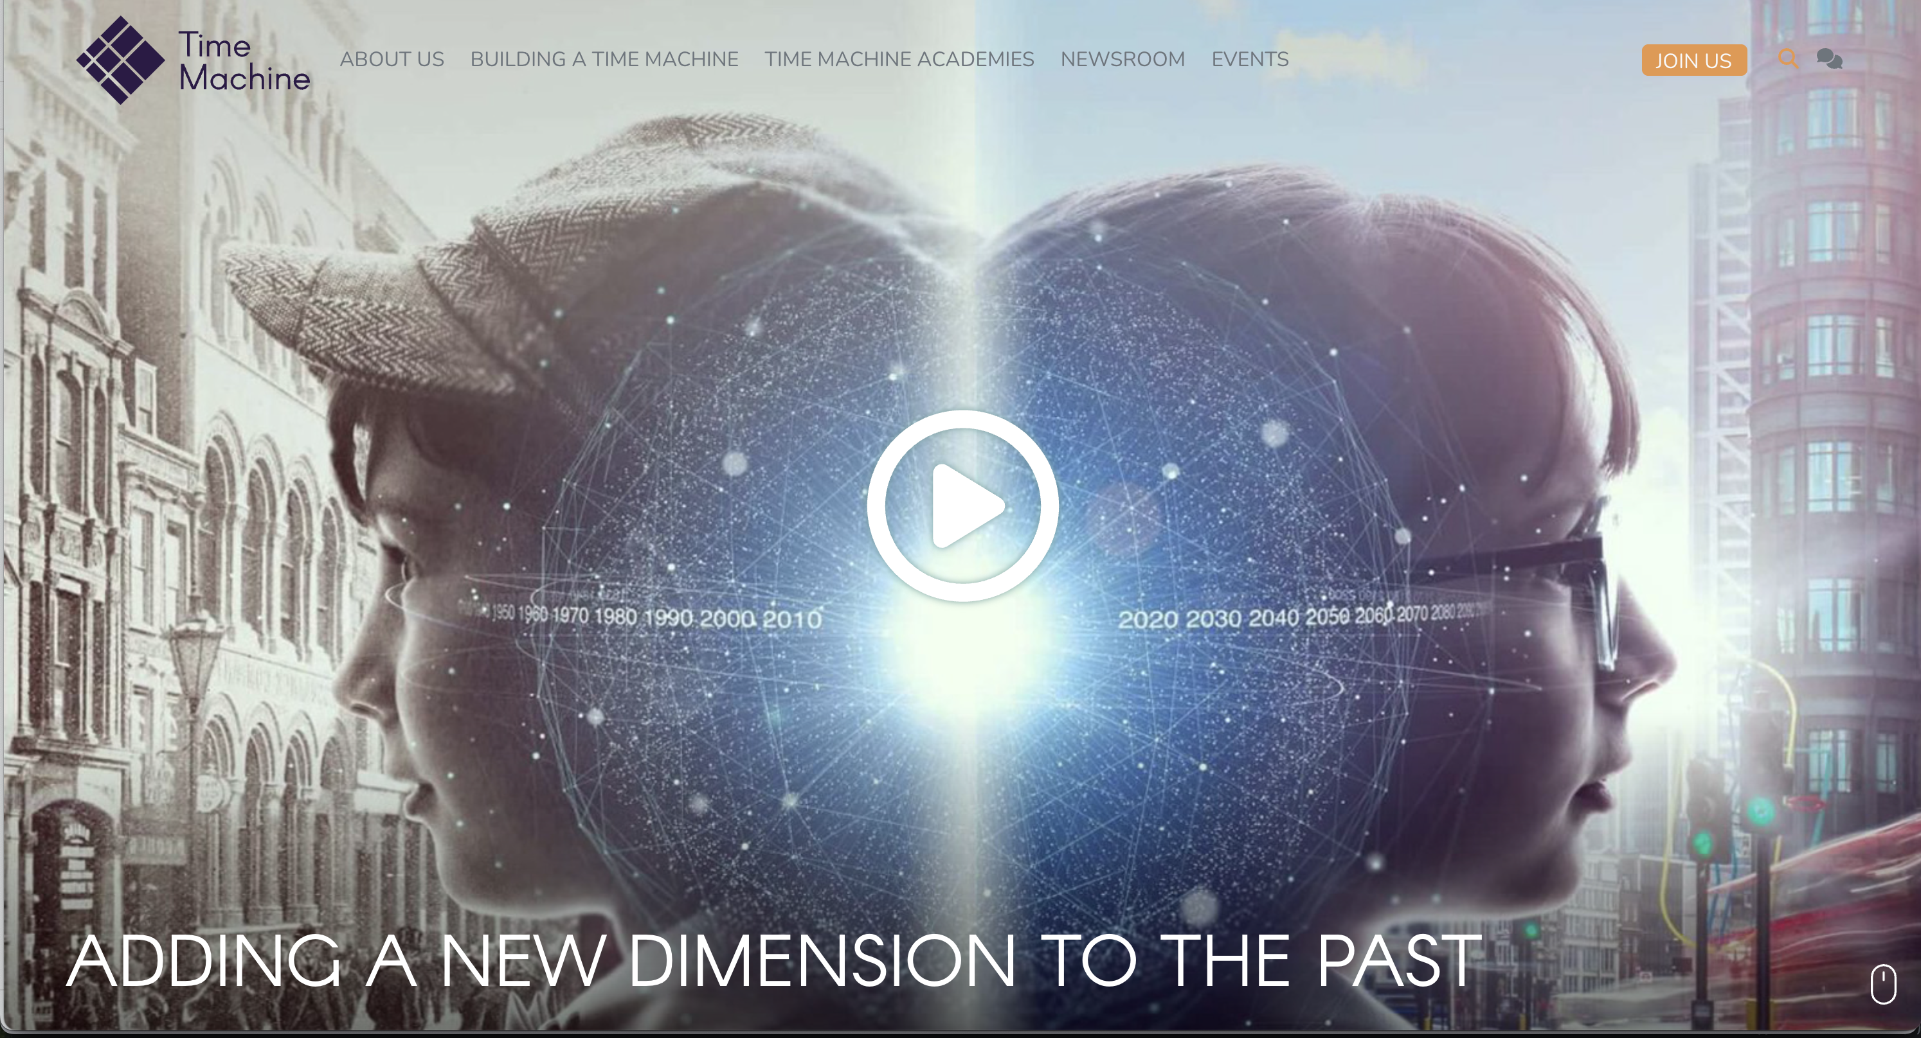
Time Machine
A massive project aiming to build a large-scale digital information system that maps millennia of European historical and geographical evolution, transforming archives and collections into "Big Data of the Past" using advanced AI
https://www.timemachine.eu/

Slide 8
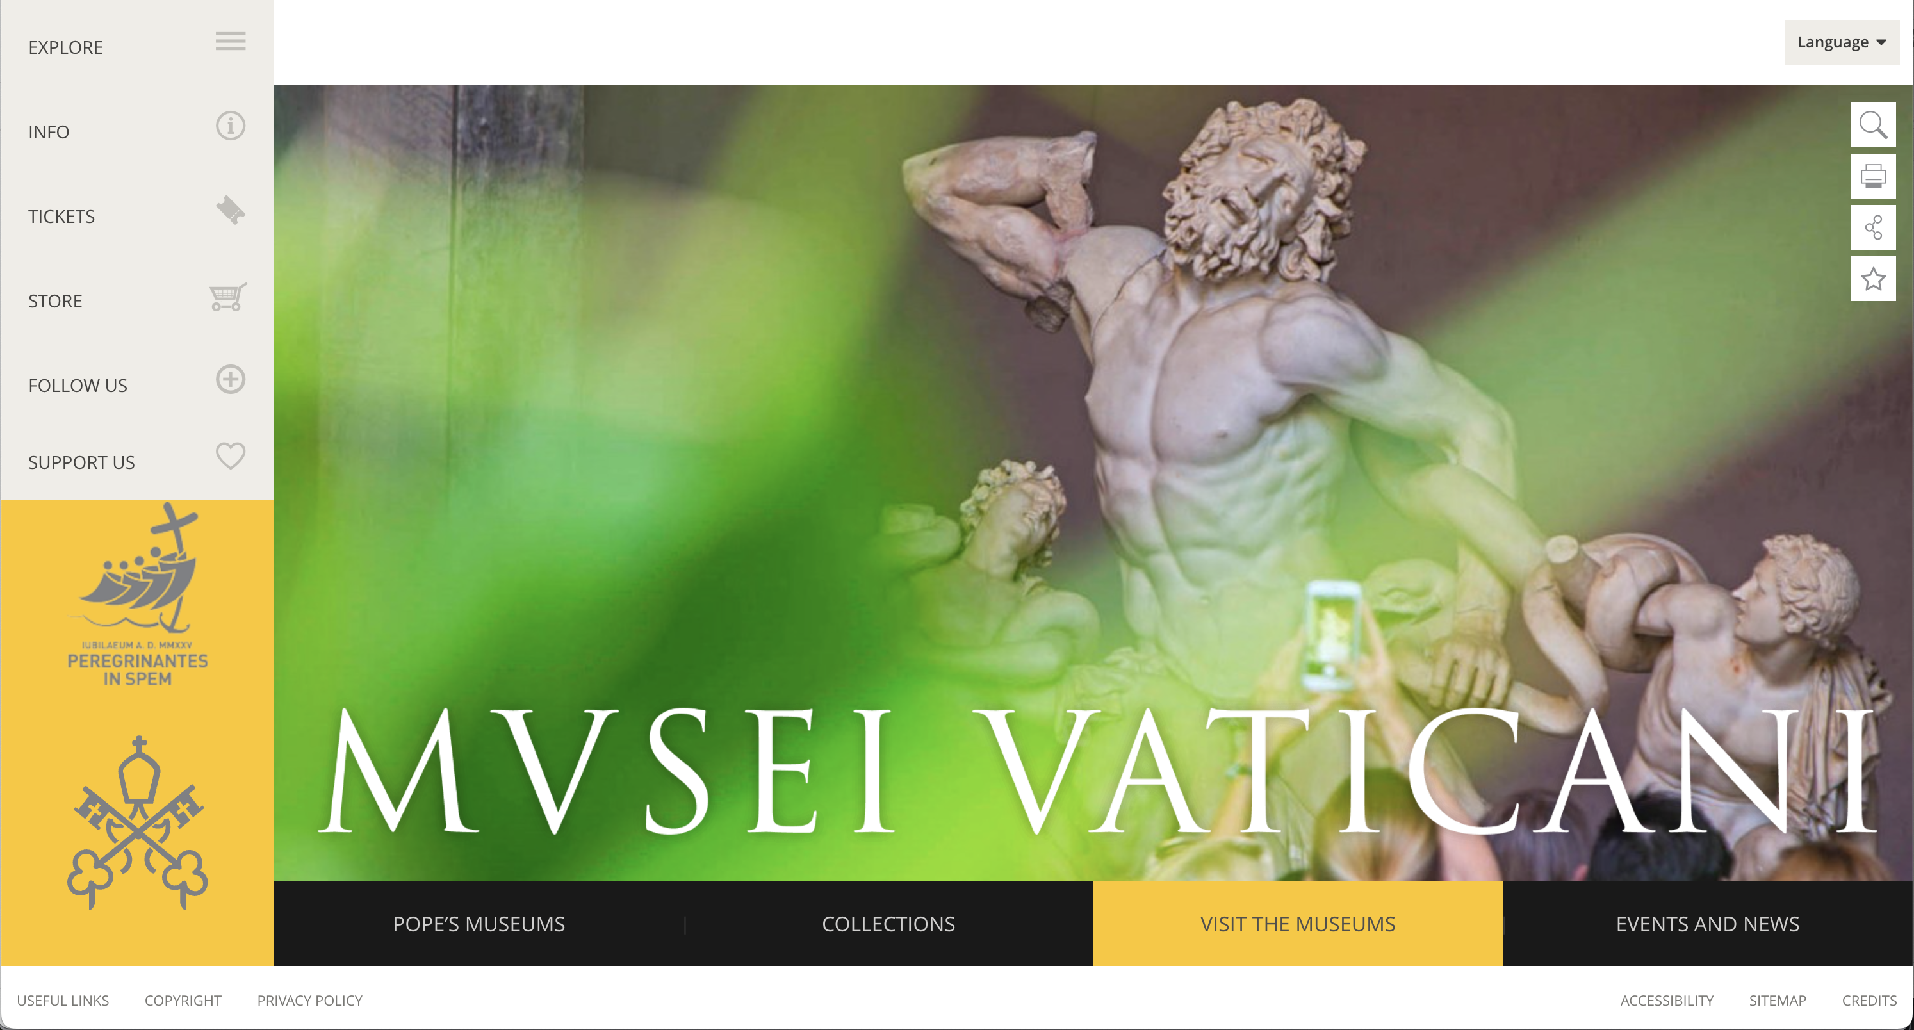
Vatican Museums Online Tours (Sistine Chapel)
Provides high-resolution, 360-degree virtual tours of key sites, most famously the Sistine Chapel.
https://www.museivaticani.va/content/museivaticani/en.html

Slide 9
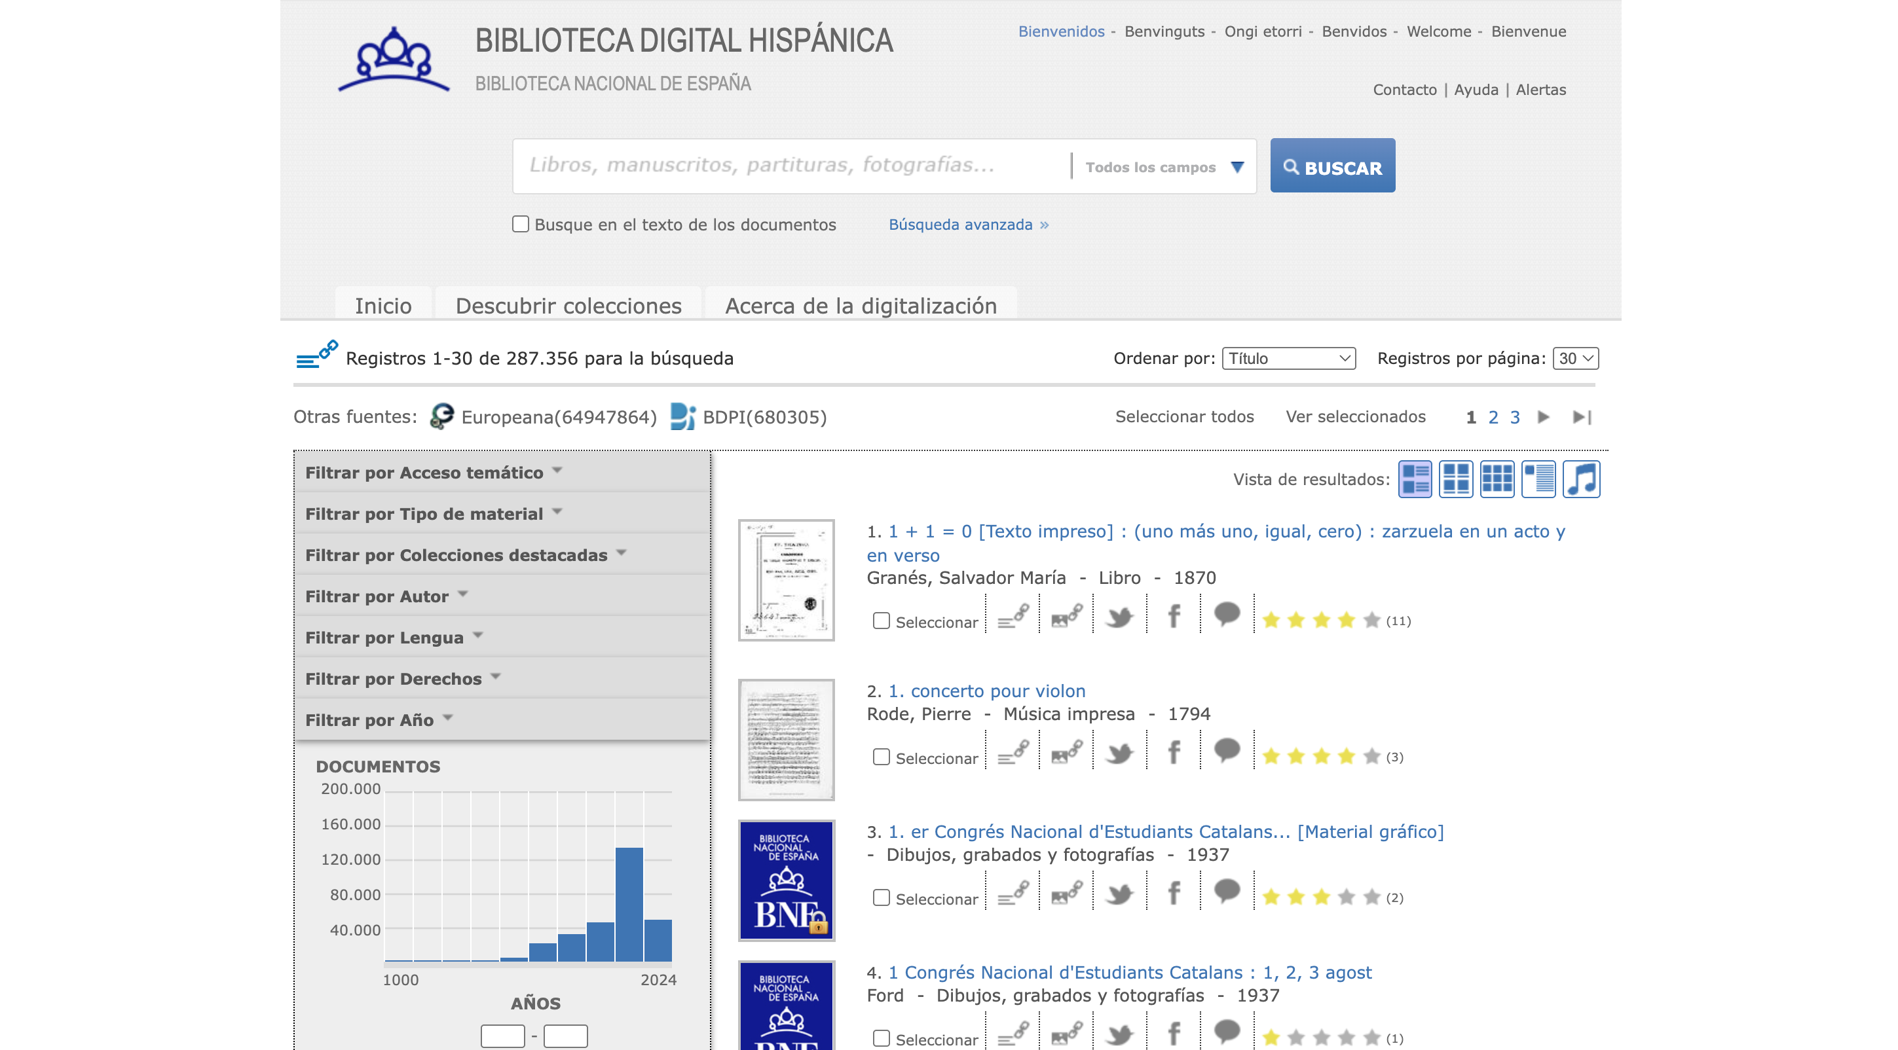
Biblioteca Digital Hispánica
The main hub for digitized Spanish texts, manuscripts, and newspapers.
https://bdh.bne.es/bnesearch/Search.do
Notes:
We can proudly and honestly claim that our research and public money have been well spent. But like every difficult reviewer, after the praise comes…

Slide 10
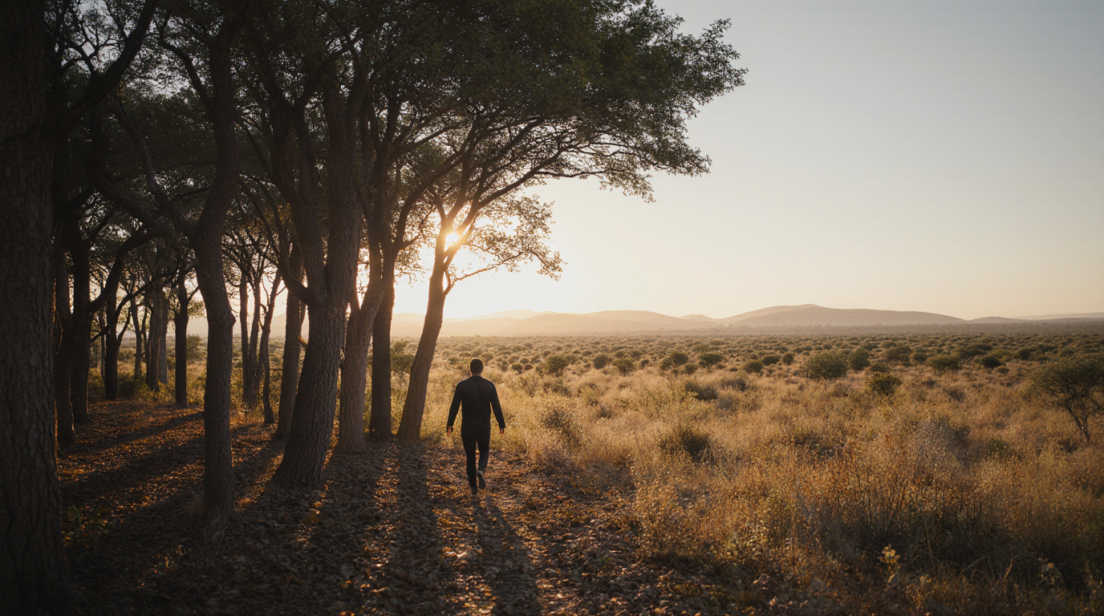
However
Image generated with Krea.ai
Notes:
However…because all such massive and good work has also produced equally big challenges

Slide 11

The Silence of the Data
We have a mountain of isolated digital objects: data silos
The value is in their connections.
Image generated with Krea.ai
Notes:
We have successfully created a mountain of beautiful digital objects, but they remain mostly isolated. We are dealing with decades of siloed digitization efforts, creating a state of fragmentation and poor communication that I call the 'Silence of the Data’. Our digital heritage is indeed a 'precious mosaic of only partially integrated data'. The true, transformative value is not in the individual digital objects, but in the connections between them. This fragmentation is the central challenge that Knowledge Graphs (KGs) were invented to solve.
Message: Massive investment has created a wealth of objects, but the crucial connections between them are missing.

Slide 12
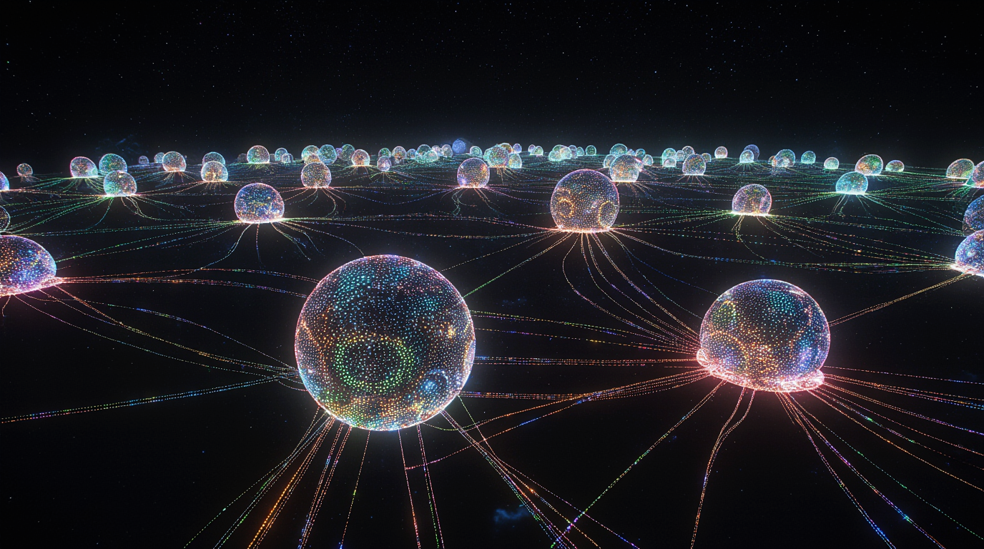
KGs: The Engine of Semantic Interoperability
Knowledge Graphs overcome fragmentation by modelling data as a semantic network.
Image generated with Krea.ai
Notes:
This is where Knowledge Graphs come in. KGs are our most powerful tool to break this silence. They move us beyond the simple linking of records to Semantic Interoperability: the ability for systems to both exchange data and "understand” its meaning. KGs treat data as a rich network of entities and relationships, which allows us to ask sophisticated questions that were previously hard or even impossible. They are the engine for connecting the past.

Slide 13
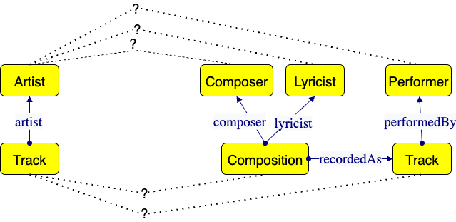
KGs: Modeling Meaning, Not Just Structure
However, this is achievable only if we use KGs to enforce semantic precision.
By modelling distinctions lost in ‘simple’ datasets.
Notes:
However, this is only achievable if we use KGs to enforce semantic precision by modelling distinctions that are lost in simple datasets.
Let me make a simple example. My group and I experienced working with music datasets in the project Polifonia, where we built a network of ontologies and knowledge graphs addressing musical heritage. Of course we wanted to reuse existing datasets and be compliant with their ontology as much as possible.
In some cases, we faced poor modelling, which made the reuse a dataset less impactful then its potential at the moment it was created . For example, the use of a class Artist to identify by whom a certain music track was created or performed. The lack of a clear distinction between composer, lyricist, and performer makes it very hard to align and integrate the data in a model that has such distinctions, such as Polifonia’s. If we fail to model these nuances, any AI system attempting to understand musical authorship will fail. KGs allow us to move from structural integration to modeling shared meaning, if the modelling achieves semantic precision through modelling important distinctions.

Slide 14
The Two Sides of the Problem
Background image generated with Krea.ai

Slide 15

The Iceberg Model: Quality vs. Ethics
Background image generated with Krea.ai
Technical errors are just the visible symptom of deeper, ethical and historical biases embedded in the source material.
Data quality
Ethical flaws
Notes:
Although this is a simple example, it is functional to explain that the problem lies in the perspective of the modeler. Such a perspective is the projection of bias, which can span from a specific project’s requirements or goals to cultural prejudices. The digital problem can be understood with the iceberg methaphor. Above the water is Data Quality: The data is inconsistent and incomplete: the technical flaws we see daily such as missing fields, inconsistent formats, and outright errors. But below the water are the Ethical Flaws: The data is not neutral. It reflects the perspectives and power structures of its creators: the fundamental biases embedded in the original cataloging process. Whose language is used? Whose stories are included? Who was excluded? Whose perspective was dominant? What political context defined the labels used? The true crisis lies below the water. An error in data quality is often a visible symptom of an invisible ethical flaw. We must address both the technical and the philosophical side of the problem.

Slide 16
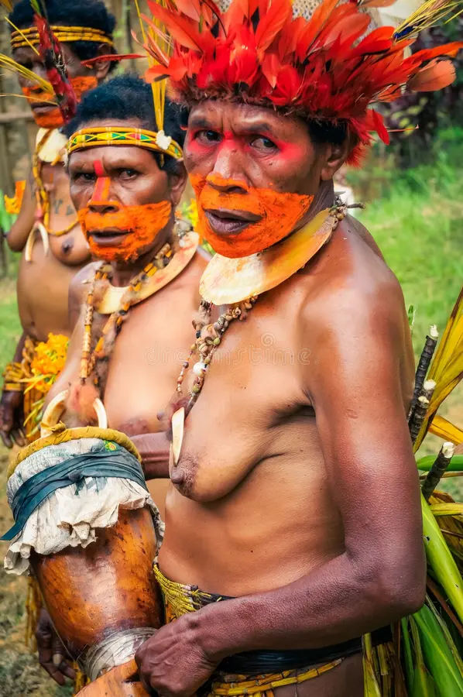
The Ethical Dimension: The Coded Gaze
Bias Definition: Visuality (how we categorize images) is a cultural practice, not a neutral fact.
The result is a 'Coded Gaze’.
See references [9,10]
Notes:
To focus on the ethical side, let's discuss the 'Coded Gaze' (Coded_Visions.pdf). Visuality, how we see and interpret images, is a cultural practice, not a neutral biological one. The labels we assign are heavily culturally coded. The risk is that we are digitizing, and thereby automating, the prejudices of the past. If a historical cataloger uses the term 'Half Naked' to describe an Indigenous person in traditional attire, that label is not a fact; it’s a cultural judgment, stabilizing a contested political category. When we feed this into AI, we teach the AI a coded, biased way of seeing. Similarly, historical records often describe the Benin Bronzes as having been 'collected' in 1897, obscuring the historical reality that they were looted by the British army. We are not just digitizing history; we are automating its dominant, often colonial, narrative.

Slide 17
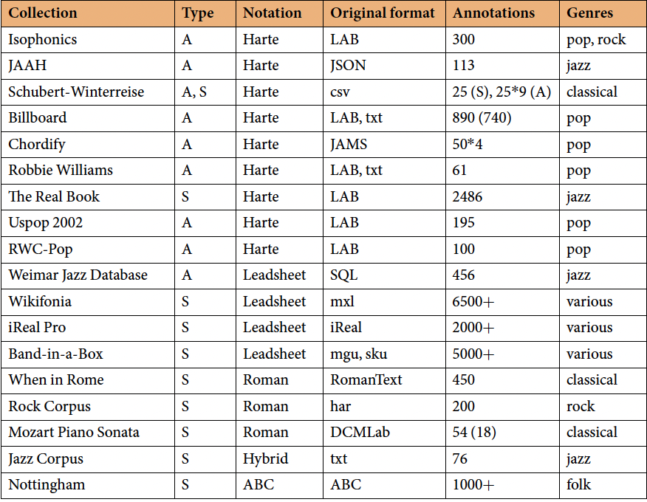
Technical Challenge 1: Extreme Heterogeneity
Problem: Data exists in countless incompatible formats, complicating integration.
Example: ChoCo integrated 18 sources using JAMS, Leadsheet, Roman numerals, ABC, etc.
See reference [11]
Notes:
On the technical front, our biggest headache is Extreme Heterogeneity. Every institution, every project, every domain uses its own formats. In the ChoCo project, a knowledge graph for musical harmony, we faced the challenge of integrating 18 different chord datasets (Choco.pdf). These sources used over half a dozen incompatible representations and formats from the technical JAMS and MusicXML files to specialized notations like Roman numerals and Leadsheet (Choco.pdf). Just reconciling the file formats and schemas is a monumental task before any semantic work even begins.

Slide 18
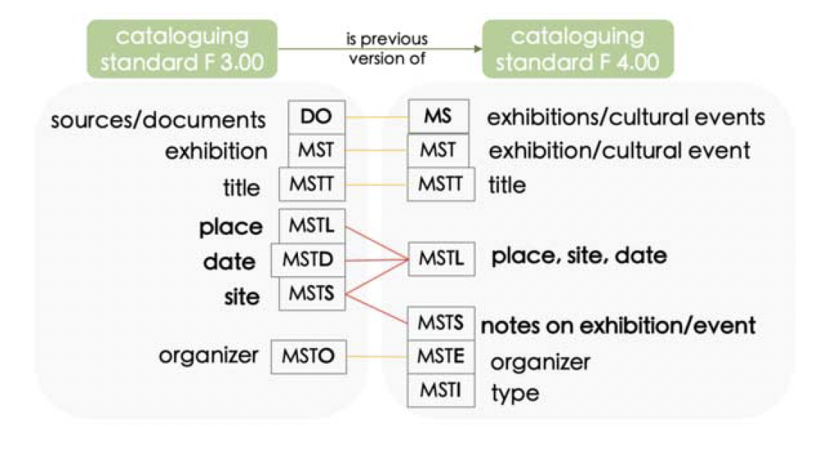
Technical Challenge 2: Inconsistency and Loss
Problem: Inconsistent cataloging and missing metadata due to legacy practices..
Example: ArCo reconciliation of Italian Catalogue records with varying field granularity.
See reference [12]
Notes:
The other technical challenge is Inconsistency and Loss stemming from legacy systems. In the ArCo project (arco.pdf), which harmonized the Italian General Catalogue data, we found rampant inconsistency based on when the record was created. Older catalogue records often had separate, fine-grained fields for place, site, and creation date, while newer records merged them into a single, less-precise field. Reconciling this meant doing 'data archaeology' to align different levels of granularity. This is how crucial metadata, the context, gets lost or obscured.

Slide 19
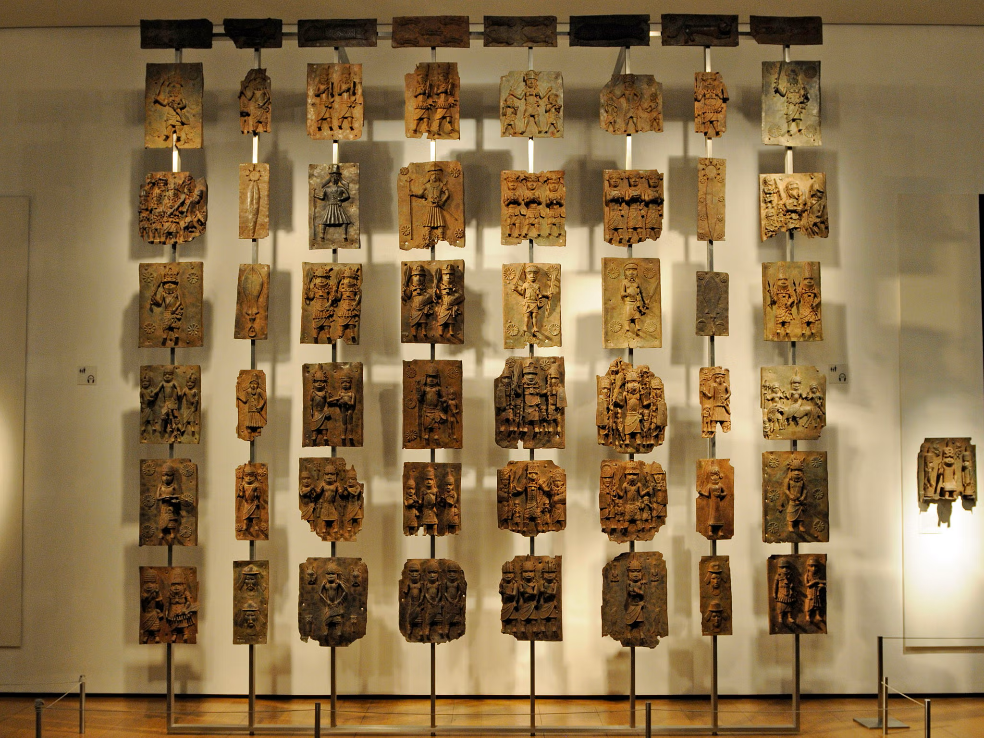
Ethical Example: The Contested Object
Context: Original labels hide political realities.
Example: Documenting the Benin Bronzes as 'collected' in 1897 (hiding the reality of them being looted).
Notes:
Let's use a critical example to connect this to ethics: the Benin Bronzes. If an institutional record describes them as having been 'collected' in 1897, we are using a label that actively obscures the violent historical reality of them being looted by the British army during a punitive expedition. A KG built only on the institutional 'collected' label validates and perpetuates that dominant, whitewashed narrative. Our digital representation must be able to hold multiple, diverse, alternative or contested views.

Slide 20

The Risk of Automating Systemic Bias
Consequence: Without intervention, AI will learn and automate historical and political biases.
This is a profound failure of the digital historian.
Historical Data
______
______
Benin Bronzes
______
______
Flawed, one-sided narratives
______
______
Benin Bronzes were collected in 1897
______
______
Machine learning
model
Notes:
The ultimate risk is that this bias becomes systemic and automated. AI systems used for cultural heritage tasks, for automatic classification, content generation, or recommendation, are only as ethical as the data they are trained on. By feeding them data containing the 'Coded Gaze' or obscured colonial histories, we are essentially automating systemic bias. We are failing in our duty as digital historians to build a fair, inclusive, and multi-vocal representation of the past.

Slide 21
Lessons learned from our projects
Background image generated with Krea.ai

Slide 22
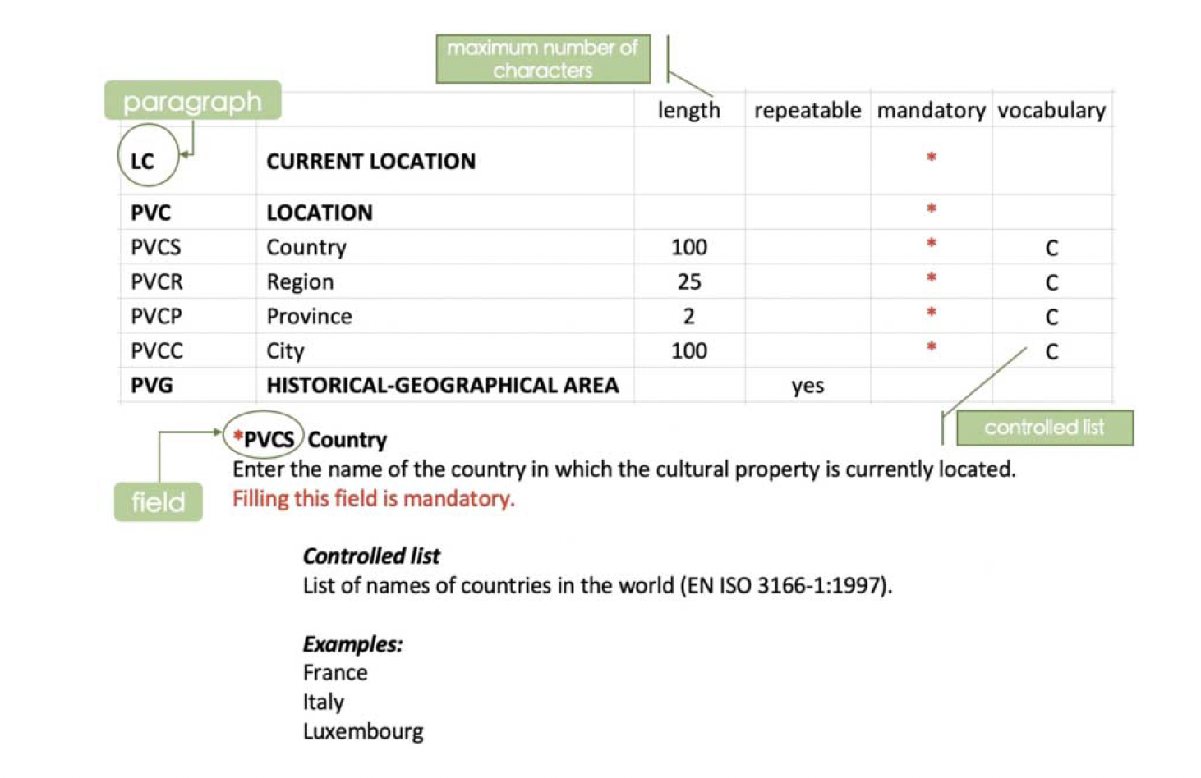
ArCo: The Italian Heritage KG at Scale
Project Scope: Transformed the entire official Italian Cultural Heritage Catalogue into a Knowledge Graph.
See reference [12]
Notes:
We recognized that to tackle the 'Silence of the Data' at a national scale, we needed a robust, fine-grained approach. The ArCo Knowledge Graph (arco.pdf) has been our effort to transform the massive, fragmented official Italian Cultural Heritage Catalogue into a semantically-rich, queryable network. This project was a major feat in data harmonization, moving a vast national repository into the Linked Open Data cloud. The core technical problem was that the original data were mainly expressed as strings. When you want to move from strings to things, there is a lot of work to do on data quality: cleaning, disambiguation, de-duplication. But many conceptual flaws emerge as well.

Slide 23
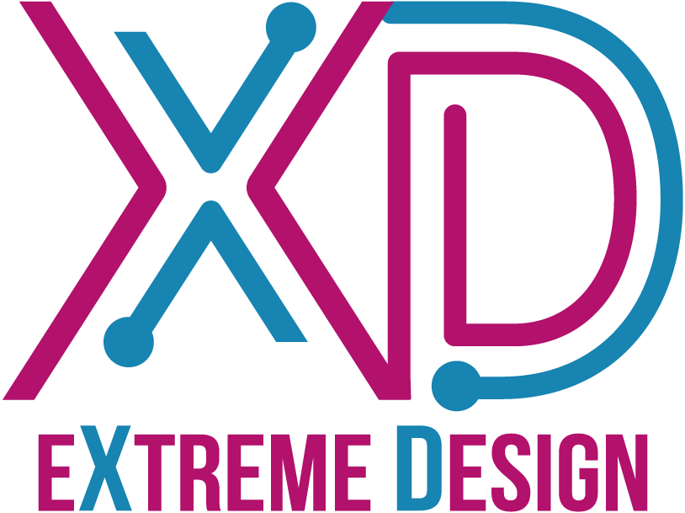
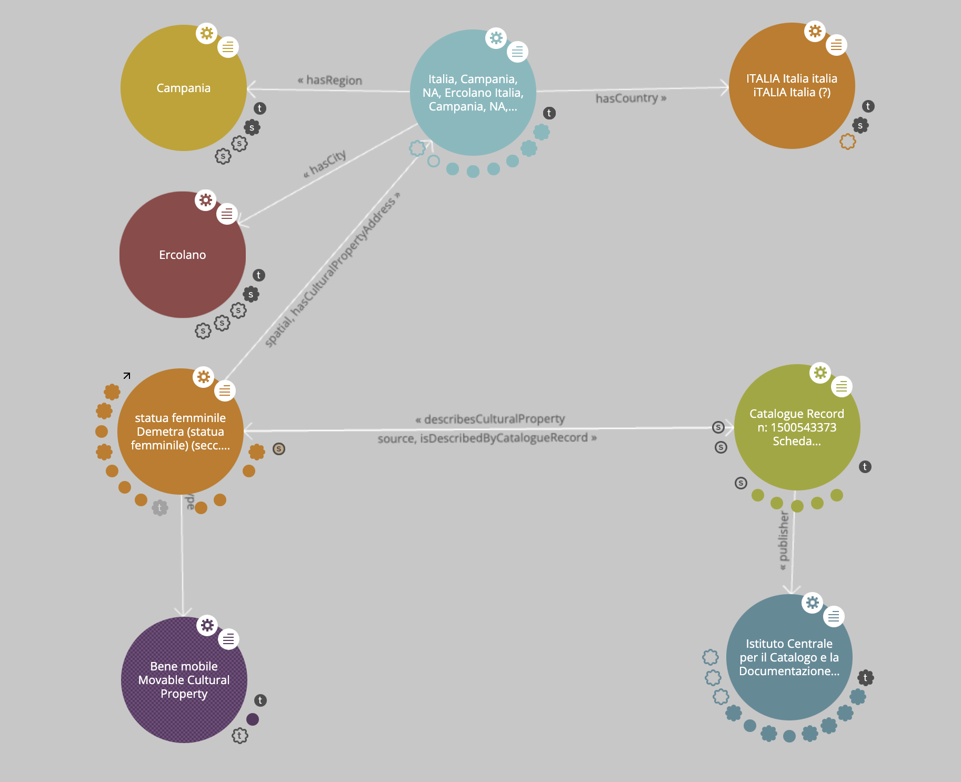
ArCo's Method: The Epistemological Stance
Innovation: Used eXtreme Design (XD) and modelled the difference between Facts, Interpretations, and Reporting Situations.
See reference [12,13]
Notes:
But there was also an “ethical” bias. The first shift was to eliminate the one-only perspective rooted in the catalogue data of catalogue records. Instead of having the cultural property as focus of the model, the system would put, as first-class entity, the catalogue record. A clear symptom of this bias was the existence of several different disconnected catalogue records for the same cultural property.
We decided to adopt the eXtreme Design (XD) methodology, which uses a pattern-based, test-driven approach to ensure high quality from the ground up. ArCo adopts an Epistemological Stance. This means it distinguishes between a raw Fact (e.g., material: wood), the Interpretation of that fact (e.g., attributed author: Leonardo), and the Reporting Situation (the specific catalogue record that asserts the claim). This allows the graph to model the dynamics of knowledge, not just static facts. Through this approach, the model supports the representation of different perspectives associated with their sources.

Slide 24
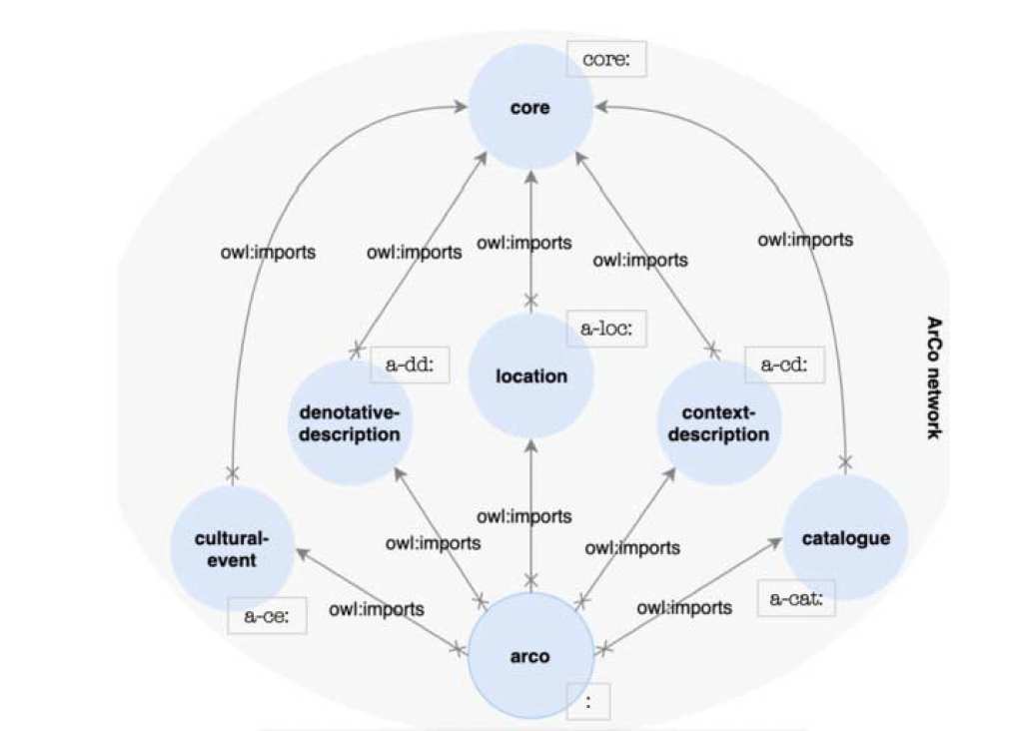
ArCo's Limit: The Single Authoritative View
Shortcoming: Focus on the official catalogue limits the KG to a top-down, institutional view.
The ontology model opens to representing alternative views.
See reference [12]
Notes:
Despite ArCo's robust engineering, it highlighted a profound limitation: its authoritative source is the official General Catalogue. As a result, ArCo is inherently limited to a top-down, institutional view. It successfully models the official facts, but it struggles to capture alternative, contested, or marginalized narratives that fall outside the purview of formal cataloging. We learned that the best engineering methodology in the world cannot fix data that is inherently limited in scope and perspective. In contrast, based on this observation, the model was defined as to allow for enriching the knowledge graph with alternative views in the future or through external connections.

Slide 25
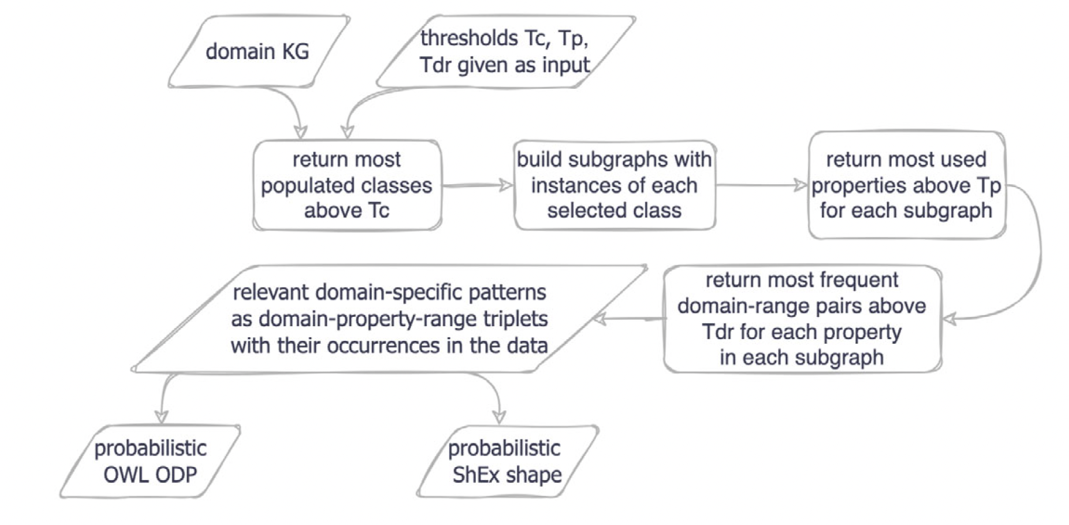
The Need for Empirical Design Patterns
Generalization: To define ontology patterns not only top-down, but empirically from existing KGs.
Approach: frequentist interpretation of probability. Threshold for building domain-property-range triplets. Probabilistic axioms. RDF-star. Shape expressions.
See reference [14]
Notes:
Another lessons learned from working on ArCo is that we can't always design the perfect ontology top-down. Sometimes we must learn from what the community is actually doing, to capture multiple perspectives. Furthermore, there are many knowledge graphs lacking a formal ontology, which hinder reusability and interoperability at the conceptual level. One notable example is Wikidata. This is why we explored a method for Empirical extraction of Ontology Design Patterns (EODPs). Our research analysed ~6M triples from Wikidata with the idea of extracting ontology patterns from observations on the data. We used BabelDomains to select the Wikidata subgraph expressing the music and the art, architecture and archaeology (AAA) domains.
The method extracts empirical patterns from a knowledge graph, with the resulting axioms and constraints depending on the KG and its state at a given time. It utilizes the frequentist interpretation of probability to assign a probability to the extracted constructs based on their regularity (relative frequency) in the data. We identify the most frequent domain-property-range triplets and build patterns based on them, with axioms reflecting the probability of evidence found in the data.
This 'bottom-up' approach, complementing the top-down XD, is essential for building KGs that reflect real-world usage and foster reusability by the broader Linked Data community.

Slide 26
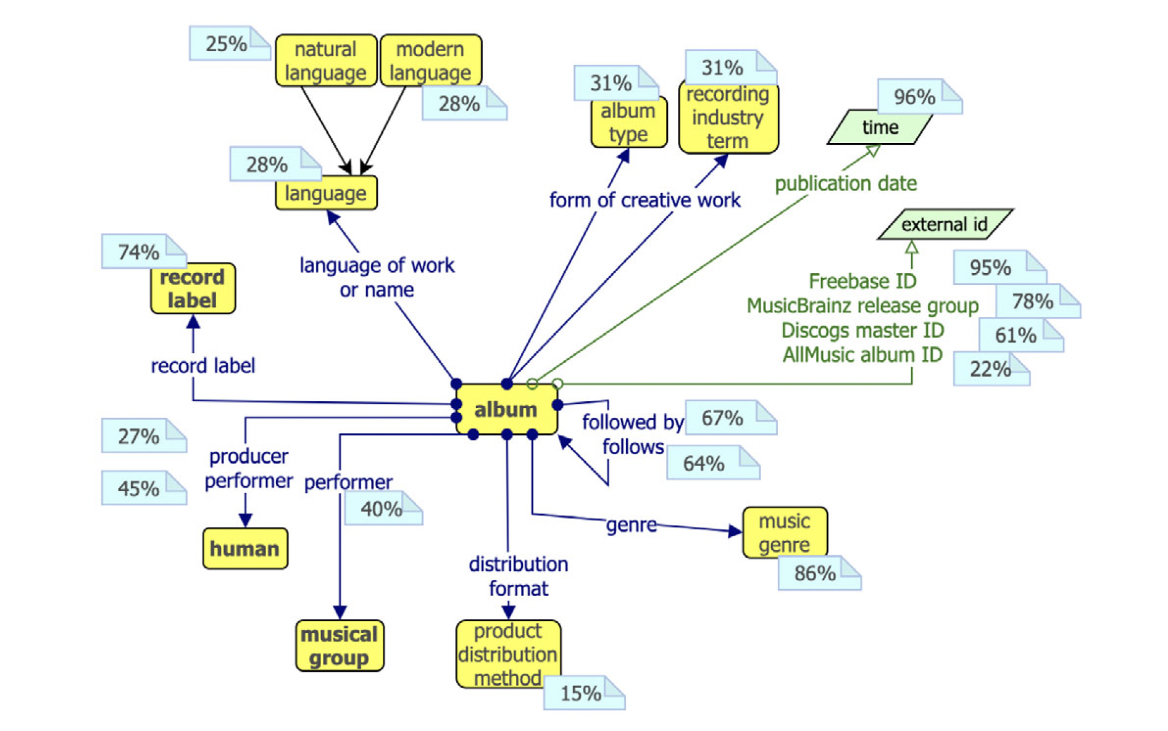
The Need for Empirical Design Patterns
Example: The Album pattern from the Wikidata music subgraph (5,083,818 triples).
Default thresholds: Tc​=0.95 (Class relevance), Tp​=0.85 (Property frequency), and Tdr​=0.5 (Range frequency).
Selected class: wd:Q482994 (album) with 63,213 instances
Album subgraph: 723,722 triples.
Selcted properties: 14 were selected, including wdt:P175 (performer).
Ranges for wdt:P175: human (wd:Q5) (Prob: 44.62%); musical group (wd:Q215380)⟩ (Prob: 40.39%)
See reference [14]
Notes:
A simple example demonstrating the flow uses the extraction of the Album pattern (wd:Q482994) from the Wikidata Music Subgraph (which contained 5,083,818 triples). The default thresholds used for this experiment were Tc​=0.95 (Class relevance), Tp​=0.85 (Property frequency), and Tdr​=0.5 (Range frequency)
The class threshold is computed as the absolute distance between the number of instances of a given class and the number of instances of the most populated class in the entire knowledge graph (KG) or domain subgraph.

Slide 27
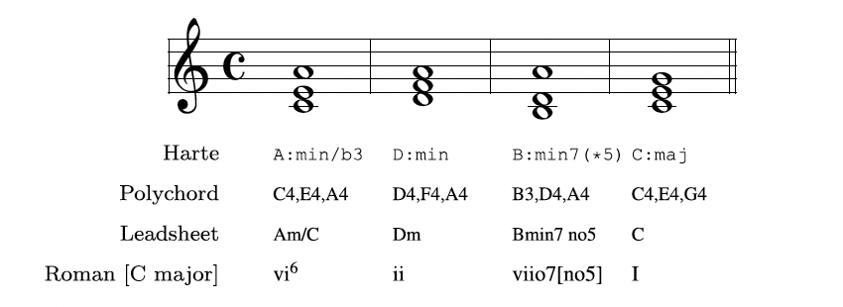
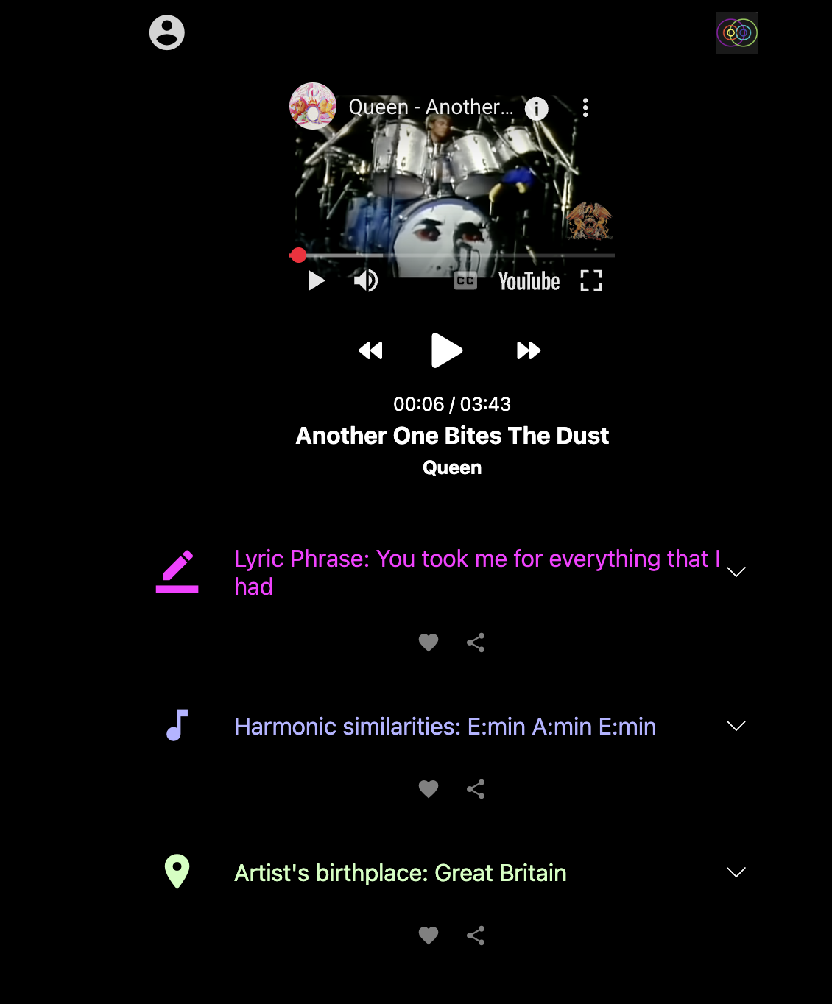
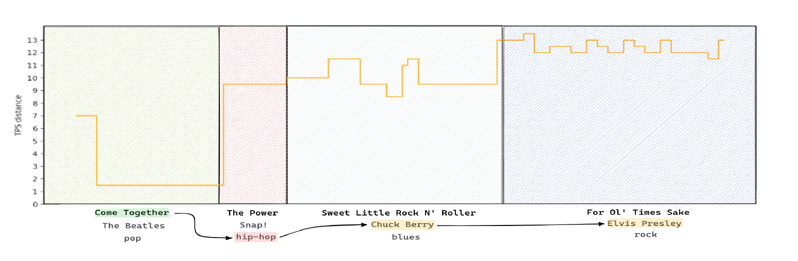
ChoCo: Unlocking Musical Harmony
Project Scope: Integrated 18 disconnected chord datasets to enable large-scale music analysis and AI research.
Example applications and research results based on cross-corpus analysis enables by ChoCo:
Semantic Music Player. [15]: augmented listening experience based on harmonic similarities
Harmonic Memory [16]: music similarity networks and their investigation using network data analysis techniques
See reference [11]
Notes:
Moving to a different domain, the ChoCo project (already mentioned earlier) tackled the fragmentation of musical harmony data. Researchers (musicologists, music historians, etc.) were hampered by dozens of small, incompatible chord datasets. Our goal was to integrate these into a single KG of 30 Million Triples, with over 4,000 links to external entities. This unlocked the ability to do large-scale, cross-corpus studies on harmony across genres and time, which was previously impossible. The knowledge graph was adopted very early by the community of music information retrieval, which was eager to have access to such a large, integrated, curated dataset

Slide 28
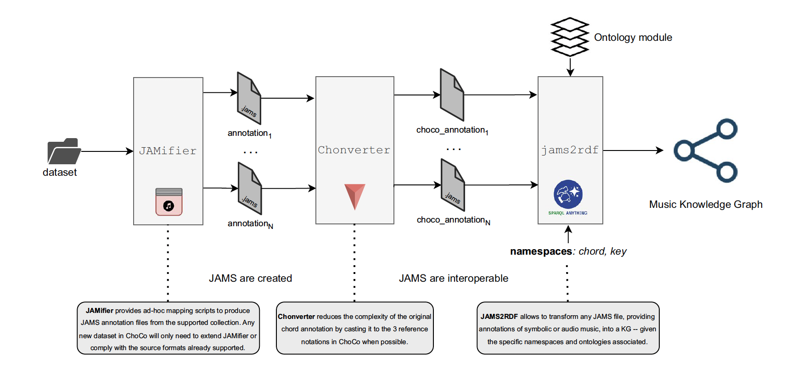
ChoCo's Workflow: Standardizing Notations
Method: The JAMifier standardises formats; the Chonverter converts diverse notations (e.g., Leadsheet to Roman numerals).
See reference [11]
Notes:
The technical innovation was our three-step Data Transformation Workflow. The JAMifier addressed the heterogeneity, standardizing the file formats into a consistent structure. It ingests chord collections (where metadata and music annotations follow collection-specific conventions and formats) to generate a JAMS dataset. This achieves two integration levels, as all metadata are consistently reorganised, and the music annotations (i.e. chord progressions, in this case) are all encoded and stored in separate JAMS files – one per track/score. But the real semantic challenge was the notation. Different sources used different conventions (Leadsheet, Roman numerals, Harte). The Chonverter component converts these diverse notations into a common, reference system, finally achieving a unified view of musical harmony across all sources. Finally, jams2rdf leverages notation-specific ontologies to generate RDF triples and create a Music Knowledge Graph

Slide 29
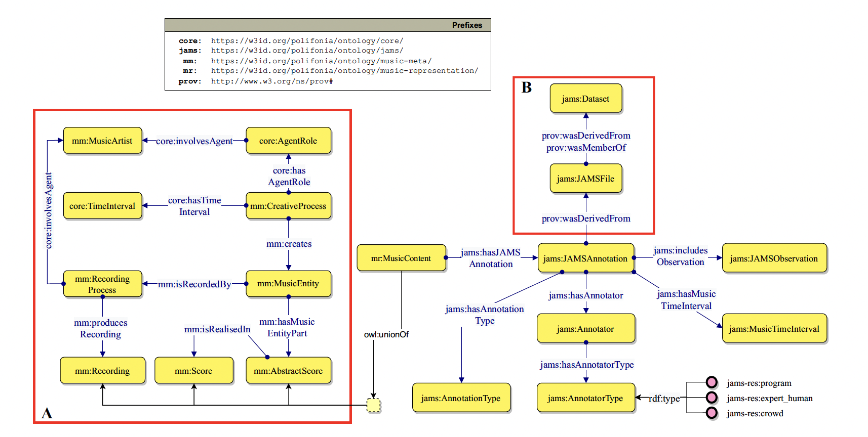
ChoCo's Limit: missing provenance data
Shortcoming: Success was largely structural.
Provenance: The Jams ontology models the provenance of annotations, but the datasets have a provenance gap (3.9% provenance info).
Provenance is key to capture the subjectivity of the annotations.
See reference [11]
Notes:
ChoCo taught us that structural interoperability is not enough. We struggled to capture the human element. For only 3.9% of the chord annotations did we know the who behind the data: who the original annotator was, their background, or when they did the work (Choco.pdf). This is a Provenance Gap. We know also from other studies that annotation is subjective: different experts label the same song differently. If we can't model that subjectivity, we risk treating highly subjective data as objective fact.

Slide 30
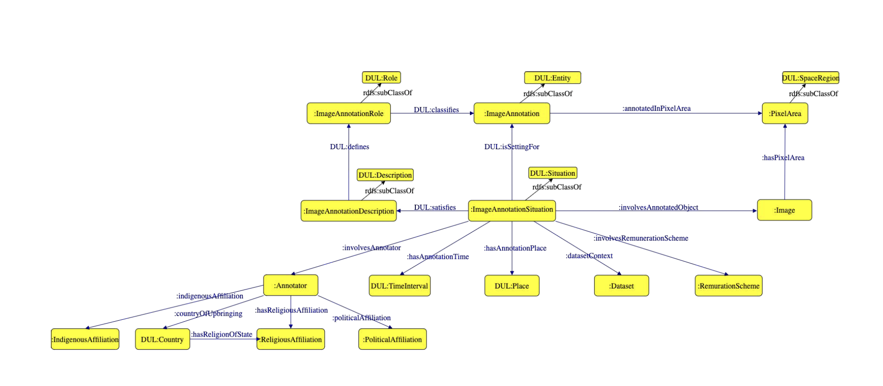
Modeling the Annotation Situation
Solution: Make bias explicit by modelling the context of data creation.
Move from asserting Facts to Contextualising Beliefs.
This pattern captures Who, When, and For What Purpose the label was created, allowing contested views to co-exist.
See reference [9]
Notes:
The problem is not the existence of bias, but its invisibility. The solution is to make the subjectivity and context explicit. We address this, for example in the visual context – but generalisable to other domains - with the Image Annotation Situations (IAS) ontology (Coded_Visions.pdf). Instead of asserting that an image is 'Half Naked', we model the entire Situation. We move from asserting facts to contextualizing beliefs.
This pattern captures the crucial contextual properties: Who made the annotation (e.g., 'Curator A'), When was it made (e.g., '1970 Cataloguing Project'), and For what purpose (e.g., 'Insurance Valuation'). By modelling the Annotation Situation, we can simultaneously represent the institutional view, the historical view, and the community view of the same object. For example, the Benin Bronze object is both 'In the British Museum' and 'Subject to Repatriation Claim'. We transform an exclusionary, one-sided graph into a multi-vocal, contestable graph.

Slide 31
Present and future…
Background image generated with Krea.ai

Slide 32



A Collective Vision: The Virtuous Projects
Context: Our work sits within a larger, global, virtuous movement towards standards and linked data.
See references [4,18,19,20]
Notes:
We are not working in a vacuum. This challenge has spurred a collective response across the globe. Projects like Europeana are pioneering metadata standardization at a continental scale. The Getty Vocabularies provide the fundamental semantic frameworks we all build upon. And the broad Linked Open Data Cloud movement is connecting archives and museums globally. This signals a shift in focus: from simple digitization to creating semantically rich, connected, and ethical data.

Slide 33




The European Policy Context
Policy: The ECCCH and DS4CH are strategic opportunities to build a trustworthy digital ecosystem.
Emphasis: FAIR principles, ethical and multi-contextual enrichment of cultural heritage data.
See references [21,22,23,24,25]
Notes:
This collective effort is now formalized at the highest level through European policy. The European Collaborative Cloud for Cultural Heritage (ECCCH) and the Common European Data Space for Cultural Heritage (DS4CH) are twin initiatives designed to accelerate digital transformation. These are not just technology platforms; they are policy frameworks emphasising FAIR principles (Findable, Accessible, Interoperable, Reusable), and the imperative for ethical, multi-contextual enrichment of metadata. This is the strategic context for our future work. A number of sibling projects are being funded to contribute to develop the ECCCH. Some are starting in 2026 and another round is coming in 2027.

Slide 34
INFINITY: The Next-Generation Ecosystem for ethical, multi-perspective ECCCH
Budget: ~6M €
Duration: 42 months (starting on January 2026)
Partners: UniBo, CNR, Italian Ministry of Culture, DigitalPaths (IT), StoryPact, AIT, Time Machine (AT), Jena Univ, Fact&Files (DE), Europeana, Sound and Vsion (NL), POLSKIEJ Univ., WROCŁAWSKI Univ (PL), Edimburgh Univ (UK), EIT CULTURE & CREATIVITY (ES), EPFL (CH).
An innovative ecosystem of tools, ontologies and knowledge graphs
to make multi-perspectivity and ethical practice the default.
Ethics-Driven Design
Operationalising ethics of data
Embedding ethics and multi-perspectivity in digital object lifecycles, ontologies, knowledge graphs, and AI-supported processes
Multidimensional KGs
Capturing shift of meaning and associations of entities across contexts and viewpoints
Notes:
Unfortunately, I cannot present here results and solutions to this paramount problem, but
among the projects starting in 2026 there is the INFINITY project that I have the opportunity and challenge to coordinate. So I look forward to meeting you in 4 years and hopefully have evidence that something has changed also thanks to this collective effort.
INFINITY is an Horizon Europe Innovation project, designed to directly support the ECCCH and DS4CH. It’s an ecosystem of tools that embed ethics, data provenance, and diverse perspectives natively into the entire digital object lifecycle. We aim to make multi-perspectivity and ethical practice the default. It stands on two innovation pillars/objectives:
The Multidimensional Knowledge Graph (mKG). A mKG must be designed to handle how the meaning of a heritage object changes across dimensions: time, space, cultural group, and legal context. For instance, an mKG can model the historical significance of a site, its current legal status (IPR ownership), and its socio-political meaning to a local community, all at the same time. This is how we provide a nuanced, holistic view of heritage. It must simultaneously represent: the institutional narrative ('collected' in 1897), the historical narrative ('looted' during a punitive expedition), and the community narrative (its spiritual significance and repatriation calls). This allows us to query not just what an object is, but how it is understood/perceived from different viewpoints, making contested histories visible and analyzable.
Ethics-driven design: meaning that we need to understand and operationalise the meaning of data ethics and embed it in digital object lifecycles, AI-based software, ontologies and knowledge graphs.

Slide 35

Challenges
Image generated with Krea.ai
Scalable Quality Assessment
Transition from validating individual projects to ensuring quality across a federated, billion-triple ecosystem.
Notes:
These goals go along with significant open challenges. The first is Scalable Quality Assessment. ArCo's quality control was feasible because it was a single source. But how do we ensure quality across a dynamic, federated ecosystem like the ECCCH, which will contain billions of triples from thousands of partners? We need advanced, automated tools for error provocation, consistency checking, and bias detection that can work at this massive scale.

Slide 36
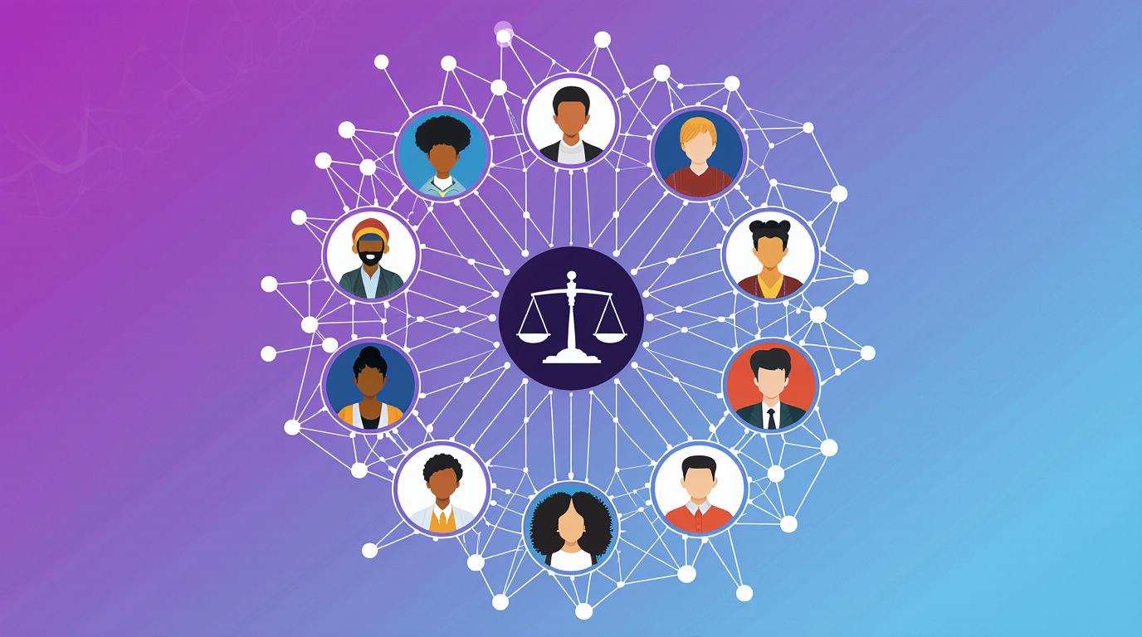
Challenges
Image generated with Krea.ai
Scalable Quality Assessment
Transition from validating individual projects to ensuring quality across a federated, billion-triple ecosystem.
Ethical Governance
We need community-wide standards that generalize principles like the CARE principles for Indigenous data.
Notes:
We need standards generalising ethical principles, like the CARE principles for Indigeneous data.

Slide 37

Challenges
Image generated with Krea.ai
Scalable Quality Assessment
Transition from validating individual projects to ensuring quality across a federated, billion-triple ecosystem.
Ethical Governance
We need community-wide standards that generalize principles like the CARE principles for Indigenous data.
AI Robustness and Semantic Drift
We must prevent AI from replicating biases and address semantic drift (concepts changing meaning over time).
Notes:
Another major challenge is ensuring AI Robustness and Mitigating Semantic Drift. AI must not simply replicate historical biases, and this requires constant monitoring. A specific technical risk is semantic drift: the meaning of concepts changes over time (e.g., the word 'artist' today versus the 18th century). Our mKGs and AI models must be able to evolve to capture these shifts and provide Explainability (XAI), so human experts can trust and verify the AI's data enrichment suggestions.

Slide 38
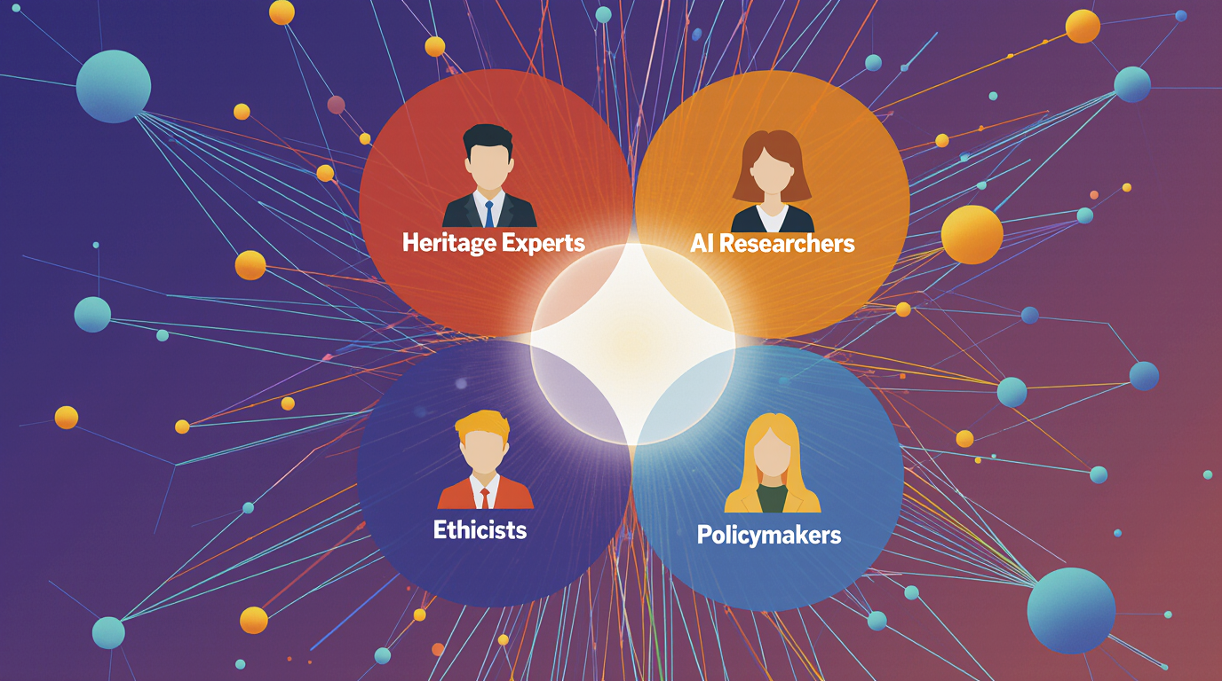
Challenges
Image generated with Krea.ai
Scalable Quality Assessment
Transition from validating individual projects to ensuring quality across a federated, billion-triple ecosystem.
Ethical Governance
We need community-wide standards that generalize principles like the CARE principles for Indigenous data.
AI Robustness and Semantic Drift
We must prevent AI from replicating biases and address semantic drift (concepts changing meaning over time).
Cross-Disciplinary Integration
Closing the gap between technology and the humanities: Heritage Experts + AI Researchers + Ethicists + Policymakers
Notes:
True Cross-Disciplinary Integration. This is not a problem that computer science can solve alone. It requires deep, sustained partnership: Heritage experts who understand the nuance of the source material; AI researchers who can build the tools; Ethicists who can ensure fairness; and Policymakers who can set the standards. Cultural institutions must develop in-house digital competencies to adopt and steer these technologies, not simply receive them.

Slide 39

Collective responsibility
Background image generated with Krea.ai
This work requires a fundamental shift in mindset:
moving from isolated projects to a shared infrastructure and ethical framework.
Notes:
In short, we are moving from a world of isolated projects to a shared, high-stakes infrastructure. This shift demands a corresponding shift in our mindset: recognizing that the quality of our data is a shared and collective responsibility. We must transition from an ad-hoc approach to one built on engineering solidity, ethical frameworks, and cross-domain collaboration to ensure the integrity of our digital memory.

Slide 40

The Take-Home Message
Image generated with Krea.ai
KGs are Vulnerable
Quality and ethical flaws are systemic.
Notes:
Let me leave you with three messages. First: Cultural Heritage KGs are powerful, but profoundly vulnerable. Their integrity depends entirely on the ethical and technical quality of the data. The technical and ethical flaws we've uncovered in ArCo and ChoCo are systemic, not accidental.

Slide 41

The Take-Home Message
Images generated with Krea.ai
KGs are Vulnerable
Quality and ethical flaws are systemic.
Quality is Ethical
We are curators of digital memory.
Notes:
Second: Data quality is an ethical act of curation. How we choose to model and represent heritage actively shapes cultural narratives and the reliability of AI. We are not just cataloguers; we are curators of digital memory.

Slide 42

The Take-Home Message
Images generated with Krea.ai
KGs are Vulnerable
Quality and ethical flaws are systemic.
Quality is Ethical
We are curators of digital memory.
Collective Effort is Key
Collaboration and shared standards are the only path forward.
Notes:
Third: Building a trustworthy digital heritage requires a collective effort. Initiatives like ECCCH, and DS4CH provide the framework, but the execution requires all of us, the researchers, the curators, and the policymakers, to work together toward shared, rigorous standards.

Slide 43

The Take-Home Message
Background image generated with Krea.ai
Heritage is not only what we preserve, but how we represent it
Notes:
In closing, let’s revisit the question: 'What happens when AI learns from a broken memory?' The answer is simple: we create a broken future. Our work is the fix. Let's ensure our digital representations are as rich, diverse, and honest as the cultures they reflect. The truth is that: 'Heritage is not only what we preserve, but how we represent it.' Thank you.

Slide 44
Thank you very much for your attention!
Background image generated with Krea.ai

Slide 45
References
[1] Cultural Heritage and Cultural and Creative Industries (CCIs): https://research-and-innovation.ec.europa.eu/research-area/social-sciences-and-humanities/cultural-heritage-and-cultural-and-creative-industries-ccis_en
[2] Digital strategy and platforms for cultural heritage: https://www.italiadomani.gov.it/en/Interventi/investimenti/strategia-digitale-e-piattaforme-per-il-patrimonio-culturale.html
[3] Recovery, Transformation and Resilience Plan: https://www.fondoseuropeos.hacienda.gob.es/sitios/dgpmrr/en-gb/paginas/plan.aspx
[4] Europeana: https://www.europeana.eu/en
[5] House of European History - Virtual tour: https://historia.europa.eu/en/digital-offer/virtual-tour
[6] Time Machine: https://www.timemachine.eu/
[7] Vatican Museums Online Tours: https://www.museivaticani.va/content/museivaticani/en.html
[8] Biblioteca Digital Hispánica: https://bdh.bne.es/bnesearch/Search.do
[9] Delfina Sol Martinez Pandiani and Valentina Presutti. "Coded Visions: Addressing Cultural Bias in Image Annotation Systems with the Descriptions and Situations Ontology Design Pattern." 6th International Conference of Graphs and Networks in the Humanities 2022.
[10] Buolamwini, J. and T. Gebru (2018). Gender shades: Intersectional accuracy disparities
in commercial gender classification. In Conference on fairness, accountability
and transparency, pp. 77–91. PMLR
[11] de Berardinis, J., Meroño-Peñuela, A., Poltronieri, A. et al. ChoCo: a Chord Corpus and a Data Transformation Workflow for Musical Harmony Knowledge Graphs. Sci Data 10, 641 (2023). https://doi.org/10.1038/s41597-023-02410-w
[12] Valentina Anita Carriero, Aldo Gangemi, Maria Letizia Mancinelli, Andrea Giovanni Nuzzolese, Valentina Presutti, and Chiara Veninata: Pattern-based design applied to cultural heritage knowledge graphs: ArCo: The knowledge graph of Italian Cultural Heritage: ArCo: The knowledge graph of Italian Cultural Heritage. Semantic Web: – Interoperability, Usability, Applicability. 2021;12(2):313-357.
[13] Extreme Design: https://extremedesign.info/
[14] Valentina Carriero, Paul Groth, Valentina Presutti. Empirical ontology design patterns and shapes from Wikidata. Semantic Web: Interoperability, Usability, Applicability. 2024;15(6):2293-2317. doi:10.3233/SW-243613
[15] Semantic music player - Sonar demo: https://polifonia-project.github.io/sonar2021_demo/home
[16] Jacopo de Berardinis, Albert Meroño-Peñuela, Andrea Poltronieri, and Valentina Presutti. 2023. The Harmonic Memory: a Knowledge Graph of harmonic patterns as a trustworthy framework for computational creativity. In Proceedings of the ACM Web Conference 2023 (WWW '23). Association for Computing Machinery, New York, NY, USA, 3873–3882. https://doi.org/10.1145/3543507.3587428
[17] Getty Vocabularies as LOD: https://www.getty.edu/research/tools/vocabularies/lod/index.html
[18] The Linked Open Data cloud: https://lod-cloud.net/
[19] The Digital Research Infrastructure for the Arts and Humanities: https://www.dariah.eu/
[20] Common Data Space for Cultural Heritage: https://www.dataspace-culturalheritage.eu/en
[21] European Collaborative Cloud for Cultural Heritage: https://research-and-innovation.ec.europa.eu/research-area/social-sciences-and-humanities/cultural-heritage-and-cultural-and-creative-industries-ccis/cultural-heritage-cloud_en
[22] ECHOES - European Cloud for Heritage OpEn Science: https://www.echoes-eccch.eu/
[23] Textile - Digitisation tools and methods for cultural heritage / ECCCH: https://textailes-eccch.eu/
[24] Heritalise - Heritage Buildings and Objects Digitisation
& Visualisation within the Cloud: https://heritalise-eccch.eu/
[25] AUTOMATA - AUTOMated enriched digitisation of Archaeological liThics and cerAmics: https://automata-eccch.eu/

Slide 46
Credits:
Background image generated with Krea.ai
Valentina Presutti
University of Bologna
valentina.presutti@unibo.it

