Slide 1
Recommendation Systems in Scholarly Publishing
Yannis Manolopoulos
Open University of Cyprus
15th IC3K Conference
November 2023, Rome
Notes:
Good morning to all and thank you for the generous introduction
Le me tell you a short story.
When I received this invitation, I did not want to repeat one of the two talks that I had delivered a few times each. So, I decided to make an effort for a brand new talk. I hope that during the next hour I will succeed in attracting your interest.
My current affiliation is with the Open university of Cyprus. The biggest part of my research contributions was delivered when I was affiliated with the Aristotle University of Thessaloniki. My lab was focusing in data management, which means classical databases, data mining, data warehouses, data structures, data science in general, and finally Scientometrics, which is my hobby.
This is how I came up with this title, which has 2 distinct components: “recommendation” and “scholarly publishing”

Slide 2
Presentation Menu
Recommendation Systems
Information age and Social networks
Challenges and Data representation
Scientometric Entities
Abundance of Scholarly Data
Taxonomy
Statistics
Approaches on the Intersection
Citation
Supervisor
Journal
Venue
Bias in Recommenders
Further Reading
Notes:
This is the outline of the presentation.
In the first two parts I am going to introduce some basic concepts about the two pillars: recommendation and scientometric entities. In particular, in the second part, I am going to deliver some statistics and show tendencies.
In the third part, I am going to present some characteristic approaches related to the above scientometric entities, like an
anthology. And “last but not least”, I will touch questions about biases.
The literature is already vast, and grows further. At the end, I will mention some interesting articles/surveys, for further reading.

Slide 3
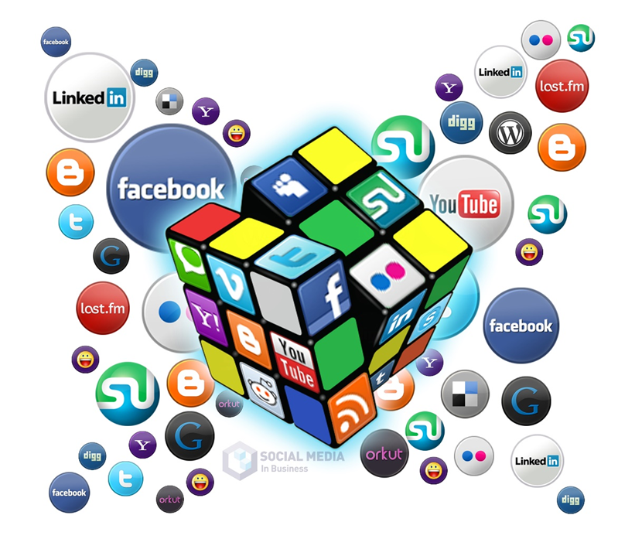
Information Age and Social Networks
Plethora of available information online
Increase in web traffic, new domains
Emergence of social networks
Emergence of recommender systems
Notes:
We all know the discussion about the so-called 4th industrial revolution. The main driving force, the main asset, is the concept of information, or data if you prefer.
It was probably 30 years ago when more than 50% of the daily produced data were machine-made (sensors, satellite, photos etc) instead of typed data by humans. The term “communication skin” was proposed to emphasize the fact that lots of data were produced from satellites (meteorological data, military spying etc). Another crucial factor was the www itself, which entered its present mature phase. New domains are appearing like eu, tv next to state domains, edu, org, gov, mil and so on.
The term Web 2.0 was coined to illustrate the web era where information is not static but users can share information such as images, videos, texts etc in social networks. This way the traffic on web reached huge numbers in quantities.
Here we focus in recommendation systems. These systems initially appeared as tools in e-commerce platforms (like amazon, for example). In an early stage recommendation was used in social networks for link prediction, that is to recommend friends to social network users based on paths of unilateral graphs.

Slide 4
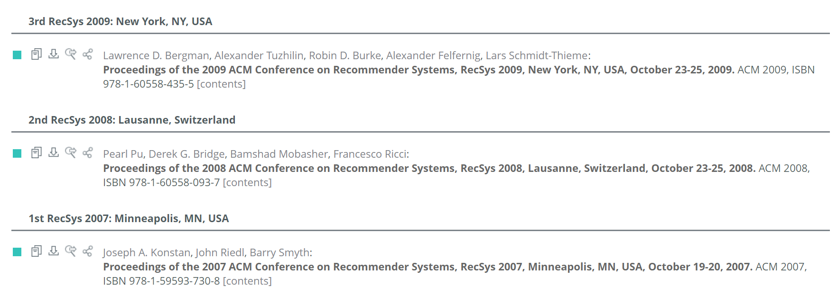
How the Community Started
82
47
38
Notes:
So, how old is the area of Recommendation Systems, how mature is the community, research-wise.
The flagship outlet is the ACM Conference on Recommendation Systems, in short RecSys.
We see how things started during the first years, 2007-2008-2009

Slide 5
How the Community Evolved
year | city | days | papers | volumes
2023 | Singapore | 5 | 197 | 2*
2022 | Seattle | 6 | 125 | 7
2021 | Amsterdam | 5 | 134 | 7
2020 | Brazil | 5 | 132 | 7
2019 | Copenhagen | 5 | 122 | 10
2018 | Vancouver | 6 | 102 | 7
2017 | Como | 5 | 96 | 10
2016 | Boston | 5 | 105 | 8
2015 | Vienna | 5 | 91 | 8
2014 | Silicon Valley | 5 | 86 | 4
2013 | Hong-Kong | 5 | 98 | 4
2012 | Dublin | 5 | 79 | 4
2011 | Chicago | 5 | 73 | 2
2010 | Barcelona | 5 | 78 | 3
2009 | New York | 3 | 82 | 1
2008 | Lausanne | 3 | 47 | 1
2007 | Minneapolis | 2 | 38 | 1
Data from DBLP.org
#papers in main volume of ACM proceedings
Notes:
And here we see how things have evolved until now. RecSys is a mega-conference, spanning several days, with lots of collocated workshops, volumes of proceedings etc.

Slide 6
Why to Use Recommenders
Value for the customer
Find products/items that are interesting
Narrow down the set of choices
Help customer explore the space of options
Value for the provider
Personalized service for the customer
Increase trust and customer loyalty
Opportunities for promotion, persuasion
Notes:
Recommenders set a win-win situation for both ends of the line: the customer and the provider.
What is the benefit for the customer ?
Focuses on interesting objects
Narrows down the plethora of choices
Further allows for browsing and explore alternatives
On the other hand, what is the benefit for the provider ?
He provides personalized services, which is a highly desired characteristic
He enjoys increased loyalty from customers due to their satisfaction
He can further increase sales by triggering and intriguing the customer.
The problem here has one name: Evaluation.
What is the probability that a customer will follow a recommendation, and he will be happy about their choice

Slide 7
Industrial Implementations
Enterprise
Google Search
Netflix, YouTube
Google News
IMDb
Last.fm
Amazon.com
Facebook
Tripavisor, Booking
Provision
Advertisements
Video
News
Movies
Music
E-commerce
Friends, Advertisements
Travel products
Goal: predict how much a consumer will like a product/item
Notes:
The number of applications of recommendation systems in practice and the number of mega-enterprises which have embraced this technology is tremendous.
We see here a few but typical examples of enterprises which are relying their businesses in recommendation

Slide 8
Challenges
Recommenders rely on collaborative filtering
Similar-minded users tend to get similar recommendations
Data sparsity: users might not have common preferences with others
Alice
M1
Cold start: users/items with no history record
Bob
M2
$$⋮$$
Jim
M3
$$⋮$$
Notes:
There are several challenges for a recommendation system to be effective and efficient.
Basically, they rely on collaborative filtering. In simple words, the system recommends to a user an object, according to the previous preferences of the user plus the preferences of users with similar taste.
For example, Bob likes movie M1 and M2. Alice likes movie M1 and seeks for a new movie. Since Bob and Alice share some preferences, we recommend Alice to see movie M2.
Here, we have two difficult problems:
Data sparsity. Imagine that databases can have thousands of movies but the average user has seen and rated very few of them
Cold start. What happens with a new user who has not expressed many preferences at all, or very few.

Slide 9
Challenges
User bias:
a user can criticize items, assigning low ratings in general
a user can be generous and assign high ratings
Item bias:
an item might get low or high ratings
$$b_{i}$$
4 | 4 | ? | 3 | 5
? | 2 | 3 | ? | ?
5 | 3 | ? | ? | ?
? | 2 | ? | ? | 1
4
2.5
4
1.5
4
2.5
4
1.5
$$b_{j}$$
4.5 | 2.75 | 3 | 3 | 3
Notes:
Bias is another important problem.
For example, the first user is very generous. We see that the average ranking is 4.
On the other hand, we see the fourth user who is very stiff, his average ranking is only 1.5.
The same problem arises in the dimension of items.
The first item has taken 4.5, the second only 2.75.
We have to normalize data before using for actual decision making

Slide 10
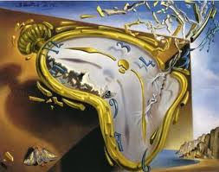
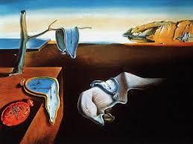
Challenges
Long-term preferences
Short-term preferences
2000
2010
2020
2000
2010
2020
1995
2005
2015
1995
2005
2015
Cartoon
Action
Romantic
Capture users’ time evolving preferences
Notes:
Preferences change with time.
Teenagers may like cartoons; then may like action movies; after years they may like romantic movies.
Also, there is periodicity according to seasons, according to big events, like vacations, family events, Christmas and so on.

Slide 11
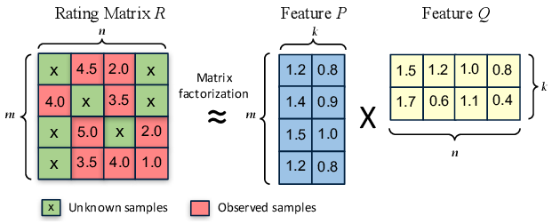
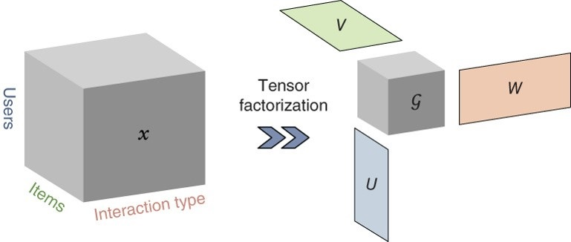
Data Representation
Matrix-based
Tensor-based
Graph-based
Hybrid
Matrix factorization
Dimensionality reduction
Notes:
Our data can be represented in several ways.
Using matrices
Using tensors
Using graphs
Using combinations of the above
An important technique to improve efficiency is matrix factorization.
We can see the 2-d table with users and movies and ratings. In reality these tables are huge and sparse.
With matrix factorization we can extract smaller tables with the same information or very similar approximate information.
For example, the left table stands for the rows feature, whereas the right table stands for the column feature.
Tensors are matrices in higher dimensions, 3, 4, and so on.
For example, here we have
- 3D tensor : User, Item, Type
We can apply tensor factorization like matrix factorization to decrease the volume, the dimensionality.

Slide 12
Presentation Menu
Recommendation Systems
Information age and Social networks
Challenges and Data representation
Scientometric Entities
Abundance of Scholarly Data
Taxonomy
Statistics
Approaches on the Intersection
Citation
Supervisor
Journal
Venue
Bias in Recommenders
Further Reading
Notes:
So, now we pass to visit some key concepts in scientometric entities and scholarly publishing

Slide 13
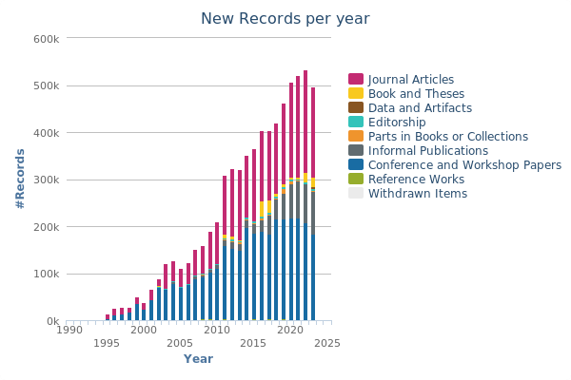
Abundance of Bibliographic Data
https://dblp.org/statistics/newrecordsperyear.html
Notes:
This figure is extracted from DBLP; I am sure that you all know this digital library, which was based initially at Trier, but now it is controlled by Schloss Dagstuhl.
Here we see how that scientific production – stored in DBLP - increases each year.
Roughly after 20 years the production is 5 to 6 times larger. Also, we can remark a linear increase.
This is figure is updated dynamically by DBLP

Slide 14
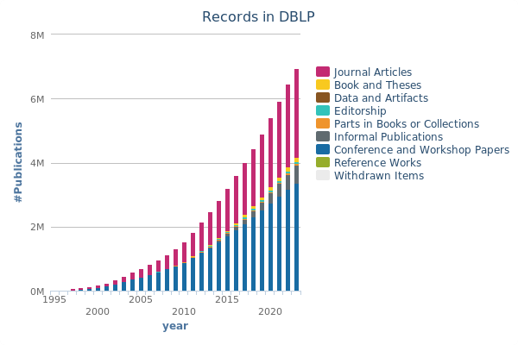
Abundance of Bibliographic Data
http://dblp.org/statistics/recordsindblp
Notes:
This figure is also from DBLP.
It shows the production which is stored in DBLP in an accumulated way.
There is a three-fold increase in 10 years.

Slide 15
Abundance of Bibliographic Data
“The rapid growth of scientific publications brings the problem of finding appropriate citations for authors”
“The increase in the number of scholarly journals has made it difficult for researchers to choose the correct journal for publishing their articles”
“Choosing a suitable academic venue for publishing one’s research can represent a challenging task considering the plethora of available conferences”
“With the explosive growth of patent applications, how to recommend relevant patents from the massive number of patents has become an extremely challenging problem”
Notes:
Please, see the underlined words.
I read with you.
Citations, Journals, conferences, patents
These are key scientometric entities.

Slide 16
Abundance of Bibliographic Data
“Finding the most suitable co-author is one of the most important ways to conduct effective research”
“With the increasing number of scientific papers, it is difficult for researchers to locate the most relevant and important keywords from the vast majority of papers and establish the research focus and preliminaries”
“With the world of academia growing at a tremendous rate, we have an enormous number of researchers on hosts of research topics”
“The steadily rising number of datasets is making it increasingly difficult for researchers and practitioners to be aware of all datasets”
Notes:
Again, please, see the underlined words.
I read with you.
Co-author, keyword, topic, dataset.
These are some other key scientometric entities.

Slide 17
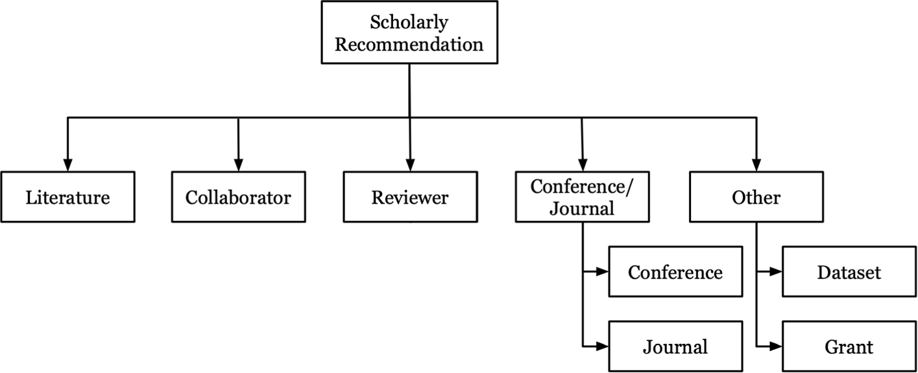
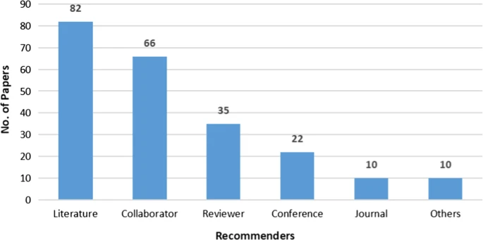
A Taxonomy of Scientometric Entities
225 papers selected from 500 papers
Zhang Z., Patra B.G., Yaseen A., Zhu J., Sabharwal R., Roberts K., Cao T. and Wu H.: “Scholarly recommendation systems: A literature survey”, Knowledge and Information Systems, 2023.
Notes:
This nice figure has been extracted from a survey which is cited here and at the end, as well.
The term “Literature” stands for paper, article, publication, patent, research document etc
The term “Collaborator” stands for co-author, researcher, etc
The term “Reviewer” stands for expert, supervisor
The term “Conference/Journal” is self explained
The term “Other” stands for topic, keyword
The authors say that they collected 500 papers, whereas their survey overviews about half of them, 225.
The bottom figure shows the frequency of the classified objects in this set of 225 paper.
More than half of the papers are related to Literature and Collaborator.

Slide 18
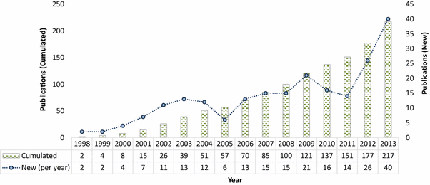
Production over the Years
2000 | 2001 | 2002 | 2003 | 2004 | 2005 | 2006 | 2007 | 2008 | 2009 | 2010 | 2011 | 2012 | 2013 | 2014 | 2015 | 2016 | 2017 | 2018 | 2019 | 2020 | 2021 | 2022 | 2023
1 |  | 2 |  | 5 |  |  | 7 | 11 | 17 | 22 | 25 | 36 | 64 | 79 | 87 | 97 | 110 | 135 | 156 | 191 | 227 | 257 | 270
1 |  | 1 |  | 3 |  |  | 2 | 4 | 6 | 5 | 3 | 11 | 28 | 15 | 8 | 10 | 13 | 25 | 21 | 35 | 36 | 30 | 13
My collection : 270 papers
Beel J., Gipp B., Langer S. and Breitinger C.: “Research-paper recommender systems: A literature survey”, International Journal on Digital Libraries, 2016.
Notes:
This figure is extracted from another survey which appeared at the Springer journal of Digital Libraries.
This set consists of 217 paper. In this set we can also the increase of production per year.

Slide 19
Production per Country
Notes:
These figures are drawn based on my own dataset of papers. I extracted from each paper the nationality of its authors. If there are 2 authors from 2 different countries, then I credit ½ point to each country, and so on.
We see that during the period China is by far first, with USA second, and then Germany, India, Canada, Iran, Korea, Netherlands and so on. I also mention Netherlands, because at Leiden there an institution focusing on scientometric studies. They also produce a university ranking.
We see how things change in the last 5 years, 2018-2023.
First is China, then Germany, India, USA, Korea, Iran etc.
This change in the national contributions triggered me.

Slide 20
Production per Country
Notes:
Here we the production of these four countries over the years.
We see how USA draws back during the last years, and USA is approached by Germany and India, in terms of annual production.

Slide 21
Main Outlets
136 papers
Notes:
Here we see the main outlets.
The big majority of my 270 papers has been published in Scientometrics/Elsevier.
It is a traditional and archival journal, with 35 years of history and about 130 volumes.
Then comes a conference, JCDL; it is the American conference on Digital libraries.
Them comes ECIR and ACM SIGIR conference, focusing on Information Retrieval.
So, basically the literature can be found in journals and conferences related to Scientometrics, DL conferences and IR conferences, plus some peripheral outlets.

Slide 22
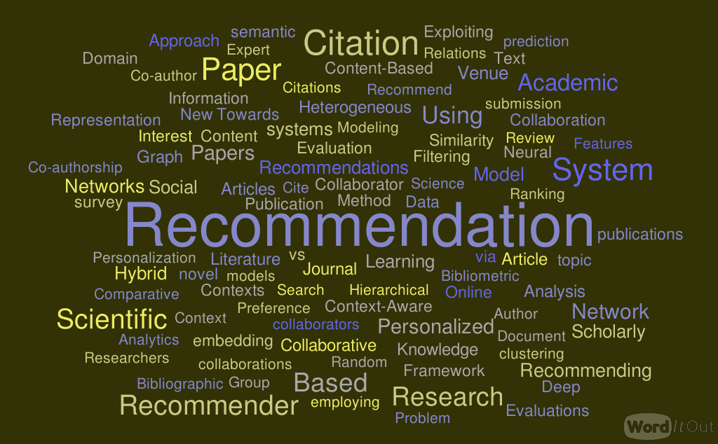
Title Cloud
100 out of 681 words
Notes:
Here is a title cloud.
My 270 paper titles contain 681 words.
This cloud consists of the 100 most common words.
I did not do any pre-process.
We see several repetitions because we have no stemming.
Also, we have singular-plural cases.
So, here the information is blurred.
In the next slide, I will focus on the keyword cloud

Slide 23
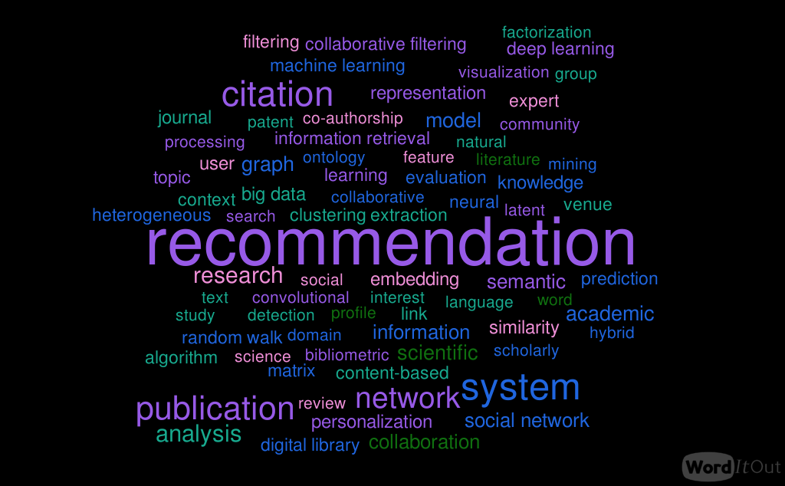
Key-word Cloud
After processing ; 75 out of 465 words
Notes:
Only singular
Personalized → personalization
Recommend, recommender → recommendation
Collaborator → collaboration
Paper, article, document → publication

Slide 24
Presentation Menu
Recommendation Systems
Information age and Social networks
Challenges and Data representation
Scientometric Entities
Abundance of Scholarly Data
Taxonomy
Statistics
Approaches on the Intersection
Citation
Supervisor
Journal
Venue
Bias in Recommenders
Further Reading
Notes:
So, we move the next part.
Here I am going to touch lightly some technical papers, their methodologies used, their technologies for the scientometric entities that we see here: Citation, supervisor, journal and venue/conference.

Slide 25
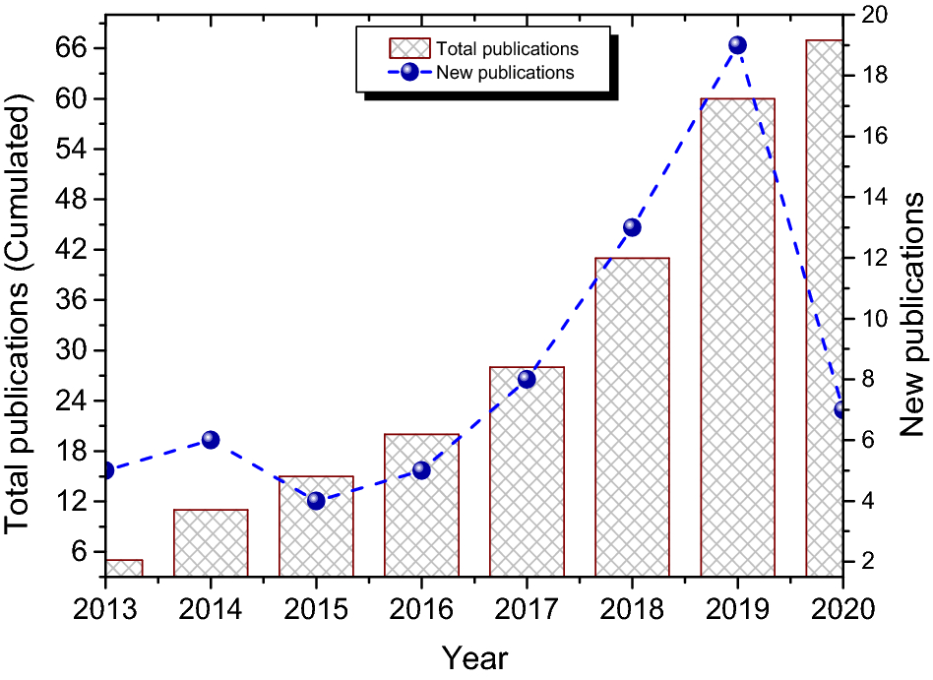
Recommending Citations
Ali Z., Ullah I., Khan A., Jan A.U. and Muhammad K.: “An overview and evaluation of citation recommendation models”, Scientometrics, 2021.
Notes:
Citations are the most popular scientometric entities studies in the filed of recommendation for scholarly publishing.
There are many surveys already which categorize and overview a long list of papers.
This paper here is one of the many which have appeared.
Again here, we see production per year and the accumulated production.
We see the linear increase of the blue line.
Of course, linear is also the increase of the total production related to citation recommendation.

Slide 26
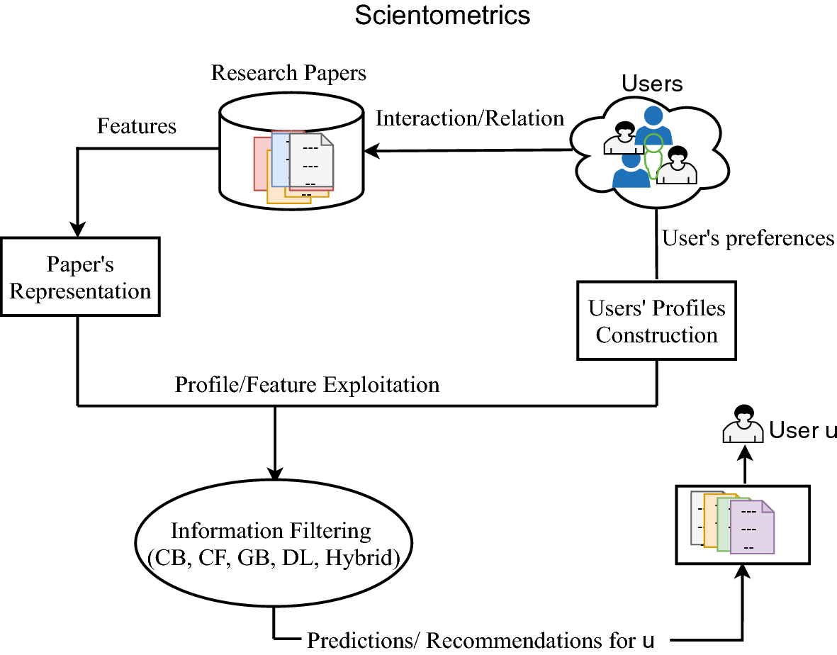
Recommending Citations
Ali Z., Ullah I., Khan A., Jan A.U. and Muhammad K.: “An overview and evaluation of citation recommendation models”, Scientometrics, 2021.
Notes:
This diagram here shows a generic workflow, a general methodology.
On one hand we have a digital library of research papers.
From these papers we extract features and metadata, keywords the most important.
On the other hand we have users. These users can be autonomous, but more often they can make a social network.
So, we extract profiles of the users.
We exploit papers features and user profiles, and via some algorithmic process we get the recommendations.
It is important to see here, what the authors mean as algorithmic processes.
We see CB, CF, GB, DL, Hybrid.

Slide 27
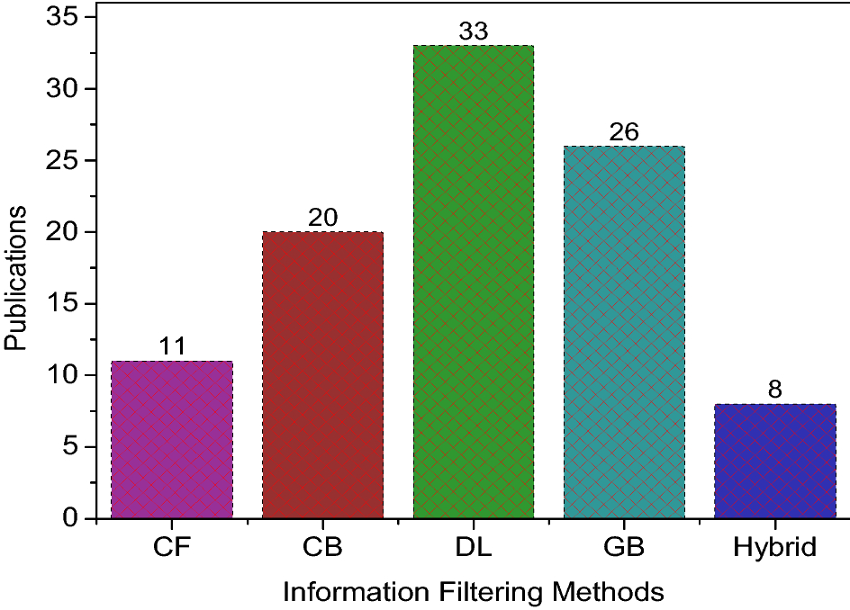
Recommending Citations
Ali Z., Ullah I., Khan A., Jan A.U. and Muhammad K.: “An overview and evaluation of citation recommendation models”, Scientometrics, 2021.
Notes:
Here, we see the distribution of papers in the specific survey with respect to the involved methodology.
Most of the papers use deep learning methods, but all other methodologies are represented very well.

Slide 28
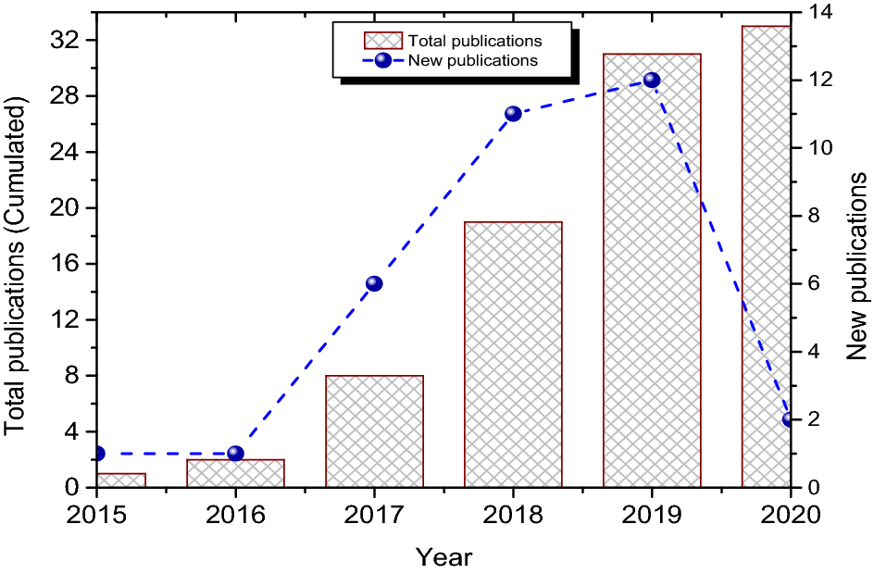
Recommending Citations
Key methodologies: deep learning based approaches.
Ali Z., Ullah I., Khan A., Jan A.U. and Muhammad K.: “An overview and evaluation of citation recommendation models”, Scientometrics, 2021.
Notes:
In a similar way to the previous figures, this one shows the recent trend towards solutions for citation recommendation based on neural networks

Slide 29
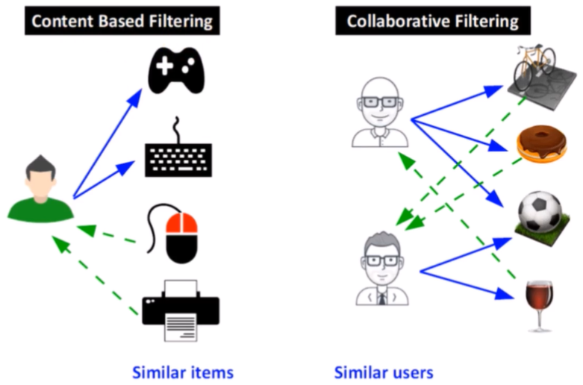
Recommending Citations
Key methodologies: Collaborative filtering vs Content-based filtering
https://www.andreaperlato.com/theorypost/recommender-system-of-scientific-paper/
Notes:
Although, in a previous slide collaborative filtering was introduced, here we show side-by-side these two methodologies which are quite siblings.
In CB filtering, the recommendation is extracted based on the similarity of objects, and only.
For example, thus user liked or bought a console and a keyboard, and the system returns some object which are similar to the previous ones according to some similarity function (Jaccard, cosine etc).
In the right, we have an example of Collaborative filtering.
The first user likes 3 items, the second likes 2. In common they like 1 item out of 4 items. The similarity degree is ¼.
So, the system provides this recommendation with green arrows.

Slide 30
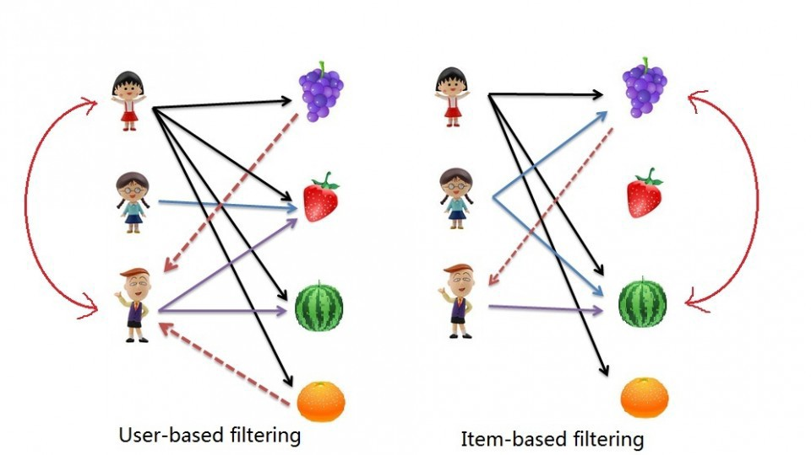
Recommending Citations
Key methodologies: user-item filtering vs item-item filtering
https://iq.opengenus.org/introduction-to-recommendation-system/
Notes:
Here we see further deeper, 2 variations of collaborative filtering.
On the left-hand side we have a bipartite graph with user and items. The recommendation is used according to user similarities.
At the right-hand side, again we have a bipartite graph but the recommendation is done based on the similarity of the items.

Slide 31
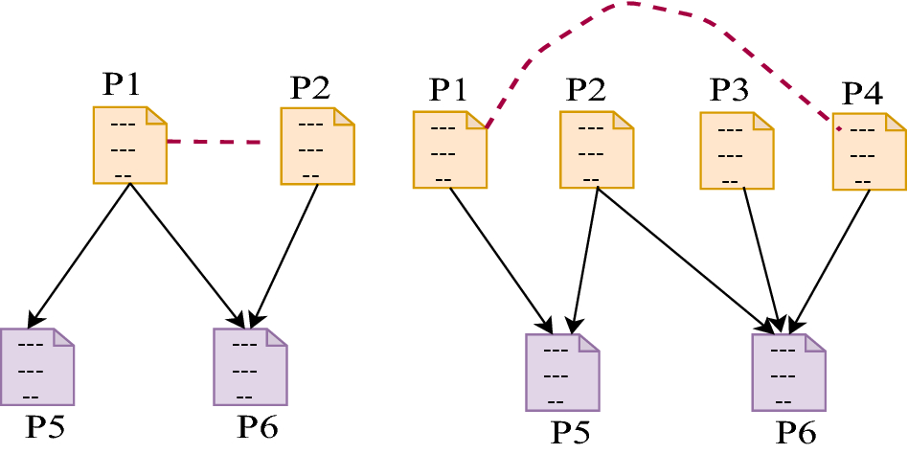
Recommending Citations
Key methodologies: Similarity calculation
Ali Z., Ullah I., Khan A., Jan A.U. and Muhammad K.: “An overview and evaluation of citation recommendation models”, Scientometrics, 2021.
Notes:
Here is another example. We have papers which cite papers.
P1 and P2 are similar because they have common citations, e.g. P6.
P1 and P4 are similar – although they have not common citation – because they have common citations with papers which have common citations.
So, we can define similarity in many ways.

Slide 32
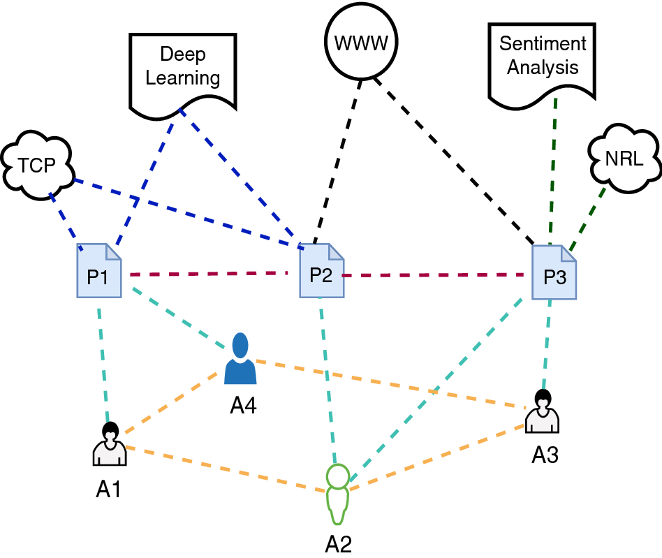
Recommending Citations
Key methodologies: graph based approaches
Ali Z., Ullah I., Khan A., Jan A.U. and Muhammad K.: “An overview and evaluation of citation recommendation models”, Scientometrics, 2021.
Notes:
Except CB, CF and DL methodologies, we have also methodologies based on graphs.
Here we have an Heterogeneous Information Network consisting of papers, users, topics and relations between them.
We will see further examples on k-partite graphs in the next.

Slide 33
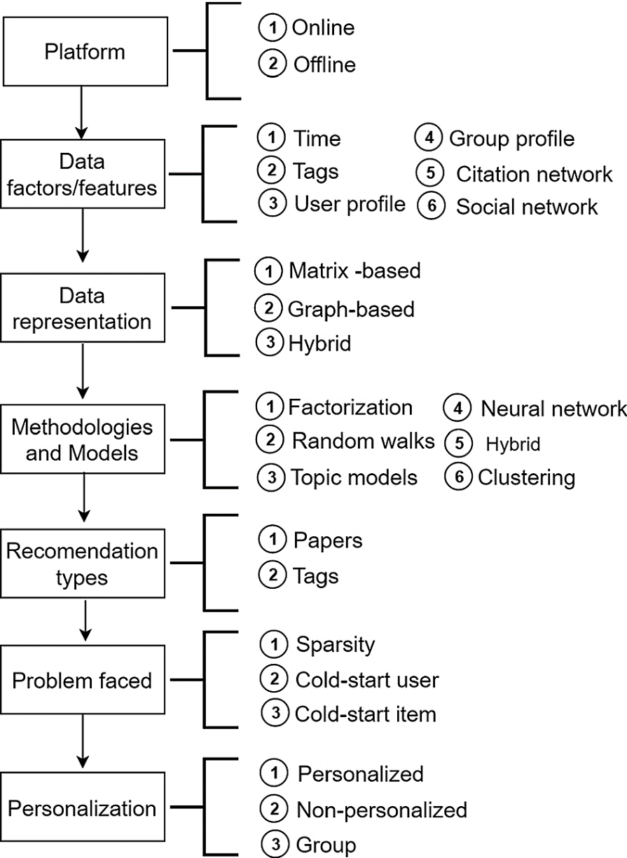
Recommending Citations
Algorithms taxonomy
Off-line majority of platforms
“Time flies”
Tags ≈ keywords
User vs group profiles
Citation vs social networks
Matrix vs graph representation
Random walk P(i,j)=1/OutDegree
With restart r = cWr+ (1-c)e
NN, Clustering, Classification
Recommendation types
Problems faced
Personalization
Ali Z., Qi G., Kefalas P., Abro W.A. and Ali B.: “A graph-based taxonomy of citation recommendation models”, Artificial Intelligence Review, 2020.
Notes:
There are many surveys already which categorize and overview a long list of papers.
I choose this as a basis for our discussion because one of the authors is a doctoral student of mine.
In this paper, the authors are categorizing citation recommendation works along many dimensions.
As you see: platform, features, data representation, methodologies, types, inherent problems, and personalization.
In fast, I am going to comment on some of them which probably need some explanations.
Most systems are off-line
Time changes the datasets and the preferences in a dynamic way
Tags are useful in the case of content-based recommendation
User profiles are useful in the case of collaborative filtering
Group profiles are harder and are against the notion of personalization
What do we represent in citation and social networks ?
Matrix and graph representations are just representation of the same thing. The difference is in the available operations on them. For example, we can view matrix as a set vector and compute similarities, or perform SVD, or LDA, or apply tf-idf, which is a standard in IR.
We categorize graphs in uni-partite, bi-partite, k-partite and so on. Random walks can be applied to graphs.
Hybrid
Factorization explained
Random walks (a drunk man will find at some point his home, a bird not). PageRank is based on RWR
Topic models
Neural networks have penetrated all types of fields. We all know the general architecture: one input layer, one output layer, and several layers in between. Convolutional NN, Recurrent NN, deep belief networks, Tensor NN, LSTM etc
Clustering, unsupervised technique (k-means, knn etc),
Classification, supervised technique (SVM, Naïve Bayes, Decision trees etc)
Problems, explained in the beginning
Personalization. Most system offer personalization. Non-personalized systems provide the same top-N to all users.

Slide 34
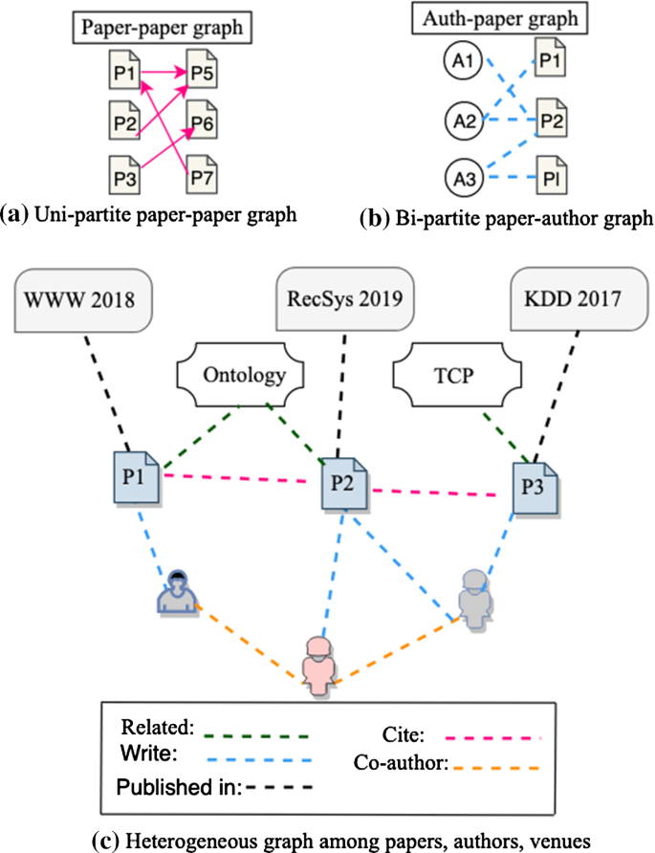
Recommending Citations
Algorithms taxonomy
Off-line majority of platforms
“Time flies”
Tags ≈ keywords
User vs group profiles
Citation vs social networks
Matrix vs graph representation
Random walk P(i,j)=1/OutDegree
With restart r = cWr+ (1-c)e
NN, Clustering, Classification
Recommendation types
Problems faced
Personalization
Ali Z., Qi G., Kefalas P., Abro W.A. and Ali B.: “A graph-based taxonomy of citation recommendation models”, Artificial Intelligence Review, 2020.

Slide 35
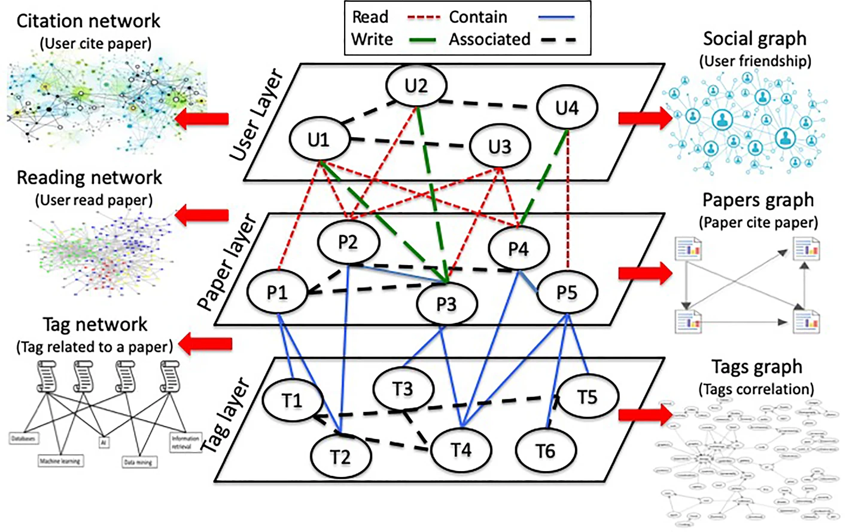
Recommending Citations
A graph-based approach
Ali Z., Qi G., Kefalas P., Abro W.A. and Ali B.: “A graph-based taxonomy of citation recommendation models”, Artificial Intelligence Review, 2020.
Notes:
Here we see another example of Heterogeneous Information Network, or 3-partite graph if you like
What are the scientometric entities here?
papers, users, tags, behaviour/activities, relationship between these entities.
We could have more entities, but it would be difficult to visualize.
Here, we several relationships: read, write etc
From this setting we can extract
Uni-partite graphs
Bi-partite graphs
Tri-partite graphs
In such a setting a random walk with restart can work and provide recommendations.

Slide 36
Recommending Supervisor
Previous approaches were based on Multiple Criteria Decision Making
Subjective criteria as they are reflecting judgements and opinions of both students and professors
RecAdvisor: a tool based on objective criteria. Data selected from MAS, CORE, CVs (e.g. info about previous students, grants etc), doctoral dissertation information etc.
First, users build their own profile into the system
Then, the system provides a list of professors with info about publications, grant record, etc
Mir Anamul Hasan and Daniel G. Scwartz: “RecAdvisor: Criteria-based Ph.D. Supervisor Recommendation”, Proceedings 41st SIGIR Conference, 2018.
Notes:
Here, the topic is supervisor recommendation.
I found this case interesting and funny.
However, the substance is the same.
We have a 2-partite graph, professors and students.
First, the specific system builds the profile of the professors based on MAS, CORE, CVs etc.
Then when a student needs to find a supervisor, then he enters some keywords and his profile is constructed.
Finally, the system provides a list of professors with info about their publication record, their research record, their supervision record etc.

Slide 37
Recommending Journals
Rejection is the norm
From Scopus we know that
The Elsevier recommender algorithm is divided in two parts
First, match the user query to the existing papers in the database, based on Okapi BM25 algorithm for IR
Then, rank the journals according to the average BM25 score per journal for the top X papers
12 millions of peer reviewed papers between 1992-2002
this number doubled during 2003-2012
Kang N. Doormenbal M. and Schijvenaars B.: “Elsevier journal finder: Recommending journals for your paper”, Proceedings 9th RecSys Conference, 2015.
Notes:
In a metaphoric manner, a colleague of mine once said: if at high jump the horizontal bar is at 2m, then you have to jump 2.01 m, not more, not less.
Again, there is a 2-phase methodology.
First the user makes a query. This query can be keywords or can be the whole abstract.
Then the system selects a number of journals and ranks according to some similarity function.

Slide 38
Recommending Journals
All major publishers have a tool
https://journalfinder.elsevier.com/
https://journalsuggester.springer.com/
https://publication-recommender.ieee.org/home
https://www.edanzediting.com/journal-selector
https://www.enago.com/researcher-hub/journal-finder.htm
https://jane.biosemantics.org/
https://www.journalguide.com/
https://www.mdpi.com/about/journalselector
https://journalfinder.wiley.com/
https://journal-recommender.sagepub.com/
https://www.cambridge.org/universitypress/author-services/services/journal-recommendation/
Nam N.D., Trung T., Trung N.T. and Thao T.P.T.: “Manuscript matcher: A tool for finding the best journal”, Proceedings 13th IMCIC Conference, 2022.

Slide 39
Recommending Journals
All major publishers have a tool
Manuscript Matchers | Title and Abstract | Keyword | Field of research | Open Access
Elsevier Journal Finder | Yes | Yes | Yes | Yes
Springer Journal Suggester | Yes | Yes | Yes | Yes
IEEE Journal Recommender | Yes | Yes | No | No
Edanz Journal Selector | Yes | Yes | Yes | Yes
Enago Open Access Journal Finder | Yes | No | Yes | Yes
Journal/Author Name Estimator | Yes | Yes | No | Yes
Journal Guide | Yes | Yes | No | Yes
Manuscript Matchers | Acceptance Rate | CiteScore | Impact Factor | Publication Time | Database
Elsevier Journal Finder | Yes | Yes | Yes | Yes | Elsevier (2900)
Springer Journal Suggester | Yes | No | Yes | Yes | Springer, Biomed (2600)
IEEE Journal Recommender | No | No | No | Yes | IEEE (1670)
Edanz Journal Selector | Yes | No | Yes | No | (28651)
Enago Open Access Journal Finder | Yes | No | No | Yes | Web of Science, Scopus (10700)
Journal/Author Name Estimator | Yes | Yes | Yes | No | Medline, DOAJ
Journal Guide | Yes | Yes | Yes | Yes | Research Square
Nam N.D., Trung T., Trung N.T. and Thao T.P.T.: “Manuscript matcher: A tool for finding the best journal”, Proceedings 13th IMCIC Conference, 2022.

Slide 40
Recommending Journals
Although the manuscript matchers are connected to particular publishers/databases, they have similar vital functions, a matching score based on impact factor, acceptance rate, production times, etc
Priority Criteria | Percentage
Acceptance rate | 30
Publication speed | 25
Publication fees | 15
Accessibility (OA), number of readers | 10
ISI/Scopus list of journals | 7
Impact Factor, Cite Score | 5
Field of research | 3
Others | 3
Nam N.D., Trung T., Trung N.T. and Thao T.P.T.: “Manuscript matcher: A tool for finding the best journal”, Proceedings 13th IMCIC Conference, 2022.
Notes:
But how users finally choose the journal to submit.
According to this survey, we see that most of the participants considered that acceptance rate and publication speed are the most important.
We could all agree more or less with this opinions.

Slide 41
Recommending ΟΑ Journals
The Open Access landscape keeps growing, making harder to choose a suitable journal to publish research findings
Bibliometric & Semantic Open Access Recommender Network
B!SON is build on top of
DOAJ: 17,669 journals, 7,489,975 articles
Open Citations: 72,268,850 articles, 1,294,283,603 citations
Journal Checker Tool: is a journal compliant with Plan-S?
Other data sources: Crossref, OpenAlex
Technologies used
Data integration: PostgreSQL, Elasticsearch, Django backend, Vue.js frontend
Recommendation: Text similarity (OKAPI BM25), bibliographic coupling, combination of text and bibliographic similarity
Entrup E., Eppelin A., Ewerth R., Hartwig J., Tullney M., Wohlgemuth M., Hoppe A.: “B!SON: A tool for open access journal recommendation”, Proceedings 26th TPDL Conference, 2022.
Notes:
When we talk about major publishing houses, we have some guarantees about quality control. Elsevier, Springer, IEEE, ACM etc etc.
However, nowadays there are many open access journals, for which we may not have information and we have to avoid predator journals. Of course, Beall list is informative on this. This flood of open access has obliged the major publishers to turn to open or hybrid style.
Here, we have a recommender for open access journals. B!SON. It extracts data from nay public information systems like DOAJ, Open Citations etc. Practically, it uses the same method of 2-phases. First the user provides a query and then the system replies a list of OA journals by using some combination of text and bibliographic information.

Slide 42
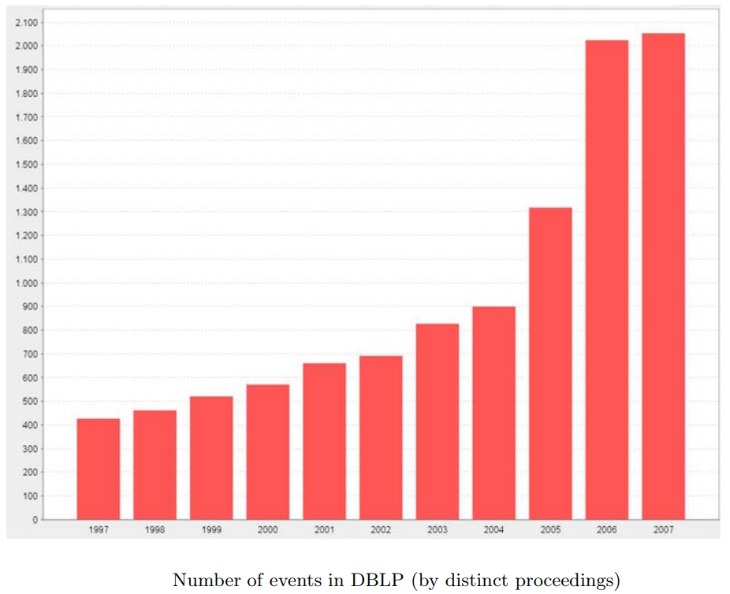
Recommending Conferences
2000+ conferences in 2006
3711 conferences in 2015
6400 conferences as of today, 15/11/2023
Klamma R., Cuong P.M. and Cao Y.: “You never walk alone: Recommending academic events based on social network analysis”, Proceedings 1st COMPLEX Conference, 2009.
Notes:
This figure is taken from a paper of 2009.
The depicted data are up to 2007. More than 2000 conferences curated at DBLP.
Additionally, I found from other papers and sources that
in 2015 the number of conferences was 3711
in 2023, as of today, the number of conferences is 400
We see a dramatic increase during the next years.

Slide 43
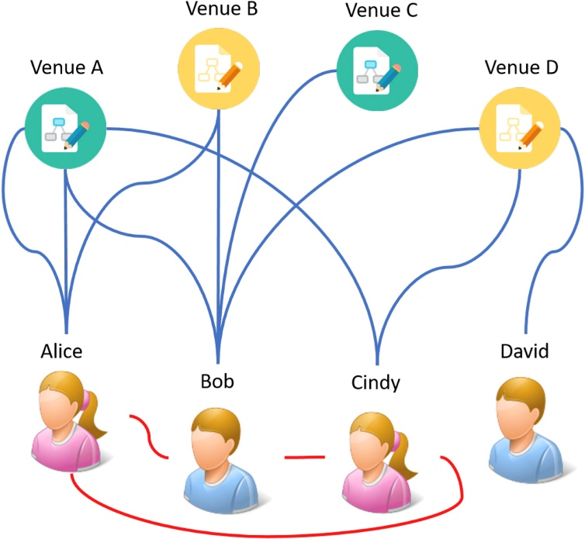
Recommending Conferences
How researchers choose conferences?
Where can I obtain high quality venues?
Which venues are most suitable for me to contribute papers?
What are the most relevant conferences I should participate?
Integrate authors, venues and publications into a co-publication network
Introduce metrics
Co-publication frequency
Relation weight
Academic level
Random Walk with Restart
Yu S., Liu J., Yang Z., Chen Z., Jiang H., Tolba A. and Xia F.: “PAVE: Personalized academic venue recommendation exploiting co-publication networks”, Journal of Network & Computer Applications, 2018.
Notes:
high quality venues, acceptance ratio, CORE etc
not only this, but also relevance
connectivity to the community
So, here we have 2-partite graph with authors and venues. We have a co-author relationship and a author-venue relationship.
Besides this graph is a weighted graph with weights on the edges.
We perform a random walk with restart on this graph.

Slide 44
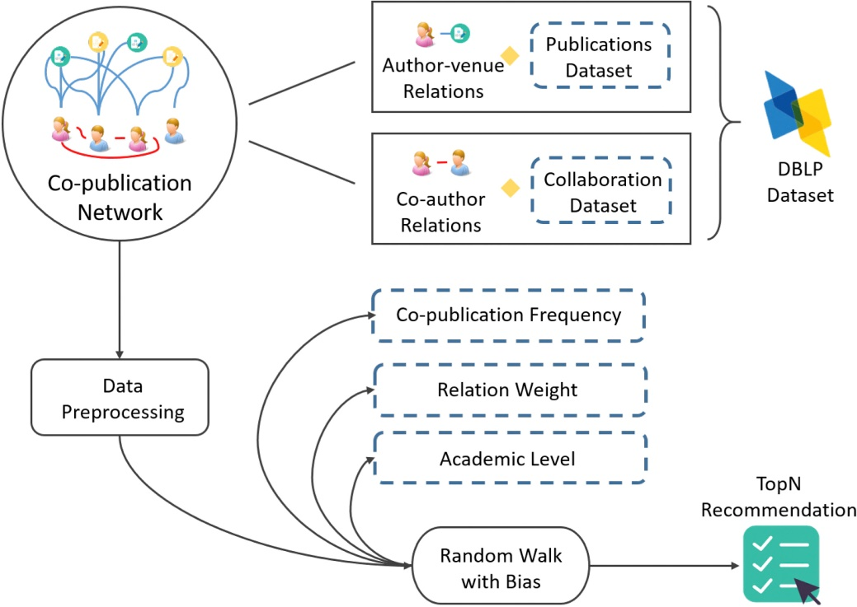
Recommending Conferences
PAVE workflow
Yu S., Liu J., Yang Z., Chen Z., Jiang H., Tolba A. and Xia F.: “PAVE: Personalized academic venue recommendation exploiting co-publication networks”, Journal of Network & Computer Applications, 2018.
Notes:
A generic architecture of the system.
They call it PAVE, Personalized Academic Venue recommendation Exploiting co-publication networks.
From DBLP data are extracted about co-authorship and author-venue relationship.
Some pre-processing of the graph takes place and then RWR is performed.

Slide 45
Presentation Menu
Recommendation Systems
Information age and Social networks
Challenges and Data representation
Scientometric Entities
Abundance of Scholarly Data
Taxonomy
Statistics
Approaches on the Intersection
Citation
Supervisor
Journal
Venue
Bias in Recommenders
Further Reading
Notes:
Now we pass to the last part, the delicate issue of ethics and bias

Slide 46
Bias of Scientific Recommenders
Scientific recommender systems risk isolating scholars in information bubbles and insulating them from exposure to different view points.
They also risk suffering from popularity biases, which lead to a winner-takes all scenario and reinforce discrepancies in recognition received by eminent scientists.
Key-words
Filter bubbles
Echo chambers
Exposure problem
Preferential attachment
Cumulative advantage
Mathew effect
“For to all those that who have, more will be given”
Andrea Polonioli: “The ethics of scientific recommender systems”, Scientometrics, 2021.
Notes:
For example, leading digital libraries such as Elsevier, PuMed, SpringerLink have systems that can send out email alerts of provide feeds on paper recommendation.

Slide 47
Bias in Scientific Recommenders
Human-caused bias
Conformation bias
Position bias
Selection bias
System-caused bias
Inductive bias
Exposure bias
Popularity bias
Unfairness
All biases concerning recommendation systems in general also are relevant to scholarly recommender systems
Färber M., Coutinho M. and Yuan S.: “Biases in scholarly recommender systems: Impact, prevalence, and mitigation”, Scientometrics, 2023.
Notes:
Users tend to conform their beliefs with those of their peers, friends, and those in the same communities, even if doing so goes against their own judgment, meaning the rating values do not always signify true user preference
Users tend to interact with items in higher position of the recommendation list regardless of the items’ actual relevance
Users sometimes choose to rate items not out of relevance or item quality, but simply because they are influenced by other factors like item popularity, higher citation count of author, paper, etc. which have little or nothing to do with relevance or quality. As a result, observed ratings are not a representative sample of all ratings
The model makes assumptions to better learn the target function and to generalize the training data
Users are exposed to certain relevant items. However, the unobserved items without interaction do not mean that they are irrelevant or represent negative preference
The tendency of the recommender system’s algorithm to favor a few popular items while under-representing the majority of other items
The system systematically and unfairly discriminates against certain individuals or groups of individuals in favor of others

Slide 48
Bias in Wikipedia citations
 | NAS subgroup |  | AS subgroup |  | All
 | Women | Men | Women | Men | Women | Men
BHS | -4,7 | 1,6 | -4,9 | 2,3 | -4,9 | 2,1
LES | -8,2 | 2,6 | -4,6 | 1,4 | -6,1 | 1,9
PSE | -45,5 | 9,4 | -13,5 | 1,8 | -31,7 | 5,3
MCS | -23,6 | 5,1 | -9,2 | 2,3 | -15,1 | 3,5
SSH | -12,5 | 6,6 | -2,8 | 1,7 | -4,8 | 2,8
200K Wiki citations
1.9M papers
Gender-level comparison of single-author publications
Gender-level comparison of multi-author publications
 | NAS subgroup |  |  | AS subgroup |  |  | Mix-sphere group |  |  | All
 | Women | Men | Mix-gender | Women | Men | Mix-gender | Women | Men | Mix-gender | Women | Men | Mix-gender
BHS | -9,7 | 6,8 | -3,1 | -6,3 | 5,1 | -3,1 | -11,5 | 11,7 | -12,5 | -7,8 | 5,9 | -3,3
LES | -8,1 | 5,3 | -3 | -3,5 | 3,6 | -3,5 | -1,5 | 6,1 | -8,8 | -6,2 | 4,6 | -3,5
PSE | -17,3 | 8,2 | -8,7 | 4,6 | 0,8 | -2,4 | -7,2 | -2,2 | 6,3 | -9,5 | 4,1 | -5,5
MCS | -36,6 | 1,2 | -15,1 | 7,4 | 5,6 | -1,3 | -1,6 | 0.3 | 1,1 | -15,8 | 8,2 | -13,3
SSH | -10,7 | 5,8 | -1,4 | -4,2 | 5,1 | -2,1 | -6,2 | 7,2 | -6,3 | -5,7 | 5,4 | -2,1
Zheng X., Chen J., Yan E. and Ni C.: “Gender and country biases in Wikipedia citations to scholarly publications”, Journal of the Association for Information Science & Technology, 2023.
Notes:
Wikipedia citations have been proposed as altmetrics. Wikipedia has been criticized for masculine and geek culture.
To what extent is this true?
Categorization according to the Center for Science and Technology Studies of the Leiden University.
Biomedical and Health Sciences
Life and Earth Sciences
Physical Sciences and Engineering
Mathematics and Computer Science
Social Sciences and Humanities
Also, Agglophone sphere vs Non-Agglophone sphere.
The authors collected ~1.9 M papers for the control group and ~200k wiki citations
What do we read these tables?

Slide 49
Bias in Wikipedia citations
 | Women subgroup |  | Men subgroup |  | All
 | NAS | AS | NAS | AS | NAS | AS
BHS | -1,3 | 3,9 | -14,8 | 6,7 | -14,5 | 6,0
LES | -9,3 | 8,0 | -9,2 | 8,0 | -9,3 | 8,0
PSE | -16,2 | 19,9 | -15,7 | 19,0 | -15,7 | 19,1
MCS | -9,2 | 7,1 | -17,2 | 19,7 | -16,4 | 18,0
SSH | -12,8 | 4,1 | -10,0 | 4,1 | -10,9 | 4,1
Country-level comparison of single-author publications
Country-level comparison of multi-author publications
 | Women subgroup |  |  | Men subgroup |  |  | Mix-gender group |  |  | All
 | NAS | AS | Mix-gender | NAS | AS | Mix-gender | NAS | AS | Mix-gender | NAS | AS | Mix-gender
BHS | -9,5 | 7,5 | -2,9 | -11,2 | 7,9 | 14,8 | -10,0 | 8,3 | 13,4 | -10,5 | 8 | 13
LES | -8,5 | 14,9 | 15,4 | -9,5 | 9,7 | 13,5 | -8,5 | 10,9 | 13,4 | -9 | 10,5 | 13,5
PSE | -18,4 | 45,2 | -7,7 | -15,8 | 21,5 | 4,7 | -17,5 | 27,8 | 20,7 | -16,5 | 24 | 8,5
MCS | -24,8 | 30,1 | -34,8 | -14,7 | 15,8 | 18,1 | -13,2 | 14,5 | 22 | -14,6 | 16 | 17,9
SSH | -22,8 | 9,0 | -3,8 | -15,3 | 9,2 | 0 | -17,4 | 9,3 | 2,4 | -17,3 | 9,2 | 0.5
Zheng X., Chen J., Yan E. and Ni C.: “Gender and country biases in Wikipedia citations to scholarly publications”, Journal of the Association for Information Science & Technology, 2023.

Slide 50
Redundancy vs. Variety
1 | 1 | 1 | 1 | 1 | 1 | 1 | 1 | 1 | 1 |  | 0 | 0 | 0 | 0 | 0 | 0 | 0 | 0 | 0 | 0 |  | 4 | 0 | 0 | 1 | 2 | 0 | 1 | 0 | 0 | 1
1 | 1 | 1 | 1 | 1 | 1 | 1 | 1 | 1 | 1 |  | 0 | 0 | 0 | 0 | 0 | 0 | 0 | 0 | 0 | 0 |  | 2 | 4 | 1 | 1 | 0 | 0 | 0 | 0 | 0 | 0
1 | 1 | 1 | 1 | 1 | 1 | 1 | 1 | 1 | 1 |  | 0 | 0 | 0 | 0 | 0 | 0 | 0 | 0 | 0 | 0 |  | 0 | 1 | 0 | 0 | 0 | 3 | 0 | 1 | 0 | 0
1 | 1 | 1 | 1 | 1 | 1 | 1 | 1 | 1 | 1 |  | 0 | 0 | 0 | 0 | 0 | 0 | 0 | 0 | 0 | 0 |  | 1 | 0 | 0 | 2 | 0 | 1 | 1 | 0 | 3 | 1
1 | 1 | 1 | 1 | 1 | 1 | 1 | 1 | 1 | 1 |  | 0 | 0 | 0 | 0 | 0 | 0 | 0 | 0 | 0 | 0 |  | 0 | 4 | 0 | 0 | 1 | 0 | 0 | 0 | 0 | 6
1 | 1 | 1 | 1 | 1 | 1 | 1 | 1 | 1 | 1 |  | 0 | 0 | 0 | 0 | 100 | 0 | 0 | 0 | 0 | 0 |  | 0 | 0 | 1 | 7 | 1 | 2 | 0 | 1 | 0 | 0
1 | 1 | 1 | 1 | 1 | 1 | 1 | 1 | 1 | 1 |  | 0 | 0 | 0 | 0 | 0 | 0 | 0 | 0 | 0 | 0 |  | 1 | 0 | 1 | 0 | 5 | 0 | 0 | 0 | 1 | 1
1 | 1 | 1 | 1 | 1 | 1 | 1 | 1 | 1 | 1 |  | 0 | 0 | 0 | 0 | 0 | 0 | 0 | 0 | 0 | 0 |  | 0 | 8 | 1 | 0 | 0 | 1 | 1 | 0 | 0 | 1
1 | 1 | 1 | 1 | 1 | 1 | 1 | 1 | 1 | 1 |  | 0 | 0 | 0 | 0 | 0 | 0 | 0 | 0 | 0 | 0 |  | 0 | 0 | 1 | 0 | 6 | 0 | 0 | 0 | 0 | 0
1 | 1 | 1 | 1 | 1 | 1 | 1 | 1 | 1 | 1 |  | 0 | 0 | 0 | 0 | 0 | 0 | 0 | 0 | 0 | 0 |  | 2 | 0 | 0 | 0 | 1 | 0 | 2 | 1 | 1 | 1
Variety Redundancy Balance
Variety: each paper is cited once
Redundancy: all papers cite one paper
In practice: Pareto distributions
Andreas Pacher: “A typology of research discovery tools: Bibliometric redundancy vs. bibliometric variety”, Proceedings 18th ISSI Conference, 2021.
Notes:
The author considers a spectrum: at one end is redundancy, at the other is variety.
At one end, recommenders choose from co-citations
At the other end recommenders choose at random
Of course, these are just models
Scenario A: each paper is cited once. So we have variety
Scenario B: all papers cite one paper. We call this redundancy (expected patterns, expected co-occurences)
These are extremes. Practically, the underlying distribution is a Pareto distribution.

Slide 51
Redundancy vs. Variety
Cited Paper | Property before it is cited | When a new paper on topic X cites it, this leads to
Paper I | Already well-cited in the field X | Redundancy (enhances the citation pattern
Paper II | A little-cited paper | Variety (it open up a novel reference)
Paper III | Well-cited paper on the topic Y, but never been cited on topic X | Variety (it bridges two topics in an original way)
Redundancy: Scholar, MAS, WoS, Semantic Scholar etc.
Variety: CVs, institutional repositories, journal ToCs, etc.
Andreas Pacher: “A typology of research discovery tools: Bibliometric redundancy vs. bibliometric variety”, Proceedings 18th ISSI Conference, 2021.
Notes:
Machines/tools draw from co-citations or key-word queries (such as academic search engines and recommender systems).
The gravity of highly-cited papers. There is a kind of reinforcement and leads to limiting the researcher’s view of the world.
Many tools are categorized in this class: Google Scholar, MAS, WoS, Semantic Scholar etc
On the other side of the spectrum: individual CVs, institutional repositories, Journal ToCs, random paper bots on Twitter.
So, basically, modern search tools lead to another kind of bias, which is against variety and innovation.

Slide 52
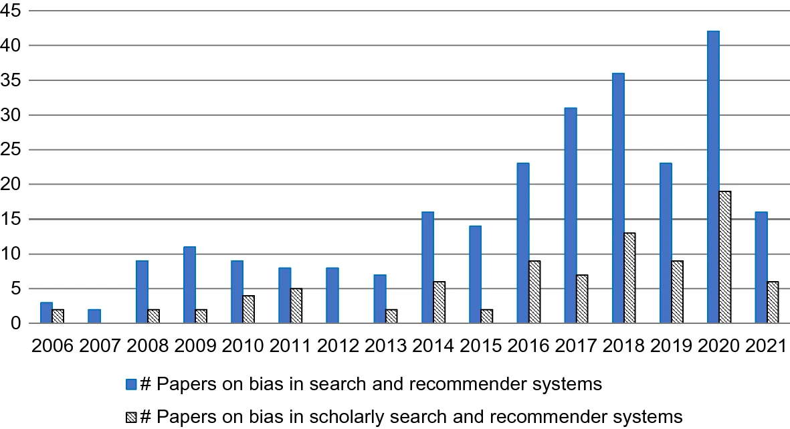
Recommendations for Scientific Recommenders
Bias affects which research ideas get promoted and are finally used in the industry, impacting the welfare of industrial countries in the long run.
Further research
Explainability
Diversifiability
Findability
Awards
SIGIR 2020
KDD 2021
Andrea Polonioli: “The ethics of scientific recommender systems”, Scientometrics, 2021.
Notes:
A system that recommends a paper stating “recommended because you read paper X” is a white-box recommender. A system that refers to top picks is a black box.
Digital libraries must consider ways to correct popularity biases (the long tail effect).
Typically, engines fail to bring relevant articles. One reason is the inability to handle synonyms. For example, “liver cell” and “hepatocyte”
Test-of-time award in KDD-2021
Best paper award in SIGIR-2020

Slide 53
Further Reading
Zhang A. et al.: “Scholarly recommendation systems: A literature survey”, Knowledge and Information Systems, 2023.
Jebari C. et al.: “Context-aware citation recommendation of scientific papers: Comparative study, gaps and trends”, Scientometrics, 2023.
Aymen A.T.M. et al.: “Scientific paper recommender systems: A review”, Proceedings IC-AIRES Conference, 2022.
El Alaoui et al.: “Overview of the main recommendation approaches for the scientific articles”, Proceedings CBI Conference, 2021.
Ali Z. et al.: “An overview and evaluation of citation recommendation models”, Scientometrics, 2021.
Ali Z. et al.: “A graph-based taxonomy of citation recommendation models”, Artificial Intelligence Review, 2020.
Ma S.: et al.: “A review of citation recommendation: From textual content to enriched content”, Scientometrics, 2020.
Farber M. and Jatowt A.: “Citation recommendation: Approaches and datasets”, International Journal on Digital Libraries, 2020.
Krutz C.K. and Schenkel R.: “Scientific paper recommendation systems: A literature review of recent publications”, International Journal on Digital Libraries, 2020.
Bai X. et al.: “Scientif paper recommendation: A survey”, IEEE Access, 2019.
Beel J. et al.: “Research-paper recommender systems: A literature survey”, International Journal on Digital Libraries, 2016.

Slide 54
Personal Involvement
Notes:
Here are two outcomes of our activities on these two areas. The first was published in 2014, the second on in 2021. Both by Springer

