Slide 1


Nexus approach for a sustainable environment: from individual modeling to digital twins
by Prof. Anthony Lehmann
Spatial Predictions and Analyses in Complex Environments
enviroSPACE
GISTAM, Porto, March 2025

Slide 2
1
Introduction
2
Essential variables and workflows
5
Need for a Nexus approach
6
Towards Digital Twins
3
Individual models approach
4
Models integration into Ecological Infrastructures
An attempt to summarize my personal journey from from individual modeling approaches to digital twins

Slide 3

Introduction on Ecosystem Services and Sustainable DEvelopment
1

Slide 4
Millenium Ecosystem Assemment 2005
Ecosystem services are the benefits that humans derive from the environment and ecosystems.
This report widely disseminated the concept of ES with its classification as:
Support
Supply
Regulation
Cultural
UN, MEA 2005

Slide 5

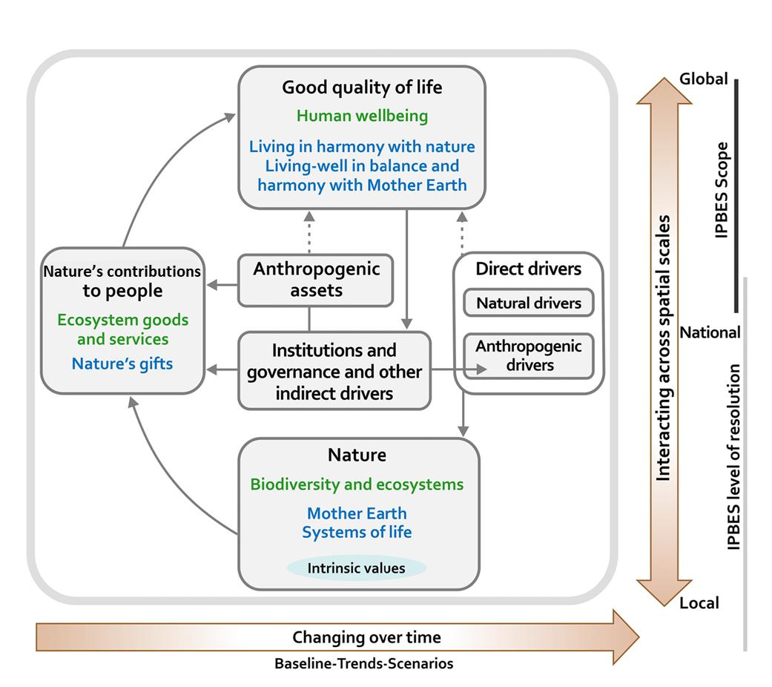
IBPES Conceptual Framework 2019
Key messages:
Nature and its vital contributions to people, which together embody biodiversity and ecosystem functions and services, are deteriorating worldwide.
Direct and indirect drivers of change have accelerated during the past 50 years.
Goals for conserving and sustainably using nature and achieving sustainability cannot be met by current trajectories, and goals for 2030 and beyond may only be achieved through transformative changes across economic, social, political and technological factors.
Nature can be conserved, restored and used sustainably while other global societal goals are simultaneously met through urgent and concerted efforts fostering transformative change
Concepts of occidental science
Other forms of knowledge
https://ipbes.net/global-assessment
Notes:
Figure X. The IPBES Conceptual Framework is a highly simplified model of the complex interactions between the natural world and human societies. The model identifies the main elements (boxes within the main panel delimited in grey), together with their interactions (arrows within the main panel), that are most relevant to the Platform’s goal. “Nature”, “nature’s contributions to people” and “good quality of life” (indicated as black headlines and defined in the box) are inclusive categories that were identified as meaningful and relevant to all stakeholders involved in IPBES during a participatory process, including various disciplines of the natural and social sciences and the humanities, as well of other knowledge systems, such as those of indigenous peoples and local communities. Text in green denotes the concepts of science; and text in blue denotes those of other knowledge systems. . Solid arrows in the main panel denote influence between elements; dotted arrows denote links that are acknowledged as important, but are not the main focus of the Platform. The thick coloured arrows below and to the right of the central panel indicate different scales of time and space, respectively. This conceptual framework was accepted by the Plenary in decision IPBES/2/4 and the Plenary took note of an update presented in IPBES/INF/24 in decision IPBES/5/1. Further details and examples of the concepts defined in the box can be found in the Glossary and in Chapter 1

Slide 6
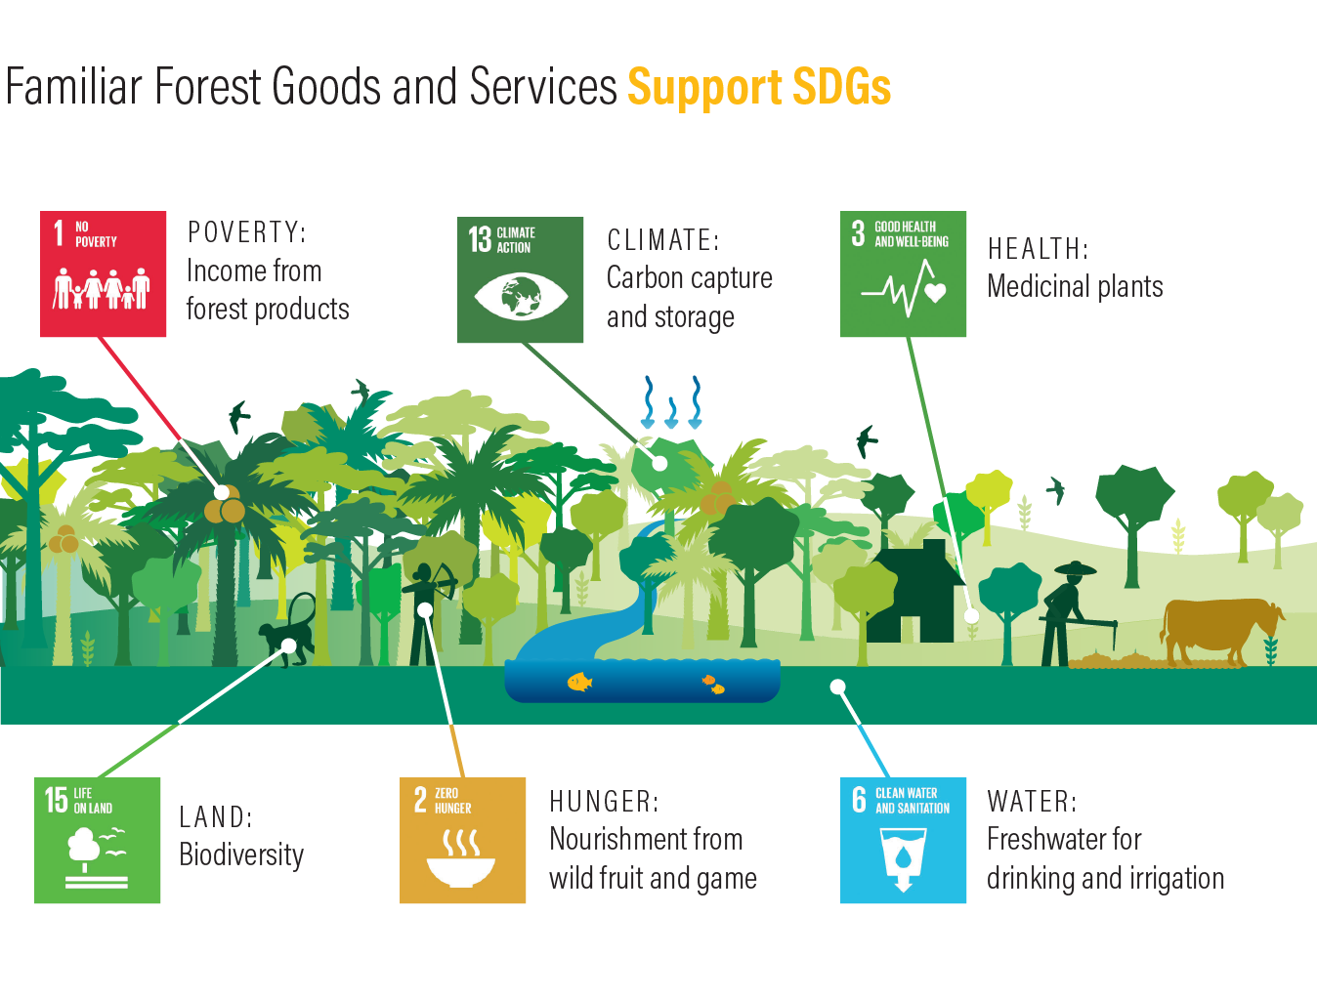
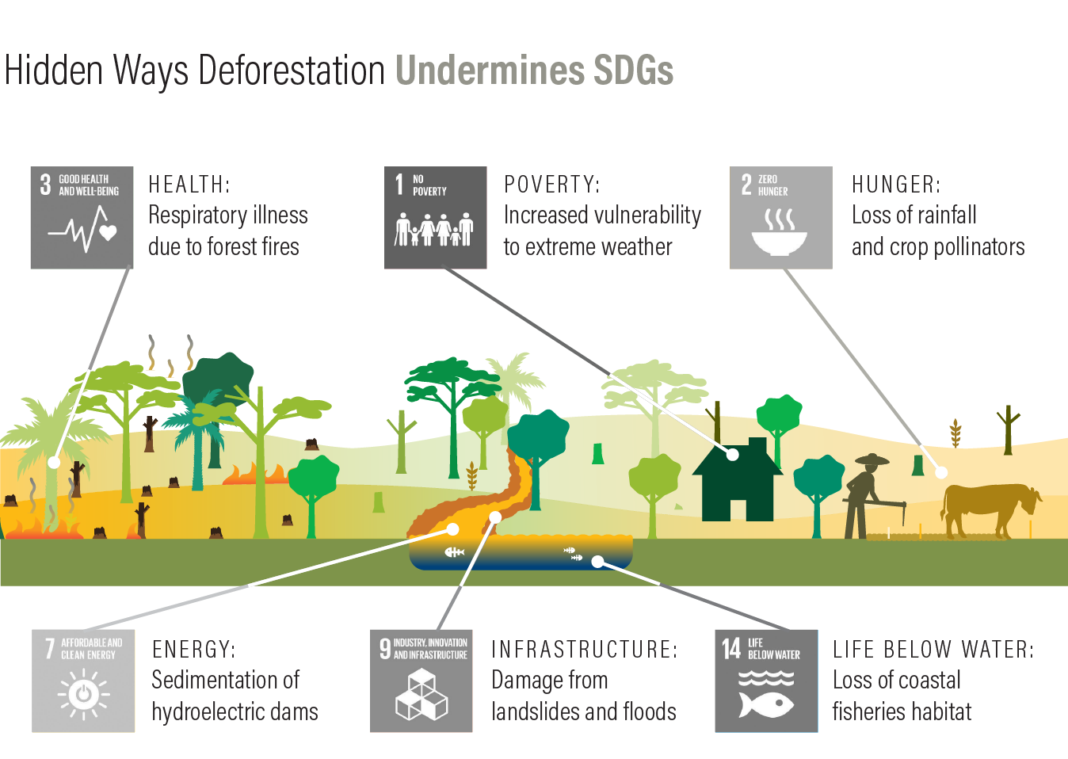
Healthy Ecosystems Provide ES to SDGs like in forests
https://wri-indonesia.org/en/blog/forests-and-sdgs-taking-second-look

Slide 7







integration
Ecosystem
Services
Footprint
Nexus
Planetary
boundaries
Population
2. Zero hunger
6. Clean water and sanitation
7. Affordable and clean energy
Climate
changes
11. Sustainable cities and communities
sustainable development goals
13. Climate action
Land use
14. Life below water
15. Life on land
local
national
regional
global
scales
Lehmann et al. 2017, Sustainability

Slide 8
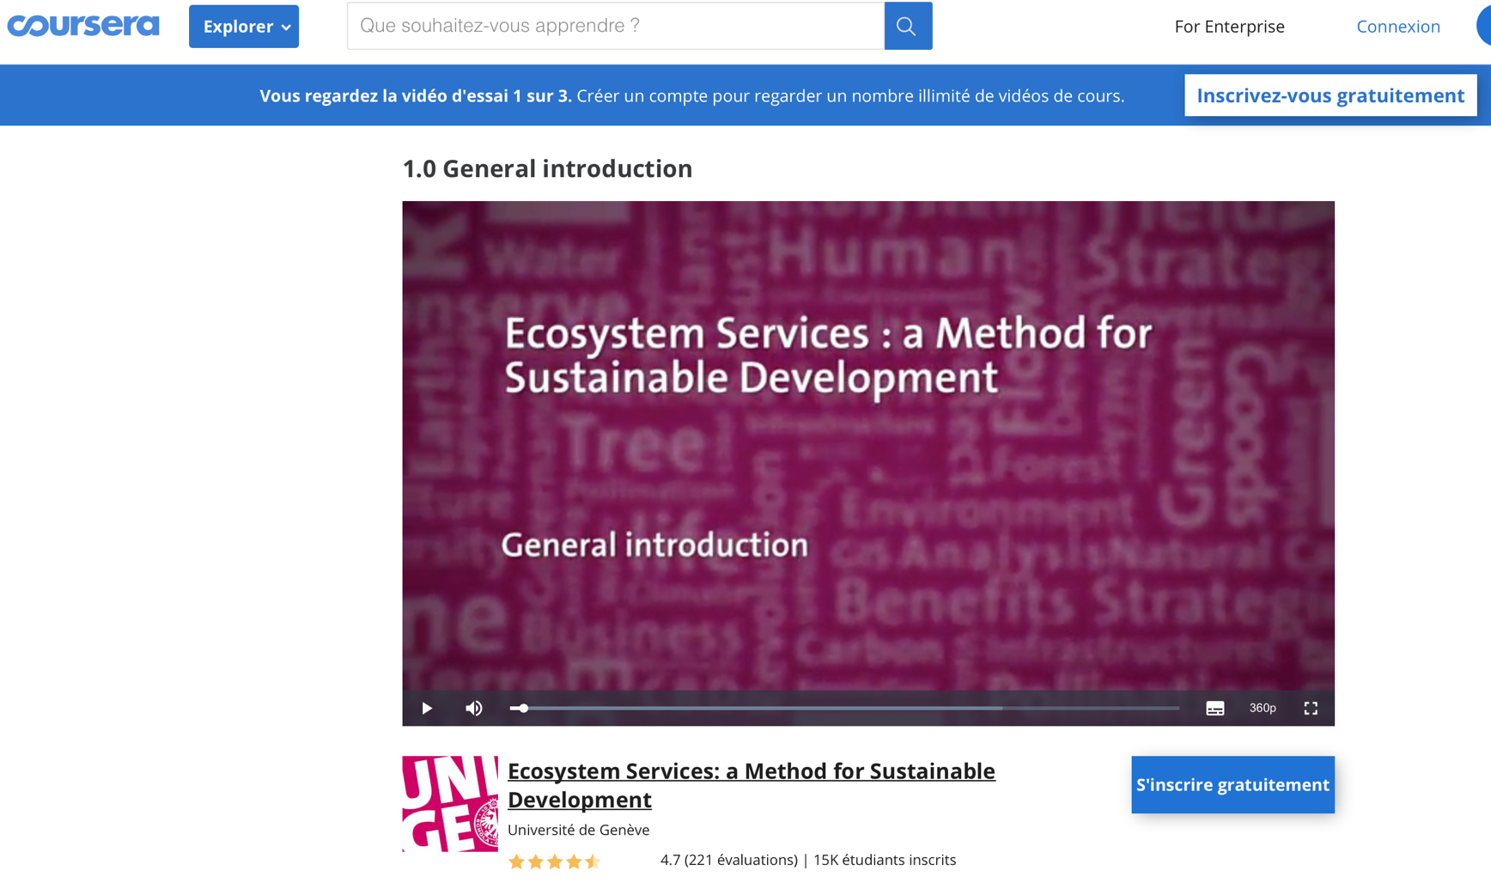
MOOC on Ecosystem services
Martin Schlaepfer
Anthony Lehmann
Juliet Fall
An online course developed at the University of Geneva that critically presents Ecosystemic Services, their economic, biophysical and spatial assessments, as well as their political implementation.
https://www.coursera.org/learn/ecosystem-services

Slide 9
Essential variables and GEOSPATIAL workflows
2

Slide 10

Group on Earth Observation:
Biodiversity Observation Network
Mission: Improve the acquisition, coordination and provision of biodiversity observations and related services to users, including policy makers and the scientific community.
Vision: A global biodiversity observation network that contributes to effective management policies for biodiversity and global ecosystem services.
https://geobon.org

Slide 11
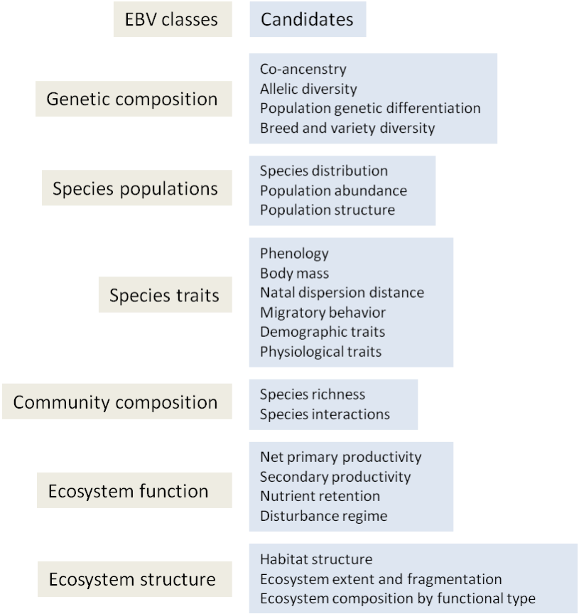
Essential Biodiversity Variables (EBVs)
Essential variables of biodiversity are defined as the derived measures needed to study, report and manage changes in biodiversity, focusing on the state and trend of biodiversity elements. They provide the first level of abstraction between low-level primary observations and high-level biodiversity indicators.
https://geobon.org/ebvs/what-are-ebvs/

Slide 12

GEOEssential project
GEOEssential general framework linking data sources to policy indicators through Essential Variables
Workflows
www.geoessential.eu
Lehmann et al. 2019. IJDE
Notes:
Figure 2. GEOEssential general framework linking data sources to policy indicators through Essential Variables with the help of a knowledge base.

Slide 13
Drivers & Pressures
Energy & Mineral (EEMV)
Societal Impacts
Urban
development
(EUV)
extractives
Health
(EHV)
Climate Services
Atmosphere (ECV)
air quality
Hydrosphere
(EWV, EOV)
Biosphere
(EBV)
Water
Services
Activities & Responses
Ecosystem services
States & Evolutions
light
Agriculture
(EAV)
Transport
& Infrastructure
(ETIV)
Geological Services
Geosphere (EGV)
Other human activities:
Land use
Demography
Economy
Natural Capitals
Benefits & Impacts
Socio-Economic System (ESESV)
Socio-ecological system
Earth System (EESV)
supporting the SDGs (ESDGV)
Lehmann et al. 2019. IJDE

Slide 14
Barriers and solutions in the flow of data to sustainability decision-making.
remote sensing
solutions
sensors
scientists
obser
vations
input
process
output
interface
D
decision makers
people
public
A
B
C
models
barriers
Lehmann et al. 2017. Sustainability
(A) access to data; (B) data size; (C) the ability to develop and iterate existing software; and (D) knowledge transmission. Simple arrows are solutions for removing obstacles, and dotted arrows represent an active feedback in the workflow.
Lehmann et al. 2017

Slide 15
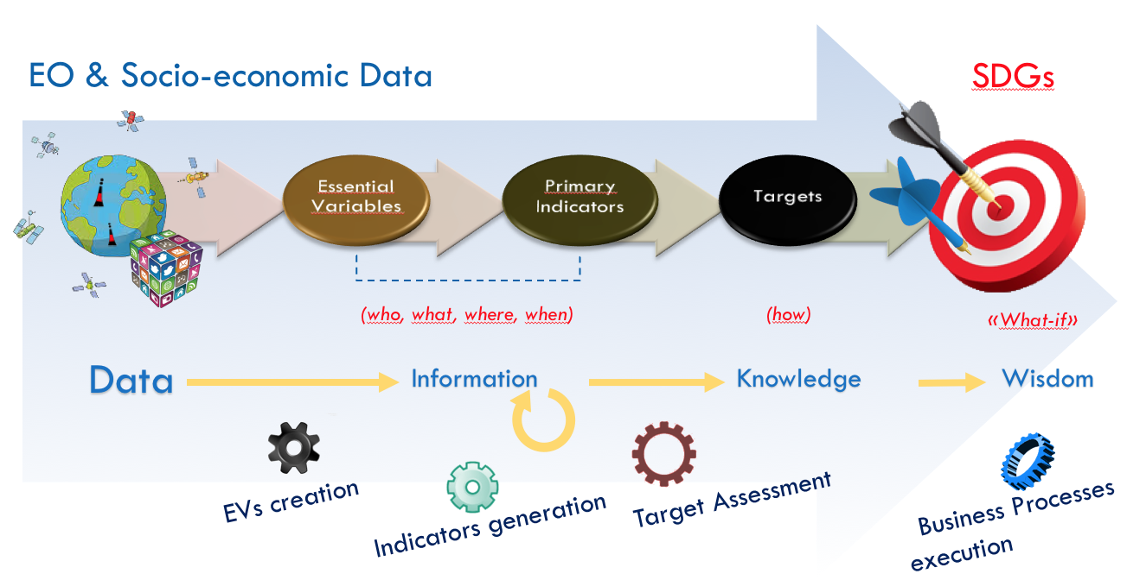
SDG workflows

Slide 16
GEOEssential workflow
Giuliani et al. 2020

Slide 17
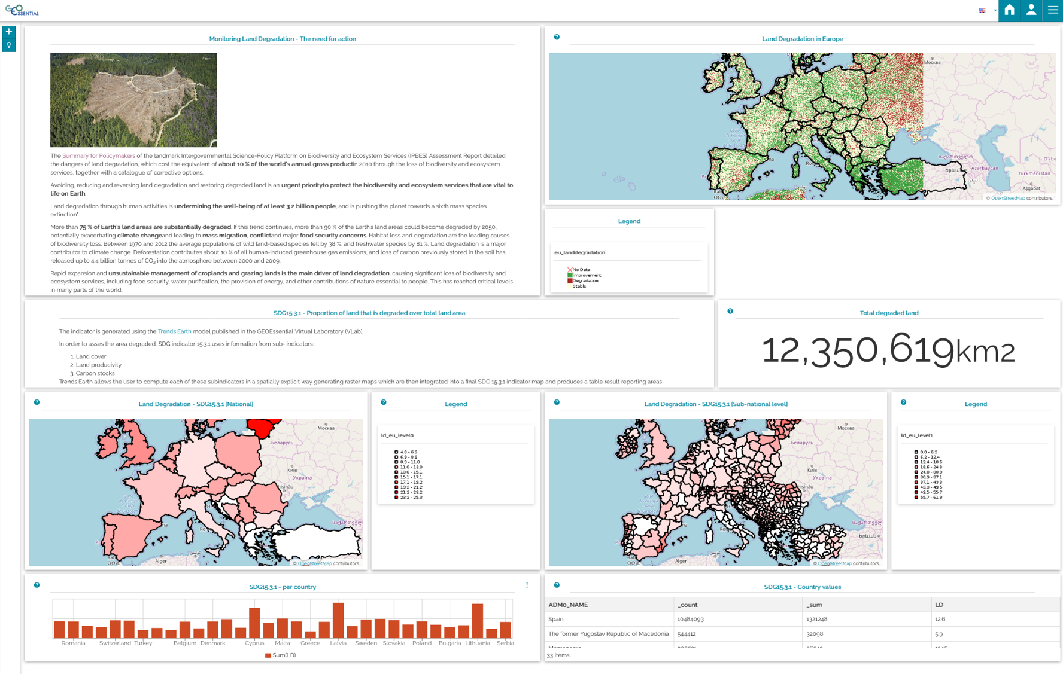
GEOEssential Dashboard…
…using GeoServer, GeoNetwork, MapStore
https://geoessential.unepgrid.ch/mapstore/#/dashboard/4
Notes:
https://geoessential.unepgrid.ch/mapstore/#/dashboard/4

Slide 18
Individual modeling approaches
3

Slide 19
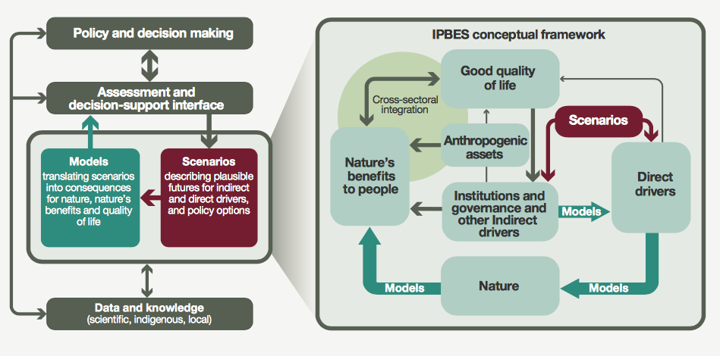
Scenarios and models
The panel on the left points out that scenarios and models are directly dependent on data and knowledge for their construction and testing and add value by synthesizing and organizing knowledge.
The right panel provides a detailed view of the relationships between scenarios, models and key elements of the platform's conceptual framework
https://www.ipbes.net/document-library-categories/assessment-reports-and-outputs

Slide 20
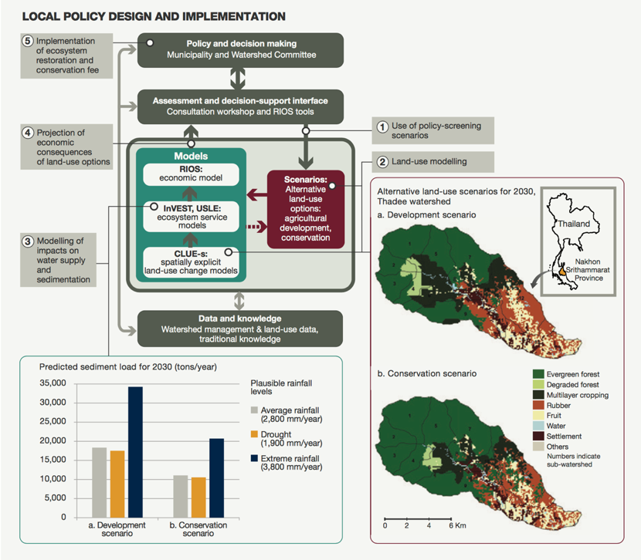
Scenarios and models
Thadee watershed, Thailand, where farmers' water supply and household consumption have been degraded by the conversion of natural forests to rubber plantations.
Notes:
Bassin versant de Thadee, Thaïlande, où l'approvisionnement en eau des agriculteurs et la consommation des ménages ont été dégradés par la conversion des forêts naturelles en plantations de caoutchouc. Des scénarios d'examen des politiques (1) ont été élaborés afin d'explorer les utilisations futures plausibles des terres (2). Des modèles ont ensuite été utilisés pour évaluer la charge en sédiments des rivières et d'autres services écosystémiques (3). L’outil RIOS a traduit ces effets en coûts et bénéfices économiques (4). La municipalité a collecté une redevance de conservation pour financer ces activités (5).

Slide 21



The tools available for spatial analyses
Statistics: GIS layer combination through a statistical model established on observation points: Regression...
Geostatistics: Spatialization of point information using spatial self-correction by interpolation: Krigeage, Neural Networks...
Dynamics: Integration of space-time dynamism in the model: cellular automatons...
Experts: Replaces the statistical model when data is missing.
Process: GIS layer combination via a conceptual model of the relationship between parameters and the search for their coefficients.
Remote sensing: Satellite or airborne, allows you to obtain a continuous description of space at different wavelengths.
Digitalization: Digitalization of existing maps remains a precise and effective way to capture spatial information.

Slide 22
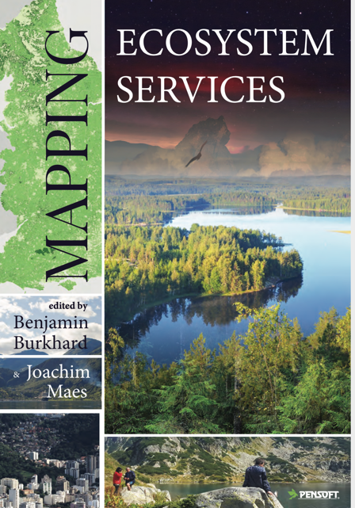
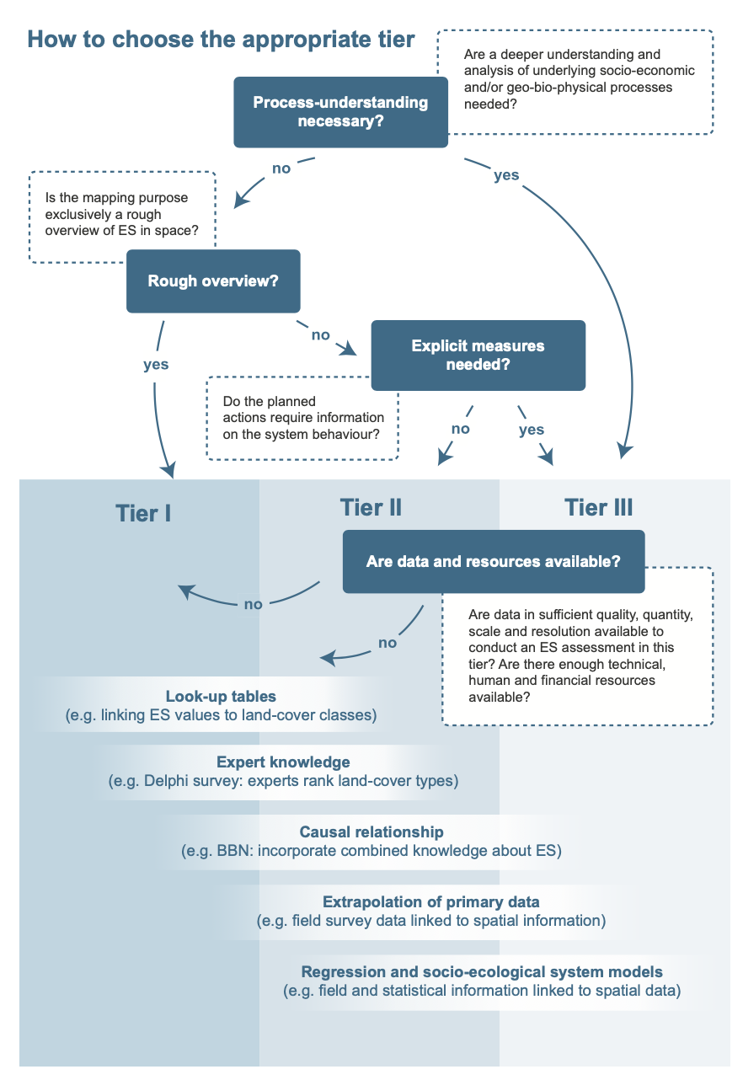
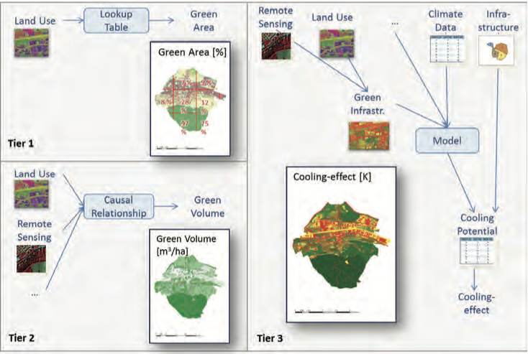
Tools available with different precision (Tier)
Different levels of accuracy are possible and used depending on the needs and data available
https://ab.pensoft.net/article/12837

Slide 23

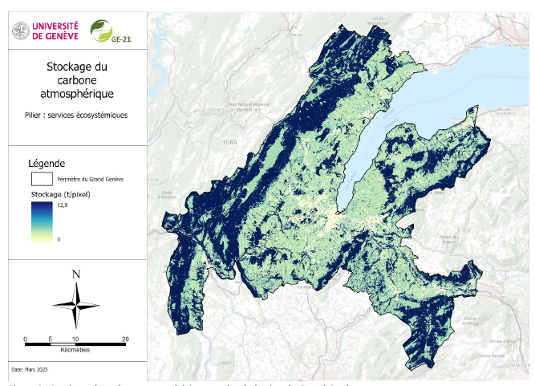

Individual model 1: Ecosystem Services modeling
Carbon storage
- Pollinator-friendly areas
- Carbon storage
- Water quality regulation
- Erosion control & sediment retention
- Local climate regulation and air quality
Honeck et al. 2020, Sanguet et al. 2023

Slide 24
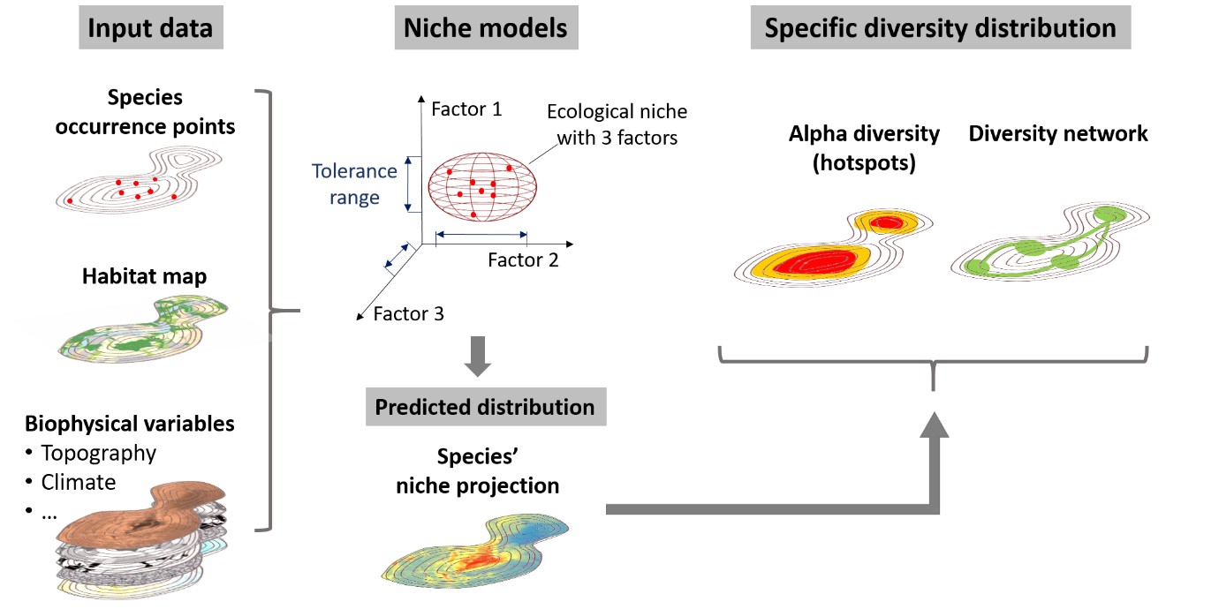

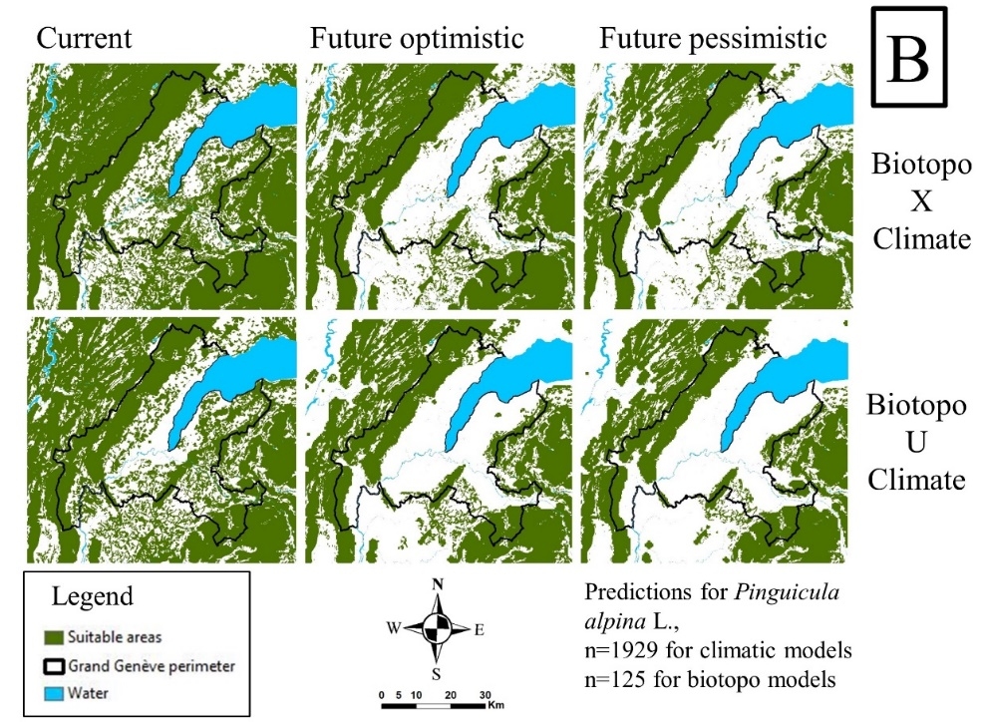
Individual model 2: Species and Ecosystems modeling
This pillar is composed of:
- 1816 maps of the distribution of plant species, 336 of which are threatened on the Swiss Red List.
- 585 distribution maps for animal species, 135 of which are threatened on the Swiss Red List.
- Natural Habitats
Honeck et al., 2020, Sanguet et al. 2022

Slide 25
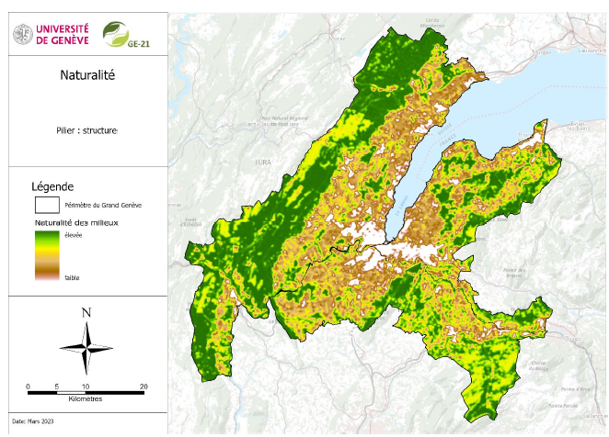


Individual model 3: Landscape structure
- Fragmentation (or continuity) index of natural habitats
- Permeability of land use classes
- Naturalness of the territory
- Diversity of green environments (Shannon index)
- Central zone indicator
Sanguet et al. 2023

Slide 26

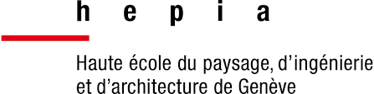
Individual model 4: Connectivity for Deer
Natural Habitats
"Current"
Connections
Loreto et al. 2023; Loreto et al. 2024

Slide 27

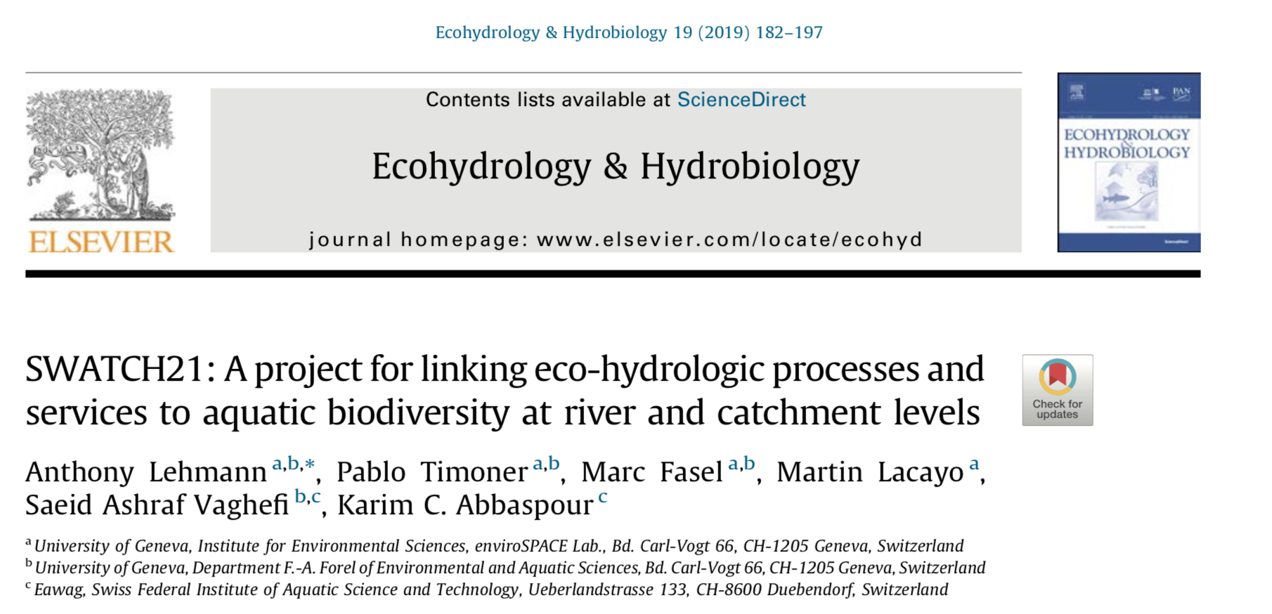
Eco-hydrologic services and biodiversity of Swiss rivers
https://doi.org/10.1016/j.ecohyd.2019.01.003

Slide 28
Modeling workflow
Forecasting
Hydropower
Water demands
Backcasting
Initial
conditions
Agriculture
River network
step 2
Snow & glacier
model
SDM
(RF, BRT)
Land use/cover
step 5
Scenarios &
Policy options
SWAT
DEM
decision making
step 6
Tools API
River discharge
INVEST
step 4
Species
distribution
models
step 1
Data
SDI&API
step 3
Hydrologic
services models
Soil
Weather
Species
Lehmann et al. 2019

Slide 29
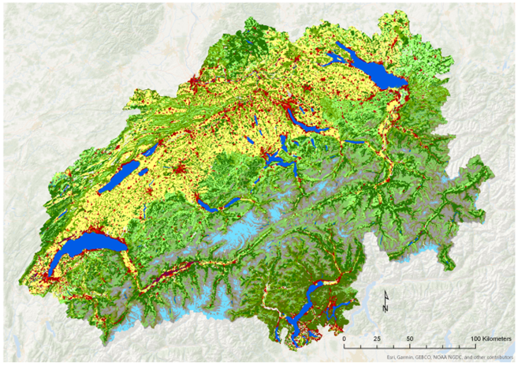
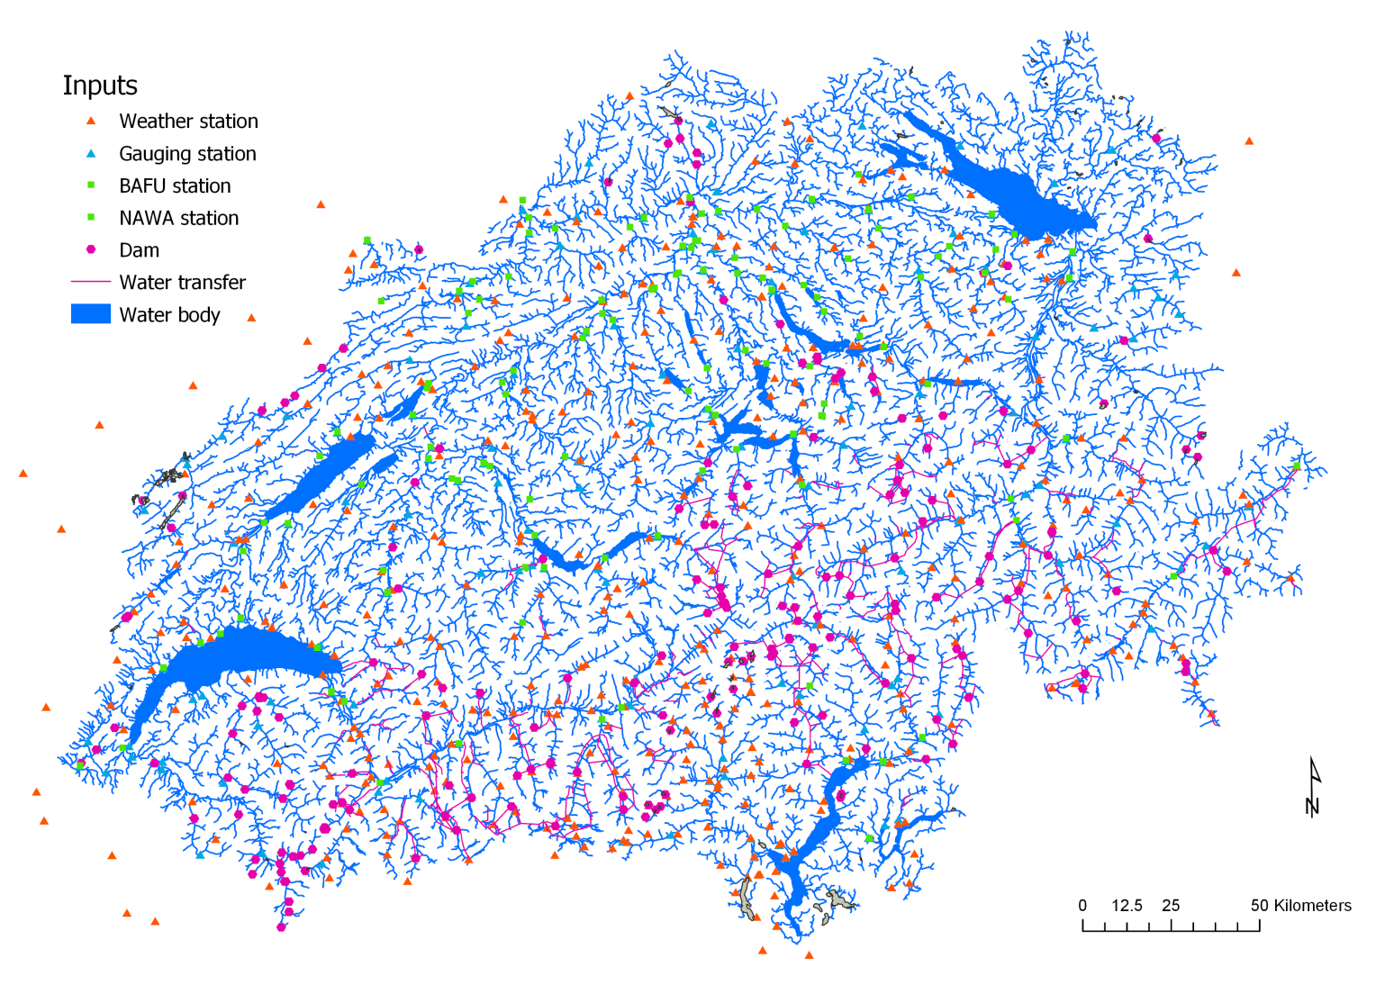
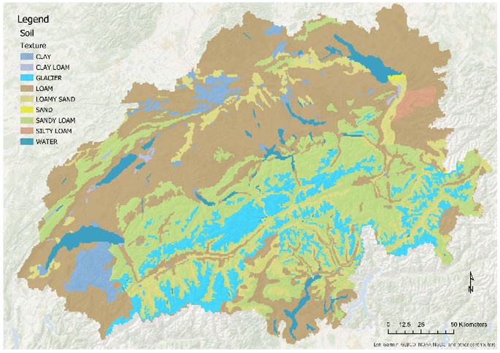
Input data for SWAT
Land use
Gages stations
Soils
Fasel et al. (in prep)

Slide 30
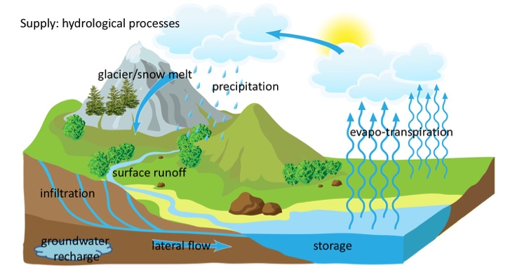
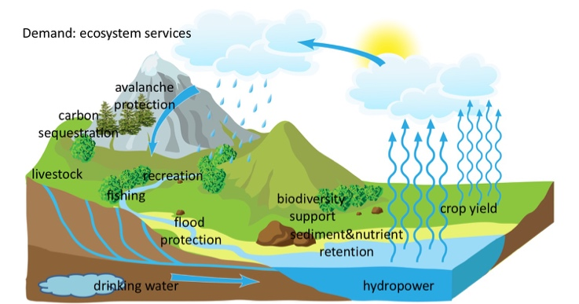
Examples of aquatic services considered
Provisioning services
§ Agriculture: crop yield will be directly derived from SWAT outputs
§ Drinking water: the amount of blue water used for drinking will be assessed from the population distribution and needs
§ Hydropower: blue water transformed in energy by hydropower will be estimated using the distribution and size of existing dams
§ Water for livestock: blue water available for livestock will be estimated from the distribution of different types of livestocks
Regulating and maintenance services
§ Biodiversity: the ecosystem diversity will be assessed by downscaling existing land use information from 100m (geostat) resolution to 25m (Lehmann et al. unpublished).
§ Flood protection: The Critical Consecutive Days Analyzer (CCDA) has been developed at EAWAG.
§ Nutrient and sediment retention will be directly derived from SWAT outputs
§ Carbon sequestration will be calculated with the InVEST package
§ Avalanche protection: this services will be assessed by GIS analyses as in Grêt-Regamey et al. (2008)
Cultural services
§ Fishing for recreation: this service will be assessed by modelling the species distribution of emblematic fish species such as trouts using species distribution models
§ Recreation: the recreational value of river beds will be assessed by a combination of GIS analyses of accessibility from roads and walking tracks, and the density of photos made available on Flickr.
https://doi.org/10.1016/j.ecohyd.2019.01.003

Slide 31
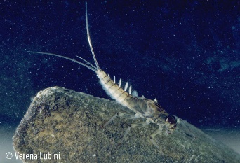
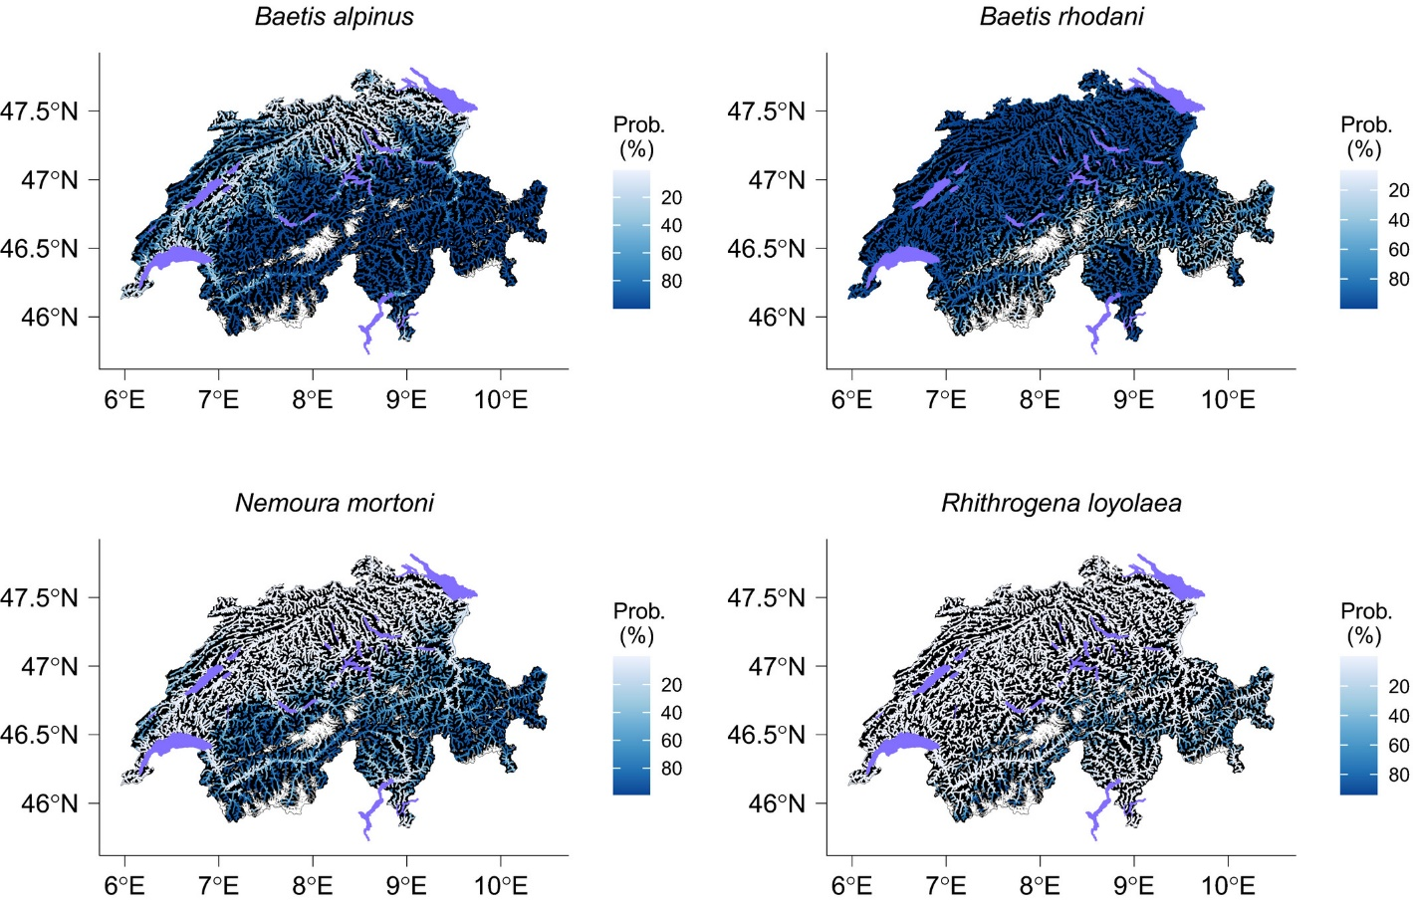
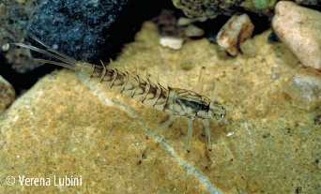
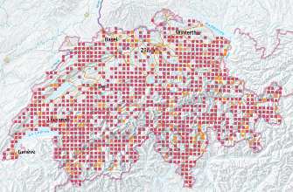
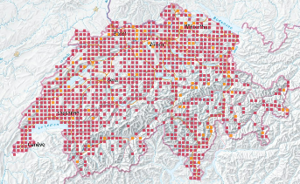
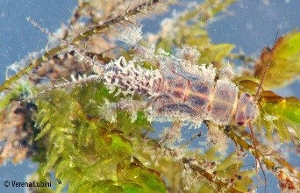
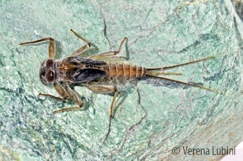
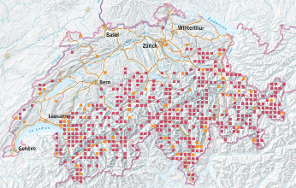
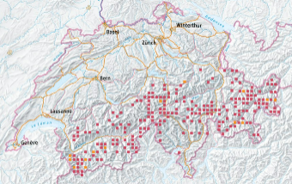
Species distribution modeling based on SWAT outputs
Timoner et al. 2021
Notes:
F I G U R E 4 Occurrence probability for Baetis alpinus, B. rhodani, Nemoura mortoni and Rhithrogena loyolaea in Switzerland. Lakes are in purple and gray areas represent glaciers

Slide 32
MODELS INTEGRATION INTO
ECOLOGICAL infrastructureS
4

Slide 33
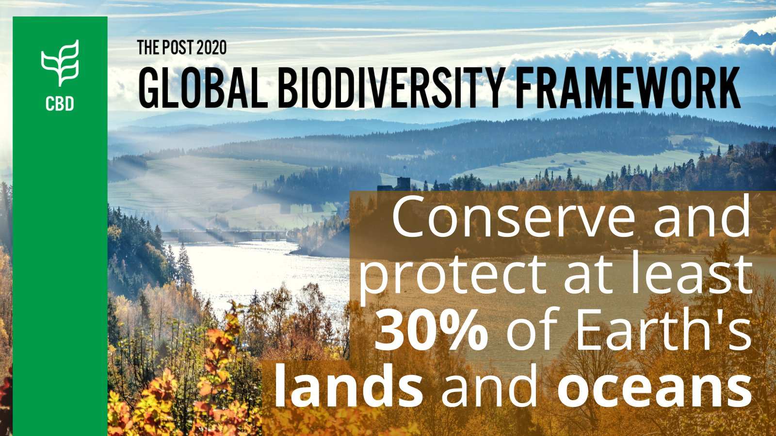
New UN Convention on Biological Diversity (CBD) agreements for 2030
https://www.cbd.int/article/draft-1-global-biodiversity-framework

Slide 34

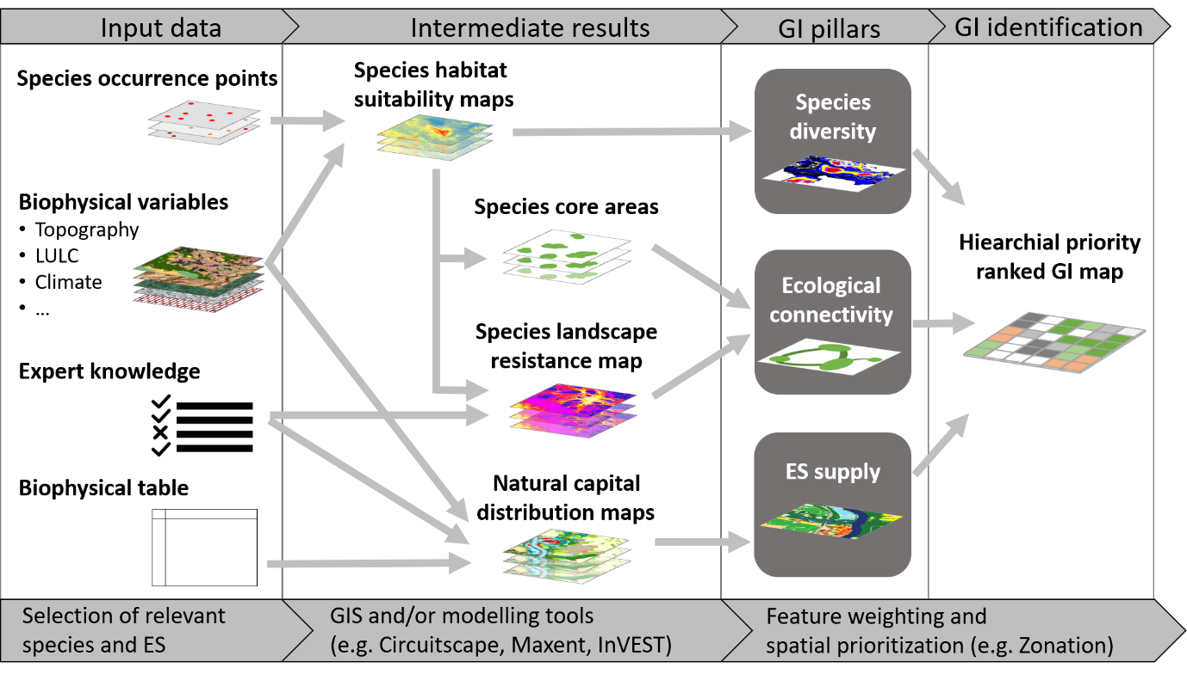

Proposed Methods for Identifying Ecological Infrastructure (best 30%)
Honeck et al. 2020a

Slide 35
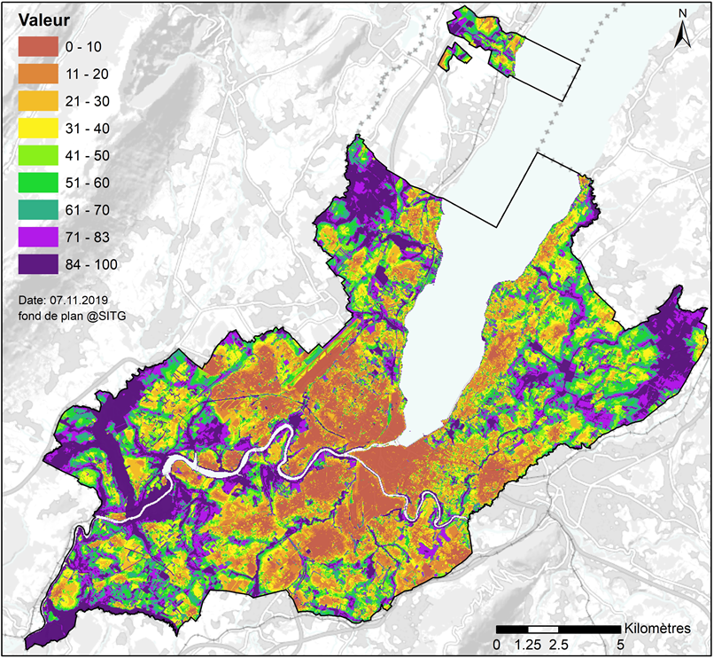
Ecological Infrastructure of Geneva
13% additional networking of main habitats
17% of the most interesting areas including existing protected areas. This correpsond to the main habitats and the CBD Aichi Object
Honeck et al. 2020: doi:10.3390/su12041387

Slide 36
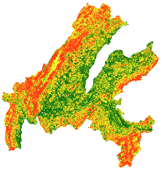
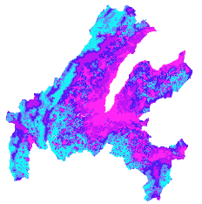
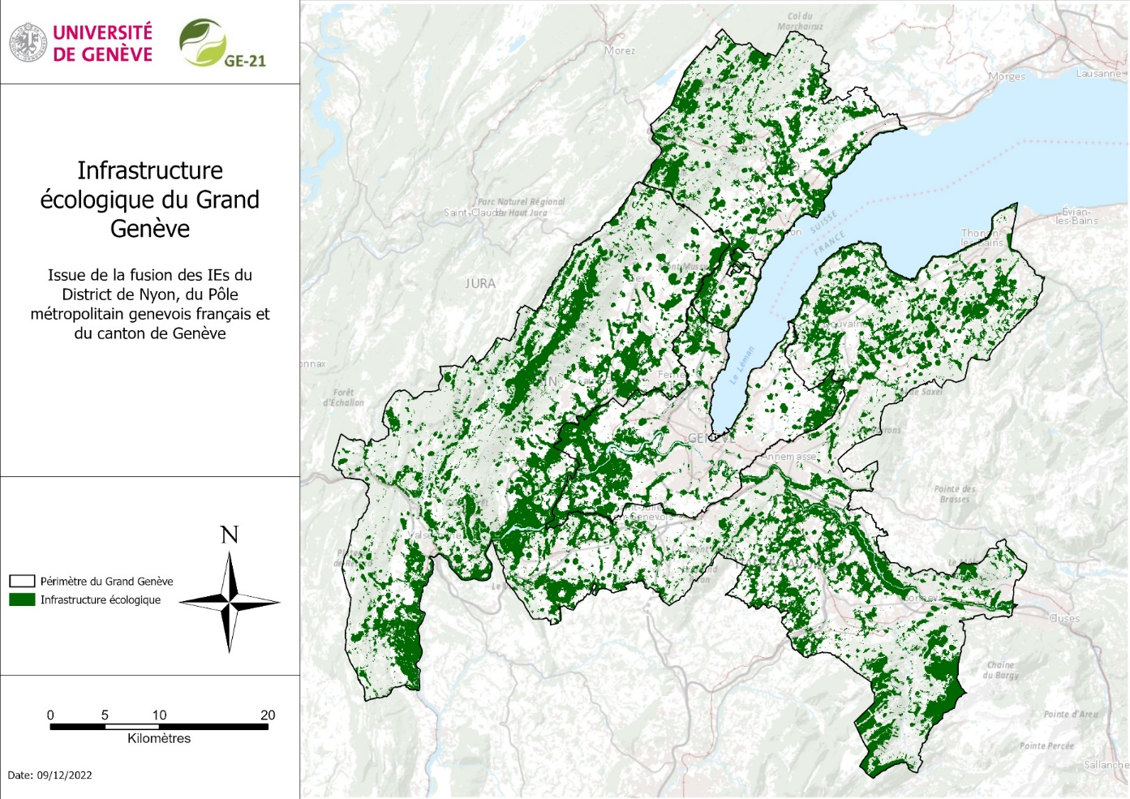
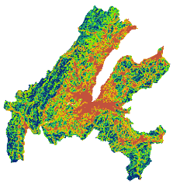
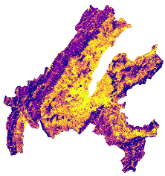

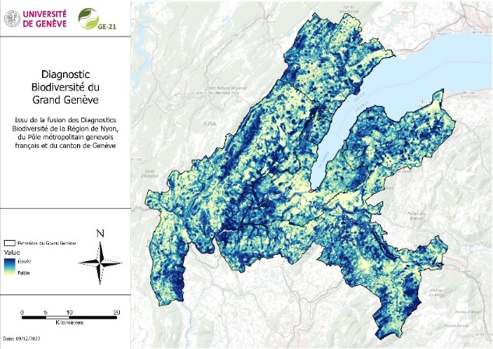
Ecological infrastructure of Greater Geneva
Composition
Connectivité
Structure
Services écosystémiques
>=70%
Diagnostic: 0 -> 100
Infrastructure: 0 / 1
Sanguet et al. 2023

Slide 37
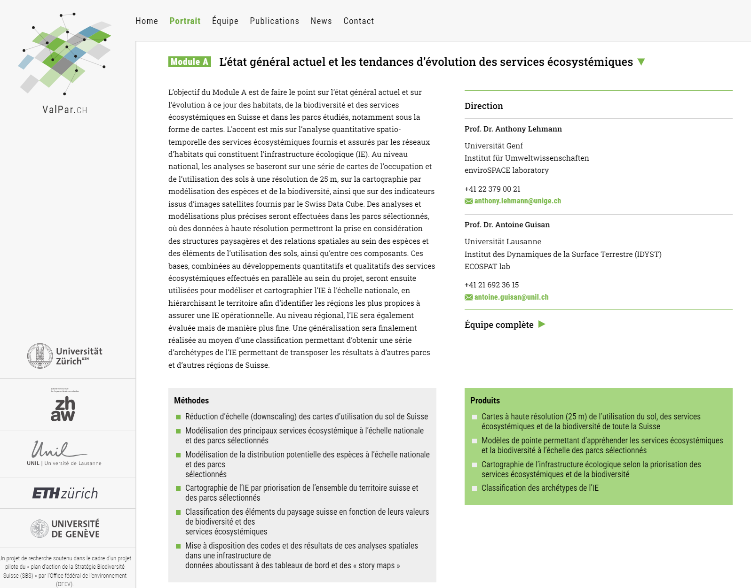
ValPar.CH: Added value of EI in Switzerland
www.valpar.ch

Slide 38
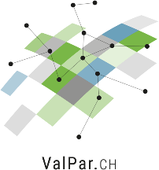
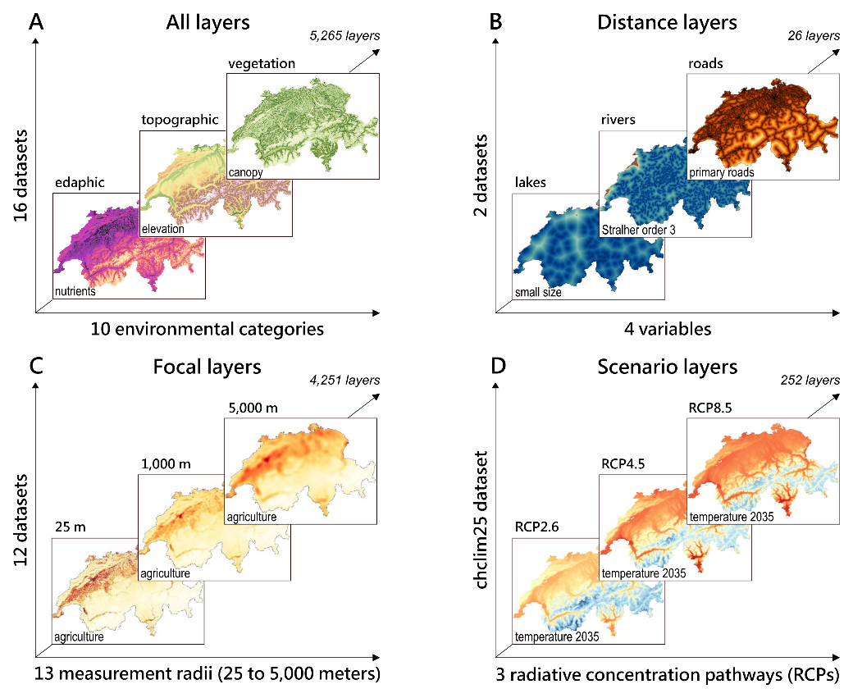
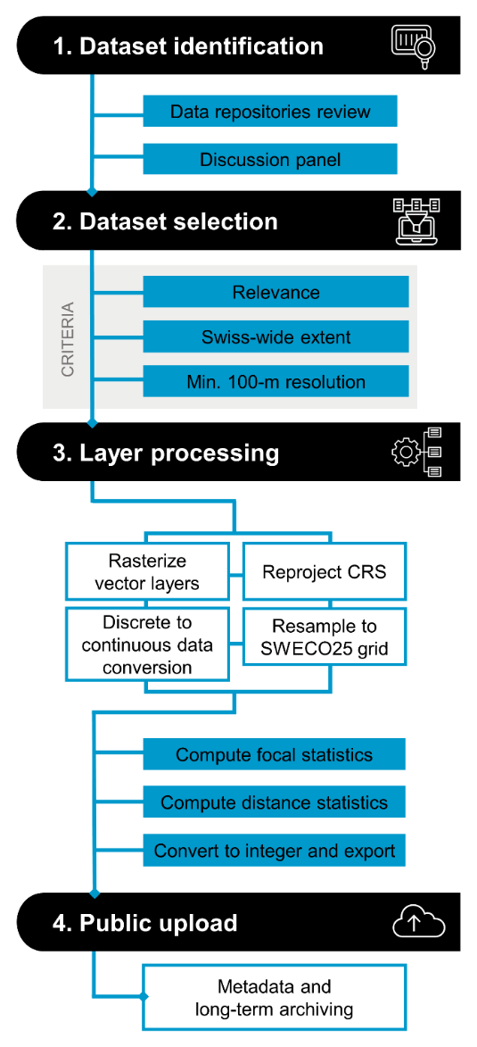
SWECO25: a raster database for ecological research in Switzerland
5 265 couches en 10 catégories: géologique, topographique, bioclimatique, hydrologique, édaphique, utilisation et couverture des sols, population, transport, végétation et télédétection
Külling, Adde et al, 2024

Slide 39
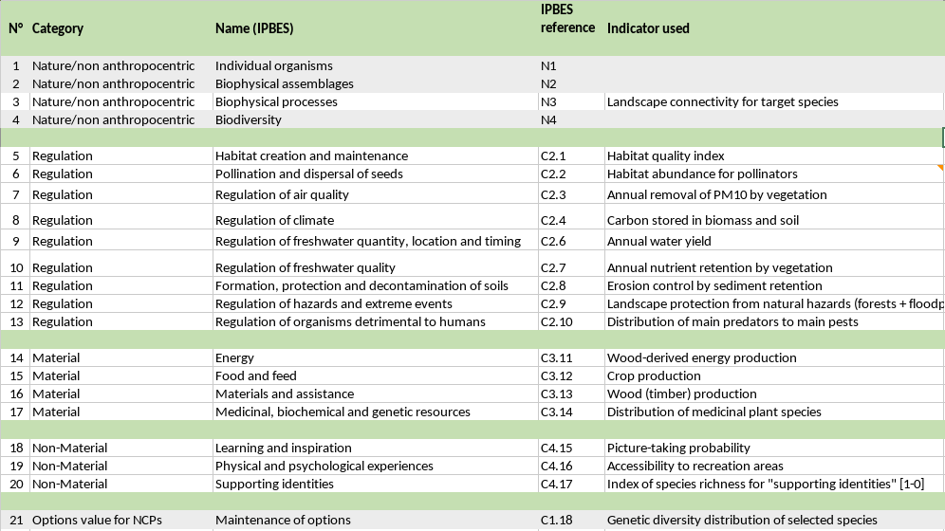
Selection of ES indicators based on the IPBES category list
Külling et al., 2024.

Slide 40
15 mapped ES and Biodiversity
Normalized distribution of indicators maps. Color schemes defined by Jenks natural breaks. BD - Red list species, HAB - Habitat quality, POL - Pollinator abundance, AIR - Removal of PM10 by vegetation, CAR - Carbon stored in biomass, NR - Nutrient retention by landscape, SR - Sediment retention by landscape, HAZ - Protective forests and floodplains, PC - Pest control species, WY - Annual water yield, MAT - Wood provision potential, FF - Landscape suitability for agriculture, MED - Medicinal plants, LI - Landscape suitability for picture-taking, REC - Recreation potential, and ID - Emblematic species.

Slide 41
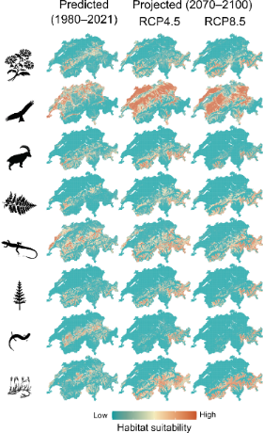
National Ecological Infrastructure
Ecosystem Services
SDMs
Regional parcs
Cantons
Communes
Külling et al, submitted.

Slide 42
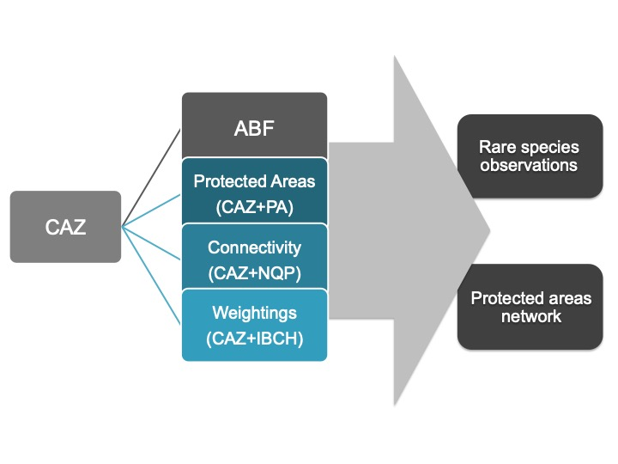
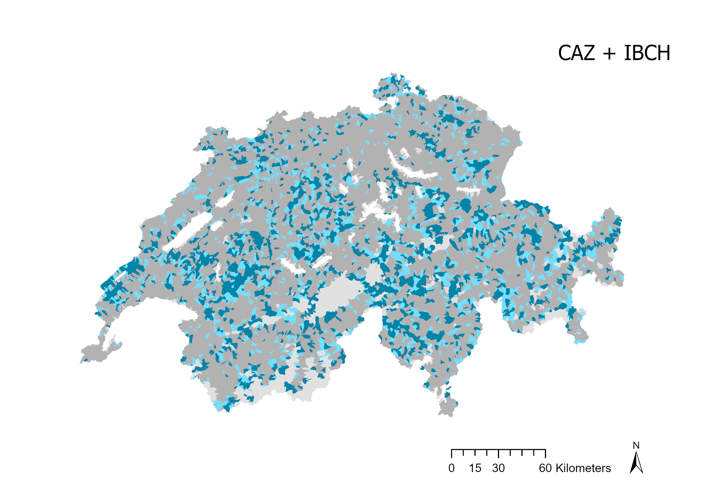
Aquatic EI: Prioritization of River catchments
River catchments prioritization based on aquatic species distribution
Cabezas Master, 2021
Notes:
Logiciel Zonation: comparaisons de ces 5 IB méthodes (4 comparaisons)
Removal rule CAZ-ABF
AVEC AP
AVEC Connectivité
Avec pondération sur IBCH
Ensuite chaque méthode → capacité à inclure les espèces rares et la proportion de ces différents réseau dans les AP existantes.

Slide 43
The need for a nexus approach
5

Slide 44
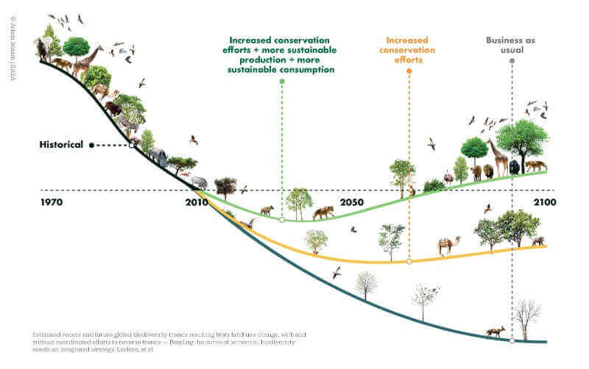
Nature positive initiative
Leclère et al. 2020. Nature 585

Slide 45

Sustainable development and the link between water and energy and food: a perspective on livelihoods
It is about achieving a sustainable balance between natural supply and human demand to ensure the security of environmental livelihoods
Environmental Science & Policy, Volume 54, 2015, 389–397
Notes:
Fig. 2. The conceptual framework for investigating environmental livelihood security (ELS) combines concepts of the water–energy–food–climate nexus with the capitals of the sustainable livelihoods framework to achieve a sustainable balance between natural supply and human demand to ensure ‘environmental livelihood security’

Slide 46
20 years of Ecosystem Services: synthesis
Costanza et al. 2017: https://doi.org/10.1016/j.ecoser.2017.09.008

Slide 47

Sustainability of Social-Ecological Systems: the Nexus between Water, Energy...
https://www.coursera.org/learn/sustainability-social-ecological-systems

Slide 48

Multi-Scale Integrated Analysis of Societal and Ecosystem Metabolism
Internal State
Environmental Pressure
https://magic-nexus.eu

Slide 49


NEXUS avec MuSIASEM
Multi-Scale Integrated Analysis of Societal and Ecosystem Metabolism
https://en.wikipedia.org/wiki/MuSIASEM

Slide 50

Characterizing the Security of Food Systems for a selected region:
the case of Greater Geneva agglomeration
Alexander Folz
Phd student, UNIGE and Liphe4
209 transboundary communes on ~ 2000 km2 [3]
~ 946 000 inhab. (2014) [3], ~ +30 % in 2040 [4]
Climatic projection in 2035 (1980-2010; RCP8.5) [5]
    Temperature ~ +1.4°C (winter) & +1.3°C (summer)
    Precipitation ~ +13.3% (winter)
    & -3.4% (summer)
      Increase in evapotranspiration
      Negative glacier balance

Slide 51

Characterizing the security of Food systems for a selected region?
Greater Geneva’s food grammar
Folz et al. submitted

Slide 52

End use (a) and environmental pressure (b) of Greater Geneva's agricultural system with diet A and B respectively.
PL – Plants; ANI – Animals; BW – Blue water; HA – Human activity;
GW – Green water; GRW – Grey water; L – Land; N/P2O5/K2O – Fertilizer ; PEST – Pesticides; MNR – Manure.
Folz et al. submitted

Slide 53
TOWARDS Digital twins
6

Slide 54

WHY DiGital twins for the environment ?
“Digital Twin Earth will help visualise, monitor and forecast natural and human activity on the planet. The model will be able to monitor the health of the planet, perform simulations of Earth’s interconnected system with human behaviour, and support the field of sustainable development, therefore, reinforcing Europe’s efforts for a better environment in order to respond to the urgent challenges and targets addressed by the Green Deal.”
www.nceo.ac.uk
https://www.esa.int/ESA_Multimedia/Images/2020/09/Digital_Twin_Earth

Slide 55
EXAMPLES of DiGital twins for the environment
1. Climate and Atmospheric Digital Twins
  Global Climate Digital Twins: Simulate and predict climate change, greenhouse gas emissions, and extreme weather events.
  Air Quality Digital Twins: Model pollution levels in urban or industrial areas for better air quality management.
  Weather Forecasting Digital Twins: Enhance weather predictions using real-time sensor data and AI.
2. Hydrological Digital Twins
  Ocean and Marine Digital Twins: Monitor sea levels, ocean currents, marine biodiversity, and pollution.
  Rivers and Watershed Digital Twins: Track water flow, flooding risks, and water quality in lakes, rivers, and reservoirs.
  Groundwater and Aquifer Digital Twins: Model underground water reserves for sustainable water management.
3. Terrestrial and Biodiversity Digital Twins
  Forest Digital Twins: Track deforestation, carbon sequestration, and ecosystem health.
  Soil and Agriculture Digital Twins: Model soil quality, erosion, and precision farming practices.
  Wildlife and Biodiversity Digital Twins: Simulate animal migration, habitat changes, and conservation efforts.
ChatGPT

Slide 56
Integration of the JupyterHub solution into the general objective of developing a digital twin for the environment in Geneva
DIGITAL TWIN
END USERS : OCEV, OCAN, OCEAU,…
Knowledge server
KNOWLEDGE PLATFORM
Dash Boards
Story Maps
WORDPRESS
Web
server
JAVASCRIPT
FAIR/CARE PRINCIPLES
GEOSERVER
SDI
server
GEONETWORK
MAPSTORE
JUPYTER HUB
Notebook server
R SERVER
DPSIR INDICATORS
QGIS & R
SDM
ZONATION
Ecological
Infrastructure
Processing server
AI
CIRCUITSCAPE
DATACUBE
INVEST
National and cantonal data
POST
GRESQL
BIO
DIV
WATER
SOIL
CLI
MATE
…
Data
Servers
EssentialVariables
(EVs)
POSTGIS
Demography
Unexpected
Climate
Land use
Lambiel et al. in prep.
Global and local changes

Slide 57

Architecture of the Shared JupyterLab Environment and the Automation Process for Ecological Infrastructure (EI) Calculation and Its Indicators
Lambiel et al. in prep.

Slide 58
Benefits of DiGital twins for the environment
Shared working environment and data sources
Versioning of outputs
Known Python and R coding environment
Reproducibility of results
Scenario making with complex workflows
…

Slide 59

COMBINING DIGITAL TWINS
FOR ENVIRNMETNAL POLICY NEEDS

Slide 60
Conclusions

Slide 61



Conclusions
We have the data and models to assess biodiversity and ecosystem services.
Whatever the approach, we exceed the planet's natural ability to regenerate the natural capital we need!
We have methods such as ecological infrastructure to integrate the outputs of complex individual models into land use planning
The Nexus approach brings new opportunities to monitor and model socio-ecological systems in order to better inform decision making for a more sustainable world

Slide 62

Is there a pilot on the plane?
The current level of control around sustainable development issues
Giampietros’ slides

Slide 63

Is there a pilot on the plane?
The level of control we'd like to see everywhere
Giampietros’ slides

Slide 64
Is there a pilot on the plane?
With a real SDG dashboard
Giampietros’ slides

Slide 65
Take home message
We urgently need to develop Digital Twins for the environment capable of measuring the past, present and future impacts of human activities
in order to
inform decision-makers from global to local scales, from public administrations to private sectors

Slide 66
Selected references from enviroSPACE
Folz et al. Reconciling urban food metabolic pattern with its environment – a “mission impossible”? (Submitted).
Giuliani, G. et al. Knowledge generation using satellite earth observations to support sustainable development goals (SDG): A use case on Land degradation: Int. Journal of Applied Earth Observation and Geoinformation (2020).
Honeck, E.C. et al. Implementing Green Infrastructure for the Spatial Planning of Peri-Urban Areas in Geneva, Switzerland: Sustainability (2020a)
Honeck, E.C. et al. Methods for identifying green infrastructure. In: SN Applied Sciences (2020b).
Külling, Adde et al. SWECO25: a cross-thematic raster database for ecological research in Switzerland. In: Scientific data (2024).
Külling, et al, Nature’s contributions to people and biodiversity mapping in Switzerland: spatial patterns and environmental drivers. In: Ecological indicators (2024).
Külling, et al. Reaching conservation targets: Spatial prioritization of national ecological infrastructure (submitted).
Loreto et al. Modeling red deer functional connectivity at a regional scale in a human-dominated landscape. In: Frontiers in environmental science (2023).
Loreto et al. Combining multi-species connectivity modelling with expert knowledge to inform the green infrastructure design. In: Journal for nature conservation (2024).
Lehmann, A. et al. Lifting the Information Barriers to Address Sustainability Challenges with Data from Physical Geography and Earth Observation. Sustainability 9 (2017).
Lehmann, A. et al. GEOEssential – mainstreaming workflows from data sources to environment policy indicators with essential variables: International Journal of Digital Earth (2019).
Lehmann, A., et al. Towards integrated essential variables for sustainability. International Journal of Digital Earth (2020).
Sanguet et al. Mapping Ecological Infrastructure in a Cross-Border Regional Context. Land, (2023).
Sanguet et a. Beyond topo-climatic predictors: Does habitats distribution and remote sensing information improve predictions of species distribution models? In: Global ecology and conservation (2022)

Slide 67
Thank you for your attention

