Slide 1



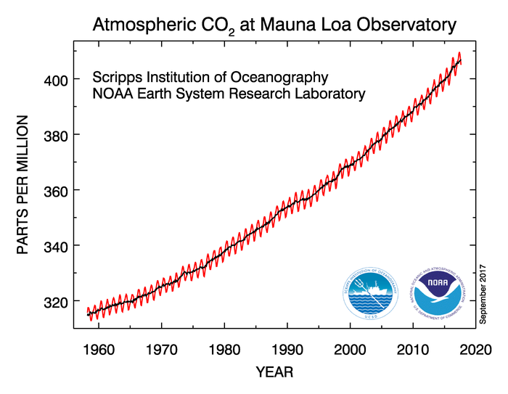
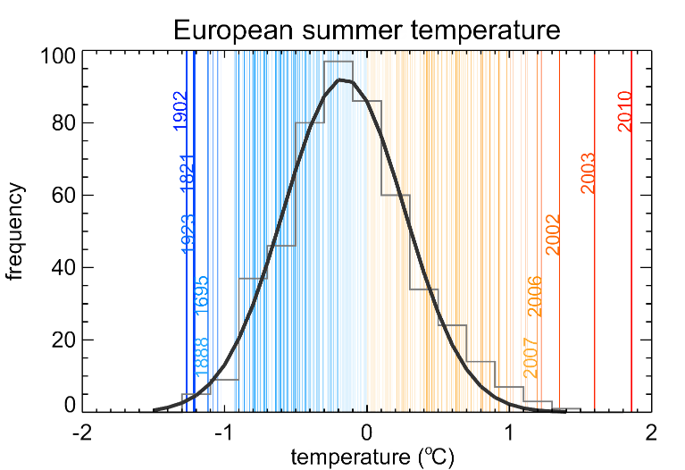

Climate change: impacts, trends, and extremes
Ricardo Machado Trigo (IDL, FCUL)

Slide 2
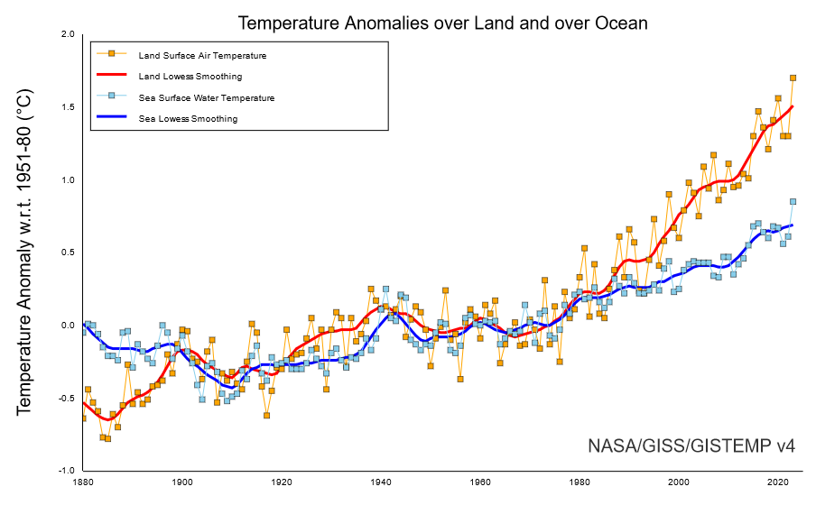
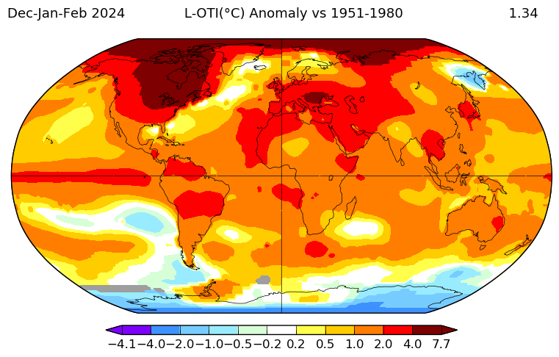
Annual temperature evolution since 1880 (NASA)

Slide 3
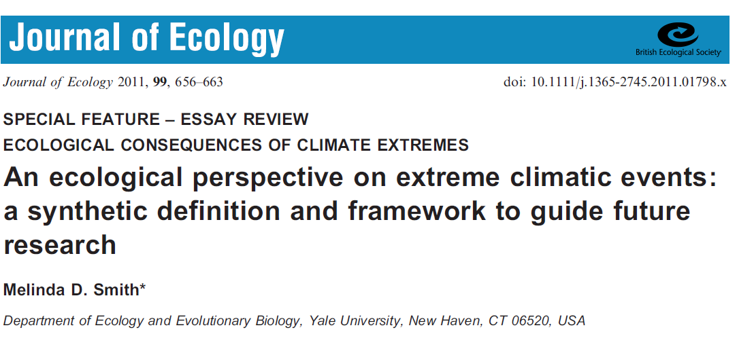
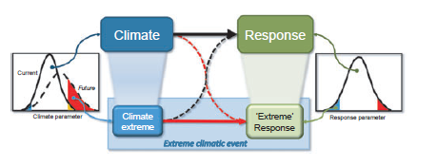
Smith (2011)

Slide 4
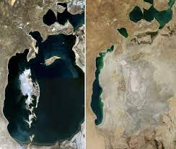
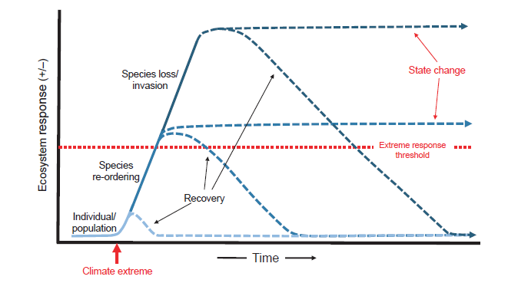
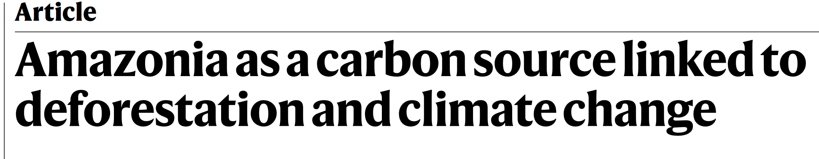
The Ecosystem response to climate extreme events
Aral Sea
Smith (2011)

Slide 5
Drought
Case-studies

Slide 6
Accumulated precipitation in Iberia between Oct. 2004 and Sept 2005
(% relative to the average for the period 1961-1990)
● C
The most intense drought:
Lisbon (since 1865) A
Madrid (since 1859) B
● D
Garcia-Herrera et al. (2007)

Slide 7
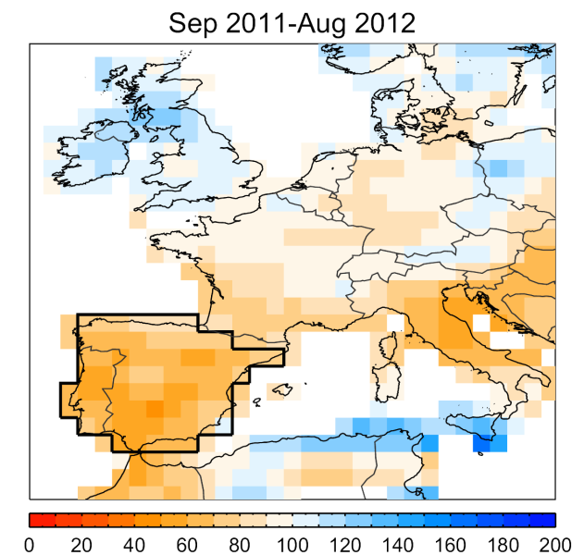
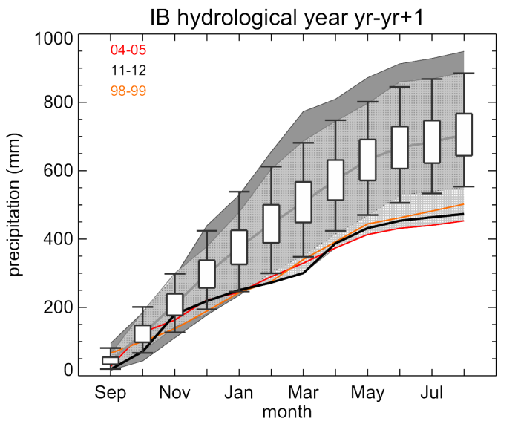
Trigo et al. (2013)

Slide 8
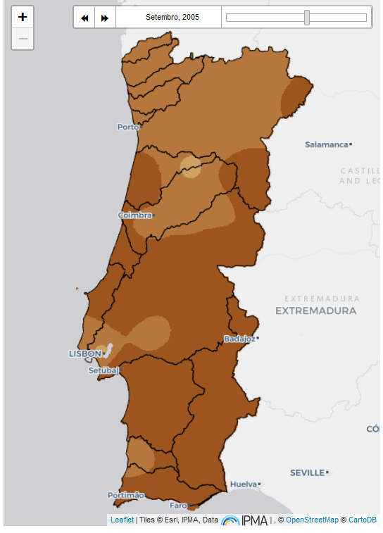
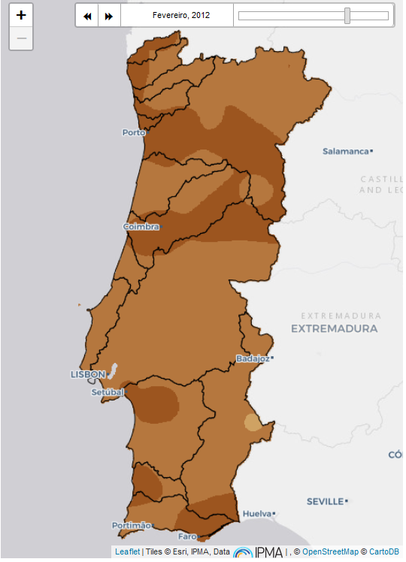
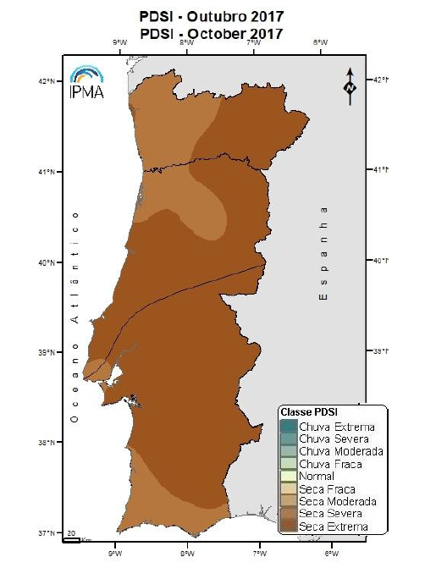
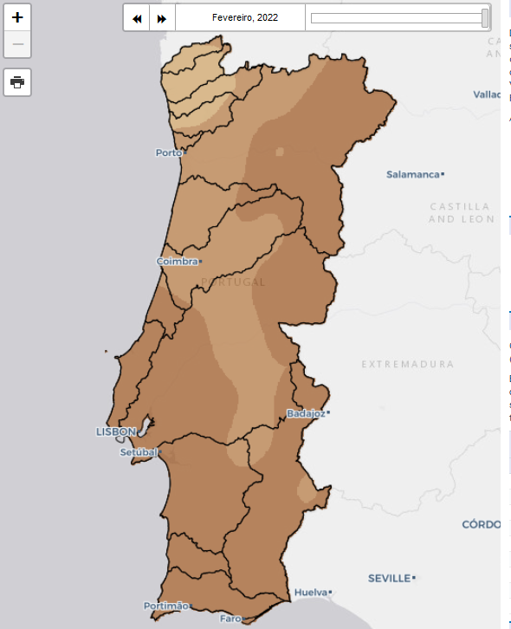
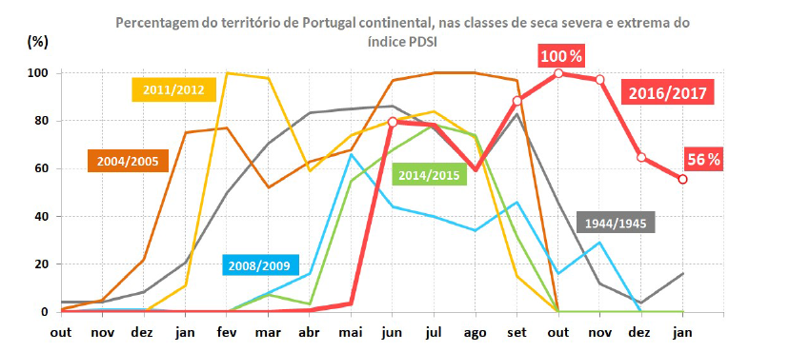
Sep 2005
Feb 2012
Oct 2017
Feb 2022
Percentage of territory under the two most severe PDSI classes

Slide 9
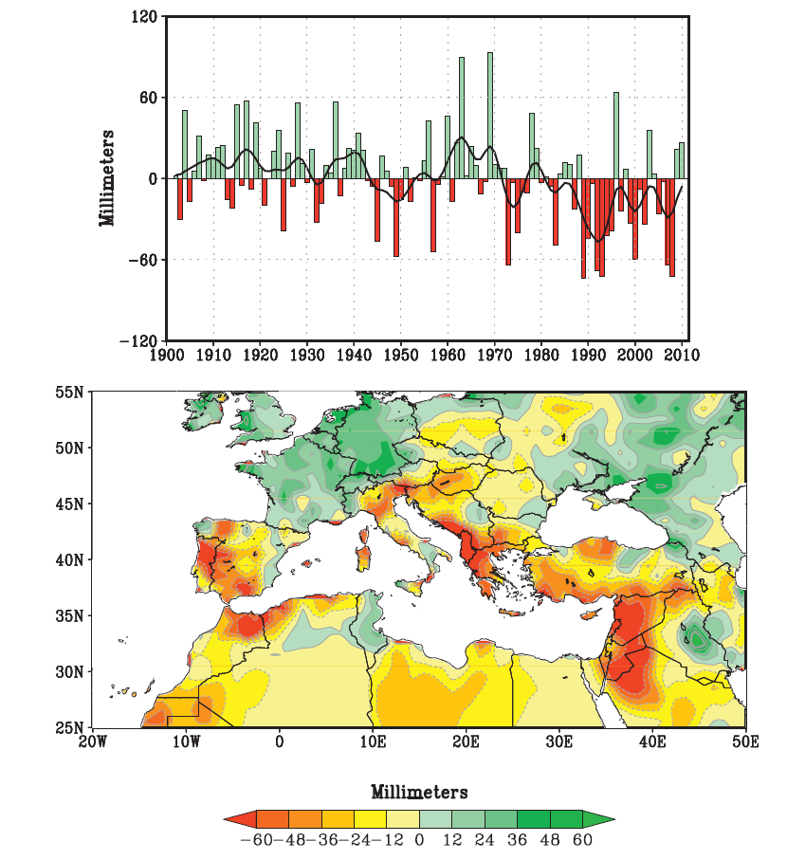
Observed precipitation changes in the Mediterranean (1902-2010)
Winter (NDJFMA) Precipitation variability for the Mediterranean area (red line)
Observed change of winter Precipitation
(1971:2010) – (1902:1970)
Hoerling et al. (2012)

Slide 10
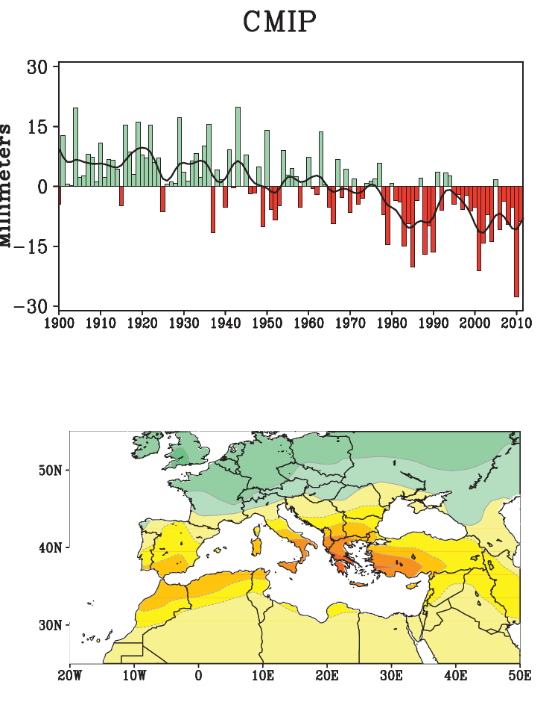
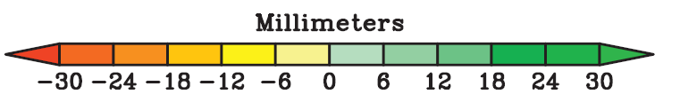
Modeled precipitation changes in the Mediterranean (1902-2010)
Modelled change of winter Precipitation
(1971:2010) – (1902:1970)
Hoerling et al. (2012)

Slide 11
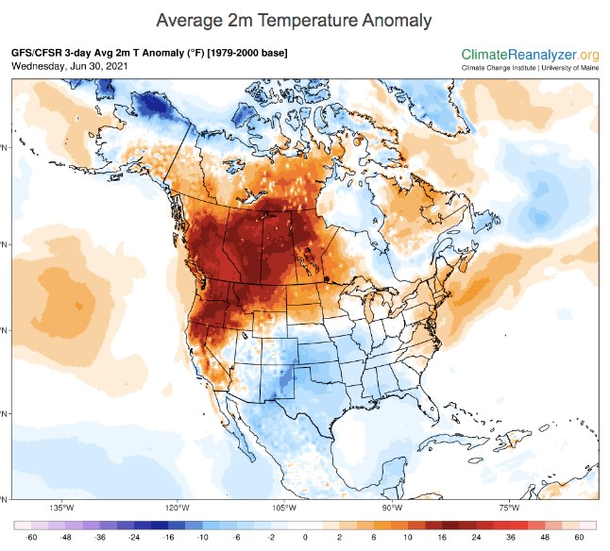
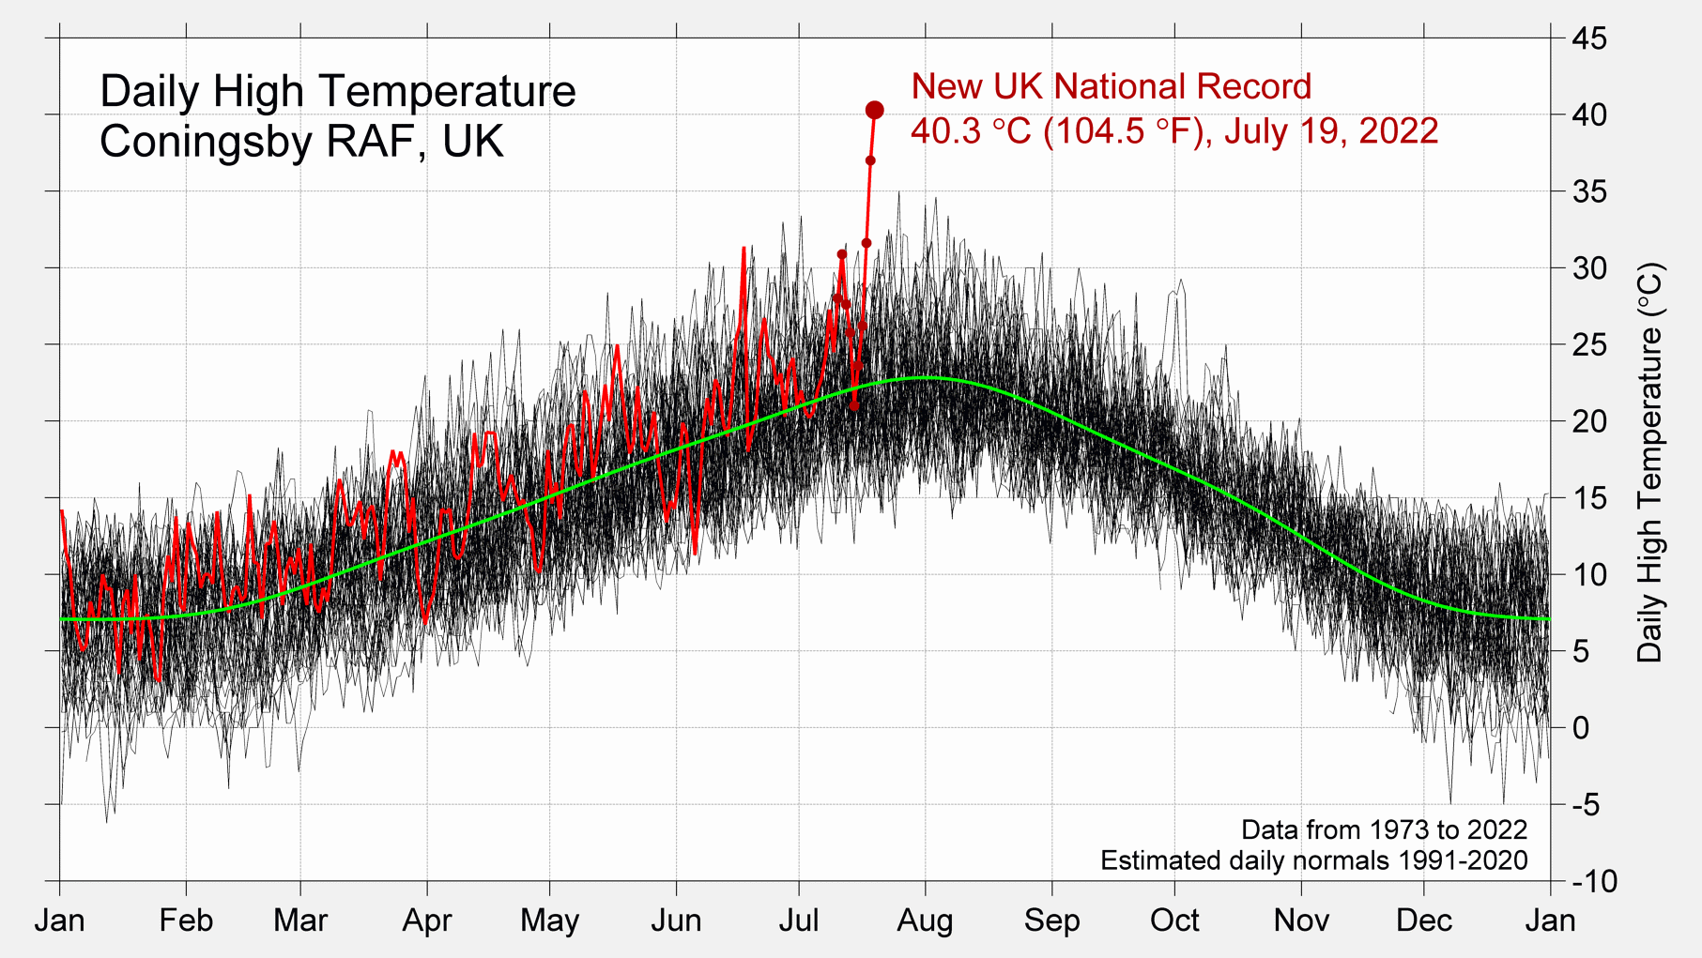
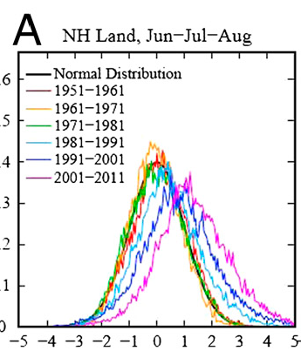
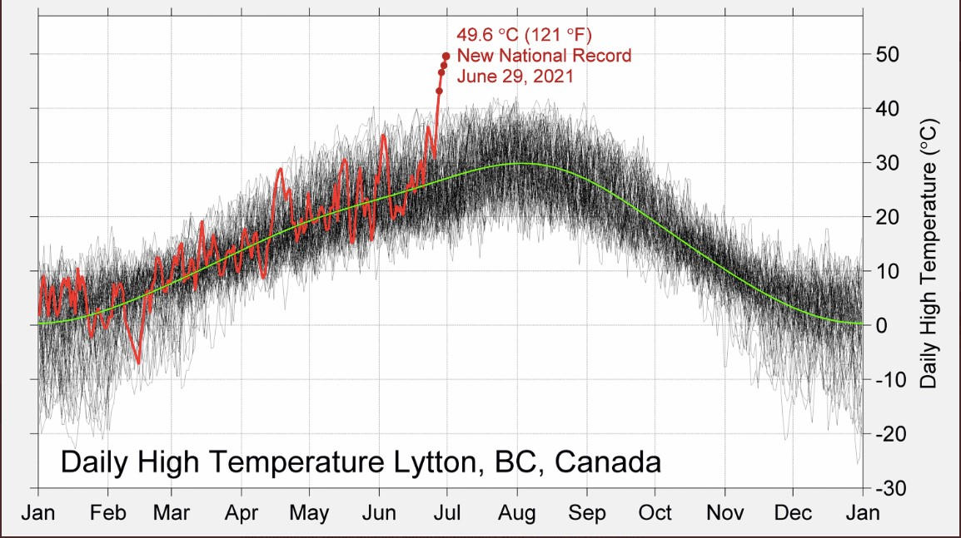
Evolution of summer NH daily temperatures between 1951 and 2011
Summer (H.N)
2011-2021 (?)
(Hansen 2012, PNAS)

Slide 12
Heatwave
Case-studies
1- The summer 2003 heatwave in Iberia/western Europe
Notes:
See Appendix for a description of the 20CR

Slide 13
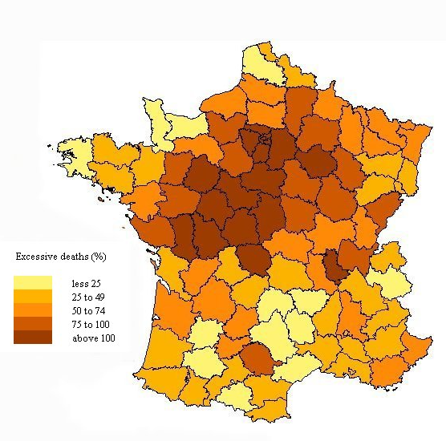
The 2003 heatwave over western Europe
Excessive mortality 1-15 August (circa 15000 in France)
1 Aug – 15 Aug
Average
Average
Anomaly
(Trigo et al., 2005, GRL)

Slide 14
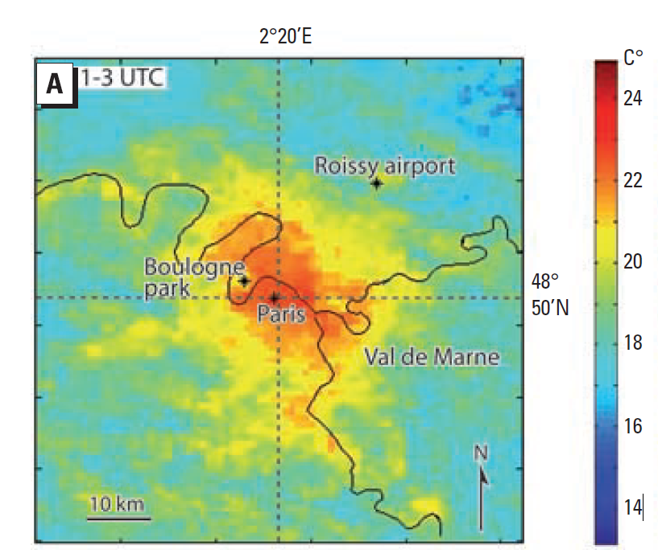

The 2003 heatwave over western Europe (UHI)
Median LST infrared images from 4–13 August 2003 averaged over 9 NOAA-AVHRR thermal images between 0100 and 0300 hours
Spatial distribution of the geocoded addresses of cases in Paris and Val-de-Marne department (black dots)
(Laaidi et al., 2012, EHP)

Slide 15
The relevance of spatial scale to evaluate excessive mortality
Municipality Parish Neighborhood
Mortality rates in Portugal between 2014 and 2017 on the scales of the municipality (a), parish (b), and neighborhood (c).
(Morais et al., 2023)

Slide 16
Parish Neighborhood
Only with GIS!
Elderly’s (over 65) heat-related cardiorespiratory mortality rates from 2014 to 2017.
(Morais et al., 2023)

Slide 17
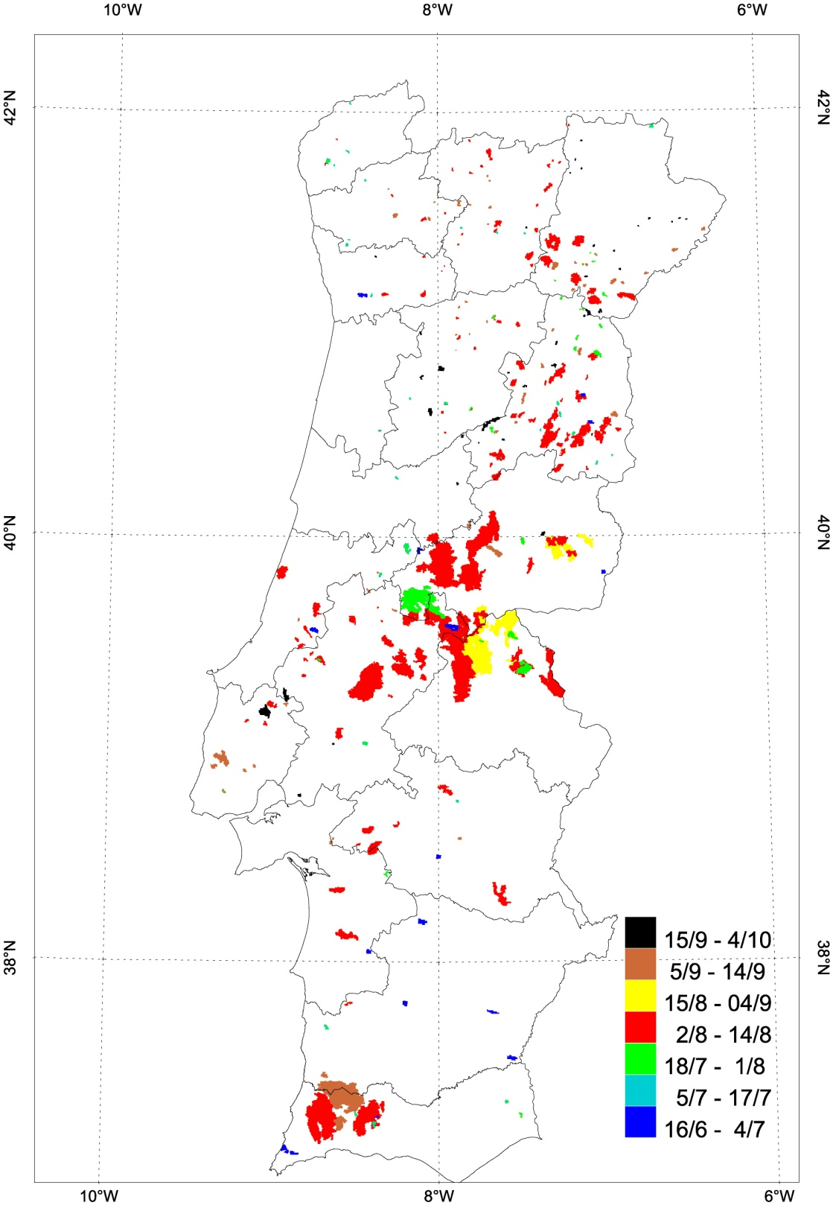
Record burned area in Portugal in 2003
Total burnt area: 450.000 ha
Mostly during the first 2 weeks of August (red colour)
Garcia-Herrera et al. (2010)

Slide 18
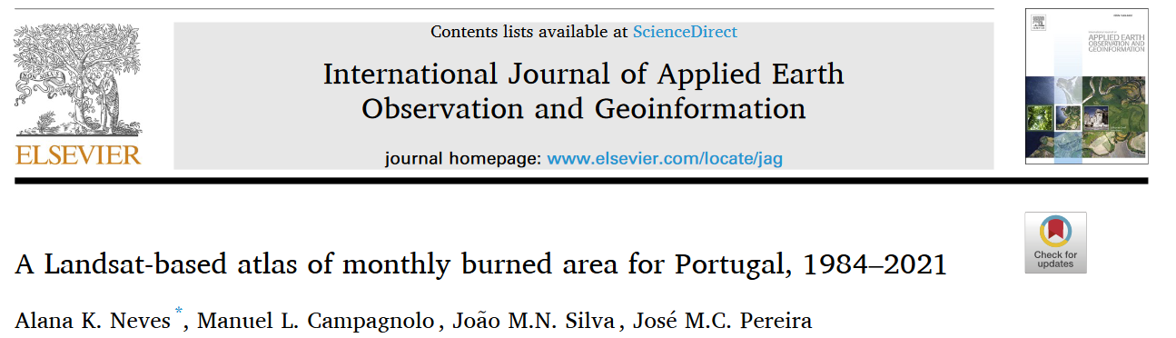
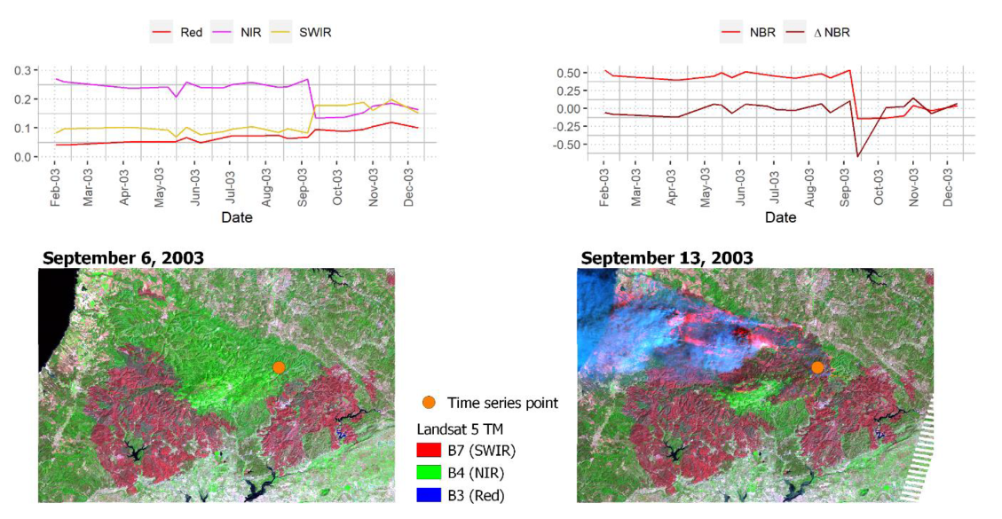
Time series showing the fire-induced NBR decrease

Slide 19
Heatwave case-studies
2) The summer 2010 heatwave in Russia / Black sea
Notes:
See Appendix for a description of the 20CR

Slide 20
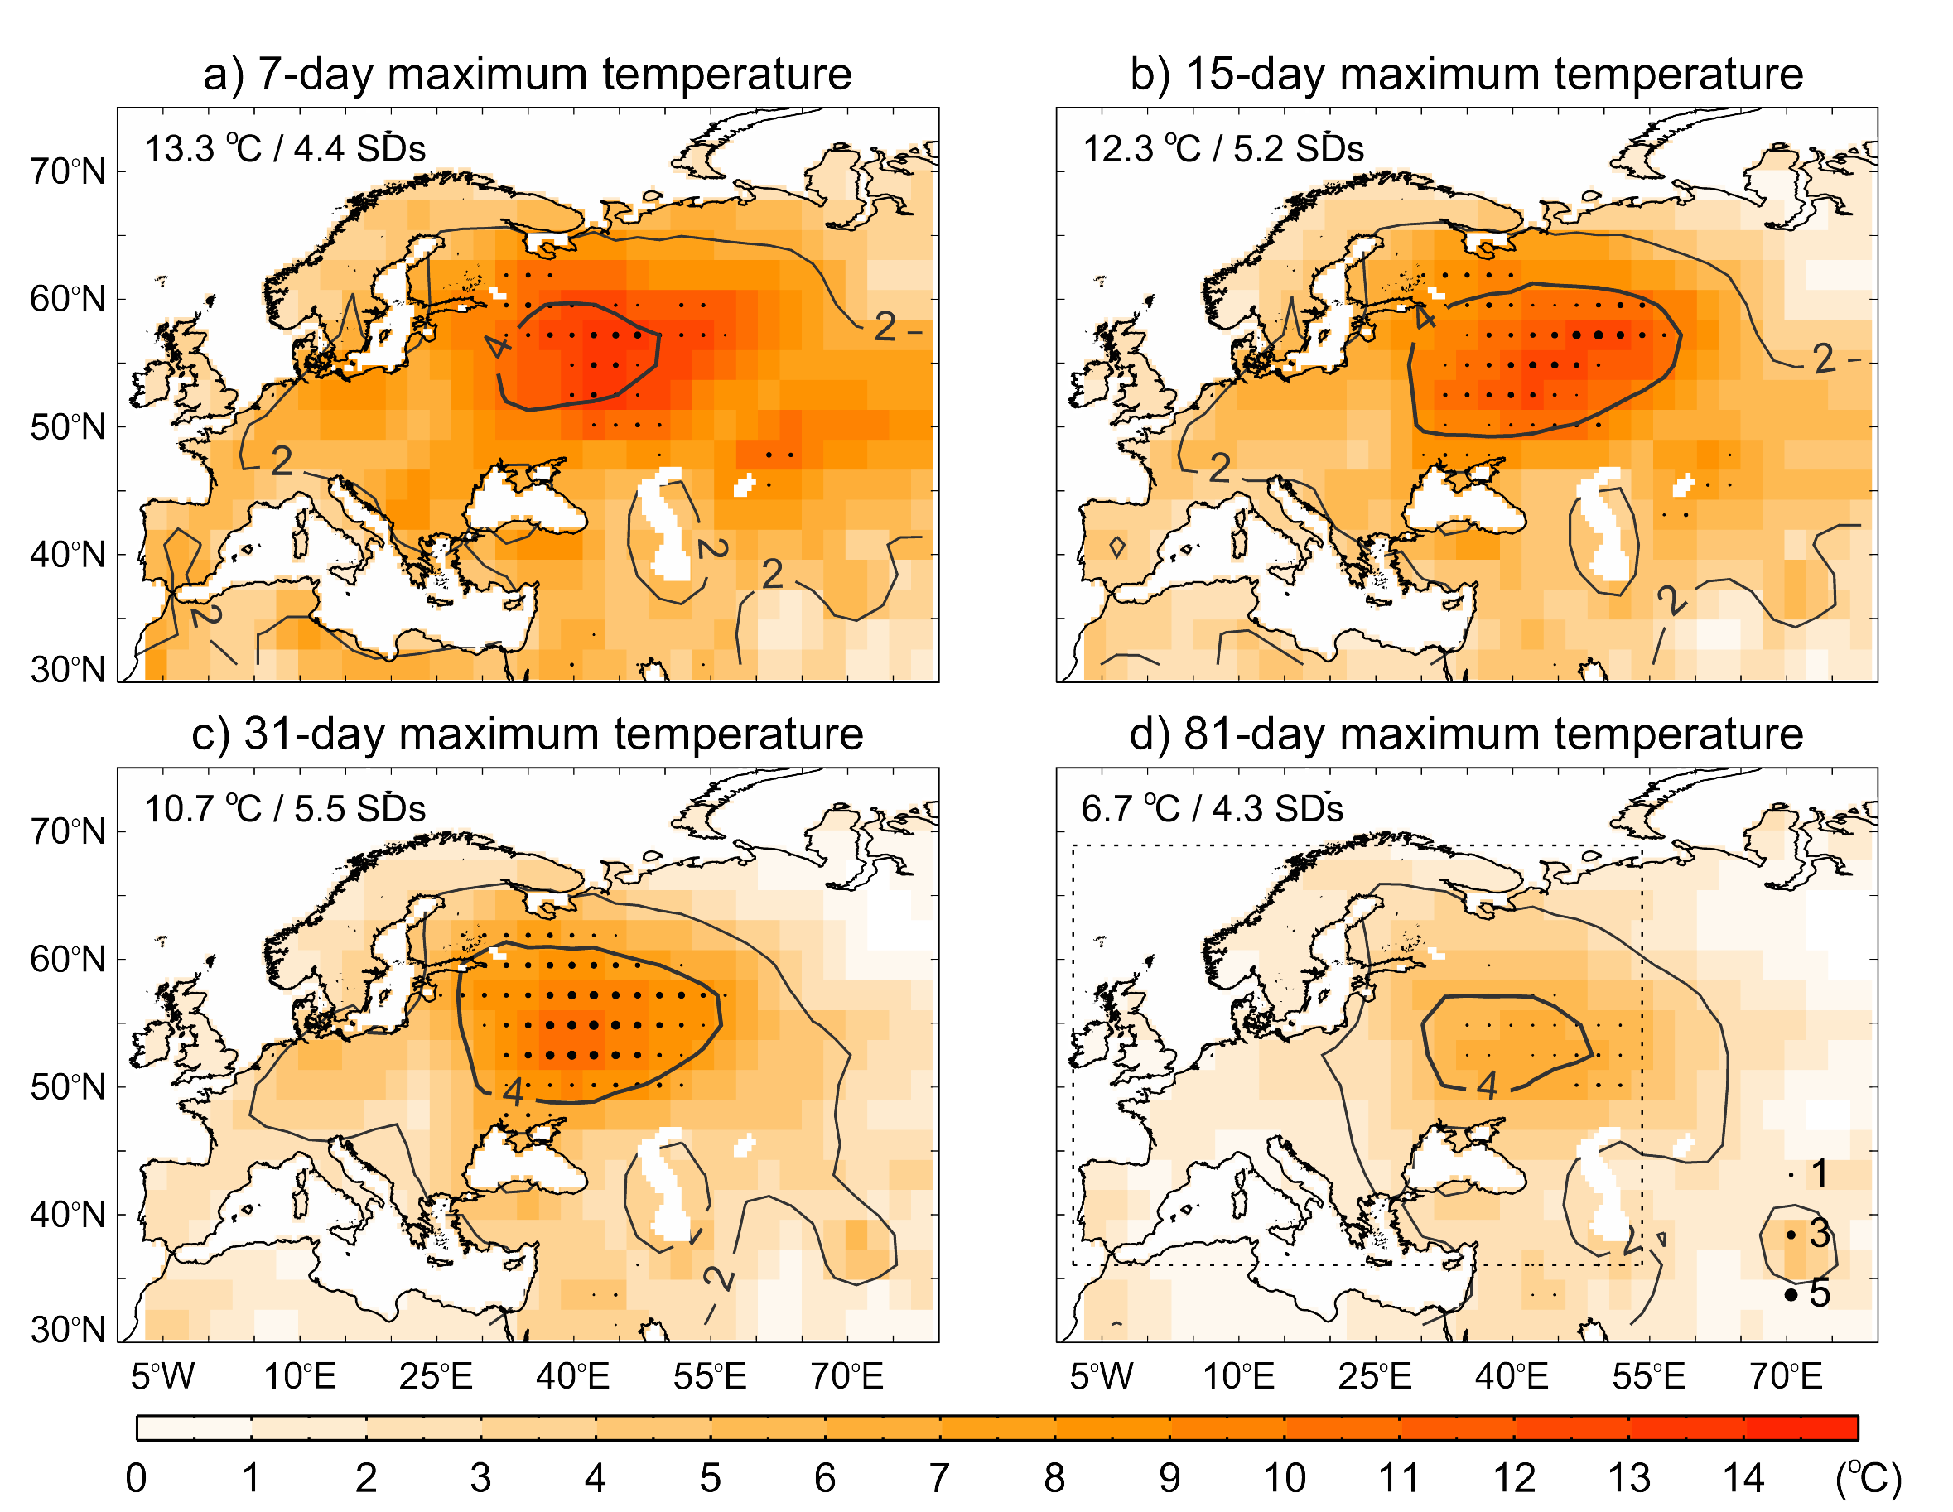
The 2010 heatwave at different temporal scales
European window considered
Notes:
Maximum temperature anomalies (ºC, relative to 1970-1999) in summer 2010 for: a) 7-day; b) 15-day; c) 31-day; d) 61-day average periods. Contour lines indicate the anomaly divided by the corresponding standard deviation of all summer days of the reference period. Black points highlight record-breaking values, the size being proportional to exceedance over the previous maximum. The maximum record-breaking temperature anomaly is shown in the upper left corner

Slide 21
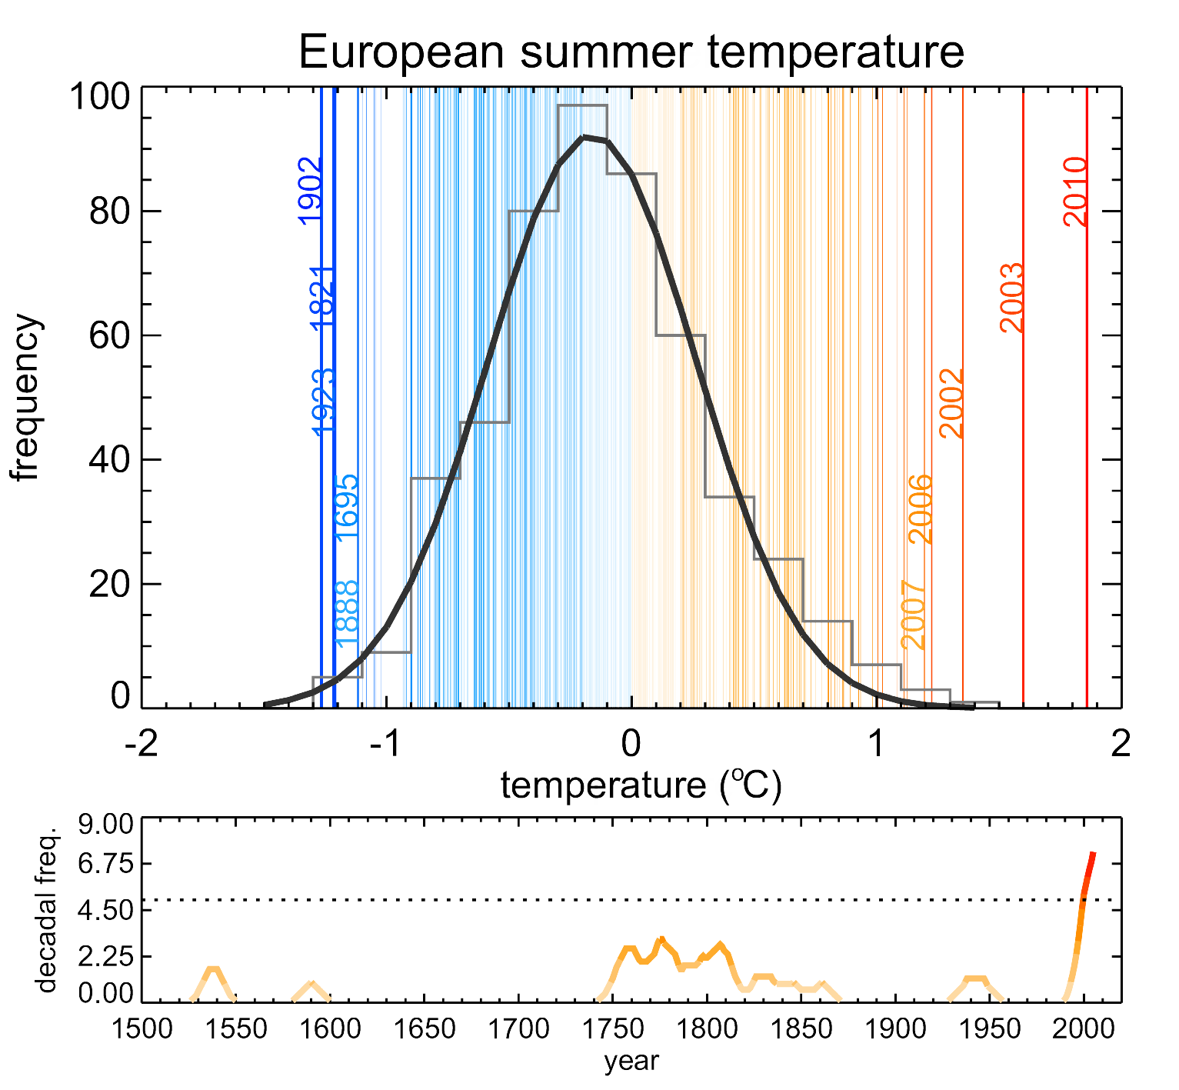
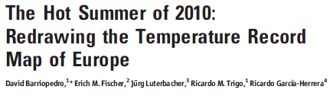
The impact of summer 2010 heatwave in Europe
Frequency distribution of European summer land temp. anomaly (ºC) for the 1500-2010 period (vertical lines).
Grey bars represent the distribution for the 1500-2002 period with a Gaussian fit in solid line.
Multiproxy temp [Luterb. (2004)] 1500-2002
Temperature [GISS NASA] 2003-2010
Notes:
Statistical frequency distribution of European ([35ºN, 70ºN], [25ºW, 40ºE]) summer land temperature anomalies (ºC, relative to the 1970-1999 period) for the 1500-2010 period (vertical lines). The five warmest and coldest summers are highlighted. Grey bars represent the distribution for the 1500-2002 period (11) with a Gaussian fit in black. Data for the 2003-2010 period are from (23). The bottom panel shows the running decadal frequency of extreme summers, defined as those with temperature above the 95th percentile of the 1500-2002 distribution. A 10-yr smoothing is applied. Dotted line shows the 95th percentile of the distribution of maximum decadal values that would be expected by random chance (15).

Slide 22
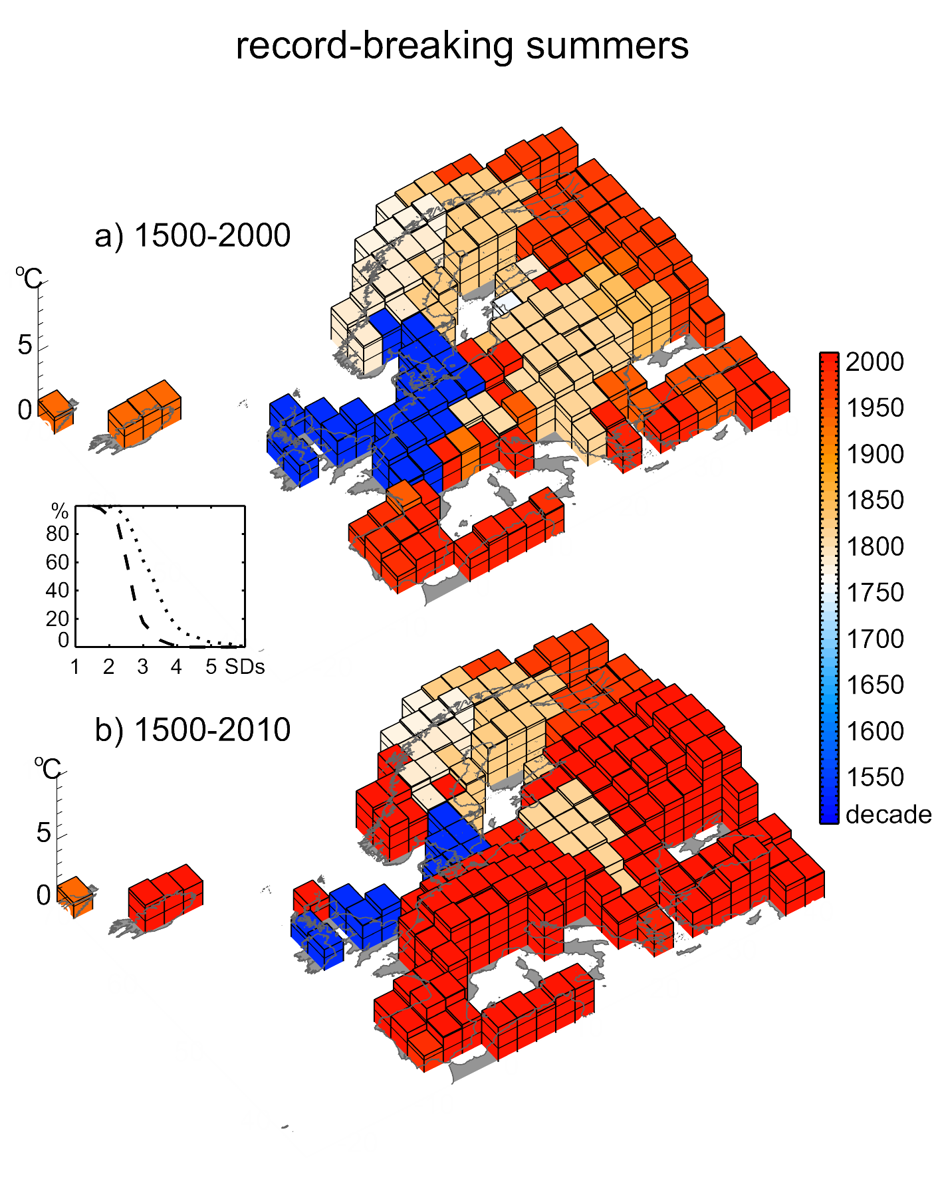
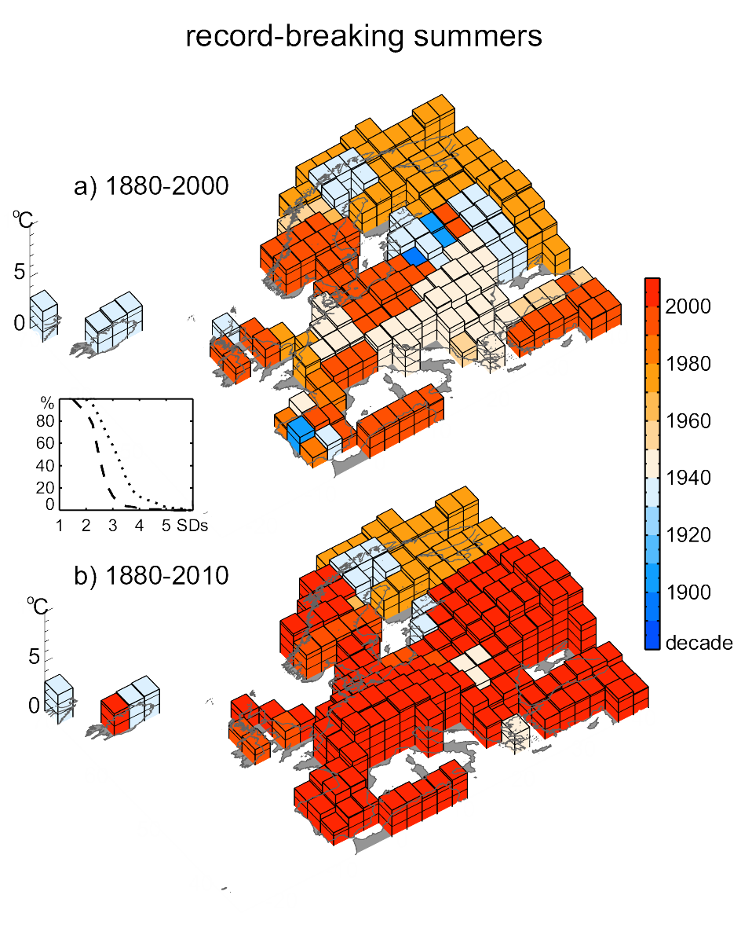
Spatial distribution of the hottest European summers since 1500
The height and the color of the bars indicate the anomaly (relative to the 1970-1999 period) and the record-holding decade, respectively, for the period:
1500-2000;
1500-2010.
Barriopedro et al. (2011, SCIENCE)
The same, but confined to the 1880-2010 (instrumental) period of GISS analysis
Notes:
The height and the color of the bars indicate the anomaly (ºC, relative to the 1970-1999 period) and the decade of the corresponding summer, respectively, for the period: a) 1500-2000; b) 1500-2010. For better readability, each bar is subdivided with 1ºC intervals. The embedded plot shows the percentage of European areas with summer maxima above the given temperature (in SDs) for the 1500-2000 (dashed line) and 1500-2010 (dotted line) periods. Data sources are (11) (1500-2002) and (23) (2003-2010).

Slide 23
Heatwave case-studies
3) The Iberian 2017 and 2018 heatwaves
Notes:
See Appendix for a description of the 20CR

Slide 24
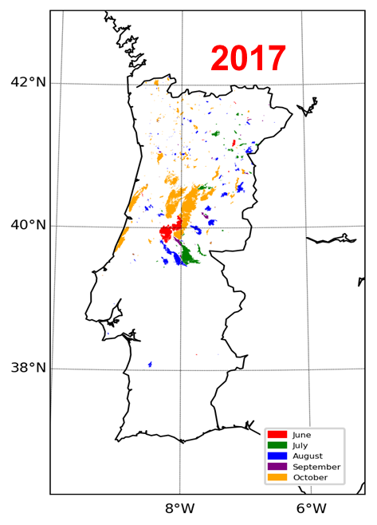
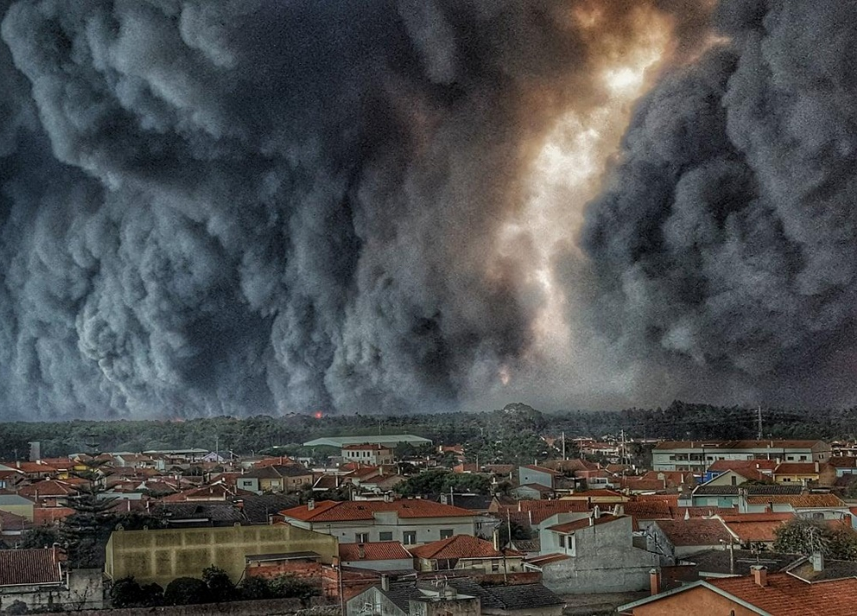
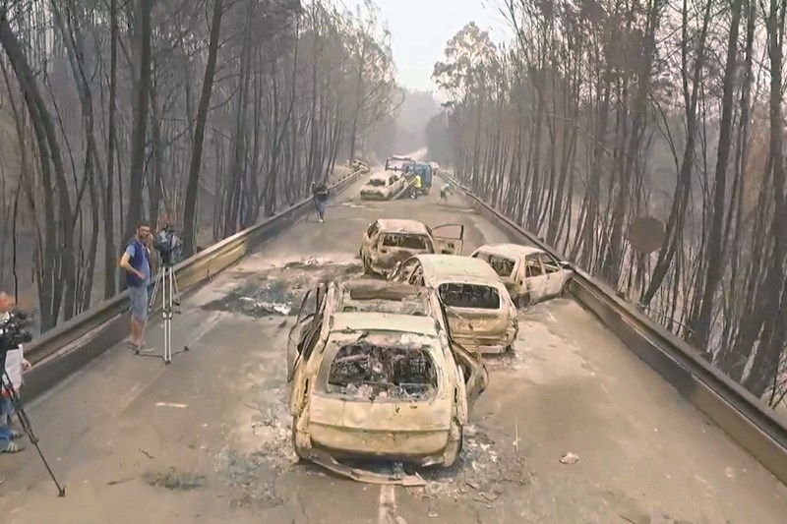
16-17 October
50 deaths
16-20 June
65 deaths

Slide 25
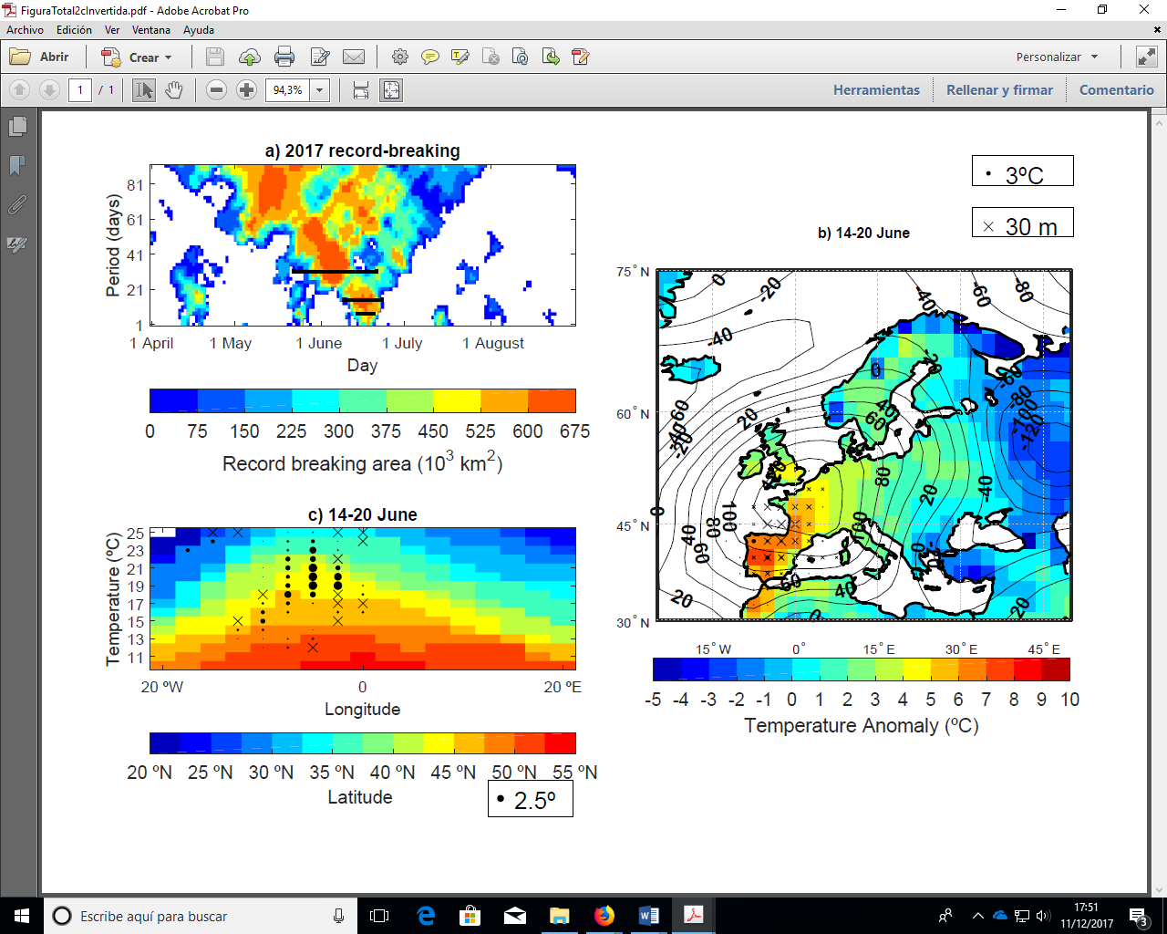
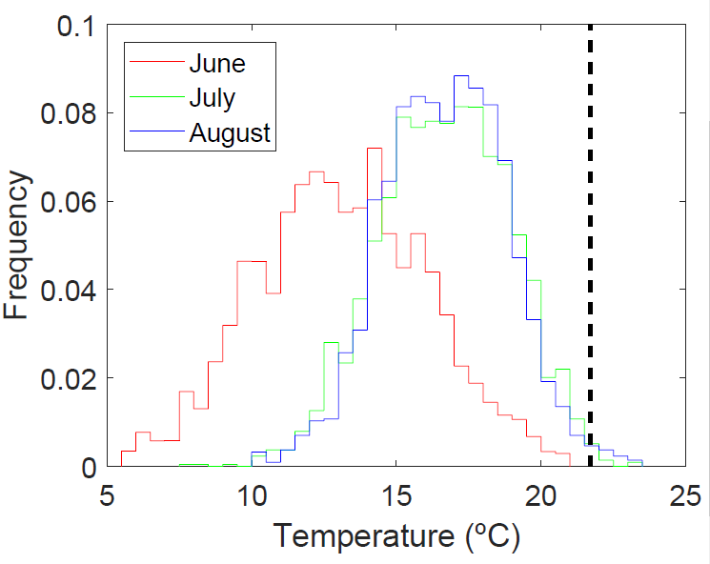
2017 June
Synoptic conditions for the 14–20 June 2017 period. Shading shows the T2m anomalies (in ºC).
Frequency distribution of 7–day mean T850 (in ºC) over Iberia in the historical period (1948–2016).
(Sánchez-Benitéz et al, 2018, GRL)

Slide 26
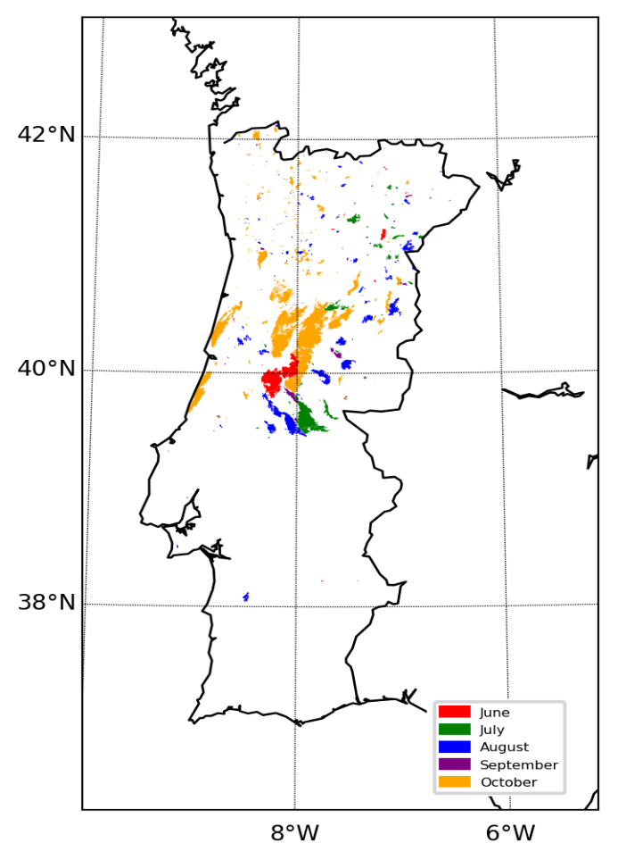
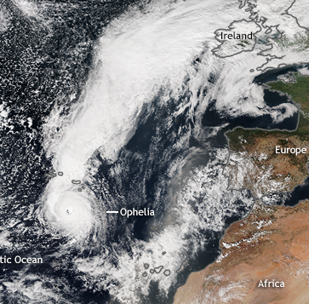
2017
October
Percentage of territory under the two most severe PDSI classes

Slide 27
The impact of summer 2018 and 2019 heatwaves in Europe
2018
2019
(Sousa et al, 2019)
Novo record absoluto de França 44,1ºC (2003)
46ºC (2019)

Slide 28
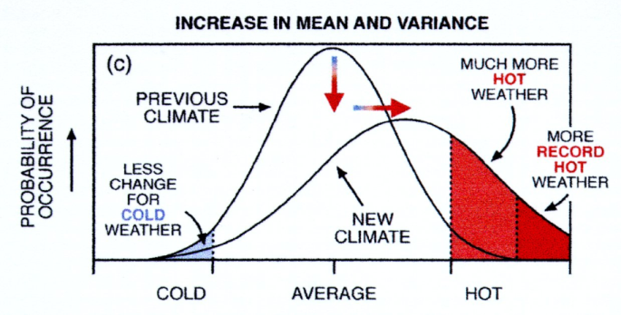
The impact of summer 2018 and 2019 heatwaves in Europe
(Sousa et al, 2020)

Slide 29
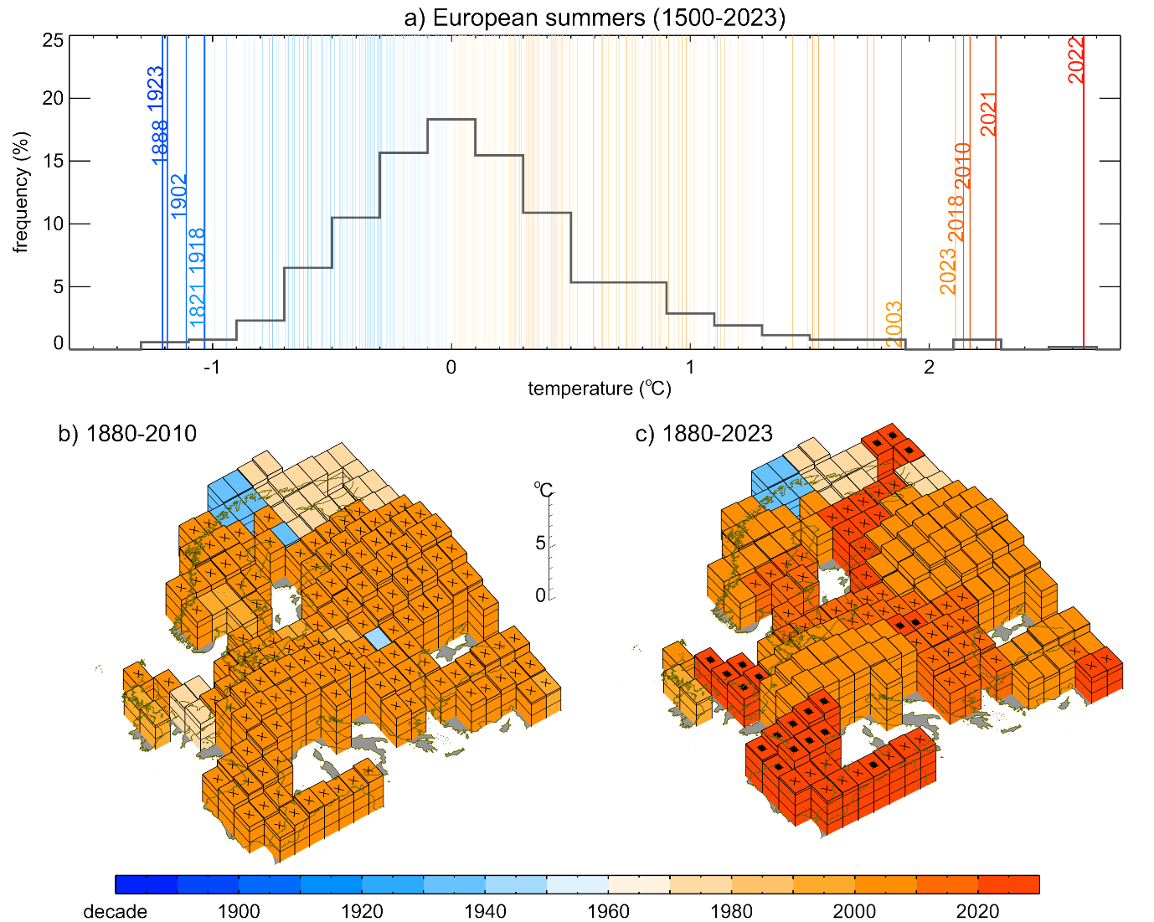
Hottest European summers since 1880. The height and the color of the bars indicate the summer temperature anomaly (1951–1980) and the decade of the corresponding summer.
GISTEMP (NASA) 1880-2023
(Trigo et al. 2024, submitted)

Slide 30
(Ruffault et al, 2020)

Slide 31
(Ruffault et al, 2020)

Slide 32
Summary
The Mediterranean basin is getting drier and drought frequency has already increased in the last 40 years partially due to GHG.
The Western (Eastern) Europe heatwave of summer of 2003 (2010) was exceptional at the monthly/seasonal, but also at the weekly and daily scales.
Winter/Spring drought conditions have exacerbated the strength of 2018 and 2019 summer heatwaves.
Regional Climate Models predict more intense heatwaves and drought episodes for the Mediterranean. In particular a significant rise in fire risk (induced by hot&dry conditions)
The use of high-resolution satellite imagery (coupled with GIS) is critical to provide appropriate spatial scale for Fires, Heatwaves, Floods associated with CC

Slide 33






Obrigado! Merci! Thanks!

Slide 34
(Fischer and Knutti, 2015)
P0: probability of exceeding a certain percentile during the pre-industrial period (99% ou 99.9%)
P1: probability of exceeding the same percentile during the Climate Change period
PR: Probability ratio (of an event being altered)
PR = P1 ⁄ P0
FAR: fraction of attributable risk to human action
FAR = 1 - (P0 ⁄ P1) = 1 - (1 ⁄ PR)
The FAR was determined at the global level in order to determine what is the fraction of extremes occurred worldwide that are (or not) attributable to human influence.

Slide 35
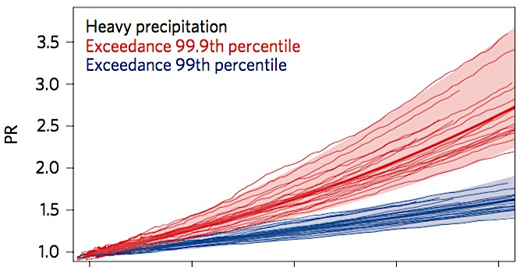
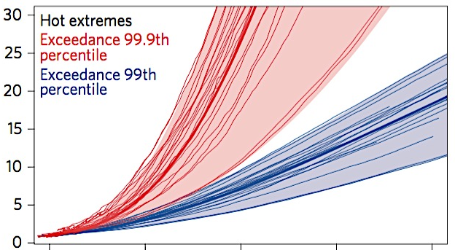
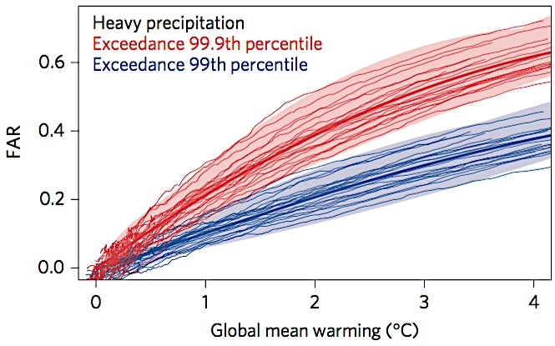
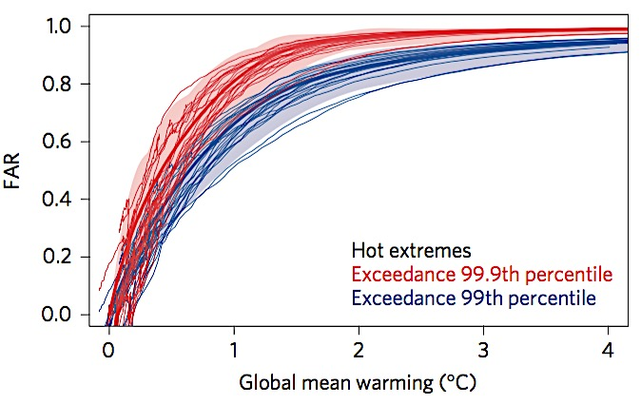
(Fischer and Knutti, 2015)
Heavy precipitation
Hot extremes
a
b
PR
PR = P1 ⁄ P0
d
c
FAR = 1 - (1 ⁄ PR)
FAR
PR increases non-linearly for higher levels of precipitation and heat.
FAR increases more for stronger extremes (99.9th percentile), indicating that the most extreme events of precipitation and heat are more attributable to human influence.
Notes:
As faixas azuis e vermelhas demonstram a maior e a menor estimativa do modelo para um determinado nível de aquecimento, refletem o modelo de propagação, ou seja, a probabilidade de exceder o percentil 99 e 99.9, respetivamente, e não uma faixa de incertezas associadas (essa faixa de incertezas associadas são os resultados apresentados para FAR na tabela 1).

Slide 36
What haapened in Pantanal in 2020?
A situation where the interaction between Droughts, Heatwaves and Fires is evident and is being amplified by Climate Change
(Libonati et al, 2020, NATURE)

Slide 37
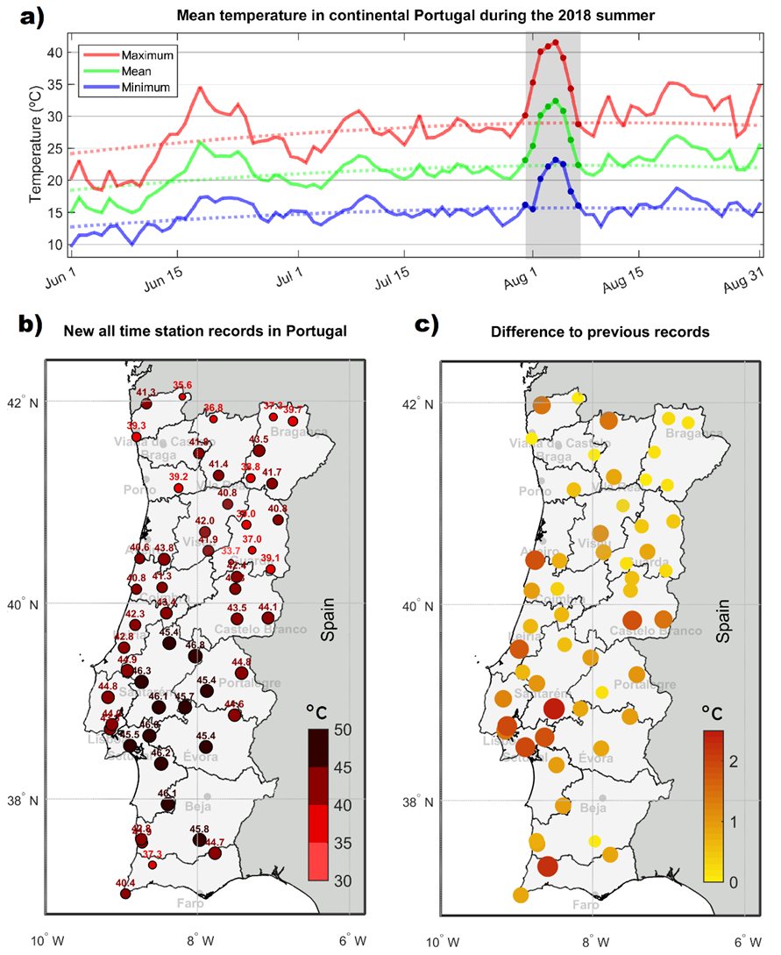
2018
Despite being a year with milder characteristics, the beginning of August 2018 registered one of the most intense heat waves ever, with new maximum temperature Tmax records throughout the entire territory.

