Slide 1
Digital Transformation: Opportunities and Challenges for Healthcare Ecosystems
Prof. Francesco Schiavone
University of Naples Parthenope, Italy
francesco.schiavone@uniparthenope.it

Slide 2
Who I Am?
Full Professor in Management, University of Naples Parthenope
Scientific Director of the VIMASS Research Lab: https://disaq.uniparthenope.it/vimass/
Affiliated Professor @ Emlyon and Paris School of Business (France)
AE of TFSC and other prestigious journals
E-mail: francesco.schiavone@uniparthenope.it

Slide 3
Agenda
The Healthcare Industry today
Digital Transformation in healthcare
Healthcare Ecosystems
Opportunities
Challenges
Conclusions

Slide 4
The Healthcare Industry today
The global population is expected to increase by 1 billion by 2025. By then, more than 500 million people will be over the age of 50.
We are also living longer, living with an increasing amount of chronic and comorbid illnesses
All of the world's major healthcare systems face enormous cost pressures and potential productivity losses.

Slide 5
The Signs of Change and New Trends
The fundamental problem compelling reform efforts in healthcare is that the value created—for patients, for providers, for payers—does not align with spending levels.
This approach is known as fee-for-service, and it utilizes tables of codes, procedures, and treatment groupings to determine how much is paid for what is done.
Today we have a need for a transition to an output-based system.

Slide 6
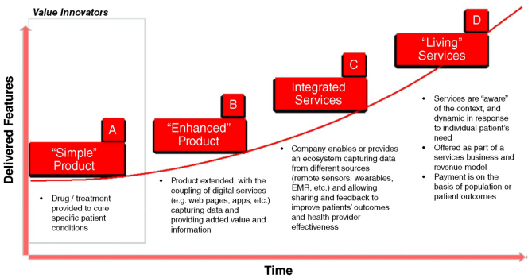
The Value Curve
Value in Health: “the health outcomes achieved per dollar spent” (Porter M., 2010)

Slide 7
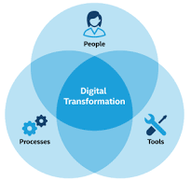
Digital Transformation: A Definition
«…a process that aims to improve an entity by triggering significant changes to its properties through combinations of information, computing, communication, and connectivity technologies.” (Vial, 2019, p. 121)

Slide 8
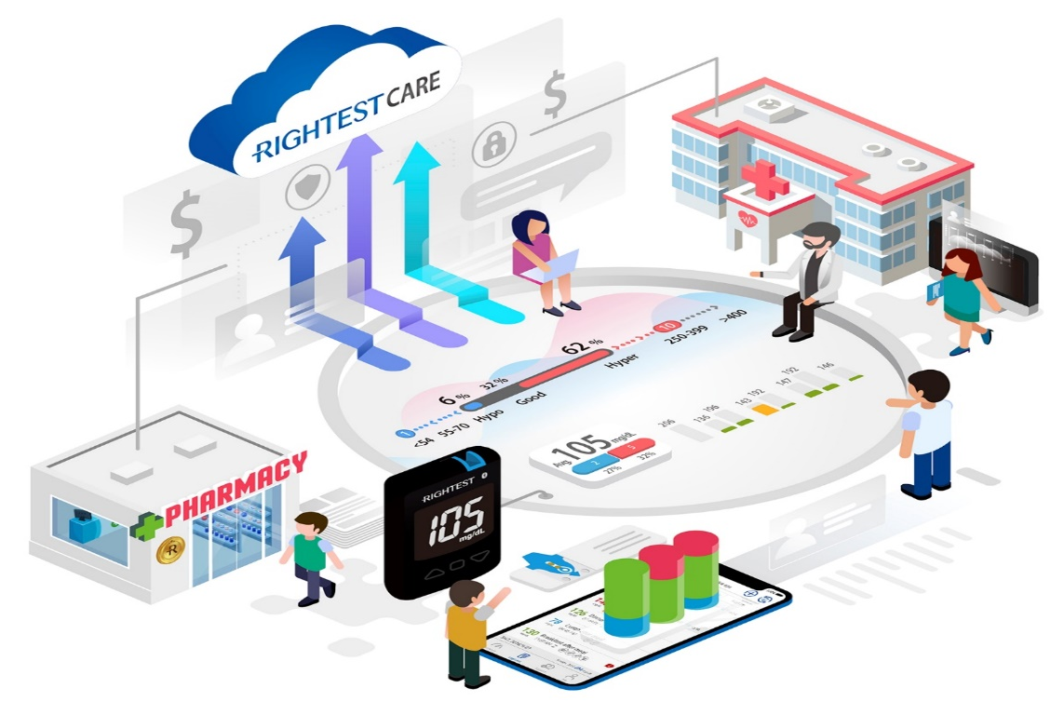
Digital Transformation in Healthcare
New business models
New technologies and tools
New types and forms of care (e.g. One Health, Personalized Medicine and so on…)

Slide 9
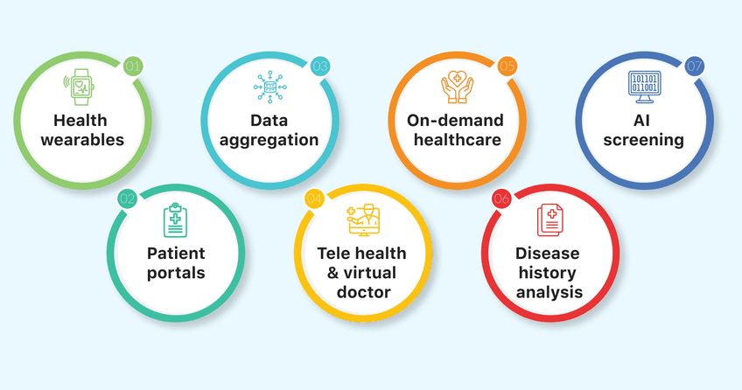
Key Trends of Digital Transformation in Healthcare

Slide 10
Patient-Generated Data (PGD)
“Health-related data created, recorded, gathered, or inferred by or from patients or their designees to help address a health concern”
In addition to the application of consumer-generated data in a health care setting, PGD includes:
patient reported outcomes
medical-device data
wearables data
IoT applications can be critical to improve and personalize health care, even encouraging behavior changes before they result in illness

Slide 11
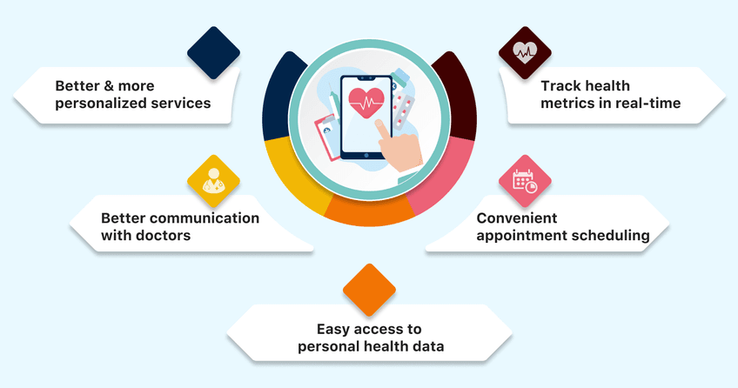
Benefits of Digital Transformation for Patients

Slide 12
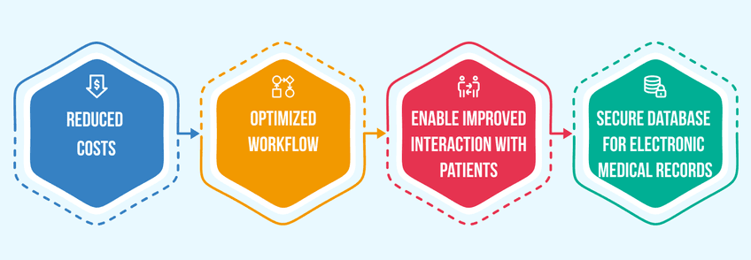
Benefits of Digital Transformation for Organizations

Slide 13
Process Improvements via DT
Finding people and equipment
Tracking hospital equipment
Patient ID and tracking
Preventing medication errors
Tracking samples (e.g. Blood samples)
Anti-counterfeiting measures
Product recalls
Tagging implants and remote charging of batteries

Slide 14
Healthcare Ecosystem
“An ecosystem is a geographic area where plants, animals, and other organisms, as well as weather and landscapes, work together to form a bubble of life”.
“A healthcare ecosystem is a network of organizations that work together to provide healthcare services. The ecosystem includes hospitals, clinics, physician practices, insurance companies, and other health-related organizations”.

Slide 15
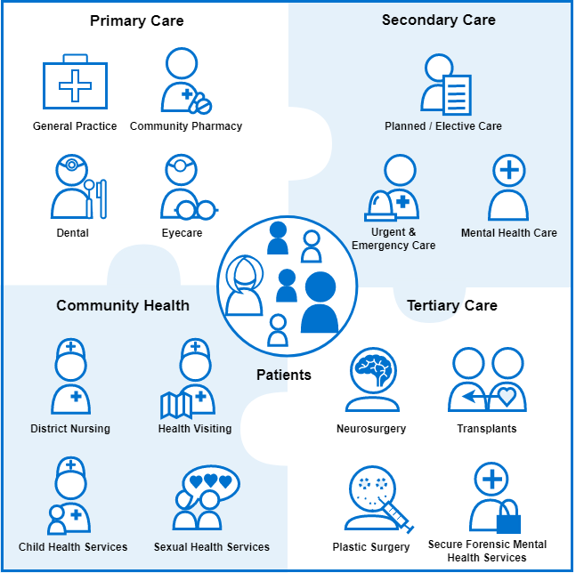
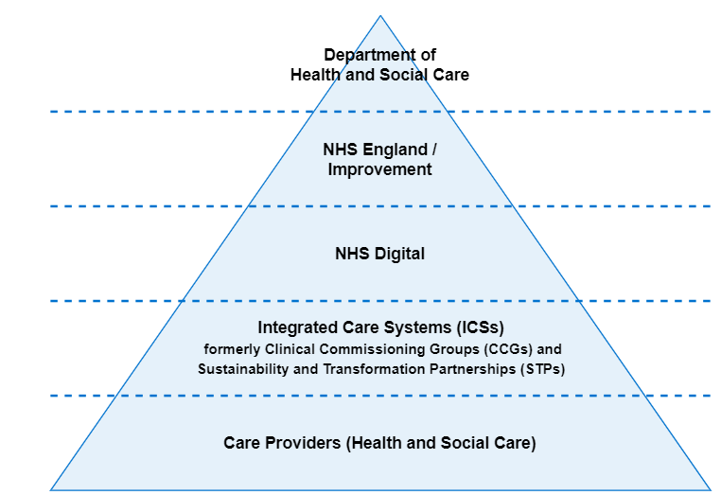
The NHS Healthcare Ecosystem (UK)
+

Slide 16
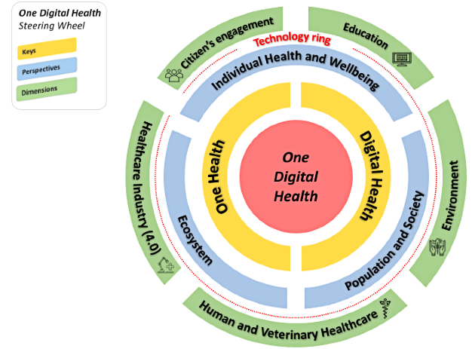
The “One Digital Health” Steering Wheel
This holistic conceptual framework is built around two keys (ie, One Health and digital health), three perspectives (ie, individual health and well-being, population and society, and ecosystem), and five dimensions (ie, citizens' engagement, education, environment, human and veterinary health care, and Healthcare Industry 4.0).
Benis, Tamburis, Chronaki & Moen (2021)

Slide 17
In other words, Digital Transformation…
…supports (but also obliges) any HC system in becoming a true
HC ECOsystem…
…for a matter of money
…for a matter of efficiency
…for a matter of impact
…for a matter of equity
Notes:
Obbligo perché non si può voltare la faccia ad un fenomeno così fortemente creatore di valore che conduce verso nuovi modelli «multistrato» di salute
Money = minori costi; Efficiency = miglior uso delle risorse non monetarie; Impact = impatto più diffuso sull’intera comunità e territorio; Equity = maggiore accesso

Slide 18
Opportunities
Exploitation and integration of new knowledge and information from novel sources for providing better care services
Better resource allocation and achievement of the so-called «Value-based Healthcare»
More collaboration (and cross-fertilization) among different ecosystem stakeholders
The total implementation of the «patient-centricity» priority
Replication of innovative forms of capitalism and business models in HC (e.g., platform economy)

Slide 19
The «VATE» Priorities
More Value for the HC ecosystem and its stakeholders
More Access to the market of care for patients
More Transparency about the ecosystem activities and operations
More Efficiency in the ecosystem transactions and processes

Slide 20
Challenges
The large eterogeneity of the ecosystem actors risks to slow down the diffusion of innovation and digital technologies
Urgent need and search of new and skilled workforce for the effective management and operations of DT-driven HC ecosystem.
Privacy concerns about the storing, transfer, and treatement of patient data within the ecosystem
Need of mapping precisely the new DT-enabled dynamics of value creation within the HC ecosystem
Risk of fragmenting too much the patient journey across a number of ecosystem actors

Slide 21
The «One Digital Health» Paradox
The ODH approach is holistic…but holism is highly resource-consuming
With holism we abandon the simpler views, interpretations and accounts based on reductionism
…so, how can we be sure these new approaches based on DT will really generate value and spread efficiency in our HC ecosystems?

Slide 22
Conclusions
DT-driven HC ecosystems are organizational forms already existing, they are not something will happen in the near future
MDs will not be the only ones impacting on the management of your health and disease
The «One Digital Health» paradox has to be managed and solved ASAP

Slide 23
Thank you for your Attention!!! Any question???
Prof. Francesco Schiavone
Dipartimento di Studi Aziendali e Quantitativi (DISAQ)
Università degli Studi di Napoli Parthenope, Italy
francesco.schiavone@uniparthenope.it

