Slide 1



Pervasive AI – (Deep) Learning into the wild
Davide Bacciu
Pervasive Artificial Intelligence Laboratory
University of Pisa
davide.bacciu@unipi.it
pai.di.unipi.it

Slide 2
Outline
Pervasive AI
Efficient RNN Design
Learning in space and time
Neural Nets & dynamical systems
Wrap-up (self-promotion alert!)
Notes:
today I’m going

Slide 3
Pervasive AI

Slide 4
Pervasive Computing
+
Artificial Intelligence
Calls for multi-disciplinary skills and putting different scientific communities in contact

Slide 5












A Prototypical Pervasive AI Application
Systems integrating real and virtual AI-based sensors for monitoring of environments, vehicles, things, animals, people
Physical Sensors
Sequential
Fast streaming
Noisy
Multi-modal
Cloud-Edge AI
AI and Machine Learning
Resource efficiency
Ability to deal with sequential tasks
Robustness
…
Intelligent Sensors

Slide 6

Pervasive AI – Distributed Learning on the Cloud-Edge Continuum
Embedded/embodied
edge intelligence
Scalable learning models from edge-to-cloud
Distributed and continually learning

Slide 7

Pervasive AI – Recipe for success
Desiderata for the learning model
Can handle timeseries (recurrent NNs)
Efficient for embedding (edge)
  Hardware friendly
Can scale (cloud)
  Communication friendly
Simple to train continually
Facilitate distributed training

Slide 8










Recurrent Neural Networks
$$y_{1}$$
$$y_{2}$$
$$y_{3}$$
Neuron state as a dynamic memory of input history
$$h_{1}$$
$$h_{2}$$
$$h_{3}$$
$$y_{t}=f(x_{t}, h_{t−1})$$
output
current input
prior history
$$x_{1}$$
$$x_{2}$$
$$x_{3}$$
Notes:
Extend the model
Relate the operation that a neural network is performing at a specific time step to both the current input AND the prior history
We introduce what is called a memory cell / memory state, that is passed across time from time step to time step

Slide 9
Propagation Issues
Fading/Exploding memory
the influence of inputs far in the past vanishes/explodes in the current state
many (non-linear) transformations
Gradient Propagation
gradient might vanish/explode through many non-linear transformations
difficult to train on long-term dependencies
Notes:
stability is

Slide 10
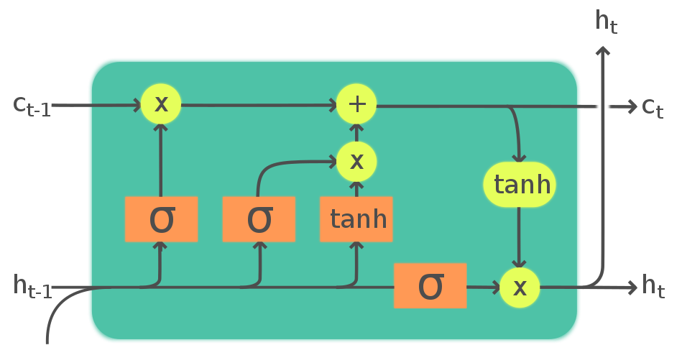
The Obvious Deep Learning Solution
Deep Learning = Architectural Biases + Learning Algorithms

Slide 11
Efficient RNN design for Pervasive AI

Slide 12
The Philosophy
“Randomization is computationally cheaper than optimization”
Rahimi, A. and Recht, B., 2008. Weighted sums of random kitchen sinks: Replacing minimization with randomization in learning. Advances in neural information processing systems, 21, pp.1313-1320.
Rahimi, A. and Recht, B., 2007. Random features for large-scale kernel machines. Advances in neural information processing systems, 20, pp. 1177-1184.
Notes:
The philosophy for this comes from a very well known quote from Rahimi and Recht, who introduced the random kitchen sinks, one of the basic shallow randomized models that usesrandom features to speed up the operations of kernel machines. Their 2007 paper won the test of time award 10 years later at NIPS 2017.
Essentially, in the random kitchen sink paper they say that randomization is cheaper than optimization.
Besides there is an interesting concept: the fact that neural networks that we commonly use are over-parametrized.
In many cases nowadays, we tend to use over-parametrized complex algorithms, and empirical methods that often achieve the accuracy that we desire, but are both hard and costly to be trained (as already discussed), and also difficult to understand, analyze and describe in a clear, rigorous way.
Randomized models like random kitchen sinks, on the other hand, can be considered both good solid baselines, and be analyzed mathematically in a clean way.
I think this is an important concept, and perhaps it is a concept that has been lost in modern deep neural networks research and practice.

Slide 13
Randomization = Efficiency
Training algorithms are cheaper and simpler
Model transfer: do not need to transmit all the weights
Amenable to embedded and neuromorphic implementations

Slide 14


Reservoir Computing: focus on the dynamical system
readout
randomized
$$y_{t}=h_{t}W_{hy}$$
$$h_{t}=tanh⁡(x_{t}W_{xh}+h_{t−1}W_{hh})$$
trainable
Randomly initialized under stability conditions on the dynamical system
Stable dynamics => Echo State Property => Echo State Networks
reservoir
fixed
input layer
Verstraeten, David, et al. Neural networks 20.3 (2007).
Lukoševičius, Mantas, and Herbert Jaeger. Computer Science Review 3.3 (2009).
Notes:
An appealing alternative is actually out there and it is called reservoir computing. This approach focuses on a major distinctive characterisation: decouple the treatment of the hidden recurrent layer from that of the output layer. Instead of - in a sense - blindly train by backpropagation the recurrent dynamics of the system, try to focus on them under the lens of dynamical system theory.
This said, we have a Recurrent Neural Network architecture as before, where the dynamical part is called the reservoir, and it is tapped by a typically linear readout. This readout is the only trained part of the architecture,
CLICK
in the exact same way as described for the feedforward models described in the first part of the tutorial. The parameters of the reservoir are left fixed after randomization-based initialization.
CLICK Click
Going a bit more into the details, the reservoir can be seen as a discrete-time non-linear and input-driven dynamical systems, which is ruled by this iterated map function, and which evolves a state of the system - indicated by h(t) - as a function of the input at the current time step t, x(t), and of the state at the previous time step, h(t-1). The influence of the new input is modulated by an input-weight matrix W and that of the previous state is modulated by the recurrent weight matrix WR. The cool thing is that we can take the elements of these to matrices randomized.
CLICK
And the crucial thing is that we can do this as long as the implemented dynamical system satisfies a global asymptotic stability property, which is in practice a fading memory property called the Echo State Property.
All right, If this echo state property is in place, the reservoir dynamics will asymptotically dependent only on the inptu time series and initial conditions progressively fade out. In a sense, the activations of the hidden units over time become an echo of the dynamical input features. The state becomes an echo of the input.
Although theoretically the story is much longer than this - and I refer to the references in the book chapter and in the website of the tutorial, In practice, the whole complicated process of training the recurrent layer of the network is replaced by a very simple algebraic process of rescaling the spectral radius of therandomly initialized recurrent weight matrix to a value that is smaller than 1. and then you’re done. you run your stable reservoir on the input time-series, you collect the hidden units activation inside a weight matrix H, you train the readout by pseudo inversion or ridge regression. as easy as this.

Slide 15
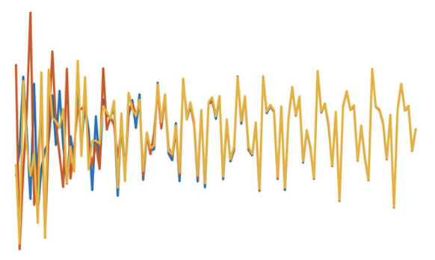
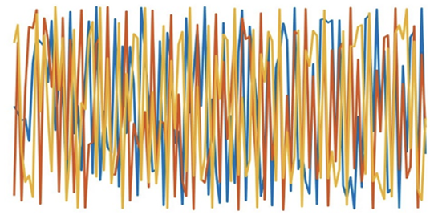



Stability in Practice
Gallicchio, Claudio. "Chasing the echo state property." ESANN 2019
Stable dynamics
orbits synchronize after a transient
$$h_{0}$$
transient
Unstable dynamics
orbits are sensitive to initial conditions
$$z_{0}$$
$$v_{0}$$

Slide 16
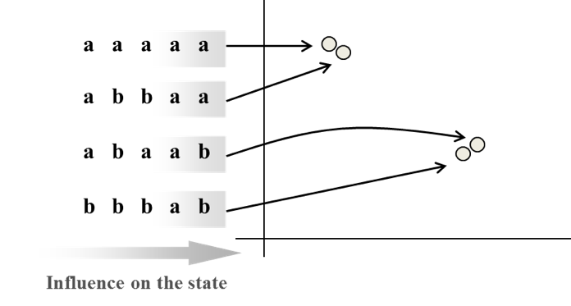
Why does it work?
C. Gallicchio, A. Micheli, “Architectural and Markovian Factors of Echo State Networks”. Neural Networks (2011)
-1
+1
+1
?
+1
-1
-1
+1
-1
Suffix-based Markovian organization of the state space of contraction reservoir mappings even prior to learning
Influence on the state

Slide 17
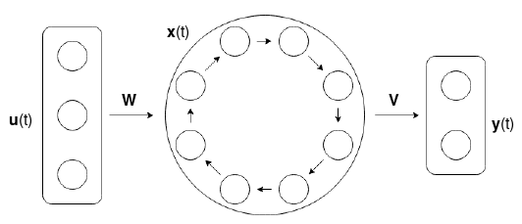
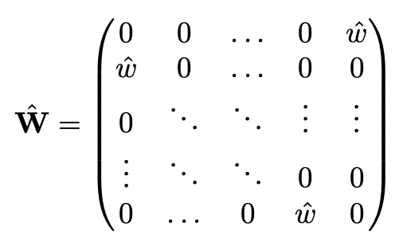


Simple Cycle Reservoir (SCR)
The reservoir layer has an easy-to-build orthogonal structure
$$\hat{W}$$
…and maximum memory capacity for linear reservoirs
Notes:
A relevant strand of works in RC research focuses on the study the topology of the reservoir layer. The idea is to try to generate “better” reservoirs than just random ones. An effective approach is to design the recurrent weight matrix Wˆ as an orthogonal matrix, which has been shown to be associated to increased short-term memory and predictive performance with respect to random reservoirs
You can find more details in this famous contribution by Rodan and Tino, but the main idea is that a simple way to achieve a reservoir system with an orthogonal recurrent structure is to shape the topology such that the neurons in the reservoir form a cycle
CLICK
This is called Simple Cycle Reservoir (SCR), and it corresponds to a recurrent weight matrix with a simple and nice structure, where the non-zero weights are limited to the elements in the sub-diagonal and in the top right,
CLICK
which are set all to the same value, which is in practice equal to the spectral radius of this matrix
-------------------
We chose as our base architecture the SCR described in the previous slide, where the reservoir nodes are connected to form a ring
We modify it slightly by introducing in the state transfer function two vectors of free parameters:
CLICK
a gain a, to modulate the net input of the state transfer function,
CLICK
and an adaptable bias b, to control the operational regime between linear and nonlinear.
So, what we want to do, given the reservoir system in the equation Is to control the proximity of the system behavior to the edge of stability. To do this we have to find a way to suitably compute its LLW. This, in turn, requires to calculate the Jacobian matrix and its eigenvalues. These mathematical steps are described in detail in the paper.

Slide 18
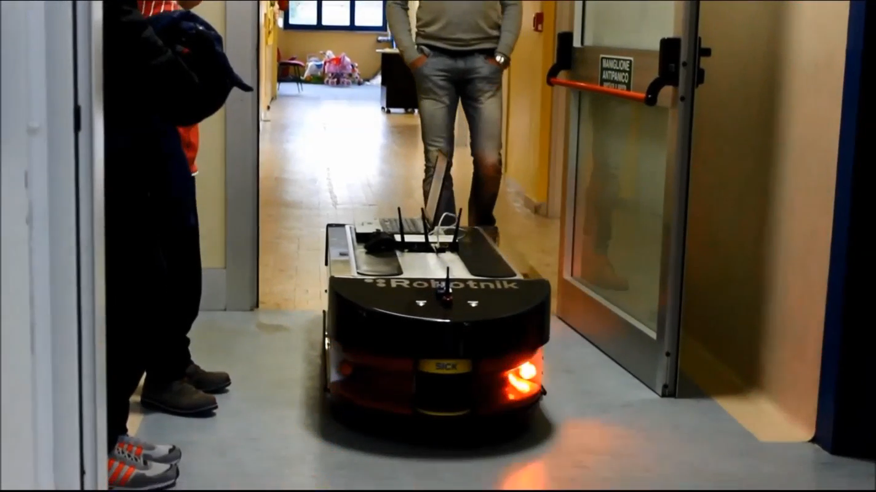
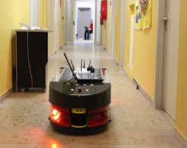


So, can this simple models do something interesting?
Indoor robot localization from radio strength information
Dragone et al, RSS-based Robot Localization in Critical Environments using Reservoir Computing, Proc. Of ESANN 2016

Slide 19

Deep Echo State Networks
reservoir layer L
Gallicchio, Claudio, Alessio Micheli, and Luca Pedrelli. "Deep reservoir computing: A critical experimental analysis." Neurocomputing 268 (2017): 87-99
fixed
reservoir layer 2
Trainable readout
reservoir layer 1
Recurrent architecture design is reflected
in the temporal representations
in the mathematical entities involved
input layer
Notes:
Ok, so in this case we talk of Deep Echo State Networks, and Deep Reservoir Computing, a model that we introduced in literature a few years ago. Deep ESNs are RC models and again their operation can be described by the composition of a dynamical reservoir and of a feed-forward readout. The crucial difference with respect to standard RC is that now the dynamical part is a stacked composition of multiple reservoirs. In practice, the reservoir is deep.
As seen in the figure, the deep reservoir contains L recurrent layers that are fixed, and the architecture is completed by a readout that is trainable as before. As the point is that we actually achieve qualitatively diverse dynamics in the different reservoir layers, sending the activations of all of them to the readout makes the learner actually able of giving the right weight to each filter. Use this when you want to deal with multiple time-scales.
CLICK
However, it could also be useful to project only the activation of the last of these filters to the readout, as in more common deep neural networks settings. Use this when you want to exploit directly the enrichment of state dynamics in higher layers and you don’t actually need multiple time-scales.

Slide 20
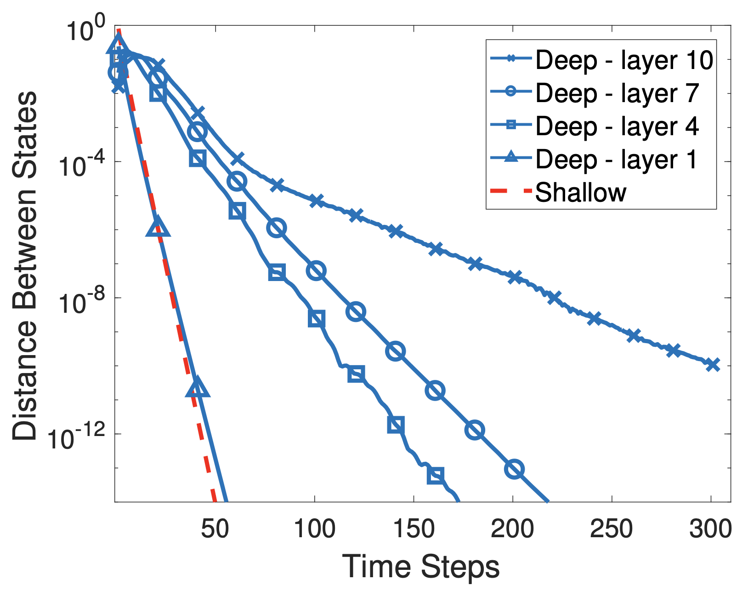
Multiple time-scales
Effects of input perturbations last longer in the higher reservoir layers
Multiple time-scales representation is intrinsic
Gallicchio, Claudio, Alessio Micheli, and Luca Pedrelli. "Deep reservoir computing: A critical experimental analysis." Neurocomputing 268 (2017): 87-99
Notes:
coming to multiple time-scales, this is one of the first experiments that we did some years ago in the first paper on the subject. this is a very simple empirical analysis: we drive the same deep reservoir system using two time-sreies: a reference time series, and a second time-series with a perturbation. then, we record the euclidean distance between the states in the corresponding layers of the architecture as a function of time. in the plot here you see the results, where the blue lines are for the layers of the deep network, and these are compared to what is achieved by a shallow 1-layer echo state net with the same total number of units (in red in the figure). very interestinly, we see that the effect of the typo in the input is actually lasting longer in higher layers than in lower layers, and the effect is intrinsic. no learning is taking place here. all layers are initialized to be asymptotically stable and that’s it. the structure of the deep recurrent neural network is the only responsible for this effect. these multiple time-scales, ordered along the hierarchy of the layers, are intrinsic. this is the most important observation, I think.

Slide 21
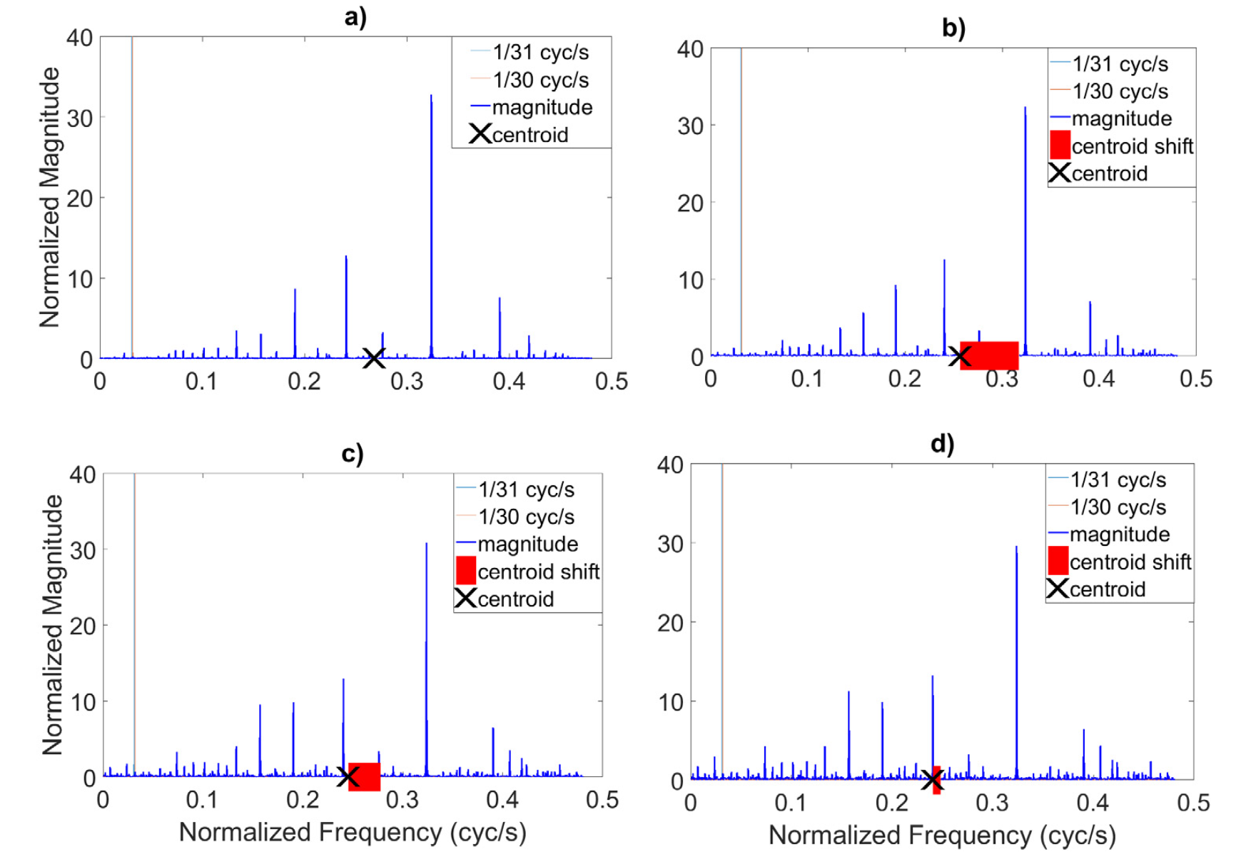
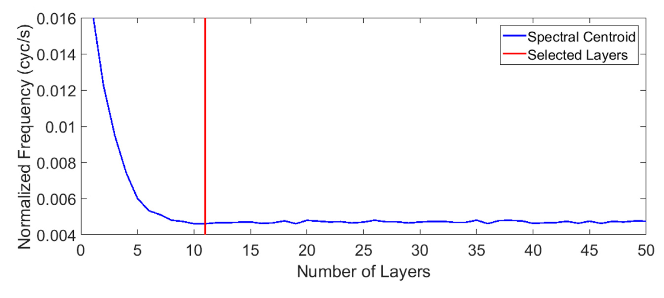
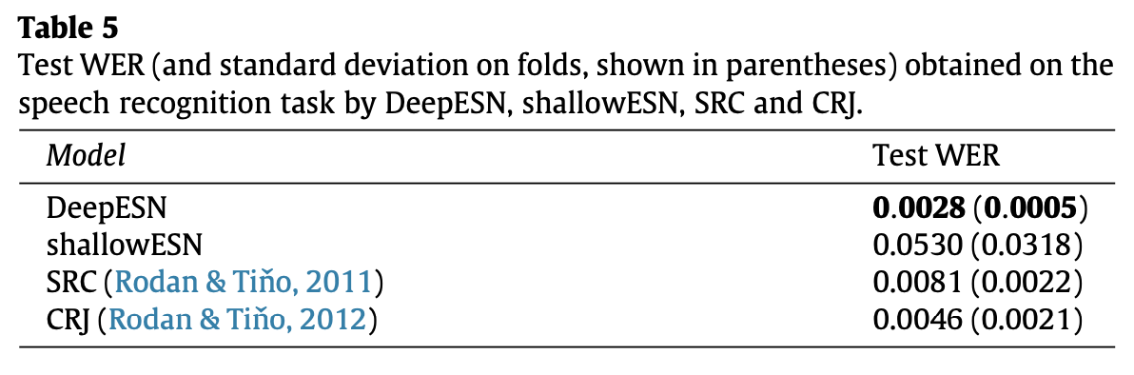
How many layers?
Gallicchio, C., Micheli, A. and Pedrelli, L., 2018. Design of deep echo state networks. Neural Networks, 108, pp.33-47.
Notes:
going ahead with this concept of multiple temporal representations one can also wonder when to stop the stacking process in the construction of the deep echo state network. well, in this paper on neural networks journal we started from previous observations, and from the fact that each reservoir layer operates like a filter that progressively removes a part of the frequency content in the driving signal propagated across the layers. and in this case it does so by a completely unsupervised process. So we can try to answer this magic question in deep learning: how many layers should I use to solve my problem? Well, in practice, until this filtering effect becomes negligible. You can actually start from your first layer and do a frequency analysis of the reservoir in that layer, an FFT of the signal in the layer. It’s plot a) on top left of the figure. then we add another layer and repeat the FFT only to that layer. we compute the center of mass of the frequency and see if there is actually a shift. we are now in the b) subplot and the shift is highlighted by the red bar. then we continue in the second row with the same operation until we reach a layer, in the bottom right, where the shiftis absolutely negligible, and there we stop.
CLICK
interestingly, the stop comes at a point after which it would make no sense to continue because in a sense we would just chase an asymptote. and interestlingly again this is a great point where to stop as also testified by the fact that the performance is a way better than the other literature alternatives on the same task, that you could find by extensive model selection.

Slide 22
Pervasive Learning
Learning in space and time

Slide 23
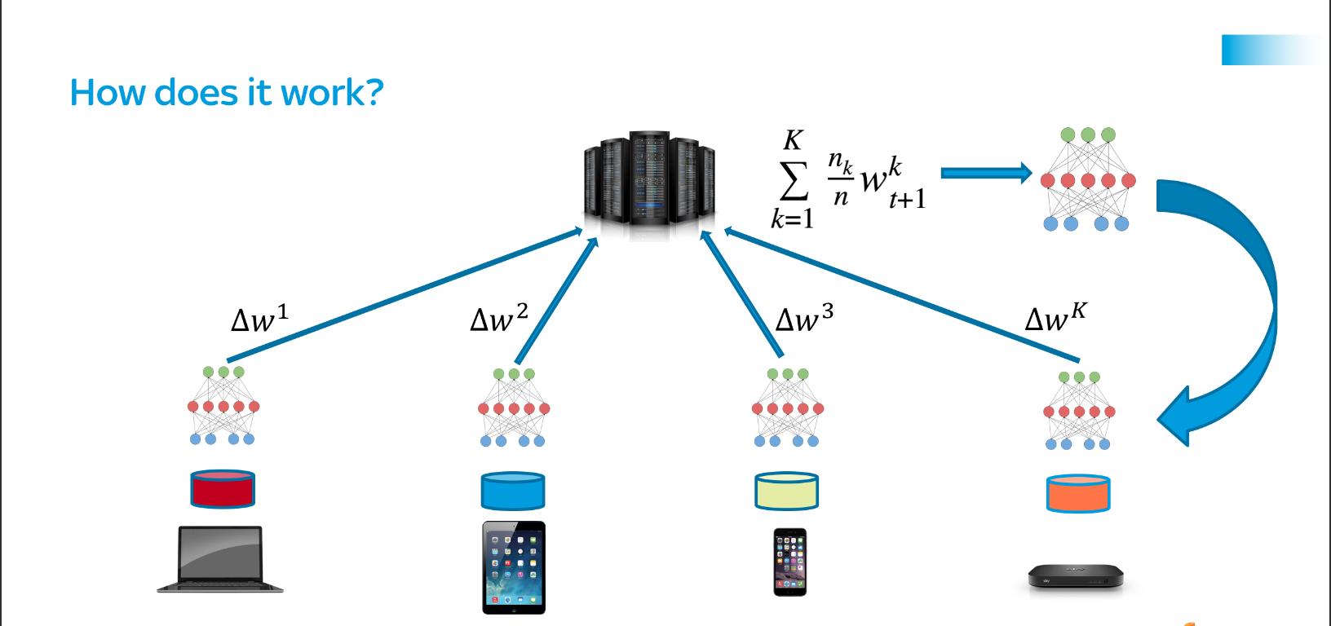
















Learning in a Pervasive Environment, Continually
V. De Caro et al, Continual Adaptation of Federated Reservoirs in Pervasive Environments, Neurocomputing (to appear)
Aggregation via centralized approach or global consensus
No data disclosure!
Local learning
Local learning
Local learning
Local learning
Mitigate forgetting and face Data Oblivion
time
time
time
time
Privacy-regulated
Resource-constrained

Slide 24
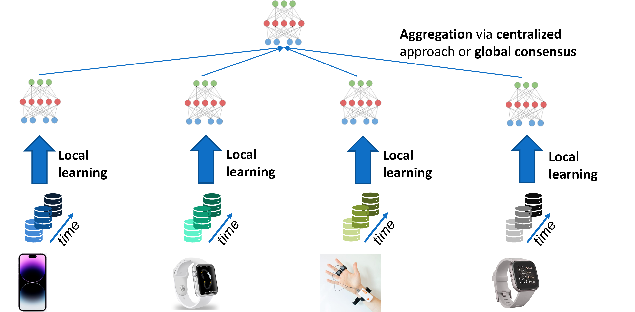
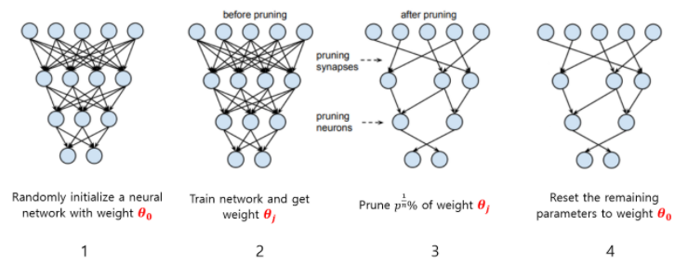
Towards Pervasive Learning
Physical Pervasiveness
Semantic Pervasiveness
Federated Learning
Continual Learning
Lightweight learning models
Computational Efficiency
Communication Efficiency
Randomized Neural Networks
Lightweight learning
Reusable and Modular Knowledge

Slide 25
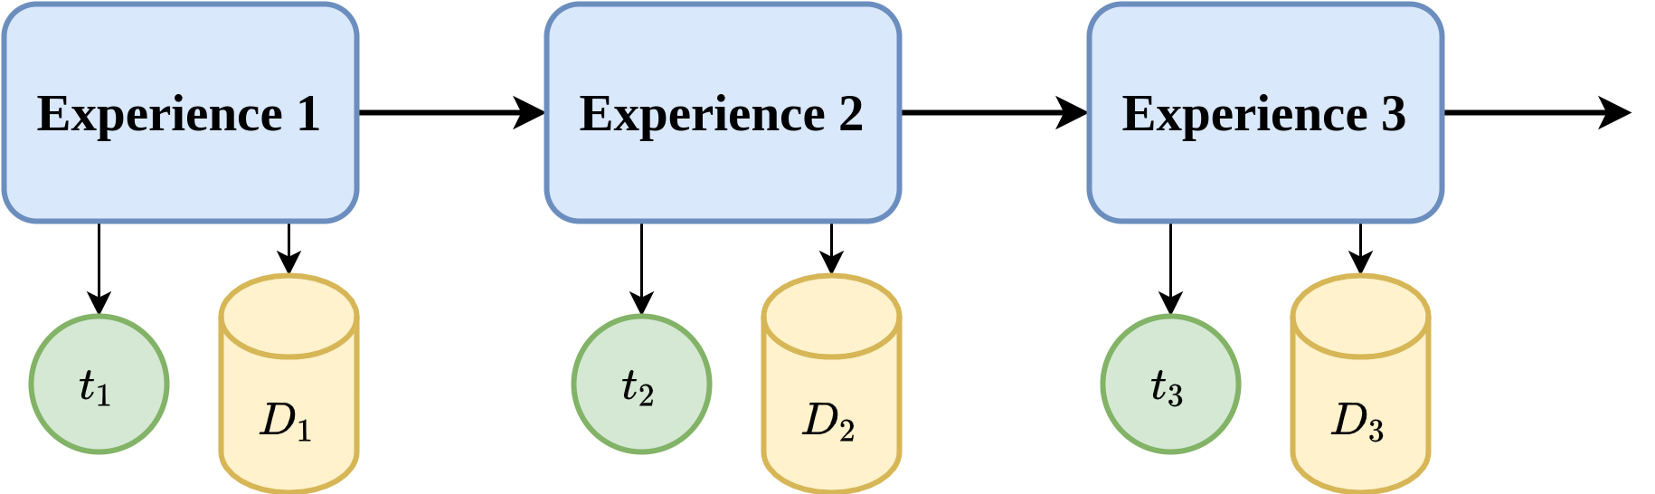
Continual Learning (CL) – Learning from a Stream of Experiences
Quickly learn new experiences (positive forward transfer)
Mitigate catastrophic forgetting (negative backward transfer)

Slide 26
Continual Learning in a Pervasive Scenario
Learning continually on streaming data
  Continual learning in recurrent neural networks
Learning from models pervasively distributed and continually updated
  Learning from models
  Distributed continual learning

Slide 27
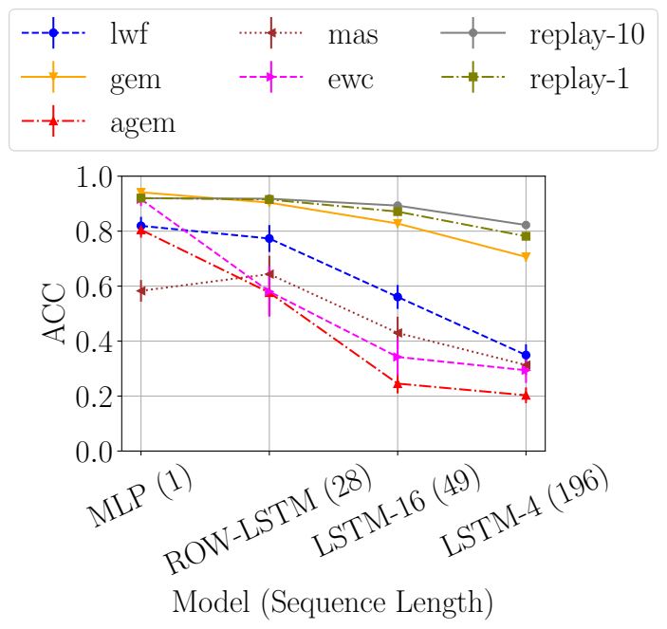
The Sequence Length Issue
Many CL strategies thought for vectorial/image data simply do not work on RNNs
Regularization strategies suffer the most
Gradient often taken as measure of “importance” for CL and RNNs suffer from exploding/vanishing gradient
=> the longer the sequence, the worse the problem
Cossu et al, Continual Learning for Recurrent Neural Networks: An Empirical Evaluation

Slide 28
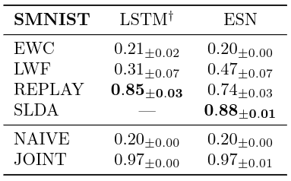
CL Strategies in Reservoir Computing
Elastic Weight Consolidation (EWC)
Learning without Forgetting (LwF)
Replay
Deep SLDA
  Linear discriminant analysis with mean vector per class + covariance matrix
  Requires pre-trained feature extractor
readout
reservoir
input layer
A. Cossu et al. "Continual Learning with Echo State Networks" ESANN 2021
Notes:
LwF enforces stability in the output layer activations by keeping a copy of the
previous model and by taking its output on the current training patterns as soft
targets in the distillation loss.
Streaming Linear Discriminant Analysis (SLDA) [13] is a strategy which
leverages a pretrained feature extractor G (a ResNet-18 in the original paper)
combined with a linear layer to compute the final output y = WG(x)+ b, where
x is the current input pattern. This strategy operates in a streaming setting,
where patterns are seen one at a time and only once (one epoch only). The
parameters W and b of the linear layer are computed through an online approx-
imation of the Linear Discriminant Analysis. The algorithm keeps a mean vector
together with an associated counter per class and a shared covariance matrix,
updated during training. Since SLDA requires a fixed feature extractor, we can
only apply it to ESNs thanks to its untrained recurrent layer

Slide 29

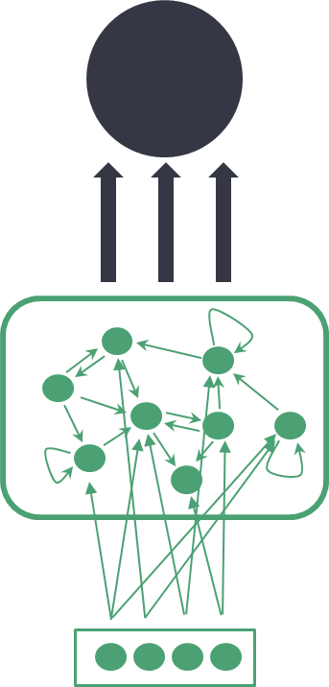






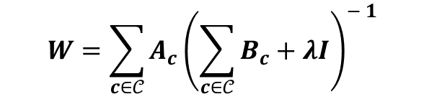
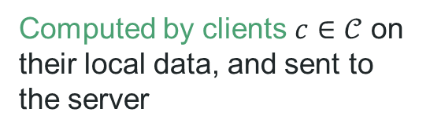

Incremental Readout Federated Learning - Supervised
Batch exact federated version of centralized redout learning (ridge-regression)
$$W=YS^{T}{\left(SS^{T}+λI\right)}^{−1}$$
$$A_{1},B_{1}$$
$$A_{C},B_{C}$$
Computed by clients $c∈𝒞$ on their local data, and sent to the server
$$A_{c}=Y_{c}S_{c}^{T}$$
$$W$$
$$W$$
$$B_{c}=S_{c}S_{c}^{T}$$
$$W=\sum_{c∈𝒞}{A_{c}}{\left(\sum_{c∈𝒞}{B_{c}}+λI\right)}^{− 1}$$
Computed by the server and sent back to clients.
D. Bacciu et al. "Federated reservoir computing neural networks." IJCNN 2021
Notes:
In Incremental Federated Learning, the number of floatingpoint values that get transferred from each client to the server
is N 2 R + NRNY , while the transmission from the server to the clients involves NRNY floating-point values. The added
transmission load with respect to Federated Averaging (which is still constant with respect to the number of examples used
for training) is justified by a better predictive performance of the aggregated model

Slide 30
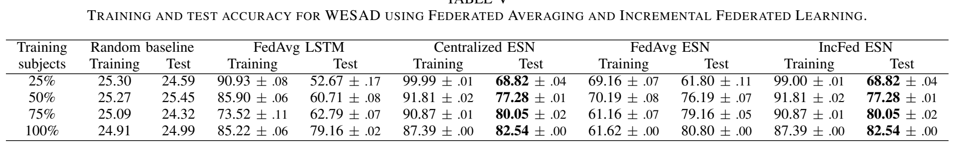
Does it Work?
TRAINING AND TEST ACCURACY FOR WESAD BENCHMARK
D. Bacciu et al. "Federated reservoir computing neural networks." IJCNN 2021
Notes:
WESAD – Cognitive state inference from wearable during activities
Given these splits, the experiments were repeated by training the global model on different percentages of training users, i.e., 25%, 50%, 75%, 100%;

Slide 31
About Supervision
Learning incrementally the readout is nice but assumes that clients have supervised information available
Can we personalize client models in an unsupervised way?

Slide 32
Optimizing the memory – Reintroduce reservoir adaptivity
Add gain and bias terms to memory computation
gain
bias
Intrinsic Plasticity: tune the probability density of reservoir neurons to maximum entropy
Gain and bias update rule by minimization of KL between empirical distribution and a desired gaussian
Improves the performance of the model and reduces the variance due to bad reservoir initializations
Schrauwen, B., Wardermann, M., Verstraeten, D., Steil, J.J. and Stroobandt, D., 2008. Improving reservoirs using intrinsic plasticity. Neurocomputing, 71(7-9), pp.1159-1171.
Notes:
When using the tanh as non-linearity, the objective of IP is to minimize the Kullback-Leibler divergence between the empirical distribution of the neuron’s activations and a desired Gaussian distributions with parameters μ and σ. This is performed with
a gradient-based approach in which the update rules are formalized as
This simple learning rules allow to maximize the information content of reservoir states, and to reduce the variance in
performance caused by bad initialization

Slide 33
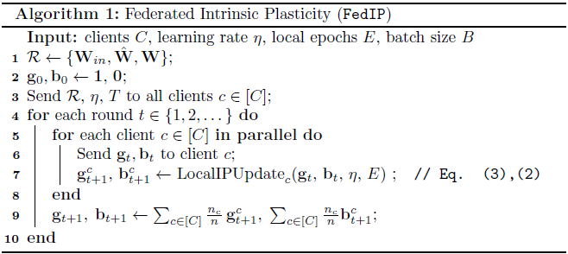












Federated Intrinsic Plasticity
V. De Caro et al “Federated Adaptation of Reservoirs via Intrinsic Plasticity" ESANN 2022
FedIP merges:
Federated Averaging as a framework for adapting a federation of clients with
Intrinsic Plasticity for learning the global gain and bias parameters
$${a,b}_{t}$$
$${a,b}_{t′}$$
$${g,b}_{t}^{1}$$
$${g,b}_{t}^{2}$$
$${g,b}_{t}^{c}$$
$${g,b}_{t}^{C}$$
$${g,b}_{t′}^{1}$$
$${g,b}_{t′}^{2}$$
$${g,b}_{t′}^{c}$$
$${g,b}_{t′}^{C}$$
$$𝒞$$

Slide 34
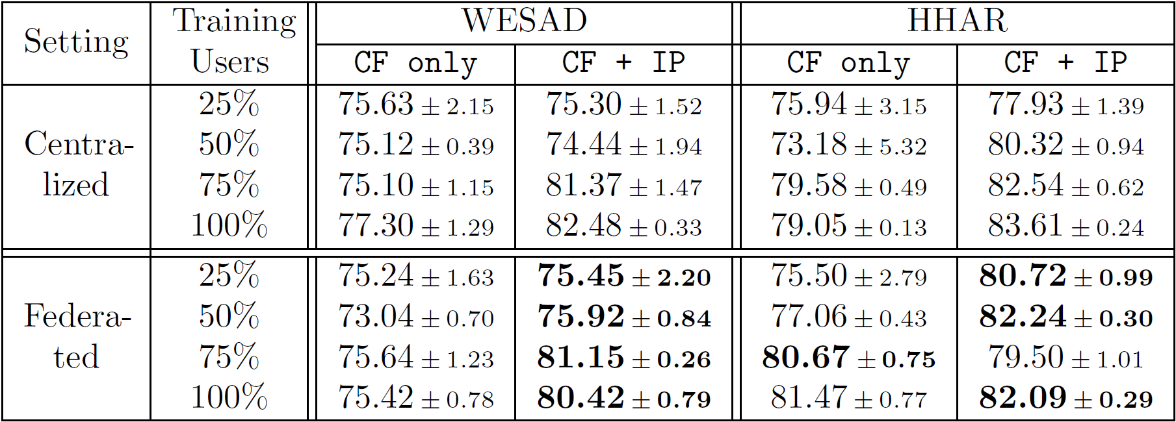
Does it Work?
V. De Caro et al “Federated Adaptation of Reservoirs via Intrinsic Plasticity" ESANN 2022
IncFed only and IncFed + FedIP respectively in FL
Baseline
FedIP doesn’t suffer from performance decrease w.r.t. centralized IP.
FedIP improves generalization capabilities of the model

Slide 35
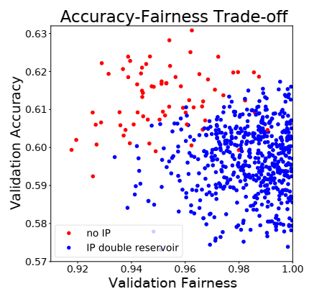
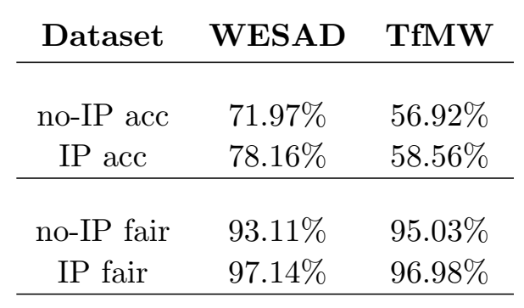
Some fun extensions
FedCLIP - Federated Continually Learning Intrinsic Plasticity
V. De Caro et al, Decentralized Plasticity in Reservoir Dynamical Networks for Pervasive Environments, ICML-LLW 2023
Leveraging intrinsic plasticity to promote fairness in Echo State Networks
A. Ceni et al, Improving Fairness via Intrinsic Plasticity in Echo State Networks, Proc. of ESANN 2023 (to appear)

Slide 36
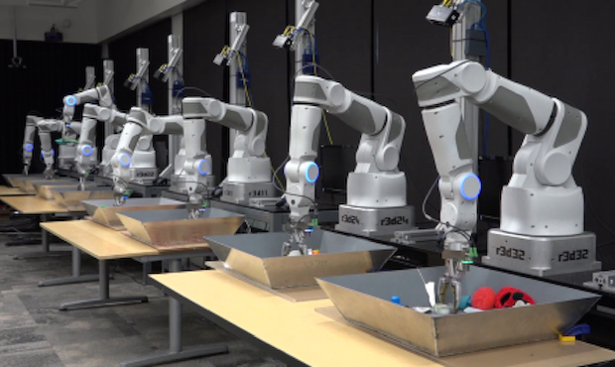
Multi-Agent Continual Learning
General framework to integrate continual learning and reuse of expert knowledge
CL agents learn over time on their own data streams.
Each agent learns independently from the others.
Agents can communicate via simple mechanisms, such as sharing the weights after learning a new task (privacy constraints)

Slide 37
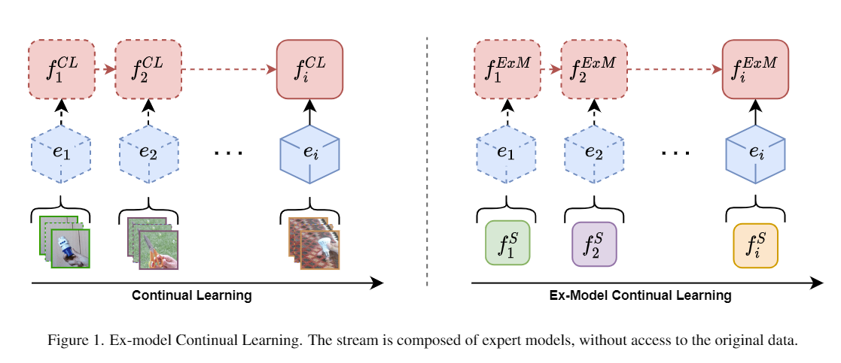
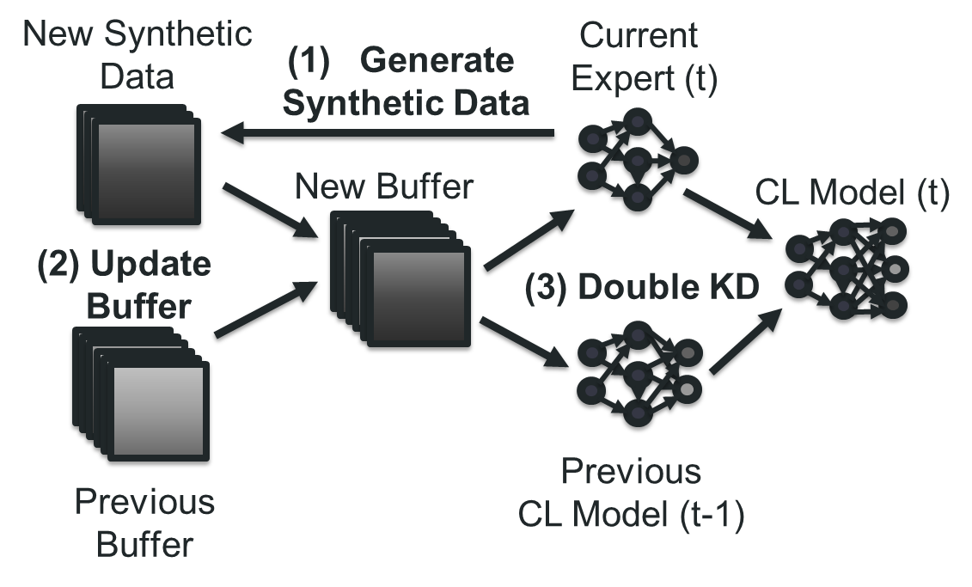
Ex-Model Learning (ExML)
Instead of data, at each learning experience
the model receives an expert model
Rehearsal with double knowledge distillation
Ex-Model: Continual Learning From a Stream of Trained Models. CLVISION@CVPRW, 2022

Slide 38
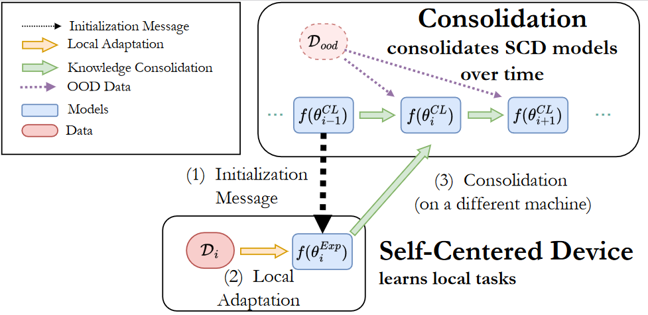
Restricting the Multi-Agent Ex-Model Scenario
Carta et al, Projected Latent Distillation for
Data-Agnostic Continual Learning with Multiple Devices, under review
Split learning phase into
Adaptation: learn the new task
Consolidation: merge the new knowledge and mitigate forgetting

Slide 39
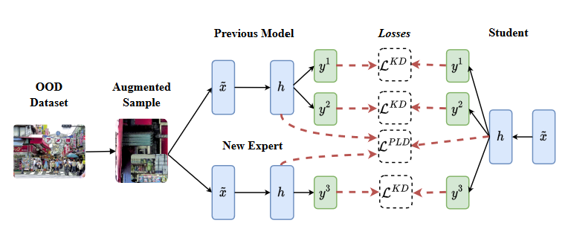
Data-Agnostic Consolidation
Carta et al, Projected Latent Distillation for
Data-Agnostic Continual Learning with Multiple Devices, under review
A single OOD image is used for distillation
Heavy augmentations provide diversity
Double Knowledge Distillation to match the output of each task
Projected Latent Distillation to match the latent spaces (up to a linear transformation)

Slide 40
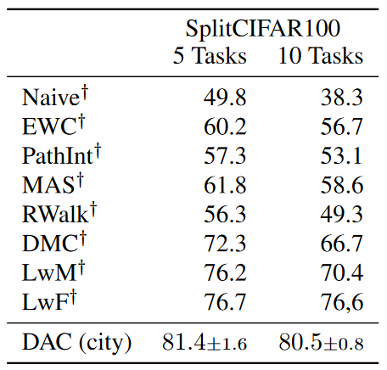
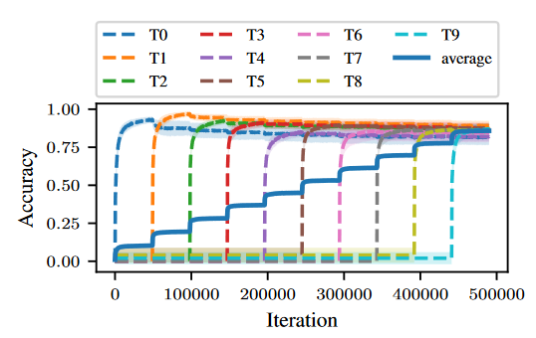
Highlights – Task-aware Split CIFAR100 (multihead)
Carta et al, Projected Latent Distillation for
Data-Agnostic Continual Learning with Multiple Devices, under review
DAC with a single image is better than methods using real data (LwF) or large OOD dataset (DMC)
Adaptation-consolidation separation provides a principled way to mitigate forgetting.

Slide 41
Neural Nets & Dynamical systems

Slide 42
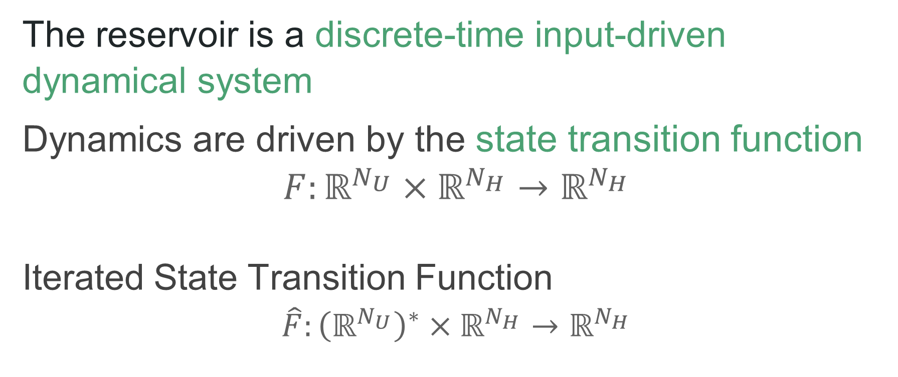
Back on Dynamical Systems View
The reservoir is a discrete-time input-driven dynamical system
Dynamics are driven by the state transition function
$$F:ℝ^{N_{U}}×ℝ^{N_{H}}→ℝ^{N_{H}}$$
Iterated State Transition Function
$$\hat{F}:{\left(ℝ^{N_{U}}\right)}^{∗}×ℝ^{N_{H}}→ℝ^{N_{H}}$$
input
state
new state
input sequence
initial state
final state

Slide 43
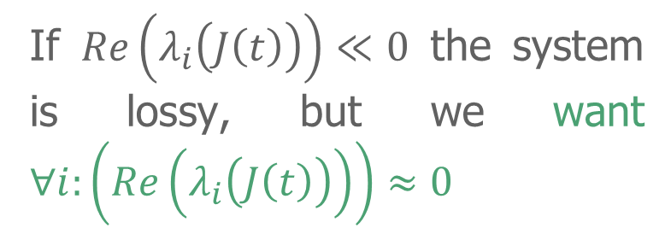
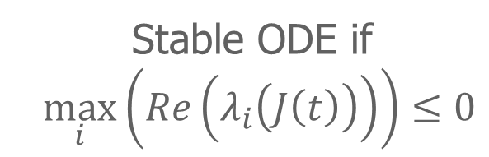
A Further Dynamical Systems Twist
We can interpret reservoir dynamics under the lens of a discretized ODE
The goal then becomes chasing optimal (forward) propagation by enforcing a stable dynamics + non-dissipation of the input over time
If $Re\left(λ_{i}\left(J\left(t\right)\right)\right)≪0$ the system is lossy, but we want $∀i:\left(Re\left(λ_{i}\left(J\left(t\right)\right)\right)\right)≈0$
Stable ODE if
$\max_{i}\left(Re\left(λ_{i}\left(J\left(t\right)\right)\right)\right)≤0$
Notes:
As argued in Haber & Ruthotto (2017), Re(λi(J (t))) 0 results in a lossy system; the energy or signal in
the initial state is dissipated over time.

Slide 44
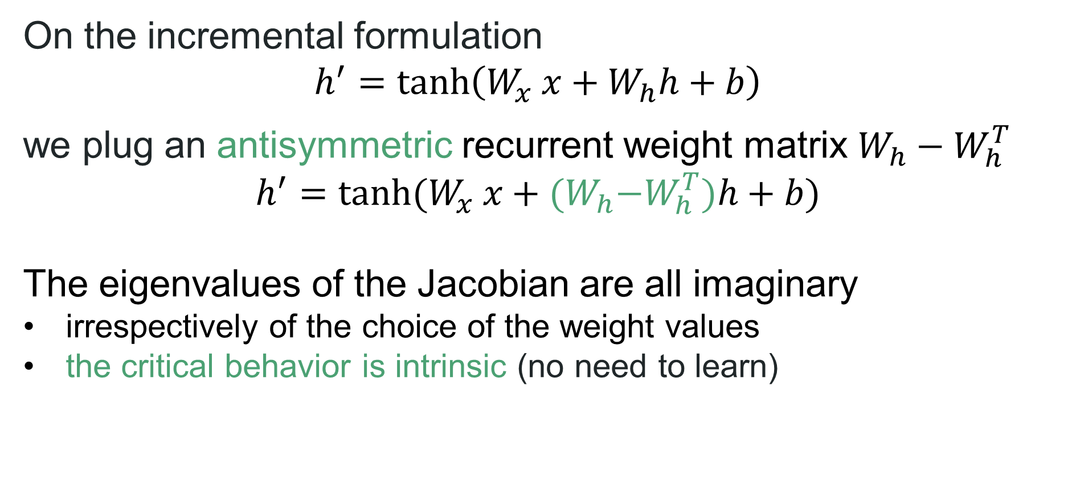
Achieving critical dynamics
On the incremental formulation
$$h^{′}=\tanh\left(W_{x} x+W_{h}h+b\right)$$
we plug an antisymmetric recurrent weight matrix $W_{h}−W_{h}^{T}$
$$h^{′}=tanh⁡(W_{x} x+{(W}_{h}−W_{h}^{T})h+b)$$
The eigenvalues of the Jacobian are all imaginary
  irrespectively of the choice of the weight values
  the critical behavior is intrinsic (no need to learn)
Notes:
Ideally, to avoid both instability and dissipation of the state content over time, it is desirable that the Jacobian of (1) has eigenvalues with ≈ 0 real part.
CLICK
A simple way of achieving such a critical condition is to use an antisymmetric recurrent weight matrix, i.e. of the form W = Wh − WhT .
Relevantly, in this latter case, the eigenvalues of the Jacobian of the transformation in (1) are all imaginary [5], irrespective of the choice of the weight values.
the critical behavior of the involved dynamics is not required to be learned from the data, rather it is an intrinsic property of the system.

Slide 45
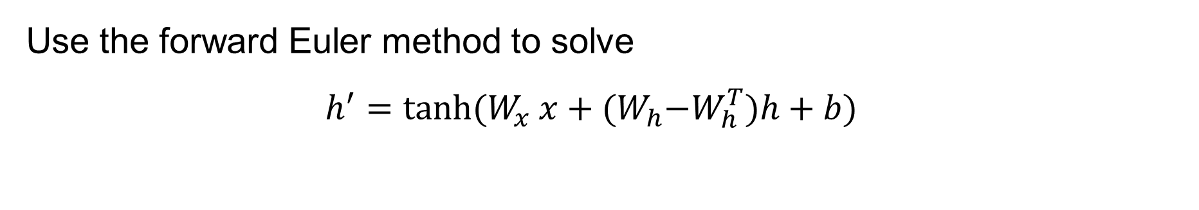
Euler State Networks (EuSN)
Use the forward Euler method to solve
$$h^{′}=tanh⁡(W_{x} x+{(W}_{h}−W_{h}^{T})h+b)$$
$$h_{t}=h_{t−1}+ε\tanh\left(W_{x} x_{t}+{(W}_{h}−W_{h}^{T}−γI\right)h_{t−1}+b)$$
step size
diffusion coefficient
Gallicchio, C., Reservoir Computing by discretizing ODEs. ESANN 2021
Notes:
In (2), ǫ and γ are both small positive scalars, representing respectively the step size of integration and a diffusion coefficient
for stabilizing the solution.
Interestingly, using standard RC arguments to analyze (2), i.e. studying the linearized system around the null state and for null input, reveals that the effective spectral radius of EuSN is given by the maximum among the absolute
eigenvalues of ̃W = (1 − ǫγ)I + ǫ(Wh − WT h ). As ǫ and γ are both small positive values, the spectral radius of ̃W is by construction confined in a small neighborhood around 1
The ODE as defined in Equation 8 is however incom-
patible with the stability condition of the forward Euler method. Since λi(Jt), the eigenvalues of
the Jacobian matrix, are all imaginary, |1 + λi(Jt)| is always greater than 1, which makes the
AntisymmetricRNN defined in Equation 10 unstable when solved using forward Euler
One easy way to fix it is to add diffusion to the system by subtracting a small number γ > 0 fromv the diagonal elements of the transition matrix. The model thus becomes

Slide 46
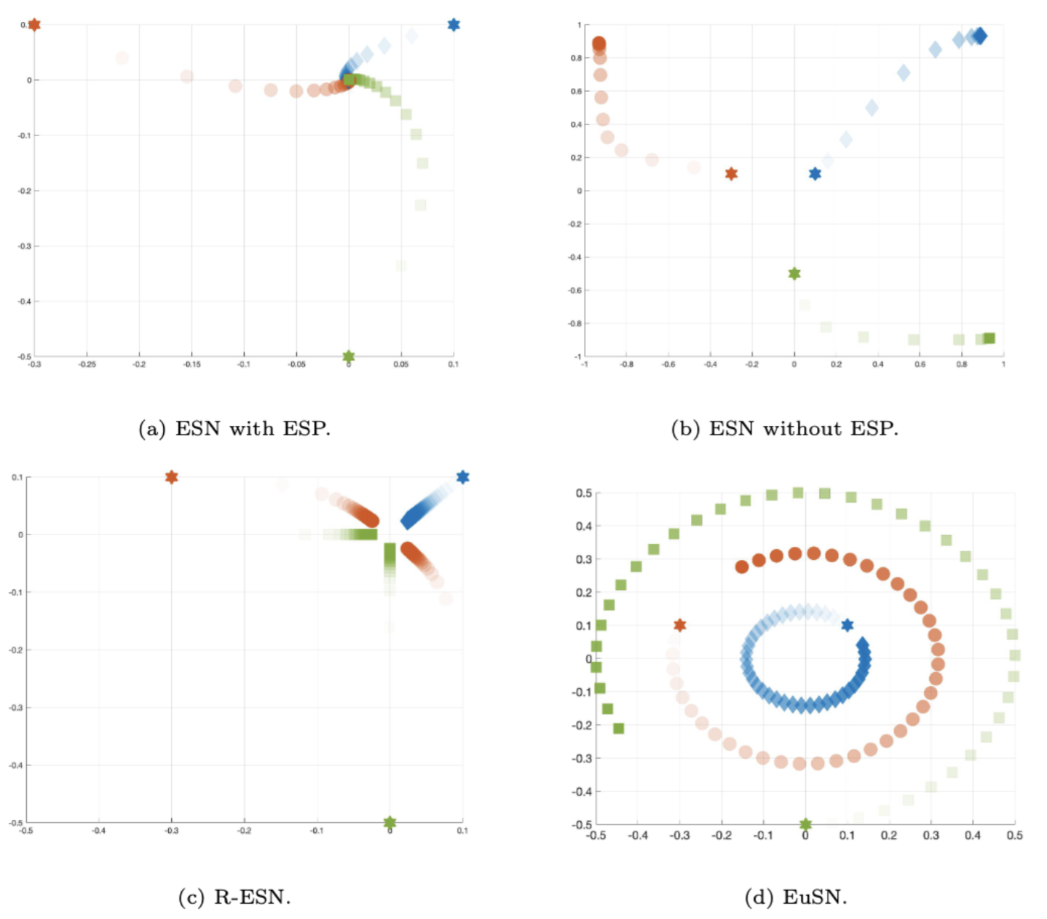
The input signal is preserved without exploding nor dissipating
Gallicchio, Claudio. "Euler State Networks." arXiv preprint arXiv:2203.09382 (2022).

Slide 47
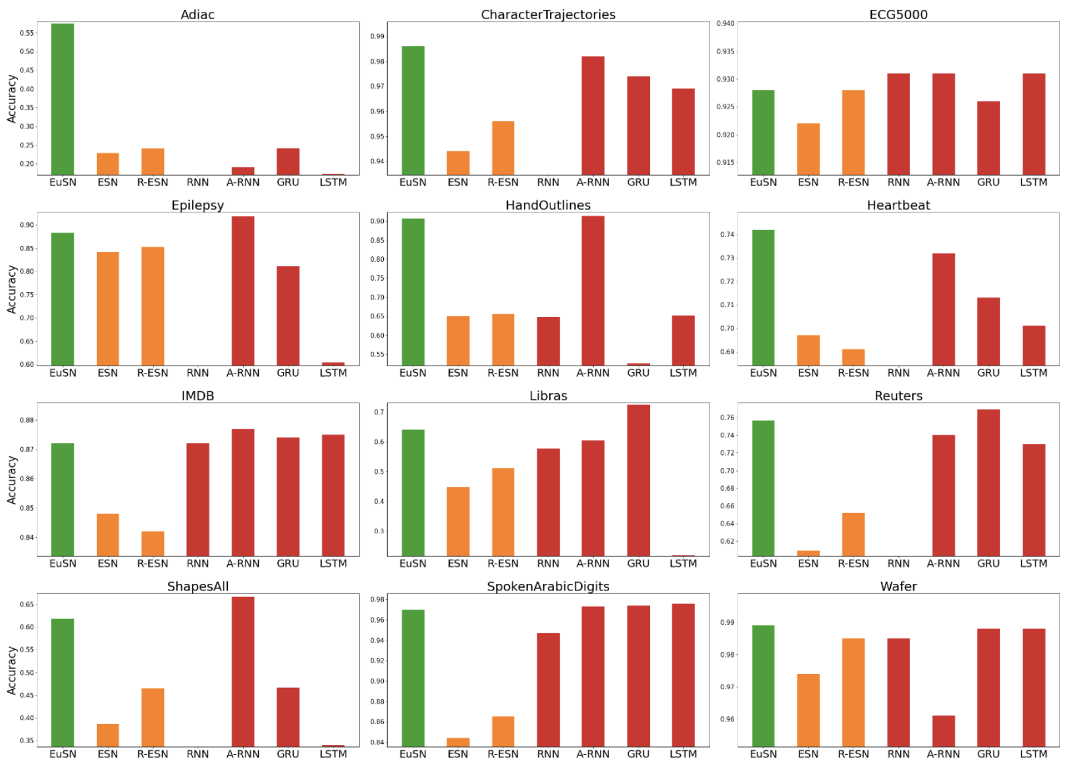
High accuracy vs state-of-the-art fully trained models & ESNs…

Slide 48
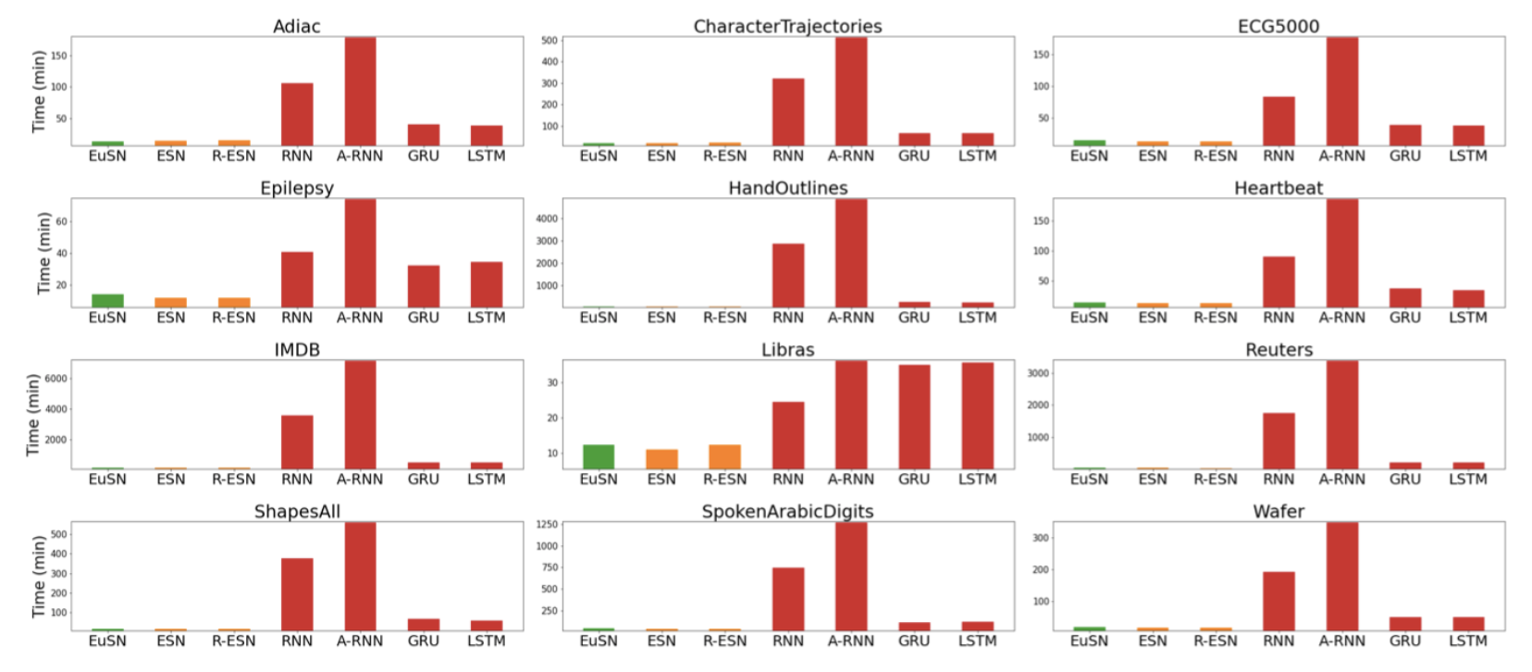

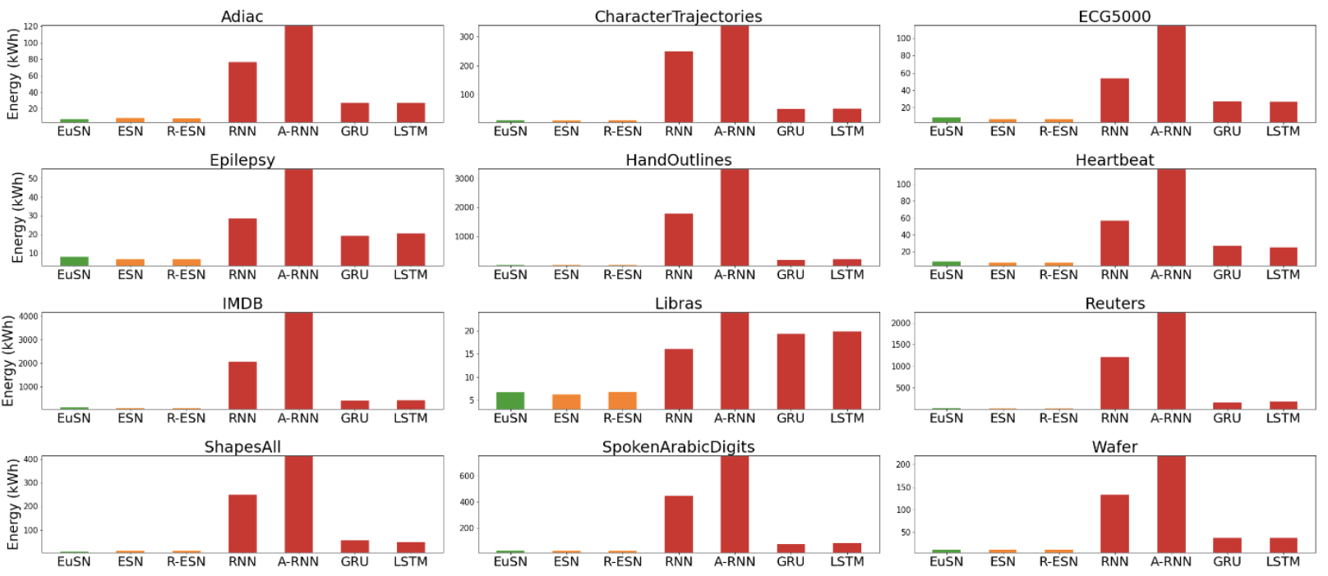

…while being extremely more efficient (up to 100x) than fully trained models

Slide 49
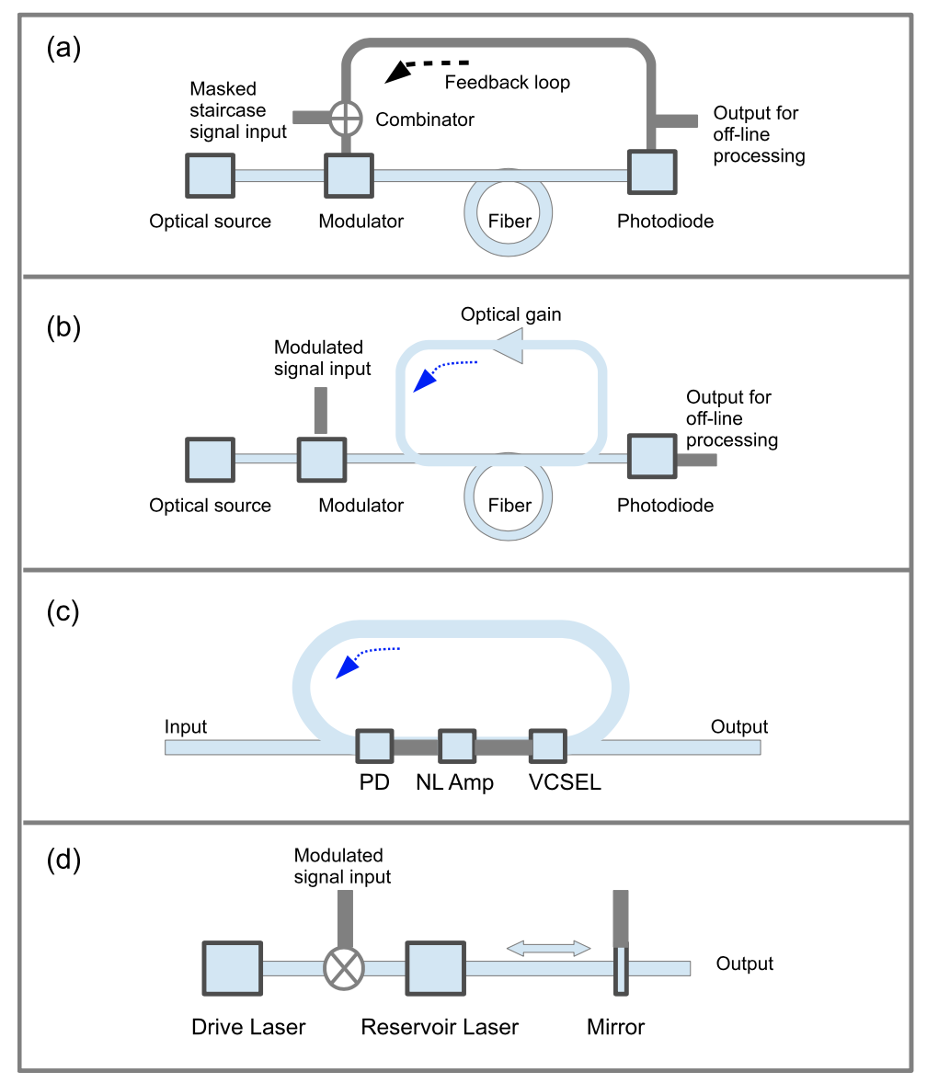
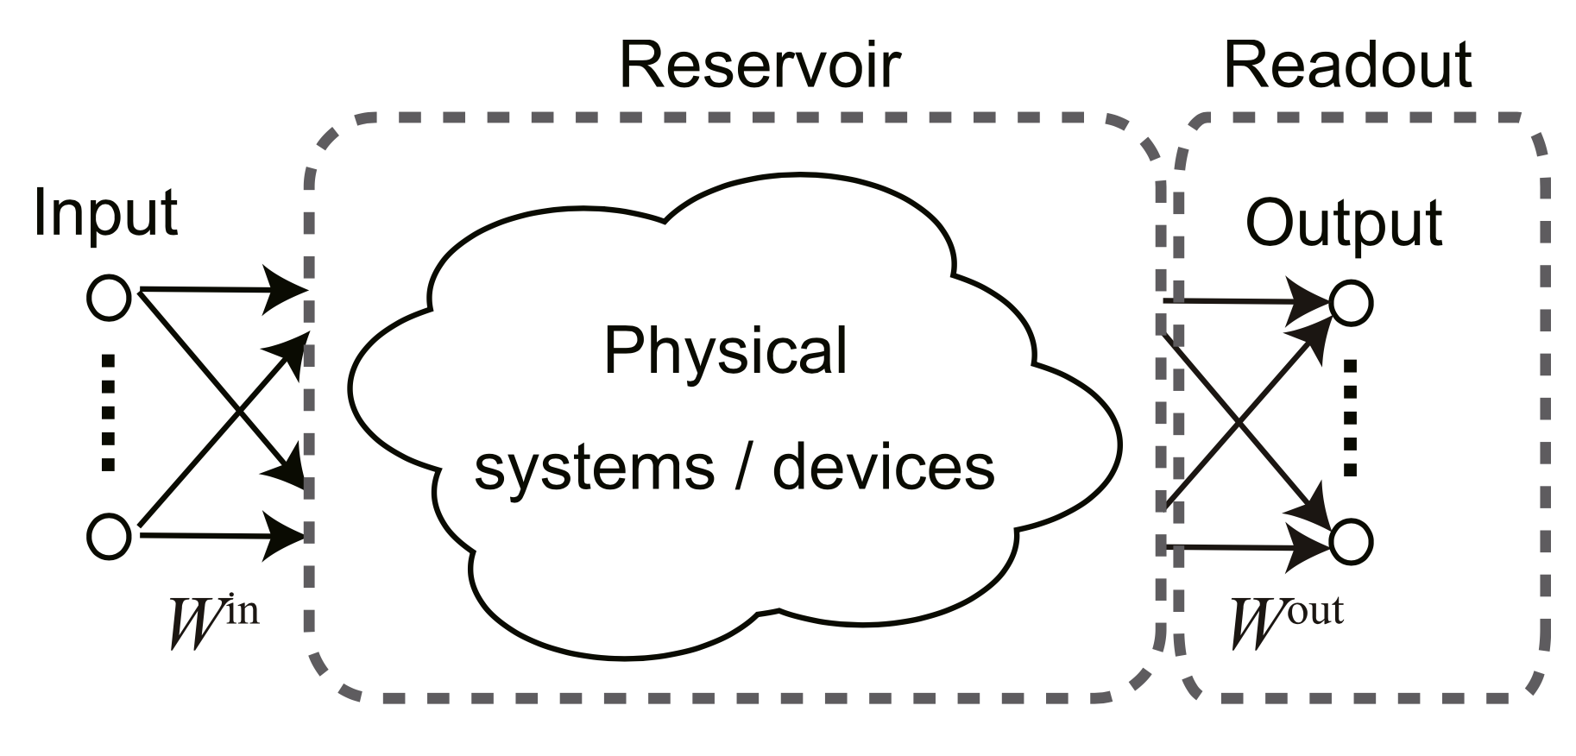
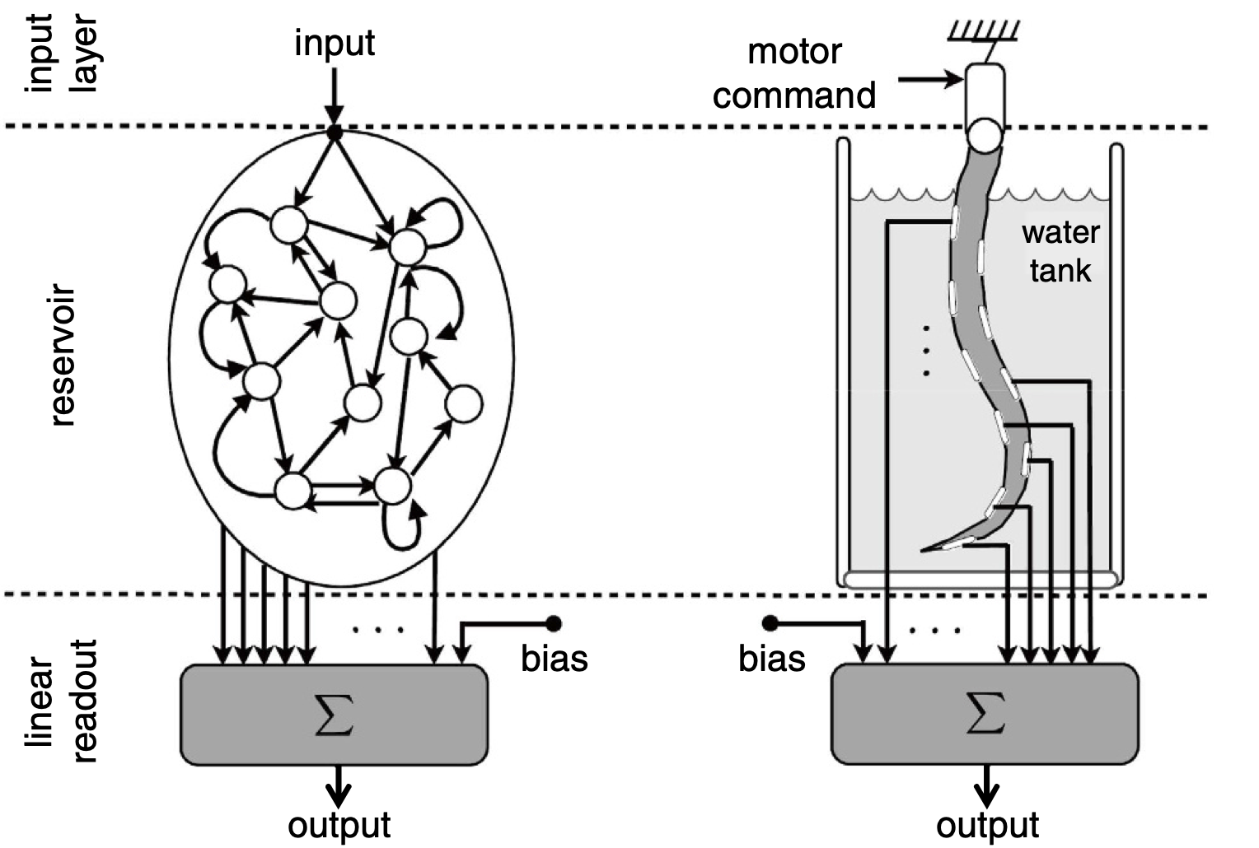
Reservoir Computing on Physical Dynamical Systems
Tanaka, G., Yamane, T., Héroux, J.B., Nakane, R., Kanazawa, N., Takeda, S., Numata, H., Nakano, D. and Hirose, A., 2019. Recent advances in physical reservoir computing: A review. Neural Networks, 115, pp.100-123.
The reservoir can be replaced by a physical system exhibiting controllable dynamics (even physical bodies)
Nakajima, Kohei, et al. Scientific reports 5.1 (2015): 1-11.
Notes:
Using the words by juan pablo ortega, another nice thing is that reservoir computing is not just a research area, it is also a community of people. and it has a very important variety of competencies in it. for example, an important part of this community is given by non-linear physicists.
long story short, reservoir computing can be implemented in neuromorphic hardware very effectively. there is a plenty of ways in which this can be done, I refer to this very good survey on the topic by tanaka and others on Neural Networks journal. essentially, the dynamical reservoir can be replaced by a physical system exhibiting controllable dynamics (and rich dynamics). for example, photonics can be used in several ways, for instance implementing the idea of ring reservoirs by time-multiplexing.

Slide 50

A Unifying Dynamical Systems Perspective on Neural Networks
$$\frac{∂x(t)}{∂t}=$$
compose
concat
$$f_{θ_{k}}(x\left(t\right),r\left(t\right))$$
$$||…||f_{θ_{p}}(x_{p}\left(t\right),r_{p}\left(t\right))$$
$$f_{θ_{l}}(x_{l}\left(t\right),r_{l}\left(t\right))∘…∘$$
Evolution of neural activations formalized and governed by the properties of a dynamical system
Principled way of shaping neural inductive biases
Learning beyond backprop
  Adapt to make the system critical, dissipative, conservative or chaotic
  Learning continually
Computing neural networks on dynamical systems
https://eic-emerge.eu/

Slide 51
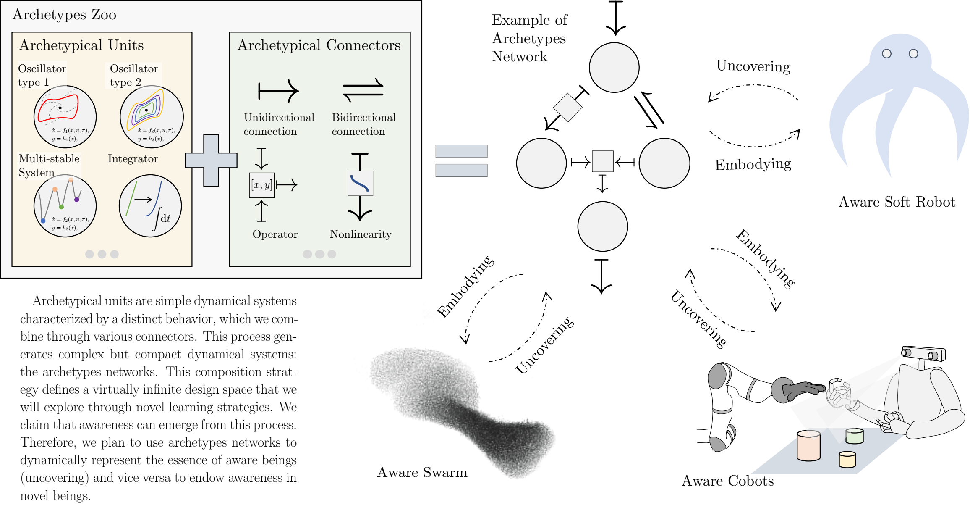
Towards neural computing on dynamical systems
https://eic-emerge.eu/

Slide 52

https://eic-emerge.eu/
Towards neural computing on dynamical systems

Slide 53

Harmonic Oscillators & Recurrent Neural Networks
$$\ddot{x}=−γx − ε\dot{x}+f(t)$$
(Harmonic) Describes oscillatory motion around an equilibrium point without energy dissipation
(Input-drive) External time-varying force
(Dampened) Introduces a source of energy dissipation
A network of driven dampened harmonic oscillators
Describe an RNN with state $x⇒$
Can be made a first order ODE and solved by Euler (coRNN)
$$\ddot{x}=f(t)−γx − ε\dot{x}$$
Input-driven by a non-linear neural layer
  $$f\left(t\right)=tanh\left(Wx+\hat{W}\dot{x}+Vu\left(t\right)+b\right)$$
Rusch & Mishra, ICLR 2023
Notes:
two main behaviours can be observed: overdamped dynamics (when ε > 2√γ) characterised by exponential decay towards y = 0 without any oscillations, or underdamped dynamics (when 0 < ε < 2√γ) characterised by an oscillatory behaviour with decreasing amplitude in time

Slide 54
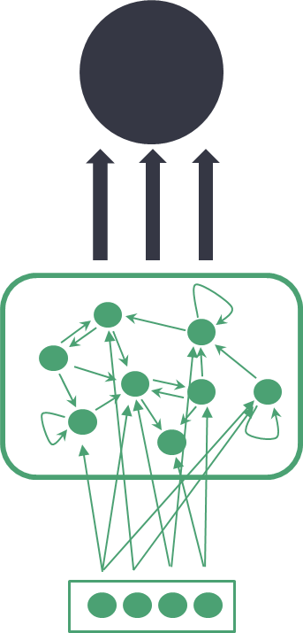
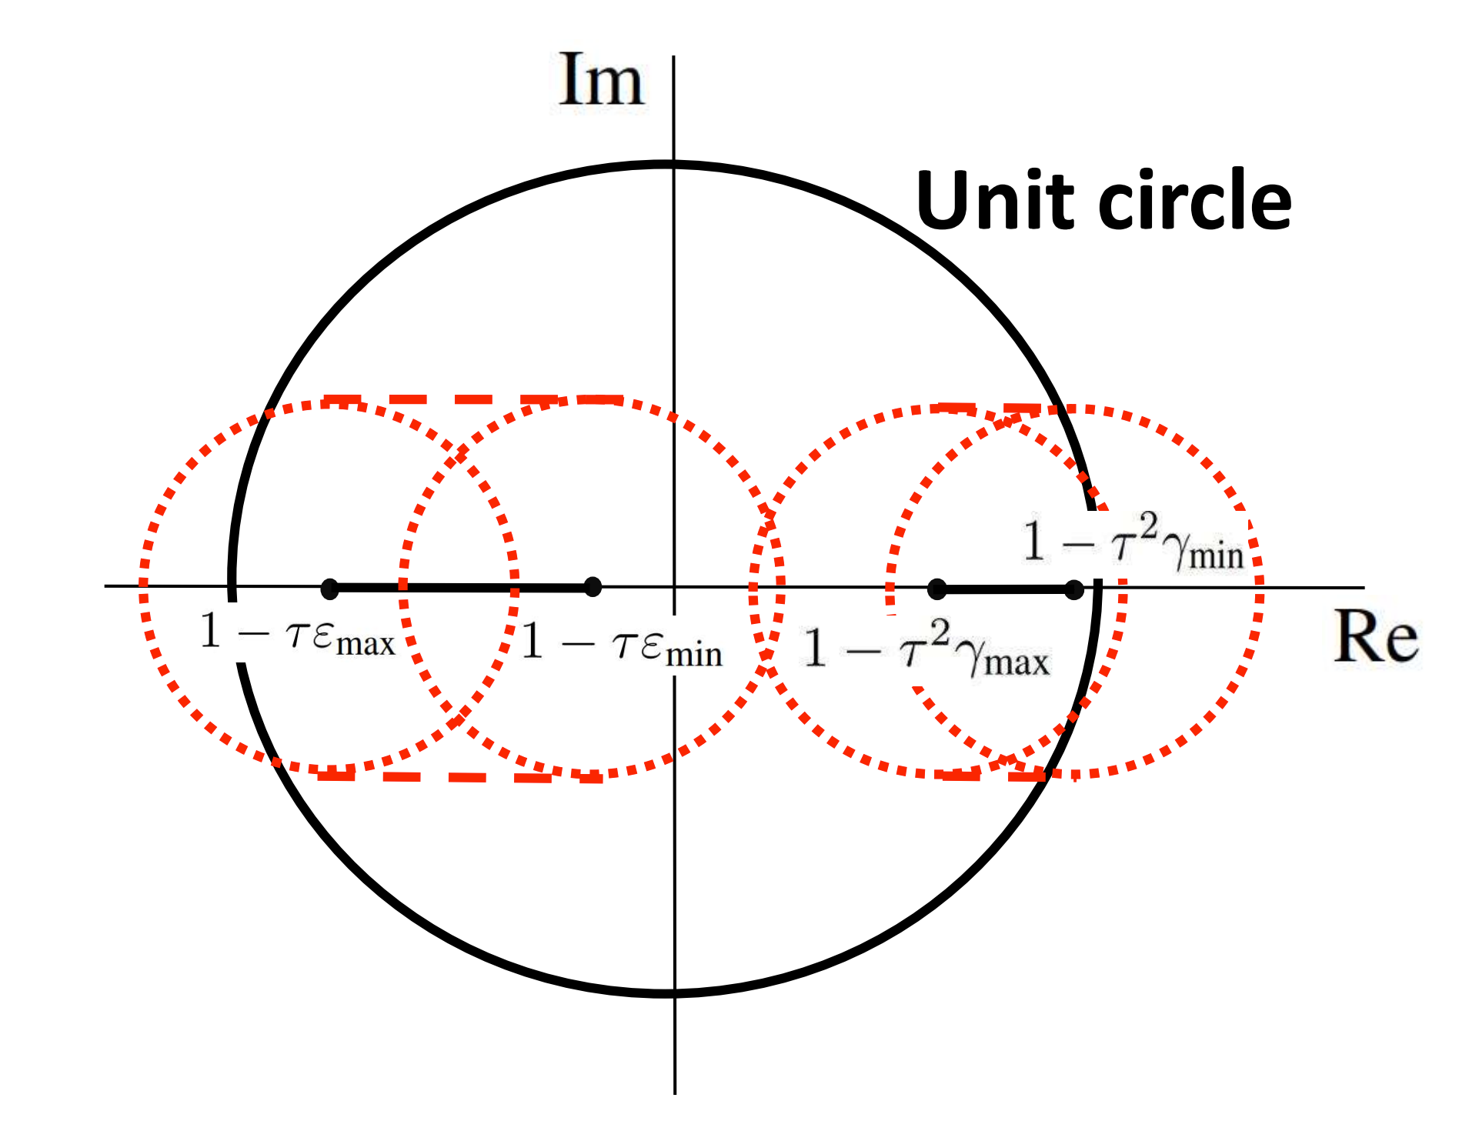
Randomly (Heterogenous) Coupled Oscillators (RCO)
Ceni et al, ICML F4LCD 2023
Euler discretization with $z=\dot{x}$vectorial frequency and dampening, $\hat{W}=0$
$$x_{t}$$
  $$x_{t+1}=x_{t}+τz_{t+1} \\ z_{t+1}=z_{t}+τ(tanh\left(Wx_{t}+Vu_{t+1}+b\right)−γ⨀x_{t} −ε⨀z_{t})$$
Untrained parameters rescaled for stability/contractivity
$$u_{t}$$
Sufficient conditions for linear stability exist, but are very restrictive on hyper-parameters configuration
Necessary conditions
  $$ε_{min}, γ_{min}≥0$$
  $$τε_{max}≤2$$
  $$τ^{2}γ_{max}≤2$$
Eigenspectrum of RCO Jacobian
Notes:
In practice, in an hcoRNN the coupling occurs only by means of the activations x, while the damping terms remains decoupled, i.e. characteristic to each neuron regardless of the behaviour of the other neurons.

Slide 55
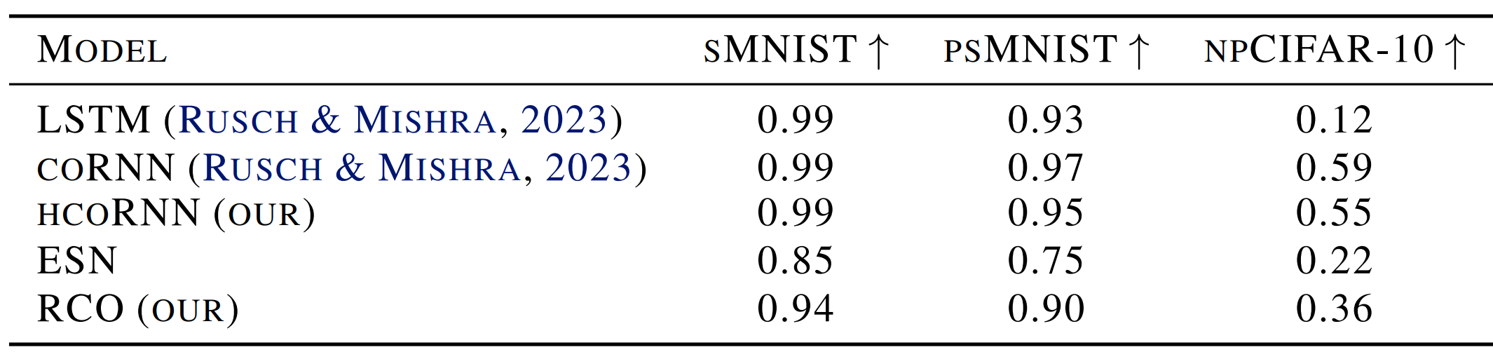
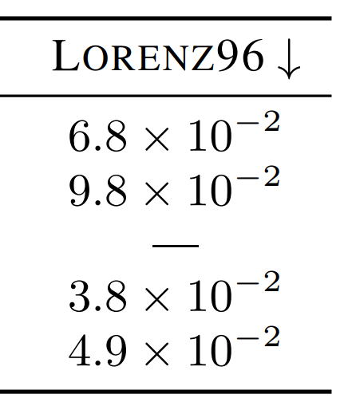

RCO - Some Results
Ceni et al, ICML F4LCD 2023
Competitive while being untrained and with two orders of magnitude lesser parameters
Sufficient conditions are not respected, necessary conditions are satisfied almost always
Describe both stable complex oscillatory dynamics and chaotic dynamics
(Fully-trained RCO)
Fading RCO promoting stability rather than guaranteeing it
Notes:
Good configurations are not entirely stable, but are closer to stable states.

Slide 56
Wrap up

Slide 57












Pervasive AI Lab – Our Libraries
Joint UNIPI-CNR lab (2019): 50 members, coordination of 4 EU projects
https://github.com/vdecaro/fedray/
FedRay - An R&D-oriented framework for Federated Learning
pai.di.unipi.it
https://avalanche.continualai.org
https://github.com/EU-TEACHING/teaching-ai-toolkit

Slide 58
Concluding Remarks
Reservoir computing
  Paradigm to design efficient recurrent neural networks
  Nice properties that support effective embedding, distribution and lifelong adaptation
Reservoir computing supports natively neuromorphic computing
  A first attempt at surpassing limitations of Von Neumann architectures
  Sustainable Artificial Intelligence
Reservoir computing is an example of dynamical systems computing
  Dynamical systems as a principled design approach for neural networks (formal language)
  Dynamical systems as a mean to efficiently execute neural networks (neuromorphic computing)
  Dynamical systems as a mean to study properties of neural networks (characterization tool)

Slide 59


Concluding Remarks
Different problems call for different stable/conservative/chaotic behaviours
  Heterogenous NNs with adaptive behaviour switch/integration
  (Lifelong) learning to optimize dynamical system properties
Identify grounded composition operators and their properties
  From tight coupling to networked systems
  Concatenation Vs Pipelining Vs Nesting
Notes:
Guy Pearce: Leonard Shelby

Slide 60







Acknowledgements
Antonio Carta
Andrea Ceni
Andrea Cossu
Valerio De Caro
Vincenzo Lomonaco
Claudio Gallicchio
Funded by the European Union under GA 101070918

