Slide 1
AI for Adaptive Tutoring and College Student Success
Zachary A. Pardos Associate Professor UC Berkeley School of Education
This work is licensed under CC BY-NC-SA 4.0
Notes:
I’m Zach, an associate professor a UC Berkeley. Pleased to introduce you to our work on designing an open-source adaptive tutoring system based on intelligent tutoring system principles to support learning sciences research

Slide 2
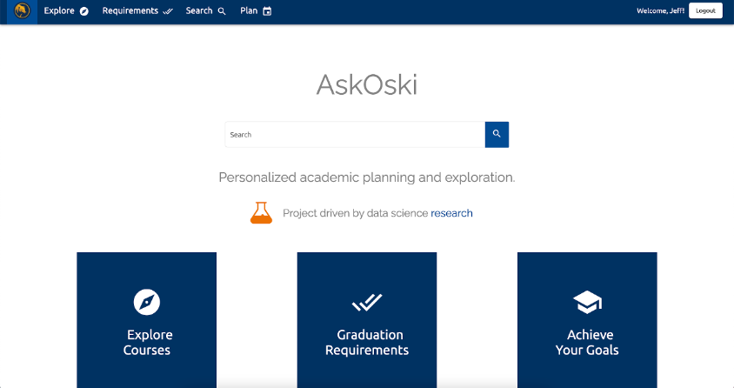
Computational Approaches to
Human Learning Lab (CAHL)
Founded @ Cal in 2013
Lab research areas
AI for advising (askoski.com)
Open source tutoring (oatutor.io)
AI for articulation and transfer
Timeline of AI for advising research from the lab:
2015: Two NSF grants awarded to apply AI to higher education
2016: First prototype of a course guidance system (AskOski) was released at UC Berkeley
2019: Development began on an Open Adaptive Tutoring System (OATutor)
2020: AI for transfer work began with two largest systems of higher education in the US

Slide 3
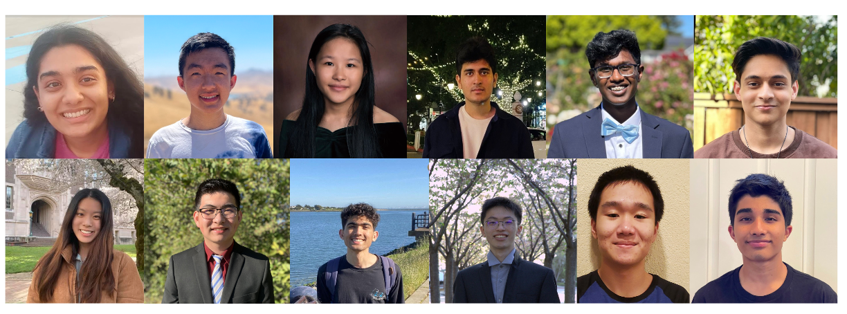
Computational Approaches to
Human Learning Lab (CAHL)
Founded @ Cal in 2013
Siddharth Adelkar
Shreya Sheel
ML
Anirudh Pai
UI/UX
Engineering
Ioannis Anastasopoulos
Yunting Liu
Pedagogy Instructional Design
Sarah Goulart
Psychometric Measurement
Transfer and Credit mobility

Slide 4
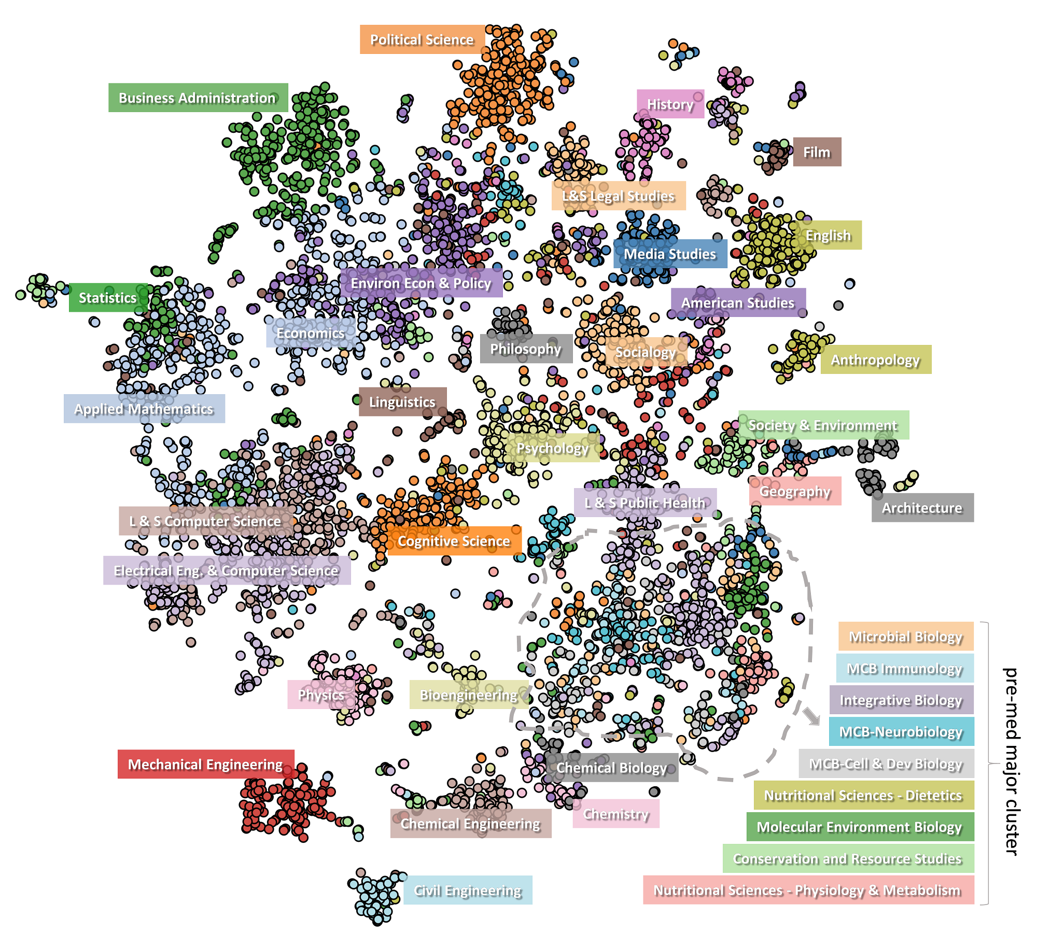
Learning about majors from enrollment data
Pardos, Z.A., Fan, Z., Jiang, W. (2019) Connectionist Recommendation in the Wild: On the utility and scrutability of neural networks for personalized course guidance. User Modeling and User-Adapted Interaction (UMUAI).
Visualization of all undergrad students at UC Berkeley the semester before they graduated

Slide 5
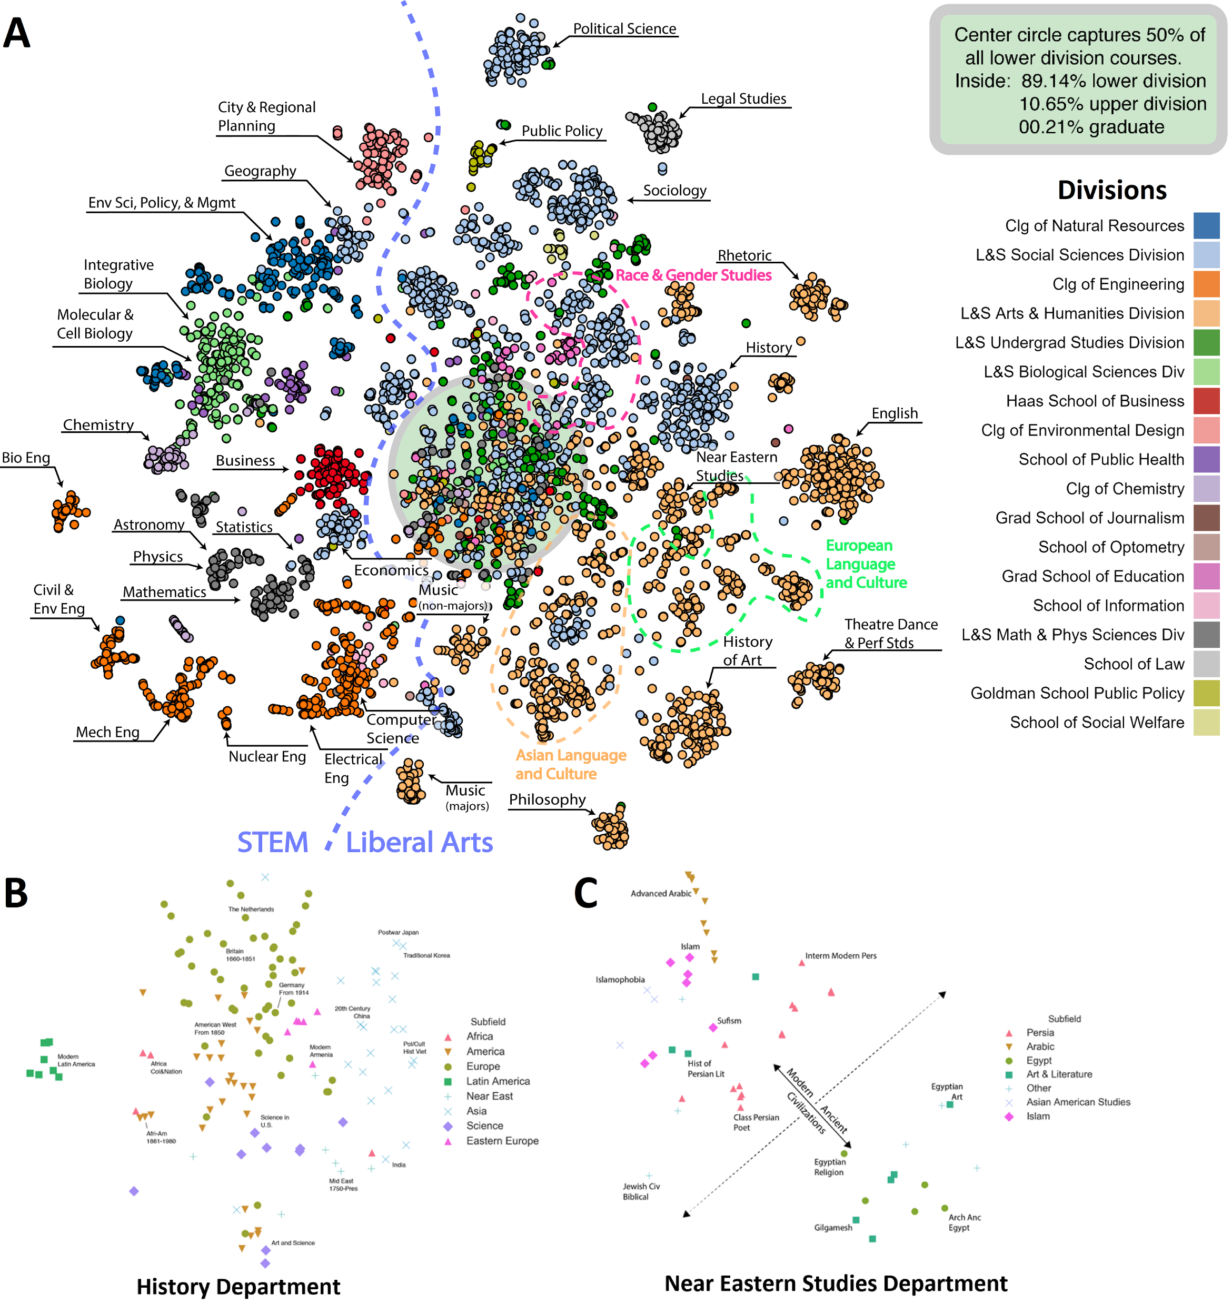
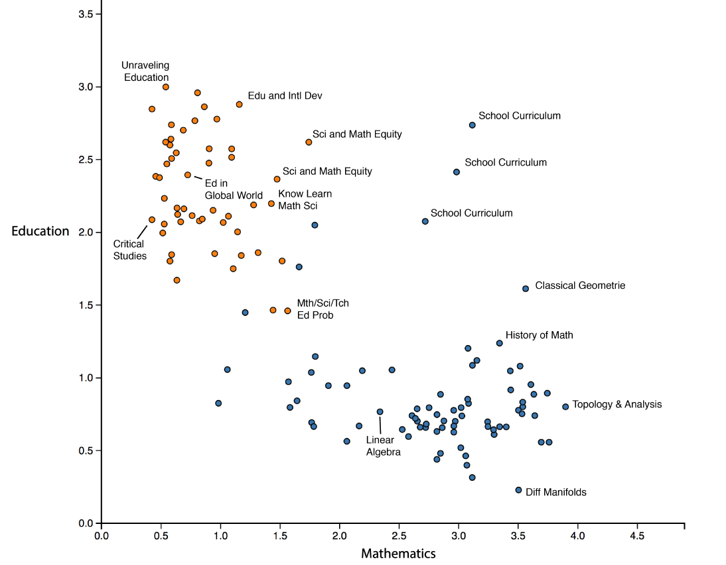
Learning about courses from enrollment data
Course relationships predicted with 51% accuracy (Jiang & Pardos, 2020)
Comparable to the 61% obtained by Mikolov in word analogies (w/1B words)
Pardos Z. A., Nam A. J. H. (2020) A university map of course knowledge. PLoS ONE 15(9): e0233207.

Slide 6
Learning about courses from enrollment data

Slide 7
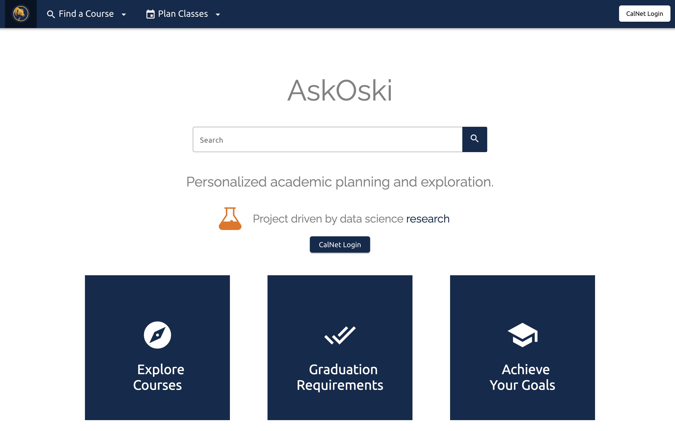
AI for advising (askoski.com)

Slide 8
AI for Advising (course selection)Degree Wayfinding
Shao, E., Guo, S., & Pardos, Z. A. (2021) Degree Planning with PLAN-BERT: Multi-Semester Recommendation Using Future Courses of Interest. In Proceedings of the AAAI Conference on Artificial Intelligence (Vol. 35, No. 17, pp. 14920-14929).

Slide 9
The advising problem in US Higher Education
27% graduation rate from 2-year programs within 3 years in the USA (NCES, Table 326.20)
Advising with low student-to-advisor ratios (i.e., 30:1 – 80:1) has been effective in improving degree attainment rates (Evans et al., 2020).
Low ratio 34:1 human advising is very expensive, estimated to cost $4,300 per student - this would add up to an advising bill of $9b/year for California’s Community Colleges
Due to cost, 1000:1 is the average student-to-advisor ratio nation-wide at community colleges (Marcus, 2012)
RQ: Can AI provide personalized, sensible multi-semester course selection advise?

Slide 10
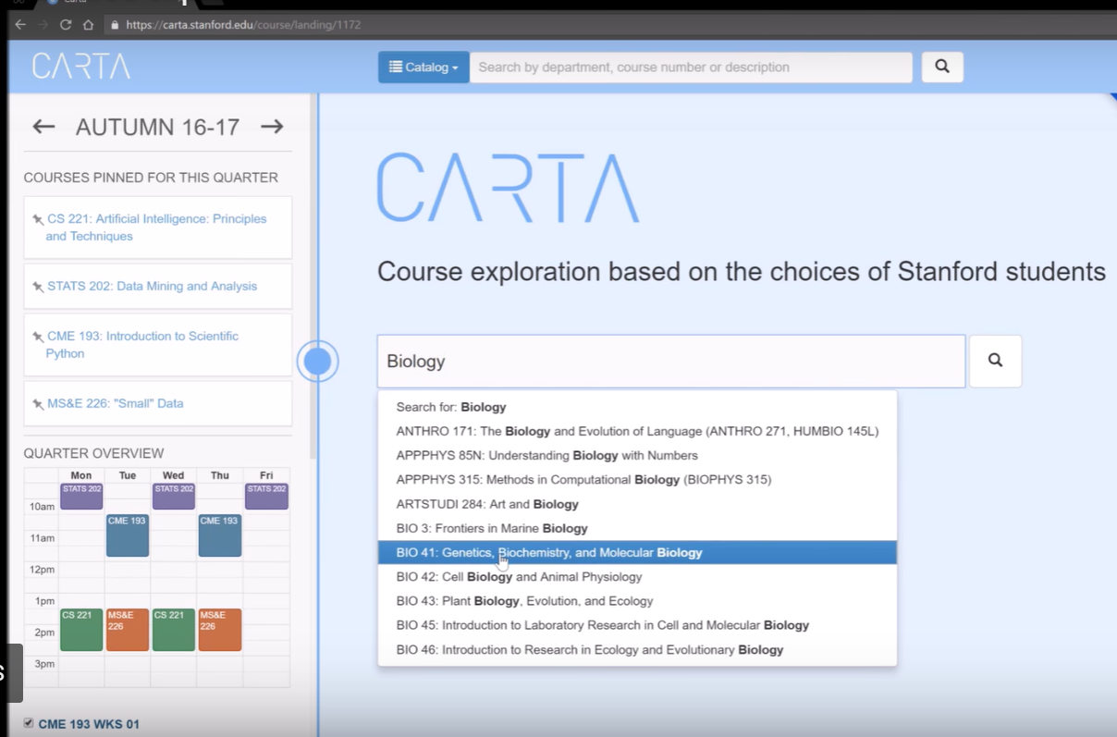
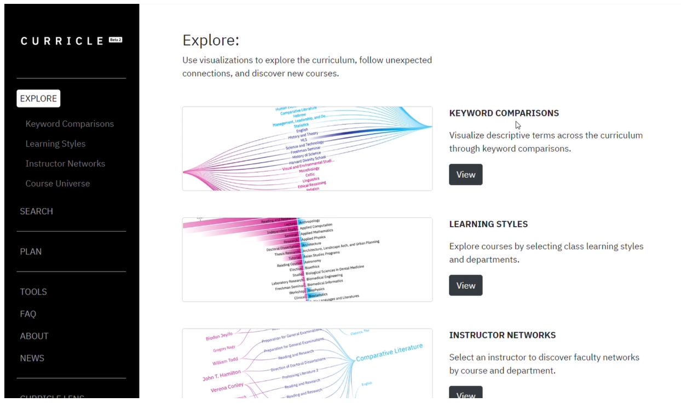
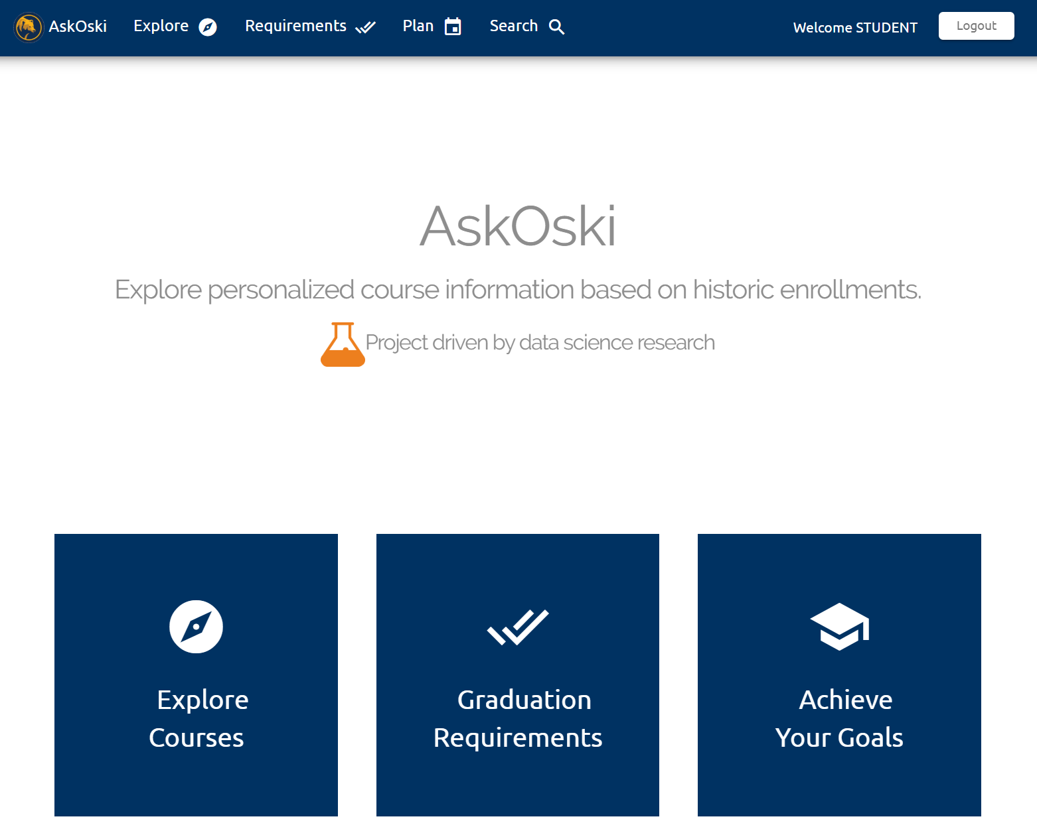
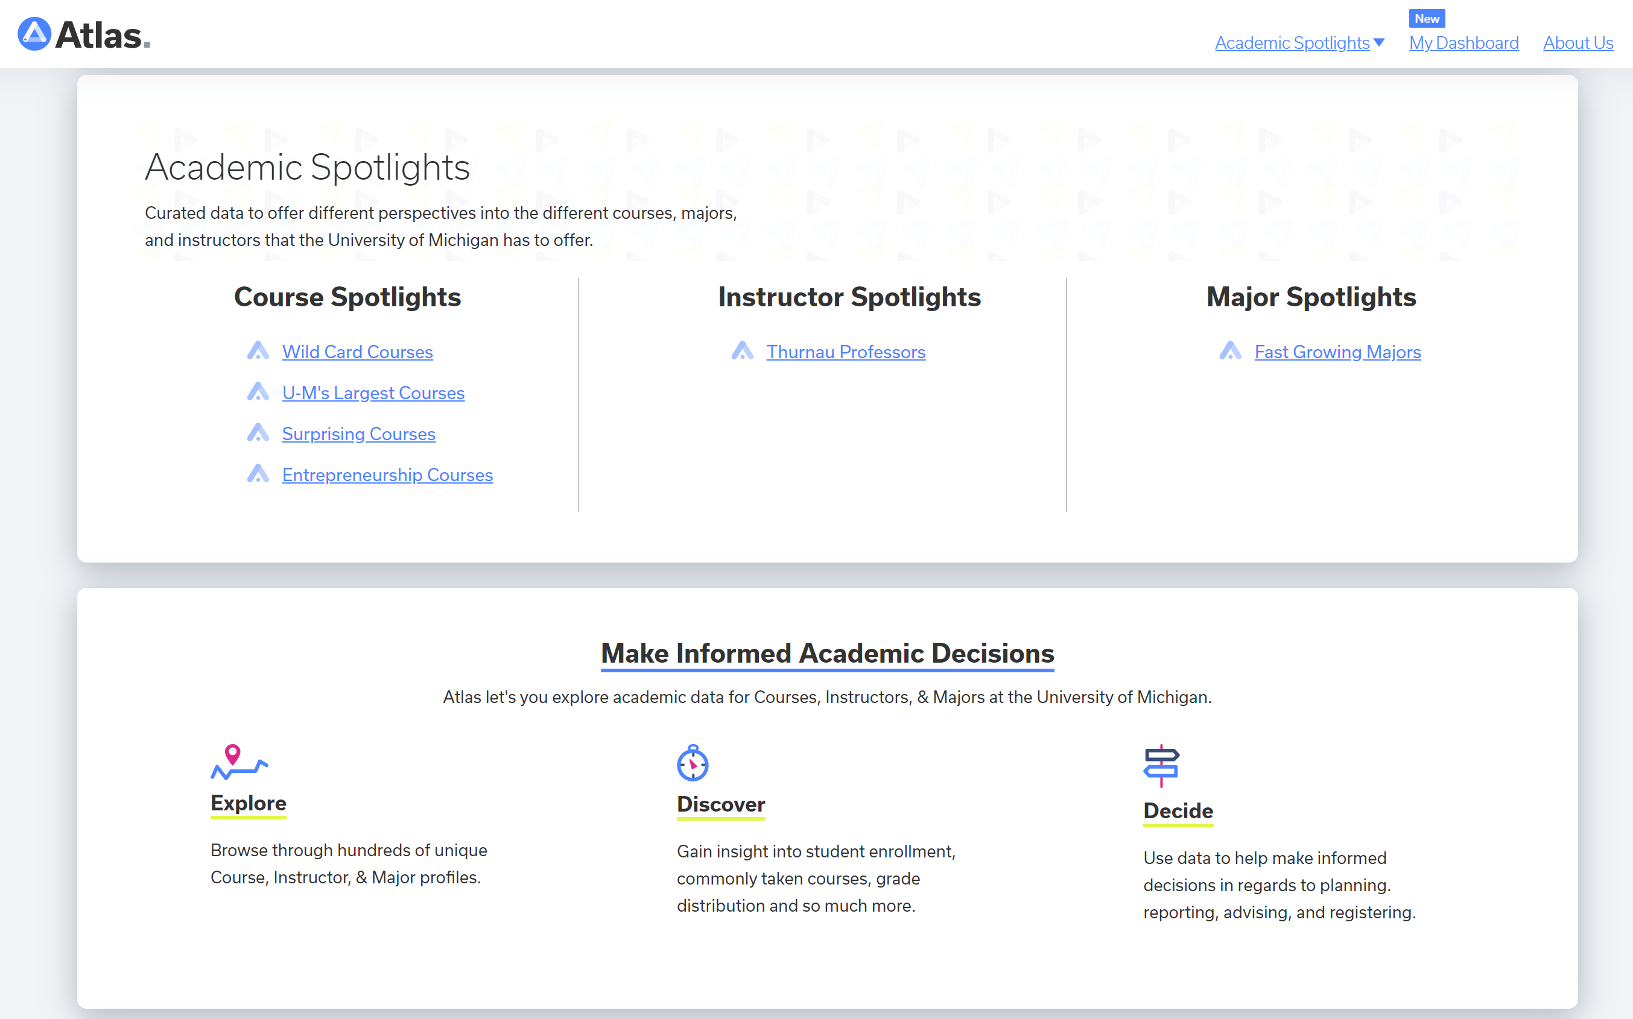
Course Analytics/Recommender Platforms
Stanford
Harvard
UC Berkeley
U Michigan

Slide 11
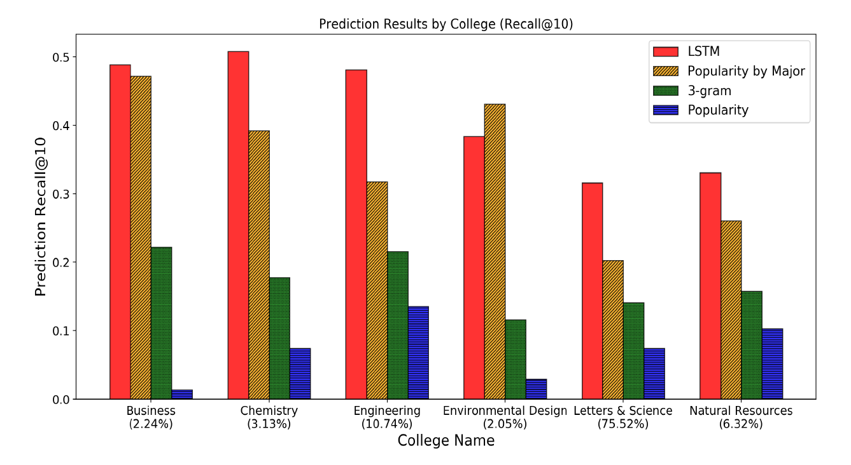
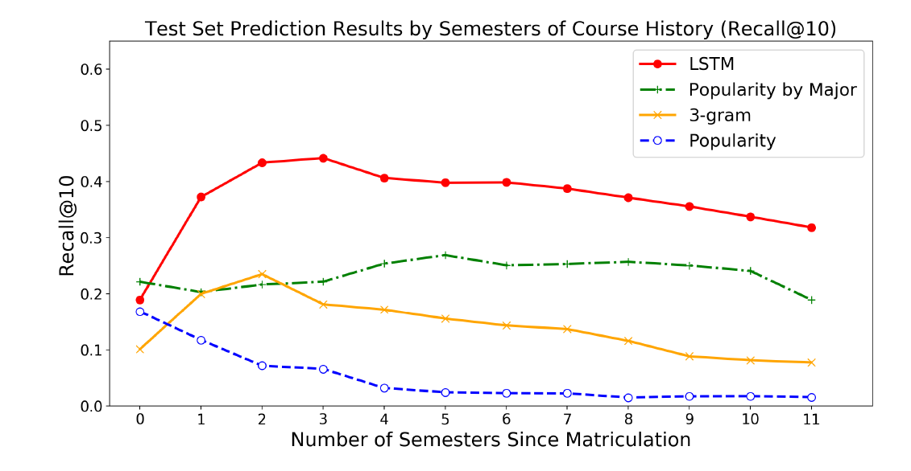
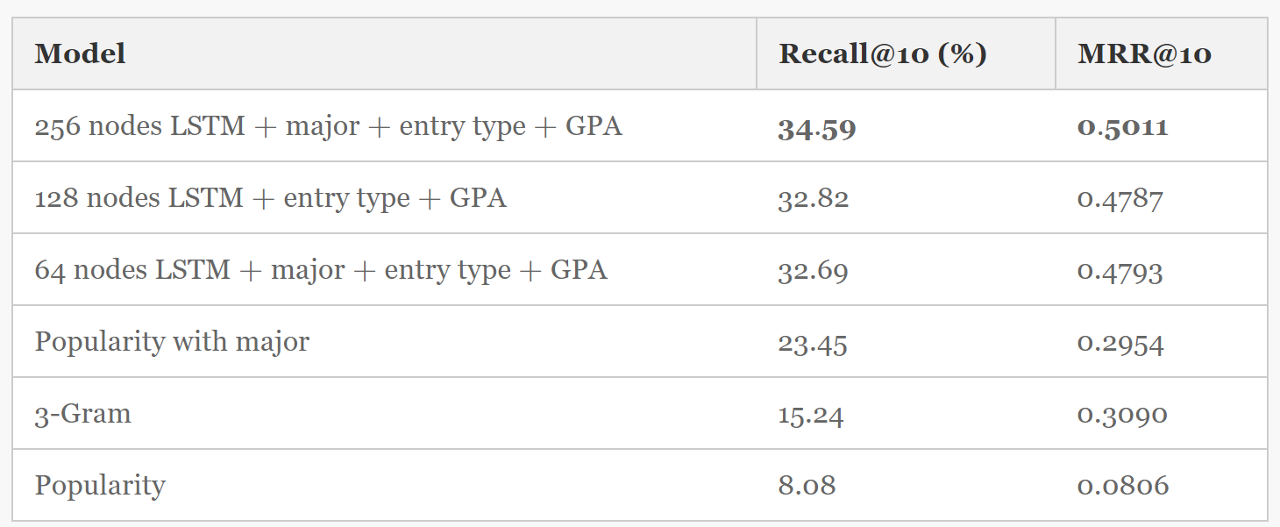
Began with next course prediction
Trained predictive models of course selection
unhappy family is
RNN language model
Mikolov et al. (2010)
Each unhappy family
Pardos, Z.A., Fan, Z., Jiang, W. (2019)

Slide 12
Session-based recommendation Next item prediction
Sequence history used to predict
the next item in the sequence
Yap, Li, & Yu (2012); Hidasi et al. (2015); Li, Zhao, & Liu (2018); Sun et al. (2019);
Guo et al. (2020)...

Slide 13
Session-based recommendation Next basket prediction
Sequence history used to predict
the next basket of items in the sequence
Wan et al. (2015); Yu et al. (2016); Pardos, Fan, & Jiang (2019)

Slide 14
Session-based recommendation
Next consecutive basket prediction
Sequence history used to predict
consecutive baskets of items in the sequence
Cheng et al. (2013)

Slide 15
Session-based recommendation Next consecutive basket prediction w/ future reference items
Sequence history used to predict
consecutive baskets of items in the sequence
using known future reference items
(Shao, Guo, & Pardos, 2021)

Slide 16
Session-based recommendation Next consecutive basket prediction w/ future reference items
Item history
Items specified by user
Sequence history used to predict
consecutive baskets of items in the sequence
using known future reference items
Benefits of future reference items
User influence on personalization
Cold-start problem
(this paper)

Slide 17
Session-based recommendation Next consecutive basket prediction w/ future reference items
Item history
Items specified by user
No sequence history available to predict
next item/basket or next consecutive items/baskets
Benefits of future reference items
User influence on personalization
Cold-start problem

Slide 18
Session-based recommendation Next consecutive basket prediction w/ future reference items
Item history
Items specified by user
Benefits of future reference items
User influence on personalization
Cold-start problem
Prediction fidelity

Slide 19
Session-based recommendation Next consecutive basket prediction w/ future reference items Application domain:
Student degree planning in higher education
(Sather Gate, UC Berkeley)
Course history
Student specified courses of interest
Fall ‘19
Spring ‘20
Summer ‘20
Fall ‘20
Spring ‘21
Summer ‘21
Fall ‘21
Courses filled in by session-based model

Slide 20
Outline:
Model Architecture
Offline Experiments
Training, Datasets, Evaluation, Results
Online Experiments
Study Design, Evaluation, Results
Conclusions

Slide 21
PLAN-BERT
Model Architecture
Bidirectional Encoder Representations from Transformers
Model: Transformer with
Basket-level input
External feature embeddings
Mostly sparse [masked] training (80% vs 15% NLP)
Model's input:
Historical & Reference Courses
Time Embedding:
Semester Embedding
Season Embedding
History Indicator
Student/User & Course/Item Features
Motivation to extend BERT:
[Masked] loss training matches imputation task
Bi-directionality well suited to utilize future items
SoA model architecture for NLP sequence prediction

Slide 22
Datasets
 | UNIVERSITY1 | SYSTEM1
Number of Institutions | 1 | 19 (17 used)
Time Span | Fall 2008 – Spring 2017 | Fall 2014 - Fall 2019
Students | 134,275 | 906,565
Class Enrollments | 4.6 million | 10.4 million
Courses | 7,252 | 25,133
Student Features | Major, College, Division, Department | Major, Degree Type
Course Features | Subject, Department | Department, Subject, Component, Department, School

Slide 23
Offline Experiment Settings Train/test split

Slide 24
Results Long-term course plan generation
*
*
*
*
*
*
*Incorporates (r = 5) future reference courses
PLAN-BERT models outperform all comparison models
Models that use future reference items (r = 5) outperform all models that do not on cold-start
Performance of cold-start PLAN-BERTiu (SoA model) rivals that of BERT with 2 semesters

Slide 25
Results
PLAN-BERT broken out by semester
PLAN-BERT models outperform all comparison models
Models that use future reference items (r = 5) outperform all models that do not on cold-start
Performance of cold-start PLAN-BERTiu (SoA model) rivals that of BERT with 2 semesters
Historical semesters almost always benefit prediction in all models

Slide 26
Results
Impact of # of future reference courses
Performance/Usability Trade-off
More Reference Courses: Likely to improve performance on sequence prediction task
Fewer Reference Courses: Reduces burden on the user to provide more up-front information
Desirable to find lowest # reference course to still provide substantial performance benefit

Slide 27
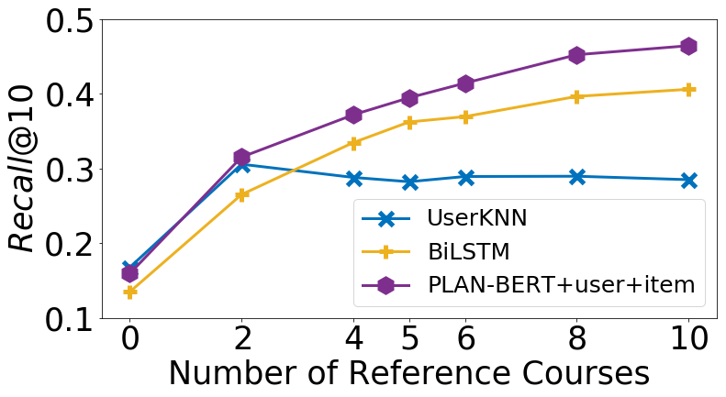
Results
Impact of # of future reference courses
By class standing (for PLAN-BERTui):
UNIVERSITY1
By algorithm (for Freshman):
UNIVERSITY1
SYSTEM1

Slide 28
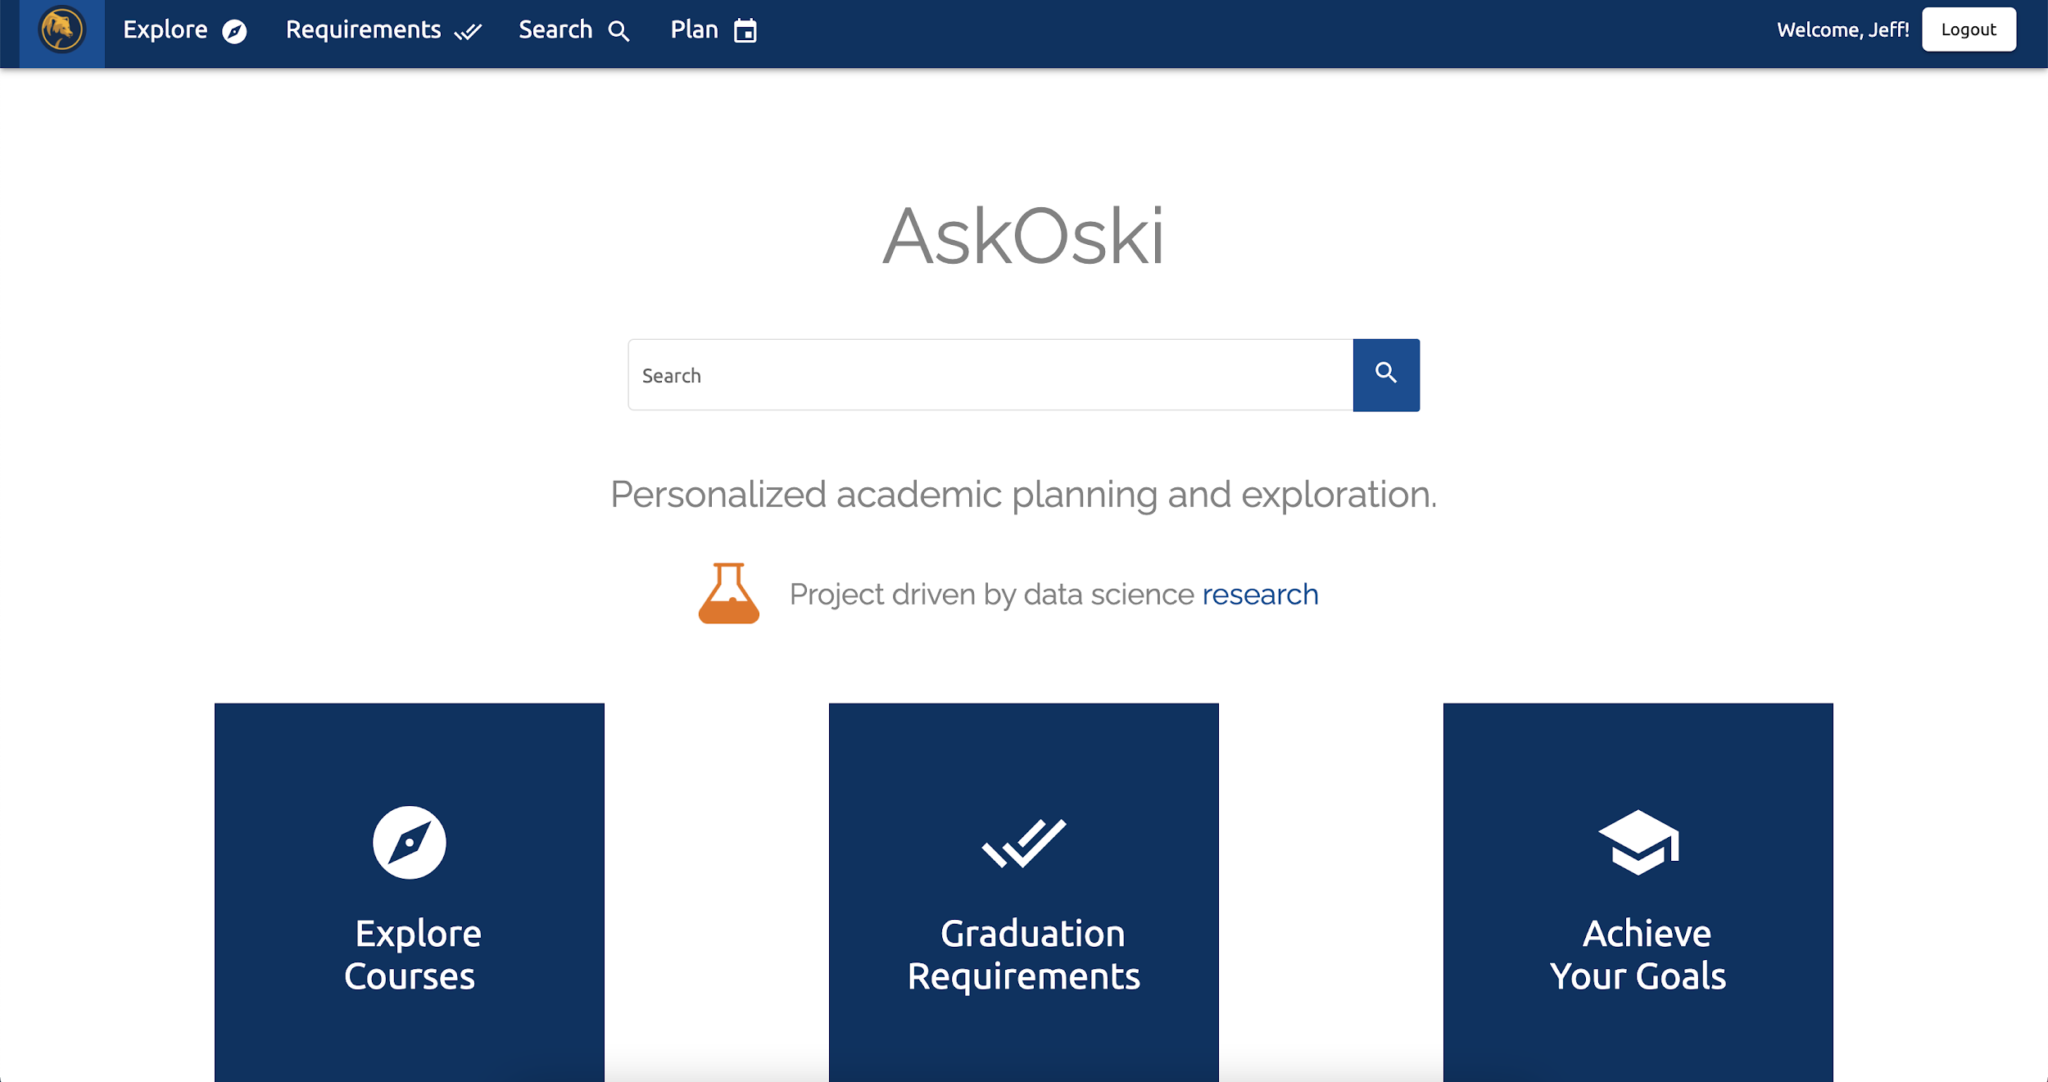
Online Study
Investigating student perceptions of recommendations
AskOski production course recommendation platform https://askoski.berkeley.edu

Slide 29
Online Study Evaluation measures
Daniel et al. (2020) chat-bot evaluation methodology adopted
Two dichotomous response measures
Specificity: is the course plan specific to the student?
Sensibility: is the course plan sensible to the student?
Comparing model plan generation quality to human benchmark
First phase asks students to rate quality of plan generated for them (“interactive evaluation”)
Second phase asks students to rate quality of plan generated for the junior and senior year of a randomly selected past student of the same major (“static evaluation”)
Both phases present plans generated from different models.
Phase 2 presents the random student’s actual junior and senior enrollments as an additional “model” (human-level comparison)
63 students recruited from UNIVERSITY1 of varrying majors

Slide 30
Online Study

Slide 31
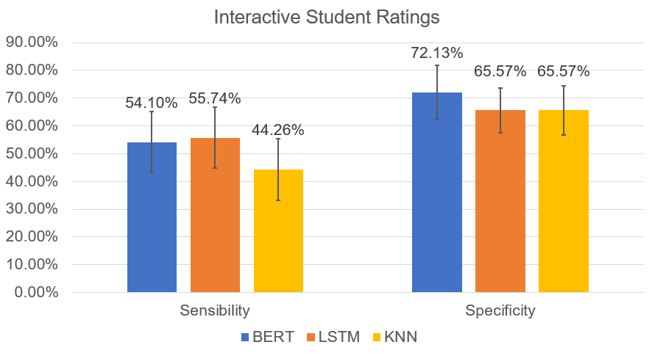
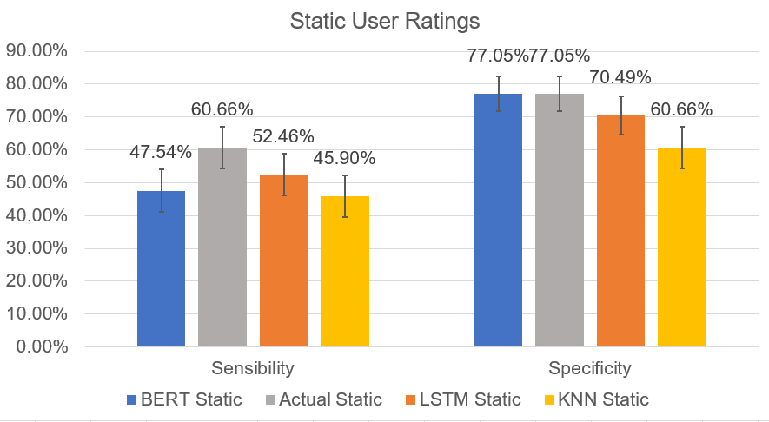
Online Study Results
PLAN
PLAN
Statistical significance of results:
No statistical significance between models from the interactive evaluation
Actual student histories were statistically significantly better than UserKNN in sensibility from the static evaluation.
In the static evaluation context, PLAN-BERT and actual student histories were statistically significantly better than UserKNN in specificity ratings

Slide 32
Challenges
Ordering issues: Upper division courses at times ordered before lower division
More constraints on plan generation are likely needed to increase sensibility
Requires structured program requirement data, prerequisites, etc
Conclusions
PLAN-BERT achieved human-level personalization (i.e., specificity) and a new baseline SotA on this multi-basket course prediction task
Future reference courses are highly valuable for prediction, more so than the same number of historic courses
Future directions
Apply and deploy PLAN-BERT to the multi-institution case (i.e., transfer)

Slide 33
AI for Articulation and Transfer

Slide 34
Background on transfer and articulation
Introduction
20 million students enter higher education in the United States each year, 45% of these students begin at 2-year public institutions
(Hossler et al., 2012)
81.4% of surveyed (N=19,000) beginning 2-year students expressed an intent to transfer to a 4-year program
(Radford et al., 2010)
Six years after starting at the 2-year, only 13% of students had obtained a 4-year degree (N=852,439)
(Shapiro et al., 2017)

Slide 35
AI for Advising (course selection)finding
Shao, E., Guo, S., & Pardos, Z. A. (2021) Degree Planning with PLAN-BERT: Multi-Semester Recommendation Using Future Courses of Interest. In Proceedings of the AAAI Conference on Artificial Intelligence (Vol. 35, No. 17, pp. 14920-14929).
AI for Articulation Personalized Degree Wayfinding
Xu, L., Pardos, Z. A., & Pai, A. (2023). Convincing the Expert: Reducing Algorithm Aversion in Administrative Higher Education Decision-making. In Proceedings of the Tenth ACM Conference on Learning@ Scale. Copenhagen, DK. ACM. Pages 215-225.

Slide 36
Course-to-Course Articulation
Which course (if any) at Institution A is academically equivalent to a course at Institution B?
Courses at Institution A
Sophomore course
at Institution B
?
Continuing 4-year program
2-year program
Taking these courses at Institution A is often required to qualify for transfer to Institution B
Alignment of programs is difficult

Slide 37
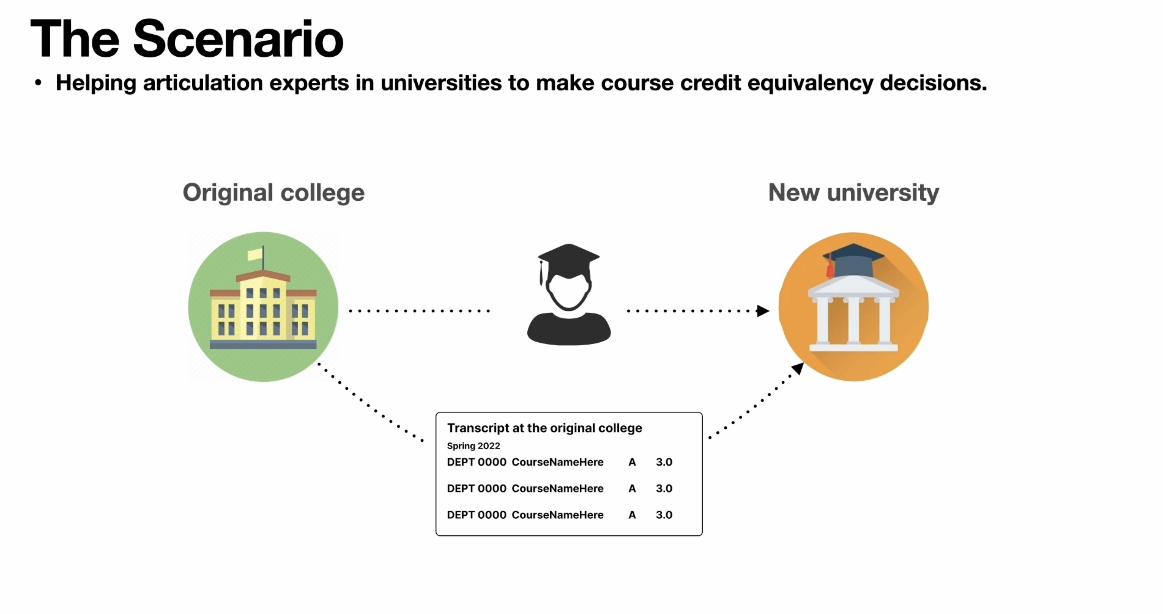

Slide 38
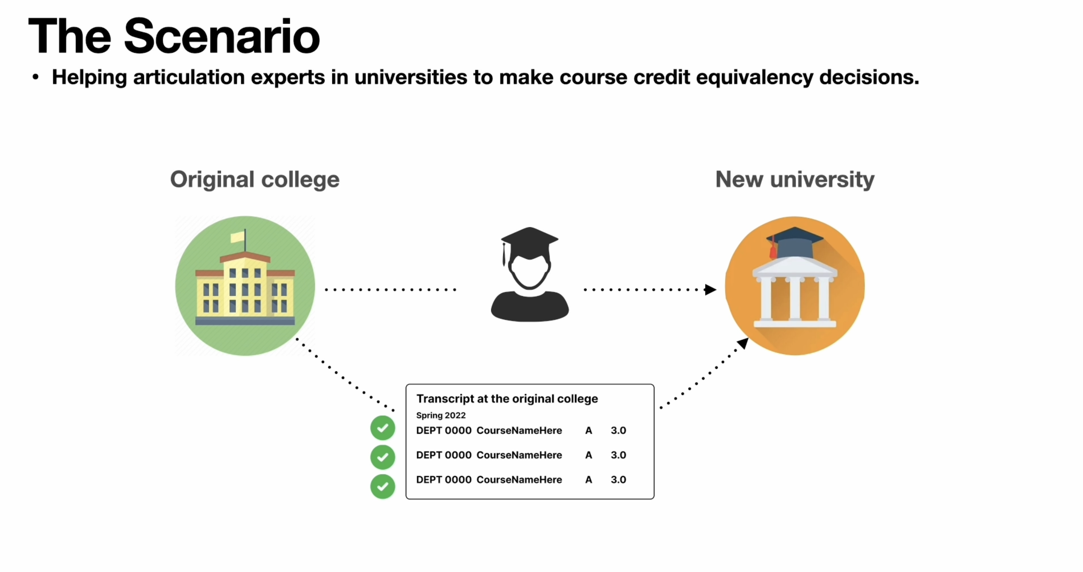

Slide 39
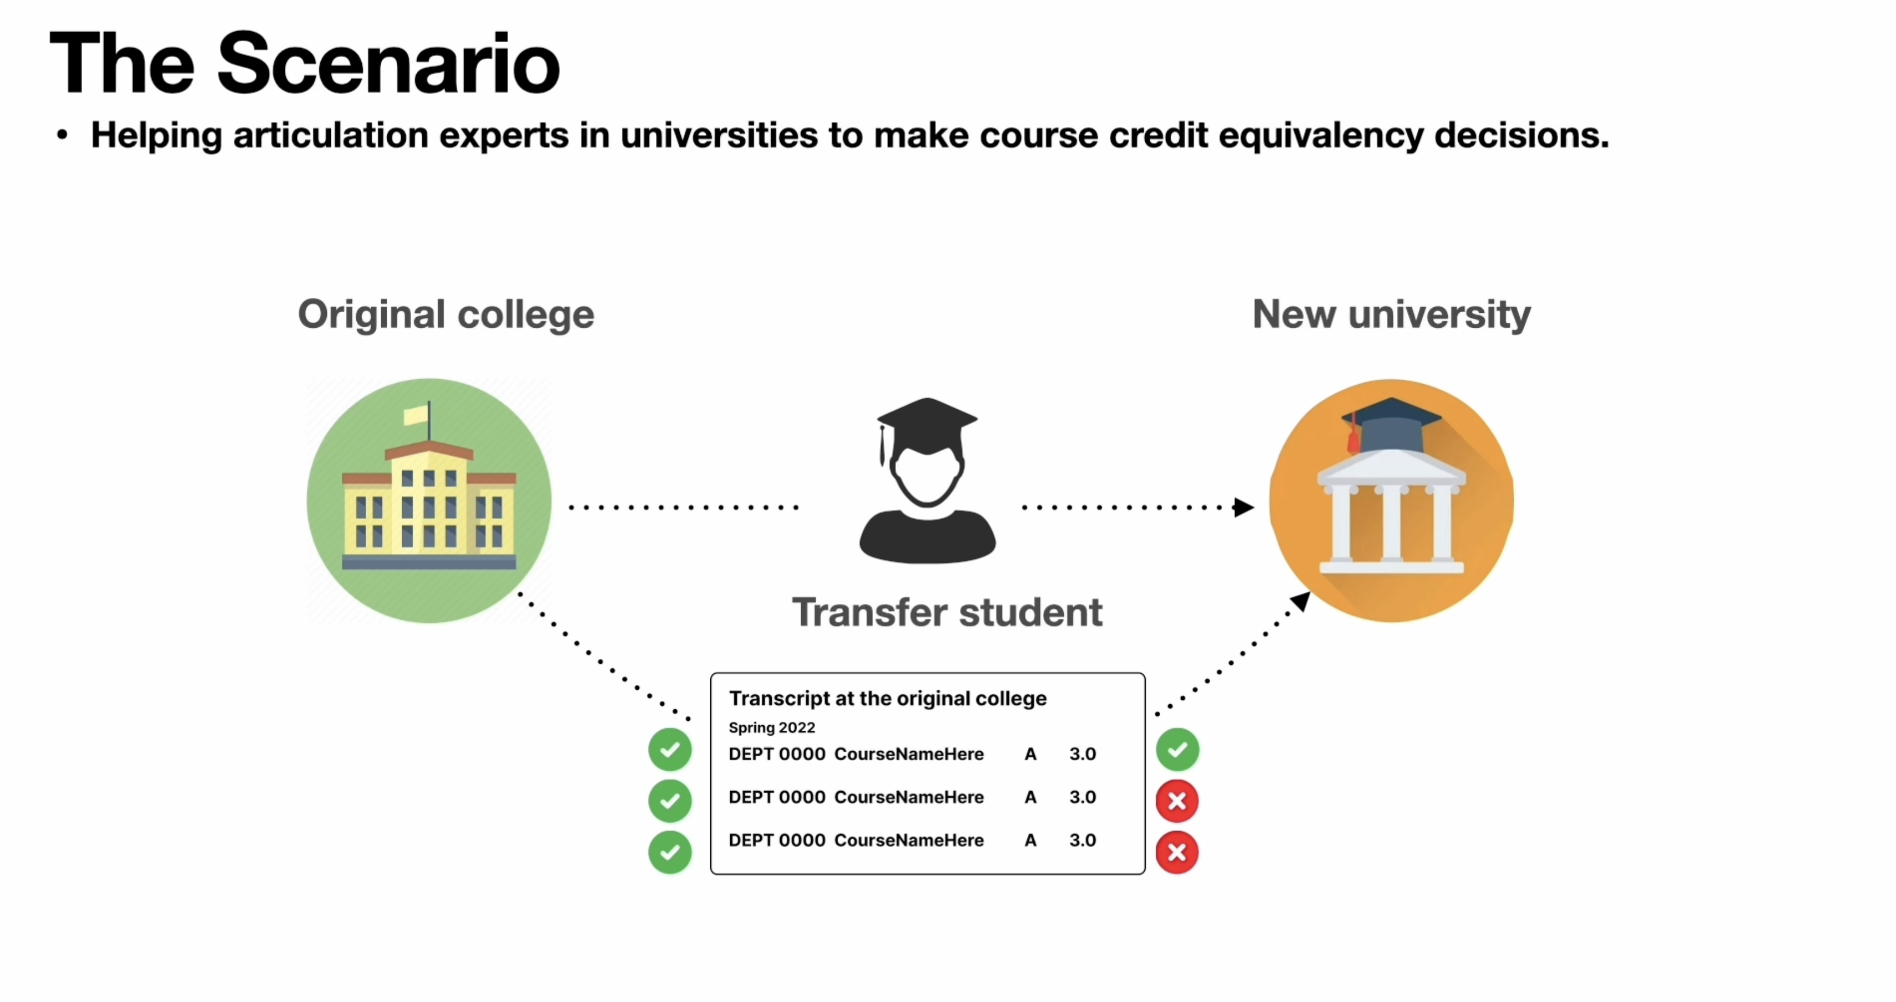
Determined by articulation rules and staff and faculty approvals

Slide 40
AI for Articulation and Personalized Degree Wayfinding
Pardos, Z. A., Chau, H., Zhao, H. (2019) Data-Assistive Course-to-Course Articulation Using Machine Translation. In J. C. Mitchell & K. Porayska-Pomsta (Eds.) Proceedings of the 6th ACM Conference on Learning @ Scale (L@S). Chicago, IL. ACM. *Best paper award*
Is this Berkeley course equivalent enough to any course at Laney College?
Title: Data Structures (CS 61B)
Catalog description: Fundamental dynamic data structures, including linear lists, queues, trees, and other linked structures; arrays strings, and hash tables. Storage management. Elementary principles of software engineering. Abstract data types. Algorithms for sorting and searching. Introduction to the Java programming language.
Title: Data Structures and Algorithms (CIS 27)
Catalog description: Use of abstract forms of data in programming: Concepts, and implementation and applicability of different forms of data to various programming problems
Corroborating course information also extracted from enrollment histories
Match?

Slide 41
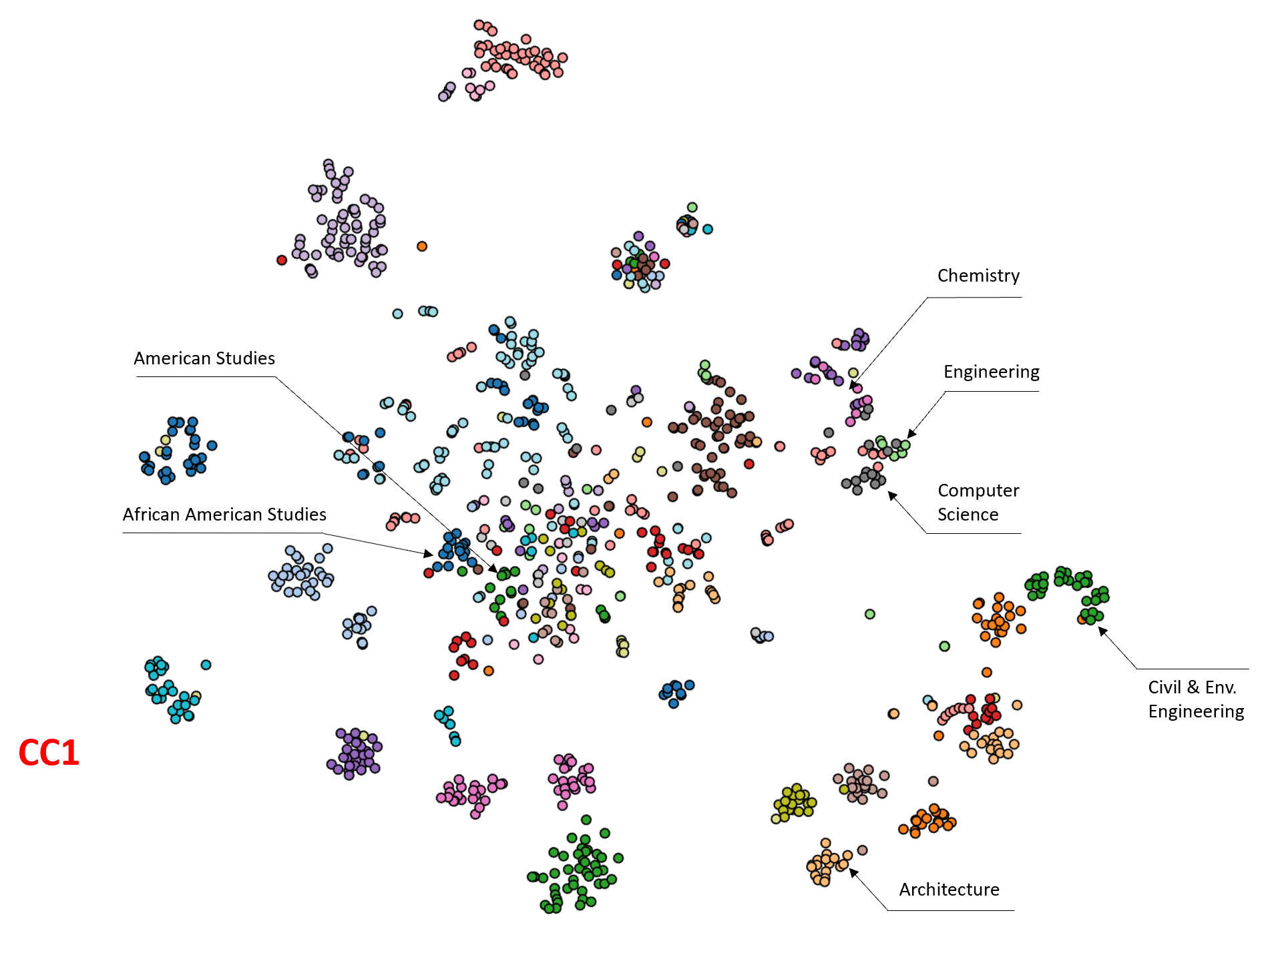
Translating between institutions (articulation/equivalency)
Pardos, Z. A., Chau, H., Zhao, H. (2019) Data-Assistive Course-to-Course Articulation Using Machine Translation. In J. C. Mitchell & K. Porayska-Pomsta (Eds.) Proceedings of the 6th ACM Conference on Learning @ Scale (L@S). Chicago, IL. ACM. *Best paper award*

Slide 42
AI for Articulation and Personalized Degree Wayfinding
Algorithmic State of the Art
Policy State of the Art
?
70% Accurate using methods from 2013
Substantial increase in accuracy using contemporary techniques (~90%)
Ready for prime time
Addressing the role of faculty and stuff in adjudicating articulations (Xu, Pardos, Pai, 2023)
Software workflow integration
Still being developed through real-world deployments

Slide 43
Deployments (to learn to solve policy challenges)
2018: AI articulation pilot between UCB and Laney Community College
2020: AI articulation pilot with City University of New York
2021: AI articulation + transfer pilot with State University of New York (BMGF)
2023: Scaled up AI articulation + transfer deployment at SUNY (BMGF/Ascendium)
Project aims for 2024
2024: Common Course Numbering for 116 California Community Colleges (FCCC/CF)
2024: Validating Connecticut Community Colleges’ 12 College Merger
2024: Substantial improvement in articulation algorithm to be published
2024: Workflow iterations based on large faculty pilot survey (Ascendium)
2024: Further SUNY scale up + several additional systems (BMGF)

Slide 44
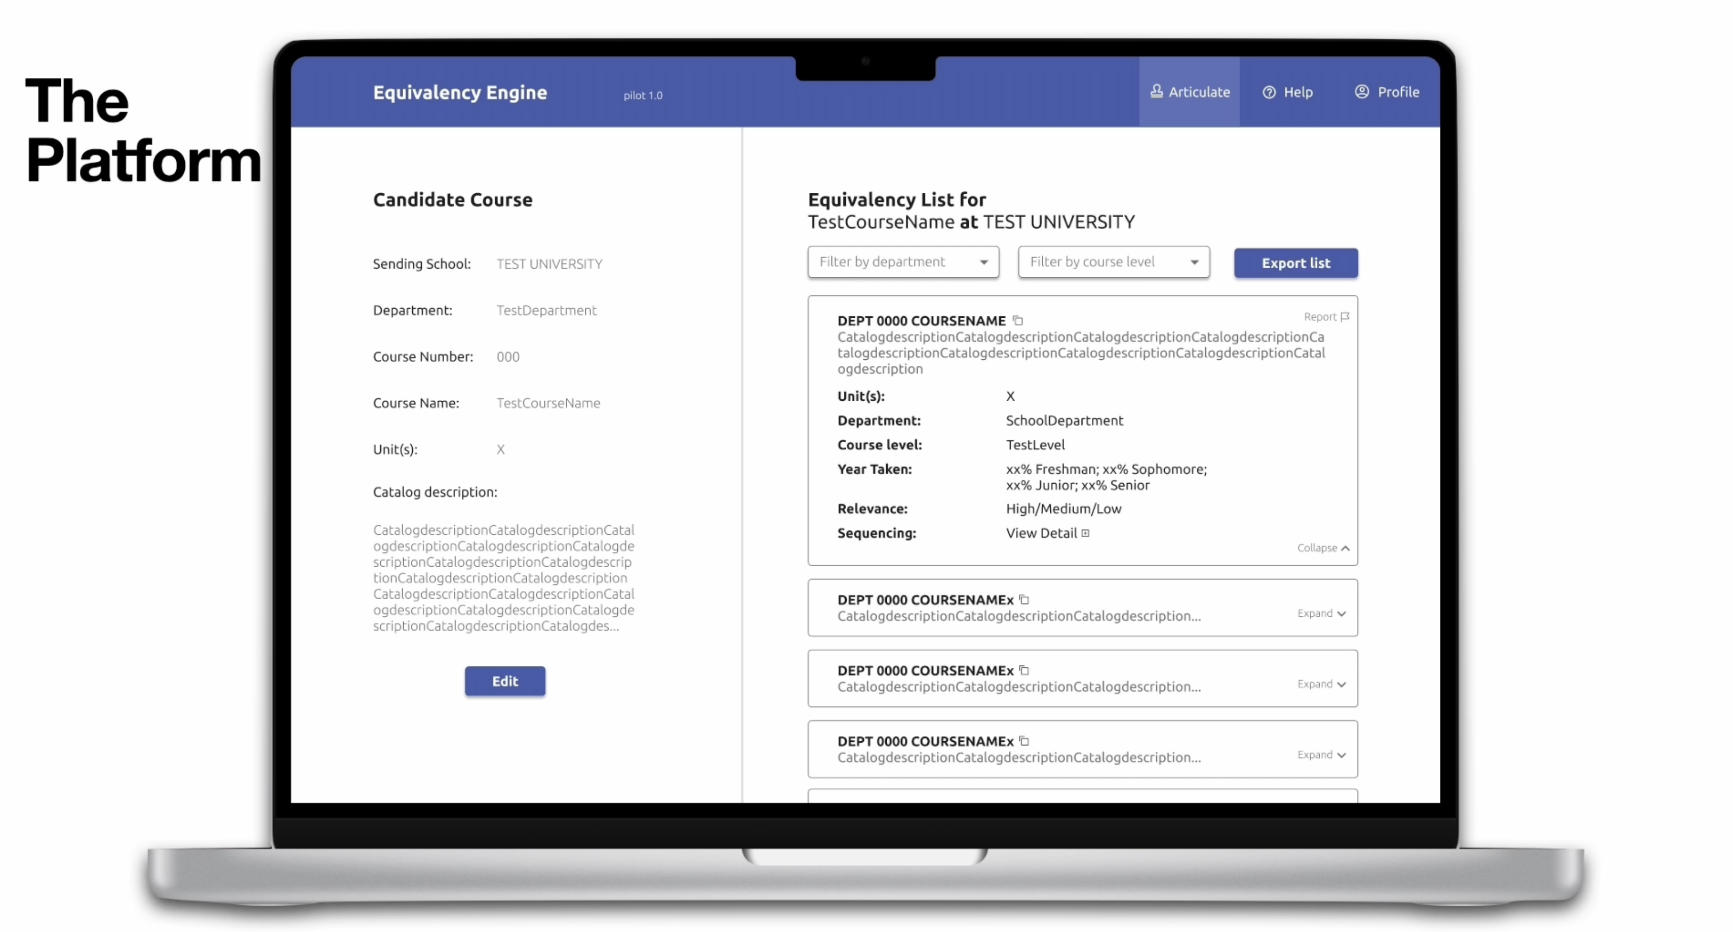
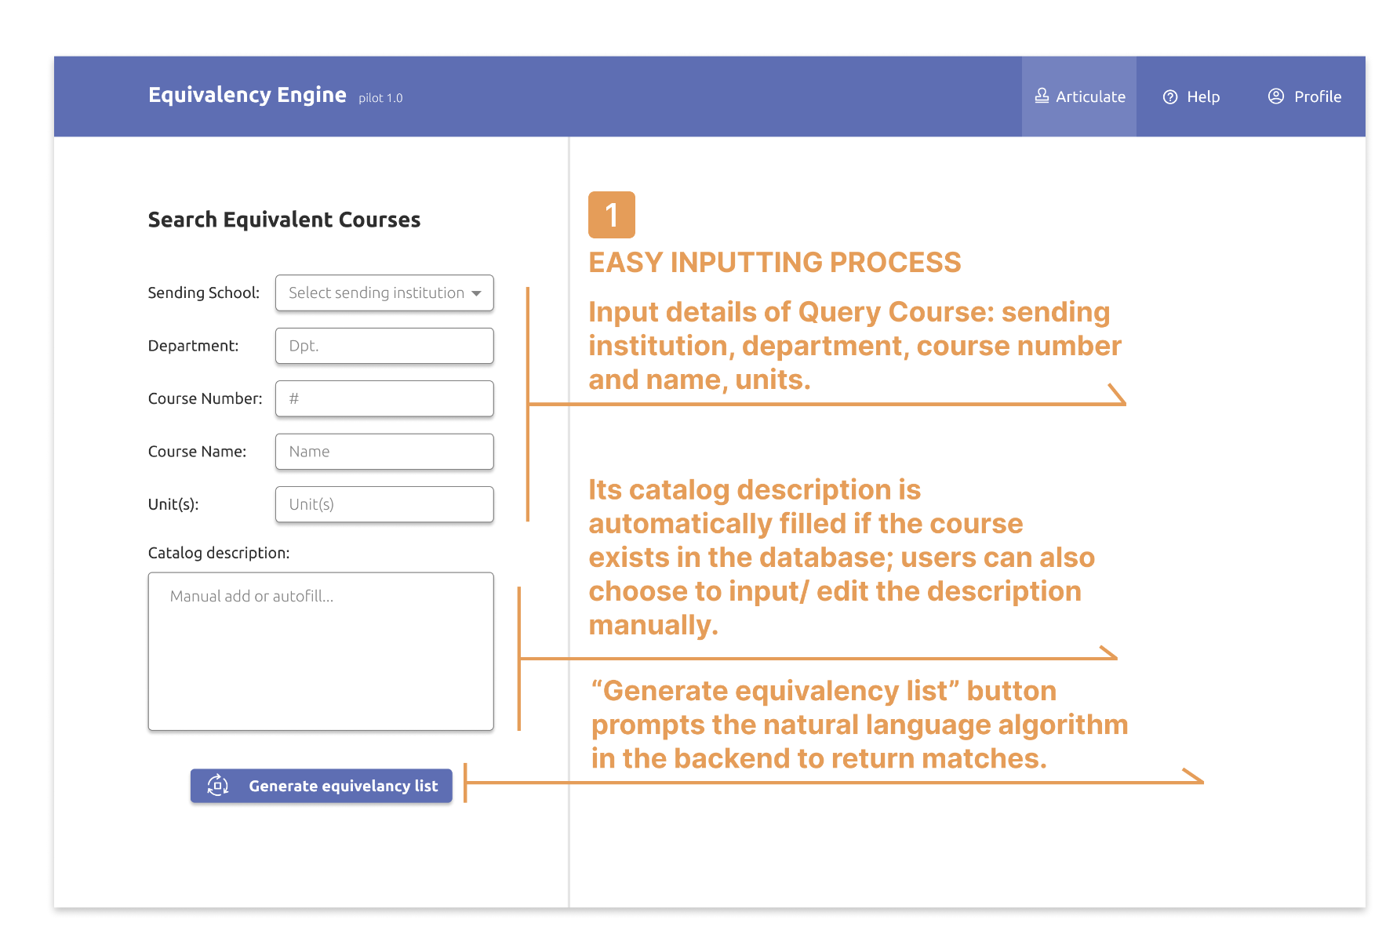
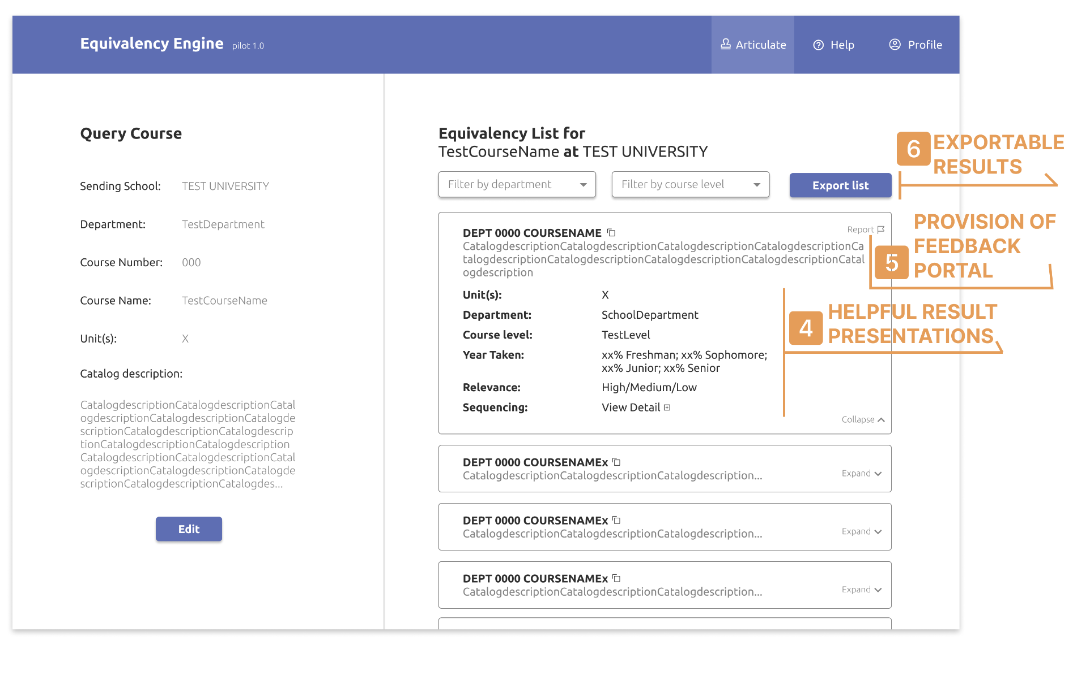
V1

Slide 45
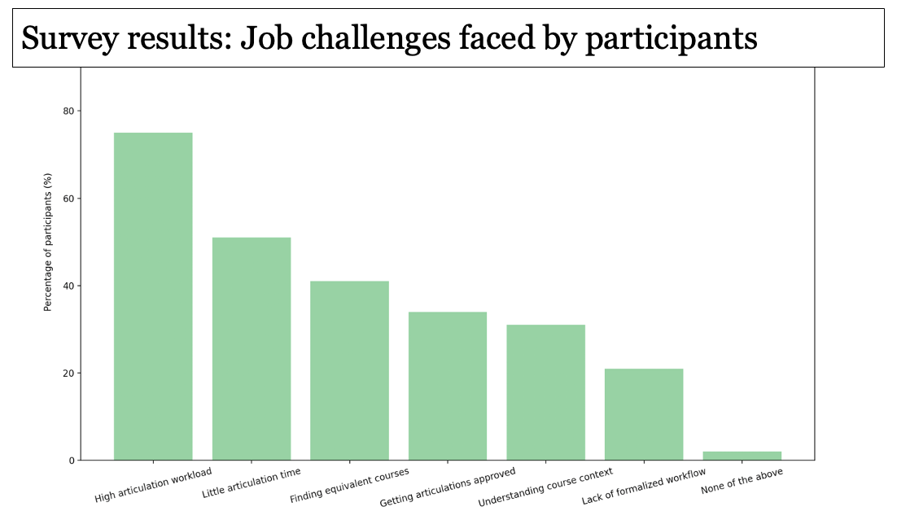
V1

Slide 46
(Commerford et al., 2021; Filiz et al., 2021; Logg et al., 2019)

Slide 47
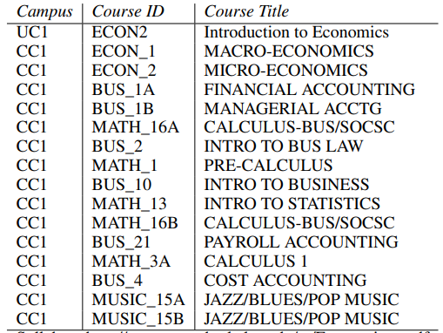
UC Berkeley course
AI suggested articulations to from Laney CC (in order of relevance)
Pardos, Z. A., Chau, H., & Zhao, H. (2019)

Slide 48
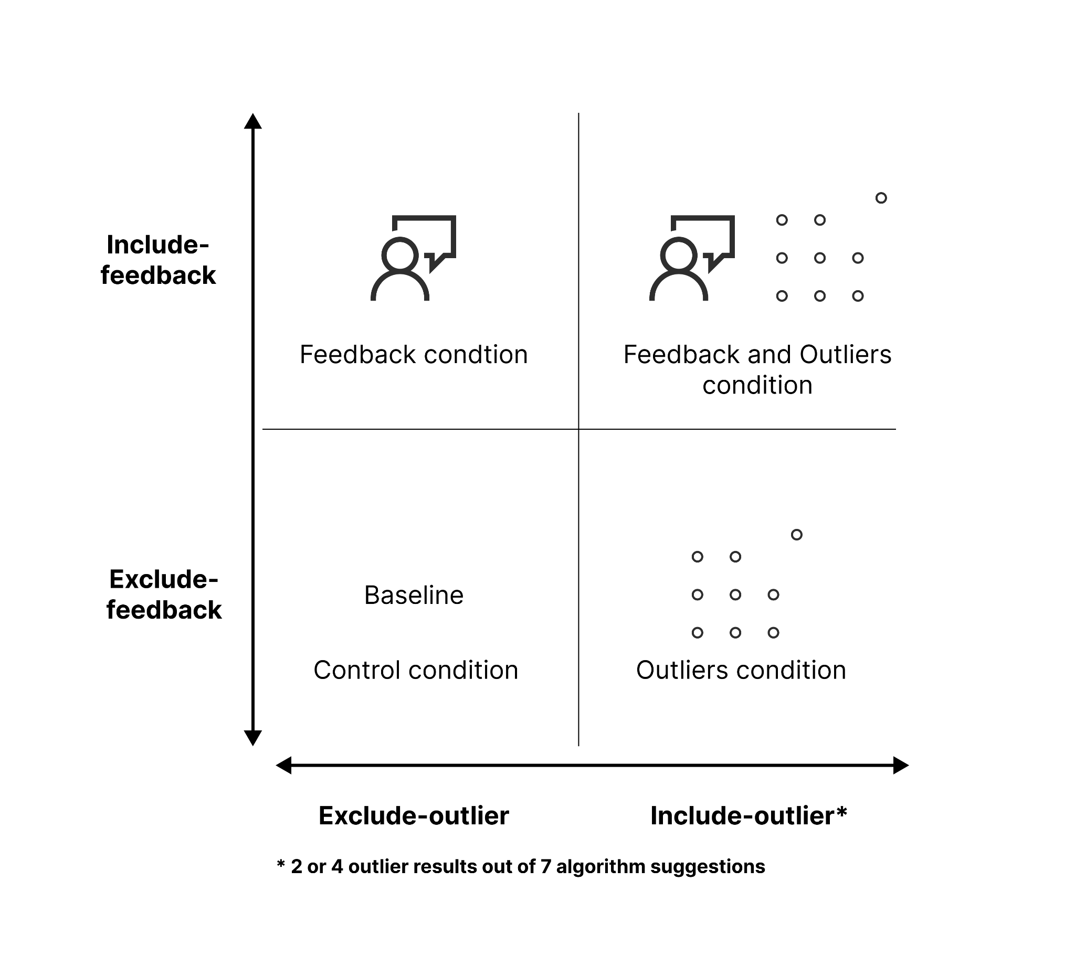
Design of 2 x 2, between-subjects experiment with the Equivalency Engine
Independent variables:
Outliers: algorithm aversion is due to people’s desire for perfect recommendations and that they can quickly lose trust in algorithms when any errors appear (Highhouse, 2008)

Slide 49
Design of 2 x 2, between-subjects experiment with the Equivalency Engine
Independent variables:
Outliers: algorithm aversion is due to people’s desire for perfect recommendations and that they can quickly lose trust in algorithms when any errors appear (Highhouse, 2008)
Feedback: Giving users ability to modify recommendations can decrease aversion (Burton et al., 2019; Dietvorst et al., 2014)

Slide 50
Primary dependent variable (outcome)
Rejection rate: Percentage of the time users select “no good matches”
Notes:
Rejection rate: A checkbox providing an option “There are no good matches” for users to select.
Quality score: On the next screen we ask users “Please rate the quality of the algorithm’s course matches on a scale of 1 (worst) to 5 (best).”

Slide 51
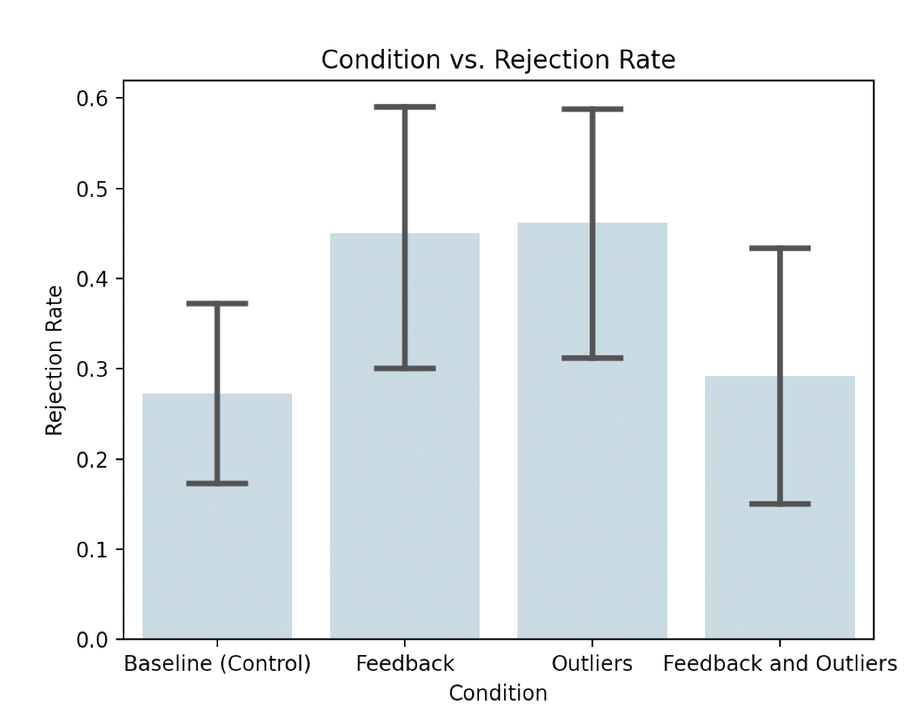
Experimental results: Rejection rate
Observations (N = 41):
Outlier condition had highest rejection rate (expected)
Feedback condition had 2nd highest rejection rate (unexpected)
Combination of Feedback + Outlier rejection rate similar to Control condition’s (unexpected)
Two-way ANOVA test (Type III):
*Outliers (p = 0.007)
*Feedback (p = 0.007)
*Interaction between variables (p < 0.001)

Slide 52
Discussion
Why did allowing Feedback lead to higher rejection rate?
Hypothesis: Feedback interface primed participants to adopt a critical mindset

Slide 53
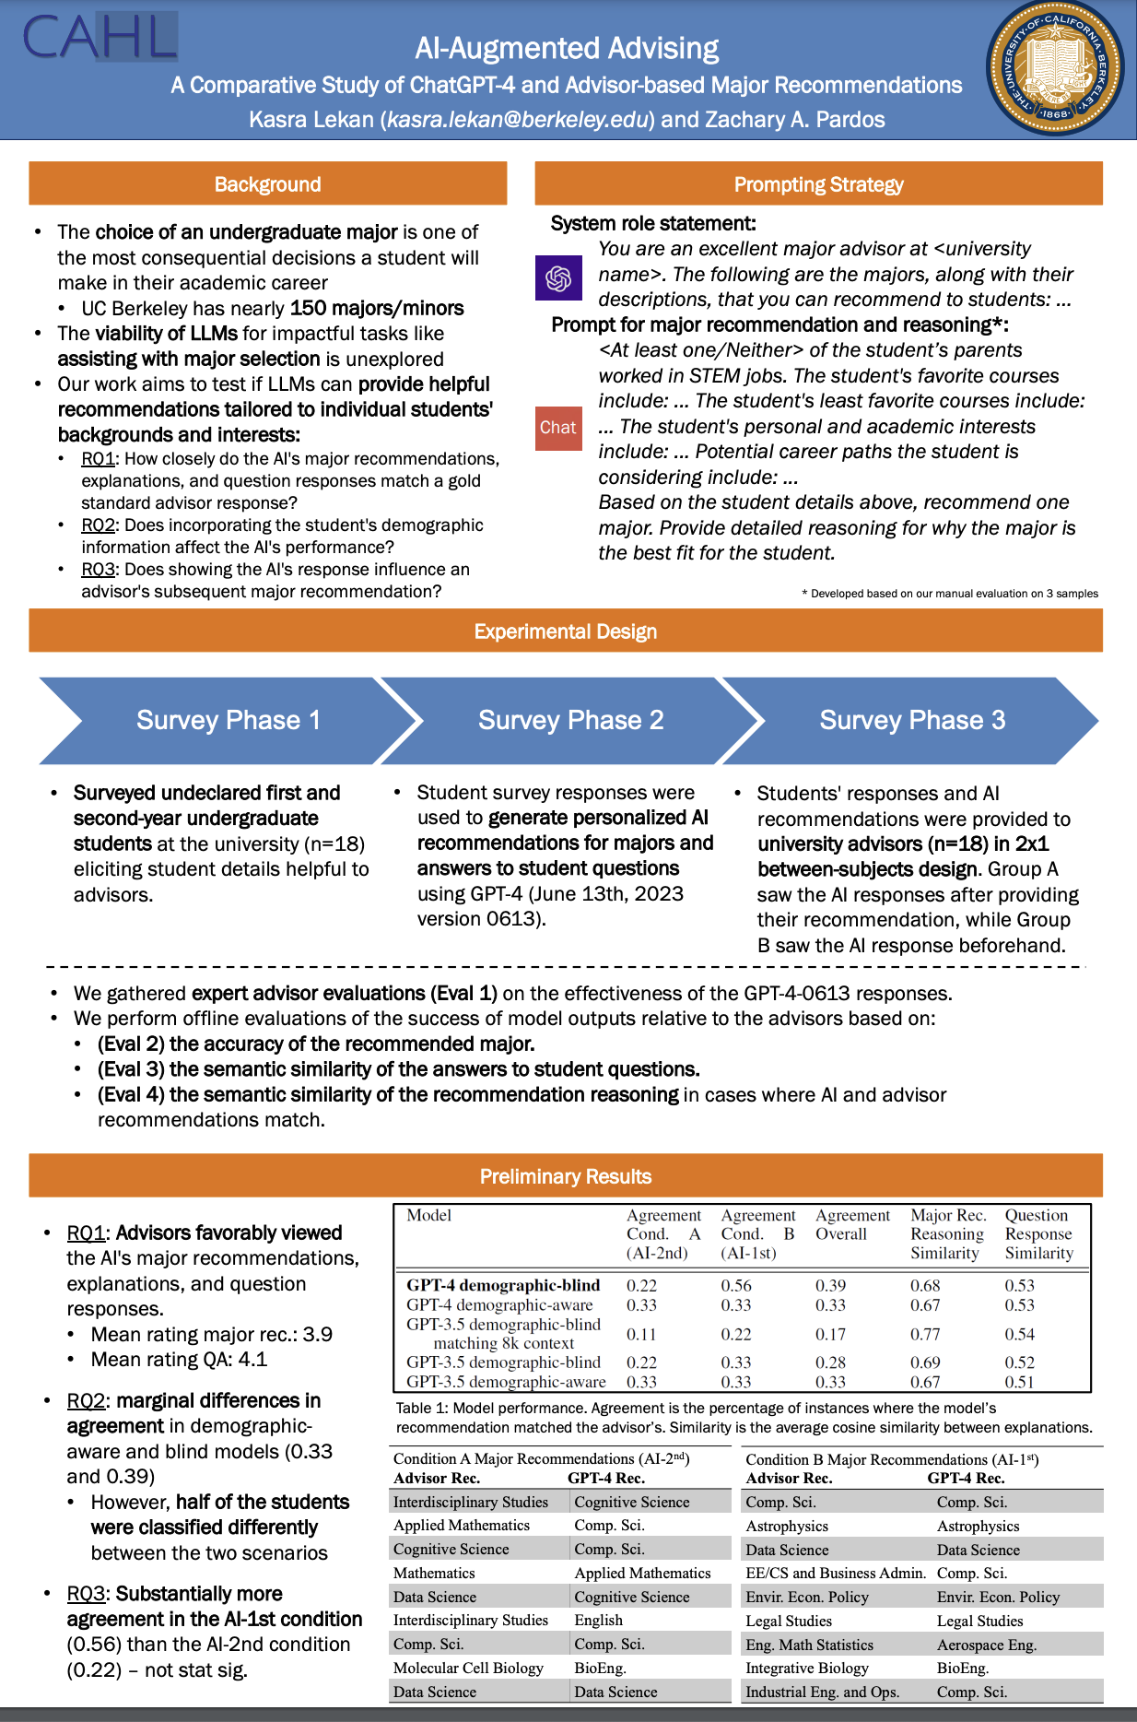
AI for Major Recommendation
Campus advisors at UC Berkeley (n=18) rated personalized AI major recommendations and explanations favorably (4.1 out of 5)
AI recommendations matched advisor recommendations for ~40% of students
Lekan, K., Pardos, Z.A. (2023). AI-Augmented Advising: A Comparative Study of ChatGPT-4 and Advisor-based Major Recommendations. Presented at the Generative AI for Education Workshop (GAIED) at the Thirty-seventh Conference on Neural Information Processing Systems (NeurIPS). New Orleans, LA.

Slide 54
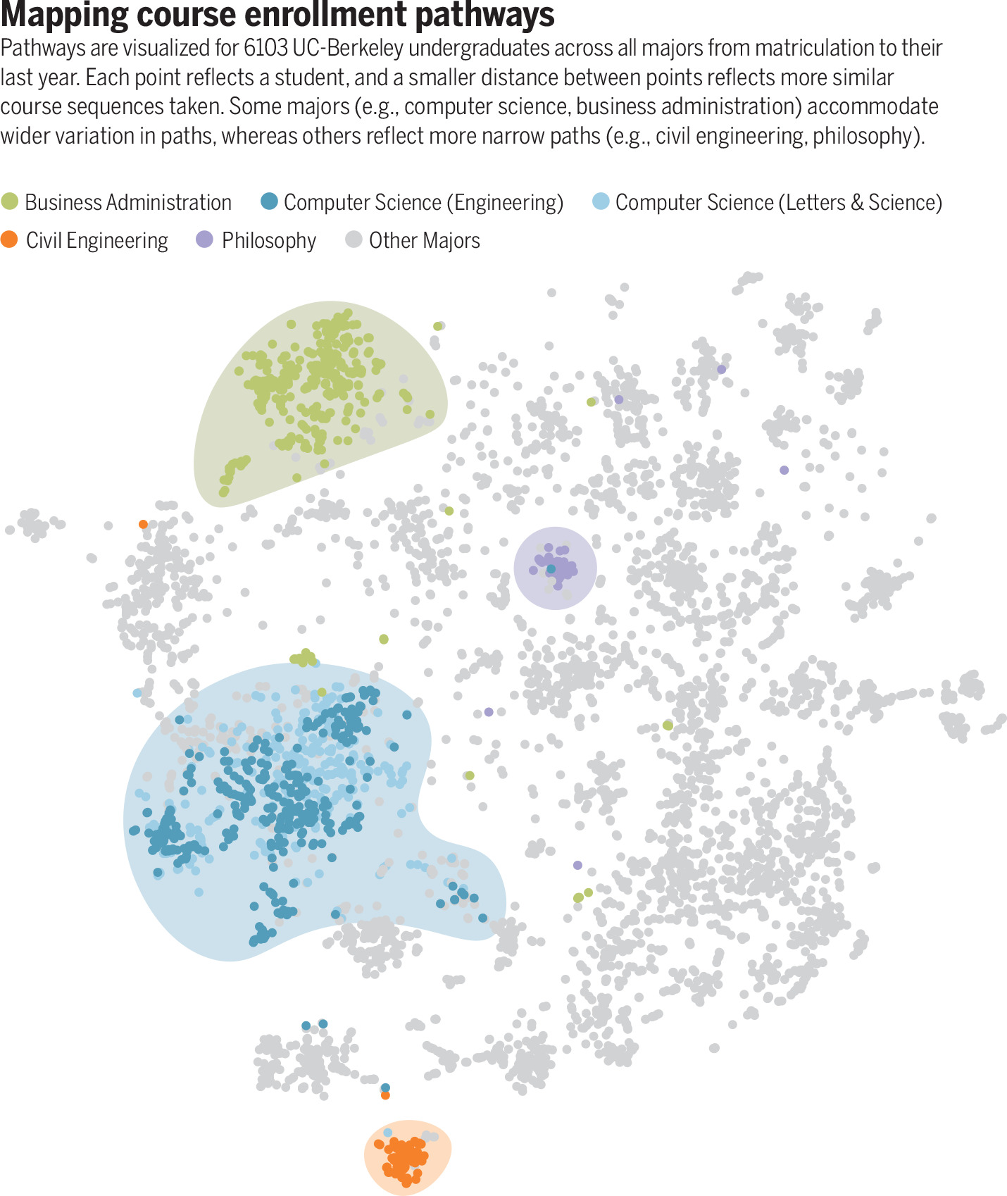
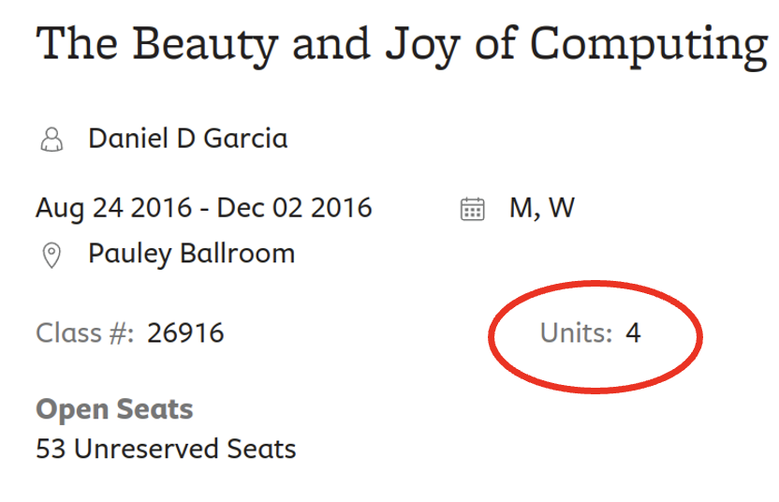
Other related work from the lab
Educational “pathways” research overview Kizilcec et al. (Science 2023)
Credit hours not indicative of course workload
Pardos & Borchers (Internet and Higher Education, 2023)

Slide 55
Open source tutoring (oatutor.io)

Slide 56
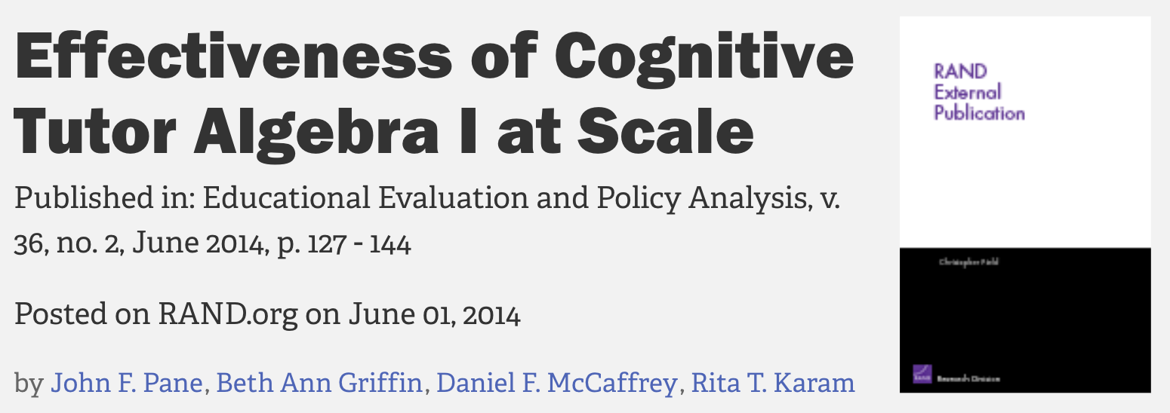
?
Where’s the open source
Corbett (2001) – “Cognitive Computer Tutors: Solving the Two-Sigma Problem” (Intelligent Tutoring Systems approach)
Notes:
One-on-one human tutoring has long since been the gold standard for students learning a new academic subject
This approach is however not scalable due to the resources involved
Therefore, ever since there have been computers there have been approaches to use human-computer interaction to attempt to rival the efficacy of one-on-one tutoring
An approach that has been among the most dependable in producing learning gains above standard classroom instruction has been intelligent tutoring systems, in which students receive an adaptive amount of practice on fine-grained skills modeled in the domain.
About ten years ago a seminal evaluation of an ITS approach was released, replicating past findings that shown significant learning gain benefits of ITS
However, despite a many decades long study of this paradigm of tutoring, some results of which have been presented at CHI over the years, no open-source implementation has yet emerged (on github or elsewhere) for the HCI and extended community to innovate with

Slide 57
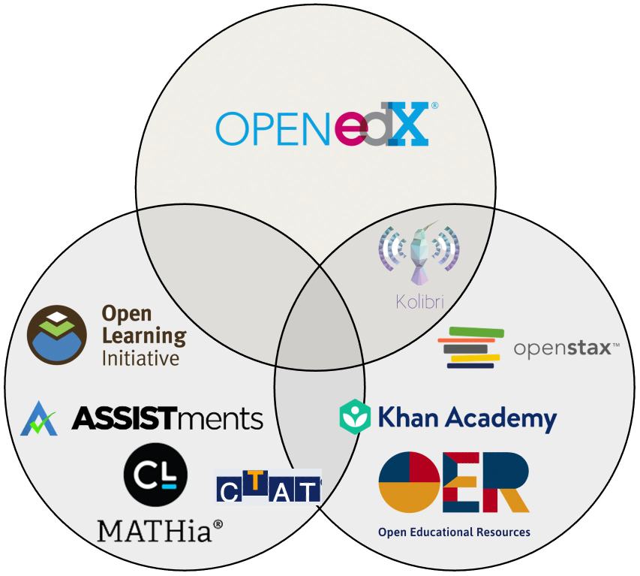
Open movements and exemplar systems
Open Source
Massive Open Online Courses
Open Data
Open Educational Resources
OATutor
Adaptive
Creative Commons
Notes:
Thought there hasn’t been an open adaptive tutoring movement, there have been other “Open” movements in education technologies
The Open in Massive Open Online Courses denoted open access or free access to online courses
The open edX platform is also open source, but is more akin to an LMS than a tutor and its content, sourced from Universities, is not open/remixable.
Open Educational Resources has been a movement synonymous with making content available under creative commons license. Though this content is often static video or problem sets, and not integrated into an interactive system
There have been a slew of adaptive systems that are either ITS themselves or ITS-adjacent in their functionality
These system have contributed to Open Data, where they have made large anonymized datasets available for study
Many of these systems are friendly to researchers in that they invite them to run content-based studies and make their userbase available for study
None of these system are open source, adaptive and creative commons. For example, if one wanted to experiment with different adaptive item selection algorithms or add inputs from wareables or outputs through a virtual or physical robotic agent, one would need a special MOU or collaborative agreement with these adaptive platforms, that is hard to come by.
Therefore, there is a gap to be filled in terms of a system for enabling this type of experimentation

Slide 58
OATutor
Road image generated by DALL-E 2
Notes:
Our work intends to move the field from this current proprietary state, where every available tutoring system has at least one critical component that is proprietary, to a completely open state

Slide 59
Research through Design
(Zimmerman, et al, 2007)
Open state
OATutor
Three-year fielding and iterative development
1 community college
7 math classrooms
Proprietary state
1 pilot teacher
4 pilot researchers
25 content authors
Pardos et al. (2023)
Road image generated by DALL-E 2
Notes:
Getting there involved a three-year journey fielding and iteratively developing the system in 7 math classrooms in 1 community college
We use a research through design methodology to collect data from our participants, 1 pilot teacher, 4 pilot researchers, and 25 content authors
Our motivation is for this to democratize research in this area, allowing more people to participate with fewer barriers We conduct this study to both: - potentially uncover insights into adaptive tutoring system design - so that research who may use our system can be confident that usability issues won’t be a confounder

Slide 60
Policy Relevance
AB 1705 / 705 – Effectively eliminates remedial English and Math classes
AB 1187 – Expands access to tutoring at community colleges
Increase in missing Calculous prerequisite preparation due to pandemic
Can OATutor be beneficial in these scenarios?

Slide 61
System

Slide 62
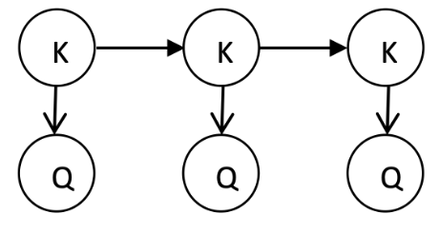
Features based on eight ITS Principles (Anderson, Corbett, Koedinger, & Pelletier, 1995)
Open Adaptive Tutor student interface
# | ITS Principle
1 | Represent student competence as a production set
2 | Communicate the goal structure underlying the problem solving
3 | Provide instruction in the problem-solving context
4 | Promote an abstract understanding of the problem-solving knowledge
5 | Minimize working memory load
6 | Provide immediate feedback on errors
7 | Adjust the grain size of instruction with learning
8 | Facilitate successive approximations to the target skill
Knowledge tracing (Corbett & Anderson, 1994)
Notes:
The design of our system, shown here, began with features based on eight ITS principles, for which learning gains have been largely attributable to
These principles translated to the following fundamental features

Slide 63
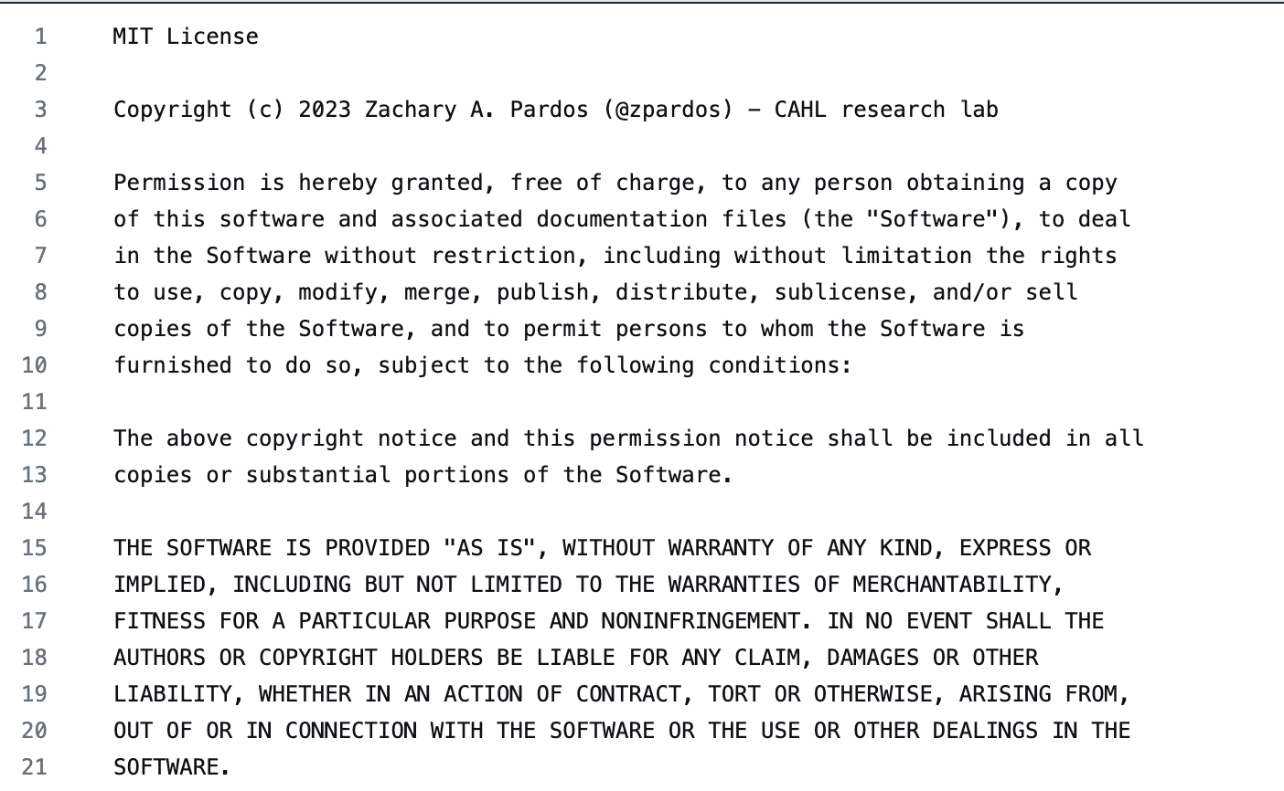
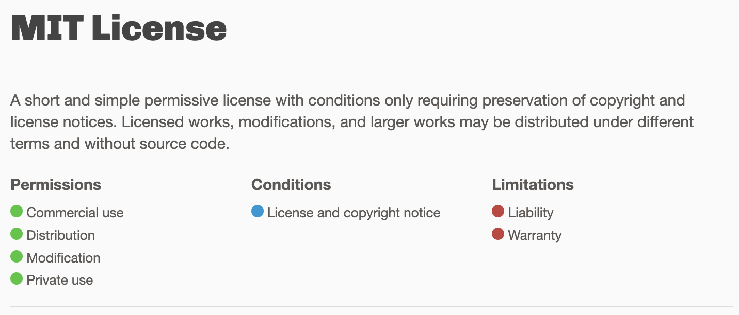
Open Source

Slide 64
Content curation process
Sheel, S., Anastasopoulos, I., and Pardos, Z.A. (2024). Comparing Authoring Experiences with Spreadsheet Interfaces vs GUIs. In Proceedings of the 14th Learning Analytics and Knowledge Conference (LAK '24). Association for Computing Machinery, New York, NY, USA, 598–607.
Completed:
In Progress:
Adapted from
(31 chapters, 199 lessons)
(23 chapters, 52 lessons)
Notes:
A tutoring system isn’t much use to students without content, so we created a mini-publisher process and authored three full textbooks of adaptive algebra content, with questions adapted from OpenStax and hints and scaffolds added by the OATutor team. The team consisted of 25 undergraduates at UC Berkeley who were screened for having some formal experience being a tutor in Mathematics. They joined the team through an undergraduate research apprenticeship program run by the University that grants them research course credit for participating in lab projects.

Slide 65
OATutor Project Content Team

Slide 66
Methods

Slide 67
Research through Design Process
Content Creators
Teachers
Researchers
25 undergraduate students
4 pilots over 7 course offerings
2 undergraduates
and 2 PhD candidates
Data Collection:
Data Collection:
Data Collection:
Weekly meetings
Survey
Co-design meetings
Interview
Student feedback via LMS
Advising meetings
Interview

Slide 68
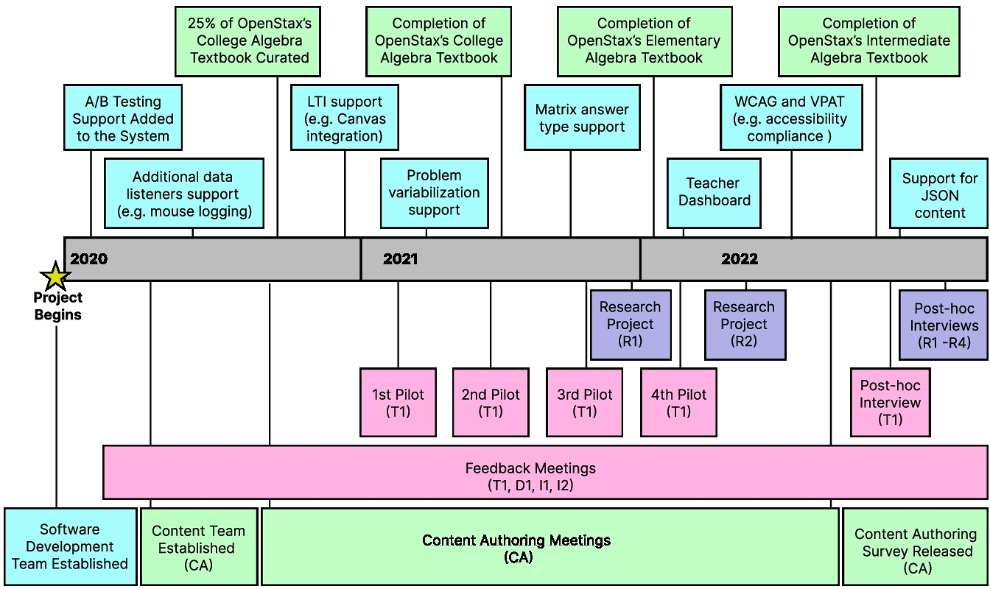
Timeline
Data collection methods: survey, semi-structured interviews with follow-up, meeting notes

Slide 69
Results

Slide 70
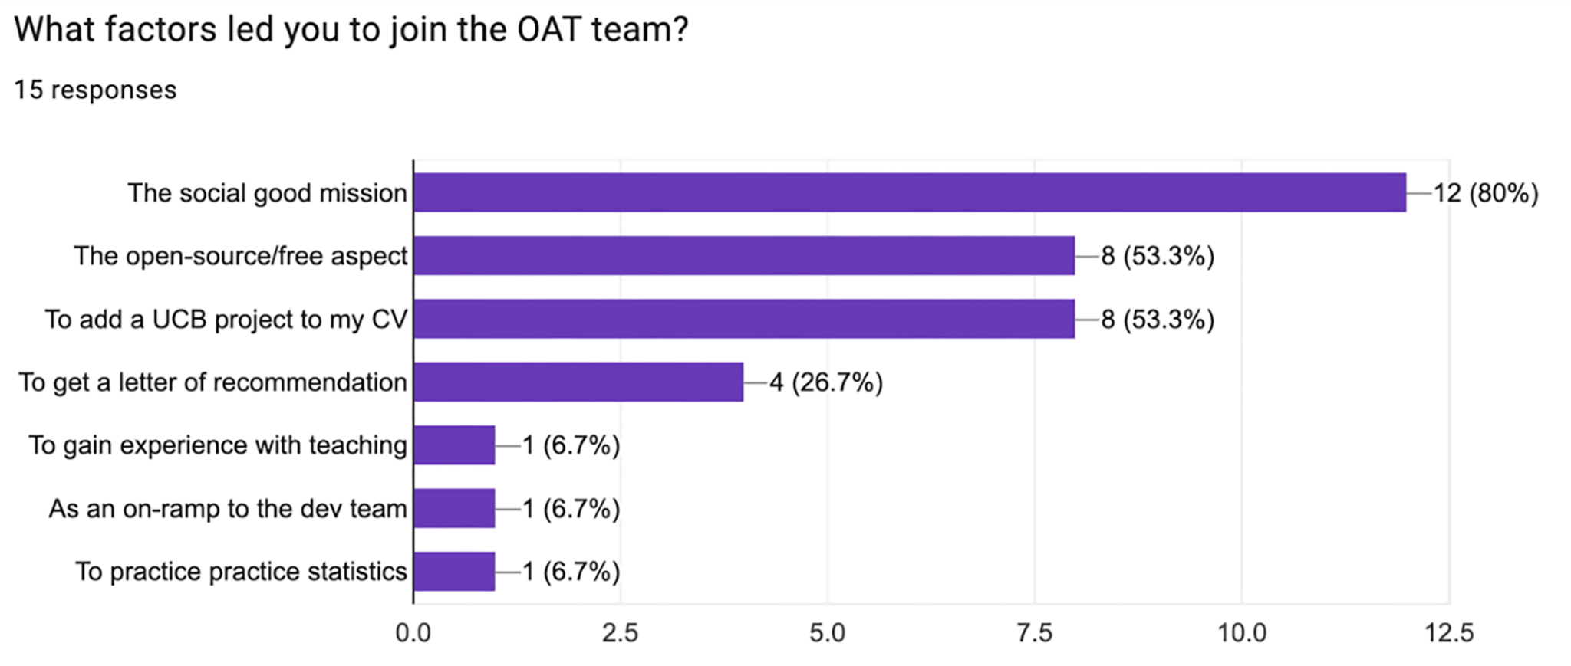
Authoring survey results (Self-report)
Average time to complete training course
2.27 hours (SD = 1.10)
Average time to create problem
11.03 min (SD = 9.11)
CA
Content Authors
Notes:
14-page checklist
Alt text for all UI elements
Researchers in the US can be confident deploying the system in institutional settings (receiving federal funding)

Slide 71
Learning Gain Results
Based on 77 crowdsourced learners
L
Learners
Elementary Algebra Learning Objective: Solve Equations Using the Subtraction and Addition Properties of Equality Intermediate Algebra Learning Objective: Solve linear equations using a general strategy

Slide 72
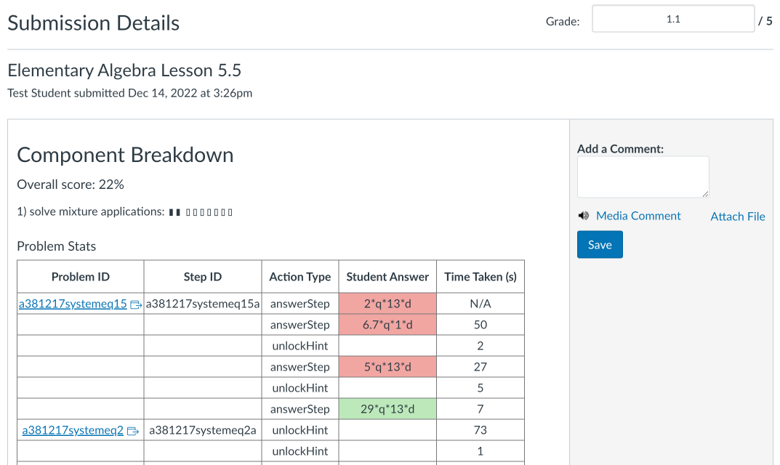
T1
Features lack consistency with other web-based platforms, such as a detailed dashboard
Teacher
Notes:
LTI dashboard code available, maybe support LAK dashboard research

Slide 73
T1
D1
Accessibility compliance under Section 508 is a requirement for software regularly used in classrooms
Teacher
Dean
https://cahlr.github.io/OATutor/static/documents/OATutor_Sec508_WCAG.pdf
Notes:
14-page checklist
Alt text for all UI elements
Researchers in the US can be confident deploying the system in institutional settings (receiving federal funding)

Slide 74
Workshops / Tutorials
github.com/CAHLR/OATutor
July 7th (full day) @ Artificial Intelligence in Education Conducting Rapid Experimentation with an Open-source Adaptive Tutoring System
July 20th (half day) @ Learning at Scale Introducing an Open-Source Adaptive Tutoring System to Accelerate Learning Science Experimentation
September 5th (half day) @ ECTEL Introducing an Open-Source Adaptive Tutoring System to Accelerate Learning Science Experimentation
September 19th (half day) @ KTH Introducing an Open-source Adaptive Tutoring System to Accelerate Learning Sciences Experimentation
Notes:
Please check our github out which includes a quick deploy collab notebook and mailing list sign-up link to keep up to date on platform developments and workshops

Slide 75
Discussion / Future Directions
Increasing adaptivity to teachers
Localization / Multi-lingual content
Generative AI
Notes:
We see OATutor as having the potential to contribute to inventive
HCI research [ 22 ], in enabling investigators to address their domain-
specific and cross-disciplinary questions through the development
and deployment of our tool. OATutor is both an adaptive tutor and
a curated content library, revealing a system that brings together
a set of capabilities to lower barriers to experimentation. Further
research on OATutor usage is needed to study the magnitude and
types of impacts the system can have on the broader research
community

Slide 76
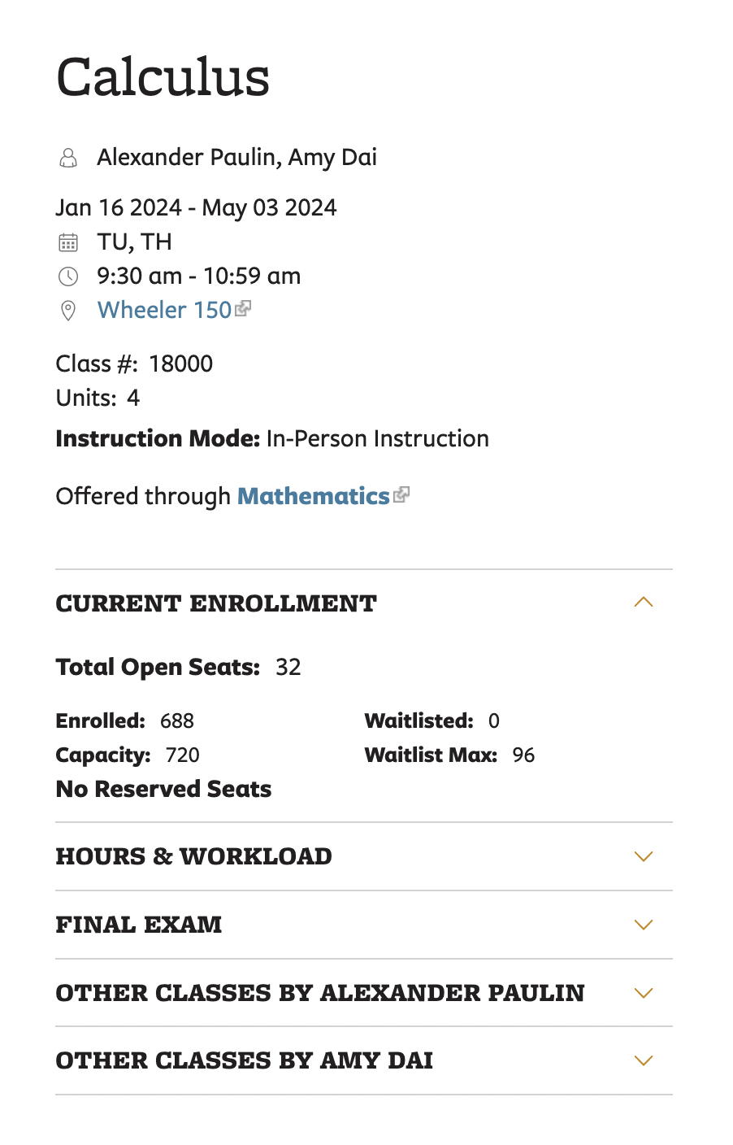
Implementation in MATH 1B
Problem Identified: Prof. Alexander Paulin has observed that many students struggled with certain prerequisite topics throughout the course.
Intervention Goal: Develop custom prerequisite mastery content in OATutor to help address gaps in prerequisite skill mastery by developing adaptive lessons for:
Exponents/Logarithms
Inequalities
Composition of Functions
Geometry in Algebra
Inverse Functions
Trigonometry/Trigonometric Functions
Transformation of Functions

Slide 77
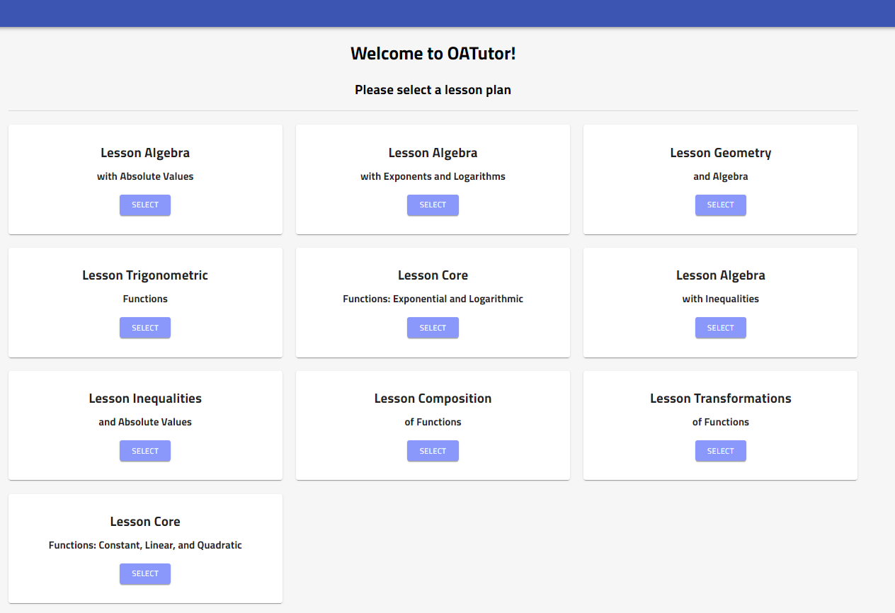
Implementation in MATH 1B
Pre-Calculus Supplementary Content
We authored 110 questions spanning 10 lessons.
Jenny Wang (URAP) and Aaron Haim (visiting student) assisted Ioannis with content authoring

Slide 78
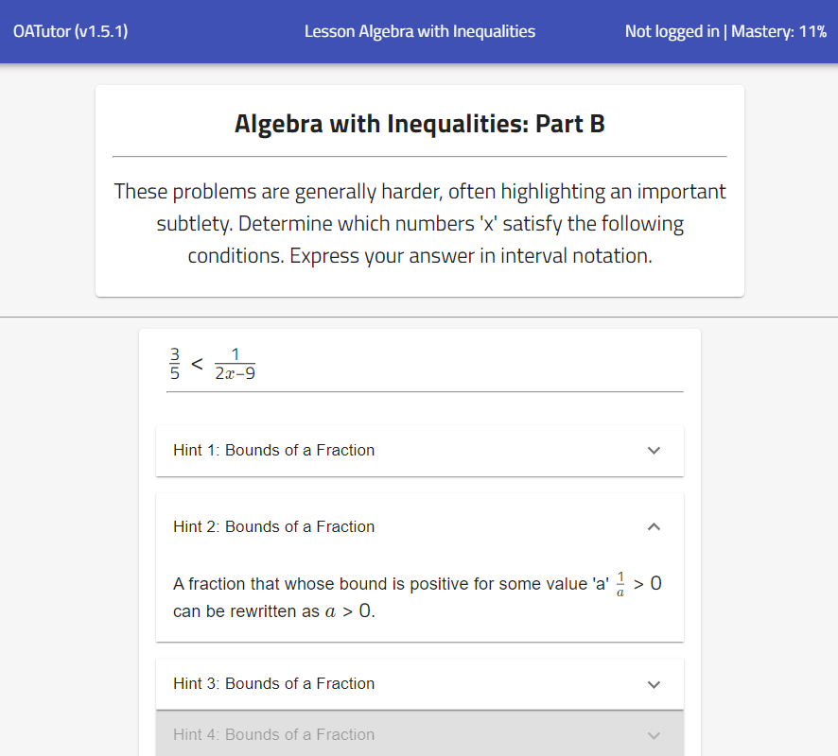
Implementation in MATH 1B
Pre-Calculus Supplementary Content

Slide 79
Discussion / Future Directions
Increasing adaptivity to teachers
Localization / Multi-lingual content
Generative AI
Notes:
We see OATutor as having the potential to contribute to inventive
HCI research [ 22 ], in enabling investigators to address their domain-
specific and cross-disciplinary questions through the development
and deployment of our tool. OATutor is both an adaptive tutor and
a curated content library, revealing a system that brings together
a set of capabilities to lower barriers to experimentation. Further
research on OATutor usage is needed to study the magnitude and
types of impacts the system can have on the broader research
community

Slide 80
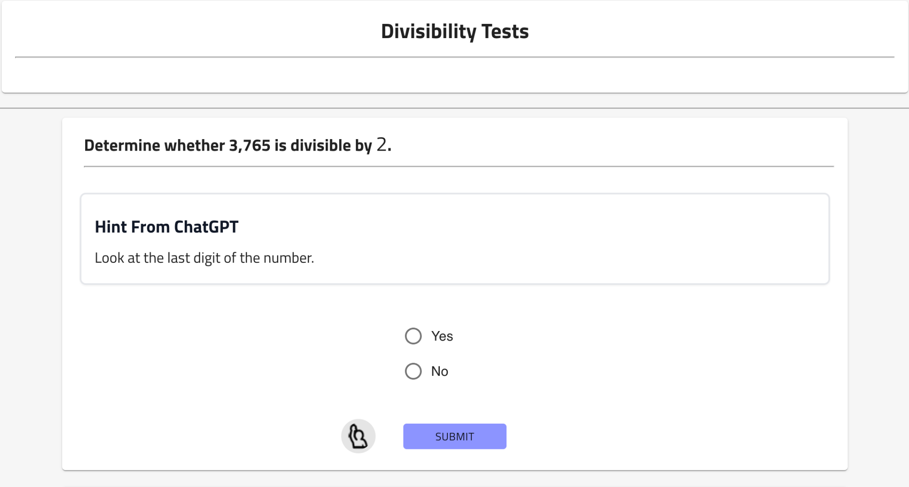
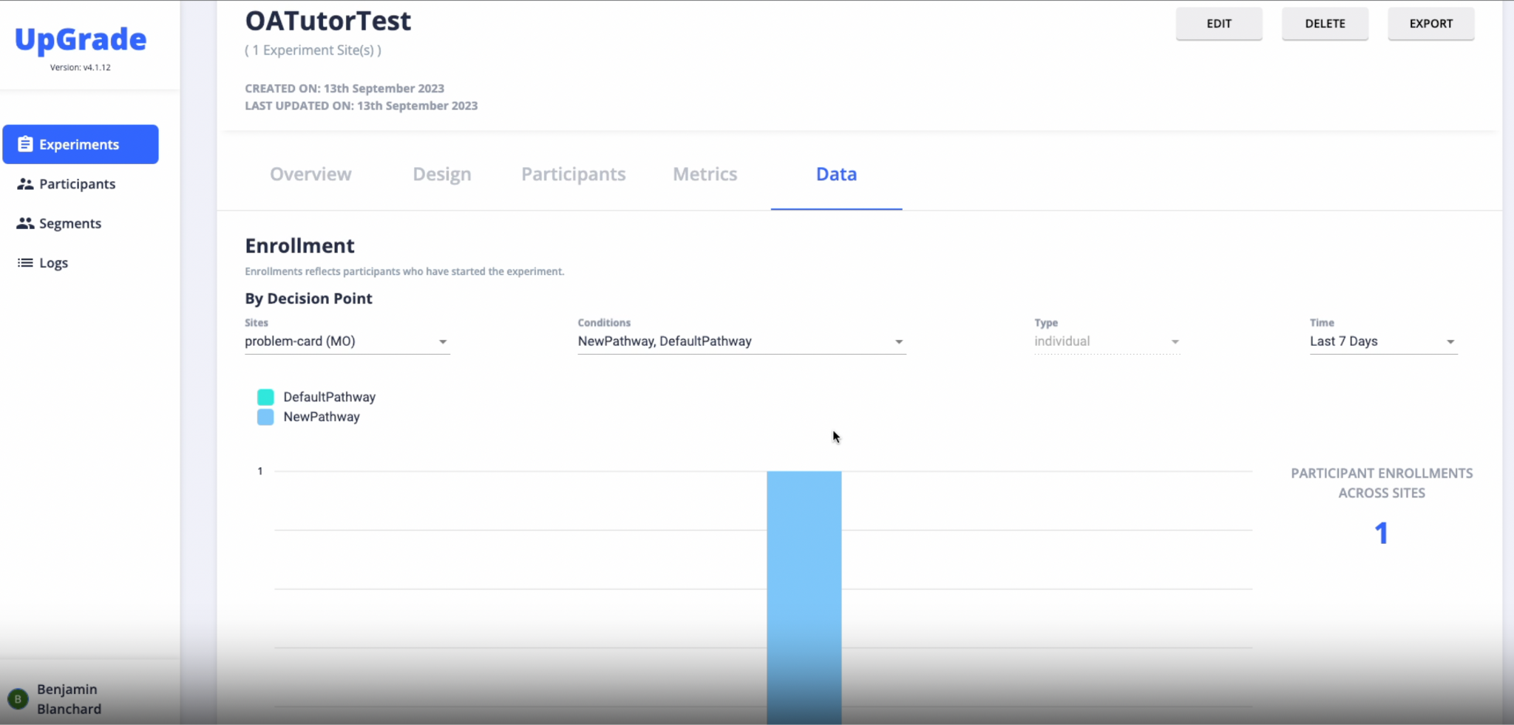
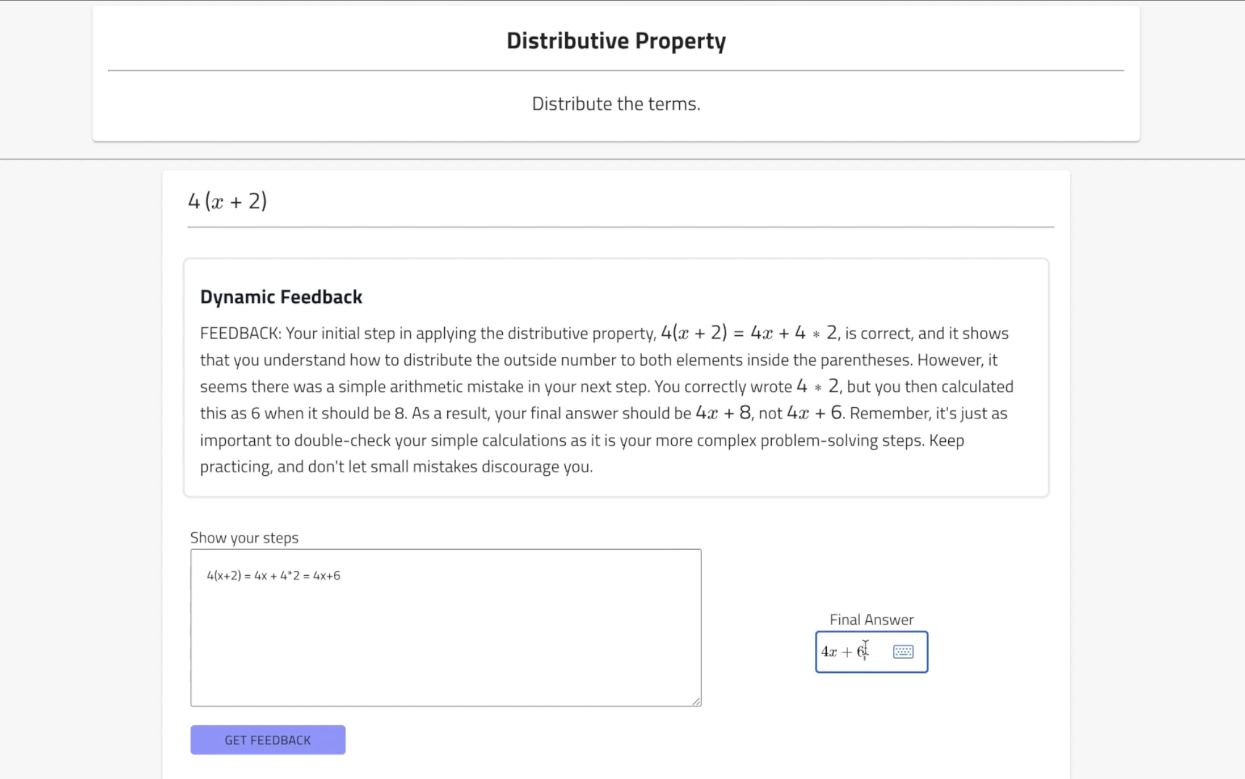
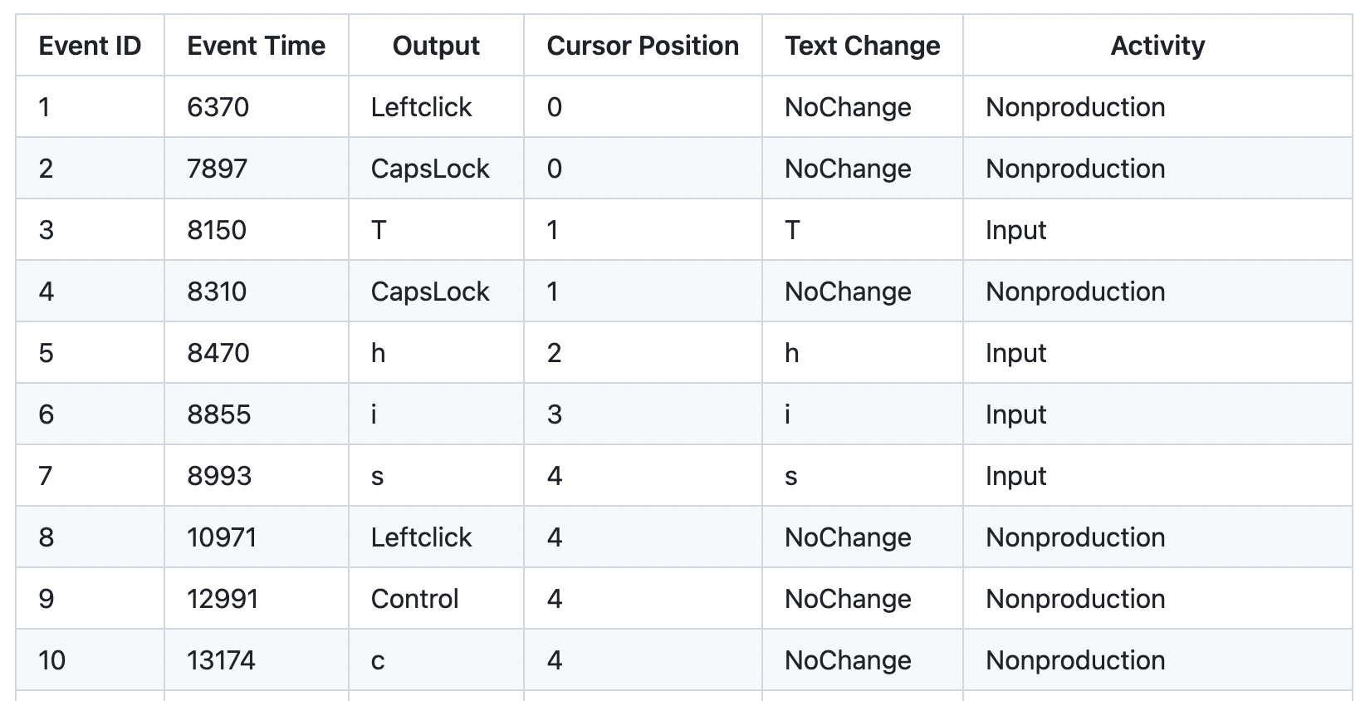
Upcoming OATutor feature milestones
Dynamic Feedback
Localization
A/B study management
Supporting different languages and adapting to country culture, both on the UI and content.
Collaboration with UpGrade to add a dashboard management system and incorporating keystroke logging.
Generating feedback from any LLM endpoint, given their answer and/or work inputted

Slide 81
Observation: Content production was EXPENSIVE
Creating each adaptive textbook took the equivalent of one year of an FTE
This is a problem for scaling and further personalizing adaptive tutoring

Slide 82
Discussion / Future Directions
Increasing adaptivity to teachers
Localization / Multi-lingual content
Generative AI
Notes:
We see OATutor as having the potential to contribute to inventive
HCI research [ 22 ], in enabling investigators to address their domain-
specific and cross-disciplinary questions through the development
and deployment of our tool. OATutor is both an adaptive tutor and
a curated content library, revealing a system that brings together
a set of capabilities to lower barriers to experimentation. Further
research on OATutor usage is needed to study the magnitude and
types of impacts the system can have on the broader research
community

Slide 83
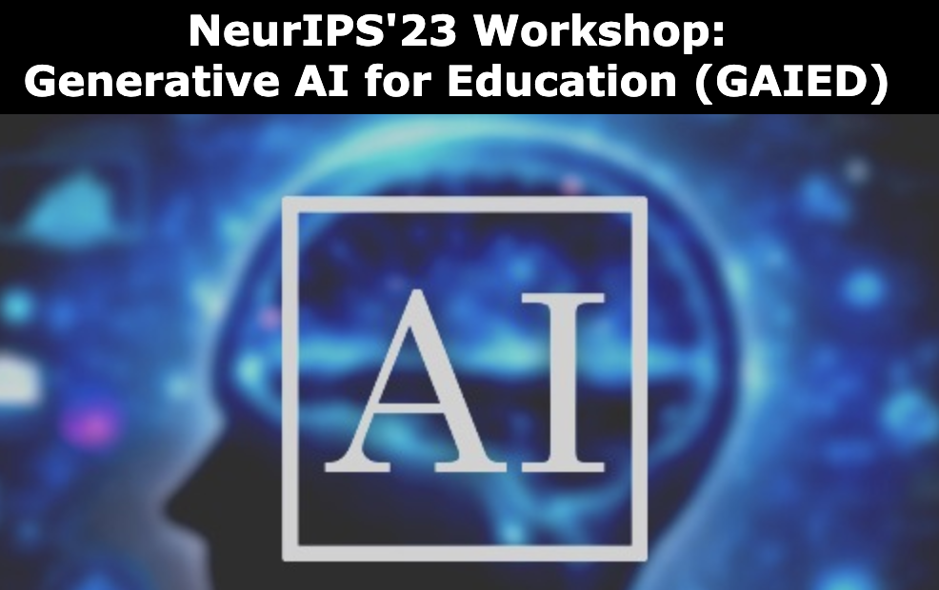
GenAI tutoring system research
👉
GPT assessment items indistinguishable from textbook items in psychometric, IRT properties
Assessment items
(Bhandari, Liu, Pardos, 2023)
GenAI
Hint generation
(Pardos & Bhandari, forthcoming) Builds on https://arxiv.org/abs/2302.06871 (cited 80+ times)
👉
GPT3.5 hints contained hallucinations 30% of the time
GPT hints were 20x faster to produce (including manual hallucination checks)
GPT and human-authored hints produce significant learning gains
👉
👉
Skill tagging
(Li, Pardos, & Cheng, 2024)
These studies were approved by the UC Berkeley Committee for the Protection of Human Subjects under IRB Protocol 2023-04-16246
👉
Zero-shot new taxonomy prediction Recall @ 3 of 0.671

Slide 84
Ethical considerations
Maintaining alignment with stakeholders (staff/teachers/faculty)
What AI error rate is low enough for interventions?
Privacy considerations when using web-based AI models
Equity gaps in benefit of technology
Mitigating the potential for displacement
Commercial/proprietary vs free/open-source AI
Other considerations?

Slide 85
Big picture
AI’s strength in text comprehension makes it well suited for course equivalence estimation tasks involved in improving credit mobility (e.g., common course numbering / articulation)
Human factors in AI interactions can be unpredictable and require study
Collaboration with AI for administrative tasks, if designed effectively, could help expand access to higher education
Generative AI can significantly reduce tutor content authoring costs while maintaining quality (as observed thus far)
Notes:
Inclusive of push back on decisions that may represent systemic biases

Slide 86
Thank you! Questions?
Zach Pardos (zp@Berkeley.edu)
Funding Acknowledgements:

