Slide 1
Adding your title
Intelligent Mentoring:
Linking Learning Analytics and Interactive Nudges to Support Life-wide Learning
Vania Dimitrova
School of Computing, University of Leeds, UK
The images used throughout this presentation are from https://unsplash.com/

Slide 2

Bias
Background
Experience
Current Activities
Human-centred AI
Researcher, learner, mentor
IAIED Society, CDT, CoE
Notes:
2

Slide 3
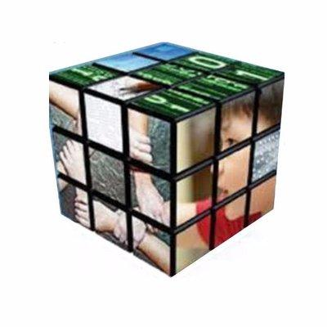
International AI in Education Society (iaied.org)
Advance science and engineering of
intelligent human-technology ecosystems that support learning
Learning ecosystems
-Interaction
-Collaboration
-Adaptation and personalisation
-Advancement of learning and teaching
-Supporting learners and teachers
- Equity, diversity and inclusion
- Ethics
Multiple disciplines & board scope
-Computer Science – AI, HCI, Human-centred AI
-Education – pedagogical models, evaluation, …
-Cognitive Science – cognition, emotion, interaction, …
-Psychology – motivation, engagement, …
-Domain specific expertise
-Broad learning scope – classroom, informal learning, wellbeing, …
-Broad range of learners – school, university, adult learners, disabilities, equity

Slide 4


Slide 5

Human-centred Artificial Intelligence
Building intelligent systems that help people do things better:
take decisions in complex settings, preserve knowledge,
learn from experience, and change behaviour
Modelling Human
Conceptual Structures
Modelling Individuals or
Groups
Intelligent Interactive
Systems
Knowledge Models
(ontologies)
User/Group Models
(dialogue / analytics)
Personalisation
(nudges)
Notes:
5

Slide 6

Challenges we have been Facing
Complex, ill-defined domains
Real world experience is crucial
Informal learning
Notes:
6

Slide 7

Diversity of learners
Vision / Direction
Notes:
7

Slide 8

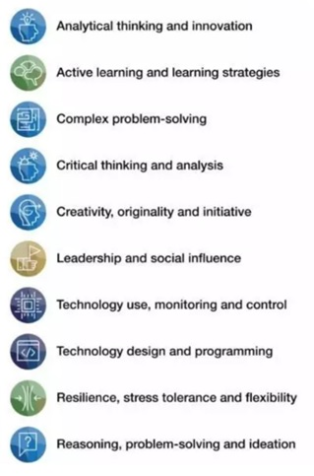
Diversity of learners
New Skills
+ interpersonal and intercultural competences
… companies should not only to train employees in interpersonal and intercultural skills, but also recruit people with these abilities
A global mindset should be a top recruitment requirement in this new era of remote work.
World Economics Forum 2020, The rise of remote work means we need better 'intercultural skills' - this is what that means
+ social and emotional skills
… empathy, self-awareness, respect for others and the ability to communicate, are becoming essential as classrooms and workplaces become more ethnically, culturally and linguistically diverse.
… perseverance, efficacy, responsibility, curiosity
and emotional stability.
World Economics Forum 2020, Future of Jobs.
OECD Future of Education and Skills 2030
Notes:
8

Slide 9

Diversity of learners
Re-skilling and Up-skilling
  “The illiterate of the 21st century will not be those who cannot read and write, but those who cannot learn, unlearn, and relearn. ”
  [Alvin Toffler]
“…people need to rely even more on their uniquely (so far) human capacity for creativity, responsibility and the ability to “learn to learn” throughout their life.”
OECD, Conceptual learning framework, skills for 2030
Notes:
9

Slide 10
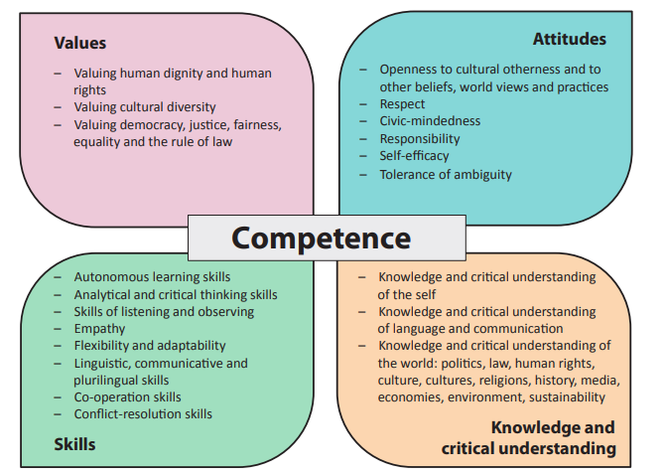
Diversity of learners
Skills for Democratic Societies
Council of Europe, Reference Framework of Competences for Democratic Culture
Notes:
10

Slide 11

Everyday Living Skills
The Future They Want
The OECD asked students from around the world to describe the future they want, to articulate their hopes, dreams and the actions needed to attain well-being.
https://www.oecd.org/education/2030-project/teaching-and-learning/learning/well-being/
Notes:
11

Slide 12

Interaction with a more experienced peer who assists with:
Self-awareness
Sensemaking
Reflection
Goal/action setting
Main mentoring actions:
Questioning
Listening
Clarifying
Reframing
Directing
Mentorship matters now more than ever
(Forbes, June 2020)
1:1
1:N
AUGMENT the Mentoring process
N:1
N:N
https://www.forbes.com/sites/forbesbusinesscouncil/2020/06/08/why-mentorship-matters-now-more-than-ever/?sh=11350eaf483f
Notes:
12

Slide 13

Diversity of learners
Vision / Direction
Intelligent mentoring/coaching
Conversational agents (Art’s talk)
Dashboards (Barbara’s talk)
Digital coaches (education, health)
Intelligent nudges
Notes:
13

Slide 14


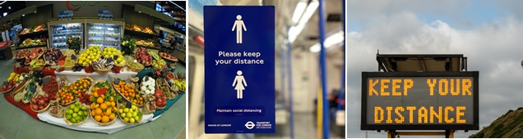
Nudging the Learners to Improve Learning Experience
Help people make choices that lead to:
better outcomes (paternalism)
in an unobtrusive and non-compulsory manner (libertarian)
(Thaler & Sunstein, 2008)

Slide 15
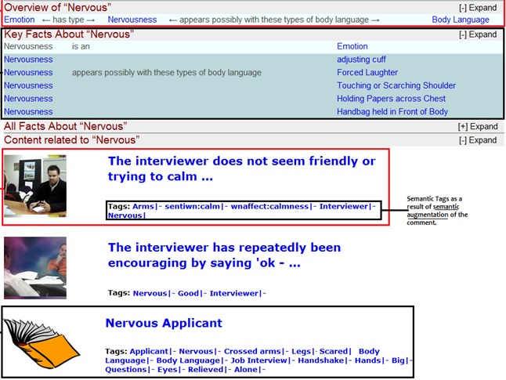
Semantic Nudges: Turning Browsing into Learning Experience
“…semantics can be successfully used in social spaces for informal learning – especially when combined with carefully designed nudges”
Nervous is a negative
emotion, you may also
look at positive emotions
like calm.
Click here to see examples
with calm.
D Thakker, V Dimitrova, L. Lau, P. Brna, Taming Digital Traces for Informal Learning: A Semantic-Driven Approach, European Conference on Technology Enhanced Learning, 2012.

Slide 16


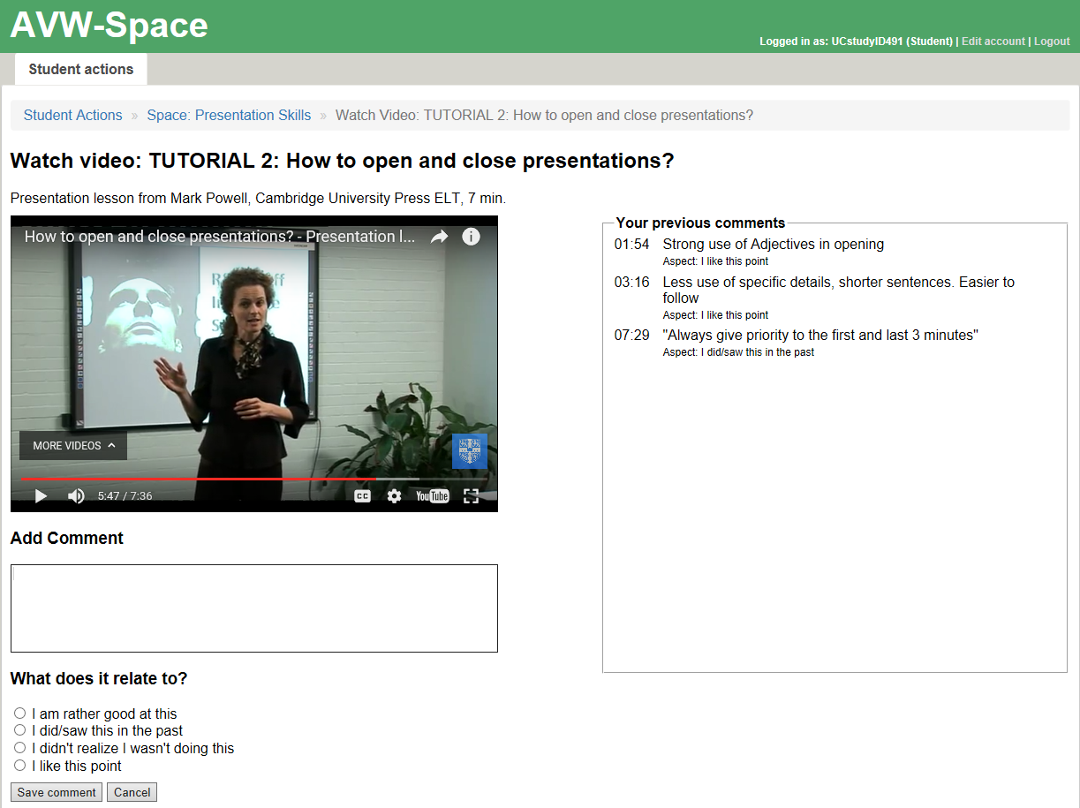
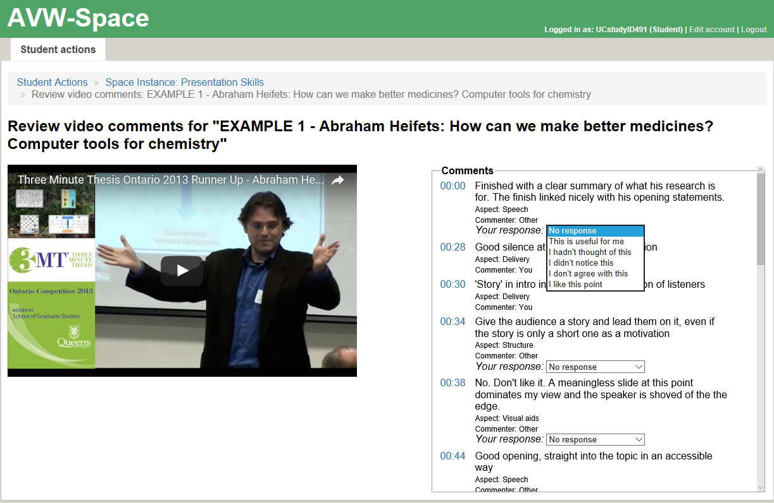
Micro-scaffolds for Self-regulated Learning
Collaboration: University of Canterbury, NZ and University of Leeds, UK
Does and how AVW support learning?

Slide 17
User Studies: How does AVW-Space support learning?
YouTube Videos on presentation skills
  4 tutorials and 4 examples
Micro-scaffolds:
  Aspects and Ratings
8 studies:
  2 with postgraduate students; 6 with undergraduate students at Univ of Canterbury
  >2000 students
Presentation skills
ontology
Phase 1: Personal Space
(video watching and note taking)
Phase 2: Social Space
(comment browsing and rating)
Survey 1:
Demographic data
Conceptual knowledge
Survey 2:
Conceptual knowledge
Usability (TAM)
Cognitive load
(NASA-TLX)
Survey 3:
Conceptual knowledge
Usability (TAM)
Cognitive load
(NASA-TLX)
AIED2017/2018/2019, UMAP2017/2018, ICCE2017, ECTEL2019

Slide 18
Findings -> Requirements for Interaction Nudges
Writing comments and rating comments led to increased conceptual knowledge
Micro-scaffolds have positive effect on learning
Writing comments is demanding
(where to look, what to write?)

Slide 19
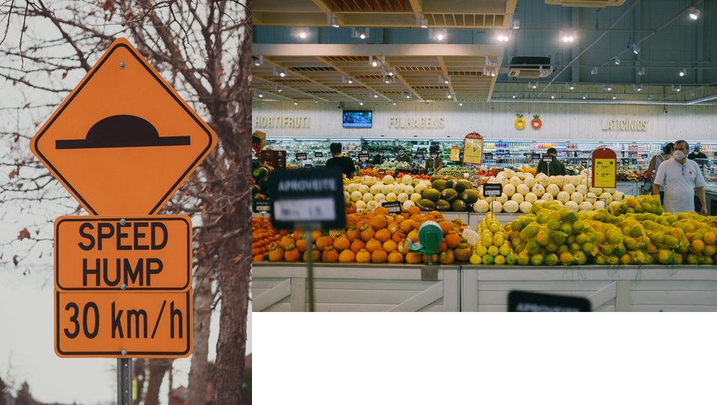
Nudges for Behaviour Change
CHOICE ARCHITECTURE
What is the target and problem behaviour?
When/What/How to nudge?
V. Dimitrova & A. Mitrovic, Choice Architecture for Nudges to Support Constructive Learning in Active Video Watching, International Journal of AI in Education, 2022.

Slide 20
decioon
observation
Choice Architecture for Interactive Nudges
passive watching
not noticing important parts
making shallow comments
not linking with personal experiences
making comments
noticing important parts
making reflective comments
referring to personal experiences
Observed
Behaviour
Target
Behaviour
Decision Information
Decision Structure
Decision Assistance
Make decision easier
Translate information
Provide social reference point
Provide default option
Increase effort
Group options
Change options
Provide reminders
Facilitate commitment
Münscher, R., Vetter, M., Scheuerle, T. (2016). A review and taxonomy of choice architecture techniques.
Journal of Behavioral Decision Making, 29, 511-524.

Slide 21
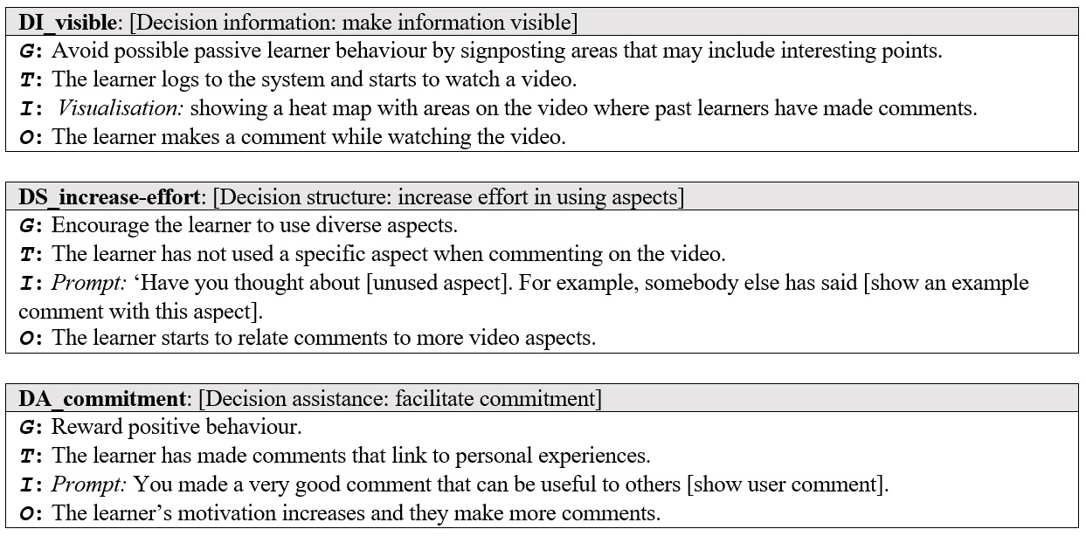
Hypothesis | PG students (Studies 1 and 3) | UG students (Study 4)
H1: Nudges would result in more comments | ✗ | ✓
H2: Nudges would result in more learning | ✓ | ✗
H3: Nudges result in a more even use of various aspects | ✓ | ✓
H4: Nudges foster active/constructive behaviour | ✗ | ✓
H5: Nudges have a positive effect on comments and learning | N/A | ✓
H6: Nudges would result in a difference in subjective opinions | ✗ | ✓
Interaction Nudges as Dialogue Games

Slide 22
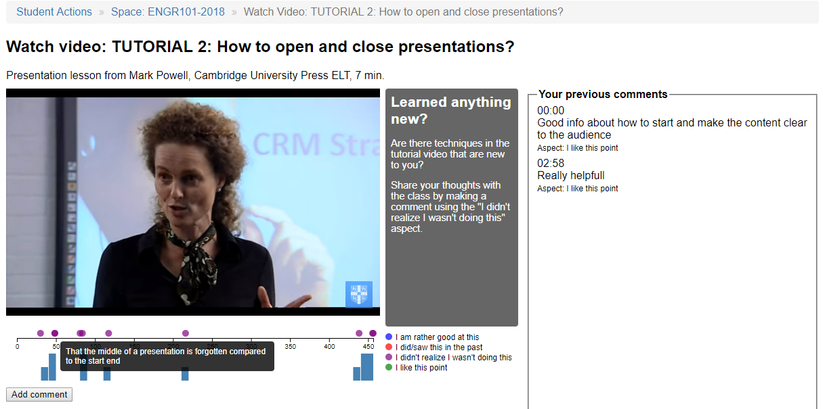
Interaction Nudges

Slide 23
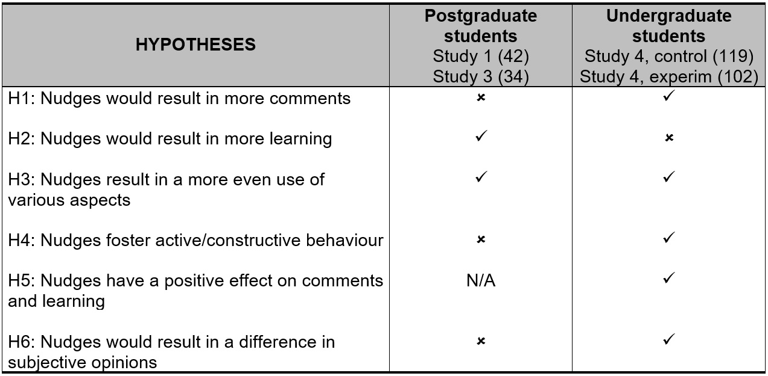
Hypothesis | PG students (Studies 1 and 3) | UG students (Study 4)
H1: Nudges would result in more comments | ✗ | ✓
H2: Nudges would result in more learning | ✓ | ✗
H3: Nudges result in a more even use of various aspects | ✓ | ✓
H4: Nudges foster active/constructive behaviour | ✗ | ✓
H5: Nudges have a positive effect on comments and learning | N/A | ✓
H6: Nudges would result in a difference in subjective opinions | ✗ | ✓
Findings: Effect of Nudges
See details of the findings in the paper.

Slide 24
Reflection: Interaction Nudges
Learnersourcing
tap into experience of other learners
Choice architecture
observed behaviour and target behaviour
Interaction means
personalised prompts, visualisations, indicators

Slide 25
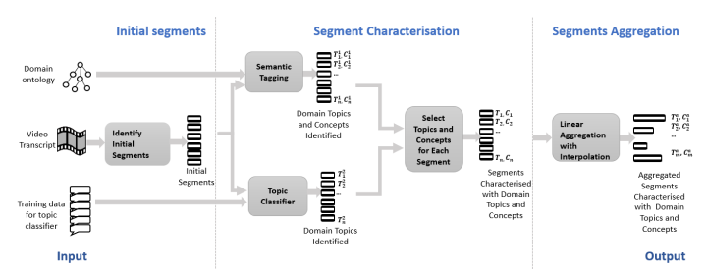
Video Segmentation and Characterisation
A. Mohammed & V Dimitrova, Video Segmentation and Characterisation to Support Learning, ECTEl2022.

Slide 26
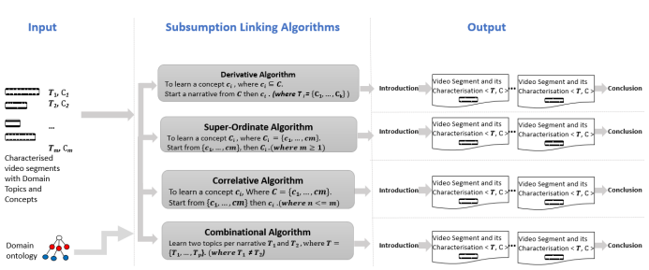
Generating Video Narratives
A. Mohammed & V Dimitrova, An Ontological Approach to Generate Video Narratives for Learning by Following
Subsumption Links, in preparation

Slide 27
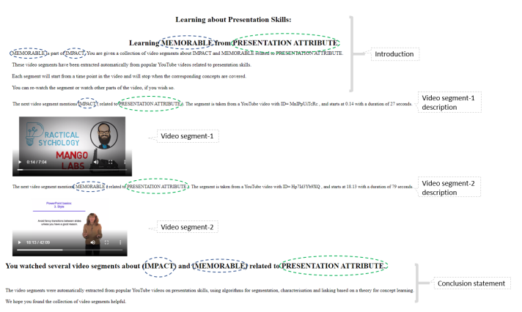
Creating Video Narratives to Support Informal Learning
Two domains:
Presentation skills
Health quality of life awareness
Currently running user studies
If you wish to participate, contact:
a.mohammed1@leeds.ac.uk
A. Mohammed & V Dimitrova, Video Segmentation and Characterisation to Support Learning, ECTEl2022.

Slide 28

Reflection
Architecture of Intelligent Mentors
Engagement, Reflection, Confidence, Motivation, Stress, Attention, …
Multi-faceted
Context Sensing
Choice
Architecture
Interaction
Nudges
Navigation
Nudges
Questions, Prompts, Clarifications, …
Tips, Suggestions, Examples, …
Notes:
28

Slide 29


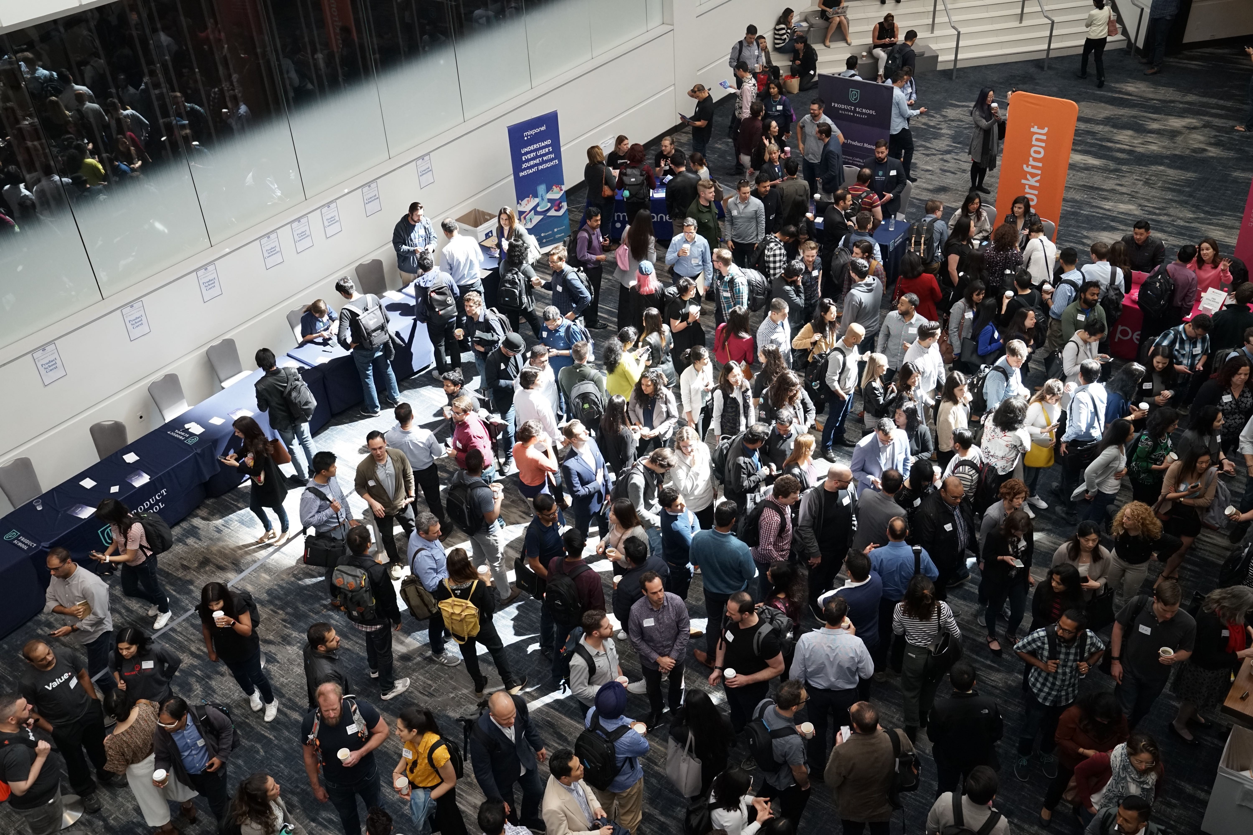
Reflection
This Conference Provided Opportunities for Learning:
What did you Learn?
References
Resources
Tools
Methods
Ideas
People
Follow on
Collaboration
Inspiration
Frustration
Your skills?
Others’ skills?
Your experience?
Others’ experience?
Your
emotions?
Notes:
29

Slide 30
Reflection
Learning is Life-wide, Contextualised, Linked to experience
Probing/
Listening
Context Sensing
Interaction (prompts/questions)
Suggesting tips, sharing experience
We can (and should!) support, automate, and scale
Notes:
30

Slide 31



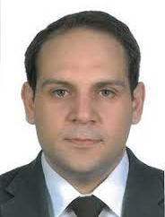










Acknowledgements
Acknowledgements
The images used throughout this presentation are from https://unsplash.com/
Lydia Lau
Alicja Piotrokowicz
Steve
Shillitoe
Paul
Brna
Dhaval
Thakker
Marwan
Al-Tawil
Abrar
Mohammed
Tanja
Mitrovic
Moffat Mathews
Jay Holland
Amali
Weerasinghe
Notes:
31

