Slide 1
Serverless Across the Edge-Cloud Continuum: Issues and Perspectives Valeria Cardellini Tor Vergata University of Rome, Italy

Slide 2
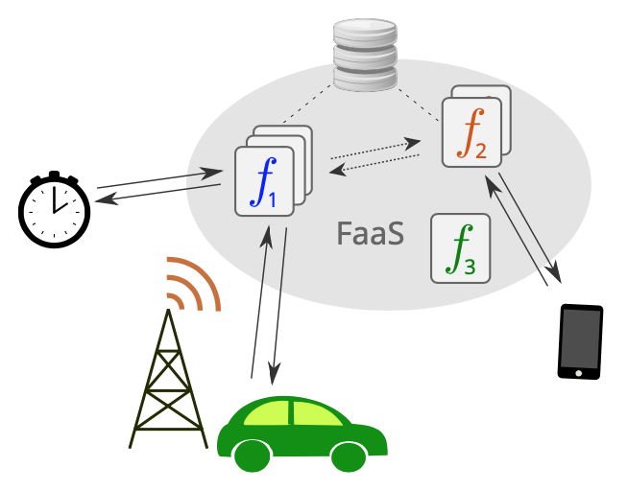
Serverless computing (and FaaS)
Increasing popularity and adoption
Simplified management of sw infrastructures
Seamless scalability
Simplified application maintenance
Fine-grained utilization-based pricing
Diverse applications, from enterprise automation to scientific computing to machine/deep learning
Notes:
Evolutionary and gradual process in the advancement of the Cloud
Develop, deploy and run applications
Free developers from infrastructure provisioning and management
Real pay-per-use billing: pay only for the time your code is executed
Offload configuring and managing operational aspects (instance deployment/life cycle, elastic scaling, fault tolerance, monitoring, and logging) to Cloud providers
Not long-running services

Slide 3
Serverless computing: a variety of definitions…
A variety of definitions, among which
Serverless computing is a cloud computing paradigm encompassing a class of cloud computing platforms that allow one to develop, deploy, and run applications (or components thereof) in the cloud without allocating and managing virtualized servers and resources or being concerned about other operational aspects. The responsibility for operational aspects, such as fault tolerance or the elastic scaling of computing, storage, and communication resources to match varying application demands, is offloaded to the cloud provider. Providers apply utilization-based billing: they charge cloud users with fine granularity, in proportion to the resources that applications actually consume from the cloud infrastructure, such as computing time, memory, and storage space.
Kounev et al., Serverless Computing: What It Is, and What It Is Not?, Comm. ACM, 2023

Slide 4
Serverless computing: … mostly in the cloud
A variety of definitions, including
Serverless computing is a cloud computing paradigm encompassing a class of cloud computing platforms that allow one to develop, deploy, and run applications (or components thereof) in the cloud without allocating and managing virtualized servers and resources or being concerned about other operational aspects. The responsibility for operational aspects, such as fault tolerance or the elastic scaling of computing, storage, and communication resources to match varying application demands, is offloaded to the cloud provider. Providers apply utilization-based billing: they charge cloud users with fine granularity, in proportion to the resources that applications actually consume from the cloud infrastructure, such as computing time, memory, and storage space.
Kounev et al., Serverless Computing: What It Is, and What It Is Not?, Comm. ACM, 2023
Notes:
Cloud-centric

Slide 5
Serverless at the edge
Cloud execution not feasible for some applications, e.g.,
Mobile augmented reality
Industrial IoT services
Extend serverless beyond traditional cloud platforms by exploiting distributed computation and storage at the edge
Low-latency
Serverless edge computing products, e.g., Akamai EdgeWorkers, AWS Lambda Edge, Azure IoT Edge, Cloudflare Workers, Fastly Compute
Aslanpour et al., Serverless Edge Computing: Vision and Challenges, Proc. ACSW 2021
Raith et al., Serverless Edge Computing — Where We Are and What Lies Ahead, IEEE Internet Comput., 2023
Notes:
Cloud far away from data sources
Bring code closer to data sources and consumers

Slide 6
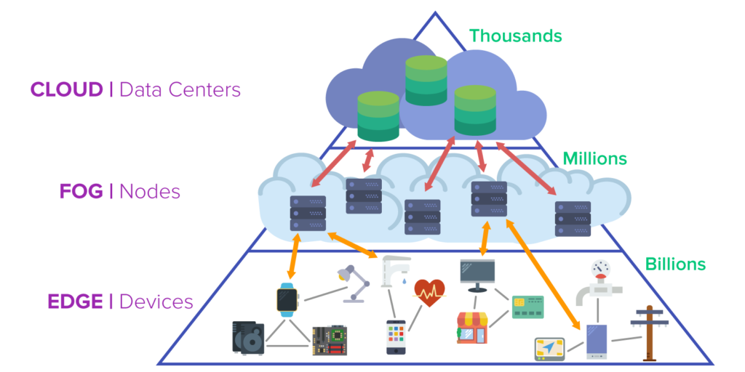
A step further: serverless across the edge-cloud continuum
What if we deploy and run serverless functions across the edge-cloud continuum?
Low-latency at the edge
Resource richness at higher layers, when needed
“A system-level architecture that distributes computing, storage, control, and networking along a cloud-to-things continuum. It places emphasis on overcoming the segregation of resources into tiers.”
Source: www.pubnub.com/blog/moving-the-cloud-to-the-edge-computing/
Nardelli et al., Compute Continuum: What Lies Ahead?, Euro-Par 2023 Workshops

Slide 7
A step further: serverless across the edge-cloud continuum
What if we deploy and run serverless functions across the edge-cloud continuum?
Low-latency at the edge
Resource richness at higher layers, when needed
But… methodologies, tools and platforms for serverless across the Edge-Cloud continuum still under development
Source: https://www.pubnub.com/blog/moving-the-cloud-to-the-edge-computing/

Slide 8
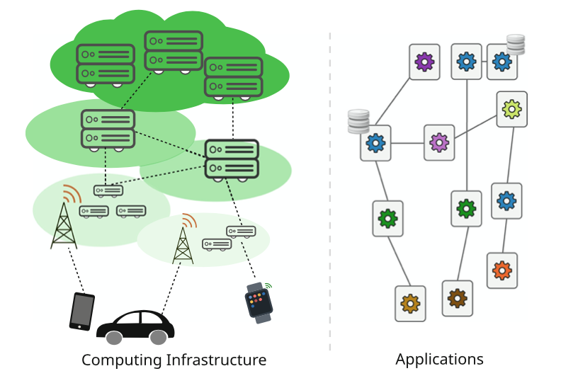
Edge-Cloud continuum: infrastructure and applications
Notes:
different types of applications deployed on decentralized computing resources
Edge intelligence

Slide 9
Key challenges of edge-cloud continuum
Infrastructure management
Require geographically distributed deployment and orchestration
Limited resources at the Edge (computation, energy, …)
Resource heterogeneity (e.g., hw accelerators)
Performance predictability
SLO/SLA-awareness
Security and privacy
Notes:
Increased complexity in infrastructure management
Dynamic environment
Workloads can highly fluctuate
Support for SLOs and execution guarantees, e.g., developer wants to specify that the inference model has a certain accuracy

Slide 10
Key challenges of edge-cloud continuum
... and serverless-specific issues:
Cold start
Container image caching
Stateful functions
Function composability
Complex workflows distributed over the Cloud and Edge layers
Russo Russo et al., Serverless Functions in the Cloud-Edge Continuum: Challenges and Opportunities, PDP 2023
Notes:
Deploy faster
Reloading images from remote storage can increase the data transmission rate and downgrade system performance
Big Players have addressed function composability by proposing their function orchestrators (e.g., Amazon Step Function, Microsoft Azure Durable Functions, and IBM Composer). However, these systems cannot be used everywhere because they are constrained at the providers’ data centers

Slide 11
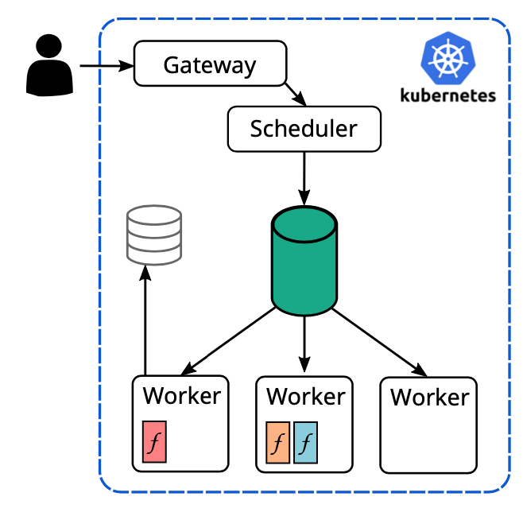
State of the art: frameworks
Popular and feature-rich FaaS frameworks, usually on top of Kubernetes
OpenWhisk, OpenFaaS, KNative, ...
Cloud-centric architecture with centralized design
Very limited support for SLO awareness
Main directions pursued to overcome limitations
Federating existing frameworks
Lightweight function isolation (microVMs, unikernels, Web Assembly)
Novel frameworks designed for the Continuum (decentralized architectures, offloading mechanisms, …)
Notes:
Include centralized scheduling and management components (e.g., the Controller in OpenWhisk, the Gateway in OpenFaaS). Both these frameworks rely on software containers for isolation.
Replacing software containers with lightweight runtime environments

Slide 12
State of the art: Scheduling and resource allocation
Efforts to efficiently run functions across the Continuum
Placement and scheduling requests to heterogeneous nodes
Mostly based on centralized schedulers
Offloading: vertical + horizontal
Various approaches (usually aiming at latency and/or cost optimization)
What about differentiated service classes?
Additional metrics?

Slide 13
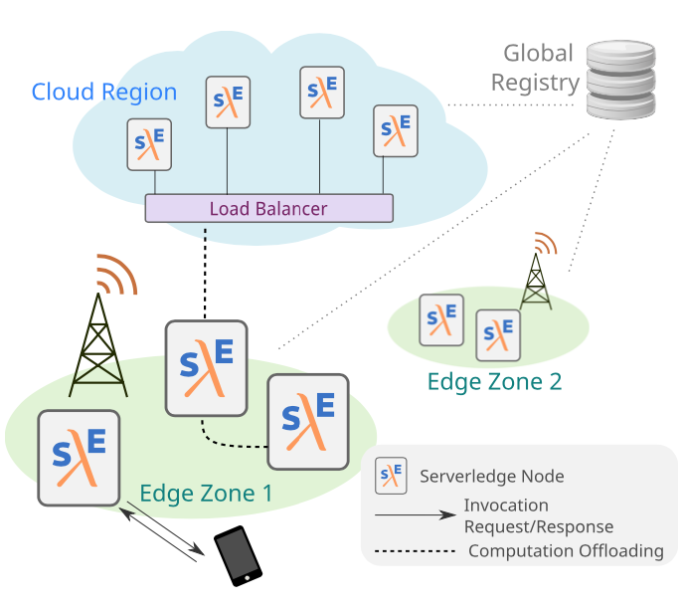
Our proposal: Serverledge
A FaaS framework designed for the Continuum
Nodes organized into Cloud regions and Edge zones
No centralized entry point!
(Replicated) Global Registry
Open source and “Artifact Evaluated” github.com/grussorusso/serverledge
Russo Russo et al., Serverledge: Decentralized function-as-a-service for the edge-cloud continuum, PerCom 2023
Russo Russo et al., A framework for offloading and migration of serverless functions in the Edge-Cloud Continuum, Pervasive Mob. Comput., 2024

Slide 14
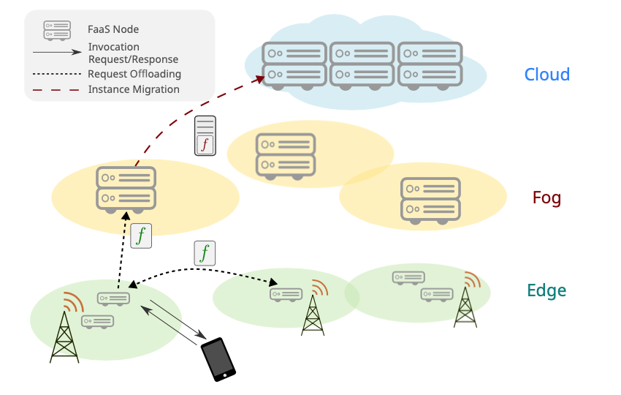
Serverledge: mechanisms and design choices
Key mechanisms and design choices in our vision:
Decentralized scheduling and resource allocation
Request offloading (both horizontal and vertical)
Live function migration
Admission control
Notes:
Each node is able to autonomously schedule and execute functions
Vertical: refers to execution requests being forwarded from Edge to Cloud nodes
Horizontal: indicates request offloading among Edge nodes

Slide 15
Serverledge: node architecture
Notes:
Global Registry: keeps information about registrered functions, including their code, and makes it available to the nodes as needed
Local Registry: acts as a local cache for information retrieved from the Global Registry
It is also responsible for storing information that we aim to collect and manage on the node, without propagating it at global level.
Monitoring + Vivaldi

Slide 16
Serverledge: journey of a request
Notes:
If local execution is not possible (either in a warm or newly created container), the Scheduler can drop the request, offload it to a remote node or push it to a local queue for future execution.
Synchronous invocation is the default behavior in Serverledge

Slide 17
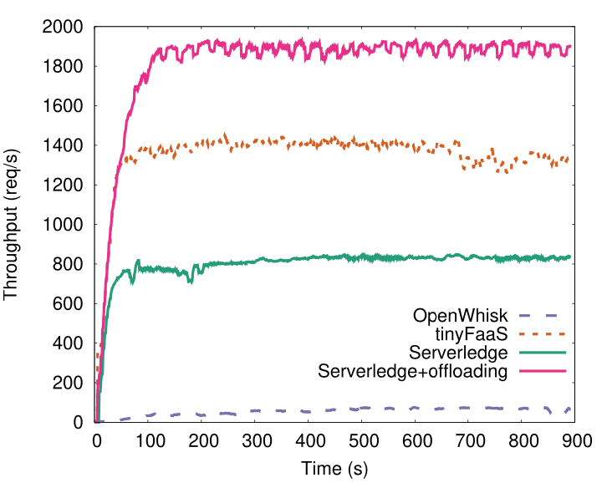
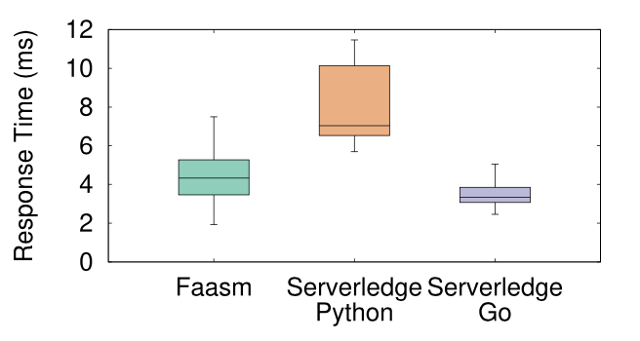
Serverledge: single-node performance
Much better than OpenWhisk
tinyFaaS has the highest throughput (thanks to relaxed isolation constraints!)
Serverledge can benefit from offloading

Slide 18
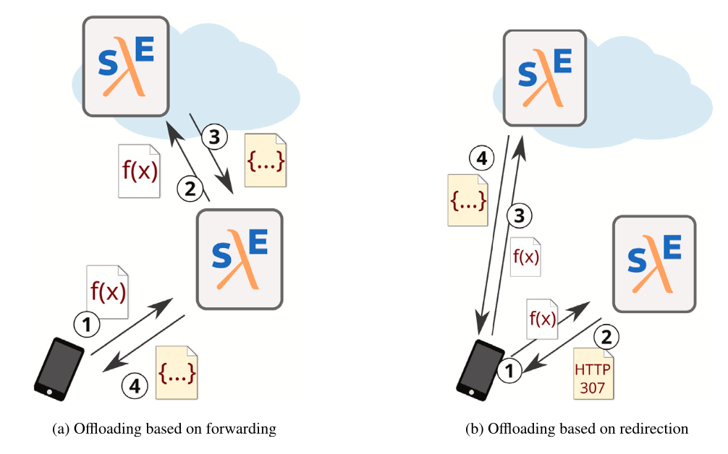
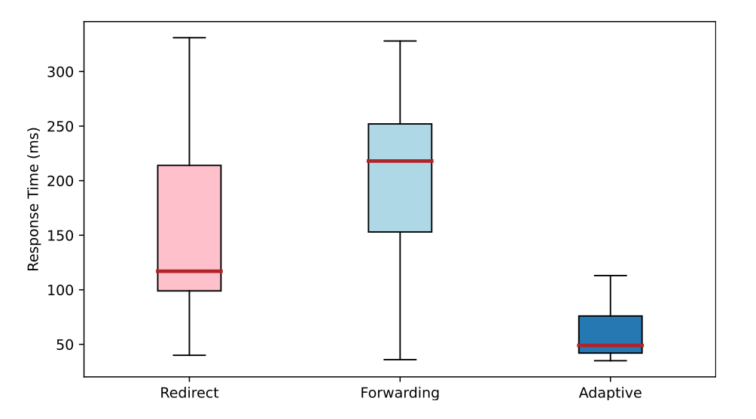
Serverledge: offloading mechanisms
Two different mechanisms for function offloading
Forwarding
Redirection
Automatically select the most suitable mechanism to use at run-time
Notes:
In case of offloading, the initial node may return the reply to the client or leave this responsibility to the remote node

Slide 19
Serverledge: scalability by means of offloading

Slide 20
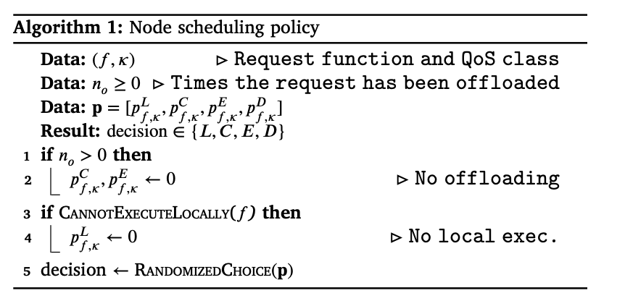
Serverledge: QoS-aware offloading policies
We propose a two-level approach, where
Serverledge nodes rely on a low-overhead randomized policy to schedule every incoming request according to a set of probability values
Periodically, a linear programming model is solved to determine the probabilities to use for scheduling
Actions
Local execution (L)
Offloading to Cloud (C)
Offloading to neighbor Edge node (E)
Discarding the request (D)
Russo Russo et al., QoS-aware offloading policies for serverless functions in the Cloud-to-Edge continuum, Future Gener. Comput. Syst., 2024

Slide 21
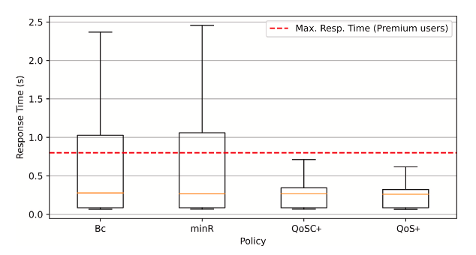
Serverledge: QoS-aware offloading policies
Offloading probabilities for each Serverledge node, function and service class determined by means of an efficient linear programming problem
Goal: maximize the expected utility generated by each node, accounting for constraints on resource capacity and monetary cost
Also taking into account cold start and limited memory capacity of nodes

Slide 22
Serverledge: energy-awareness
Heterogeneity and resource constraints of Edge-Cloud continuum
Existing scheduling and offloading approaches mostly consider performance- and cost-related metrics
How to provide energy-aware function execution and offloading over the Edge-Cloud continuum?
What about energy consumption?
Not easy to measure and predict!

Slide 23
Serverledge: energy-awareness
We extend Serverledge to integrate energy- related components and functionalities
Mechanism for run-time selection of function implementations to trade-off energy consumption with computation accuracy
Energy-aware policy to extend the lifespan of battery-powered Serverledge nodes, exploiting computational offloading and multiple function implementations
Calavaro et al., Towards Energy-Aware Execution and Offloading of Serverless Functions, Frame@HPDC 2024

Slide 24
Take-away
Serverless gets more challenging in the Continuum
Increasing interest from the research community and industry
Several open issues to work on
Including stateful functions, composition, specialization to AI inference/training
Serverledge can help researchers to evaluate new solutions

Slide 25
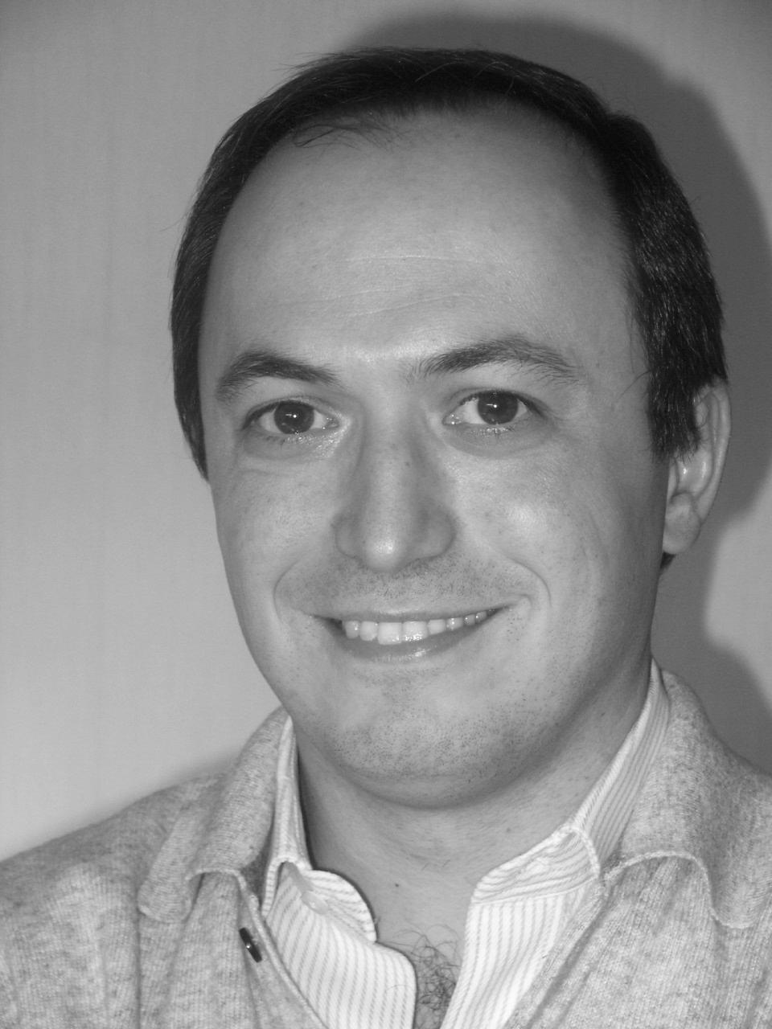
Acknowledgements – Co-authors
Plus Cecilia Calavaro and MSc students at Tor Vergata University: Daniele Ferrarelli, Tiziana Mannucci, Diana Pasquali, Martina Salvati
Thank you!
Valeria Cardellini
cardellini@ing.uniroma2.it
http://www.ce.uniroma2.it/~valeria
Gabriele Russo Russo
Francesco Lo Presti

