Slide 1
CHIRA 2026
The Challenges of Measuring UX
Some lessons from digital games
Professor Paul Cairns
University of York
paul.cairns@york.ac.uk

Slide 2
So many acronyms questionnaires
SUS, UMUX, NASA-TLX…
AttrakDiff, UEQ…
PXI, PENS, BANGS, GEngQ, GExpQ…
IEQ, CEGEQ, CORGIS, PUGS, CCPIG…

Slide 3
Measuring the Subjective
UX is central
UX is subjective
..and possibly sub/unconscious
Need questionnaires

Slide 4
Range of an experience
Questionnaire
Item 1
Item 2
Item 3
… | …

Slide 5
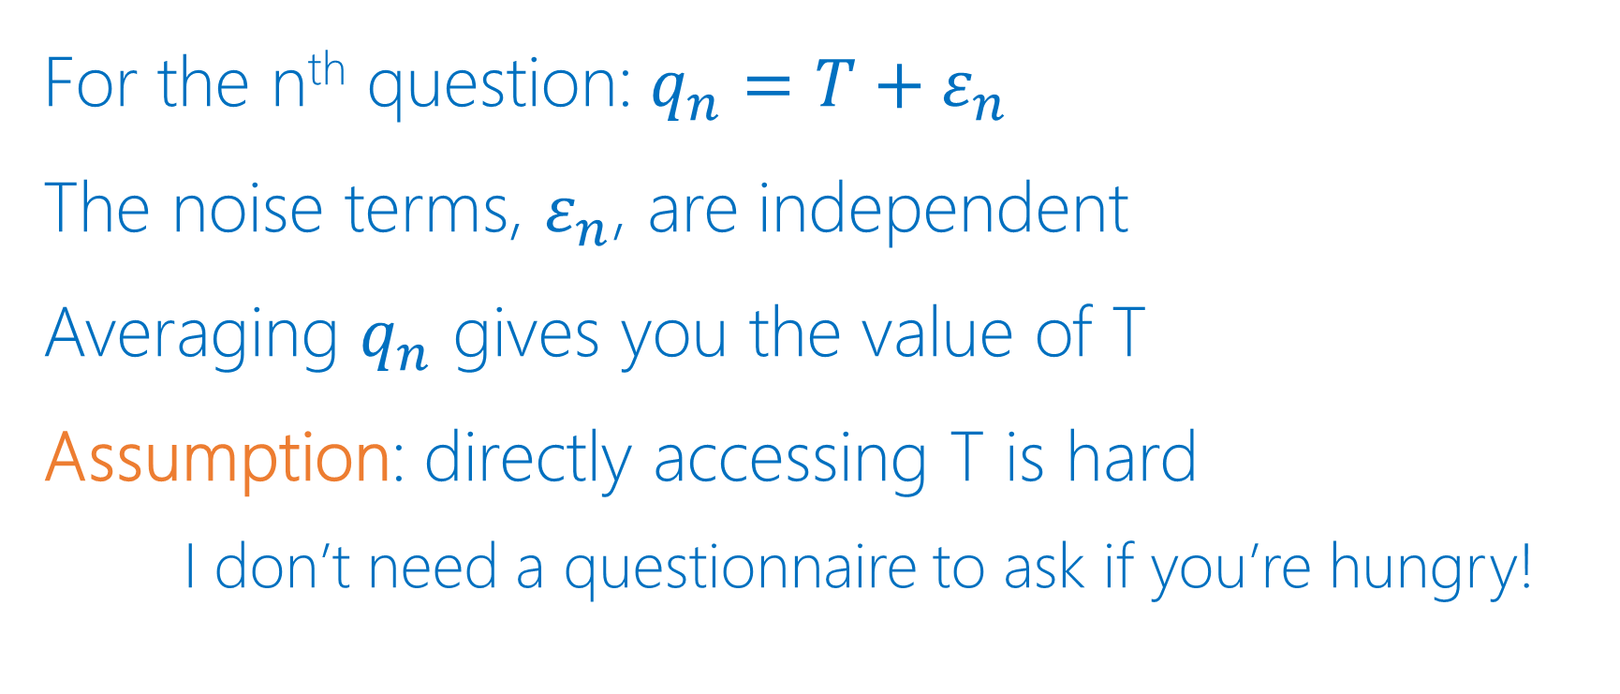
A little maths
For the n^{th} question:$q_{n}=T+ε_{n}$
The noise terms, $ε_{n}$, are independent
Averaging $q_{n}$ gives you the value of T
Assumption: directly accessing T is hard
    I don’t need a questionnaire to ask if you’re hungry!

Slide 6
But how do we know?
Process
    Devise plausible items
    Refine & Pilot
    Exploratory then Confirmatory Factor Analysis
    Reliability and fit
    Convergent & Discriminant Validity

Slide 7
But how do we know?
Process
    Devise plausible items
    Refine & Pilot
    Exploratory then Confirmatory Factor Analysis
    Fit & Reliability
    Discriminant & Convergent Validity

Slide 8
The challenge of factors

Slide 9

Immersion
“Lost in a game”
Cognitive experience
Intuitively understood
Brown & Cairns (2004) A grounded investigation of immersion in games

Slide 10
Scale and factors
IEQ: 31 items
  Real world dissociation
  Cognitive Involvement
  Emotional Involvement
  Control
  Challenge
Jennett et al (2008) Measuring & defining the experience of immersion…

Slide 11

Immersion changes with…
Screen size
Player perspective
Controllers
Time pressure
Other players…
Denisova & Cairns (2018) The placebo effect in digital games…

Slide 12
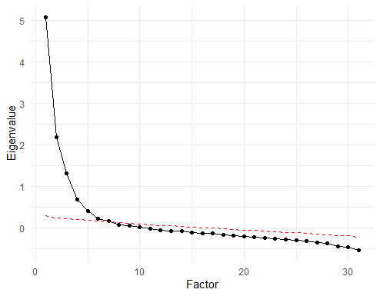
Revising the IEQ
Reduced to 11 items
Found 3 factors
    Involvement
    RWD
    Challenge
Cutting et al (2025) The development & validation of the IEQ-SF

Slide 13
One or three immersions?!
EFA | F1 | F2 | F3
Item 1 | 0.54 | 0.12 | 0.32
Item 2 | 0.43 | 0.06 | 0.16
Item 3 | 0.82 | 0.21 | 0.02
Item 4 | 0.32 | 0.73 | 0.14
Item 5 | 0.28 | 0.45 | 0.21
Item 6 | 0.13 | 0.28 | 0.67
…
CFA | F1 | F2 | F3
Item 1 | 0.65 | 0 | 0
Item 2 | 0.47 | 0 | 0
Item 3 | 0.81 | 0 | 0
Item 4 | 0 | 0.79 | 0
Item 5 | 0 | 0.44 | 0
Item 6 | 0 | 0 | 0.72
…

Slide 14
Bifactor Analysis
Bifactor | g | Inv | RWD | Ch
Item 1 | 0.79 | 0.11 | 0 | 0
Item 2 | 0.58 | 0.25 | 0 | 0
Item 3 | 0.63 | 0.4 | 0 | 0
Item 4 | 0.17 | 0 | 0.77 | 0
Item 5 | 0.41 | 0 | 0.42 | 0
Item 6 | 0.35 | 0 | 0 | 0.75
…

Slide 15
One immersion. Probably.
Unidimensional core
Explanatory facets
Core Immersion
RWD
Core Immersion
Inv
SJ Gould (1996) The mismeasure of man

Slide 16
The challenge of reliability

Slide 17
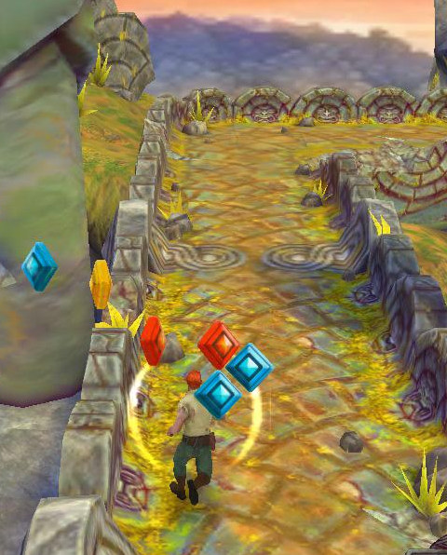
Forms of reliability
Test re-test
Inter-method
Internal consistency

Slide 18
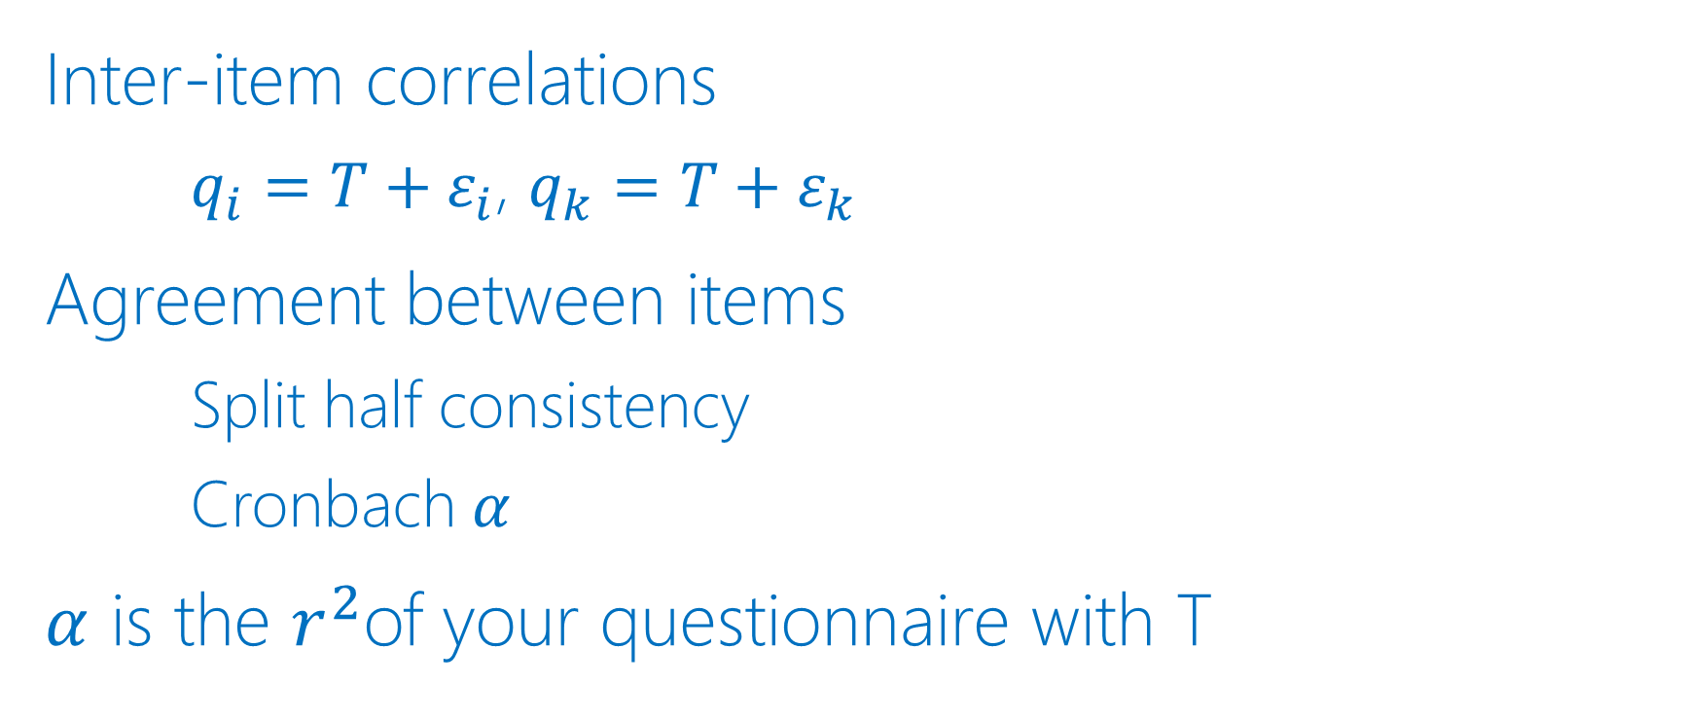
Internal consistency
Inter-item correlations
    $q_{i}=T+ε_{i}$, $q_{k}=T+ε_{k}$
Agreement between items
    Split half consistency
    Cronbach $α$
$α$ is the $r^{2}$of your questionnaire with T

Slide 19
Standard interpretation
<0.5 Unacceptable
>0.7 Acceptable
>0.8 Good
>0.9 Excellent!
But why? And what does that mean?
Nunally (1975) Psychometric Theory

Slide 20
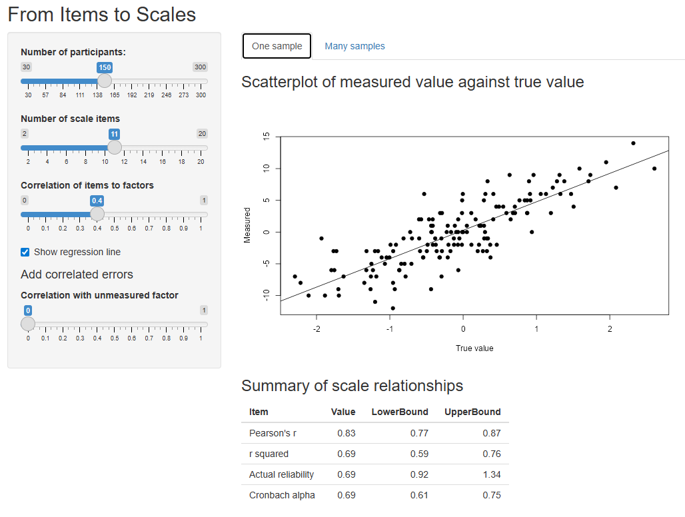

Slide 21
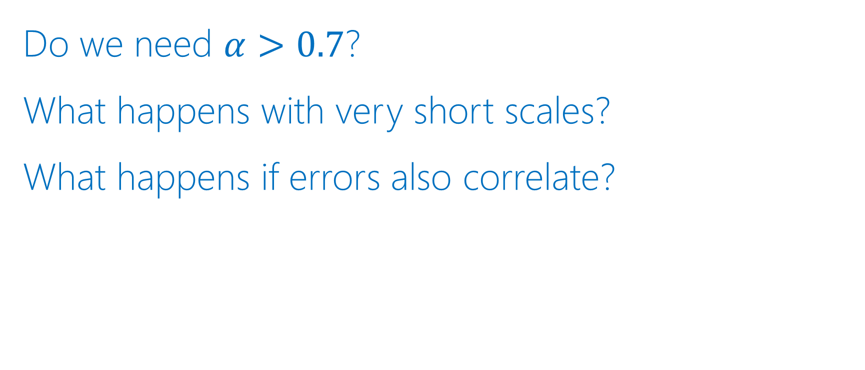
Questioning reliability
Do we need $α>0.7$?
What happens with very short scales?
What happens if errors also correlate?

Slide 22
The challenge of convergent validity

Slide 23
Immersion in Player Experience
Player Experience of Needs Satisfaction (PENS), 2006
    3 motivation factors including immersion
Game Engagement Questionnaire (GEQ), 2009
Player Experience Inventory (PXI), 2020
    10 factors including immersion
Denisova et al (2016) The convergence of player experience questionnaires

Slide 24
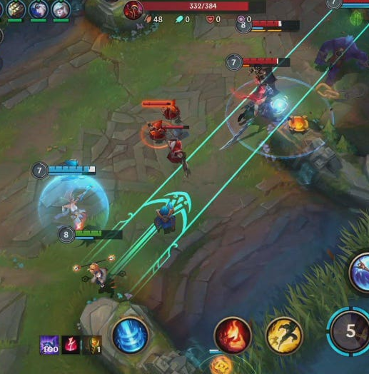
Immersion vs Immersion
League of Legends Players
Set of questionnaires…
… including PXI & IEQ-SF

Slide 25
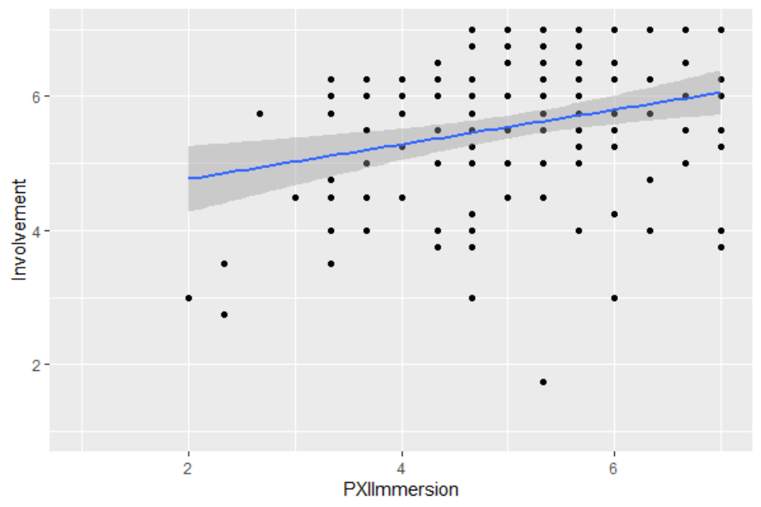
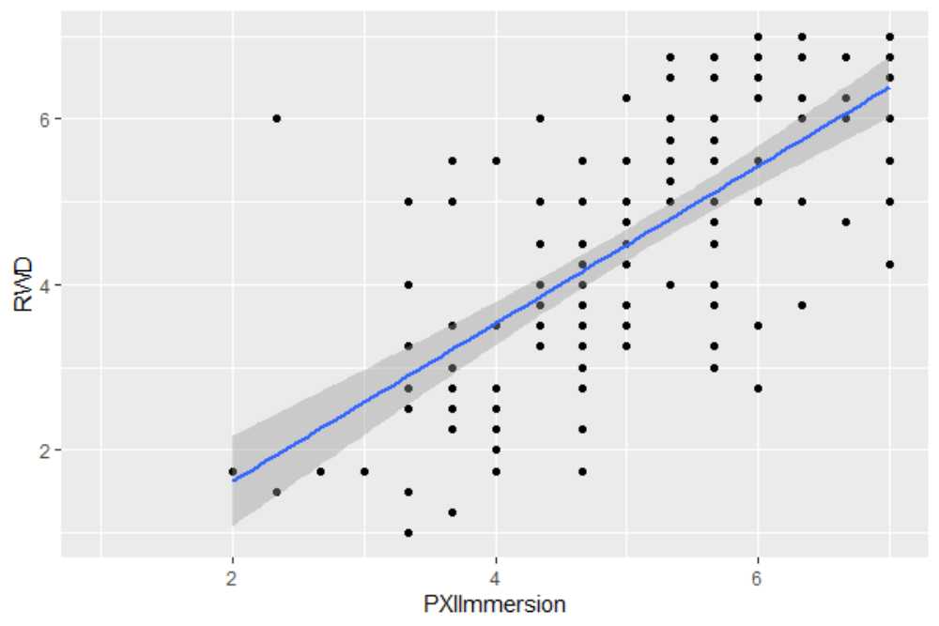
Same but different
Winter & Cairns (2026) The Jingle of Contrasting Constructs

Slide 26
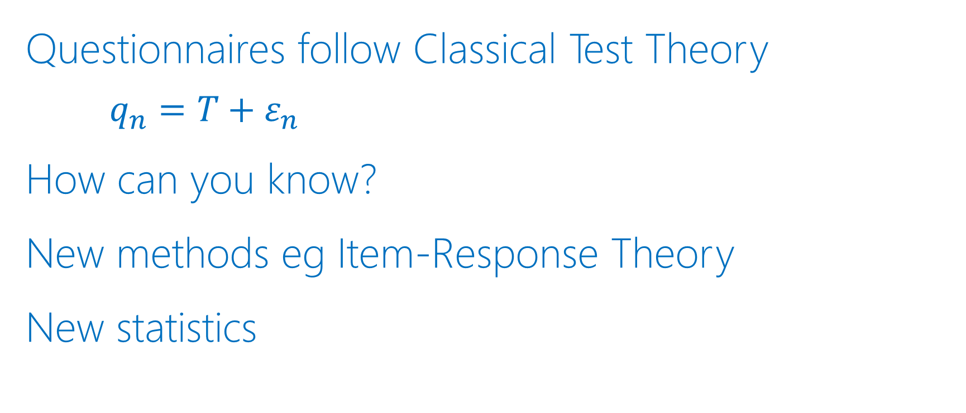
The really big assumption
Questionnaires follow Classical Test Theory
    $$q_{n}=T+ε_{n}$$
How can you know?
New methods eg Item-Response Theory
New statistics

Slide 27
So am I measuring immersion?
I believe so!
Is immersion real?
    We don’t have a guiding star
    It’s real because it works

Slide 28
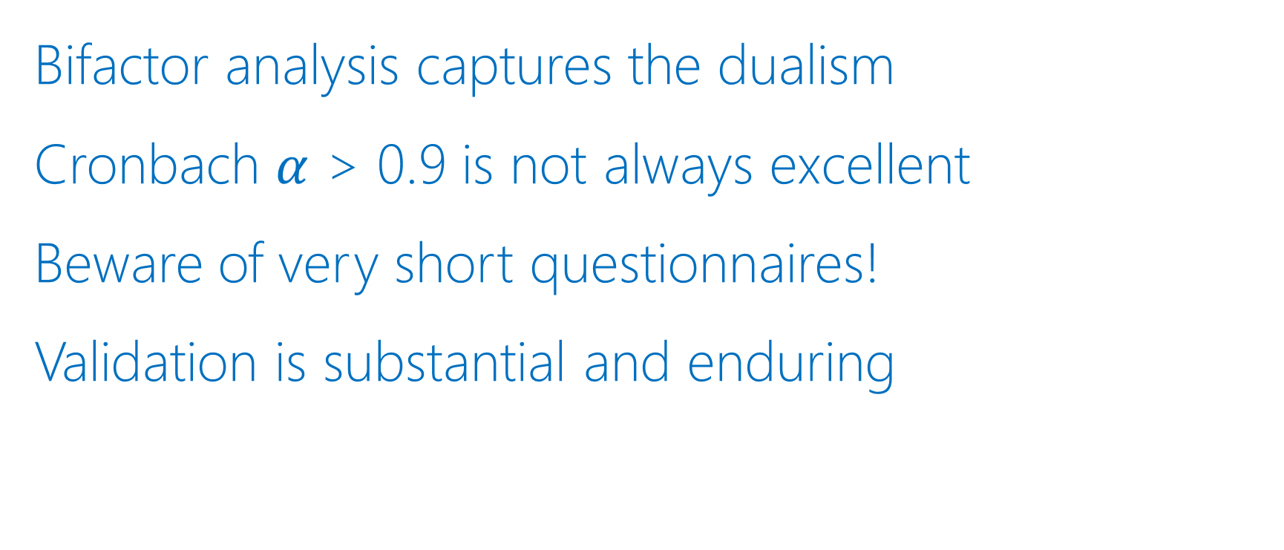
Conclusions
Bifactor analysis captures the dualism
Cronbach $α$ > 0.9 is not always excellent
Beware of very short questionnaires!
Validation is substantial and enduring

Slide 29
Thank you! Any questions?

Slide 30
Little bits of truth
Likert items:
“I lost track of time”
Strongly Disagree … Strongly Agree
Definitely not immersion
But it is a little bit of immersion

Slide 31

https://jwst.nasa.gov/

Slide 32

