Slide 1

AI in Medicine
March 4, 2026
Progress, Perils, and Perspectives
Prof. Tim Hahn Medical Machine Learning Lab, University of Münster, Germany

Slide 2

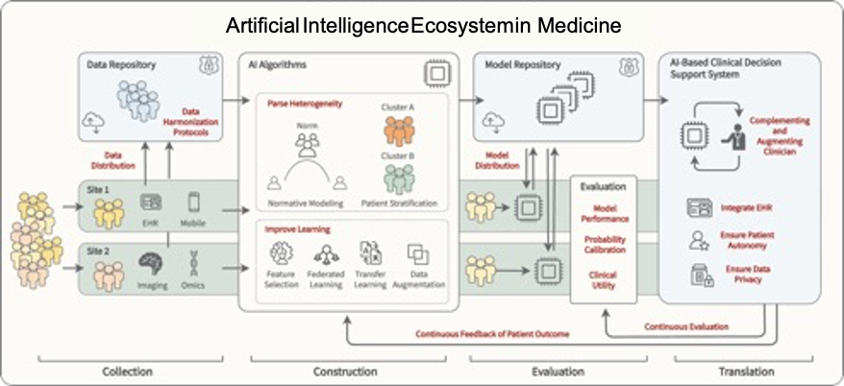
The Medical Machine Learning Lab
Medical Machine Learning Lab
AI Software Infrastructure (Development, Optimization & Evaluation)
Winter, … Hahn (2021) "From multivariate methods to an AI ecosystem." Molecular Psychiatry
Leenings… Hahn (2021) "PHOTONAI—A Python API for rapid machine learning model development." PLoS

Slide 3

The Medical Machine Learning Lab
Medical Machine Learning Lab
AI Software Infrastructure (Development, Optimization & Evaluation)
AI quality assurance & certification (generalization, model scope, bias, safety & security, risk profiles…)

Slide 4

The Medical Machine Learning Lab
[Text]
Medical Machine Learning Lab
AI Software Infrastructure (Development, Optimization & Evaluation)
AI quality assurance & certification (generalization, model scope, bias, safety & security, risk profiles…)
Machine Learning research and application

Slide 5
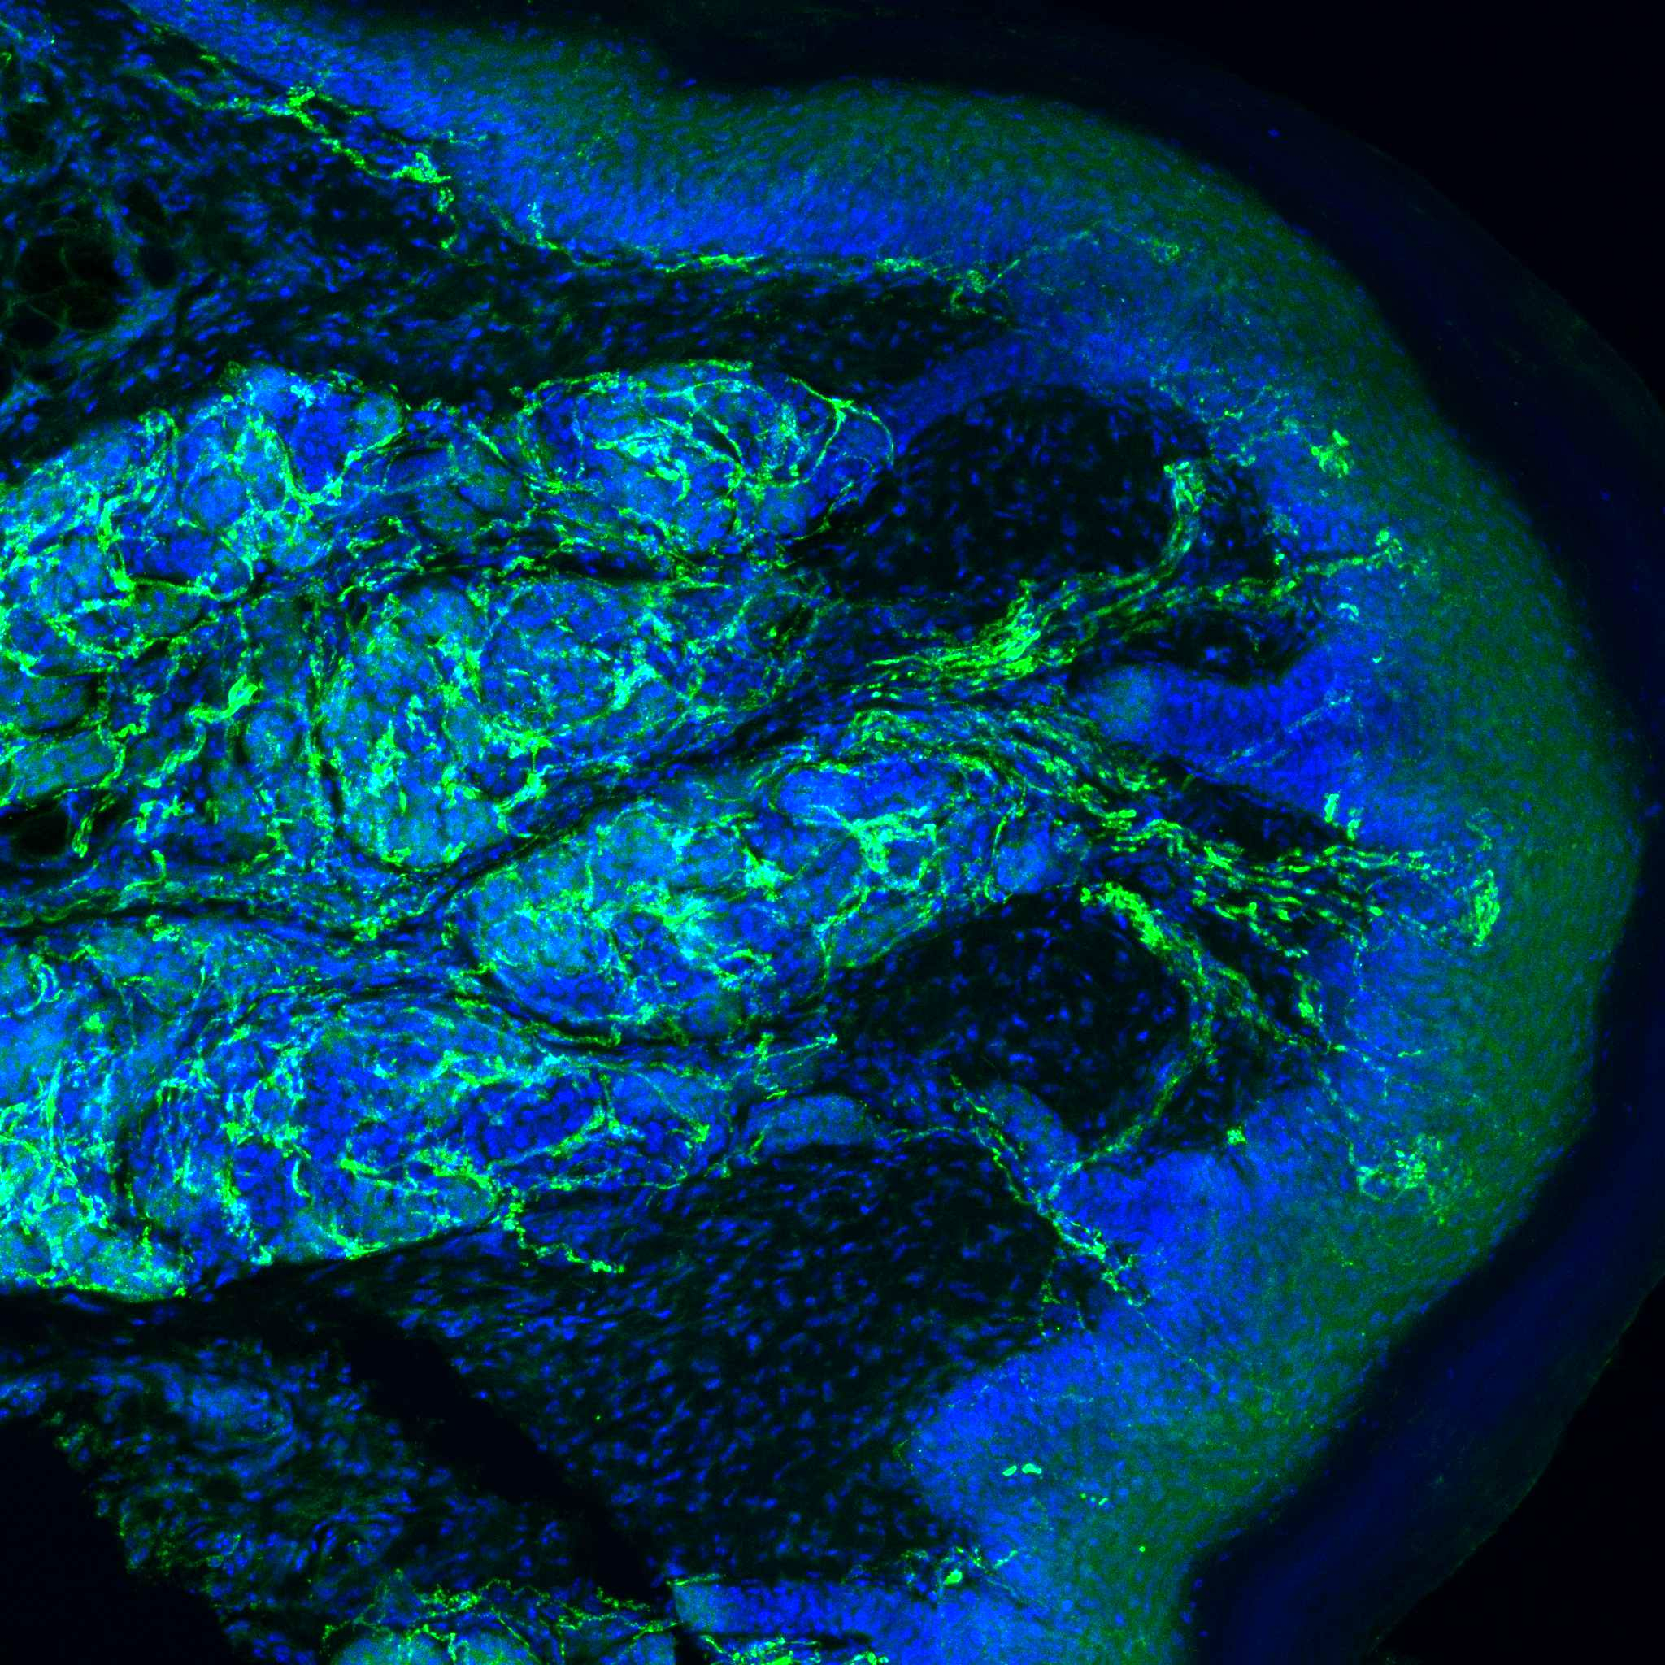
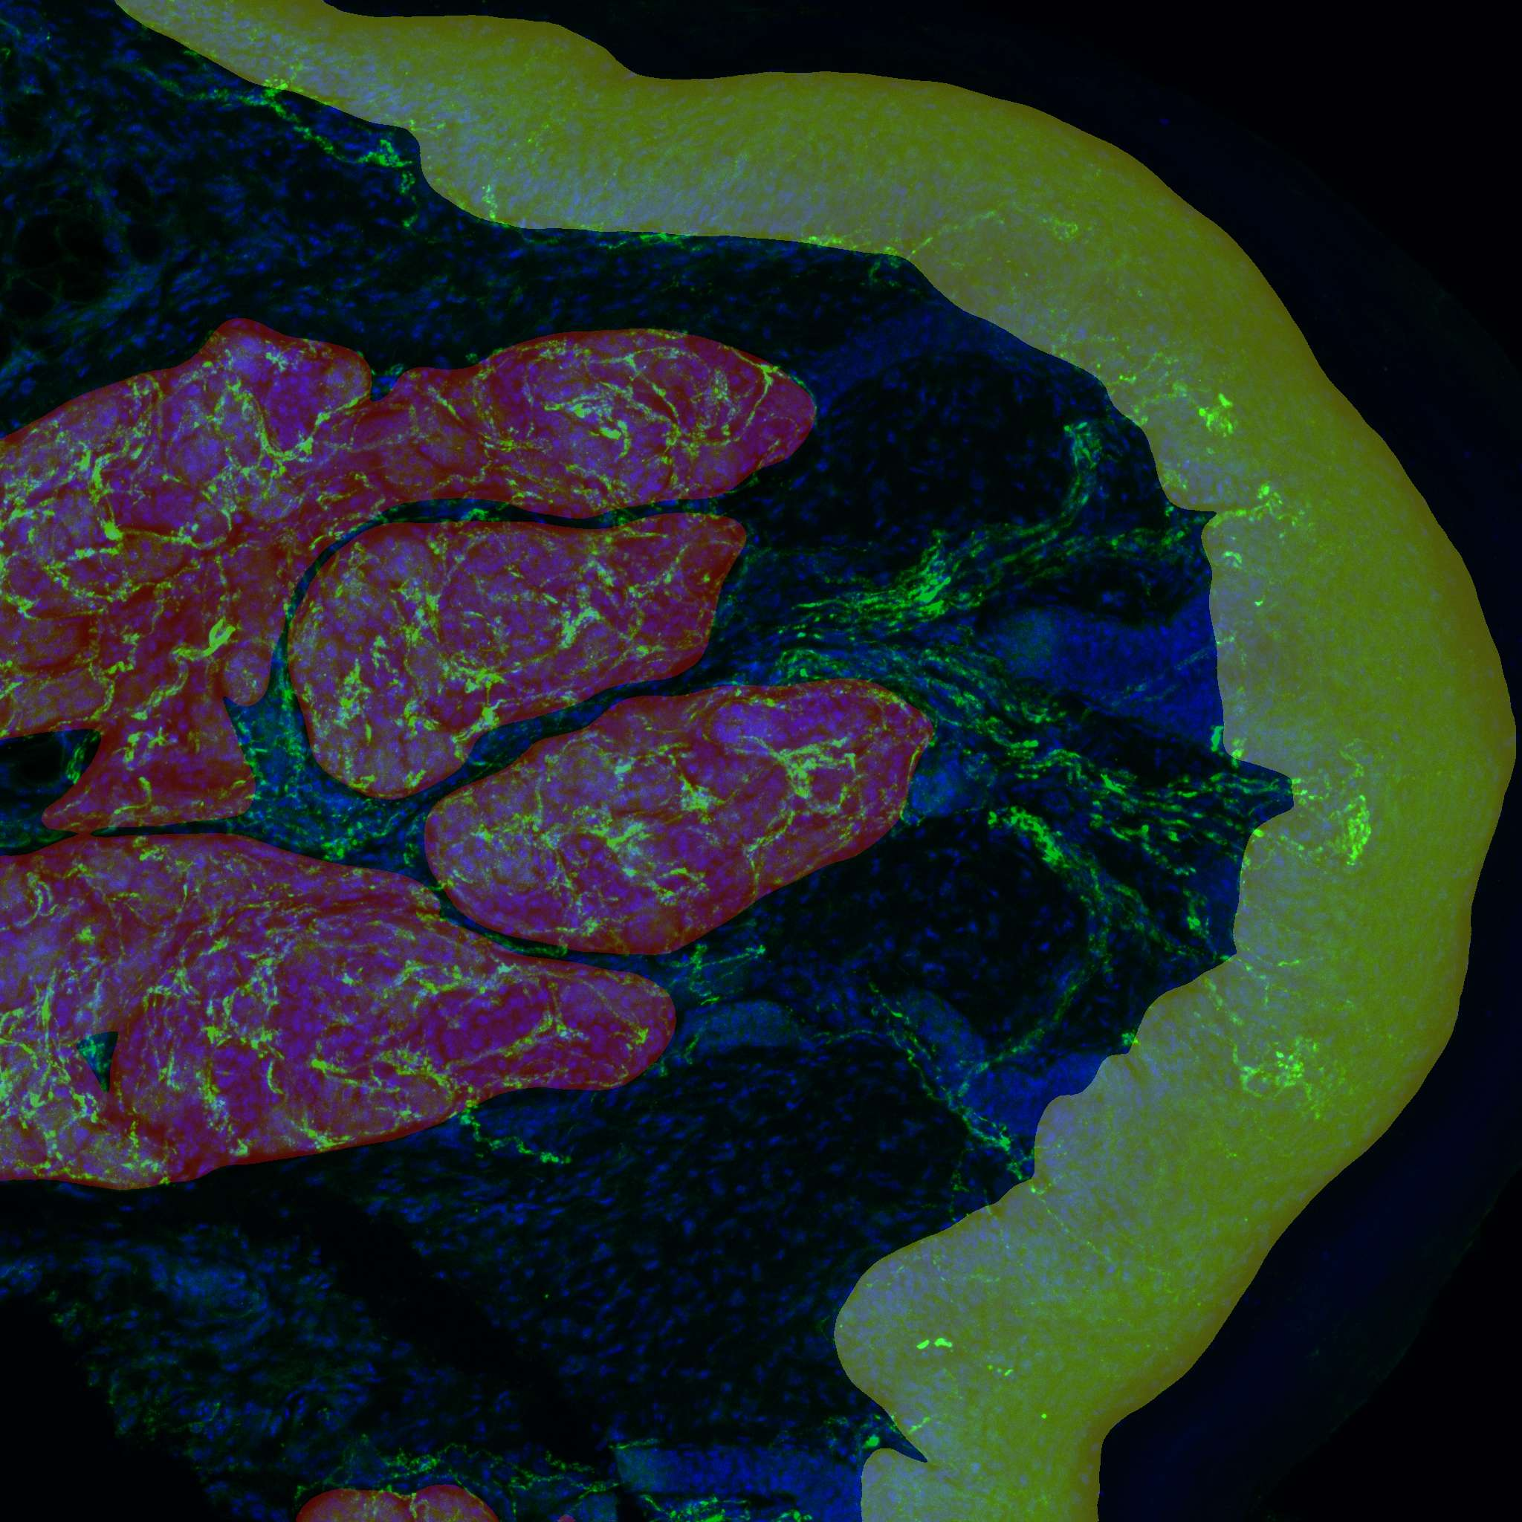
Projects (selection)
Quantification of nerve fibers (segmentation)

Slide 6
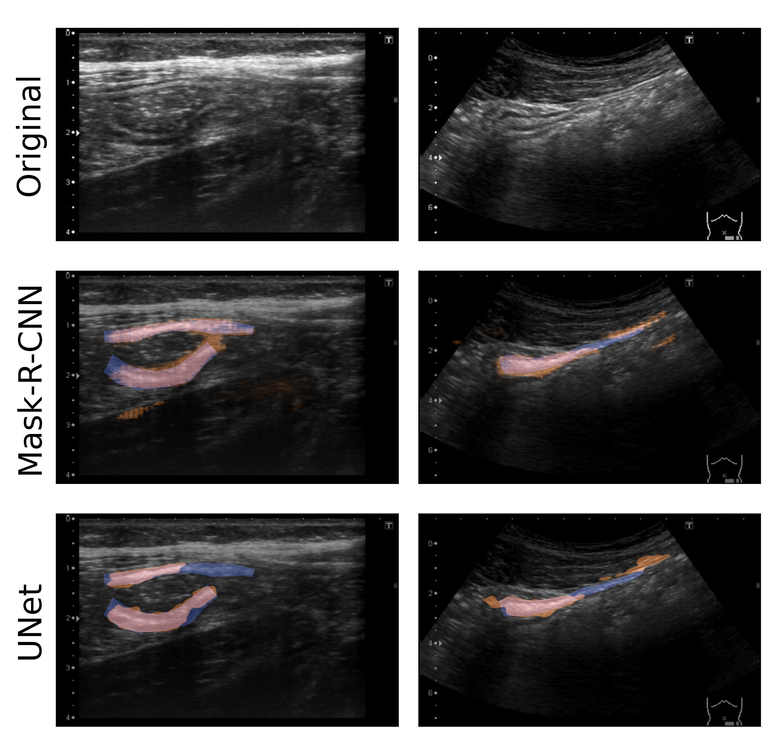
Projects (selection)
Quantification of nerve fibers (segmentation)
Ultrasound-based colon segmentation

Slide 7
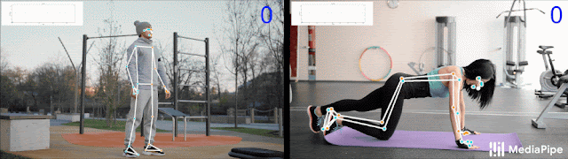
Projects (selection)
Quantification of nerve fibers (segmentation)
Ultrasound-based colon segmentation
Pre/post surgery motion quantification
https://ai.googleblog.com/2020/08/on-device-real-time-body-pose-tracking.html
https://developer.apple.com/videos/play/wwdc2020/10653/

Slide 8
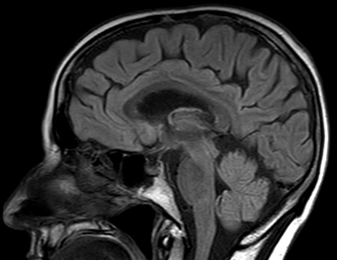
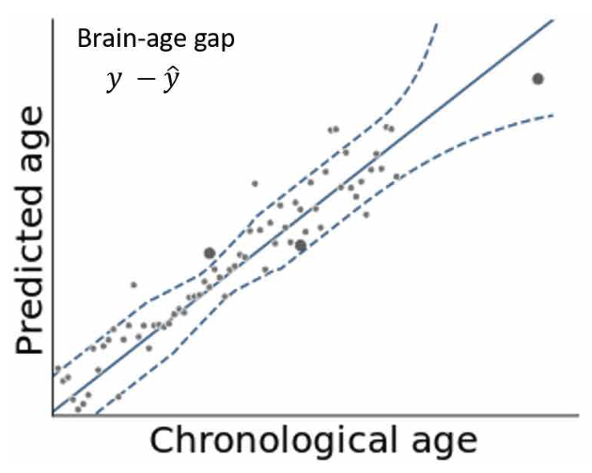
Projects (selection)
Quantification of nerve fibers (segmentation)
Ultrasound-based colon segmentation
Pre/post surgery motion quantification
Measurement of BrainAging

Slide 9
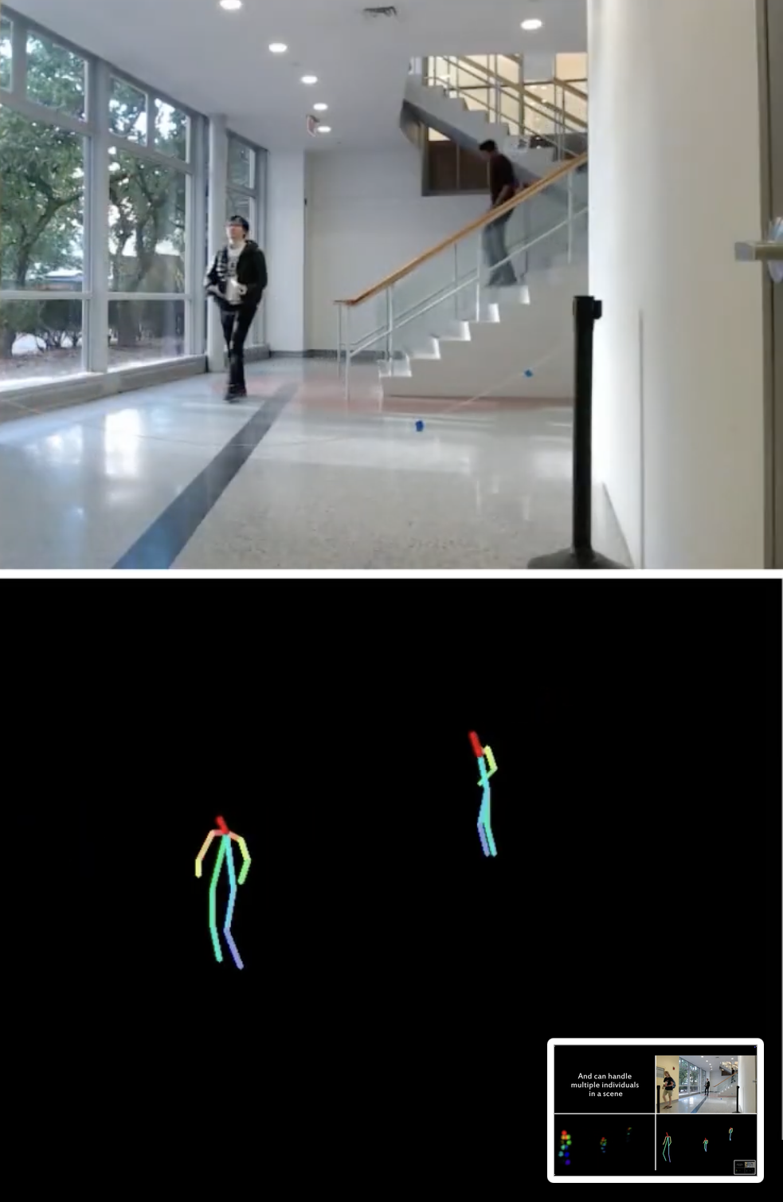
Projects (selection)
Quantification of nerve fibers (segmentation)
Ultrasound-based colon segmentation
Pre/post surgery motion quantification
Measurement of BrainAging
Pose Tracking with WiFI
https://www.youtube.com/watch?v=HgDdaMy8KNE&t=64s

Slide 10
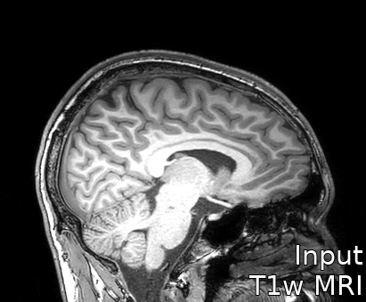
Projects (selection)
Quantification of nerve fibers (segmentation)
Ultrasound-based colon segmentation
Pre/post surgery motion quantification
Measurement of BrainAging
Pose Tracking with WiFI
Acceleration of MRI preprocessing

Slide 11
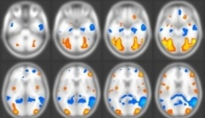
Towards Personalized Medicine
„We are drowning in information and starving for knowledge.“
- John Naisbitt
(Differential) Diagnosis
Personalized Therapy
Patient Management
Intervention Design
?
Data
Large-scale, multimodal datasets
Deep ecologically valid phenotyping
Winter, …, Hahn (2021) From multivariate methods to an AI ecosystem. Molecular Psychiatry
Hahn et al. (2017). The Emerging Field of Predictive Analytics in Mental Health. Molecular Psychiatry
Notes:
Medicine as a whole – and Psychiatry in particular – are at a pivotal point where we have to answer the question of how translate the massive and ever growing amounts of data pouring in from ever more high-throughput platforms and large-scale consortia around the world into practical improvements in clinical practice such as…

Slide 12
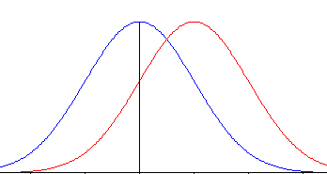
Towards Personalized Medicine
„We are drowning in information and starving for knowledge.“
- John Naisbitt
(Differential) Diagnosis
Personalized Therapy
Patient Management
Intervention Design
Group-level Inference
Data
Winter, … Hahn. (2022). More Alike than Different: Quantifying Deviations of Brain Structure and Function in Major Depressive Disorder across Neuroimaging Modalities. JAMA Psychiatry
Notes:
It is evident that classic group-level statistics has greatly contributed to this endeavor as it enables us to test hypothesis and falsify theories; thereby gaining insight into processes and mechanisms.
However, it does not easily lend itself to making predictions for individuals. Also, it does not usually consider the fact that mental disorders are inherently “multivariate” in nature. I.e. there is no single genetic variant or psychometric score, but the interesting information appears to be in the pattern of variables.

Slide 13
Group-Level Statistical Inference
Here, we tested differences in means in a fully harmonized cohort
N=861 chronically or currently depressed patients & N=948 healthy controls
Marburg-Münster Affective Cohort Study (MACS) has the same
Inclusion criteria
Psychometric assessment and structured clinical interviews
Neuroimaging sequences and protocolls
Quality control
Background regarding health care system etc.
MACS: Vogelbacher, … Hahn et al. The Marburg-Münster Affective Disorders Cohort Study (MACS): A quality assurance protocol for MR neuroimaging data. Neuroimage 2018; 172: 450–60.

Slide 14
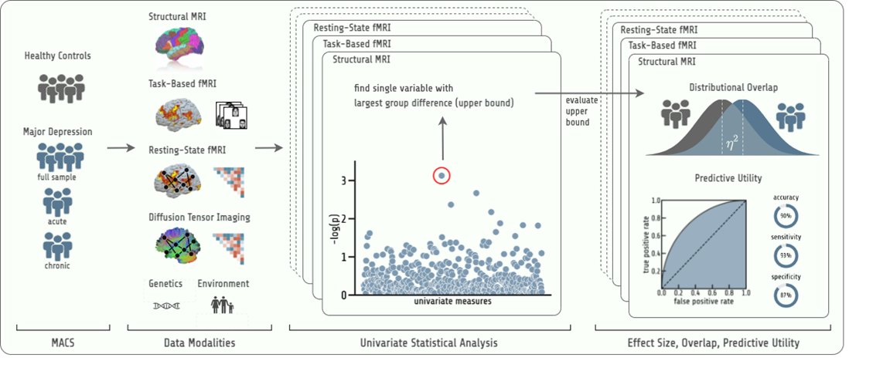
Group-Level Statistical Inference
Winter, … Hahn. (2022). More Alike than Different: Quantifying Deviations of Brain Structure and Function in Major Depressive Disorder across Neuroimaging Modalities. JAMA Psychiatryç

Slide 15
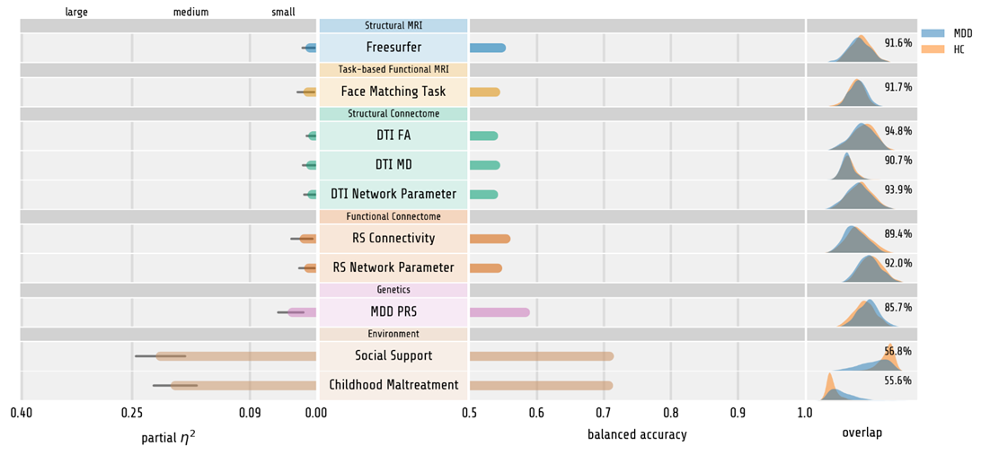
Group-Level Statistical Inference
Winter, … Hahn. (2022). More Alike than Different: Quantifying Deviations of Brain Structure and Function in Major Depressive Disorder across Neuroimaging Modalities. JAMA Psychiatryç

Slide 16
Group-Level Statistical Inference
Winter, … Hahn. (2022). More Alike than Different: Quantifying Deviations of Brain Structure and Function in Major Depressive Disorder across Neuroimaging Modalities. JAMA Psychiatryç
16

Slide 17
Towards Personalized Medicine
„We are drowning in information and starving for knowledge.“
- John Naisbitt
(Differential) Diagnosis
Personalized Therapy
Patient Management
Intervention Design
?
Group-level Inference
Single-subject prediction is necessary
Disorders are “multivariate”
”Replication Crisis”
Requires quantitative theory!
Data
Winter, … Hahn. (2022). More Alike than Different: Quantifying Deviations of Brain Structure and Function in Major Depressive Disorder across Neuroimaging Modalities. JAMA Psychiatry
Notes:
It is evident that classic group-level statistics has greatly contributed to this endeavor as it enables us to test hypothesis and falsify theories; thereby gaining insight into processes and mechanisms.
However, it does not easily lend itself to making predictions for individuals. Also, it does not usually consider the fact that mental disorders are inherently “multivariate” in nature. I.e. there is no single genetic variant or psychometric score, but the interesting information appears to be in the pattern of variables.

Slide 18
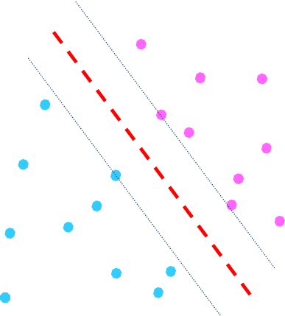
Towards Personalized Medicine
„We are drowning in information and starving for knowledge.“
- John Naisbitt
(Differential) Diagnosis
Personalized Therapy
Patient Management
Intervention Design
Machine Learning
single-subject prediction
multivariate pattern recognition
Built-in replication/validation
Potential for direct application
Group-level Inference
Data
Winter, … Hahn. (2023). Identifying Machine Learning-based Biomarkers for Major Depressive Disorder across Neuroimaging Modalities. JAMA Psychiatry
Winter, …, Hahn (2021) From multivariate methods to an AI ecosystem. Molecular Psychiatry
Hahn et al. (2017). The Emerging Field of Predictive Analytics in Mental Health. Molecular Psychiatry
Notes:
It is approaches from machine learning, artificial intelligence, and statistical learning which close this gap and can provide direct translational potential.
Usually, I would now showcase our recent studies and depict the technological advances.

Slide 19
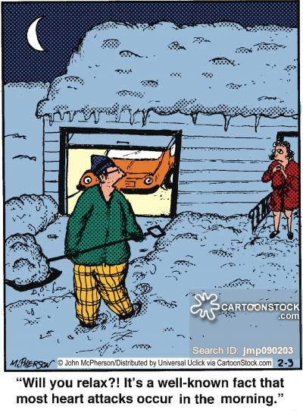
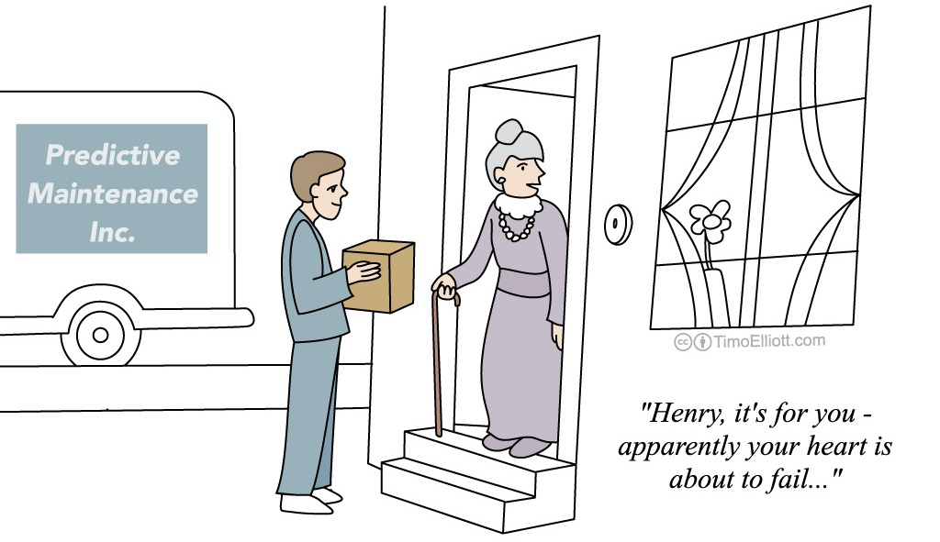
From group-level inference to single-subject prediction
„Will you relax?! It’s a well-known fact that most heart attacks occur in the morning.“
„Henry, it’s for you - apparently your heart is about to fail…“
https://s3.amazonaws.com/lowres.cartoonstock.com/medical-heart_attack-wives_tale-cardio-cardiologist-increased_risk-jmp090203_low.jpg
http://timoelliott.com/blog/2014/01/cartoon-predictive-health-analytics.html

Slide 20
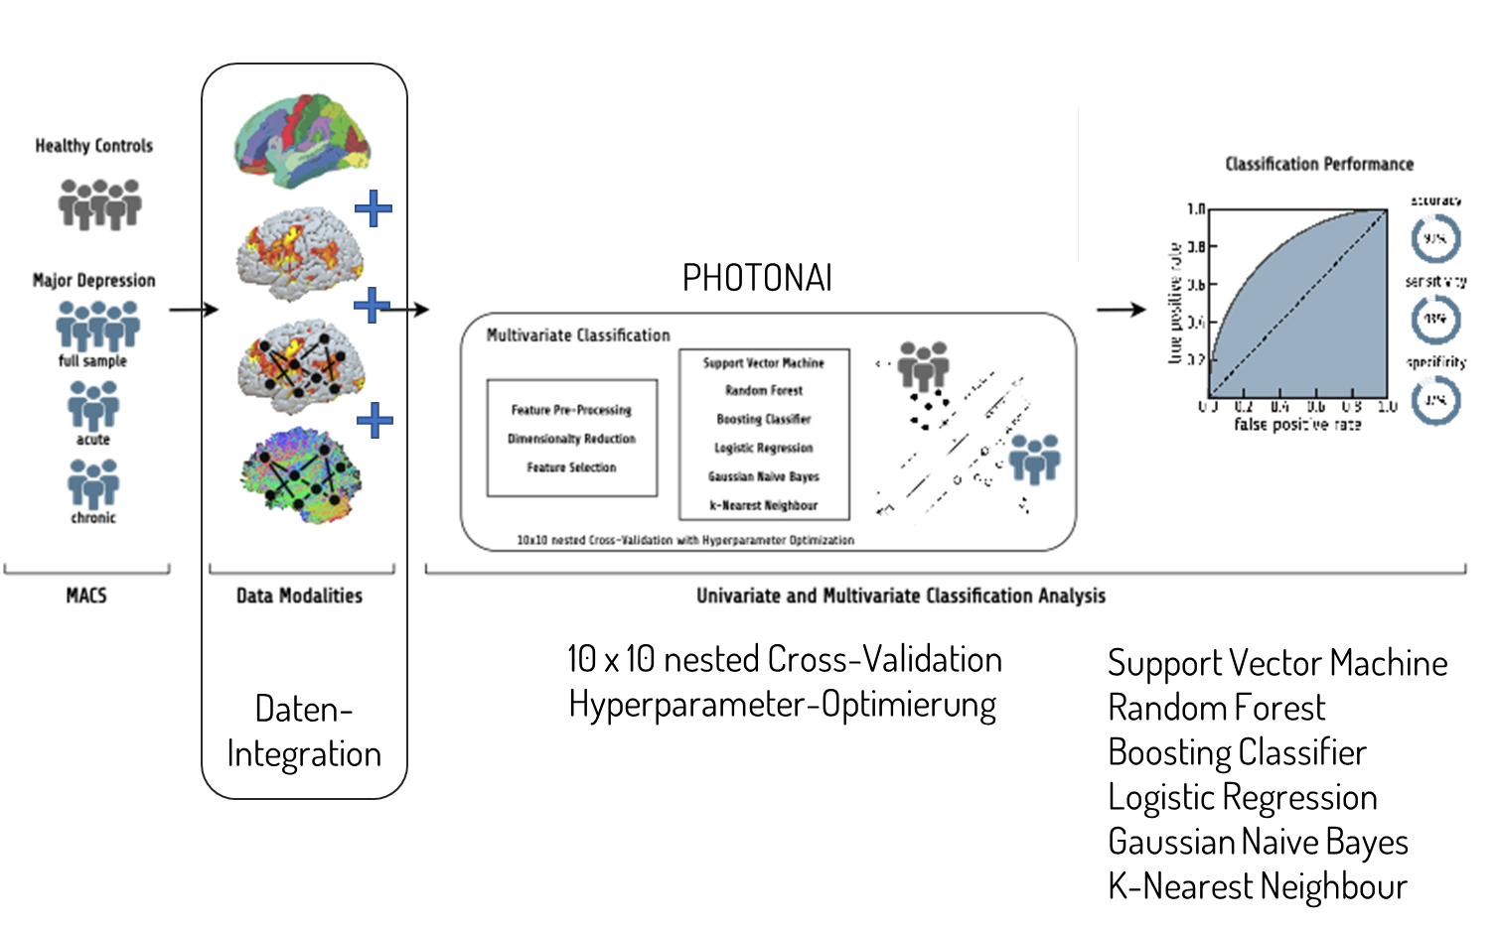


Towards Personalized Medicine
Does multivariate Machine Learning for biomarker identification change the picture?
Single-subject prediction instead of group-level differences
Enables multimodal data integration
1.12 million Machine Learning models trained and tested
Winter, … Hahn. (2023). Identifying Machine Learning-based Biomarkers for Major Depressive Disorder across Neuroimaging Modalities. JAMA Psychiatry
Notes:
280 configs x 8 modalities x 5 samples
1,120,000 Machine Learning models trained

Slide 21
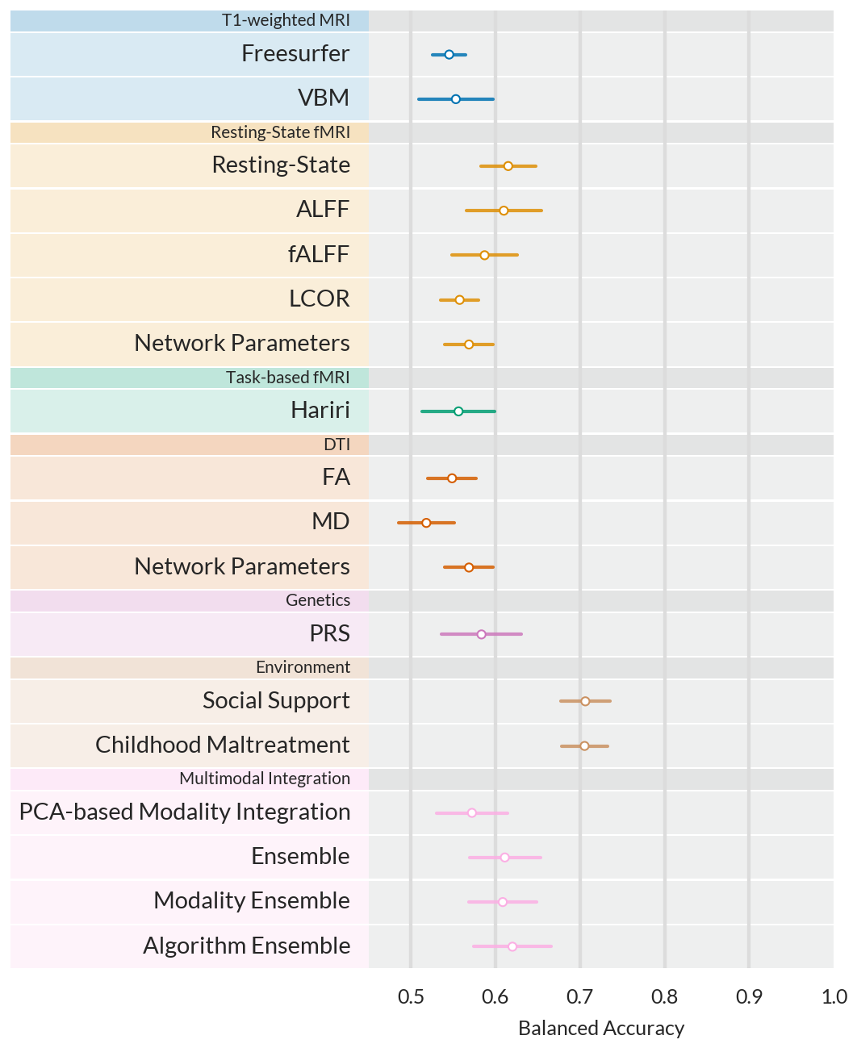
Towards Personalized Medicine
Winter, … Hahn. (2023). Identifying Machine Learning-based Biomarkers for Major Depressive Disorder across Neuroimaging Modalities. JAMA Psychiatry

Slide 22
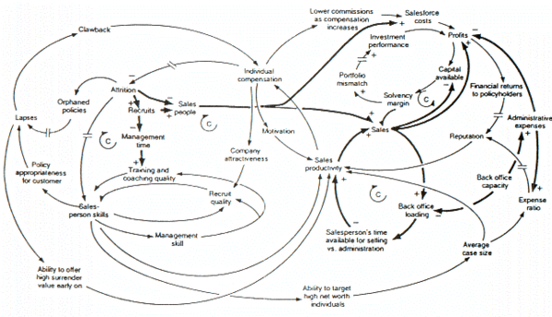
Towards Personalized Medicine
„We are drowning in information and starving for knowledge.“
- John Naisbitt
Prescriptive Models
(Differential) Diagnosis
Personalized Therapy
Patient Management
Intervention Design
Machine Learning
Principled intervention design
Dynamical System models
Group-level Inference
Data
Stocker, … Hahn et al. Formalizing psychological interventions through network control theory. Scientific Reports 13.1 (2023): 13830.
Stocker, … Hahn et al. Formalizing psychological interventions through network control theory. Scientific Reports 13.1 (2023): 13830.
Notes:
It is approaches from machine learning, artificial intelligence, and statistical learning which close this gap and can provide direct translational potential.
Usually, I would now showcase our recent studies and depict the technological advances.

Slide 23

From Prediction to Control
http://gif-finder.com/wp-content/uploads/
2014/12/Domino-Chain-Reaction.gif
http://timoelliott.com/blog/2014/01/cartoon-predictive-health-analytics.html
http://gif-finder.com/wp-content/uploads/2014/12/Domino-Chain-Reaction.gif

Slide 24
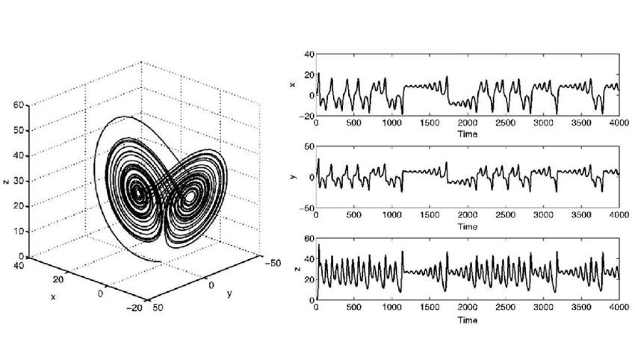
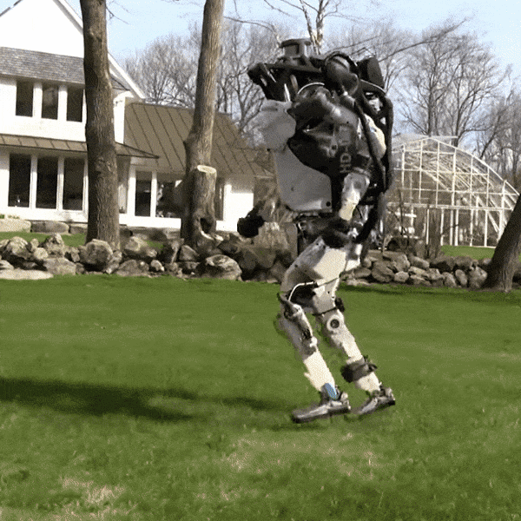
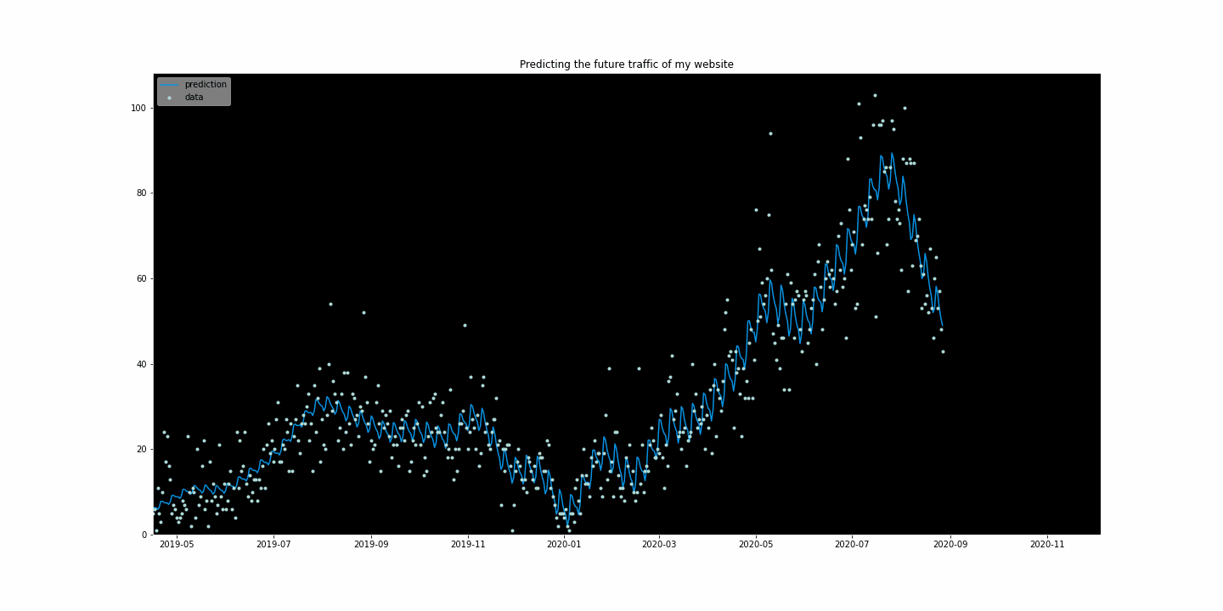
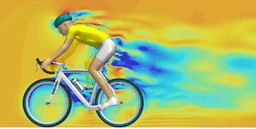
From Prediction to Understanding Dynamical Systems
The Dynamical Systems View
Initial state evolves over time according to a fixed rule
If we new this rule, we could
Predict future states of the system
Simulate the system (Digital Twins)
Control the system to achieve desired outcomes
https://towardsdatascience.com/forecasting-web-traffic-with-python-and-google-analytics-fb066659ae8f
https://makeagif.com/gif/cfd-simulation-of-a-pedaling-cyclist-0Ge2cw
https://www.nbcnews.com/mach/science/boston-dynamics-atlas-robot-goes-run-burbs-ncna873381

Slide 25
From Prediction to Understanding Dynamical Systems
Applying the Dynamical Systems View in Mental Health research
Model the energy landscape of symptom dynamics to predict future symptom severity
Analyze control dynamics to optimize Electroconvulsive Therapy (ECT)
Controlling the Neural Dynamics of Perception

Slide 26
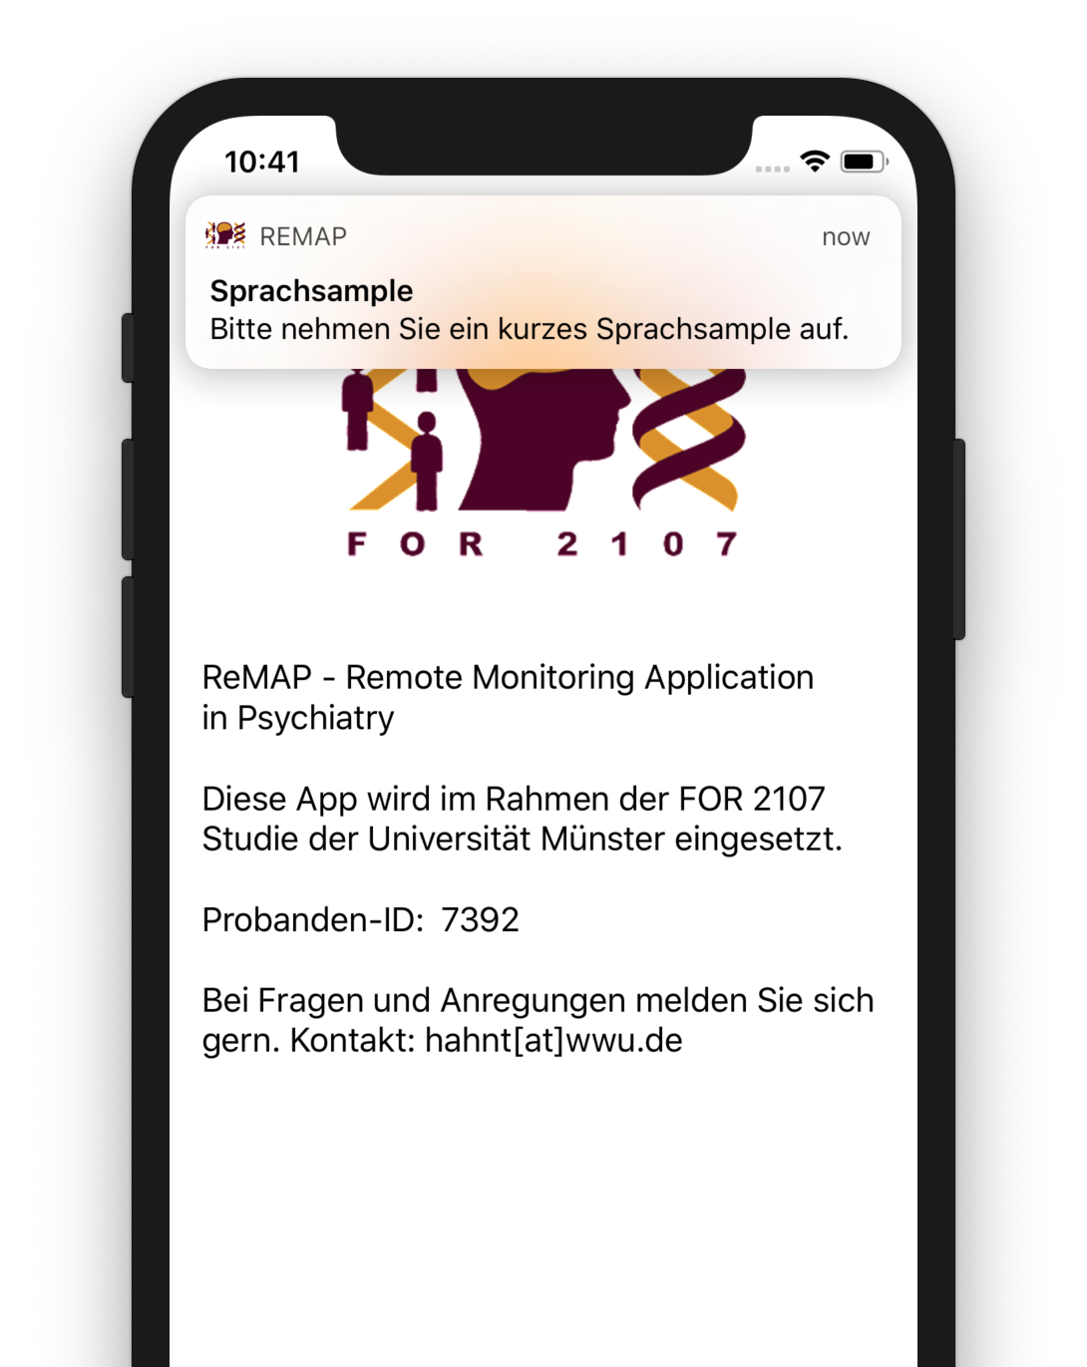
Longitudinal Symptom Dynamics modeling
Passive data acquisition
Number of steps, distance walked
Geolocation (GPS)
Acceleration (continous, 3d)
Active measurements (optional, weekly)
Voice samples
Affect
Sleep duration
Beck Depression Inventory (bi-weekly)
N~1,000 enrolled since December 2019
> 3 million events so far
Goltermann, … Hahn, Opel. (2021) Smartphone-Based Self-Reports of Depressive Symptoms Using the Remote Monitoring Application in Psychiatry (ReMAP). JMIR mental health
Emden, …, Hahn, Opel. (2021) Technical feasibility and adherence of the Remote Monitoring Application in Psychiatry (ReMAP) for the assessment of affective symptoms. Journal of Affective Disorders

Slide 27
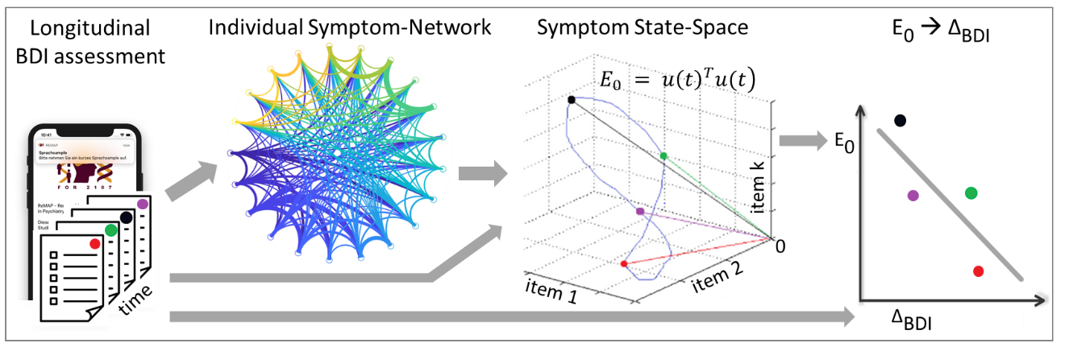
Longitudinal Symptom Dynamics modeling
Does the energy required to move to a “no symptoms” at t1 predict symptom change at t2
Hahn, Jamalabadi et al. "A Network Control Theory Approach to Longitudinal Symptom Dynamics in Major Depressive Disorder." (in preparation).

Slide 28
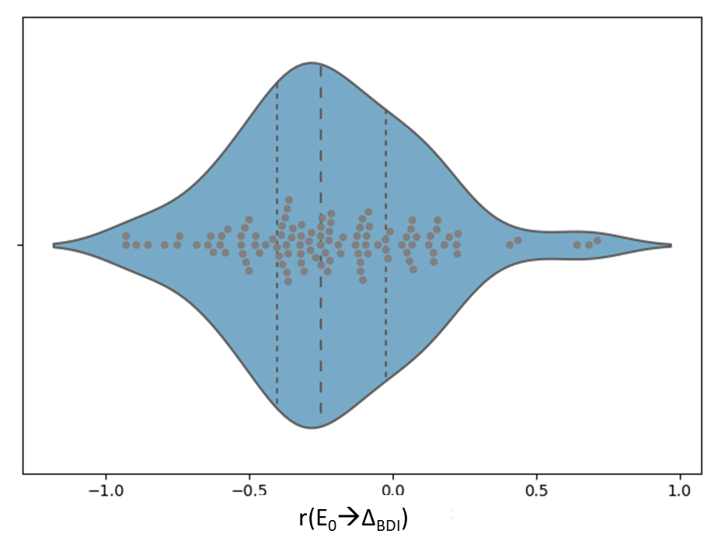
Longitudinal Symptom Dynamics modeling
E₀ was indeed negatively associated with symptom change at the next time point
mean Spearman r(107)=-0.26; 95% CI [-.40 – -.10]; p=0.003; one-tailed
higher theoretical energy required to reach a symptom-free state is associated with less improvement (or worsening) at the next measurement
But, high variability of this association
Hahn, Jamalabadi et al. "A Network Control Theory Approach to Longitudinal Symptom Dynamics in Major Depressive Disorder." (in preparation).

Slide 29
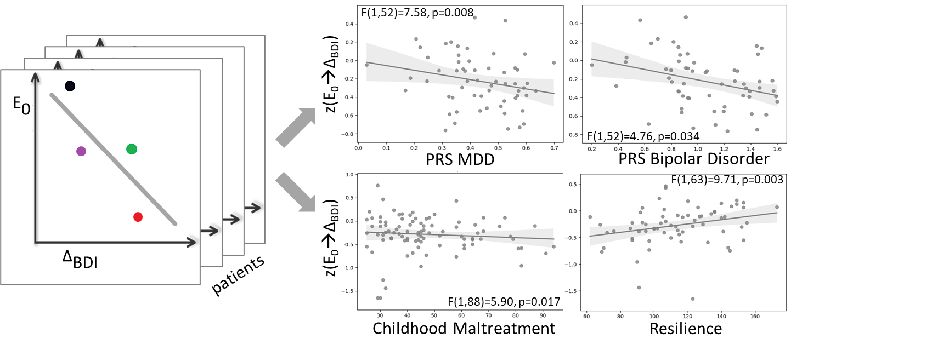
Longitudinal Symptom Dynamics modeling
Can this inter-individual variance in the association be explained by
Genetics
Environmental risks (childhood maltreatment)
Resilience
Hahn, Jamalabadi et al. "A Network Control Theory Approach to Longitudinal Symptom Dynamics in Major Depressive Disorder." (in preparation).

Slide 30
From Prediction to Understanding Dynamical Systems
Applying the Dynamical Systems View in Mental Health research
Model the energy landscape of symptom dynamics to predict future symptom severity
Analyze control dynamics to optimize Electroconvulsive Therapy (ECT)
Controlling the Neural Dynamics of Perception

Slide 31
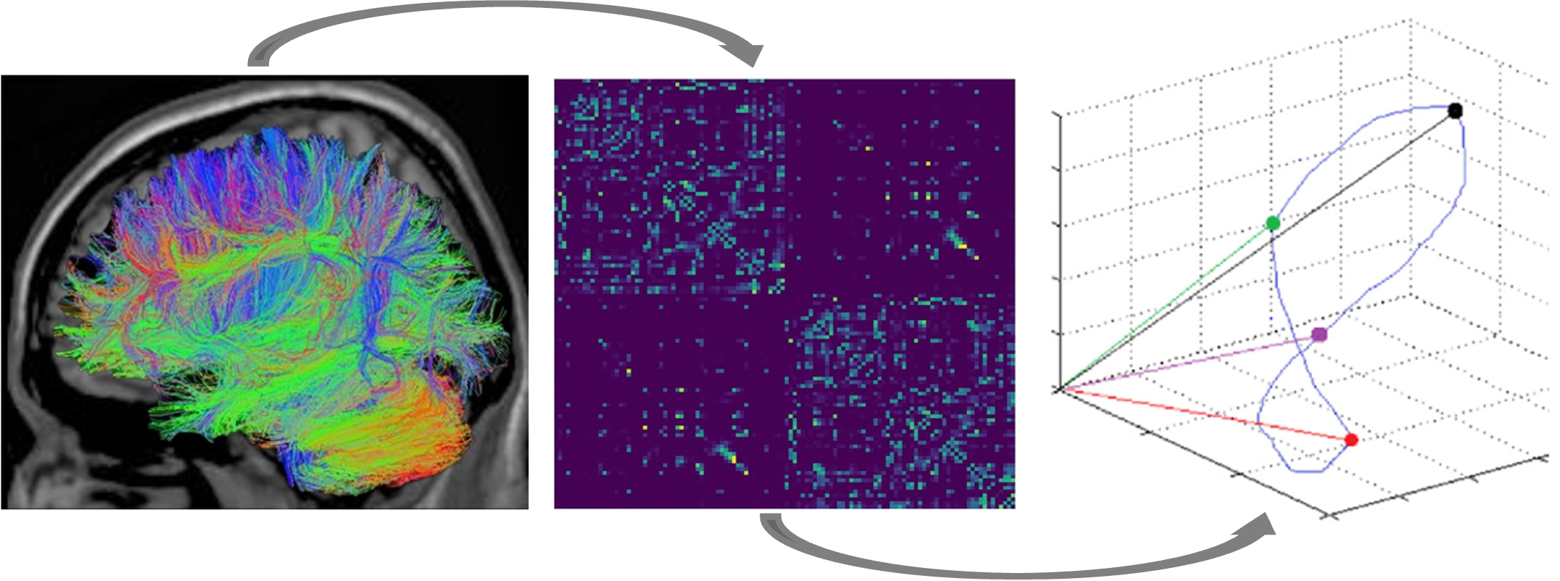
Theory-driven theranostic markers for ECT response
Electroconvulsive Therapy (ECT) is the most effective treatment for therapy-resistant depression.
Response greatly varies between patients.
Can we use Control Theory (modal & average controllability) to predict ECT response (difference in Hamilton Depression Rating Scale; HDRS)?
Hahn, Jamalabadi … Repple. (2023) "Towards a Network Control Theory of Electroconvulsive Therapy Response" PNAS Nexus. Hahn, …. Repple. (2023) "Genetic, Individual, and Familial Risk Correlates of Brain Network Controllability in Major Depressive Disorder." Mol. Psychiatry.
Notes:
Electroconvulsive Therapy (ECT) is the most effective treatment for therapy-resistant depression.
However, response greatly varies between patients.
How to predict therapeutic response?
One predictive study from our lab. No theory.
However, we can measure Postictal Suppression Index (PSI) which has been shown to be associated with ECT response

Slide 32
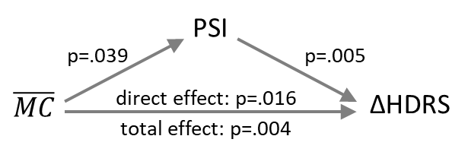
Theory-driven theranostic markers for ECT response
Electroconvulsive Therapy (ECT) is the most effective treatment for therapy-resistant depression.
Response greatly varies between patients.
Can we use Control Theory to predict ECT response (difference in Hamilton Depression Rating Scale; HDRS)?
Postictal Suppression Index
Hahn, Jamalabadi … Repple. (2023) "Towards a Network Control Theory of Electroconvulsive Therapy Response" PNAS Nexus. Hahn, …. Repple. (2023) "Genetic, Individual, and Familial Risk Correlates of Brain Network Controllability in Major Depressive Disorder." Mol. Psychiatry.
Notes:
One predictive study from our lab. No theory.
However, we can measure Postictal Suppression Index (PSI) which has been shown to be associated with ECT response
PSI quantifies how well the brain is suppressing the artificially induced seizure

Slide 33
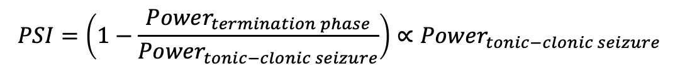
Theory-driven theranostic markers for ECT response
Electroconvulsive Therapy (ECT) is the most effective treatment for therapy-resistant depression.
Response greatly varies between patients.
Can we use Control Theory to predict ECT response (difference in Hamilton Depression Rating Scale; HDRS)?
$$PSI=\left(1−\frac{Power_{termination phase}}{Power_{tonic−clonic seizure}}\right)∝Power_{tonic−clonic seizure}$$
Hahn, Jamalabadi … Repple. (2023) "Towards a Network Control Theory of Electroconvulsive Therapy Response" PNAS Nexus. Hahn, …. Repple. (2023) "Genetic, Individual, and Familial Risk Correlates of Brain Network Controllability in Major Depressive Disorder." Mol. Psychiatry.

Slide 34
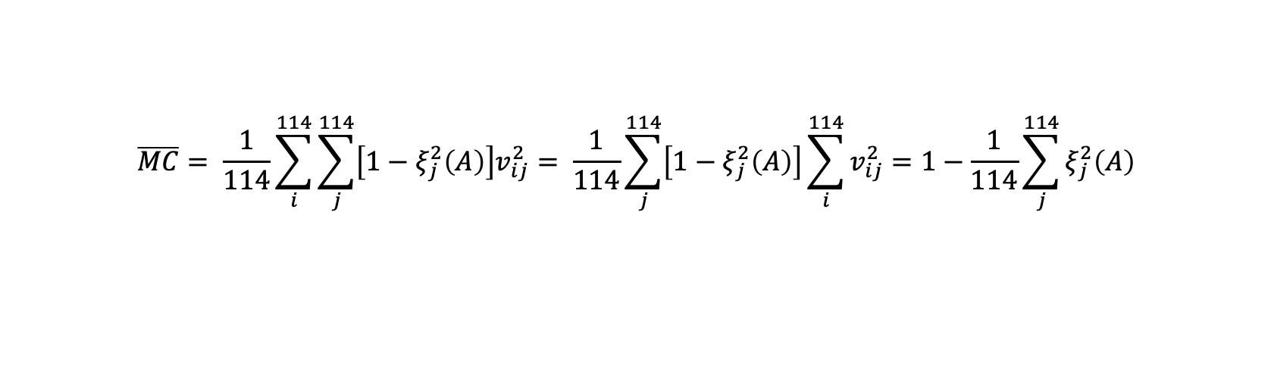
Theory-driven theranostic markers for ECT response
Electroconvulsive Therapy (ECT) is the most effective treatment for therapy-resistant depression.
Response greatly varies between patients.
Can we use Control Theory to predict ECT response (difference in Hamilton Depression Rating Scale; HDRS) based on structural connectome data (DTI)?
$$\overline{MC}= \frac{1}{114}\sum_{i}^{114}{\sum_{j}^{114}{\left[1−ξ_{j}^{2}\left(A\right)\right]v_{ij}^{2}= \frac{1}{114}\sum_{j}^{114}{\left[1−ξ_{j}^{2}\left(A\right)\right]}}}\sum_{i}^{114}{v_{ij}^{2}}=1−\frac{1}{114}\sum_{j}^{114}{ξ_{j}^{2}\left(A\right)}$$
Hahn, Jamalabadi … Repple. (2023) "Towards a Network Control Theory of Electroconvulsive Therapy Response" PNAS Nexus. Hahn, …. Repple. (2023) "Genetic, Individual, and Familial Risk Correlates of Brain Network Controllability in Major Depressive Disorder." Mol. Psychiatry.

Slide 35
Theory-driven theranostic markers for ECT response
Electroconvulsive Therapy (ECT) is the most effective treatment for therapy-resistant depression.
Response greatly varies between patients.
Can we use Control Theory to predict ECT response (difference in Hamilton Depression Rating Scale; HDRS) based on structural connectome data (DTI)?
Hahn, Jamalabadi … Repple. (2023) "Towards a Network Control Theory of Electroconvulsive Therapy Response" PNAS Nexus. Hahn, …. Repple. (2023) "Genetic, Individual, and Familial Risk Correlates of Brain Network Controllability in Major Depressive Disorder." Mol. Psychiatry.

Slide 36
Theory-driven theranostic markers for ECT response
Electroconvulsive Therapy (ECT) is the most effective treatment for therapy-resistant depression.
Response greatly varies between patients.
Can we use Control Theory to predict ECT response (difference in Hamilton Depression Rating Scale; HDRS) based on structural connectome data (DTI)?
Hahn, Jamalabadi … Repple. (2023) "Towards a Network Control Theory of Electroconvulsive Therapy Response" PNAS Nexus. Hahn, …. Repple. (2023) "Genetic, Individual, and Familial Risk Correlates of Brain Network Controllability in Major Depressive Disorder." Mol. Psychiatry.
Notes:
Direct effect: Effect, after controlling for PSI

Slide 37

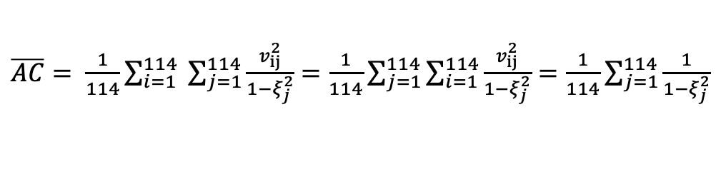
Theory-driven theranostic markers for ECT response
Electroconvulsive Therapy (ECT) is the most effective treatment for therapy-resistant depression.
Response greatly varies between patients.
Can we use Control Theory to predict ECT response (difference in Hamilton Depression Rating Scale; HDRS) based on structural connectome data (DTI)?
$\overline{AC}= \frac{1}{114}\sum_{i=1}^{114}{ \sum_{j=1}^{114}{\frac{v_{ij}^{2}}{1−ξ_{j}^{2}}}}=\frac{1}{114}\sum_{j=1}^{114}{\sum_{i=1}^{114}{\frac{v_{ij}^{2}}{1−ξ_{j}^{2}}}}=\frac{1}{114}\sum_{j=1}^{114}{\frac{1}{1−ξ_{j}^{2}}}$
Hahn, Jamalabadi … Repple. (2023) "Towards a Network Control Theory of Electroconvulsive Therapy Response" PNAS Nexus. Hahn, …. Repple. (2023) "Genetic, Individual, and Familial Risk Correlates of Brain Network Controllability in Major Depressive Disorder." Mol. Psychiatry.
Notes:
One predictive study from our lab. No theory.
However, we can measure Postictal Suppression Index (PSI) which has been shown to be associated with ECT response

Slide 38
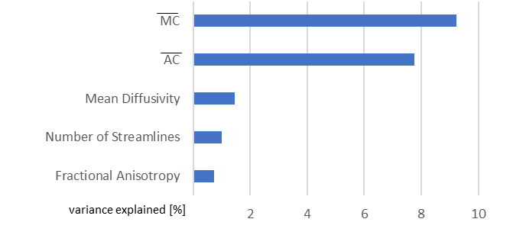
Theory-driven theranostic markers for ECT response
Average and modal controllability are more predictive than an extensive array of multivariate machine learning models on structural connectome data
Hahn, Jamalabadi … Repple. (2023) "Towards a Network Control Theory of Electroconvulsive Therapy Response" PNAS Nexus. Hahn, …. Repple. (2023) "Genetic, Individual, and Familial Risk Correlates of Brain Network Controllability in Major Depressive Disorder." Mol. Psychiatry.
Notes:
35 ML pipelines

Slide 39
From Prediction to Control
We show evidence from connectome and longitudinal psychometric data
that mean whole-brain average and modal controllability
should theoretically be associated with a known theranostic marker of ECT response (PSI) and thus with ECT response
are indeed associated with ECT response and that this relation is mediated by PSI
Hahn, Jamalabadi … Repple. (2023) "Towards a Network Control Theory of Electroconvulsive Therapy Response" PNAS Nexus. Hahn, …. Repple. (2023) "Genetic, Individual, and Familial Risk Correlates of Brain Network Controllability in Major Depressive Disorder." Mol. Psychiatry.

Slide 40
From Prediction to Understanding Dynamical Systems
Applying the Dynamical Systems View in Mental Health research
Model the energy landscape of symptom dynamics to predict future symptom severity
Analyze control dynamics to optimize Electroconvulsive Therapy (ECT)
Controlling the Neural Dynamics of Perception

Slide 41
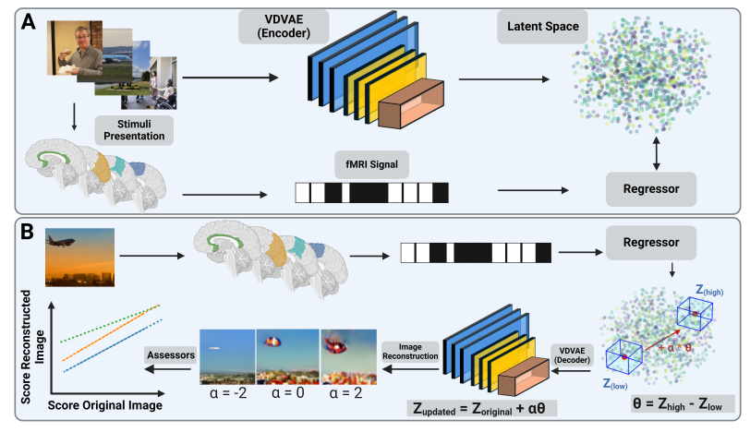
From Prediction to Control
Train autoencoder on natural images
Acquire fMRI on the same images (N=4, k=25k trials)
Align latent space
(Artifically) alter fMRI data to increase emotional valence
Reconstruct images based on the fMRI data
Assess valence of reconstructed images
10% valence increase without visual distortion
Controlling Neural Dynamics of perception
Rothermel, … Hahn, Jamalabadi. (in preparation) “ Cognitive Alignment between Artificial and Biological Neural Networks“.

Slide 42

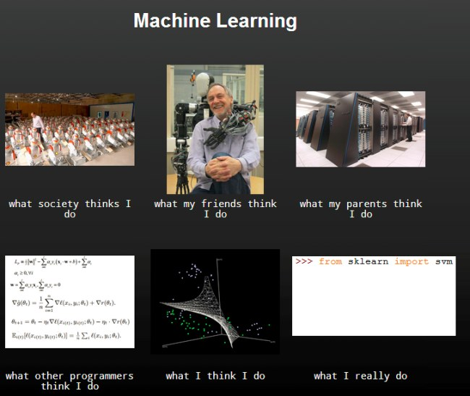

www.mmll.uni-muenster.de
THANK YOU

