Slide 1
The Three Worlds of MRI
Robert Turner
CUBRIC, Cardiff University
Sir Peter Mansfield Magnetic Resonance Centre, University of Nottingham

Slide 2
Introduction
Magnetic Resonance Imaging has become a major clinical modality due to the interactions between three social worlds
  Research Physics
  Radiology
  Industrial Engineering
Each has its own structures of authority, economics, ethos, and culture
I will describe eight breakthroughs illustrating their mutual involvement

Slide 3
MRI Breakthroughs Leading to Imaging Neuroscience
Observation of coronary arteries in adult human heart, in Nottingham in 1987.
Dramatic improvements in gradient coil technology, from 1986 to 1990, at Nottingham and elsewhere.
Development by Pykett and Rzedzian of a purpose-built whole-body MRI scanner capable of snapshot echo-planar imaging, at Advanced NMR Systems in Massachusetts in 1987
Introduction of diffusion-weighted EPI by Turner and Le Bihan as a clinical modality in radiology at NIH, between 1989 and 1992.
Implementation of EPI on a clinical Siemens scanner by Schmitt at Erlangen in 1987-91
Discovery of BOLD contrast fMRI, 1990-2, at Bell Labs, Minneapolis, Boston and NIH
Establishment of routine functional MRI scanning for studies of cognition at Functional Imaging Laboratory, Queen’s Square, London in 1995
Development of NextGen 7T MRI scanner, Berkeley, by Feinberg and colleagues, 2022.

Slide 4
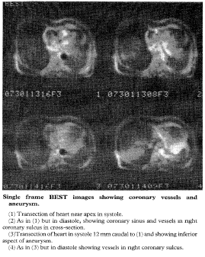
1) Observation by echoplanar MRI of coronary arteries in adult human heart, in Nottingham in 1987
Sir Peter Mansfield invented EPI in 1977.
He won the Nobel Prize in 2003
Magnet field strength 0.1 T
The slice thickness was 12 mm and each image consisted of 64 x 64 original pixels with 6 mm resolution
Acquisition time was 35 ms
Home-built software and hardware
Lancet, October 24, 1987
M. Stehling, B. Chapman, P. Glover, R.J. Ordidge, P. Mansfield, D. Dutka, A. Howseman, R. Coxon, R. Turner, G. Jaroszkiewicz, G.K. Morris, B.S. Worthington, R.E. Coupland
Dutka and Morris were cardiologists
Brian Worthington was a pioneering radiologist
Coupland was an anatomist
All the other authors were physicists

Slide 5
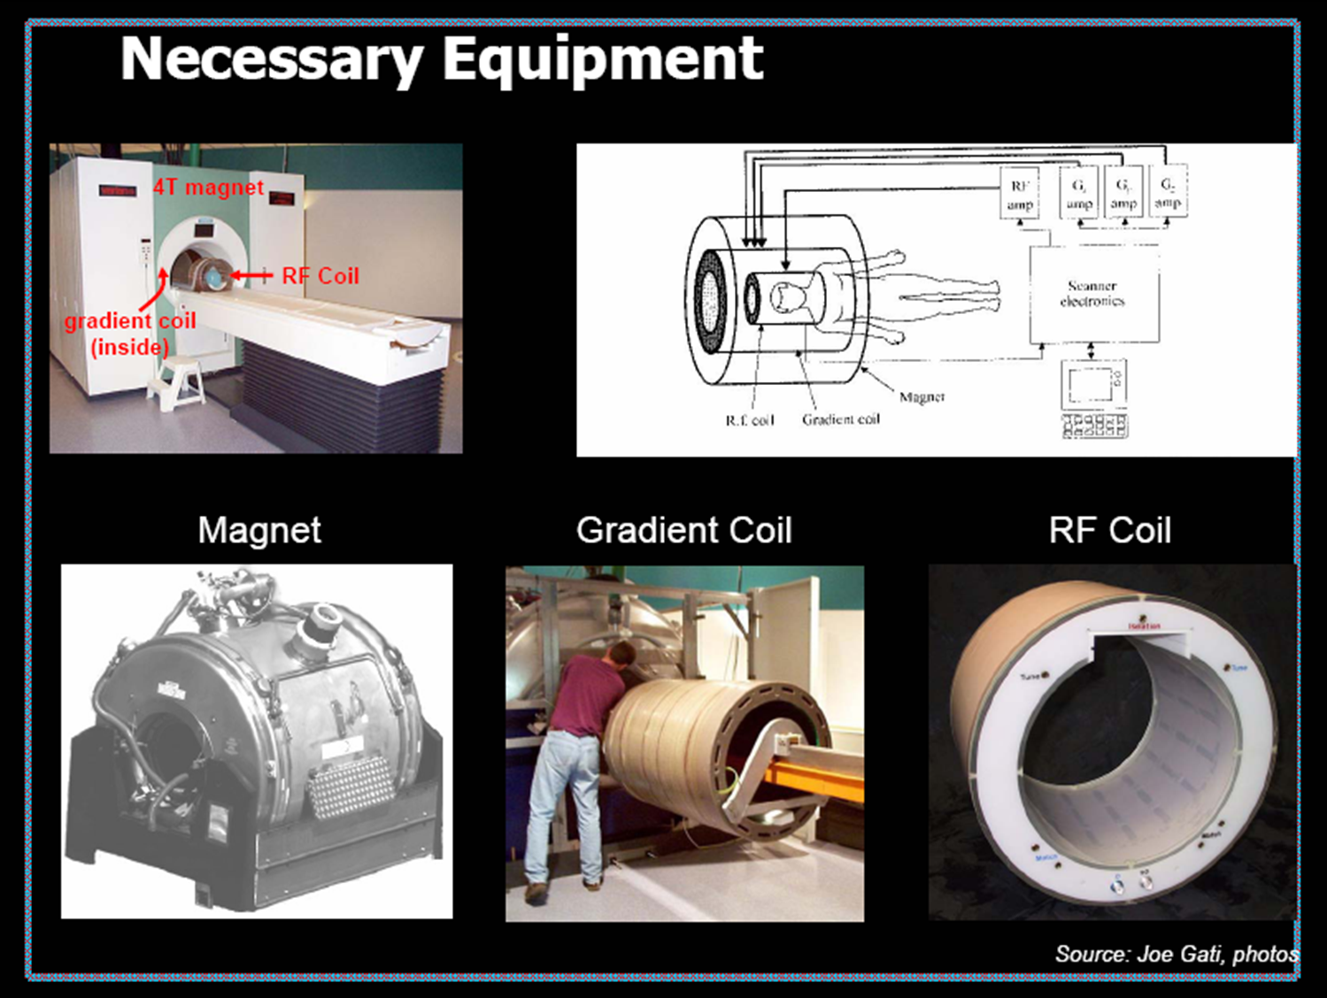
2) Transformative improvements in gradient coil technology, from 1986 to 1990, at Nottingham and GE Schenectady

Slide 6
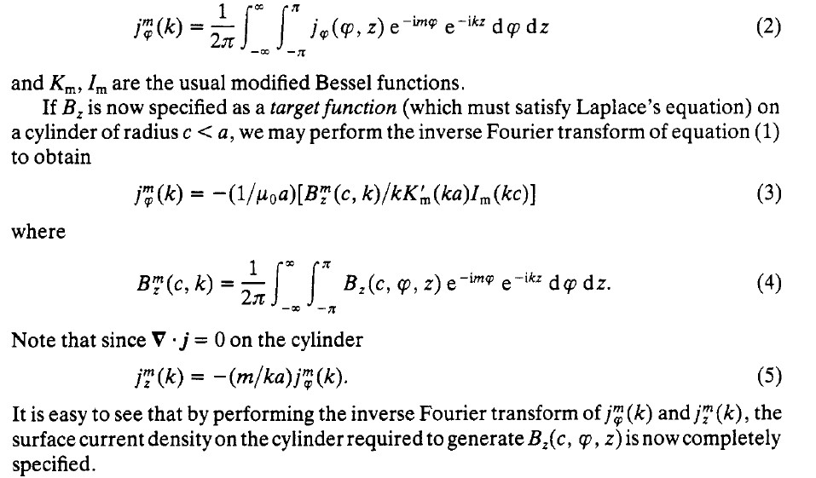
Target Field Method for designing gradient coils (Turner, 1986)

Slide 7
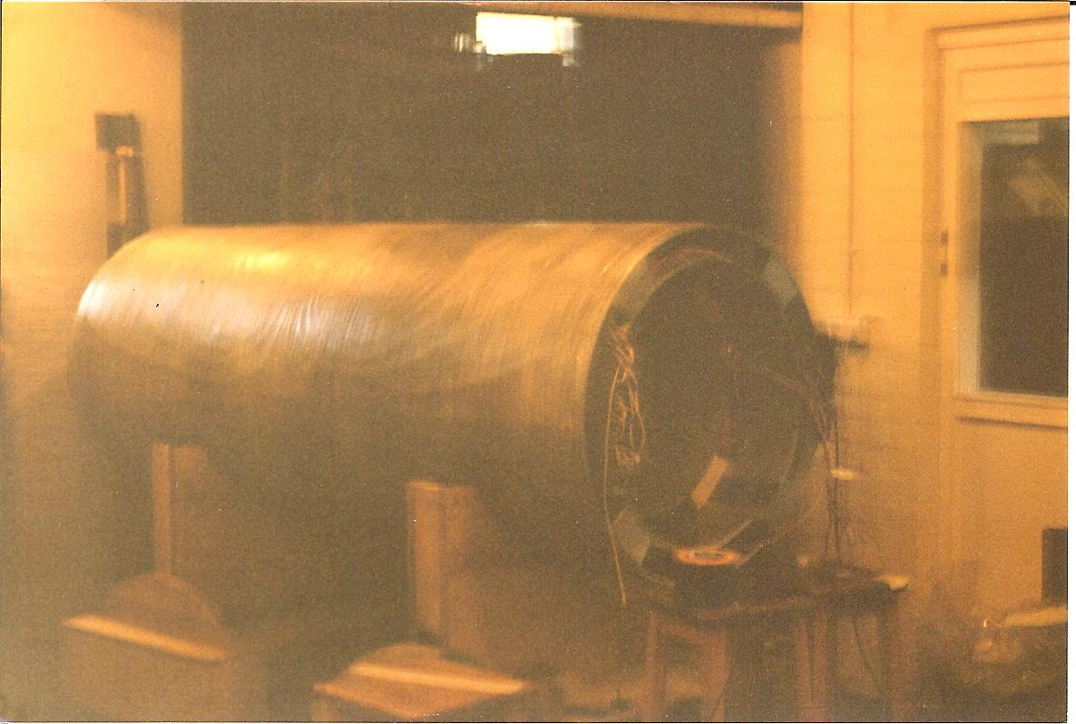
Nottingham, 1984-88 : Peter Mansfield, Barry Chapman, Roger Bowley
Double-shielded whole body gradient coil, designed by Bob Turner (x and y gradients)
and Barry Chapman (z-gradients). Primary transverse gradients were conventional
double-saddles
Built in 1987 by Oxford Magnets

Slide 8
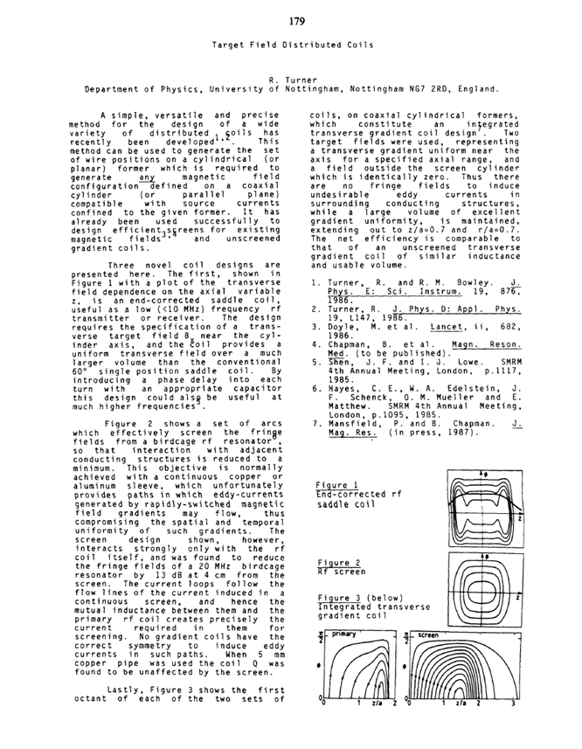
Target Field Method
First SMRM presentation in 1987 of integrated gradient coil design

Slide 9
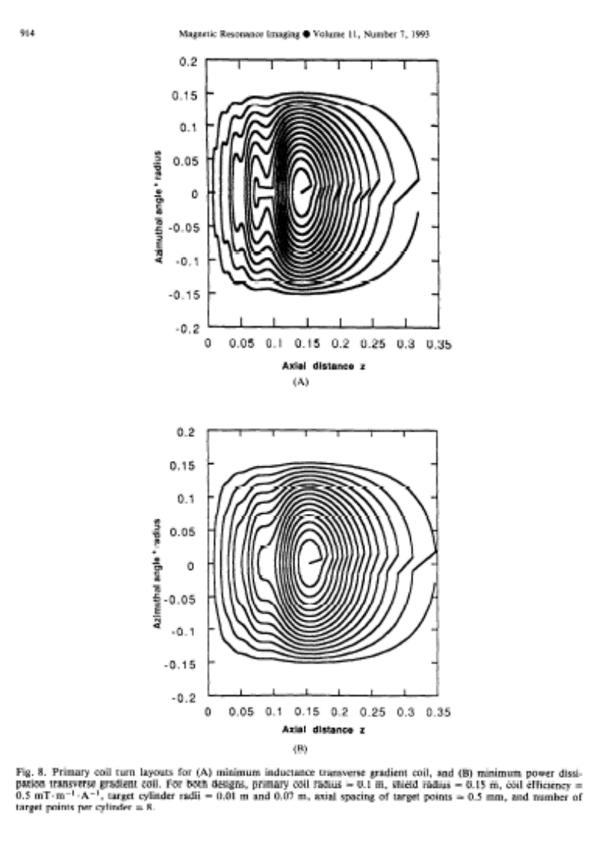
Active shielding of gradient coils (with Peter Mansfield, 1986)
The Shielding Equation (Turner 1986)
f^{m}_{φ}(k) = F^{m}_{φ}(k) [a I_{m}'(ka))/(b I_{m}'(kb)]
Here a is the radius of the primary coil, b the radius of the shield coil, F and f are the Fourier transformed current densities in the primary and shield coils, and I_{m}(x) is the Modified Bessel Function of the first kind
Shielded gradients produce much smaller eddy currents

Slide 10
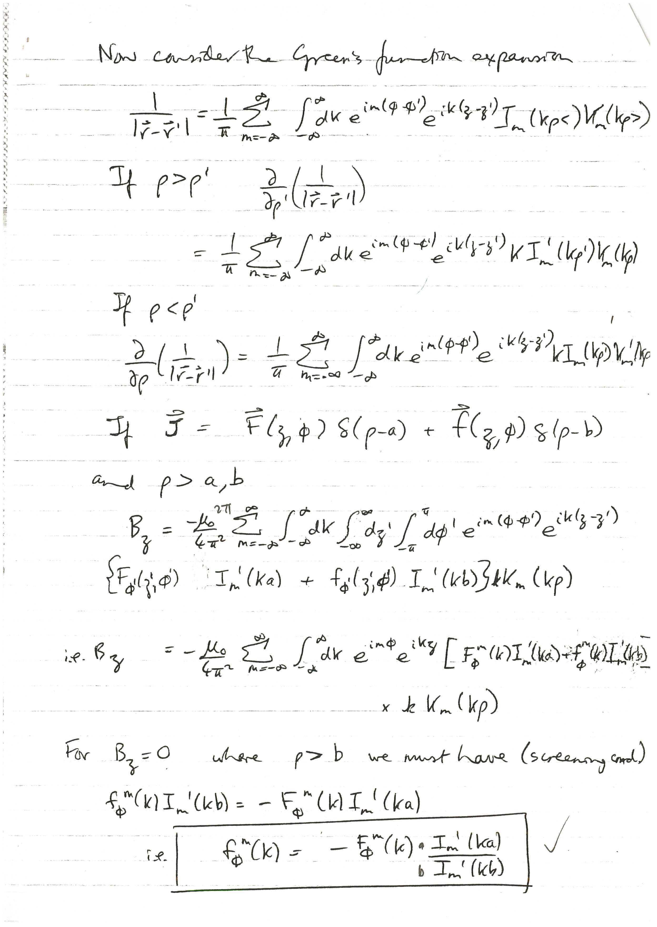

Slide 11
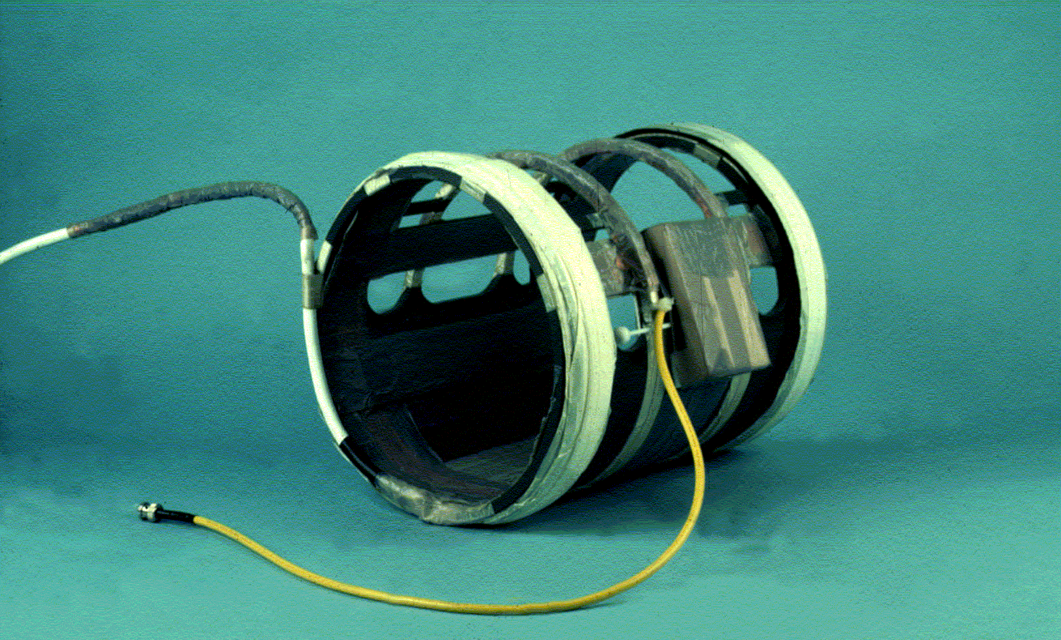
Home-built z-gradient coil, (Turner, NIH, 1990)
This provided the very first diffusion-weighted EPI images of human brain

Slide 12
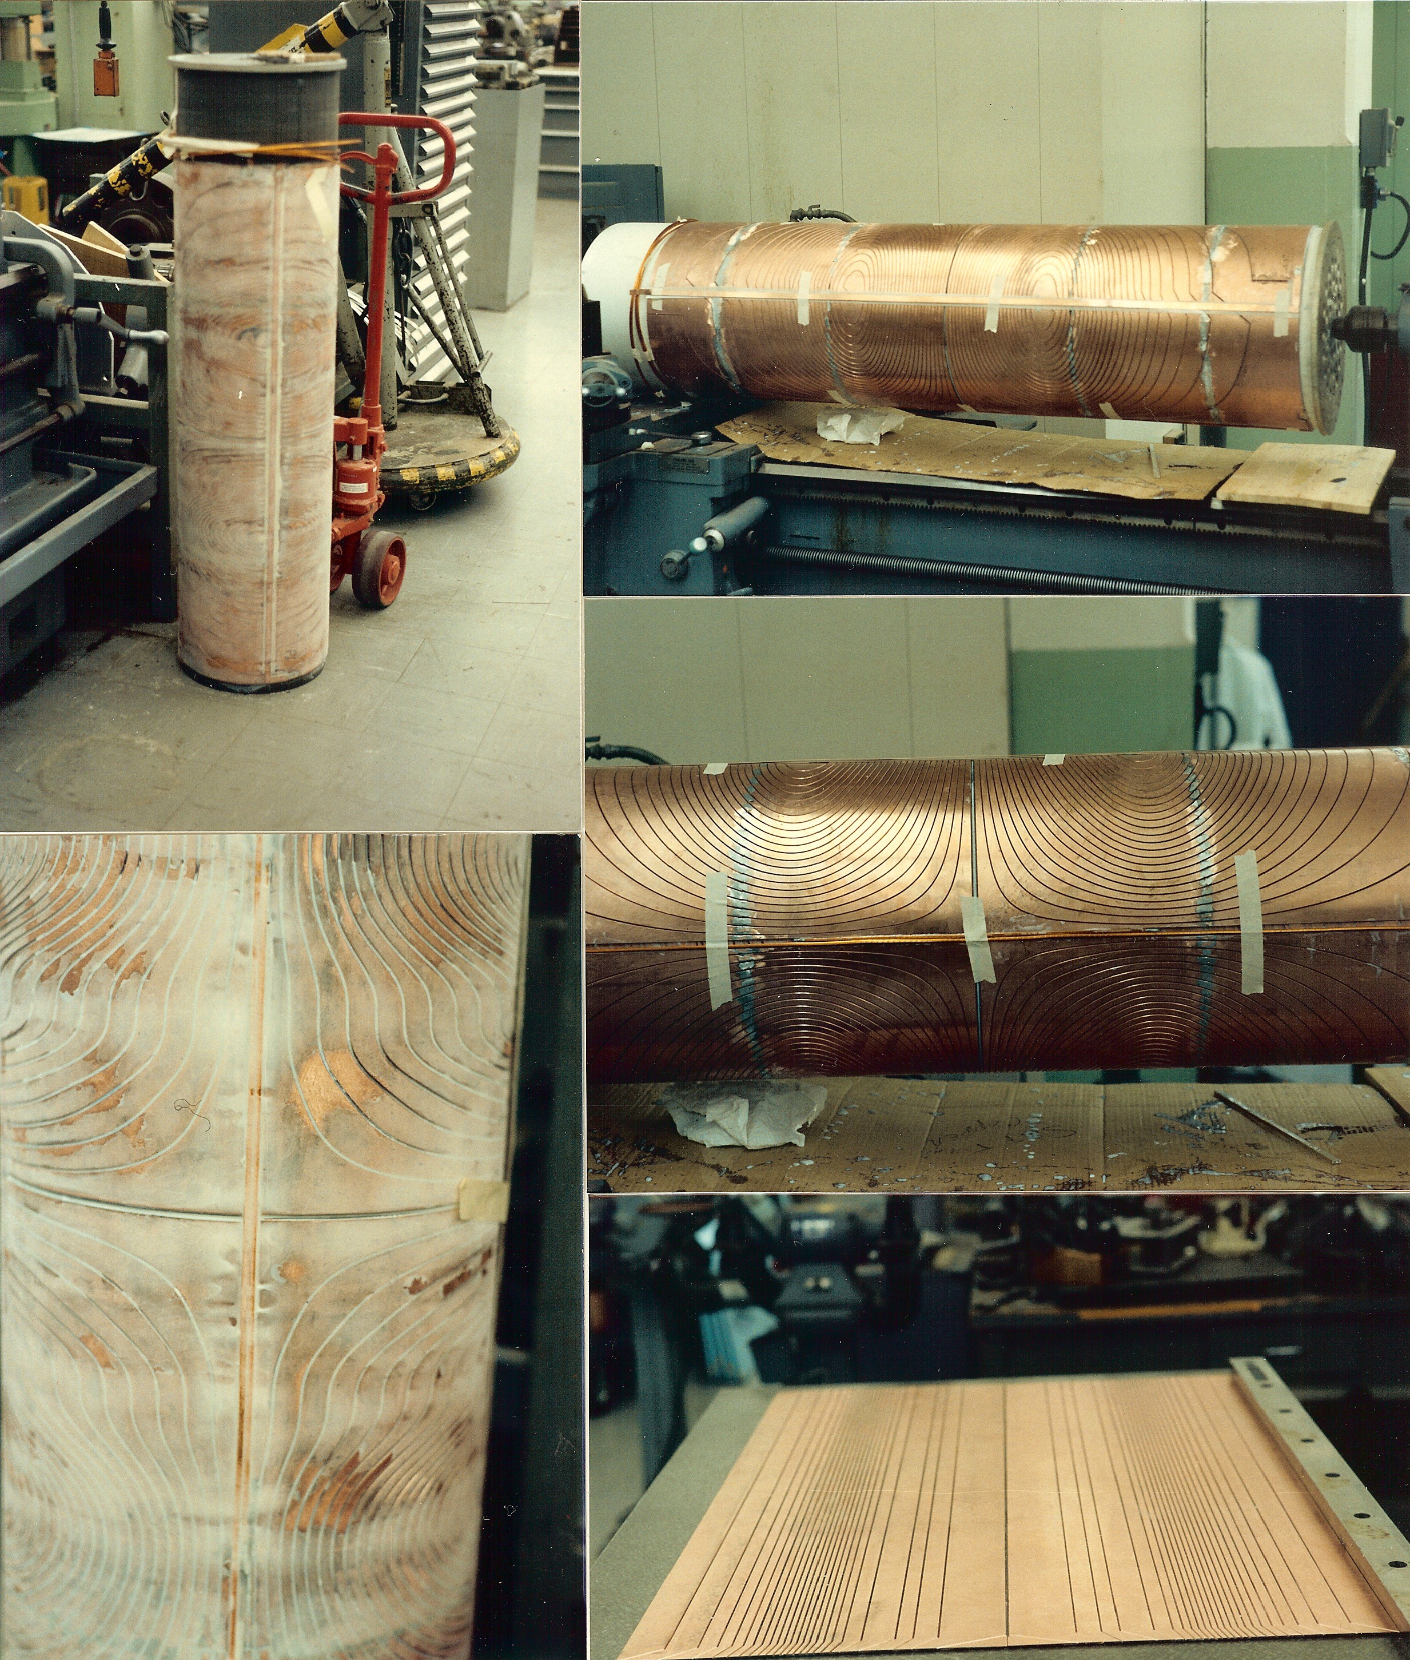
NIH, 1988-1993
Prototype 3-axis shielded gradient set
for animal MRI built in 1990
Built by engineers in Biomedical
Engineering and Instrumentation
Program (BEIP) using my digital
track placement data

Slide 13
Gradient Coil Development
Driven by the ambition to obtain very fast images of human head
  For measurement of water diffusion and brain function
Mathematics and design entirely performed by physicists
Construction in laboratory machine shops, or commissioned
No direct industrial involvement, no radiology involvement
Later developments by Peter Roemer and Bill Edelstein (both physicists) at GE research labs in Schenectady, who also derived the Shielding Equation
Rapid take-up of Nottingham’s patent licenses from British Technology Group ensured that the new technology penetrated quickly across MRI manufacturing industry
  Fingerprint coil designs
  Active shielding

Slide 14
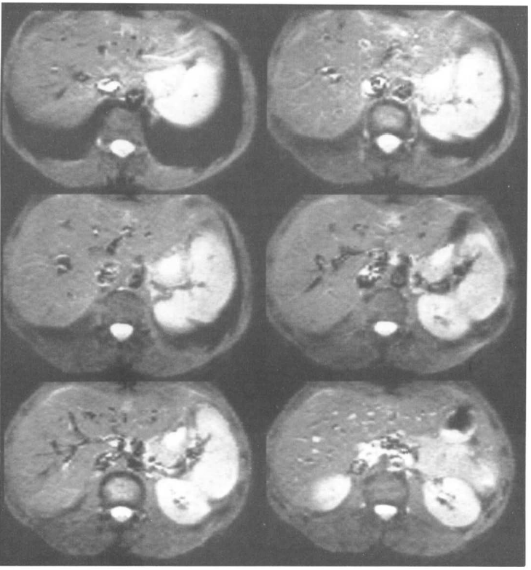
3) Development by Pykett and Rzedzian of a purpose-built whole-body MRI scanner capable of snapshot echo-planar imaging, at Advanced NMR Systems in Massachusetts in 1987
Ian Pykett and Richard Rzedzian were PhD EPI students with Mansfield in Nottingham University’s Physics Department
Pykett joined the MGH Radiology Department in 1980, Rzedzian later
They founded Advanced NMR Systems, Inc in Massachusetts in about 1984
Implemented EPI using gradient coils driven into powerful oscillation with large capacitors
Employed Mark Cohen and Robert Wesisskoff in 1987
Installed first commercial EPI scanner at MGH in 1986-87

Slide 15
Physics/Radiology Interactions
Ian Pykett joined MGH Radiology, Boston, in 1981
Tom Brady was head of MGH Radiology, and helped the British scientists Pykett and Rzedzian to attract major venture capital funding for ANMR
MGH installed the first EPI scanner built by ANMR
Bruce Rosen, a young MD/PhD radiology professor at MGH, made great contributions to early EPI papers
Unusual partnership between MRI physics and radiology
GE tried and failed to obtain ANMR’s trade secrets, even after major investment in the company
Eventually GE and Siemens came up with better products

Slide 16
4) Introduction of diffusion-weighted EPI by Turner and Le Bihan as a clinical modality in radiology at NIH, between 1989 and 1992
Bushell and Taylor, and then Le Bihan, proposed diffusion-weighted MRI in 1985
Turner proposed the first diffusion-weighted EPI sequences in 1986, when still at Nottingham
Turner arrived at the NMR Centre, NIH in 1988, and started to work with Denis Le Bihan
Visiting Scientist with the Biomedical Engineering and Instrumentation Program
Set up gradient coil design software and construction processes
Implemented EPI on 2.0T and 4.7 GE Omega MRI animal scanners
  For the first time at NIH
  Using GE-manufactured shielded gradient coils
  Software assistance from Sukumar
  Obtained good quality diffusion-weighted MRI of cat brain
Used home-built single-axis head gradient coil on Signa 1.5T whole-body scanner to implement human head EPI in 1989
  With software help from James McFall, Bob Vavrek and Joe Maier, GE engineers in skunkworks at GE Waukesha

Slide 17
Imaging diffusion in living human brain
Molecular self-diffusion can be measured using NMR
Magnetic field gradient pulses, applied before signal acquisition, dephase and then rephase the nuclear spin magnetization (Stejkal and Tanner, 1965)
  Spins that have moved before rephasing gradient applied are poorly refocused, and thus give lower signal
To image effect of diffusion: introduce balanced motion encoding gradients into MR imaging sequence
Big problem
  These gradient pulses sensitize signal greatly to bulk motion of object
  Human heads move distances of millimeters over minutes, even if clamped
  In 1985, almost all MRI applications used multipulse imaging sequences
  Signal from each rf excitation in a multipulse MRI sequence becomes incoherent
  This generates severe distributed motion artefacts in the image

Slide 18
In 1986, I Proposed the Solution
Collect all the data required to form the MR image after one RF excitation
  in less than 100 milliseconds
Apply diffusion encoding gradients only once per entire image slice
Head motion artifact cannot occur
Optimal choice in 1986: Echo Planar Imaging
  Invented by Sir Peter Mansfield in 1977, and implemented in
    Nottingham, at 0.5 T field strength
    Advanced NMR, Massachusetts, at 2 T field strength
In 1986, I proposed diffusion-weighted EPI
  at the NATO Advanced Study Institute on Cerebral Blood Flow: Mathematical Models, Instrumentation, and Imaging Techniques for the Study of CBF
  Held June 2-13, 1986, in L'Aquila, Italy
  Proceedings published in 1988 (eds. A Rescigno and A Boicelli, Plenum Press)
  Main motivation was to measure perfusion by IVIM

Slide 19
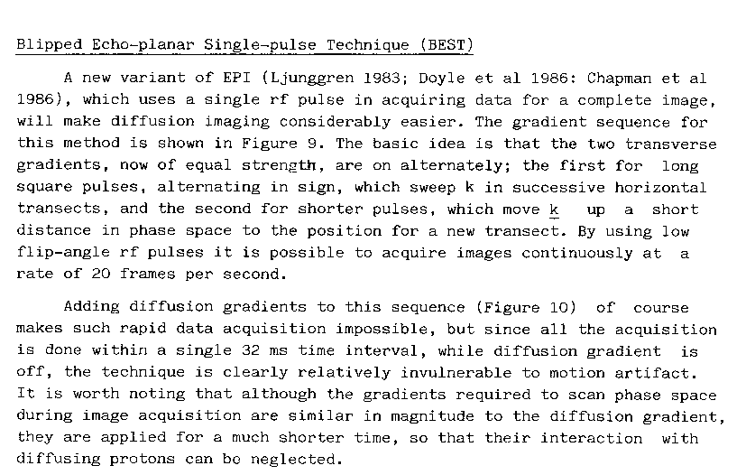
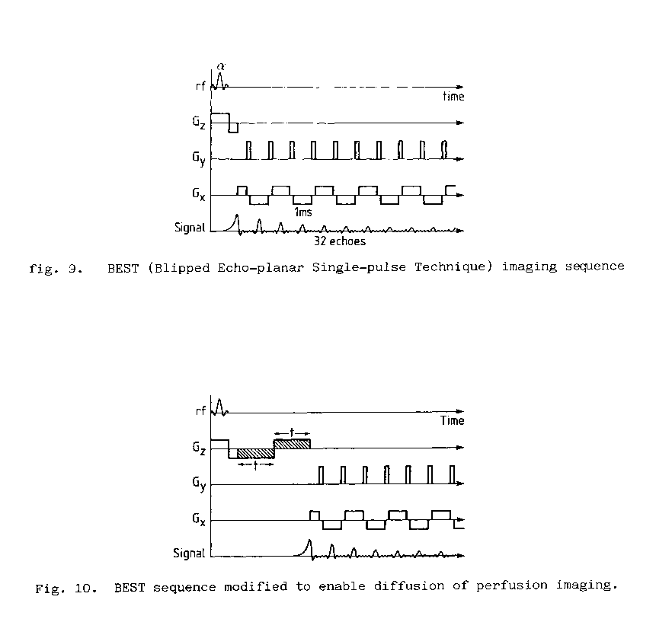
First-Presented Diffusion-Weighted EPI Sequence (1986)

Slide 20
May 1988—I moved from Nottingham to NIH
During 1988
  I started working with Denis Le Bihan
  Implemented EPI on 2T and 4.7 T animal scanners
  Implemented DW-EPI on these scanners
In 1989
  I built a head gradient coil for the 1.5 T GE Signa MRI scanner
  Implemented EPI on this scanner and obtained DW-EPI images

Slide 21
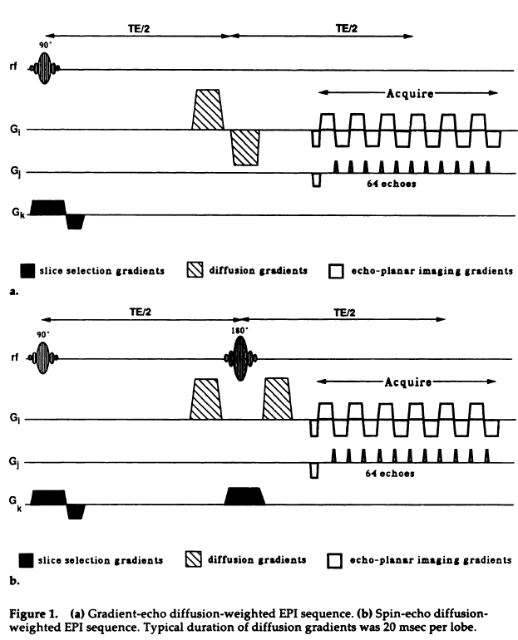
R Turner, D Le Bihan, J Maier, R Vavrek, LK Hedges, and J Pekar
Echo-planar imaging of intravoxel incoherent motion
Radiology 1990; 177: 407.

Slide 22
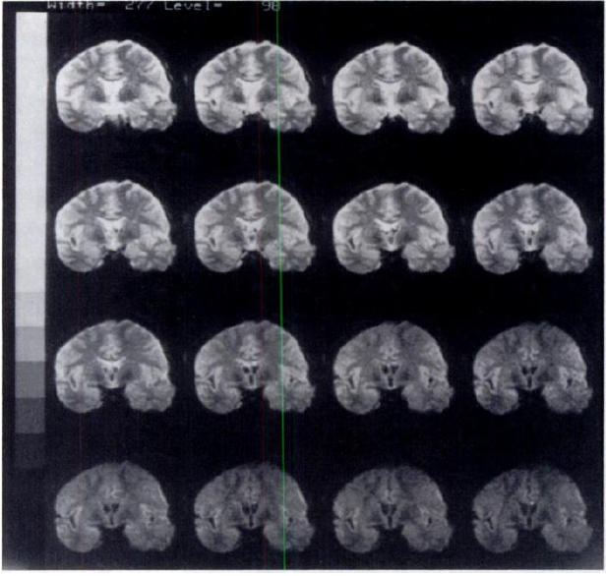
Figure 6. Sixteen diffusion-weighted coronal echo-planar images of the brain of a volunteer, at 1.5 T
64 x 64-pixel images, FoV 16 cm, in-plane resolution 2.5 x 2.5 mm.
Slice thickness was 10 mm.
Diffusion gradients varied from 0 to 38 mT/m, in z-direction
The duration of each lobe was 20 msec.
Turner et al, 1990

Slide 23
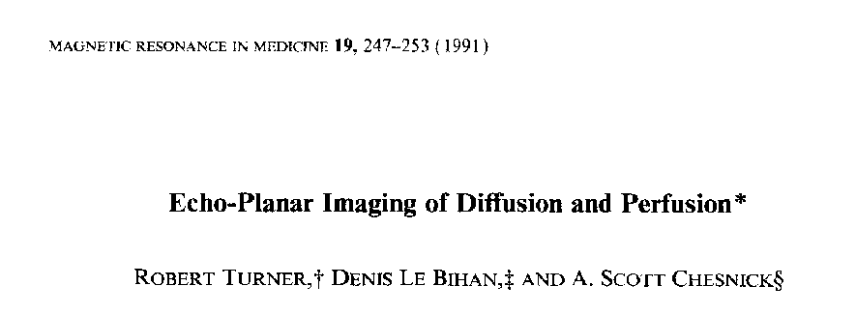
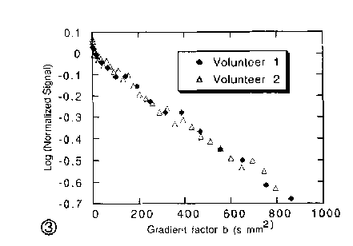
ROI placed in amygdala

Slide 24
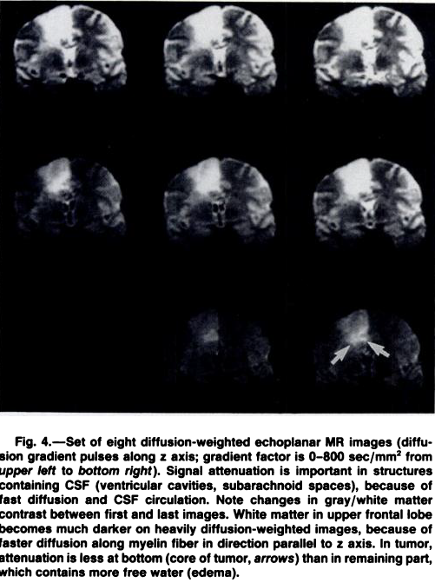
Physics, Industrial Engineering and Radiology—in Partnership
Fundamental physics idea: snapshot imaging of diffusion
Alliance with Le Bihan provided interest from radiology
Assistance from NIH engineers enabled gradient coil construction
Assistance from GE software engineers gave EPI implementation
Radiology Department at NIH provided access to tumor patients
Diffusion MR imaging: clinical applications.
  Le Bihan D, Turner R, Douek P, Patronas N. AJR Am J Roentgenol. 1992 Sep;159(3):591-9

Slide 25
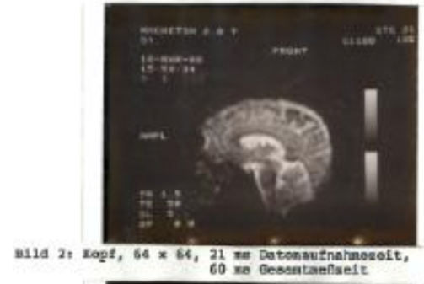
5) Implementation of EPI on a clinical Siemens scanner by Schmitt at Erlangen in 1987-92
Siemens management directed Franz Schmitt to lead a small group of Erlangen engineers to investigate EPI in 1987
Interactions with Michael Stehling, MD/PhD (Nottingham) provided insight
Single-axis head gradient coil was built at Erlangen in 1987, first acceptable images of human brain in 1988
Clinical EPI scanner installed at Beth Israel Hospital, Boston in 1992
Cohen MS, Schmitt F. Echo planar imaging before and after fMRI: a personal history. Neuroimage. 2012 Aug 15;62(2):652-9.

Slide 26
6) Discovery of BOLD contrast fMRI, 1990-2, at Bell Labs, Minneapolis, Boston and NIH
Historical Context
  Recording human brain activity in-vivo was either
    Invasive using implanted electrodes
    Invasive and low resolution in time and space using injected radiotracers and PET
    Or low spatial resolution with scalp electrodes or magnetometers
MRI had rapidly become the domain of radiologists
Neuroscientists had difficulty gaining access to MRI, even if they wanted it
  Seen as merely a means of confirming anatomy
  Not as discovery science

Slide 27
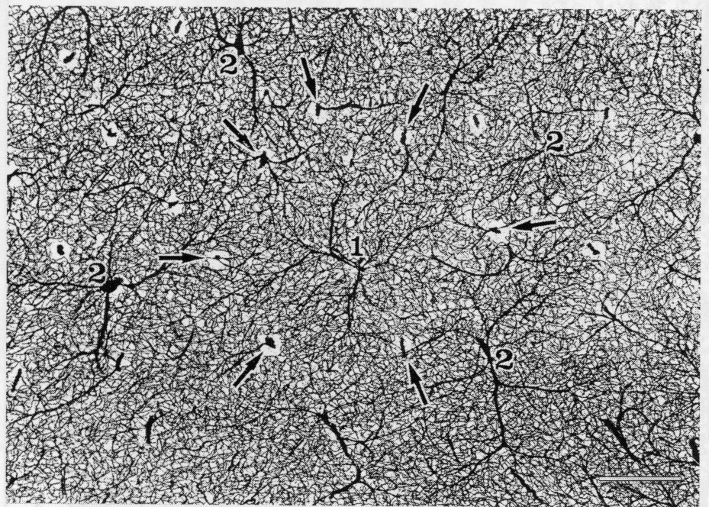
Brain Nutrition: Intracortical Network
Arrows indicate cortical arterioles, numbers indicate principal intracortical veins. Scale bar = 0.5 mm (Duvernoy 1999)

Slide 28
Cortical vasculature (Risser et al 2007)

Slide 29
The Discovery of BOLD Contrast
Pauling L and Coryell CD (1936). The magnetic properties and structure of hemoglobin, oxyhemoglobin and carbon-monoxyhemoglobin. Proc Natl Acad Sci USA 22: 210-216
Thulborn et al (1982). Oxygenation dependence of the transverse relaxation time of water protons in whole blood at high field. Biochim. Biophys. Acta. 714: 265-270
Ogawa et al (1990). Oxygenation-sensitive contrast in magnetic resonance image of rodent brain at high magnetic fields. Magn. Reson. Med. 14: 68-78
Turner et al (1991). Echo-planar time course MRI of cat brain oxygenation changes, Magn. Reson. Med. 22:159-166
Kwong et al (1992). Dynamic magnetic resonance imaging of human brain activity during primary sensory stimulation. Proc Natl Acad Sci USA 89: 5675-5679
Ogawa et al (1992). Intrinsic signal changes accompanying sensory stimulation: functional brain mapping with magnetic resonance imaging. Proc Natl Acad Sci U S A. 89: 5951-5.
Bandettini et al (1992). Time course EPI of human brain function during task activation. Magn Reson Med. 25(2): 390-7.
All physicists, working in physics research laboratories

Slide 30
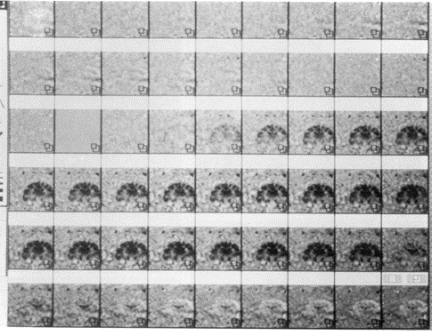
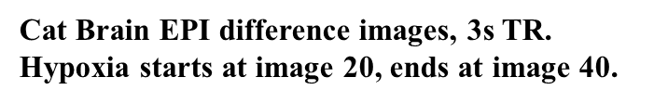
BOLD Functional MRI: How Does It Work?
(Turner 1991)

Slide 31
Effect of Increase in Neuronal Activity
Resting cortex
arteriole
venule
Activated cortex
arteriole
venule
capillary bed

Slide 32
BOLD Causal Chain
1) The brain is called upon to perform some additional task.
2) Neuronal activity increases in specific areas of brain grey matter.
3) Mitochondrial metabolic activity is increased in these areas.
4) The rates of oxygen and glucose usage in these areas are increased.
--Blood oxygenation may transiently decrease in the capillary bed supplying the neuronally active tissue (Malonek 1996).
5) Vasodilatory compounds are released at increased rate within the electrically active tissue, for as long as the extra electrical activity persists.
6) These compounds diffuse to the capillaries and resistance arterioles supplying the electrically active tissue.
7) The resistance arterioles and pericytes dilate (Peppiatt 2006), and this dilation is propagated along the arterioles by transmitted endotheliar depolarization (Segal 1989).
8) Blood flow increases in the resistance arterioles, and hence in the capillary bed supplied by these arterioles.
9) Capillaries experiencing increased blood flow dilate by 5 - 10 % (Hudetz 1997) and local blood volume increases by 10-20 %
10) Oxygen supply to electrically active tissue begins to exceed demand.
--Blood oxygenation increases in capillaries and the venules that drain them (Villringer 1995).
11) When neuronal activity returns to baseline, release of vasodilatory substances also returns to baseline, causing blood flow to return to baseline.
12) Metabolic activity returns to baseline when equilibrium PCr has been restored.

Slide 33
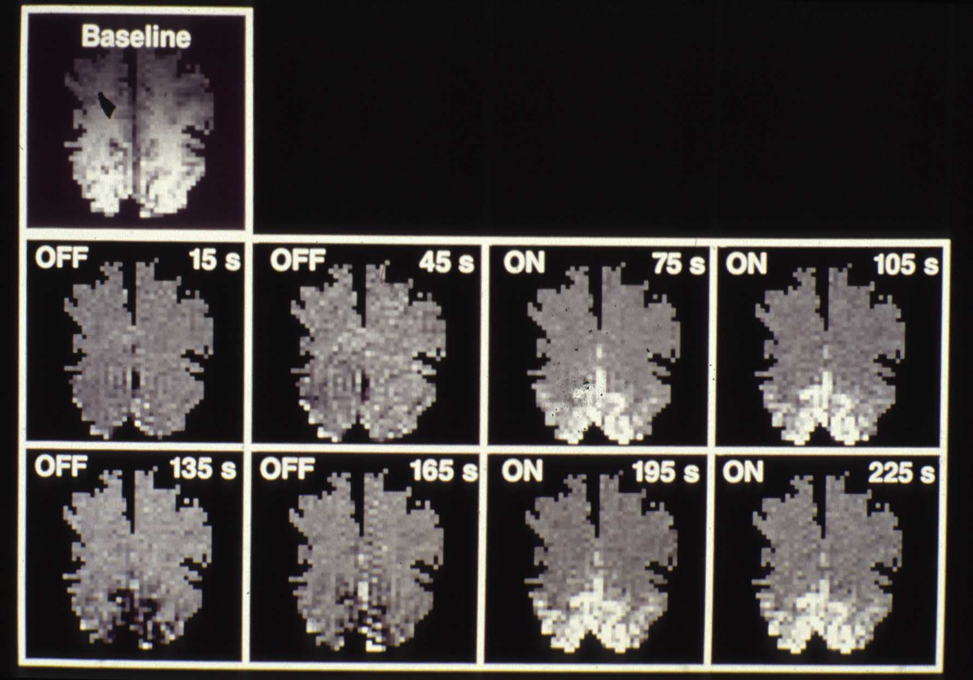
Used ANMR scanner running EPI

Slide 34
Outcomes of 1991 discovery of BOLD in human brain
Announcement papers in 1992 by Kwong et al, and by Ogawa et al, in PNAS, and by Bandettini et al in Magnetic Resonance in Medicine
Implementation of BOLD EPI in humans at 4T, at Minnesota (Ugurbil) and at NIH (Turner, using home-made EPI and gradient coil)
Neuroscientists initiated six discovery-science fMRI projects at NIH in 1993, guided by Turner
Other fMRI projects started at Minnesota (motor control), MGH (visual cortex) and Milwaukee (language)
First ever fMRI presentations at annual Society for Neuroscience meeting in 1993
MRI industries and radiology departments not involved for at least two years
Organization for Human Brain Mapping founded in 1995
  Current international annual attendance by >3000 scientists
Now more than 4000 refereed papers using fMRI published per year.

Slide 35
7) Establishment of routine functional MRI scanning for studies of cognition at Functional Imaging Laboratory, Queen’s Square, London in 1995
In 1993 the Wellcome Trust awarded £20 million to a group of brain scientists to build the world’s first dedicated laboratory for the study of imaging neuroscience using PET and fMRI, in Queen Square, London
In 1994 Turner worked with Karl Friston in establishing a version of Statistical Parametric Mapping (SPM) for statistical analysis of fMRI data, which included an algorithm for removal of effects of head motion.
Ahead of the September 1995 London installation of the Siemens 2T Vision MRI scanner, Turner spent 5 weeks in Erlangen in July 1995 on the training course for installation engineers.
During this time he developed personal friendships with several Siemens MRI engineers
As soon as the scanner was installed, Turner with his team of physicists set up a 64x64x64 voxel EPI sequence to include entire brain
This standardized sequence and analysis package became the paradigm method for fMRI studies for most of the next decade
There was strong support from Siemens development engineers. Turner had his own team of physicists. No radiologists had any involvement.

Slide 36
How do imaging neuroscientists analyze fMRI data?
Standard practice was introduced by Turner and Friston, with their groups in London
Up to 400 brain volumes collected per run
Functionally significant differences in image intensity are < 5 %, often much smaller
Need to compare results across subjects
  To discover what is typical
  To identify significant abnormality
Normally at least 16 subjects per group to give statistical generality
  Need enough to calculate variance across subjects

Slide 37


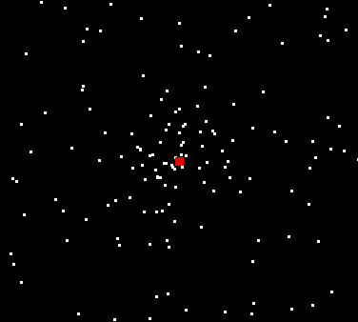
fMRI using photic stimulation
Design matrix
SPM{Z}
LGN activation
SPM{F}
stimulus
Bold EPI T2* at 2 Tesla, TR = 3.22s
4 conditions: Fixation, visual motion with and without attention and stationary dots
Buechel et al, Brain 1998

Slide 38
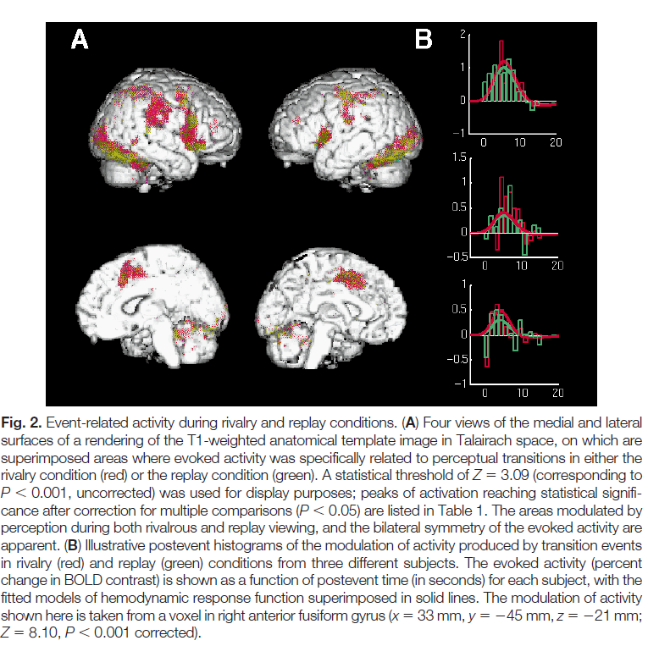
Neural Correlates of Perceptual Rivalry in the Human Brain
Erik D. Lumer, Karl J. Friston, and Geraint Rees
Science, 19 Jun 1998 Vol 280, Issue 5371, pp. 1930-1934
An early fMRI study
Binocular rivalry occurs when eyes receive different stimuli
The percept alternates over times of a few seconds
Only fMRI is capable of showing what part of the brain drives the perceptual switch

Slide 39
8) Development of NextGen 7T MRI scanner, Berkeley, by Feinberg and colleagues, 2022
Granularity in human neuroimaging science continues to improve
A next-generation 7 Tesla magnetic resonance imaging scanner was designed and built, by teams of physicists at Berkeley and MGH, and engineers at Siemens
Reached ultra-high resolution by implementing several advances in hardware
  Included a head-only asymmetric gradient coil (200 mT/m, 900 T/m/s)
    with an additional third layer of windings
  A 128-channel receiver system was integrated with 64- and 96-channel receiver coil arrays to boost signal in the cerebral cortex
  A 16-channel RF transmit system reduced power deposition and improved image uniformity.
The scanner routinely performs functional imaging studies at 0.35–0.45 mm isotropic spatial resolution
  Revealing cortical layer-dependent functional activity
  Achieving high angular resolution in diffusion imaging
  Reducing acquisition time for both functional and structural imaging

Slide 40
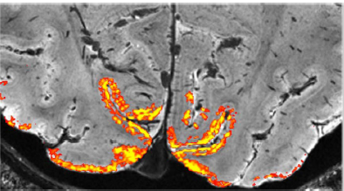
Next-generation MRI scanner designed for ultra-high-resolution human brain imaging at 7 Tesla.
Feinberg DA, Beckett AJS, Vu AT, Stockmann J, Huber L, Ma S, Ahn S, Setsompop K, Cao X, Park S, Liu C, Wald LL, Polimeni JR, Mareyam A, Gruber B, Stirnberg R, Liao C, Yacoub E, Davids M, Bell P, Rummert E, Koehler M, Potthast A, Gonzalez-Insua I, Stocker S, Gunamony S, Dietz P.
Nat Methods. 2023 Dec;20(12):2048-2057.
Layer fMRI, combining 0.45 mm and 0.39 mm isotropic resolution data (in 2-mm-thick V1 human cortex) differentiates activation in cortical layers in supra- and infra-granular layers from a flashing checkerboard task.

Slide 41
Conclusion and Take Home Messages
In 40 years, MRI has benefitted from tremendous cumulative advances in technique
  In fields like MRI, the inventiveness of physicists is vital
    but also greatly needs the amplification factor of radiological interest to make any change to standard equipment and practise.
    MRI physicists need to learn to think and speak like radiologists.
  MRI scientists are strongly encouraged to develop personal links based on shared research interest and mutual respect with engineers in the companies that provide their equipment.
  Wise management is required when the skills and objectives of all three worlds, physics, radiology and engineering, need to be combined.
    Interests and rewards need to be carefully balanced.
  Large companies often benefit by quietly encouraging the independent enterprise of their more ambitious engineers.
  The limiting factor for scientific discovery should never be the inadequacy of the equipment, but only the creative imagination of the innovator.

