Slide 1

From Models to Knowledge: Fusing Multimodal Information from Physiological Data
Anna M. Bianchi - Politecnico di Milano - DEIB

Slide 2


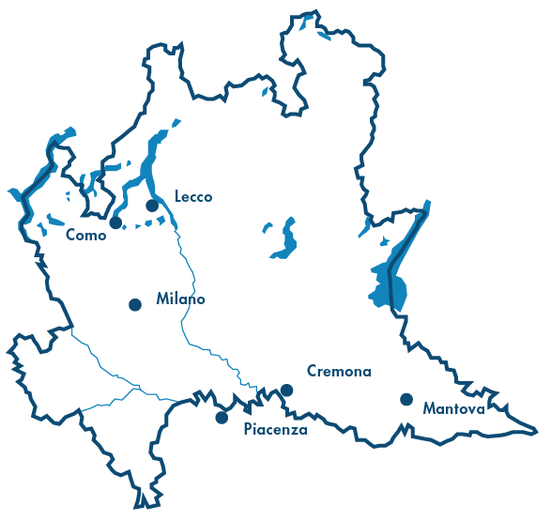
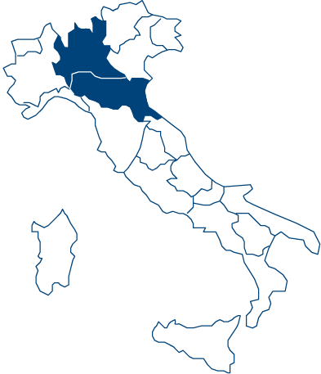
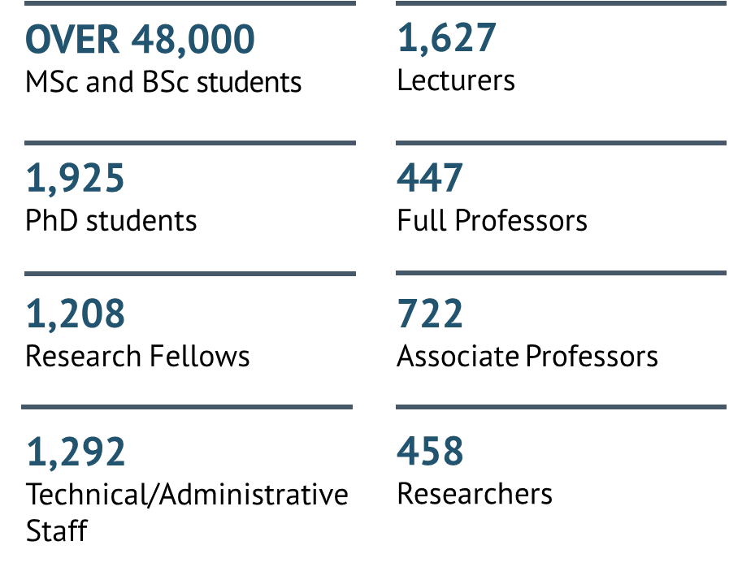
OUR SCHOOLS
OUR COMMUNITY (2022/23 DATA)
Notes:
Ritagliare figura Poli, aggiungere mappa Milano e Lombardia – qualche dato

Slide 3
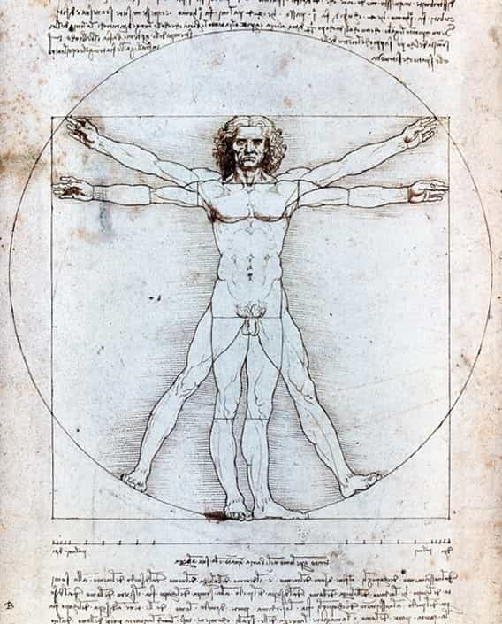
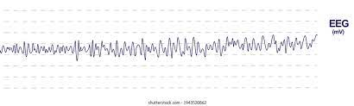
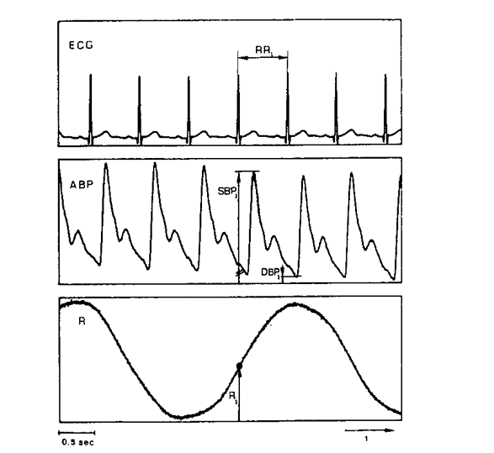
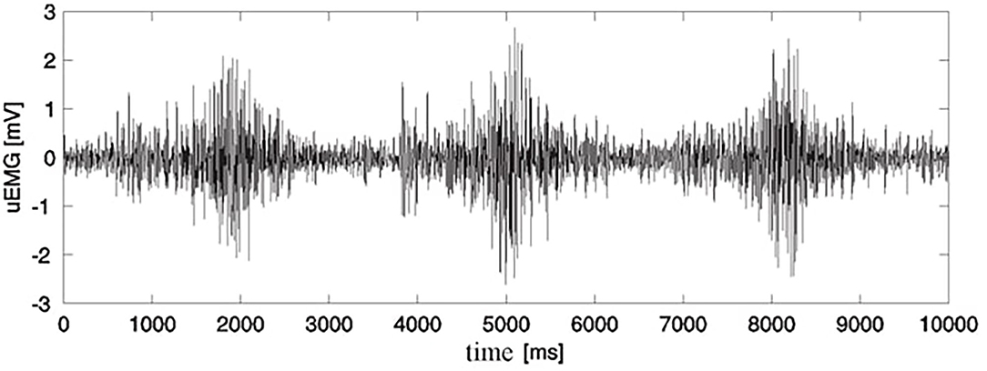
Introduction
SIGNAL = a physical quantity varying with time
Biomedical signals carry information about the generating physiological systems.
The processing of signals allow:
  i) to quantify and
  ii) to qualify such information (for validating physiological modelling) mainly through mathematical tools

Slide 4
Contents
Models as tool for signal/image processing and data interpretation
Models for signals and data integration
  Multiresolution
  Multichannel
  Multimodal
  Multiorgan
Some applications examples
  Cardiovascular system
  Neurosensorial system
Final considerations
Notes:
DA RIVEDERE
Physiological signals and data are expressions of complex biological mechanismis.
A single signal or a single type of data usually provide only a very partial and limited view of the underlying process. Thus we need many different signals or images or data:
Multichannel EEG
Mutimodal images (structural and functional)
Multi-organ or multisystem data (cardio-vascular, cardio-respiratory, central nervous system vs peripheral nervous system)
Multi-scale data, behaviours at macroscale are determined by micro or nanoscale characteristics of the system (ECG or ECG anomalies coused by single variation at genomic level)
And actually, nowadays we have the possibility of collecting many different data, at the same time , during specific protocols, during daily life (wearable systems), mobile devices. So now the problem cpuls be mostly related to the proper processing of all these data and to provide a synthesis and an interpretation of thesse data, to be used in clinical setting, for decision making, for monitoring, and so on so forth.
In this lesson we will approach models that can be used for data analysis and for data interpretation. We will see different appeoaches related to the use of models, and in particular we will focus on black box models. Input/output relationships without a specific and detailed description of the ongoing process. This could be really useful when dealing with physiological data. In fact the detailed model are difficult ro be identified and impemented and sometmes they require restrictive and non-realistic hypothesis, or some aspects are not fully known and cannot be modeled.
This is the reason why black box modeling are preferred in many cases. And they are really able to provide relevant informations.
Black box models vs gray models (examples)

Slide 5
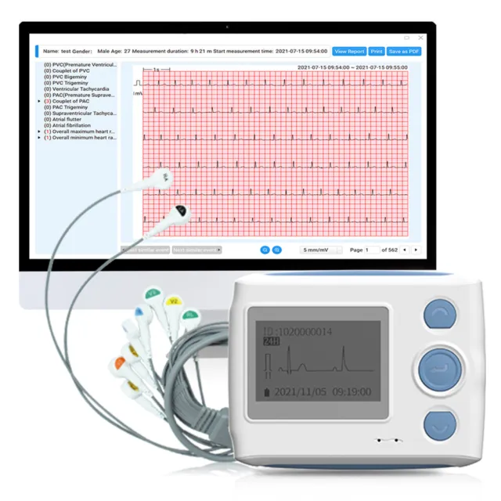
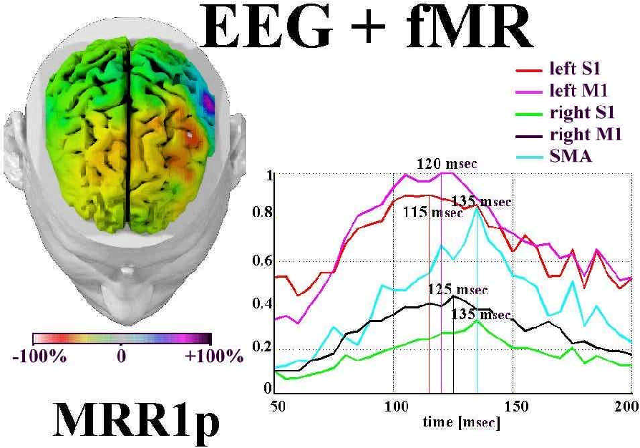
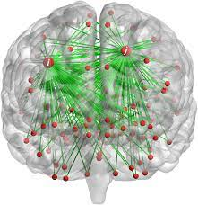
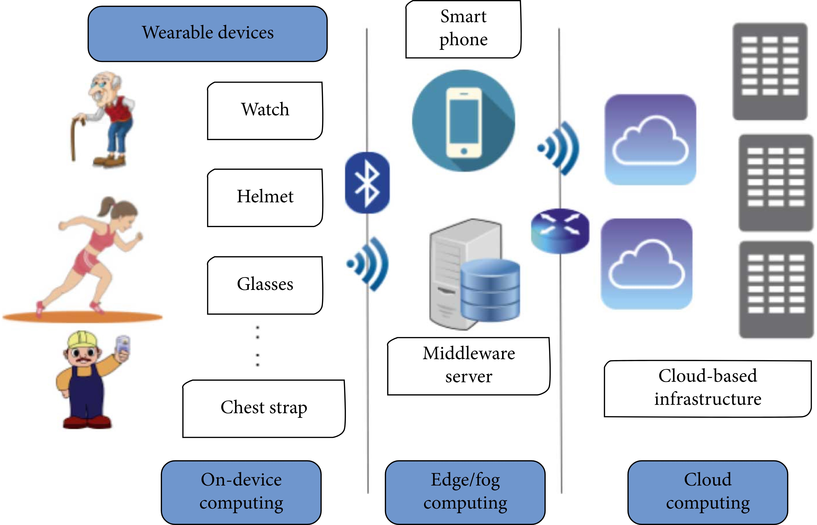
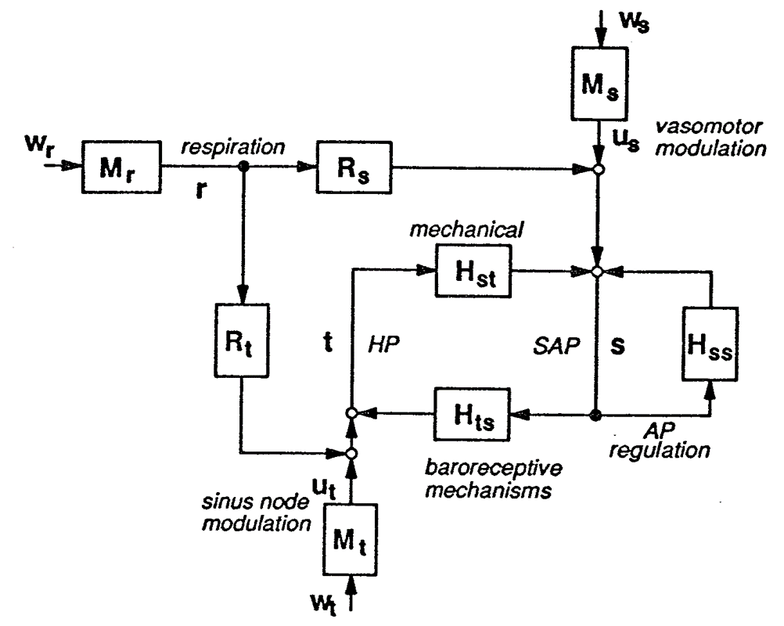
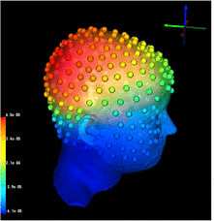
Evolution of Biomedical Signal Processing
biomimesi e nano dispositivi
I generation
II generation
III generation
Very low temporal & spatial resolution
Improved temporal and spatial resolution
High temporal and spatial resolution (AI era)
From visual inspection to computerized analysis of signals: long time recordings (Holter), high density recordings and physiological mapping (EEG, ECG, …), signal compression
Multichannel, multimodal, multiorgan integration, modelling, source reconstruction, connectivity
Real world data: wearable, implantable devices; telemonitoring; ML and AI for feature extraction and classification, mobile-health, digital twins
Performance/complexity
< 90s
2000s - 2010s
2020s

Slide 6
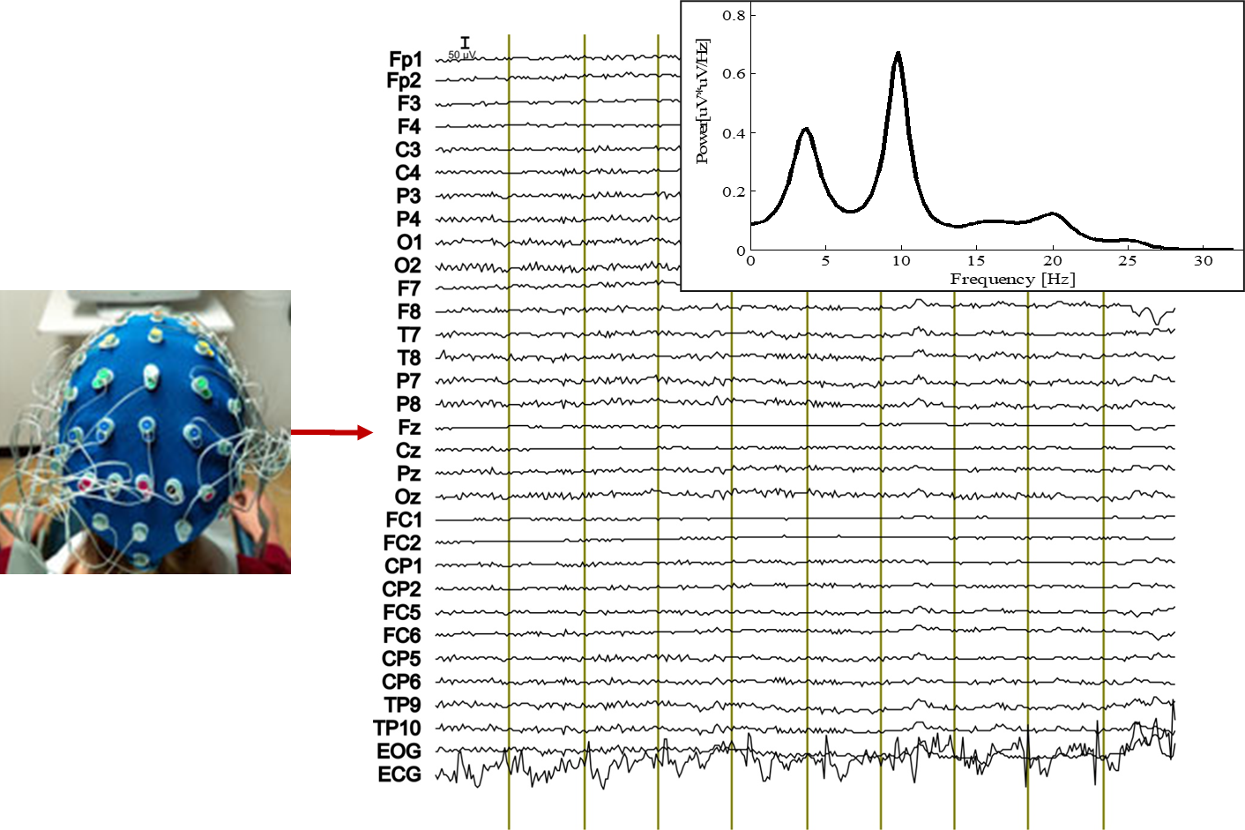
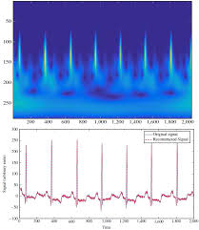
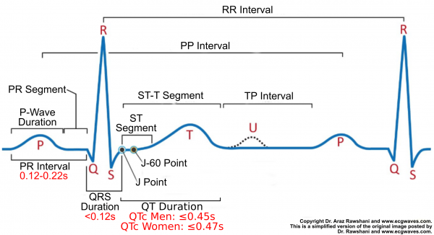
«Classical» Signal processing methodologies
Deterministic or stochastic they are based on a direct analysis of the signal
  Fourier transform
  Wavelet transform
  Numerical filters (FIR, IIR)
  …
Advantages
  Can be applied to a wide class of signals (e.g. finite energy);
  There are powerful algorithms of immediate application
  Can reproduce all aspects of the signal (zero error variance)
Notes:
Here a summary of the more traditioal tools for signal processing. We have direct analysis of the sigansl or of the data.
We operate some tranformation on the data.
Very wide possibility of applications,
kind of signals
Any spect of the signal is described
Esempio: segnale e trasformata
Filtraggio dei segnali etc. etc.

Slide 7
Limits
  They simply move the representation from one domain to another, with no interpretation of the mechanisms generating the signal;
  No reduction in the size of the problem (same number of samples);
  No predictive capabilities (or very limited capabilities);
  They do not highlight relationships between different signals (besides phase relationships and coherence values).
Notes:
View of the same think from a diferent point of view
Same number of the data (non synthetic representation, non synthesis of the data) with wavelets we have redundancy in data representation
Bivariate spectral analysis, cross-spectrum, coherency and phase

Slide 8
Models of the geerating mechanism
Real world
Abstraction
Model of the world
MODELS ARE BUILT FOR A SPECIFIC REASON
Abstraction: the process of identifying a few elements of a physical process and then using these to create a model of the process.
Models are always:
Less detailed than the real world: data are lost in the abstraction process
Not unique: many models can be created, the number of possible models is infinite

Slide 9
Descriptive models
Knowledge about the physical structure of the system is used
The equations are not universal (depend on data availability).
The parameters have a precise physiological and / or clinical meaning, assigned a priori
A crucial aspect for the use of interpretative models is the assignment of a value to the parameters
  Based on physiological and / or clinical knowledge (paradigmatic use of the model);
  Based on a fitting on measured data (processing use)
u[n]
y[n]
!
Notes:
Try to reproduce in equation the actual system
Equations depend on the specific system and on the available data (sometimes simplified models)
Values in the parameters are assigned a priori (measures, literature, estimated, other sources ….)

Slide 10
Models: an example on the diastolic blood pressure trend
mmHg
systole
120
diastole
Mechanism of signal generation
80
0
time
i(t)
v(t) → arterial pressure
i(t) → blood flow
C → arterial compliance
R → peripheral resistences
Generator (Pulse) → heart
Diode → aortic valve
dv/dt = -1/RC v(t)
v(t) = v(0) e^{-t/RC}
C
R
v(t)
Notes:
Aggungere modello caduta diastolica da diapo lezione

Slide 11
Use of models
simulation: given the initial conditions, the model allows to calculate the temporal evolution of the system
prediction: given some past values, predicting a future value through a simulation
interpolation: replace a noisy or missing signal section as simulated by the model calibrated on the available sections.
filtering: estimate a model from a noisy signal and replace the trend described by the model parameter extraction,
data compression: few parameters can describe long stretches of signal
RC
Notes:
Very simple model. Windkassel model for the description of the diastolic decay in the blood pressure.
This is a physiological model (non black box model) come from the electrical model of peropheral resistences and vascular compliance (electrical capacity) v(t) is the blood pressure, i(t) the blood flow.
Differential equation and
Difference equation.
Both describe an exponential decay in the signal, where RC is the time constant
Different uses of models

Slide 12
Descriptive models
PROS
CONS
Ability to describe signals and processes concisely (a few parameters that vary from case to case);
From the value of the parameters it is possible to obtain information on the physiological processes that generate the signal;
Relationships between signals can be highlighted;
The model (if valid) can have predictive capabilities.
The model describes only part of the data variability.
The algorithm is not universal (it may not converge to an acceptable value, convergence may have to be "guided");
The solution may not be unique;
The process under analysis may be too complex to reliably represented by a descriptive model
Notes:
Start discussion about the models used by the students
Which models are they using?

Slide 13
Black – box models
An "input-output" relationship is used for describing a process
The model does not explicitly make use of knowledge on the inner nature of the system that generates the signal (black-box).
Data driven approach
The same type of model can be applied to different systems.
u[n]
y[n]
?
Notes:
We are going to describe just input output relationships. (i.e. blood pressure, heart rate)
In same cases we do not have an explicit inpunt (i.e. EEG) so we may assume a very generic input (i.e. a white noise) which is stocastic, non predictable, and contains all the freqiencies with the same weight.
Aggiungere figura modello AR con funzione di trasferimento e diagramma poli e zeri

Slide 14
Steps for construction of a black box model
Data collection
Definition of the protocols
Equation describing the evolution of the process (signal) in which the «parameters» are unknown
Estimation of the unknown parameters based on the optimization of a «cost function»
Validation is based on statistical tests and on the comparison between models of different order (estimation error)
Test is based on the behavior of the model with respect to data others from the ones used for training
Choice of the
model family
Training set
Identification
Validation and test
NO
YES
Test set
Use

Slide 15
Choice of the model family
A model family has a predifined structure and unknown coefficients (or parameters) → ∞ models
Assigning a value to the unknown parameters we select ONE model
u[n]
y[n]
wn[n]
y[n]
?
?
a₀y(n) + a₁y(n-1) + …. + a_{L}(n-L) +
+ f (u(n), u(n-1), u(n-M), y(n-1), … , y(n-L)) =
= b₀u(n) + b₁u(n-1) + … + b_{M}u(n-M) + e(n)
Notes:
Riporatre equazioni

Slide 16
Choice of the model family
A model family has a predifined structure and unknown coefficients (or parameters) → ∞ models
Assigning a value to the unknown parameters we select ONE model
u[n]
y[n]
wn[n]
y[n]
?
?
a₀y(n) + a₁y(n-1) + …. + a_{L}(n-L) +
+ f (u(n), u(n-1), u(n-M), y(n-1), … , y(n-L)) =
= b₀u(n) + b₁u(n-1) + … + b_{M}u(n-M) + e(n)
Notes:
Riporatre equazioni

Slide 17
Choice of the model family
A model family has a predifined structure and unknown coefficients (or parameters) → ∞ models
Assigning a value to the unknown parameters we select ONE model
u[n]
y[n]
wn[n]
y[n]
?
?
a₀y(n) + a₁y(n-1) + …. + a_{L}(n-L) +
+ f (u(n), u(n-1), u(n-M), y(n-1), … , y(n-L)) =
= b₀u(n) + b₁u(n-1) + … + b_{M}u(n-M) + e(n)
Notes:
Riporatre equazioni

Slide 18
Choice of the model family
A model family has a predifined structure and unknown coefficients (or parameters) → ∞ models
Assigning a value to the unknown parameters we select ONE model
u[n]
y[n]
wn[n]
y[n]
?
?
a₀y(n) + a₁y(n-1) + …. + a_{L}(n-L) +
+ f (u(n), u(n-1), u(n-M), y(n-1), … , y(n-L)) =
= b₀u(n) + b₁u(n-1) + … + b_{M}u(n-M) + e(n)
Notes:
Riporatre equazioni

Slide 19
Choice of the model family
A model family has a predifined structure and unknown coefficients (or parameters) → ∞ models
Assigning a value to the unknown parameters we select ONE model
u[n]
y[n]
wn[n]
y[n]
?
?
a₀y(n) + a₁y(n-1) + …. + a_{L}(n-L) +
+ f (u(n), u(n-1), u(n-M), y(n-1), … , y(n-L)) =
= b₀u(n) + b₁u(n-1) + … + b_{M}u(n-M) + e(n)
Notes:
Riporatre equazioni

Slide 20
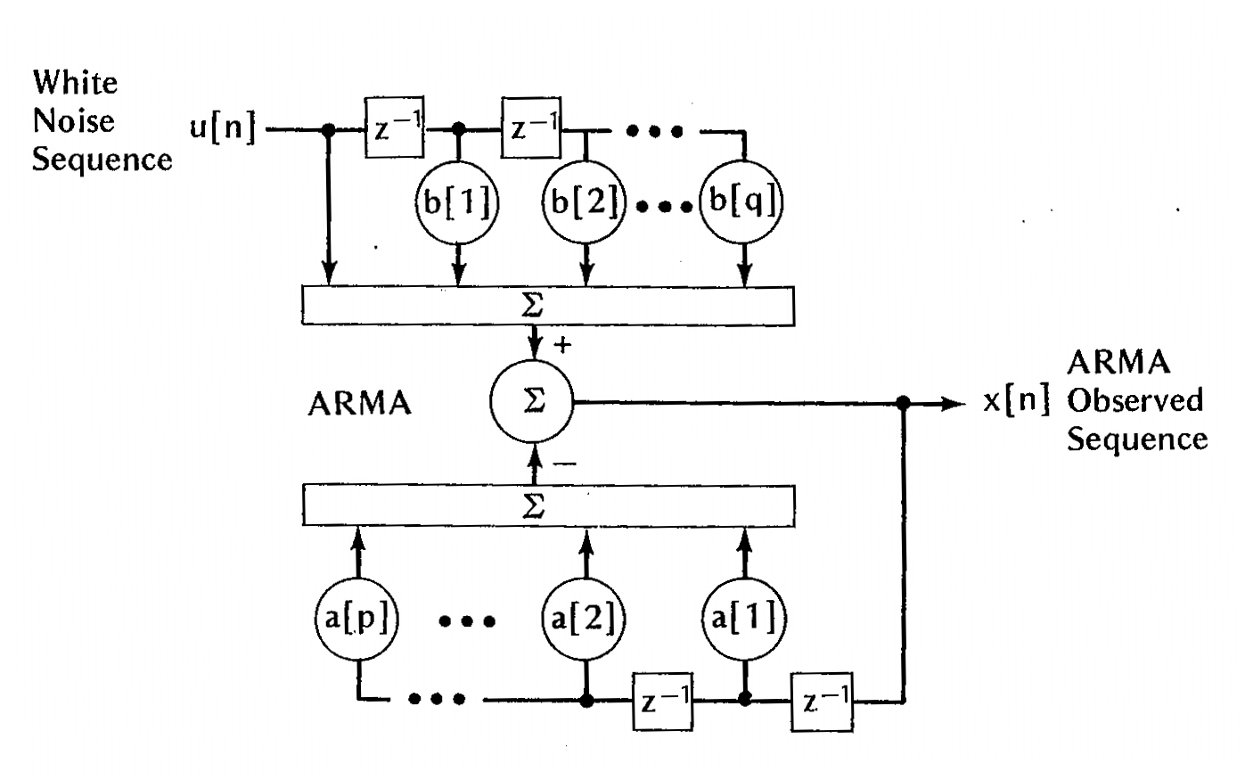
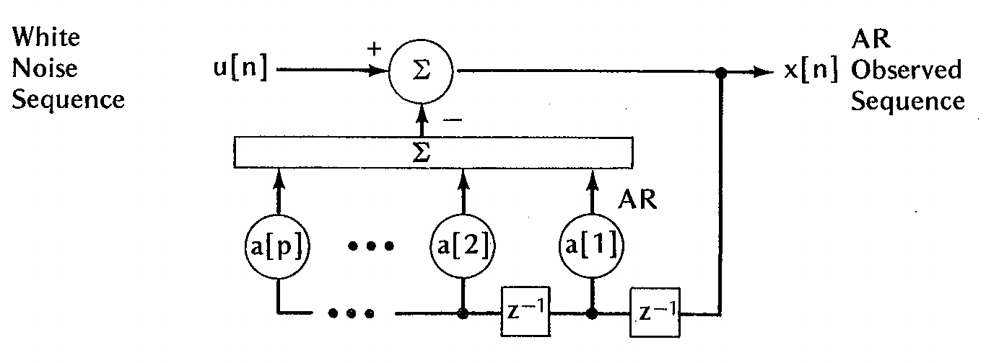
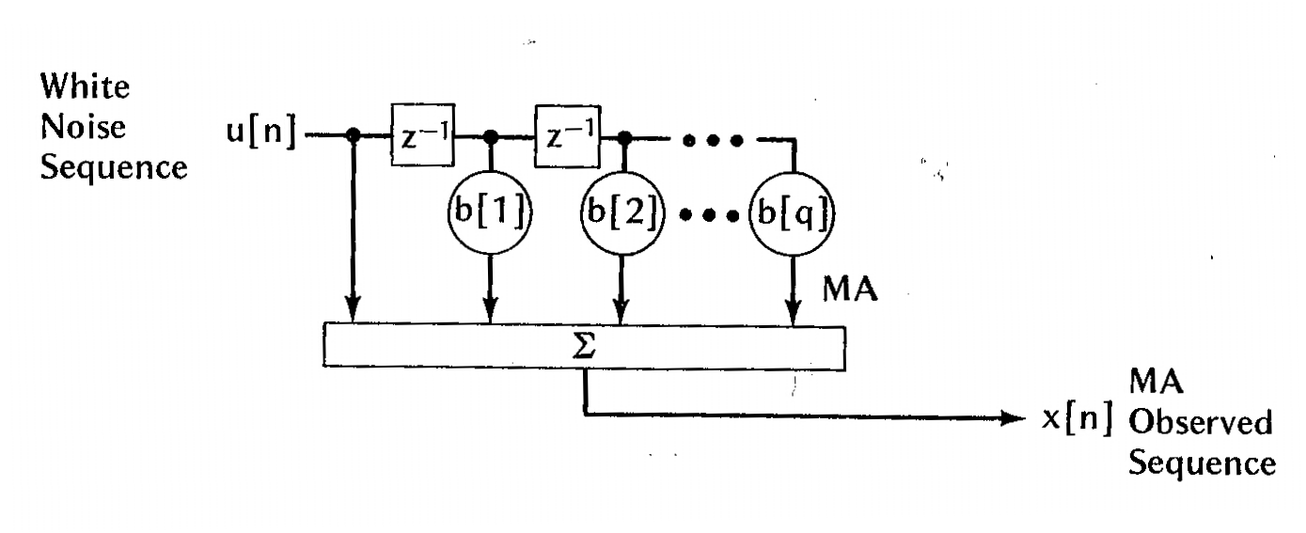
Black – box models: example 1
Linear models
MA
y[n]
MA - Moving Average
AR
y[n]
y(n) = Bu(n) = b_{k}u(n-k)
AR - Auto Regressive
Ay(n) = u(n): y(n)= - a_{k}y(n-k)+u(n)
ARMA
Ay(n) = Bu(n): a_{k}y(n-k)
= b_{k}u(n-k)
ARMA
y[n]

Slide 21
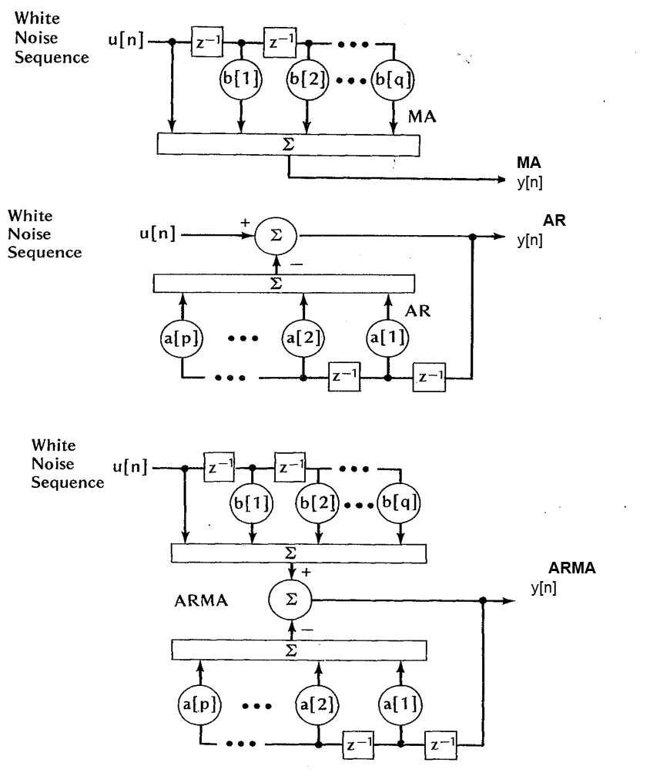
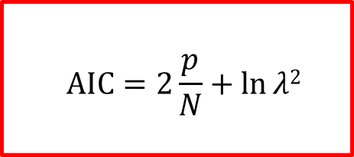
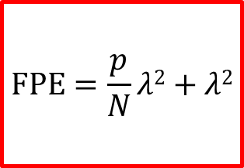
Selection of the model: Wald’s theorem
overfitting
$$FPE=\frac{p}{N}λ2+λ2$$
$$AIC=2\frac{p}{N}+ln⁡λ2$$
WALD’s Theorem
ARMA (p,q) = AR (∞) = MA (∞)

Slide 22
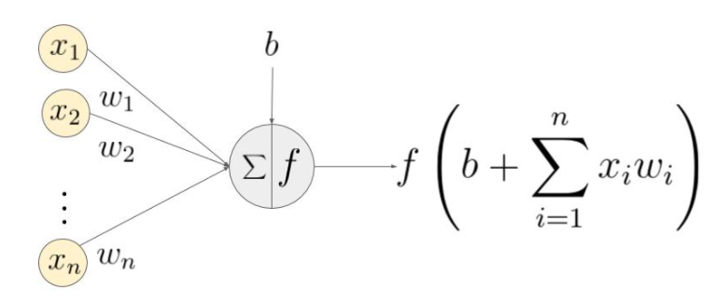
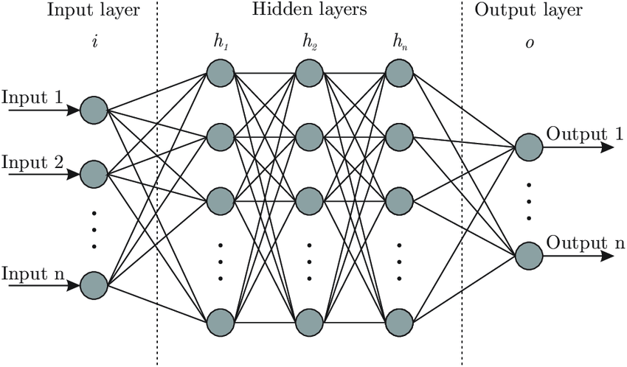
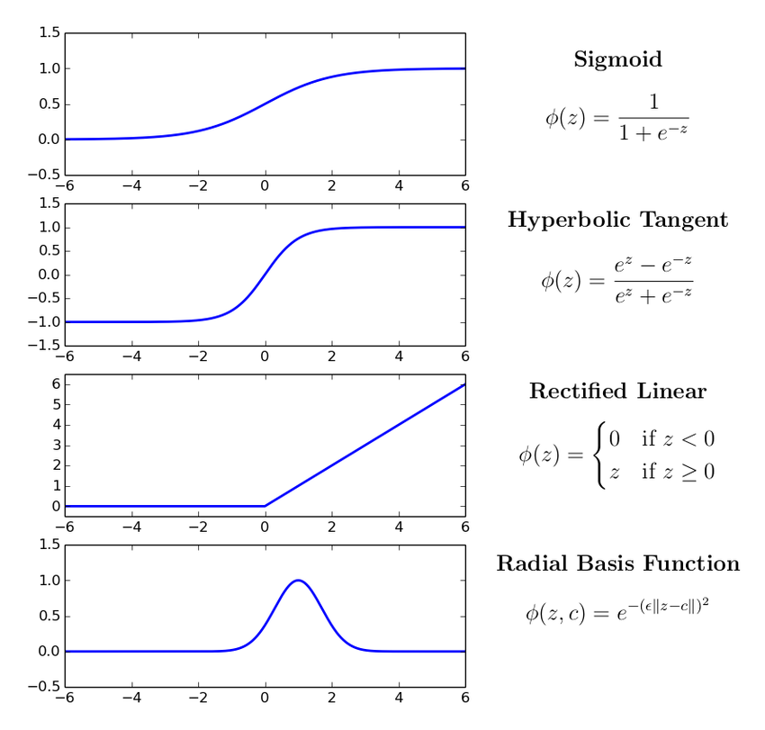
Black – box models: example 2
Neuron
Artificial Neural Network
Activation functions
Network architecture and number of neurons
Activation functions of the neurons
Network training
Notes:
Also a neural network is a black box model. Z e f(z)
General structure of the model we have to assign a value to the weights.
Many possible choices for the structure and the nature of the network

Slide 23
Model Identification (or training)
An equation family relating input to output
Search through family of possible equations to find one that fits training data
Definition of a cost function (loss function)
  Least square
  Maximum likelihood
Solution in closed form
Recursive solution

Slide 24
Testing
To test the model, run on a separate test dataset of input / output pairs
See how well it generalizes to new data
Test with different set of paired input/output data
  Measure performance
  Degree to which this is same as training = generalization
Might not generalize well because
  Model too simple
  not able to capture the nature of the process
  Model too complex
    fits to statistical peculiarities of data this is known as overfitting

Slide 25
Black – box models
PROS
CONS
Prediction error
Concise representation (usually less parameters than data);
They exhibit a predictive ability;
They can give information on the functioning of the system;
Standard algorithms.
They do not reproduce the signal entirely.
Although concise, the representation can be complex and expensive.
It is difficult to identify the exact number of parameters (overfitting or underfitting);
It is not always easy to deduce the physiological meaning of the parameters from the model structure.
Notes:
Many data in order to have robustness in the identification and to avoid overfitting, and to have a generalizable model
Sometimes the parameters of the model can be associated to some physiological parameter → information on the physiological system generating the signal (sympathovagal balance)
Also in case of very different signals or systems or situations, we can use the same algorithms
Using themodel we cal predict the behaviour of a process (statistical properties)

Slide 26
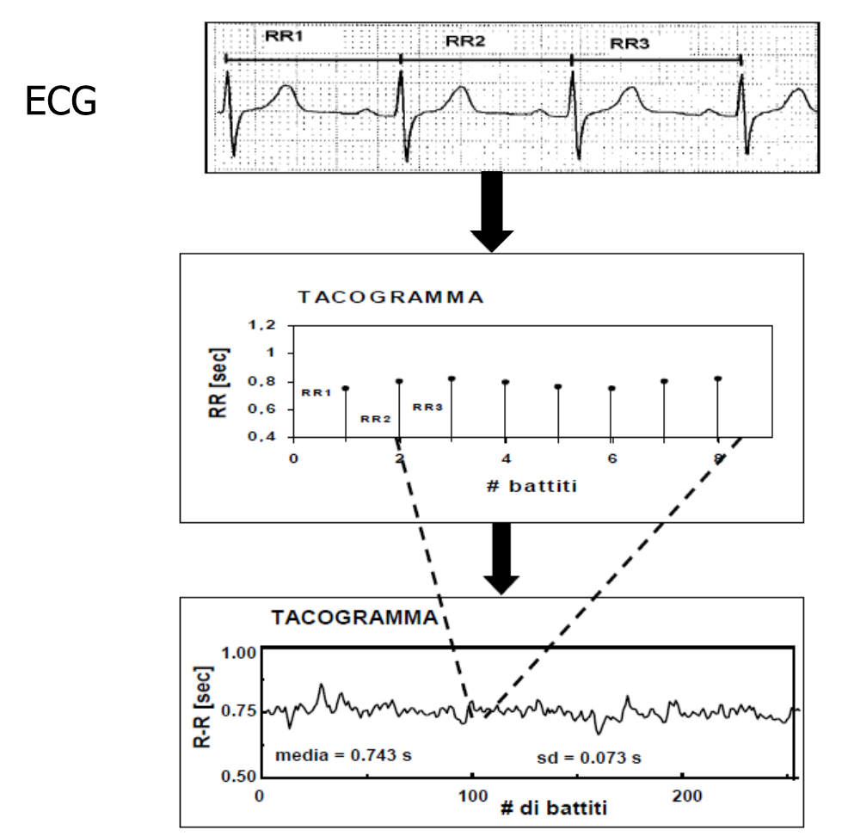
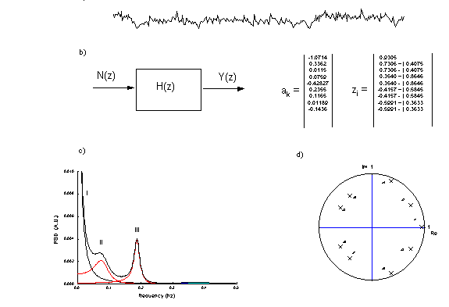
Autoregressive model for Heart Rate Variability signal
Choice of the model (AR)
Model identification
Estimation of the Power Spectral Density (PSD)

Slide 27
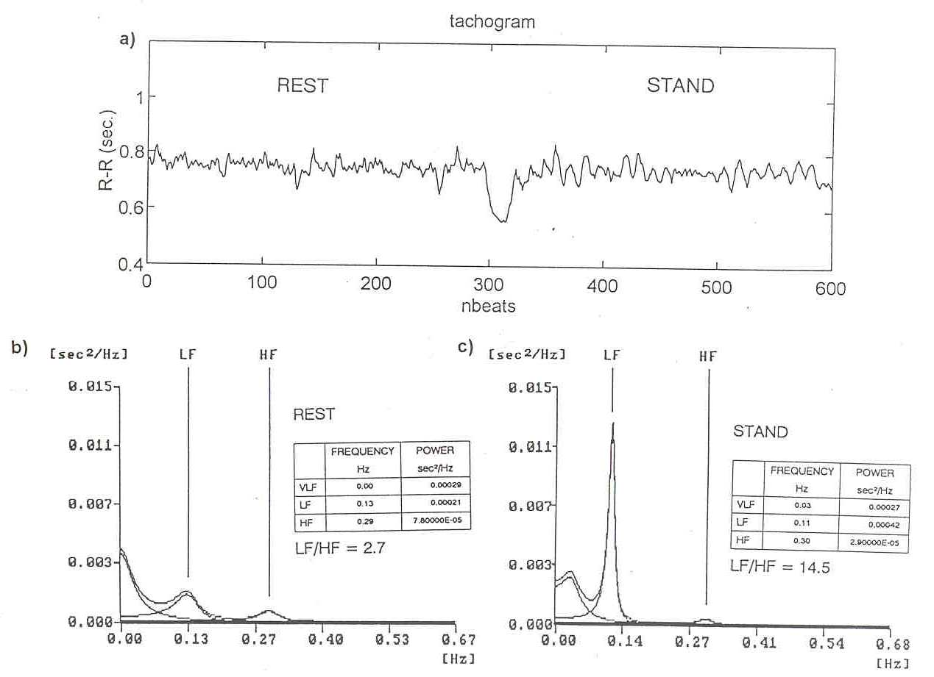
Analysis of the Heart Rate Variability Signal
Frequency analysis of cardiovascular variability signals allows to obtain reliable indicators of the sympatho-vagal balance (LF and HF components and LF/HF ratio)
Notes:
27

Slide 28
MMMM (4M) paradigm: some exemples
Multiscale
Multichannel
Multimodal
Multiorgan

Slide 29
Multiscale: Time from beat to beat to long term correlation analysis

Slide 30
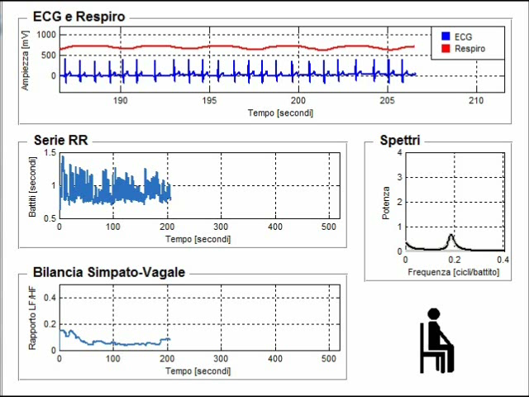
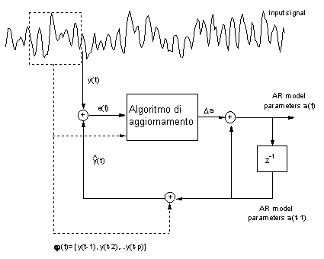
Models can be made adaptive
Model in prediction form
y(i)
i
Notes:
Formula e figura ricorsiva

Slide 31
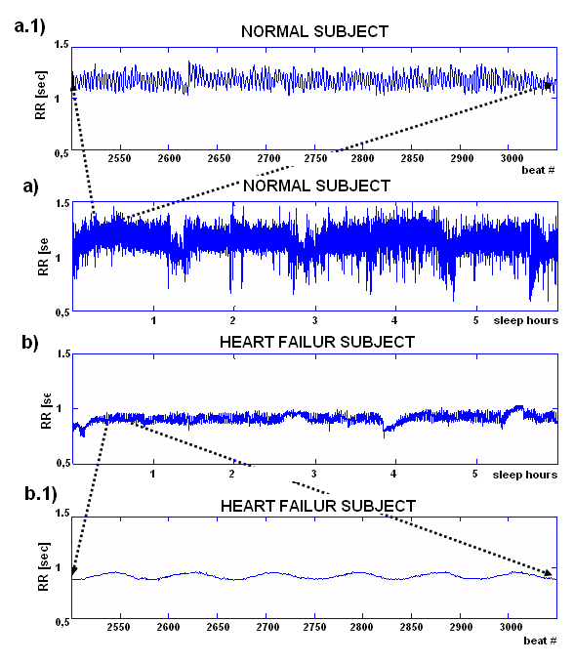
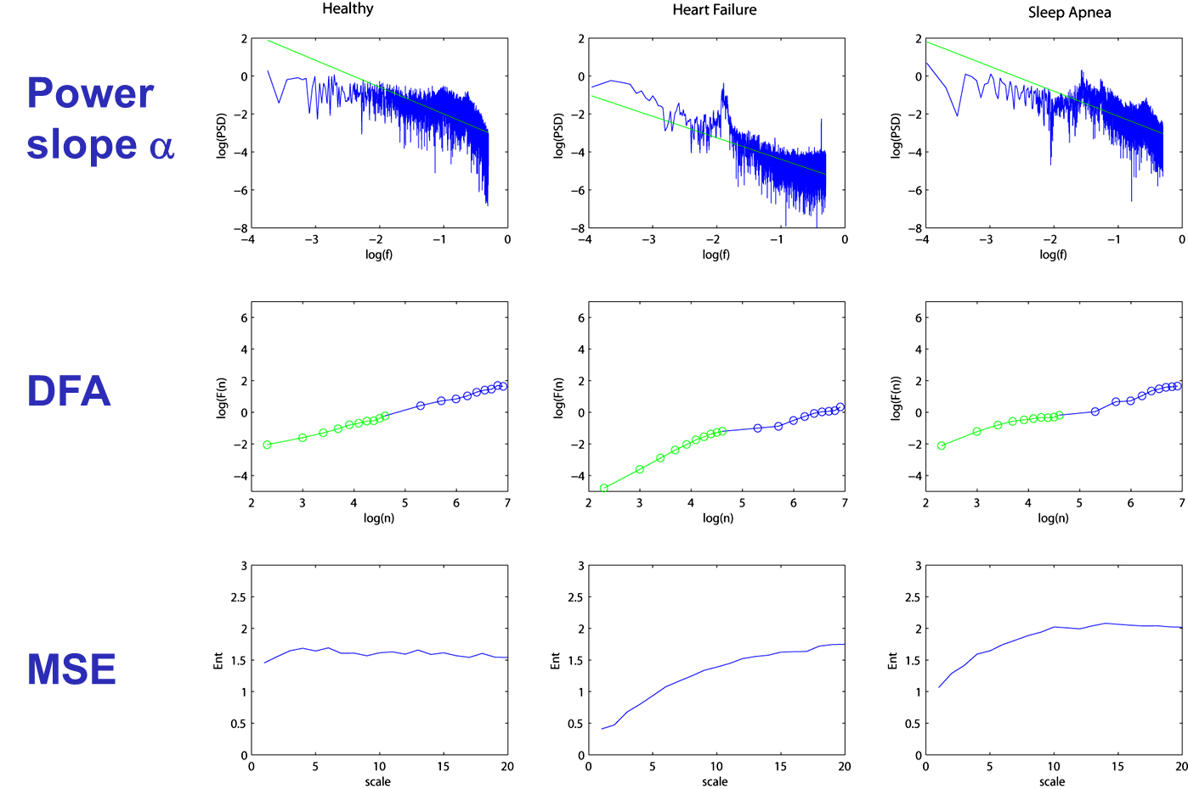
Long time correlation analysis

Slide 32
Multiscale: Space from single cells to whole organs (or systems)

Slide 33
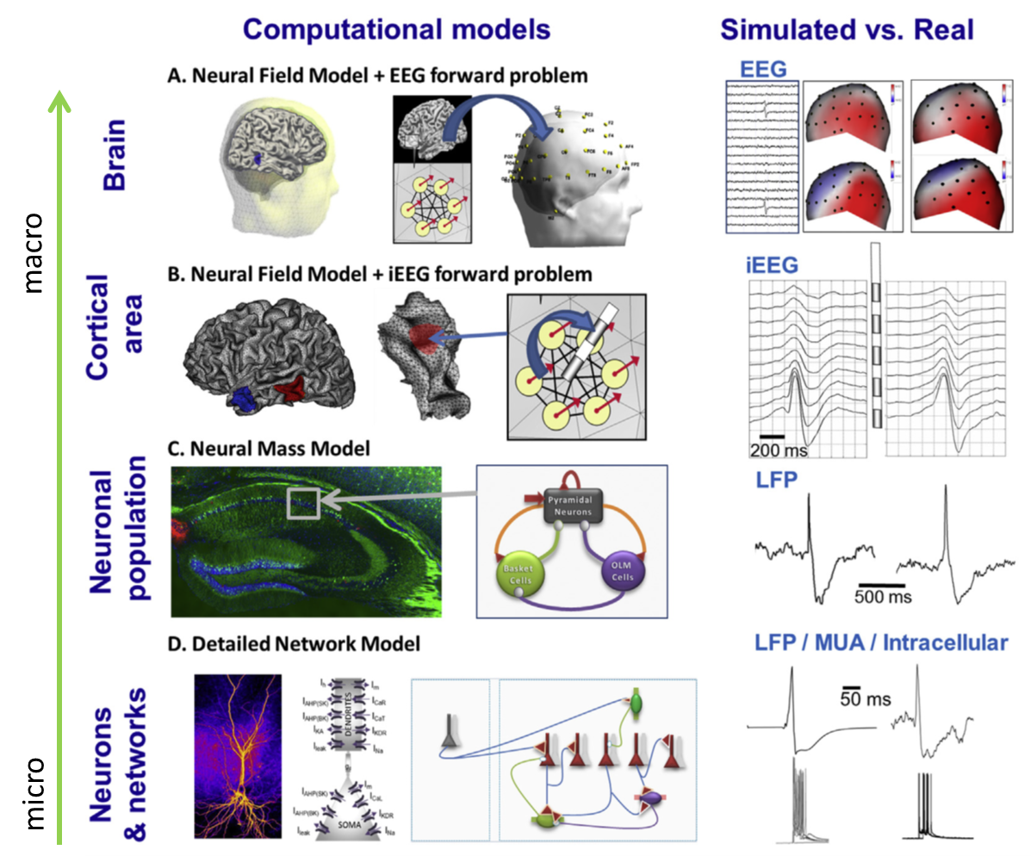
Modeling the central nervous system
At macro-scale, brain areas are represented as nodes having a defined dynamic (NMM, NFM, oscillators)
Nodes are connected through edges of different strengths, usually based on structural connectivity representing white matter connections
Meso-scale models describe the collective activity of interconnected subpopulations
Neural Field Models (NFM) for cortical areas and structures spatiotemporal evolution NFMs
Neural Mass Models (NMMs): systems of nonlinear ordinary differential equations approximate the
Hodgkin-Huxley model for neuron action potential
Statistical models for describing neuron firing activity
Notes:
The challenge faced by any modeling approach is to capture the essential features of the system under study.
In the brain, the level of modeling is a crucial choice and depends on the type of behavior to be modeled, the nature of and the data it relates to:
single-unit recordings, local field potentials (LFPs)
electroencephalographic (EEG) signals magnetoencephalographic(MEG) signals
functional magnetic resonance imaging (fMRI)
systems of nonlinear ordinary differential equations
Neural Field Models (NFM) are used to model cortical areas and structures and describe the spatiotemporal evolution of coarse grained variables such as synaptic or firing rate activity in coupled populations of neurons.
NFMs can be viewed as an extension of NMMs that only described the temporal dynamic of neuronal populations activity. NFMs have the advantage to account for the spatial features (geometry, extent, connectivity) of neuronal sources, in addition to their temporal features like the synchronization level among neurons.
Neural Field Models (NFM) are used to model cortical areas and structures and describe the spatiotemporal evolution of coarse grained variables such as synaptic or firing rate activity in coupled populations of neurons.
NFMs can be viewed as an extension of NMMs that only described the temporal dynamic of neuronal populations activity. NFMs have the advantage to account for the spatial features (geometry, extent, connectivity) of neuronal sources, in addition to their temporal features like the synchronization level among neurons.
If we model the brain as a large complex network, the areas can be represented by nodes of the network. The nodes are connected by edges that are the representation of the structural or anatomical long-range connection fibers. The detail of these connection can vary, depending on the ‘size’ of the nodes. The structural connectivity matrix can be dervide from DTI processing of mri imaging, so it could be personalized, or we can use a standard matrix derived from studies on non human primate like the cocomac that include 76 areas (38 for hemisphere)

Slide 34
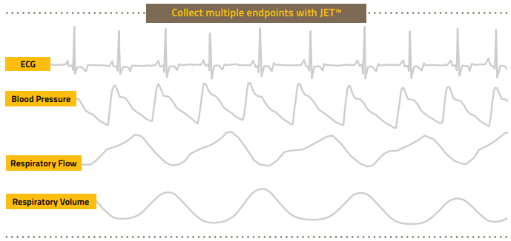
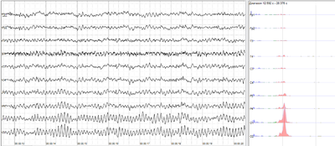
Multichannel: relationshops among channels and signals
Cardiovascular system
Neurosensorial system
Notes:
Multi- signal processes need to be described
Signals of different nature (sistema cardiovascolare)
Signals of the same nature (EEG multicanale)

Slide 35
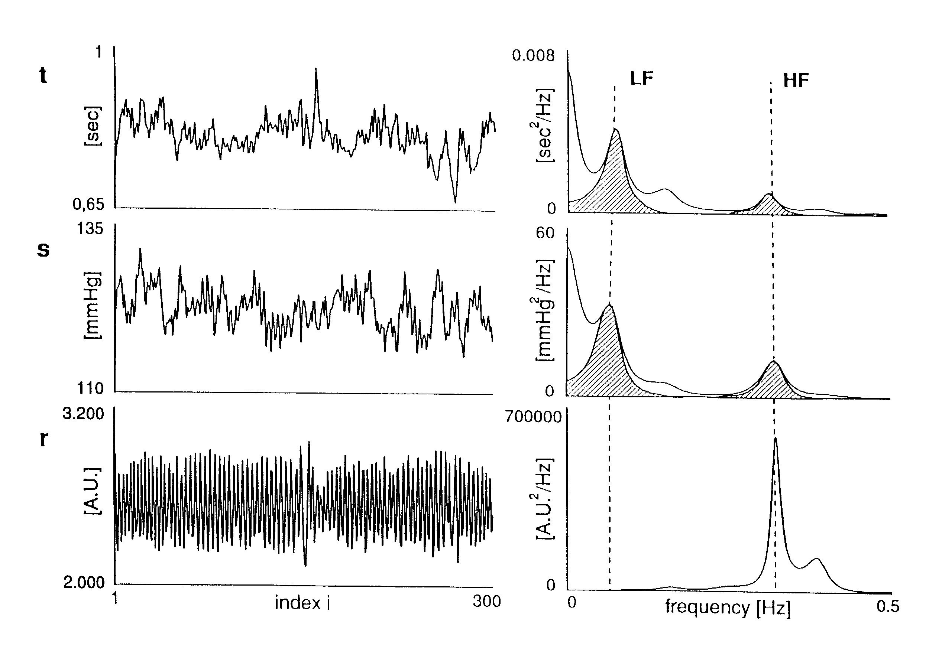
Cardio-Respiratory System
Notes:
Let’s start from a few signals that can be obtained non-invasively, and with simple instrumentation from the cardio-vascular and respiratory systems and which are widely emploied for describing mechanisms involved in the autonomic regulation of the cardiovascular and cardio-respiratory system..
Let’s consider ECG, BP and Respiration signals. Of course, they are not independent from each other.
We can extract variability signals from ECG (RR time intervals as function of the beat number, which is the tachogram),
From the Blood Pressure (we obtain the sequence the sequence of the systolic values, which calle systogram), and from the respiration activity (which is resampled for each cardiac beat in order to have a series synchronized with the previous ones). This last time series is called respirogram.
Other time series could also be taken into consideration (i.e. diastolic blood pressures, or mean pressure, or pulse pressure, etc.).
Observing these varibility series, in the frequency domain, we clearly see that they are characterized by some well defined peaks. We have a HF peak, both in the tachogram and in the systogram, at the same frequency as respiration, and an LF peck both in tachogram and in systogram. Thus these signals are not independent.
It is well known from the literature, and also from many studies that have been carried out along many years, that for a good understanding and separation of the different contributions acting on the HRV signal, we need to model interactions among the different variables in the cardio-respiratory and in the cardiovascular system. The cardiovascular system is complex and there are many different variables and many different mechanisms which are involved and need to be properly described in order to provide a correct view of what is going on in physiological or in pathological situations.

Slide 36
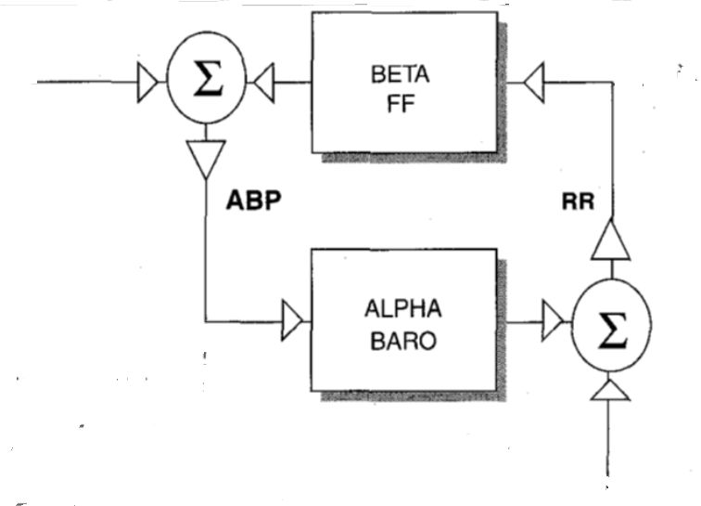
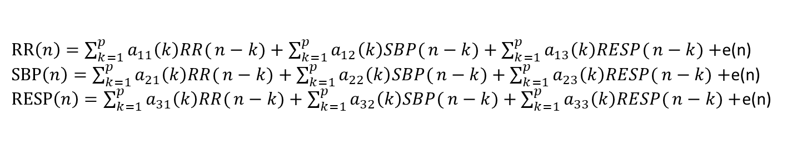
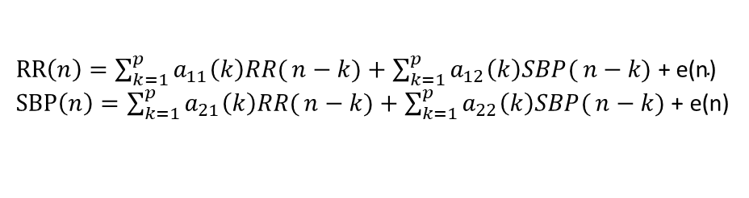
Multivariate AR model
TRIVARIATE CLOSED LOOP MODEL
BIVARIATE CLOSED LOOP MODEL
RR$\left(n\right)=\sum_{k=1}^{p}{a_{11}\left(k\right)RR(}n−k)+\sum_{k=1}^{p}{a_{12}\left(k\right)SBP(}n−k\text{) }\text{+ }\text{e}\text{(}\text{n}\text{)}$
SBP$\left(n\right)=\sum_{k=1}^{p}{a_{21}\left(k\right)RR(}n−k)+\sum_{k=1}^{p}{a_{22}\left(k\right)SBP(}n−k)$ + e(n)
RR$\left(n\right)=\sum_{k=1}^{p}{a_{11}\left(k\right)RR(}n−k)+\sum_{k=1}^{p}{a_{12}\left(k\right)SBP(}n−k)+\sum_{k=1}^{p}{a_{13}\left(k\right)RESP(}n−k)+$e(n)
SBP$\left(n\right)=\sum_{k=1}^{p}{a_{21}\left(k\right)RR(}n−k)+\sum_{k=1}^{p}{a_{22}\left(k\right)SBP(}n−k)+\sum_{k=1}^{p}{a_{23}\left(k\right)RESP(}n−k)+$e(n)
RESP$\left(n\right)=\sum_{k=1}^{p}{a_{31}\left(k\right)RR(}n−k)+\sum_{k=1}^{p}{a_{32}\left(k\right)SBP(}n−k)+\sum_{k=1}^{p}{a_{33}\left(k\right)RESP(}n−k)+$e(n)
Notes:
Formula più figure multivariato

Slide 37
Adding physiologocal knowledge

Slide 38
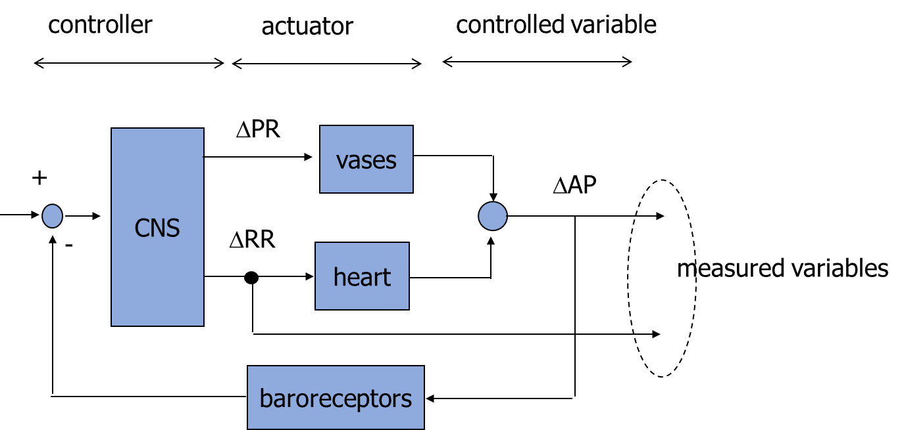
Open loop model
physiologically, blood pressure is regulated in a closed loop through changes in peripheral resistance (PR) and duration of the cardiac cycle (RR)
a vasoconstrictor drug (e.g., phenylephrine) opens the regulation loop, increases peripheral resistance and consequently blood pressure; a corresponding increase in the duration of the cardiac cycle is recorded
Notes:
Slope of the curve has a relevant prognosti value in post MI patients

Slide 39
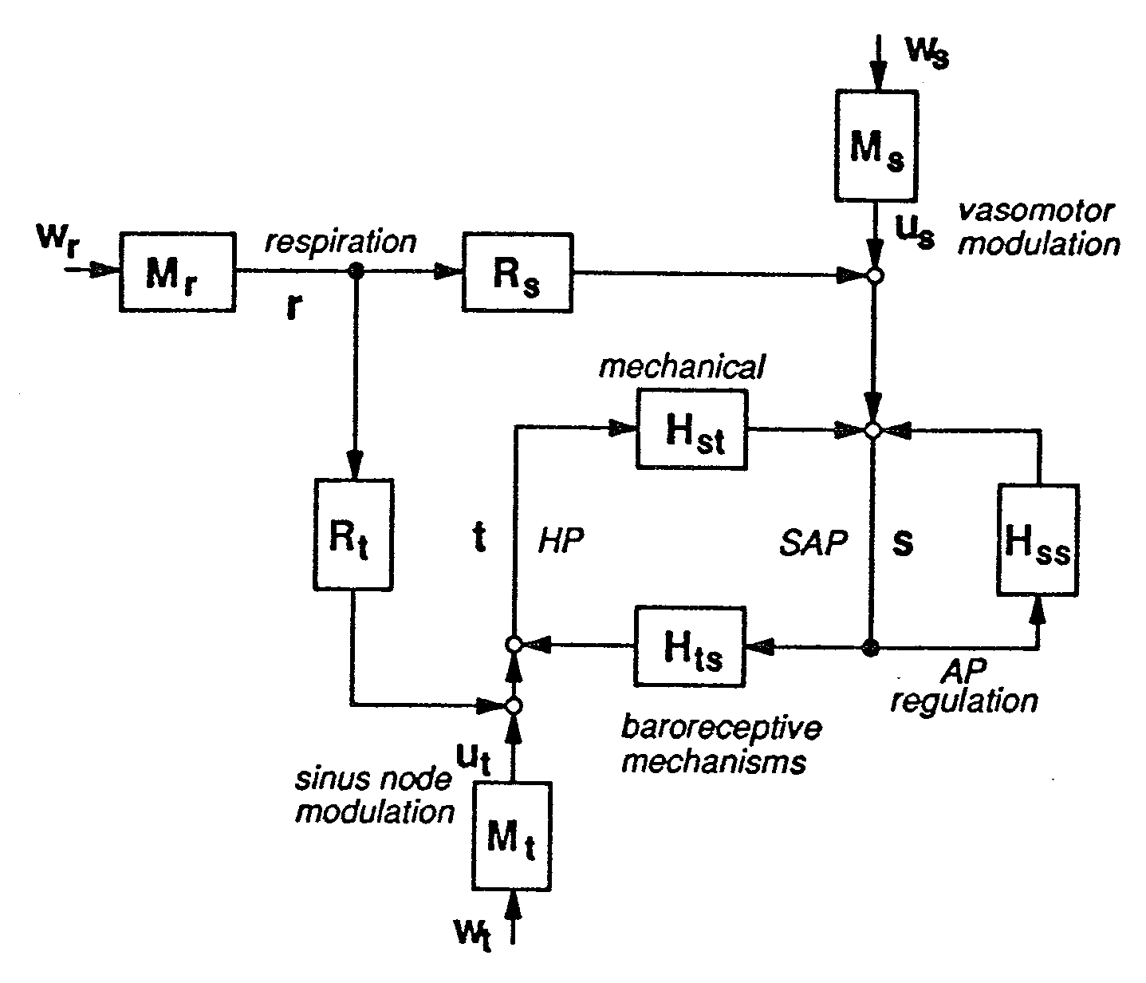
Closed loop model: different formulations
ε₁
1/(1-A₁₁)
v₁
v₂
sap
v₁
ε₂
v₂
sap
rr
rr
1/A₂₂
A₁₂/(1-A₁₁)
G₁₂(z)
G₂₁(z)
A₂₁/A₂₂
Notes:
Interactions among signals – closed loop models

Slide 40
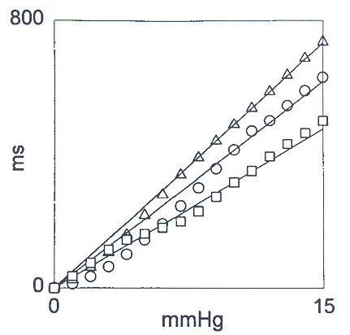
Estimation of the baroreceptive gain: relevance of the model
w_{rr}
X
sap
rr
A_{rr,sap}
guadagno di A_{rr,sap} in risposta a rampa
XAR
w_{rr}
v_{rr}
1/D_{rr}
sap
rr
A_{rr,sap}
XXAR
w_{rr}
v_{rr}
1/D_{rr}
resp
A_{rr,resp}
sap
rr
A_{rr,sap}
Porta et al., 2000

Slide 41
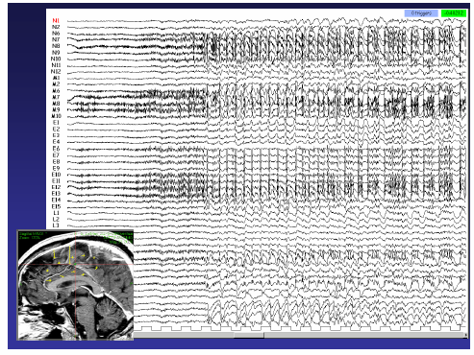
Multichannel intracranial EEG recordings

Slide 42

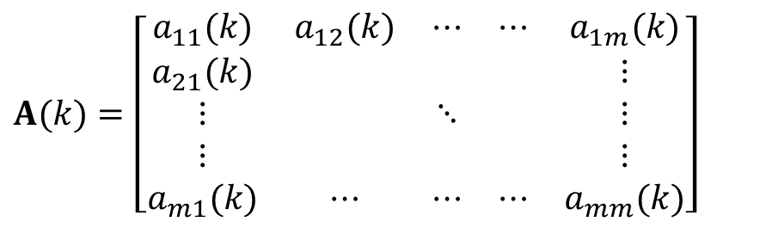
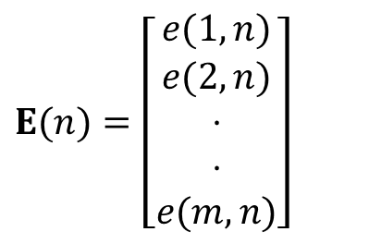
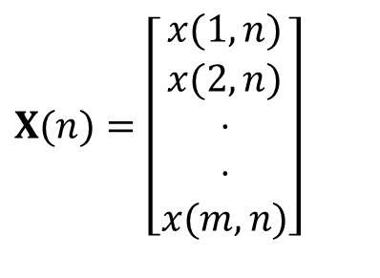
Multivariate AutoRegressive Model
$$X(n)=A(1)X(n−1)+.....+A(p)X(n−p)+E(n)$$
$$X(n)=\left[\begin{matrix}x(1,n) \\ x(2,n) \\ ⋅ \\ ⋅ \\ x(m,n)\end{matrix}\right]$$
$$E(n)=\left[\begin{matrix}e(1,n) \\ e(2,n) \\ ⋅ \\ ⋅ \\ e(m,n)\end{matrix}\right]$$
e₁
x₁
e₂
H
x₂
…
…
e_{m}
$$A(k)=\left[\begin{matrix}a_{11}(k) & a_{12}(k) & ⋯ & ⋯ & a_{1m}(k) \\ a_{21}(k) & & & & ⋮ \\ ⋮ & & ⋱ & & ⋮ \\ ⋮ & & & & ⋮ \\ a_{m1}(k) & ⋯ & ⋯ & ⋯ & a_{mm}(k)\end{matrix}\right]$$
x_{m}
$$X(z)={\left(I−A(z)\right)}^{−1}E(z)={\bar{A}}^{−1}(z)E(z)=H(z)E(z)$$
$$X(f)=H(f)E(f)$$
z=e^{j2πf}

Slide 43
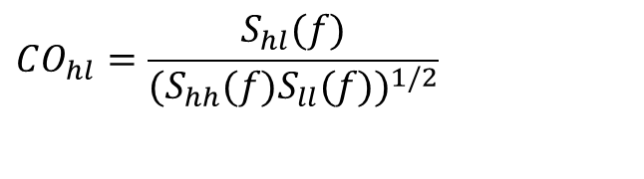
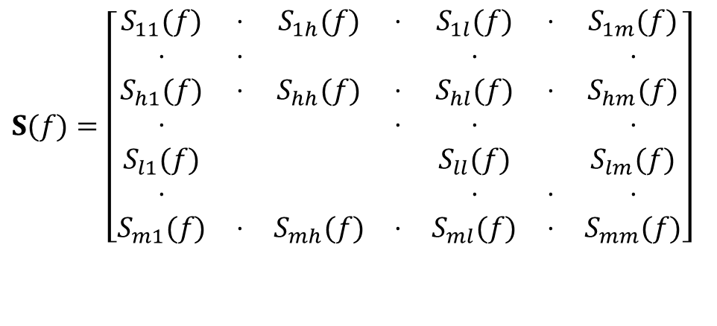
Spectral analysis
PSDs
$$S(f)=X(f)⋅X^{H}(f)=H(f)ΣH^{H}(f)$$
Total Coherence
$$S(f)=\left[\begin{matrix}S_{11}(f) & ⋅ & S_{1h}(f) & ⋅ & S_{1l}(f) & ⋅ & S_{1m}(f) \\ ⋅ & ⋅ & & & ⋅ & & ⋅ \\ S_{h1}(f) & ⋅ & S_{hh}(f) & ⋅ & S_{hl}(f) & ⋅ & S_{hm}(f) \\ ⋅ & & & ⋅ & ⋅ & & ⋅ \\ S_{l1}(f) & & & & S_{ll}(f) & & S_{lm}(f) \\ ⋅ & & & & ⋅ & ⋅ & ⋅ \\ S_{m1}(f) & ⋅ & S_{mh}(f) & ⋅ & S_{ml}(f) & ⋅ & S_{mm}(f)\end{matrix}\right]$$
$$CO_{hl}=\frac{S_{hl}(f)}{(S_{hh}(f)S_{ll}(f))^{1/2}}$$

Slide 44
Directionality of the interacions
C
B
B
C
CO_{BC} ~ 1
B
B
A
C
C

Slide 45
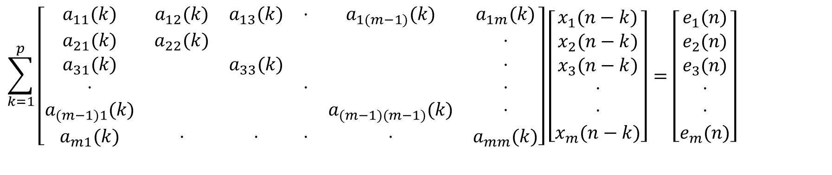
Partition of the process
$$\sum_{k=1}^{p}{\left[\begin{matrix}a_{11}(k) & a_{12}(k) & a_{13}(k) & ⋅ & a_{1(m−1)}(k) & a_{1m}(k) \\ a_{21}(k) & a_{22}(k) & & & & ⋅ \\ a_{31}(k) & & a_{33}(k) & & & ⋅ \\ ⋅ & & & ⋅ & & ⋅ \\ a_{(m−1)1}(k) & & & & a_{(m−1)(m−1)}(k) & ⋅ \\ a_{m1}(k) & ⋅ & ⋅ & ⋅ & ⋅ & a_{mm}(k)\end{matrix}\right]}\left[\begin{matrix}x_{1}(n−k) \\ x_{2}(n−k) \\ x_{3}(n−k) \\ ⋅ \\ ⋅ \\ x_{m}(n−k)\end{matrix}\right]=\left[\begin{matrix}e_{1}(n) \\ e_{2}(n) \\ e_{3}(n) \\ ⋅ \\ ⋅ \\ e_{m}(n)\end{matrix}\right]$$

Slide 46

Partition of the process
$$\sum_{k=1}^{p}{\left[\begin{matrix}a_{11}(k) & a_{12}(k) & a_{13}(k) & ⋅ & a_{1(m−1)}(k) & a_{1m}(k) \\ a_{21}(k) & a_{22}(k) & & & & ⋅ \\ a_{31}(k) & & a_{33}(k) & & & ⋅ \\ ⋅ & & & ⋅ & & ⋅ \\ a_{(m−1)1}(k) & & & & a_{(m−1)(m−1)}(k) & ⋅ \\ a_{m1}(k) & ⋅ & ⋅ & ⋅ & ⋅ & a_{mm}(k)\end{matrix}\right]}\left[\begin{matrix}x_{1}(n−k) \\ x_{2}(n−k) \\ x_{3}(n−k) \\ ⋅ \\ ⋅ \\ x_{m}(n−k)\end{matrix}\right]=\left[\begin{matrix}e_{1}(n) \\ e_{2}(n) \\ e_{3}(n) \\ ⋅ \\ ⋅ \\ e_{m}(n)\end{matrix}\right]$$
$$\begin{matrix}e_{1}(n) \\ e_{2}(n)\end{matrix}$$

Slide 47






Partition of the process
$$\sum_{k=1}^{p}{\left[\begin{matrix}a_{11}(k) & a_{12}(k) & a_{12}(k) & ⋅ & a_{1(m−1)}(k) & a_{1m}(k) \\ a_{21}(k) & a_{22}(k) & & & & ⋅ \\ a_{31}(k) & & a_{33}(k) & & & ⋅ \\ ⋅ & & & ⋅ & & ⋅ \\ a_{(m−1)1}(k) & & & & a_{(m−1)(m−1)}(k) & ⋅ \\ a_{m1}(k) & ⋅ & ⋅ & ⋅ & ⋅ & a_{mm}(k)\end{matrix}\right]}\left[\begin{matrix}x_{1}(n−k) \\ x_{2}(n−k) \\ x_{3}(n−k) \\ ⋅ \\ ⋅ \\ x_{m}(n−k)\end{matrix}\right]=\left[\begin{matrix}e_{1}(n) \\ e_{2}(n) \\ e_{3}(n) \\ ⋅ \\ ⋅ \\ e_{m}(n)\end{matrix}\right]$$
$$\sum_{k=1}^{p}{\left[\begin{matrix} & & & \\ & & & \end{matrix} \right]}\left[\begin{matrix} & & \\ & & \end{matrix} \right]=\left[\begin{matrix} & \\ & \end{matrix} \right]$$
$$\begin{matrix}a_{11}(k) & a_{12}(k) \\ a_{21}(k) & a_{22}(k)\end{matrix}$$
$$\begin{matrix}x_{1}(n−k) \\ x_{2}(n−k)\end{matrix}$$
$$\begin{matrix}e_{1}(n) \\ e_{2}(n)\end{matrix}$$
Partial coherence
$$k_{12:Y}(f)=\frac{\left|S_{X:Y(12)}(f)\right|}{{\left(S_{X:Y(11)}(f)S_{X:Y(22)}(f)\right)}^{1/2}}$$

Slide 48

Partition of the process
$$\sum_{k=1}^{p}{\left[\begin{matrix}a_{11}(k) & a_{12}(k) & a_{13}(k) & ⋅ & a_{1(m−1)}(k) & a_{1m}(k) \\ a_{21}(k) & a_{22}(k) & & & & ⋅ \\ a_{31}(k) & & a_{33}(k) & & & ⋅ \\ ⋅ & & & ⋅ & & ⋅ \\ a_{(m−1)1}(k) & & & & a_{(m−1)(m−1)}(k) & ⋅ \\ a_{m1}(k) & ⋅ & ⋅ & ⋅ & ⋅ & a_{mm}(k)\end{matrix}\right]}\left[\begin{matrix}x_{1}(n−k) \\ x_{2}(n−k) \\ x_{3}(n−k) \\ ⋅ \\ ⋅ \\ x_{m}(n−k)\end{matrix}\right]=\left[\begin{matrix}e_{1}(n) \\ e_{2}(n) \\ e_{3}(n) \\ ⋅ \\ ⋅ \\ e_{m}(n)\end{matrix}\right]$$

Slide 49





Partition of the process
$$\sum_{k=1}^{p}{\left[\begin{matrix}a_{11}(k) & a_{12}(k) & a_{13}(k) & ⋅ & a_{1(m−1)}(k) & a_{1m}(k) \\ a_{21}(k) & a_{22}(k) & & & & ⋅ \\ a_{31}(k) & & a_{33}(k) & & & ⋅ \\ ⋅ & & & ⋅ & & ⋅ \\ a_{(m−1)1}(k) & & & & a_{(m−1)(m−1)}(k) & ⋅ \\ a_{m1}(k) & ⋅ & ⋅ & ⋅ & ⋅ & a_{mm}(k)\end{matrix}\right]}\left[\begin{matrix}x_{1}(n−k) \\ x_{2}(n−k) \\ x_{3}(n−k) \\ ⋅ \\ ⋅ \\ x_{m}(n−k)\end{matrix}\right]=\left[\begin{matrix}e_{1}(n) \\ e_{2}(n) \\ e_{3}(n) \\ ⋅ \\ ⋅ \\ e_{m}(n)\end{matrix}\right]$$
$$\sum_{k=1}^{p}{\left[\begin{matrix} & & & \\ & & & \end{matrix} \right]}\left[\begin{matrix} & & \\ & & \end{matrix} \right]=\left[\begin{matrix} & \\ & \end{matrix} \right]$$
$$\begin{matrix}a_{11}(k) & a_{13}(k) \\ a_{21}(k) & a_{23}(k)\end{matrix}$$
$$\begin{matrix}x_{1}(n−k) \\ x_{3}(n−k)\end{matrix}$$
$$\begin{matrix}e_{1}(n) \\ e_{3}(n)\end{matrix}$$
Partial coherence
$$k_{12:Y}(f)=\frac{\left|S_{X:Y(13)}(f)\right|}{{\left(S_{X:Y(11)}(f)S_{X:Y(33)}(f)\right)}^{1/2}}$$

Slide 50
Granger causality
Granger causality is a statistical concept of causality that is based on prediction. According to Granger causality, if a signal X₁ "Granger-causes" (or "G-causes") a signal X₂, then past values of X₁ should contain information that helps predict X₂ above and beyond the information contained in past values of X₂ alone.
Partial Directed
Coherence
(PDC)
Direct
Transfer Function
(DTF)
full frequency Direct
Transfer Function
(ffDTF)
directed Direct
Transfer Function
(dDTF)

Slide 51





Directionality indices
Partial Directed Coherence
$$\bar{A}(f)=\left[\begin{matrix}{\bar{a}}_{11}(f) & ⋯ & {\bar{a}}_{1j}(f) & ⋯ & {\bar{a}}_{1m}(f) \\ {\bar{a}}_{21}(f) & ⋱ & ⋮ & & ⋮ \\ ⋮ & & {\bar{a}}_{jj}(f) & & ⋮ \\ ⋮ & & ⋮ & ⋱ & ⋮ \\ {\bar{a}}_{m1}(f) & ⋯ & {\bar{a}}_{mj}(f) & ⋯ & {\bar{a}}_{mm}(f)\end{matrix}\right]$$
$$π_{ij}(f)≜\frac{{\bar{a}}_{ij}(f)}{\sqrt{{\bar{a}}_{j}^{H}(f){\bar{a}}_{j}(f)}}$$
Full Frequency Direct Transfer Function
$$η_{ij}^{2}(f)≜\frac{{\left|h_{ij}(f)\right|}^{2}}{\sum_{f}{\sum_{k=1}^{m}{{\left|h_{ik}(f)\right|}^{2}}}}$$
$$H(f)=\left[\begin{matrix}h_{11}(f) & h_{12}(f) & ⋯ & ⋯ & h_{1m}(f) \\ ⋮ & ⋱ & & & ⋮ \\ h_{i1}(f) & ⋯ & h_{ii}(f) & ⋯ & h_{im}(f) \\ ⋮ & & & ⋱ & ⋮ \\ h_{m1}(f) & & ⋯ & & h_{mm}(f)\end{matrix}\right]$$
Directed Direct Transfer Function
$$δ_{ij}(f)≜k_{ij}(f)⋅η_{ij}(f)$$

Slide 52


Ictal activity in multichannel intracranial recordings
PDC
dDTF
11-15 Hz
15-20 Hz
μV
s

Slide 53
Multimodal

Slide 54
Anatomical, functional, metabolic, …

Slide 55
Different resolutions

Slide 56
EEG-fMRI integration approaches

Slide 57

fMRI: General Linear Model including EEG

Slide 58


Task regressor
C3 alpha and betha
C4 alpha and betha
Regions in the LEFT hemisphere
High probability to belong to the left precentral gyrus (MOTOR CORTEX) or left postcentral gyrus (SOMATOSENSORY CORTEX)
PREMOTOR CORTEX activation → coordination of complex movement.
α-rhythm linked to the SOMATOSENSORY SYSTEM
β-rhythm more related to MOTOR PROCESSING
Activation in extrarolandic regions visible both in α and β wave regressors → ATTENTIONAL NETWORK
No significant correlation between BOLD and C4 α-rhythm
β-rhythm activations in extrarolandic regions only → brain regions that are NOT DIRECTLY INVOLVED in motor performance

Slide 59
Multiorgan - Multisystem

Slide 60
Sleep: a multi-system phenomenon
During REM sleep the LF/HF ratio increases along the night and reaches, at the end of the night, values comparable to those obtained during upright position.
U. Scholz,J., A. Bianchi,M., S. Cerutti, and S. Kubicki, Vegetative backgroung of sleep: spectral analysis of the heart rate variability Phys. & Behav. vol. 62, pp. 1037-1043, 1997

Slide 61

CAP (Cyclic Altrenating Pattern) sleep analysis
EEG
EMG
RR
RESP
Notes:
The Cyclic Alternating Pattern (CAP) is a periodic EEG activity occurring during NREM sleep. It is characterized by cyclic sequences of cerebral activation (phase A) followed by periods of deactivation (phase B). This a physiological phenomenon during sleep, on the other hand it is associated to some sleep disturbances (sleep apneas) and pathological states (heart failure). An increase in CAP rate can be indicative of some disturbances.
Also peripheral signals are involved during CAP, with a very high synchrony.
EMG at the leg (myoclonus)
Heart rate
Respiration

Slide 62
Multisystem - Multimodal

Slide 63

Relating Autonomic Nervous System and Central Nervous System
GLM
HF as measure of the vagal modulation
HF series as regressor for the analysis of fMRI
Autonomic regressor in GLM
Notes:
This example focuses on the use of fMRI.
FMRI analysis allows to highlight brain areas that are activated during the execution of specific tasks or in consequence of specific stimuli. In particular in the GLM (General Linear Model) approach. In practice, the time course of the BOLD (Blood Oxygenation Level Dependent) signal is modeled as a linear combination of proper regressors correlated with a task, or with a noise source, or other physiological variables.
In this specific example the central command of cardiovagal outflow was put into evidence by using the temporal trend of HF timeseries as a regressor to the fMRI data analysis.

Slide 64
Relating Autonomic Nervous System and Central Nervous System
Notes:
The HRV signal was processed in order to obtain the high-frequency (HF) index varying along time, so that it reflects the time-varying dynamics of efferent cardiovagal modulation.
A grip task was also introduced in order to perturb and modulate the parasympathetic outflow. The HF timeseries was used as a regressor for the fMRI data analysis. The combined HRV-fMRI approach demonstrated HF correlation with fMRI activity in many brain structures.
Results show that parasympathetic (HF) modulation correlated with fMRI signal in several brainstem, subcortical, and cortical regions. Among the others (PBN=parabrachial nucleus; LC=locus ceruleus; Amyg=amygdala; Hyp=hypothalamus; PAG=periaqueductal gray; pIns=posterior insula; DLPFC=dorsolateral prefrontal cortex).

Slide 65
Relating Autonomic Nervous System and Central Nervous system
Notes:
In another study skin conductance level was considered as a marker of sympathetic outflow to the sudomotor glands of the skin. Thus the skin conductance was used as regressor describing the sympathetic outflow.
The study related to nausea indiction put demonstrated involvenebt of different brain regions such as vlPFC prefrontal and orbitofrontal cortices, anterior insula, inferior and superior parietal lobule, and precuneus.

Slide 66
Multimodal - Multichannel

Slide 67

Epilepsy: epileptic source identification and connectivity analysis
Notes:
I metodi inclusi nel toolbox sono stati applicati su un dataset composto da 5 pazienti epilettici, che presentavano crisi durante l’acquisizione contemporanea EEG/fMRI. In figura è riportata la localizzazione delle aree coinvolte in uno dei soggetti, con il relativo tracciato EEG su cui sono riconoscibili gli episodi ictali. La matrice di adiacenza corrispondente, calcolata utilizzando l’indice PDC, permette di identificare la sorgente della rete in corrispondenza della porzione posteriore della corteccia temporale fusiforme destra, in quanto mostra un’assenza di connessioni entranti e un elevato valore di connessioni uscenti. Al contrario, il pozzo della rete risulta essere il polo frontale destro, avente solo connessioni entranti.
I risultati di questo studio sono stati pubblicati dalla rivista Brain Topography.

Slide 68
From models to digital twins
Sub-models are integrated and personalized with data from individual patients. The digital twin can be used to derive predictions about diagnosis, prognosis, and efficacy and optimization of therapeutic interventions
Science 371 (6534), . DOI: 10.1126/science.abf3370

Slide 69
Discussion and final considerations
Models provide better insights into complex systems
Interconnections and relations among signals in complex systems
Mechanisms of data generation
Synthesis of the data
Models are abstraction of the real world
Models provide only a partial view of the real world
Initial hypothesis are relevant
Need of validation
Different models of the same system are needed for a complete view of reality
Notes:
When we are analysisng complex systems, like the cardiorespiratory system, we need models able to properly decsribe the different interacions and the relevant characteristics of the system. On the other hand, while using models we are doing hypothesis that must be verified.

