Slide 1



AI in medicine: lesson learned from the 70s to the present day and needs for new synergies and professional roles
Silvana Quaglini
Department of Electrical, Computer and Biomedical Engineering
Biomedical Informatics Lab “Mario Stefanelli”
University of Pavia
SIBIM Italian Society of Biomedical Informatics
CHT Center for Health Technology
Notes:
Il mio compito e’ quello di fare una panoramica dei diversi metodi e tecniche che si possono usare per costruire un dss e mostrare la loro peculiarita’ rispetto allo scopo del dss

Slide 2
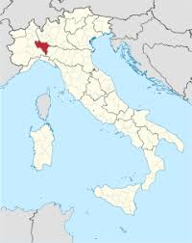
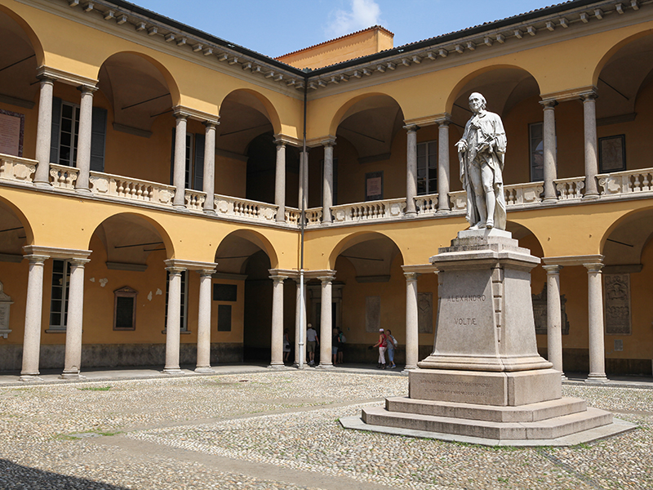
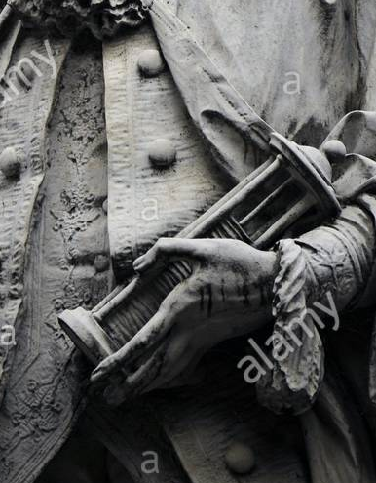

Where I come from
Pavia
The university dates back to 1361
Alessandro Volta (1745–1827) inventor of the battery → ‘Volt’ unit of measure for electric potential

Slide 3
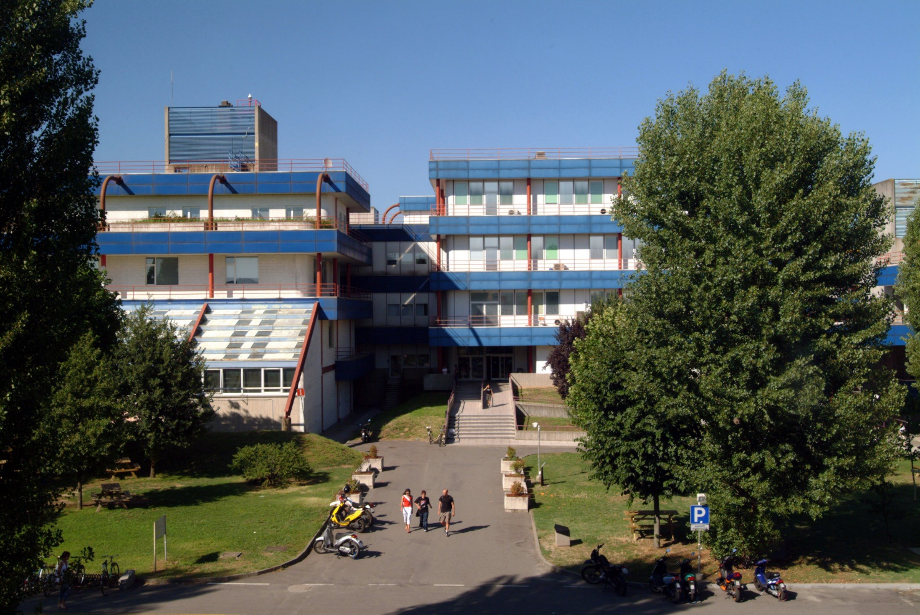
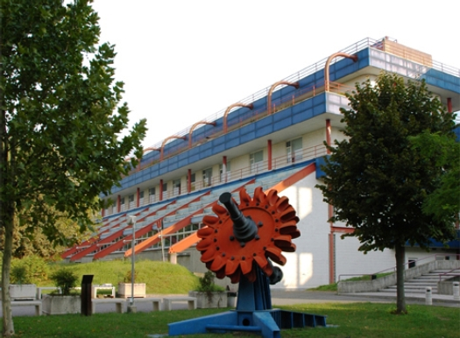
The faculty of engineering

Slide 4
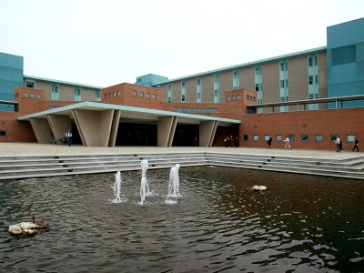
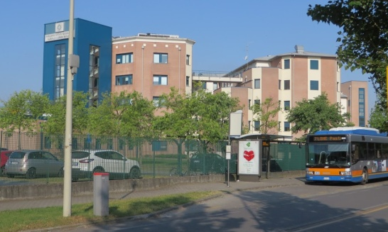
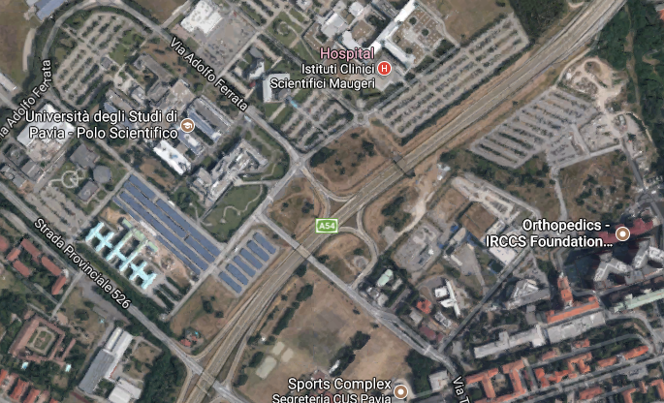
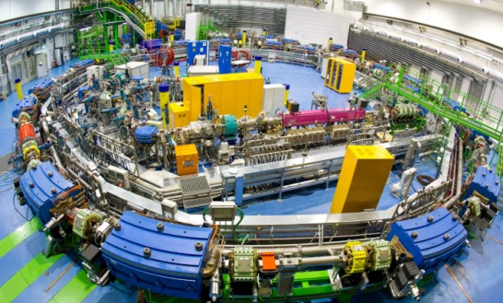
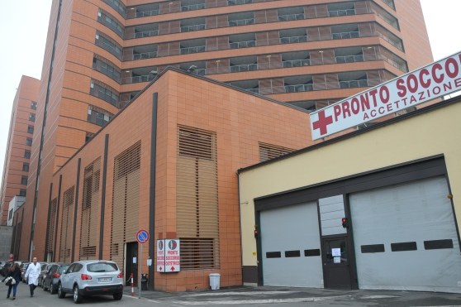
Pavia: the biomedical research square mile
Mondino (Neurology)
Maugeri (Rehabilitation)
campus
CNAO (Adrotherapy)
San Matteo (big general hospital)
Notes:
Vi mostrero’ diverse applicazioni, rese possibili anche dalla nostra vicinanza con centri medici dove si fa sia clinica sia ricerca, quali ….
senza dimenticare la ASST di Pavia con la quale collaboriamo da tanti anni per i progetti sul territorio

Slide 5

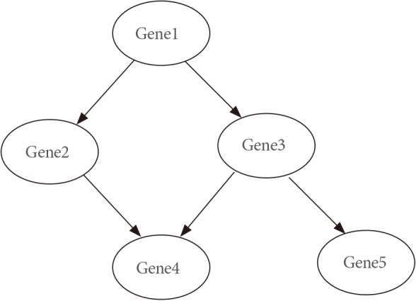
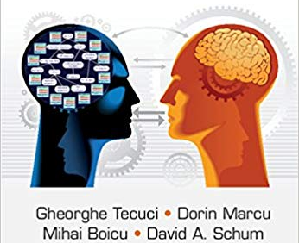
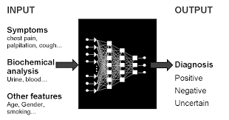
AI for Decision support systems (DSS)
Knowledge-driven
  Knowledge-based systems
  Knowldege engineering
  Rule-based systems
  Ontolgy-based system
  Symbolic AI
K&Data-driven
  Bayesian networks
  Probabilistic networks
  Causal Networks
Data-driven
  Machine learning-based systems
  (neural networks, support vector machines, deep learning)
  Classification trees (symbolic)
  Soft computing
  Connectionism
  Cognitive computing
Explicit representation of knowledge

Slide 6
KNOWLEDGE – DRIVEN systems

Slide 7
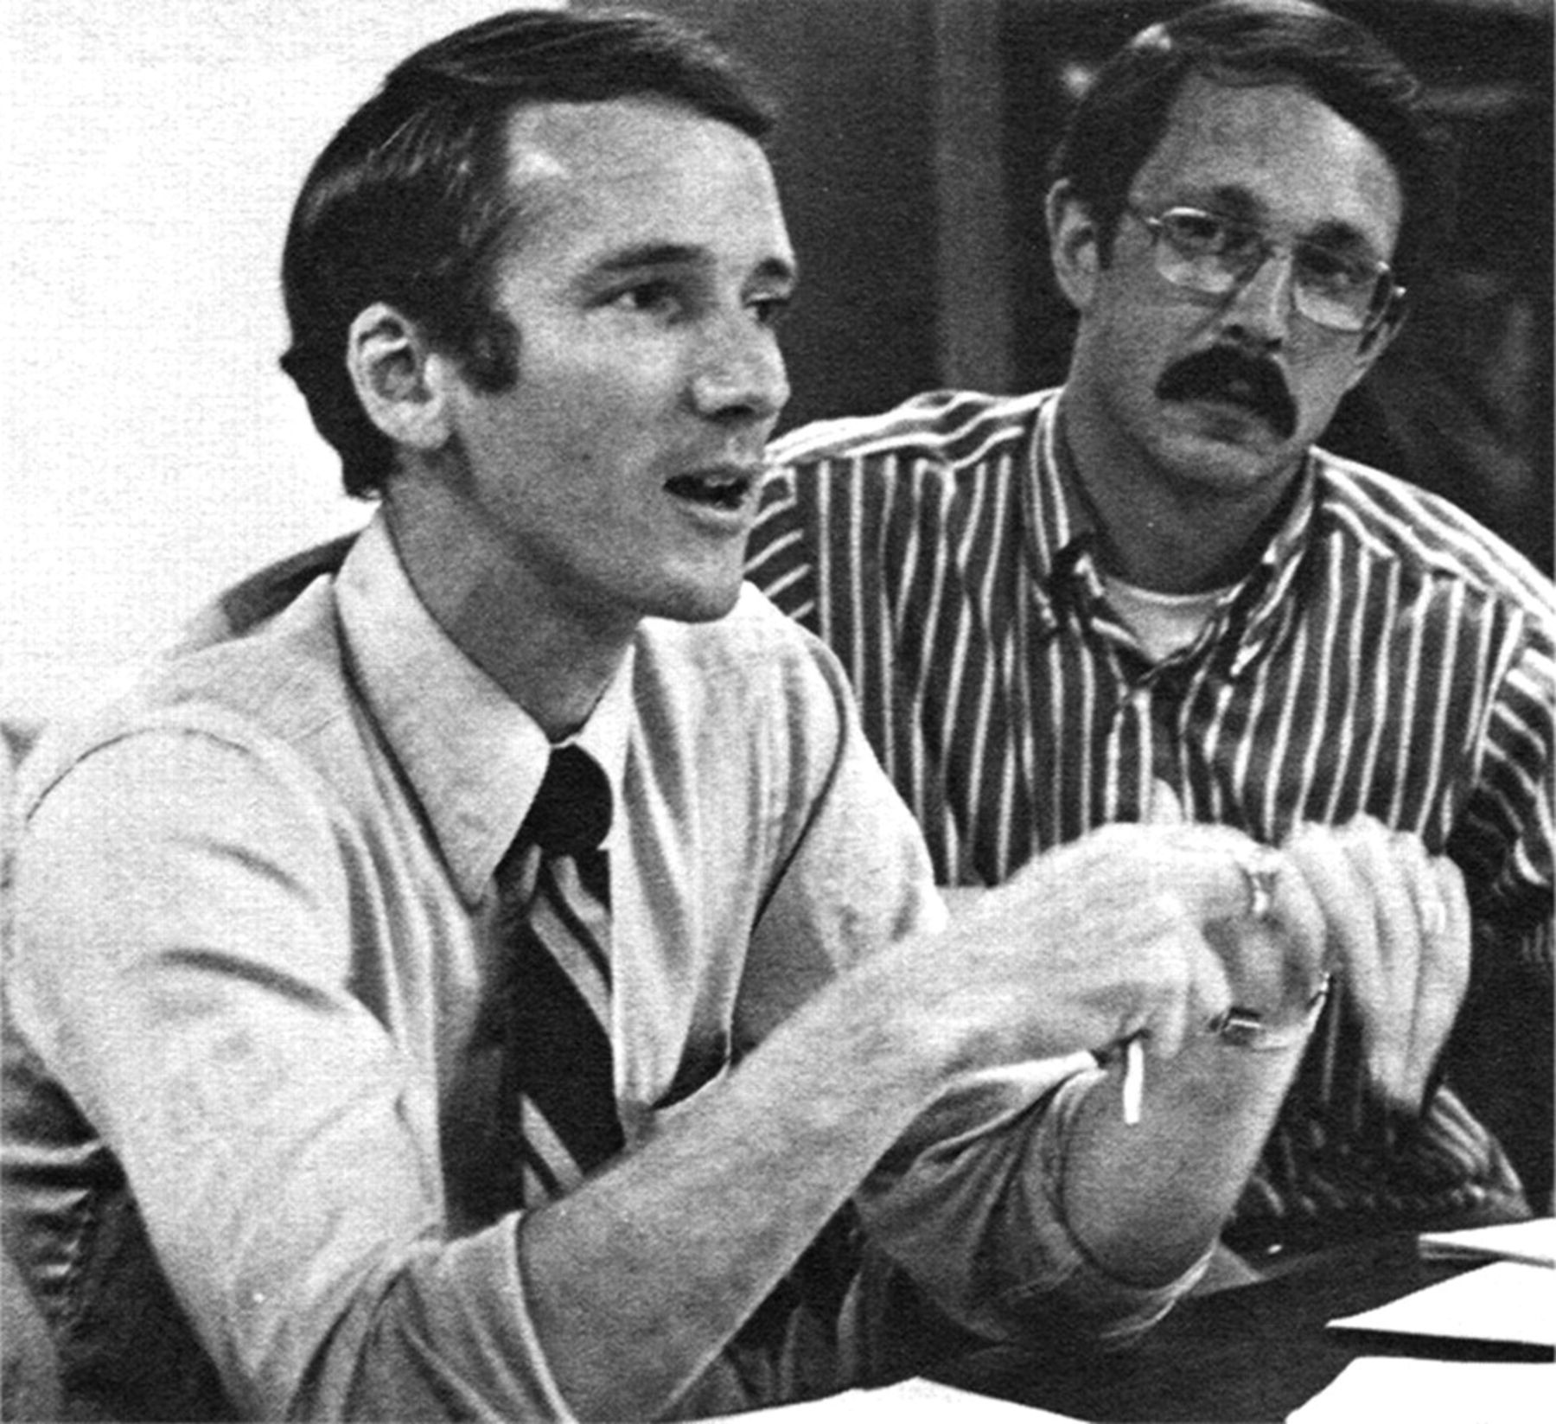
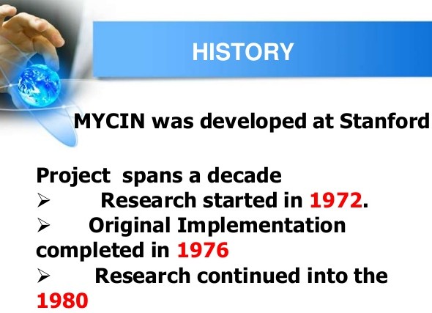
AI in medicine – since 1970
MYCIN – an expert system
for infections diagnosis
Ted Shortliffe and Bruce Buchanan as
young Stanford faculty members, 1979.
We develop systems that emulate human reasoning, by representing in the system the existing, explicit knowledge directly elicited from the domain expert
Shortliffe EH, Davis R, Axline SG, Buchanan BG, Green CC, Cohen SN. Computer-based consultations in clinical therapeutics: explanation and rule acquisition capabilities of the MYCIN system. Comput Biomed Res. 1975
Notes:
Per fare un po’ di chiarezza ho pensato di ripercorrere la storia di questi sistemi. L’immagine mostra …
7

Slide 8
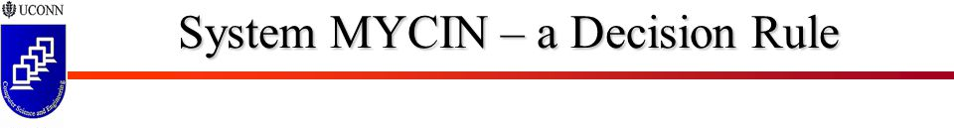
IF CONDITION THEN CONCLUSION
(the conclusion may be a recommendation, diagnostic hypothesis, suggestion, etc)
IF
1) the infection is primary-bacteremia AND
2) the site of the culture is one of sterile sites AND
3) the suspected portal of entry of the organism is the gastro-intestinal tract
THEN
there is a suggestive evidence (0.7) that the identity of the organism is bacteroides
Uncertainty coefficient
Notes:
I primi sistemi esperti erano basati sulle cosiddette «regole di produzione». Ecco un esempio tratto da MYCIN
8

Slide 9
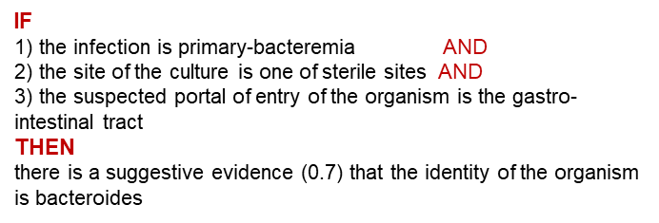
Core architecture of a rule-based expert system
IF
1) the infection is primary-bacteremia AND
2) the site of the culture is one of sterile sites AND
3) the suspected portal of entry of the organism is the gastro-intestinal tract
THEN
there is a suggestive evidence (0.7) that the identity of the organism is bacteroides
rule 1
rule 2
rule 3
rule 4
rule 5
…
KNOWLEDGE BASE
Forward chaining
Age= 53
Gender= female
Site of culture = blood
Suspected portal of entry = wound
….
Patient’s data
(Electronic Health record )
Backward chaining
Conflict resolution
Inference engine
System answer (suggestion, recommendation, etc.)
Notes:
Immaginando di immagazzinare nel sistema un grande numero di queste regole, si forma la cosiddetta «base di conoscenza». Una volta che abbiamo i dati relativi al paziente per cui vogliamo un supporto, viene attivato il motore inferenziale, che applica le regole e produce delle conclusioni
9

Slide 10
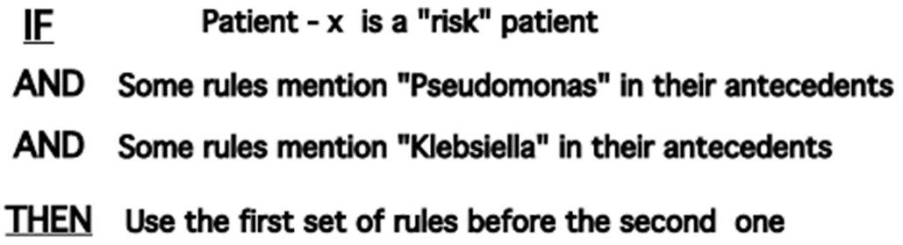
Different inferential mechanisms
Meta-rules
Forward chaining
The system gets all the available patient’s data, fires the rules that mention those data in their conditions (IF part), and generate the recommendations according to the rules conclusion (THEN part)
Backward chaining
The system gets a user question (e.g., «is the pathogen a bacteroides» ?) and checks the conditions of all the rules that have that concept as a conclusion
Conflict resolution
The system controls if the different rules led to conflicting conclusions and try to resolve it, using euristics based on the uncertainty factors
Notes:
Il motore inferenziale è la parte più «intelligente» del sistema, e può funzionare in diversi modi. Innanzi tutto possono esistere, nella base di conoscenza, delle metartegole, che governano la sequenza di regole da applicare. Quindi … forward … backward … risoluzione conflitti
10

Slide 11




System interface explanation was already known as a crucial aspect
IF
1) the infection is primary-bacteremia AND
2) the site of the culture is one of sterile sites AND
3) the suspected portal of entry of the organism is the gastro-intestinal tract
THEN
there is a suggestive evidence (0.7) that the identity of the organism is bacteroides
Knowledge acquisition
Interface
KNOWLEDGE BASE
Conflict resolution
Backward chaining
Forward chaining
Data acquisition interface
Patient DATABASE
Results presentation Interface
inference engine
Explanation request
Notes:
L’architettura completa comprende inoltre le interfacce, che consentono al medico, con l’aiuto dell’ingegnere della conoscenza, di inserire le regole per formare/aggiornare la base di conoscenza, consentono di inserire i dati, che negli anni ‘70 venivano inseriti per lo piu’ a mano dall’utente, mentre oggi possono essere recuperati dalla cartella clinica elettronica laddove esiste, e infine ci sono le interfacce per la presentazione dei risultati che consentono all’utente di interagire col sistema, ad es. per chiedere spiegazioni.

Slide 12
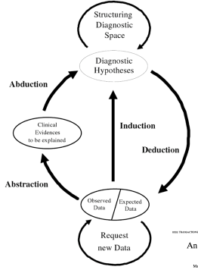
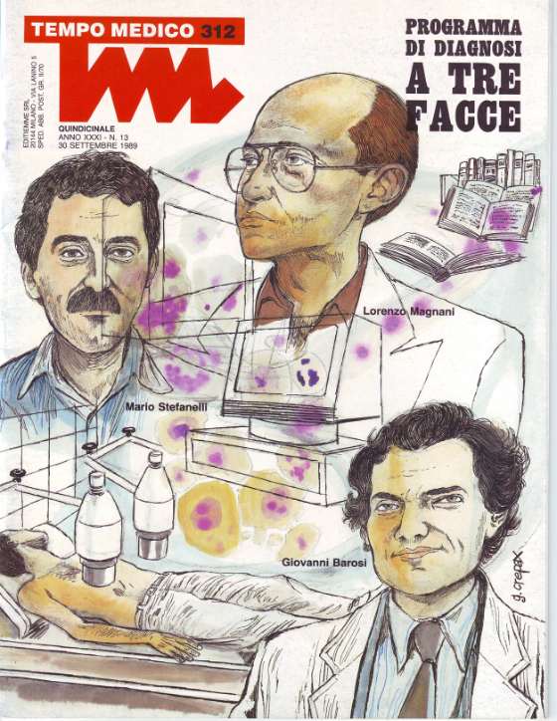
Theoretical foundations (1989)
Mario Stefanelli, engineer
Giovanni Barosi, physician
Lorenzo Magnani, phylosopher
Barosi G, Magnani L, Stefanelli M. Medical diagnostic reasoning: epistemological modeling as a strategy for design of computer-based consultation programs. Theor Med. 1993 Mar;14(1):43-55
Lanzola G, Stefanelli M, Barosi G, Magnani L. NEOANEMIA: a knowledge-based system emulating diagnostic reasoning. Comput Biomed Res. 1990 Dec;23(6):560-82.

Slide 13
Some famous 1970-80’s systems based on the «explicit knowlgede representation» paradigm
INTERNIST (Pittsburg, US)
  QMR (Quick medical reference)
CasNet – Glaucoma (Rutgers, US)
PIP, the Present Illness Program (renal diseases, MIT-Tufts, US)
ONCOCIN - chemotherapy protocols (Stanford, US)
Anaemia - diagnosis and treatment of anaemia (Pavia, Italy)
In pilot studies, those systems performed as well as, and sometime better than clinical experts
Notes:
Furono sviluppati sulla base di questa (o simili) architettura diversi sistemi esperti, che negli studi pilota hanno dato risultati incoraggianti. Pero’ non sono mai andati oltre questi studi pilota. Uno dei grossi problemi di questi sistemi e’ la loro poca flessibilità ad adattarsi ai casi che non rientrano esattamente nei contesti previsti dalle regole

Slide 14
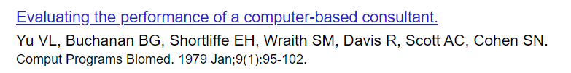


Evaluation studies

Slide 15
Critique: no sound theory for uncertainty propagation
IF
1) the infection is primary-bacteremia AND
2) the site of the culture is one of sterile sites AND
3) the suspected portal of entry is the gastro-intestinal tract
THEN
there is a suggestive evidence (0.7) that the identity of the organism is bacteroides
Uncertainty coefficient

Slide 16
Critique: no sound theory for uncertainty propagation
Rules were combined using euristics to manage uncertainty:
Number of rules with positive/negative confidence levels
Preferring the rules with highest confidence levels
Using additive/multiplicative models for confidence levels
etc.

Slide 17
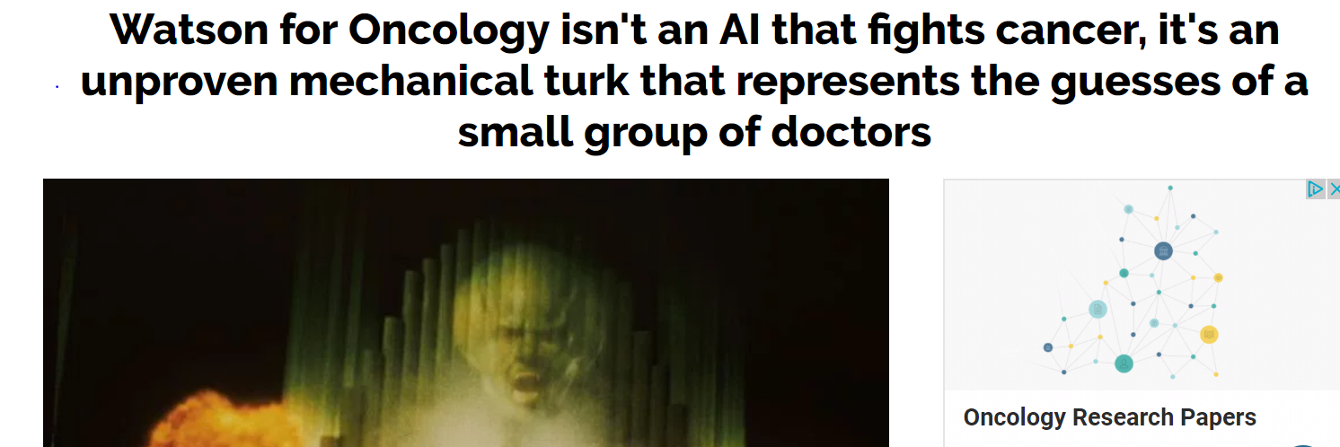
The same critique to Watson in 2018 !!
Which in fact adopt (also) production ruels

Slide 18
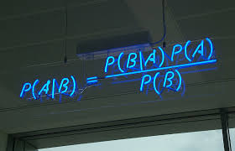
Expert systems based on probabilistic networks
1980-90’s: Proposal – the bayesian paradigm
Prior probabilities of variables (e.g., diagnostic hypotheses, prognoses, etc.) are updated as far as new patient’s data (symptoms, signs, etc.) are collected
Notes:
Ecco allora che si sono affacciati in quest’area dei sistemi che utilizzano una teoria forte, ovvero la teoria della probabilità.

Slide 19
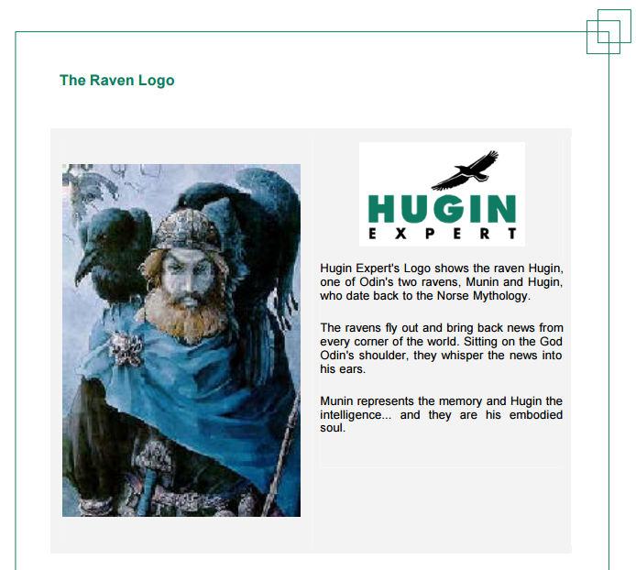
A well-known system: Hugin expert
Andreassen S, Riekehr C, Kristensen B, Schønheyder HC, Leibovici L. Using
probabilistic and decision-theoretic methods in treatment and prognosis modeling.
Artif Intell Med. 1999 Feb;15(2):121-34
Andreassen, Olesen, et al, Alborg, Denmark
Notes:
Sono quindi stati sviluppati dei sistemi per la rappresentazione di queste reti. Il piu’ noto e’ HUGIN …. descrivere brevemente …

Slide 20
From purely knowledge-driven approach to knowledge and data-driven approach
We develop systems that emulate human reasoning, by representing in the system the existing, explicit knowledge directly elicited from the domain expert
Medical reasoning and available data are uncertain : let’s represent uncertainty through probabilistic frameworks, in order to achieve coherent conclusions
Notes:
Per fare un po’ di chiarezza ho pensato di ripercorrere la storia di questi sistemi. L’immagine mostra …
20

Slide 21
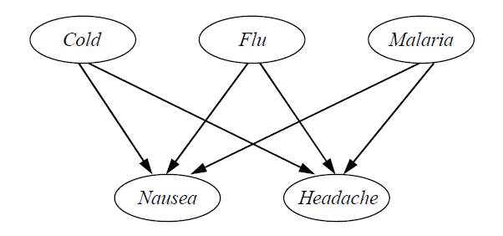
A simple belief network
To build the network we need to know:
1) Causal relationships (to build the structure of the network)
2) Probabilities
  - Prior probability of Cold, Flu, Malaria (i.e., prevalence)
  - Conditional probabilities
  P(Headache| Cold, Flu, Malaria)
  P(Nausea| Cold, Flu, Malaria)

Slide 22



The aim of the network
0.8
0.6
0.3
E.g., Given a patient suffering from nausea but without headache, which is most probable dagnosis ?

Slide 23
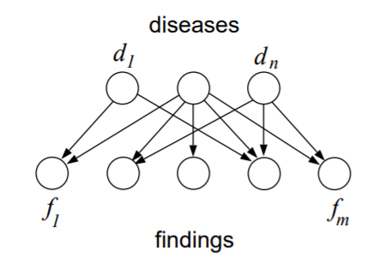
The QMR-DT network (the probabilistic version of the INTERNIST expert system)
Approximately
600 diseases and 6000 findings
Shwe, M., Middleton, B., Heckerman, D., Henrion, M., Horvitz, E., Lehmann, H., & G. Cooper (1991). Probabilistic diagnosis using a reformulation of the INTERNIST1/QMR knowledge base I. The probabilistic model and inference algorithms. Methods of Information in Medicine, 30, 241{255.

Slide 24

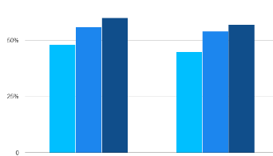
Where a BN knowledge come from?
1) Causal relationships
2) Probabilities
Learning the structure from data is much more difficult !
Learn the strength of the arcs
Knowledge and data driven

Slide 25
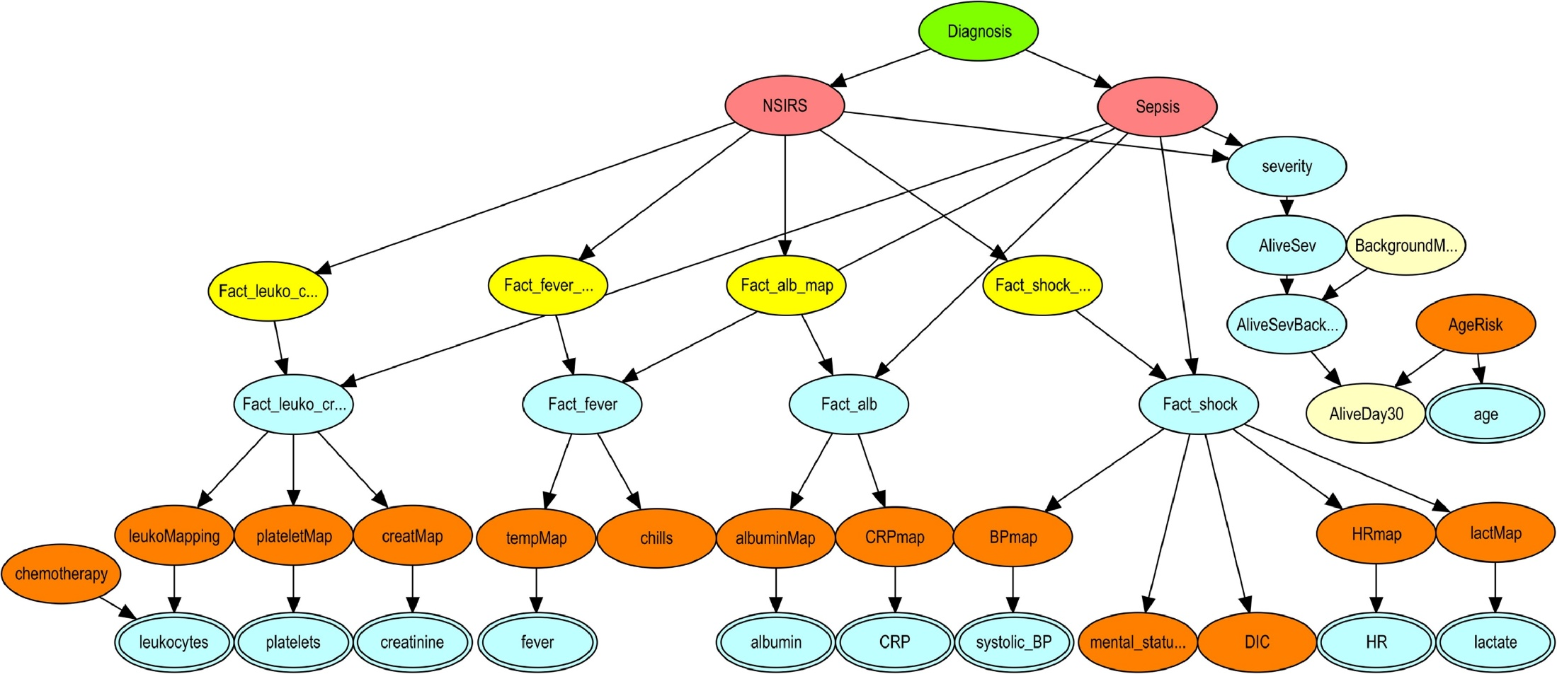
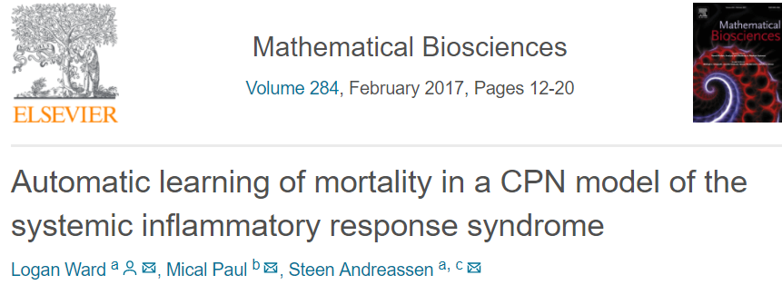
Distinguishing sepsis/no sepsis
Network quantified using data from 3594 patients
prediction of 30-day mortality
with an area under the ROC curve of 0.79.

Slide 26

From belief networks to influence diagrams
Drug 1
Survival
Decision node
Drug 2
Costs
Value
node
Drug 3
Life quality
Multiattribute utility
Shared decision making framework

Slide 27
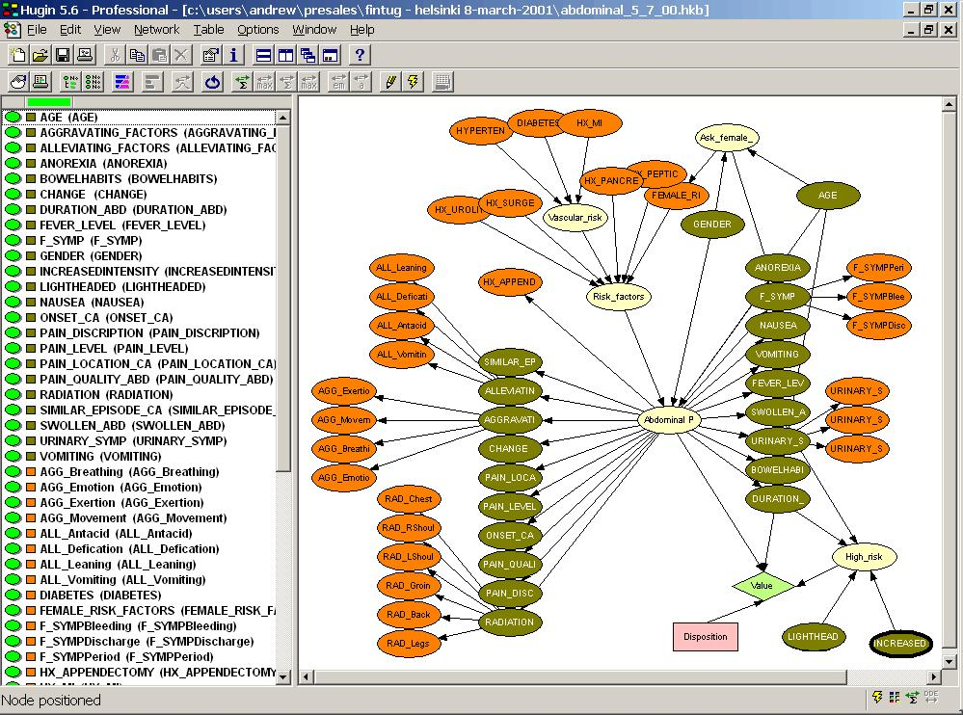
An influence diagram for triage of abdominal pain patients
Other examples in:
Andreassen S. et al.
Using probabilistic and decision-theoretic methods in treatment and prognosis modeling
Artif Intell Med. 1999 15(2):121-34.
Notes:
Con HUGIN sono state create reti anche molto complesse, con centinaia e addirittura migliaia di nodi

Slide 28
Also the most part of those systems did not enter the clinical routine

Slide 29
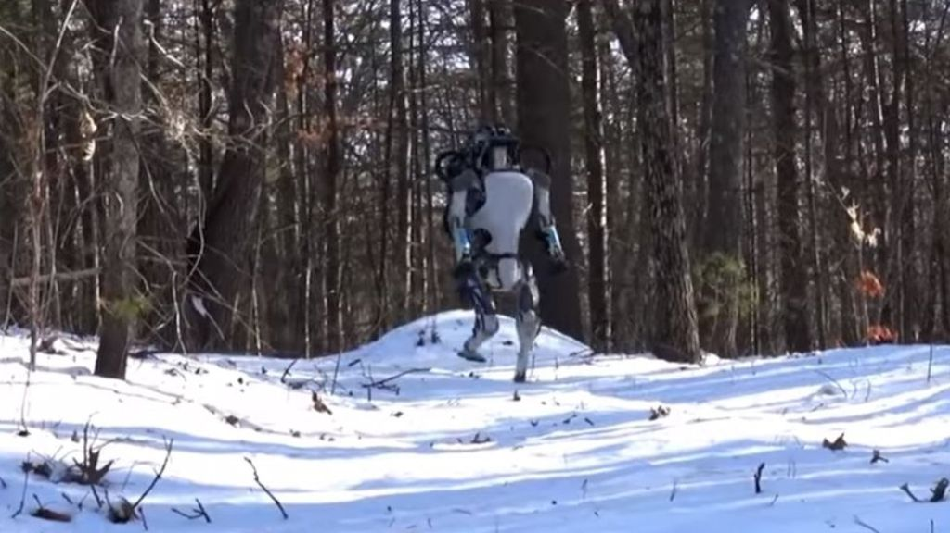
Despite their performance, those systems never/rarely entered the clinical routine. Why?
Unclear knowledge source (often a single expert or a single research group)
Stand-alone systems, i.e., lack of integration with the clinical workflow, or with the electronic health record, when existing
Lack of flexibility, i.e., the system was unable to reason outside the pre-defined knowledge
Weak involvement of the medical community
    Often the systems were proposed by the computer scientists, the need did not come from doctors
AI winter

Slide 30
What is changed around 2000’s ?
New conditions for decision support systems to be more successful?

Slide 31
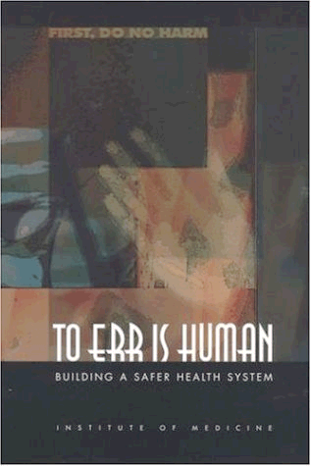
The awarness of the medical community about the medical errors issue
1999, IOM:
98000 deaths due to medical errors in the US
Notes:
Dato il tema del forum, ovvero il «risk management», vorrei iniziare parlando degli errori in medicina, e quindi su come sia possibile mitigare il rischio di errore con l’aiuto della tecnologia informatica. La grande enfasi sull’errore medico parte dal primo e ormai famoso report dell’Institute of Medicine del 1999 arrivando alle pubblicazioni uscite anche in Italia e recentemente venute alla ribalta anche sulla stampa nazionale.

Slide 32
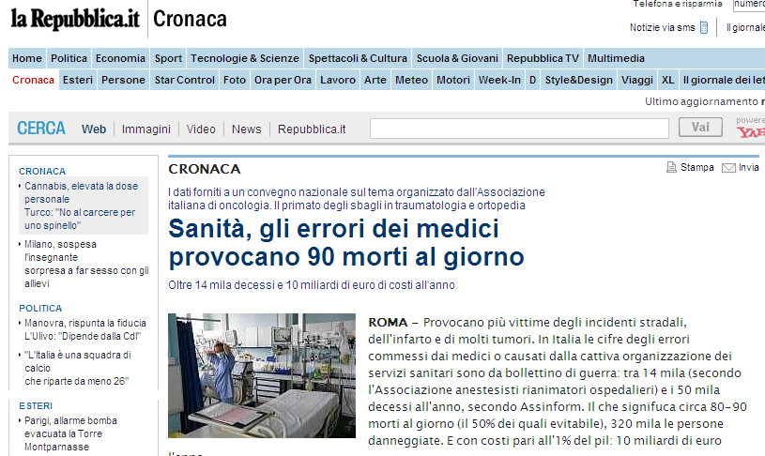
Media starts sensitizing population about the issue
2000’s:
80-90 deaths/day due to medical errors in Italy
Notes:
Dato il tema del forum, ovvero il «risk management», vorrei iniziare parlando degli errori in medicina, e quindi su come sia possibile mitigare il rischio di errore con l’aiuto della tecnologia informatica. La grande enfasi sull’errore medico parte dal primo e ormai famoso report dell’Institute of Medicine del 1999 arrivando alle pubblicazioni uscite anche in Italia e recentemente venute alla ribalta anche sulla stampa nazionale.

Slide 33



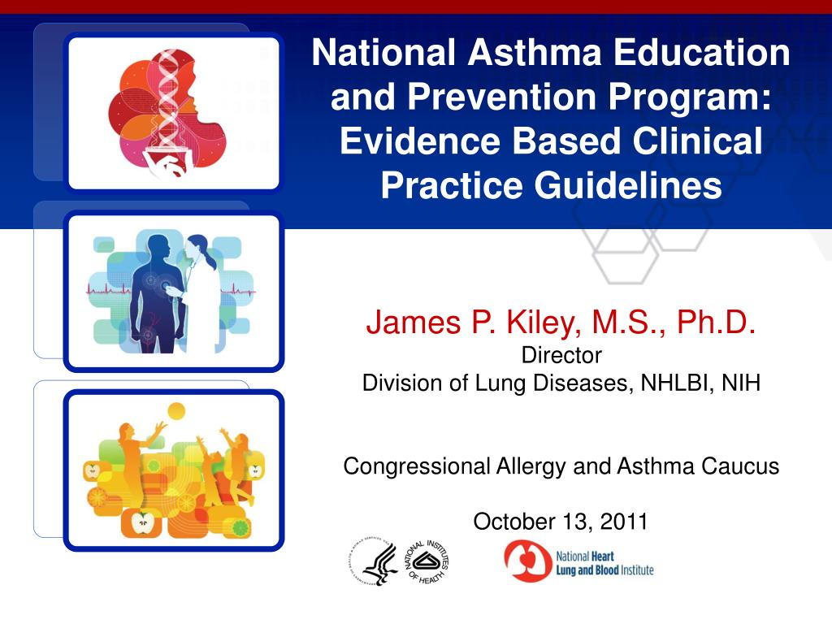
The response of the medical scientific community to the problem of medical errors
Clinical practice guidelines
The scientific societies of the various medical areas delegate expert panels to develop clinical practice guidelines based on the best available scientific evidence (mainly based on clinical trials results)
Notes:
Innanzi tutto negli ultimi 20 anni la richiesta di un supporto decisionale e’ venuta dalla comunita’ medica … descrizione slide …

Slide 34
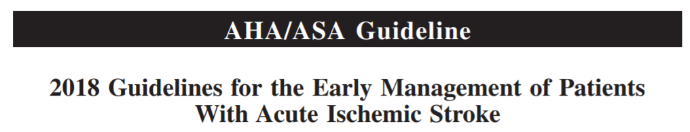
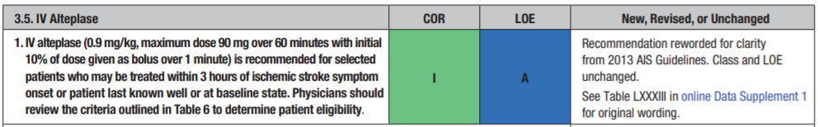
Computer-interpretable Guidelines
IF Ischemic stroke AND Deficit still present AND Symptoms onset <=3 hours
THEN recommended treatment = Alteplase
It may be respresented using PRODUCTION RULES, same formalisms developed in the 1970s !!

Slide 35
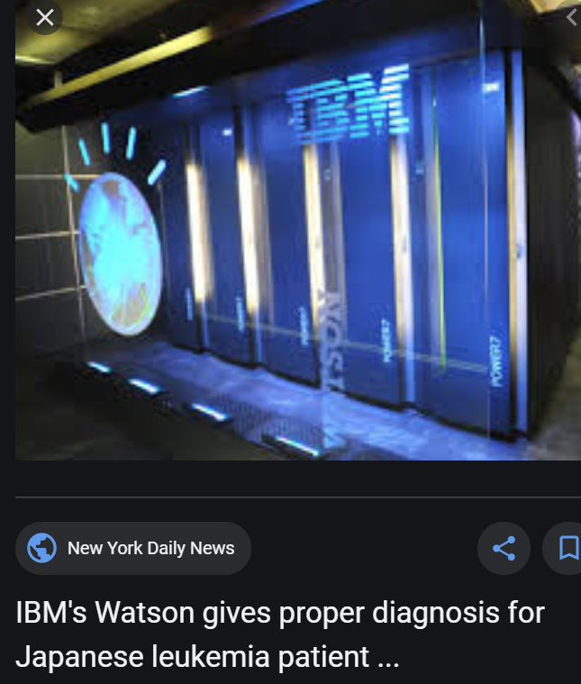
Keep attention, even the most recent systems may use knowledge representation formalisms back to 1970 !!
Most of the knowledge about oncology is represented by production rules

Slide 36
From “Expert Systems”
to
“Computer-interpretable guidelines (CIGs)”
Is it only a label change ?

Slide 37

What has changed since the 70s?
Recommendations are (as much as possible) evidence-based
  There is a sound methodology for developing recommendations (e.g., NICE, AHRQ)
  There are sound methodologies for literature revisions (Cochrane Collaboration)
Their reliability is made explicit
There is a “consensus” about the knowledge reported in GLs
There is a community taking care for a guideline updates

Slide 38
Formalisms for guideline representation must take into account those new features
(late 90’s -2000’s)
GLIF – Guideline Interchange Format (M. Peleg, Haifa, Stanford)
Arden syntax MLM- medical logic module (HL7, US)
GEM – Guideline Element Model (Shiffman, US)
GUIDE – (Ciccarese, Italy)
GLARE – (Terenziani, Italy)
PROFORMA - (Fox, UK)
….
Peleg M, Tu S, Bury J, Ciccarese P, Fox J, Greenes RA, Hall R, Johnson PD, Jones N, Kumar A, Miksch S, Quaglini S, Seyfang A, Shortliffe EH, Stefanelli M. Comparing computer-interpretable guideline models: a case-study approach. J Am Med Inform Assoc. 2003 Jan-Feb;10(1):52-68

Slide 39
Currently used in the practice
MLM
PROFORMA
  Commercial platform ALIUM (Deontics, London)

Slide 40
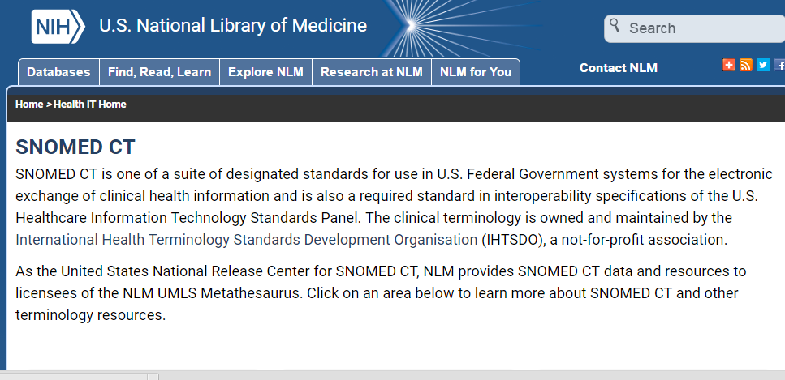


- Interoperability: guidelines can be integrated into the EHR interface

Slide 41
How a computer-interpretable guideline can enhance the doctor’s interface,
adding decision support ?

Slide 42
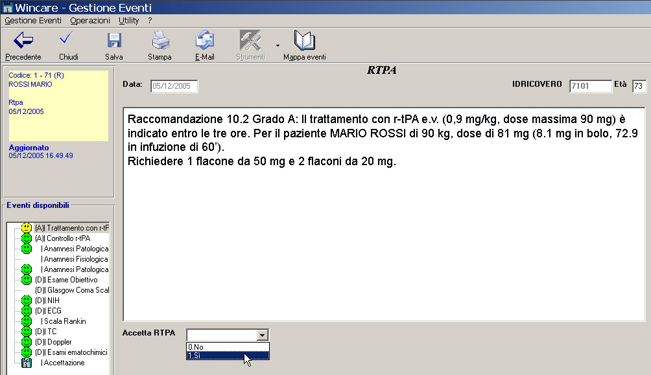
Showing the most urgent recommendations

Slide 43
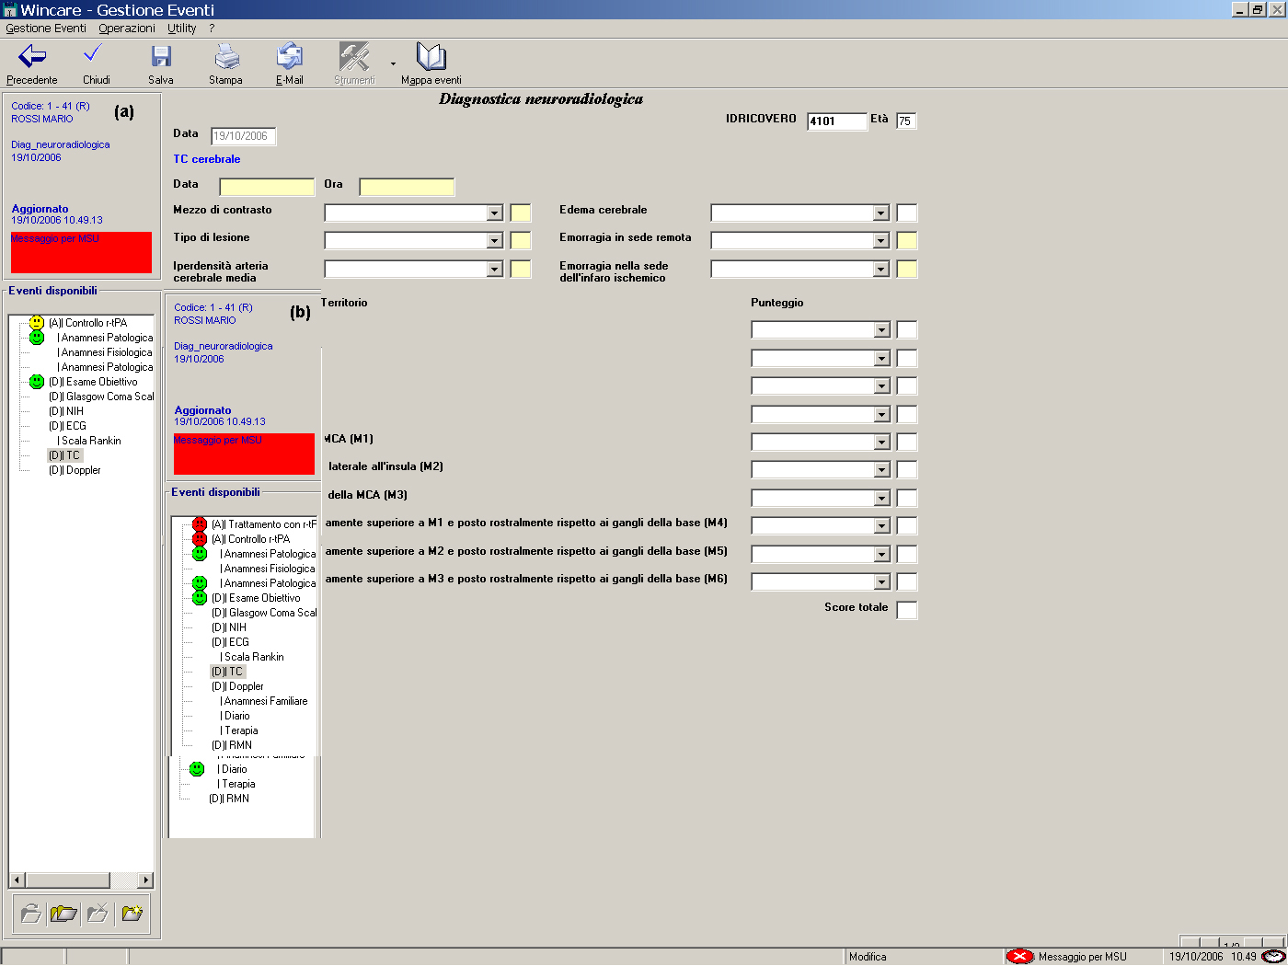
Patient-specific To-Do List
Procedurer that should be executed
Procedure completed
Procedures to be avoided
Time over for Alteplase
Notes:
43
Prima di tutto la lista delle procedure che prima era semplicemente in ordine alfabetico ora è molto + strutturata ed è legata alle specificità del singolo paziente. Incone di diverse colore indicano procedure che devono essere eseguite che sono state eseguite che non devono essere eseguite perché controindicate. Ad esempio in questo caso il paziente è eligibile per la trombolisi e quindi l’attiviltà di controllo delle controindicazioni è evidenziata in giallo. Se per qualche motivo il paziente esce dalla finestra terapeutica k’icona diventa rossa indicando che l’attività nn è + da svolgere.

Slide 44
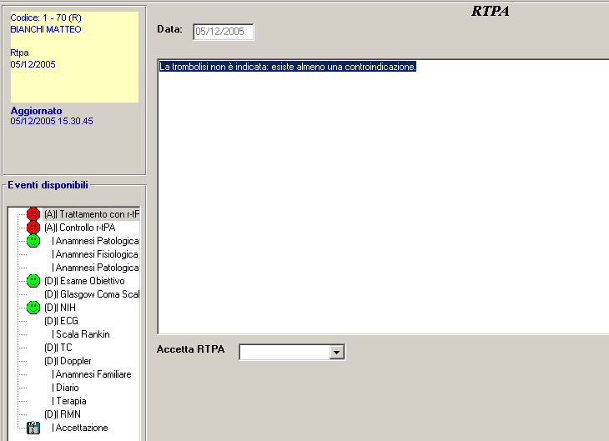
Explanations
Clicking on the red icon
the motivation is shown
Thrombolysis no more indicated: therapeutic window (3 hours for this patient) is over
Explanation capability is important also for shared decision making

Slide 45
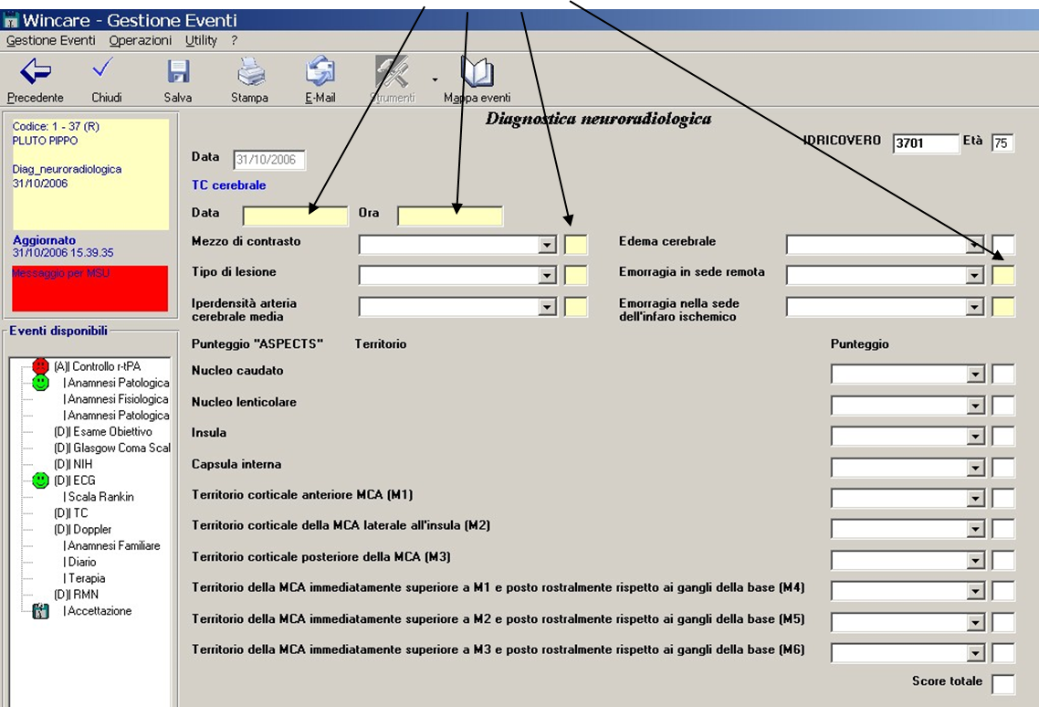
Highlighting the most urgent information to be provided

Slide 46
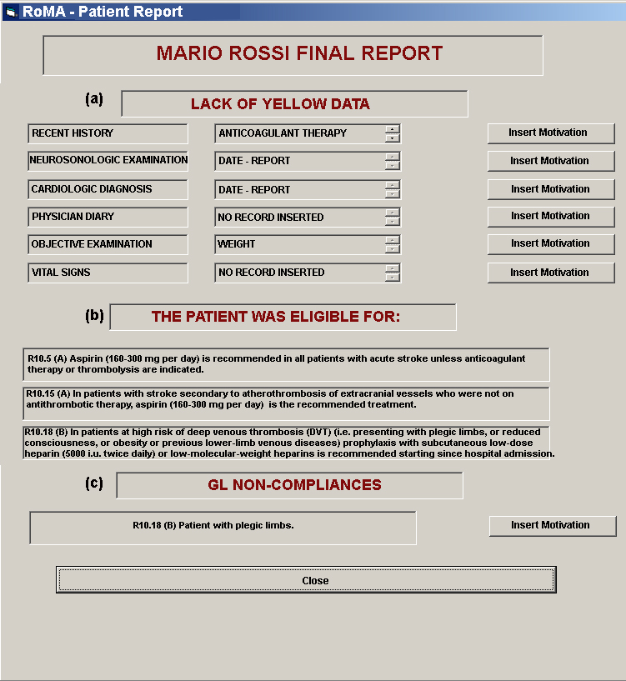
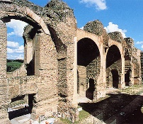
Non-compliance detection

Slide 47
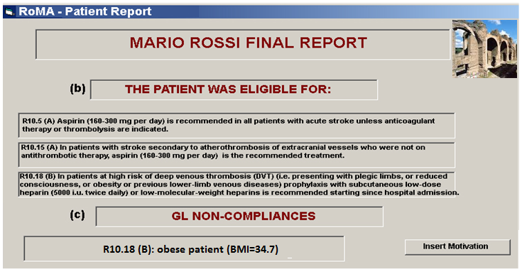
Motivations for non-compliance
Mr. Rossi is obese, but he’s always walking around, in his room and in the ward

Slide 48
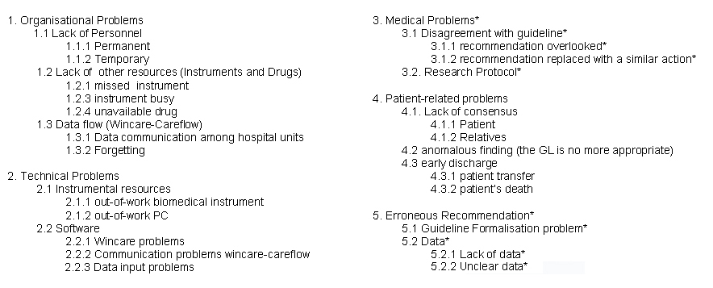
Taxonomy of motivations for non compliance

Slide 49
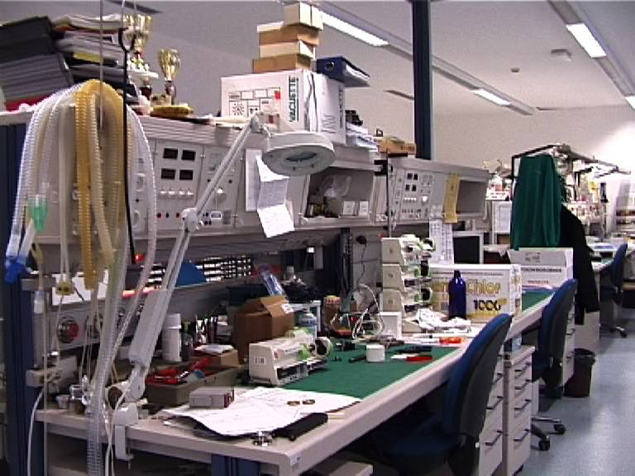

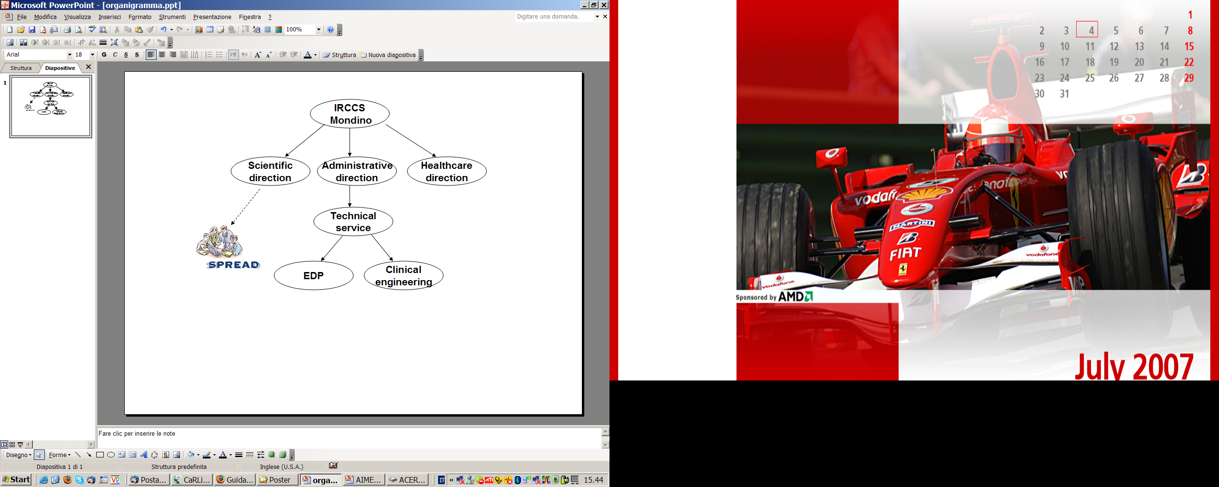
Feedbacks to responsibles for GLs, services, etc
Clinical engineering
EDP
GL development team

Slide 50
GLs derive from clinical trials and we know that clinical trials have some limitations, e.g., they consider particular populations (e.g., <80 yrs, males, …)
Are we sure that knowledge in guidelines is complete, reliable, and always applicable?
Secondary use of non-compliance data for knowledge discovering
We must constantly monitor if compliance with guidelines really improves outcomes

Slide 51
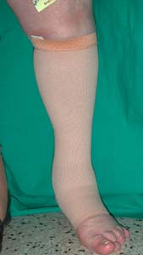
Evaluating the outcome as a function of compliance to a guideline
an example
Recommendation for TVP prevention: Early mobilization, hydration and graduated compression elastic stockings”
Input: NIHSS, Rankin Scale at admission, age, gender + ACTIONS
Output: Rankin scale at discharge
(0-1=good; >=2 bad)

Slide 52
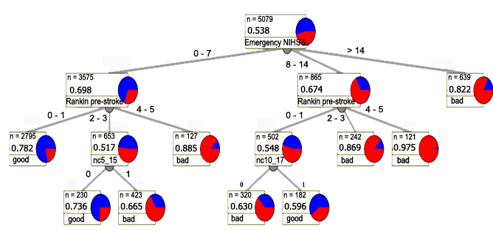

Evaluating the outcome as a function of compliance to a guideline

Slide 53
Checking the guideline efficacy using data mining may inform about need for additional research
“Effectiveness of thigh-length graduated compression stockings to reduce the risk of deep vein thrombosis after stroke (CLOTS trial 1): a multicentre, randomised controlled trial.
... These data do not lend support to the use of thigh-length GCS in patients admitted to hospital with acute stroke. National guidelines for stroke might need to be revised on the basis of these results.” Lancet. 2009

Slide 54
A guideline- based DSS
knowledge – driven systems +
Data- driven system for continuous monitoring of the effectiveness
This allows to harmonize the EBM paradigm with the Personalised Medicine paradigm

Slide 55
DATA – DRIVEN systems
  … big data

Slide 56






Machine learning algorithms
Bad outcome
Intermediate
Training set
Good
Known data
Model
Test set
Known
outcome
Prediction
New Data,
Unknown outcome
Possible algorithms
Logistic Regression
Support Vector Machines
Classification Trees
Neural Networks
…

Slide 57

These techniques may be applied also when data are pixels from an image
(face recognition, protein spatial structure, etc)

Slide 58

Distinguishing malignant from benign skin lesions
Known images
Deep
Neural
network
Known
outcome

Slide 59
Challenges
Explainability
  Should a doctor accept a decision proposed by an algorithm without understanding the motivation?
  What if something goes wrong? How to justify his action in a court?
Reliability of the data used for training
  Is the quality of data guaranteed?
  what if my patient belongs to a population different from that used for training?
Knowledge of the regulations
  A DSS (unless it simply visualizes data without doing any reasoning) is a medical device

Slide 60

Contacts
Thank you for your attention
Laboratory of Biomedical Informatics
“Mario Stefanelli”
Department of Computer Science and Systems,
University of Pavia, Italy
Web-site: www.labmedinfo.org
E-mail: silvana.quaglini@unipv.it

